Slide 1
Fine Freq Resolution TF Measurements of a Cavity System to Characterize High-Q Mechanical Resonances
P. Varghese, B. Chase, J. Einstein
TF Measurments for High-Q Resonances
26 October 2018

Slide 2
Measurement Goals
Use higher resolution measurements to capture
high Q resonances
Obtain frequency response function based on input
output time series data
Use System Identification Tools to create a system
model
Apply controllability and observability tests to see
if system is controllable

Slide 3
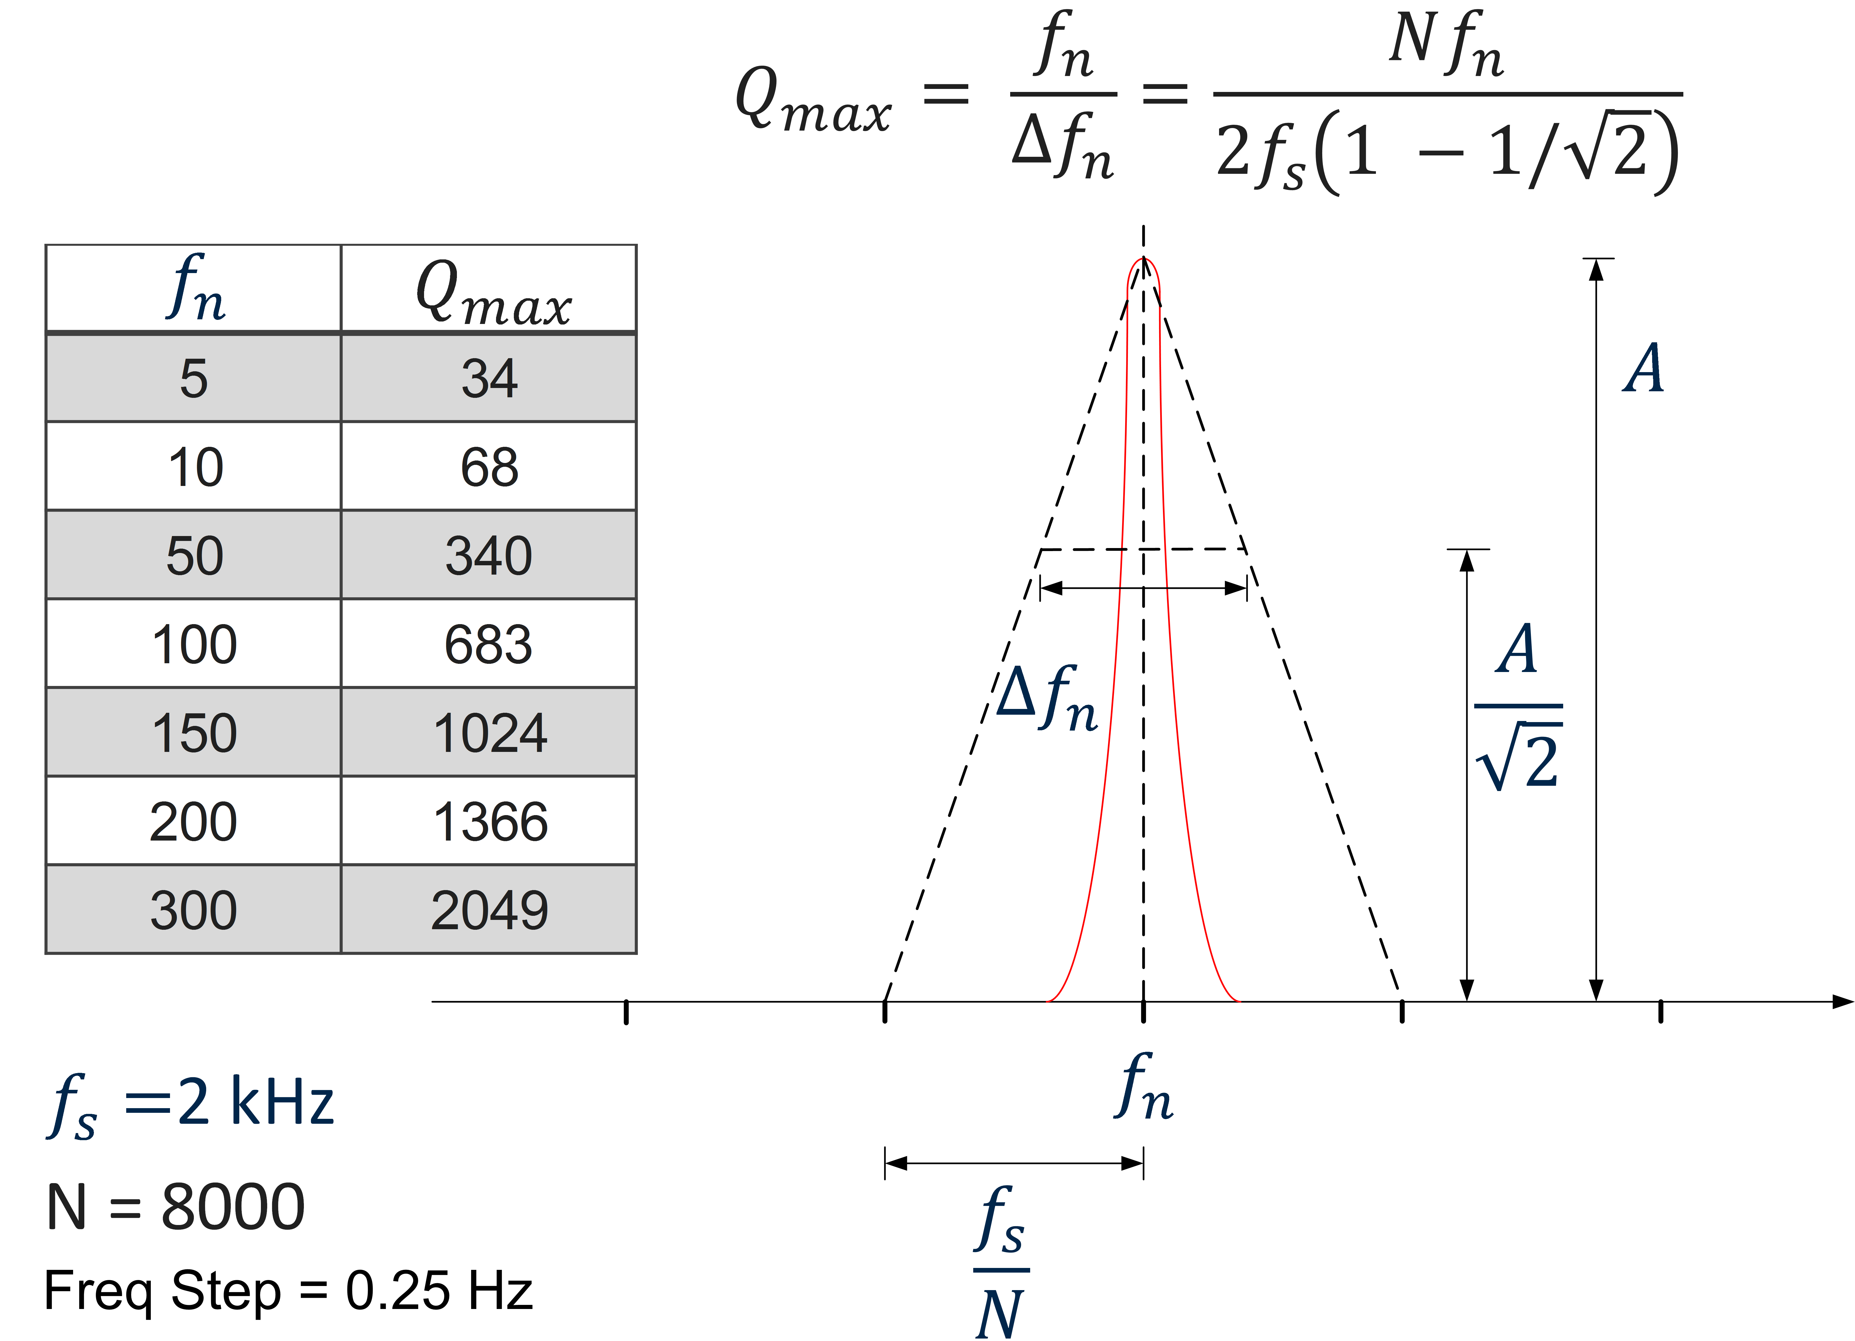
Frequency resolution vs Detectable Resonance Q

Slide 4
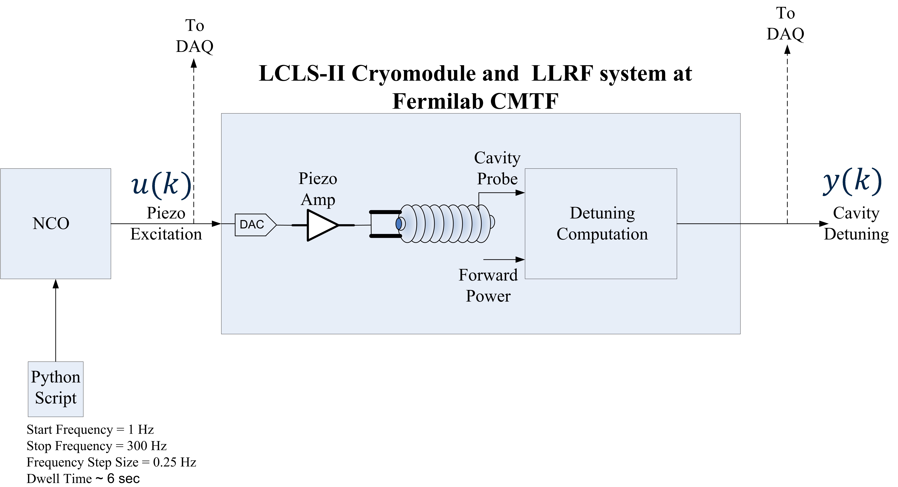
Test Setup

Slide 5
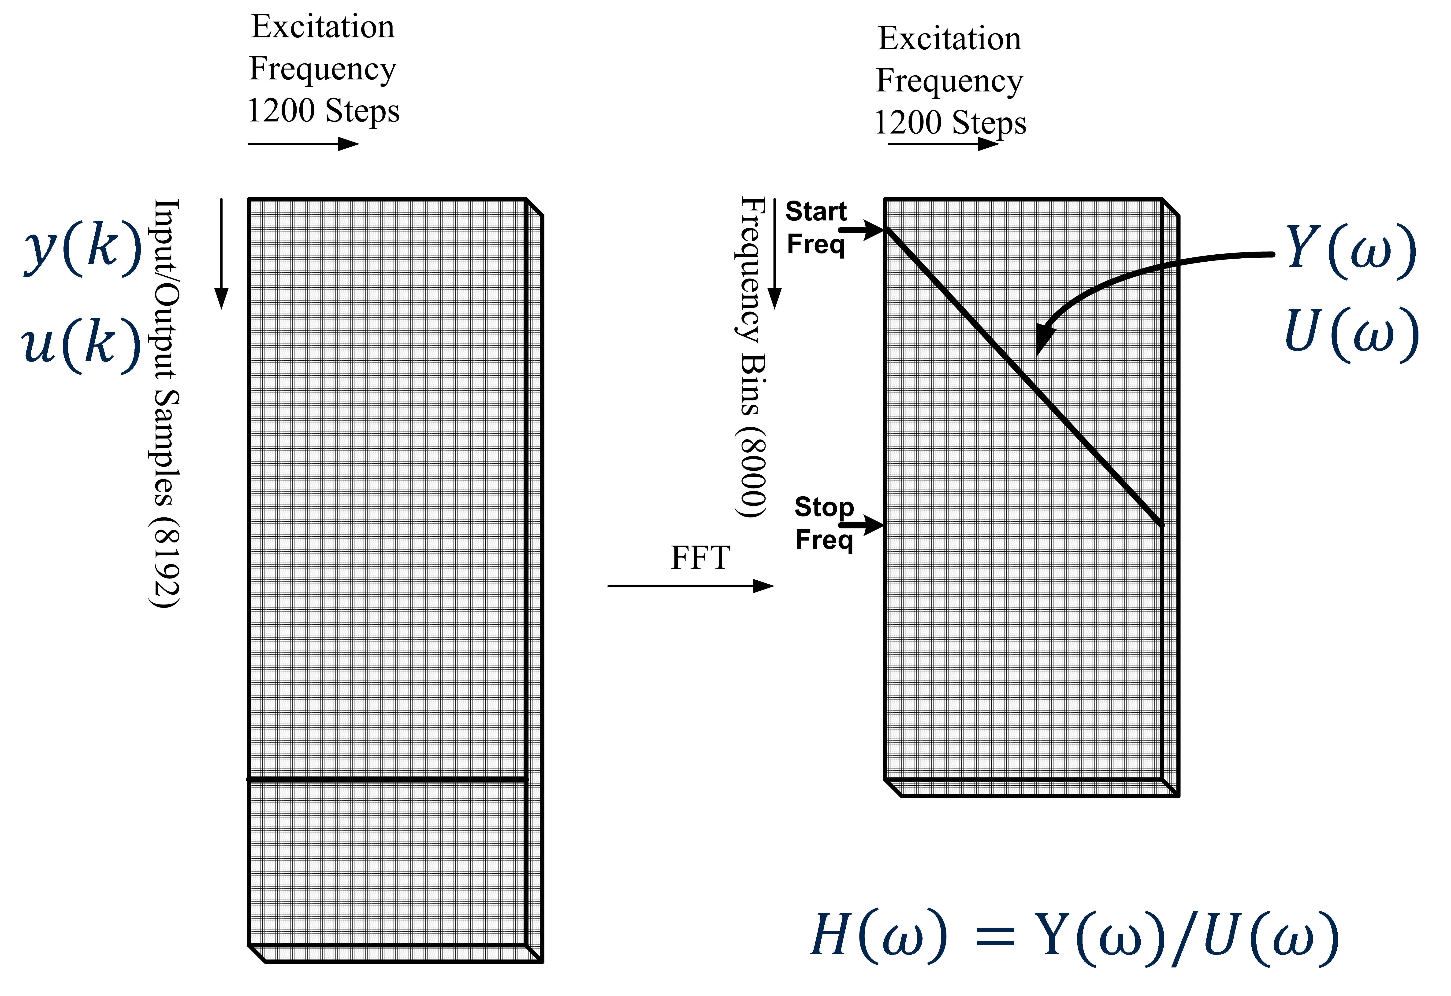
Transfer Function Computation

Slide 6
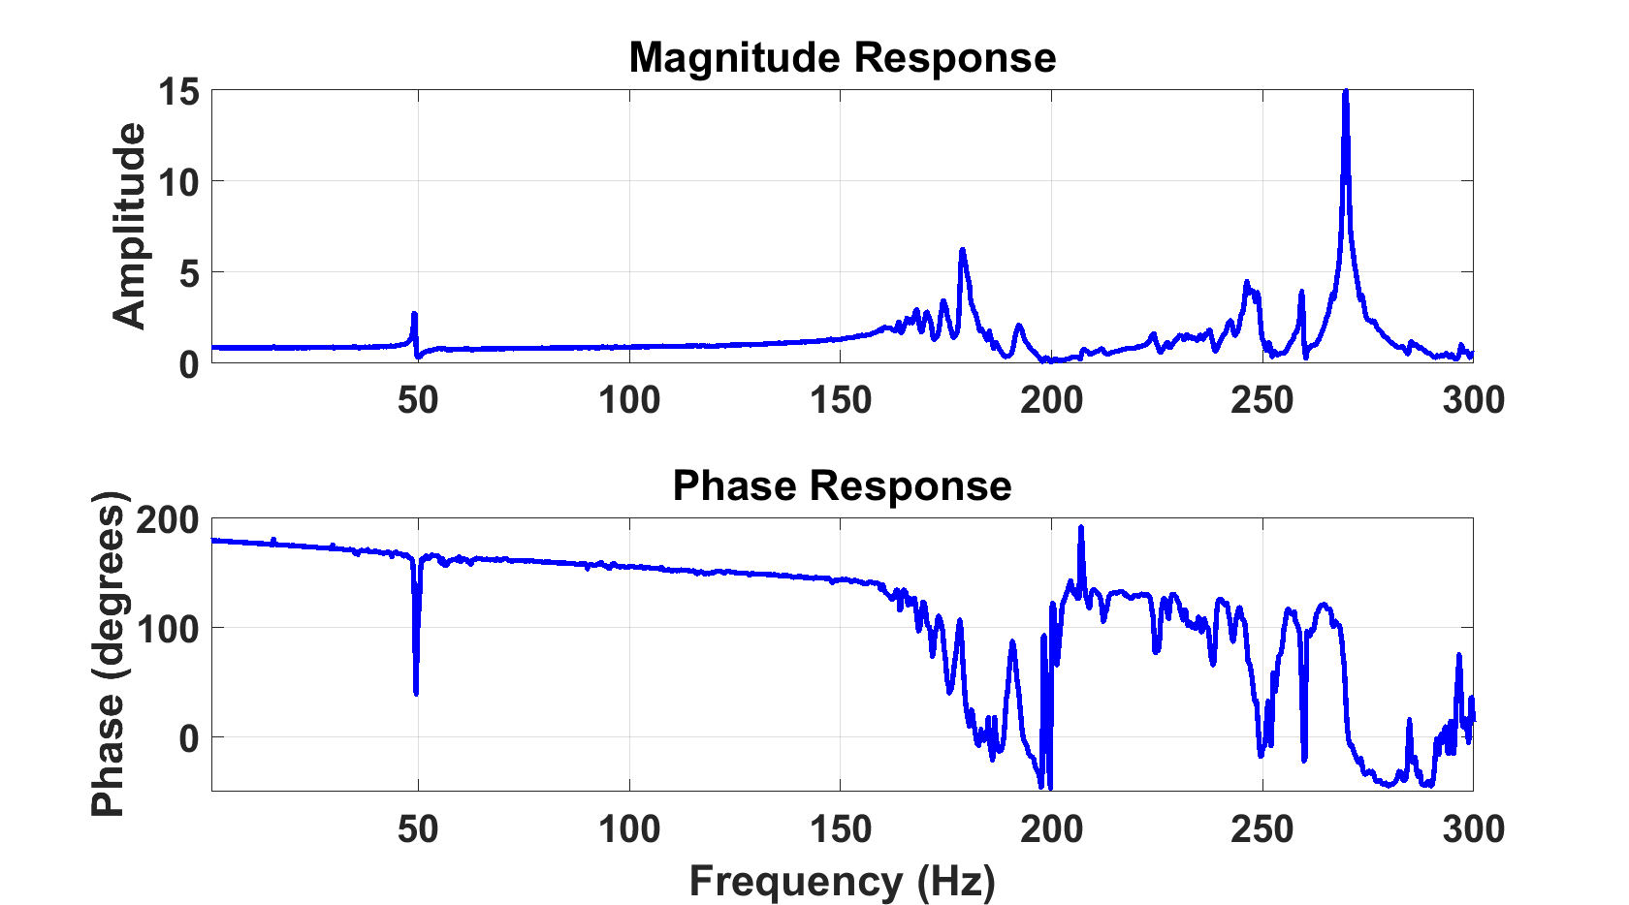
Measured Frequency Response

Slide 7
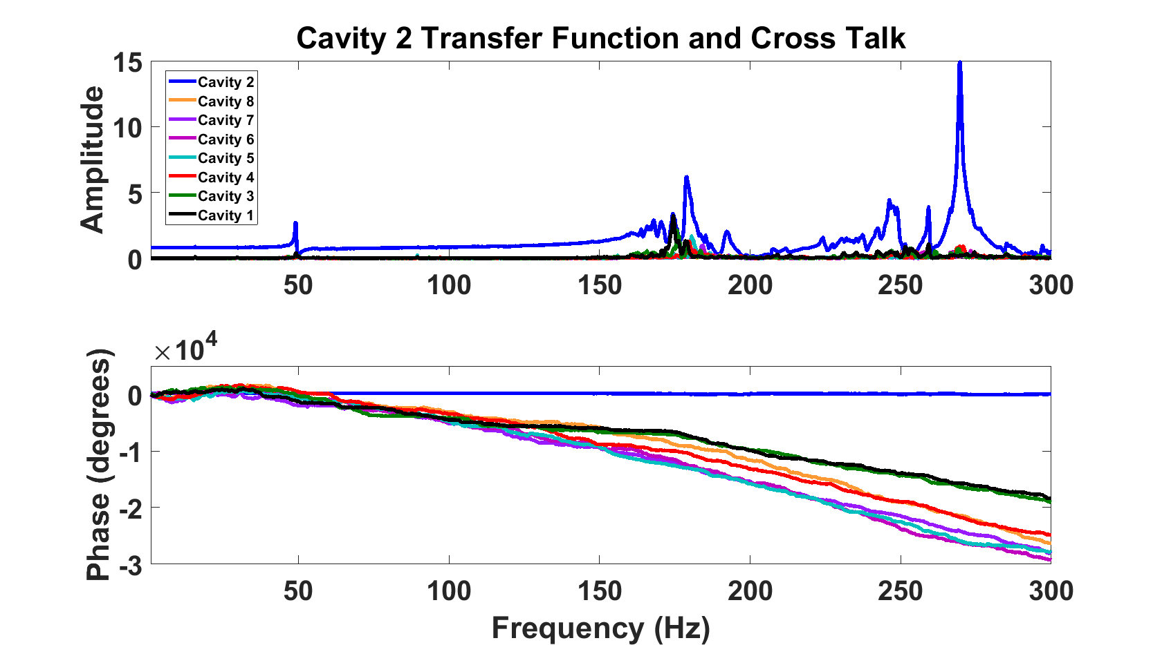
Cross Talk Frequency Response

Slide 8
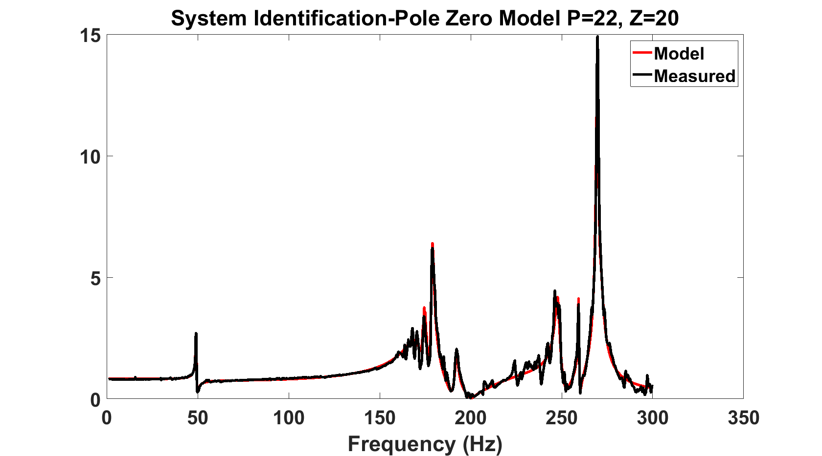
Model Fit using System Identification

Slide 9
State Space Model
$$x\left(k+1\right)=Ax\left(k\right)+Bu\left(k\right), A →n×n, B →n×r$$
$$y\left(k\right)=Cx\left(k\right)+Du\left(k\right), C→m×n, D→m×r$$
A SISO system has $r,m=1$
Eigen values of A represent the poles of the system
The imaginary part represents resonant frequencies $f_{n}$
0 | 49 | 172 | 174 | 180 | 192 | 223 | 248 | 259 | 270 | 271

Slide 10
System Controllability/Observability
$$P=\left[B ⋮AB ⋮A^{2}B ⋮ ⋯ ⋮ A^{n−1}B\right] , P→n×rn$$
$$Q=\left[ C^{T}⋮A^{T}C^{T}⋮{{(A}^{T})}^{2}C^{T} ⋮ ⋯ ⋮{{(A}^{T})}^{n−1}C^{T}\right] , Q→n×mn$$
System is completely controllable if and only if the rank of P is n
If a system is controllable, it can be driven from an initial state x(0) to zero in a finite number of steps N.
System is completely observable if and only if the rank of Q is n
If a system is observable, its state x(0) can be determined from the outputs y[0,N] where N is finite

Slide 11
Example
$A= \left[\begin{matrix}−7 & −2 & 6 \\ 2 & −3 & −2 \\ −2 & −2 & 1\end{matrix}\right]$
$A= \left[\begin{matrix}−7 & −2 & 6 \\ 2 & −3 & −2 \\ −2 & −2 & 1\end{matrix}\right]$
$B= \left[\begin{matrix}1 & 1 \\ 1 & −1 \\ 1 & 0\end{matrix}\right]$
$C= \left[\begin{matrix}−1 & −1 & 2 \\ 1 & 1 & −1\end{matrix}\right]$
Eigen values of A are -1, -3 and -5, the state equations can be represented in the canonical form with a co-ordinate transformation $q=Mx ,$ the state equations can be written as
$\dot{q}=\left[\begin{matrix}−1 & 0 & 0 \\ 0 & −3 & 0 \\ 0 & 0 & −5\end{matrix}\right]q+\left[\begin{matrix}0 & 0 \\ 1 & 0 \\ 0 & 1\end{matrix}\right]$u,
$y=\left[\begin{matrix}1 & 0 & 0 \\ 0 & 1 & 0\end{matrix}\right]$q,
Mode 1 is not controllable and mode 3 is not observable

Slide 12
Controllability/Observability Test
$$P=\left[B ⋮AB ⋮A^{2}B ⋮ ⋯ ⋮ A^{21}B\right] , P→22×22$$
$$Q=\left[ C^{T}⋮A^{T}C^{T}⋮{{(A}^{T})}^{2}C^{T} ⋮ ⋯ ⋮{{(A}^{T})}^{21}C^{T}\right] , Q→22×22$$
$$Rank\left(P\right)=22, System Controllable$$
$$Rank\left(Q\right)=14, System not Observable$$

Slide 13
Conclusions
Piezo actuator in the longitudinal axis cannot directly cancel out vibrations
excited in the transverse axis
Even if transverse vibrational modes are uncontrollable, the detuning that they
create may be counteracted by the longitudinal piezo actuator
The controllability tests on the model extracted indicates that it should be possible to build a stable state feedback system for this model.
Controller design and simulation needs to be done to validate the model and evaluate the performance

