Slide 1


Microphonics control studies for high Q_{L} SRF Cavities
Module commissioning of the bERLinPro SRF Gun
A. Neumann
Helmholtz-Zentrum
Berlin
Second Topical Workshop on Cryomodule Microphonics and Resonance Control, Brooklyn, NY

Slide 2
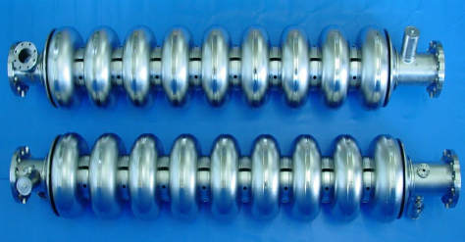
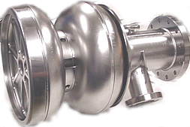
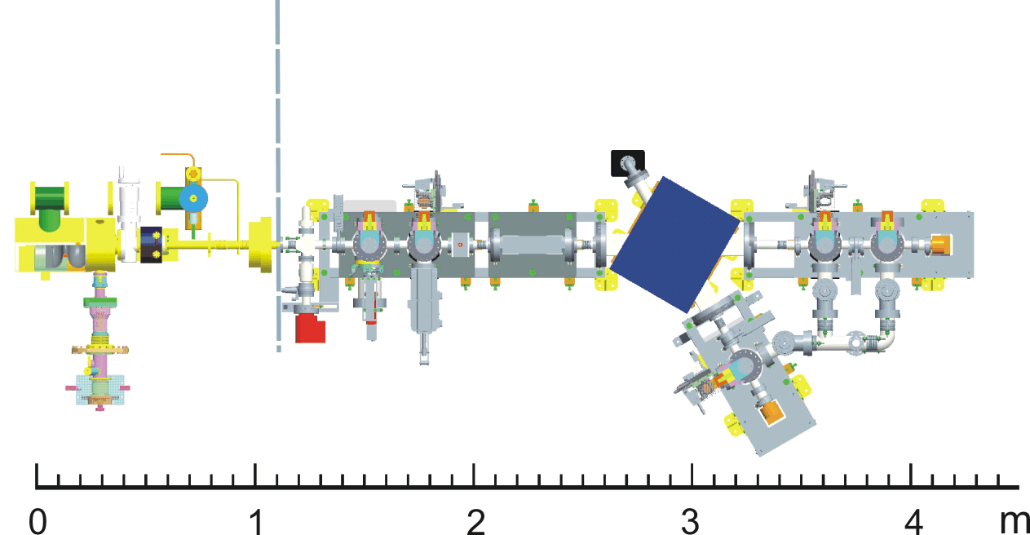
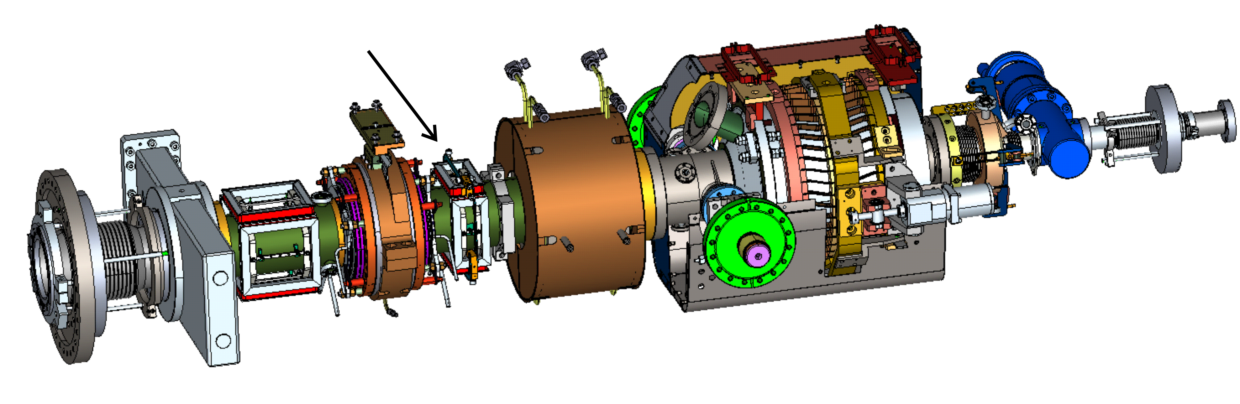
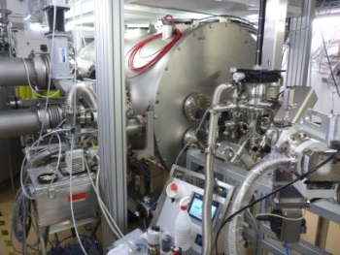
Systems under study
CW modified TESLA cavity for BESSY-FEL (2005-2008)
  Studied mainly at HTS (HoBiCaT)
  Q_{L} from 5.10⁶-2.10⁸, E_{acc}=8-22 MV/m
  CW studies, heat load, microphonics compensation
  high Q_{L} LLRF
HoBiCaT
cryomodule
Nb Pb lead cathode DESY
gun (1.6 cell), 2011-2012
  Studied with diagnostics
  beamline
  E₀=12-25 MV/m
  Q_{L}=3.10⁶-1.5.10⁷
  Δf/ΔP=100 Hz/mbar
  Δf/ΔE₀²=1 Hz/(MV/m)²
Drive laser
port
DESY-JLab-HZB coll.
2-phase line
Slit
ICT
Cathode
Bending magnet
Beam dump+
Faraday Cup
Cavity
SC solenoid
Stripline
YAG-Screens
TTF-III coupler
YAG-Screen
Faraday Cup
Beam dump+
Faraday Cup
SRF Photoinjector (ERL), today
  Studied with diagnostics
  beamline + cathode transfer
  E₀=8-35 MV/m
  Q_{L}=1.10⁷-2.8.10⁷
  Δf/ΔP=33 Hz/mbar
  Δf/ΔE₀²=3.4 Hz/(MV/m)²
bERLinPro ERL medium power SRF gun
cavity cold string

Slide 3
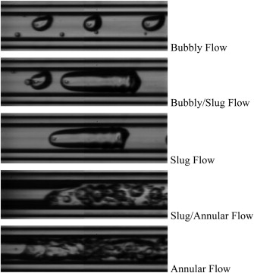
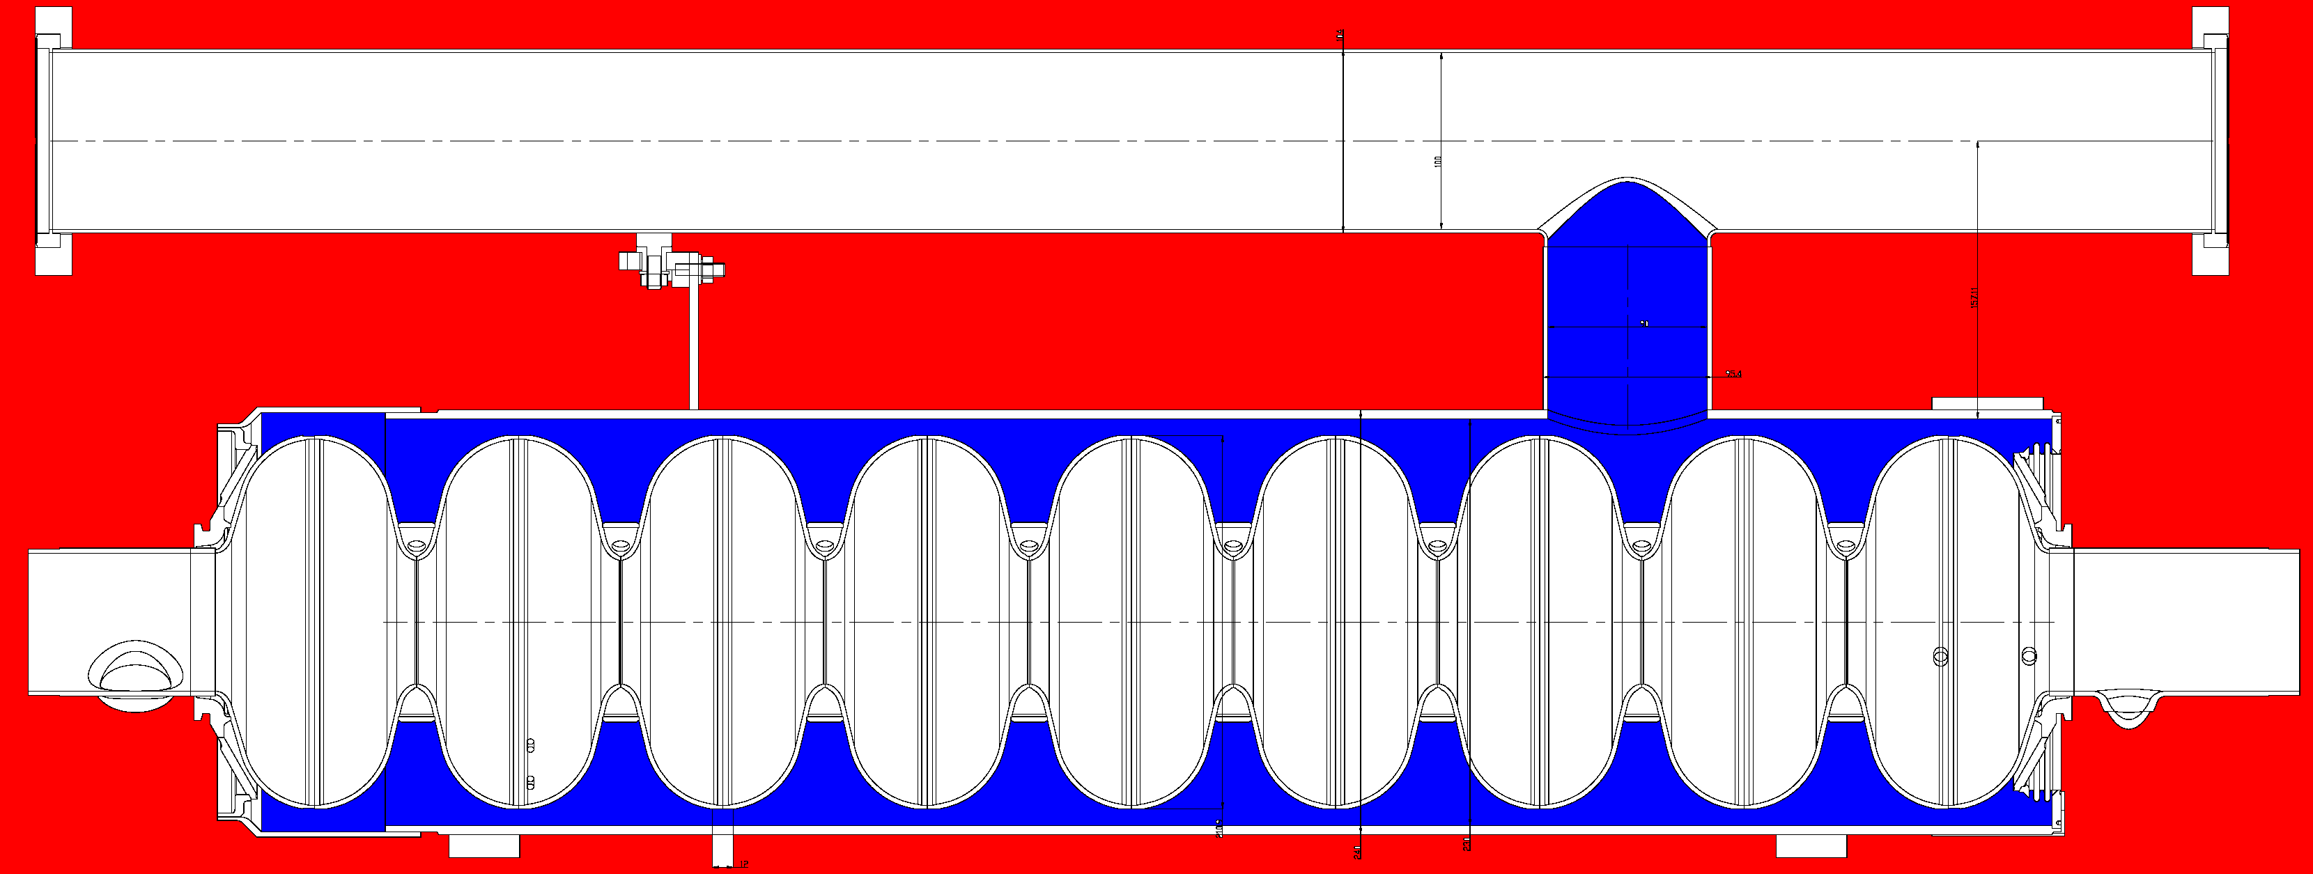
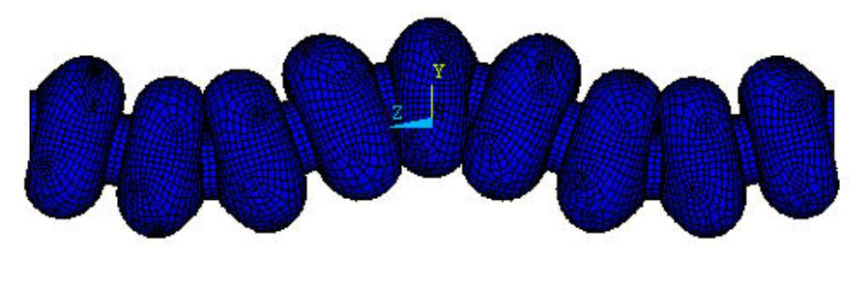
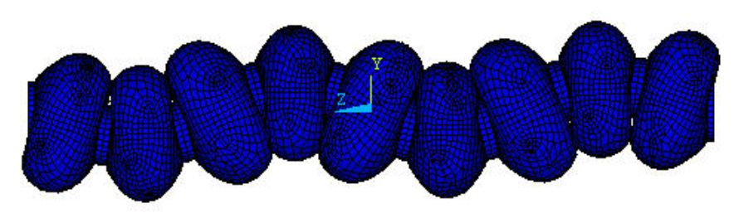
Microphonics: How does it appear?
Field amplitude variation:
Dynamic Lorentz force, Δf/ΔE_{acc}² = 1-3Hz/(MV/m)²
→ Ponderomotive instability
Helium pressure fluctuations
Δf/Δp = 50-60 Hz/mbar,
SRF Gun:30-100 Hz/mbar
16 mbar±30 µbar
2.5-3 mm Niobium walls
Heat transport
dynamics in LHe
Thermo-acoustic
oscillations
(cryo valves…)
Stochastic
background
noise
Deterministic,
narrow-band
sources:
Vacuum pumps
Mechanical oscillations of the Cavity:
Microphonics
Response of the
Cavity-Helium vessel-Tuner
system:
Mechanical Eigenmodes
222 Hz
G. Bissofi
Lowest modes:
Usually transverse
151 Hz
Is that the whole story?
G.P. Gelata et al. International Journal of Thermal Sciences
Volume 58, August 2012, Pages 1-8

Slide 4
Microphonics: What do we see?
The cavity is the best sensor of mechanical excitation itself, true?
→ What deformation affects actually the RF mode (TM_{0yz} different than e.g. TM_{1yz})?
Cavity design: Cavity sensitivities
Helium bath often main driver of microphonics, usually the static term Δf/ΔP can
be measured or the cavity design optimized for
→ What about dynamic response?
Detuning is often obtained by comparing forward and transmitted (reflected) wave
of the TM₀₁₀ π-mode (or FPC excited RF mode).
→ We only see what affects the RF mode, not all oscillations, do we care?
Cavity oscillations w.r.t. beam motion?
Is this always what we consider microphonics (oscillations in acoustic regime)?
Can we compensate every oscillation which affects the wanted cavity RF mode
using tuner with e.g. piezos?
Be aware of other contributions to appear in the signal:
  Transient beam-loading (hopefully repetitive, but what about beam losses in
  recirculating machines?) ←→ beam arrival jitter, synchrotron oscillations
  Multipacting in more special cavities (e.g. SRF gun, coaxial parts)
  Loop oscillates if stability criterion is not met
  Coaxial FPC: Oscillation of inner conductor (cooling media)
  → Some of them alter the measurement, some are real detuning, but
  eventually not tackled by tuners

Slide 5
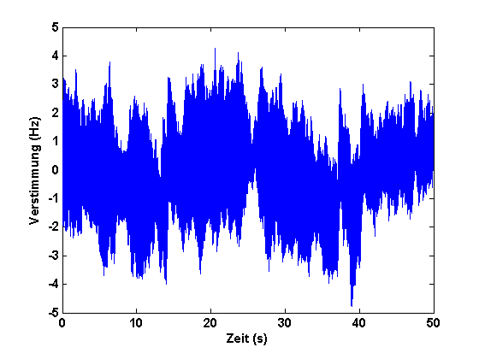
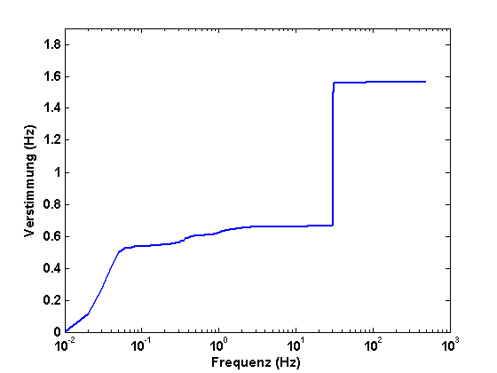
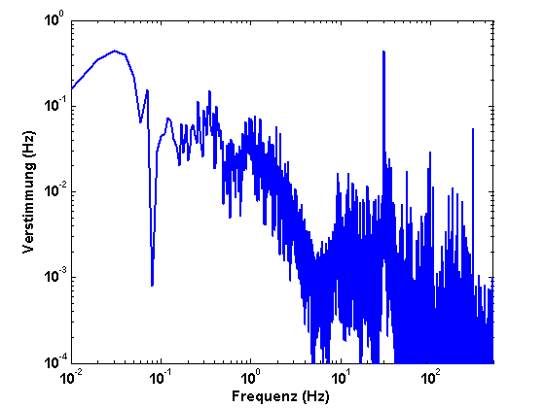
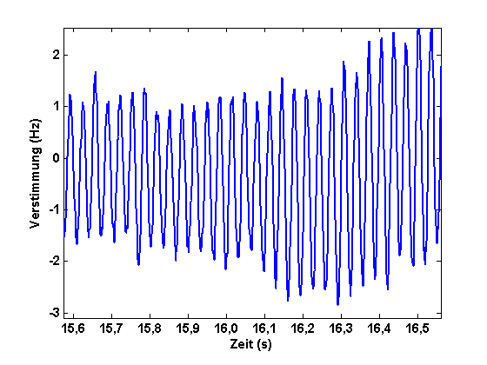
Detuning characterization of a TESLA cavity, short-term
Characterisation: Measurement results
For elliptical cavity, usually transverse mode
σ_{f} = 1.56 Hz
He pressure-
variations
Detuning (Hz)
ΣFFT
FFT
Excited Eigenmode
HoBiCaT: σ_{f} = 1 - 5 Hz (rms)
←→ 2-13° phase error (Aim: 10⁻² °)
„open loop“ „closed loop“
He pressure variations: f_{mod} < 1 Hz
Cavity specific: First mode at 20 - 50 Hz
Spectrum can appear more populated
→ depends on cavity system
Detuning (Hz)
Time (s)

Slide 6
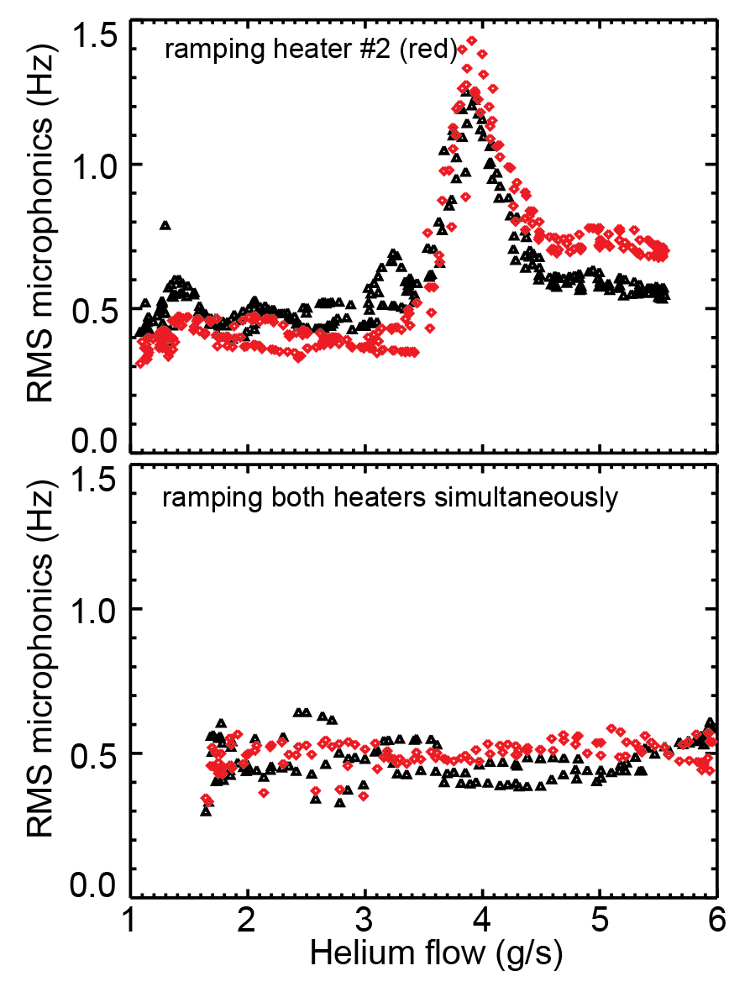
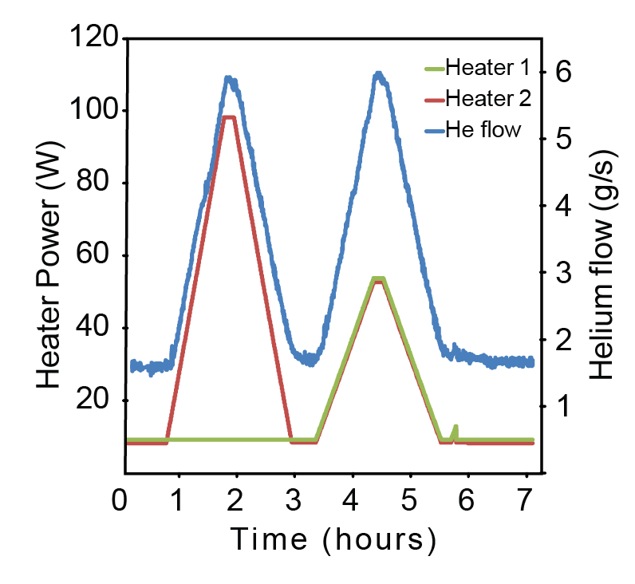
Microphonics and thermal load on cavity tank
30mbar
Simultaneous 2 cavity operation
(TESLA cavities)
Heaters attached at each tank
Monitor microphonics due to thermal
load on cavities
Onset of non-laminar Helium flow?
Chimney limit

Slide 7
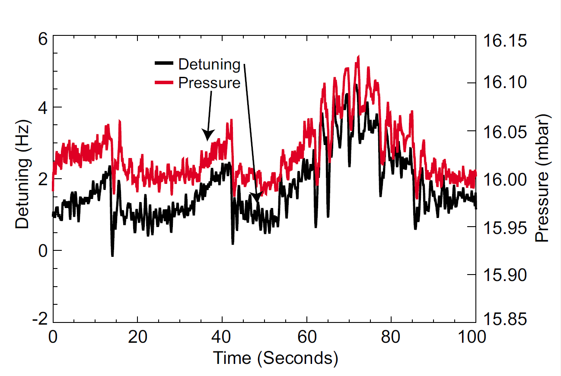
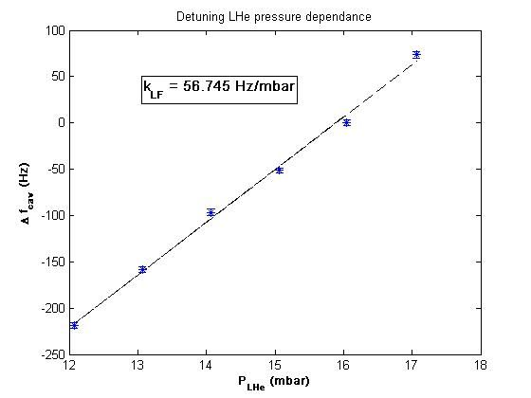
Correlation of Helium pressure and detuning of cavity
TESLA cavity
Open loop measurement of cavity frequency and He pressure
50-60 Hz/mbar down to resolution limit of pressure meters (~1Hz)
Evidence that main contribution of microphonics mediated through superfluid Helium

Slide 8
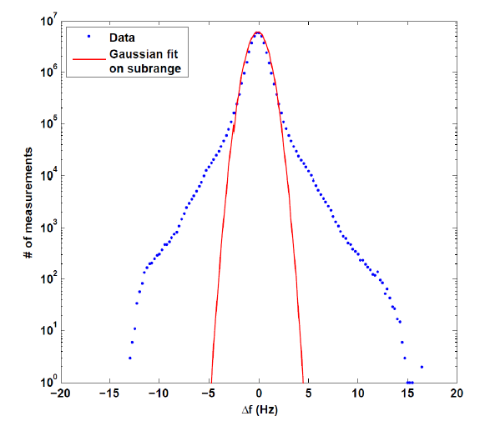
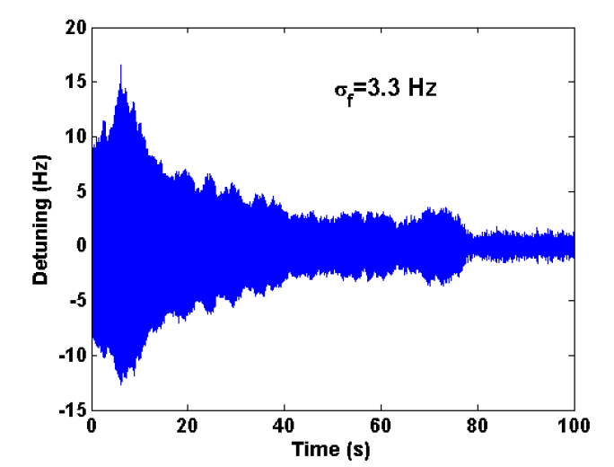
Longterm stability: Peak events→ how much, how often?
Microphonics recorded at HoBiCaT with TESLA cavity for 48 hours at E_{acc}=8MV/m
RMS Values around 1-5 Hz ← Determines field stability and thermal loading of RF system (5 kW)
Peak values extend out to 17 σ! ← Determines RF power installation (15 kW)
Peak events occur 10-20 times a day!
(This was partly improved by changes to
the control settings of the under-press.
pumps.)
Expected field stability: 0.02 - 0.1°
For „comfort“ want to reduce
the microphonics
Gaussian sub-range
0.8 Hz rms
Excited 1st mech. resonance: Transverse mode

Slide 9
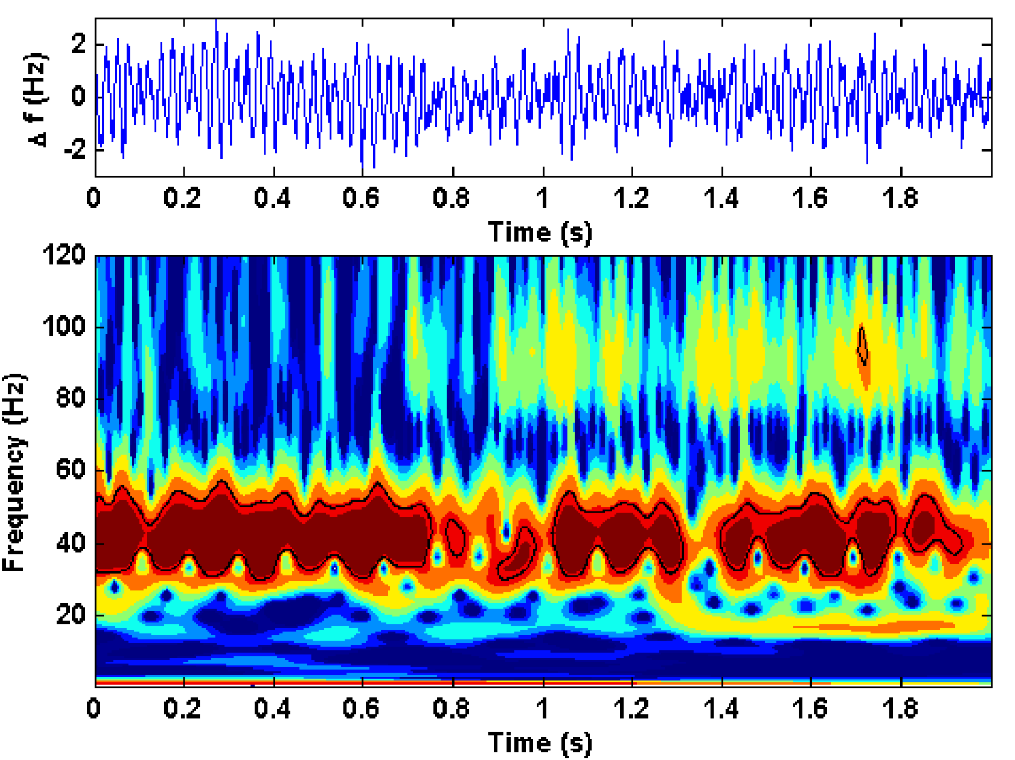
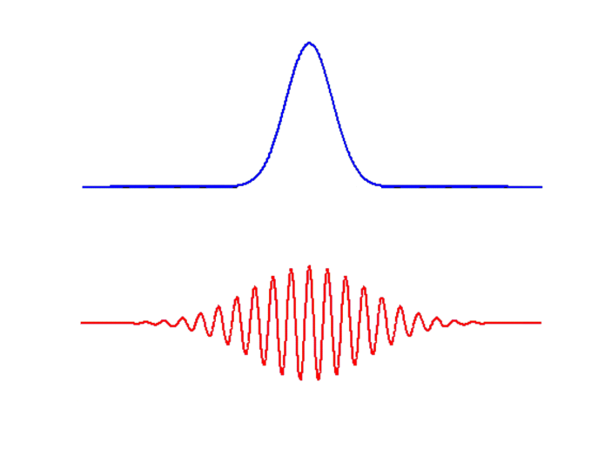

Time-frequency analysis by Wavelets
^
ψ
Morlet
Δf (Hz)
ψ
s. ω
0
t/s
Variation up to Δf =10 Hz
on a ~100 ms time scale
Spectrum of He-pressure variations of
stochastic nature
Adaptive, „learning“ (dynamic)
compensation mandatory
Need for classic feedback control

Slide 10
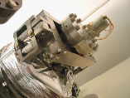
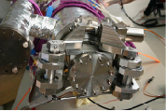
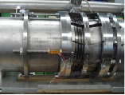
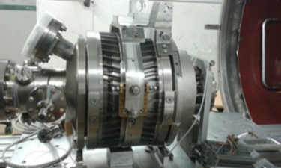
Tuner qualification
Tested 3(4) different
tuner systems
 | Saclay I* | Saclay II | INFN Blade**
Mech. principle | 1-lever+flexures | 2-levers+flexures | Knee-lever+blades
Tuning resolution | 0.176Hz/step | 0.09 Hz/step | 2.6 Hz/step
Drive | Phytron / HD 1:88 | Phytron / HD 1:88 | Sanyo / PG 1:100
Max remanence | 30 Hz | 55 Hz | 380 Hz
Coarse tuning range | 750 kHz | 500 kHz | 720 kHz
Coercitive steps | 180 (no backlash) | 350-500 (backlash) | 100 (backlash)
Used piezo type | HV (0-1000V) | LV (-10-150V) | LV (0-200V)
Piezo tuning range | 750 Hz | 1420 Hz | 800 Hz
Group delay (dφ/dω) | 290 µs | 150 µs | 650 µs (138 µs)***
Lowest resonance | 40 Hz | 40 Hz (double) | 35 Hz
→ Important for CW piezo based detuning control
* Increased stiffness of piezo holder frame
** Several versions exist
*** 138 µs for 1.4 cell SRF gun with Cornell blade tuner

Slide 11

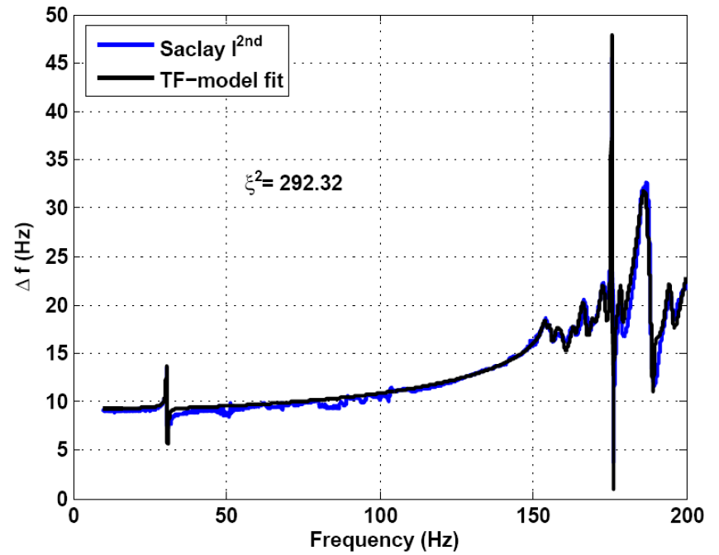
Model based controller: Fit of the system
TESLA Cavity
Fit: Parallel acting 2nd
order systems
Evaluate response of higher
modes at lower frequencies
>20 modes needed for fit
Systems complexity complicates
use of model based feedbacks
(e.g. Kalman filter)
Individual for:
Each cavity tuner combination
Changes with coarse tuning or
helium pressure
Affected by cav. mech. design
Degeneration of 1st mode
Transfer function as
look-up table or
Kalman approach tested
with cavity simulator
See talk A. Ushakov
Relevant for tuning
But: Only LF and piezo transfer functions accesible
in operation!

Slide 12
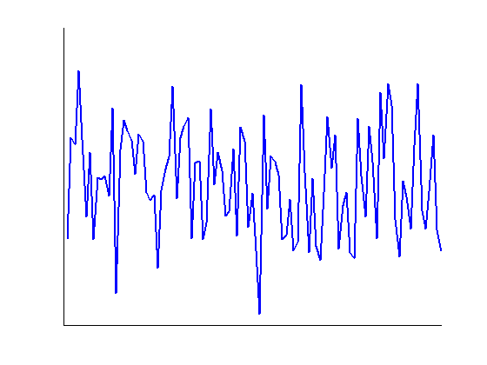
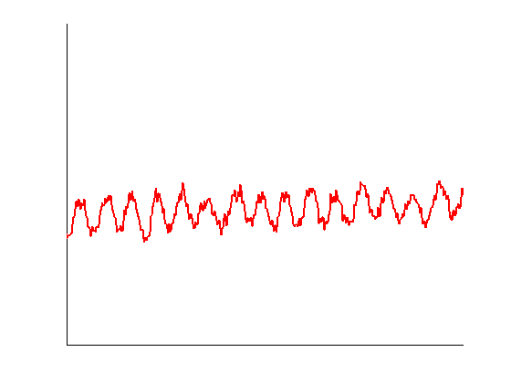
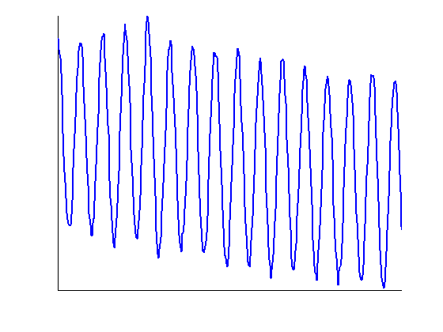
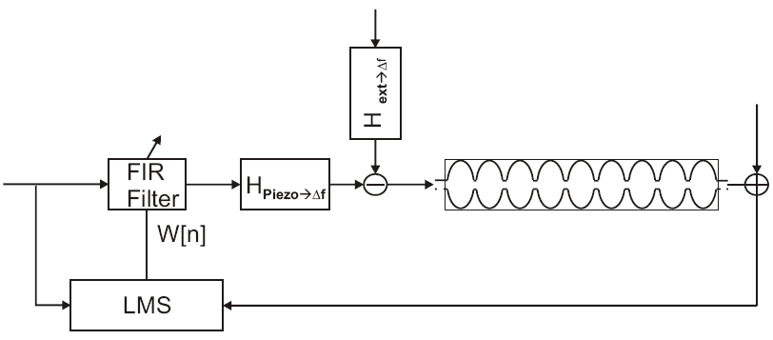
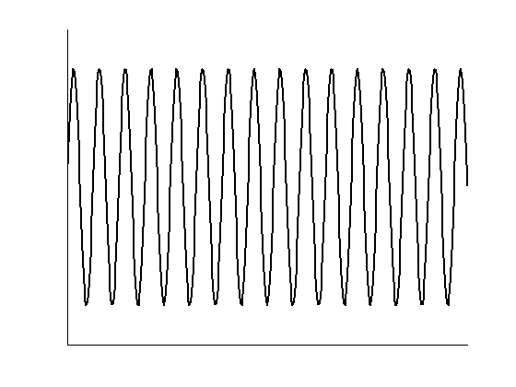
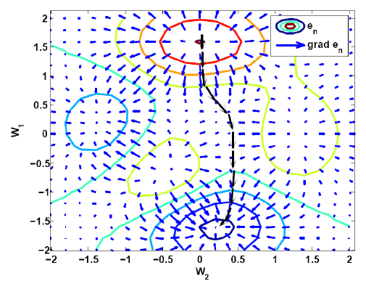
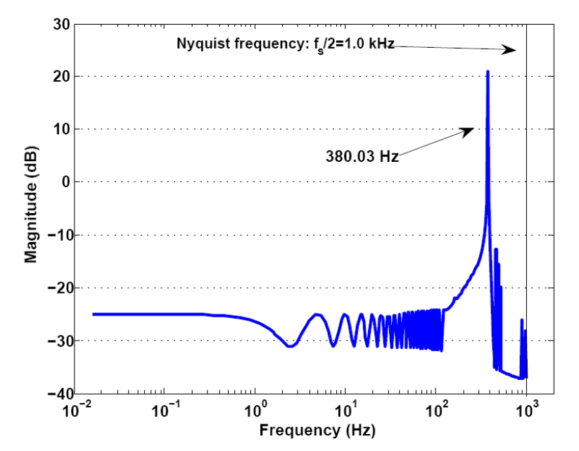
A tested scheme: Least-mean-square based adaptive feedforward
External mechanical → Mostly by helium system, unknown!
oscillations
Δl (nm)
FFT
Compensating
signal
t (s)
Detuning
of the cavity
Δf (Hz)
ΔU (V)
IFFT
∙H⁻¹
t (s)
t (s)
or IIR
Calculation
of optimal
FIR filter
parameters
For white noise excitation
The FIR filter would be
H⁻¹_{piezo→Δf}
A. Neumann et al, Phys. Rev. ST Accel. Beams 13, 082001

Slide 13
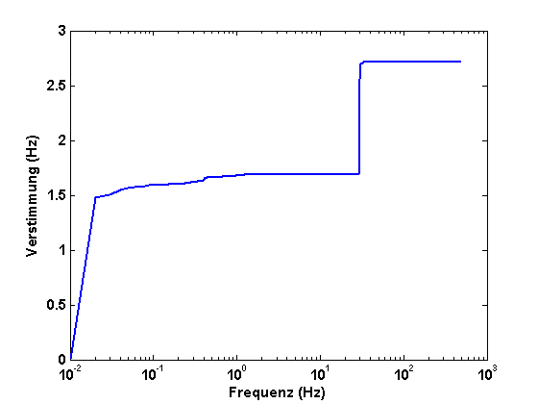
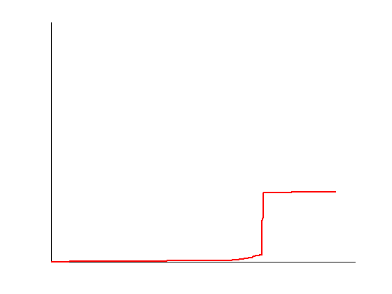
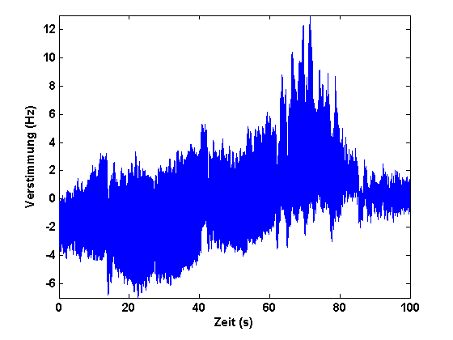
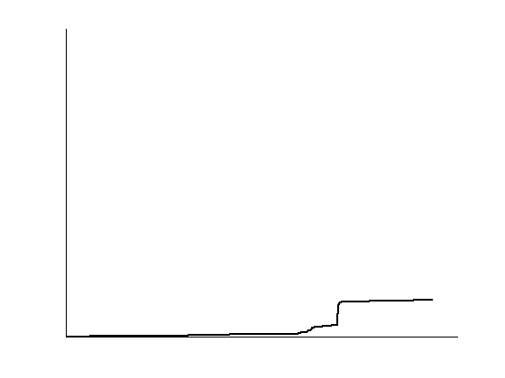
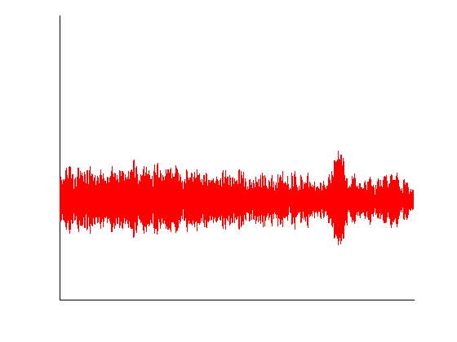
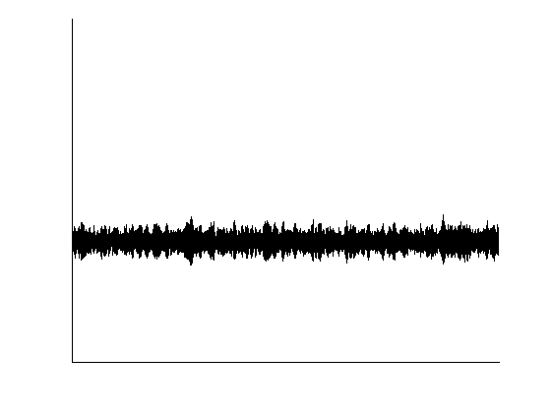
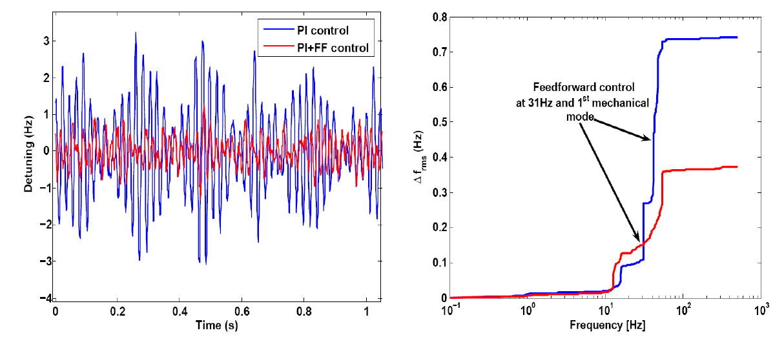
Piezo based compensation results
Single-resonance control:
Results:
ΣFFT
Q_{L}=6.4.10⁷
σ_{f} = 2.52 Hz
Open
loop
Feedback only
σ_{f} = 0.89 Hz
Feedback
and Feed-
forward
σ_{f} = 0.36 Hz
14 deg phase mod. down to 2 deg → sub-promille stability in theory possible
Multi-resonance control:
Piezo resolution seems
to limit control of
neighboring modes
→ transfer of energy
Resonances: Control voltage of mV regime required before amplifier

Slide 14
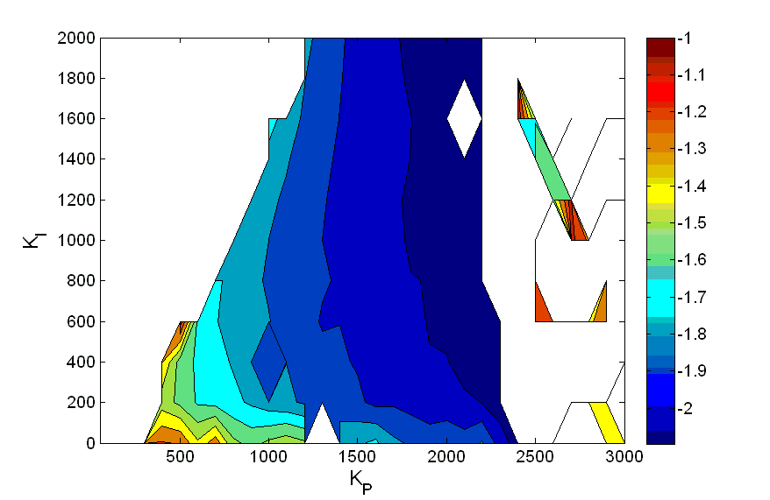
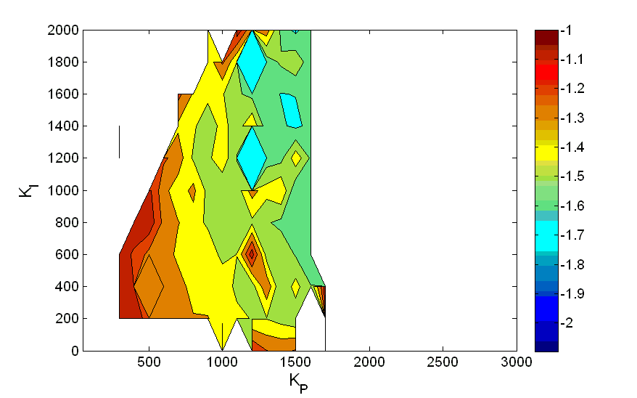
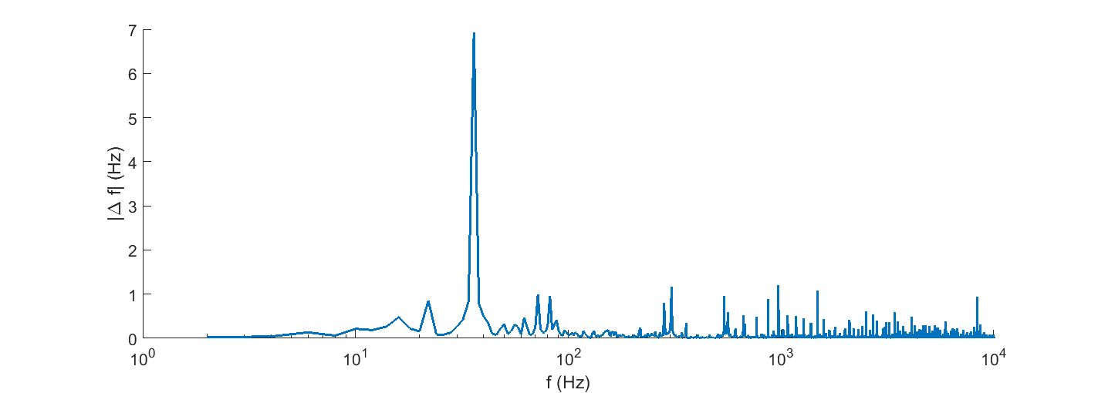
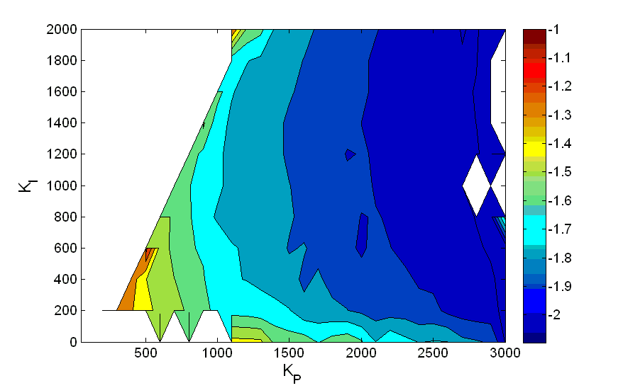
LLRF studies with U Cornell: Limits of Q_{L}
f_{1/2}=13 Hz
log(σ_{φ})
f_{1/2}=3.25 Hz
P_{f}=325W
at 12 MV/m
Q_{L} | σ_{φ} (deg.)
5.10⁷ | 0.008°
1.10⁸ | 0.0093°
2.10⁸ | 0.0236°
TESLA cavity
E_{acc}= 10-12 MV/m
T_{bath}= 1.8 K
PI piezo loop
Integrator vs.
LF detuning
8/9-π filter optimized
σ_{f} = 5-10 Hz,
Δf_{peak}= 15-25 Hz
1st MEM
f_{1/2}=6.5 Hz
LF detuning → IOT beam instable
Cavity field trip
Areas with σ_{φ}>0.1 were blanked out

Slide 15

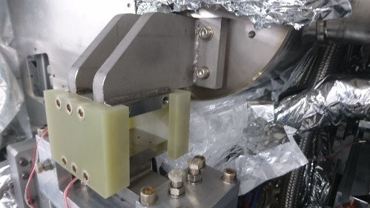
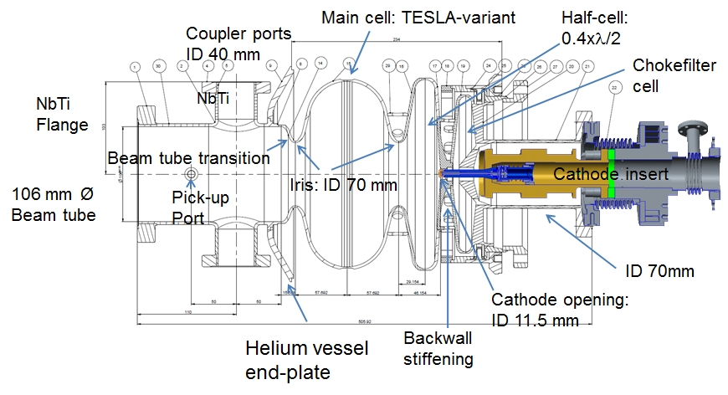
SRF Gun for bERLinPro: Stability issues
Thermal short → high static losses (20 W)
trial to cool via filling line, no phase separator,
thus flash gas lead to bubble formation beating the cavity
up to 3 kHz (PLL-mode)!
Capacitive sensors
for cathode positioning, BW 5kHz
SRF gun cavities have high sensitivity to Lorentz force, up to 3 kHz
tuning for target field required, higher probability of ponderomotive
instabilities
Several cooling media attached to cavity and ancillaries:
Cooling of normal conducting cathode via 80K helium gas
→ Vibration of cathode? Would act as a plunger modulating
the TM₀₁₀-π mode (depending on cathode position)
80 K cooling of HOM absorber….

Slide 16
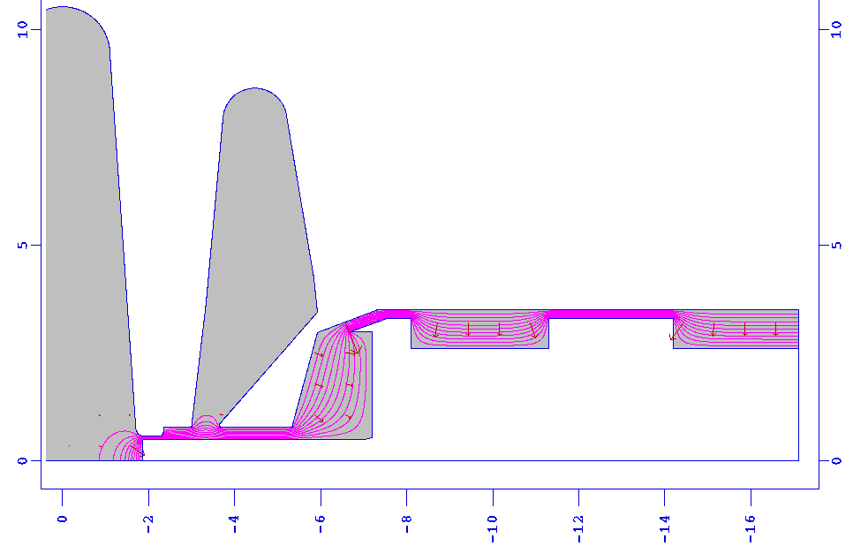
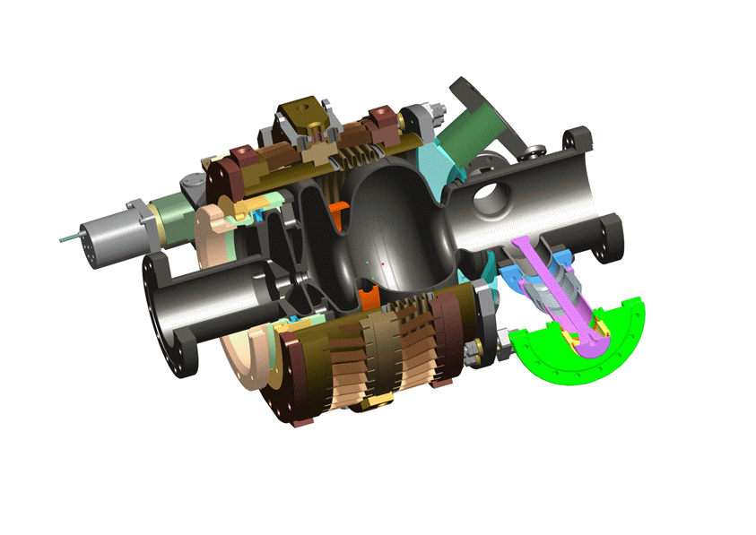
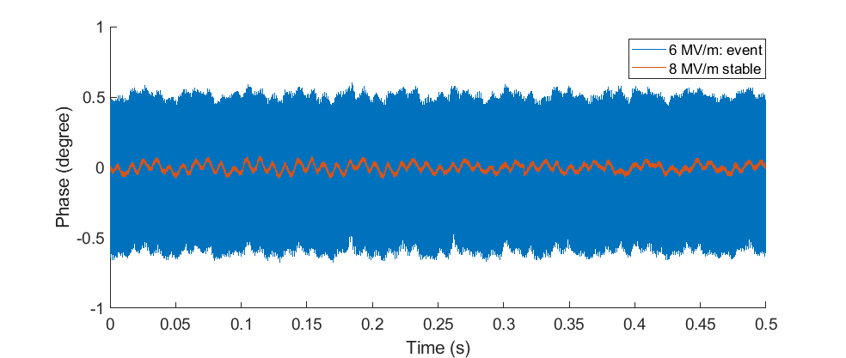
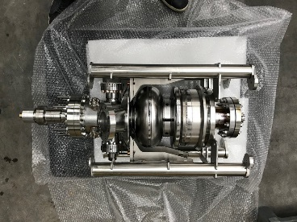


Some example during SRF gun operation
RF Phase
Poisson result:
Courtesy J. Völker
σ_{f}=9 Hz
σ_{f} → ∞
Half-cell
Choke
Forward Power
DC bias simulation
No direct correlation to loop gain!
This instability was affected
by DC bias voltage in
cathode channel
This is used to mitigate
Multipacting
Strong correlation with
vacuum activity
Piezo in lowpass PI loop
Multipacting?
Detuning

Slide 17






SRF gun cavity LLRF operation
Piezo tuner transfer function
Stability paid by 4xpower
overhead
Phase spectrum
Q_{L}=2.83.10⁷
Δf_{peak}=20 Hz
σ_{f}=9.8 Hz
→
σ_{φ}=0.03 deg.
σ_{A}/A=1.5.10⁻⁴
Detuning spectrum
To be controlled!

Slide 18




SRF gun cavity LLRF operation: Limits
Insufficient
cooling of cathode
Helium bath
activity?
@25 MV/m, quench
would occur after few minutes
DESY
Nb/Pb gun
1st MEM
First MEM
at 220 Hz
A lot of power dissipated in LHe bath → effect on microphonics?

Slide 19
Message to be delivered
Low beam-loaded high Q_{L} operated multi-cell SRF
elliptical cavities can be operate up to Q_{L} of 2.10⁸
with stability below 0.02°
→ For better stability 5-7.10⁷
Microphonics compensation can gain an order of magnitude and
thus lower thermal load via FPC
Major contributions by excited mechanical eigenmode,
often lowest transverse mode
Excitation most probably transferred via helium system
Special cavities like SRF guns demand for higher level of tuning
control as they are more susceptible by design (half-cell)
Operation at high losses or close to quench limit will
open up new surprises, higher level of microphonics
Future studies→
Apply Kalman (A. Ushakov) and LMS feedforward control to SRF cavities
as SRF gun, Booster 2-cell and Linac multi-cell
+ collaborate with DESY LLRF team at CMTB
Develop tuning strategies and firmware for high current and
transient beam-loading cases (see talk P. Echevarria)

Slide 20

















Questions?
Thanks to all collaborators and partners of the past, present and future
projects and co-workers at HZB:
Further readings:
A. Neumann, W. Anders, O. Kugeler, J. Knobloch (2010).
“Analysis and active compensation of microphonics in continuous wave
narrow-bandwidth superconducting cavities“,
Phys. Rev. ST Accel. Beams 13, 082001.
O. Kugeler, A. Neumann, W. Anders, J. Knobloch (2010).
“Adapting TESLA technology for future cw light sources using HoBiCaT”,
Rev. Sci. Inst. 81 (7).
A. Ushakov, P. Echevarria, A. Neumann
Developing Kalman Filter Based Detuning Control with a Digital SRF CW Cavity Simulator
Proc. of IPAC 2018, Vancouver, Canada, WEPAK012

Slide 21
Back-up slides down here

Slide 22



CW operation: A electro-magnetic-mechanical
-thermo-acoustic coupled problem?
P_{heater} (W)
Δf (Hz) rms
Regimes of non-stratified flow?
Q_{crit} (W/cm²)
P_{heater} (Δf_{max}) (W)
T_{LHe} (K)
T. Peterson, TESLA-Report 1994-18
T=1.5-1.9K
P_{LHe} (mbar)
Cavity driven by LLRF at E₀=15 MV/m
Piezo compensation in PI loop mode
with low-pass filtering, Q_{L}=1.4.10⁷
Additional power dissipated in L_{He} bath
by heater (few cm²) within liquid
Microphonics recorded while heater is powered

Slide 23


LLRF studies: Summary
Q_{L} | σ_{f} (Hz) | σ_{φ} (deg) | σ_{A}/A | P_{f} (kW)
5.10⁷ | 9.5 | 0.008 | 1.10⁻⁴ | 1.106
1.10⁸ | 7.9 | 0.009 | 2.10⁻⁴ | 0.595
2.10⁸ | 4.2 | 0.024 | 3.10⁻⁴ | 0.324

Slide 24

Tuner dynamics: Higher order response?
Microphonics
background
substracted
Here complete
detuning spectrum taken
at a given excitation
frequency
Usually transfer functions
taken with lock-in
amplifier to reduce
noise content
(Stanford Research,
SR850)
Transfer function
Higher harmonics
Measured with first version of piezo frame (2005-2006)
Higher harmonic content most probably by piezo amplifier (even within drive signal?)
Measured at high excitation amplitudes (above 20 Hz)

Slide 25



Detuning spectrum versus bandwidth
For two different tuning schemes (Saclay I and
INFN Blade) open loop measurements of
microphonics vs. Q_{L} were performed
Both tuners showed to have different transfer
functions and thus detuning spectra
on the same cavity type!
Q_{L,Saclay}: 3.10⁷-4.10⁸
Q_{L,Blade}: 7.10⁵-2.10⁷
Blade: Mechanical eigenmode
at 300 Hz, vacuum pump freq.
Saclay: Excitation of 1st
mechanical eigenmode sets in

