Slide 1
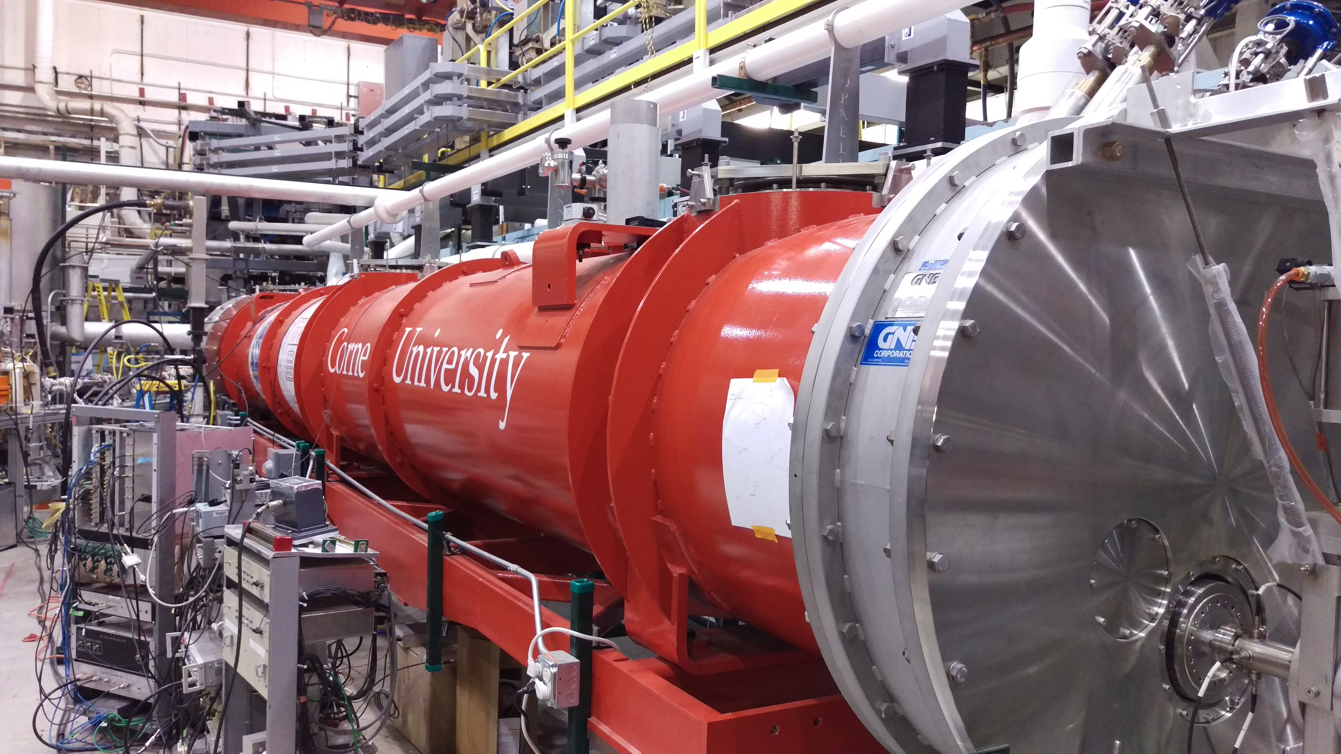
Experience with Microphonics in the CBETA Main Linac Cryomodule
Nilanjan Banerjee
Cornell University
Notes:
Change pictures!

Slide 2
Overview
Introduction
Initial Measurements
Vibration Sources
Mitigation Results
Active Resonance Control
Results
Conclusion
Notes:
Clean this up!s

Slide 3
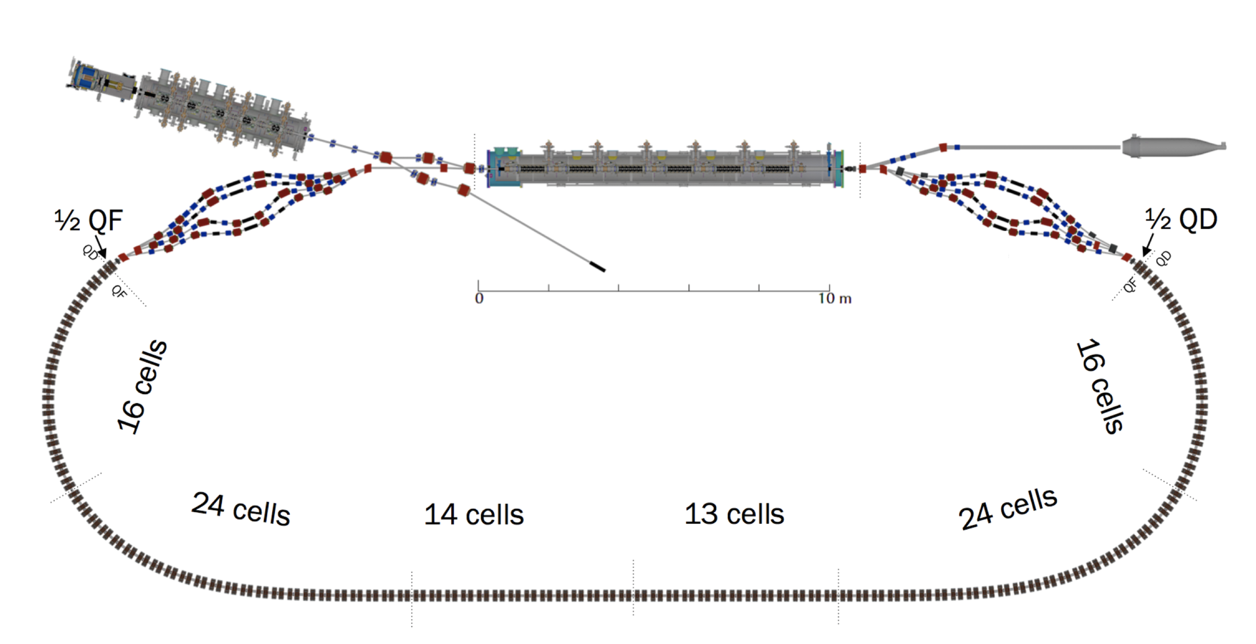
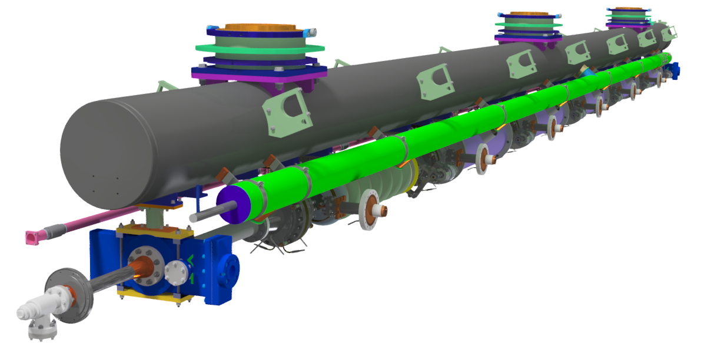
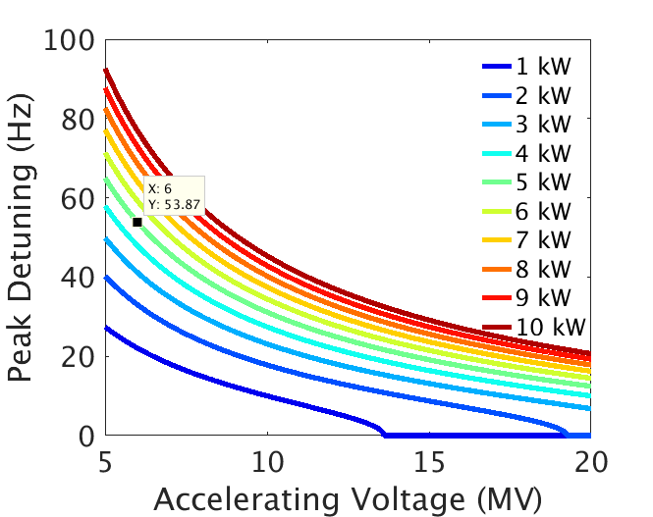
Introduction
The Cornell-BNL ERL Test Accelerator is a 4-turn energy recovery Linac with a FFA return loop.
Injector Linac
40 mA CW
Main Linac
320 mA CW
Input Power Coupler (Max 10 kW)
Helium Gas Return Pipe
Q_{L} = 6 x 10⁷
6 7-cell Cavities
ΔE = 6 MeV
σ_{A}/A ~ 10⁻⁴, σ_{φ} ~ 0.1°
The peak detuning of the cavity must be less than 54 Hz in order to sustain a cavity voltage of 6 MV using a power amplifier capable of delivering 5 kW.

Slide 4
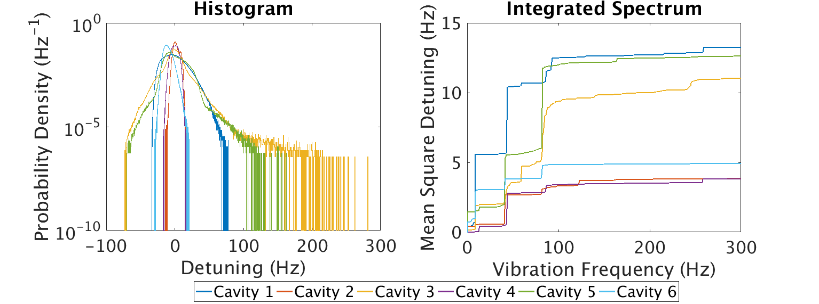
Microphonics Detuning
Cavity Number | 1 | 3 | 5 | 2 | 4 | 6
Peak Detuning (Hz) | 78 | 280 | 163 | 18 | 18 | 33
Major Vibration Frequencies (Hz) | 8, 40, 80 | 8, 40, 80 | 40, 80 | 40, 80 | 40, 80 | 8, 40, 80
RF Power Constraint Mitigation
We relax the peak detuning limit by using 10 kW power amplifiers for unstiffened cavities.
We can further relax the limit by changing the loaded quality factor to Q_{L} ~ 2 x 10⁷ using a 3 stub tuner.

Slide 5
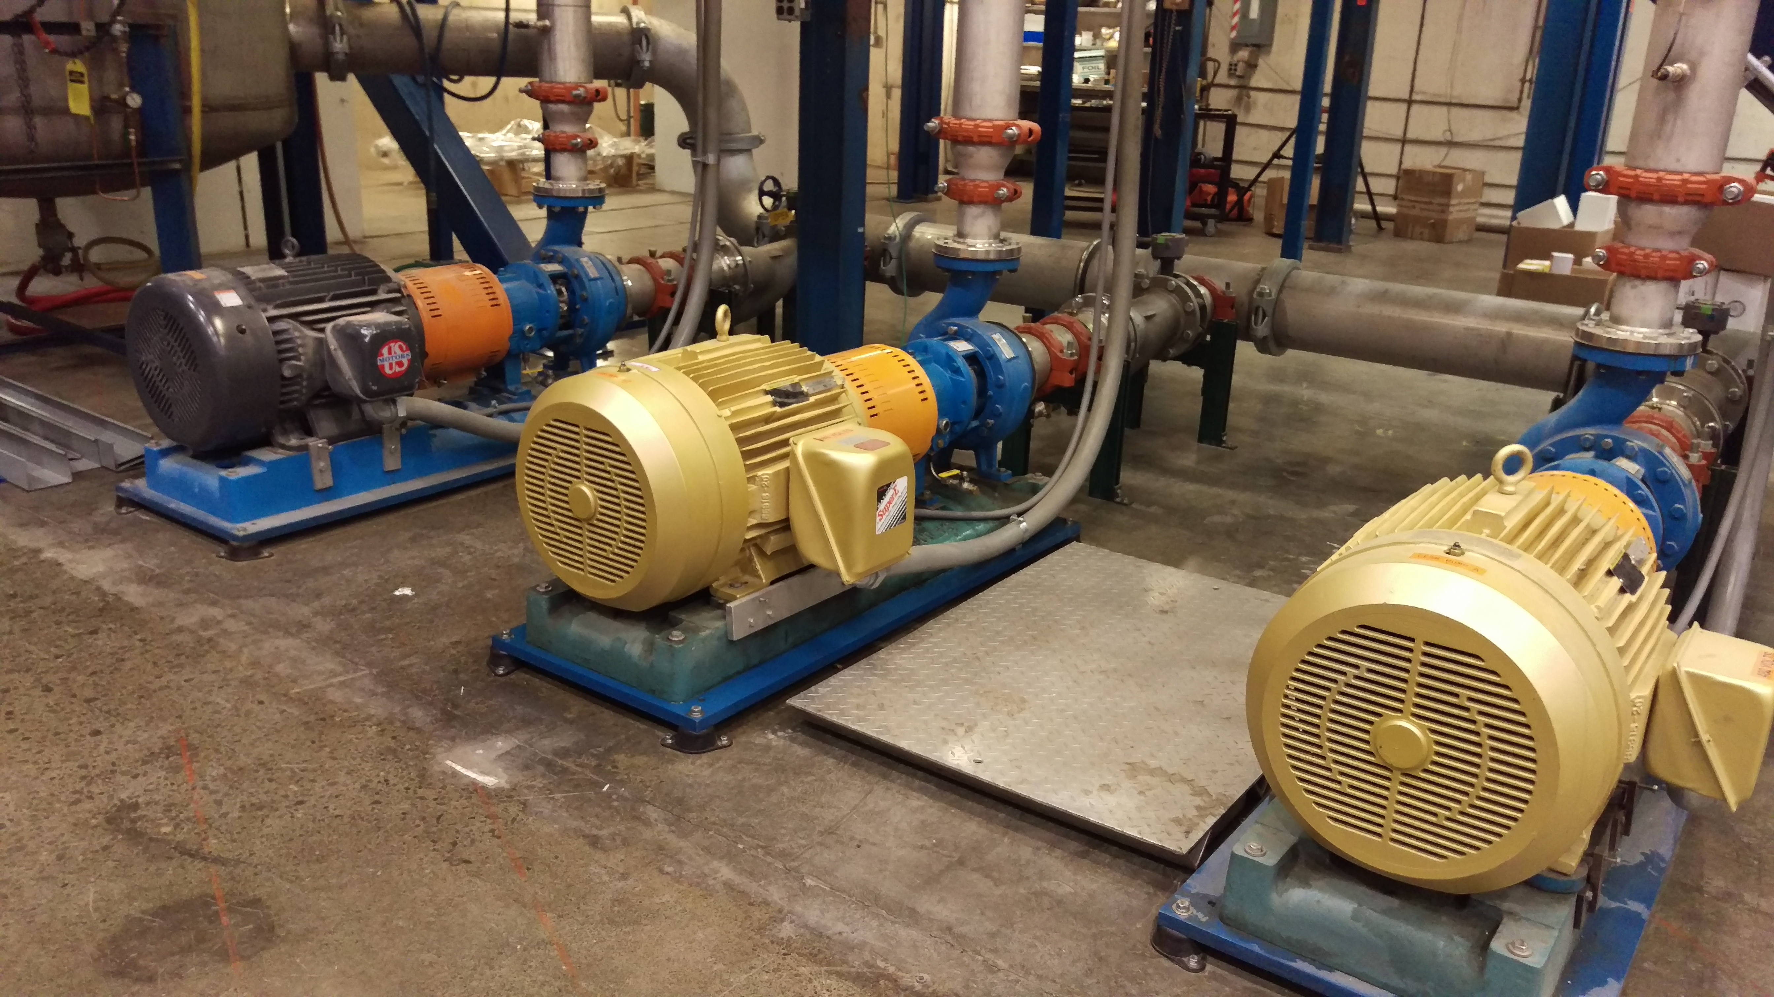
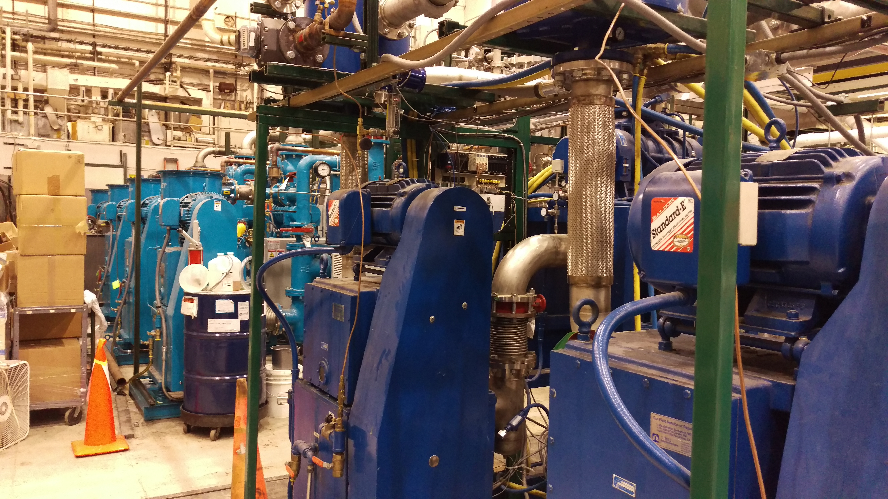
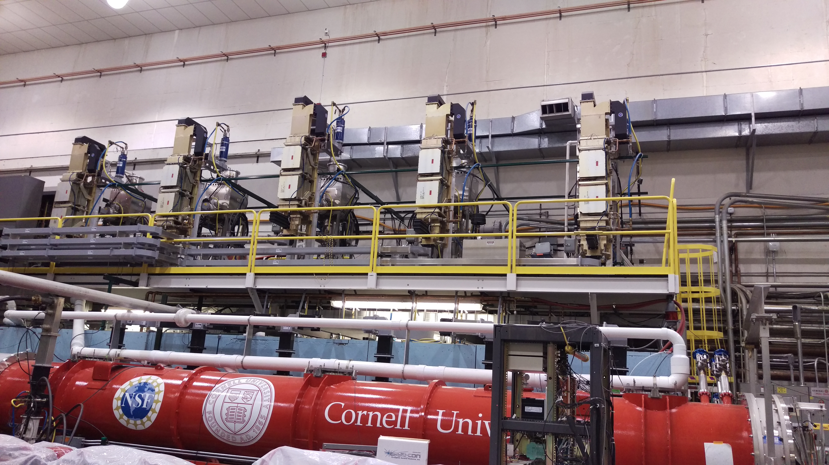
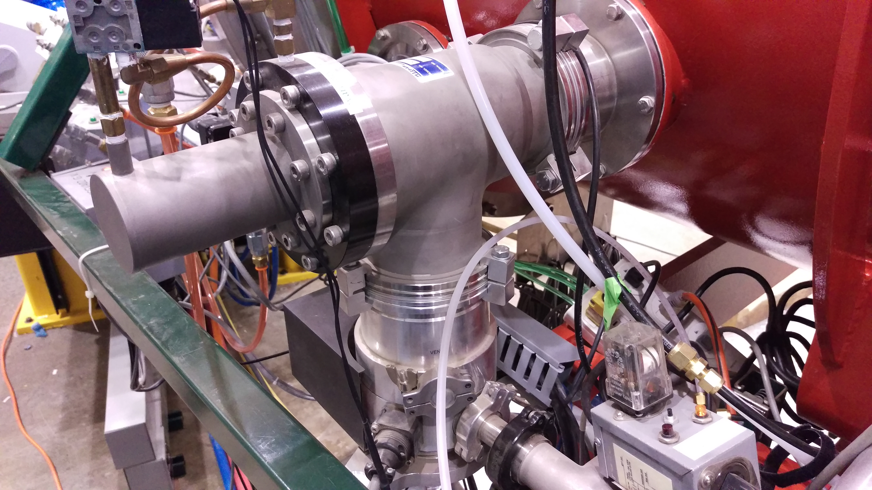
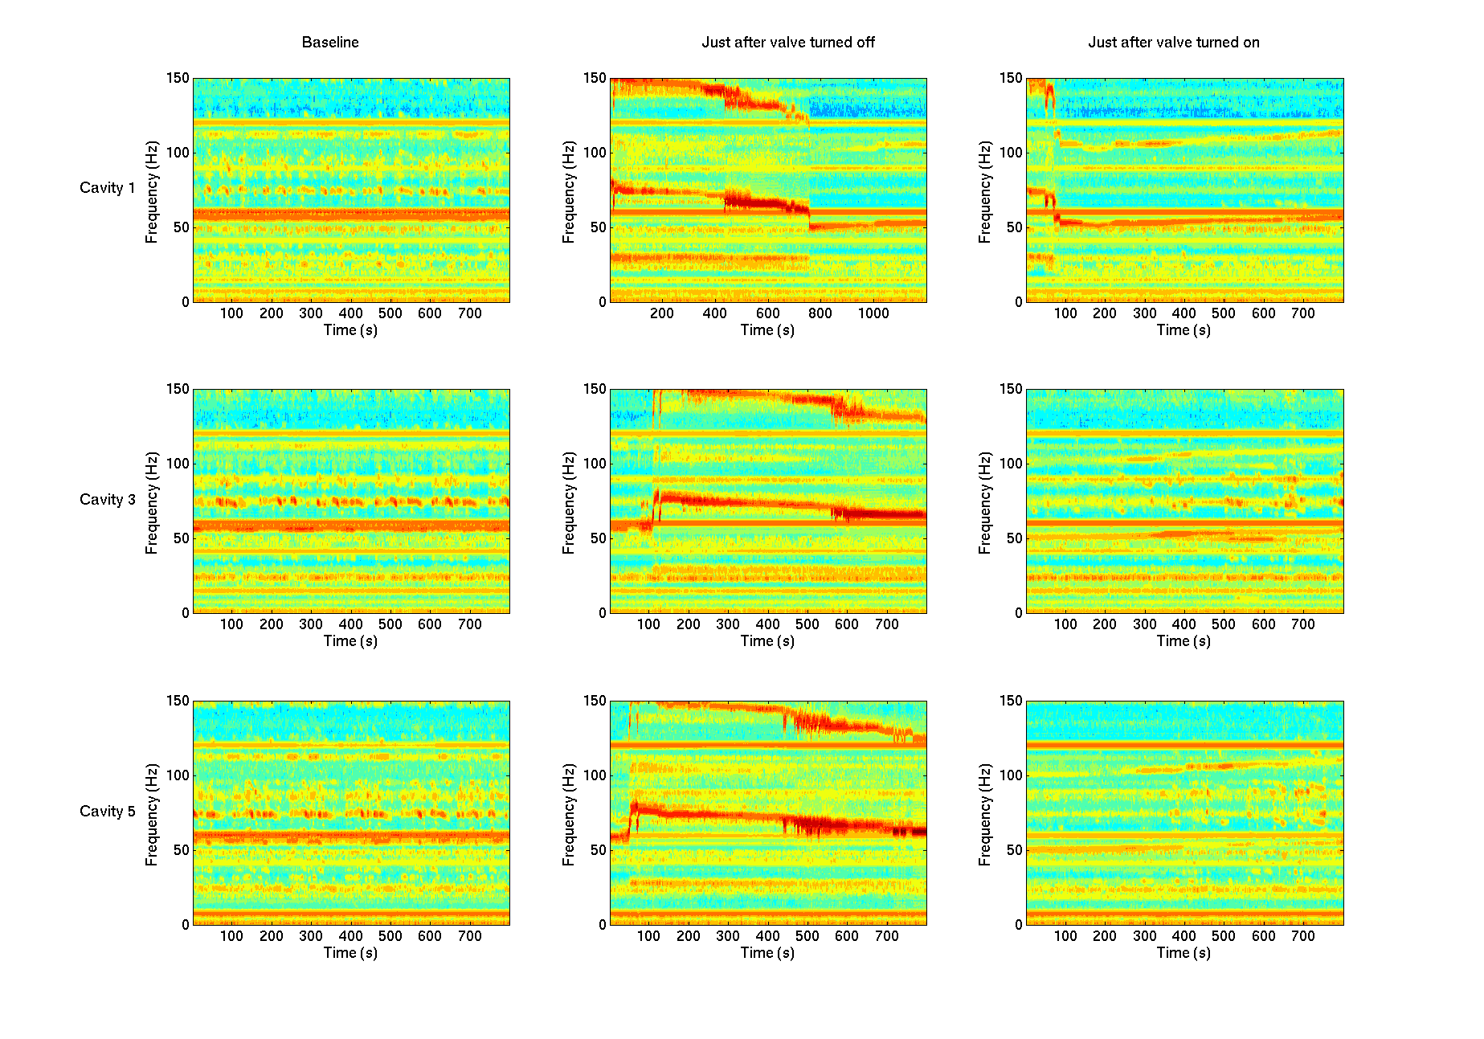
Vibration Sources
Vibrations can couple into the cryomodule from outside sources.
Water Pumps (6 m away)
No contribution
Blower Pumps
(4 m away)
No direct contribution
Klystron Platform
59 Hz vibrations coupled in through waveguide suspended from platform.
Vibrations can also come from inside the cryomodule.
5 K Helium System
Turning off gas flow changes vibration spectrum quite a bit!
Turbomolecular Pump with Backing Pump
Weak source

Slide 6
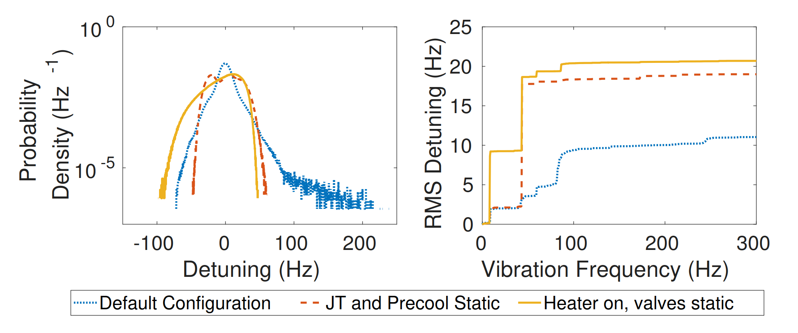
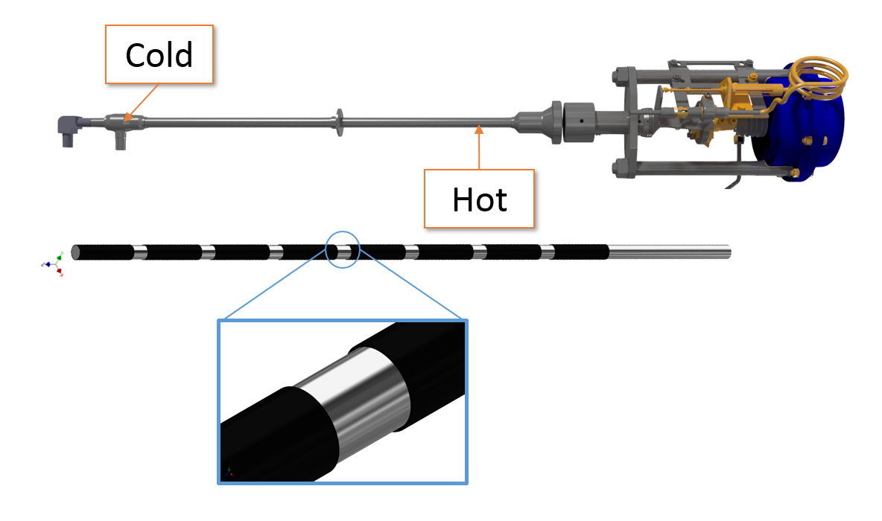
Mitigation
1. Valve Actuation
Actuation of the JT valve correlates with peak detuning events of as much as 280 Hz in cavity 3.
Valves made static and the Helium level control done using 2 K 2 Phase heater.
Addressed!
2. Excited Structural Resonances
The gas flow due to pump skid excites 8 Hz. The amplitude of this line increases when heat load is high.
Impulse response testing will be done to ascertain this effect and steps will be taken to damp it.
3. Thermo-acoustic Oscillations[1]
Thermo-acoustic oscillations in the needle valve produce 40 Hz and 80 Hz.
Fit PEEK plastic sleeves on the 5K adjust valve stem to reduce the gas flow and damp the instability.
Addressed!
[1] LCLS – II cryomodule commissioning in FermiLab

Slide 7
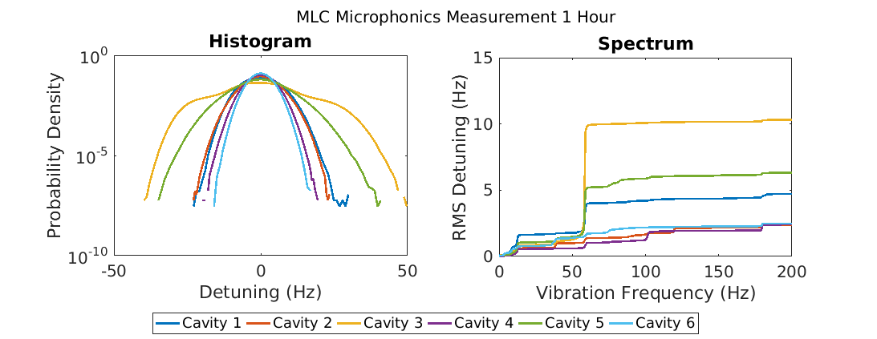
Mitigation Results
Cavity | Stiffened | Old Peak Detuning (Hz) | New Peak Detuning (Hz) | Field (MV) | Nominal Amplitude Stability
1 | No | 78 | 30 | 6 (9.5) | 4.0 x 10⁻⁴
2 | Yes | 18 | 25 | 6 (10) | 3.9 x 10⁻⁴
3 | No | 280 | 50 | 6 (8) | 4.0 x 10⁻⁴
4 | Yes | 18 | 20 | 6 (10) | 4.1 x 10⁻⁴
5 | No | 163 | 41 | 6 (8.5) | 3.1 x 10⁻⁴
6 | Yes | 33 | 18 | 6 (11.3) | 2.9 x 10⁻⁴
Valve modification was highly successful! Exceeded design energy gain by 50 %!

Slide 8
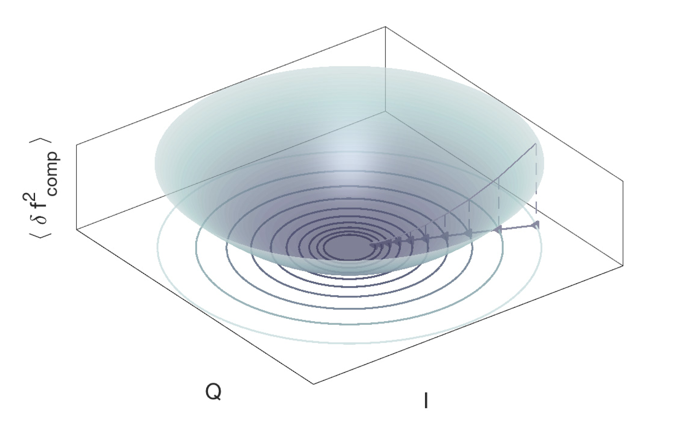
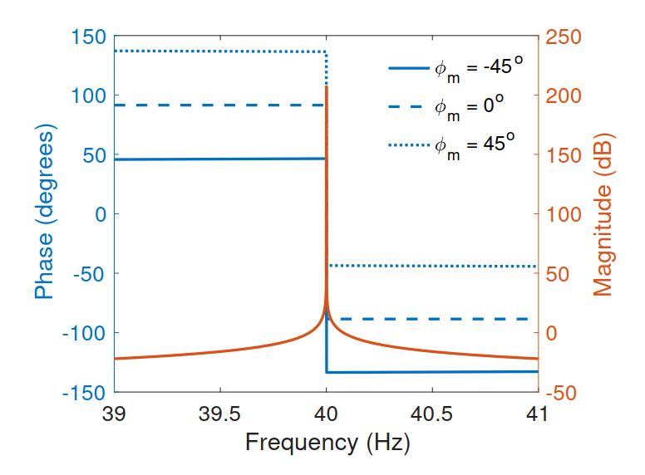
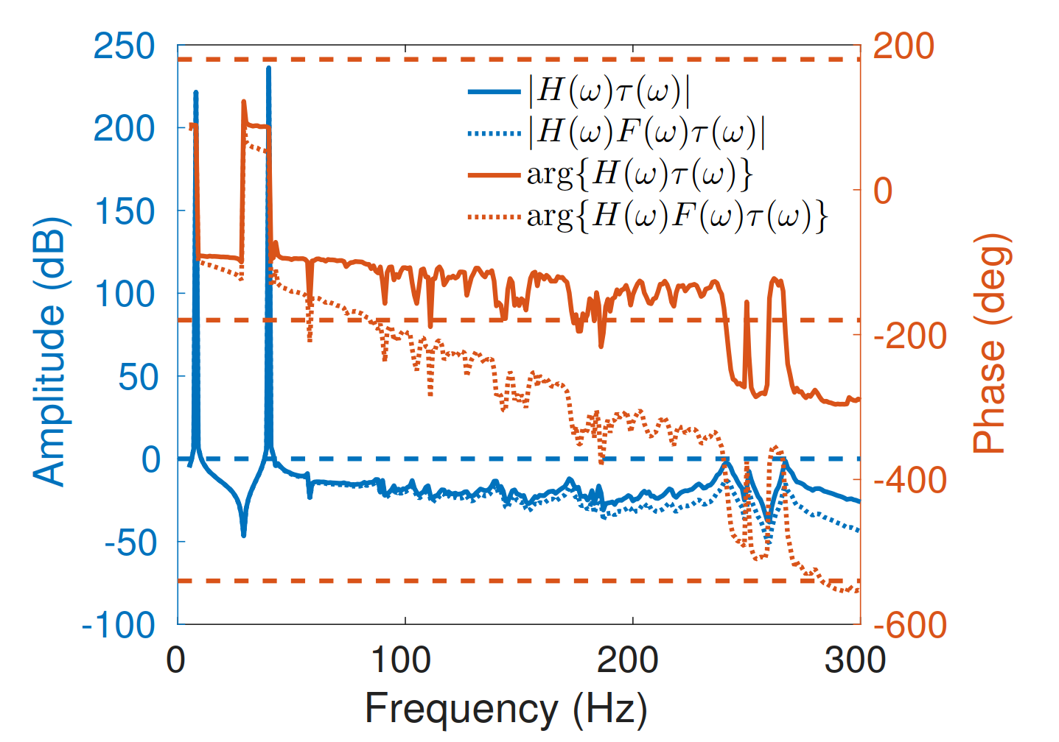
Narrowband Active Noise Control
Besides mitigation of vibration sources, an active control system is also necessary!
We can compensate for narrowband microphonics detuning by applying a sum of sine waves on the actuator. (Narrowband Active Noise Control (ANC))
Problem: Adjust I_{m} and Q_{m} to modulate the carriers at frequencies ω_{m} to reduce detuning.
Fixed Parameters: Learning Rate (gain) μ_{m} and Controller Phase φ_{m}
Equivalent to a set of IIR Notch Filters
Stability:
There is a range of controller phase φ_{m} within which the system is stable. As the gain increases this span decreases.
There is an upper limit to gain μ_{m} inversely proportional to group delay and tuner transfer function amplitude.
Tuner resonances also affect stability.
We use a FIR low pass filter to suppress resonances above 200 Hz.

Slide 9
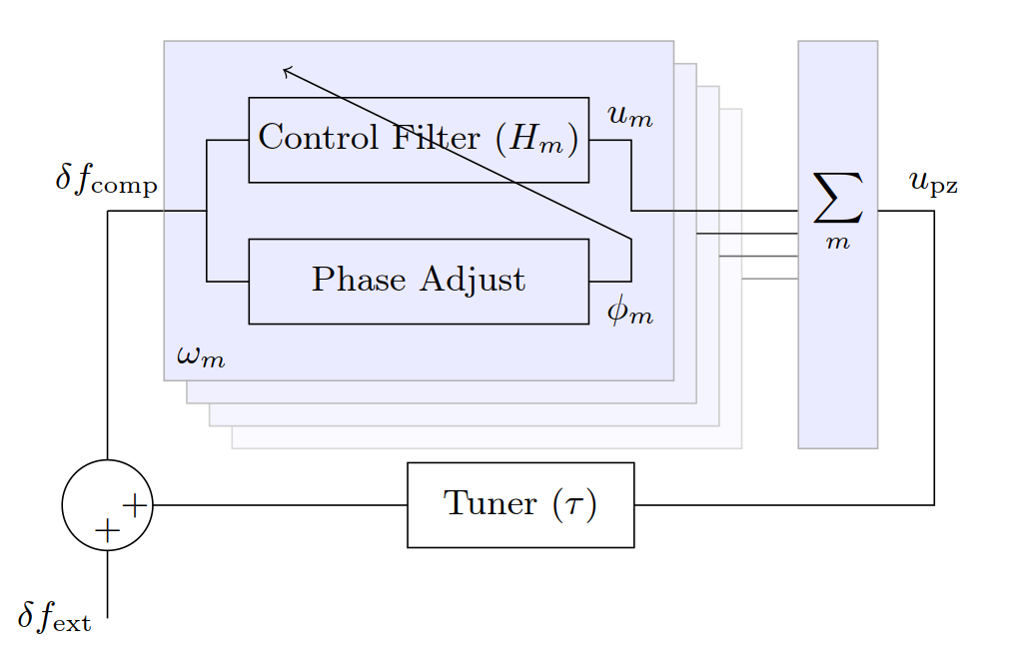
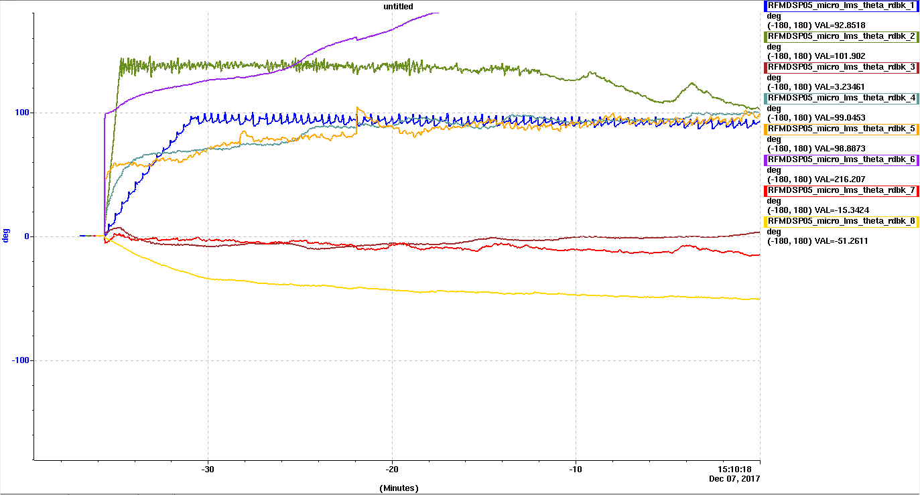
Phase Adaptation
How to choose controller parameters?
Simulation
Instead of depending on transfer function measurements, use Least Mean Square (LMS) to determine optimum controller phase in-situ and introduce η _{m}
The modified ANC algorithm estimates the phases and keeps them in the stable region even if the transfer function changes.

Slide 10
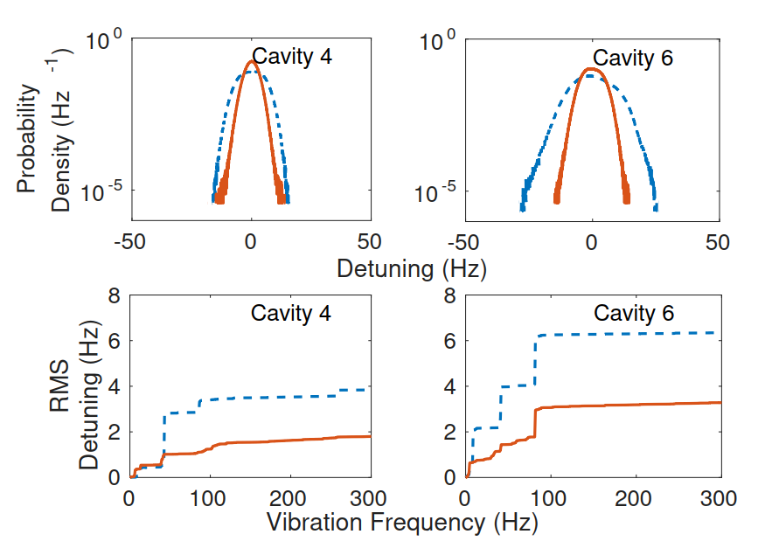
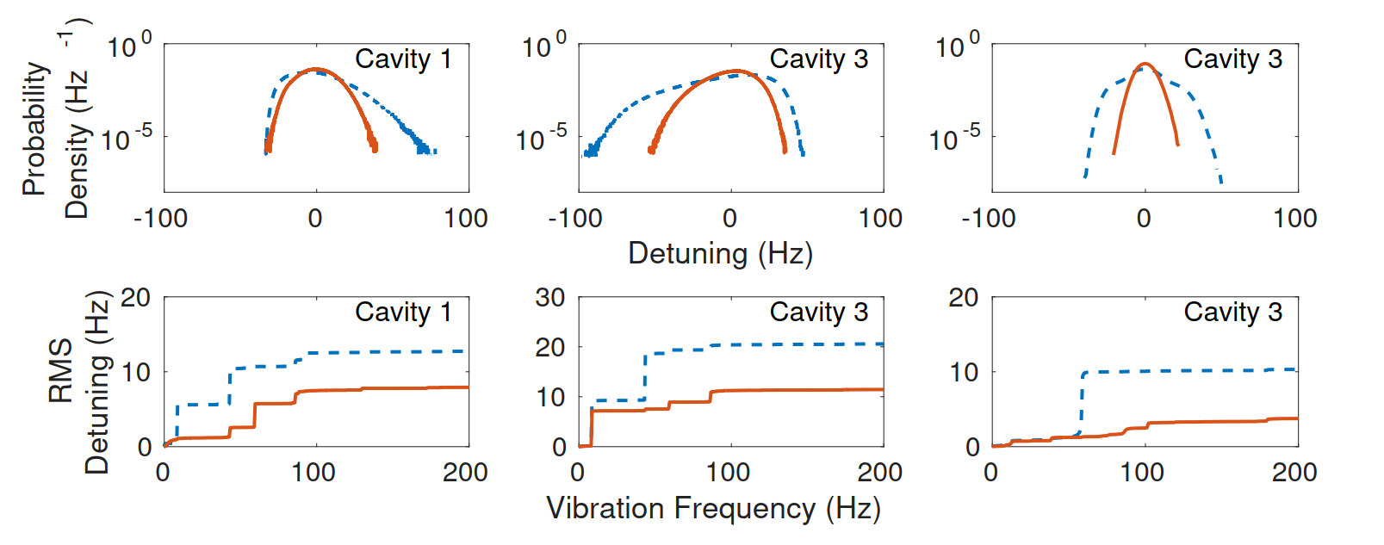
Results
The modified narrowband ANC was tested on some cavities of the main linac.
Run Description | Peak Detuning (Hz) |  | RMS Detuning (Hz)
 | ANC Off | ANC On | ANC Off | ANC On
Cavity 1 with JT and precool static | 78 | 45 | 13.6 | 9.1
Cavity 3 with JT and precool static | 100 | 57 | 20.8 | 11.7
Cavity 3 with JT and precool static and 5 K valve modified | 50 | 22 | 10.7 | 4.6
Cavity 4 with JT and precool static | 17 | 19 | 4.4 | 2.4
Cavity 6 in original configuration | 30 | 15 | 6.4 | 3.4
The algorithm is effective and stable over hours of operation! No mechanical coupling with neighboring cavities because of bellows in our cryomodule.

Slide 11
Conclusions
Initial Measurements
The peak detuning for un-stiffened cavities were more than 100 Hz compared to the 54 Hz maximum which a 5 kW system can tolerate while maintaining the CBETA design energy gain of 6 MeV. Microphonics was mainly dominated by 40 Hz and 80 Hz vibrations along with sudden impulses of large amplitude.
Cryogenic System Modifications
We made the JT and precool valves static to prevent large impulsive detuning. We fit the 5 K adjust valve stem with plastic sleeves to damp thermo-acoustic oscillations at 40 Hz and 80 Hz. After the modifications, maximum peak detuning was 50 Hz on cavity 3 primarily caused by 59 Hz vibrations coupled in through the waveguide.
We exceeded our required energy gain by 50% during beam operations.
Active Resonance Control
We developed a modified narrowband Active Noise Control algorithm which optimizes the controller phase parameter online and requires three parameters frequency ω_{m}, gain μ_{m} and adaptation rate η _{m}. These parameters along with the mechanical eigenmodes determine the stability and we used additional filtering to attenuate the eigenmodes.
Results
We demonstrated stable and effective operation of the algorithm with beam over multiple hours with almost a factor of 2 reduction in the peak detuning on both stiffened and un-stiffened cavities.

Slide 12
Acknowledgements
Peter Quigley, Vadim Vescherevich, Adam Bartnik, John Dobbins, Fumio Furuta, Colwyn Gulliford, Georg Hoffstaetter, Roger Kaplan, Matthias Liepe, Dan Sabol, James Sears, Colby Shore, Eric Smith
We would also like to thank Warren Schappert and Ben Hansen for discussing their experience with LCLS-II cryomodule commissioning at FNAL, prompting us to look for it in our Main Linac.
Thank you!

Slide 13
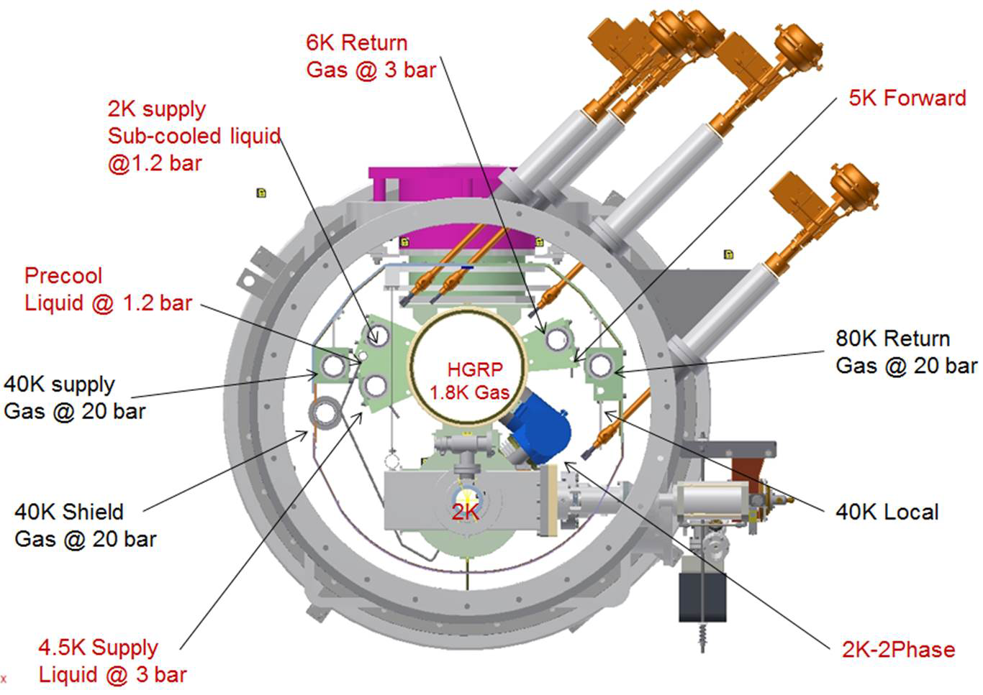
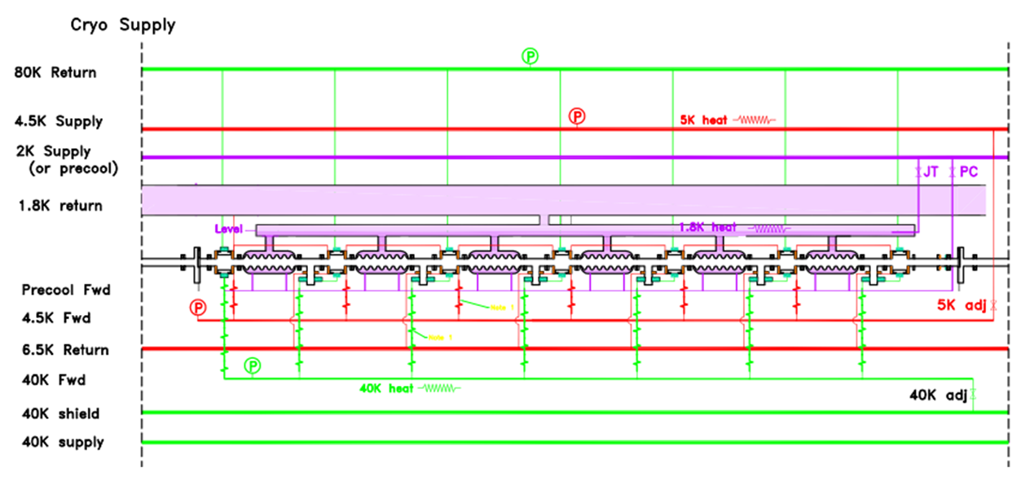
Cryogenic System
Three subsystems:
40 K / 80 K
Thermal shield, input couplers, HOM loads.
4.5 K/ 6.5 K
Input couplers, beam pipe.
2 K/ 1.8 K
Cavities.
2 K liquid Helium system controlled by:
Pneumatic Joule-Thomson (JT) and precool valve.
Controls amount of LHe entering the 2 K 2 phase pipe.
2 K 2 Phase heater
Adds heat load if necessary.
Pump Skid
Controls vapor pressure in 2 K 2 phase pipe supplying to the Helium vessels thus controlling bath temperature.

Slide 14
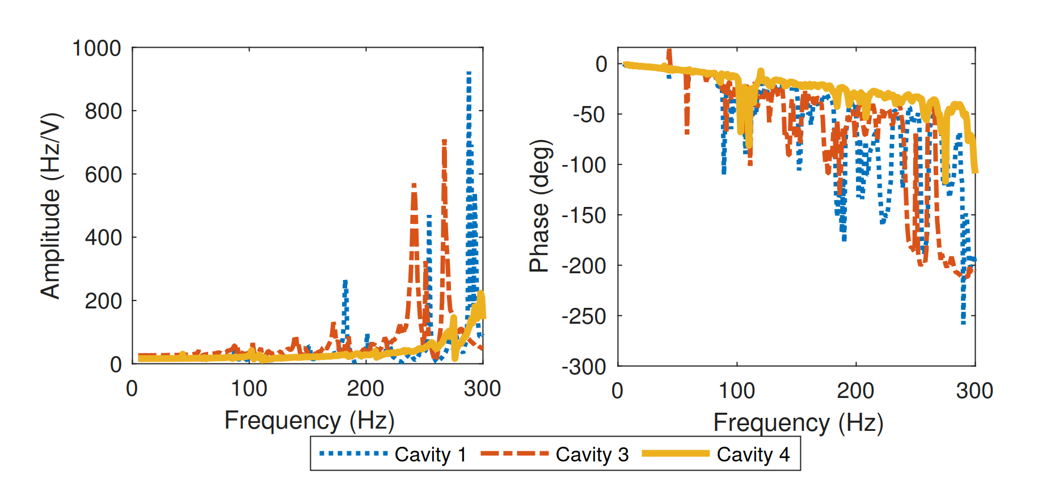
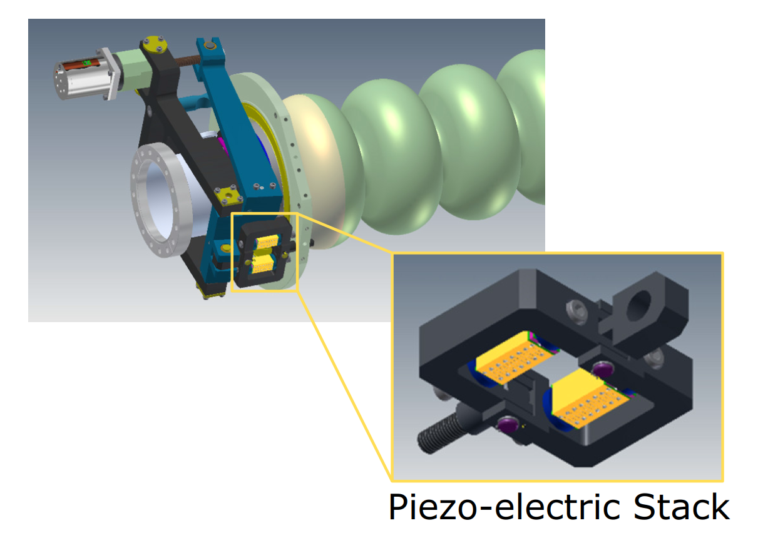
Active Resonance Control
Mitigation of vibration sources is the preferred method of reducing peak microphonics detuning, but having an active control system is also necessary!
The Main Linac 7 cell cavities are attached to a tuner based on the Saclay I design with added fast actuators.
Observations:
Phase response is almost 0° up to 30 Hz, this makes it ideal for proportional integral feedback control.
For higher frequencies of the phase response is very noisy, especially for un-stiffened cavities.
The mechanical eigenmodes of stiffened cavity starts at a higher frequency and in general has a smaller response amplitude.

Slide 15
Modified Narrowband ANC
Idea: Treat this as a real time least squares optimization problem.
Actuator Signal:
Assuming that the tuner is a LTI system the detuning can be written as:
Where, α_{m} and φ_{m} describe the transfer function from actuator to detuning at the frequency ω_{m}.
Mean Square Detuning:
Minimize the mean square detuning using a gradient descent algorithm.
ω_{m} ,µ_{m} and φ_{m} are fixed by the operator.

Slide 16
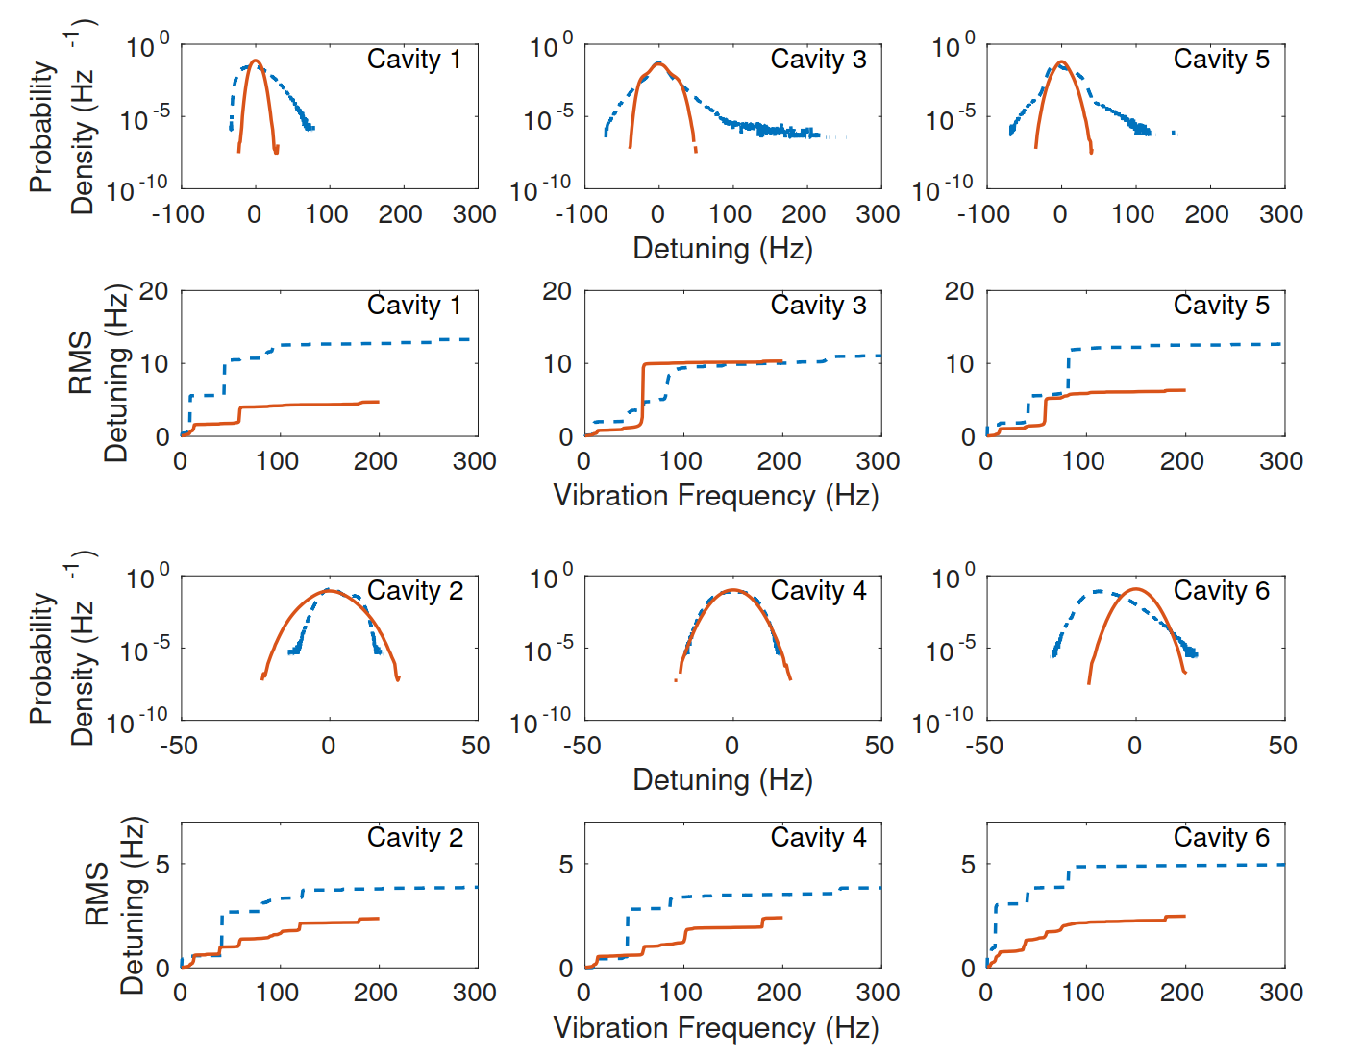
FAT Microphonics

