Slide 1

Microphonics Considerations for BESSY-VSR
Pablo Echevarria, on behalf of LLRF team
Second Topical Workshop on Microphonics
Brooklyn, NY
25-26 Oct. 2018

Slide 2
Outline
  The BESSY VSR concept
  LLRF challenges
  mTCA.4 single cavity control
  BESSY-VSR cavities and cryomodule
P. Echevarria, Microphonics Workshop 2018, Brooklyn.

Slide 3
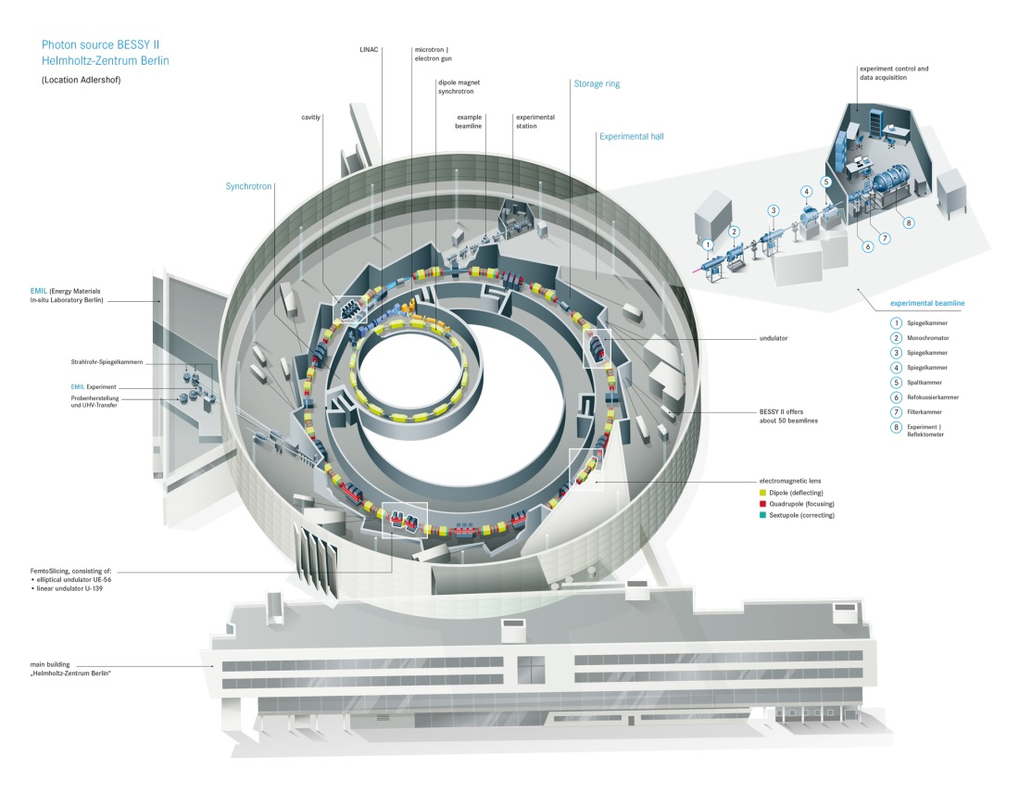
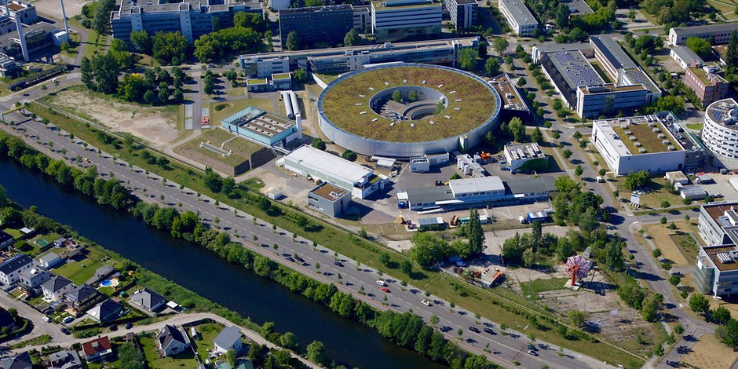
BESSY-II
The SR BESSY II is a 1.7 GeV synchrotron radiation source operating for 20 years in Berlin
BESSY II emits extremely brilliant photon pulses ranging from the long wave terahertz region to hard X rays
Pioneer in offering low α operation with a comunity of users performing dynamic measurements in „functional materials“
In order to remain competitive among the international synchrotron sources a superconducting upgrade is undergoing
P. Echevarria, Microphonics Workshop 2018, Brooklyn.

Slide 4
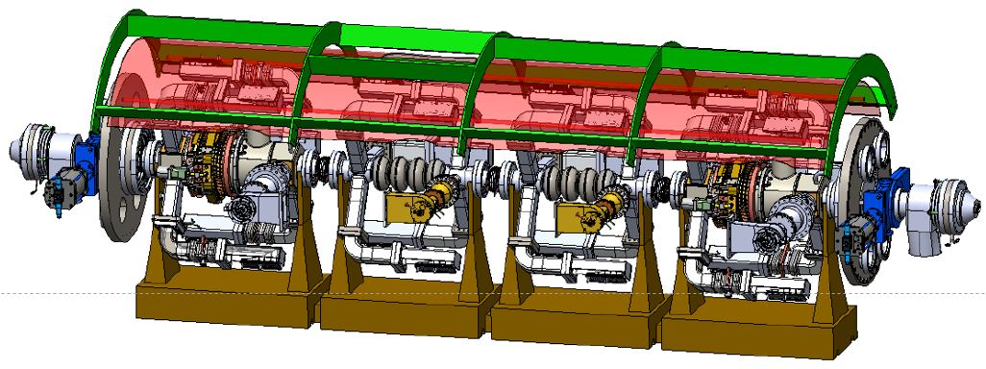
The concept of BESSY-VSR
BESSY II , SC Upgrade
G.Wüstefeld et al.
„Simultaneous long and short electron bunches in the BESSY II storage ring“ IPAC2011
1.5GHz and 1.75GHz ---- RF beating
Odd (voltage cancelation, 15 ps bunches)
Even (voltage addition, long.focussing, 1.7 ps)
Machine optics
Courtesy of F. Glöckner
Hardware (RF cavities)
Present
Phase I
Phase II
15 ps bunch
1.7 ps bunch
Voltage / MV
sum voltage
Time (ns)
Time (ns)
Time (ns)
Voltage: 1.5 MV @ 0.5 GHz
Voltage: 20 MV @ 1.5 GHz
Voltage: 20 MV @ 1.5 GHz
+ 17.1 MV @ 1.75 GHz
P. Echevarria, Microphonics Workshop 2018, Brooklyn.
Slide courtesy of A. Velez

Slide 5
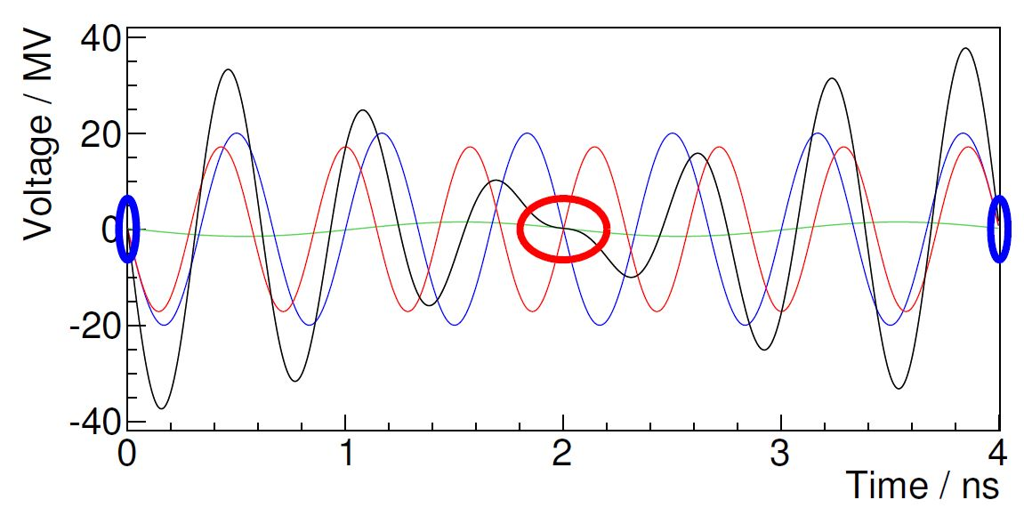
BESSY-VSR‘s LLRF challenges
BESSY-VSR: two superposing voltages at 1,5GHz and 1,75 GHz → Beating of voltage to create RF buckets for long and short bunches
Zero-crossing operation for focussing/defocussing
Long bunches lay in opposite slopes→ cancellation two large voltages
any deviation from nominal is magnified
P. Echevarria, Microphonics Workshop 2018, Brooklyn.

Slide 6
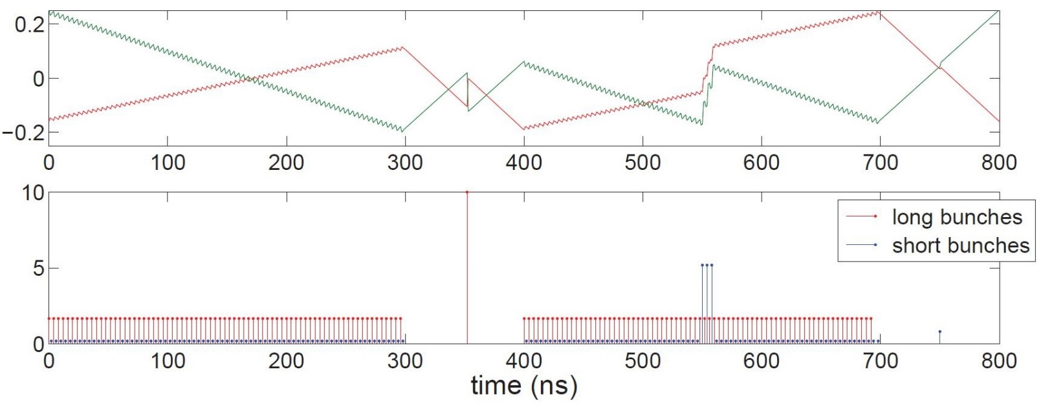
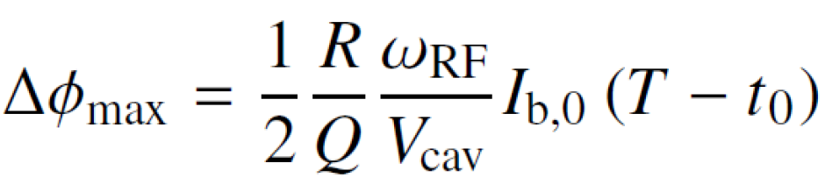
BESSY-VSR‘s LLRF challenges
Non uniform bunch train induces a transient beam loading → Different zero crossing for each bunch! → unwanted shorter bunches + lifetime
Robinson instabilities → Not fulfilled by 1,75GHz cavities → Stability scales with the LLRF loop gain.
Low beam-loading allow operation at high Q_{L} (5x10⁷) → Microphonics!
Phase(deg.)
Current (mA)
Δl = 1 nm ←→ Δf = 0.6 Hz ←→ ΔΦ = 1,14° for BESSY-VSR Cavities
P. Echevarria, Microphonics Workshop 2018, Brooklyn.

Slide 7
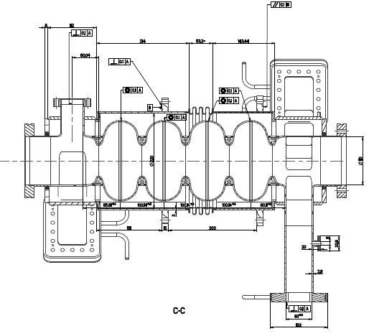

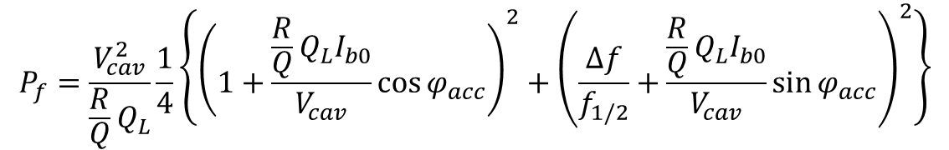
BESSY-VSR‘s LLRF challenges
Parameter per cavity | 1.5 GHz | 1.75 GHz
E_{acc} (MV/m) | 20 | 20
Q_{L} | 5x10⁷ | 5x10⁷
φ_{acc} (degrees) | 90 | -90
Δf for beam loading (kHz) | 11,25 | 15,3
Average Pf (kW) | 1,49 | 1
$$P_{f}=\frac{V_{cav}^{2}}{\frac{R}{Q}Q_{L}}\frac{1}{4}\left\{{\left(1+\frac{\frac{R}{Q}Q_{L}I_{b0}}{V_{cav}}\cos{φ_{acc}}\right)}^{2}+{\left(\frac{∆f}{f_{1/2}}+\frac{\frac{R}{Q}Q_{L}I_{b0}}{V_{cav}}\sin{φ_{acc}}\right)}^{2}\right\}$$
resistive
reactive
$∆f$=-$\frac{R}{Q}\frac{f_{rf}I_{b0}}{{2V}_{cav}}\sin{φ_{acc}}$
15 kW SSA → RF overhead for:
60 Hz peak detuning or
Current jump of 1.5 mA
P. Echevarria, Microphonics Workshop 2018, Brooklyn.

Slide 8
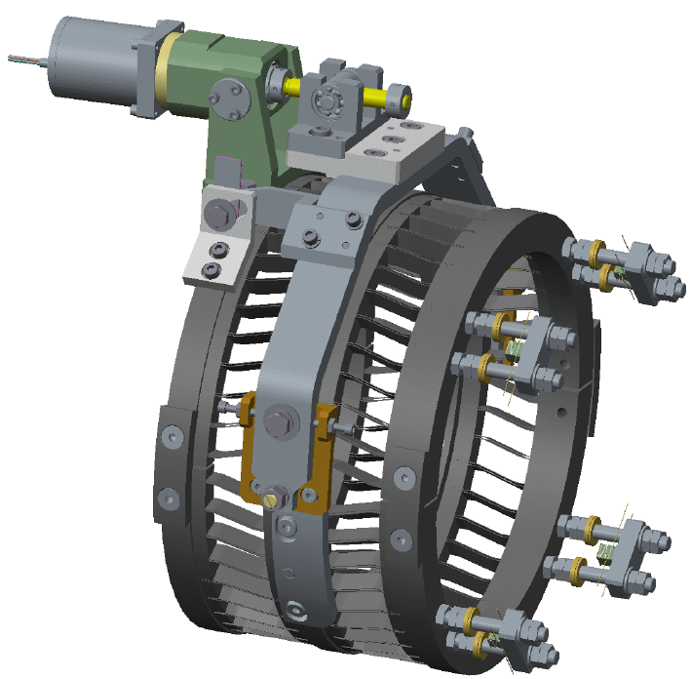
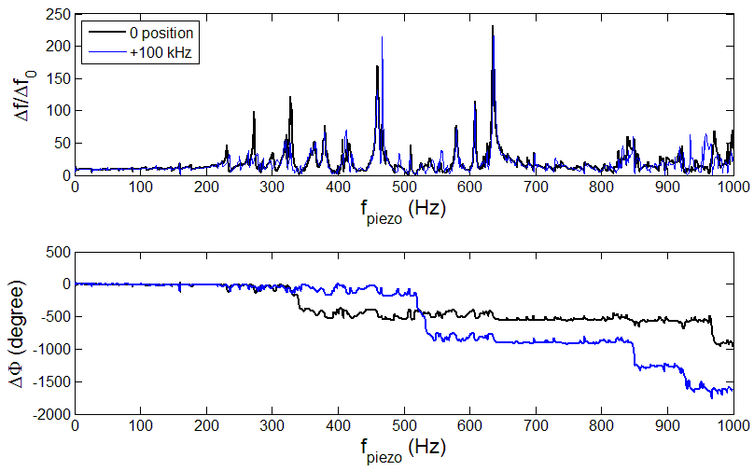

BESSY-VSR‘s LLRF challenges
Several detuning control strategies:
Classical PID +
FIR filter + LMS learning algorithm.
Kalman filtering + adaptive control
A. Neumann, PRST 2010
A. Ushakov, yesterday
Blade tuner: motor + piezos
“Iterative process that uses a set of equations and consecutive data inputs to estimate the true value of the object being measured, when the measured values contain unpredicted or random error, uncertainty, noise or variation or when the physical description is not complete”
Measured mechanical response
1st modes
Phase lag
Discretized state-space model
$${\left(\begin{matrix}x_{1} \\ x_{2}\end{matrix}\right)}_{n+1}=\left(\begin{matrix}1 & ∆t \\ −ω_{m}^{2}∆t & 1−\frac{ω_{m}}{Q}∆t\end{matrix}\right){\left(\begin{matrix}x_{1} \\ x_{2}\end{matrix}\right)}_{n}+\left(\begin{matrix}0 \\ ±k2π∙ω_{m}^{2}\end{matrix}\right)E_{acc}^{2}\left(t\right)$$
P. Echevarria, Microphonics Workshop 2018, Brooklyn.

Slide 9
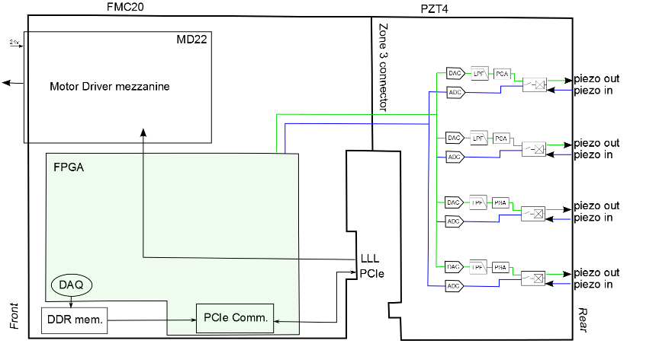
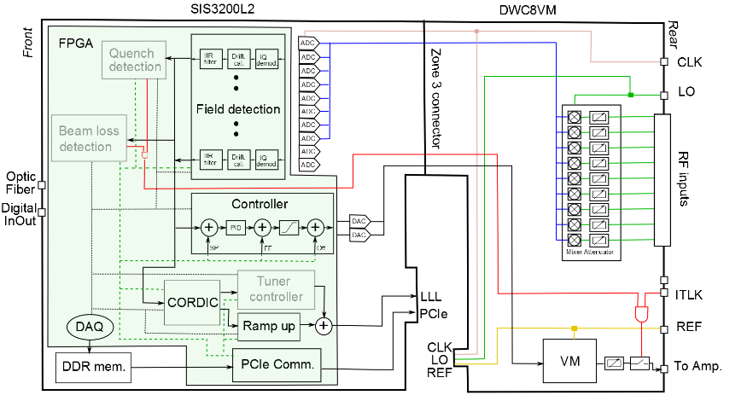
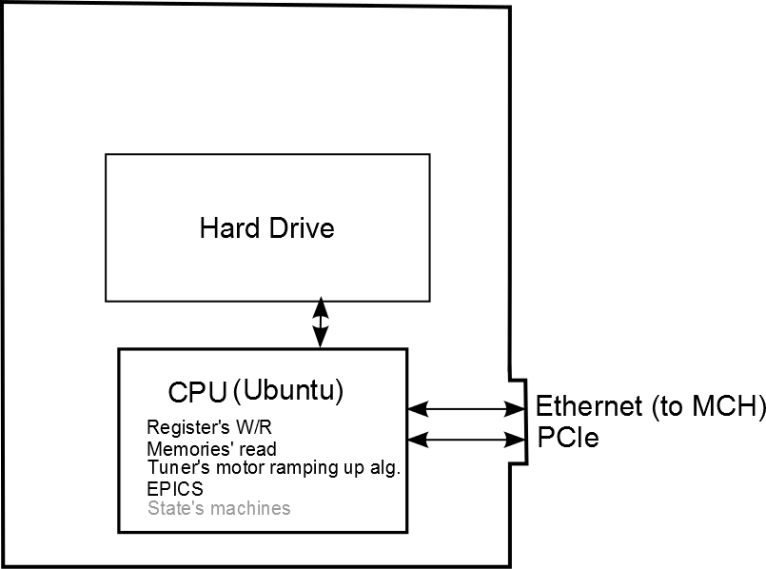
mTCA.4 single cavity control
1 RF amplifier per cavity → no Vector Sum needed
Used in EXFEL’s gun and ELBE
Around 600ns of latency
Low Latency Link
PCIe
P. Echevarria, Microphonics Workshop 2018, Brooklyn.

Slide 10
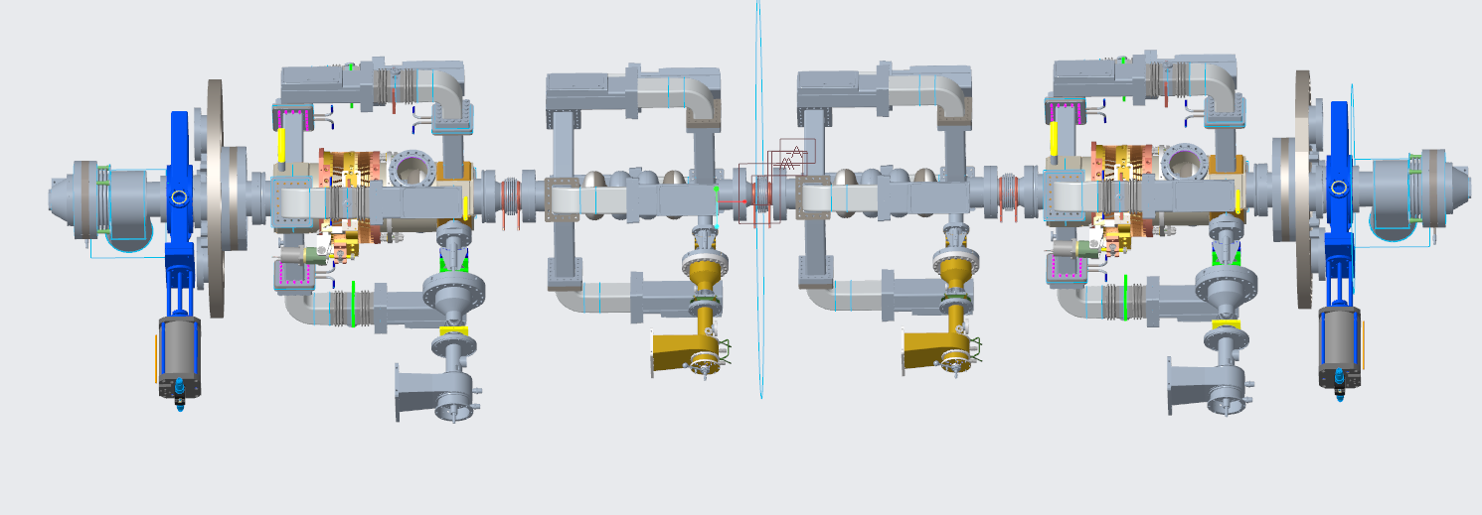
BESSY-VSR cavities and cryomodule
Beampipe
HOM Absorber
1.5 GHz Cavity
1.75 GHz Cavity
1.5 GHz Cavity
Beampipe
HOM Absorber
Transition Bellow
shielded bellow
collimating bellow
shielded bellow
Transition Bellow
coupler
P. Echevarria, Microphonics Workshop 2018, Brooklyn.
Courtesy of F. Glöckner

Slide 11
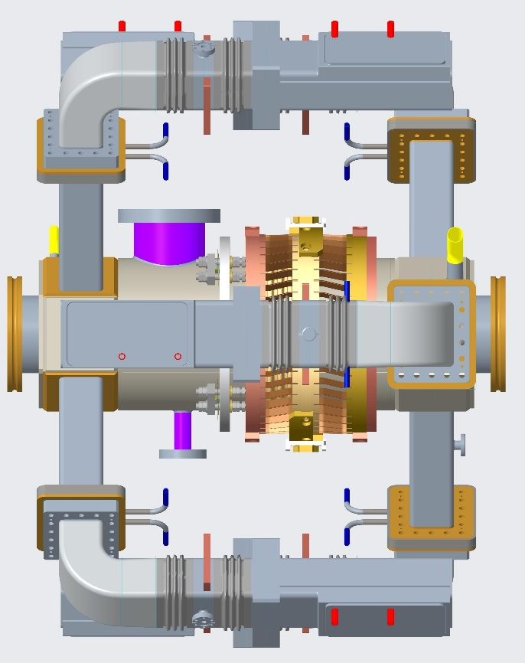
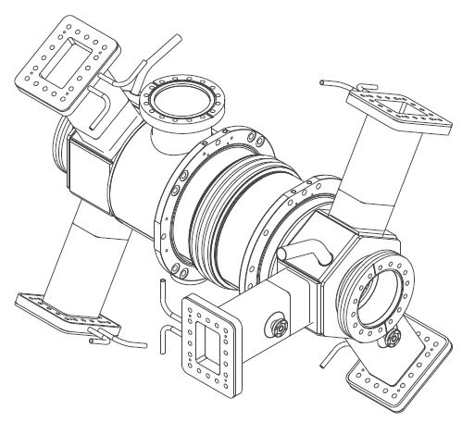
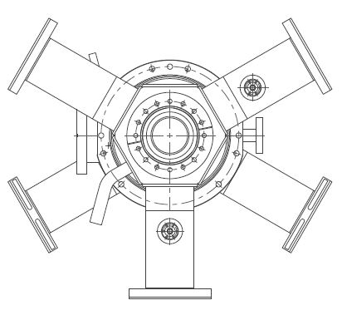
BESSY-VSR cavities and cryomodule
WG HOM Load (330 K)
80 K intercept (12.5 bar)
5 K intercept (3 bar)
300 K He cooling, 3bar
(warm parking)
1.8 K HGRP, 16 mbar (normal operation)
1.8 K liquid line/precooling (1 bar)
Tuner
P. Echevarria, Microphonics Workshop 2018, Brooklyn.
Courtesy of N. Wunderer and F. Glöckner

Slide 12
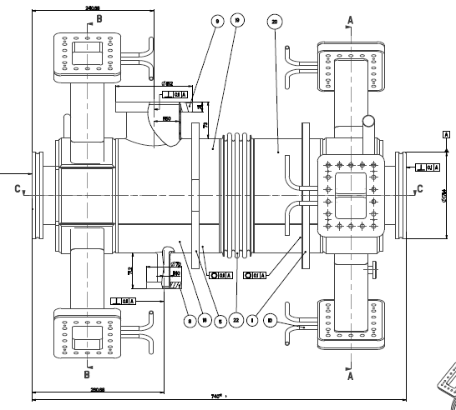
BESSY-VSR mechanical vibrations
Currently designing the cyomodule. Paying attention to:
  Water cooling of HOM loads
  Helium gas cooling of the wave guide flanges
Vibration analysis of the string to be done. ANSYS is useful to determine mech. modes. Is there any software to simulate responses to excitation signals?
Determine possible capacitive sensors which can go to the module without harming the RF operation of the cavity.
  Measure the excitation spectrum in the BESSY tunnel
After construction a modal analysis will be done:
  Hammer impact test?
  Reasonable locations for input and output measurement need to be determined.
  Cold/warm tests?
P. Echevarria, Microphonics Workshop 2018, Brooklyn.
Courtesy of N. Wunderer

Slide 13
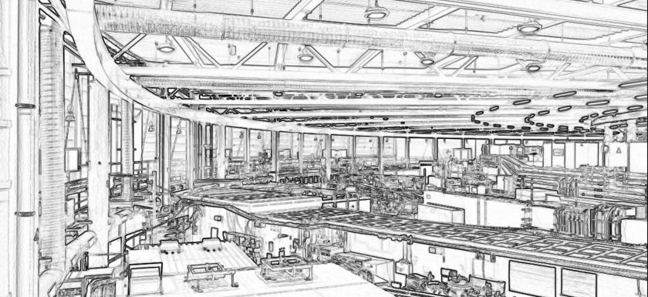
Thanks for your attention!
P. Echevarria, Microphonics Workshop 2018, Brooklyn.

