Slide 1
Microphonics experience in HIE-ISOLDE at CERN
A. Miyazaki^{1,2} D. Valuch¹, and W. Venturini Delsolaro¹
¹ Organisation européenne pour la recherche nucléaire (CERN), Switzerland
² School of Physics and Astronomy, the University of Manchester, UK
Email: Akira.Miyazaki@cern.ch
LLRF2018 topical Workshop on Microphonics @ NY

Slide 2
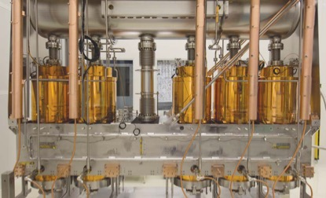
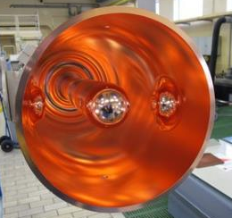
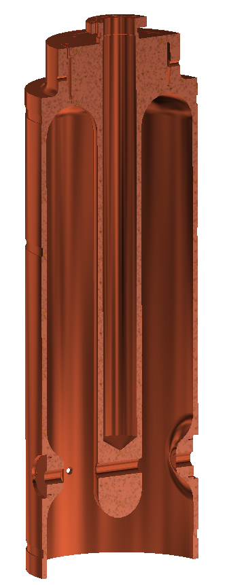
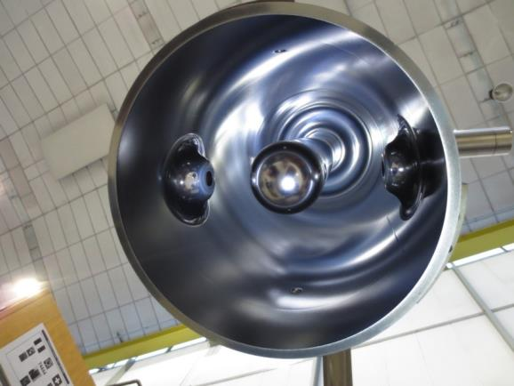
HIE-ISOLDE Cryomodule
L⁴He (4.5K)
conduction cooling
75 cm
5 Quarter-wave resonators (QWR) in 1 CM
Nb film sputtered on Cu substrate (10 mm thick)
  Cf. bulk Nb cavities 3 mm thick
Conduction cooling through Cu
Common vacuum inside and outside the cavity
Pressure sensitivity 0.01 Hz/mbar
Nb/Cu cavities can be robust against microphonics
Thermal issue in coupler → Operation BW 5-10 Hz

Slide 3
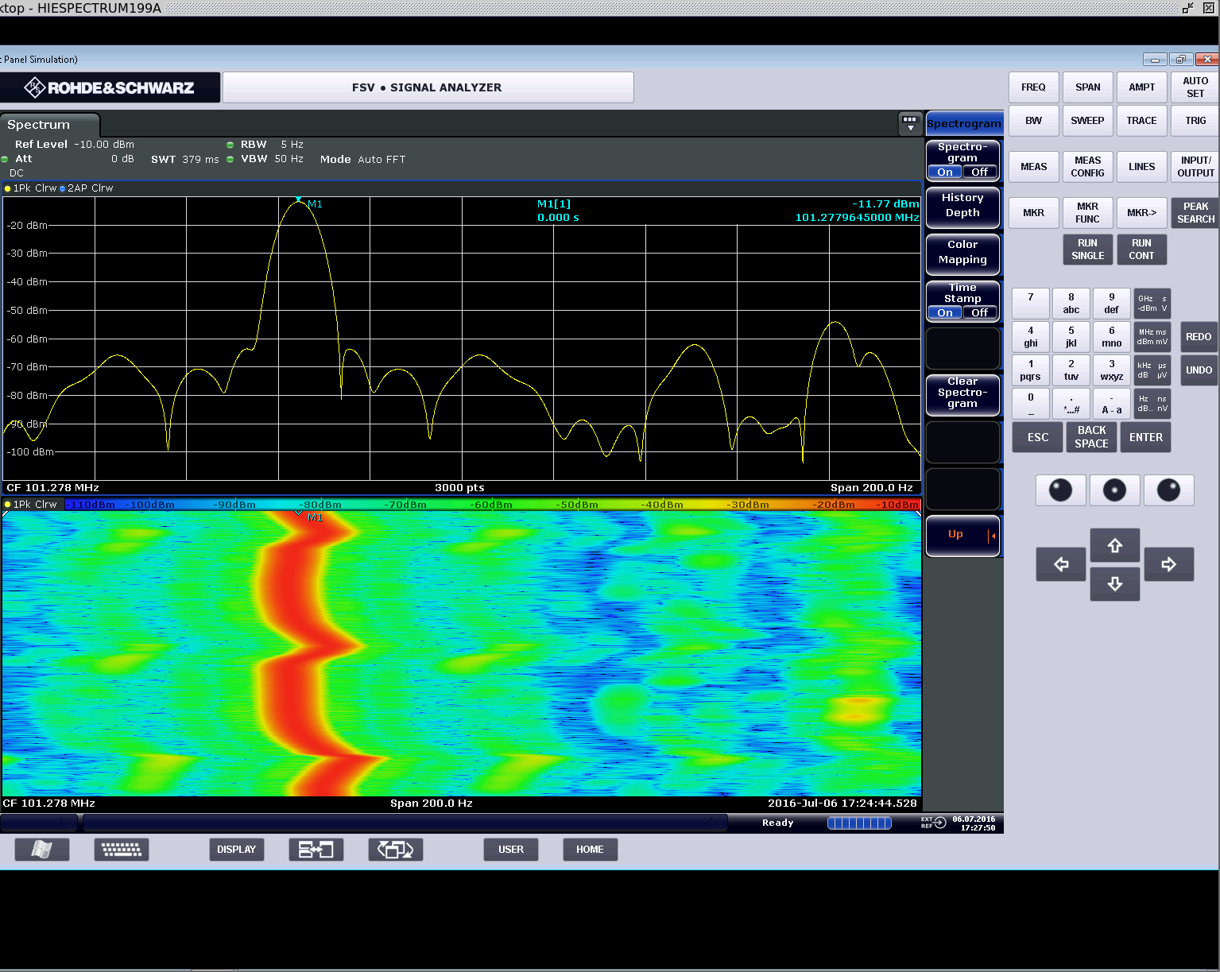
Frequency perturbations (measured in SEL mode)
Stepper motor
Pressure variation
LHe tank
10 Hz
1 min
Cavity oscillates
Fixed point of the TP is free from the cavity
Lever
The frequency was sharply and periodically shifted!

Slide 4
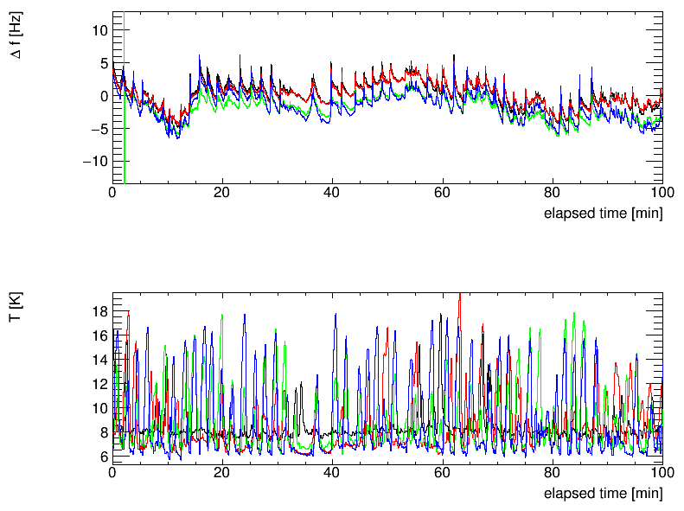
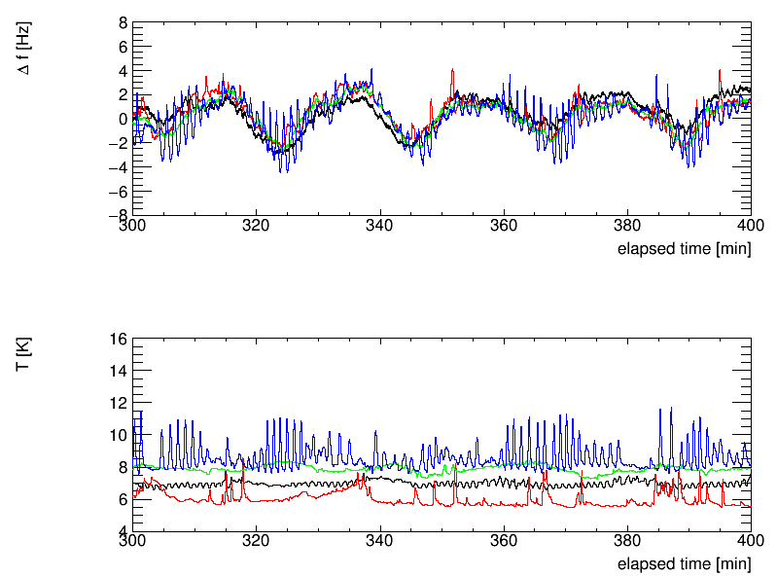
Cryogenic perturbation during RF commissioning 2018
Initial perturbation > BW
Optimized cryogenic parameters
BW (FWHM)
BW
CM1, CM2, CM3, CM4
Return gas He temperature and pressure oscillate
The fast oscillation was mitigated
Optimize PID parameters and regulation target in cryogenic system → stabilize the system

Slide 5
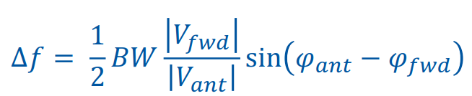
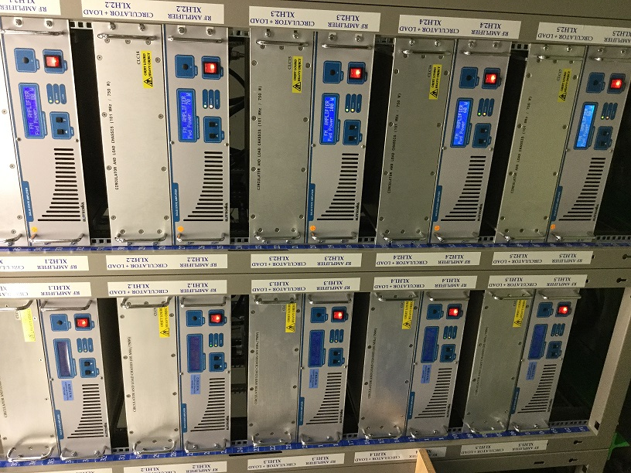
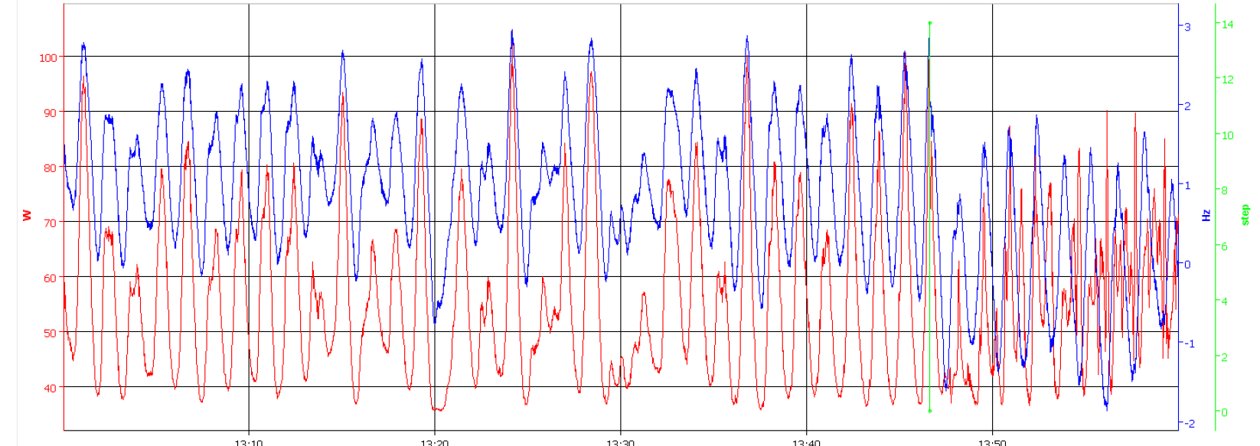
Strategy from LLRF side
Δf [Hz]
Tuner step
forward power [W]
No stepper-motor motion
Compensated by forward power (RMS 100W, max 750W)
Solid-state amplifiers (750W) can still handle the system

Slide 6

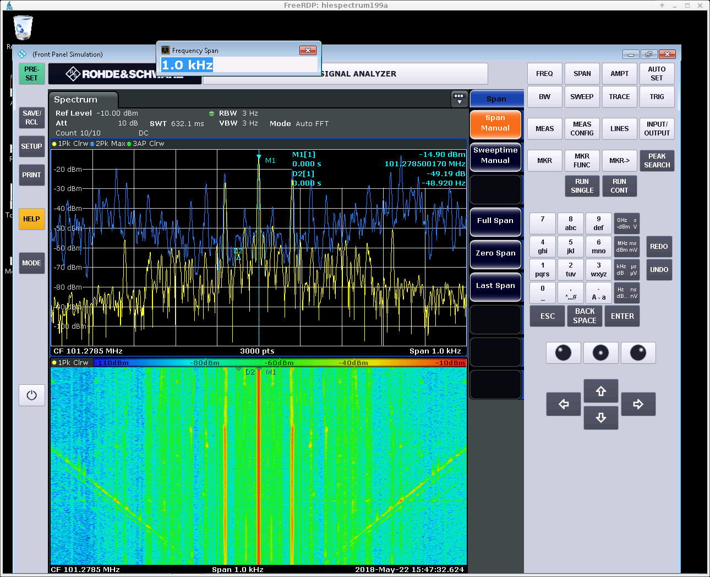
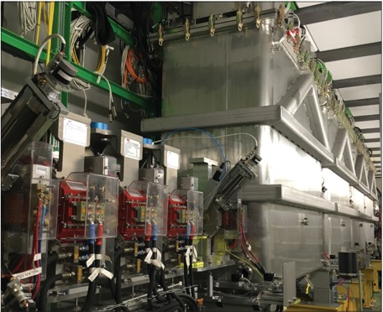

Faster microphonics observed in one cavity
78 Hz noise
We felt obvious vibration on the vessel in this particular CM
The FB operation required much higher power than other cavities (400W >>RMS 40W)
Demodulation of spectrum analyzer signal showed 78 Hz vibration in resonant frequency
Tunnel access → obvious vibration was detected by hand in one cryomodule
Stop active pumping → vibration and correspondingly frequency modulation stopped

Slide 7
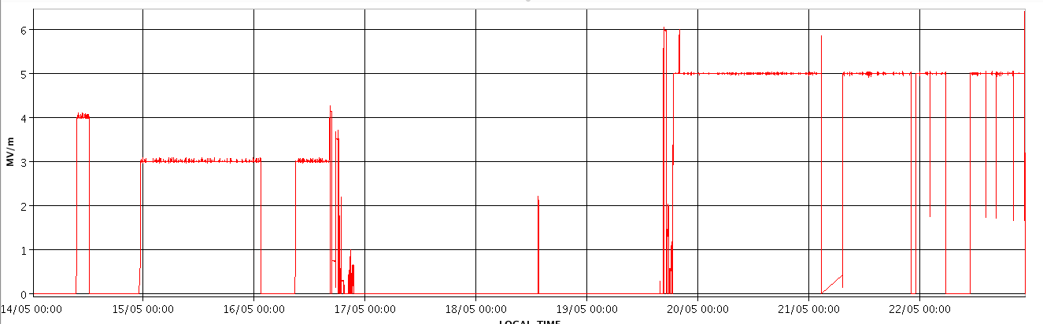
w/ and w/o active pumping
Stable at high field
More trips?
E_{acc} [MV/m]
Active pump stopped
Active pump re-started
Intuitively, more trips with active pumping but no enough time to do statistical testing during RF commissioning
We decided to keep active pumping and limit the field level of this cavity (4MV/m < nominal 6MV/m)

Slide 8
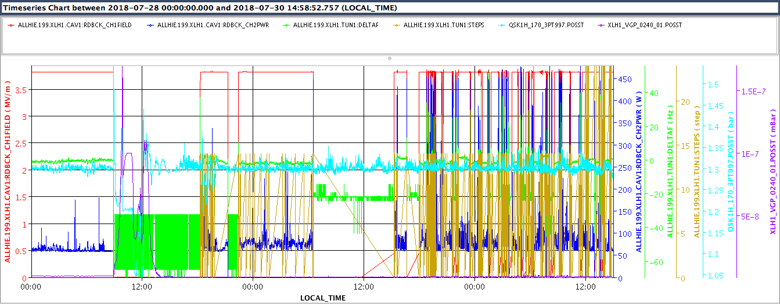
Impact of power cut (July 28th)
Power cut
cryogenics recovery
The cryogenic plant stopped by (short) power cut and took 6 hours to restart sending LHe
A sensitive cavity was affected by the cryogenic instability for a couple of days
We skipped the cavity for the physics run during that week

Slide 9
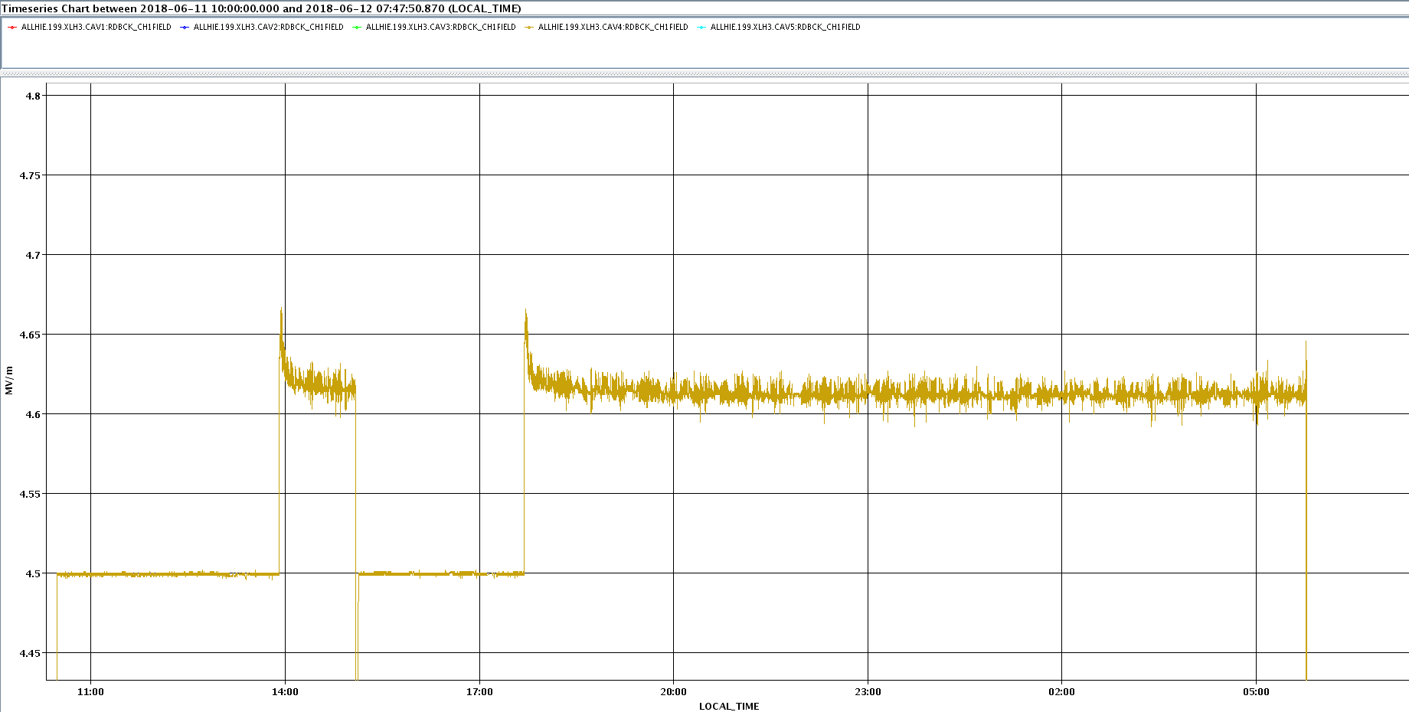
Rare events
Jump up to pseudo stable point
E_{acc} [MV/m]
Target field by FB
Observed twice during 2018 summer
19th cavity on June 12th : lasted 1 week and disappeared
9th cavity on September 6th : lasted 1 week and disappeared
We did not change any parameters!

Slide 10
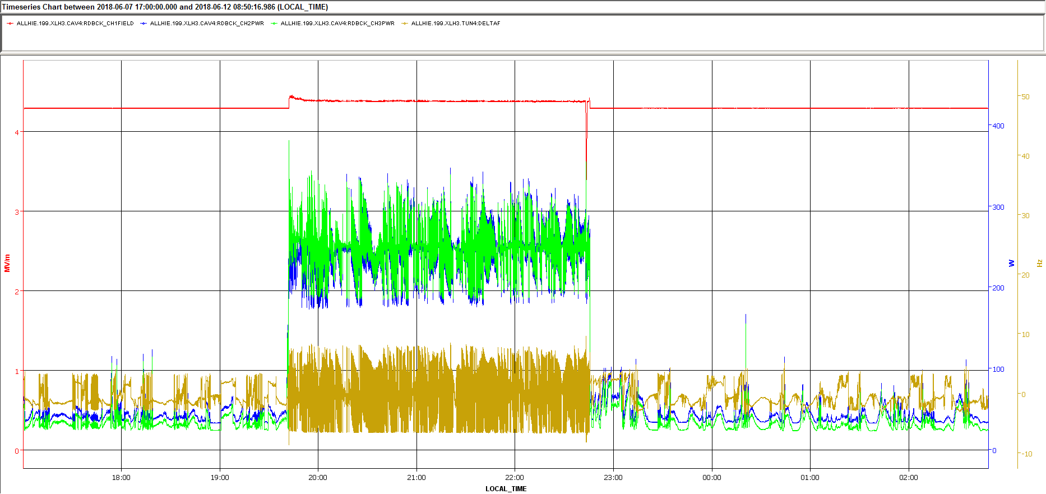
Rare events
Field level
Forward power
25W→250W
This over-heats the coupler
Reflected power
frequency
>BW
Apparently, FB algorithm found strange “operation point” where the tuner loop cannot fix the resonance
No field emission in the cavity, cryogenics is stable, …
The LLRF card was replaced → no impact
We suspect field-induced vibration of probably the tuning plate → dedicated test in vertical cryostat is planned

Slide 11
Summary
The thick Cu wall is very insensitive to pressure variation but the thin tuning plate is an issue when operation BW is extremely low
  Thicker TP is recommended for the future project (better understanding of pre-tuning)
HIE-ISOLDE cryomodules suffer from three different “vibrations”
  Slow but significant (>BW) mechanical detuning per 1-2min
  Fast microphonics probably due to active pumping
  Maybe very rare field-induced vibration when certain condition is fulfilled
LLRF system compensate the oscillation by the margin of 750W solid-state amplifier, and is operational if cryogenic system is quiet enough
Sometimes we face rare events which cannot be just solved by LLRF and we pragmatically either limit the field level or skip the cavity
  The users during very precious beam time never wait us!

Slide 12
backup

Slide 13
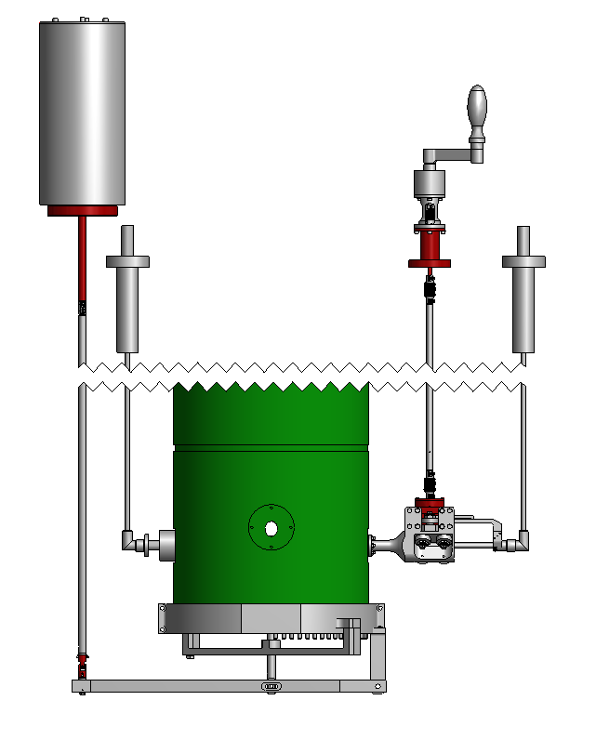
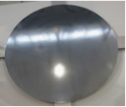
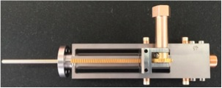
Tuner and coupler
Cavity and motor system is mechanically coupled to the insert
stepper motor for tuner and coupler
pickup RF line
fundamental coupler RF line
Outside the cryostat (300K air)
3m
inside the cryostat (4.5K, beam vacuum)
Mobile coaxial coupler
Thin Nb coated Cu plate (0.3 mm)
tuning range 40 kHz

Slide 14
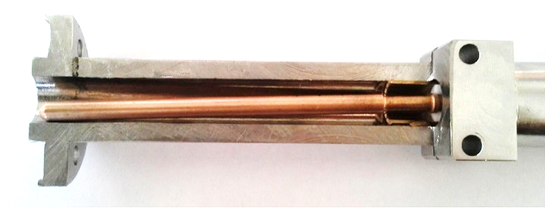
Tuner and coupler
Cavity and motor system is mechanically coupled to the insert
stepper motor for tuner and coupler
pickup RF line
fundamental coupler RF line
Outside the cryostat (300K air)
3m
inside the cryostat (4.5K, beam vacuum)
Mobile coaxial coupler
Thin Nb coated Cu plate (0.3 mm)
tuning range 40 kHz

Slide 15
Tuner and coupler
Cavity and motor system is mechanically coupled to the insert
stepper motor for tuner and coupler
Thermal fault of fundamental power coupler
→ Extremely narrow Operation BW 5-10 Hz
pickup RF line
fundamental coupler RF line
Outside the cryostat (300K air)
3m
inside the cryostat (4.5K, beam vacuum)
Mobile coaxial coupler
Thin Nb coated Cu plate (0.3 mm)
tuning range 40 kHz

Slide 16
Stable condition

Slide 17
Lesson learned
Microphonics issues are linked to all the aspects of the project
  Nb/Cu is potentially insensitive to vibration thanks to its thicker wall
  Frequency pre-tuning was not precise → wide tuning range required (40kHz) → very thin TP → sensitive to vibration
  Poor cooling of the coupler did not allow wide BW (>30Hz) operation → extremely narrow BW (5Hz)
  Common vacuum → stepper motor far away and no fast tuner like piezo next to the TP → only slow mechanical tuning no possible active damping
  Cryogenics perturbation
  Vibration propagated from the active pumping unit
LLRF algorithms can compensate the issues but there are certain limitations
Pragmatic decision is sometimes necessary once physics campaign starts

