Slide 1
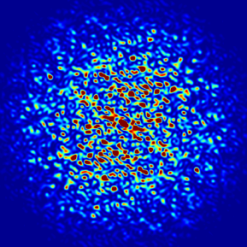
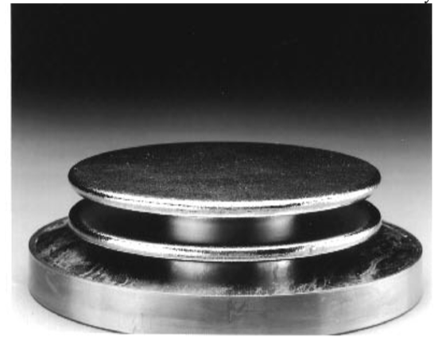
Low Beta Tuner Design
(ANL Pneumatic Tuner)
Michael Kelly, Zack Conway, Gary Zinkann, Ken Shepard, Sanghoon Kim (FRIB)
Physics Division
Argonne National Laboratory
Second Topical Workshop on Cryomodule Microphonics and Resonance Control
October 25-26, 2018
Notes:
Univ of Chicago Review, Aug. 30, 2010
1

Slide 2
Opening Remarks: ANL Pneumatic Tuner for Superconducting Cavities
Purpose: Tune cavity frequency to within ~1 Hz of a master clock in the presence of detuning forces (helium pressure, CW Lorentz detuning)
Concept: Use helium pressure inside an expandable bellows to tune each cavity’s frequency
History: 4 decades in ATLAS; >5x10⁶ operating hours with 77.82 hours of downtime from 1994 to 2011 (G.P. Zinkann) (very roughly 50 tuners at 5000 hours/year operation)
Recent developments:
  ANL pneumatic tuner prototypes are the basis for ~200 FRIB HWR cavity tuners
  Elliptical-cell pneumatic tuner has been tested with a 1.4 GHz Bunch Lengthening System cavity for the APS-Upgrade at Argonne

Slide 3
Features of the Pneumatic Tuner
Mechanically simple, few moving parts, no mechanical feedthroughs
  Low hysteresis, backlash, vibration
An expandable bellows is actuated with helium gas; Bellows is the only moving part
Bellows with helium gas typically runs at 80 K
  Straightforward to design with low heat leak (~200 mW per cavity into 2K/4K helium)
Large force (>10 kN) capability (bellows @ 4 atm. and ~20 cm size)
Fast slew rate (up to 10’s of kHz/s)
Device is mechanically compliant with similar rigidity as the cavity itself (not rigid like a e-cell end lever or blade tuner)
  Not intended to be integrated with a fast tuner

Slide 4
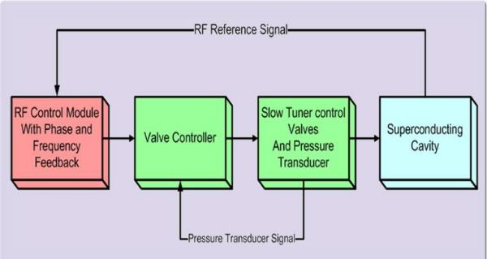
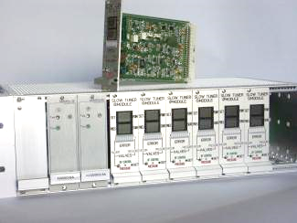
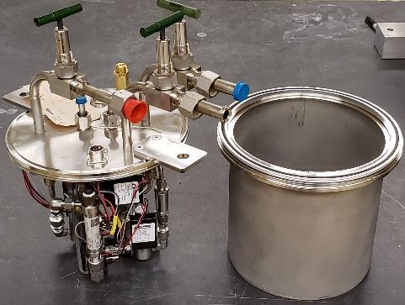
Components of ANL pneumatic slow tuner system
1
2
3
3
1
2

Slide 5
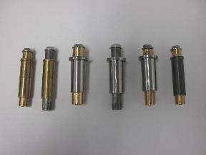
Tuner for ATLAS 72 MHz Quarter-wave Cavities
(Similar for other coaxial TEM-mode cavities, i.e. HWR)
Primary thermal isolation (4 K to 80 K)
Nitronic 60 bars attached to cavity beam port flanges
(at cavity temp, 2K-4K)
Cavity squeezed at beam ports
Bellow expands
No bellows guide posts in newest tuner (similar for FRIB, photo courtesy S. Stark)
Edge-welded stainless bellows (80 K)

Slide 6
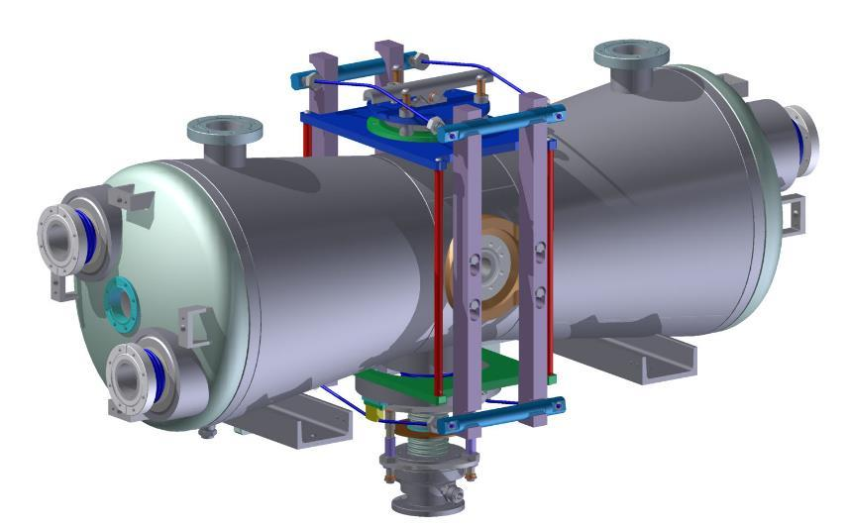
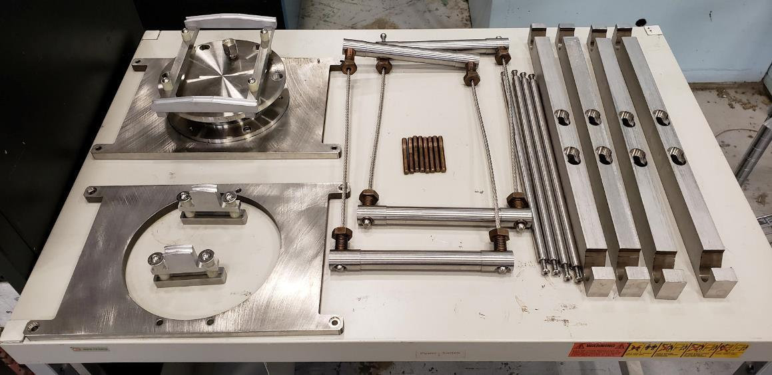
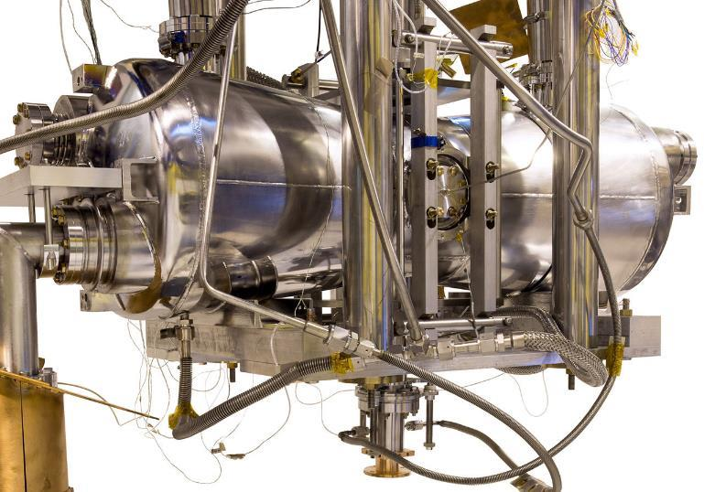
Pneumatic Tuner Subcomponents
PIP-II Half-wave Cavity

Slide 7
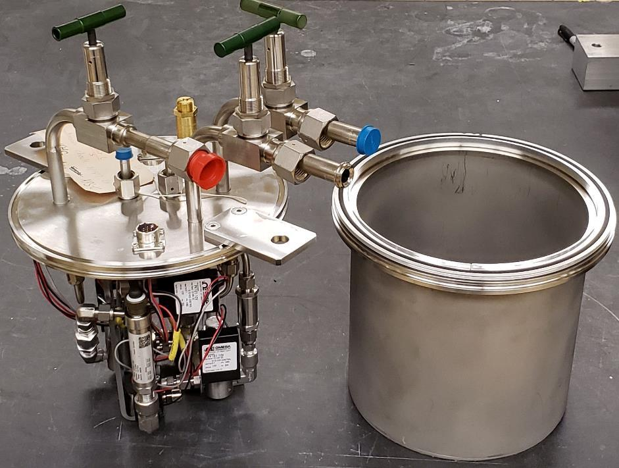
Pneumatic Tuner Gas Handling System
High pressure
~4 atm
To cavity tuner
Low pressure
(vacuum to 1 atm)
He blanket gas
Voltage proportional valves

Slide 8
Example of Slow Tuner Mechanical Properties for PIP-II 162.5 MHz HWR
Parameter | Calculated Value | Measured (296K)
Δf, Slow Tuner Range (ANSYS) | 130 kHz
Required force at cavity flange | 5 kN
Force sensitivity, Δf/ΔF | -26 Hz/N | -27.9 Hz/N
Force sensitivity, Δf/Δx | 133 kHz/mm | 119 kHz/mm
Required slow tuner frequency resolution | ~1 Hz
Slow tuner force resolution at cavity flanges | 0.038 N
Positional control at the beam port flanges of the order 10 nm!!

Slide 9
Tuner for E-cell Cavity

Slide 10
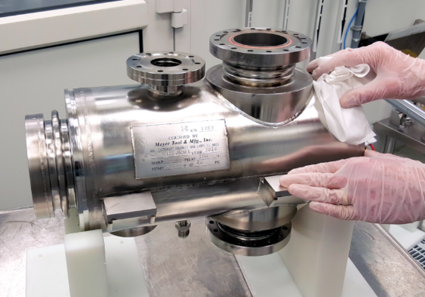
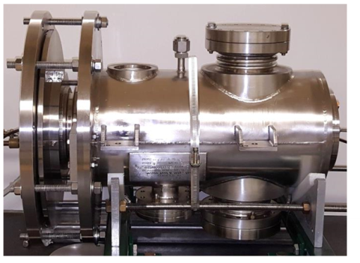
Single-cell Elliptical Cavity Tuner for APS-U Bunch Lengthening System
Increases the beam lifetime in the electron storage ring
Cavity with pneumatic tuner
1.4 GHz SRF Cavity

Slide 11
Cross Section of Elliptical Cavity with Pneumatic Tuner
R&D program on BLS technical systems is complete (May 2017)
Insulating
vacuum
Helium
Bellows

Slide 12
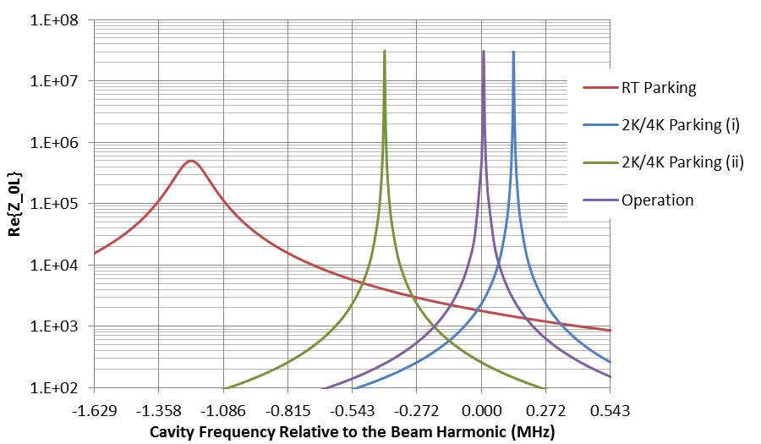
Cavity Operation Modes Using Pneumatic Slow Tuner
f_{2K,Park(i)} = f_{b} + 136 kHz: 1/2 revolution frequency higher than the 4th harmonic
f_{2K,Park(ii)} = f_{b} – 407 kHz: 1-1/2 revolution frequency lower than the 4th harmonic
f_{RT,Park} = f_{b} – 1.22 MHz: 4-1/2 revolution frequency lower than the 4th harmonic at RT
f_{RT,Park}
f_{2K,Park(i)}
+1275 kHz: RT->2K
+85 kHz: Depressurizing ST
f_{2K,Op}
Harmonic Voltage
  0.1 MV @ 2K/4K Parking(i)
  36 kV @ 2K/4K Parking(ii)
  12 kV @ RT Parking
Wall Dissipation Power
  10 mW/0.6 W @ 2K/4K Parking(i)
  1 mW/0.06 W@ 2K/4K Parking(ii)
  140 W @ RT Parking
f_{2K,Park(ii)}
-126 kHz: Pressurizing ST
-85 kHz: Pressurizing ST
f_{RT,ready}
-543 kHz: Pressurizing ST
f_{b}=1408.128 MHz*
4th
Notes:
RT: 1406.593 MHz, cav under vacuum, He pres=1.6 psig, 2 K: 1407.868 MHz at zero field

Slide 13
Open-loop full range measurement on APS-U cavity
The first cycle of increasing and decreasing pressure is analyzed for hysteresis. The 600 kHz range is plotted against the 50 psi pressure change. Increasing pressure is plotted in blue and decreasing pressure is plotted in red.

Slide 14
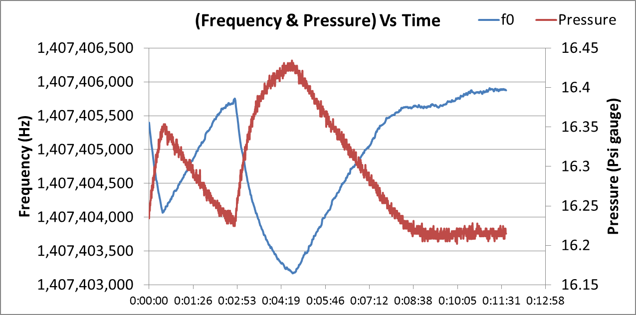
Open-loop tuner measurements on APS-U cavity
Look for any ‘step-wise’ behavior
Slow tuner open loop response to small changes in tuner pressure (red) applied manually with a gas bottle: The vertical frequency scale covers 2.5 kHz. The applied pressure change was 0.2 psi.
Tuner response is smooth with no step-wise behavior at a level of better than 100 Hz

Slide 15
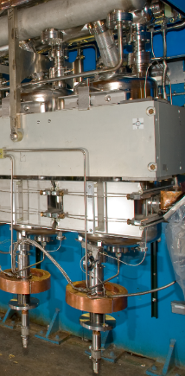
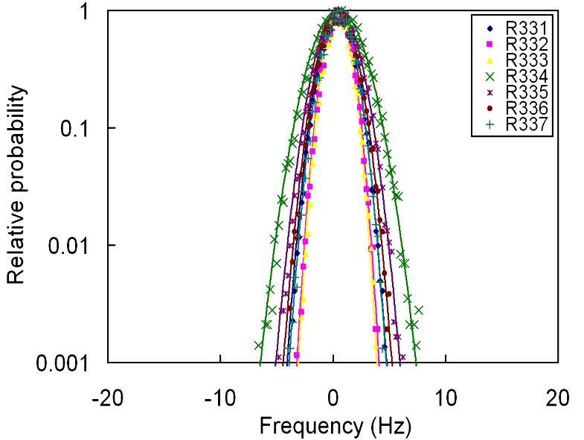
Example: Tuner and Microphonics Data for 109 MHz QWR Cryomodule (2009)
Measured cavity microphonics – All 7 cavities at 2 MV/cavity with slow tuner in operation
Tuner full range testing

Slide 16
Final Comments
Key features: mechanical simplicity, low microphonics
Limitations: not many; perhaps difficult to directly integrate a piezo tuner
4 decades in ATLAS with good reliability and maintenance record
Can be designed for low heat leak into 2 Kelvin
Experience has been with low-beta (TEM-mode) cavities
  Appears equally suitable select e-cell applications

Slide 17
Backup: Slow Tuner PID

