Slide 1
CEBAF Tuners: 1980 - 2018
Naeem Huque on behalf of the JLab SRF team
MRCW18 – October 25th – 26th, 2018

Slide 2
Introduction
A number of different cryomodules are (have been) in operation at CEBAF
C20/C50
Renascence (C100 Prototype)
C100
The CMs have unique tuner styles
Microphonics issues found during testing and operation have been solved by both design and retroactive modification

Slide 3
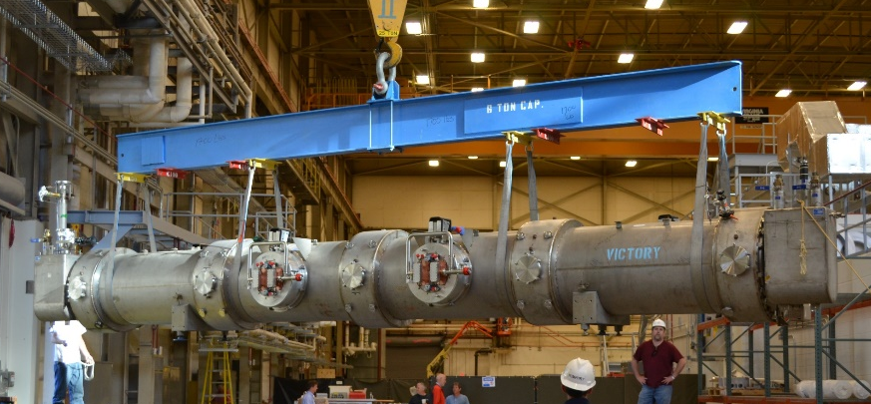
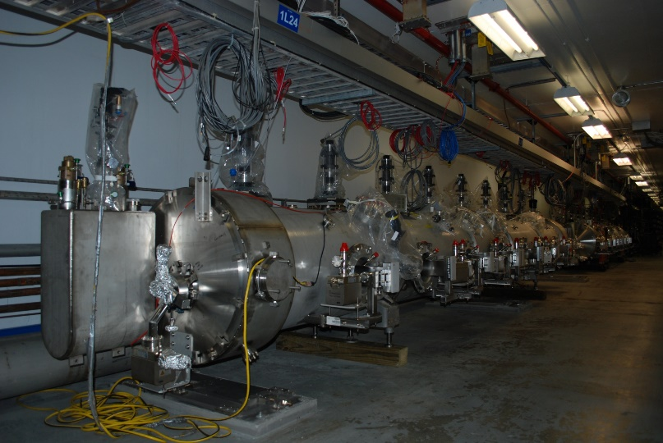
CEBAF Cryomodules
C20/C50
Original CEBAF cryomodules (C20)
Reworked to create C50 cryomodules
Renascence
CEBAF Upgrade prototype
C100
Upgrade CEBAF cryomodules

Slide 4
Overview
 | CEBAF (C20/C50) | CEBAF Upgrade (Renascence) | CEBAF Upgrade (C100)
Cavity | 5-Cell | 7-Cell | 7-Cell
Frequency (MHz) | 1497 | 1497 | 1497
Gradient per Cavity (MV/m) | 5 | 18 | 19.2
Operating Mode | CW | CW | CW
Bandwidth (Hz) Q_{external} | 220 6.6 x 10⁶ | 75 2.0 x 10⁷ | 75 2.0 x 10⁷
Lorentz Detuning (Hz) | 75 | 324 | 312
Microphonics (Hz, 6σ) | - | ±10 | ±10
Stiffness (lb/in) | 26,000 | 20,000-40,000 | 37,000
Sensitivity (Hz/μm) | 373 (calc) | ~300 (calc) | 267 (calc)
J.Delayen, Tuning Systems, USPAS 2008

Slide 5
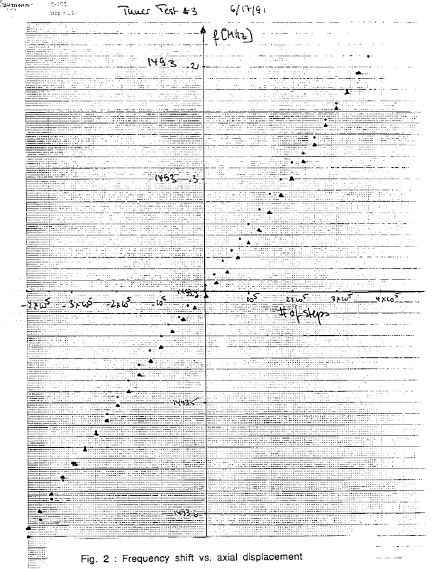
C20/C50 Tuner specs
 | C20/C50 Tuner
Coarse Range (kHz) | +/- 200
Coarse Resolution (Hz) | NA
Backlash (Hz) | > 100
Fine Range | None
Fine Resolution (Hz) | N/A
Tuning Method | Tension/Comp
Tuner Environment | Immersed (He)
Drive Environment | Vacuum/Warm
Motor Stoke (in) | 0.25
P. Kneisel, J. Mamosser, Mechanical Tuner for 5-Cell Cavity, JLab Tech Note TN91-043

Slide 6
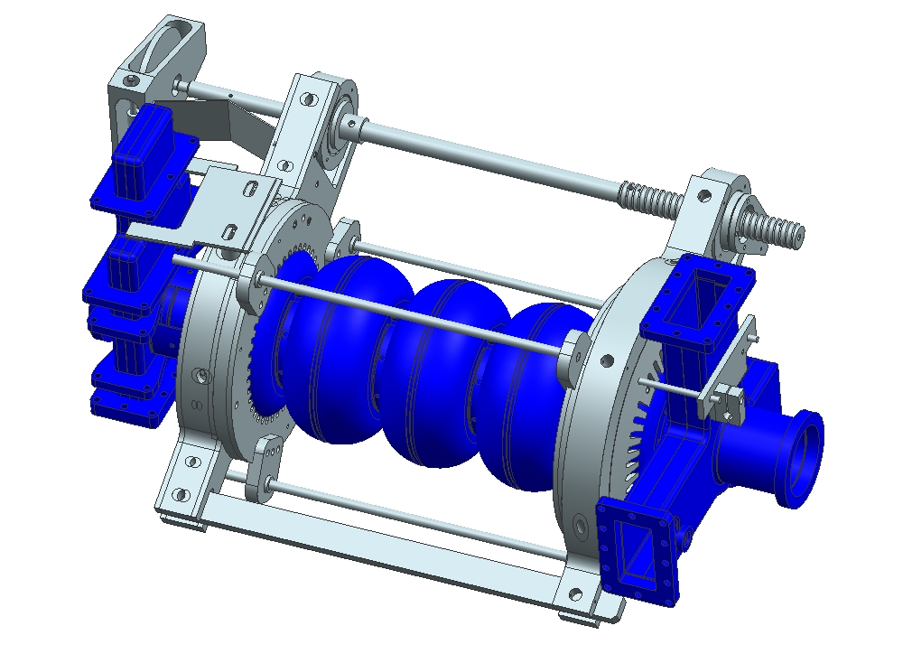
C20/C50 Tuner
Worm/Wheel Gear Assembly
Drive Shaft
Swivel Cell Holder
Axial Movement
Fixed Cell Holder
Titanium Rod

Slide 7
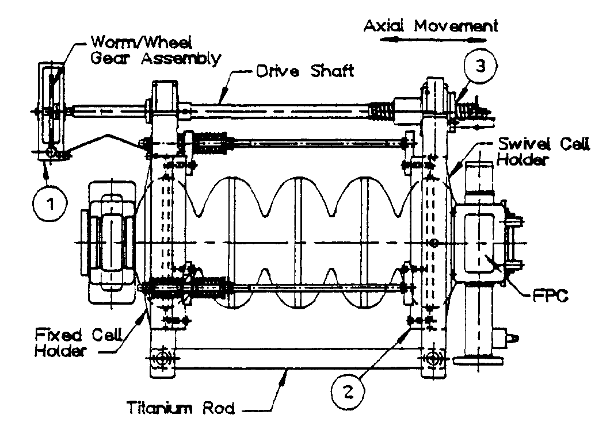
C20/C50 Tuner
The tuner is attached to the first cell with a fixed cell holder, and to the fifth with a swivel cell holder.
4 cells are tuned, with the 5th being fixed
A rigid titanium rod connects the two holders at one end and a drive shaft assembly connects the two at the other end.
Tuning is accomplished by translating rotational motion of the worm/wheel gear assembly into axial movement of the swivel cell holder
J. Marshall, J. Preble, W. Schneider, Superconducting Cavity Tuner Performance at CEBAF, PAC 1993

Slide 8
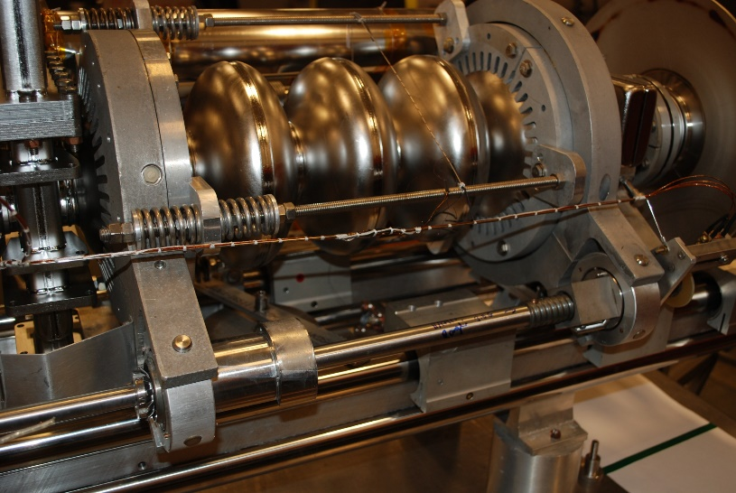
C20/C50 Tuner Performance
Feedback control system measures the phase difference between the forward and transmitted power, calculates the tuning angle, and drives the tuner stepper motor
20 degrees of phase shift corresponds to 41 Hz of frequency shift
Changes in angle results from fluctuations in helium bath pressure, where +/- 1 torr results in shift of 100 Hz
At the design gradient of 5 MV/m, the frequency shifts ~75 Hz due to radiation pressure
Tuner on original 5-Cell cavity (top) and an improved low loss 5-Cell cavity (bottom) for new C75 cryomodules
J. Marshall, J. Preble, W. Schneider, Superconducting Cavity Tuner Performance at CEBAF, PAC 1993

Slide 9
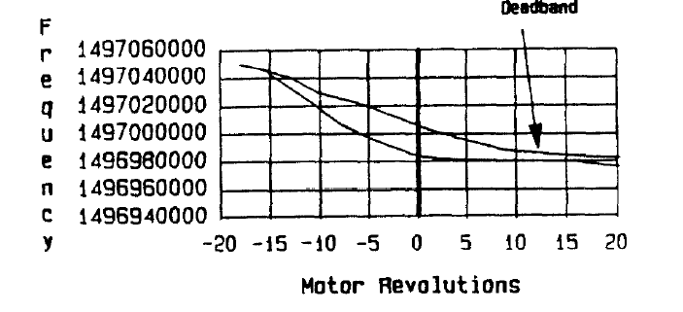
C20/C50 Tuner Issues
Early production tuners had several functional issues (see below):
Backlash caused by motor-to-tuner gear slop
Cell/cell holder thermal mismatch
Deadband due to lack of cavity/tuner pre-stress
Hysteresis at resonance was +/- 10 kHz, mostly due to cell/holder gap
Excessive motor operation could lead to repairs every 7 years against expected maintenance every 10 years
J. Marshall, J. Preble, W. Schneider, Superconducting Cavity Tuner Performance at CEBAF, PAC 1993

Slide 10
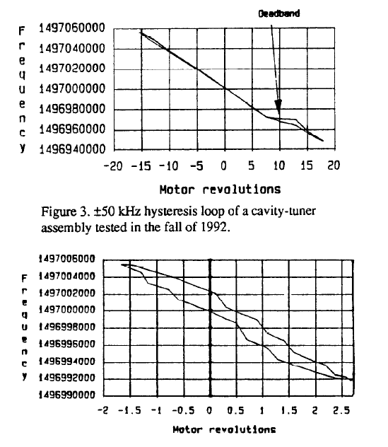
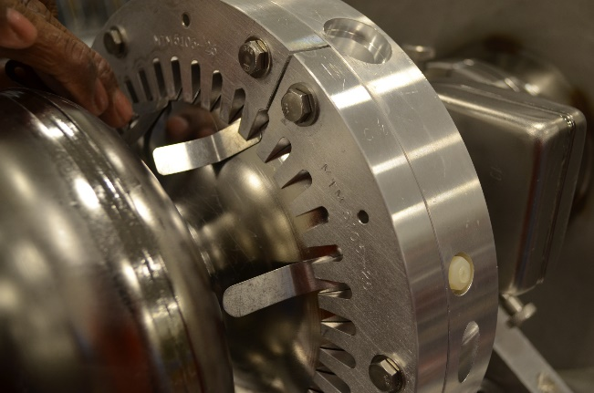
C20/C50 Tuner Remedies
Difference in thermal coefficients between aluminum and Nb results in inherent hysteresis
Holders were manufactured as half-cells matching contours of the cavities
Final assembly included the addition of shims (~0.010 thick)
Deadband was shifted to 30 KHz under resonance
Plots show +/- 50kHz and +/- 5kHz hysteresis loops
Cell holder shapes have been modified for use in new C75 cryomodules
J. Marshall, J. Preble, W. Schneider, Superconducting Cavity Tuner Performance at CEBAF, PAC 1993

Slide 11
Renascence Tuner Specs
 | Renascence Tuner
Coarse Range (kHz) | > 400
Coarse Resolution (Hz) | < 100
Backlash (Hz) | < 25
Fine Range (kHz) | 1.0
Fine Resolution (Hz) | < 1
Tuning Method | Tension
Tuner Environment | Vacuum
Drive Environment | Vacuum/Cold

Slide 12
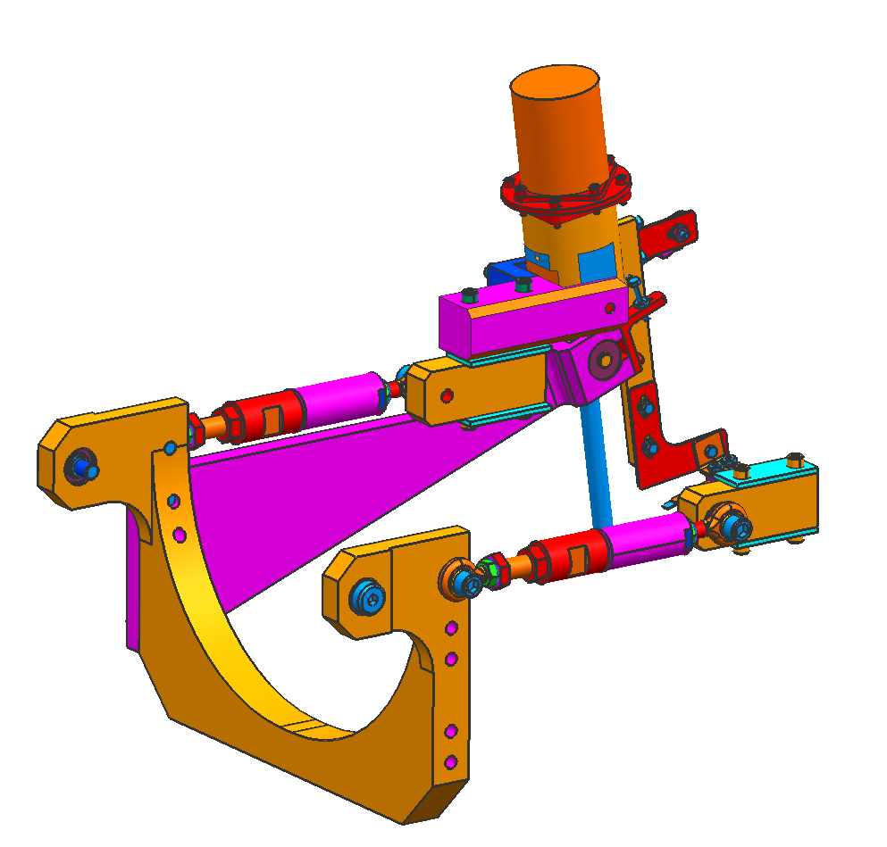
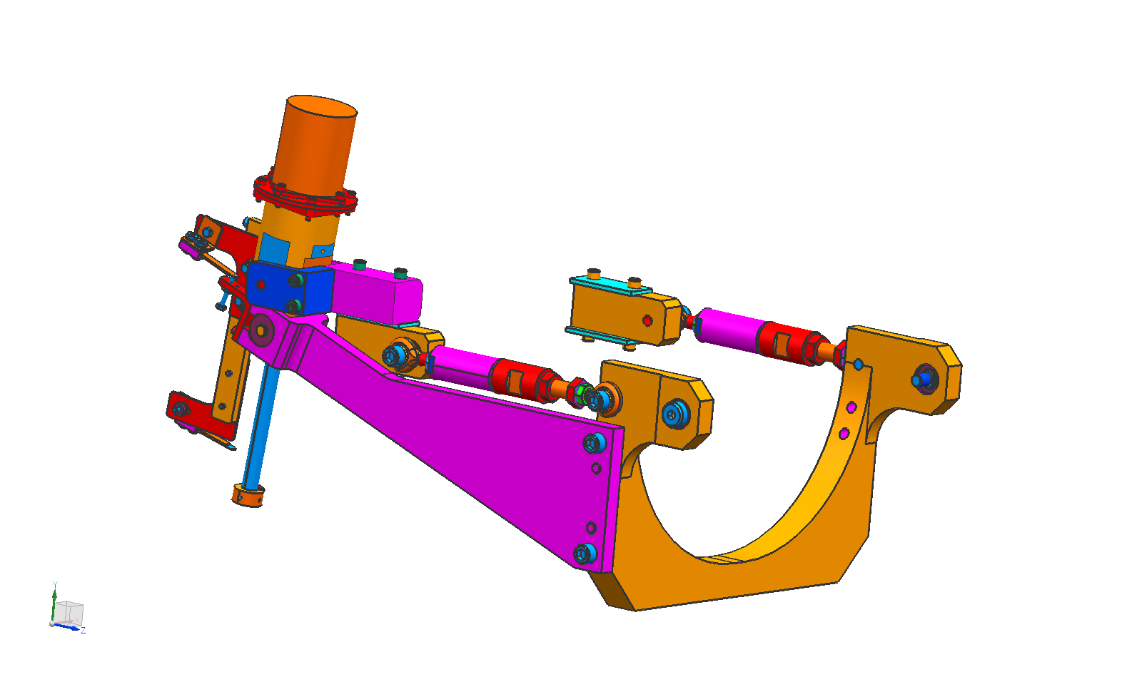
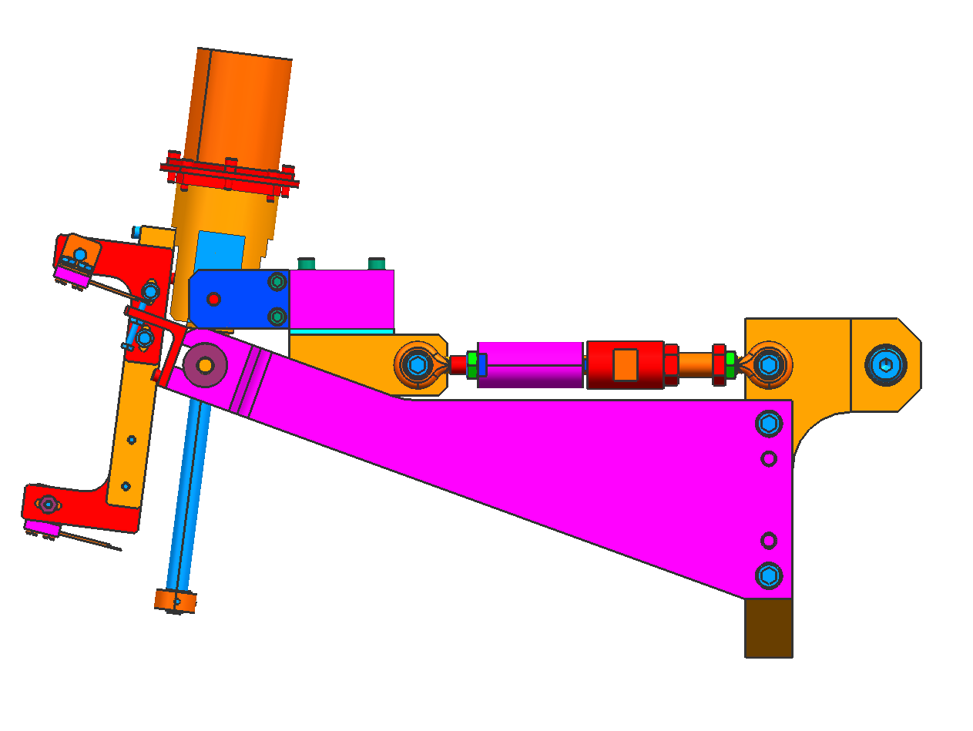
Renascence Tuner
Phytron Stepper Motor
Harmonic Drive
Piezo Stacks
Axial Movement
Dicronite Coated BeCu M12x1.5 Spindle
Primary Lever
Secondary Lever

Slide 13
Renascence Tuner Features
New HOM design for upgrade cavities left no beamline space for cavity tuner
Renascence tuner is designed to apply a large force over a relatively short distance; it has a mechanical advantage of 30:1
Coarse tuning is via a Phytron stepper motor (200 steps/rev) attached to a Harmonic Drive (Ratio 100:1)
Fine tuning is via a 40mm Piezo stack
Components are in insulating vacuum and operate cold
Vacuum vessel included flange ports to allow for motor and piezo replacement
E.Daly, G.K. Davis, W.R. Hicks, Testing of the New Tuner Design for the CEBAF 12 GeV Upgrade SRF Cavities, PAC 2005

Slide 14
Renascence Tuner Operation
Tuner is installed on individual cavity helium vessels
Cavities tuned in tension by stepper motor and harmonic drive (ratio 100:1)
Motor pushes one end of the primary lever downwards
Primary lever motion causes secondary lever to rotate about pins and stretch cavity in tension
Secondary lever ensures even load distribution on cavity
Piezo actuator stacks are compressively loaded as motor is actuated
Piezos can compress or expand to provide fine tuning
E.Daly, G.K. Davis, W.R. Hicks, Testing of the New Tuner Design for the CEBAF 12 GeV Upgrade SRF Cavities, PAC 2005

Slide 15
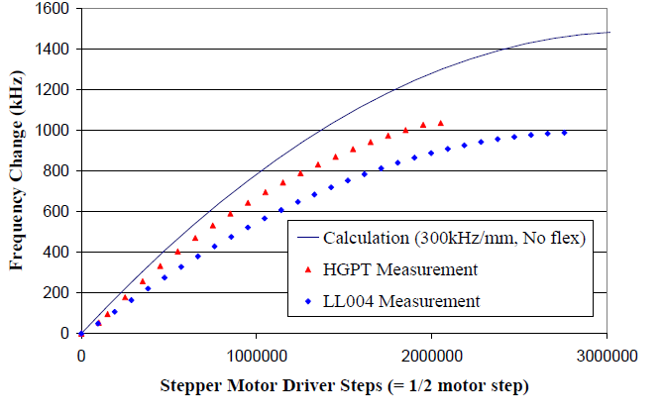
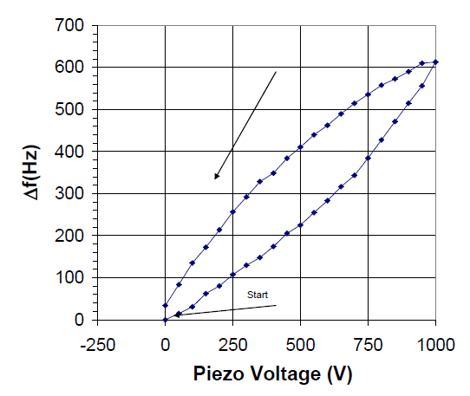
Renascence Tuner Performance
Tuner was tested on Low Loss (LL004) and High Gradient (HGPT) cavities
Tuner range:
1000 kHz (spec 400kHz)
Tuning sensitivity (top graph):
0.73 Hz per step for HGPT
0.57 Hz/step for LL004
Decrease in frequency change is due to tuning mechanism following cosine function
Piezo response:
0.35 – 0.60 Hz/volt (bottom graph)
Possible reliability issues with cold motor/piezos caused this tuner design to be scrapped for future C100 cryomodules
E.Daly, G.K. Davis, W.R. Hicks, Testing of the New Tuner Design for the CEBAF 12 GeV Upgrade SRF Cavities, PAC 2005

Slide 16
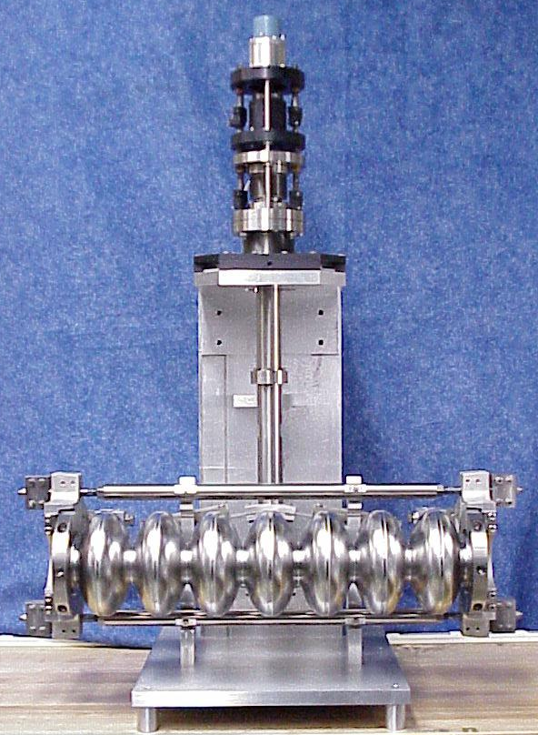
C100 Tuner Specs
 | C100 Tuner
Coarse Range (kHz) | +/- 200
Coarse Resolution (Hz) | < 2
Backlash (Hz) | < 3
Fine Range | 550 Hz (150V)
Fine Resolution (Hz) | <1
Tuning Method | Tension
Tuner Environment | Vacuum
Drive Environment | Vacuum/Warm

Slide 17
C100 Tuner
Motor
Concentric Tubes
Pivot Plate
Axial Movement
Fulcrum Bar
Flexure Joints

Slide 18
C100 Tuner
Stepper Motor
200 step/rev
Harmonic Drive
Gear Reduction = 80:1
Low voltage piezo
50 μm stroke (150 V)
Ball screw
Lead = 4 mm
Pitch = 25.75 mm
Bellows/slides
axial thermal contraction
Motor
Piezo
J.R. Delayen, L. Doolittle, E. Feldl, V. Nguyen, W. Sachleben, Frequency Tuning of the CEBAF Upgrade Cavities, PAC 1999, New York

Slide 19
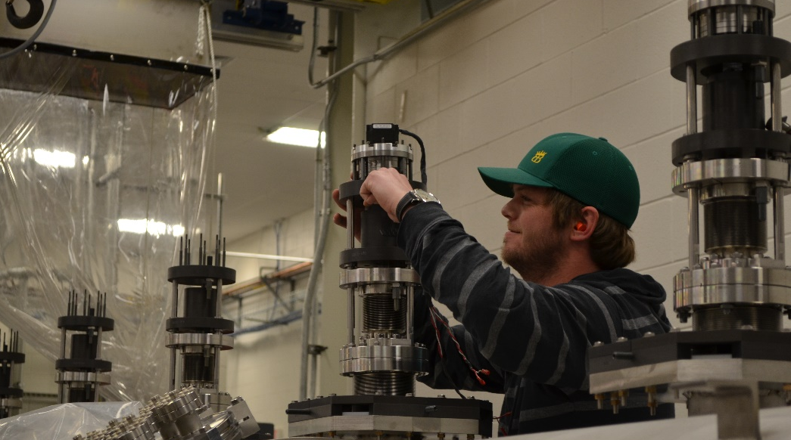
C100 Tuner Features
Scissor jack mechanism
Ti-6Al-4V Cold flexures & fulcrum bars
Cavity tuned in tension only
Warm transmission
Stepper motor, harmonic drive, piezo and ball screw mounted on top of CM
Openings required in shielding and vacuum tank
Originally due to a lack of confidence in the reliability of cold motor systems
E.F. Daly, Overview of Existing Tuner Systems, ERL Workshop 18-23 MAR 2005

Slide 20
C100 Tuner Operation
Motion transferred through concentric tubes moving axially, relative to one another
Tubes engage scissor-jack assembly
Attached to hubs on cavity
Pivots against fulcrum bars
Downward motion of ball-screw causes cavity stretch
Piezo stacks originally installed as back-up for coarse tuner not being able to fine tune
No bellows between cavities
Need to accommodate thermal contraction of cavity string
Pre-load and offset each tuner while warm
G. Davis, J. Delayen, M.Drury, E. Feldl, Development and Testing of a Prototype Tuner for the CEBAF Upgrade Cryomodule

Slide 21
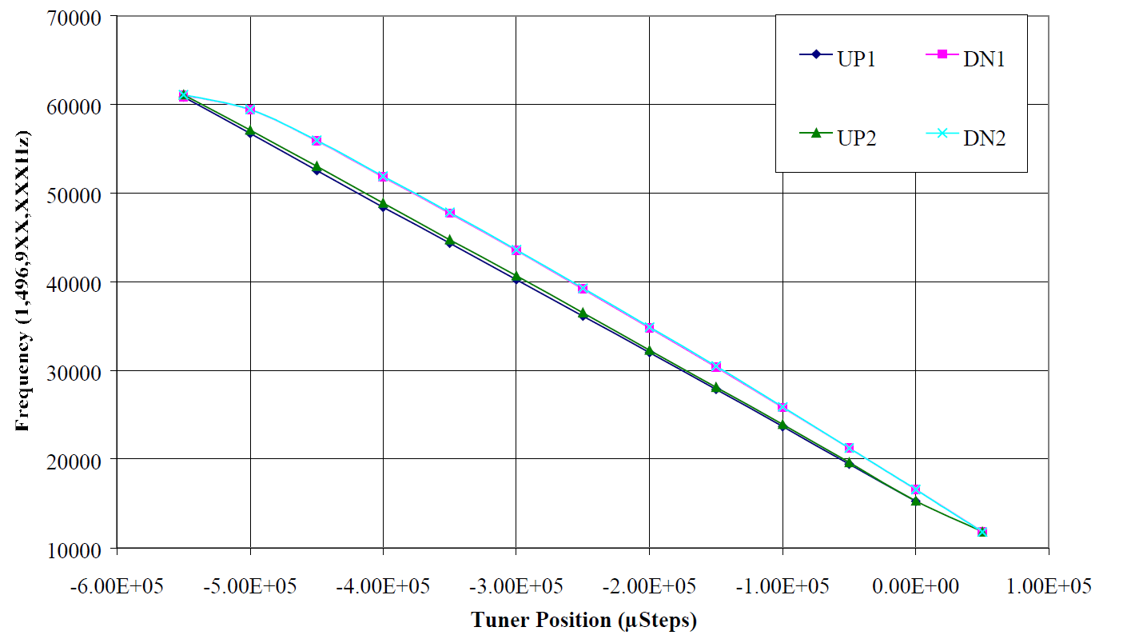
C100 Tuner Performance
Coarse Tuner:
Range: 343 kHz
Resolution: < 2 Hz
Hysteresis (at 700 Hz): 153 Hz
Repeatability (at 700 Hz): 37 Hz
Fine Tuner (Piezo):
Range: 2.4 kHz
Resolution: 1 Hz
Hysteresis (at 2.5 kHz): 933 Hz
Repeatability (at 2.5 kHz): 329 Hz
Note: Piezo stacks are currently only installed on one C100 in the CEBAF tunnel
G. Davis, J. Delayen, M.Drury, E. Feldl, Development and Testing of a Prototype Tuner for the CEBAF Upgrade Cryomodule

Slide 22
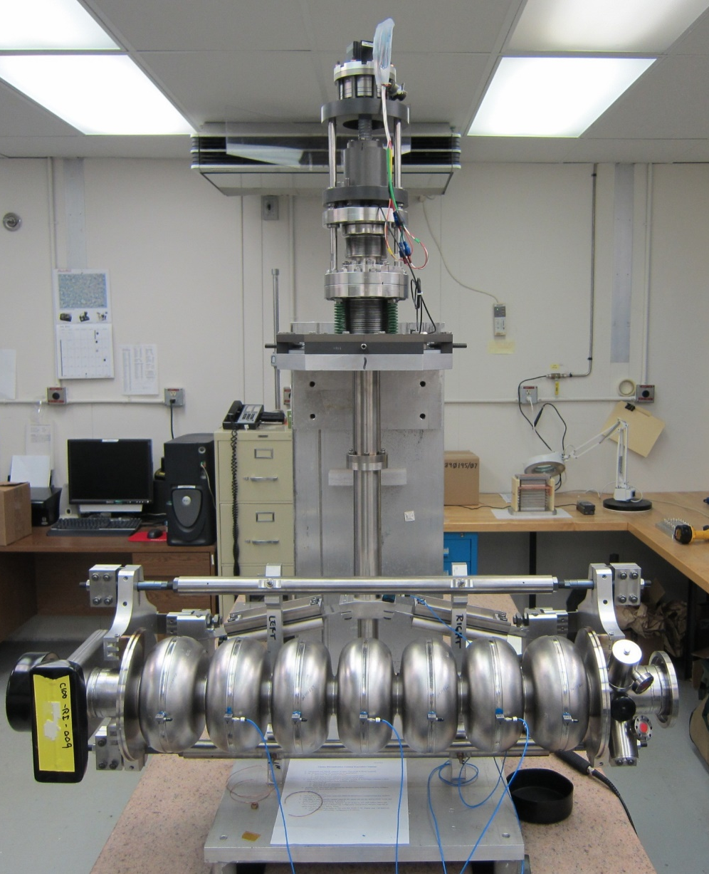
C100 Microphonics
Operational microphonics were found to be higher than the 10 Hz spec
The cause was determined to be cost-saving measures that reduced the stiffness of the tuner/cavity
Thicker Pivot Plates were proposed as the simplest solution
New setup tested warm on test bench, and on C100-5 in the tunnel
New design (C100-4 onwards) showed marked improvement
Retrofits applied to C100-1 to C100-3
Stiffen tuner stack
Bracing for waveguides
Bricks and bags (see T.Powers talk)
K. Davis, J. Matalevich, T. Powers, M. Wiseman, Virbation Response Testing of the 12GeV Upgrade Cryomodule, LINAC 2012

Slide 23
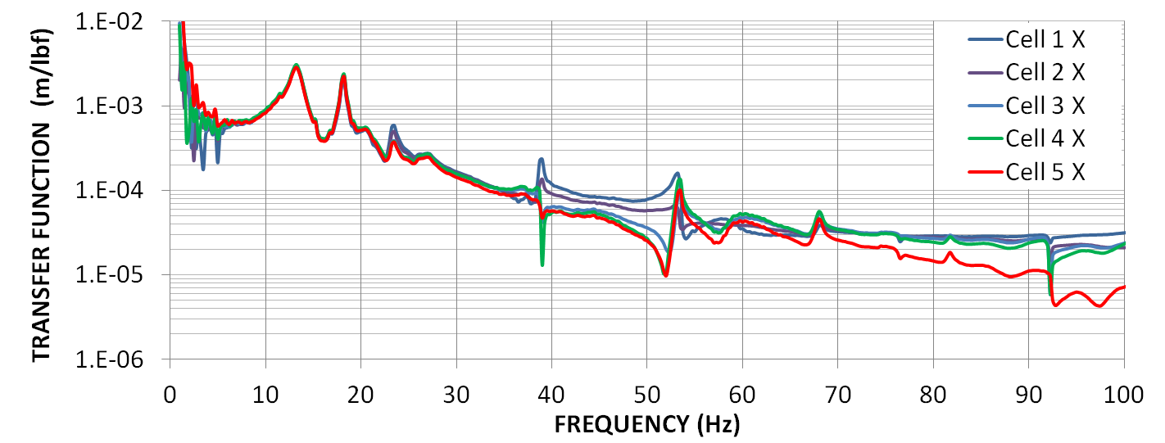
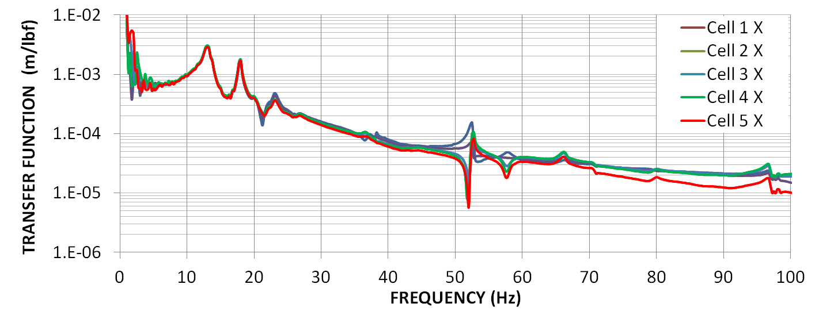
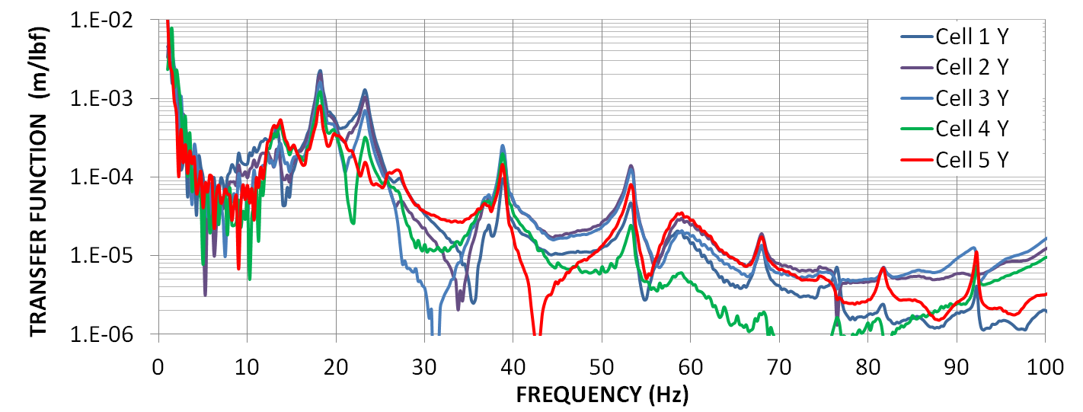
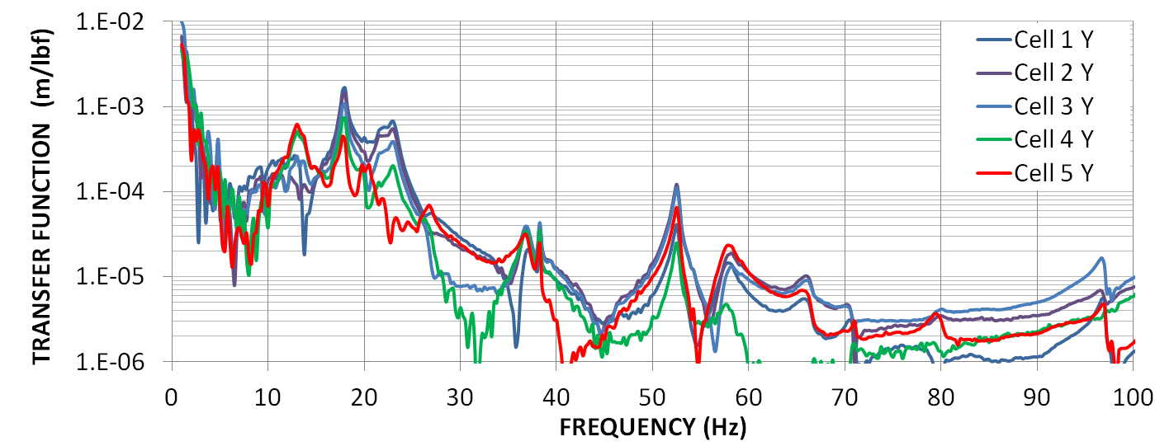
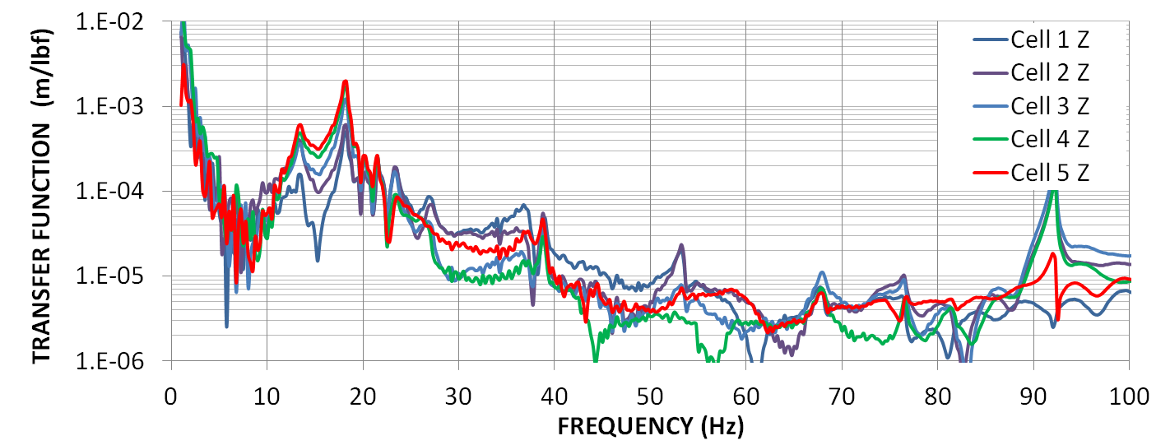
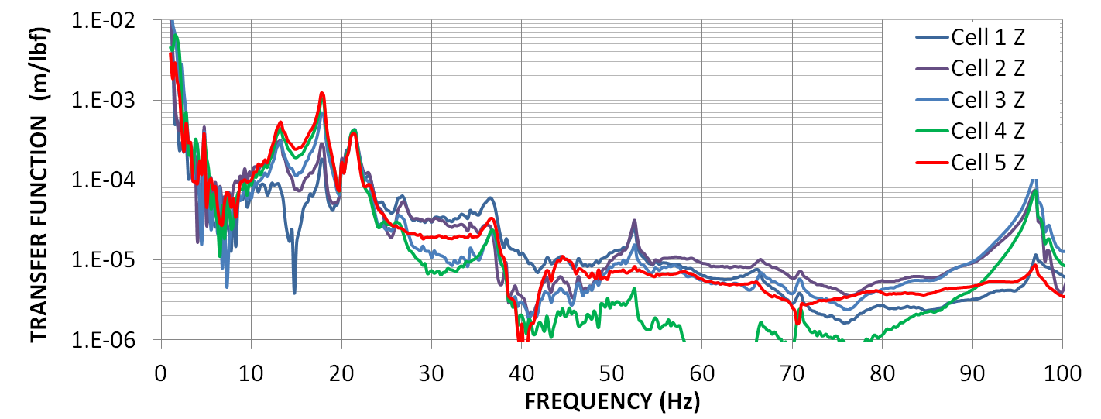
C100 Microphonics
Warm Transfer Function Measurements
Improvements to the tuner stiffness did not significantly affect the axial vibrational response of the cavity
Improvements to the tuner stiffness did reduce the lateral, bending, modes of the cavity. It also reduced cavity response to the 10 Hz rigid-body mode of the entire 8-cavity string.
Original Tuner
Stiffened Tuner
K. Davis, J. Matalevich, T. Powers, M. Wiseman, Virbation Response Testing of the 12GeV Upgrade Cryomodule, LINAC 2012

Slide 24
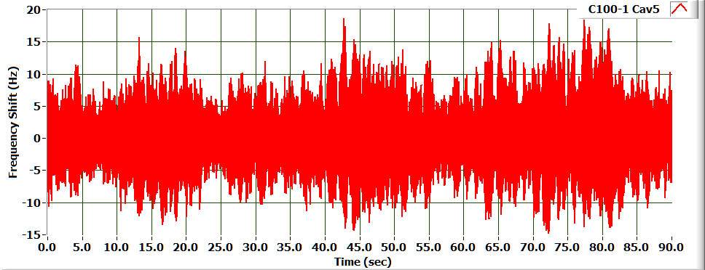
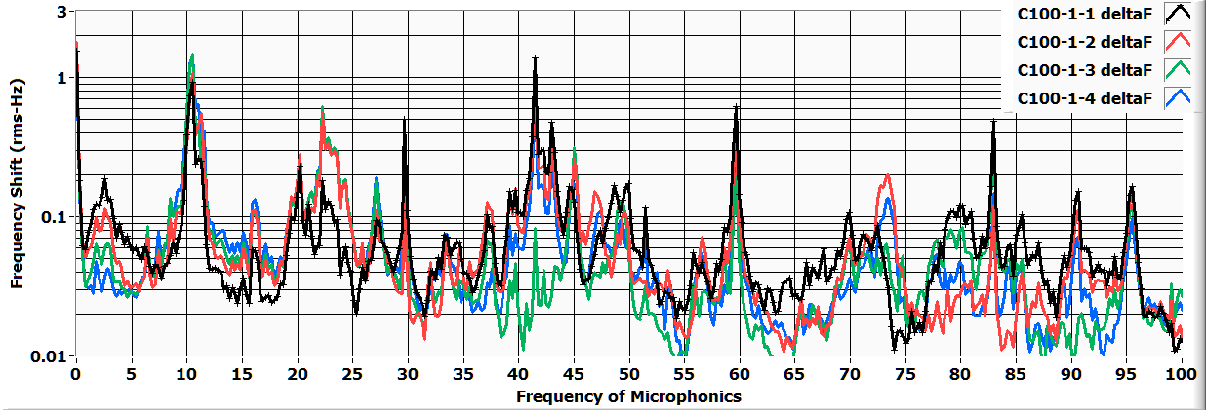
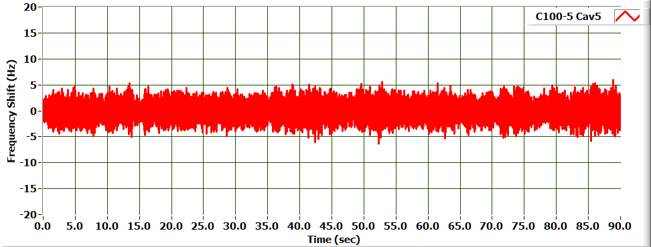
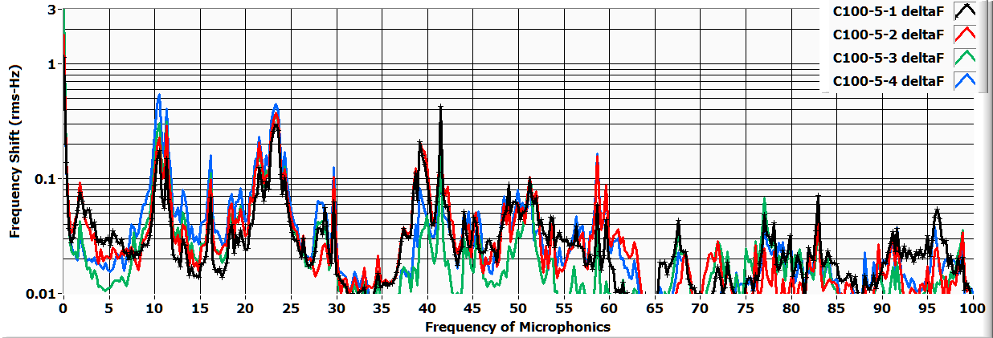
C100 Microphonics
Comparison of C100-1 (Original Tuner) and C100-5 (Stiffened Tuner)
Original Tuner (Top) and Stiffened Tuner (Bottom)
Original Tuner (Top) and Stiffened Tuner (Bottom)
K. Davis, J. Matalevich, T. Powers, M. Wiseman, Virbation Response Testing of the 12GeV Upgrade Cryomodule, LINAC 2012

Slide 25
C100 Microphonics
The microphonics are substantially smaller in the cryomodule with stiffened tuners.
The harmonics at 10 Hz and 45 Hz were substantially reduced in the cryomodule with the stiffened tuners.
The 25 Hz component in C100-1 was not reduced substantially in C100-5. However, it was shifted up in frequency slightly as predicted by the modeling and warm tests.
Operational testing in the CEBAF LINAC show an average of 47% improvement for ambient microphonic detuning for C100-5 (modified tuner) vs C100-1 (baseline tuner).
Studies ongoing to use piezos to control microphonics
Cryomodule | C100-1 (baseline) | C100-5 (modified) | % Improved
Cavity 1 | 11.8 Hz | 5.1 Hz | 57%
Cavity 2 | 12.8 Hz | 6.7 Hz | 48%
Cavity 3 | 13.7 Hz | 5.6 Hz | 59%
Cavity 4 | 13.5 Hz | 7.4 Hz | 46%
Cavity 5 | 18.0 Hz | 9.6 Hz | 46%
Cavity 6 | 9.1 Hz | 8.5 Hz | 8%
Cavity 7 | 9.7 Hz | 5.6 Hz | 42%
Cavity 8 | 8.9 Hz | 5.8 Hz | 35%
Operational Microphonics in the CEBAF Tunnel, Baseline vs Modified Design (Peak Detuning)
K. Davis, J. Matalevich, T. Powers, M. Wiseman, Virbation Response Testing of the 12GeV Upgrade Cryomodule, LINAC 2012

Slide 26
Summary
Unique tuners are in operation on several cryomodule/cavity types in the CEBAF tunnel
C20/C50 tuners and C100 tuners are in current operation, and the Renascence-style tuner was also tested in the tunnel
Lessons from testing and operations lead to improvements in design
Questions?

