Slide 1
Pneumatic Tuner Digital Control
Harsh Maniar RF Controls Engineer II

Slide 2
Agenda
Overview
System diagram
Analog circuit
Digital implementation of pneumatic tuner control
Pressure transducer
User interface
Pneumatic valve calibration
Conclusions & Reference

Slide 3
FRIB Linac Overview
System | Area | Frequency | Cavity Type | Required RF Power | Amplifier Type | Tuner | Qty
Ion Source | FE | 14 GHz | ECR | 2 kW | Klystron | N/A | 1
LEBT Multi-Harmonic Buncher | FE | 40.25 MHz - 120.75 MHz | RT | 100 W | SS | N/A | 3
RFQ Driver | FE | 80.5 MHz | RT | 8 kW | SS | N/A | 1
RFQ Final (Tetrode) | FE | 80.5 MHz | RT | 100 kW | Tetrode | Servo (water) | 1
MEBT Buncher | FE | 80.5 MHz | RT | 4 kW | SS | 2-phase stepper | 2
β=0.041 (accelerating) | LS1 | 80.5 MHz | SC | 700 W | SS | 2-phase stepper | 12
β=0.085 (accelerating and matching) | LS1 - FS1 | 80.5 MHz | SC | 2.5 kW | SS | 2-phase stepper | 92
IH Multi-Gap Buncher | FS1 | 161 MHz | RT | 18 kW | SS | 5-phase stepper | 2
β=0.285 (accelerating and matching) | LS2 | 322 MHz | SC | 3.0 kW | SS | Pneumatic | 72
β=0.530 (accelerating and matching) | LS2- LS3 | 322 MHz | SC | 5.0 kW | SS | Pneumatic | 148

Slide 4
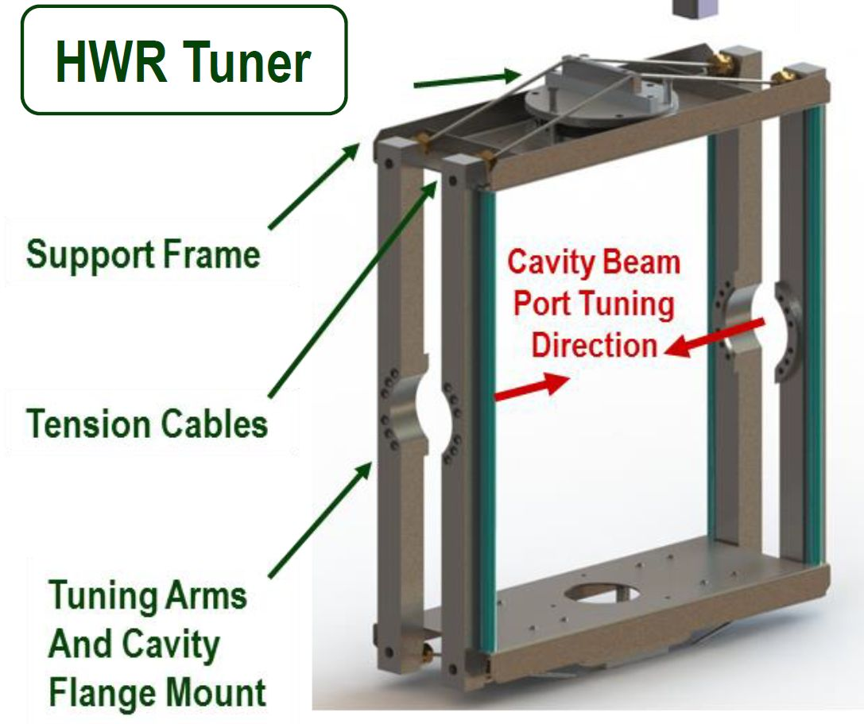
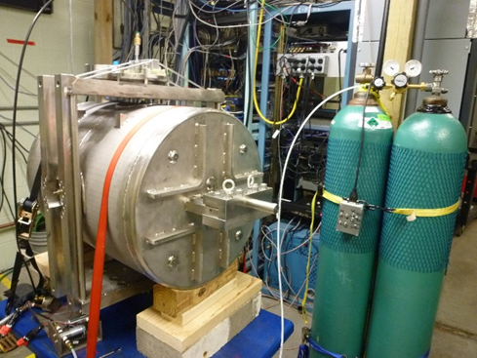
Pneumatic Tuner Overview
Half Wave Resonator(HWR) cavities use pneumatic tuner to adjust cavity frequency
72 of β = 0.29 and 148 of β = 0.53 cavities in FRIB
Digital implementation of pneumatic tuner control has been developed based on analog pneumatic tuner control used at ANL [1]
Helium gas manifold pressure is controlled by opening and closing of pneumatic control valves (supply and return)
Pneumatic valve calibration technique has been developed
Improper tuner control voltages and calibration can lead to cavity detuning due to Lorentz force

Slide 5
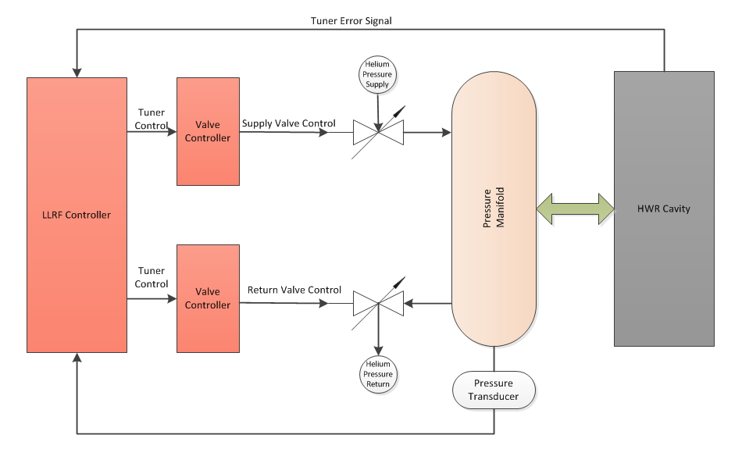
System Diagram

Slide 6
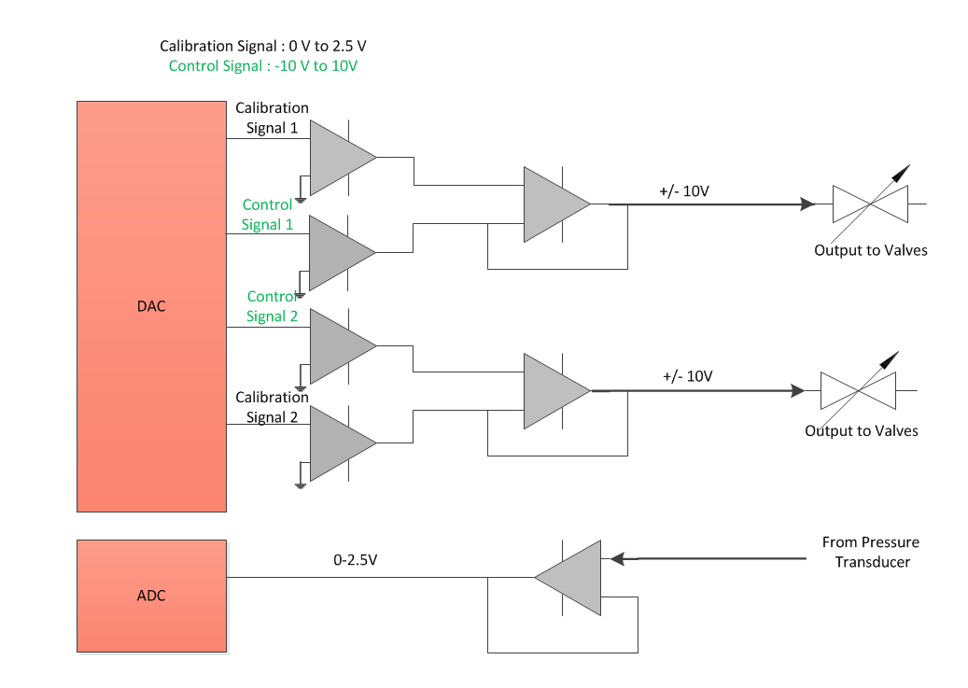
Analog Circuit
Prototype 1 developed at FRIB, based on ANL design

Slide 7
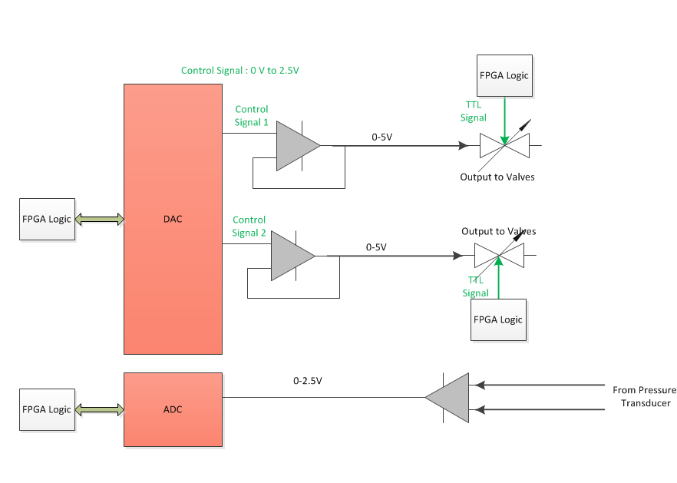
Digital Implementation Circuit
Simplified circuit
Removed calibration signals and related parts, logic implemented in FPGA
Added TTL signals to enable / disable valves digitally
Pressure transducer differential input for better resolution
Added temperature sensor to monitor PCB overheating

Slide 8
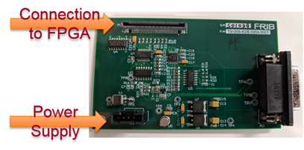
LLRF Hardware
Connection to valves and pressure transducer
Pneumatic Tuner Board
RF Board
FGPDB

Slide 9
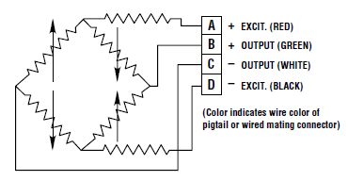
Pressure Transducer
Installed pressure sensor to monitor accurate manifold pressure
Safety features developed i.e. disable supply valve when pressure is too high
APG PT-L9-C-100
Range : 0 to 100 psi
Output : 10 mV/V
Excitation : 12 VDC
Full scale output : 120mV/ 100psi
Wheatstone bridge
Tuner driver circuit provides excitation voltages between A and D
Differential output from B and C provides 120mV maximum output
Tuner circuit has internal gain to amplify this signal before ADC
Tested with 100 feet cable (approximate distance between transducer and tuner circuit)

Slide 10
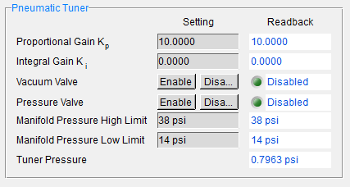
User Interface
User screens have been developed to let user
Calibrate valves (in Volts)
Enable / disable valves
Change gain
Set absolute pressure limits (in psi)
Firmware development
Four different signals to control opening and closing of supply and return valves
Range : 0-5V
Pressure Close : PC, Vacuum Close : VC
Pressure Open : PO, Vacuum Open : VO
Safety features : Closes supply valve if pressure reaches high limit
Formula used for conversion from voltage to psi
Full scale pressure / Sensor sensitivity * Excitation voltage * Differential amplifier gain

Slide 11
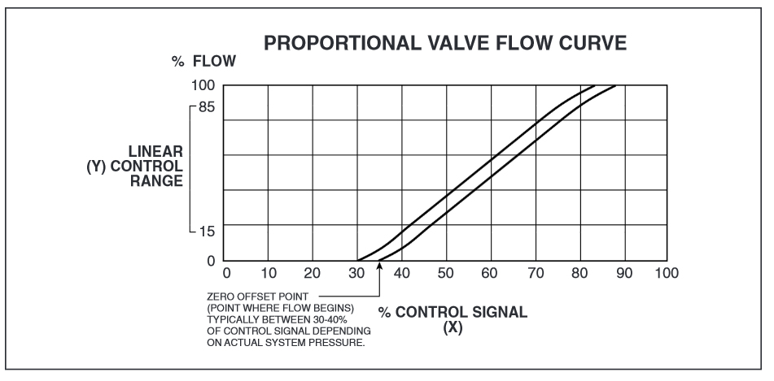
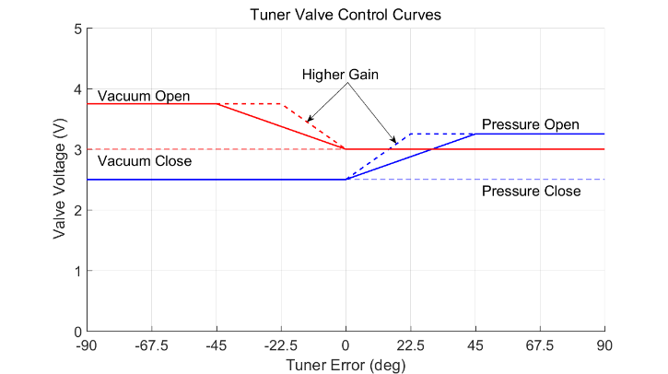
Valve Calibration (1)
Adjust spring screw and valve control voltages to keep control signal at zero offset point

Slide 12
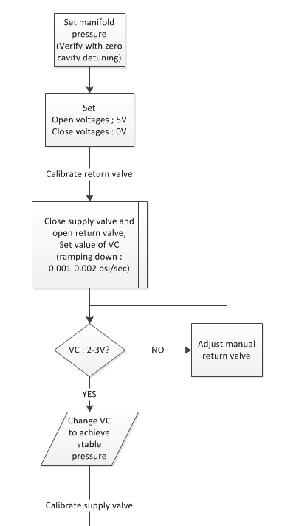
Valve calibration (2)
Set manifold pressure needed for 322 MHz
Verify pressure with zero cavity detuning
In Self-Excited Loop (SEL) mode
Or in open loop mode and tuner ON
Set open and close values for pneumatic valves
Calibrate return valve
Close supply manual valve and open return manual valve
Set value of VC so manifold pressure starts ramping down at 0.001-0.002 psi/sec rate
Typically value of VC should be in range of 2-3V to avoid hysteresis on valves
If not, adjust spring screw on manual return valve
Change VC so pressure gets stable and note that value, set VC to 0 volts after that to calibrate supply valve

Slide 13
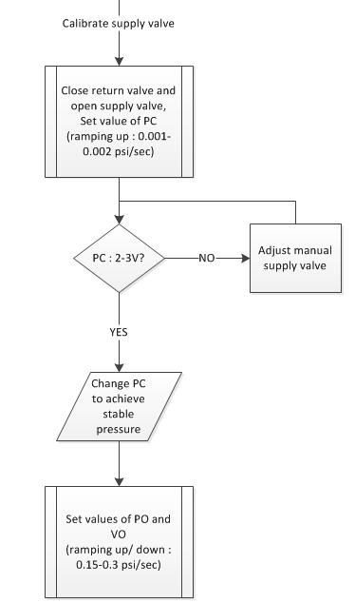
Valve calibration (3)
Calibrate supply valve
Close return manual valve and open supply manual valve
Set value of PC so manifold pressure starts ramping up
Typically value of PC should be in range of 2-3V to avoid hysteresis on valves
If not, adjust spring screw on manual supply valve
Change PC so pressure gets stable and note that value
Set VC and PC values from noted calibration values, open both manual valves
Set PO and VO values so pressure increase/ decrease at rate of 0.15-0.3 psi/ sec
Typical open voltage values 3-3.5 volts

Slide 14
Conclusions
Resonance control with the developed digital pneumatic tuner has been verified multiple times during cryo-module tests at FRIB
Cavities can be stably locked at designed field
Valve calibration technique has been proved efficient to achieve stable pressure level for smooth operation
Tuner tracks changes in bath pressure and compensates for Lorentz force detuning
Pressure transducer differential feedback (in mV) and differential amplifier gain provides correct pressure level inside manifold
TTL signals allow users to enable / disable valves from CS-Studio screens
Safety features developed in firmware
Avoid excessive manifold pressure and damage to cavities by disabling supply valve when pressure is too high

Slide 15
Path Forward
Develop scripts to run automatic valve calibration for FRIB Linac
Manifold pressure keeps changing with change in cryo parameters (i.e. bath pressure), which changes operating point
Might need to re-calibrate all valves when installed in FRIB Linac

Slide 16
Authors
H. Maniar, D. Morris, S. Zhao
FRIB, Michigan State University, East Lansing, MI 48824, USA
Acknowledgement
Special thanks to Gary Zinkann (ANL), Sergey Sharamentov (ANL)
Argonne National Laboratory, Argonne, IL 60439, USA
Reference
[1] G. Zinkann, E. Clifft, S.I. Sharamentov, An Improved Pneumatic Frequency Control for Superconducting Cavities, Proc. of PAC-2005, p.4090.

