Slide 1
LEReC Overview
The Linac of Low Energy RHIC electron Cooler (LEReC) is designed to deliver a 1.6 MeV to 2.6 MeV electron beam, with peak-to-peak dp/p less than ±7e-4.
It is soft with tight requirement on voltage fluctuation.

Slide 2
What is crosstalk?
Direct coupling between FPC and PU.
In circuit model it is represented by a capacitor between two couplers.
it is a translation of the original Lorentz curve.
Y. Zhao, 2002 https://www.bnl.gov/isd/documents/79902.pdf.
F. He, B. Zhang, W. Xu, et al., Analytical and Experimental Study of Crosstalk in the Superconducting Cavity, in Proceedings of Particle Accelerator Conference 2009, Vancouver, BC, Canada, 2009, p. 2098. http://accelconf.web.cern.ch/AccelConf/PAC2009/papers/we5pfp045.pdf.

Slide 3
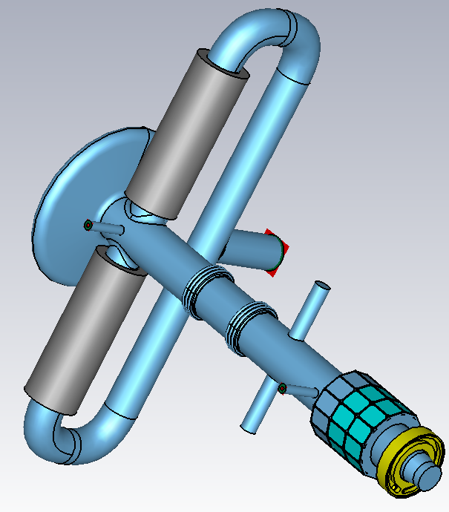
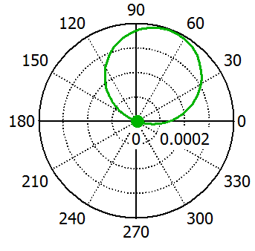
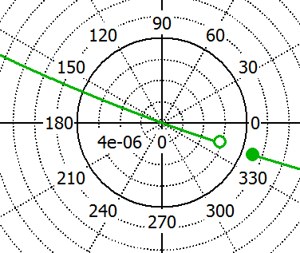
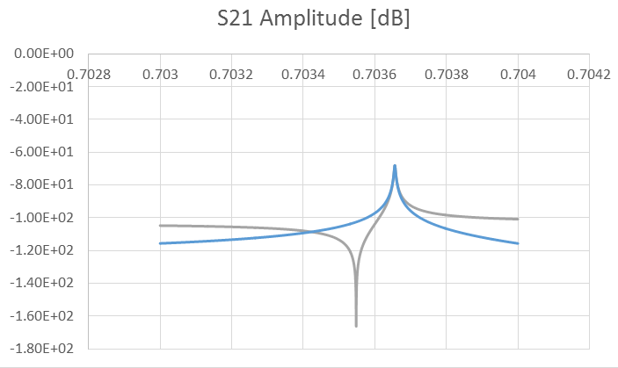
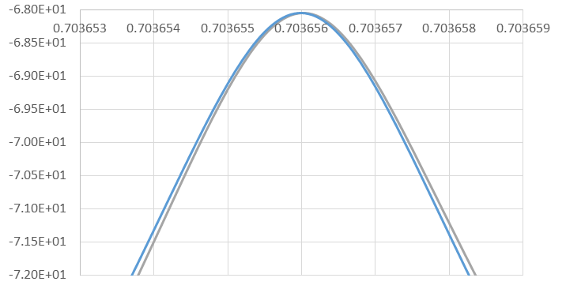
In Booster cavity
PU port (3)
25Ω FPC port (1)
HOM port (4)
1kHz → 0.08dB → 0.93% in voltage

Slide 4
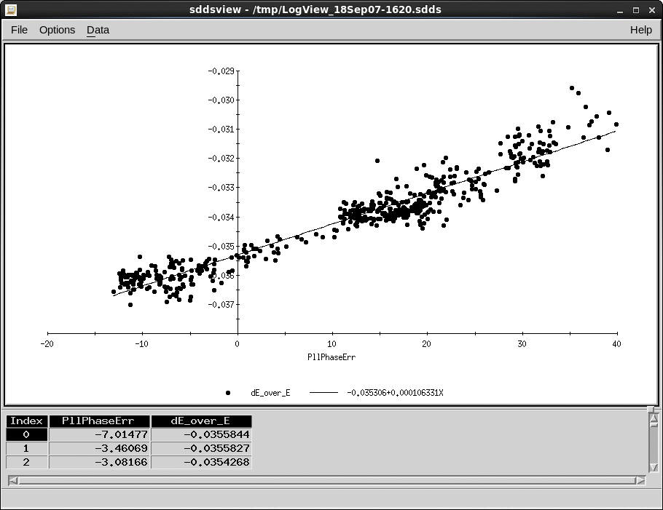
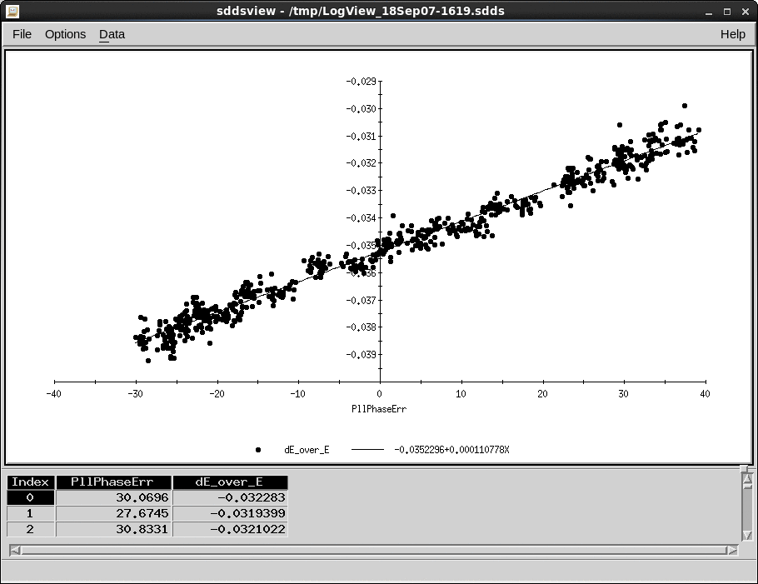
Why do we care
For fixed Vpu:
With 1kHz difference between fc and fa, Vacc changes 1% (measured to be 0.3%).
1kHz variation is a slow change and can be stabilized by feedback loop, if we know how.
Microphonics (200 Hz design value) eat the dp/p budget.

Slide 5
What is next
Measure S21 in narrow/broad band with coarse IF bandwidth, to get f0, Q and S21 close to f0.
Use fine IF bandwidth to resolve the S21 near two frequency points: f0±∆f, with the selection of ∆f big enough so that L>>d.
Integrate the measurement results into LLRF.
d
L

