Slide 1





Status Update from the PHYS WG
JETSCAPE Collaboration Meeting, 06/29/2018
Shanshan Cao
Wayne State University

Slide 2
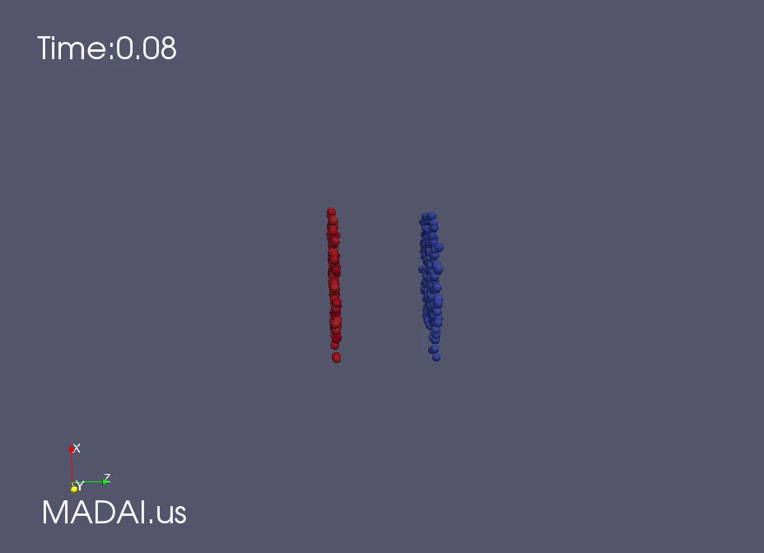

Nuclear matter under extreme conditions
RHIC: Au-Au (up to 200 AGeV)
LHC: Pb-Pb (up to 5.02 ATeV)
Initial state
Pre-equilibrium state
QGP: initial temperature ~ 500 MeV (10¹² K), lifetime ~ 8 fm/c (10⁻²³ s)
Hadron gas

Slide 3
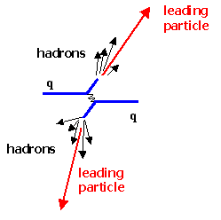
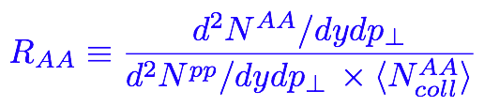
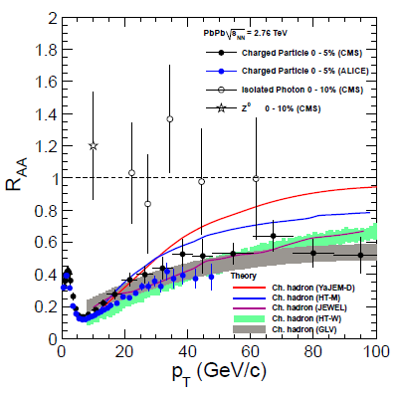
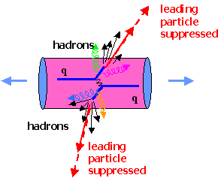
Probing QGP with jets
Nuclear Modification Factor:

Slide 4
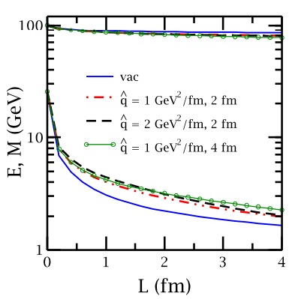
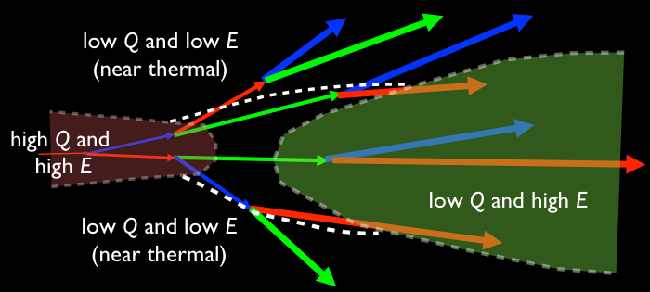
Multistage jet evolution in heavy-ion collisions
Stage 1: High Q and high E (DGLAP, higher-twist); lose Q faster than E [ Majumder and Putschke, PRC 93 (2016) ]
Stage 2: low Q and high E (Transport, higher-twist, AMY)
Stage 3: low Q and low E (near thermal) (strongly coupled approach)
However, one usually applies a single theory through all stages

Slide 5
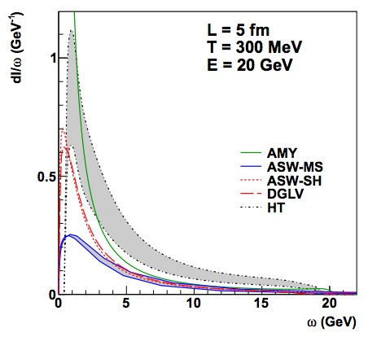
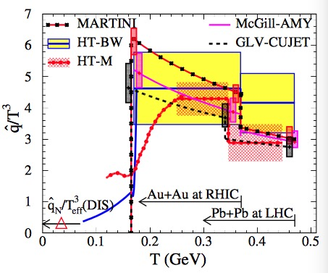
Goals of different collaboration work
[ TECHQM: PRC 86 (2012) 064904 ]
[ JET: PRC 90 (2014) 014909 ]
TECHQM: comparison of medium-induced gluon spectra in a brick
JET: constraint on q in realistic hydro medium using different theories
^
JETSCAPE: to combine theories from different stages into a unified approach: DGLAP (high Q) + transport (low Q) + strongly coupled (thermal) [PRC 96 (2017)]

Slide 6
Accomplishments of PHYS WG in Year 2
Finished developing the multi-stage approach of jet evolution in static medium and published the 1st collaboration paper
Finished working with COMP and SIMS to embed the jet evolution and hadronization models in the JETSCAPE framework
Finished calibrating JETSCAPE on p-p data (ready for publication)
Obtained preliminary results in A-A using JETSCAPE
Worked with STAT to set up the statistical analysis framework to extract jet transport parameter in QGP (ready for publication)

Slide 7
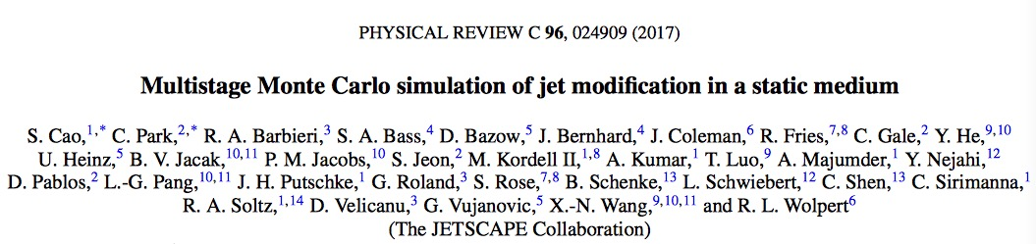
Part I: A multi-stage approach for jet evolution

Slide 8
Stage 1: high Q and high E
MATTER (The Modular All Twist Transverse-scattering Elastic-drag and Radiation) [Wayne: PRC 88, 014909, arXiv:1702.05862)]
Sudakov form factor ( probability of NO splitting in [ Q , Q_{max} ] ):
Splitting function (from the higher-twist formalism):
jet transport parameter
Use MATTER to simulate virtuality-ordered parton showers from initial Q_{max} to Q₀

Slide 9
Stage 2: low Q and high E
LBT or MARTINI (time-ordered transport model) simulates parton showers at (or below) Q₀ (with on-shell approximation)
LBT (Linear Boltzmann Transport) [LBL-CCNU: PRL 111 (2013) 062301, PRC 94 (2016) 014909, PLB 777 (2018) 255-259, PLB 777 (2018) 255-259, etc.]
Evolution of jet parton “1”:
Elastic Scattering rate:
Inelastic scattering rate (average gluon number per Δt):
Medium-induced gluon spectrum: HT (single scattering single emission)

Slide 10
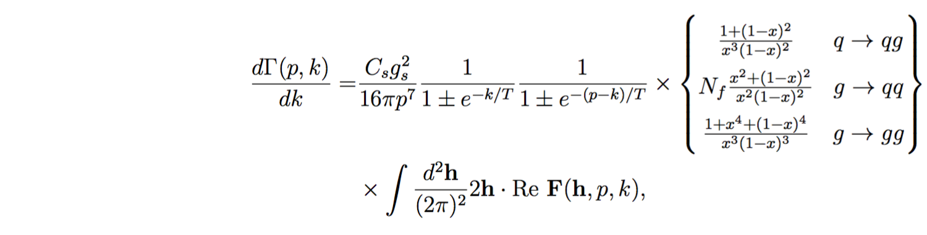
Stage 2: low Q and high E
MARTINI (Modular Algorithm for Relativistic Treatment of heavy IoN Interactions) [McGill: PRC 80 (2009) 054913]
AMY formalism for 1->2 splittings where LPM effect is included (multiple scattering induced single emission):
[S. Jeon and G. Moore PRC 71 (2005) 034901, S. Jeon NPA 830 (2009) 107 ]
Note: LBT and MARTINI provide similar parton spectra in a static medium (T = 250 MeV) between t = 2 fm and 6 fm (comparable to average temperature and lifetime scales of realistic QGP in central 200 AGeV Au-Au and 2.76 ATeV Pb-Pb collisions).

Slide 11
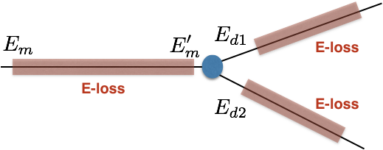
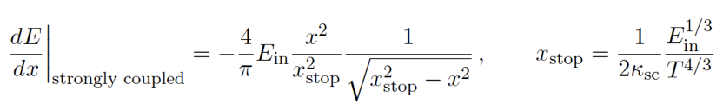
Stage 3: low Q and low E (near thermal)
Strongly coupled approach (AdS/CFT based model) [JHEP 03 (2016) 053, JHEP 10 (2014) 019]
Apply strongly coupled drag on partons
strong coupling parameter
[P. Chesler and K. Rajagopal PRD 90 (2014) 025033, JHEP 1605 (2016) 098]

Slide 12
Separation scales
1. MATTER (virtuality-ordered) evolves partons (Q>Q₀, E>E₀)
2. LBT/MARTINI (time-ordered) continues parton evolution (Q<Q₀, E>E₀)
3. AdS/CFT drag (time-ordered) is introduced when (Q>Q₀, E<E₀)
Virtuality separation scale Q₀
Fixed Q₀: 1, 2 or 3 GeV will be used and compared.
Dynamical Q₀ (virtuality gain from scattering with the medium):
Extracted from model to data comparison (see Part III)
Energy separation scale E₀
Under investigation

Slide 13
Separation time between MATTER and LBT/MARTINI
when a given parton hit Q₀ after multiple splittings
medium length (4 fm)
The multi-stage approach is necessary: the switching time between MATTER and LBT/MARTINI varies with E and Q₀.

Slide 14
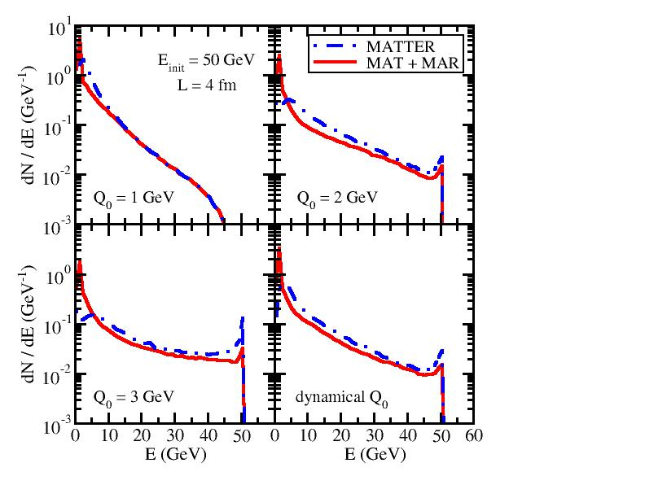
MATTER vs. LBT/MARTINI contribution
Energy spectra of daughter partons initiated by a single quark at 50 GeV
Recall: It takes longer time for high E partons to hit Q₀ in MATTER and leaves shorter time for the subsequent LBT/MARTINI.
Energy loss from LBT/MARTINI in MATTER + LBT/MARTINI is weak for high E partons, but becomes stronger for low E ones.

Slide 15
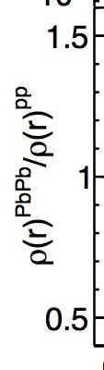
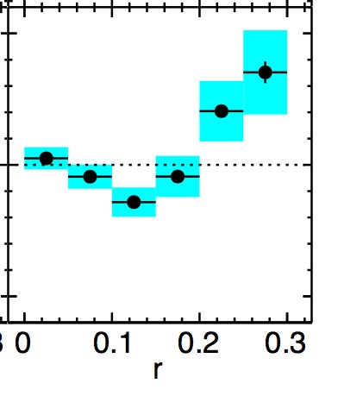
dE/dθ of daughter partons (jet shape)
In-medium evolution changes the jet shape – depletes energy in small cone and enhances energy in large cone.
LBT is more effective than MATTER in shifting energy distribution into larger angle since elastic scattering is included in LBT.
Interesting non-monotonic behavior at Q₀ = 1 GeV -- enhanced Sudakov type splitting at very small r in MATTER and LBT scattering at large r. (Jet shape can be partially understood even with a brick.)

Slide 16
Part II: Physics results from JETSCAPE 1.0
(In collaboration with COMP and SIMS)

Slide 17
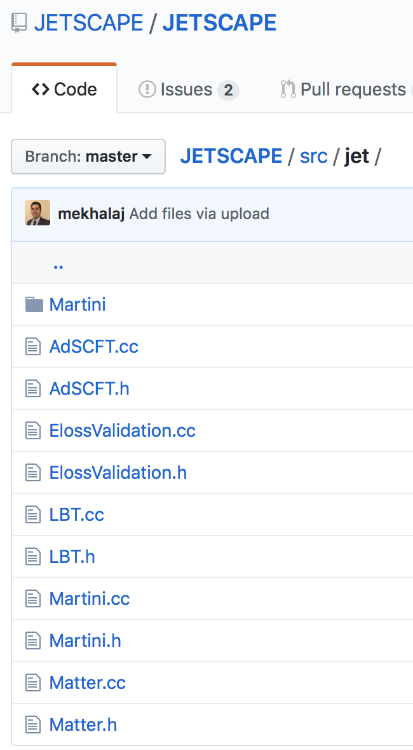
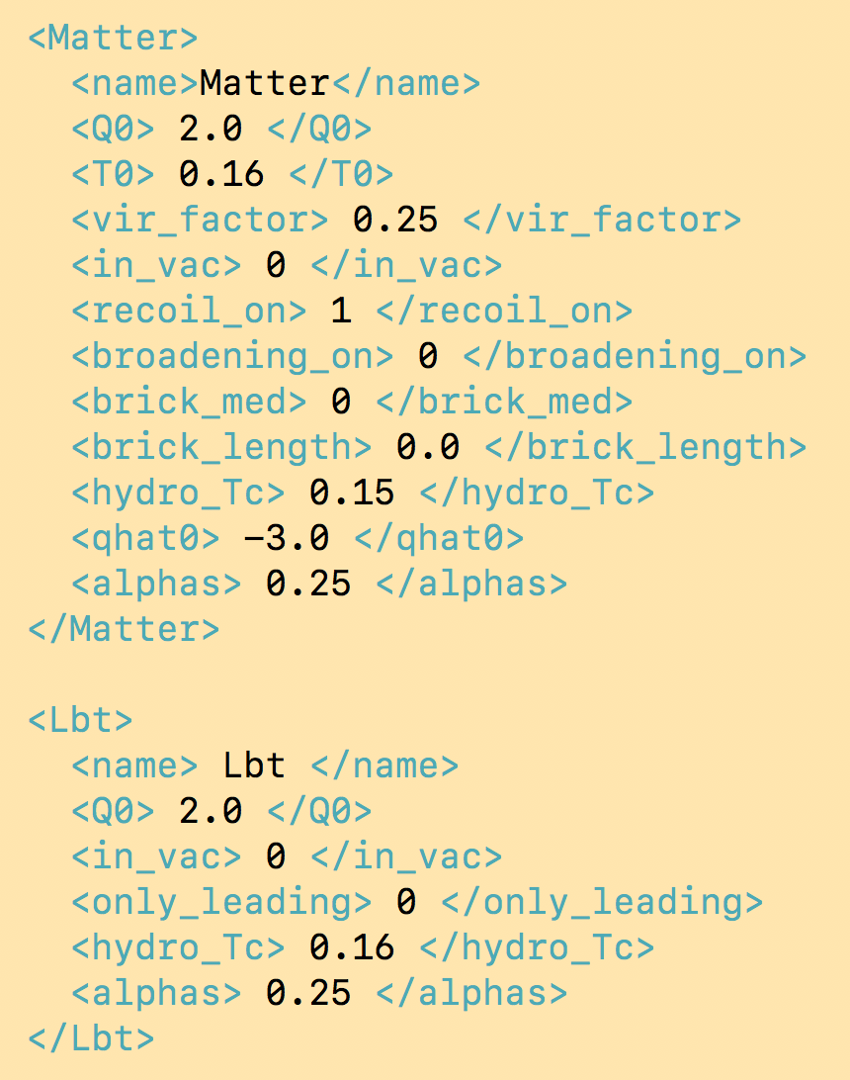
Embed 4 energy loss modules into JETSCAPE
Realize multi-stage jet evolution using the xml input file
separation scale Q₀
AdS/CFT
coupling const. ⍺_{s}
LBT
separation scale Q₀
MARTINI
MATTER
coupling const. ⍺_{s}

Slide 18
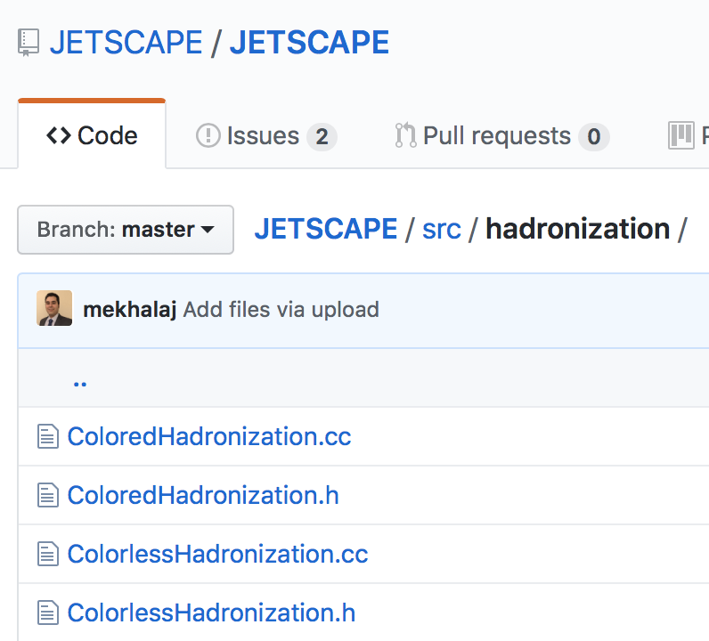
Embed 2 hadronization modules into JETSCAPE
Colored
Colorless
Colored hadronization: track color information during parton showers and construct string for Pythia fragmentation in the end
Colorless: assign colors to final state partons based on their phase space configuration (more flexible for A-A collisions)

Slide 19
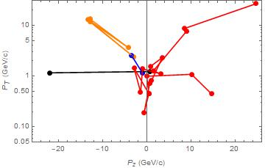
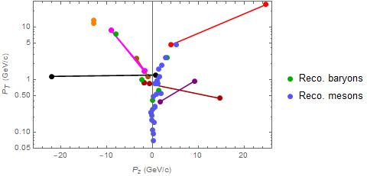
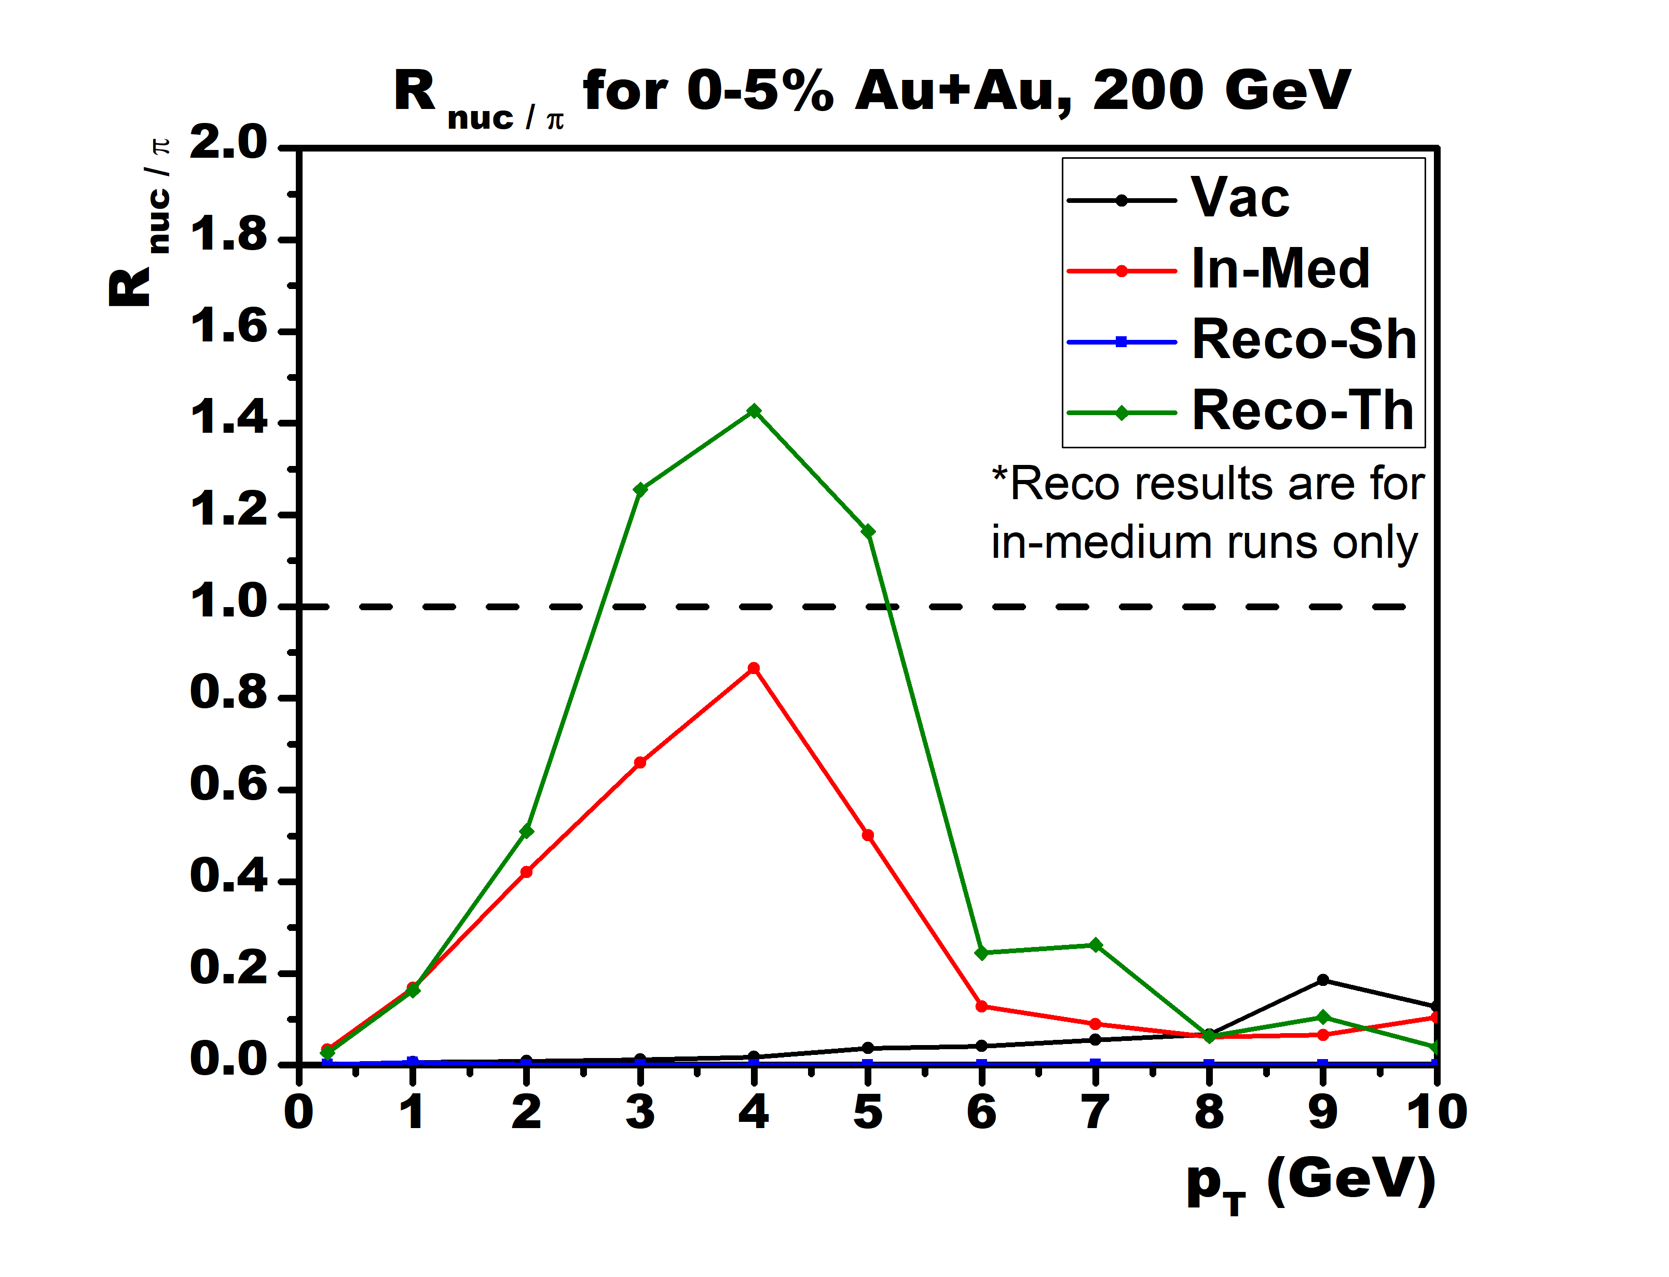
Hybrid hadronization (recombination-string)
Recombination (dense parton limit), string fragmentation (dilute parton limit), relative probability from parton-hadron wavefunction overlap
Finished v2.2 (“patch code / benchmark version”): FORTRAN & PYTHIA 6
Original string structure
After recombination step
Jets
J
Diquark
Junction
v2.2 PRELIMINARY
  Full color flow p+p events
  Add thermal medium: enhance nucleon to pion ratio
v3.0 (C++&PYTHIA 8): ready for release this summer and embedded into JETSCAPE
MATTER jets embedded in hydro

Slide 20
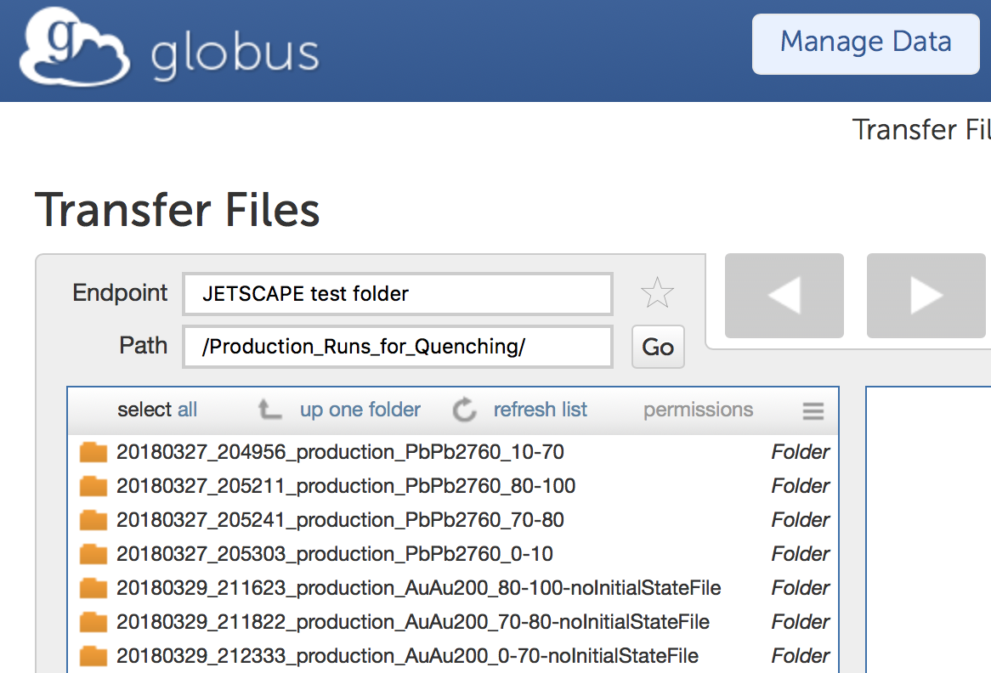
Bulk profiles of the hot nuclear matter
Local (T, s, v, …) of the nuclear matter is provided by Trento (initial condition) + free streaming (pre-equilibrium) + VISHNEW hydrodynamic model (QGP)
Data files of the bulk profiles have been prepared by SIMS and shared through OSIRIS
bulk profiles for various collision systems

Slide 21
Flow chart of p-p and A-A simulations
Colored hadronization
(more rigorous)
Pythia hard scattering
(no Final State Radiation)
MATTER vac. shower
(easy to extend to AA)
p-p
Colorless hadronization
(flexible to extend to AA)
* can be replaced by pure Pythia with FSR on
Pythia hard scattering
(no Final State Radiation)
P
MATTER med. modified shower + LBT/MARTINI + AdS/CFT
A-A
Colorless hadronization
X
Trento Initial condition
bulk (T, v, …)
initial s(X)
Free-streaming (pre-thermal)
Hydrodynamics (QGP)

Slide 22
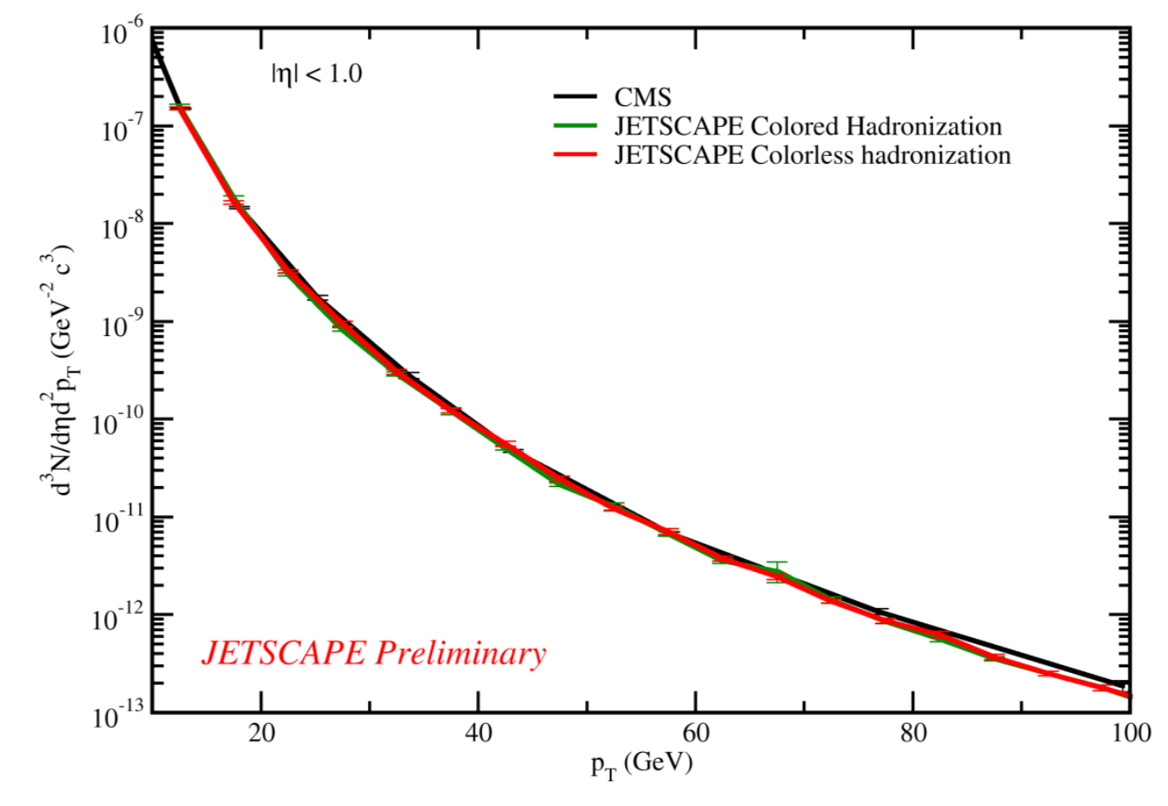
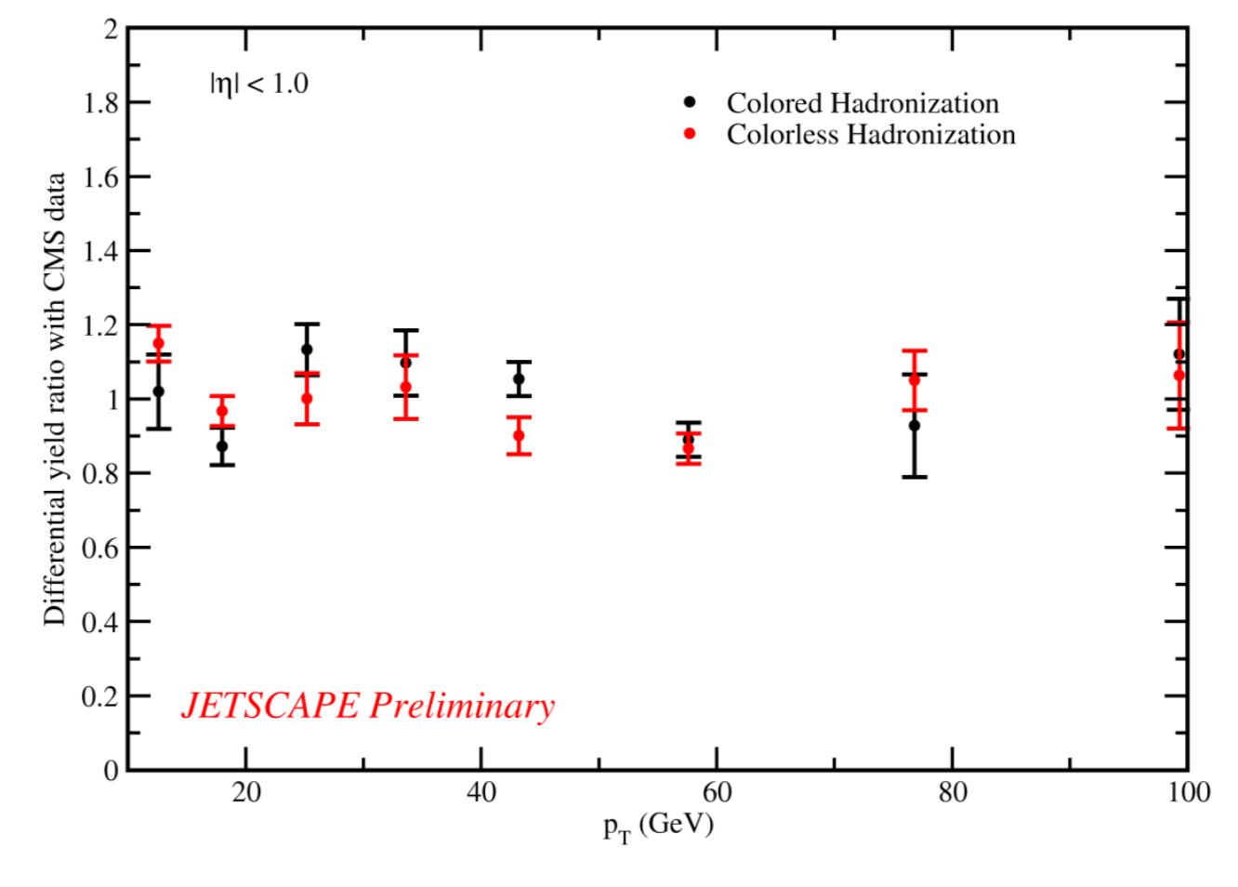
Jet observables in p-p collisions
Pythia hard scattering (FSR off) + MATTER vacuum showers
Parameter tuning
Maximum possible virtuality:
Scale parameter in the running coupling:
Charged hadron spectra
Good agreement with data [EPJ C72,1945 (2012)]
No significant differences between the two hadronization models

Slide 23
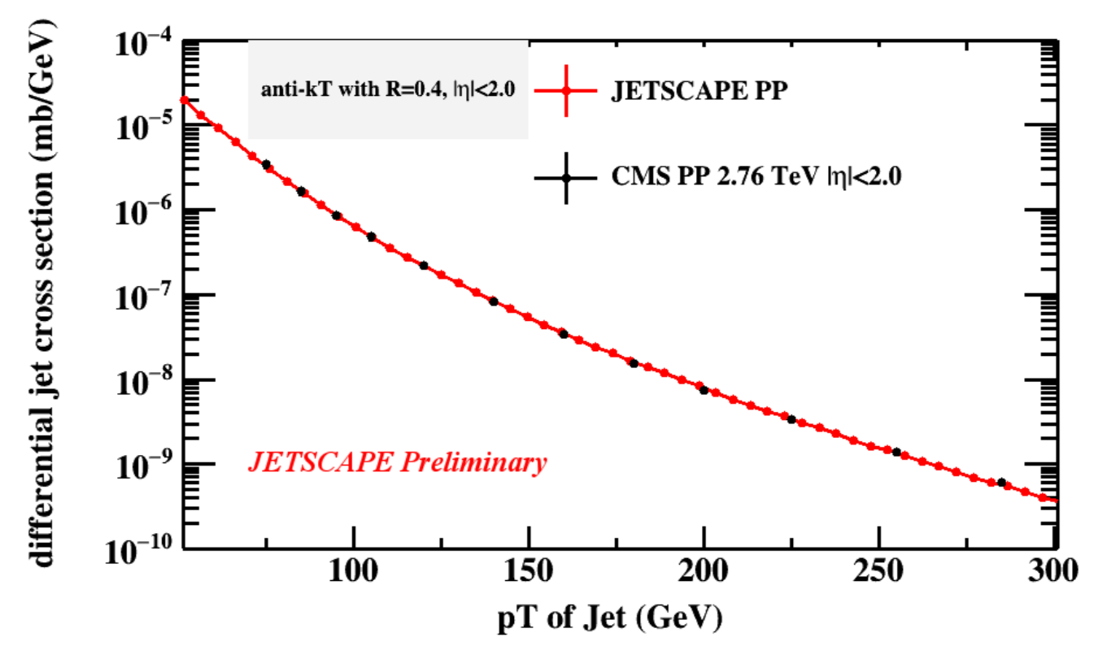
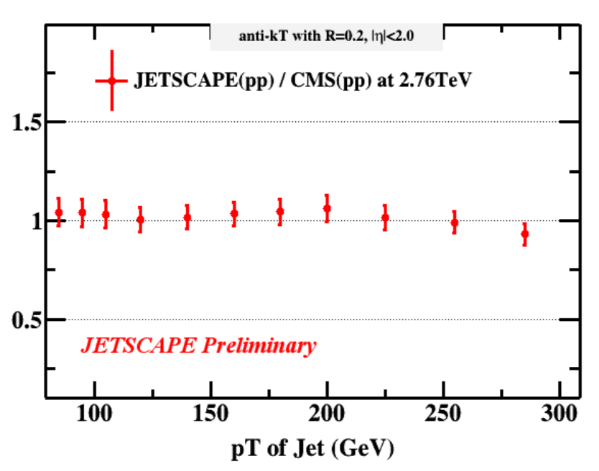
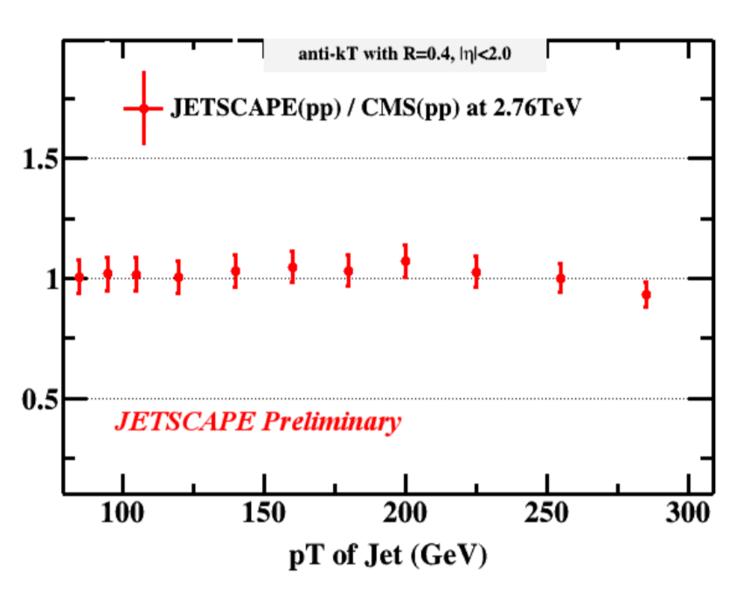
Single inclusive jet spectra
X ALICE
X partonic
X hadronic
Anti-k_{T}, |η|<2
R=0.4
σ(R=0.2) / σ(R=0.4)
Good agreement with data [PRC 96, 015202 (2017)]
Necessary to include proper hadronization scheme for the cone size dependence
R=0.2
R=0.4

Slide 24
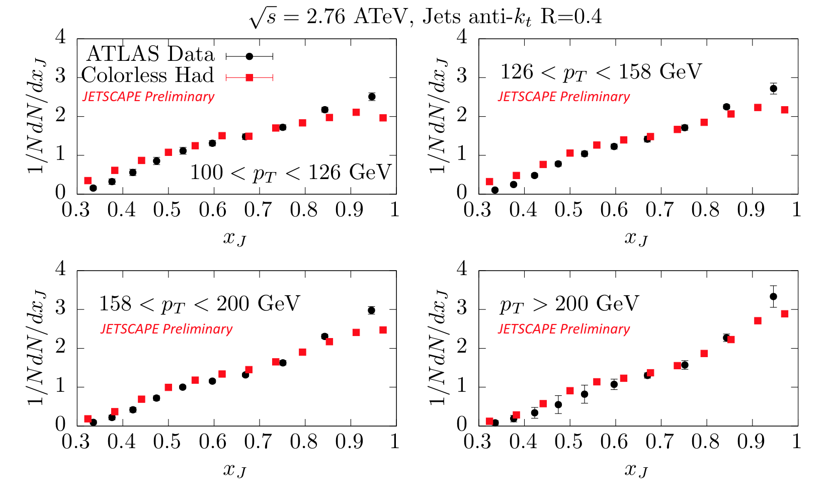
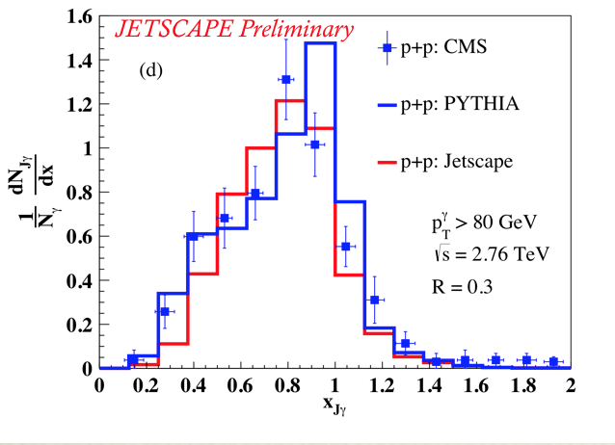
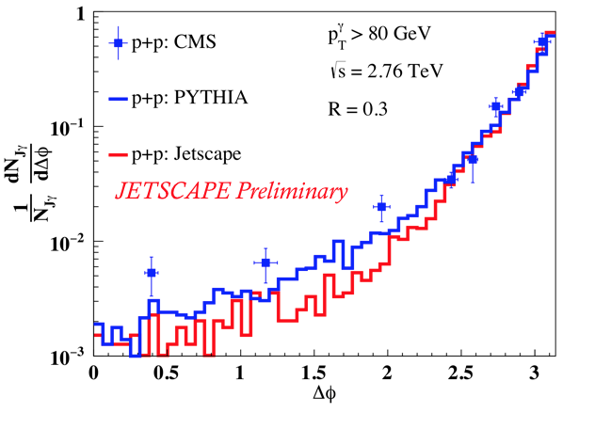
Dijets and γ-jets
di-jet asymmetry
𝛾-jet asymmetry
Di-jet asymmetry in good agreement with data [ATLAS, PLB 774, 379 (2017)]
𝛾-jet asymmetry consistent with Pythia (smearing to be added to compare to data) [CMS-PAS-HIN-13-006]

Slide 25
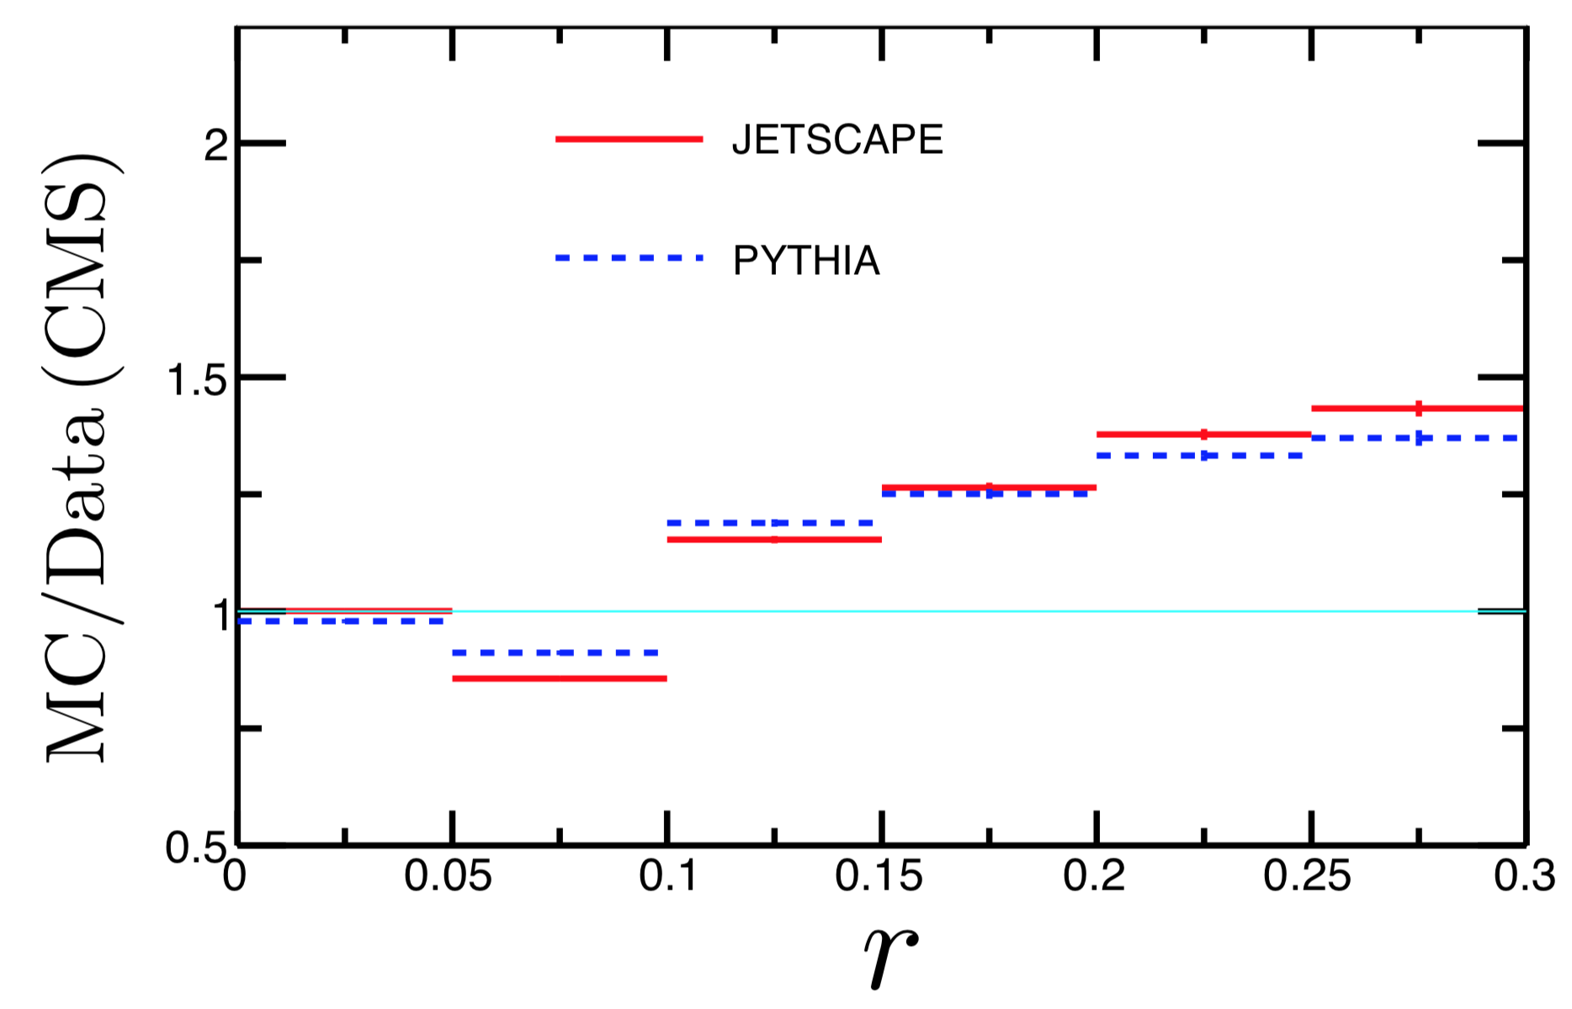
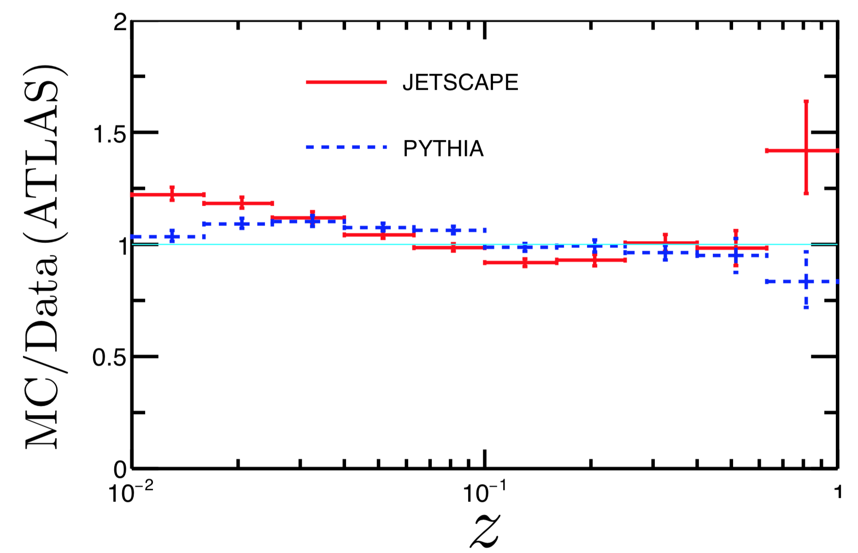
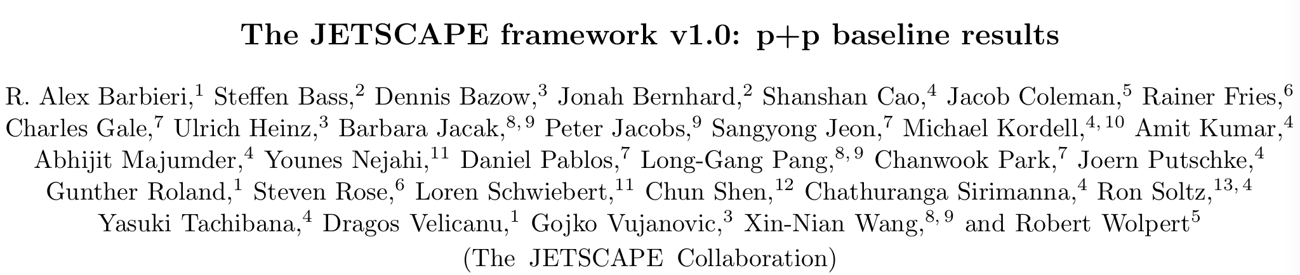
Jet fragmentation function and shape
Jet Shape
Jet FF
PLB 730, 243 (2014)
EPJ C77, 379 (2017)
Similar description to Pythia while similar challenges remain
Publication under preparation

Slide 26
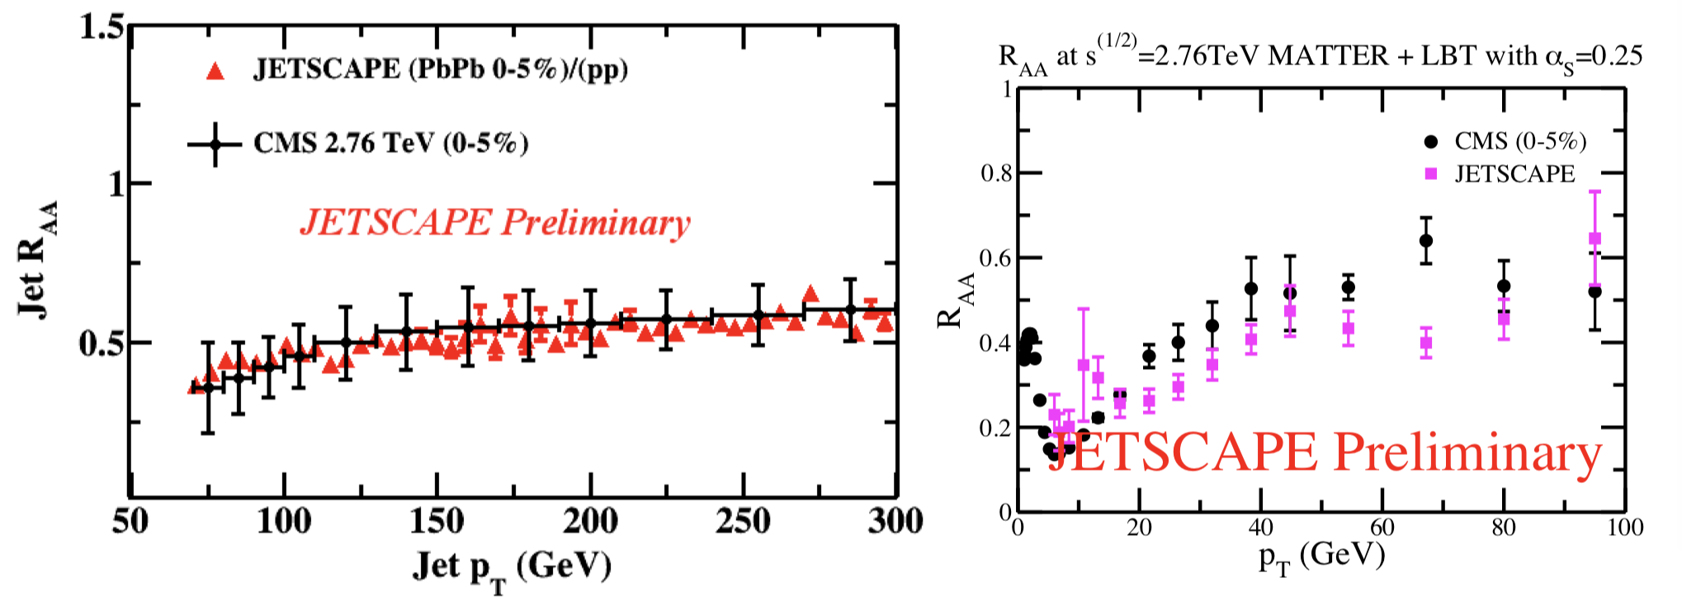
Nuclear modification of jets in A+A collisions
single inclusive jet
charged hadron
MATTER+LBT within JETSCAPE 1.0, Q₀ = 2 GeV, ⍺_{s} = 0.25
Reasonable descriptions of both jet and charged hadron R_{AA}

Slide 27
Part III: Bayesian extraction of q
^
(In collaboration with STAT)

Slide 28
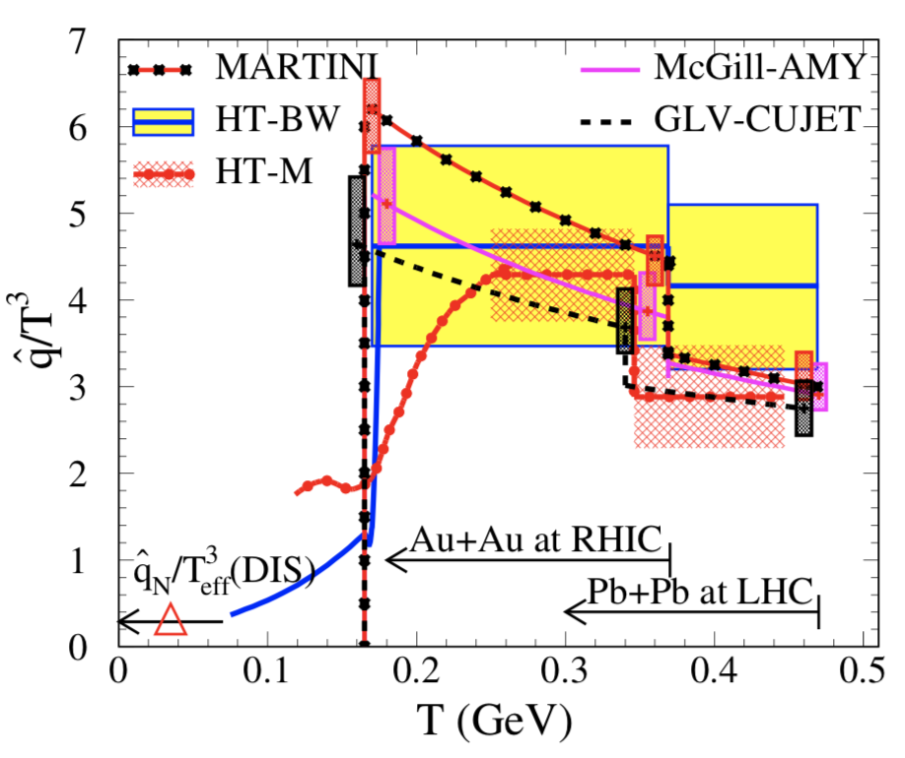
Paradigm shift of model to data comparison
[ JET: PRC 90 (2014) 014909 ]
[ JESCAPE preliminary ]
Single parameter fit to single data set
Two separate values of q at RHIC and LHC
Simultaneous calibration of multiple parameters on multiple data sets
q as a smooth function of the medium temperature
^
^

Slide 29
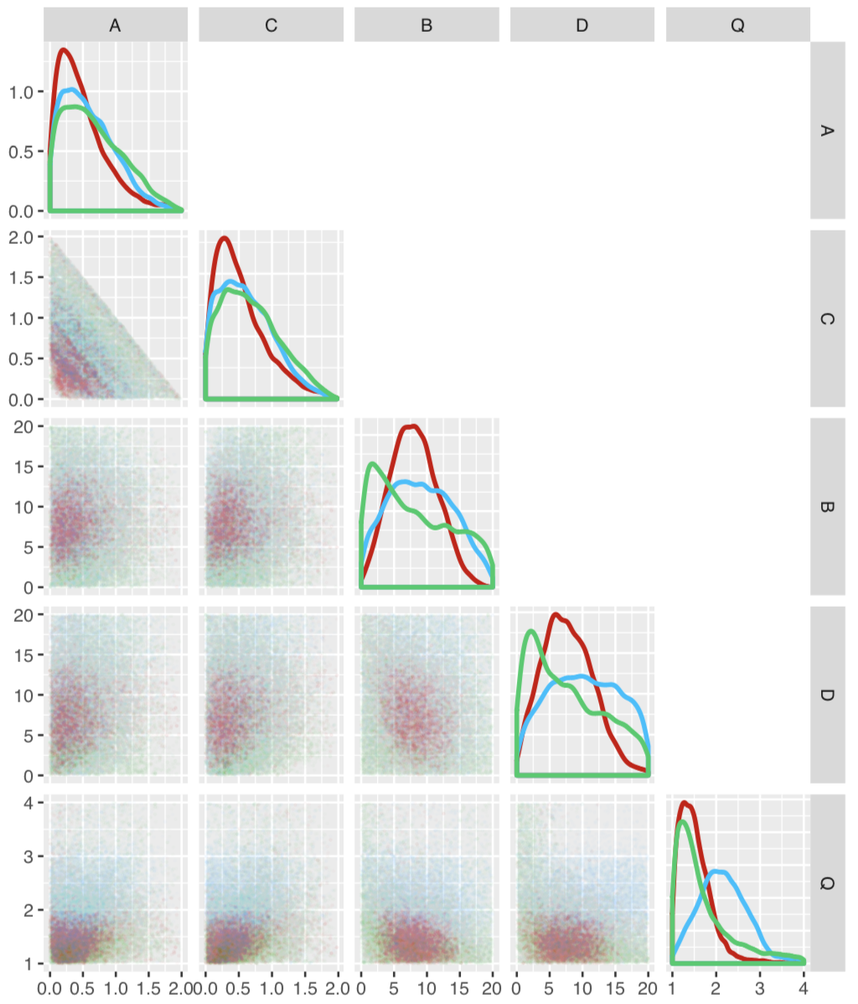
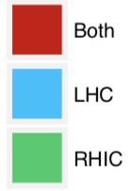
Extraction of Q₀ in MATTER+LBT
First constraint on Q₀ (around 1.5 GeV)
Larger constant Q₀ at LHC than at RHIC if conducting separate calibration
motivates to search for a universal function form of Q₀(E, T)
Q₀

Slide 30
Summary
Developed a multi-stage approach that combines jet evolution at high and low virtuality into a unified approach
Embedded the multi-stage jet evolution together with two hadronization models into JETSCAPE 1.0
Obtained good descriptions of jet observables with JETSCAPE 1.0 in both p-p and A-A collisions
Introduced Bayesian method to extracting the jet transport coefficient and investigated the separation scale Q₀ in multi-stage jet evolution for the first time

Slide 31
Thank you!
Outlook for Year 3
Incorporate physics in the hadronic phase (after QGP)
Incorporate heavy quarks (c and b) physics
Incorporate hybrid hadronization scheme
Realize concurrent simulation of bulk and jet evolution and study jet-induced medium excitation

Slide 32
backup

Slide 33
Stage 1: high Q and high E
MATTER (The Modular All Twist Transverse-scattering Elastic-drag and Radiation) [Wayne: PRC 88, 014909, arXiv:1702.05862)]
DGLAP evolution for parton fragmentation function at high Q:
Sudakov form factor ( probability of NO splitting in [ Q , Q_{max} ] ):
Splitting function (from the higher-twist formalism):
jet transport parameter
Use MATTER to simulate virtuality-ordered parton showers from initial Q_{max} to Q₀

Slide 34
Stage 2: low Q and high E
LBT or MARTINI (time-ordered transport model) simulates parton showers at (or below) Q₀ (with on-shell approximation)
LBT (Linear Boltzmann Transport) [LBL-CCNU: PRL 111 (2013) 062301, PRC 94 (2016) 014909, PLB 777 (2018) 255-259, PLB 777 (2018) 255-259, etc.]
Evolution of jet parton “1”:
Elastic Scattering rate:
Inelastic scattering rate (average gluon number per Δt):
Medium-induced gluon spectrum is taken from HT (same as MATTER)

Slide 35
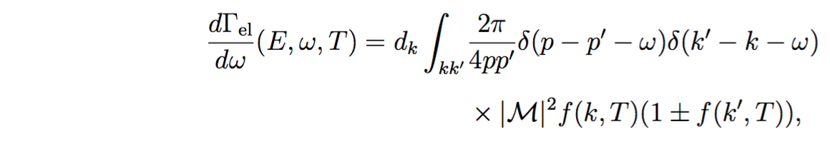
Stage 2: low Q and high E
MARTINI (Modular Algorithm for Relativistic Treatment of heavy IoN Interactions) [McGill: PRC 80 (2009) 054913]
AMY formalism for 1->2 splittings where LPM effect is included:
F(h, p, k) [p – jet parton, k – emitted gluon, h = p × k] is the solution of an integral (Schwinger-Dyson) equation describing how |p − k; k⟩⟨p| evolves with t due to collisions and the energy difference between the two states.
Elastic scattering rate for 2->2 scattering process:
[S. Jeon and G. Moore PRC 71 (2005) 034901, S. Jeon NPA 830 (2009) 107 ]

Slide 36
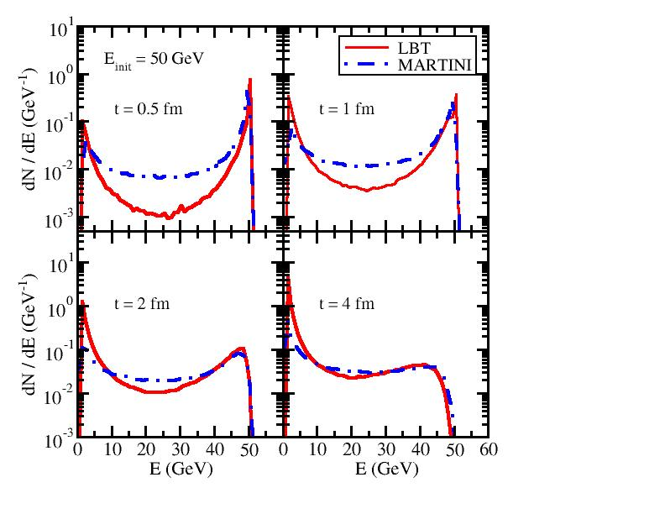
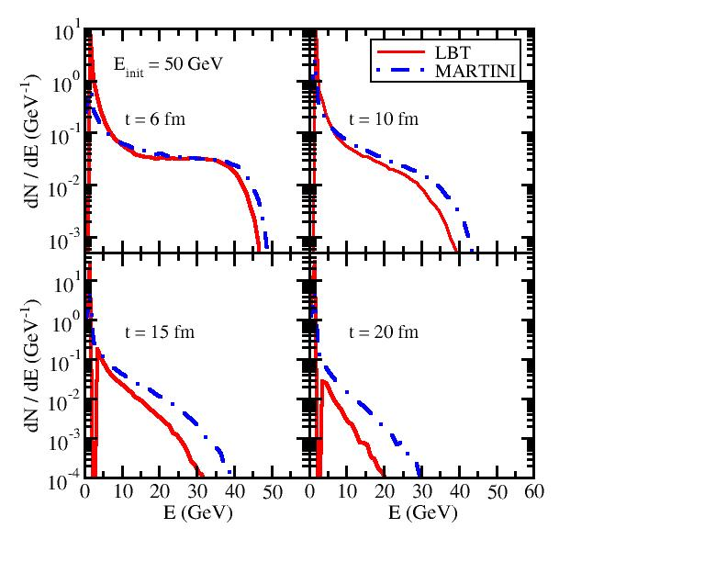
LBT vs. MARTINI at different times
Energy spectra of daughter partons initiated by a single quark at 50 GeV
brick
T = 250 MeV
Parton energy loss in LBT (HT) is weaker than in MARTINI (AMY) at early t, but catches up and becomes stronger when t is large
At t around the QGP lifetime, LBT and MARTINI are indistinguishable

Slide 37
Stage 3: low Q and low E (near thermal)
Strongly coupled approach (AdS/CFT based model) [JHEP 03 (2016) 053, JHEP 10 (2014) 019]
Apply strongly coupled drag on partons
strong coupling parameter
[P. Chesler and K. Rajagopal PRD 90 (2014) 025033, JHEP 1605 (2016) 098]

Slide 38
Parameter space design
Pure dependence on the scale of jet when Q >> T
Perturbative scattering with quasi-particles from a thermal medium (T)
Physics model: MATTER, LBT, MATTER+LBT (with additional Q₀)
Data: single inclusive hadron R_{AA} at RHIC and LHC
Model to data comparison: Bayesian method (see STAT report)

Slide 39
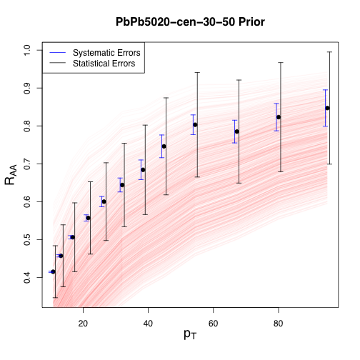
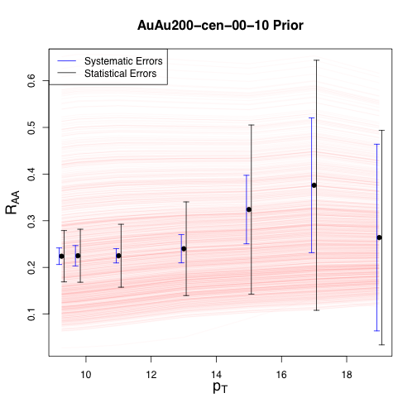
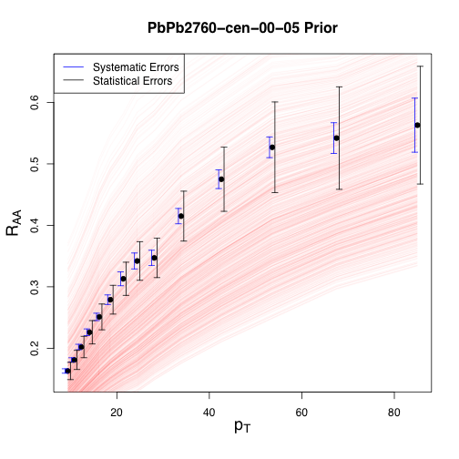
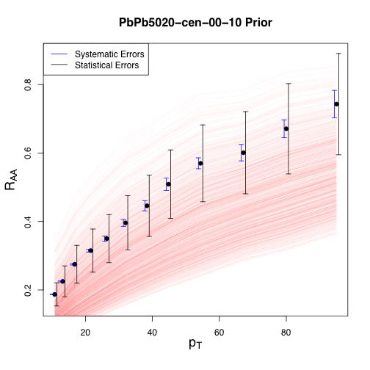
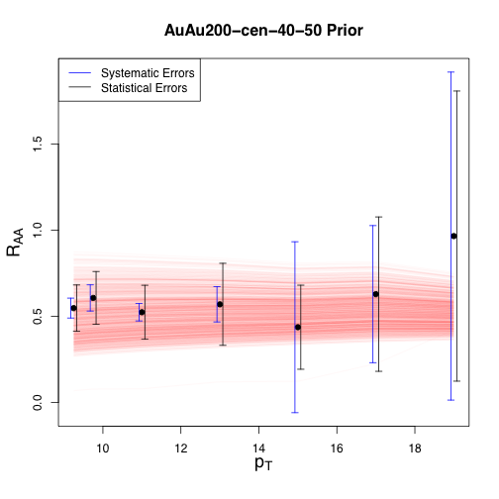
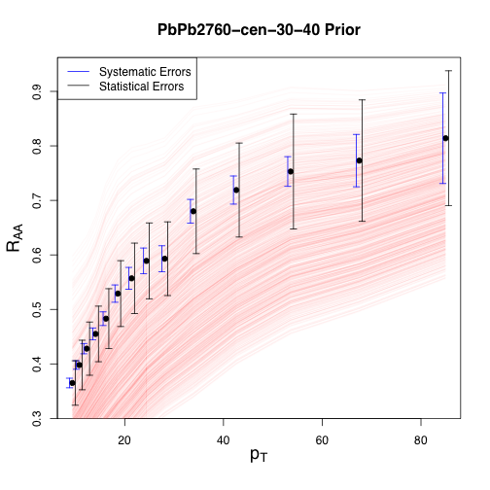
Before Bayesian calibration
systematic
statistic

Slide 40
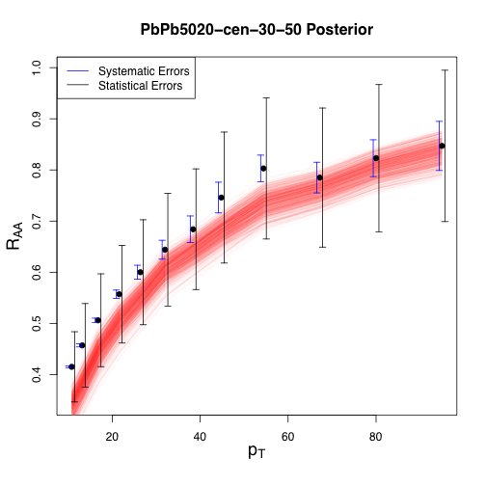
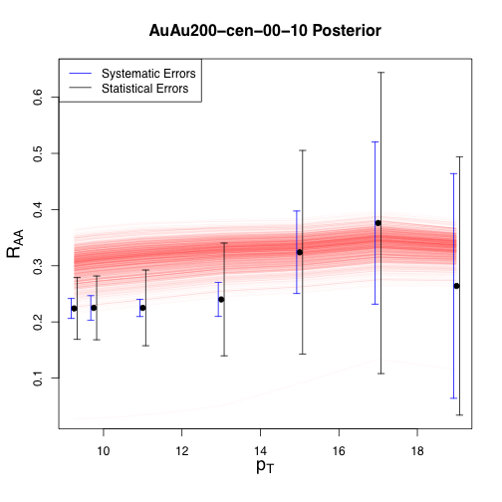
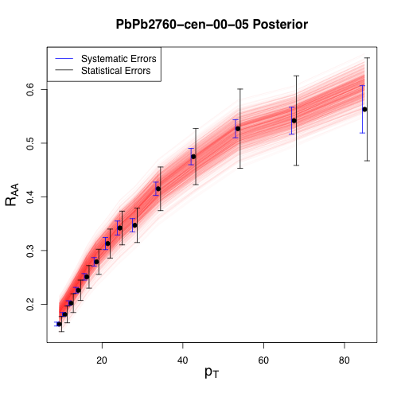



After Bayesian calibration
systematic
statistic

Slide 41
Extracted parameter space distribution
MATTER
MATTER
prefer the A term
LBT
prefer the C term

Slide 42
Extracted jet transport coefficient
^
Smooth functions of q (mean value together with a 90% C.R.)
Larger value extracted from MATTER than from LBT
Stronger T dependence extracted from LBT than from MATTER

Slide 43
Calibration with MATTER+LBT
First constraint on Q₀ (around 1.5 GeV)
Larger Q₀ at LHC than at RHIC if conducting separate calibration
Better constraint on parameters if more data are included
MATTER
Q₀

Slide 44

dN/dE of daughter partons (jet FF)
Energy distribution of final shower partons from a single quark with a fixed initial energy E_{init} through a brick with length L.
Four model setups:
Vacuum: Sudakov type of shower with vacuum P(z)
MATTER: Sudakov type of shower with vacuum + medium induced P(z)
LBT/MARTINI: Partons from vacuum shower evolve the entire 4 fm in LBT/MARTINI
MATTER+LBT/MARTINI: Combined scheme – partons evolve in MATTER up to t₀ and then in LBT/MARTINI till 4 fm

Slide 45



MATTER vs. vacuum shower
50 GeV jet
200 GeV jet
Energy loss in MATTER is stronger when Q₀ is smaller
Energy loss in MATTER disappears when (medium scale).
increases with the jet energy; MATTER evolution is more important to high energy partons than to low energy ones

Slide 46

Pure MATTER vs. Pure LBT/MARTINI
On-shell time-ordered transport models are NOT constrained by any virtuality scale in the phase space ➔ energy loss in pure LBT/MARTINI evolution is stronger than that in pure MATTER

Slide 47

MATTER vs. LBT/MARTINI in the combined approach (dependence on jet energy)
50 GeV jet
200 GeV jet
Recall: It takes longer time for high E partons to hit Q₀ in MATTER and leaves shorter time for the subsequent LBT/MARTINI.
Energy loss from LBT/MARTINI in MATTER + LBT/MARTINI is weak for high E partons, but becomes stronger for low E ones.

Slide 48

MATTER vs. LBT/MARTINI in the combined approach (dependence on medium length)
For pure MATTER, when Q₀ = 1 GeV, stronger energy loss of hard parton is observed when L is extended from 4 to 8 fm. However, for Q₀ ≥ 2 GeV, no obvious difference can be observed since most partons hit Q₀ before L = 4 fm (no more effect between 4 and 8 fm).

Slide 49

MATTER vs. LBT/MARTINI in the combined approach (dependence on medium length)
For pure MATTER, when Q₀ = 1 GeV, stronger energy loss of hard parton is observed when L is extended from 4 to 8 fm. However, for Q₀ ≥ 2 GeV, no obvious difference can be observed since most partons hit Q₀ before L = 4 fm (no more effect between 4 and 8 fm).
Extending L from 4 to 8 fm leaves longer time for LBT/MARTINI evolution. Time-ordered transport model is more important if the medium path length is longer.

Slide 50

Range of the dynamical Q₀
50 GeV jet
200 GeV jet
Result from the dynamical Q₀ is close to that from the fixed Q₀ = 2 GeV for 50 GeV quark jet, and close to 3 GeV for 200 GeV quark jet.
Energy dependence of the dynamical Q₀:

