Slide 1

JETSCAPE Future plan
By COMP Group, Convener
Long-Gang Pang
UC Berkeley & LBNL

Slide 2
Future
Plan
Concurrent running Jet + Hydro.
Hadronic cascade.

Slide 3

What is concurrent running?
No concurrent running, no jet-induced medium excitation.
Just like stone-skipping without fluid ripples.

Slide 4
The known effect of concurrent running
CMS Talk @ Quark Matter 2018,
arXiv:1801.04895
Enhancement of particles carrying small momentum fraction -> recoiled partons that are knocked out of the medium by jet shower.
CoLBT-hydro: Phys.Lett. B777 (2018) 86-90

Slide 5
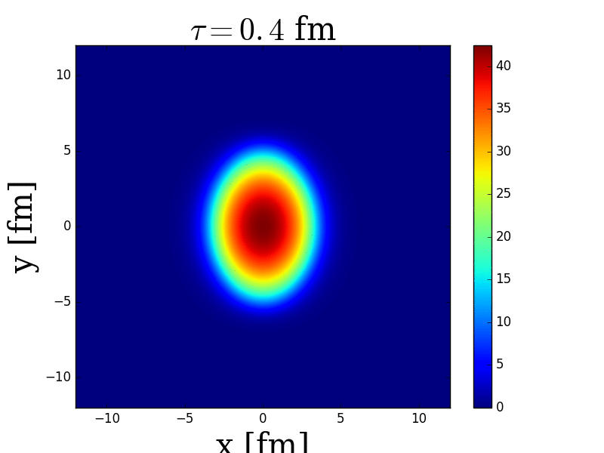
Simple simulations
Y [fm]
X [fm]

Slide 6
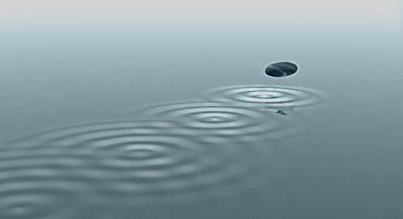



The raw idea
$$J^{ν}$$
$$∇_{μ}T^{μν}=0$$
$$∇_{μ}T^{μν}=$$
Fluid evolution
Jet Source
Add energy-momentum deposition as source terms of the fluid
The long-term plan set up in the very beginning, now comes to its implementation stage.

Slide 7



Current status
Jet Eloss Modules
Signal slots
(3+1)D Hydrodynamics
Collide with
T, u, …
Jet shower
Thermal partons
$$∇_{μ}T^{μν}=0$$
1st run
no
E > E_{cut}
$$∇_{μ}T^{μν}=J^{ν}$$
2nd run
$J^{ν}=$energy momentum deposition
yes
Jet shower
Run hydrodynamic simulations twice to study jet energy loss and jet induced medium excitation separately.

Slide 8
Where con-current running is needed?
Heavy quark
Jet 1
t_{new}
t_{old}
Jet 2
For nonrelativistic heavy quark jet, the next collision might be affected by the sound wave of a previous collision.
The sound waves caused by multiple light jets (jet shower) will affect each other.

Slide 9


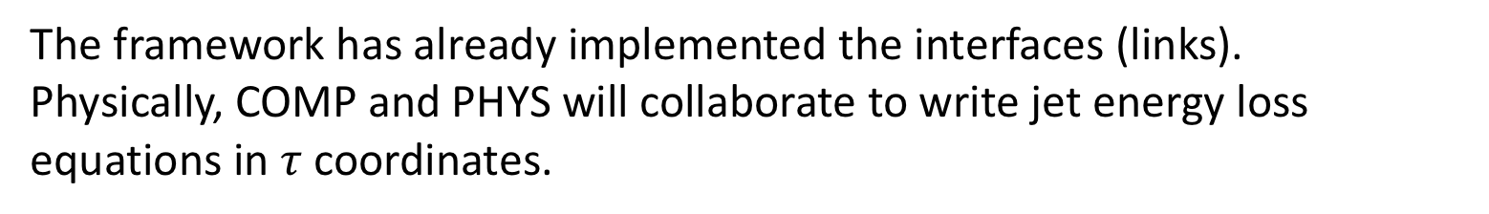
More detailed concurrent running plan
Jet Eloss Modules
Signal slots
(3+1)D Hydrodynamics
Collide with
T, u, …
Jet shower
Thermal partons
Medium
no
E > E_{cut}
$$∇_{μ}T^{μν}=J^{ν}$$
$J^{ν}=$energy momentum deposition
yes
Jet shower
Thermal partons
Medium
The framework has already implemented the interfaces (links).
Physically, COMP and PHYS will collaborate to write jet energy loss equations in $τ$ coordinates.

Slide 10
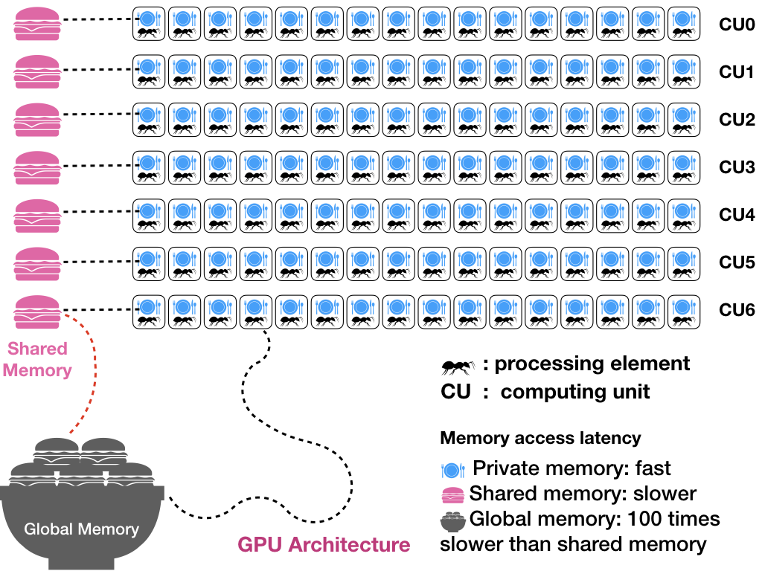
Speed up hydro with GPU parallel
CLVisc: using OpenCL
GPU-VH: using CUDA
Two JETSCAPE associated (3+1)D relativistic hydrodynamic codes that are parallelized on GPU using OpenCL or CUDA.

Slide 11
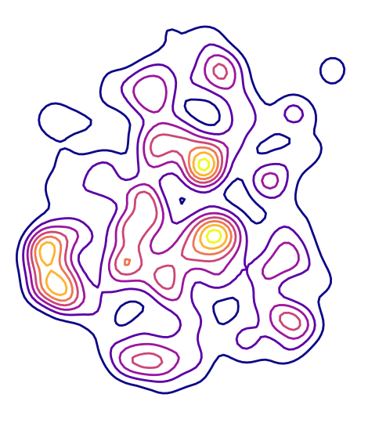
Fluctuating background
Jet shower instead of single jet
Jet flies with different momenta
Jet starts from random position
Realistic simulations
Event-by-event simulations to accumulate big data.
The JETSCAPE event-generator must be efficient (reuse medium info).

Slide 12
backward-rapidity
mid-rapidity
forward-rapidity
Realistic simulations
Reuse
Reuse
Update

Slide 13
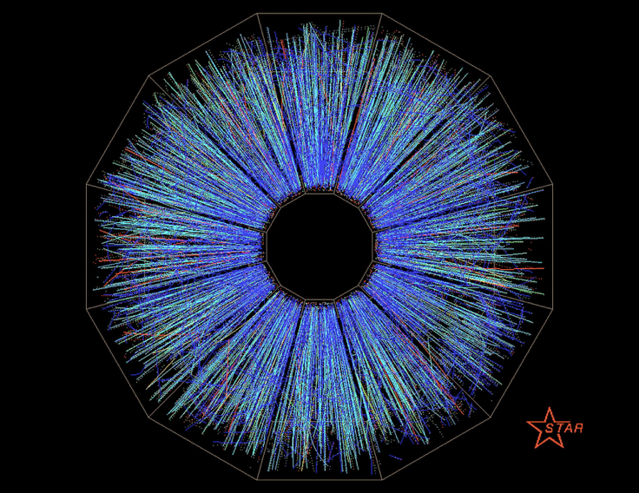

Hadronic cascade (SMASH)
After Quark Gluon Plasma particalization, before particles (tracks) being detected, there is a period when hadrons scatter with each other and decay.
This physical process is important to describe soft particle distribution and jet energy loss at hadronic stage.

Slide 14
Hadronic cascade (SMASH)
SMASH: a new Hadronic Transport Approach from Frankfurt group
C++
Well documented and tested.
Will be open sourced this fall.
Efficient.
Most importantly, we have developers from SMASH group
and are migrating SMASH to JETSCAPE, which will finish
in several weeks.

Slide 15
Goal:
Release
JETSCAPE 2.0
[Info] *--------------------------------------------------------------*
[Info] | |
[Info] | /\ |
[Info] | / \ |
[Info] | / | \ |
[Info] | / | \ /\ |
[Info] | / | \ /\/ \ |
[Info] | / \ | / \ /\/ | \/\ |
[Info] | / \ | / \ / % | % \ |
[Info] | __/ \|/ \__/ %|% \/\__ |
[Info] | |
[Info] | JETSCAPE beta release 1.0rc |
[Info] | |
[Info] | The Jet Energy-loss Tomography with a Statistically |
[Info] | and Computationally Advanced Program Envelope |
[Info] | http://jetscape.wayne.edu |
[Info] | |
[Info] | Please cite xxx if you use this package for scientific work. |
[Info] | |
[Info] | JETSCAPE is provided without warranty under the terms |
[Info] | of the GNU GPLv3. It uses xxx code(s). |
[Info] | See COPYING file for details. |
[Info] | |
[Info] *--------------------------------------------------------------*
The framework
Trento initial condition
Pre-equilibrium evolution
MATTER, LBT/MARTINI, AdS/CFT jet eloss
(3+1)D hydrodynamics
[Info] *--------------------------------------------------------------*
[Info] | |
[Info] | /\ |
[Info] | / \ |
[Info] | / | \ |
[Info] | / | \ /\ |
[Info] | / | \ /\/ \ |
[Info] | / \ | / \ /\/ | \/\ |
[Info] | / \ | / \ / % | % \ |
[Info] | __/ \|/ \__/ %|% \/\__ |
[Info] | |
[Info] | JETSCAPE beta release 2.0 |
[Info] | |
[Info] | The Jet Energy-loss Tomography with a Statistically |
[Info] | and Computationally Advanced Program Envelope |
[Info] | http://jetscape.wayne.edu |
[Info] | |
[Info] | Please cite xxx if you use this package for scientific work. |
[Info] | |
[Info] | JETSCAPE is provided without warranty under the terms |
[Info] | of the GNU GPLv3. It uses xxx code(s). |
[Info] | See COPYING file for details. |
[Info] | |
[Info] *--------------------------------------------------------------*
Concurrent running Jet + Hydro
Hadronic cascade (SMASH)
All physics included in JETSCAPE 2.0
6 months for implementation, more for testing.

Slide 16
Goal:
Release
JETSCAPE 2.0
[Info] *--------------------------------------------------------------*
[Info] | |
[Info] | /\ |
[Info] | / \ |
[Info] | / | \ |
[Info] | / | \ /\ |
[Info] | / | \ /\/ \ |
[Info] | / \ | / \ /\/ | \/\ |
[Info] | / \ | / \ / % | % \ |
[Info] | __/ \|/ \__/ %|% \/\__ |
[Info] | |
[Info] | JETSCAPE beta release 2.0 |
[Info] | |
[Info] | The Jet Energy-loss Tomography with a Statistically |
[Info] | and Computationally Advanced Program Envelope |
[Info] | http://jetscape.wayne.edu |
[Info] | |
[Info] | Please cite xxx if you use this package for scientific work. |
[Info] | |
[Info] | JETSCAPE is provided without warranty under the terms |
[Info] | of the GNU GPLv3. It uses xxx code(s). |
[Info] | See COPYING file for details. |
[Info] | |
[Info] *--------------------------------------------------------------*
More tests
More users
More physical studies using JETSCAPE 2.0
Framework that is more modular such that new physics can be easily integrated (such as EIC).

Slide 17
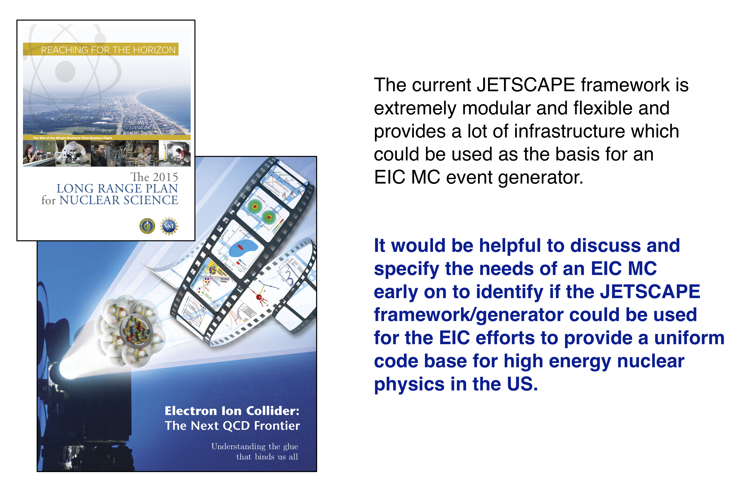
Framework
Reuse in EIC

