Slide 1
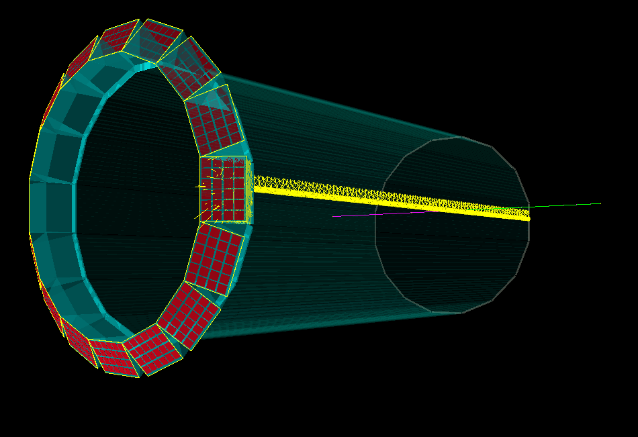

High-Performance DIRC Detector for future EIC Detector
Greg Kalicy
Outline:
Simulations
3-layer lens prototypes
April 4th, 2018

Slide 2
High-Performance DIRC Activities
Simulation studies:
Studies of design using stand alone Geant4 package.
Implementing High-Performance DIRC into the sPHOENIX and BeAST simulation.
Hardware activities:
The prototype of 3-layer spherical and cylindrical lens validation in the test beam.
Mapping focal plane of the lenses.
Radiation hardness test of candidates for middle layer of the lens.
Preparing next prototype lens

Slide 3
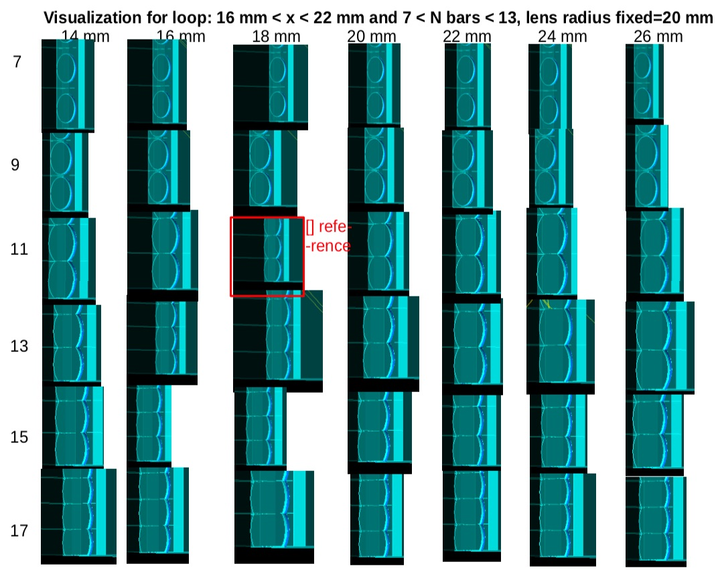
High-Performance DIRC Simulation
Studies of design using stand alone Geant4 package.
Implementing High-Performance DIRC into the sPHOENIX and BeAST simulation.

Slide 4
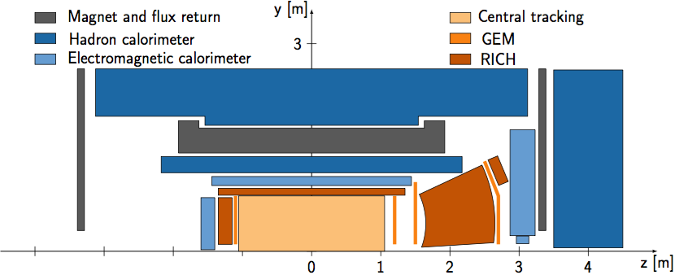
High-Performance DIRC Simulation
Studies of design using stand alone Geant4 package.
Implementing High-Performance DIRC into the sPHOENIX and BeAST simulation.
BNL ePHENIX EIC central detector

Slide 5
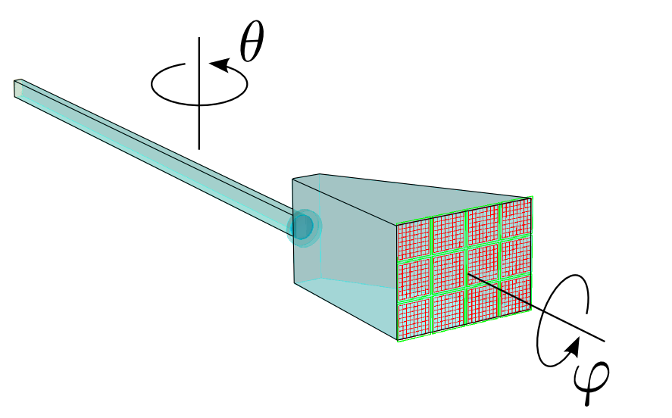
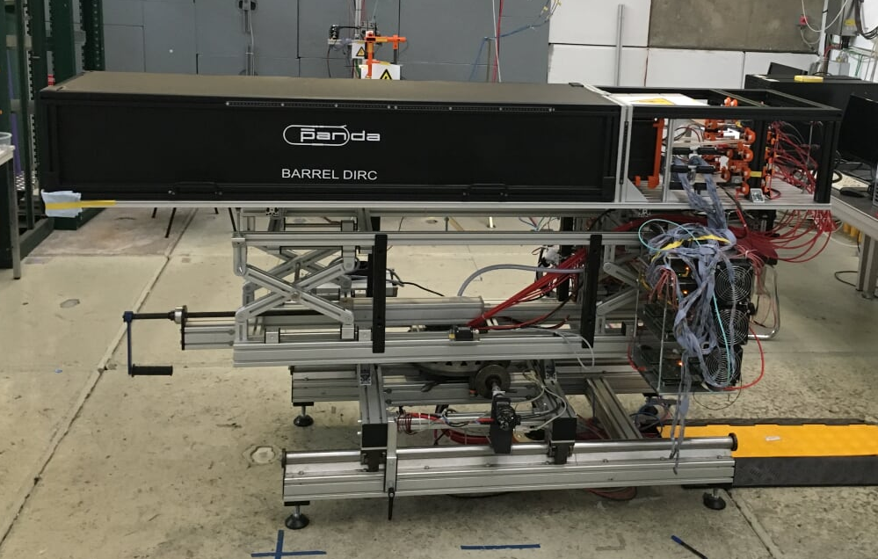
3-layer Lens Performance verification
Full system PANDA barrel DIRC prototype
New cylindrical lens tested!
Readout section
Optics section
Supporting
structure
Readout
electronics
Polar angle 90^{O}
Azimuthal angle 0^{O}

Slide 6
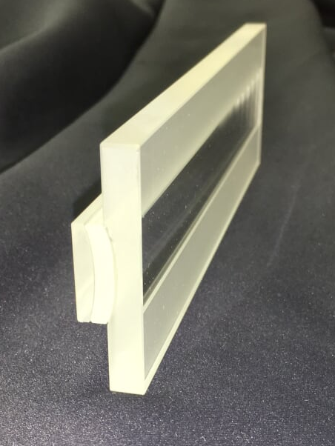
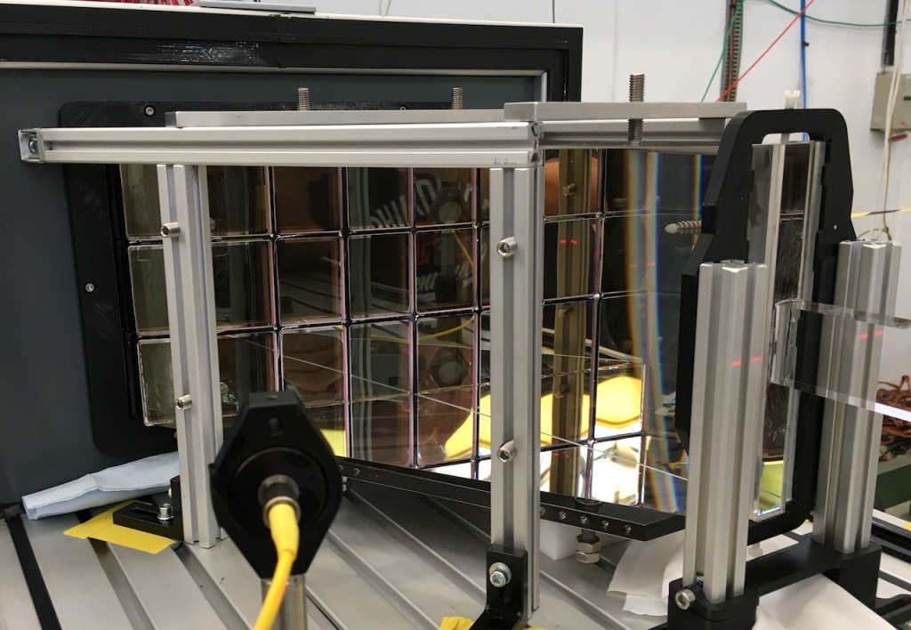
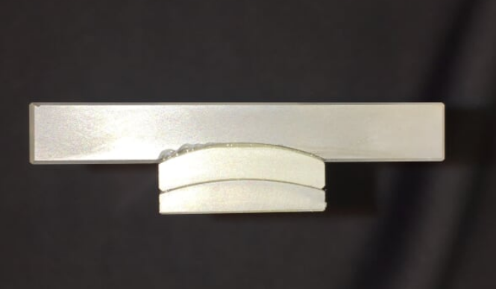
3-layer Lens CERN Beam Test 2017
Lens

Slide 7
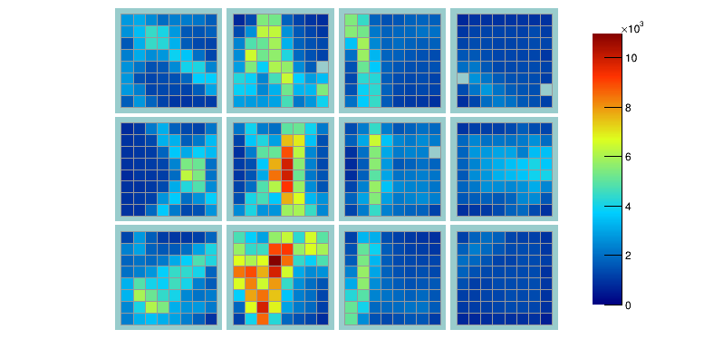
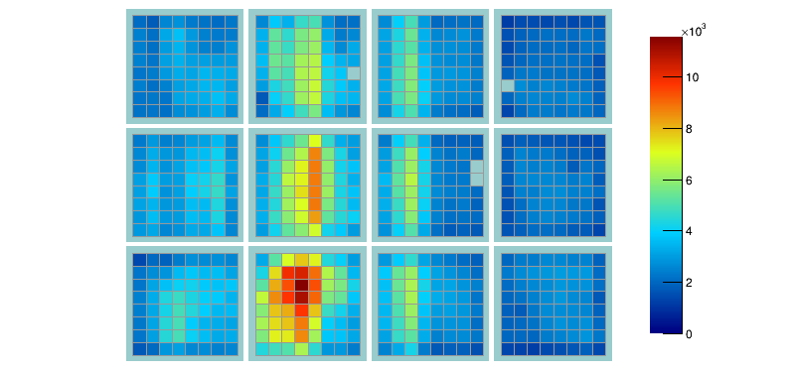
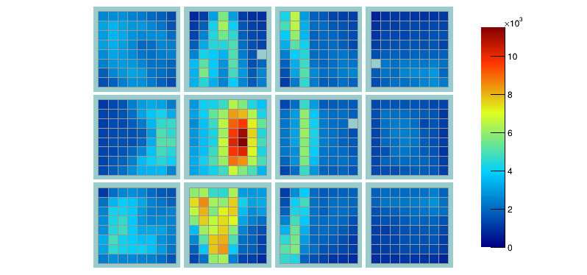
3-layer Lens CERN Beam Test 2017
25 degree polar angle
beam data with pion tag @ 7 GeV/c
bar + 3 layer spherical lens
bar + 3 layer cylindrical lens
plate + 3LC lens
Roman Dzhygadlo

Slide 8
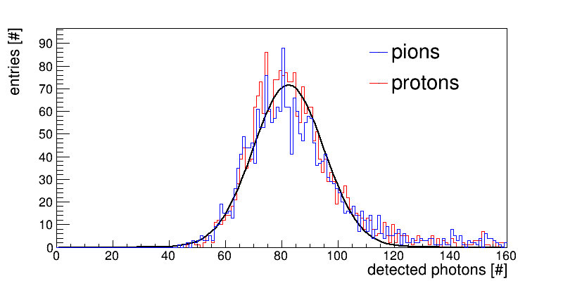
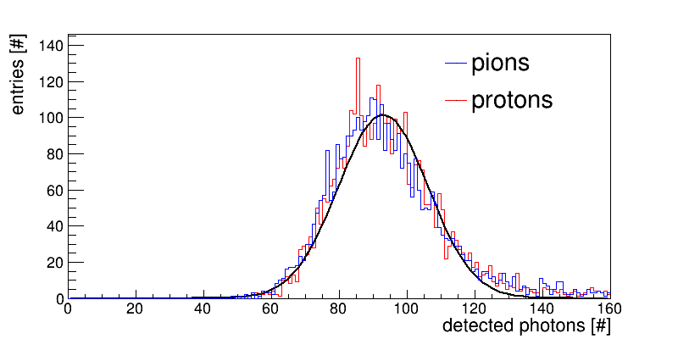
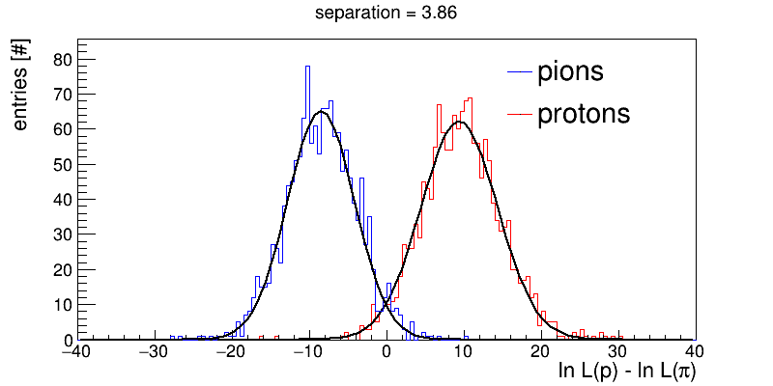
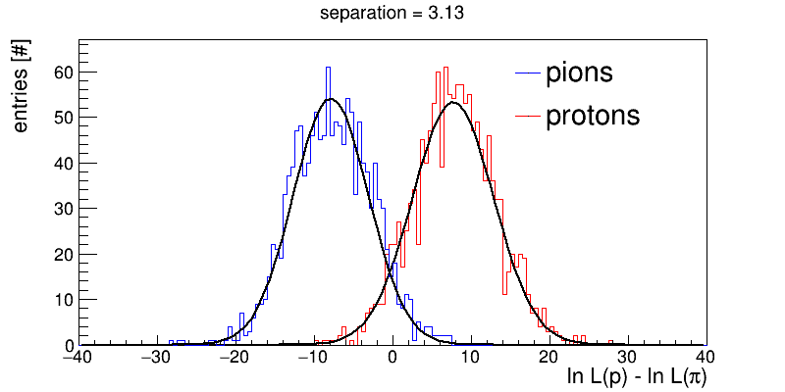
3-layer Lens CERN Beam Test 2017
bar + 3 layer spherical lens
plate + 3 layer cylindrical lens
Photon yield:
data ~82 photons
sim ~80 photons
data ~93 photons
sim ~90 photons
geant
simulation
Preliminary
π/p separation power @ 7 GeV/c (~ π/K @ 3.5 GeV/c):
data 3.9 s.d.
sim 4.2 s.d.
data 3.1 s.d.
sim 3.4 s.d.
Preliminary
good agreement with simulations
Roman Dzhygadlo

Slide 9
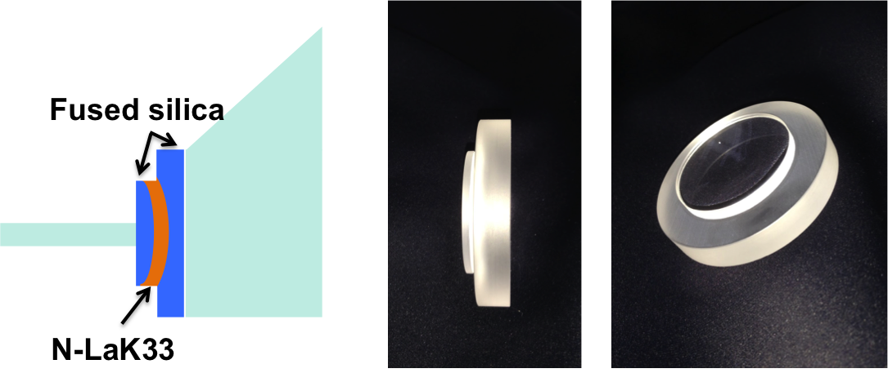
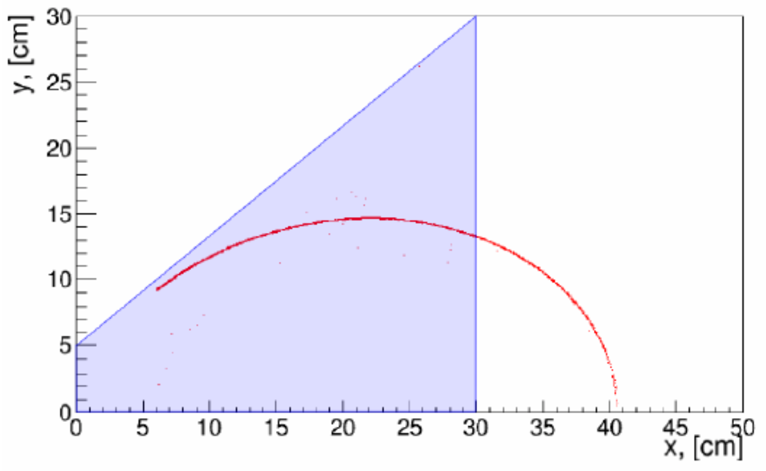
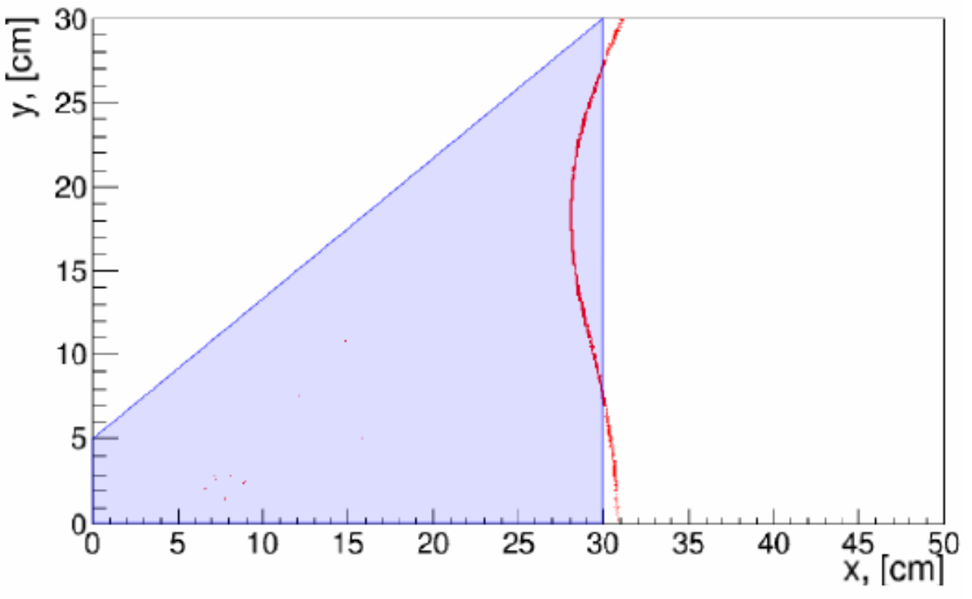
DIRC@EIC Prototype 3-component lens
Limitations of standard focusing lenses:
Significant photon yield loss around 90° particle track
Aberration for photons with steeper angles
Spherical 3-layer lens prototype
Geant4 simulation of focal plane:
Standard lens 3 component lens
Simulated data
R. Dzhygadlo, G. Kalicy, C. Schwarz

Slide 10
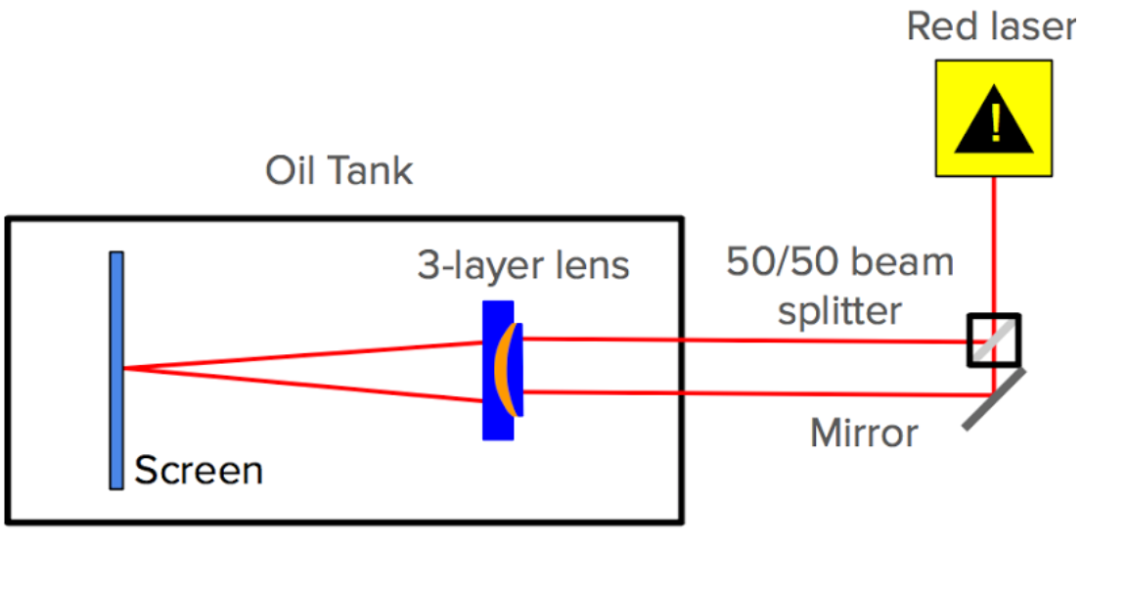
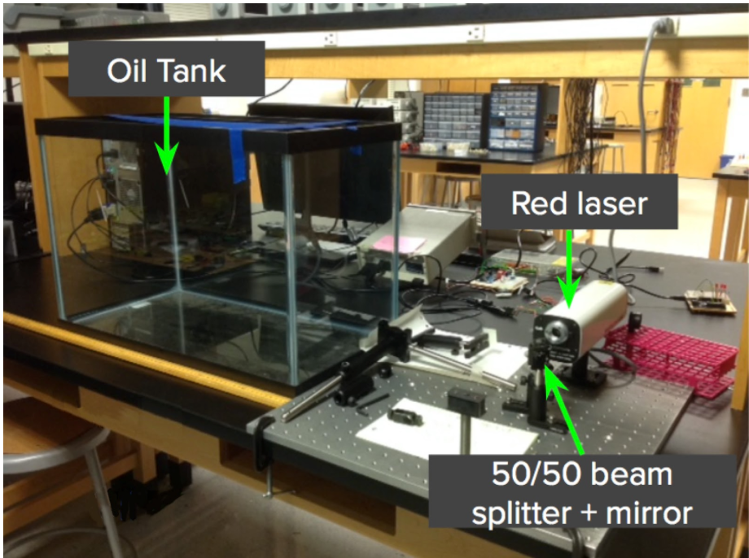
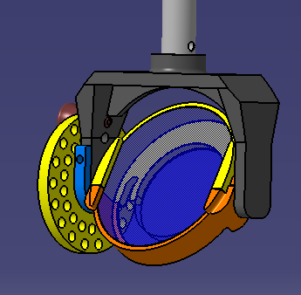
3-layer Lens Performance verification
Mapping focal plane of 3-layer lens:
Lens holder designed to rotate in two planes for the 3D mapping of the focal plane and shifts of lens in horizontal plane.
Laser setup to map the focal plane
3D lens holder
L. Allison, R. Dzhygadlo, G. Kalicy, C. Schwarz

Slide 11
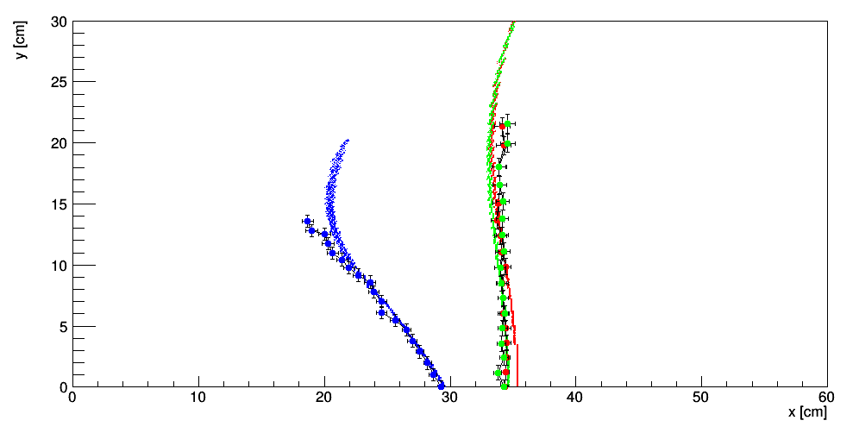
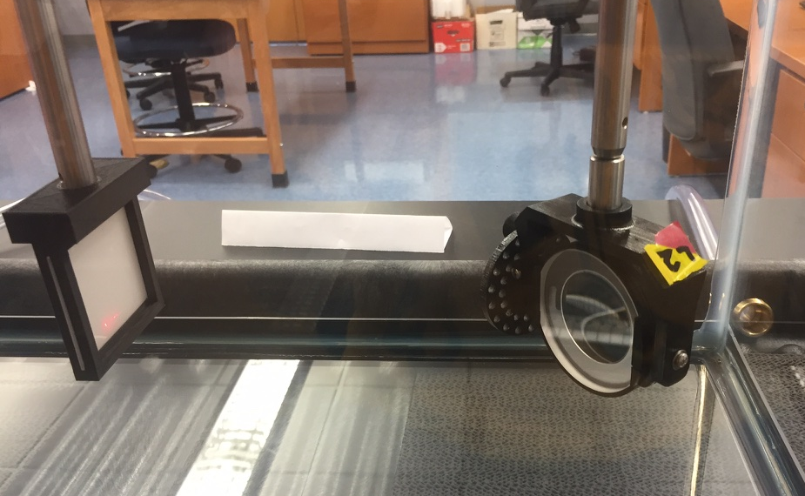
3-layer Lens Performance verification
Mapping focal plane of 3-layer lens:
Lens holder designed to rotate in two planes for the 3D mapping of the focal plane and shifts of lens in horizontal plane.
Spherical 3-layer lens:
Results of measurements confirm desired flat focal plane for centered laser beams on the lens
Off-center laser beams in agreement with simulation
Measured and simulated focal plane of
spherical 3-layer lens
L. Allison, R. Dzhygadlo, G. Kalicy, C. Schwarz

Slide 12
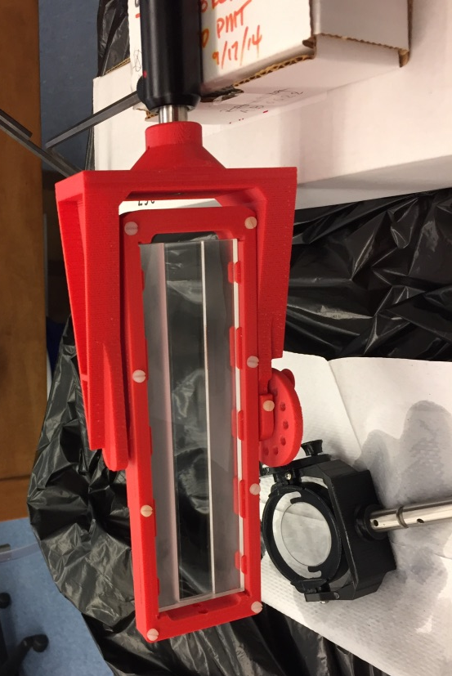
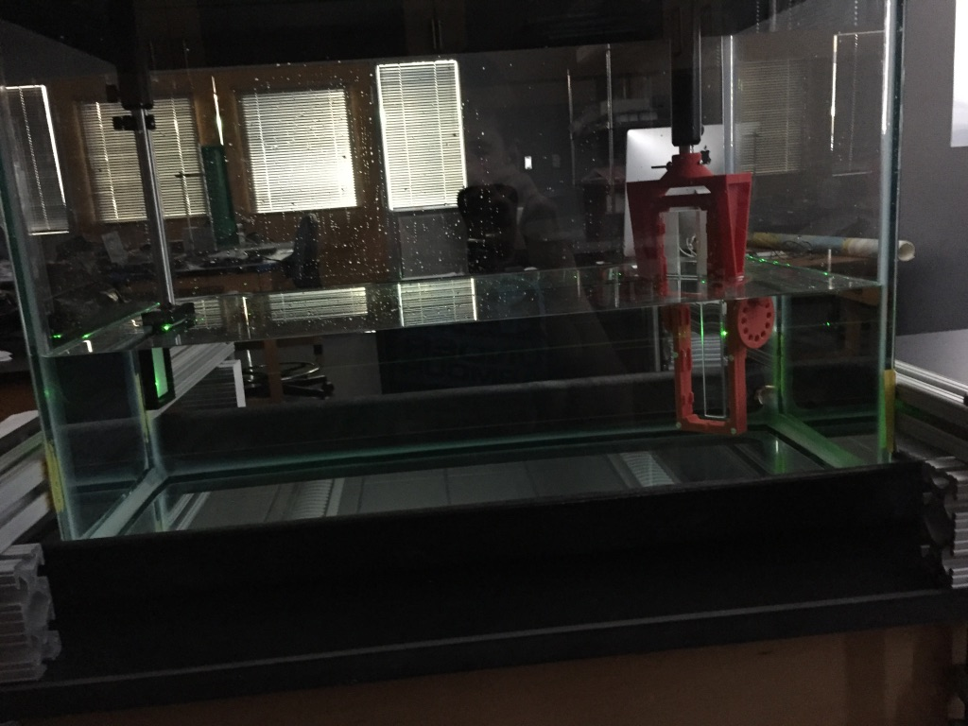
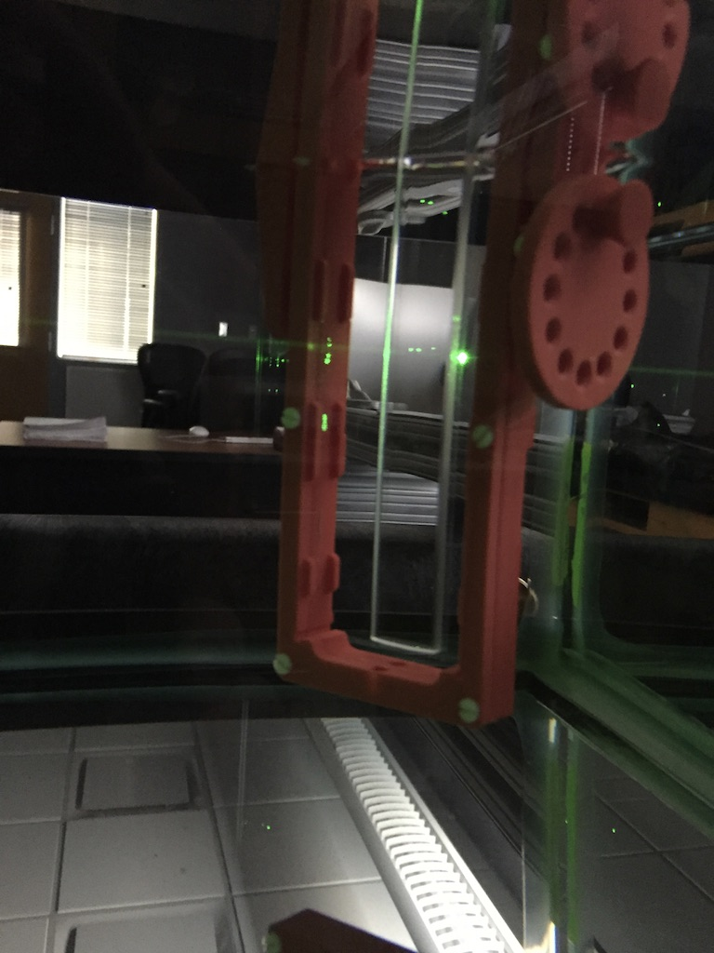
3-layer Lens Performance verification
Cylindrical 3-layer lens:

Slide 13
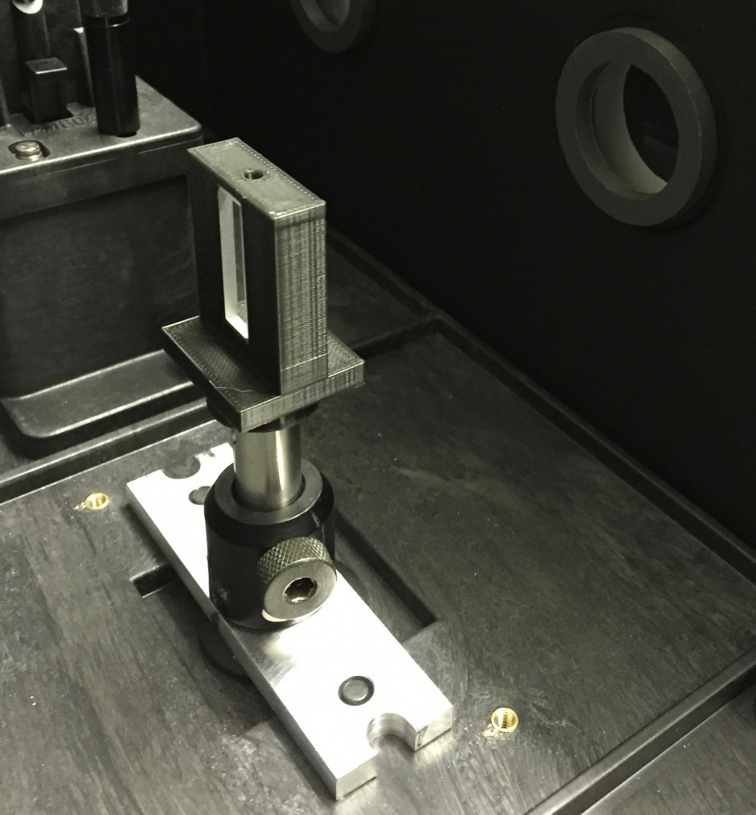
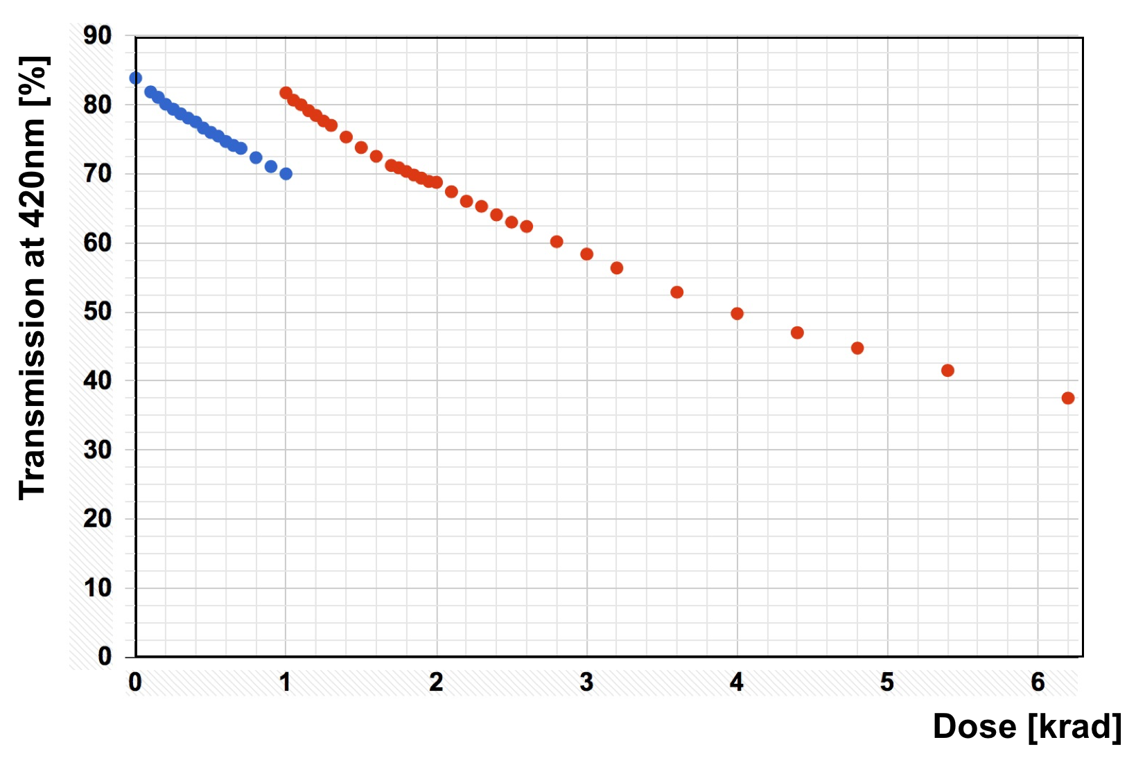
3-layer Lens Radiation Hardness
NLaK33 sample
in CUA setup
Radiation hardness tests of NLaK33 material at CUA
Measurements using X-Ray source show the transmission at 420 nm drops by over 1% per 100 rad.
Annealing process of the transmission observed, is being further investigated.
Spherical 3-layer lens
Measured transmission (not Fresnel corrected ) through the NLaK33 irradiation dose for 420 nm.

Slide 14
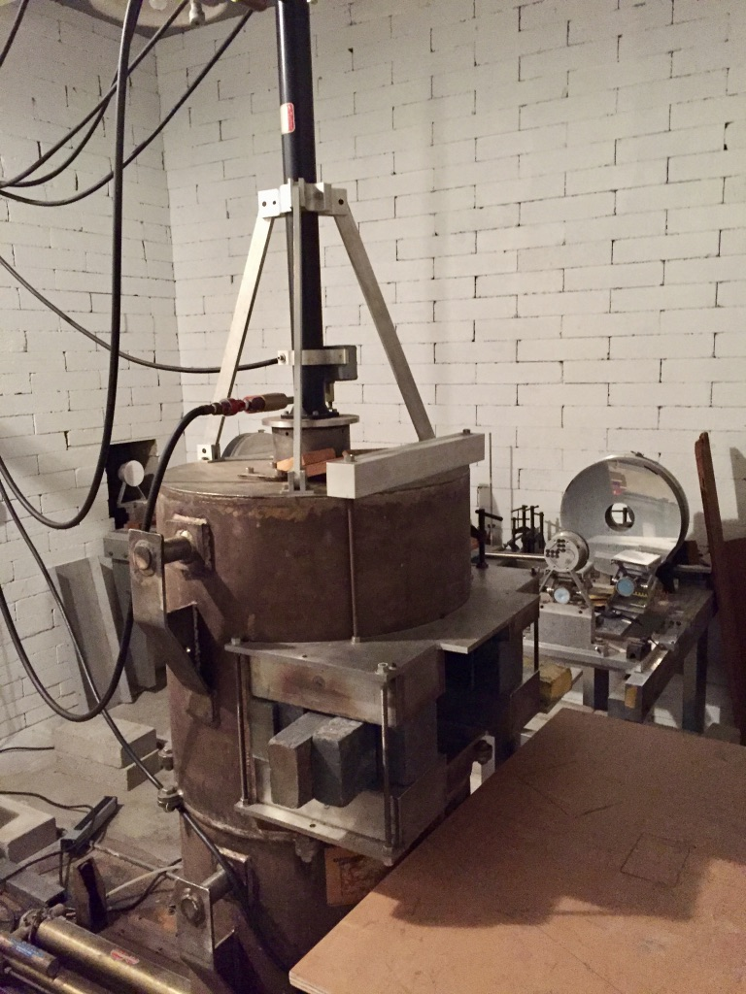
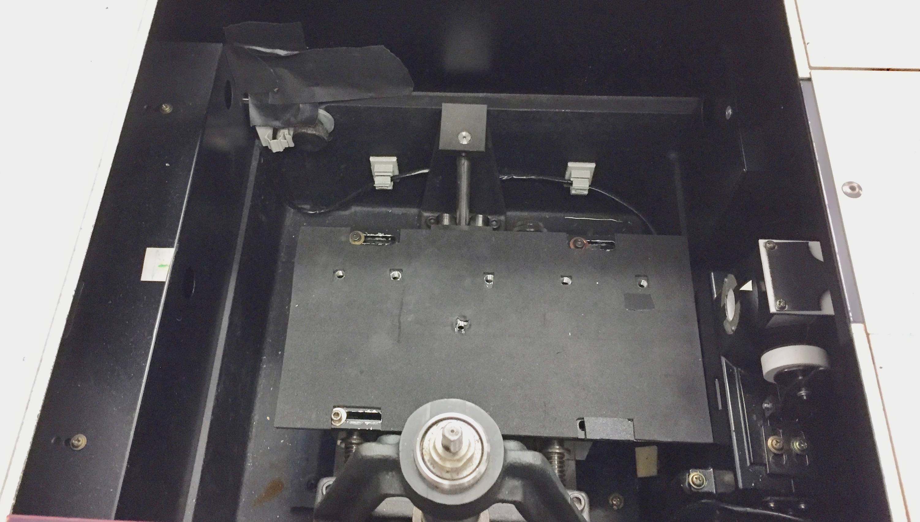
3-layer Lens Radiation Hardness
Radiation hardness tests of at BNL:
Irradiation with Co⁶⁰, possibility of testing with neutrons later.
Monochromator to measure transmission.
PbF₂, two glasses from Schott , NLaK33, and material for Fresnel Lens will be tested.
Annealing process of the materials has to be understood as the measurement will take 1-2 weeks.
Co⁶⁰ Chamber
Monochromator

Slide 15
High-Performance DIRC Activities
Simulation studies:
Studies of design using stand alone Geant4 package. (in progress)
Implementing High-Performance DIRC into the sPHOENIX and BeAST simulation. (early stage)
Hardware activities:
The prototype of 3-layer spherical and cylindrical lens validation in the test beam. (analysis in progress)
Mapping focal plane of the lenses. (already started)
Radiation hardness test of candidates for middle layer of the lens. (scheduled for May or August)
Preparing next prototype lens:
Candidate to polish PbF2 (waiting for the quote)
Discussion with RMI on 20th of April

Slide 16
Backup

Slide 17
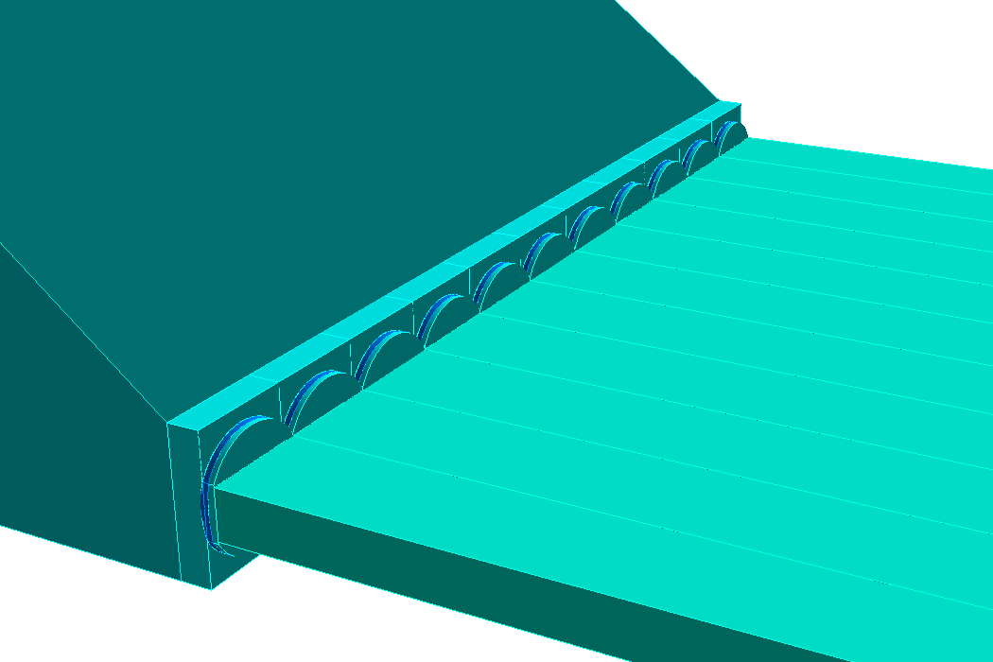
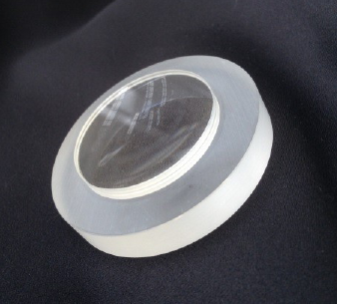
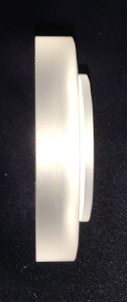
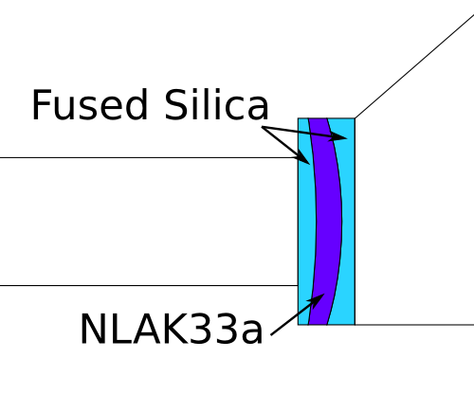
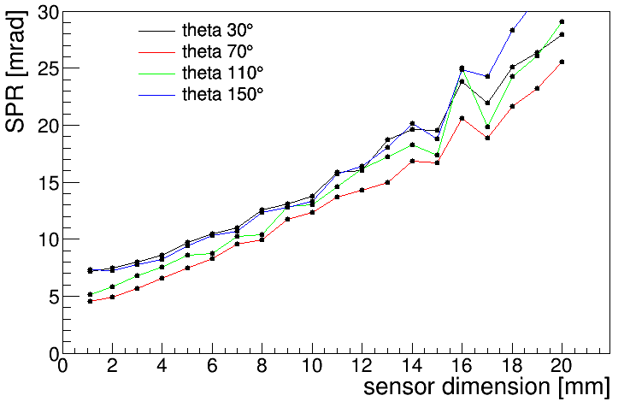
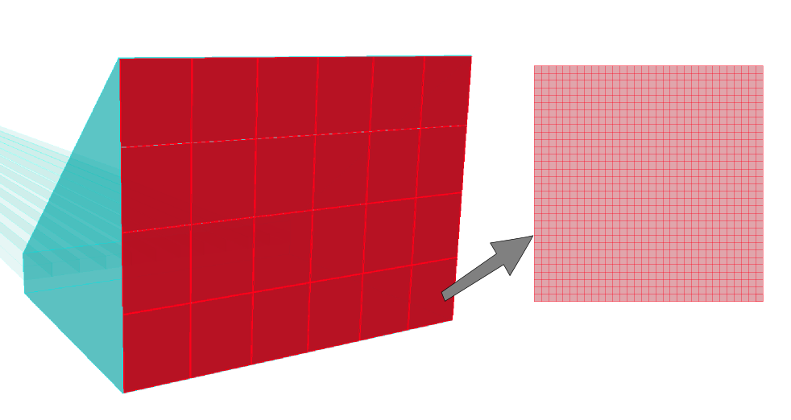
High-performance DIRC Reaching Performance
Improving focusing: 3-layer spherical lens
Prototype:
6 cm
Optimizing pixel size:
6 cm

Slide 18
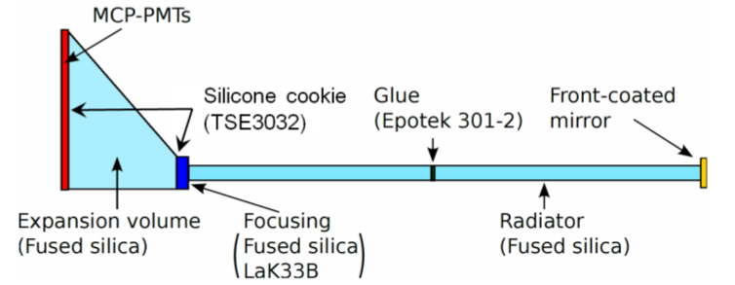
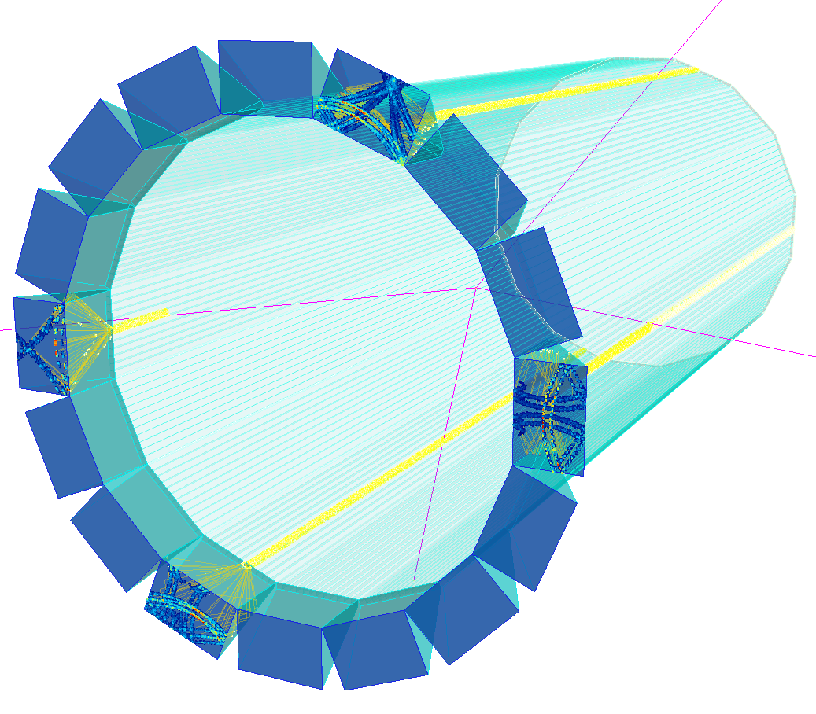
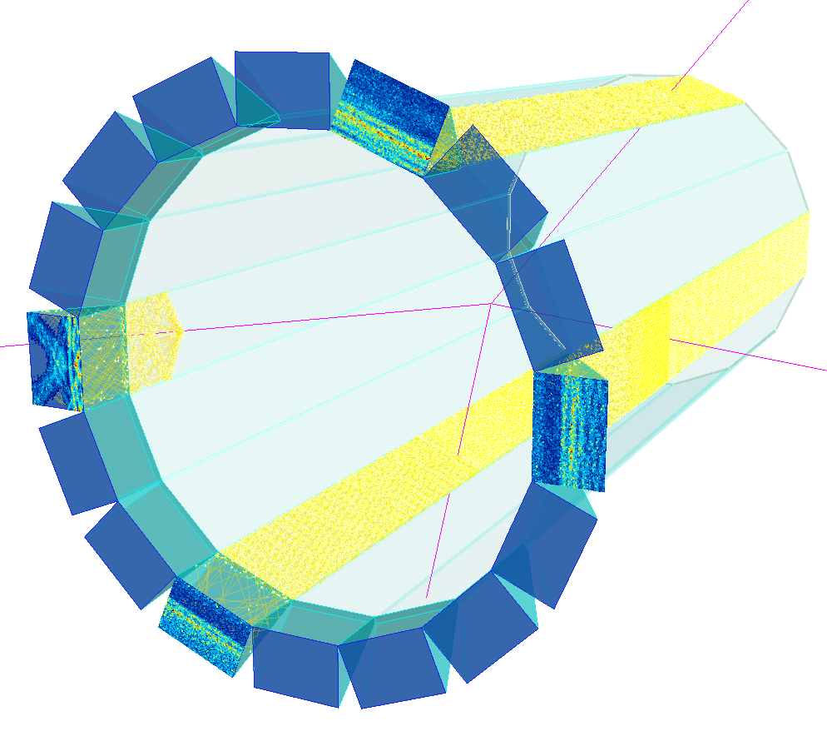
High-performance DIRC Design
Simplified view of one section:
16 section design with one prism in each as expansion volume
GEANT4 visualization of the designs:
11 narrow bars in each section
1 wide bar (plate) in each section

Slide 19
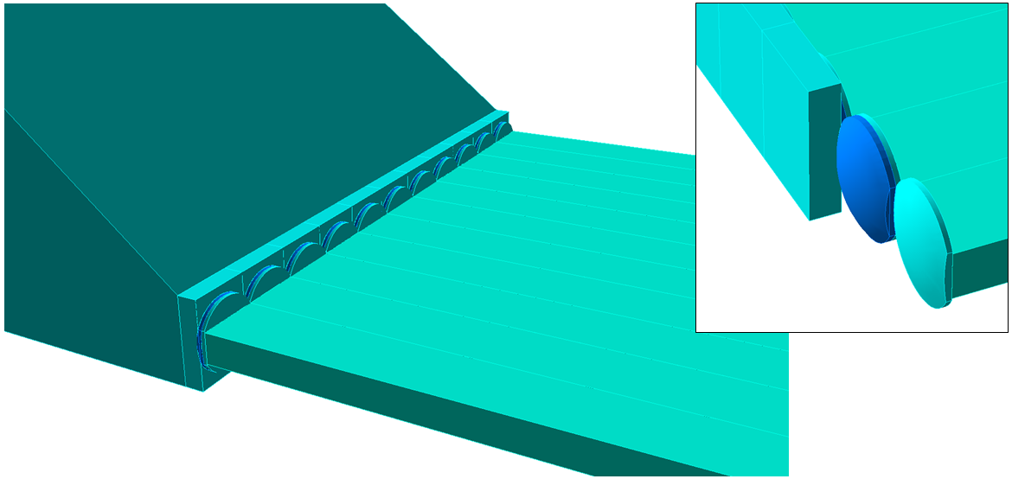
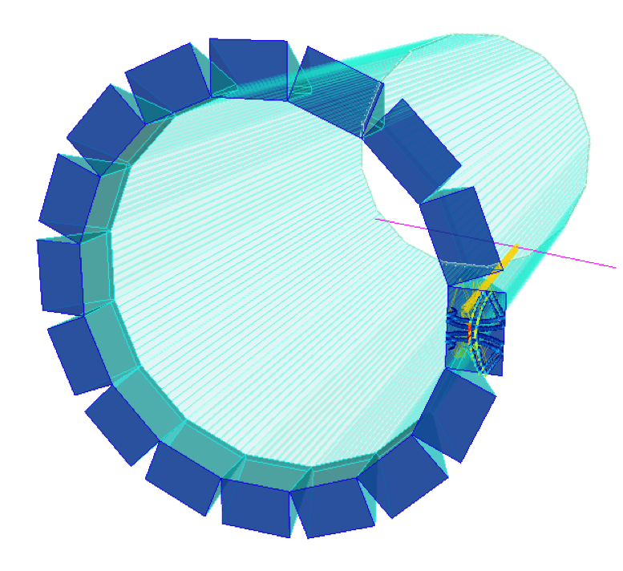
High-performance DIRC Narrow bar design
Radiator bars
17 x 35 x 4200 mm
11 bars per box
16 bar boxes, 1m from IP
3 component lens
14 x 35 x 50 mm
radiuses: 47 mm, 29 mm
Expansion volume
Prism with 38° opening angle
285 x 390 x 300 mm
Sensors
208k pixels, each 3 mm²
Geant4 simulation of High-Performance DIRC detector

Slide 20
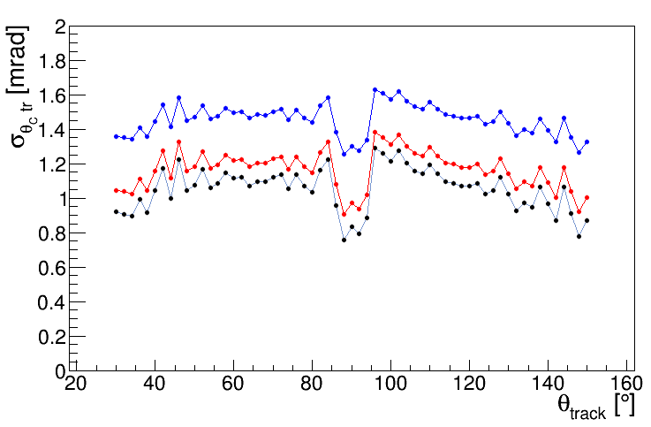
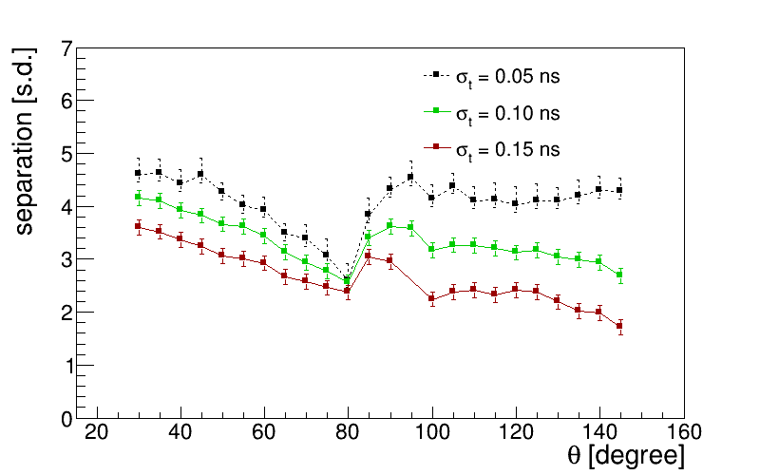
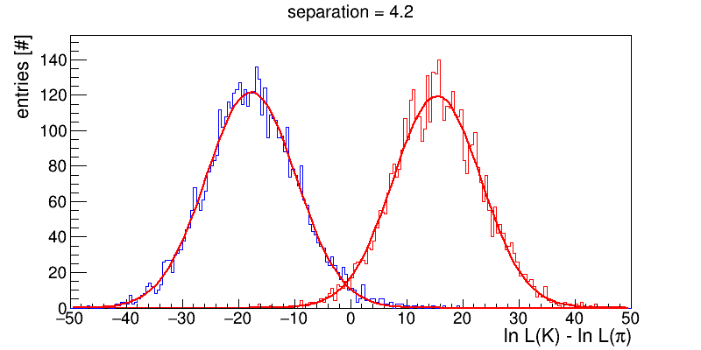
High-performance DIRC Performance
Configuration:
17x32x4200 mm³ bars
3-layer spherical lens
3x3 mm² pixels
100 ps time resolution
blue: 1 mrad track resoution
red: 0.5 mrad track resoution
black: ideal tracking
~4.2 s.d. separation at 6 GeV/c,
30^{O} polar angle
polar angle [deg]
π
K
polar angle [deg]
design meets the requirements for PID in the barrel region

