Slide 1





Inaugural Symposium CFNS, 28-30 November 2018
3D structure of QCD and entanglement
Piet Mulders
p.j.g.mulders@vu.nl

Slide 2
abstract
Could the 3D structure of QCD and the symmetries of
the Standard Model be linked to entanglement?
Look at a possible emergence of symmetries in
the standard model from a simpler basis and
less dimensions. Even if at this stage it
may not make striking predictions,
my hope is that it could shed light on
the peculiarities of the spectrum and
symmetries of the Standard Model and
simplify our understanding of the 3D quark and
gluon structure of hadrons at low and high energies.

Slide 3
A selection of basic questions about Standard Model
Why are leptons color-blind while quarks have electroweak structure?
How is a pure nucleon state entangled, leading to ensemble of partons?
  Nucleons are composite and resolved at high energies!
Partons are pure states that fragment into an ensemble of hadrons?
What about the jet structure and substructure in QCD?
Why is SCET so successful and are transverse modes less relevant?
  Confinement and scale of QCD!
Phenomena at low x (saturation, color glass condensate)?
Where is basic supersymmetry (essential, even showing up in hadron spectrum, nuclear spectra)?
What about scalar sector, naturalness, ... (Higgs, XQCD, ...)
EIC questions

Slide 4

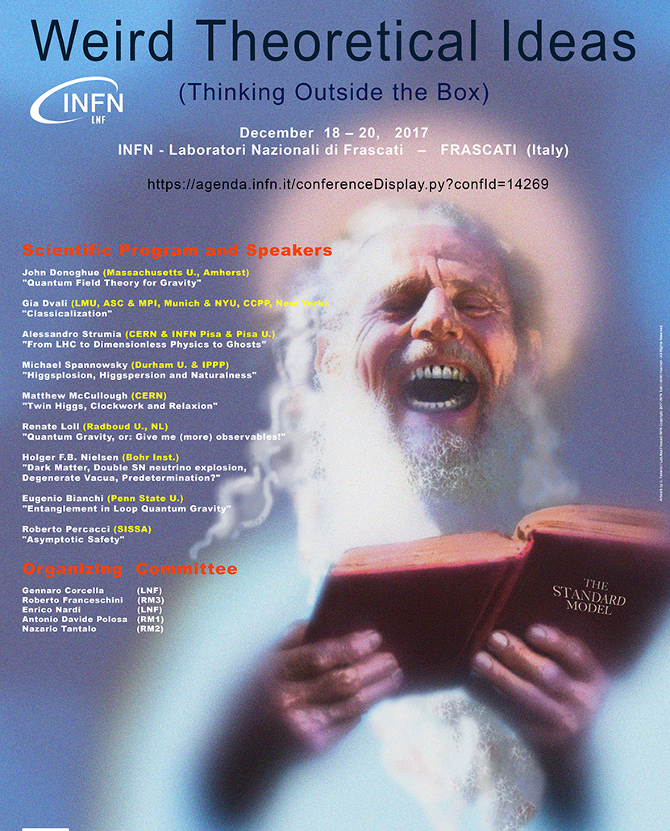
Motivation
(NOT) HAPPY WITH STANDARD MODEL
In spite of the success of Standard Model!
Three families, colors, space dimensions!
Left-right (a)symmetry? B-L?
Naturalness? Missing supersymmetry?
Confinement and Collinearity in QCD?
PJM 1601.00300 (POETIC)
PJM 1801.03664 (Lightcone)
PJM 1806.09797 (Phys. Lett. B)

Slide 5
QCD – entangled states and QIT
Parton-hadron duality in hard QCD scattering: PDFs x FFs
  nucleon is pure state → ensemble of partons (good light-front states)
  [see for instance Kharzeev & Levin (1702.03489)]
  hard (short distance) process: partons → partons
  emerging partons are pure state(s) → ensemble of hadron states
Entangled (pure) states |Φ> in multipartite space, with a density matrix ρ = |Φ><Φ|, lead to ensembles (non-pure state) in the reduced spaces.
  EPR bipartite pure state leads to a 50% - 50% ensemble in both subspaces.
Both hadrons and partons might live in a tripartite space!
Possibly combined with a principle of maximal entanglement (MaxEnt), such as hinted at in Cervera-Lierta, Latorre, Rojo & Rottoli (1703.02989): maximally entangled chiral left/right two-particle states are consistent with QED (g_{A}=0) & electroweak (g_{V}=0), at least if sin Θ_{W} = ½

Slide 6
Conjecture
My conjectures goes one step further:
Quarks and leptons are entangled states belonging to different classes of maximally entangled (MaxEnt) states in a multipartite space
  Criterion for these classes is equivalence under Stochastic Local Operations and Classical Communication (SLOCC), for our purposes Local Unitary (LU) equivalence
  Nonequivalence of classes (not locally connected) corresponds to absence of leptoquarks in SM
Furthermore spatial degrees of freedom and internal degrees of freedom are intrinsically connected (as is the concept LOCAL in QIT). This corresponds to local gauge invariance in SM

Slide 7
Bipartite entangled states
Bell states are maximally entangled (MaxEnt) states in product space :
or
They belong to the same class (SLOCC, for us local unitary, local = subspace)
Symmetry eigenstates are in general aligned and/or entangled
Bell
entanglement measure:
(Schmidt decomp.)
products
A x B
aligned
Generators
singlet
triplet
generators
Bell

Slide 8
Symmetries and multipartite states
Relevant symmetry in tripartite space is Z(3), S(3), SO(3), and SU(3)
  Example: a 3D harmonic oscillator: states |n_{x}n_{y}n_{z}> or |n_{r}lm>
  3D HO is separable, has rotational [SO(3)] and more [SU(3)] symmetry. Symmetry eigenstates are in general entangled states (see H. Georgi, Group Theory, Ch. 13)
  Bosons & Fermions
E
10
E
+7/2
6
+5/2
3
+5/2
+3/2
1
+3/2
1
+1/2
+1/2
3*
−1/2
−1/2
3
−3/2
−3/2
1

Slide 9
Basic Hilbert space for Standard Model
Basic Hilbert space needs right- and left-states (R and L):
Basic Hilbert space needs SU(3) symmetry eigenstates: (1, 2, 3) or (+, −, 0)
Spectrum in SM (quarks, leptons, gauge bosons, Higgs) is CP symmetric, thus also starting basis
Supersymmetry is natural (bosons φ and fermions ξ) in basic space(s), but will be hidden in tripartite space

Slide 10
Tripartite entangled chiral states
Two classes of maximally entangled ABC states:
(Dur, Vidal, Cirac 2000)
Beyond tripartites there is an infinite number of classes!
GHZ: fragile
W: robust

Slide 11
EMERGENCE OF SPACE-TIME DEPENDENCE

Slide 13
Basic symmetries including SUSY
Hilbert space
Supercharges
For boson and fermion fields
Implement symmetries via constraints F
... and a nontrivial vacuum (not everything is for free!)
hamiltonian/number operators (i=j, k=l)
& unitary rotations
Single (free) field
unitary rotations

Slide 14
Emerging symmetries and space-time
Fields
Generators
Space-time & Internal
Real/Majorana:
(Wess-Zumino)
H
P⁺, P⁻ K, SU(3)
U(1)_{R} x U(1)_{L} x SU(3)

Slide 15
Emerging symmetries and space-time
Fields
Generators
Space-time & Internal
Real/Majorana:
(Wess-Zumino → gauge theory)
1D:
H
P⁺, P⁻ K, SU(3)
Z(2)
H, P, K SU(3)
P(1,1) x SU(3)

Slide 16
Emerging symmetries and space-time
Fields
Generators
Space-time & Internal
Real/Majorana:
(Wess-Zumino → gauge theory)
1D:
3D:
H
P⁺, P⁻ K, SU(3)
Z(2)
H, P, K SU(3) =
[SO(3),SU(2)xU(1)]
Z(3)
H, P, K, J SU(2)xU(1)
P(1,3) x SU(2) x U(1)

Slide 17
Emerging symmetries and space-time
Fields
Generators
Space-time & Internal
Real/Majorana:
(Wess-Zumino → gauge theory)
1D:
3D:
and ....
in order to match space-time and field symmetries and respect Coleman-Mandula
H
P⁺, P⁻ K, SU(3)
Z(2)
H, P, K SU(3) =
[SO(3),SU(2)xU(1)]
Z(3)
H, P, K, J SU(2)xU(1)
A(4)
P(1,3) x SU(2) x U(1)

Slide 18
DYNAMICS

Slide 19
Dynamics
Right-Left symmetry
Supersymmetry (Wess-Zumino structure)
  Bosons:
  Fermions:
Wess-Zumino in 1+1 dim including potential and vev determining symmetry
Pseudoscalar fields (θ) → gauge fields
... + masses through symmetry breaking
Link to gravity (?) via constraint
SO(3) symmetry via vev

Slide 20
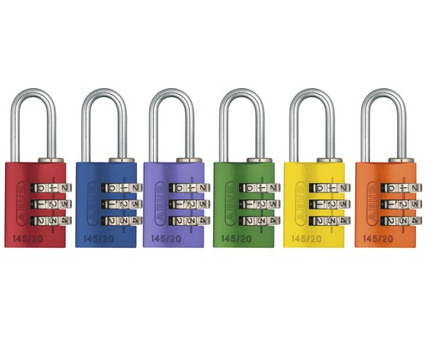
FERMIONS AND BOSONS AS TRIPARTITE STATES

Slide 21
Leptons
GHZ class, has same symmetry as basis (including chirality)
Using note that is LU equivalent to and the aligned GHZ states can be SO(3) multiplets (living in 3D) identified with leptons
Embedding symmetry A(4) has three singlet representations: families
This gives tri-bimaximal family – electroweak mixing [slightly different from the way obtained by Fritsch & Xing, or Harrison, Perkins & Scott]

Slide 22
Quarks
For W-class chirality is more complex
again employ SU(3) and SU(2) x U(1)
subgroups (I, U, V) in bipartite classes
→
A(4) symmetry: three singlets and three triplets
Construct SU(3) root diagram to see all GHZ- and W-states

Slide 23
Fermionic excitations: tripartite entanglement
Tripartite states (R: 1 2 3 & L: 1 2 3)
Aligned (RRR, LLL): GHZ states
  I, U, and V allowed
  SO(3) → asymptotic/space
  Three A(4) singlets
Mingled (RRL, RLL): W-states
  I, U, or V allowed
  non-asymptotic
  Three A(4) triplets (color)

Slide 24
Fermionic excitations: electroweak identification
Tripartite states (R: 1 2 3 & L: 1 2 3)
Aligned (RRR, LLL): LEPTONS
  I, U, and V allowed
  SO(3) → asymptotic/space
  Three A(4) singlets
Mingled (RRL, RLL): QUARKS
  I, U, or V allowed
  non-asymptotic
  Three A(4) triplets (color)
Resembles the rishon model (Harari & Seiberg 1982)

Slide 25
Bosons
Boson fields appear as Higgs field and in covariant derivatives:
Depending on implementation:
Gauge fields linked to symmetry
generators
More or less like SM starting with
  Need for radiative corrections
1D
3D

Slide 26
Composites & local versus global symmetries
Strong Interactions: resembles XQCD₁₊₁ (analogous to Kaplan 1306.5818), while dynamics governed via Wilson loop (including freezing of color at small x/high energies)
Elementary constituents only involve entanglement in discrete R/L and 1,2,3 degrees of freedom; composites entangled in the continuous space-time degrees of freedom
lightcone (PDF) → light-front (TMD)
Τ
ξ
−
Quark-entangled states form hadrons that are global SU(3) color singlets. Color local in 1D and global in 3D valence – current quarks (ontological basis choice, G ‘t Hooft)
More to incorporate in QCD:
  collinearity and TMD
  light-front dominance, OPE
  jets, SCET
  AdS/CFT
  color-kinematic dualities

Slide 27
SUMMARY AND OUTLOOK

Slide 28
Emergence in Standard Model
Choice of basic ‘internal’ degrees of freedom and embedding them in R^{1,1} or R^{1,3} via tripartite entanglement:
  Advantageous for convergence: d[φ] = (d-2)/2 → 0, d[ξ] = (d-1)/2 →½, naturalness, … [see Stojkovic – 1406.2696]
  What are consequences in higher order corrections, e.g. g-2, EW+strong, …
  Supersymmetry included, but invisible in 3D !
  Gravity also emerges in 1D → 3D.
Does it provide a consistent framework to look at family structure and symmetries of standard model as emergent phenomena?
  e.g. tri-bimaximal mixing for leptons, zeroth order parameters in SM
Tripartite space for quarks naturally has color dual to space/electroweak:
  explains why color decoupled from electroweak interactions (no lepto-quarks)
  color invisible in 3D: local gauge invariance! No asymptotic quarks or gluons!
  global color remains visible in 3D via color factors such as N vs 1/N, f x D (distribution x fragmentation)

Slide 29
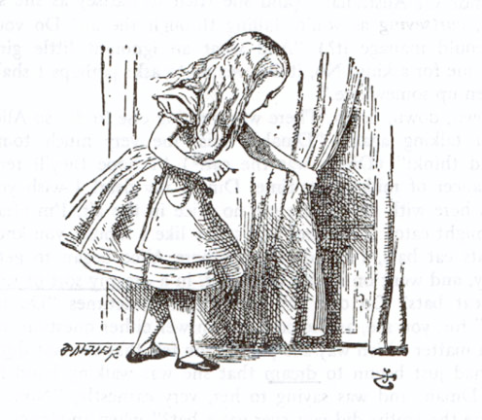
Let’s continue to look for new ways out
L R

