Slide 1

JLab 12 GeV science and evolution into EIC
Robert McKeown
Center for Frontiers in Nuclear Science
November 29, 2018

Slide 2
Outline
Recent Highlights
12 GeV Program
Future Projects
EIC
Summary

Slide 3
Jefferson Lab User Growth
“Other Users” include US National Labs and Industry

Slide 4
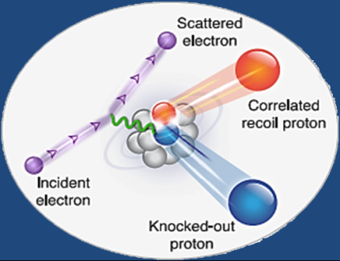

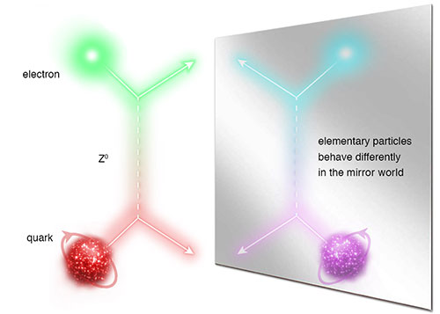
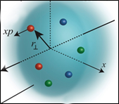
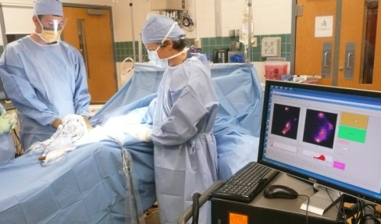
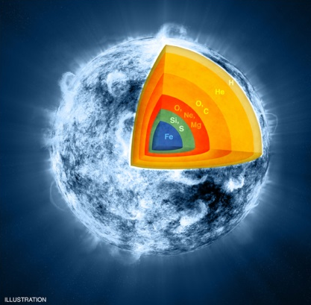
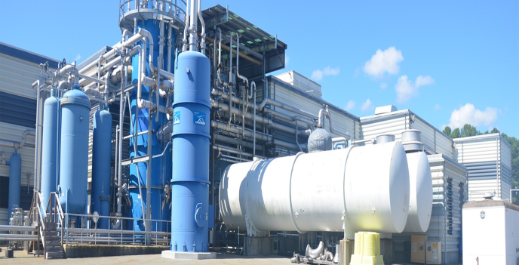
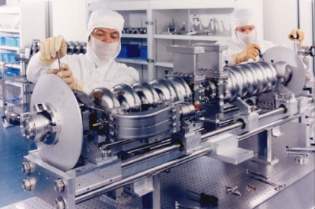

Jefferson Lab: A Laboratory For Nuclear Science
Z⁰
Nuclear Structure
Fundamental
Forces & Symmetries
Structure of Hadrons
Medical Imaging Technology
Nuclear Astrophysics
Cryogenics
Accelerator S&T
Theory & Computation

Slide 5
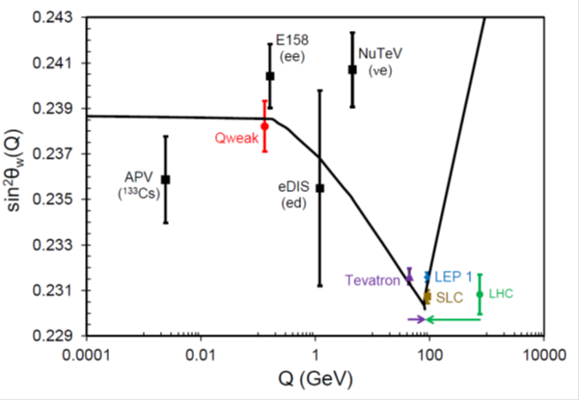
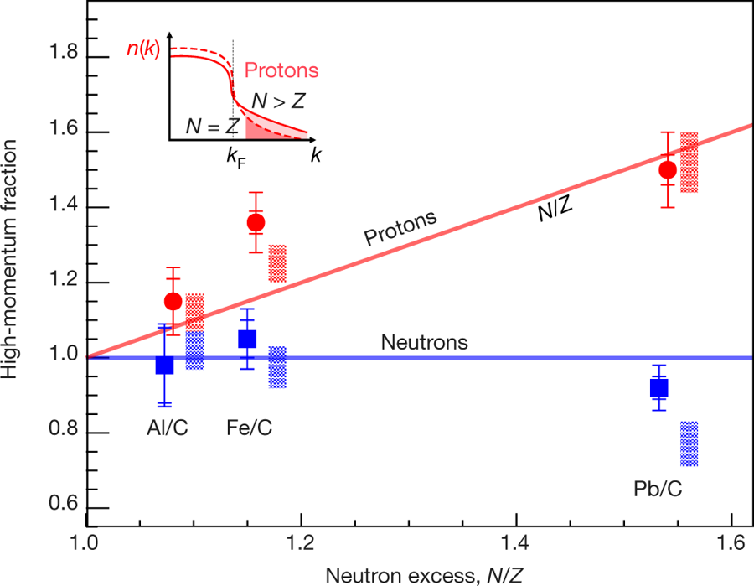
Results Published in Nature
Final Qweak results:
Nature 557, 207–211 (2018)
An accurate calculation of the nucleon axial charge with lattice QCD:
Nature 558, 91-94 (2018)
The weak charge of the proton – “Qweak”, represents the (tiny) difference of the charge of the proton and it’s mirror image
The pressure distribution in the proton:
Nature 557 (2018) no.7705, 396-399
Ultrafast Nucleons in Asymmetric Nuclei:
Nature 560 (2018) no.7720, 617-621
Analysis of 6 GeV CLAS DVCS data on the proton.

Slide 6
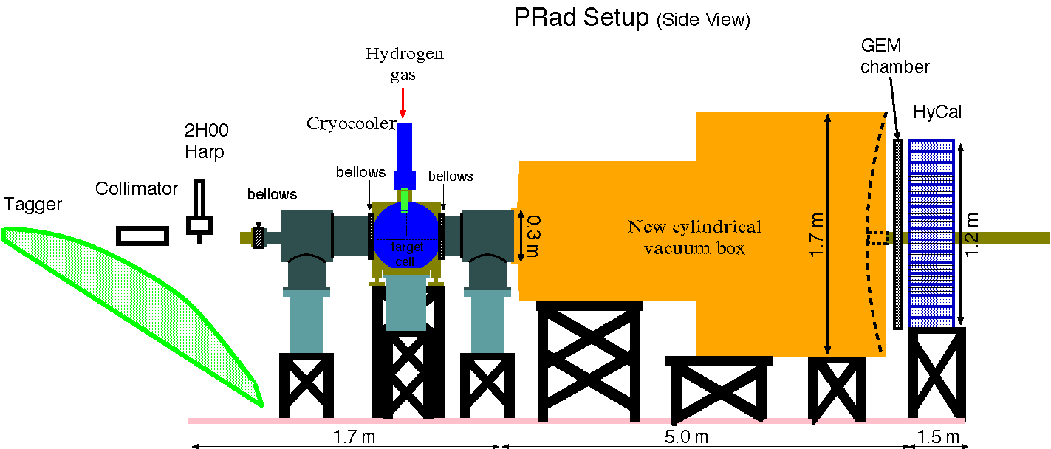
Prad: First completed experiment in 12 GeV era
e - beam

Slide 7
Proton Radius Result from PRad (Preliminary)
PRad Preliminary result:
R_{p} = 0.830 ± 0.008 (stat.) ± 0.018 (syst.) fm

Slide 8
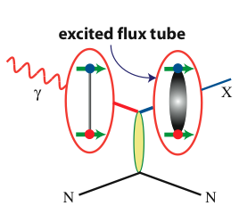
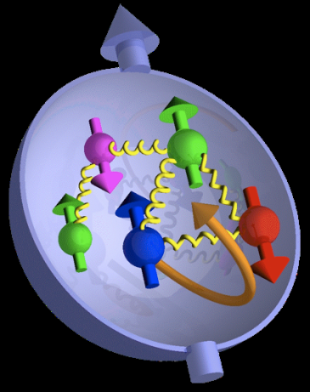

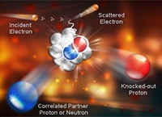
Jefferson Lab @ 12 GeV Science Questions
excited gluon field
What is the role of gluonic excitations in the spectroscopy of light mesons?
Where is the missing spin in the nucleon?
Role of orbital angular momentum?
Can we reveal a novel landscape of nucleon substructure through 3D imaging at the femtometer scale?
What is the relation between short-range N-N correlations , the partonic structure of nuclei, and the nature of the nuclear force?
Can we discover evidence for physics
beyond the standard model
of particle physics?

Slide 9
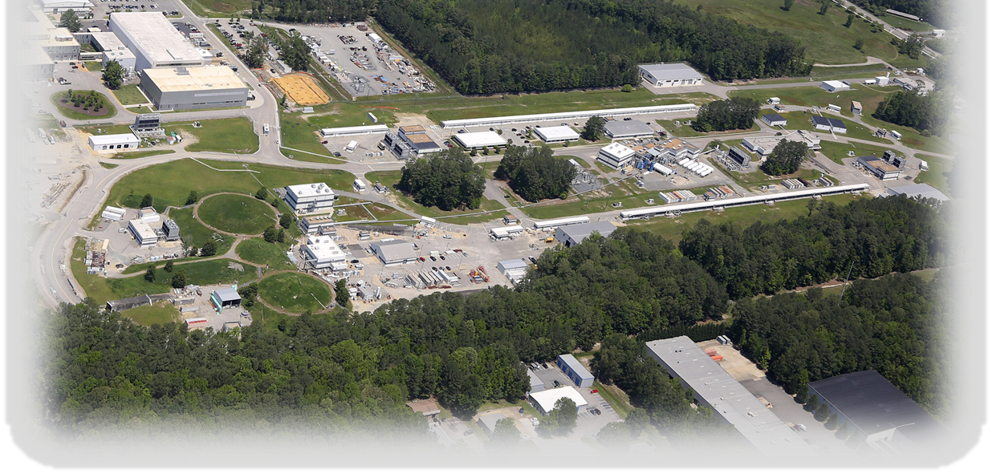
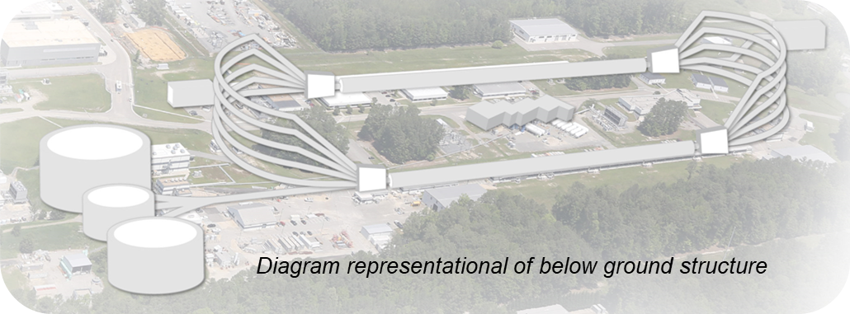
CEBAF at Jefferson Lab
Located in Newport News (VA) – In operation since 1995
D
2
1
3
A
3
2
INJECTOR
LINACS
RECIRCULATION ARCS
B
C
CEBAF World-leading Capabilities
Nuclear experiments at ultra-high luminosities, up to 10³⁹ electrons-nucleons /cm²/ s
World-record polarized electron beams
Highest intensity tagged photon beam at 9 GeV
Unprecedented stability and control of beam properties ➔ Excellent for low energy SM tests
Ability to deliver a range of beam energies and currents to multiple experimental halls simultaneously
CEBAF Upgrade completed in September 2017
  CW electron beam
  E_{max} = 12 GeV
  I_{max} = 90 μA
  Pol_{max} ~ 90%
Physics Operation
  4 halls running simultaneously since January 2018

Slide 10
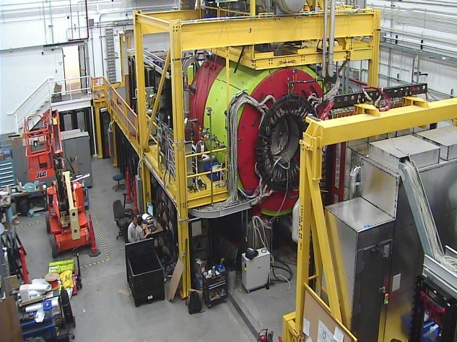
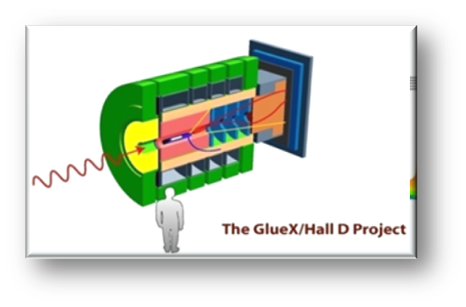
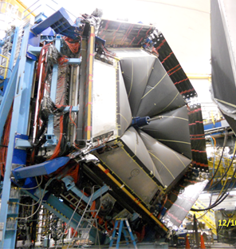
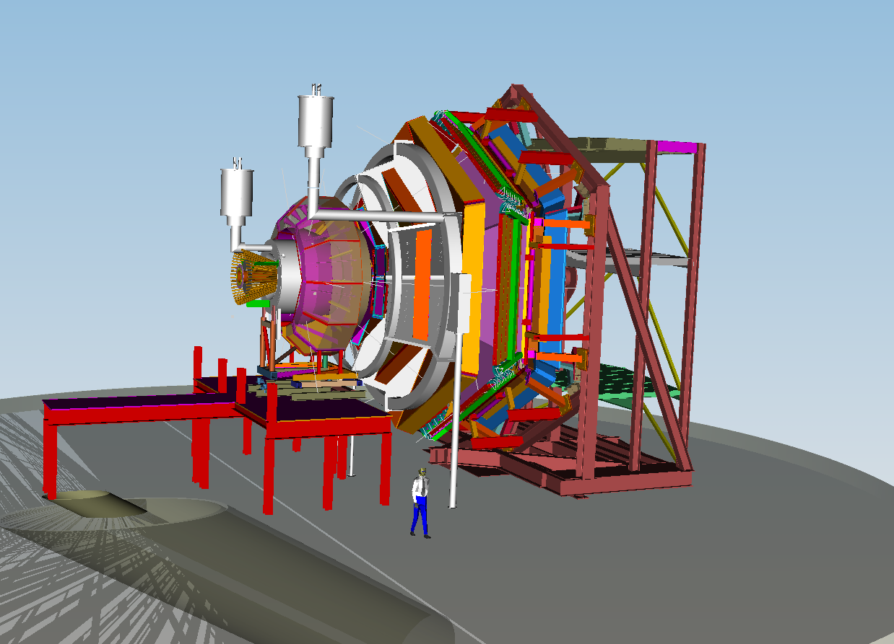
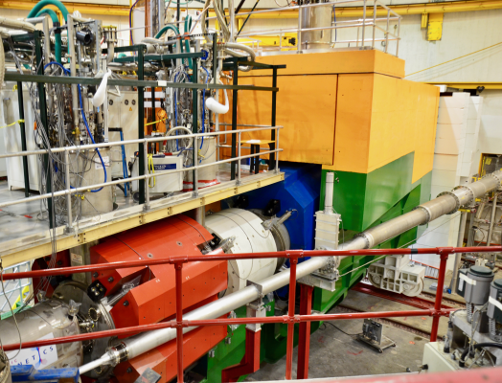
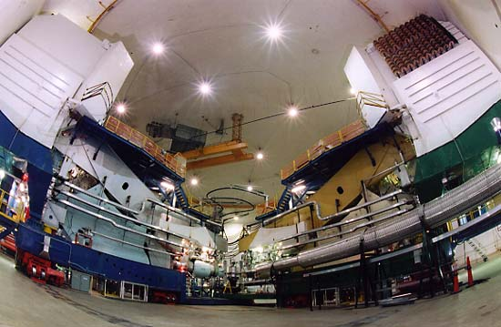

12 GeV Scientific Capabilities
Hall D – exploring origin of confinement by studying
exotic mesons
Hall B – understanding nucleon structure via generalized parton distributions and transverse momentum distributions
Hall C – precision determination of valence quark properties
in nucleons and nuclei
Hall A – short range correlations,
form factors, hyper-nuclear physics,
future new experiments (e.g., SoLID and MOLLER)
Notes:
10

Slide 11
Theory at Jefferson Lab

Slide 12
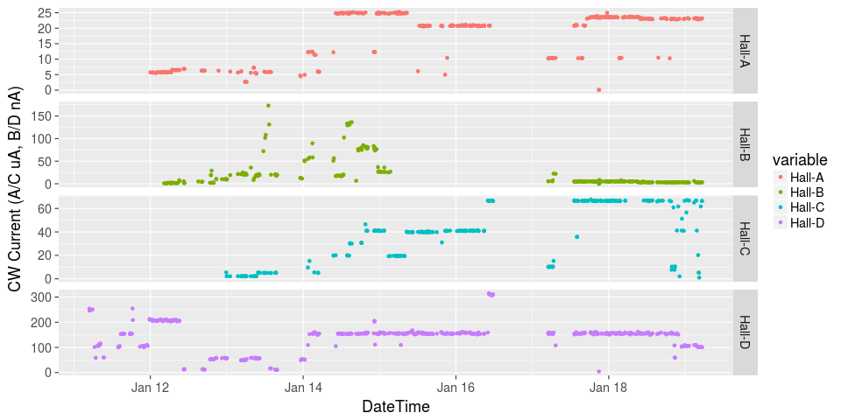
Initiated Four Hall Operation!
μA
A up!
nA
Installation
B up!
Beam Current
Pass Change
μA
C up!
D up!
nA

Slide 13
Approved experiments
Topic | Hall A | Hall B | Hall C | Hall D | Other | Total
The Hadron spectra as probes of QCD | 0 | 2 | 1 | 3 | 0 | 6
The transverse structure of the hadrons | 6 | 3 | 3 | 1 | 0 | 13
The longitudinal structure of the hadrons | 2 | 3 | 6 | 0 | 0 | 11
The 3D structure of the hadrons | 5 | 9 | 6 | 0 | 0 | 20
Hadrons and cold nuclear matter | 8 | 5 | 7 | 0 | 1 | 21
Low-energy tests of the Standard Model and Fundamental Symmetries | 3 | 1 | 0 | 1 | 2 | 7
Total | 24 | 23 | 23 | 5 | 3 | 78
Total Experiments Completed | 4.6 | 2.7 | 2.1 | 0.8 | 0 | 10.2
Total Experiments Remaining | 19.4 | 20.3 | 20.9 | 4.2 | 3.0 | 67.8

Slide 14
Approved Experiments – PAC Days
Topic | Hall A | Hall B | Hall C | Hall D | Other | Total
The Hadron spectra as probes of QCD | 0 | 219 | 11 | 540 | 0 | 770
The transverse structure of the hadrons | 150.5 | 85 | 110 | 25 | 0 | 370.5
The longitudinal structure of the hadrons | 65 | 230 | 165 | 0 | 0 | 460
The 3D structure of the hadrons | 409 | 872 | 197 | 0 | 0 | 1478
Hadrons and cold nuclear matter | 220 | 275 | 205 | 0 | 14 | 714
Low-energy tests of the Standard Model and Fundamental Symmetries | 547 | 180 | 0 | 79 | 60 | 866
Total Days | 1392 | 1861 | 688 | 644 | 74 | 4658.5
Total Days - Without SoLID | 917.5 | 1861 | 688 | 644 | 28 | 4139
Total Approved Run Group Days (includes MIE) | 1392 | 1026 | 645 | 444 | 74 | 3581
Total Approved Run Group Days (without SoLID) | 917.5 | 1026 | 645 | 444 | 28 | 3061
Total Days Completed | 138.4 | 52 | 44.5 | 93 | 0 | 327.9
Total Days Remaining | 779 | 974 | 600.5 | 351 | 28 | 2733
A Decade of Experiments!

Slide 15
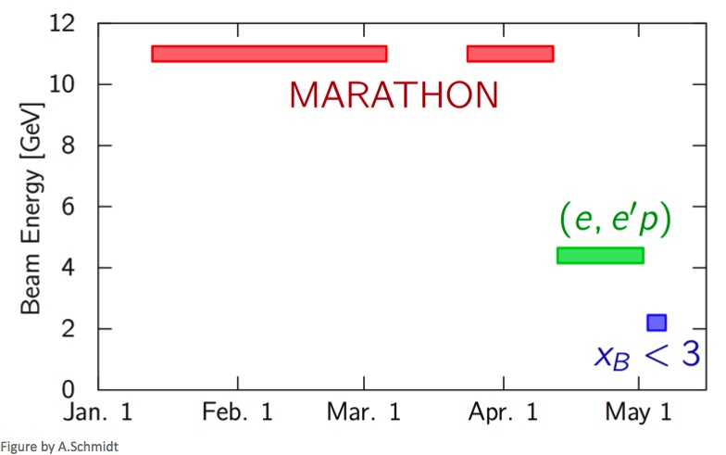
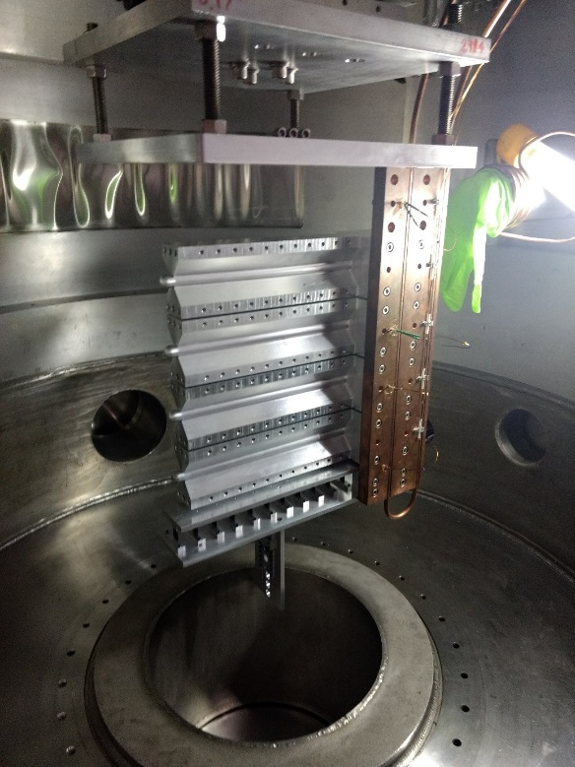
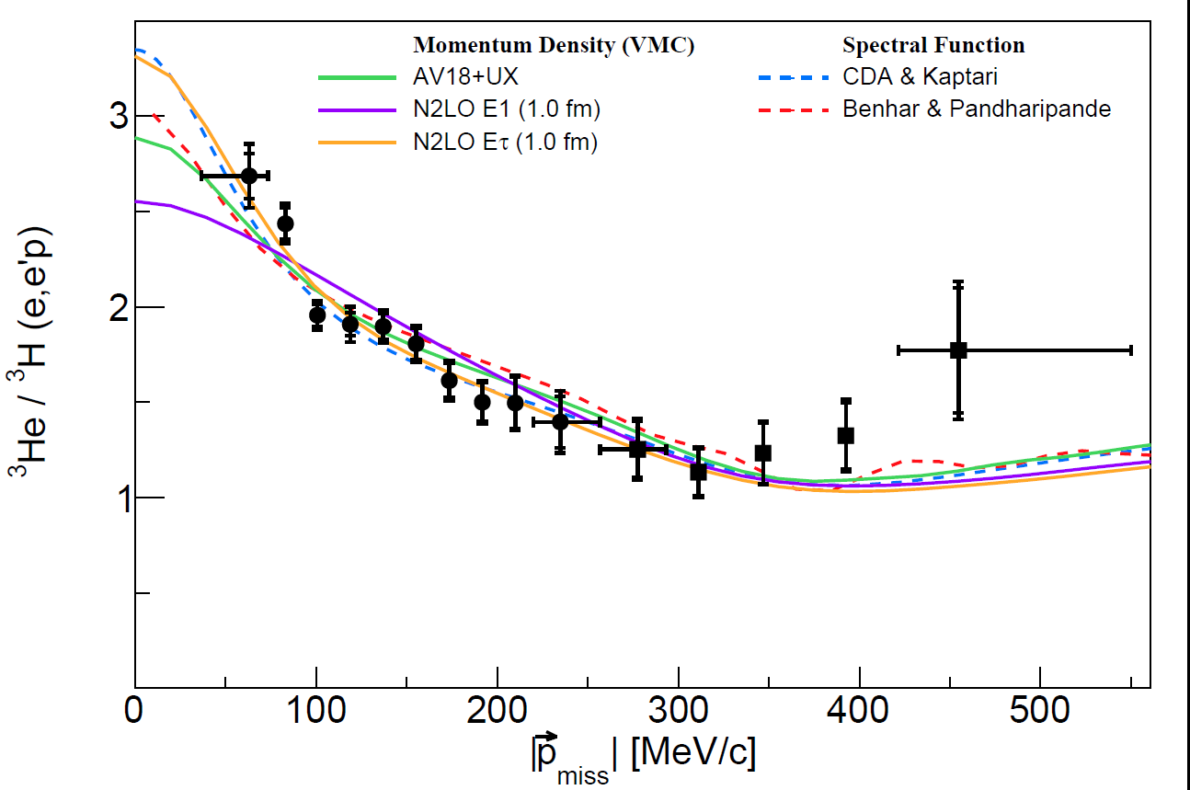
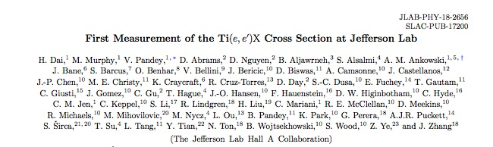
Hall A
Running tritium family of experiments in 2018 – all 4 complete!
Continue to publication results of previous 12 GeV experiments
Published in Phys. Rev. C98 (2018) no.1, 014617

Slide 16
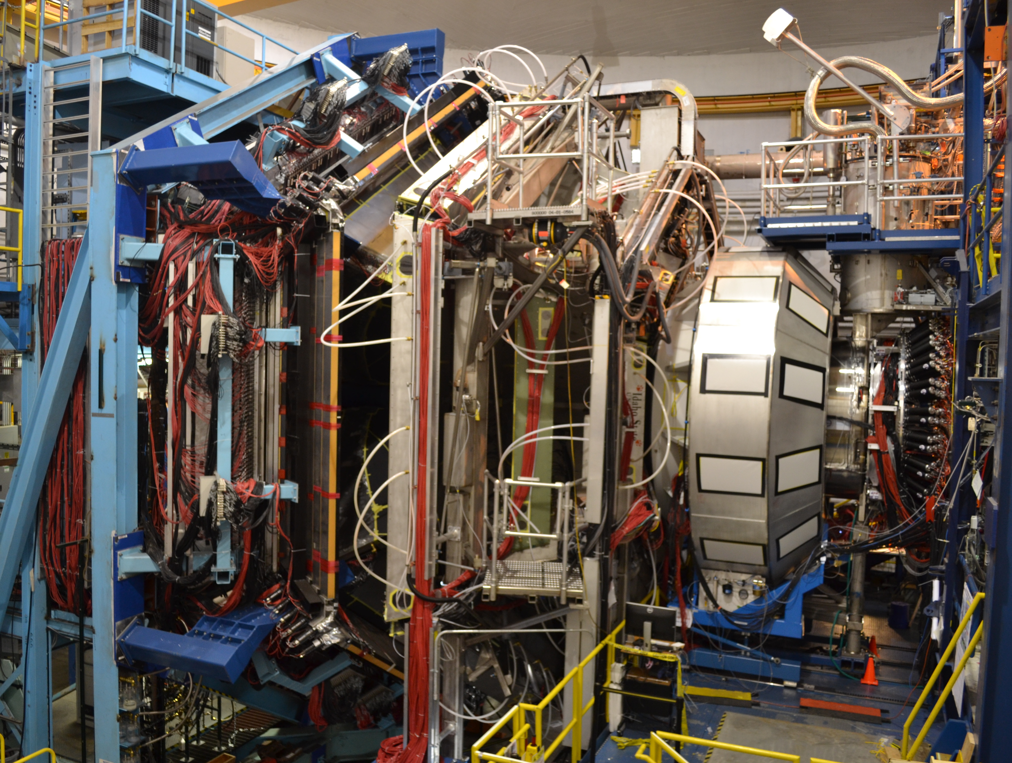
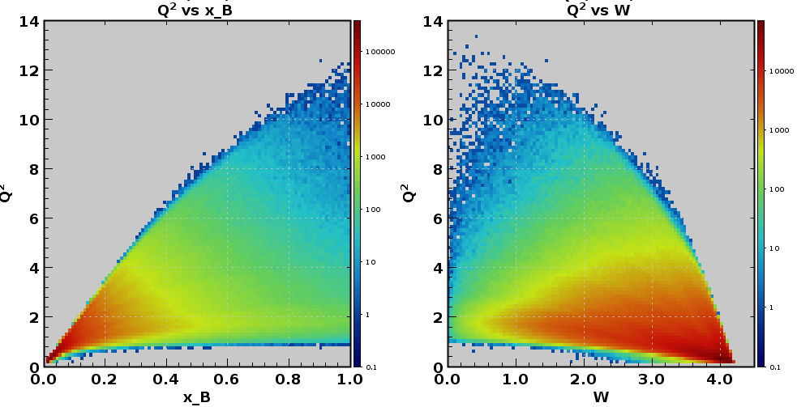
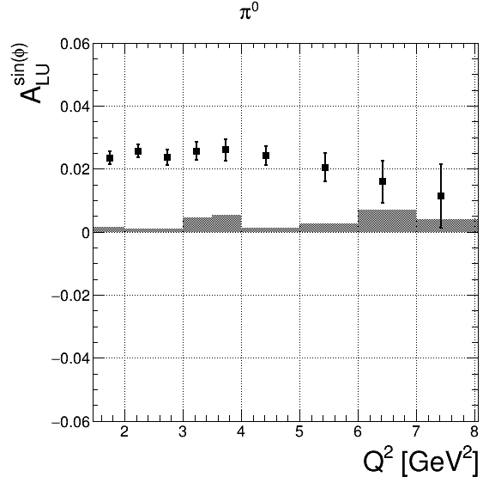
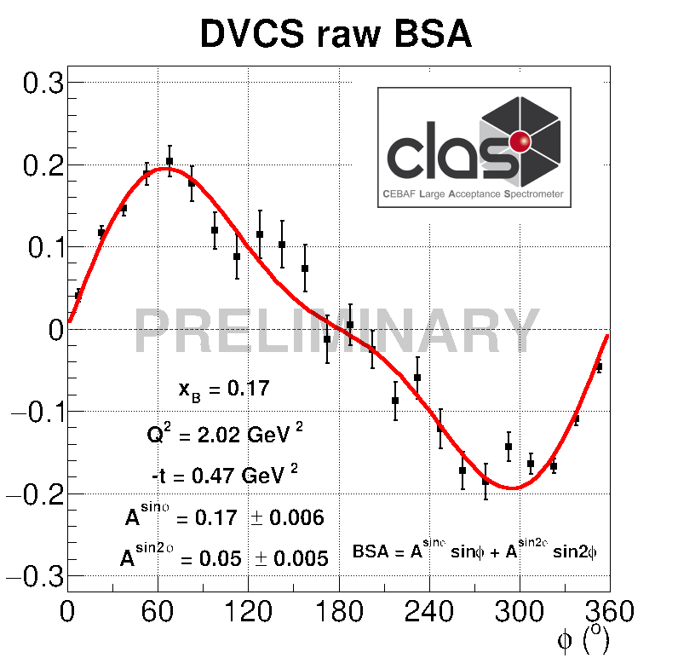
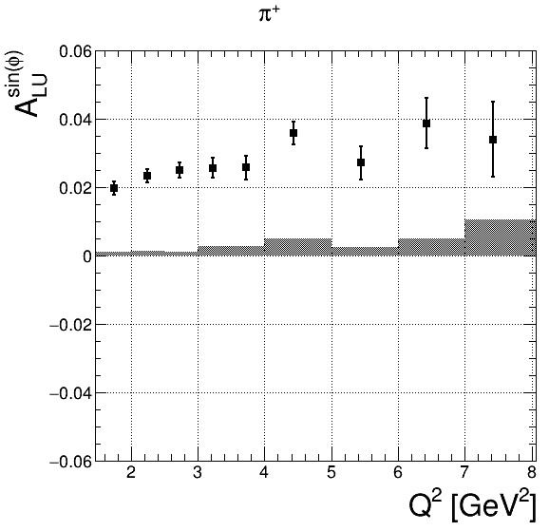
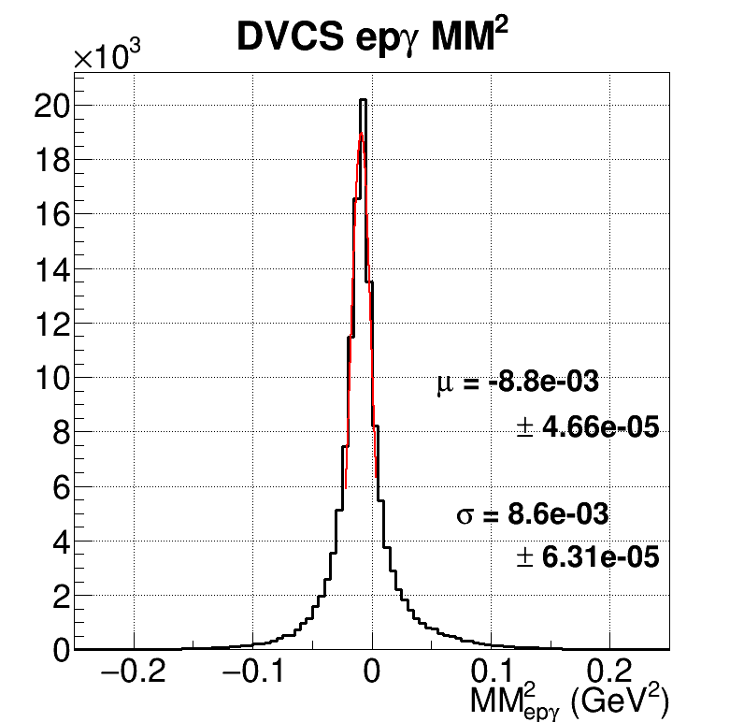
Hall B – CLAS12: toward High Impact science
Kinematic reach at 10.6 GeV
p(e,e’π)X
Beam-spin asymmetry
p(e,e’)X
Q² (GeV²)
π⁰
￼
x_{B}
π⁺

Slide 17
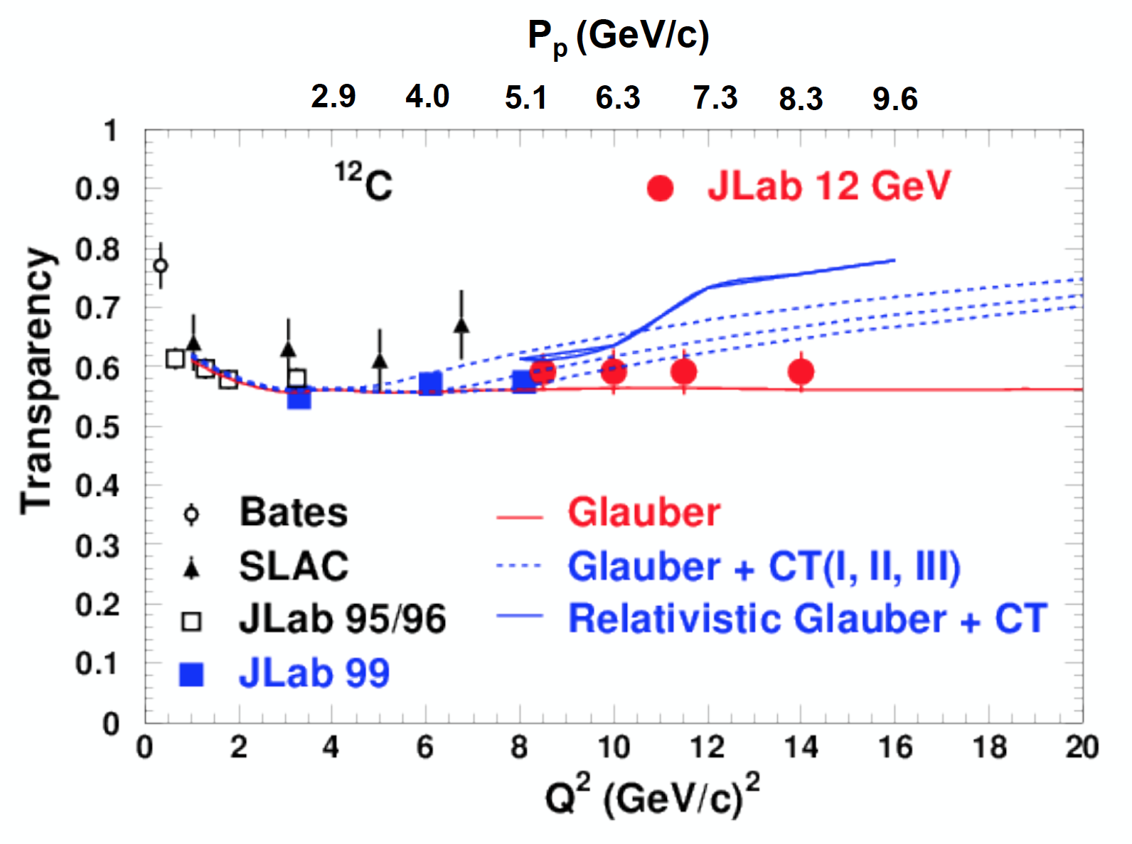
Hall C
SHMS calibration initial physics data acquired
  F₂^{H,D} structure functions, EMC effect
  D(e,e’p) at high missing momentum
  Color Transparency (CT) – ¹²C(e,e’p)
    Data for 3 points acquired.
    Highest Q² is where BNL A(p,2p) saw rise in transparency
  TMD studies (SIDIS) and Kaon electroproduction scaling measurement underway
Analyses of CT, F2, D(e,e’p), EMC underway
Projected Color Transparency errors
overlaps BNL data
Preliminary

Slide 18
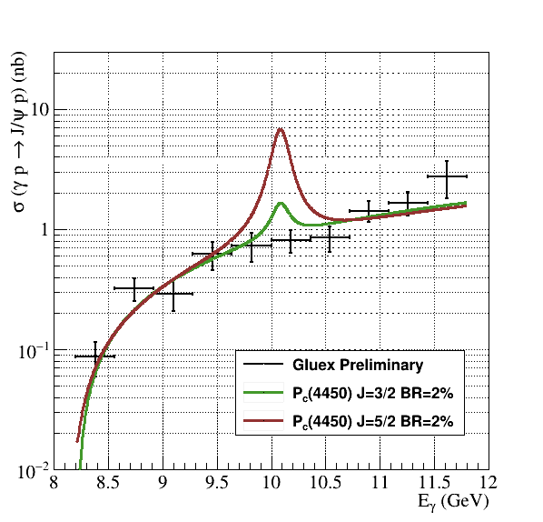
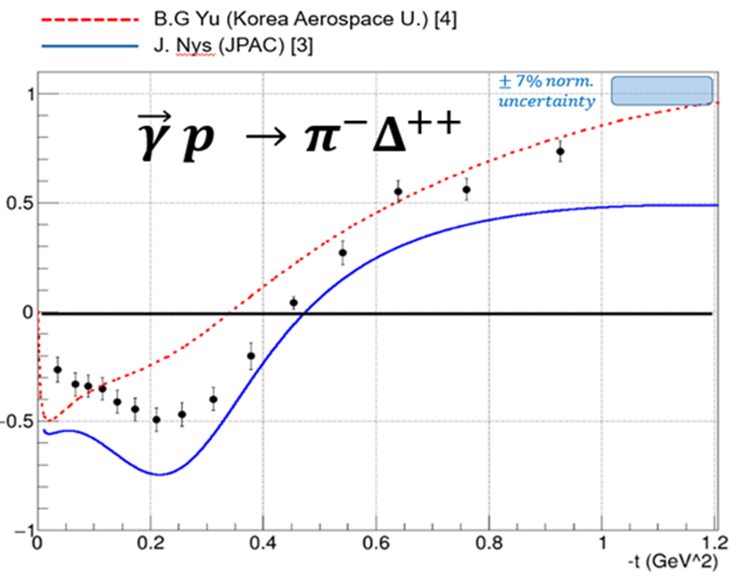
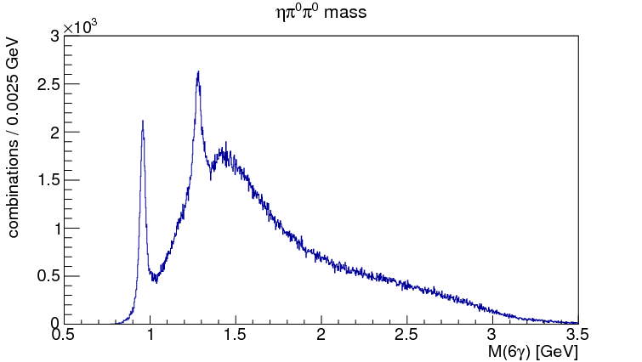


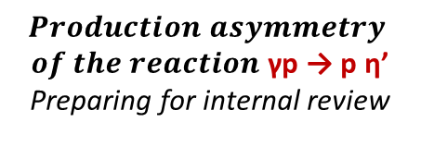
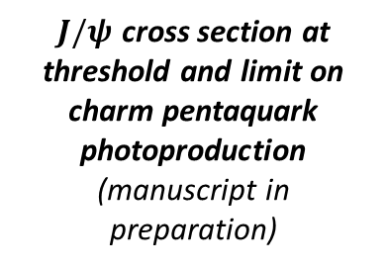

Hall D: analysis as of Fall 2018
$J/ψ$ production at threshold
$$Production Asymmetries$$
η′
$$Production asymmetry$$
$of the reaction$ γp → p η’
Preparing for internal review
$$Production asymmetry of$$
$the reaction$ γp → π⁻ Δ⁺⁺
Preparing for internal review
$J/ψ$ cross section at threshold and limit on charm pentaquark photoproduction
(manuscript in preparation)
f₁(1285)/η(1295)
GlueX-I is complete
25% of data analyzed
3 papers in preparation
Getting ready for Primex-η and GlueX-II (with DIRC)
η′
γp → p ηπºπº → p 6γ

Slide 19
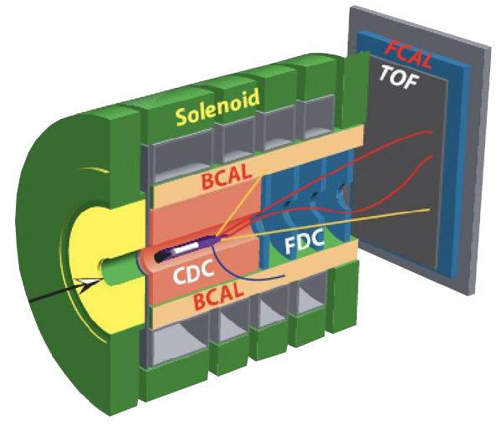

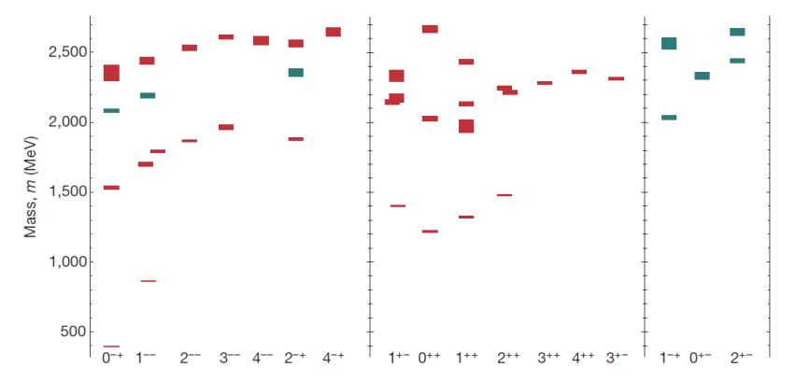

Gluonic Excitations and the Mechanism for Confinement
Excited Glue
Hall D@JLab
States with Exotic Quantum Numbers
Searching for the rules that govern hadron construction
M. R. Sheperd, J. J. Dudek, R. E. Mitchell

Slide 20

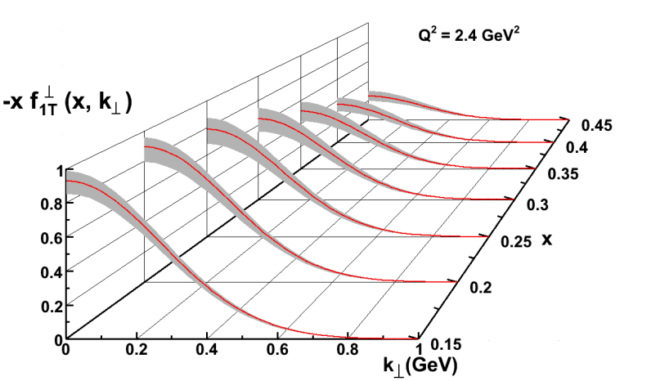
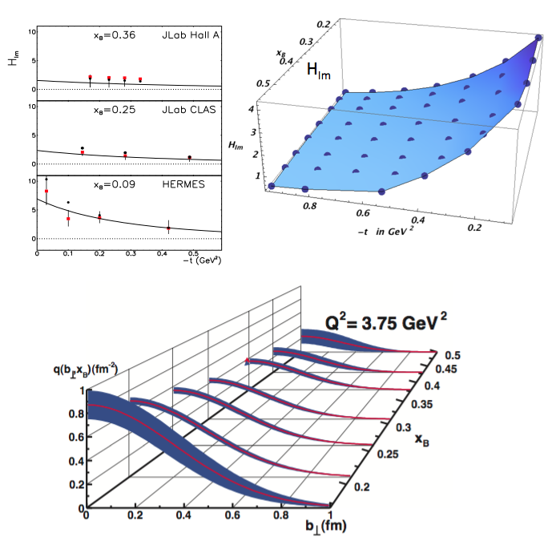
Nuclear Femtography
5D
Transverse Momentum Distribution (TMD)
– Confined motion in a nucleon (semi-inclusive DIS)
Generalized Parton Distribution (GPD)
– Spatial imaging (exclusive DVCS)
Requires
– High luminosity
– Polarized beams and targets
– Sophisticated detector systems
3D
Center for Nuclear Femtography
Proposal to Commonwealth of Virginia
  Initial request of $0.5M for pilot study awarded; funding of ~$2M/year envisioned
Consortium of Virginia universities
Theoretical physics, experimental physics, computation, data science, statistics – interdisciplinary effort
Benefit to 12 GeV program and future EIC studies
Symposium on Imaging and Visualization in Science’ , UVa, Dec. 10-11, 2018.
Major new capability
with JLab @ 12 GeV

Slide 21
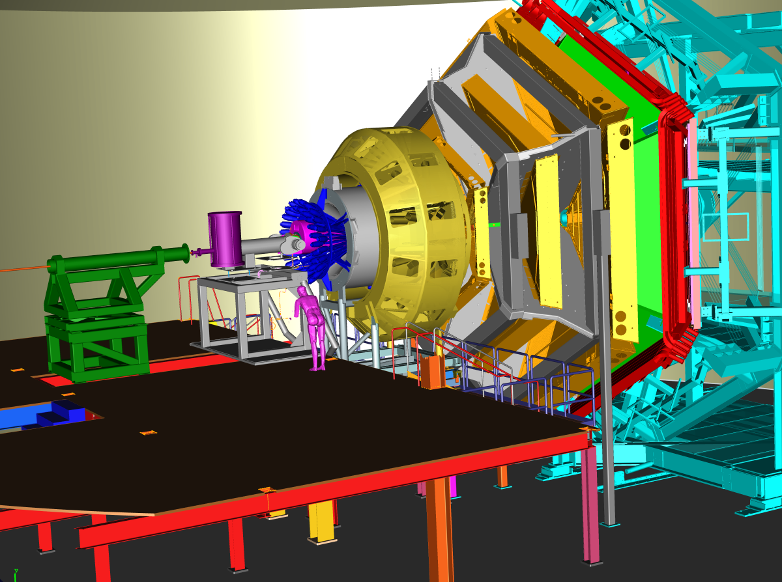
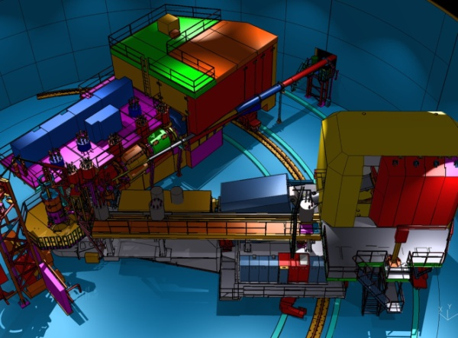
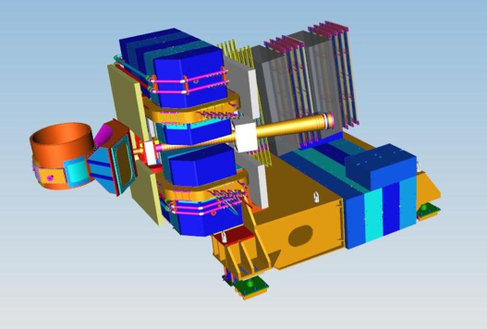
Imaging With JLab @ 12 GeV
Generalized Parton Distributions (GPDs) and Transverse Momentum Distributions (TMDs)
CEBAF Large Acceptance Spectrometer (CLAS12) in Hall B: general survey experiments, large acceptance and medium luminosity
SHMS, High Momentum Spectrometer (HMS) and Neutral-Particle Spectrometer (NPS) in Hall C: precision cross sections for L-T studies and ratios, small acceptance and high luminosity
Super Bigbite Spectrometer (SBS) in Hall A : dedicated large-x TMD study
medium acceptance and high luminosity
Future: Solenoidal Large Intensity Device (SoLID) in Hall A: large acceptance and high luminosity
Notes:
Bob reworked

Slide 22
DVCS @ 11 GeV
CLAS12 (projected)
A_{LU}
Published in Nature

Slide 23
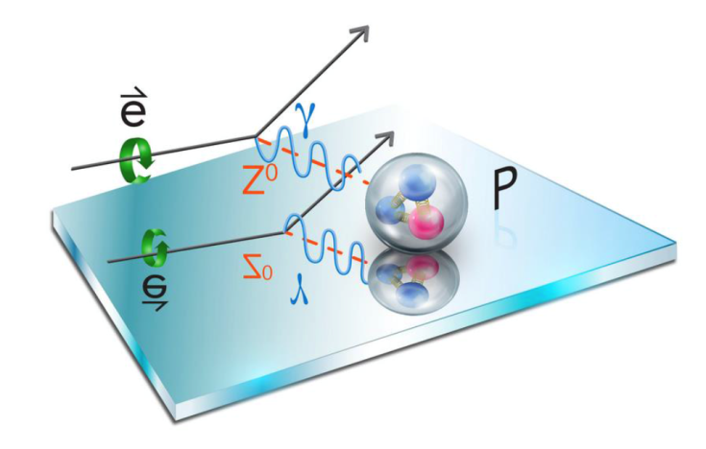
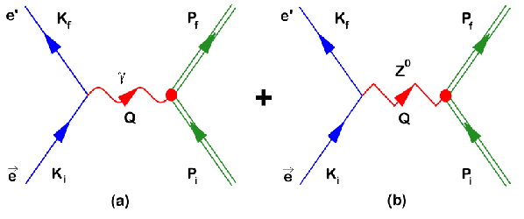
JLab: an ideal place for PV experiments
Changing beam helicity is equivalent to changing parity
~ 10⁻⁴ Q² ~ 10⁻⁴  10⁻⁷
Three motivations for this program:
To measure the parameters of the SM
To search for new parity-violating interactions (BSM physics)
To constrain physics of the neutron stars
High-quality, intense, polarized electron beam
- Statistical and systematic errors better than 1 ppb

Slide 24
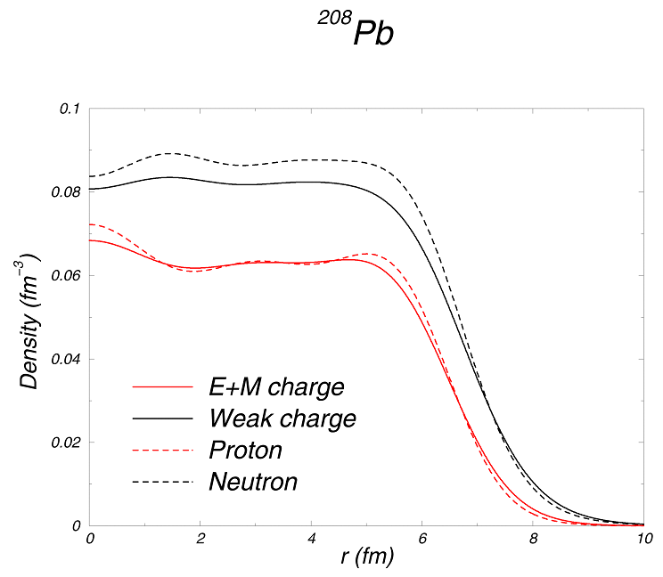
Measuring the Neutron “Skin” in the Pb Nucleus
Q_{w}^{p} =(1 – 4 sin² θ_{W})
Q_{W}^{n} = -1
Weak interaction selects neutrons
γ
Z⁰
γ
2
Parity violating electron scattering
Sensitive to neutron distribution
Applications: Nuclear Physics, Neutron Stars, Atomic Parity, Heavy Ion Collisions

Slide 25
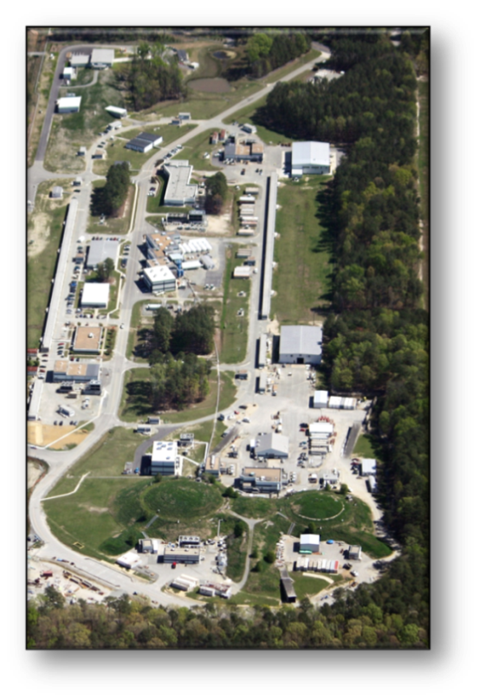
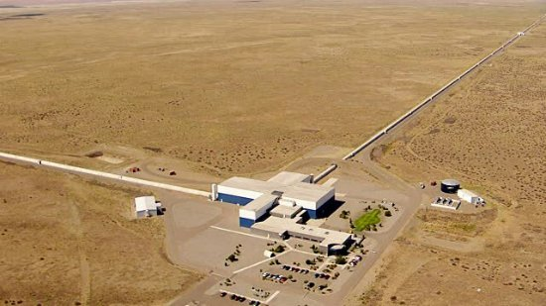




Nuclear Physics and Neutron Stars
(LIGO)
(JLab)
Measurement of neutron skin at JLab constrains tidal polarizability of neutron stars
PREX-II
Projected
Courtesy of NASA/Goddard Space Flight Center
arXiv:1711.06615

Slide 26



Heavy Photon Search
Search for a U(1) Heavy Gauge Boson following up on cosmological observations (PAMELA, AMS)
HPS (Hall B)
2015 Engineering Run
1.7 PAC days @ 1.05 GeV
2 GeV data taken in 2016,
under analysis
APEX (Hall A)
Search for 50-500 MeV A’ decaying promptly to e⁺e⁻ pairs
Displaced decay vertex search
2019 Program: HPS (upgraded), APEX

Slide 27


Future Projects
MOLLER experiment
– DOE science review (Sept. 2014) – strong endorsement
– Director’s Cost, Schedule and Technical review held Dec. 2016
– CD-0 approved, Dec. 2016
(project paused due to budget)
– Developing project structure in
preparation for FY19 Director’s Review
SoLID
– New pre-CDR completed
– Briefed ONP, Pre-R&D request
– Awaiting science review from ONP

Slide 28





Precision Tests of the Standard Model at JLab
EW Radiative Corrections
+New Physics?
Standard Model
JLab
Data
JLab
Data
Projected
JLab data:
Parity violating electron scattering provides a high precision test of the standard model.
Complementary to measurements at CERN’s Large Hadron Collider

Slide 29



SoLID: a Bridge to EIC Science on full imaging of nucleons
SoLID - high precision extraction of Sivers
function in the valence quark region
– complementary to EIC Sivers measurement
Transversity distribution (valence quark dominant) and tensor charge – unique SoLID contribution
CEBAF 12 Range
EIC Range
Polarized Quark 3D Momentum distributions
A fundamental QCD quantity
Matrix element of local operators
3. Calculable in lattice QCD.
4. Connects to quark electric dipole moment and sensitive to new physics beyond SM

Slide 30
SoLID: a Bridge to EIC Science on full imaging of nucleons
(TMD example)
CEBAF 12 Range
EIC Range
3D Gluon distributions
Polarized Quark 3D Momentum distributions

Slide 31







Mass of the Nucleon
“The mass is the result of the equilibrium reached through dynamical processes.” X. Ji
“… The vast majority of the nucleon’s mass is due to quantum fluctuations of quark-antiquark pairs, the gluons, and the energy associated with quarks moving around at close to the speed of light. …” The 2015 Long Range Plan for Nuclear Science
Chiral
Symmetry
Breaking
Quantum
Fluctuations
Relativistic Motion
X. Ji, PRL 74 1071 (1995)
Quark Energy
Gluon Energy
Quark Mass
Trace Anomaly
Criticisms: not scale-invariant, decompositions: Lorentz invariant vs. rest frame
Great interest at workshops: Temple U., March 2016; ECT, April 2017
Community wide consensus on how to determine the different contributions not
yet reached
Lattice QCD providing estimates
Trace anomaly:
Upsilon production
near threshold
J/Ψ, Υ, …
~30%
~40%
~10%
~ 25%
arXiv: 1710.09011

Slide 32



Charm @ SoLID and Beauty @ EIC
Total elastic Electro and photo-Production of J/psi
Total elastic Electro and photo-Production of Upsilon
SoLID with J/psi
EIC with Upsilon
Trace of EMT proportional to Quarkonium-proton scattering amplitude
to be measured at JLab with J/psi at SoLID or Upsilon at EIC

Slide 33






EIC Science: Nuclei and quarks/gluons (Deuterons)
JLEIC figure-8 design enable polarized (vector and tensor)
deuteron beams (>80% polarization).
Collider → allows a precision measurement of the spectator nucleon.
First precision measurement of polarized (and unpolarized) neutron is possible at JLEIC (LDRD)
Extrapolation to
from bound to
free neutron
under control
Polarized
Neutron
Structure
F₂n can be extracted at % level
accuracy
Investigate nuclear effects at the level of partons with Tensor Polarization Observables
Polarized Deuteron St. Function b1
Gluon Transversity
Non-nucleonic
gluon component!
Lattice results

Slide 34

From jlab12 to EIC
High Luminosity
◻ 10³⁴ cm⁻²s⁻¹
Low x regime
x ◻ 0.0001
High Polarization
◻ 70%
JLab
12
EIC
Luminosity cm.⁻² sec. ⁻¹
Discovery
Potential!
EMC
HERMES

Slide 35



EIC white paper Science goals
Note: Total of ~640 fb⁻¹
  10³⁴ cm⁻²s⁻¹  6 fb⁻¹/week,
  ( >100 fb⁻¹ /year)
  10³³ cm⁻²s⁻¹  0.6 fb⁻¹/week,
  ( >10 fb⁻¹ /year)

Slide 36





Electron Ion Collider at Jefferson Lab
JLab EIC Figure 8 Concept
    High Polarization (including deuterons)
    High Luminosity
    Energy Range: √s : 20 to 100-140 GeV (magnet technology choice)
    Low technical risk
    Flexible timeframe for construction
    consistent w/running 12 GeV CEBAF
    High performance, low-risk, well-reviewed
    Cost effective operations
    Fulfills White Paper, NAS Requirements
100 fb⁻¹/yr
Strong multi-institutional effort including:
ANL, BNL, FNAL, LBNL, SLAC
+ With DC and BB cooling
× With DC cooling only

Slide 37
Summary
12 GeV science program at JLab is underway
  4 Hall operation is now routine
  A broad program of 78 approved experiments with many opportunities for discovery is planned
  Initial science results are already being reported
Future Equipment projects
  MOLLER: CD0 – hope for FY20 start
  SoLID: Prepare for DOE science review
JLab program builds a strong foundation for future studies at EIC

