Slide 1
RHIC Science Program and its Evolution into an EIC
Robert Tribble
Deputy Lab Director
November 29, 2018

Slide 2

RHIC: A Unique Discovery Facility
Unrivaled range in energy, nucleon doping, collision system choice
Exploring the limits of ordinary matter
Enabling very diverse science program
Continued enhancement of collider and detector capabilities to address scientific questions with highest discovery potential
  Low-energy electron cooling (2019)
  STAR acceptance upgrade (2019)
  sPHENIX detector upgrade (2023)
Discoveries: most “perfect” (inviscid) fluid, most vortical fluid, gluon component of proton spin paving the way to an EIC
Recent example: QGP vorticity (more to follow!)
Diversity of research topics at RHIC facility
A fluid with minimal viscosity, such as the QGP, can preserve its vorticity for a long time, but it is difficult to set it into rotation. What makes the RHIC’s QGP spin?

Slide 3
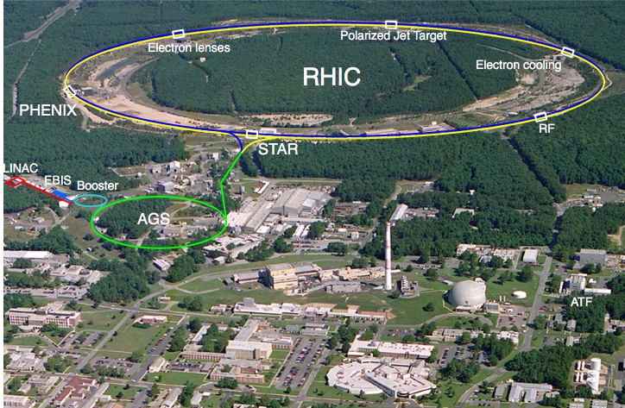
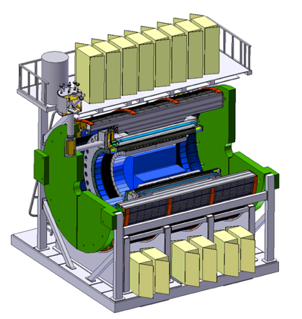
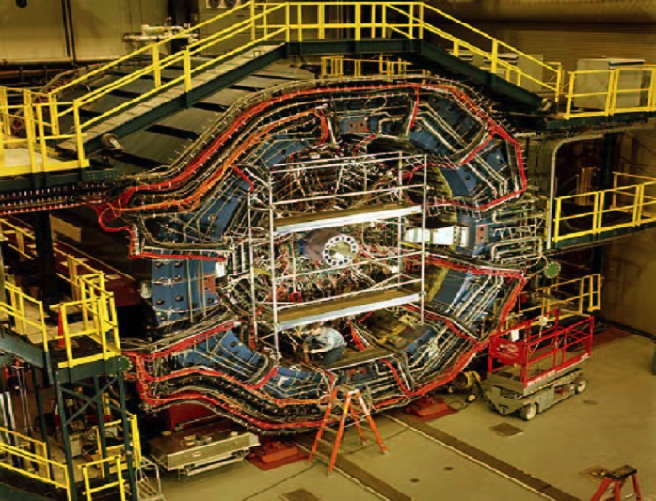

The RHIC Facility Going Forward
s

Slide 4
Highlights of RHIC run 2018
Run 2018:
  Isobar system (⁹⁶Ru - ⁹⁶Zr) comparison run
  27 GeV Au+Au run, 3 GeV Au+Au fixed target run
  Test of signatures of Chiral Magnetic Effect and measurement of vorticity
  CeC test, (successful) fixed target prototype run
Notes:
15 weeks only pp

Slide 5

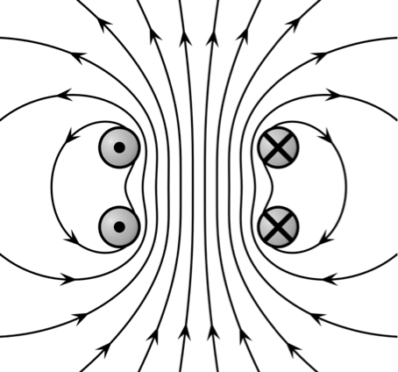
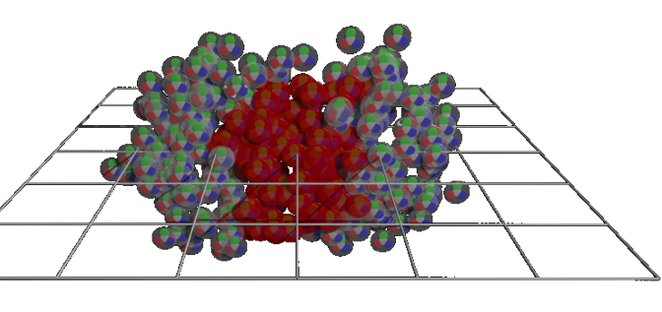
Probing Chiral Symmetry with Quantum Currents
The chiral anomaly of QCD creates fluctuating differences in the number of left and right handed quarks, characterized by a chiral chemical potential μ5.
In a chirally symmetric QGP, this imbalance generates an electric current along the magnetic field (chiral magnetic effect).
+
Spin
electric charge separation
B
Momentum
B≈10¹⁸ Gauss
+
−
−
μ5 > 0
Notes:
Something that ties together a wide range of topics in QCD: How do collective, many body phenomena arise from QCD.

Slide 6
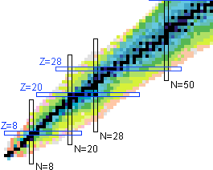
Probing Chiral Symmetry (Run-18)
Background effects unrelated to the chiral magnetic effect explain part of the observed charge separation (STAR, ALICE, CMS), but how much?
Relative difference in charge separation effects (Ru vs Zr)
The isobar comparison with 3B MB events for each system will enable detection of a CME contribution within +/- 4% of the observed effect.
Notes:
Something that ties together a wide range of topics in QCD: How do collective, many body phenomena arise from QCD.

Slide 7
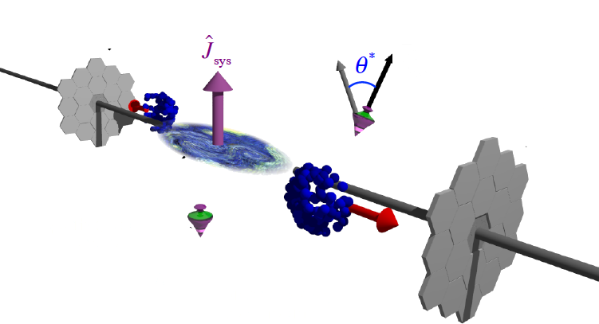
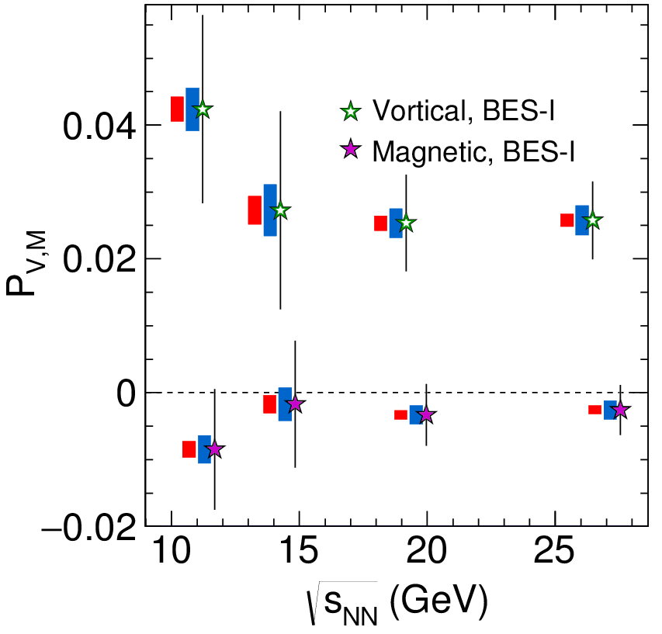
Global Λ polarization (Run-18)
New tool for studying QGP and relativistic quantum fluid vorticity
27 GeV Au+Au run will increase statistics by factor 10 & improve reaction plane resolution
Global angular momentum
transfer to hyperon polarization
Late time magnetic field would generate difference between hyperons and anti-hyperons
7

Slide 8
Highlights of RHIC runs 2018-21
Run 2018:
  Isobar system (⁹⁶Ru - ⁹⁶Zr) comparison run (>1.2B events each)
  27 GeV Au+Au run, 3 GeV Au+Au fixed target run
  Test of signatures of Chiral Magnetic Effect and measurement of vorticity
  CeC test, (successful) fixed target prototype run
Beam Energy Scan II:
  Low energy (√sNN = 7.7, 9.1, 11.5, 14.5, 19.6 GeV) Au+Au runs using electron cooling to increase luminosity at lowest energies
  Fixed target runs at √sNN = (3.0), 3.2, 3.5, 3.9, 4.5, 5.2, 6.2, 7.7 GeV
  Search for signs of critical phenomena in event-by-event fluctuations
Notes:
15 weeks only pp

Slide 9
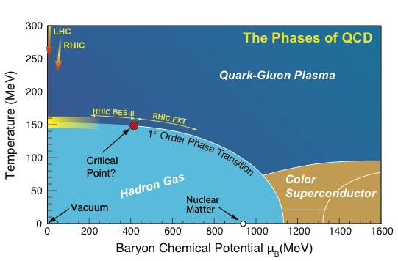
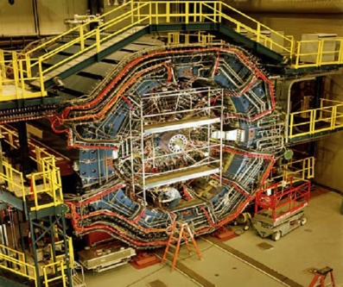
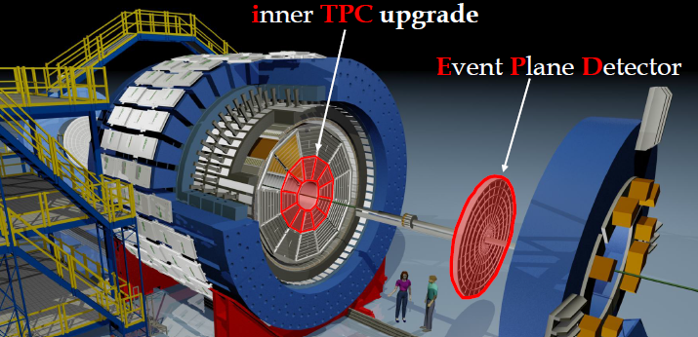
Beam Energy Scan II (2019-21)
s
What are the limits (the phase boundary) of ordinary nuclear matter, i.e. matter composed of baryons and mesons?
Can the presence of a critical point in the QCD phase diagram be established experimentally?

Slide 10
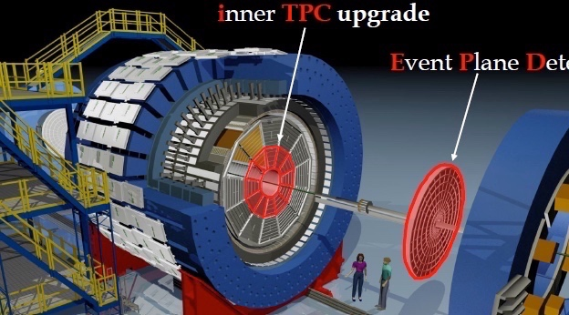
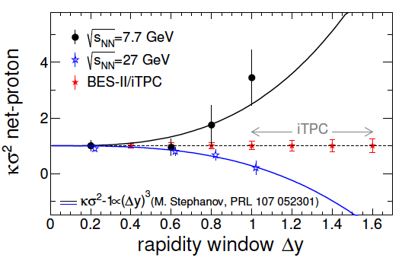
Mapping the QCD phase diagram
Higher statistics
Low energy RHIC electron cooling upgrade
Larger acceptance
10

Slide 11
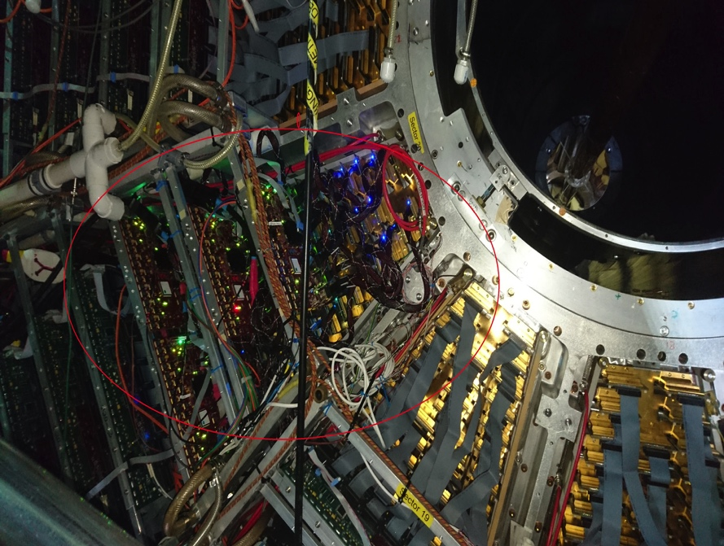
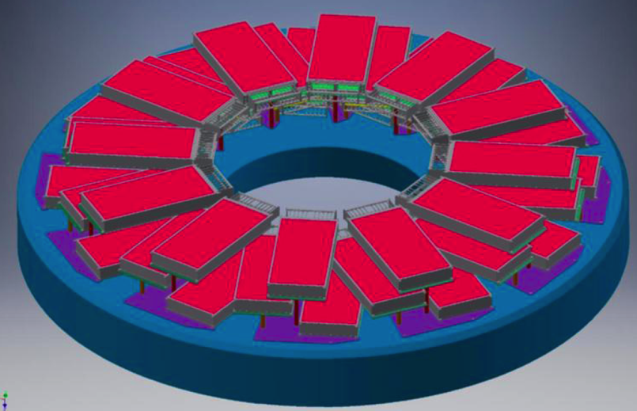
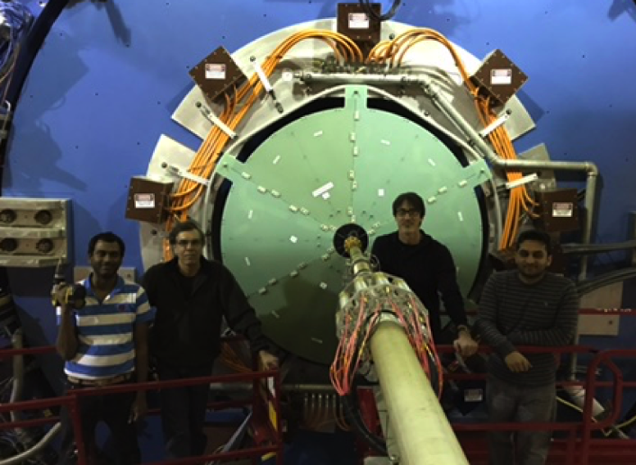
STAR Upgrades for BES-II
iTPC upgrade (2018)
Replace inner TPC Sectors
Extend rapidity coverage
Better particle ID
Extend low p_{T} coverage
Event Plane Detector
Improved Event Plane Resolution
Centrality definition
Improved trigger
Endcap TOF
CBM (FAIR)

Slide 12
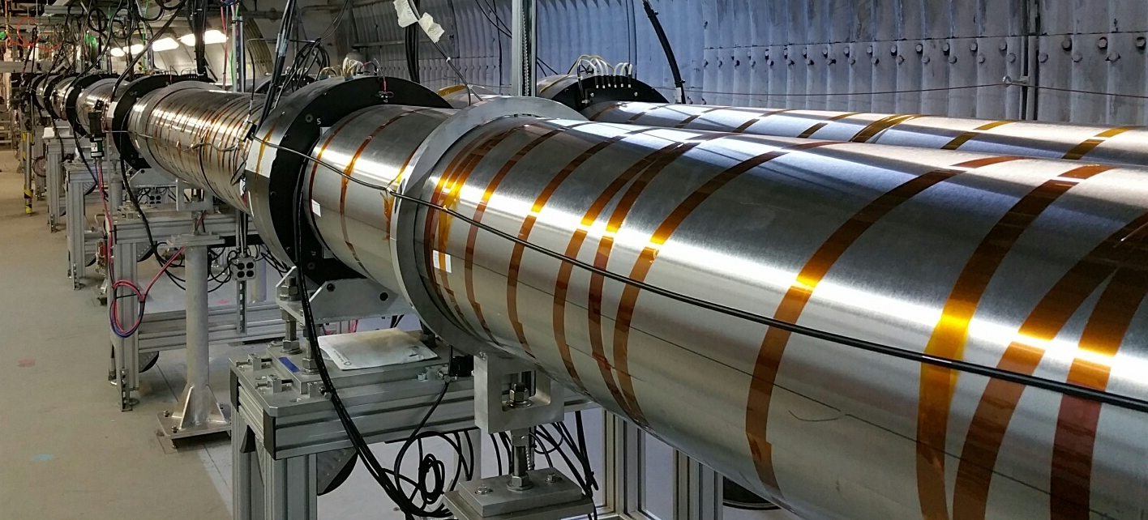
Low Energy RHIC e-Cooling
Cooling of lowest energy heavy ion beams with bunched electron beam(never attempted before!) increases luminosity by factor 3-4
Installation complete – commissioning w/o ion beams has started
Requires extensive commissioning with ion beams (ca. 11 weeks in 2019/20)
LEReC beam line

Slide 13
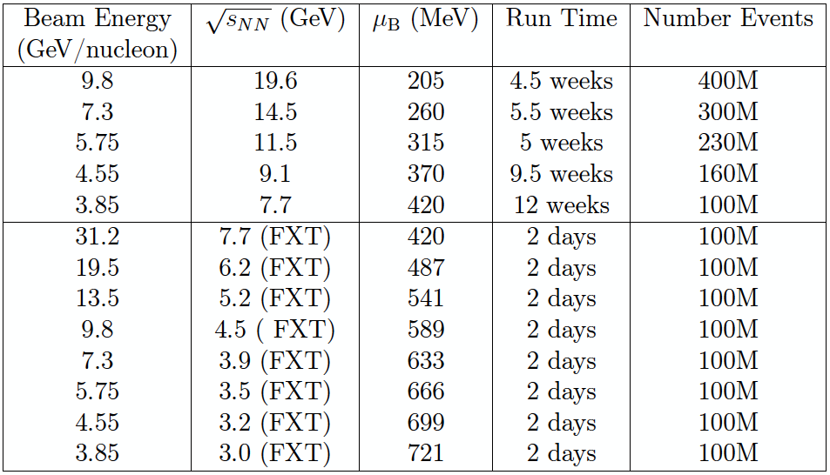
Tentative BES II program
Run 19
Run 20
Run 21

Slide 14
Highlights of RHIC runs 2018-24
Run 2018:
  Isobar system (⁹⁶Ru - ⁹⁶Zr) comparison run (>1.2B events each)
  27 GeV Au+Au run, 3 GeV Au+Au fixed target run
  Test of signatures of Chiral Magnetic Effect and measurement of vorticity
  CeC test, (successful) fixed target prototype run
Beam Energy Scan II:
  Low energy (√sNN = 7.7, 9.1, 11.5, 14.5, 19.6 GeV) Au+Au runs using electron cooling to increase luminosity at lowest energies
  Fixed target runs at √sNN = (3.0), 3.2, 3.5, 3.9, 4.5, 5.2, 6.2, 7.7 GeV
  Search for signs of critical phenomena in event-by-event fluctuations
Runs with sPHENIX:
  Full energy (√sNN = 200 GeV) Au+Au, p+p, p+Au
  Fully resolved jets, Upsilon states, heavy quarks as QGP structure probes
Notes:
15 weeks only pp

Slide 15


sPHENIX
1.5 T Superconducting Magnet - Inner Silicon Tracking - Fast TPC/GEM Read-out - EM and Hadron Calorimeters
Successful CD-1/3a Review
Construction starts in FY 2019
Data taking to start in 2023
s
Resolution
High energy jets probe the structure of the QGP on different length scales and determine where and how it changes from particle-like quarks and gluons to a structureless “perfect” liquid
Heavy quark atoms (Upsilon) also probe the QGP structure at different scales
sPHENIX will increase the data-taking rate by a factor 10
fully utilizing the enhanced RHIC luminosity

Slide 16

Schematic Design
MVTX

Slide 17
sPHENIX science pillars
c
b

Slide 18
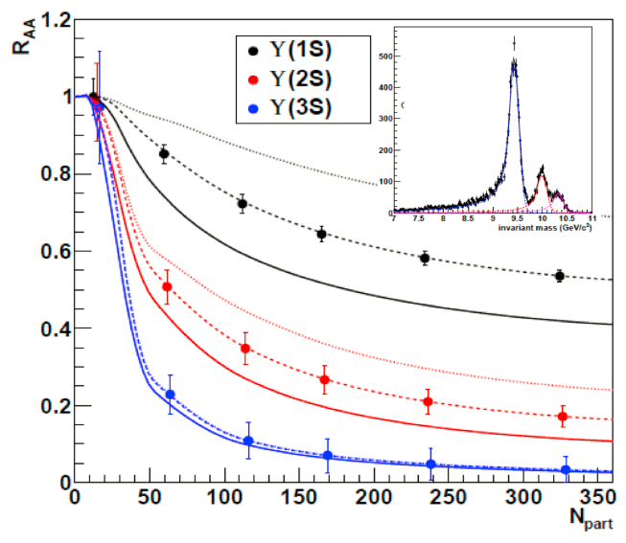
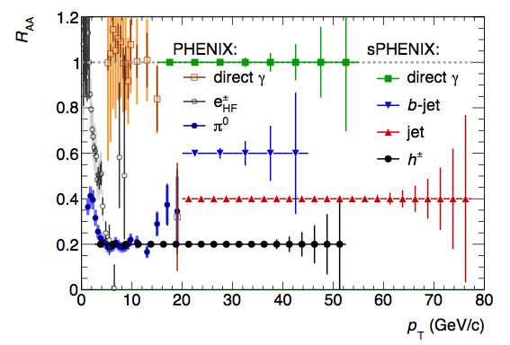
Perfomance
sPHENIX
capabilities
Complete calorimetric
jet spectroscopy
Completely resolved
Upsilon spectroscopy

Slide 19
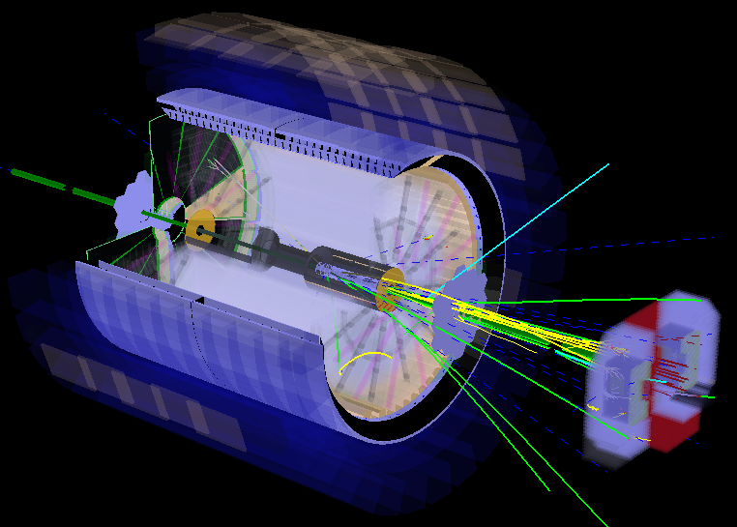
STAR Opportunities beyond BES
STAR collaboration has proposed modest forward upgrades for RHIC runs beyond BES-II with significant Chinese contributions.
Physics program described in 2016 RHIC Cold QCD Plan
Endorsements from 2017 & 2018 PAC.
Possible stand-alone p+p run after the BES-II followed by running in parallel to sPHENIX.
Refurbished EMCal, new Hcal, STAR Pre-shower, FMS, and sTGC based tracking system, covering 2.5<η<4.
Upgrade proposal in evaluation.

Slide 20
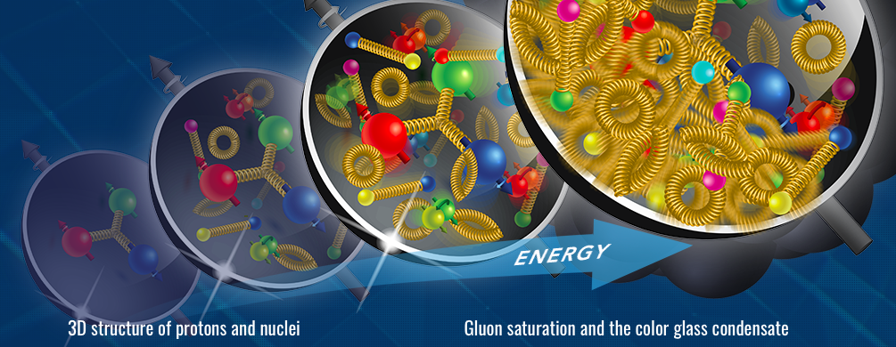
EIC Science Pillars
Precision
Without gluons, there would be no protons, no atomic nuclei, and hence no visible matter in the Universe!
Discovery
The EIC will collide high-energy electrons with high-energy protons or heavier atomic nuclei to produce “freeze-frame” snapshots of their inner structure, creating precise first-ever tomographic images of the “ocean” of gluons within. These images will tell us how gluons and quarks bind each other to form the particles that lie at the core of all atoms.
New experiments and advances in theory suggest that protons, neutrons, and nuclei appear as dense “walls” of gluons when probed at high energy, creating what are conjectured the strongest fields in nature. Discovering and studying this new form of matter, the “color glass condensate,” will give us additional insight into why matter in this sub-atomic realm is stable.
EIC Science Program was reaffirmed by NAS Study (July 2018)

Slide 21
eRHIC Design
The BNL design team has completed a Pre-conceptual Design Report for a facility based on the Ring-Ring concept that is capable of addressing the full range of science covered in the EIC White Paper with a low-risk, cost-effective solution for the first phase:
Polarized (~70%) electrons, protons, and light nuclei (h³He, hd),
Ion beams from deuterons to the heaviest stable nuclei,
Variable CM energies ~20–100 GeV, an easy upgrade to ~140 GeV (e-p),
Collision luminosity ~10³³⁻³⁴ cm⁻²s⁻¹,
Up to two interaction regions.
Capable of executing the full science program outlined in NAS Report.

Slide 22
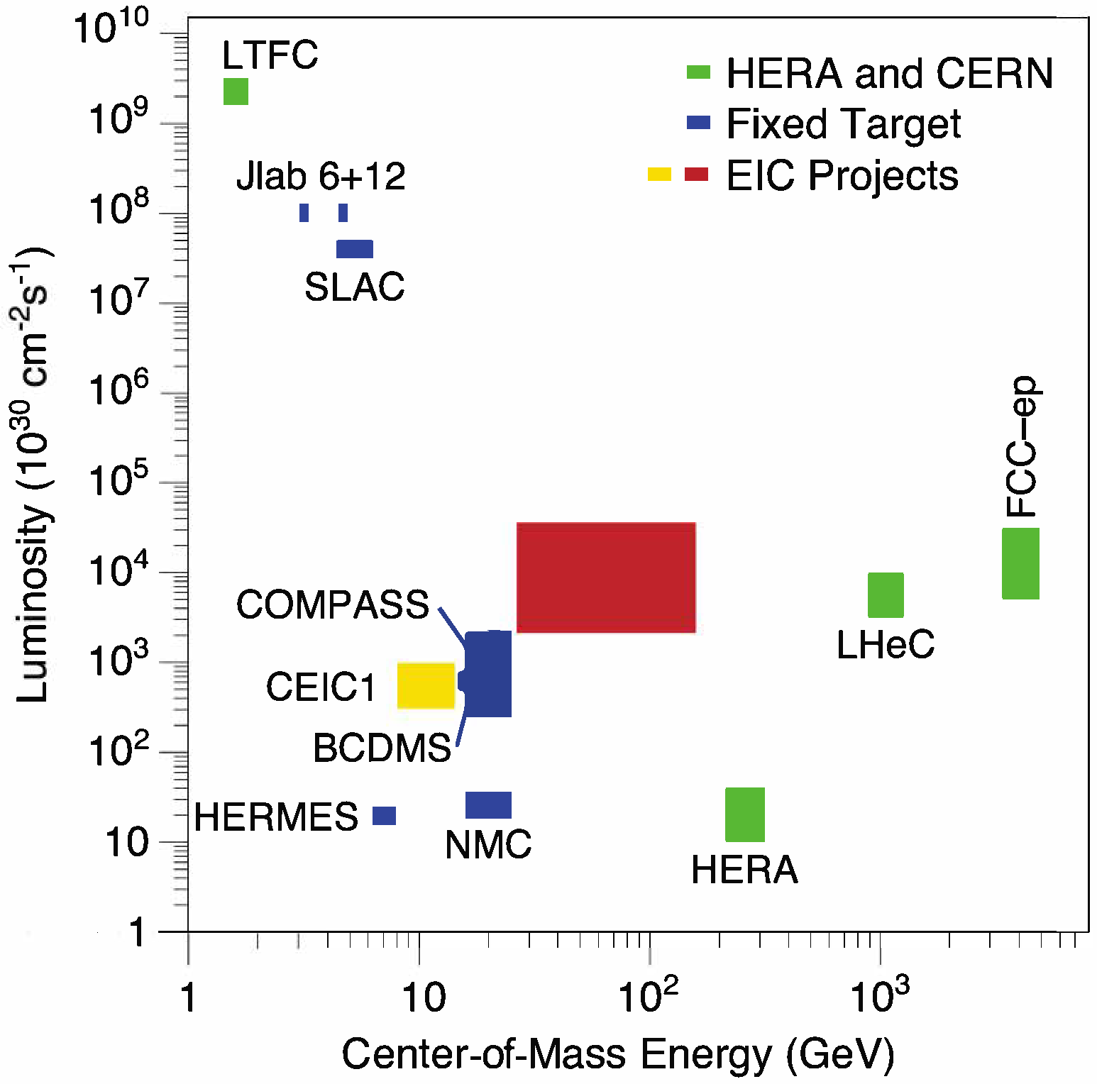
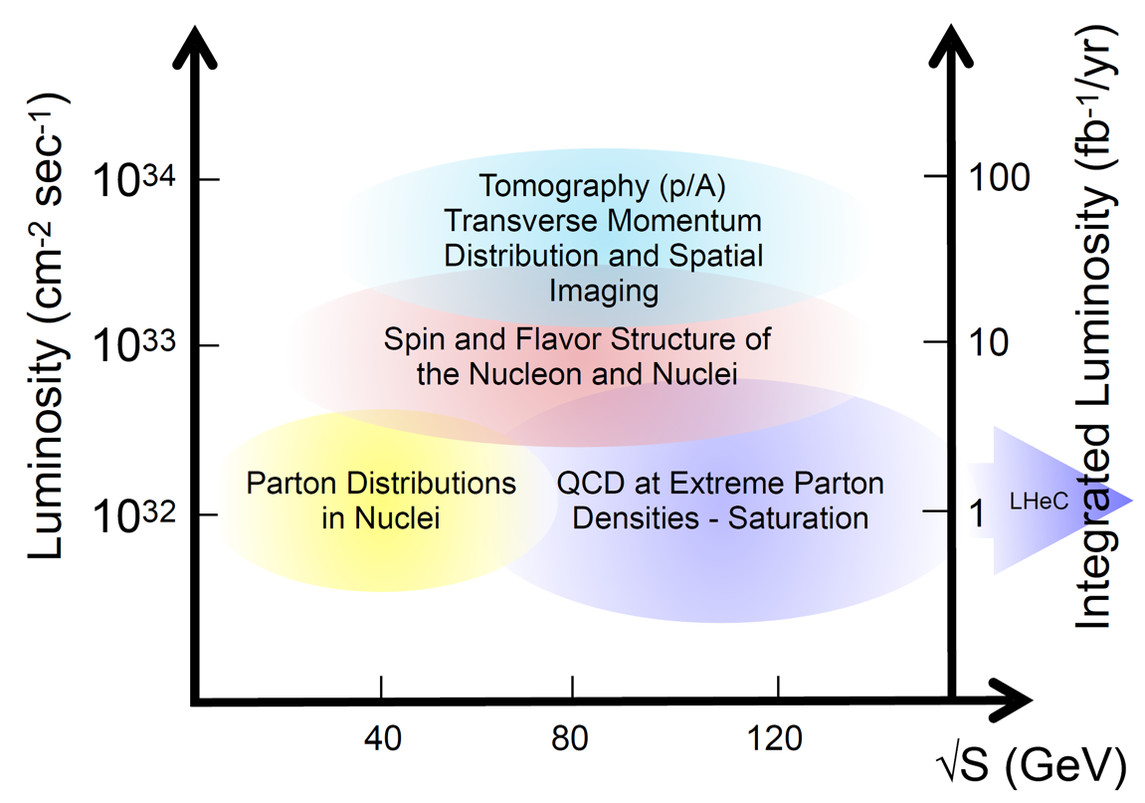
The Electron-Ion Collider (EIC)
Light and heavy nuclear beams
Polarized light ion beams (p/d/t)
1000x HERA luminosity
Courtesy: Bernd Surrow
The EIC will occupy a totally unexplored parameter space.
Notes:
Combination of new territory and precision
Three pilar: spin, gluon imaging, saturation

Slide 23
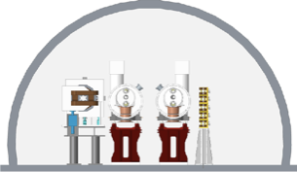
eRHIC: The EIC at BNL
The eRHIC concept is economical, re-uses the large investment in RHIC, and is based on established technologies, except for strong hadron cooling
Notes:
Two US-based designs, potential for first beam in late 2020s
Recently: an early (high energy) EIC concept from China in the 2030+

Slide 24
6 snakes, polarimeter Feedback Diagnostics
eRF, Cold p RF
Cooling
Beam dump
e-Injection
p-instrumentation
eRHIC
Layout
h-warm RF,
h-injection
Detector, IR magnets
Crab cavities, Spin rotators
Detector, IR magnets
Crab cavities, Spin rotators

Slide 25


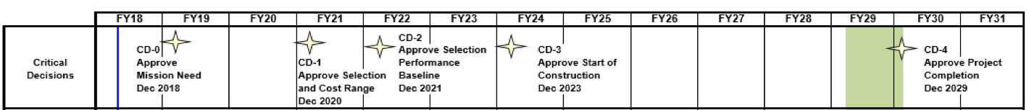
Timeline (Past)
2011 2012 2013 2014 2015 2016 2017 2018
LRP:
We recommend a high-energy high-luminosity polarized EIC as the highest priority for new facility construction following the completion of FRIB.
NAS Review of the science case for a U.S.-based EIC:
…the committee finds a compelling scientific case for such a facility.
Timeline (Future?)
RHIC Science Program
eRHIC
Notes:
EU strategy....

Slide 26
There are, indeed,
Exciting Times Ahead!

