Slide 1
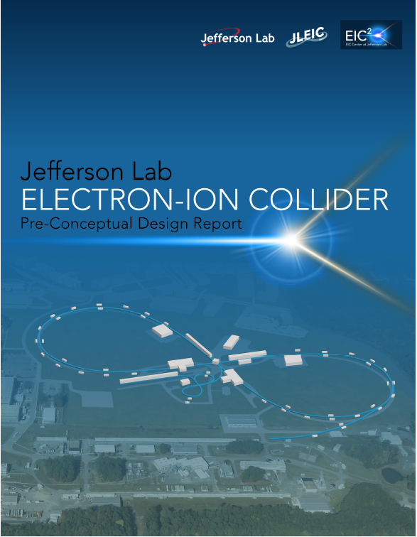
EIC: Accelerator Challenges and Opportunities
Andrei Seryi
Jefferson Lab
Inaugural Symposium of the Center for Frontiers in Nuclear Science
Stony Brook University
November 29, 2018

Slide 2
Plan of the talk
HERA lepton-hadron collider
Requirements for the next EIC
B-factories design approaches & lessons
Collisions with larger crossing angle
  Crab cavities
Polarization preservation
  Siberian snakes, Figure-8 layout
Beam cooling
  Electron cooling, energy recovery
  Magnetized electron cooling
  Coherent / enhanced electron cooling
eRHIC electron-ion collider design (8 slides)
JLEIC electron-ion collider design (8 slides)
eRHIC and JLEIC Luminosity & parameters
Examples of ongoing EIC R&D
Summary
Some of common ideas and recent advances that will help to bring EIC performance to the needed level

Slide 3
HERA
The first and only lepton-hadron collider, DESY, Hamburg, Germany
Proposed in 1981, approved 1984
Operated for physics 1992-2007
Collided 27.5 GeV spin polarized leptons (e+; e- ) with 920 GeV protons
HERA reached a luminosity of 5x10³¹ cm⁻² s⁻¹
Many lessons from HERA are relevant for EIC
  Vertical beam-beam tune shift for lepton beam reached & exceeded values planned for EIC
  The necessity to minimize synchrotron radiation in the IR, IR vacuum pressure, and to avoid halo of the proton beam
  The techniques developed to maximize the spin polarization in presence of three pairs of spin rotators and strong beam-beam forces can be applied to EIC
F. Willeke, HERA and the Next Generation of Lepton-Ion Colliders", in Proc. of EPAC'06 , Edinburgh, paper FRXBPA01

Slide 4
HERA Luminosity
Total delivered luminosity about 1 fb⁻¹
Review of Searches for Rare Processes and Physics Beyond the Standard Model at HERA, David M. South, Monica Turcato, May 2016, European Physical Journal C 76(6).

Slide 5
EIC requirements – White Paper
Highly polarized ( ~70%) electron and nucleon beams
Ion beams from deuteron to the heaviest nuclei (uranium or lead)
Variable center of mass energies from ~20 to ~100 GeV, upgradable to ~140 GeV
High collision luminosity of ~10³³⁻³⁴ cm⁻² s⁻¹
Possibilities of having more than one interaction region
”White Paper”: A. Accardi et al. , “Electron Ion Collider: The Next QCD Frontier - Understanding the Glue that Binds Us All”, Eur. Phys. J. A52 , p. 268 (2016), https://doi.org/10.1140/epja/i2016-16268-9

Slide 6
EIC Projected Luminosity Needs (White Paper)
EIC Integrated luminosity needs versus energy ranges and ion species for a physics program corresponding to the Whitepaper. Dual columns with different hashing represent different polarization (LL and LT) – each requiring integrated luminosity proportional to the height of the bar. Measurements that can be done concurrently are superimposed on taller columns.
(UU)
100
GPDs / Gluon TMDs
(LL)
GPDs / Gluon TMDs
(LT)
GPDs
Saturation
Saturation
Integrated Luminosity (fb⁻¹)
Total needs ~700 fb^-1
eAuPb/U
Quark TMDs / Gluon Spin
e^{40,48}Ca
Quark TMDs / Gluon Spin
Gluon Spin / Saturation
Quark TMDs
Quark TMDs
10
eD/e³He
ep
~ 20 GeV
~ 40 GeV
~ 60 GeV
~ 100 GeV
~ 140 GeV

Slide 7
B factories - KEK B and PEP-II
When B factories design started ~1990, e+e- colliders barely reached 10³² cm⁻²s⁻¹
PEP-II and KEKB aimed in their design to luminosity of 0.3 – 1 x 10³⁴ cm² s⁻¹
Features built-in into the design:
  Crossing angle and crab crossing with crab cavity (KEKB)
  Chromaticity compensation by sextupole pairs with –I transformation (as in SLC and FFTB)
  Local chromaticity correction around IP
  RF cavities and vacuum chamber compatible with ampere-scale beams
  Bunch-by-bunch feedback
  Continuous top-up injection mode
Challenges met after operation start, and solutions:
  Transverse coupled–bunch instability due to electron cloud & low-B solenoids
  Luminosity-dependent background (PEP-II) & masking
  RF transients, reduction of abort gap from 5% to 1.5% & LLRF improvements…

Slide 8
B factories – PEP II
PEP-II design luminosity of 3 x 10³³ cm² s⁻¹ was first reached on Oct 29, 2000
I.e. after one and a half year of operation
Further operation – exceeded design by a factor of four
Last Year of PEP-II B-Factory Operation,
J. T. Seeman, EPAC 2008

Slide 9
B factories - KEK B
KEKB’s design luminosity of 1 x 10³⁴ cm² s⁻¹ was first reached in May 2003
I.e. about 3 years from start of operation
Further operation – exceeded design by a factor of two
KEKB B-Factory, The Luminosity Frontier
Katsunobu Oide
Progress of Theoretical Physics, Vol. 122, No. 1, July 2009

Slide 10
B factories - KEK B and PEP-II – challenges & lessons
Challenge: when B factories design started ~1990, e+e- colliders barely reached 10³² cm⁻²s⁻¹
Aim: PEP-II and KEKB aimed in their design to luminosity of 0.3 – 1 x 10³⁴ cm² s⁻¹
Approach: build-in necessary features to achieve high Lumi into the design
Result: fast start-up – achieve design Lumi in 1.5-3 years
with further efforts exceed design Lumi x2-4 times
Lesson for EIC:
  Despite of challenging requirements, it should be possible to design machine that will allow fast ramp-up to design luminosity
  Should set a goal to achieve EIC design Lumi soon after the start
  Necessary provisions/systems required for luminosity should be built-in into the design

Slide 11
Crab crossing
With crossing angle θ_{c}, the projected x-size is (σ_{x}²+θ_{c}²σ_{z}²)^{0.5} ~θ_{c}σ_{z}
→ significant reduction in L without corrections
Use transverse (crab) RF cavity to ‘tilt’ the bunch at IP:
R. B. Palmer, Energy Scaling Crab Crossing and the Pair Problem, SLAC-PUB-4707 (1988)

Slide 12
Crab crossing at KEK-B factory and HL-LHC
KEKB used global crab crossing scheme with single crab cavity per ring
Crossing angle of 22 mrad compensated
Lumi record of 2.1E34 was achieved with crab-cavity
HL-LHC plan to use local crabbing
Crossing angle about 0.6 mrad
Two version of crab cavity being tested at SPS
This is global efforts where BNL, FNAL, JLab, LBNL, Old Dominion University, SLAC, UK labs and CERN are involved
KEK-B SC crab cavity
K Oide and K Yokoya 1989 Phys. Rev. A 40 315
T Abe et al., PAC07, MOZAKI01
S. U. De Silva and J. R. Delayen, Phys. Rev. ST Accel. Beams 16, 012004 (2013)
B. P. Xiao et al., Phys. Rev. ST Accel. Beams 18, 041004 (2015)

Slide 13
Polarization preservation
Spin motion in accelerator: spin vector precesses around its guiding field along the vertical direction
Spin tune Qs: number of precessions in one orbital revolution: Qs = γG
  Anomalous g- factor for proton G= 1.793
  Anomalous g- factor for deuteron G= -0.143
B
Depolarization due to resonances:
Imperfection resonances:
Qs = n
Intrinsic resonances:
Qs = nP +- Qy
beam

Slide 14
Polarization preservation – Siberian snakes
Siberian snakes – special (e.g. helical) magnets that rotate spin (preserving orbit outside)
Full Siberian snakes flip spin 180 degrees. Two full snakes make Qs = 1/2
  Two full snakes control:
    Intrinsic resonances
    Imperfection resonances
Partial Siberian snake
  Break coherent build up of perturbation of spin
    Some control of imperfection resonances
Polarization kinematics of particles in storage rings.
Ya.S. Derbenev, A.M. Kondratenko (Novosibirsk, INP) Jun 1973.
Zh.Eksp.Teor.Fiz.64:1918-1929,1973

Slide 15
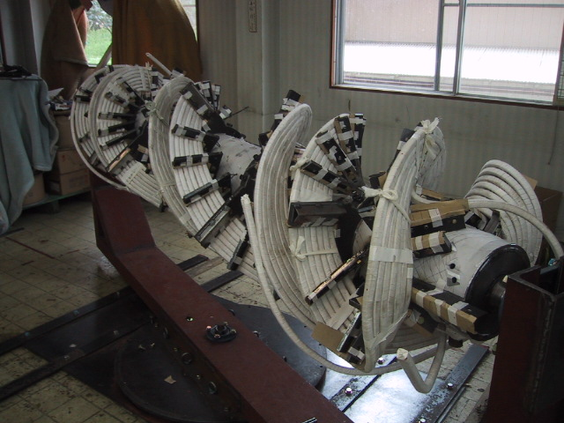
Polarization preservation – Siberian snakes
Siberian snakes in RHIC – two full snake than make Qs = ½
AGS – partial Siberian snakes
For deuteron full snake 12.5 times longer
Full snake may be impractical for deuteron – partial snakes may need to be used
AGS partial snake experience is relevant in this case
RHIC snake: 4T, 2.4m/snake, 360º twist, 100mm aperture
First Polarized Proton Collisions at RHIC. T, Roser, et al,
AIP Conference Proceedings 667, 1 (2003)
Warm partial AGS Snake

Slide 16
Polarization preservation – Figure-8 ring
Figure-8 ring topology makes Qs=0
No need for Siberian snakes to flip spin
Works equally well for deuterons
Ya.S. Derbenev, “The Twisted Spin Synchrotron”, University of Michigan report, UM HE 96-05 (1996).
Spin-transparency mode for deuterons in a 200 GeV/c racetrack can be produced by two solenoidal snakes of 2500 T*m each or dipole snakes with 150 T*m each.
In comparison, figure-8 provides spin transparency automatically (while requiring ~3 T*m rotators to provide spin stability)
High polarization sources and excellent polarization preservation in figure-8 allow aiming to achieve high polarization in EIC – up to 80-85%
The polarization measurement accuracy in nuclear femtography is proportional to the square of the polarization in each beam
Thus, as compared with the minimum requirement (70%), the time needed for an experiment is halved
This is equivalent to doubling the luminosity

Slide 17
The need for beam cooling – IBS
Intrabeam Scattering (IBS): Lorentz boosted Coulomb scattering inside bunches
Higher charge and smaller emittances increase IBS growth rate
IBS can be partially mitigated by reducing dispersion and increasing energy spread
IBS rates for JLEIC and eRHIC parameters range from ~min to ~hour
Beam cooling methods needed to counteract IBS
Factor γ in Δp

Slide 18
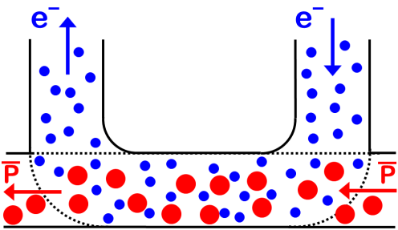
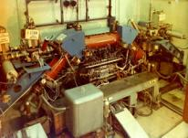
Electron Cooling
Electron cooling concept
When electron cooling idea was first presented (1966), the common opinion was “brilliant idea, but unfortunately non-realistic”
Budker G.I., Effective method of damping particle oscillations at proton antiproton storage rings, Atomic Energy 1967, v.22, №5, p.346
First e-cooler at INP

Slide 19
Electron Cooling & Energy Recovery
Standard electron cooling use energy recovery
For example, if we need 1A @ 1MeV electron beam, it does not mean we need 1 MW power supply
Typical arrangements of e-cooler power supplies:
Proton beam
B
B
P
B
P
B
B
1A @ 50 kV
e-beam
U⁻
Cathode
Collector
1mA @ 1 MV
Losses of 1A e-beam due to interaction with p-beam or scattering are low
Thus, power of 1MV power supply is defined by e-beam losses and can be much lower than 1MW

Slide 20
Electron Cooling & Electron Beam Magnetization
Initial measurements at INP show cooling time of 17 s (protons, 65 MeV)
There was expectation that protons will cool to equilibrium temperature of 1000K (cathode temperature)
However, after modification of the magnetic system, the cooling time became 0.05 s
Consistent with electron beam temperature 1K
Reasons:
1) Longitudinal T of electrons flattens due to acceleration:
2) Transverse T of electrons does not play any role if Larmor radius << n^{-1/3}
The magnetization effects in electron cooling, Ya. Derbenev, A. Skrinsky, Rus. Plasma Physics, v.4 (1978) 492

Slide 21
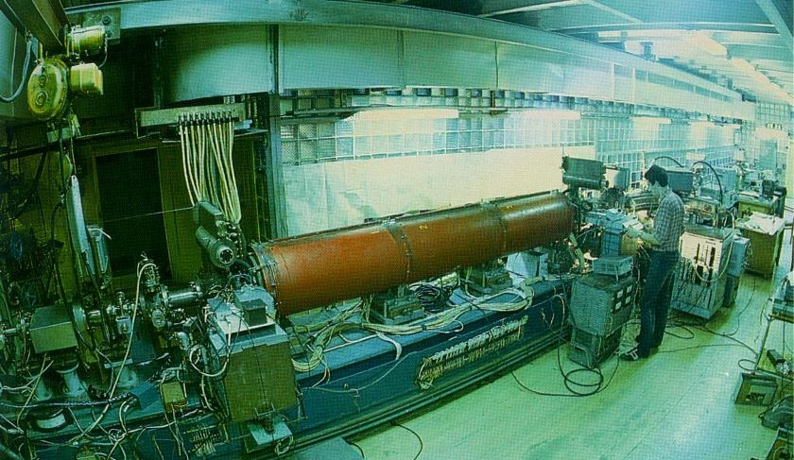
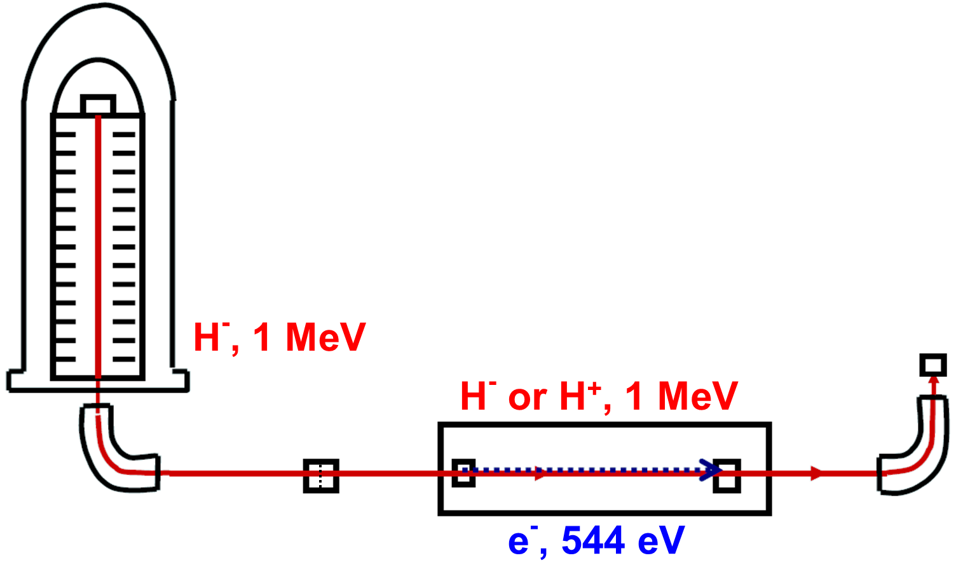
Single Pass Electron Cooling Experiment
Magnetization effects allowed to observe difference of e-cooling friction force (which is normally ~e²Z²) on charge of the particle
Experiment “MOSOL” (MOdel of SOLenoid) – Budker INP, Novosibirsk, ca. 1986 (on the photo – today’s speaker)
Experiment at MOSOL revealed large difference in cooling force for positive and negative particles

Slide 22
Enhanced / coherent electron cooling
Amplification the electron cooling by instability inside electron beam, Y.S. Derbenev, Proceedings of the 7th National Accelerator Conference, V. 1, p. 269, (Dubna, Oct. 1980)
Coherent Electron Cooling, V. N. Litvinenko and Ya. S. Derbenev, Phys. Rev. Lett. 102, 114801 (2009)
Microbunched Electron Cooling for High-Energy Hadron Beams, D. Ratner, Phys. Rev. Lett. 111, 084802 (2013)
Notes:
VL: A general schematic of the Coherent Electron Cooler (CEC) comprising three sections: A modulator; a FEL plus a dispersion section; and, a kicker. The FEL wavelength, λ, in the figure is grossly exaggerated for visibility.
Ratner: Schematic of the cooling mechanism. In the first stage, an ion modulates the energy of the local electrons. In the dispersive region, ions and electrons move longitudinally due to energy differences, creating an electron density spike at the overlap. In the kicker stage, an ion with nominal energy E=¯¯¯Eion (red, middle) returns to the center of the spike and does not change energy. A low energy ion with E<¯¯¯Eion (purple, lower) falls behind its original position, and receives a positive energy kick from the electron spike. A high energy ion with E>¯¯¯Eion (orange, upper) slips ahead of its electron spike and receives a negative energy kick. The result is that all ions are pushed towards the average ion energy.

Slide 23
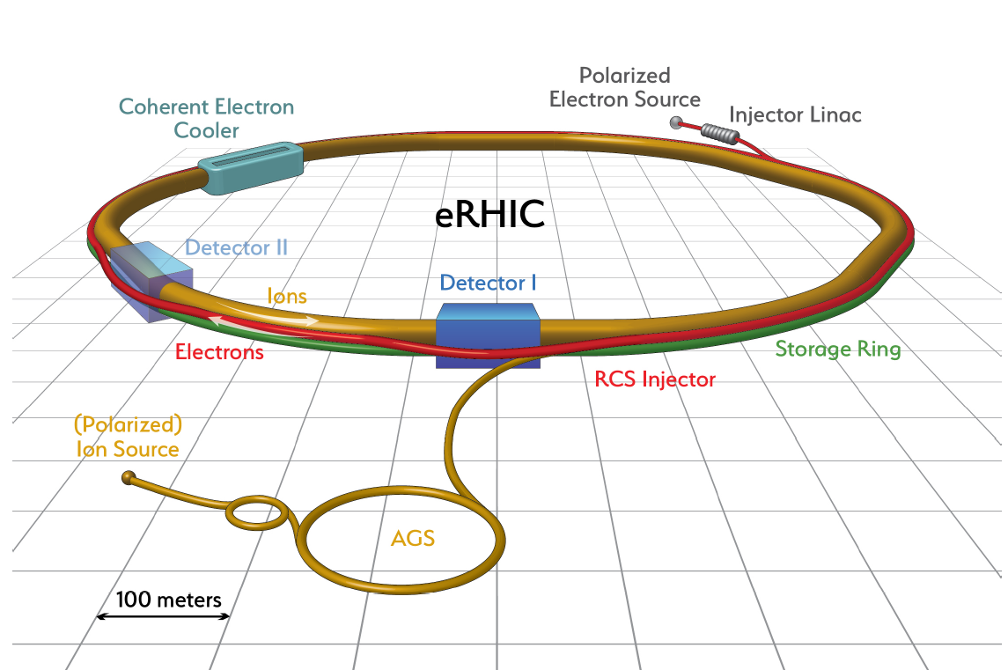
eRHIC electron ion collider – built up on RHIC
Following C. Montag talk at EIC Collab meeting, Oct 2018
Two superconducting storage rings
3.8km circumference
Energy up to 255GeV protons, or 100GeV/n gold
110 bunches/beam
eRHIC designed to meet the following requirements:
High luminosity: L = (10³³-10³⁴) cm⁻²sec⁻¹
Large range of center-of-mass energies E_{cm}= (29-140) GeV
Polarized beams with flexible spin patterns
Favorable condition for detector acceptance such as p_{T} =200 MeV
Large range of hadron species: protons ….Uranium
Collisions of electrons with polarized protons and light ions (h³He, hd,…)
60% proton polarization – world’s only polarized proton collider
6 interaction regions, 2 detectors
In operation since 2001
Exceeded original design luminosity by factor 50 – unprecedented performance

Slide 24
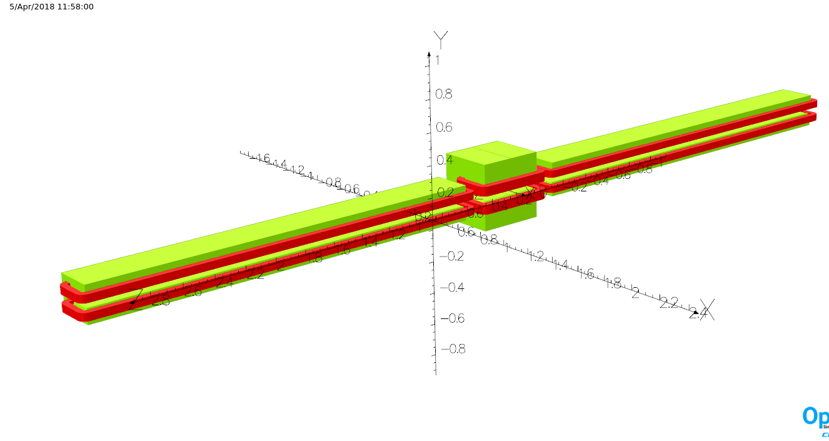
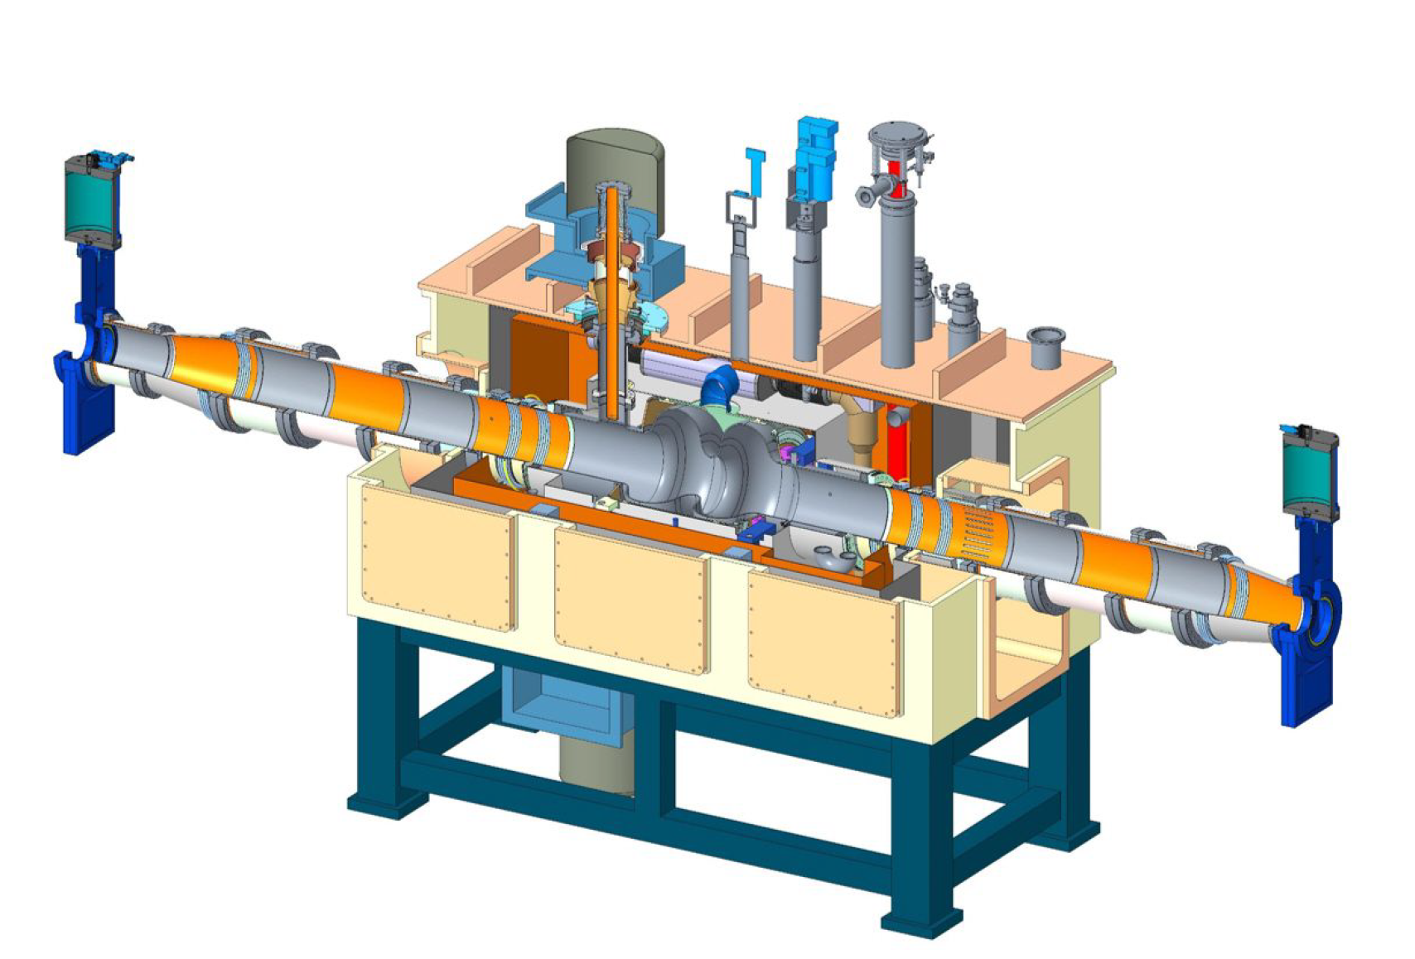
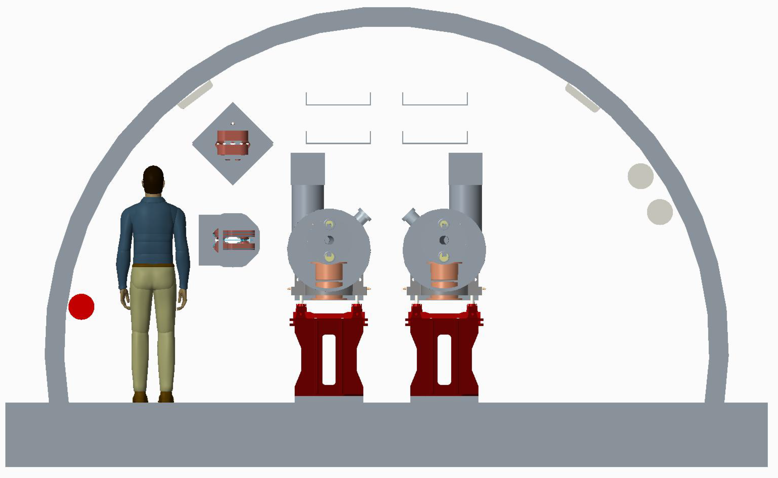
eRHIC – electron storage ring
Following C. Montag talk at EIC Collab meeting, Oct 2018
Composed of six FODO arcs with 60º /cell for 5-10 GeV
90º /cell for 18 GeV
Super-bends for 5-10 GeV for emittance control
5 straight sections with simple layout, plus IR straight
Radiate approx. 10 MW for maximum luminosity parameters at 10GeV
➔ 12 superconducting 2-cell RF cavities
Storage
Ring

Slide 25
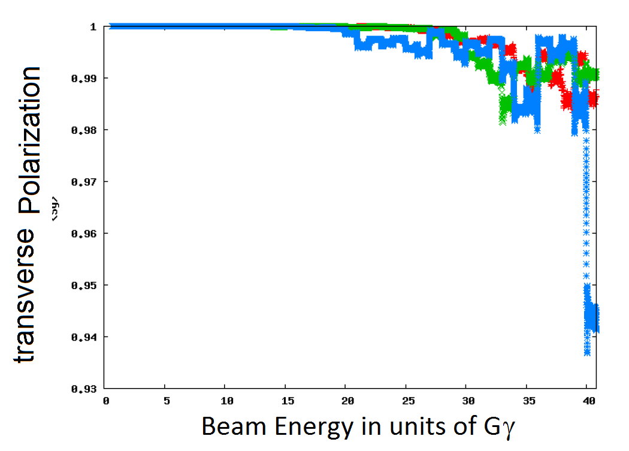
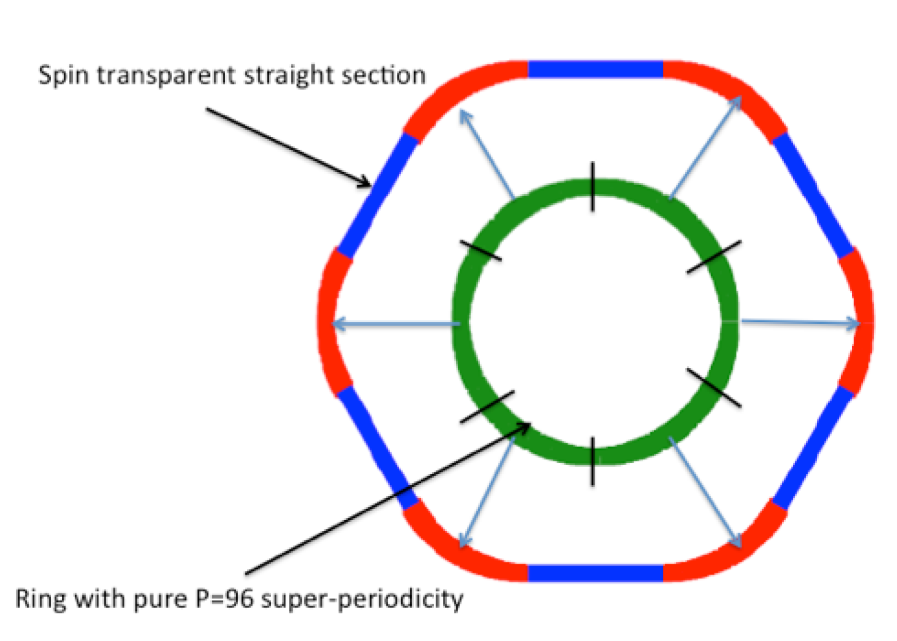
eRHIC – rapid cycling synchrotron
Following C. Montag talk at EIC Collab meeting, Oct 2018
eRHIC requires a full energy polarized injector for rapid electron bunch replacement
A rapid cycling synchrotron is the most cost effective solution
High periodicity and proper tune choice ensures polarization preservation on the ramp
Straight sections designed as unit matrices
Simulations show good robustness of spin preservation against
machine errors (alignment, field errors, …)
High quasi-symmetry
➔ Good spin transparency properties
Blue asterisk: 200 ms ramp time

Slide 26
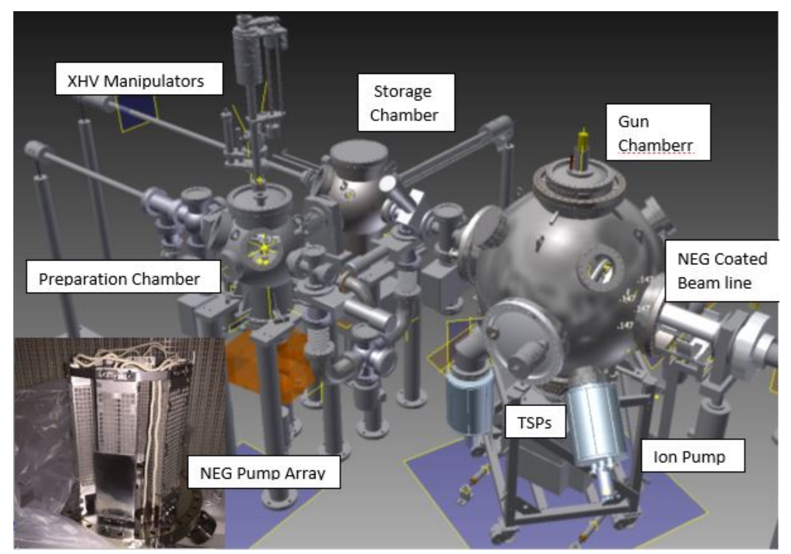
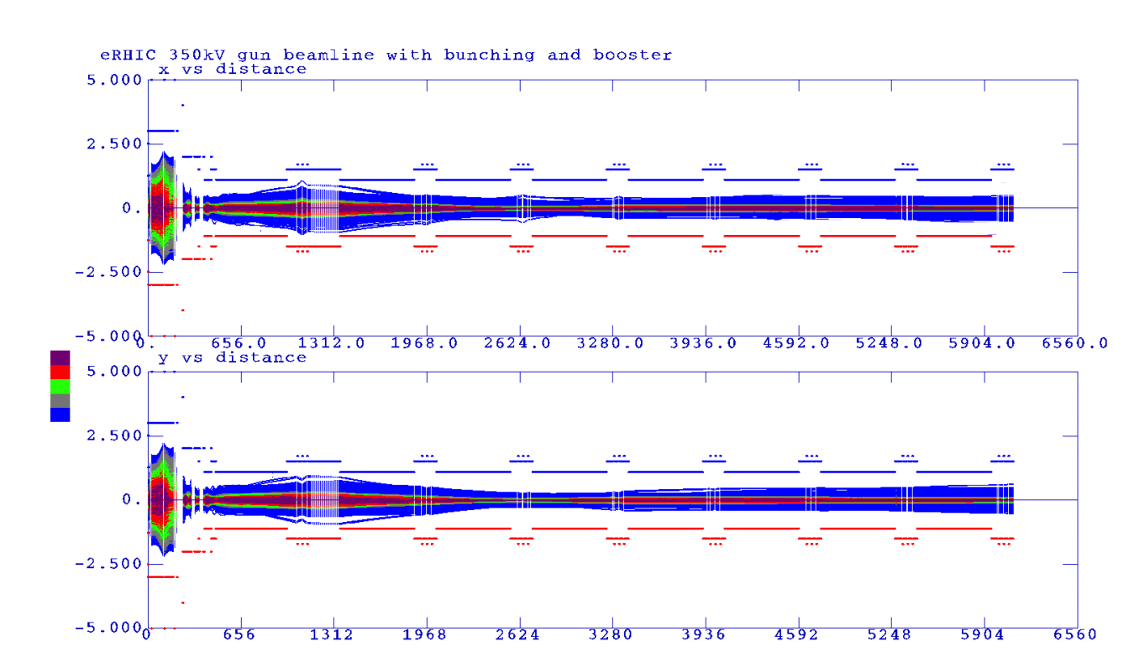
eRHIC – polarized electron source
Following C. Montag talk at EIC Collab meeting, Oct 2018
Need to provide 10 nC of polarized electrons/second
SLC Gun with 16 nC 120 Hz operation is the existence proof
eRHIC polarized gun is based on the JLAB inverted gun
Design verified by PIC beam dynamics simulations
400 MeV injector linac will be a SLAC type S-band linac.
Beam transport simulated and found to be ok for eRHIC beams.
Wien filter, polarimeter design already in fairly large detail

Slide 27
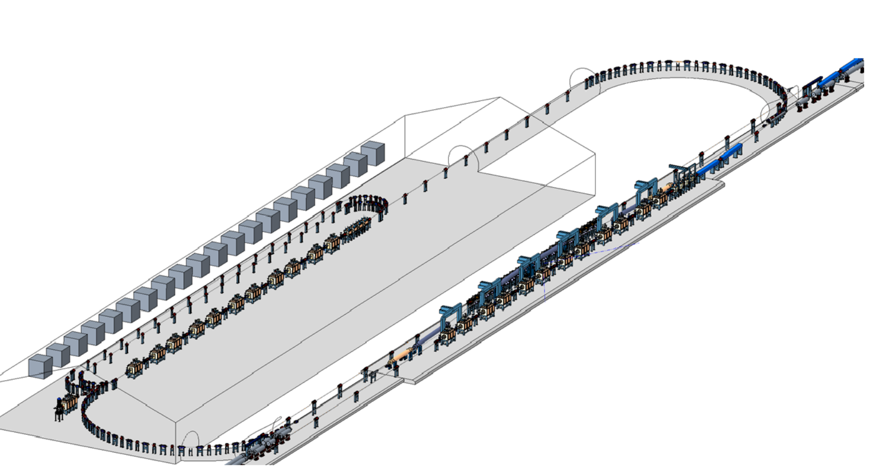
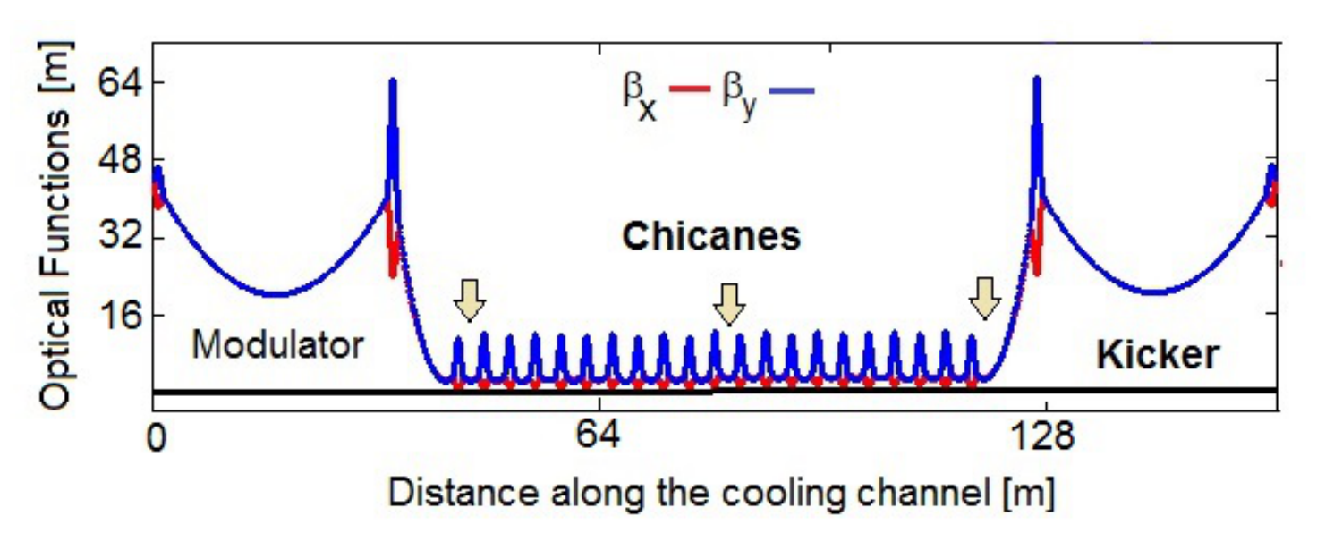
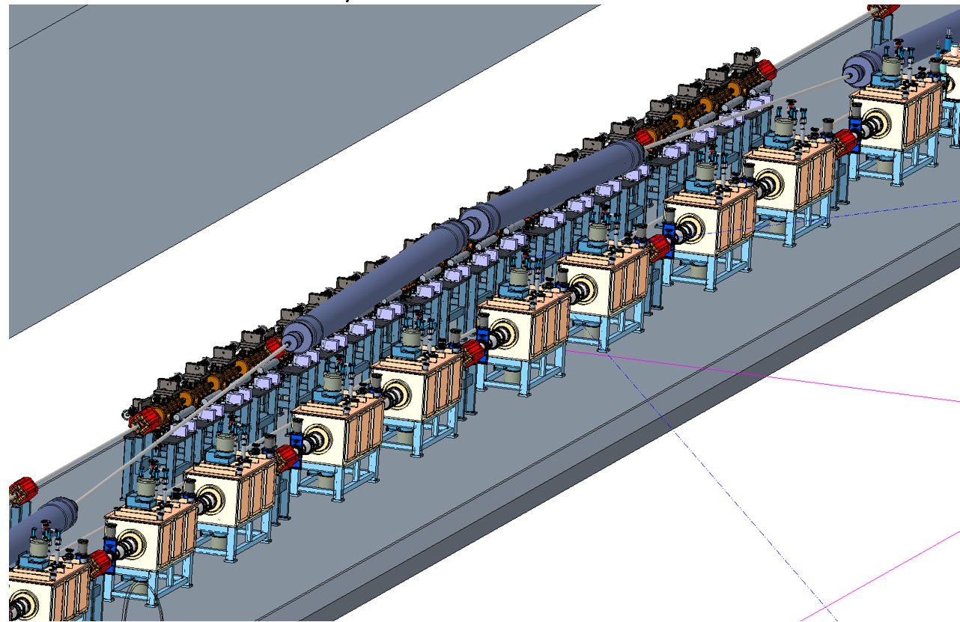
eRHIC – Strong Hadron Cooling
Following C. Montag talk at EIC Collab meeting, Oct 2018
Challenges:
2 hour IBS growth times require strong hadron cooling
100 mA CW electron source is beyond state of the art
Hadron chicane to compensate for electron delay in the micro-bunching chicanes is a considerable effort (need several Blue ring s.c. RHIC magnets)
Unexplored:
Short bunches might boost the cooling rate, reduce the electron current and reduce number of amplifications.
To Do:
3-D model
Simulation including space charge and drifts
Optimization of parameters for short bunches

Slide 28
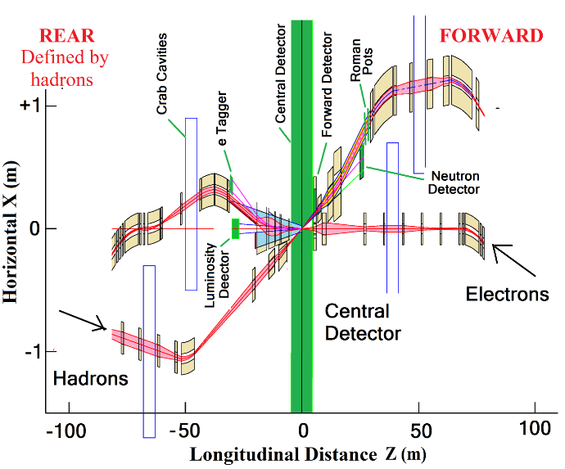
eRHIC – IR layout
Following C. Montag talk at EIC Collab meeting, Oct 2018
IR design requirements:
  Small β* for high luminosity
  Limited IR chromaticity contributions
  Large final focus quadrupole aperture
  Large detector acceptance
  ➔ Large quadrupole aperture, limited beam divergence
  Accommodate spectrometer in the low-β optics
  No accelerator magnets +/-4.5 m
  25 mrad crossing angle (increased from 22 mrad to ease magnet design), crab crossing, crab cavities 90° from IP
  Avoid synchrotron radiation:
  - no electron bends on the forward side
  - absorb SR far from IP
  - need mask against backscattered SR photons
  Accommodate spin rotators, spin matching
  Space for luminosity monitor, neutron detector, “Roman Pots”
Multi-stage separation:
Electrons from protons
Protons from neutrons
Electrons from Bethe-Heitler photons (luminosity monitor)
Design meets all requirements
➔ Very constrained systems, requires novel types of magnets in the IR

Slide 29
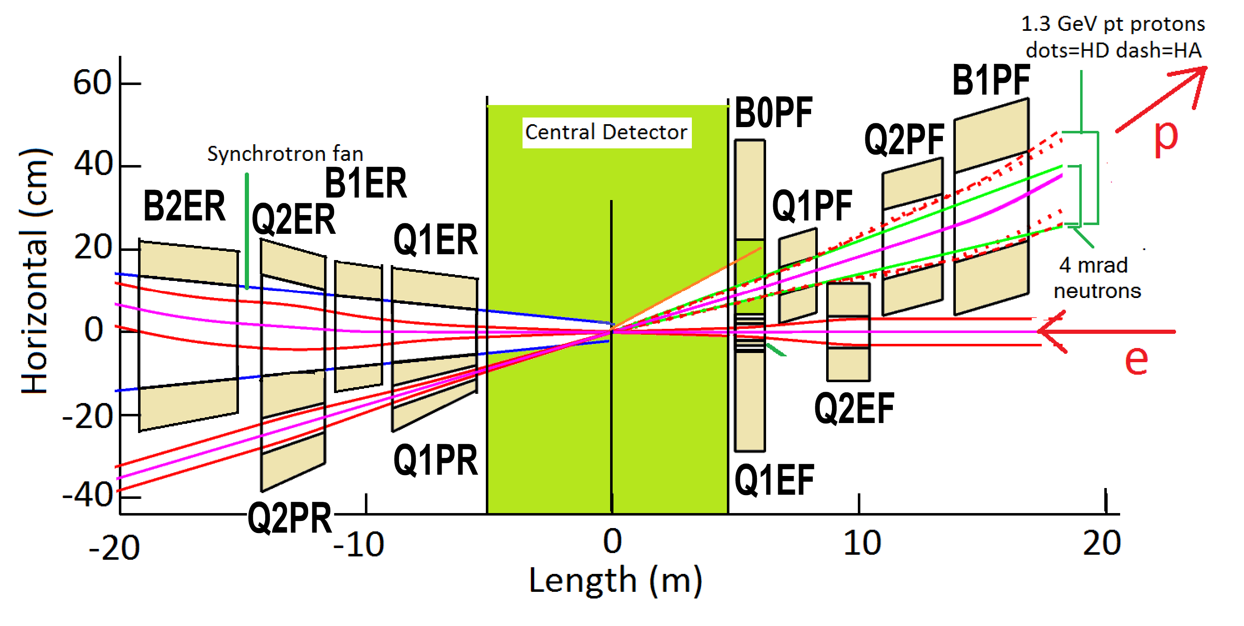
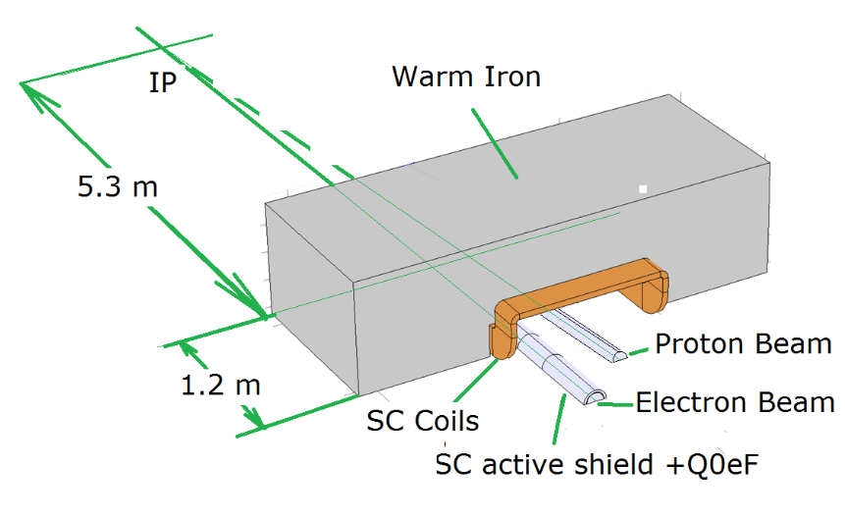
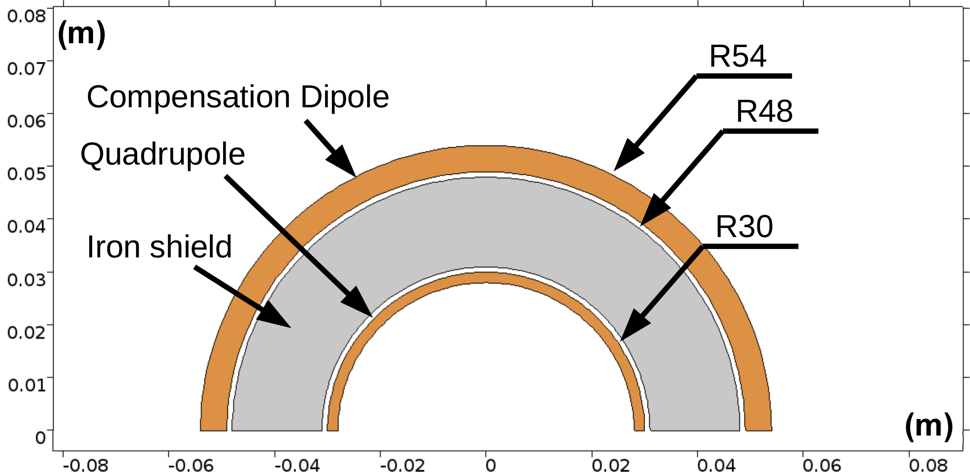
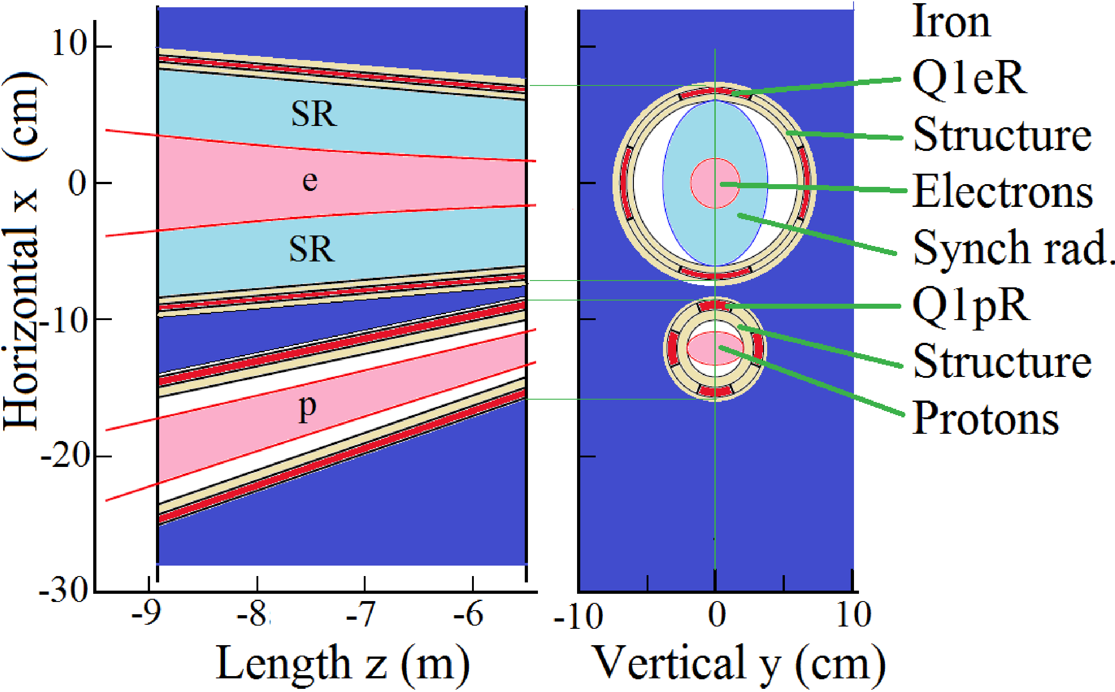
eRHIC – IR magnets
Following C. Montag talk at EIC Collab meeting, Oct 2018
1.3 T Cancel Coil Detail
Q1EF

Slide 30
eRHIC summary
Following C. Montag talk at EIC Collab meeting, Oct 2018
“eRHIC design reaches a peak luminosity of
L= 1.05·10³⁴cm⁻²s⁻¹
^{with 2 hour IBS growth times}
However, this can only be achieved with strong hadron cooling, which is beyond state of the art, and is a topic of ongoing R&D.
Without hadron cooling a peak luminosity of
L= 0.44·10³⁴cm⁻²s⁻¹
is reached, with IBS growth times of 9 hours
eRHIC design has progressed very well and a tremendous amount of design work was accomplished.
There are still critical beam dynamic issues which require more effort. They could have an impact on achievable luminosity but do not constitute a risk of missing the EIC White Paper Requirement
While a large amount of work is still ahead to arrive at a Conceptual Design, we believe that the present state of the eRHIC design matches well the expectations of a Pre-Conceptual Design”

Slide 31
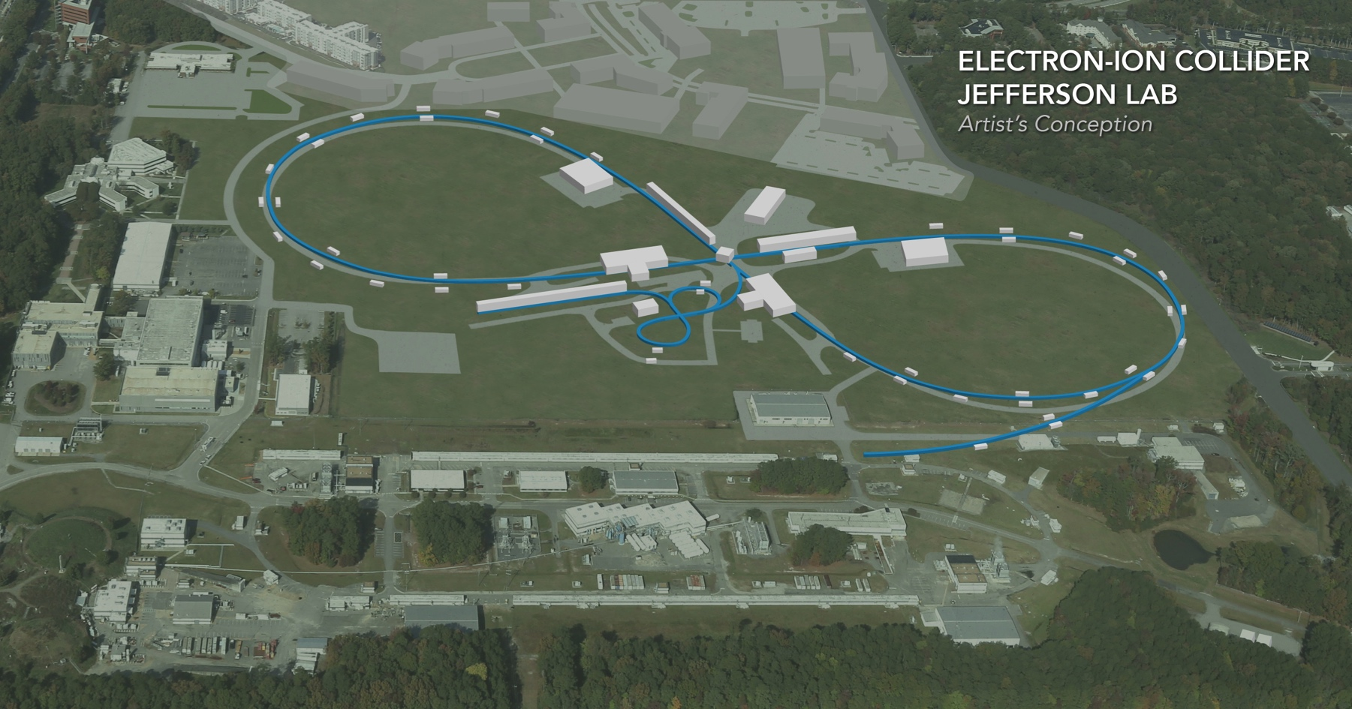
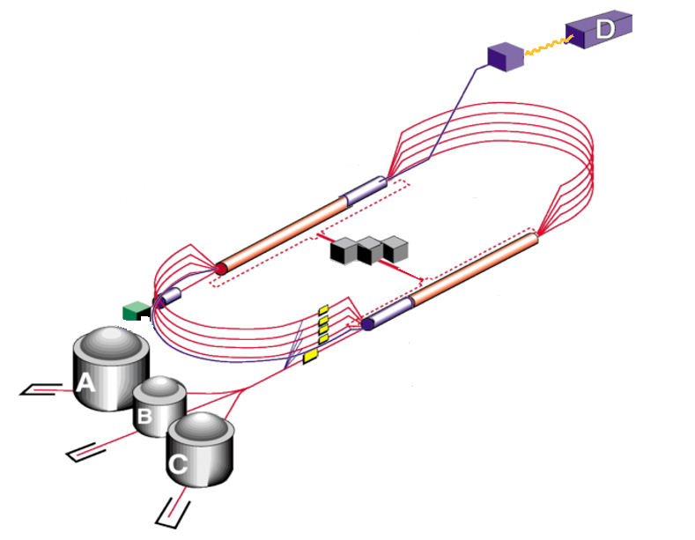
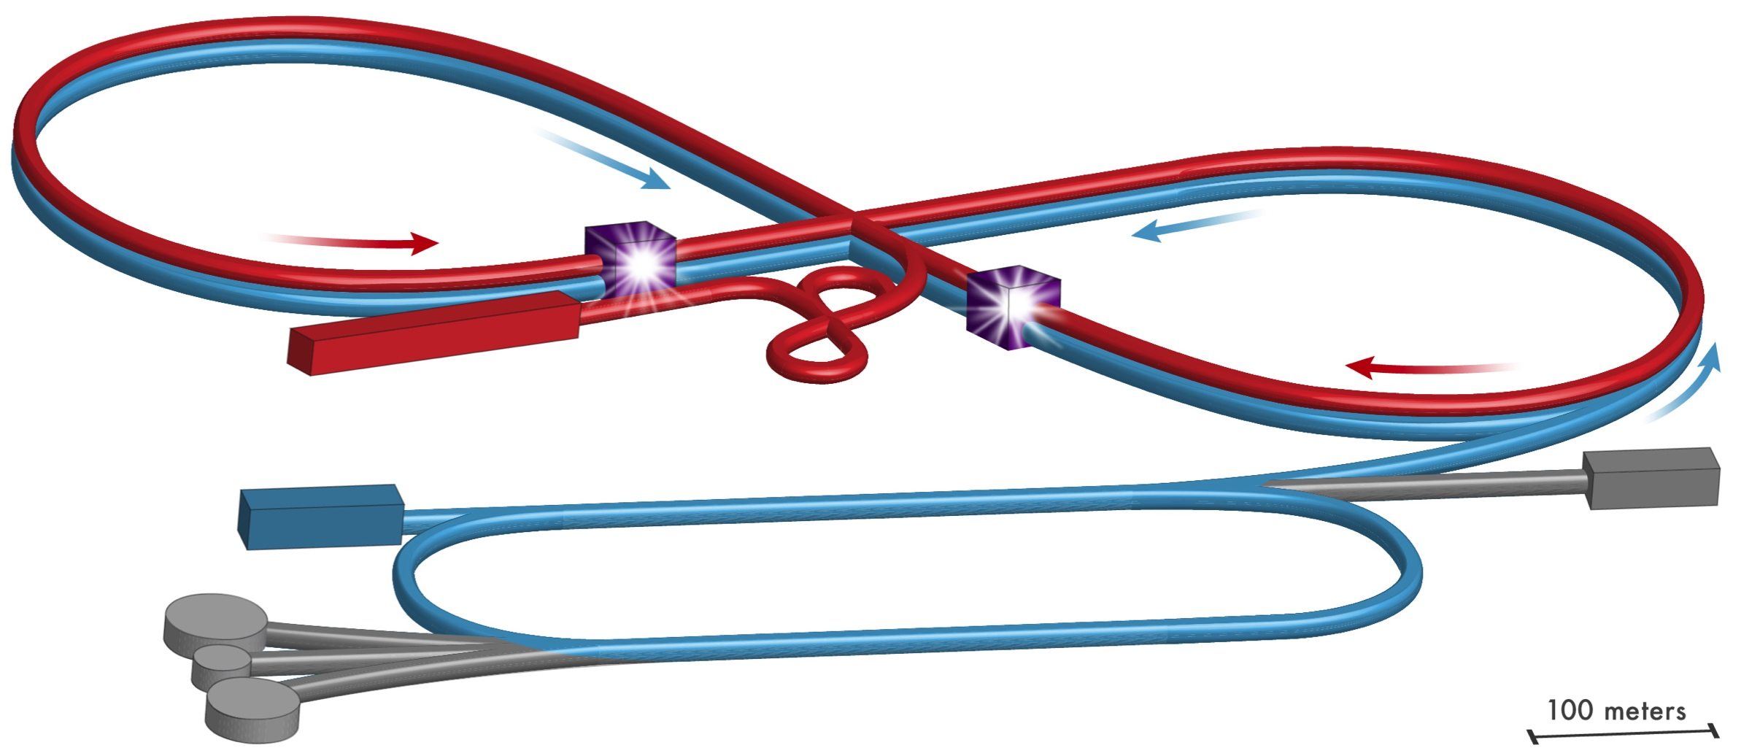
JLEIC electron-ion collider design – built up on CEBAF
CEBAF extensive fixed-target science program
  Fixed-target program compatible
  with concurrent JLEIC operations
CEBAF 12 GeV : JLEIC injector
  Fast fill of collider ring
  Full energy
  ~90% polarization
  Enables top-off
New operation mode but
no hardware
modifications
Up to 12 GeV
to JLEIC
Electron complex: CEBAF as a full energy injector, Electron collider ring
Ion complex: Ion source, SRF linac, Booster, Ion collider ring

Slide 32
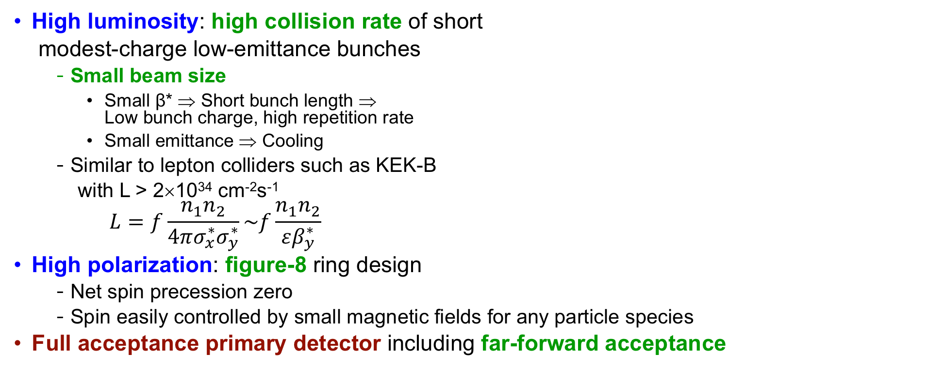
JLEIC Key Design Concepts
High luminosity: high collision rate of short
modest-charge low-emittance bunches
  Small beam size
    Small β* ⇒ Short bunch length ⇒
    Low bunch charge, high repetition rate
    Small emittance ⇒ Cooling
  Similar to lepton colliders such as KEK-B
  with L > 2×10³⁴ cm⁻²s⁻¹
$$L=f\frac{n_{1}n_{2}}{4πσ_{x}^{∗}σ_{y}^{∗}}\sim f\frac{n_{1}n_{2}}{εβ_{y}^{∗}}$$
High polarization: figure-8 ring design
  Net spin precession zero
  Spin easily controlled by small magnetic fields for any particle species
Full acceptance primary detector including far-forward acceptance
Design concept has been stable over the last ~9 years
Latest design optimization: Replaced super-ferric magnets by conventional cos-theta SC magnets
Working now on converting 65 GeV CM optimized design (pre-CDR, Oct 2018) to 100 GeV CM design

Slide 33
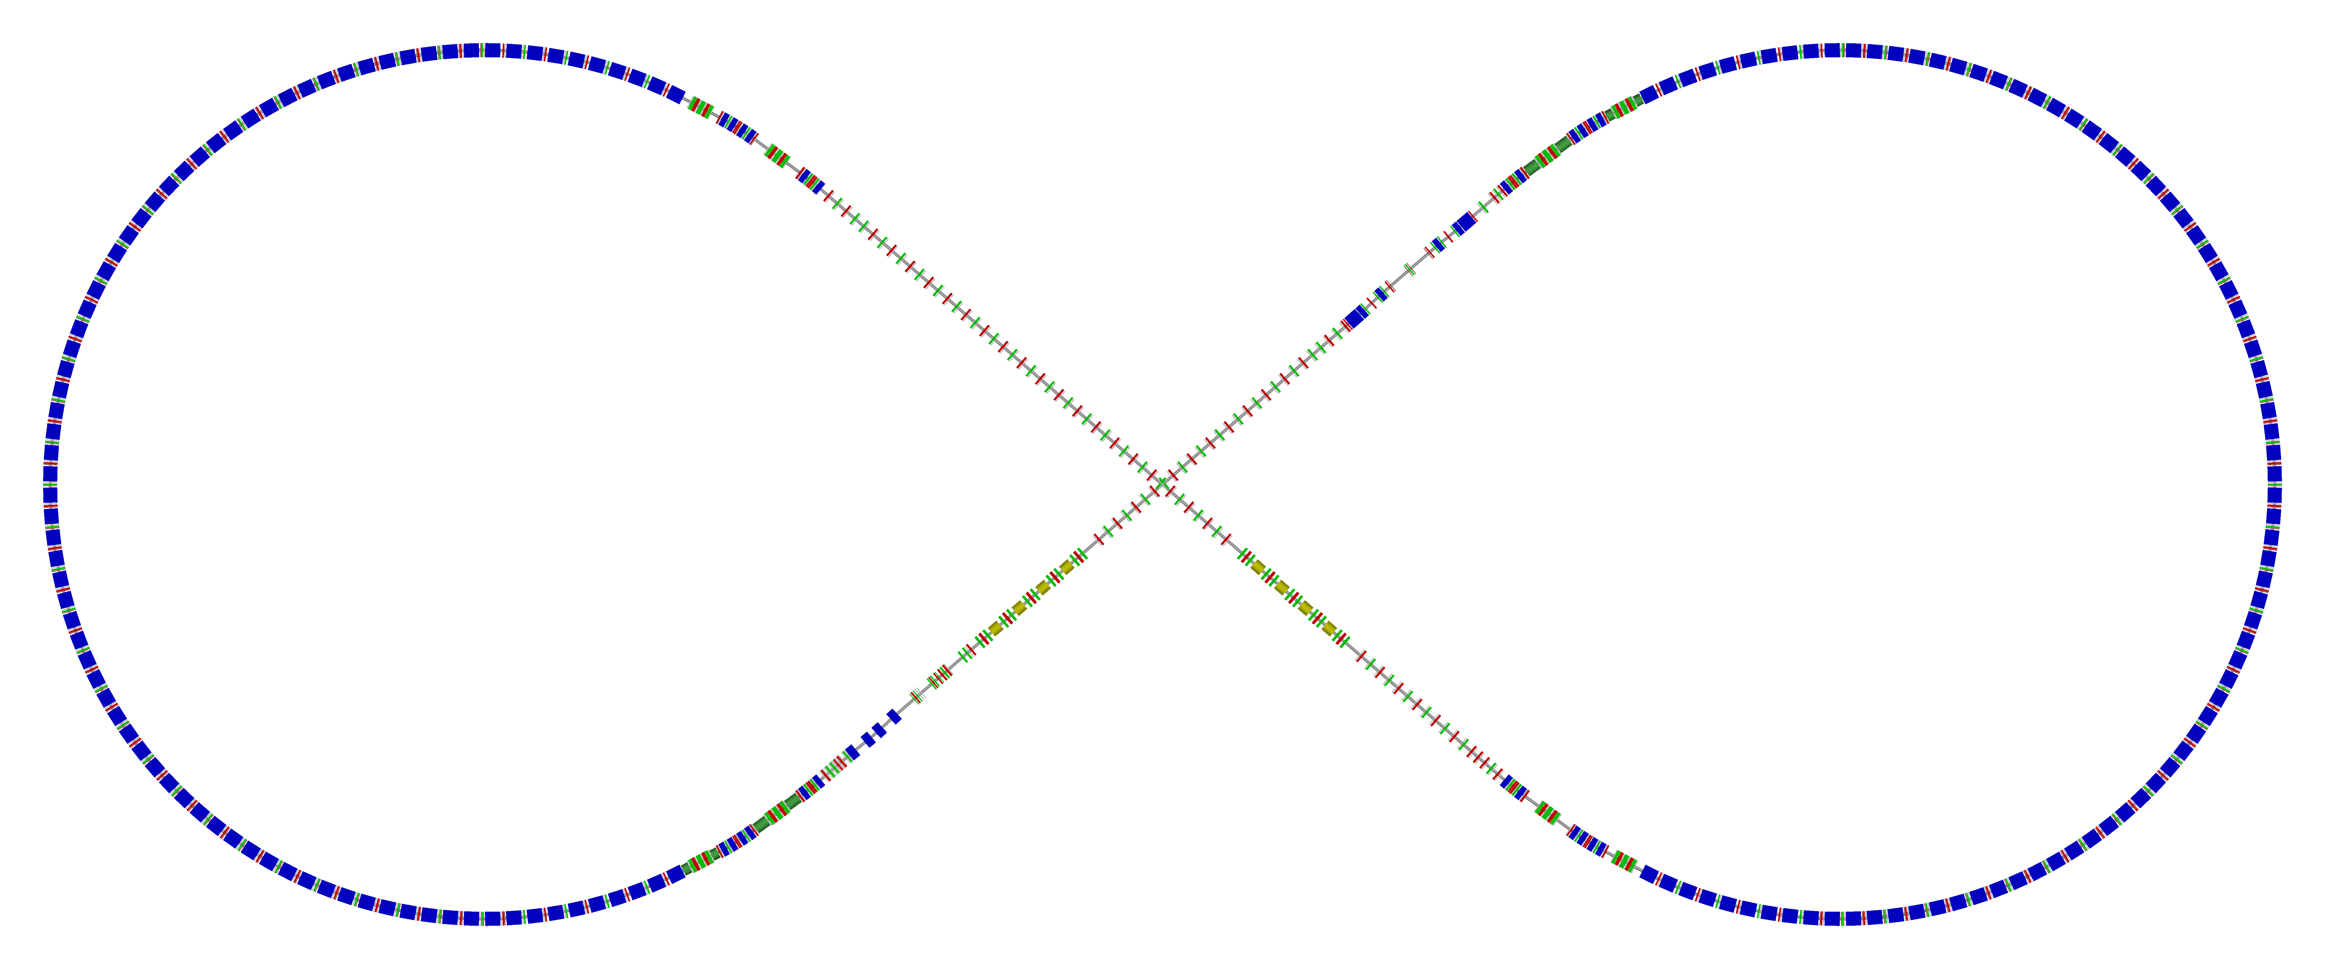
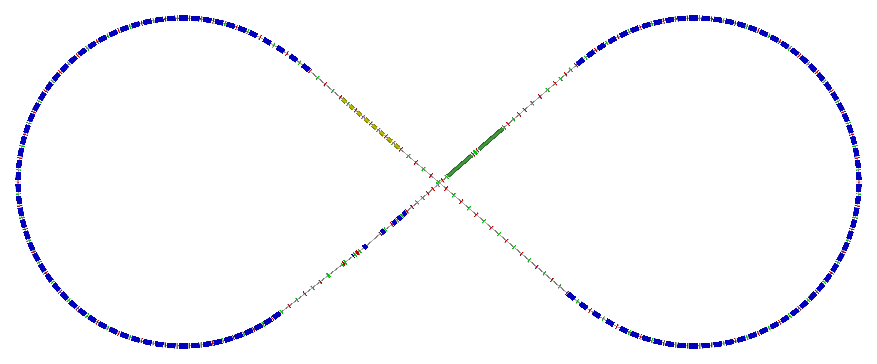
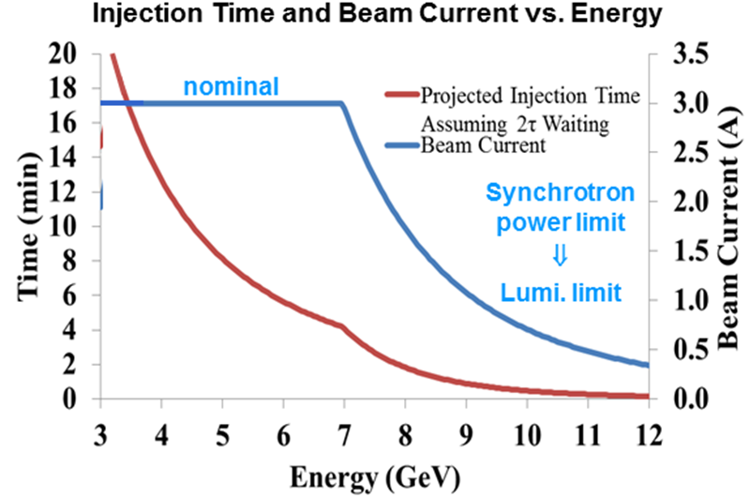
JLEIC ion and electron rings
  Electron ring
Spin rotator
  Two rings stack vertically
  Horizontal crab crossing at IPs
  Electron vertical chicane
  Supports two IPs, fit to JLab site
  Beamline/optics design completed (including low-β insertion, etc.)
Spin rotator
Arc, 257.4°
CCB
R=155m
77.4°
2nd IP
e⁻
IP
Forward e⁻ detection
RF
RF
 |  | p | e
Circum. | m | ~2257
Crossing | deg | 77.4
Lattice |  | FODO
Dipole/quad | m | 8/0.8 | 5.4/0.45
Cell length | m | 22.8 | 15.2
Max. dipole | T | 3 | ~1.5
SR power | kW/m |  | 10
Transition γ_{tr} |  | 12.5 | 32.0
Electron beam
  3 A at up to 7 GeV
  Emittance 54 µm@5 GeV
  SR density < 10 kW/m
  Total power up to 10 MW
Spin rotator
Spin rotator
  Ion ring

Slide 34
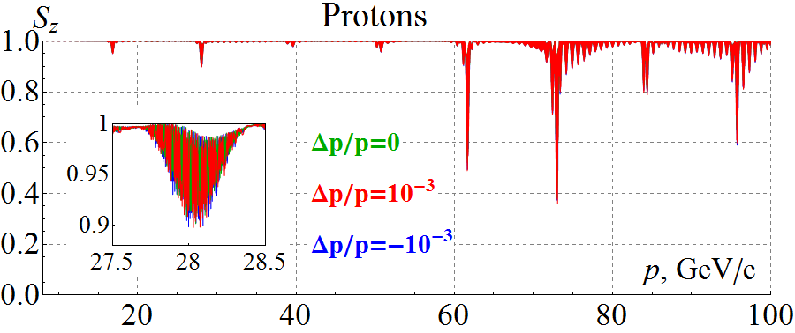
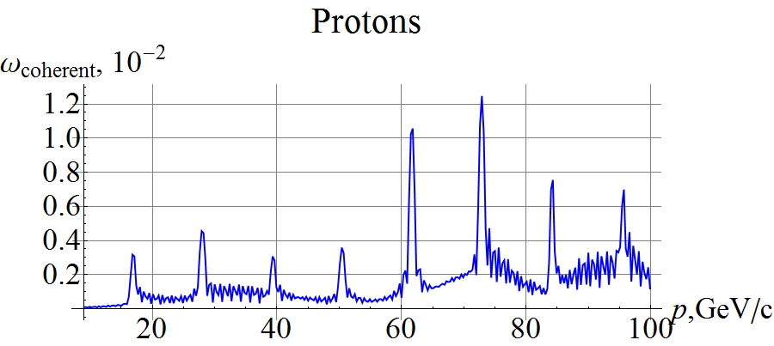
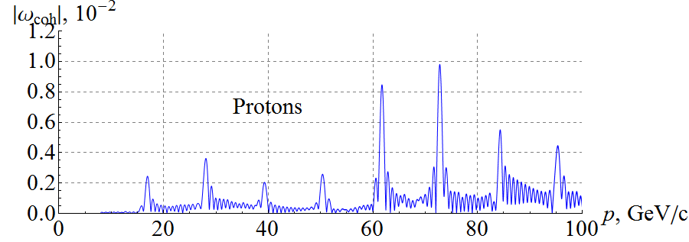
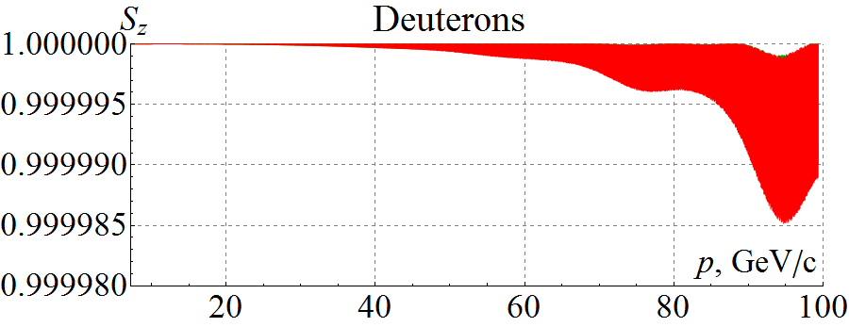
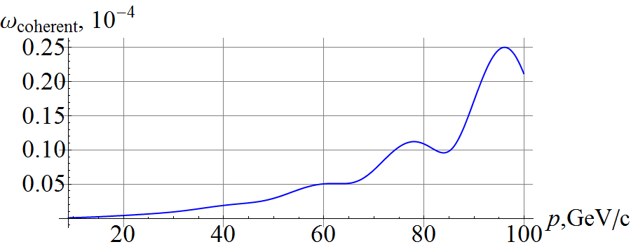
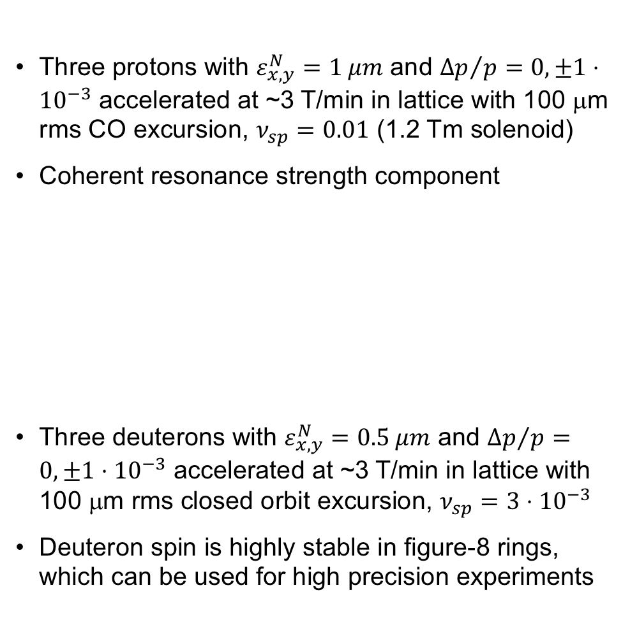
JLEIC start to end polarization simulations
Three protons with $ε_{x,y}^{N}=1 μm$ and ${Δp}/p=0, ±1⋅{10}^{−3}$ accelerated at ~3 T/min in lattice with 100 μm rms CO excursion, $ν_{sp}=0.01$ (1.2 Tm solenoid)
Coherent resonance strength component
Three deuterons with $ε_{x,y}^{N}=0.5 μm$ and ${Δp}/p=0, ±1⋅{10}^{−3}$ accelerated at ~3 T/min in lattice with 100 μm rms closed orbit excursion, $ν_{sp}=3⋅{10}^{−3}$
Deuteron spin is highly stable in figure-8 rings, which can be used for high precision experiments
Zgoubi simulation
Analytic prediction
Zgoubi simulation
(Zgoubi simulation)
Analytic prediction

Slide 35
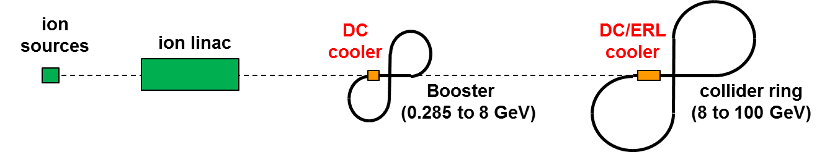
JLEIC multi stage cooling
Cooling of JLEIC proton/ion beams for
  Achieving small emittance (~10x reduction)
  Reaching short bunch length ~1 cm (with SRF)
  Suppressing IBS induced emittance degradation
Pre-cool when energy is low
Booster
0.280 to 8 GeV
Collider ring
8 to 100 GeV
Cool when emittance is small
(after pre-cool at low energy)
Ring | Functions | Kinetic energy (GeV / MeV) |  |  | Cooler type
 |  | Proton | Lead ion | Electron
booster ring | Accumulation of positive ions |  | 0.1 (injection) | 0.054 | DC
collider ring | Maintain emitt. during stacking | 7.9 (injection) | 2 (injection) | 4.3 (for proton) 1.1 (for lead) | DC
 | Pre-cooling for emitt. reduction | 7.9 (injection) | 7.9 (ramp to) | 4.3 | DC
 | Maintain emitt. during collision | Up to 100 | Up to 40 | Up to 54.5 | BBC/ERL

Slide 36
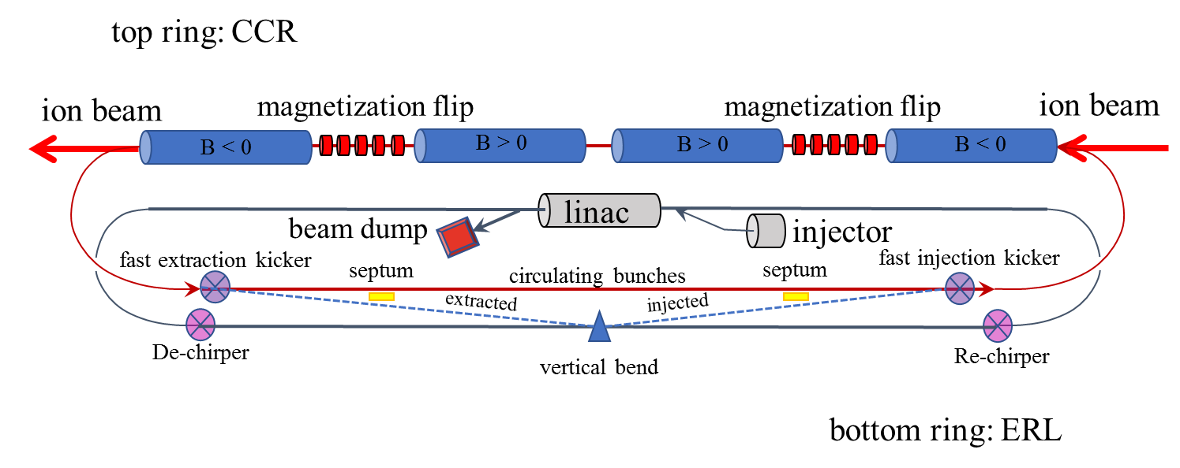
JLEIC cooling ring fed by ERL
Same-cell energy recovery in 952.6 MHz SRF cavities
Uses harmonic kicker to inject and extract from Circulating Cooling Ring (divide by 11)
Assumes high charge, low rep-rate injector (w/ subharmonic acceleration and bunching)
Use magnetization flips to compensate ion spin effects

Slide 37



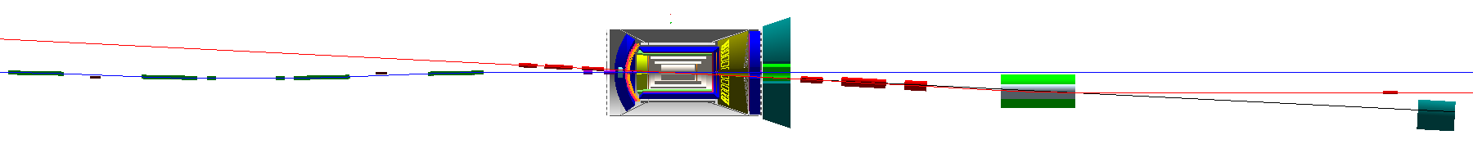
JLEIC Interaction Region
Integrated detector region design developed satisfying requirements of detection, beam dynamics and geometric match
GEANT4 detector model developed, simulations in progress
IP
e
Compton polarimetry
forward ion detection
ions
forward e detection
spectrometers
dispersion suppressor/
geometric match
p
(top view in GEANT4)
e
low-Q² electron detection
and Compton polarimeter
Forward hadron spectrometer
ZDC

Slide 38
JLEIC summary
The design concepts (luminosity and polarization) have been stable over the last ~9 years
Continued JLEIC design and improved the design performance
Significant progress has been made in many design aspects and experimental demonstrations
Completed documenting JLEIC self-consistent design with the CM energy up to 65 GeV
Design delivers ~2E34 at max Lumi point and above ~1E33 in entire E-range
Prospects of 80-85% polarization (w.r.to min required 70%) due to figure-8 topology equivalent to a factor of two Lumi boost
Working on converting the design to 100 GeV CM, upgradable to 140 GeV CM

Slide 39
eRHIC and JLEIC key parameters at max Lumi points
Assumptions on integrated luminosity: Accelerator is 75% of the time in colliding beam mode; 25% of the time is needed for injection, acceleration, run preparation as well as maintenance, machine development, and failures. The average luminosity within a luminosity run is very close to the peak luminosity (> 95%) due to strong hadron cooling.

Slide 40
eRHIC and JLEIC luminosity curves
eRHIC electron-proton average luminosity vs. center-of-mass energy with strong hadron cooling

Slide 41
eRHIC and JLEIC luminosity curves
JLEIC e-p average luminosity for the 65 GeV CM optimized design
JLEIC e-p average luminosity for 100 GeV CM collider design and its 140 GeV CM upgrade. Work-in-progress.

Slide 42
EIC R&D – examples
High-Priority EIC R&D topics defined by the Jones review panel
A number of joint R&D funded by NP – FY17, significant progress achieved in:
  Crab system design and experimental test
  Electron cooler design
  IR magnet design
  Simulation software development
Example of awarded FY18-19 proposals:
  Crab cavity operation in a hadron ring (Lead: ODU, collaborators: JLab, BNL)
  Strong hadron cooling
    Development of innovative high-energy magnetized electron cooling for an EIC (Lead: JLab, collab.: BNL, FNAL, ODU)
    Strong hadron cooling with micro-bunched electron beams (Lead: BNL, collaborators: JLab, SLAC, ANL)
  Magnet design
    High Gradient Actively Shielded Quadrupole (Lead: BNL, collaborators: JLab, LBNL)
    Validation of EIC IR magnet parameters and requirements using existing magnet results (Lead: JLAB, collab.: SLAC, LBNL)
  Benchmarking of EIC simulations
    Development & test of simulation tools for EIC beam-beam interaction (Lead: BNL, collaborators: JLab, MSU, LBNL)
    Experimental verification of spin transparency mode in an EIC (Lead: JLab, collaborator: BNL)
  Electron complex
    High Bandwidth Beam Feedback Systems for a High Luminosity EIC (Lead: ANL, collaborator: JLab)

Slide 43
EIC will boost accelerator technology impact on other areas
NAS report: “development of an EIC would advance accelerator science and technology in nuclear science; it would also benefit other fields of accelerator-based science and society, from medicine through materials science to elementary particle physics.”
Chart from Robert W. Hamm, Accelerator-Industry Co-Innovation Workshop, Brussels, February 6, 2018

Slide 44
Summary
EIC accelerator design team is working on design of EIC that will enable new physics
Two versions of design – eRHIC and JLEIC
Number of challenges & simultaneously number of opportunities – taking lessons from recently operated colliders such as B-factories, from electron cooling machines, etc
Collaborative efforts on design and on R&D
The team aim is to design and build a modern 21st century collider that will enable new discoveries in nuclear physics
Thanks to all BNL and JLAB colleagues for help with materials for this talk

