Slide 1
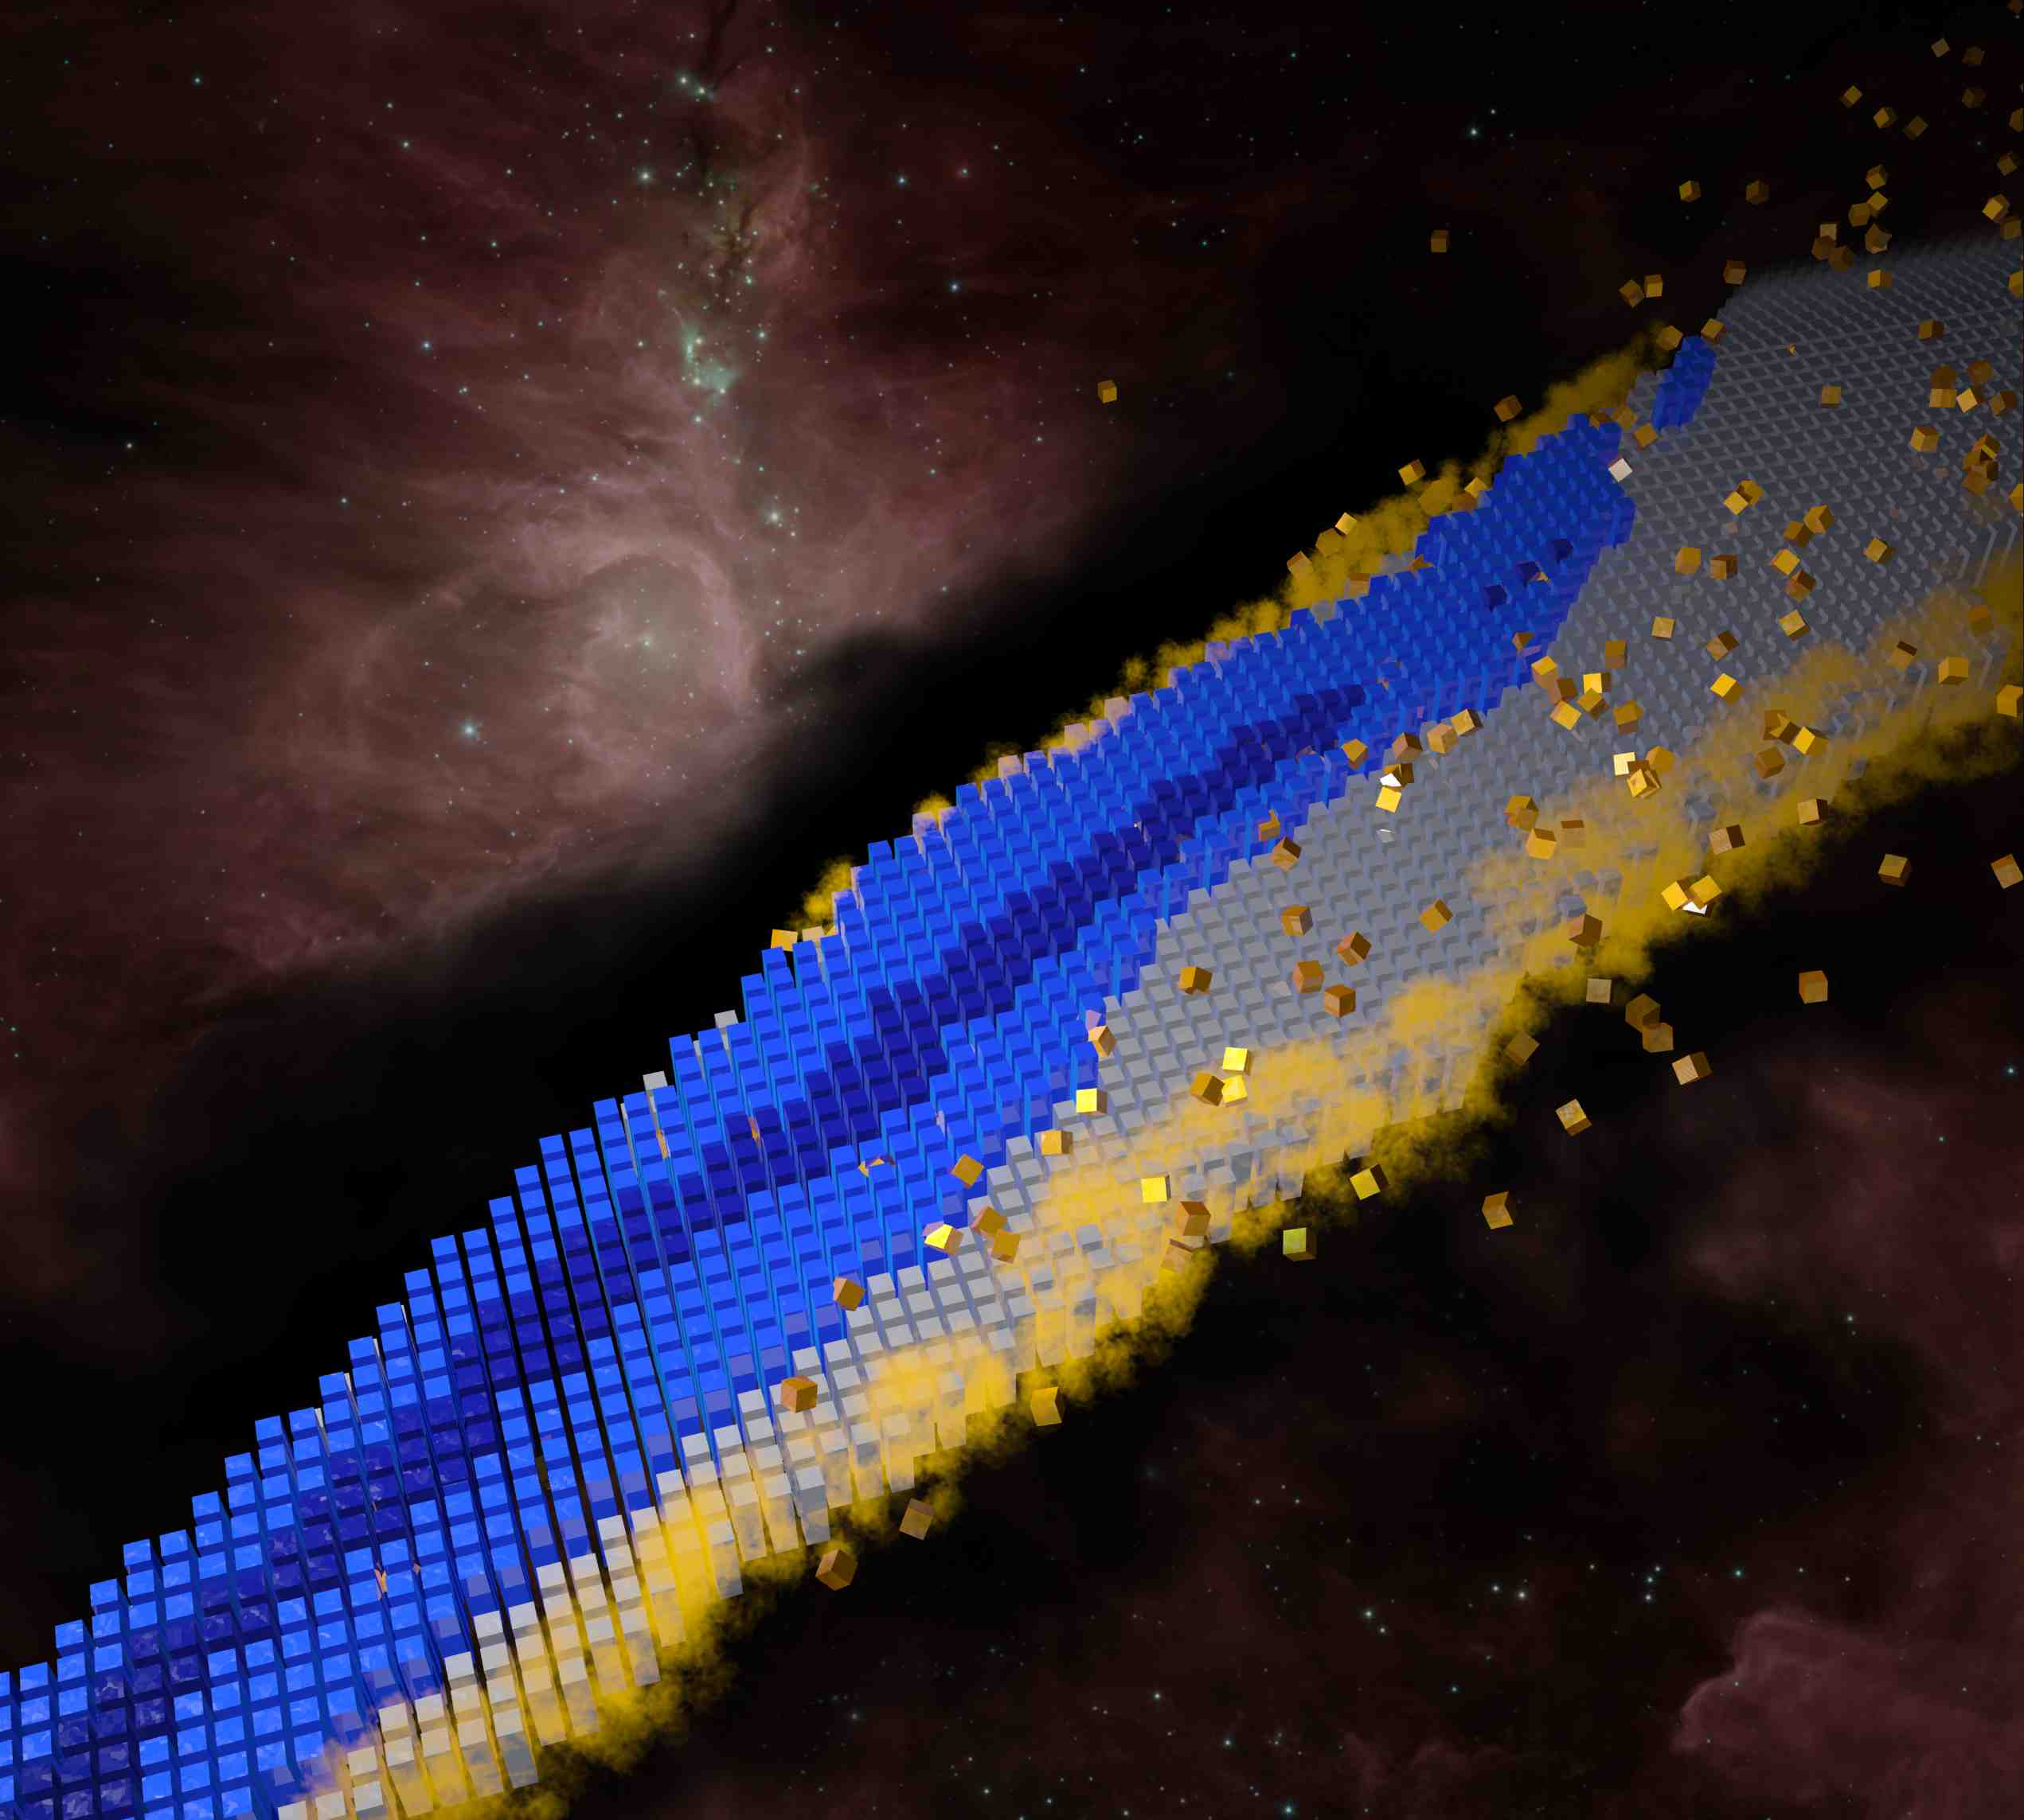
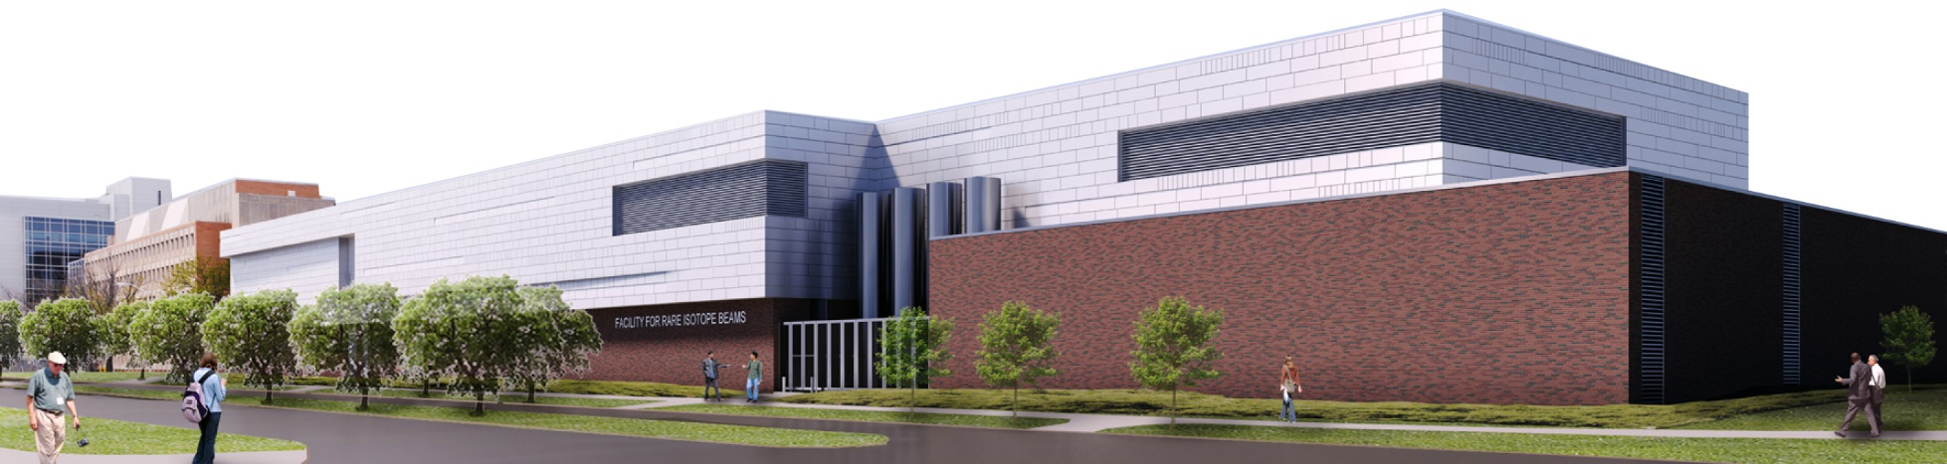
Excitement and Challenges in Nuclear Structure:
Science of Facility for Rare Isotope Beams (a 30,000-foot view)
Witold Nazarewicz (FRIB/MSU)
Nov. 28-29, 2018, CFNS Stony Brook
FRIB update
Major science themes
Perspectives

Slide 2
Prelude
“All the matter that makes up all the living organisms and ecosystems, planets and stars, throughout every galaxy in the universe, is made of atoms, and 99.9% of the mass of all the atoms in the (visible) universe comes from the nuclei at their centers which are over 10,000 times smaller in diameter than the atoms themselves” US National Academy of Sciences Decadal Study Report
Overarching questions:
Where do atomic nuclei and elements come from?
How are atomic nuclei made and organized?
What are the fundamental particles and forces at work inside atomic nuclei?
What are nuclei good for?

Slide 3
FRIB Project
FRIB will be world’s most powerful rare isotope research facility
FRIB will be a national user facility funded by the Department of Energy Office of Science (DOE-SC), Michigan State University, and the State of Michigan, representing an investment of $1B in public funds (DOE: $730M; MSU >$300M; MI: $94.5M)
FRIB will serve as a national user facility for world-class rare isotope research, and builds on more than 50 years of nuclear science expertise developed at MSU
  Nuclear physics research began at Michigan State University in 1958
  National Superconducting Cyclotron Laboratory (NSCL) enables world class discoveries by pioneering research with rare isotopes.
  MSU’s nuclear physics graduate program ranks No. 1 nationally
An artist's rendering of the FRIB building
Notes:
Other Points to Mention:
DOE contribution $730 million
FRIB enables scientist to make discoveries in properties of atomic nuclei, nuclear astrophysics, tests of fundamental symmetries, and isotope research for society
More than 1,400 world-class scientists are engaged and belong to the FRIB Users Organization (FRIBUO)
Made possible by partnerships with the best in the nation and world; 13 active Work-for-Others agreements and 14 active MOUs

Slide 4
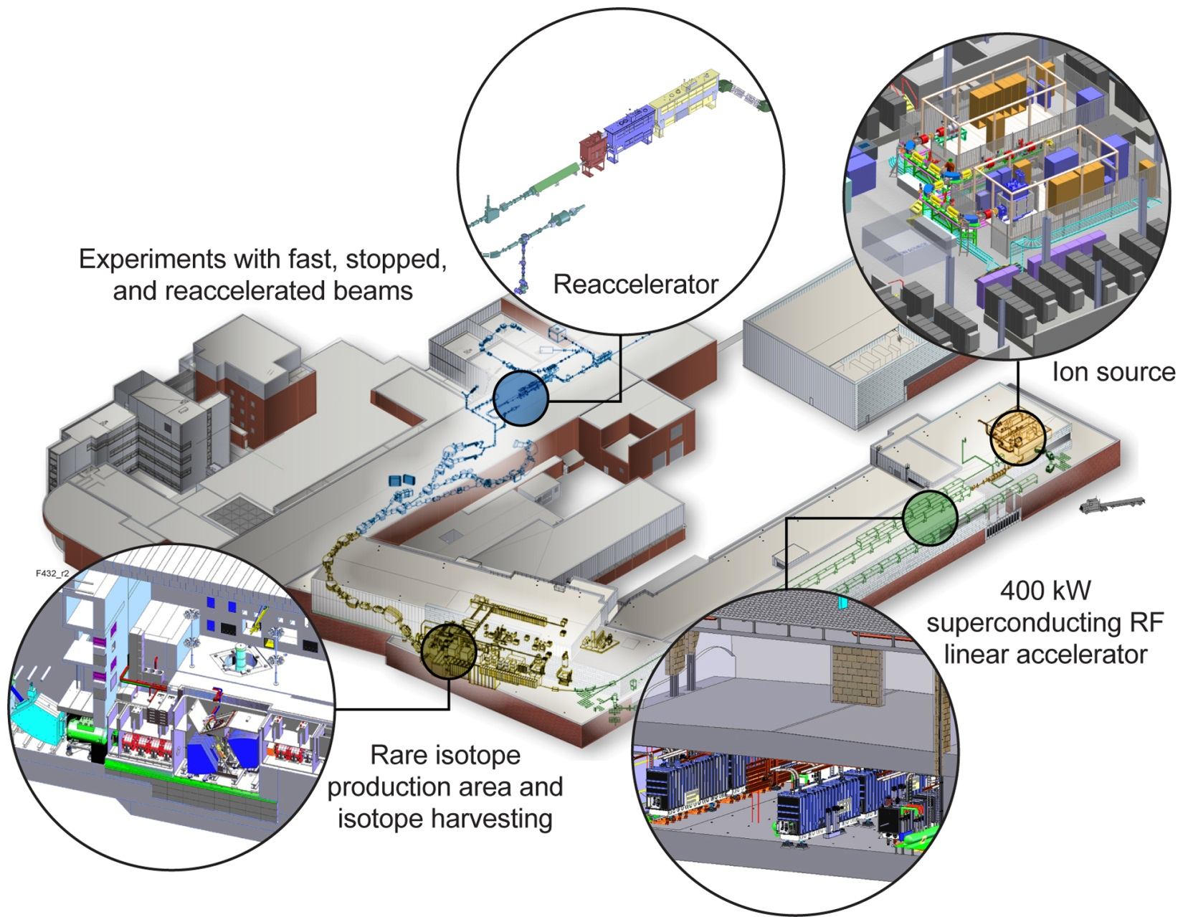
FRIB Scope and Requirements
Layout Frozen Since 2011
Deliver FRIB accelerator as part of a DOE-SC national user facility with high reliability & availability
Accelerate ion species up to ²³⁸U with energies of no less than 200 MeV/u. FRIB linac will be the world’s most powerful rare isotope accelerator
Provide beam power up to 400 kW
Option for energy upgrade to >400 MeV/u
Maintain Isotope Separation On-Line (ISOL) option
Upgradable to multi-user simultaneous operation of light / heavy ions with addition of a light-ion injector

Slide 5
Schedule on track, FRIB project is 87% complete
Oct. 1, 2018

Slide 6
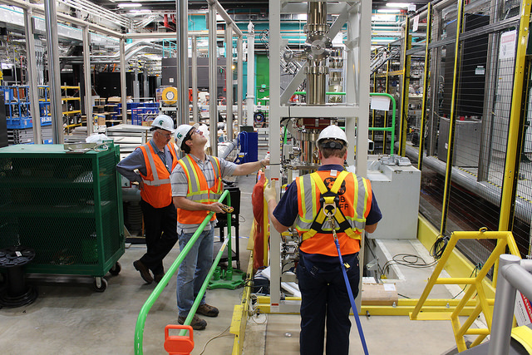
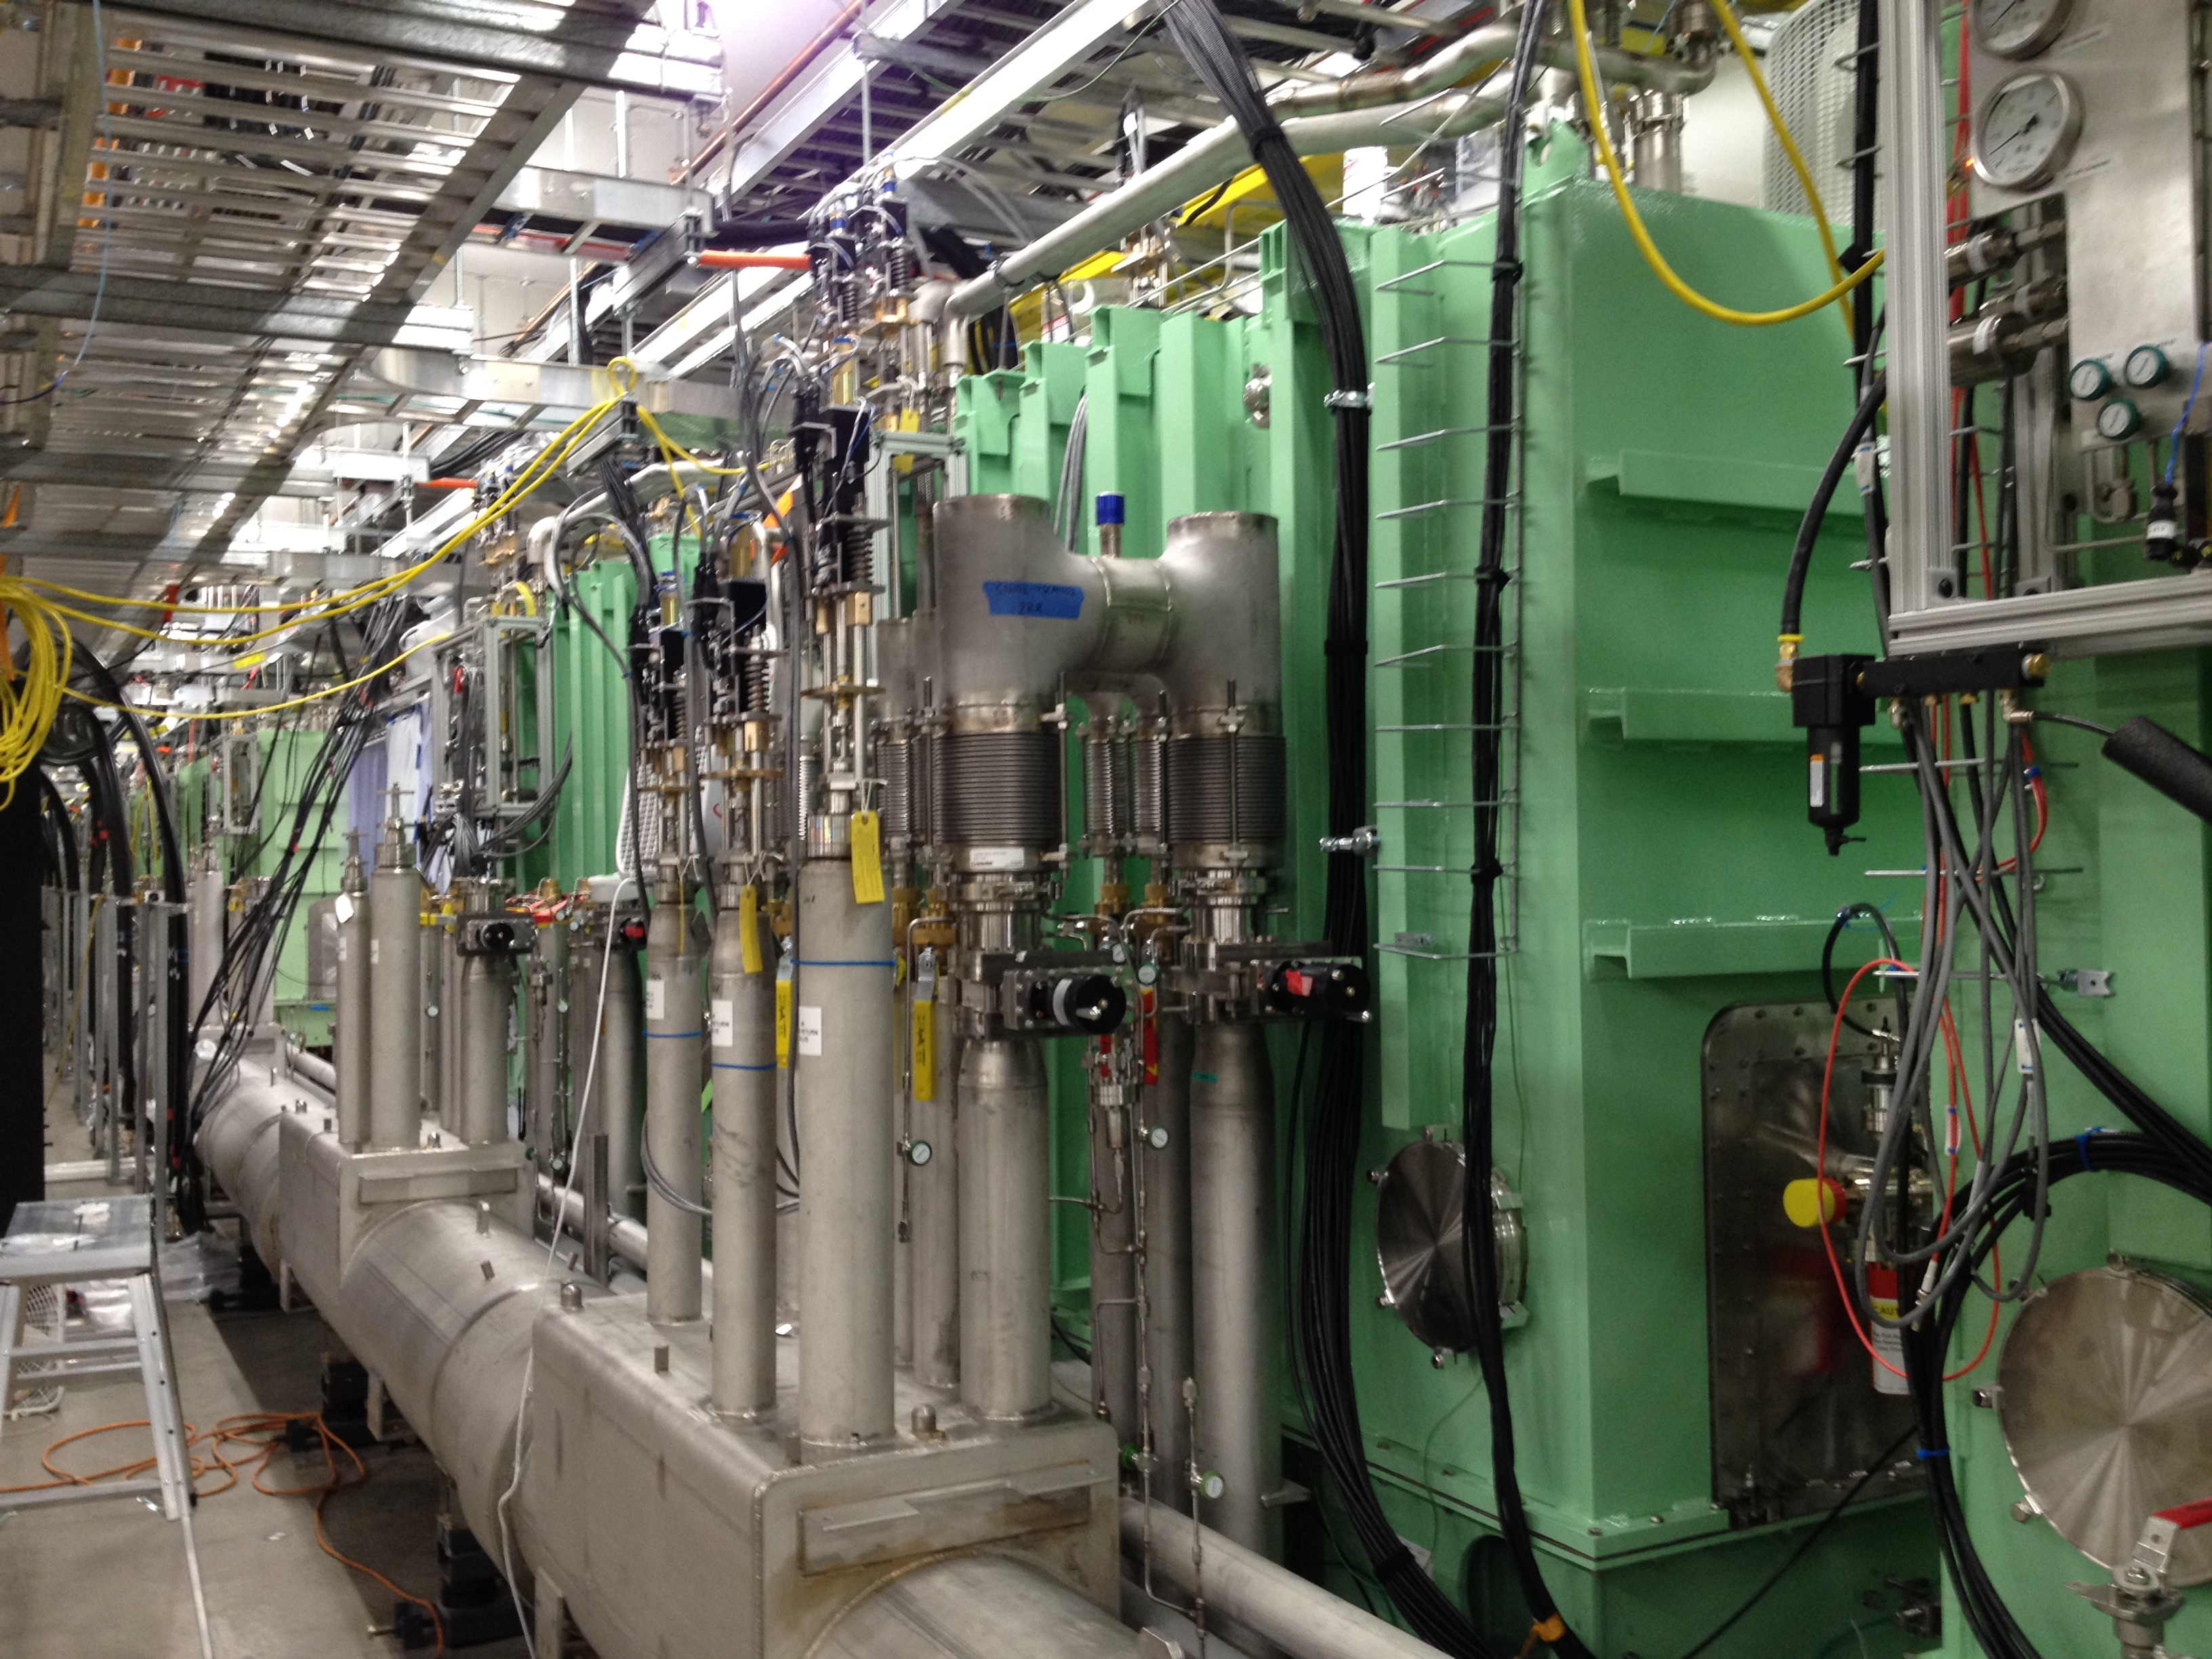
Getting There…
May 2017: Lowering the vertical beamline into the front end of the facility
July 2018: FRIB accelerated first beam in three of forty-six superconducting cryomodules
http://video-monitoring.com/construction/msufrib/slideshow.htm
Science 24 Nov 2017. Vol. 358, Issue 6366, pp. 981-982
http://science.sciencemag.org/content/358/6366/981.full

Slide 7

The Science is in the FRIB Logo
Properties of atomic nuclei
  Develop a predictive model of the atomic nucleus
Societal applications and benefits
  Medicine, energy, materials, national security
Nuclear processes in the cosmos
  Origin of the elements
  Stellar explosions
  Neutron stars
Tests of laws of nature
  Tiny effects amplified in certain nuclei; complementary information to collider data, e.g., at LHC
Middle circle:
FRIB capabilities (fast, stopped, reaccelerated, and harvested beams) that match the science program
Notes:
FRIB capabilities (fast, stopped, reaccelerated, harvested beams) that match the science program

Slide 8
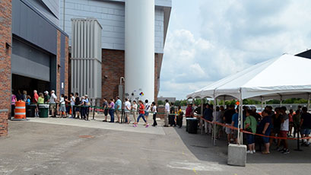
1,400 Users Engaged and Ready for Science
www.fribusers.org
Users organized as part of independent FRIB Users Organization (FRIBUO)
  Chartered organization with an elected executive committee
  1,400 members (from 117 U.S. colleges and universities, 12 national laboratories, 52 countries)
  19 working groups on instruments
Annual low-energy nuclear science
community meetings (since 2011)
Nearly 260 users participated in the most recent community meeting (August 2018) held at FRIB
Next community meeting at TUNL in August 2019
FRIB Open House on 18 August, 2018: 4,000 visitors

Slide 9
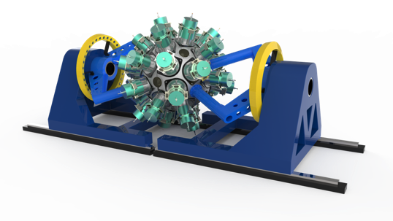
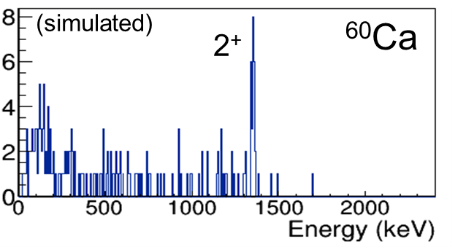
Many instrumentation projects ongoing: community engaged http://fribusers.org/workingGroups/index.html
Equipment from Si detector arrays to spectrometers in various stages of development
Example: The 4π γ-ray tracking array GRETA will be a powerful instrument needed to accomplish a broad range of experiments from nuclear structure physics to nuclear astrophysics.
DOE CD-3a approval in August 2018
Equipment for Astrophysics
Decay Station
EoS Physics
GRETINA/GRETA
Isotopes and Applications
Jet Target
Lasers
Neutron Detection
Scintillators
ReA12 Separator
Silicon Arrays
Solenoids
High Rigidity Spectrometer
Target Laboratory
New technologies and electronics
Time Projection Chamber
Traps
http://greta.lbl.gov/

Slide 10
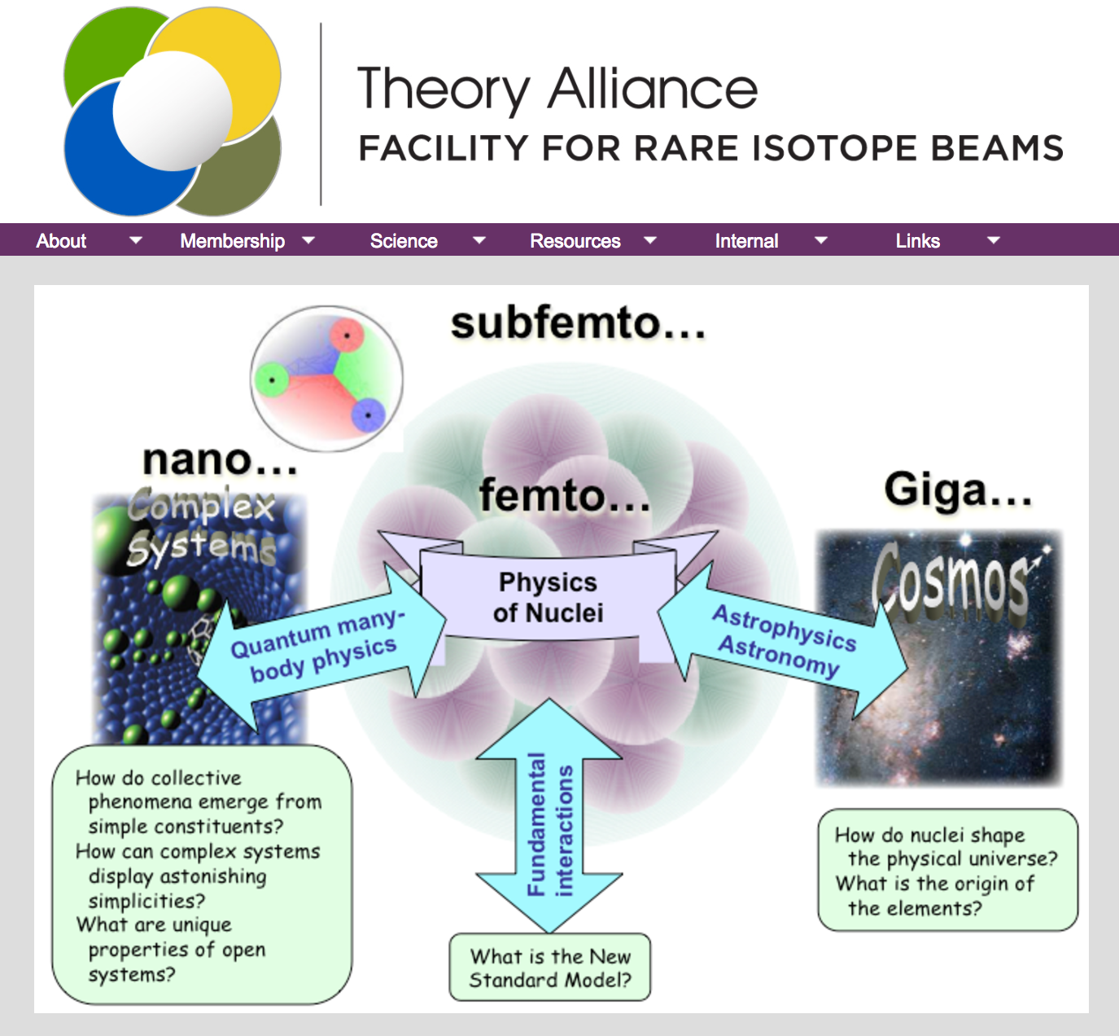

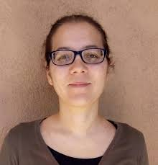
FRIB Theory Alliance
FRIB-TA was a part of the LRP 2015 theory initiative
Started June 2015
The goals
  Expand fellow program (to grow from 2 to 4)
  Implement bridge program. First two bridge theorists appointed recently by WUSTL:
  Includes visitor program and meetings
  International links
  Education (TALENT)
http://fribtheoryalliance.org/
TALENT: http://nucleartalent.org

Slide 11
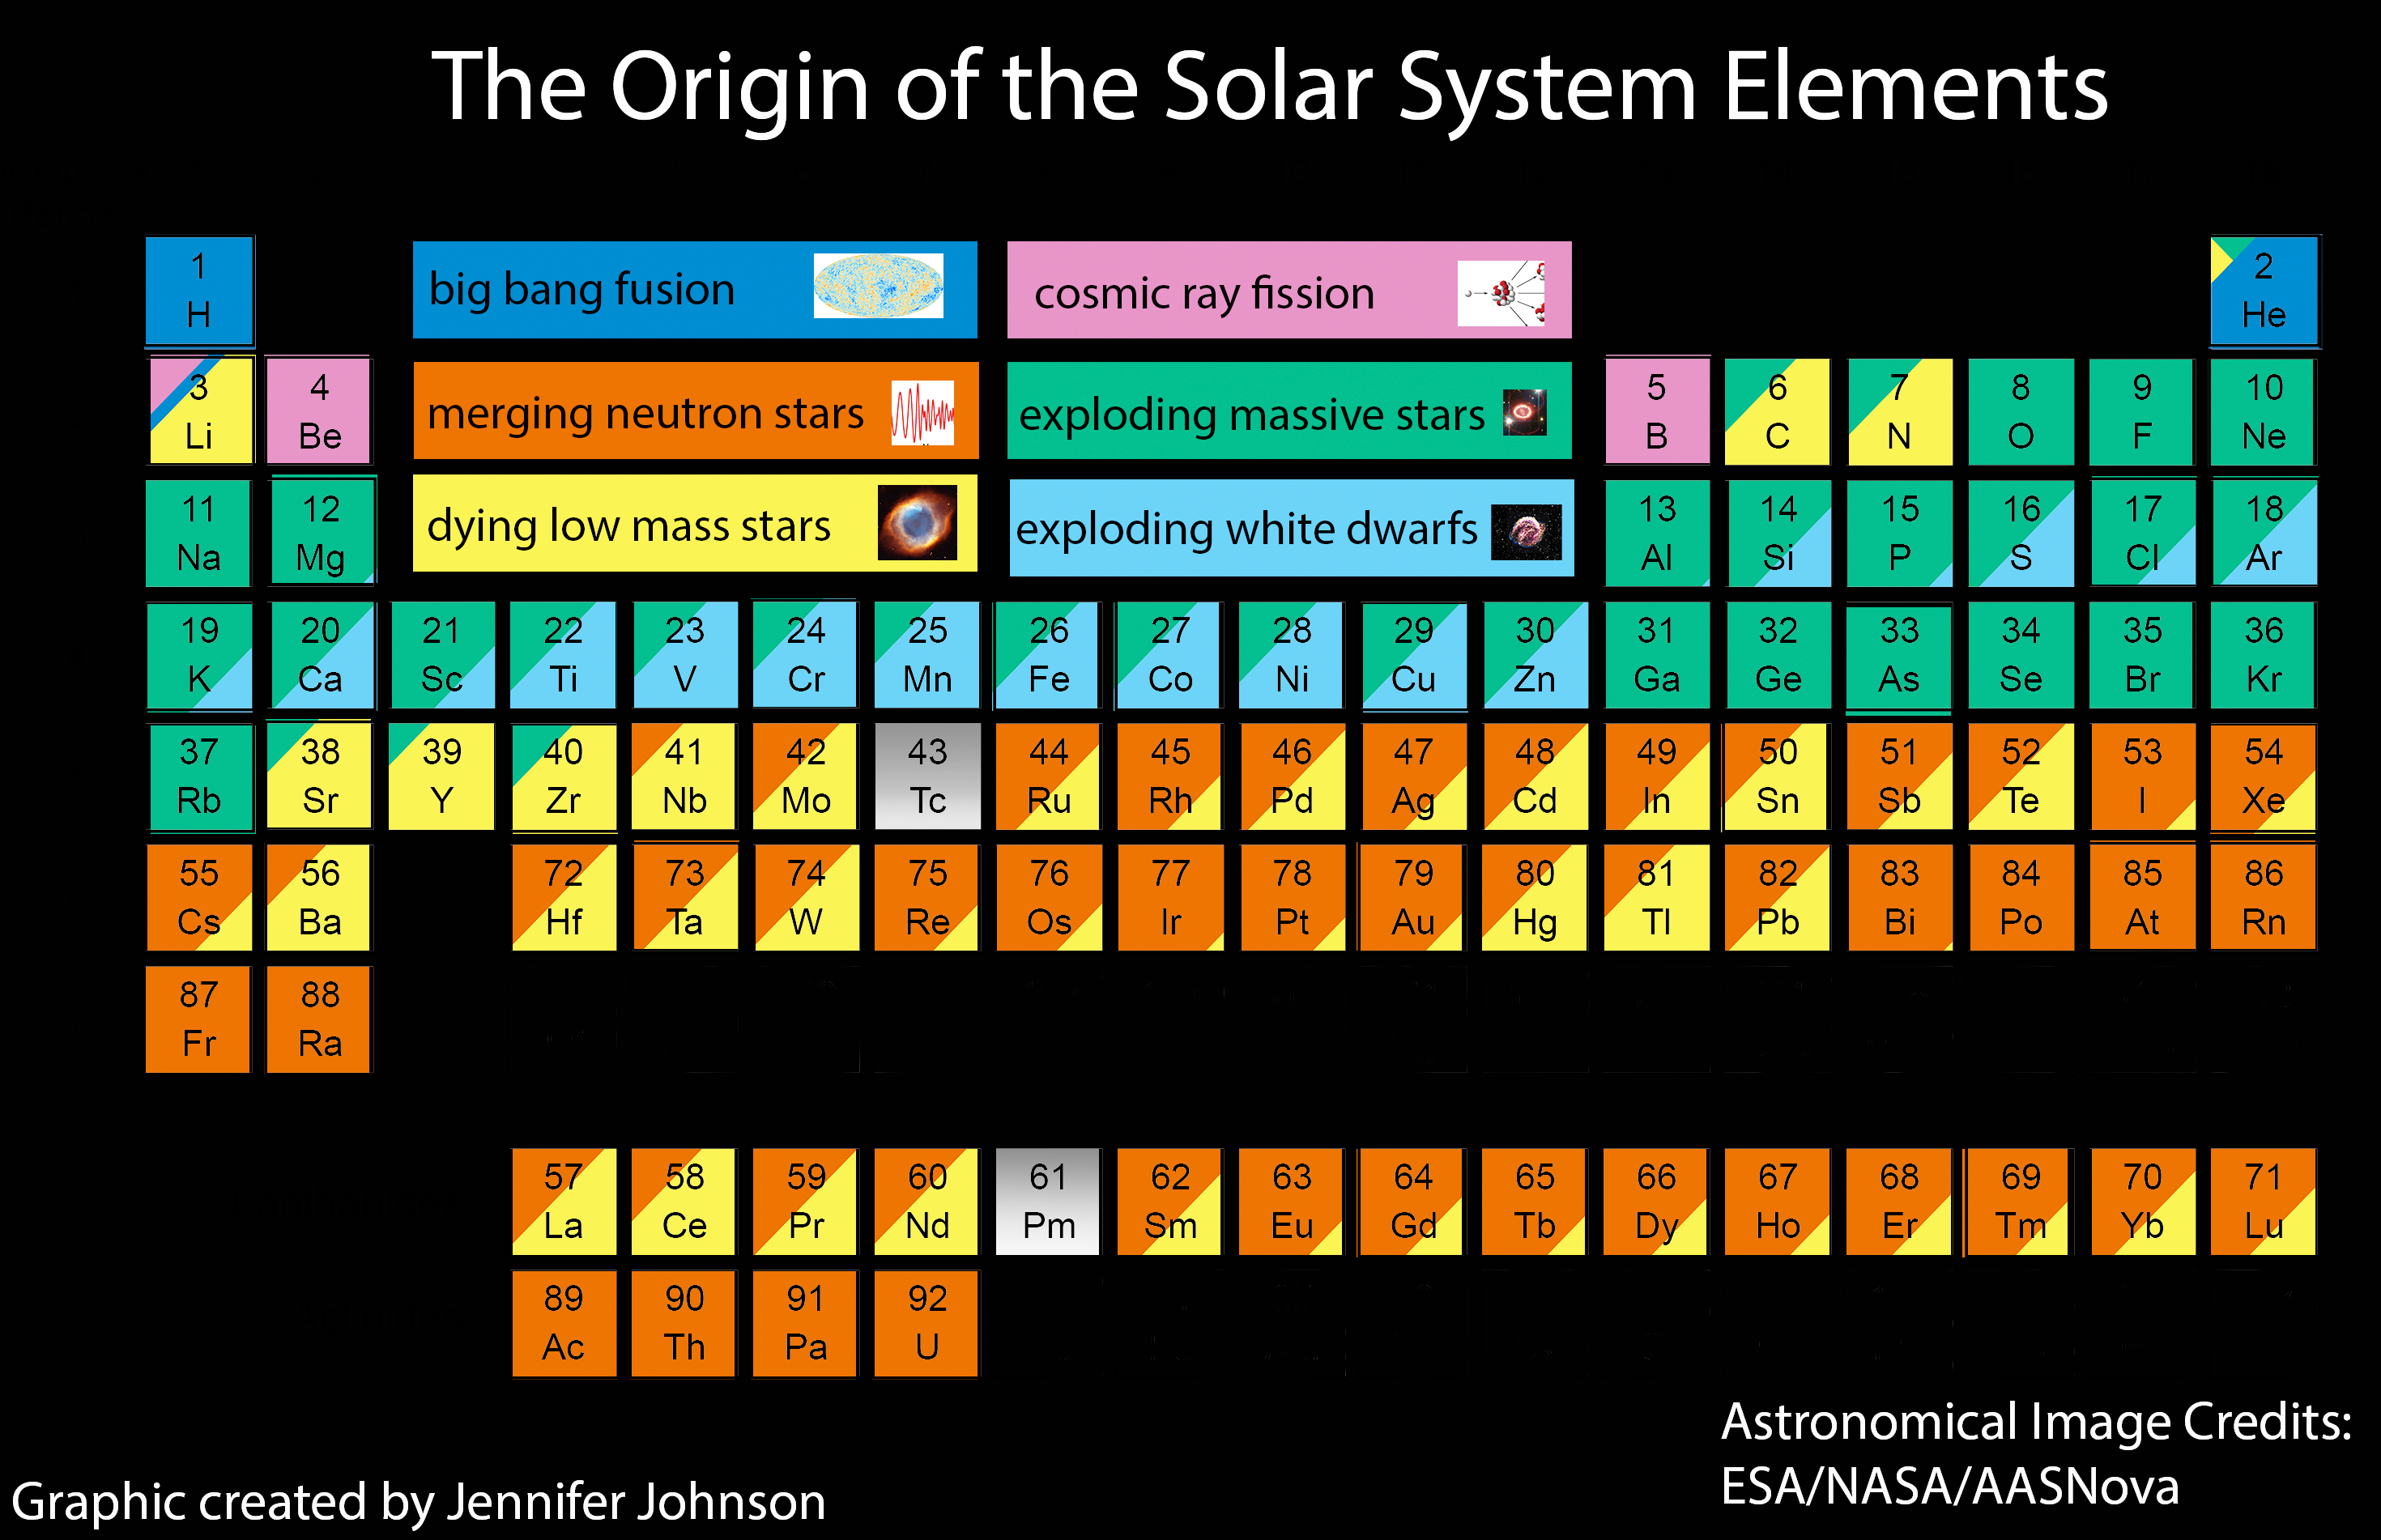

Where do atomic nuclei and elements come from?

Slide 12
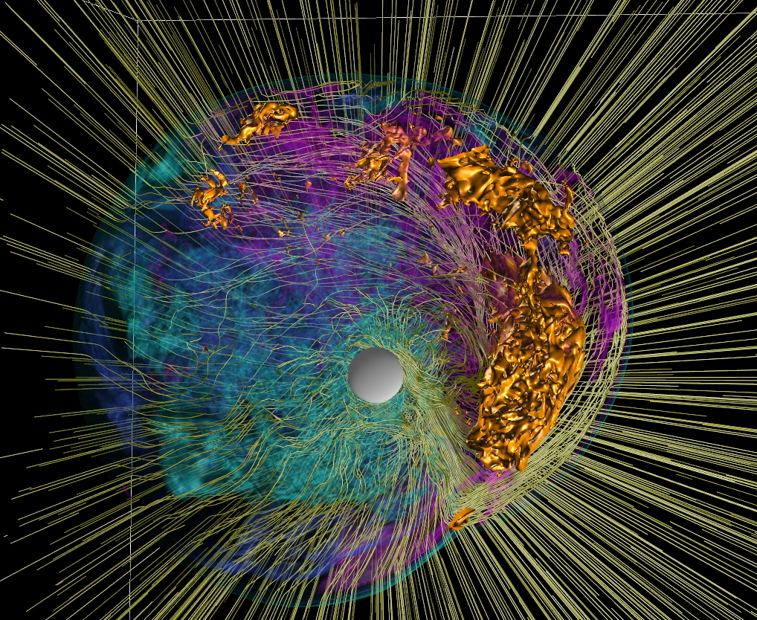
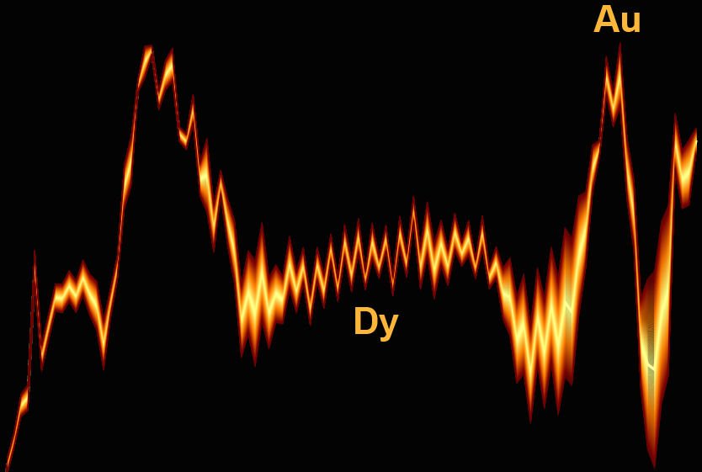
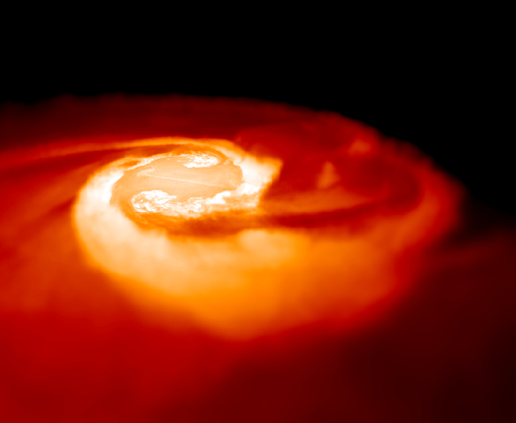
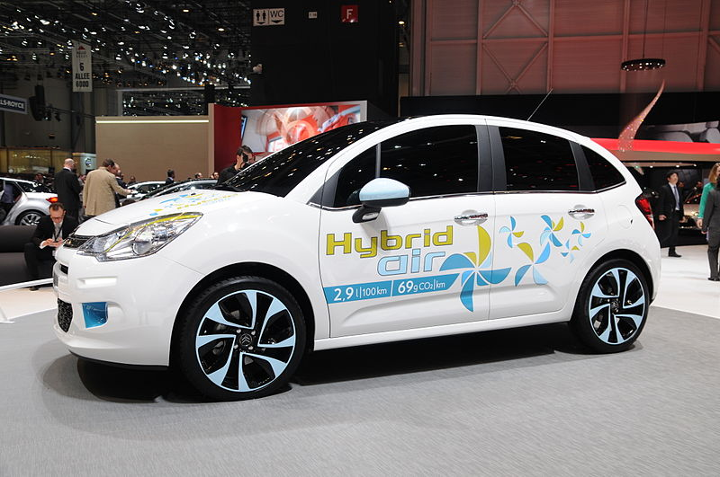
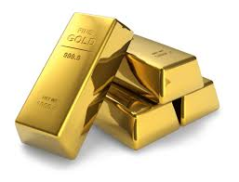
Half of the neutron-rich atomic nuclei heavier than iron are built by neutron driven r-process. The final abundances reflect the structure of nuclei, which determines the nucleosynthesis trajectories.
supernova
abundance
The main site of the r-process has been debated for ~60 years.
Nature 445, 58 (2007)
neutron star mergers
atomic number
Au
Dy
Mon. Not. R. Astron. Soc. 430, 2585 (2013)

Slide 13
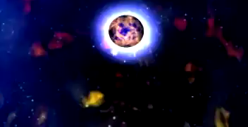
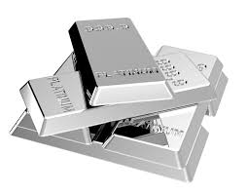
GW170817: a gravitational wave signal observed by the LIGO and Virgo detectors on 17 August 2017; collision of two inspiraling neutron stars with a total mass of 2.82 solar masses, duration of 100 sec.
A play in three acts
Act 1: Ligo-Virgo detect GW from BNS merger. Source properties inferred. Extraction of “chirp” mass and “tidal polarizability”. New limits on the EOS of dense matter.
Act 2: Fermi/Integral detect short γ-ray burst ~2 seconds after GW signal. Confirms the association between BNS merger and γ-ray bursts
Act 3: ~70 telescopes tracked the “kilonova”. Afterglow of the explosive merger ~11 hours later. Powered by the radioactive decay of r-process elements. BNS mergers as a critical site for the r-process!
NASA/Dana Berry
A total of 16,000 times the mass of the Earth in heavy elements is believed to have formed, including approximately ten Earth masses just of the two elements gold and platinum.
FRIB will give access to the extremely neutron-rich isotopes that have now been identified to play a key role in explaining the observed kilonova.
13

Slide 14
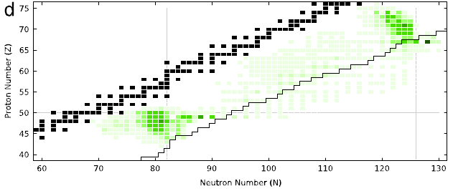
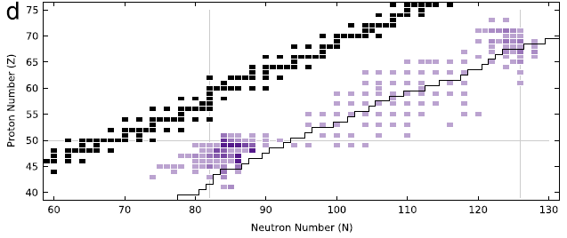
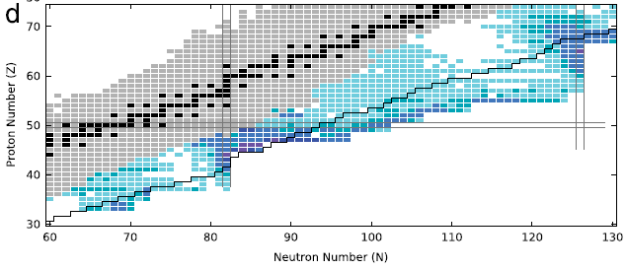
FRIB: r-process machine
By reaching into the r-process nuclei, FRIB will provide constraints on key observables
Prog. Part. Nucl. Phys. 86, 86 (2016)
neutron capture rates
FRIB line: 10⁻⁴ particles/s
β-delayed neutron emitters
Sensitive masses

Slide 15
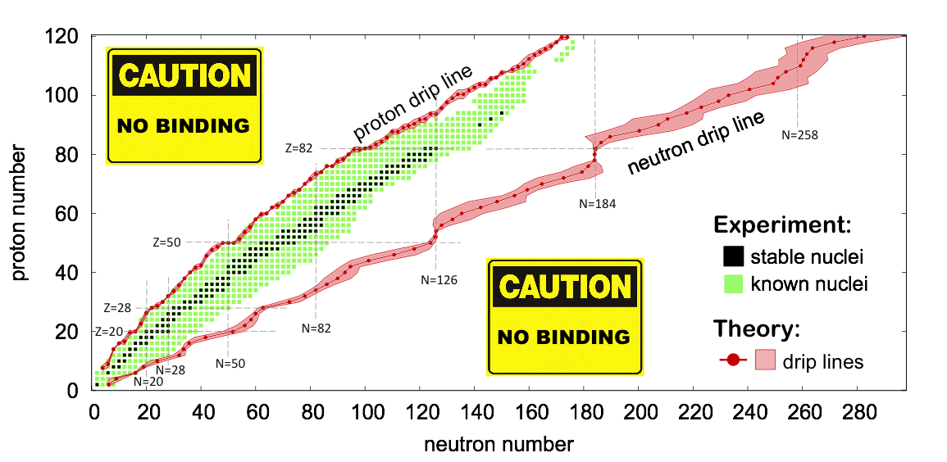
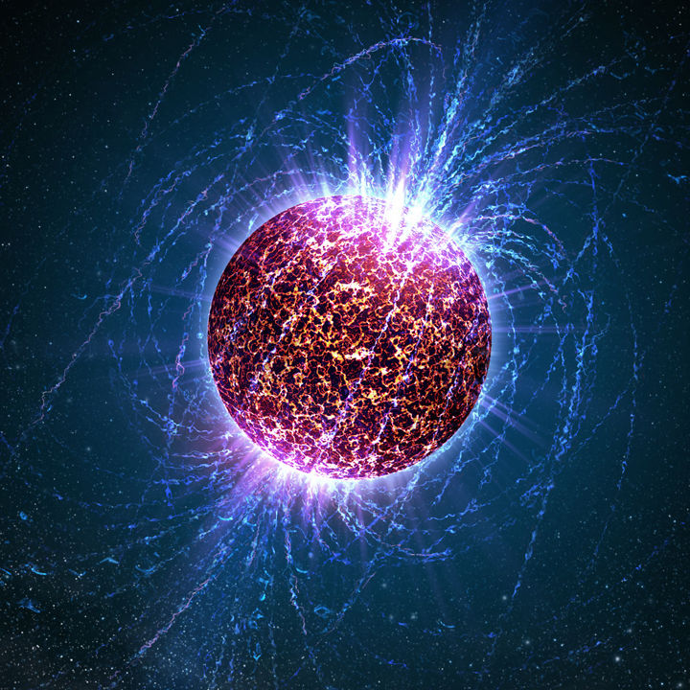
Exploring the Grand Nuclear Landscape
How are nuclei made and organized?
superheavy
nuclei
Unknown territory
N~10⁵⁷

Slide 16
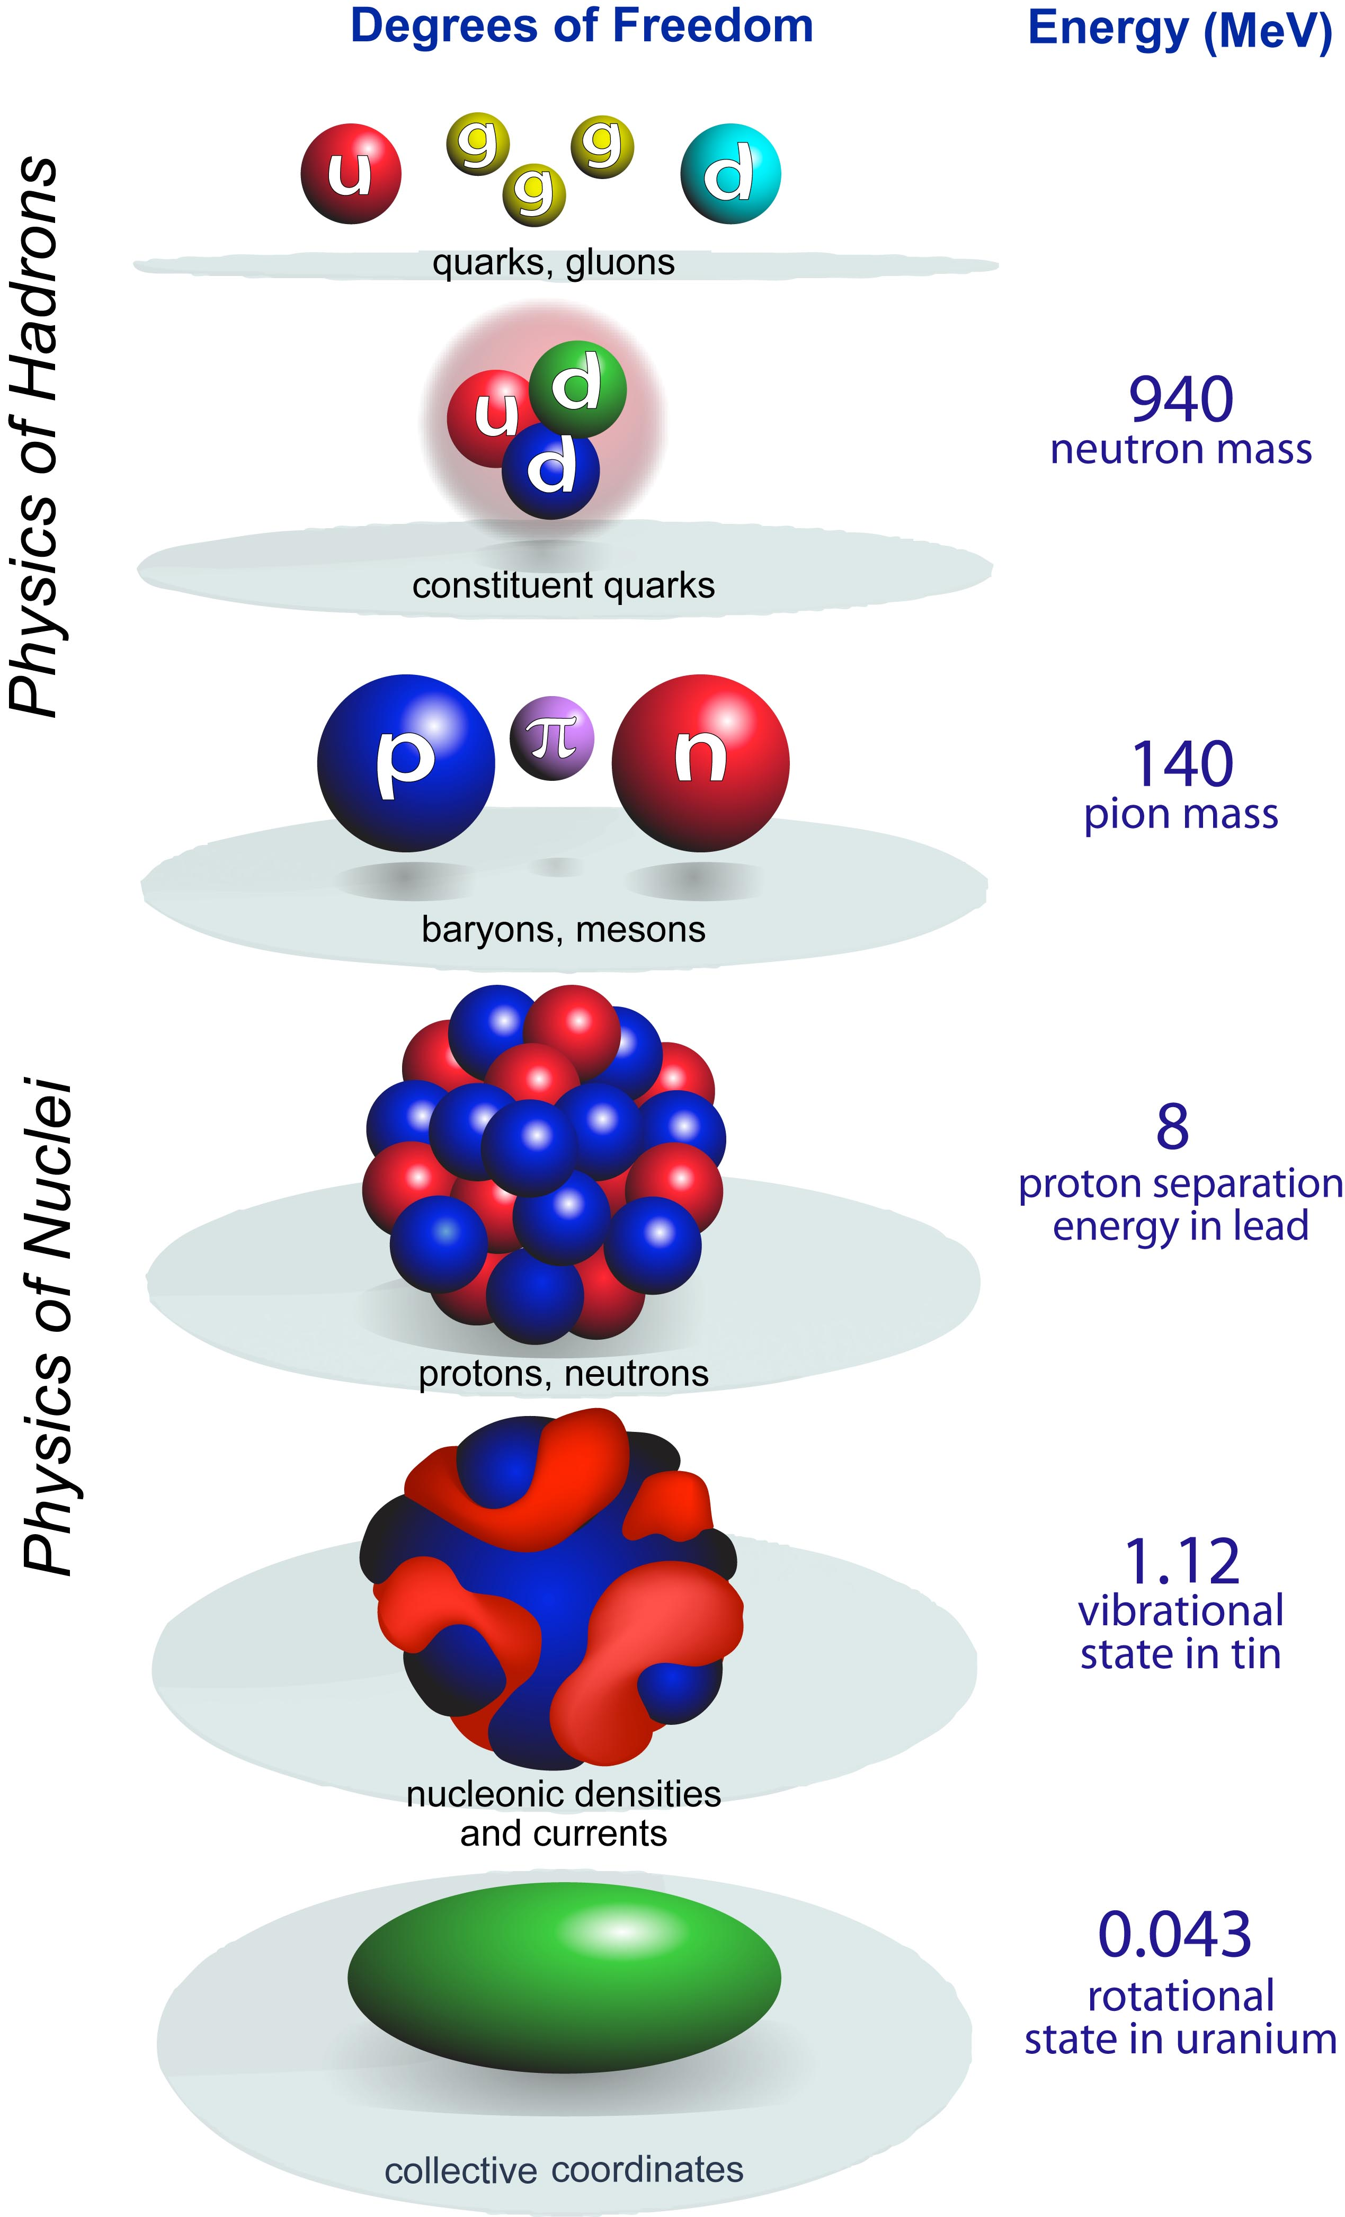

scale
separation
LQCD
Hot and dense quark-gluon matter
Hadron structure
quark
models
Resolution
Nuclear-Particle Physics
A-body
Nuclear structure
Nuclear reactions
New standard model
Societal applications
Effective Field Theory
CI
DFT
Most efficient approach: resolving power of a theoretical model taken as low as reasonably possible for the question at hand
collective
Notes:
All nuclear models are phenomenological but at different resolution

Slide 17
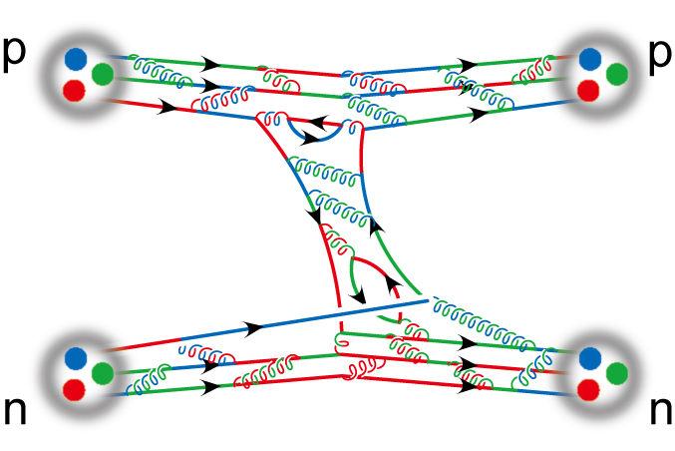
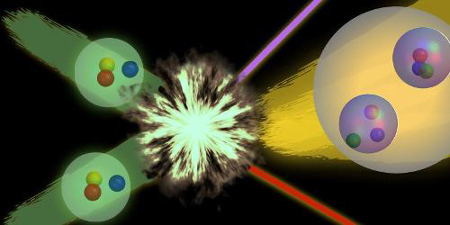
Rooting nuclei in QCD
LQCD predictions for magnetic moments A<4
PRL113, 252001 (2014)
Proton fusion and tritium decay from LQCD
PRL113, 062002 (2017)
A LQCD calculation of the nucleon axial charge g_{A} Nature 558, 91 (2018)

Slide 18
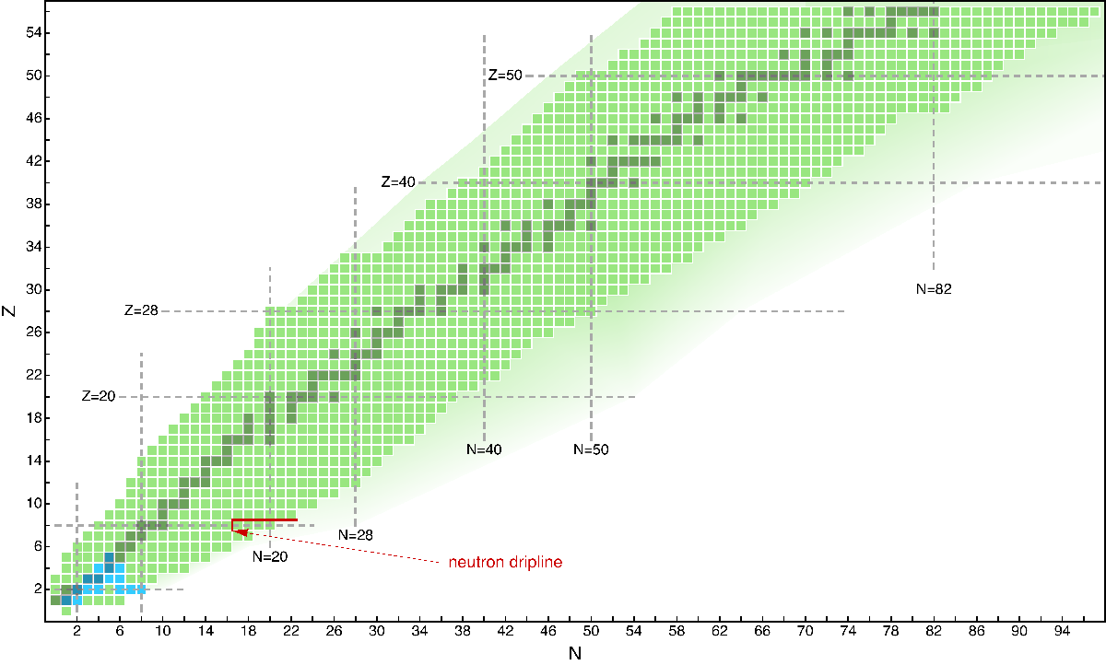
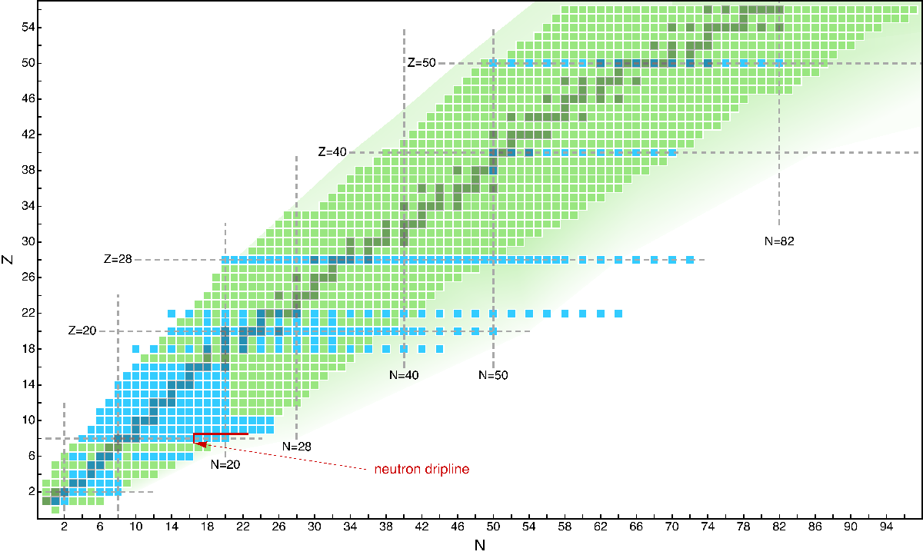
Nuclei from NN+NNN interactions
PRL117, 172501 (2016)
(2005)
Phys. Rept. 621, 1765 (2016)
Super-allowed Gamow-Teller decay of ¹⁰⁰Sn
Hagen et al., submitted
(2015)

Slide 19
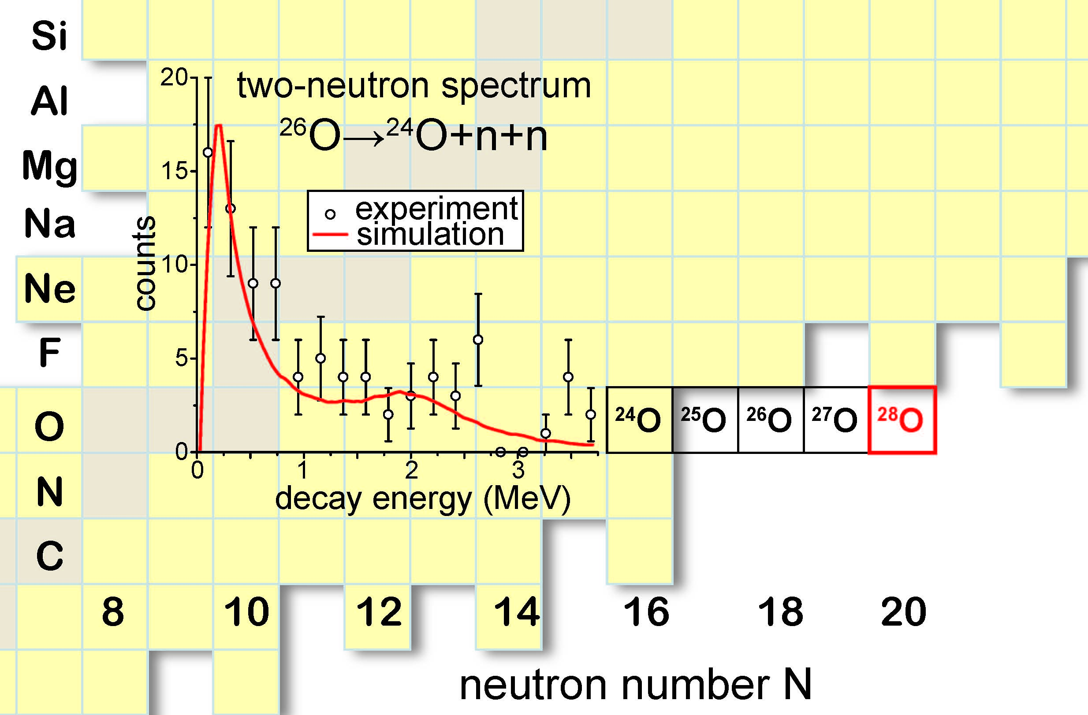
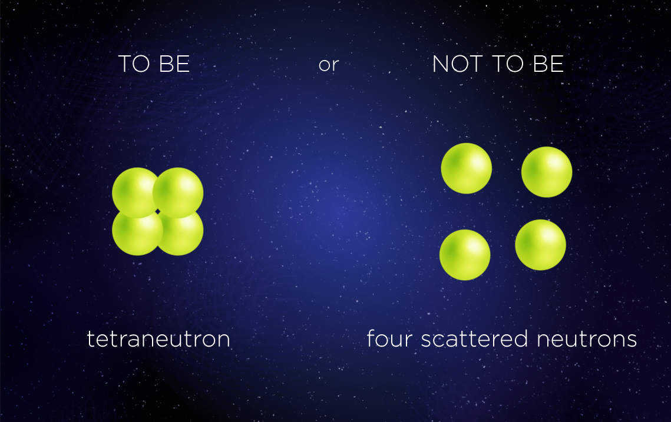
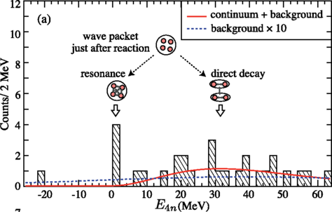
Revision of nuclear structure textbooks in the neutron-rich territory
Challenging 4n system
A dineutron in ²⁶O
Structure of (doubly-magic) ¹⁰He, ²⁸O. Threshold systems
Unbound ¹¹O found, a mirror nucleus to ¹¹Li
PRL 116, 052501 (2016)
Theory says: NO

Slide 20
Example: Charge radii of calcium isotopes
Where A-body and DFT meet…
Nature Physics 12, 594 (2016)
Recent optimization Fy(Δr)
Phys. Rev. C 95, 064328 (2017)
BECOLA: Proton superfluidity and charge radii in proton-rich calcium isotopes, submitted

Slide 21
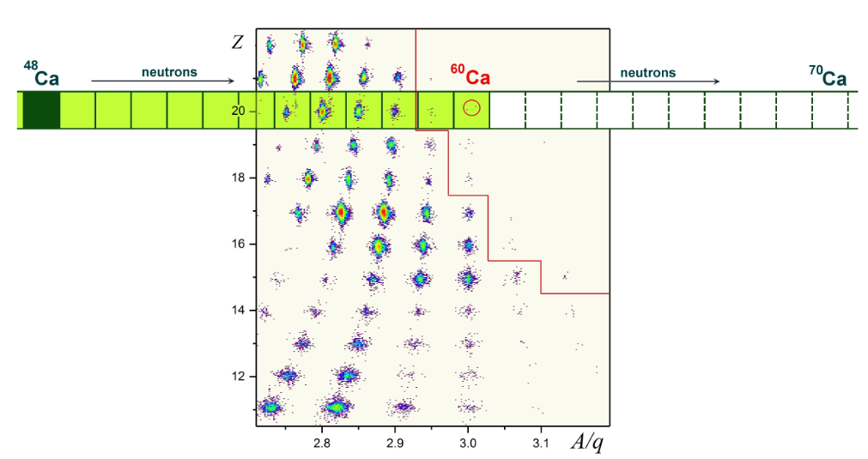
How many Ca nuclei exist? ⁶⁰Ca was observed experimentally. Theory: The jury is still out …
A-body
⁶⁰Ca weakly bound/unbound, ⁶¹⁻⁶²Ca are located right at threshold
PRL 118, 032502 (2017)
Calcium isotopes bound out to about ⁷⁰Ca
Phys. Scr. 2013, 014022 (2013)
Discovery of ⁶⁰Ca
DFT
Phys. Rev. Lett. 121, 022501 (2018)

Slide 22
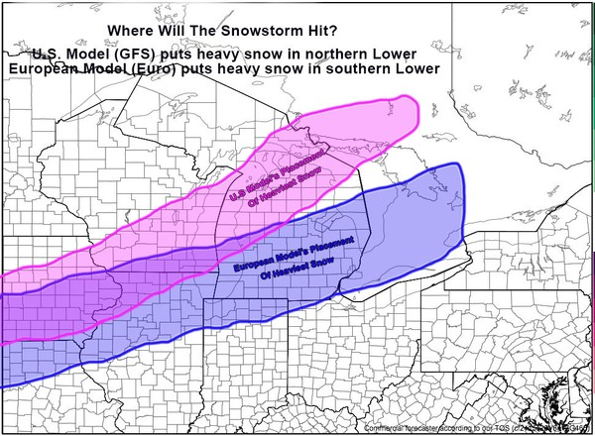
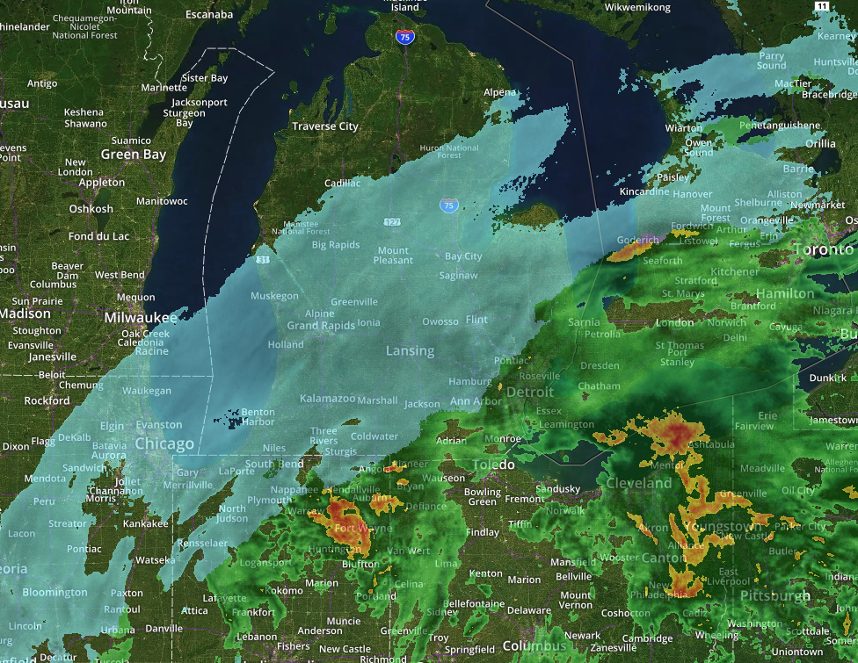
Nov. 24, 2018, 8am
Nov. 26, 2018, 5.30am
www.mlive.com/

Slide 23
Future: Quantified predictions with machine learning
Probability of existence
Bayesian approach to model-based extrapolation of nuclear observables
Phys. Rev. C 98, 034318 (2018)
Bayesian model mixing

Slide 24
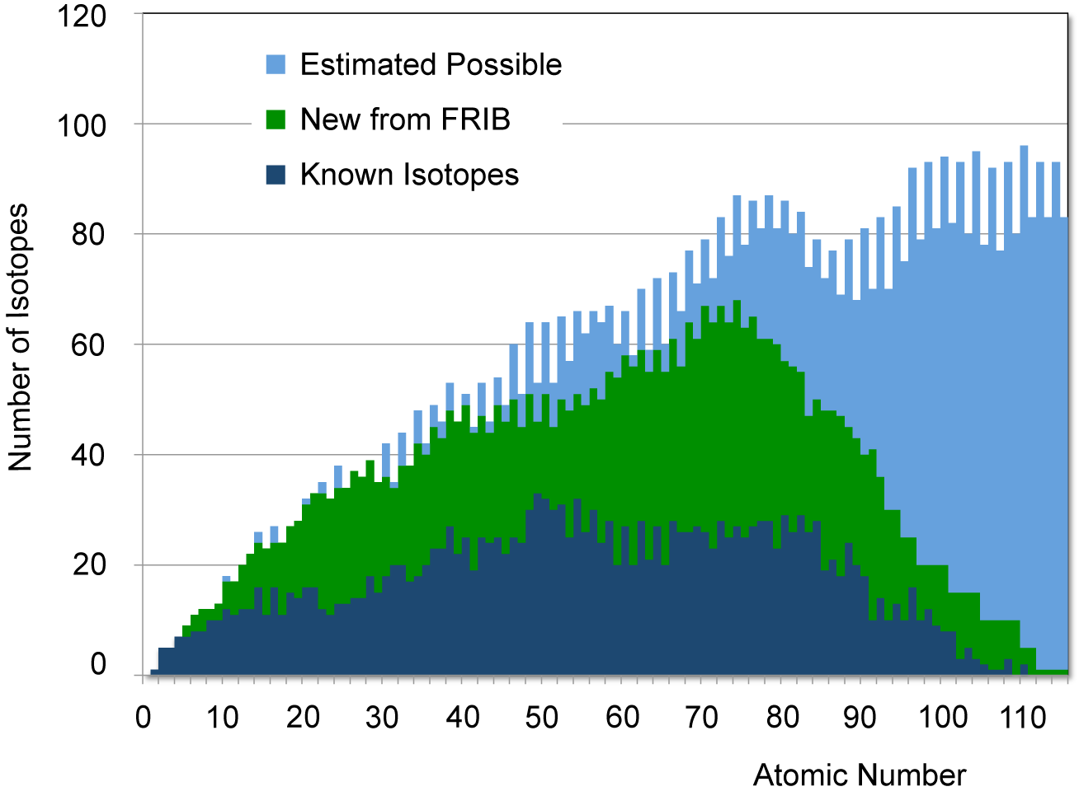
The Reach of FRIB
FRIB will double the knowledge of known nuclei; it will access 80% of all isotopes predicted to exist for elements below uranium
FRIB will extend the neutron drip line from Z=8 (now) to approximately Z=40
The unprecedented reach of FRIB will give access to entirely unexplored regions of the nuclear chart where large neutron skins and extreme halos exist
DFT
FRIB
current
Cross section corresponding to the production of 1 atom/week at FRIB: 3 x10⁻²⁰ b, 5 orders of magnitude lower than at present facilities.

Slide 25

What are the limits of atoms and nuclei?
FRIB will help delineate HI fusion mechanism with neutron rich beams
BGS+FIONA
Experiment

Slide 26
Shell structure and fermion localization
P. Jerabek et al., Phys. Rev. Lett. 120, 053001 (2018)
electrons
nucleons

Slide 27
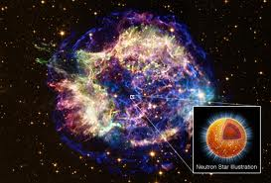
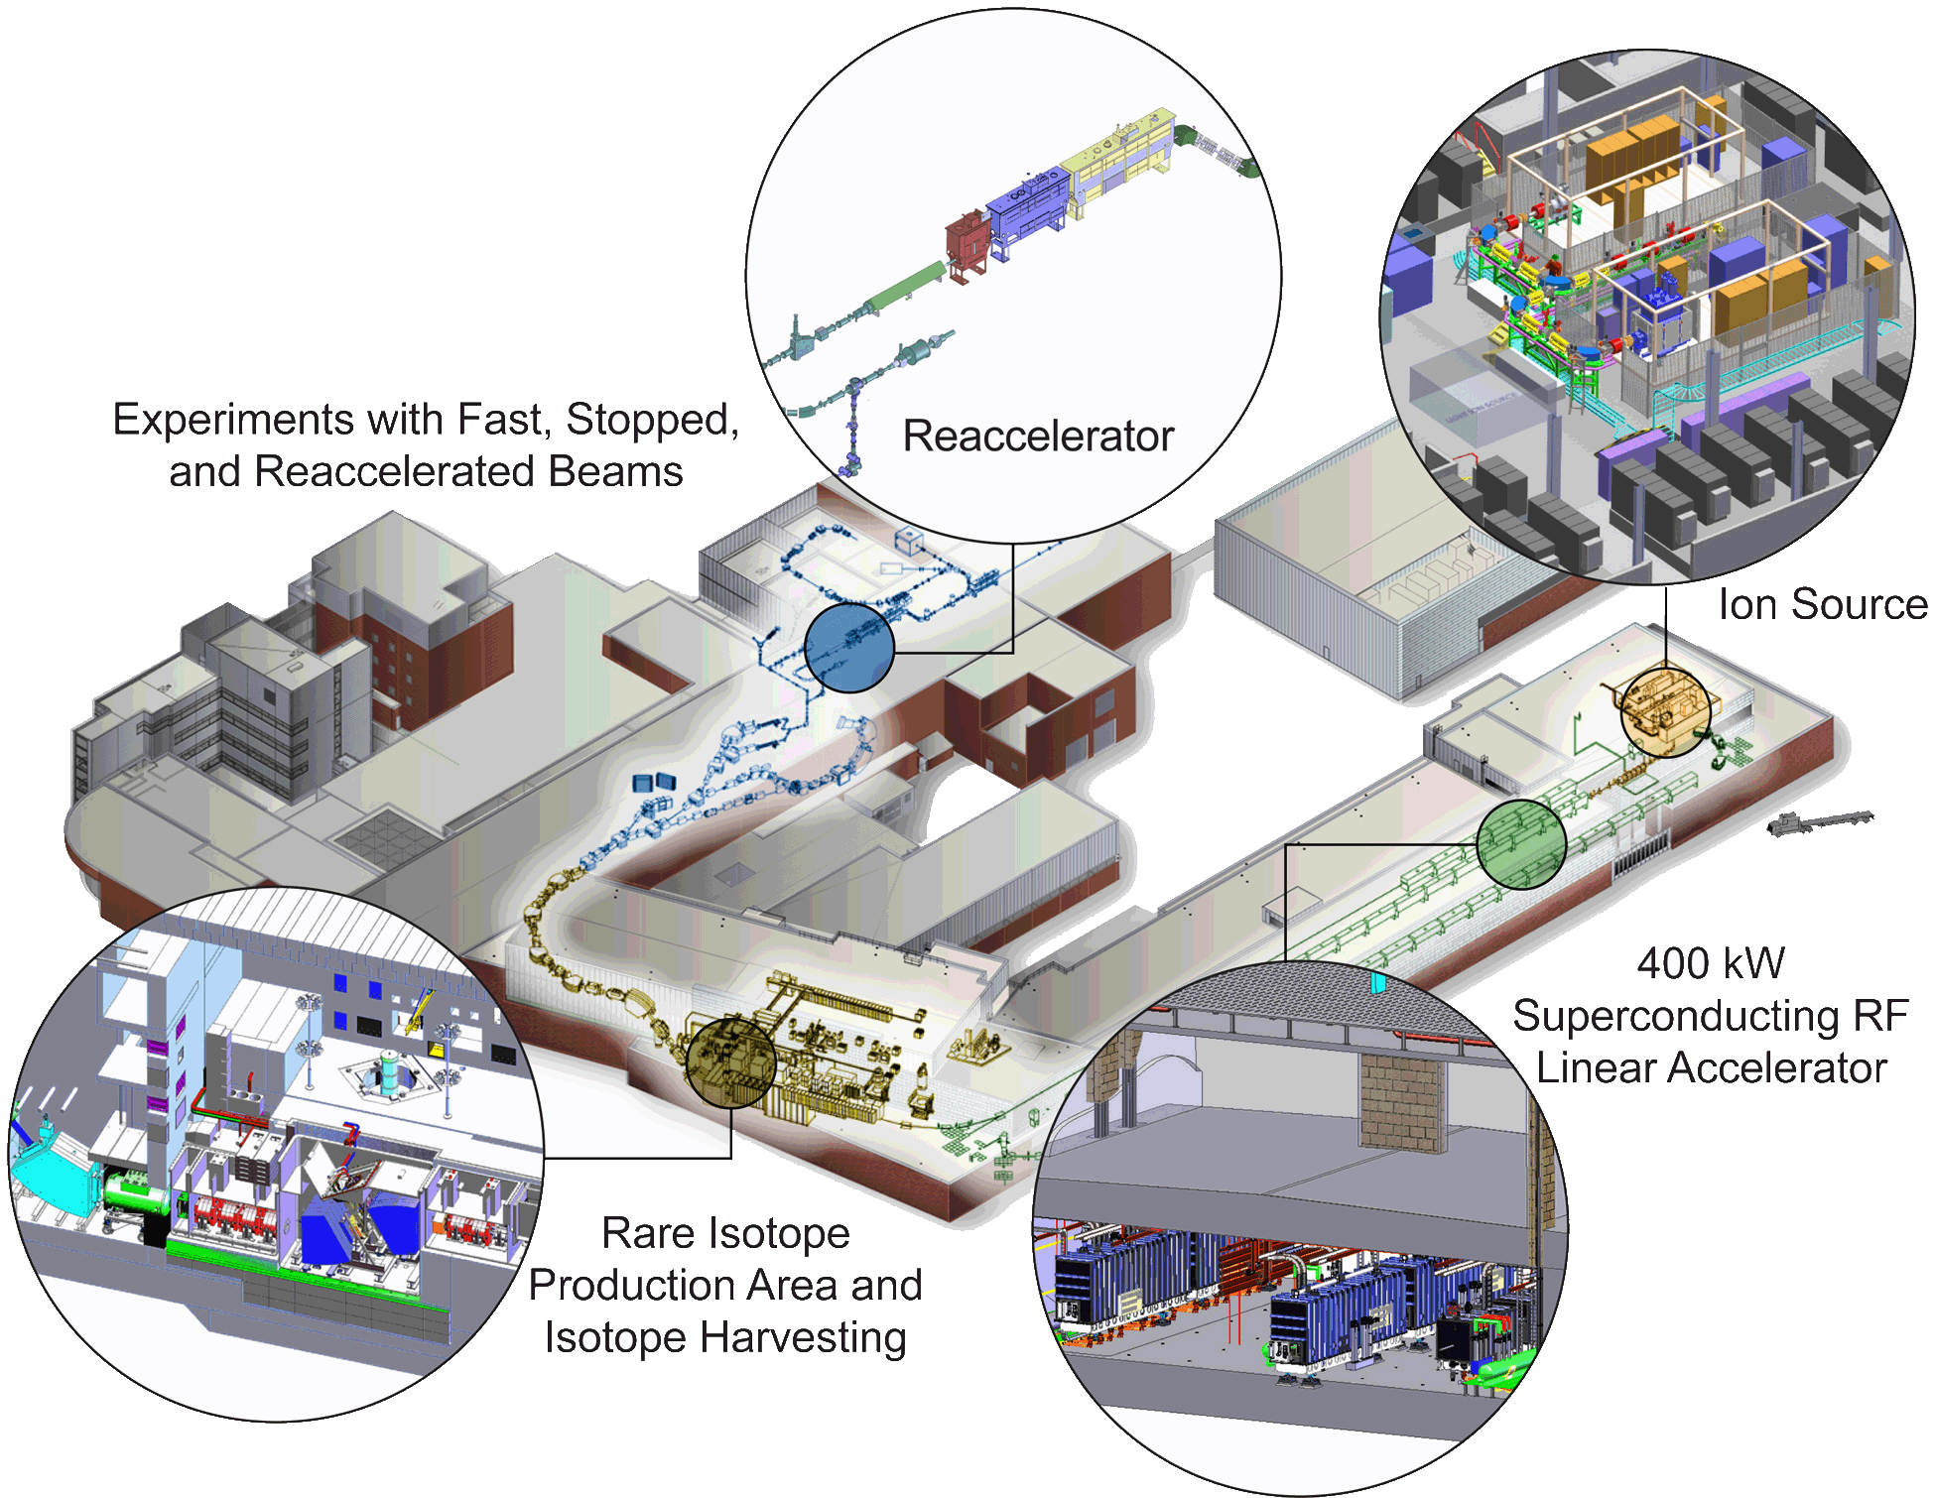
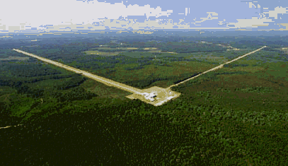
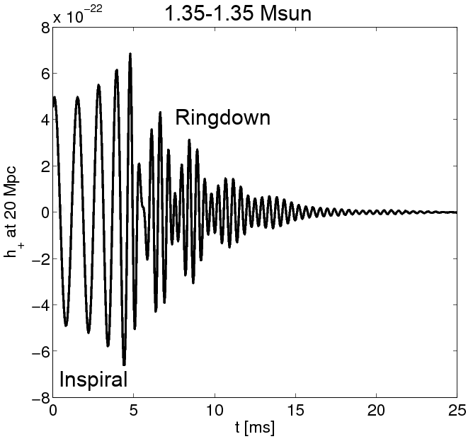
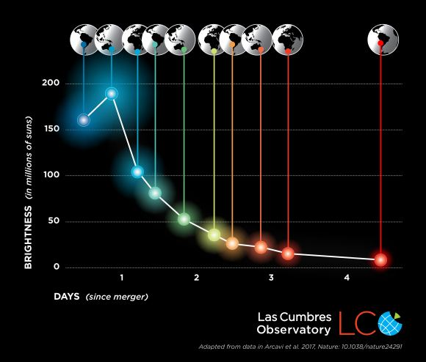
Quest for understanding the neutron-rich matter on Earth and in the Cosmos
Data
Crustal structures in neutron stars
GW signal
EOS
NS mass
kilonova
Time evolution determined by the radioactive decay of r-process nuclei

Slide 28
Nuclear matter equation of state
Erler et al., Phys. Rev. C 87, 044320 (2013)
Tews et al, ApJ 848, 105 (2017)
Access to nuclei with large neutron skins

Slide 29


Testing the fundamental symmetries of nature
Parity violation
studies in francium
126
Weak interaction
studies in N=Z nuclei
CKM matrix unitarity
82
EDM search
in radium
ββ0ν searches
50
protons
82
28
  Specific nuclei offer new opportunities for precision tests of fundamental symmetries.
  How will we turn experimental signals into precise information on physics beyond the standard model?
20
50
8
28
2
20
neutrons
2
8
neutron EDM

Slide 30
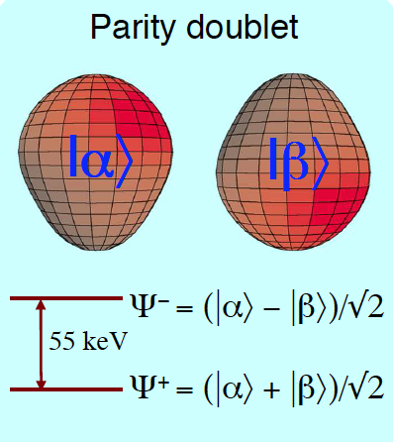
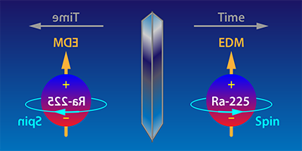
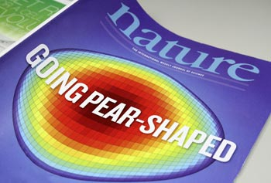
Rare Isotopes and fundamental symmetry tests
Atomic electric dipole moment: The violation of CP-symmetry is responsible for the fact that the Universe is dominated by matter over anti-matter
Closely spaced parity doublet gives rise to enhanced electric dipole moment
Large intrinsic Schiff moment
  ¹⁹⁹Hg (Seattle, 1980’s – present)
  ²²⁵Ra (ANL, KVI)
  Parker et al. 2015, d<5x10⁻²² e cm
  ²²³Rn at TRIUMF (E929)
  FRIB
  Widest search for octupole deformations
  ²³⁸U beam, beam dump recovery: ²²⁵Ra: 6x10⁹/s, ²²³Rn: 8x10⁷/s
  ²³²Th beam: ²²⁵Ra: 5x10¹⁰/s, ²²³Rn: 1x10⁹/s
  10¹²/s w ISOL target FRIB upgrade
Gaffney et al., Nature 199, 497 (2013)
Notes:
the decays of K and B mesons,
EDM: involves Lund, Jyvaskyla, Helsinki

Slide 31
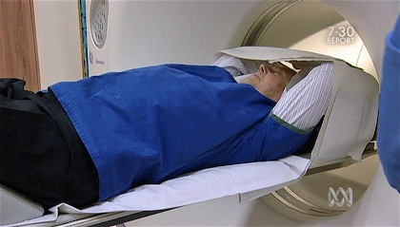
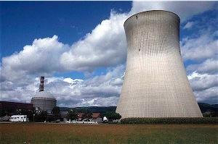
Who cares?
What are practical and scientific uses of nuclei?
FRIB will
allow “harvesting” of key isotopes in research quantities for development of medical applications
advance the U.S. national security missions in stockpile stewardship and nuclear forensics
provide isotopes that support new research in ecology and biochemistry
produce the relevant actinides and their fission products important for the nuclear power industry
provide new isotopes that will serve as tools for nanoscience, material science, and engineering

Slide 32
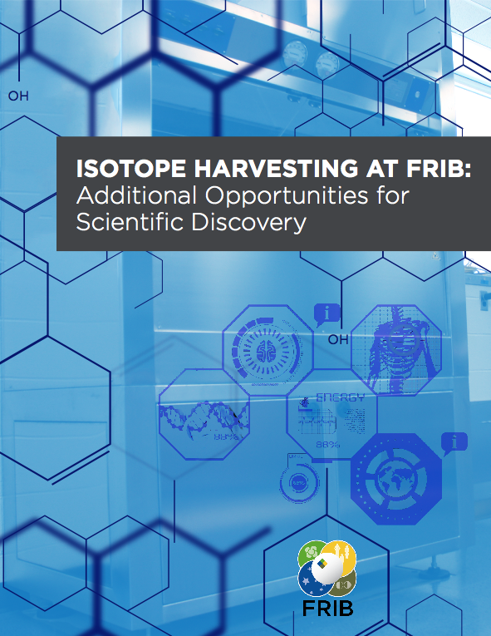
FRIB’s on-line isotope harvesting capability is ideally suited to support a broad program in applied isotope research
Harvesting can be in place on day-one
R&D for developing necessary techniques underway at NSCL. Proof or principle: A 76 MeV/u ⁶⁷Cu beam produced by projectile fragmentation was stopped in water and successfully isolated from the aqueous solution
Scientific Reports 4, 6706 (2014)
Medical applications
Biochemistry and materials
Trace-nutrient transport in plants, soil, and the microbiome
Radio-thermal generators
Stewardship science applications
…
http://frib.msu.edu/_files/newsletters/frib_luu/Isotope-Harvesting-at-FRIB-TC-Dec21.pdf
32

Slide 33
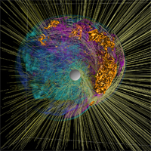
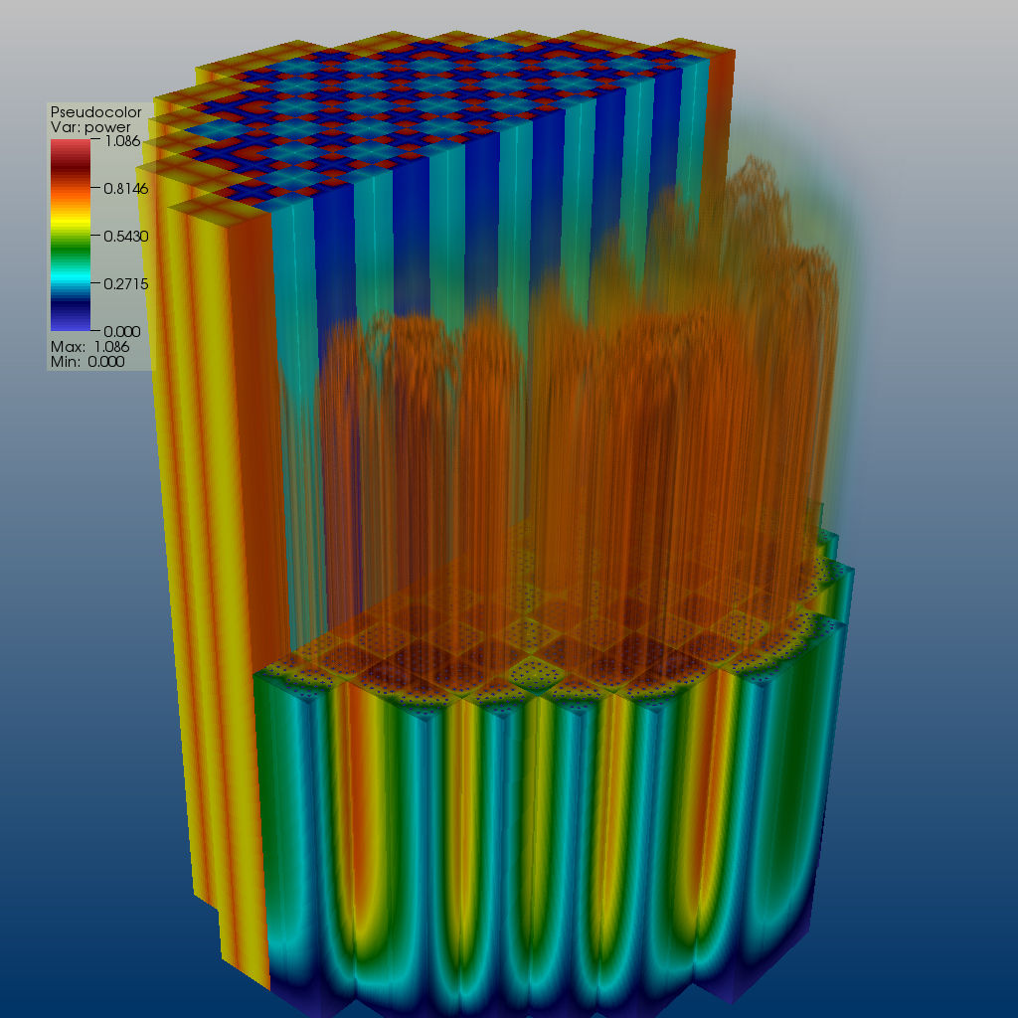
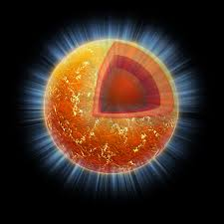

Bayesian inference & FRIB science
Beam time and compute cycles are difficult to get and expensive
  What is the information content of measured observables?
  Are estimated errors of measured observables meaningful?
  What experimental data are crucial for better constraining current nuclear models?
New technologies are essential for providing predictive capability, to estimate uncertainties, and to assess extrapolations
  Theoretical models are often applied to entirely new nuclear systems and conditions that are not accessible to experiment
Statistical tools can help us revealing the structure of our models
  Parameter reduction
  Uncertainty quantification

Slide 34

"It is exceedingly difficult to make predictions, particularly about the future” (Niels Bohr)
Looking into the crystal ball: year 2030 and beyond
The rate of progress is excellent!
J. Phys. G 43, 044002 (2016)
Notes:
The quote comes from a question and answer period during a seminar in Copenhagen where Danish Physicist Niels Bohr laid out the fundamental nature of quantum physics for the public. Included was the description of the Heisenberg Uncertainty Principle which basically says that you can't predict where a particle will be at a specific place in time, or vice versa. The question that triggered the answer was: What do you predict the influence of Quantum Physics will have on the world in the future?" and Niels Bohr said, somewhat tongue in cheek due to the prominence of the principle, that "it is exceedingly difficult to make predictions, particularly about the future" (because we can't even know what the state of our situation is NOW, much less in the future). Yogi never said it and Sam probably stole it if he ever uttered the phrase.

Slide 35
Looking into the crystal ball: year 2030 and beyond
Where do nuclei come from?
We will understand the QCD origin of nuclear forces and key operators. We will connect nuclei with hadrons.
We will develop the predictive and quantified A-body description of light and medium-mass nuclei and their reactions, including electroweak probes.
We will construct the spectroscopic-quality energy density functional that will extrapolate in mass, isospin, and angular momentum.
We will have a comprehensive description of weak transitions in nuclei and utilize them in multi-dimensional stellar evolution simulations.
Key regions of the r-process will be accessible for the first time for mass and decay-property measurements.

Slide 36
Looking into the crystal ball: year 2030 and beyond
How are nuclei organized?
We will delineate the neutron drip line up to Zr (A=120) and for the light hypernuclei; will know if very long-lived superheavy elements exist in nature.
We will understand the mechanism of clustering and other aspects of open many-body nuclear systems.
We will develop the comprehensive reaction theory of medium-mass and heavy nuclei consistent with nuclear structure.
We will know whether proton-neutron superfluidity exists in finite nuclei.
We will know the nuclear equation of state for normal and neutron matter from 0.1 to twice the saturation density. Gravitational waves will provide some information about EOS.

Slide 37
Looking into the crystal ball: year 2030 and beyond
What are nuclei good for?
We will have a quantitative microscopic model of fission that will provide the missing data for nuclear security, astrophysics, and energy research.
We will predict important light-ion fusion reaction rates important for fusion research, astrophysics, and nuclear forensics.
We will improve the sensitivity of EDM searches in atoms by two to three orders of magnitude over current limits.
We will provide quantified and validated nuclear matrix elements for 0νββ

Slide 38
Conclusions
Revolution due to major advances in accelerator technology, experimental techniques, theory, and computing. Today, we are constructing a roadmap that will lead to a complete picture of atomic nuclei and their role in the cosmos. With FRIB, we are poised for breakthroughs
To Understand and Use…
Thank You

Slide 39
Backup

Slide 40
FRIB Early Program: Benefits for Society
FRIB offers opportunities to harvest isotopes for applications
No | Programs | Example RI | Objective | Instrumentation
10 | Medical isotopes | ¹⁴⁹Tb and ²¹¹At | Commensal isotope harvesting. Research quantities of these isotopes and others will advance the development of targeted cancer therapy | Harvesting at FRIB fragment separator
11 | Stewardship | R: ^{88,89}Zr Stopped beams | Inverse kinematic reactions to determine (n,γ) and (n,2n) rates. Neutron capture rates. Enable a more reliable modeling of nuclear weapons tests for stockpile stewardship. | GRETINA/GRETA, Si array, Helios, SuN, Decay station
FRIB’s on-line isotope harvesting capability is ideally suited to support a broad program in applied isotope research
Equipment for isotope harvesting not included in FRIB baseline, but provisions to incorporate are
  Harvesting can be in place on day-one
  R&D for developing necessary techniques underway at NSCL. Proof or principle: A 76 MeV/u ⁶⁷Cu beam produced by projectile fragmentation was stopped in water and successfully isolated from the aqueous solution
Scientific Reports 4, 6706 (2014)

Slide 41

Superheavy territory
The limits of nuclear mass and charge, Nature Physics 14, 537 (2018)
≈100 isotopes of Og
proton drip line
N=170
beta stable
N≈192
neutron drip line
N≈270

Slide 42
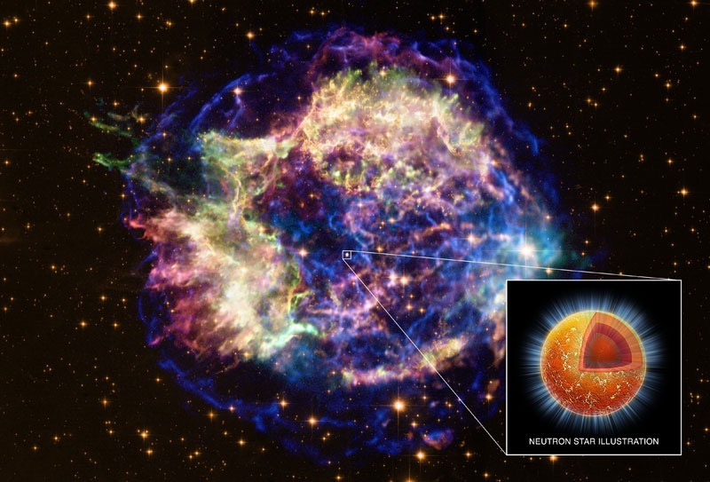

The anatomy of a neutron star
Atmosphere (10 cm): Shapes Thermal Radiation
Envelope (100 m): Huge Temperature Gradient
Outer Crust (400 m): Coulomb Crystal (Exotic neutron-rich nuclei)
Inner Crust (1 km): Coulomb Frustration (“Nuclear Pasta”)
Outer Core (10 km): Uniform Neutron-Rich Matter (n,p,e)
Inner Core (?): Exotic Matter (Hyperons, condensates, quark matter)

Slide 43

Comments on theory of nuclei
Input
Forces, operators
¹²C*
²⁶O
²⁴⁰Pu
²⁹⁸U
Many-body
dynamics
Open
channels
Z – atomic (proton) number
N – neutron number
A=Z+N – mass number
coupled integro-differential equations in 3A dimensions
¹²C (Z=6, N=6)
²⁴⁰Pu (Z=94, N=146)

Slide 44






Future: large multi-institutional efforts involving strong coupling between physics, computer science, and applied math
fusion
Validated Nuclear
Interactions
Chiral EFT
Ab-initio
Optimization
Model validation
Uncertainty Quantification
Structure and Reactions:
Light and Medium Nuclei
Neutron drops
EOS
Correlations
Structure and Reactions:
Heavy Nuclei
Stellar burning
Ab-initio
RGM
CI
Load balancing
Eigensolvers
Nonlinear solvers
Model validation
Uncertainty Quantification
DFT
TDDFT
Load balancing
Optimization
Model validation
Uncertainty Quantification
Eigensolvers
Nonlinear solvers
Multiresolution analysis
Neutrinos and Fundamental Symmetries
Neutron Stars
Fission

Slide 45






Some nuclei are more important than others
Over the last decade, tremendous progress has been made in techniques to produce and describe designer nuclei, rare atomic nuclei with characteristics adjusted to specific research needs and applications
nuclear structure
tests of fundamental laws of nature
⁴⁵Fe
+
-
+
-
+
²²⁵Ra
-
+
-
+
-
astrophysics
applications
¹⁸F,²²Na
¹⁴⁹Tb
Notes:
The Alchemist’s Dream Come True: nuclear physicists can transmute the elements
45Fe: decays by emitting a pair of protons thus telling us about proton superconductivity
18F,22Na: rare isotopes synthesized in Nova explosions
225Ra: Why More Matter than Antimatter? CP violation through EDM searches
149Tb: an “alpha knife”radionuclide that kills cancer cells

