Slide 1

Detectors at an EIC not your Standard Collider Detector
E.C. Aschenauer
Electron Ion Collider

Slide 2
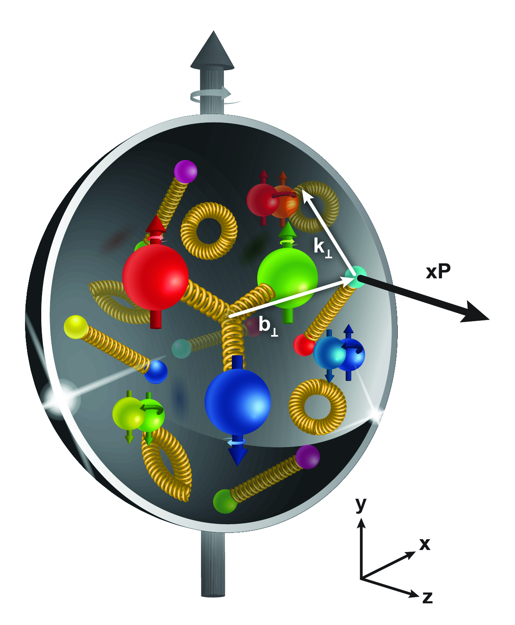
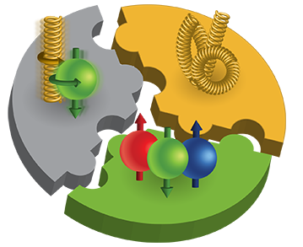
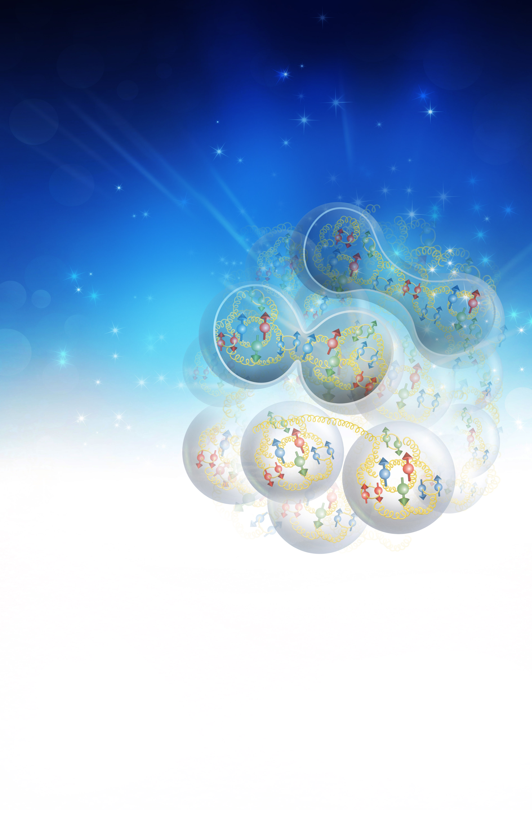
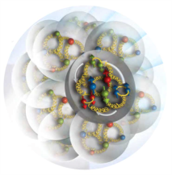
The EIC Physics
How are the sea quarks and gluons, and their spins, distributed in space and momentum inside the nucleon?
How do the nucleon properties emerge from them and their interactions?
How do color-charged quarks and gluons, and colorless jets, interact with a nuclear medium?
How do the confined hadronic states emerge from these quarks and gluons?
How do the quark-gluon interactions create nuclear binding?
How does a dense nuclear environment affect the quarks and gluons, their correlations, and their interactions?
What happens to the gluon density in nuclei? Does it saturate at high energy, giving rise to a gluonic matter with universal properties in all nuclei, even the proton?
gluon
emission
gluon recombination
?
=

Slide 3
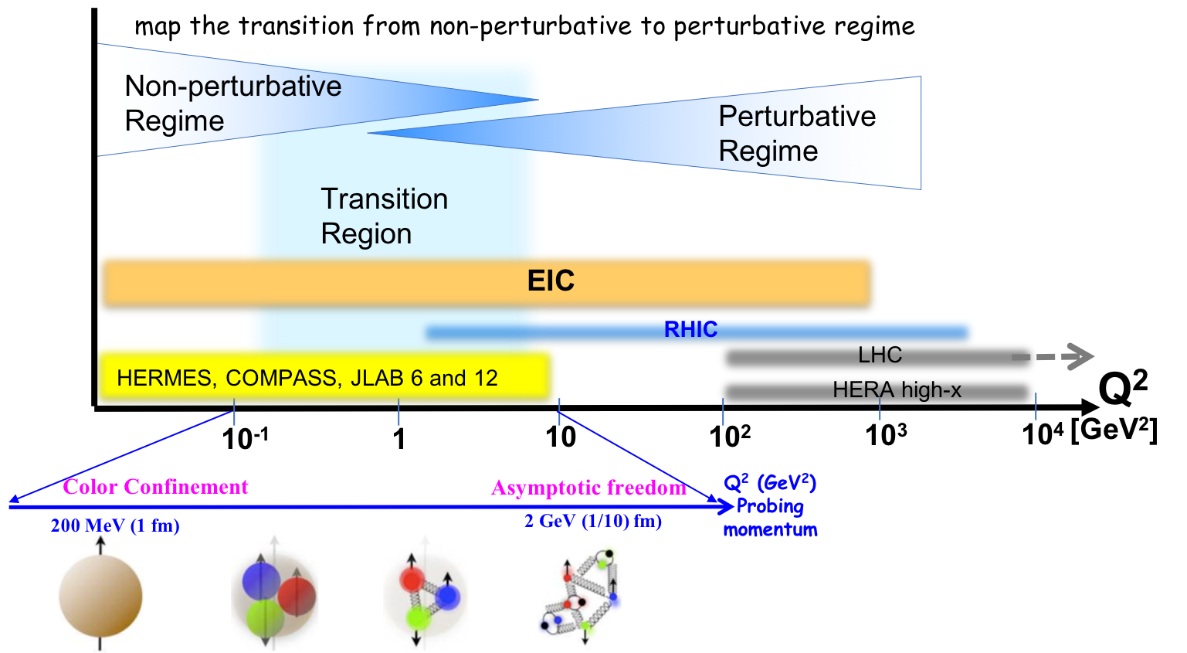
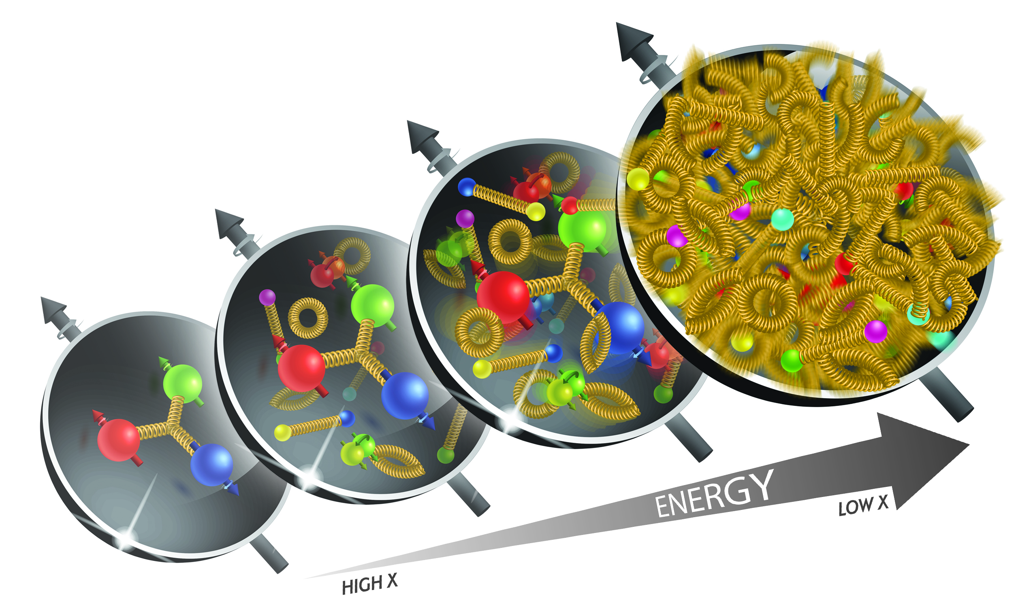
What is needed to address the EIC Physics
large kinematic coverage:
access to x and Q² over a wide range
→ center-of-mass energy √s: 20 – 140 GeV
polarized electron and hadron (p,d,He-3) beams:
access to spin structure of nucleons and nuclei
Spin vehicle to access the spatial and momentum structure of the nucleon in 3d
Full specification of initial and final states to probe q-g structure of NN and NNN interaction in light nuclei
nuclear beams: D to Pb
accessing the highest gluon densities → saturation
quark and gluon interact with a nuclear medium
high luminosity 10³³⁻³⁴ cm⁻²s⁻¹:
mapping the spatial and momentum structure of nucleons and nuclei in 3d
access to rare probes, i.e. Ws

Slide 4
The EIC: A Unique Collider
EIC
LHC /RHIC
collide different beam species: ep & eA
consequences for beam backgrounds
  hadron beam backgrounds,
  i.e. beam gas events
  → synchrotron radiation
asymmetric beam energies
boosted kinematics
  high activity at high |η|
High repetition rate
JLEIC: 2.1ns eRHIC 8.7ns between bunches
crossing angle
eRHIC 25mrad JLEIC: 50mrad
wide range in center of mass energies
factor 7
both beams are polarized
→ stat uncertainty: ~ 1/(P₁P₂ (∫L dt )^{1/2})
collide the same beam species: pp, pA, AA
→ beam backgrounds
  hadron beam backgrounds,
  i.e. beam gas events, high pile up
symmetric beam energies
kinematics is not boosted
  most activity at midrapidity
moderate repetition rate
25 ns between bunches
no crossing angle yet
limited range in center of mass energies
LHC: factor 2
RHIC: factor 26 in AA and 8 in pp
no beam polarization
→ stat uncertainty: ~1/(∫L dt )^{1/2}
Differences impact detector acceptance and possible detector technologies

Slide 5
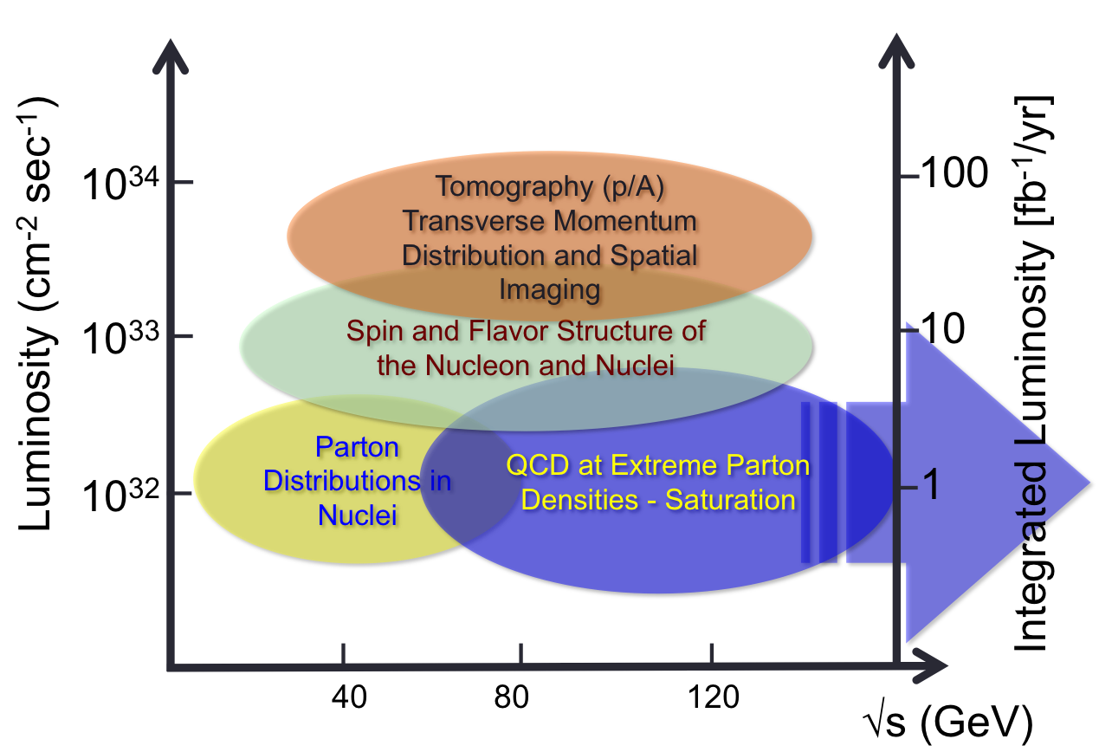


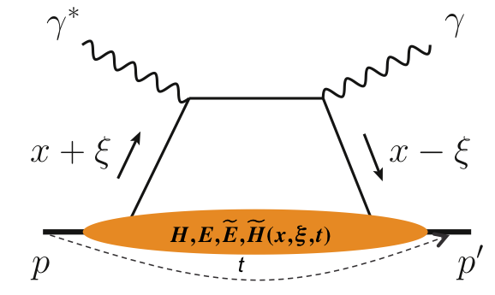
What is needed experimentally?
experimental measurements categories to address these physics:
inclusive DIS
critical to detect
scattered electron
with high
precision
semi-inclusive DIS
detect the scattered
lepton and final state
(jets, hadrons,
correlations in final state)
exclusive processes
all particles in the
event need to be
measured

Slide 6
What is needed experimentally?
experimental measurements categories to address EIC physics:
∫Ldt
inclusive DIS
1 fb⁻¹
fine multi-dimensional binning
→ x, Q²
machine & detector requirements
semi-inclusive DIS
5-dimensional binning
→ x, Q², z, p_{T}, Θ
to reach pT > 1 GeV
10 fb⁻¹
exclusive processes
10
-
100 fb⁻¹
4-dimensional binning
→ x, Q², t, Θ
to reach |t| > 1 GeV²

Slide 7
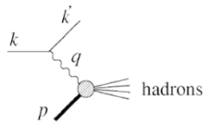
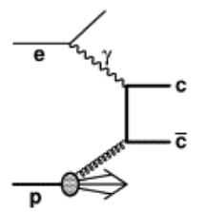
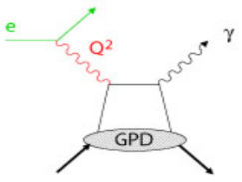
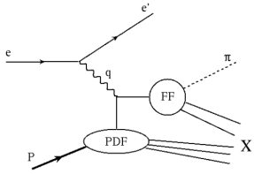
Measurements at an EIC
Physical quantity | Process | Measurement challenges
Structure functions F₂, F_{L} Nuclear structure functions | Inclusive scattering | Electron identification, Hadron measurement background rejection, luminosity
Spin structure functions | Inclusive scattering | + polarization
Gluon density | Charm, Di-jet production … | Secondary vertex, pion/kaon separation, hadronic jets
Generalized Parton Distributions GPDs | Deeply Virtual Compton Scattering | Forward proton, e, γ measurements background rejection
Transverse Momentum Distributions TMDs | Semi-inclusive Deep Inelastic Scattering | Pion/kaon separation
Nuclear PDFs | Scattering on nuclei | Nuclear fragments
Many more

Slide 8
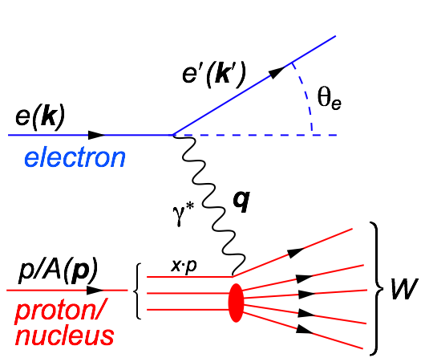
Deep Inelastic Scattering
Kinematics:
Measure of resolution power
Measure of inelasticity
Measure of momentum fraction of struck quark
low y-coverage: limited by E’_{e} resolution
y-coverage can be extended:
beam energy scan → costly $ & beam time
→ or by detector design
Possible limitations in kinematic coverage:
high y limited by
photon radiation from the lepton before or after the collision
→ Bethe Heitler

Slide 9
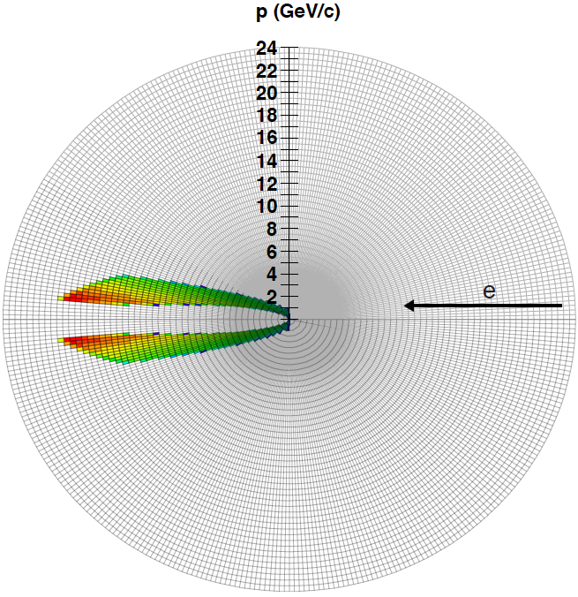
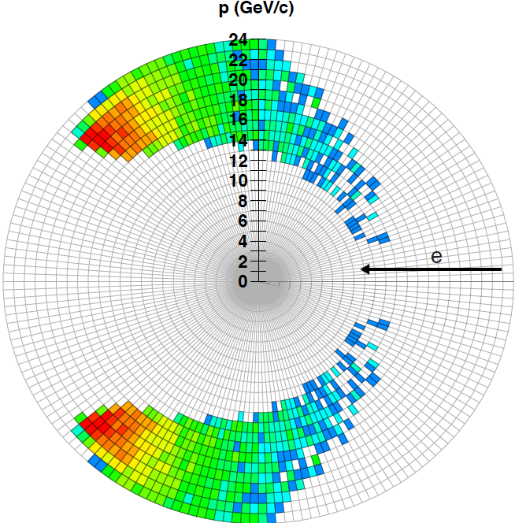
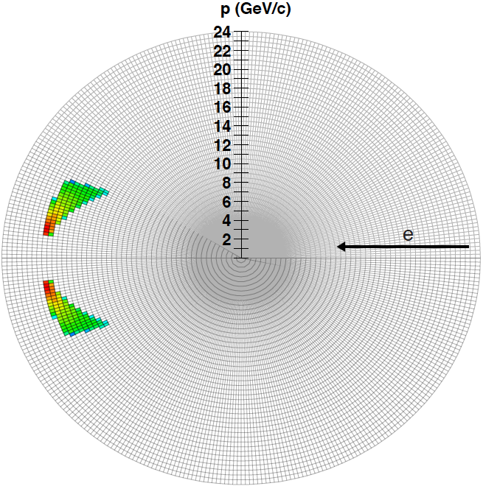
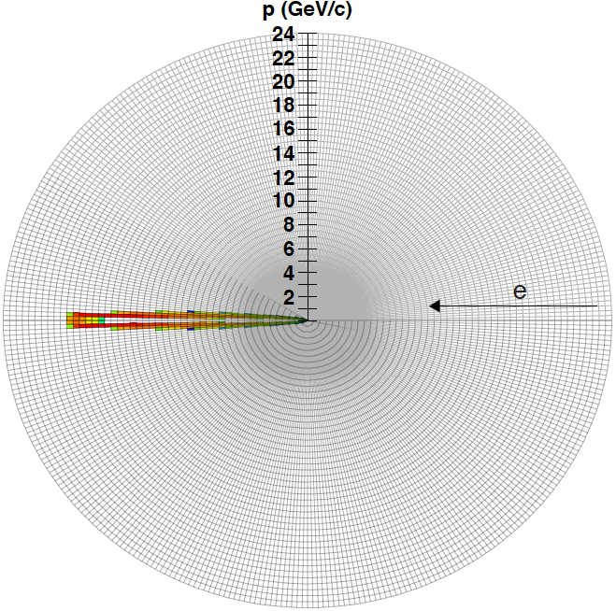
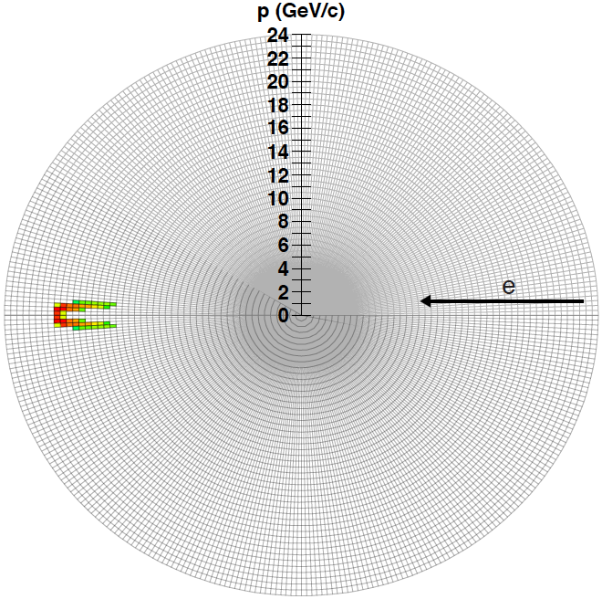
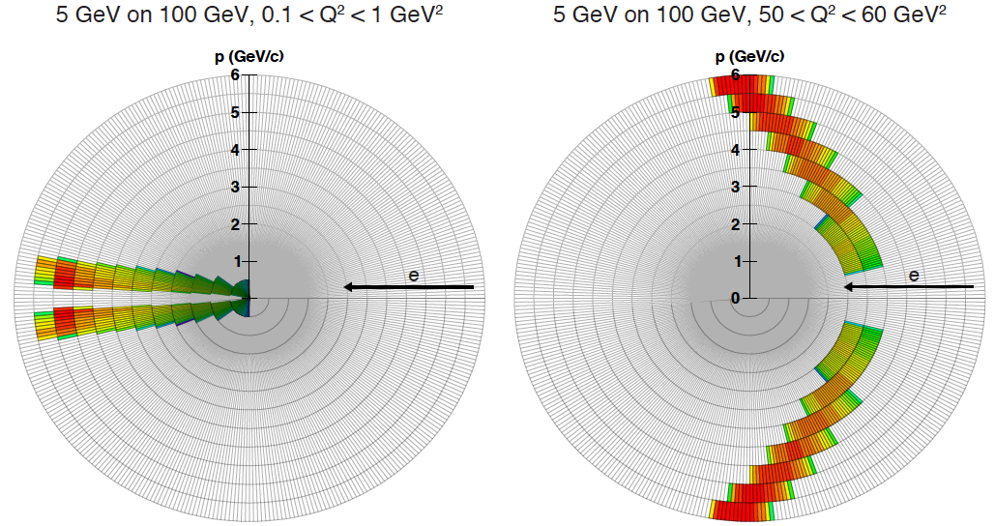
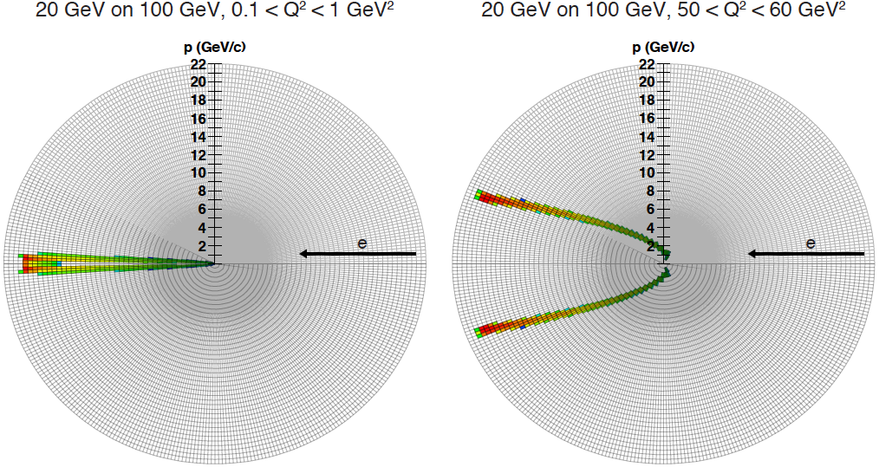
Detector Requirements
Inclusive Reactions in ep/eA:
identify scattered lepton
  excellent electron id
    equal rapidity coverage for tracking and calorimeter
    low material budget → reduce bremsstrahlung
Momentum/energy and angular resolution of e’ critical
Remember:
scattered lepton gives kinematics for all event classes
scattered lepton kinematics: independent on hadron beam energy
lepton beam energy → strong Q² – η correlation
−η
+η
lepton beam
hadron beam
5
4
3
1
2

Slide 10
Detector Requirements
Exclusive Reactions in ep/eA:
Exclusivity criteria:
  eA: large rapidity coverage → rapidity gap events
    HCal for 1<η<4.5
  ep: reconstruction of all particles in event
    wide coverage in t (=p_{t}²) → Roman pots
eA: large acceptance for neutrons from nucleus break-up
  Zero Degree Calorimeter
    veto nucleus breakup
    determine impact parameter of collision
→ Poses stringent requirements on IR design
t=p_{t}²
scattered protons
-4.5<η<4.5
DVCS – photon kinematics:
Cuts: Q²>1 GeV, 0.01<y<0.85
break-up neutrons

Slide 11

EIC PID
needs
are more demanding
then your
normal
collider detector
EIC
needs absolute
particle numbers at
high purity and low
contamination
E

Slide 12
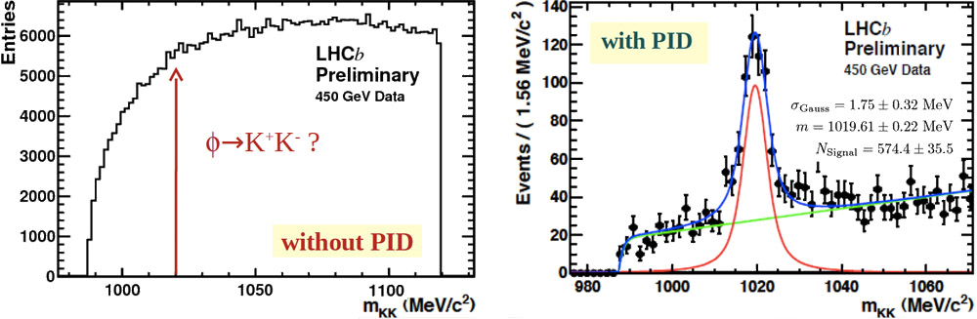
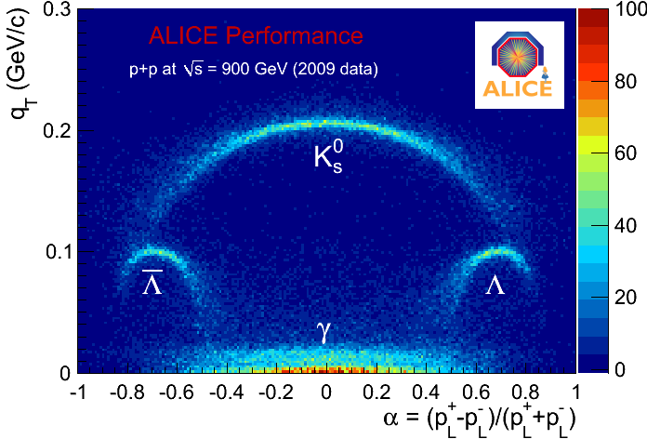
PID at LHC
Reference: Ch. Lippmann arXiv:1101.3276
PID predominately used to suppress background → search for resonances
Only few HEP PID applications require
absolute identified particle numbers
at high purity and high efficiency
c.s measurements in e+e- → FF
spectra measurements in HI
q_{T} represents the transverse component of the
momentum of the positive decay product.

Slide 13
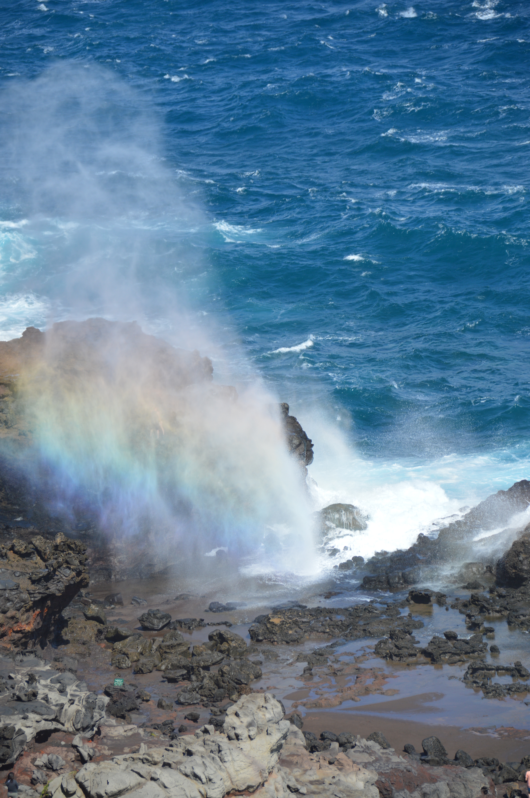
The inner life of hadrons
      flavor separated parton structure

Slide 14
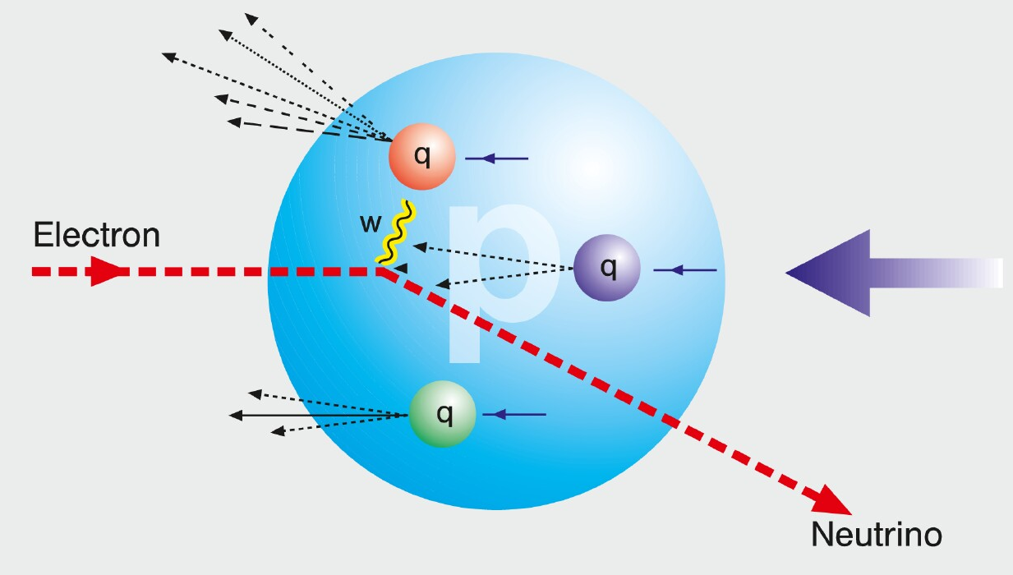
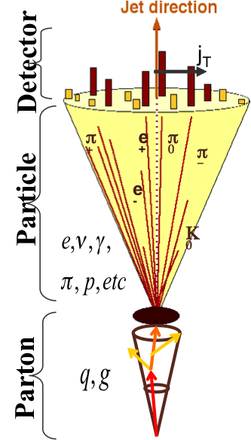
HOW TO ACCESS PARTONS IN DIS
SIDIS:
Detect identified hadrons in coincidence to
scattered lepton
needs fragmentation functions to correlate
hadron type with parton
→ Detector: PID over a wide range of η
Charge Current:
W-exchange: direct access to the quark flavor
no FF – complementary to SIDIS
→ Detector: large rapidity coverage and large √s
Jets:
tag sea-quarks through the sub-processes and
jet substructure
→ Detector: large rapidity coverage and PID

Slide 15
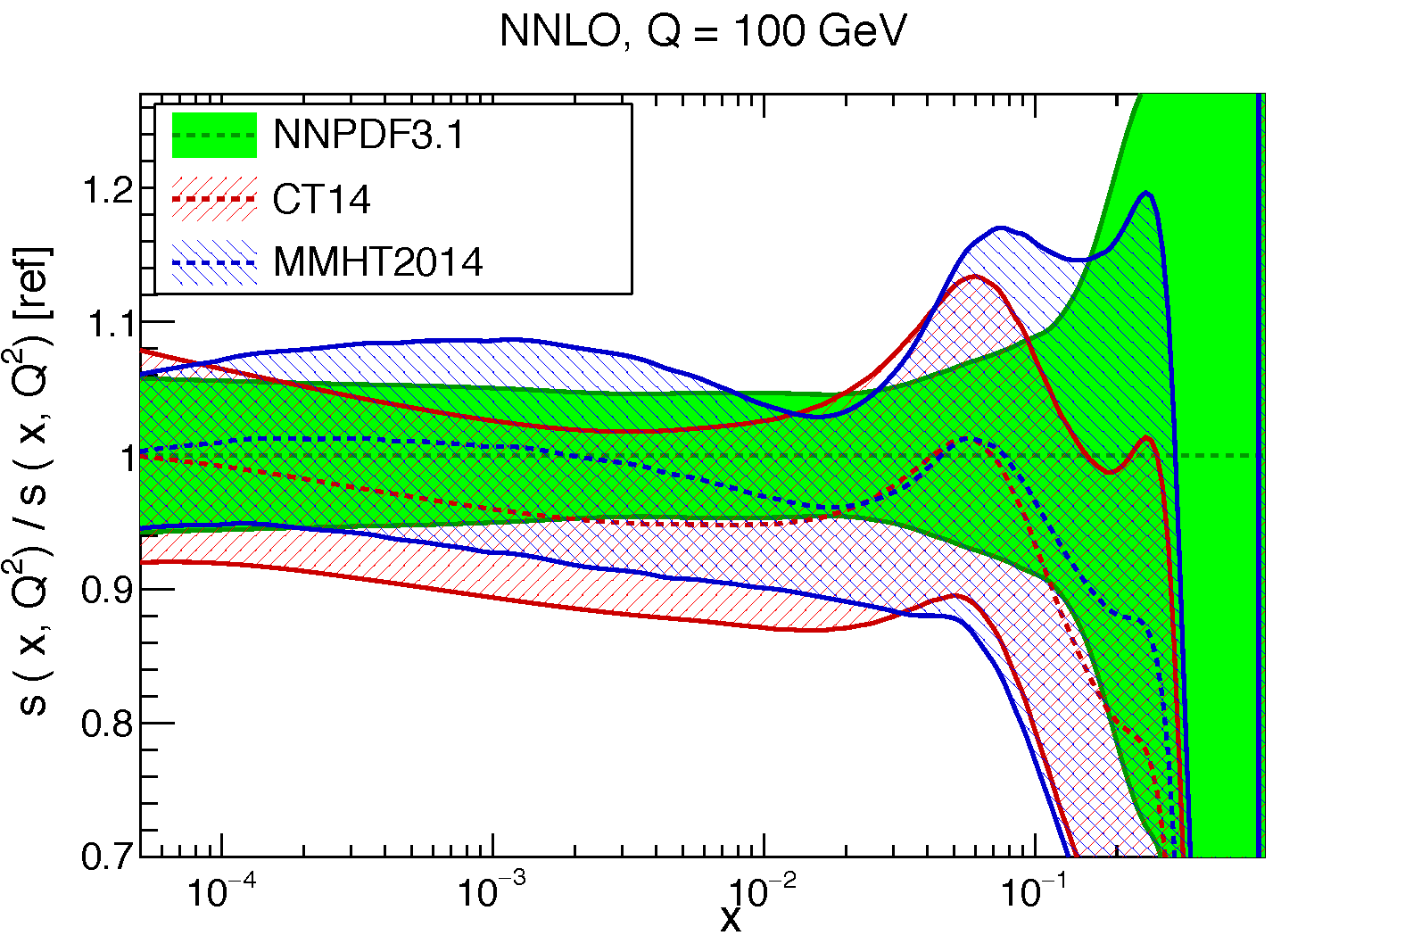
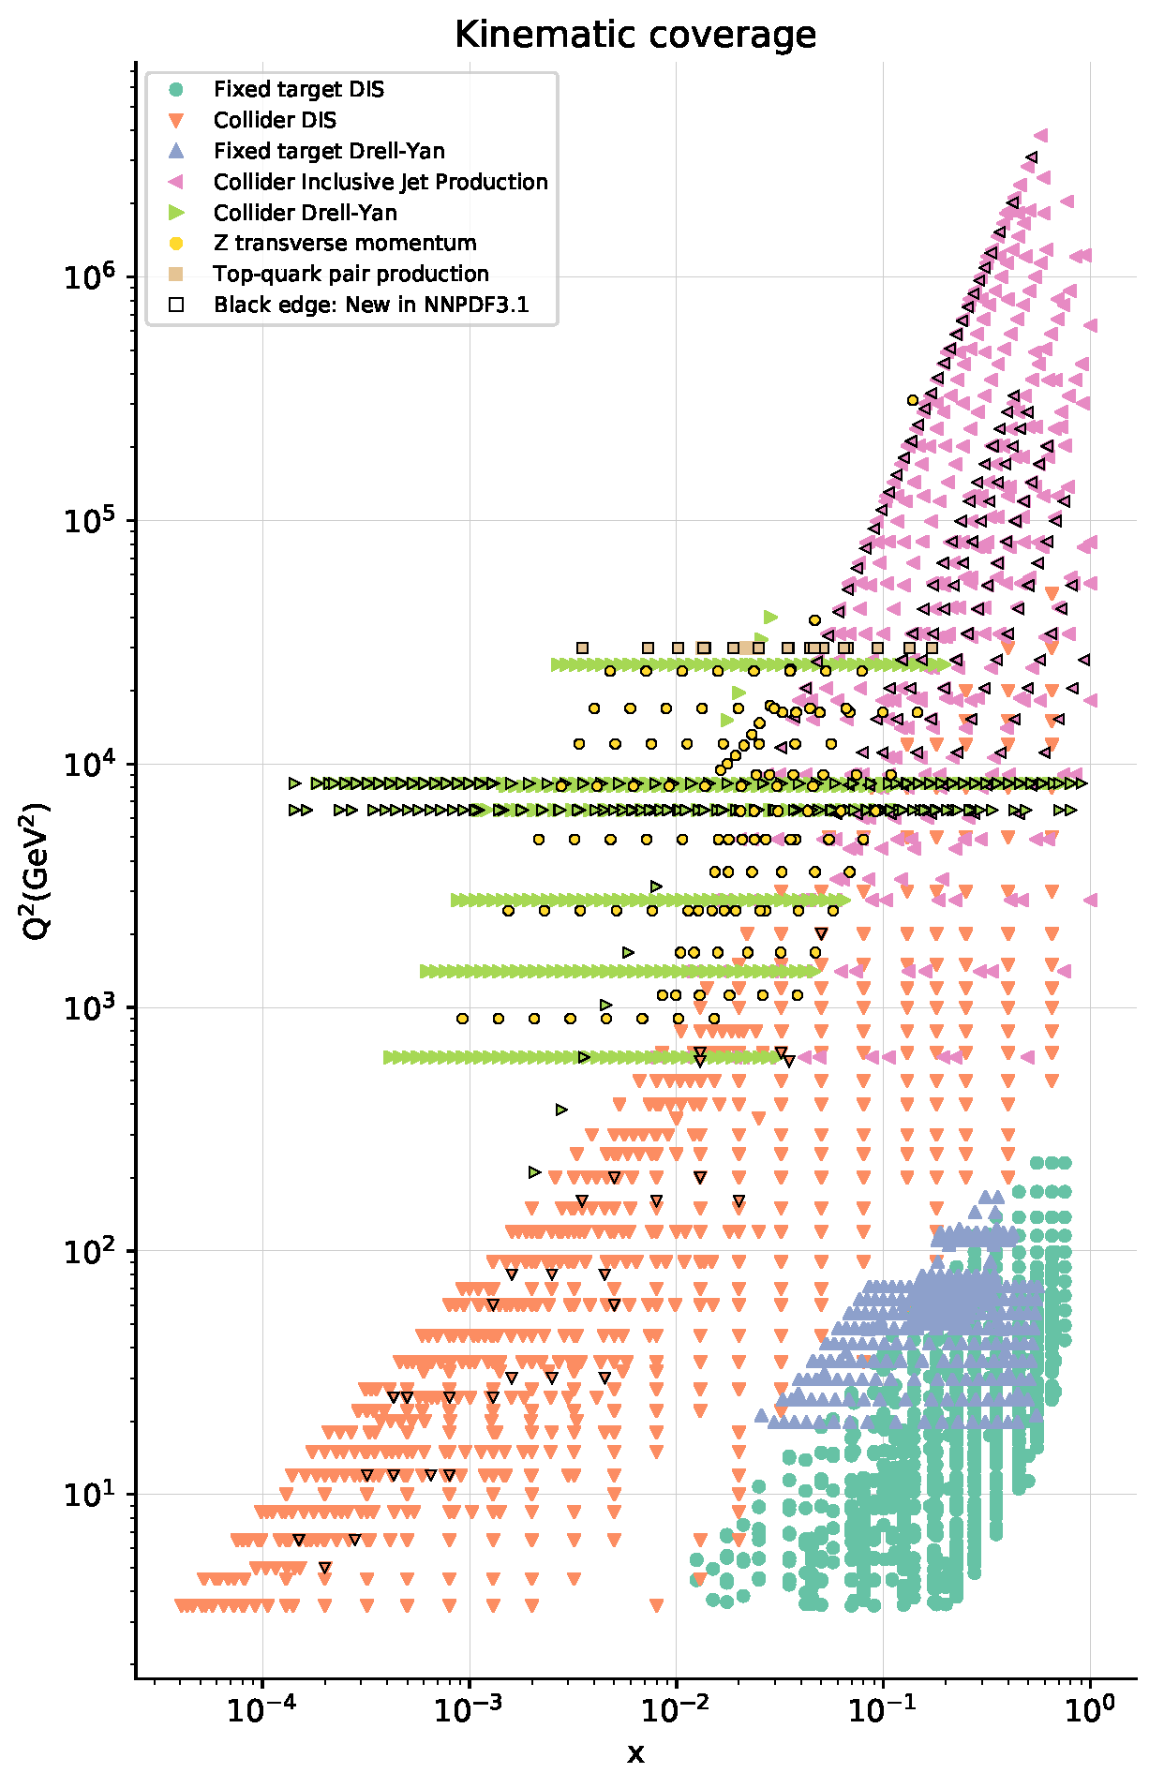
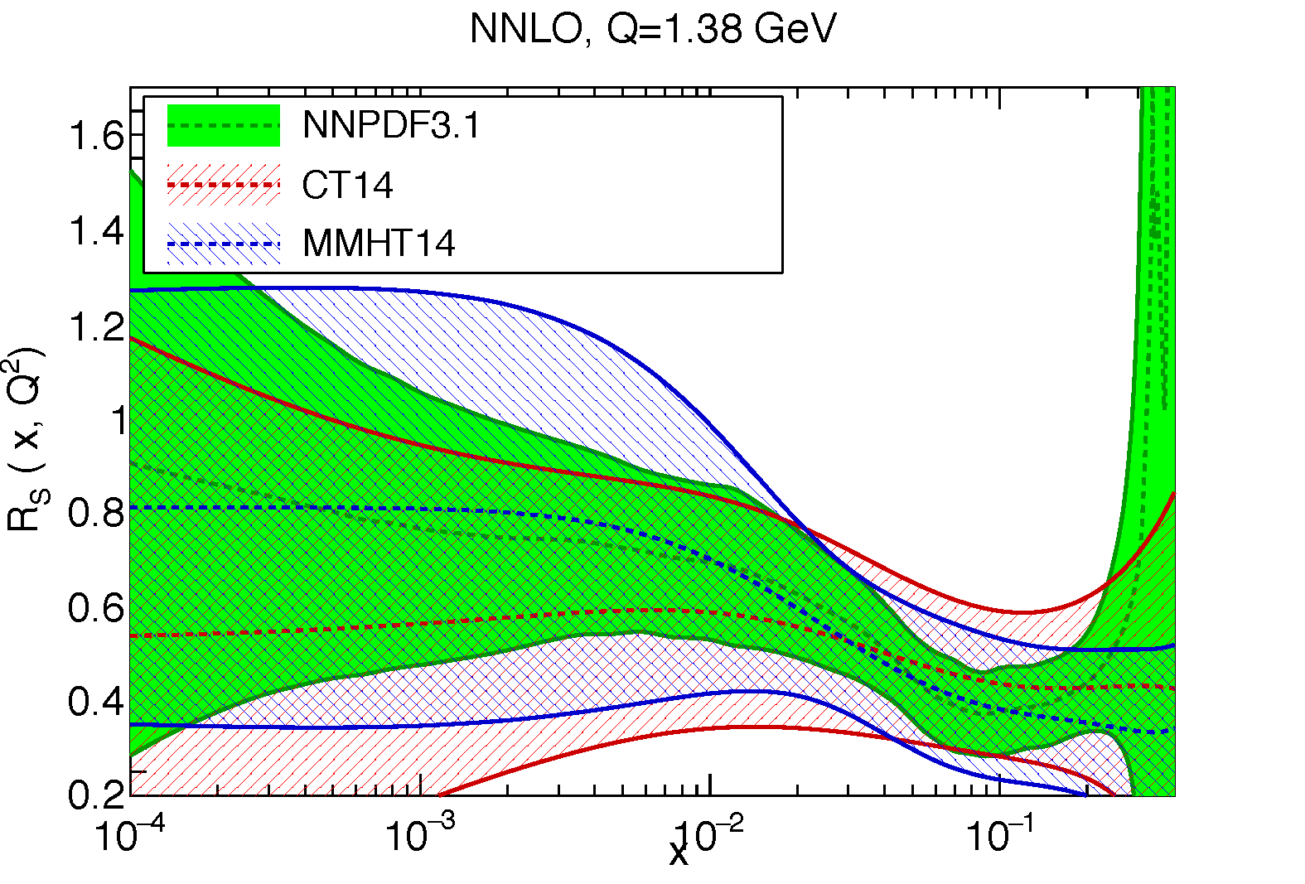

s(x) and sbar(x) where do we stand?
NNPDF 3.1 arXiv:1706.00428

Slide 16
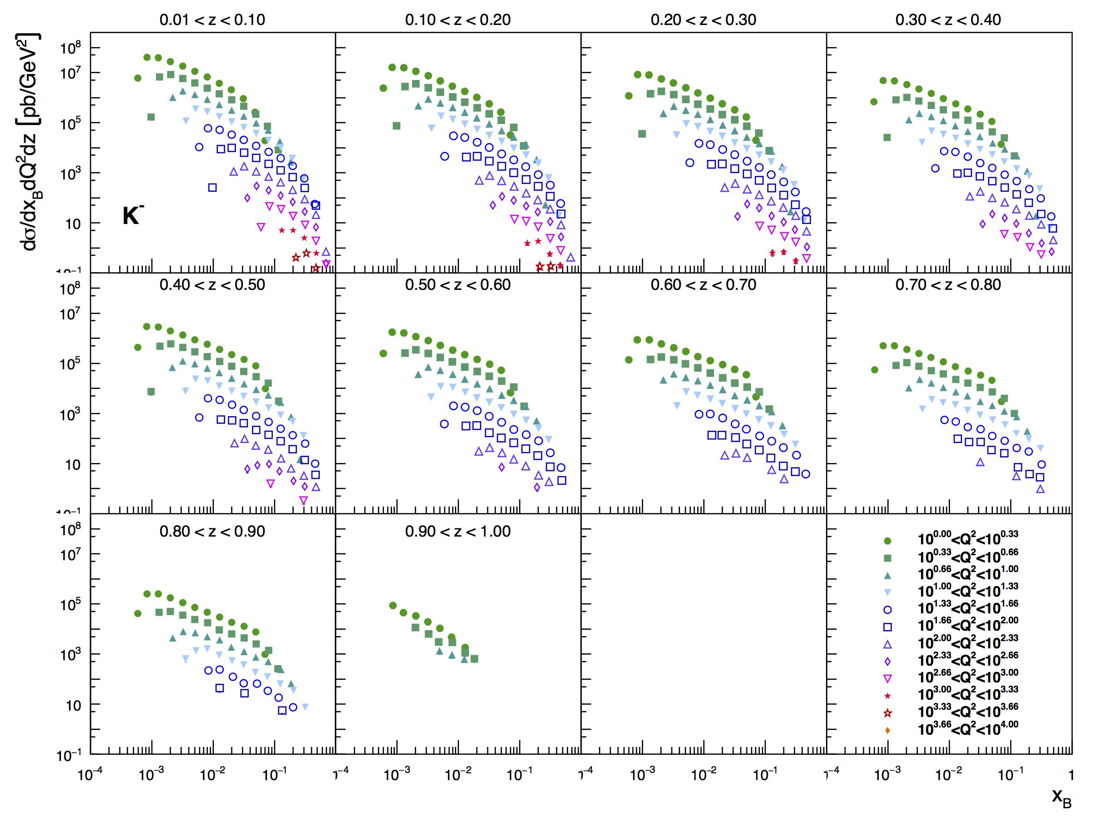
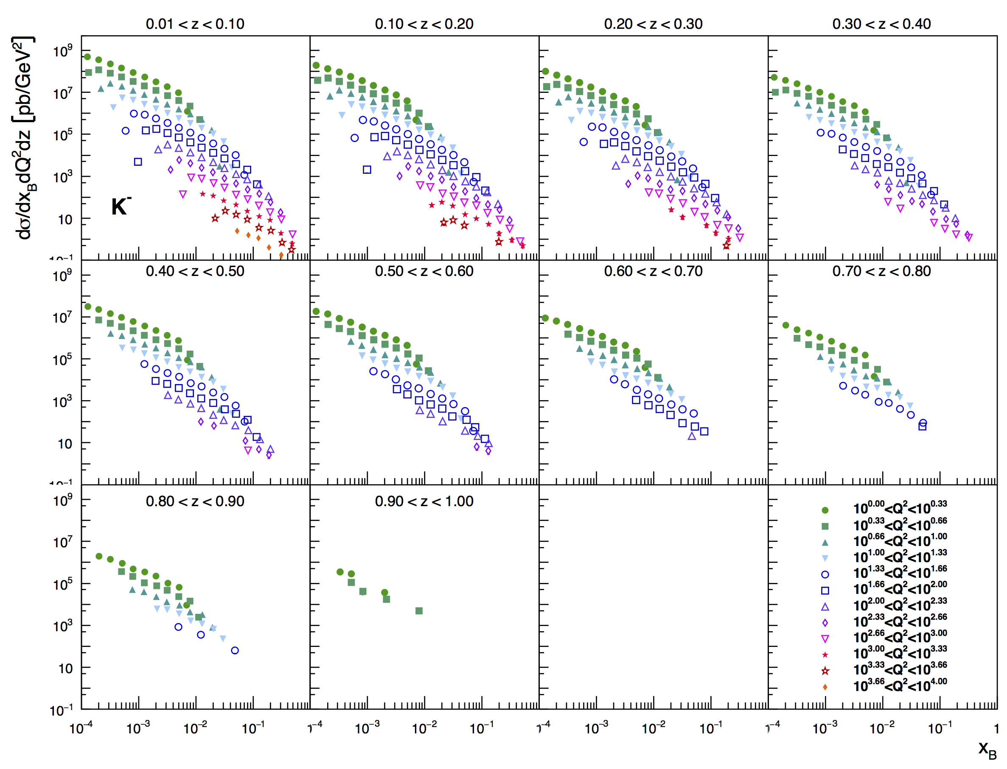
What can SIDIS@EIC Teach us
Ch.vanHulse, I. Borsa, R. Sassot, ECA
Cuts:
Q²>1 GeV² 0.1<y<0.95 W²>10 GeV² p_{T} > 0.2 GeV
PID:
5 GeV x 100 GeV
20 GeV x 250 GeV

Slide 17
PDF Constrain from SIDIS@EIC
√s=45 GeV
√s=145 GeV
If you want to know
s-PDF ask the EIC
→ impact grows with √s

Slide 18
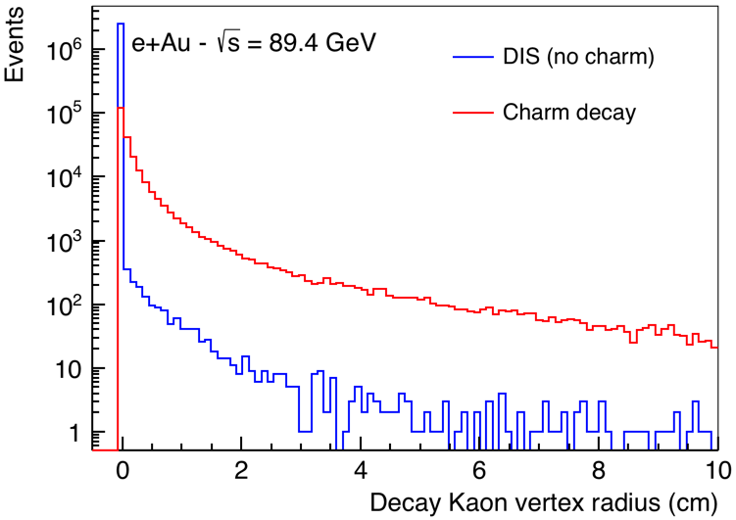
Tagging Charm
Standard charm tagging through displaced leptons → 6.5%
EIC:
advantage: Detector with π, K, p PID over a wide range in rapidity (-3.5 < η < 3.5)
combined with excellent vertex resolution
Kaon vertex distribution
Cut: 0.01 cm < vtx < 3 cm
momentum spectrum of K from
charmed mesons
→ excellent fit to PID with dE/dx
and aerogel RICH
Charm efficiency: 30%
Bckg. from non-charm < 2%

Slide 19

from
Physics

Slide 20
Detector Requirements
Semi-inclusive Reactions in ep/eA:
π±,K±,p± separation over a wide range |η|<~3.5
  → Excellent particle ID
  → excellent momentum resolution at forward rapidities
need to cover entire kinematic region in p_{t} & z
need full Φ-coverage around γ*
Excellent vertex resolution → Charm & Bottom tagging
hadron kinematics: with increasing √s hadrons boosted to negative η
momentum – η correlation → PID detector technology
Cuts: Q²>1 GeV, 0.01<y<0.95, z>0.1

Slide 21
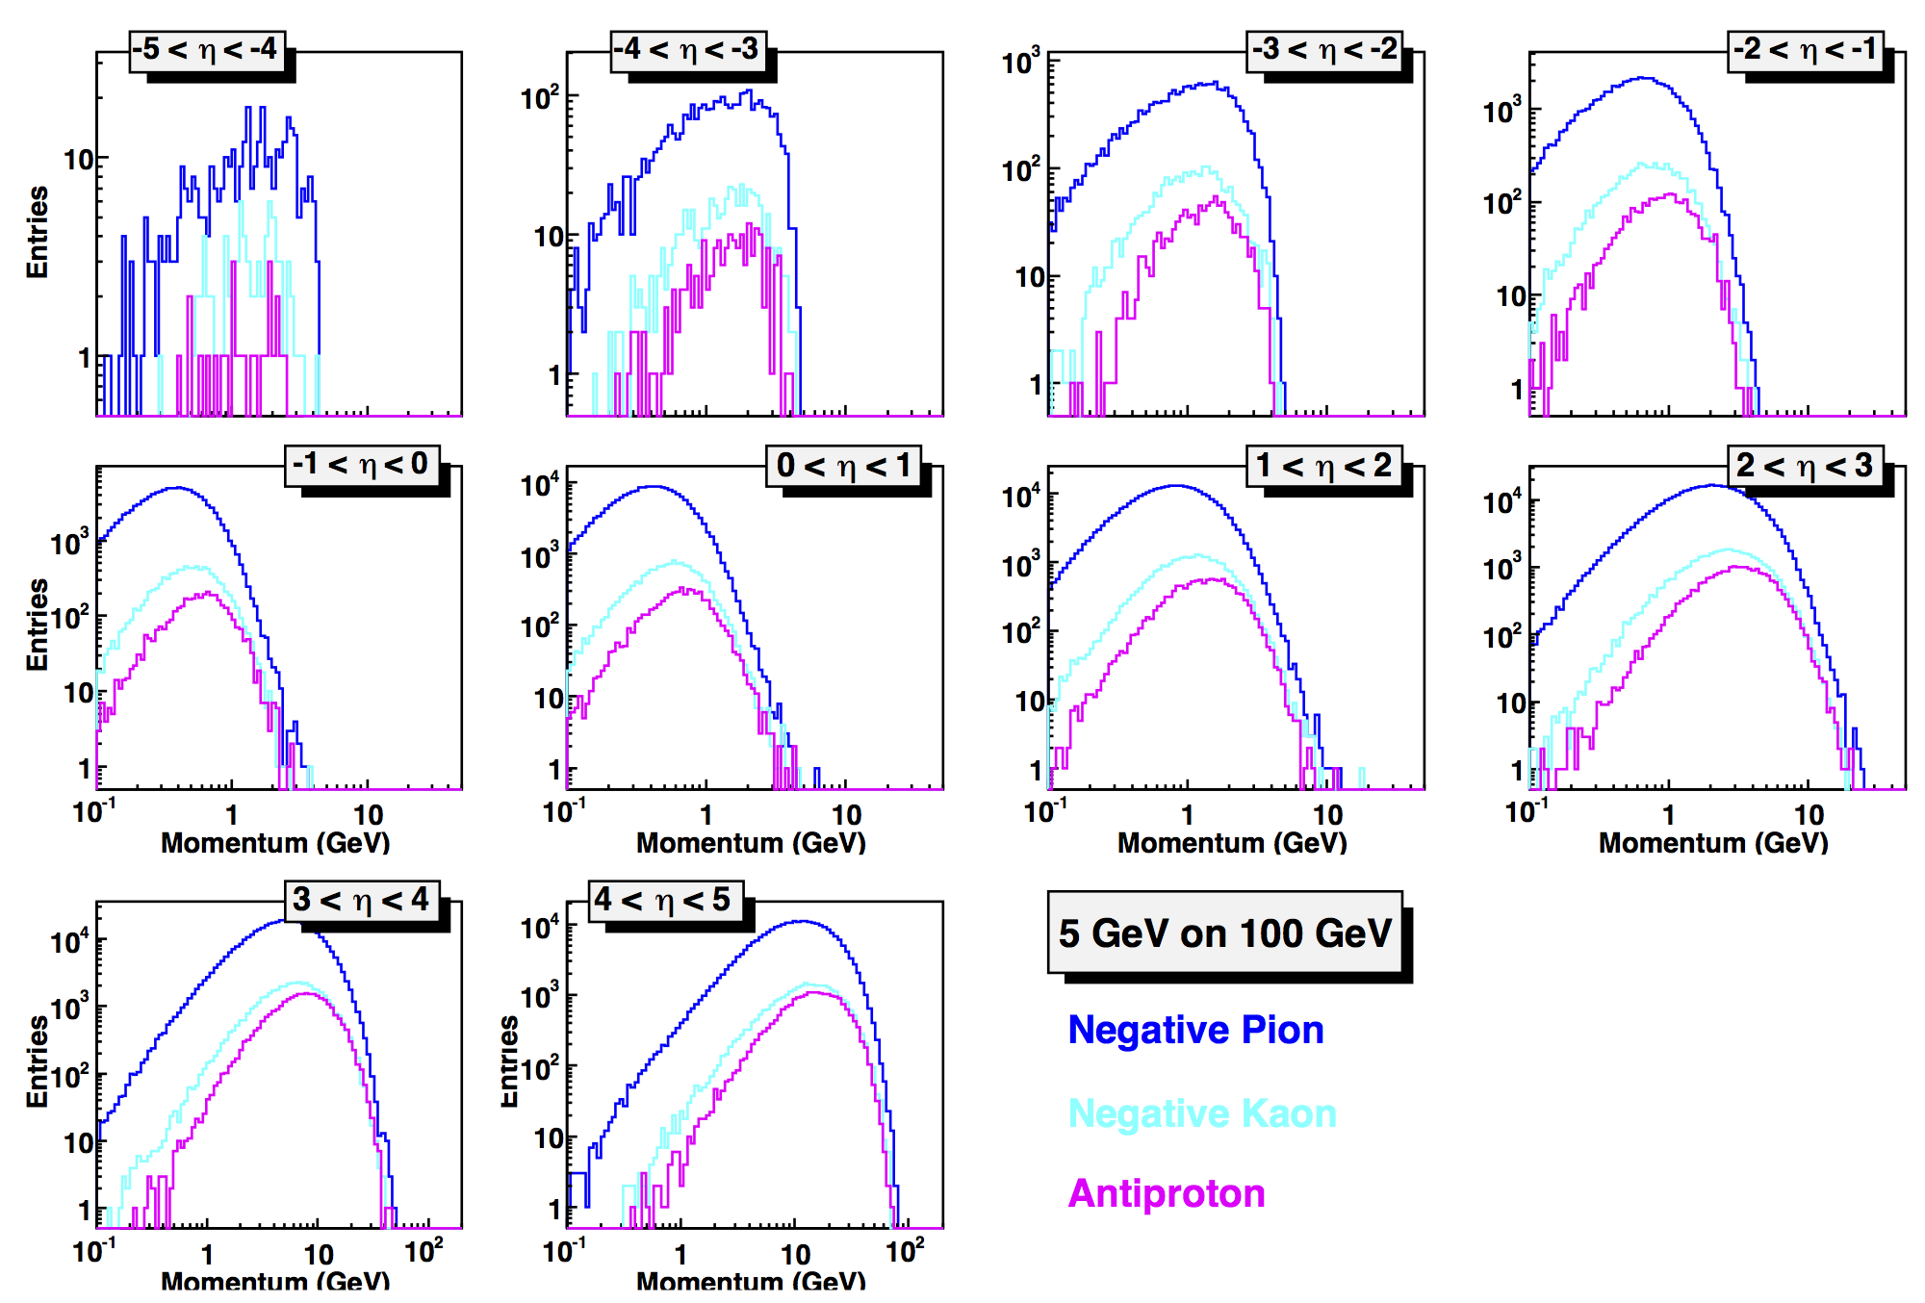
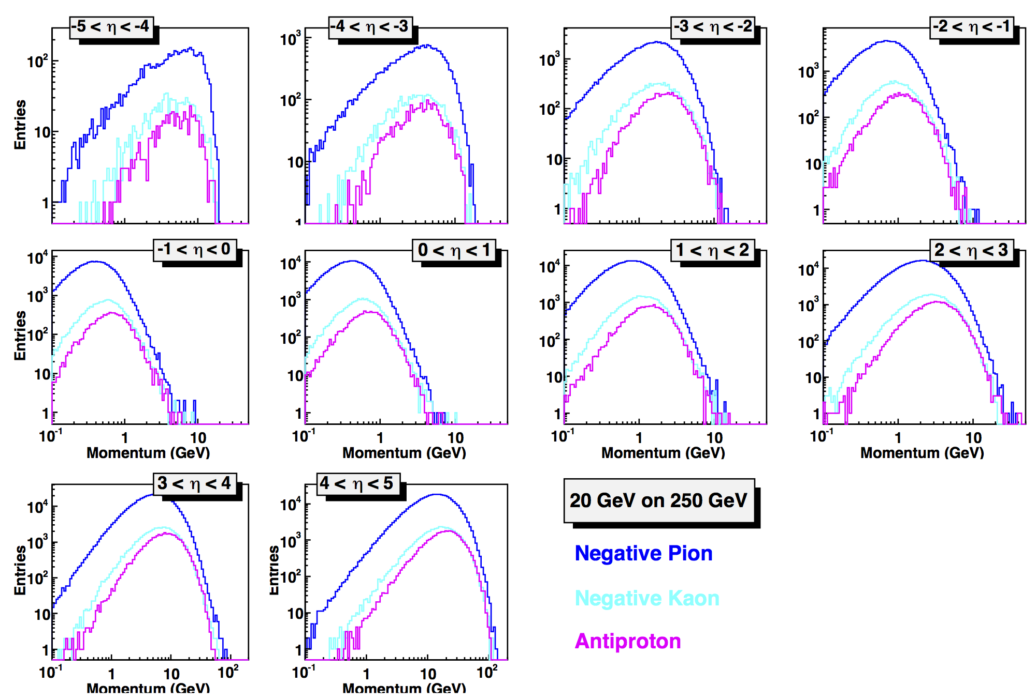
Hadron Kinematics
lepton beam energy
hadrons are
boosted
more and more
to −η
hadron beam energy
influences
max. hadron energy
at fixed η
Hadron-PID:
1T-Magnet → p_{T} > 200 MeV
3T-Magnet → p_{T} > 500 MeV
π/K ratio 3-4
K/p ~ 1
-5 < η < 2:
0.1 GeV < p < 10 GeV
2 < η < 5:
0.1 GeV < p < 100 GeV
impact on choice of technology

Slide 22
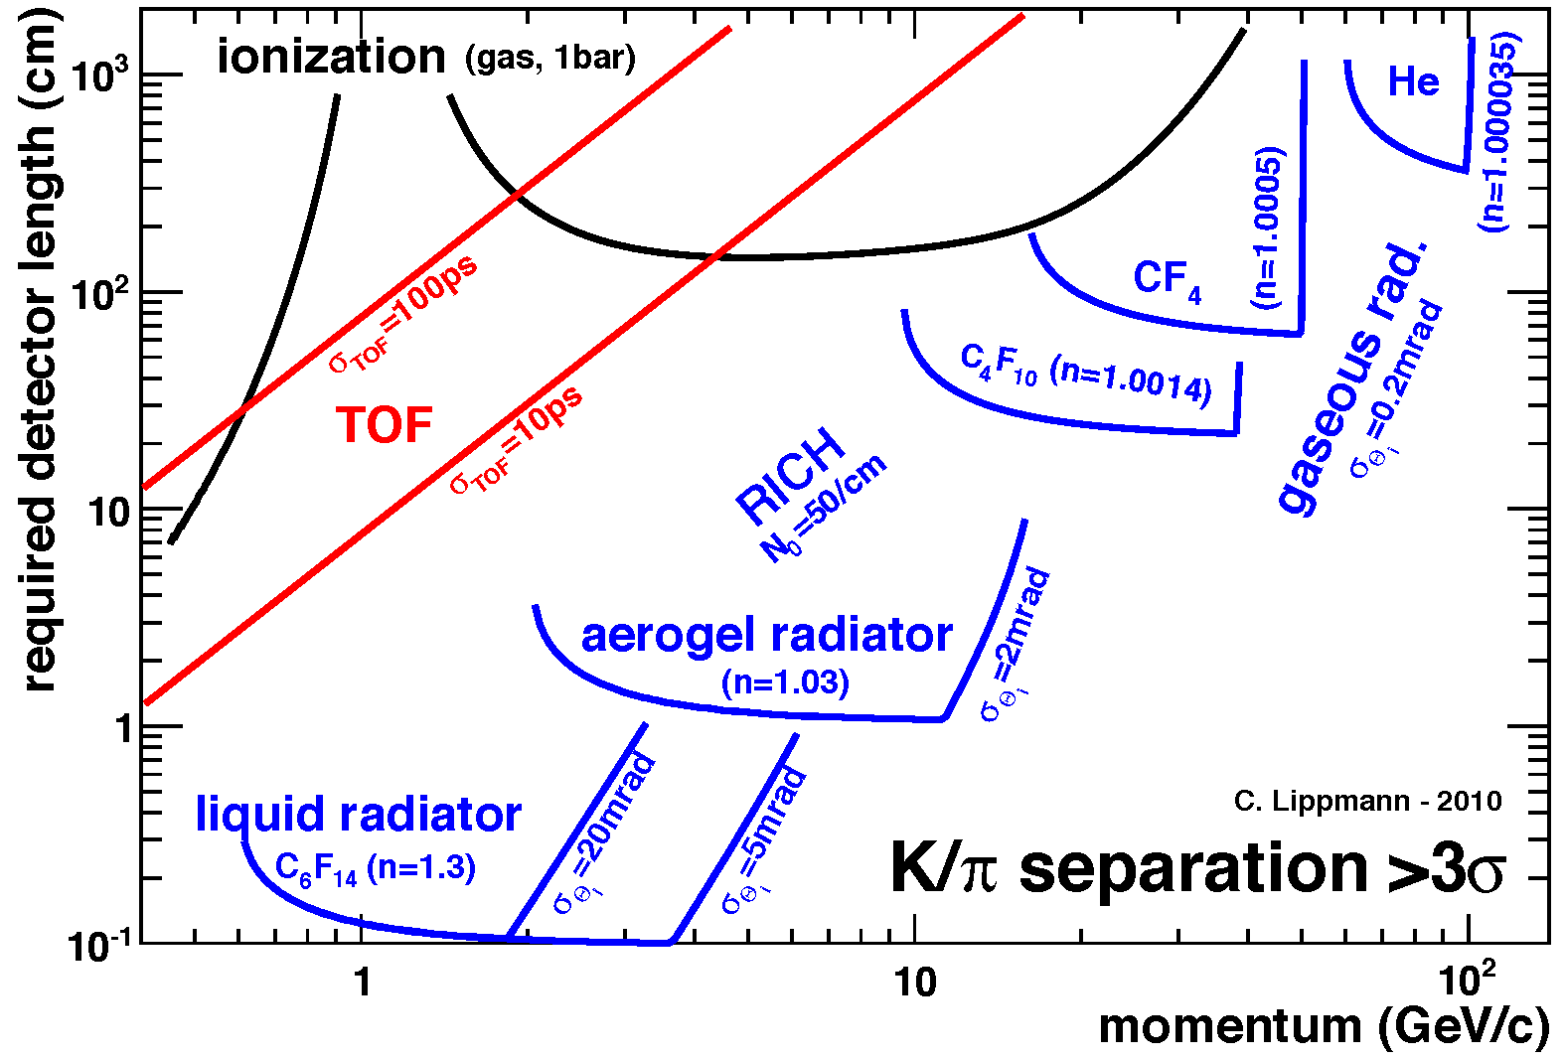
What does this mean for the PID techniques
EIC will need for most of the physics
5σ separation for π-K and K-p separation
to really get cleanly identified particle – types
→ (un) polarized cross sections
Need more than one technology to cover the entire
momentum ranges at the different rapidities
For much more details: S. Dalla Torre https://wiki.jlab.org/cuawiki/images/a/a2/RICH_DallaTorre_29072018.pdf

Slide 23


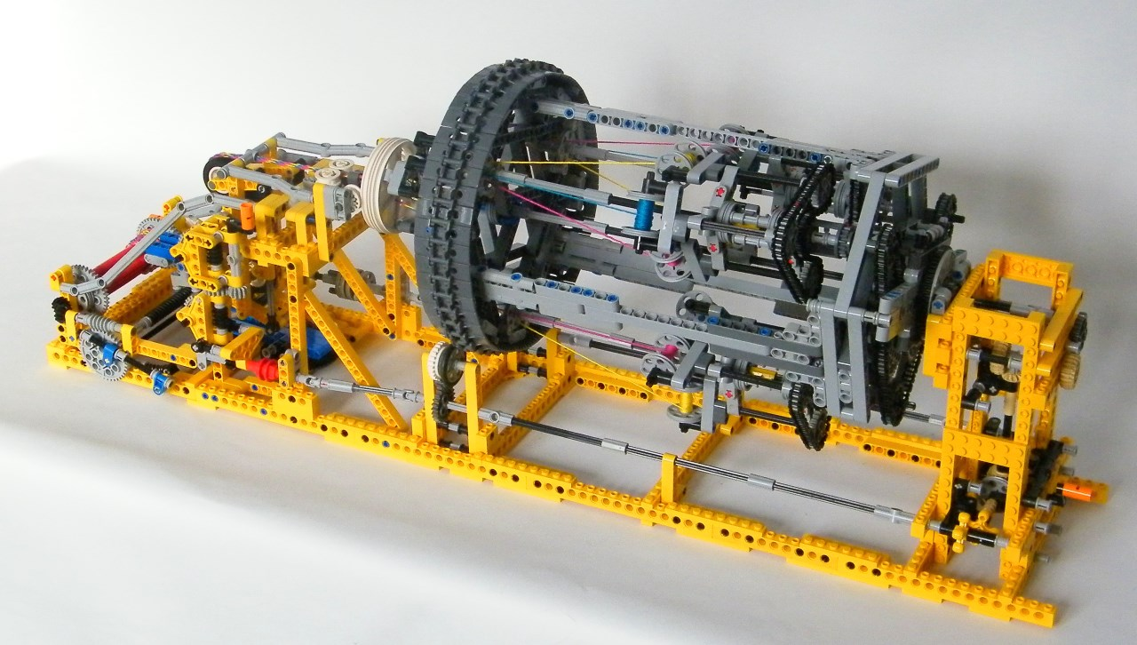



Lets put all together

Slide 24
Possible Detector Choices
General purpose detectors
similar to ATLAS and CMS at the LHC or H! and ZEUS at HERA
Advantage:
one device for all physics, better background rejection and systematic control
More challenging to design
or
Specialized detector
such as ALICE and LHCb at the LHC
Advantage:
Potentially better for the measurement of a particular process
Less boundary conditions -> easier to design
or
Mixture of both
Discuss in the following only general purpose detectors
have been the focus of the detector designs

Slide 25
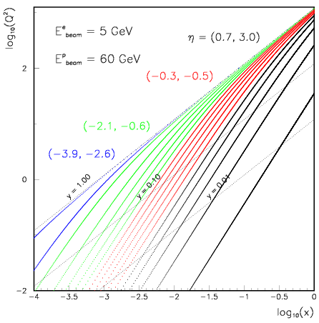
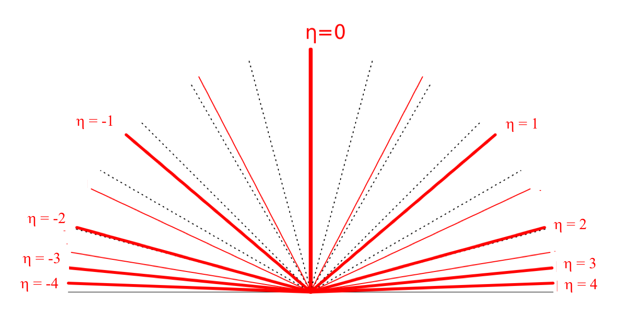
EIC General Purpose Detector Sketch
scattered quark in
NC and CC DIS
hadrons
leptons
Backward
Forward
Lepton
Endcap
Barrel
Hadron
Endcap
z
low Q2 scattered leptons
Bethe-Heitler photons
for luminosity
particles from nuclear
breakup, i.e. neutrons
scattered protons and ions
from diffractive reactions
EIC is a high luminosity machine 10³³⁻³⁴ cm⁻²s⁻¹
such controlling systematic uncertainties becomes crucial
Needs to be integrated in detector design

Slide 26
Requirements for EIC Detectors
Vertexing
Event vertex, secondary vertices, track impact parameter
Vertex detector
Central tracker and solenoid
Electron identification and measurement
-4 < η < +4
Central tracker and solenoid
Calorimeter
Jet measurement
Excellent energy resolution, kinematic reconstruction
-4 < η < +4
Central tracker and solenoid
Calorimeter
Pion/kaon/proton separation
Barrel PID needed for p < 10 GeV/c
In forward direction needed for p < 50 GeV/c
In backward direction needed for p < 10 GeV/c
Central tracker and solenoid
Forward dipole/toroid
TOF or Čerenkov
Forward proton/ion detection and measurement
Large acceptance for momenta up to almost the beam energy
Roman pots
with timing
Forward neutron detection and measurement
Excellent energy and angle measurement
0⁰ calorimeter

Slide 27
Popular choices for the Major Subsystems
Vertex detector → Identify event vertex, secondary vertices,
track impact parameters Silicon pixels, e.g. MAPS
Central tracker → Measure charged track momenta
Drift chamber, TPC + outer tracker or Silicon strips
Forward tracker → Measure charged track momenta
GEMs, Micromegas, or Silicon strips, MAPS
Particle Identification → pion, kaon, proton separation
Time-of-Flight or RICH + dE/dx in tracker
Electromagnetic calorimeter → Measure photons (E, angle), identify electrons
Crystals (backward), Shashlik or Scintillator/Silicon-Tungsten
Hadron calorimeter → Measure charged hadrons , neutrons and K_{L}⁰
Plastic scintillator or RPC + steel
+ Beam pipe, Solenoid, very forward and backward detectors
Radius/Distance from IP

Slide 28
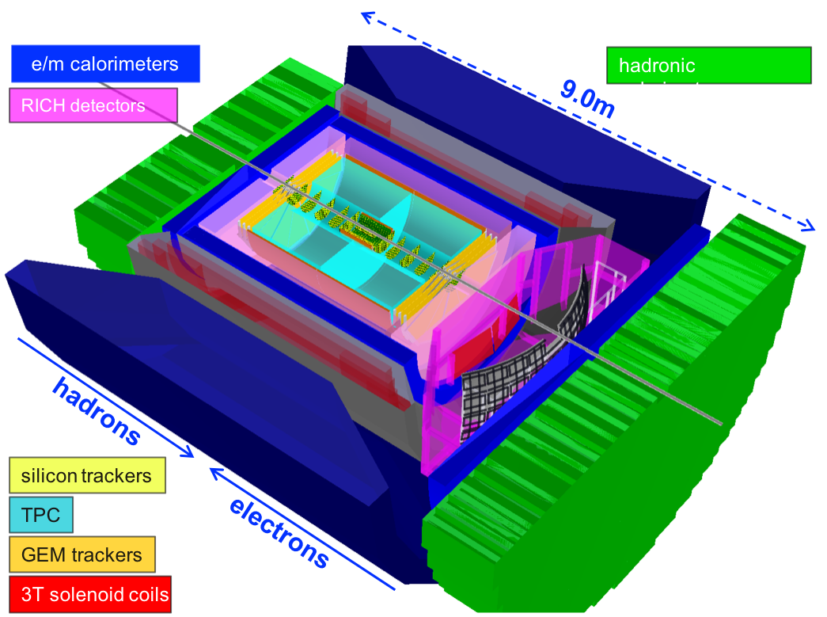
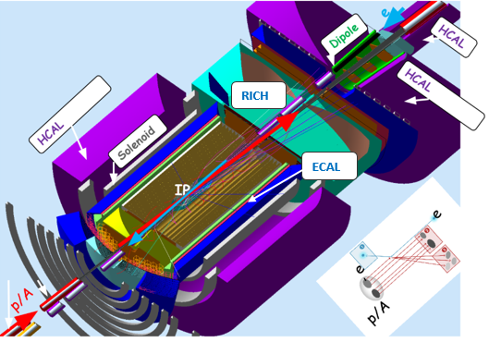
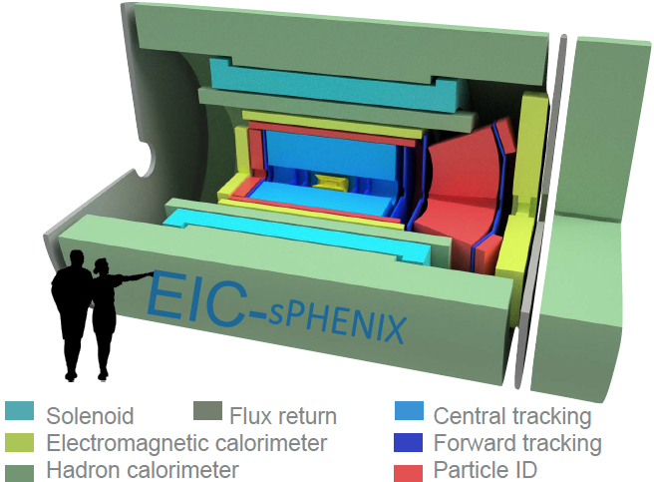
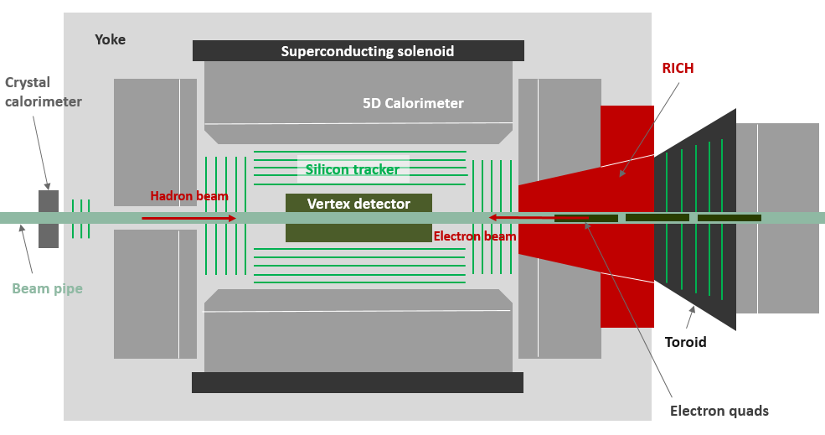
Current EIC General Purpose Detector Concepts
Brookhaven concept: BEAST
Jefferson lab concept: JLEIC
sPHENIX → EIC
Argonne concept: TOPSiDE

Slide 29

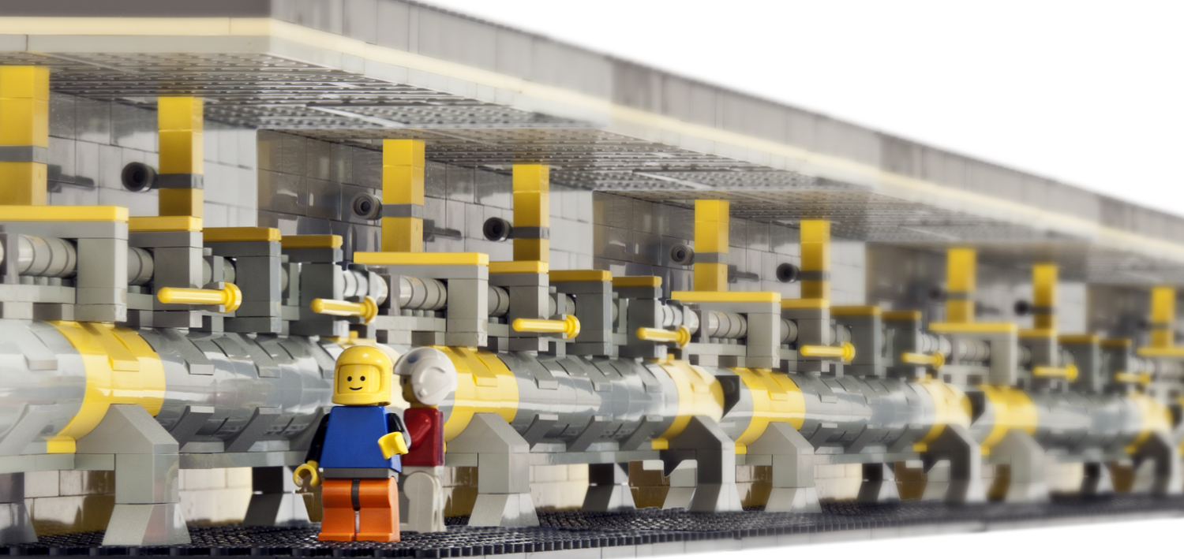
Important Missing Puzzle Stones
Interaction Region
and
ancillary detector systems:
hadron and lepton polarimeters
luminosity detector
low Q² tagger
ZDC and Roman Pot systems
all needed from the beginning

Slide 30
IR Requirements from Physics
 | Hadron | Lepton
Machine element free region | High Luminosity → beam elements need to be very close to IP eRHIC: +/- 4.5 m JLEIC: +/- 3.5 m for main detector
Beam pipe | Low mass material i.e. Beryllium
Low Q² tagger |  | Acceptance: Q² < ~0.1 GeV
Zero Degree Calorimeter | 60cm x 60cm x 2m @ ~30 m
scattered proton/neutron acc. all energies for ep | Proton: 0.2 GeV < p_{t} < 1.3 GeV Neutron: p_{t} < 1.3 GeV
scattered proton/neutron acc. all energies for eA | Proton and Neutron: Θ < 6 mrad (√s=50 GeV) Θ < 4 mrad (√s=100 GeV)
Integration of detectors | Local polarimeter
Luminosity | Relative Luminosity: R = L^{++/--}/L^{+-/-+} < 10⁻⁴
 |  | γ acceptance: +/- 1 mrad → δL/L < 1%

Slide 31
eRHIC: IR Design
25 mrad crossing angle
main emphasis on integrating requirements for hadron beam direction
  B0Fp: Forward Spectrometer (6 - 20 mrad)
  Roman pots (Sensitive 1 to 5 mrad)
  Neutron Detector (0 to 4 mrad)
B1Re and B2Re: separate BH photons from beam, separate low Q² electrons from beam
and lepton beam from SR-fan
electron and hadron polarimetry at IP-12
need still to integrate a local IR hadron polarimeter to monitor degree of long. polarisation

Slide 32
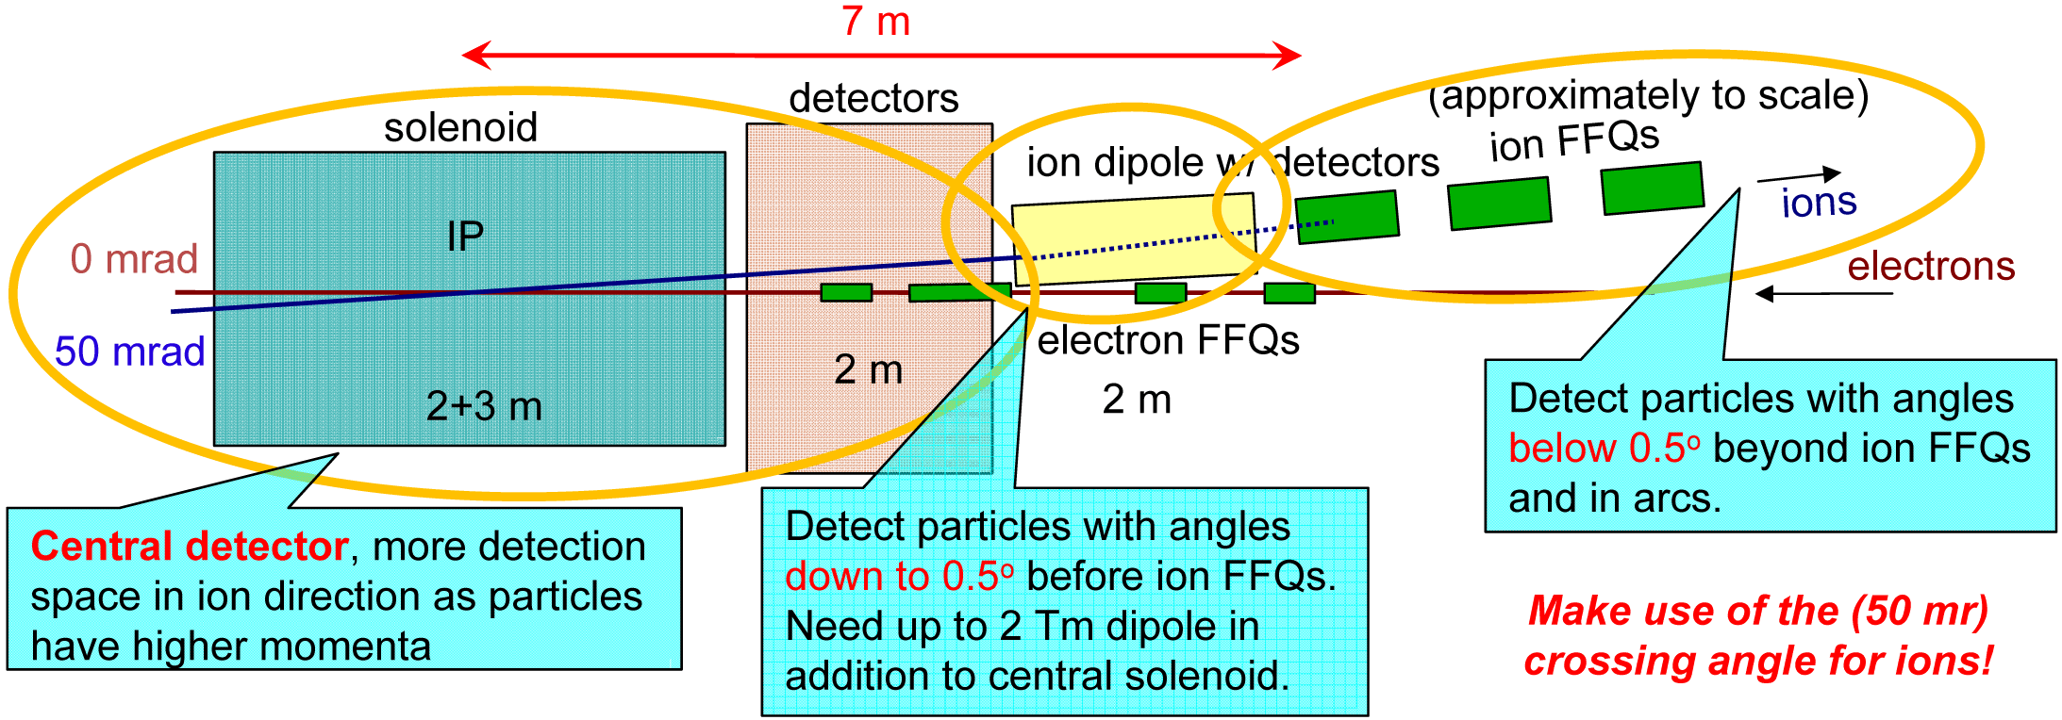



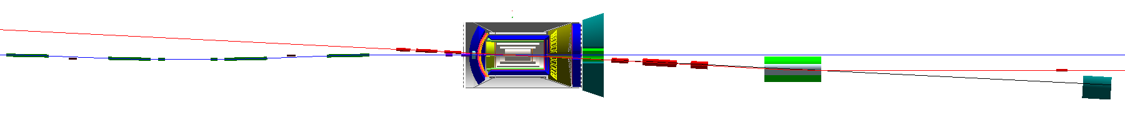
JLEIC IR Design
50 mrad crossing angle
Forward hadron detection in three stages
Endcap
Small dipole covering angles up to ~2-3°
Far forward, up to ~10 mrad, for particles
passing through accelerator quads
Low-Q2 tagger
  Small-angle electron detection
IP
e
Compton polarimetry
forward ion detection
ions
forward e detection
spectrometers
dispersion suppressor/
geometric match
p
(top view in GEANT4)
e
low-Q² electron detection
and Compton polarimeter
ZDC
Forward hadron spectrometer

Slide 33
Hadron Polarimetry in Storage Ring
Polarized hydrogen Jet Polarimeter (HJet)
  Source of absolute polarization (normalization of other polarimeters)
  Slow (low rates ⇒ needs looong time to get precise measurements)
Proton-Carbon Polarimeter (pC)
  Very fast and high precision ⇒ main polarization monitoring tool
  Measures polarization profile and lifetime
  Needs to be normalized to HJet
IR Local Polarimeters
  Defines spin direction and degree of rotation in experimental area
All of these systems are critical for polarization measurements and monitoring at RHIC
Will be critical for EIC
Will need to be adapted to high luminosity and high frequency EIC beams

Slide 34

Summary
Let’s get to work
Big Thanks to everybody for material / slides /ideas

Slide 35


Slide 36

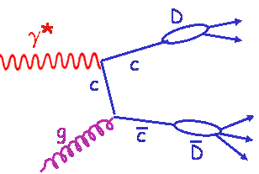
How to access Gluons in DIS
Several different complementary channels to access gluons
Indirect: the scaling violation of the cross section as function of x and Q²
dF2(x,Q²)/dlnQ² → G(x,Q²)
Direct: the measurement of F_{L}
Direct: tagging the photon gluon fusion process
    Di-jets
    charm production, i.e. F₂^{CC}
quark+anti-quark
momentum distributions
gluon momentum
distribution
All these process need a wide coverage in x and Q²

Slide 37
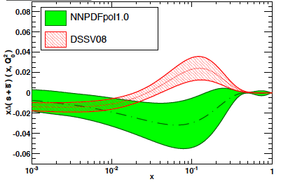
What forms the Spin of the Proton
total
quark spin
gluon
spin
angular
momentum
What do we know:
Why is separating quark flavors important?
nuclear structure is encoded in parton distibution functions
understand dynamics of the quark-antiquark fluctuations
flavor asymmetry in the light quark sea in the proton
unpolarized: ubar < dbar Helicity: Δubar > Δdbar TMDs: ?????
shape of polarized sea-quark PDFs critical for quark contribution to spin
ΔΣ does not converge at low x
due to current constrains put in the fits
strangeness was identified to be one of the least known quantities
  both unpolarized and polarized
from
SIDIS
K-data
SIDIS
data
indirect
from
inclusive
DIS-data
1st moment
constrained
by 3F-D

Slide 38
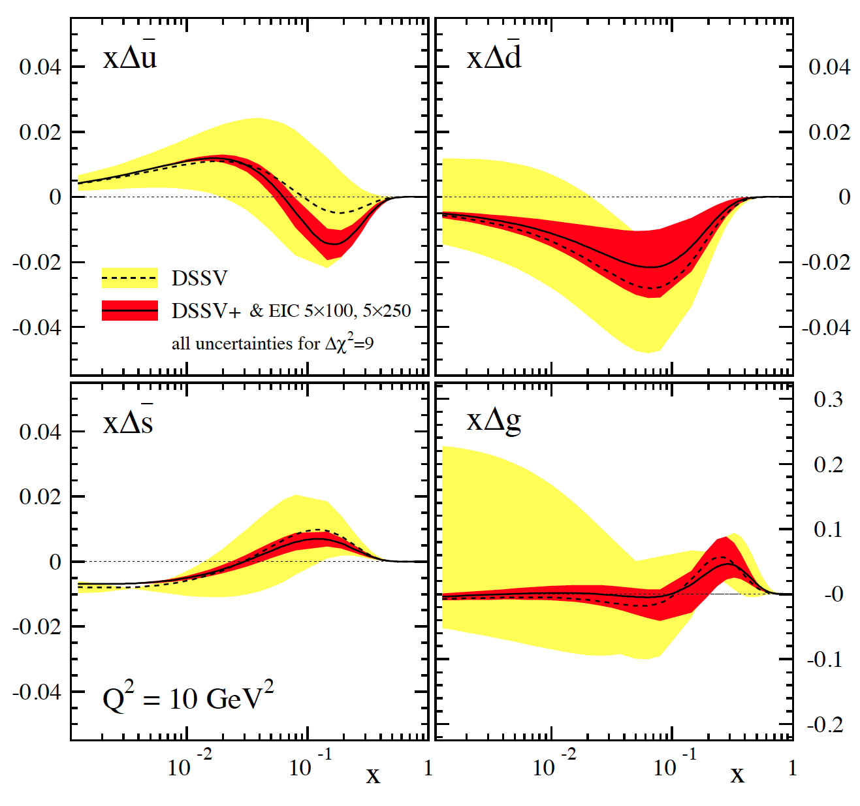
SIDIS@EIC: HELICITY PDFs
Can cover the same kinematics for g₁^{π,K} as for g₁
→ will constrain Δq
yet, small x behavior completely
unconstrained
→ determines x-integral,
which enters proton spin sum
includes data for
√s=45 GeV & 70 GeV
can be pushed to x=10⁻⁴ with
√s=140 GeV data
dramatic reduction
of uncertainties:
“issues”:
(SI)DIS @ EIC limited by
systematic uncertainties
need to control rel. lumi,
polarimetry, PID performance,
… very well

Slide 39
The Partonic Structure of Photons
PRD 96, 074035 (2017)
Di-jets@EIC ideal probe to constrain (un)polarised Photon-PDFs
unpolarized cross section:
polarized cross section:
Precision (un)polarised partonic structure of photons

Slide 40
Photon Parton Structure
Jets from photon and proton side
are well separated in η for quark
initiated processes
identified hadron tagging in jet
enhances flavor sensitivity

Slide 41
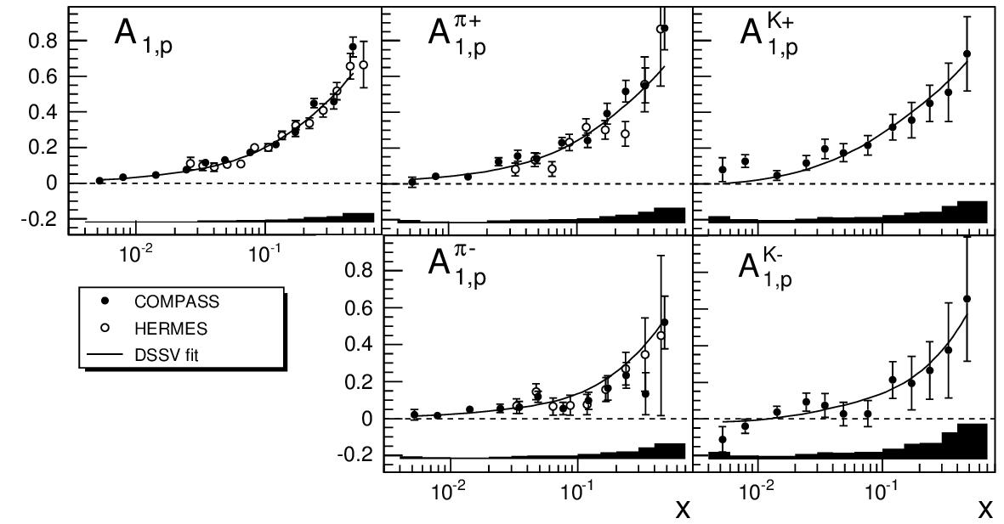
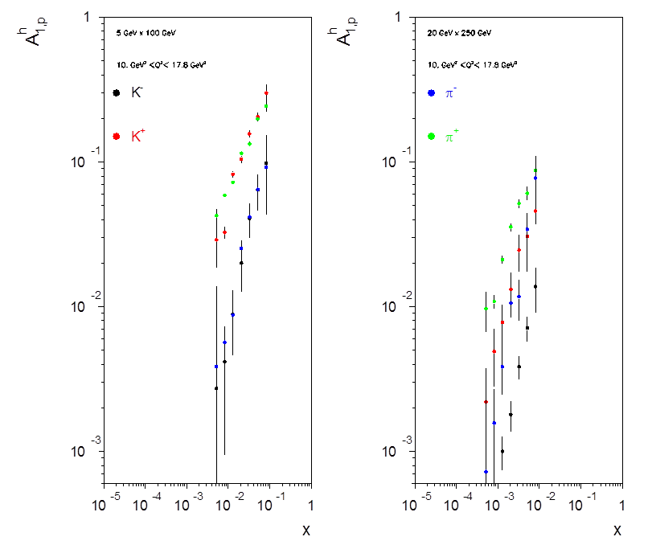
Asymmetries for identified hadrons
incl.
π⁺
K⁺
π –
K⁻
EIC
K- asymmetries are dominated by sea-quarks
A_{π}- > A_{K}- But #K = 1/3 #π
at low x A_{K}- = 1/10 A_{π}-
need excellent purity

Slide 42
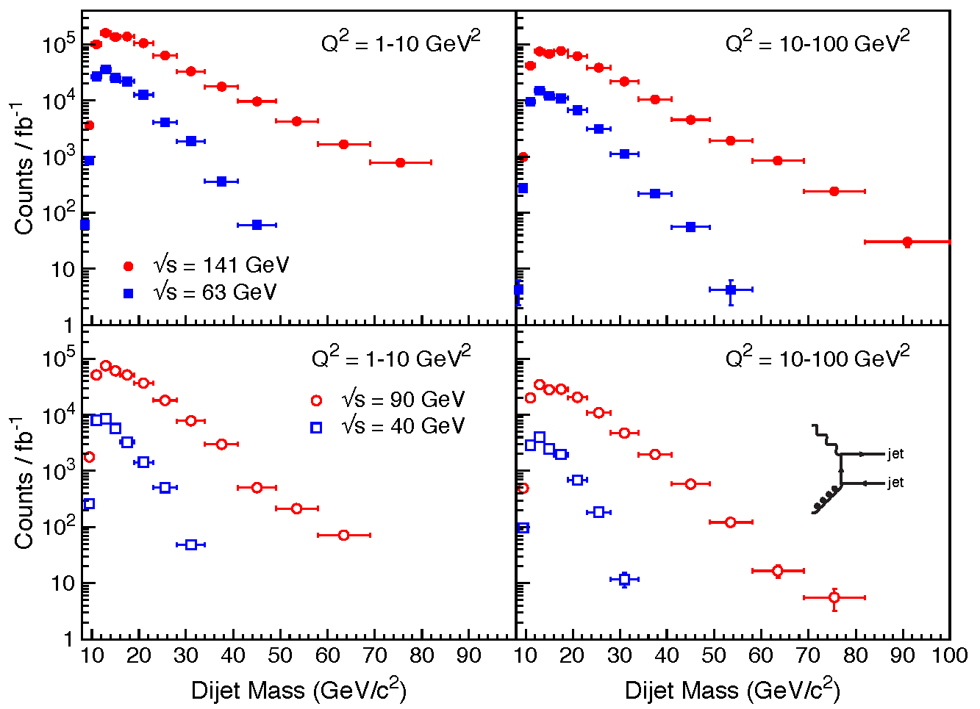

Requirements from Jets
Jet solid angle with R goes like R²/cosh²(η).
so for fixed jet multiplicity, dN/dΩ grows like cosh²(η)
15 times larger at η =2,
100 times larger at η =3
We want to detect with high efficiency and purity the ID of individual particles in a jet
→ overlaps of RINGs in RICH detectors

Slide 43

What about Nuclei?
Incoming
Electron Beam
Objectives: Answer the 3 conundrums of the initial state:
Precision map of the initial state → nPDFs
What is the spatial transverse distributions of nucleons and gluons?
3. How much does the spatial distribution fluctuate? Lumpiness, hot-spots etc.
4. How saturated is the initial state of the nucleus?
→ unambiguously see saturation

Slide 44
nPDFs before and after EIC
Ratio g(x,Q²)_{pb} /g(x,Q²)_{p}
DGLAP:
predicts Q² but not A-dependence and x-dependence
Saturation models:
predict A-dependence and x-dependence but not Q²
→ Need: large Q² lever-arm for fixed x, A-scan
LHC
RHIC
Measure different structure function in eA → constrain nPDF:
quark+anti-quark
momentum distributions
gluon momentum distribution
or tag on charm → F₂^{C}

Slide 45

Charm Cross-Sections in eA
arXiv:1708.05654
Direct Access to gluons at
medium to high x by tagging
photon-gluon fusion through
charm events
stringent test of general-mass
variable flavor number scheme

Slide 46

What do we know and what can EIC do
light hadrons
Hermes:
E_{e} = 27 GeV → √s = 7.2 GeV
E_{h} = 2-15 GeV
Unprecedented precision to distinguish between different models
large ν range
hadronization in- and outside
of nucleus
first time for charm
Simulations: A. Accardi & R. Dupre
z
EIC:

Slide 47



What does this mean for the PID techniques
Example: LHC-b
Aerogel
C₄F₁₀
CF₄
Radiators are an excellent match to EIC
needs
RICH-1 good model design
different/modified photon-detector

Slide 48

What does this mean for the PID techniques
Do not have 3.5 m flight path → need much better time resolution
Midrapidity: ~1 – 1.2 m Forward / Rear Rapidity: 2 – 2.5 m
What would be the goal for ToF in an EIC detector
For p >> mc:

Slide 49



What does this mean for the PID techniques
dE/dx to separate particles
below < 2 GeV with n_{σ}>3

Slide 50
Hadron PID Requirements
Interplay between different technologies
Here, electron/hadron separation shown only from Cherenkov detectors.
Main e/h rejection is done by calorimeters.

Slide 51

Recall Kinemtics
scattered quark in NC and CC DIS
scattered lepton in NC DIS
At low y, quark energy good estimator of x
→ Good hadron energy resolution essential
At low y, electron energy is a poor estimator of x
Electron angle good estimator of Q²
→ Need large coverage and good lepton ID

Slide 52

Requirements for Lepton Beam
Luminosity Detector
Concept:
Use Bremsstrahlung ep → epγ as reference cross section
different methods:
  Bethe Heitler, QED Compton, Pair Production
Hera: reached 1-2% systematic uncertainty
Goals for Luminosity Measurement:
Integrated luminosity with precision δL/L< 1%
Measurement of relative luminosity:
physics-asymmetry/10 → ~10⁻⁴ – 10⁻⁵
EIC challenges:
with 10³³ cm⁻²s⁻¹ one gets on average 23
bremsstrahlungs photons/bunch for proton
beam
→ A-beam Z²-dependence
Need more sophisticated solution
BH photon cone < 0.03 mrad
→ acceptance completely dominated by
lepton beam size
EIC first collider with polarized lepton and hadron beams
  luminosity measurement depends on beam polarization
pair spectrometer
low rate
High precision measurement for physics analysis
The calorimeters are outside of the primary synchrotron radiation fan
zero degree photon calorimeter
high rate
Fast feedback for machine tuning
measured energy proportional to # photons
subject to synchrotron radiation

Slide 53

A typical High Energy Detector
Particle types:
  neutrinos (missing energy)
  muons m
  hadrons π, K, p
    quarks, gluons → jets
  electrons, photons, π⁰
  charged particles
Rough Classification
track detectors for charged particles
  “massless” detectors
    gas detectors
    solid state detectors
beam pipe
magnet coil
  (solenoid, field || beam axis)
Calorimeter for energy measurement
electromagnetic
  high Z material (Pb-glas)
hadronic
  heavy medium (Fe, Cu, U)
  + active material
absorber (mostly Fe)
  flux return yoke +
active material

Slide 54

η = -1
η = 1
η = -2
η = 2
η = -3
η = 3
η = -4
η = 4

