Slide 1
Vision for the
Center
Abhay Deshpande
Stony Brook University & Brookhaven National Laboratory
Inaugural Meeting 2018

Slide 2
Overview
The Vision for the Center for Frontiers in Nuclear Science
  Emerged from my personal experiences, observations, lessons learnt & discussions with many in the community
CFNS Activities (2018 and future)
  This serves as an introduction to tomorrow’s CFNS Review
Invitation:
Your involvement in the Center’s activities: welcome, essential & critical

Slide 3
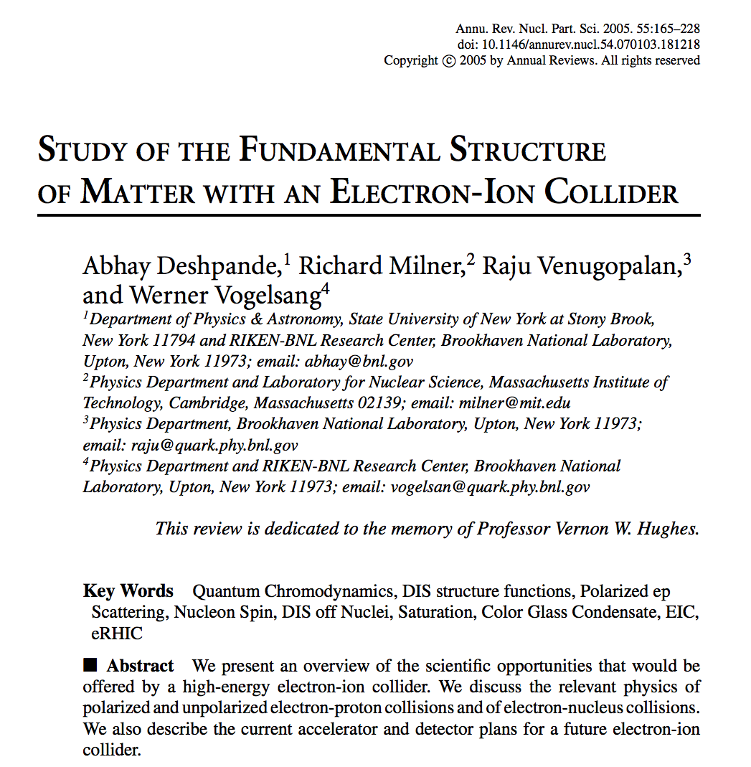
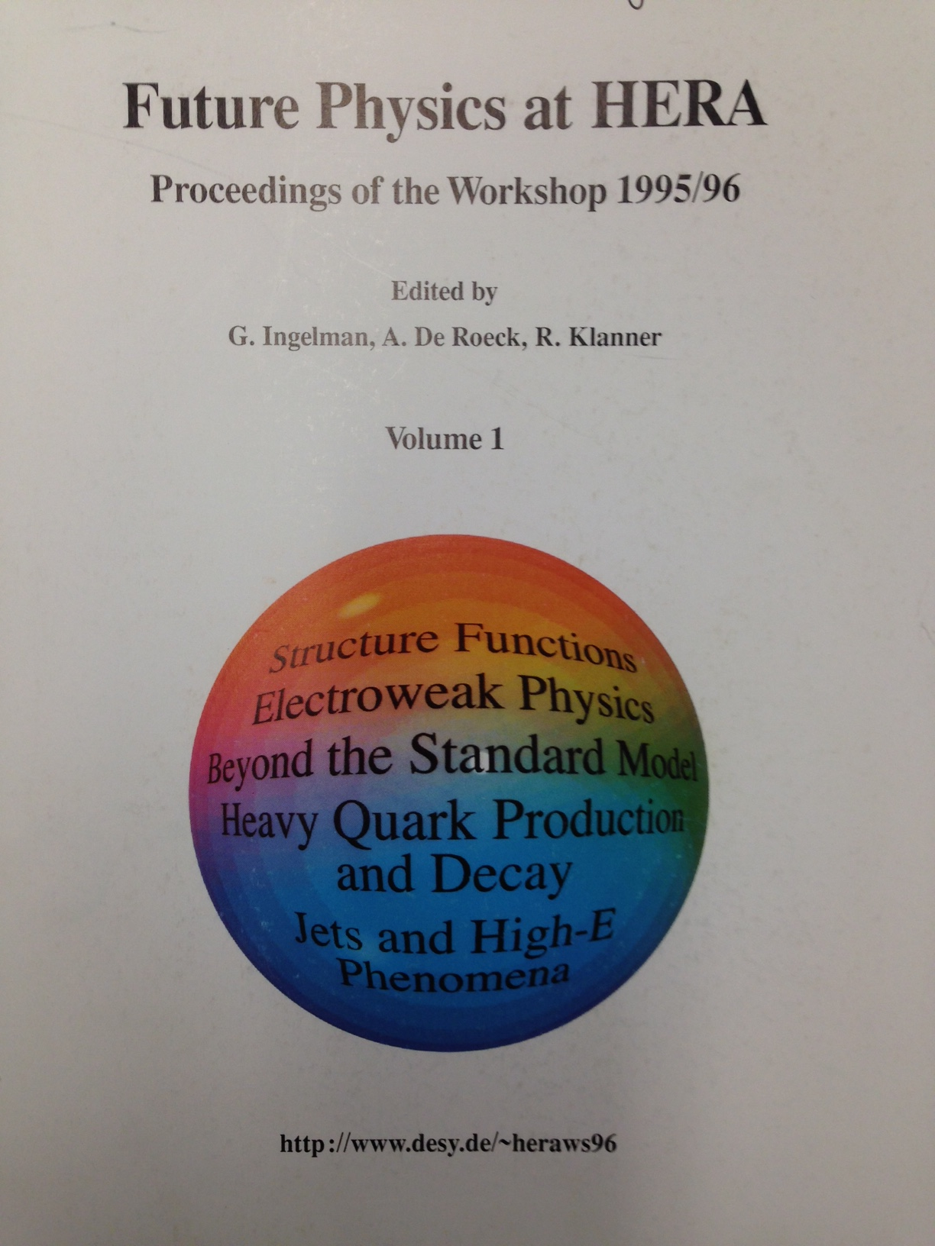
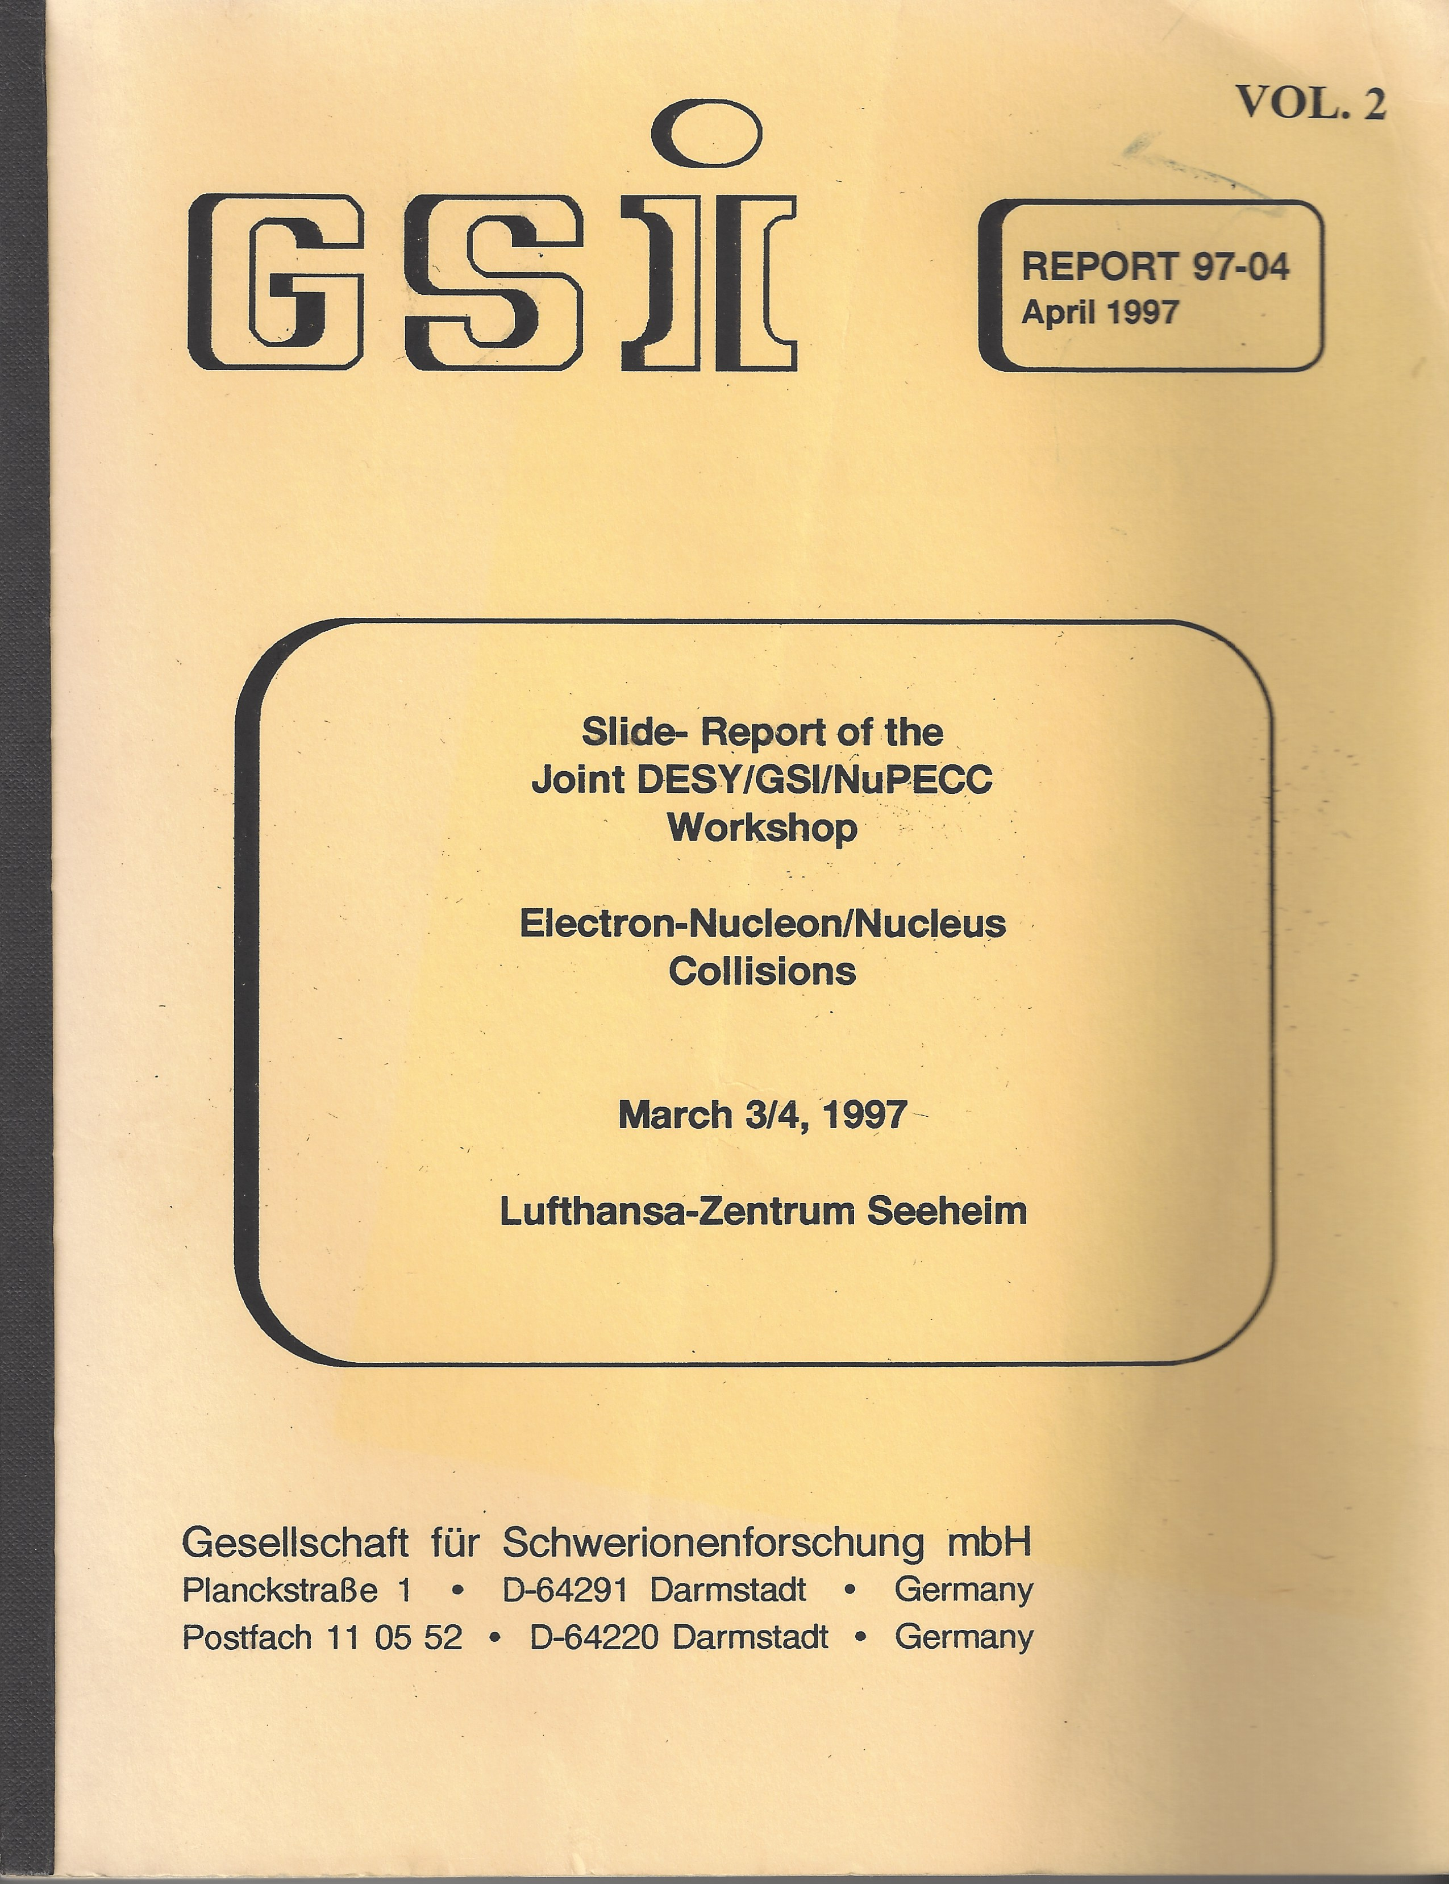
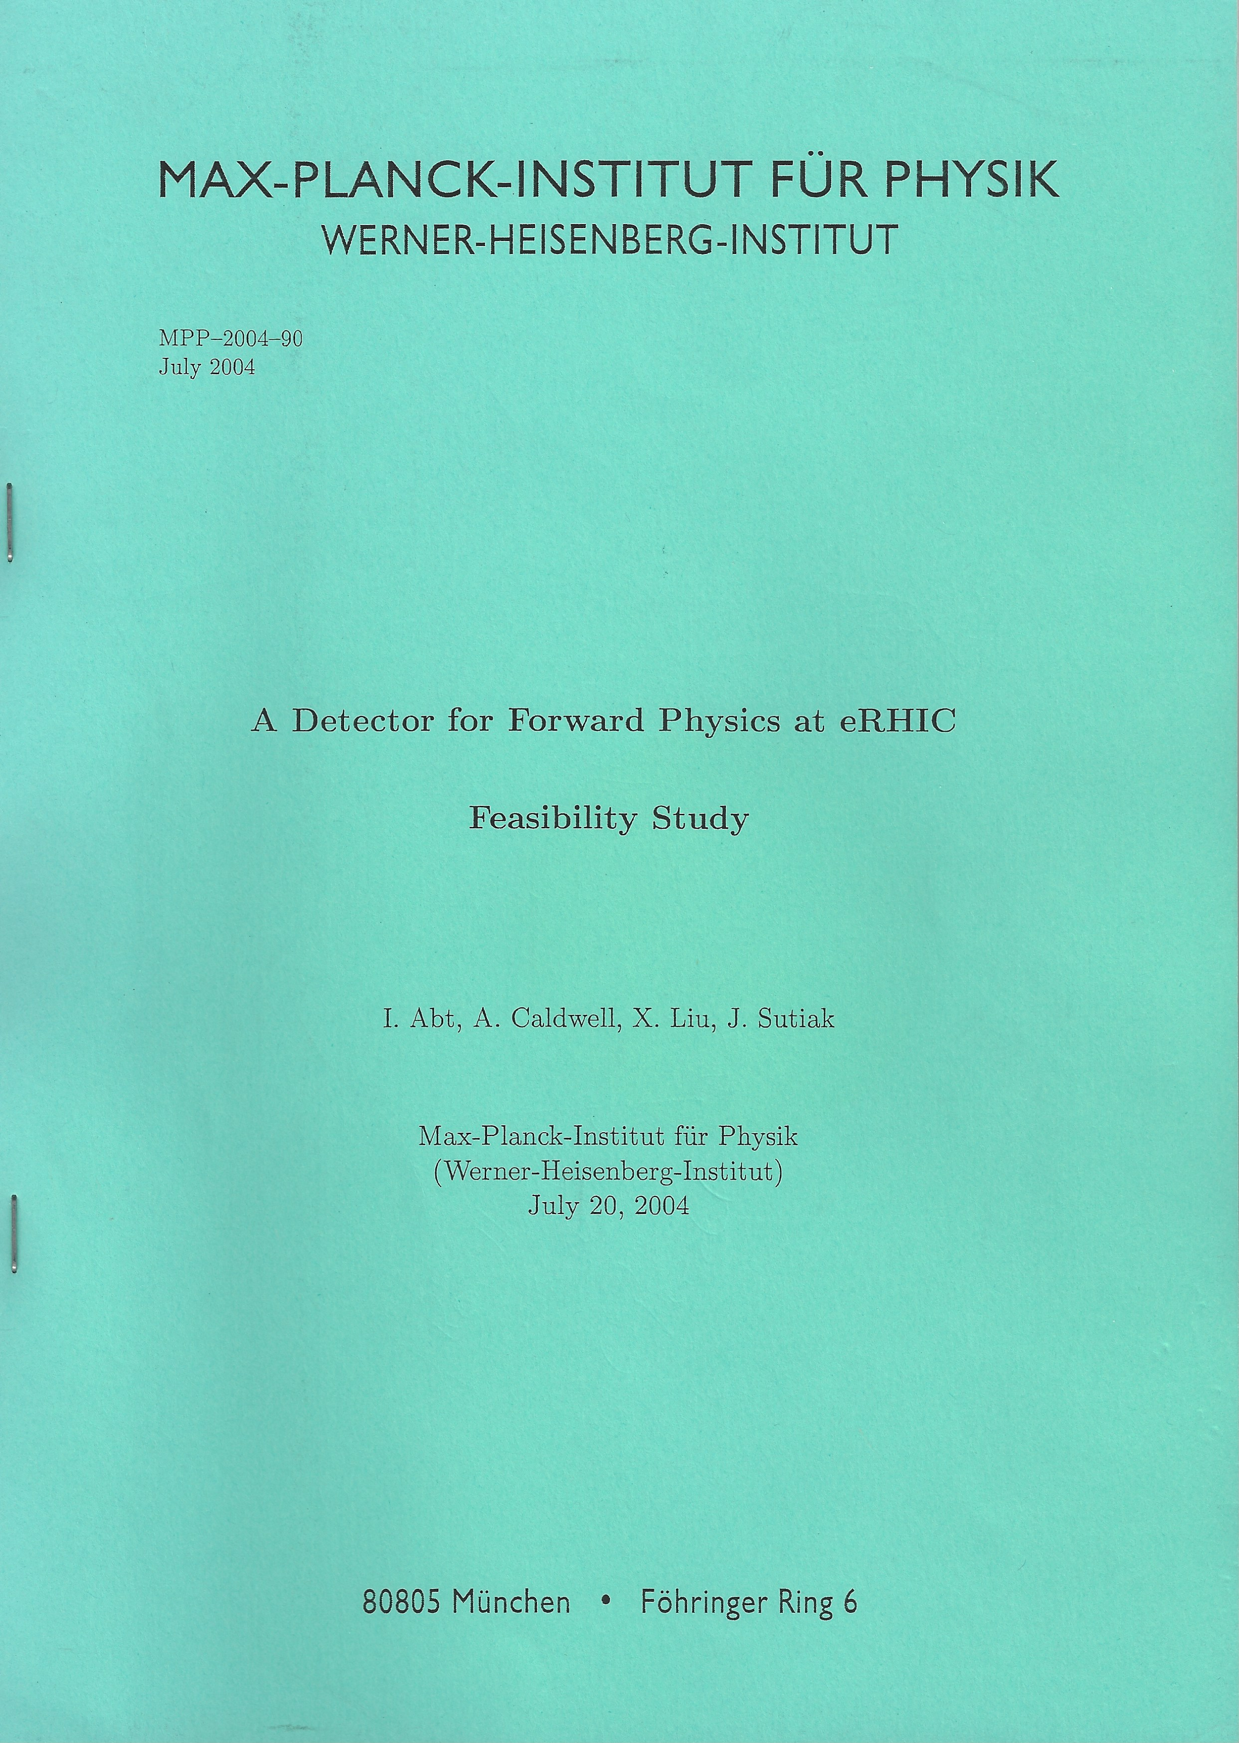
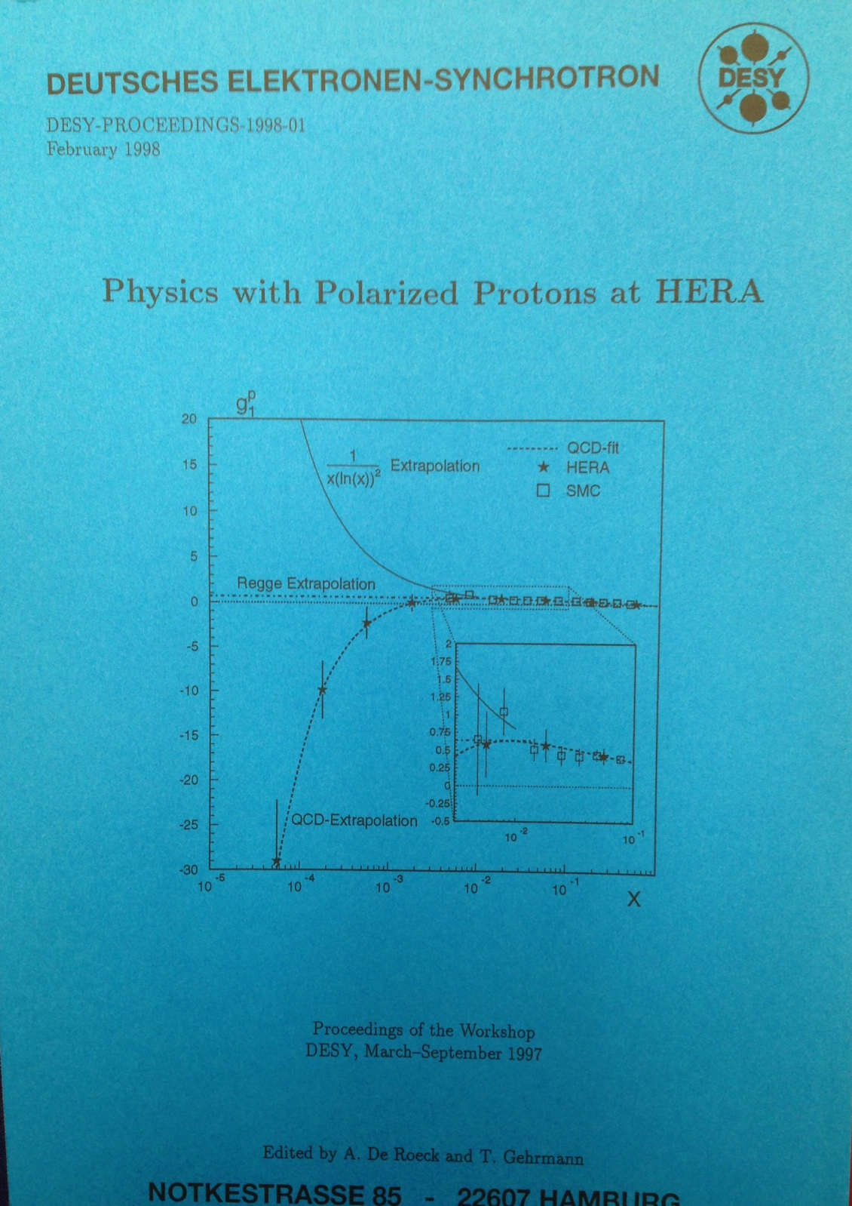
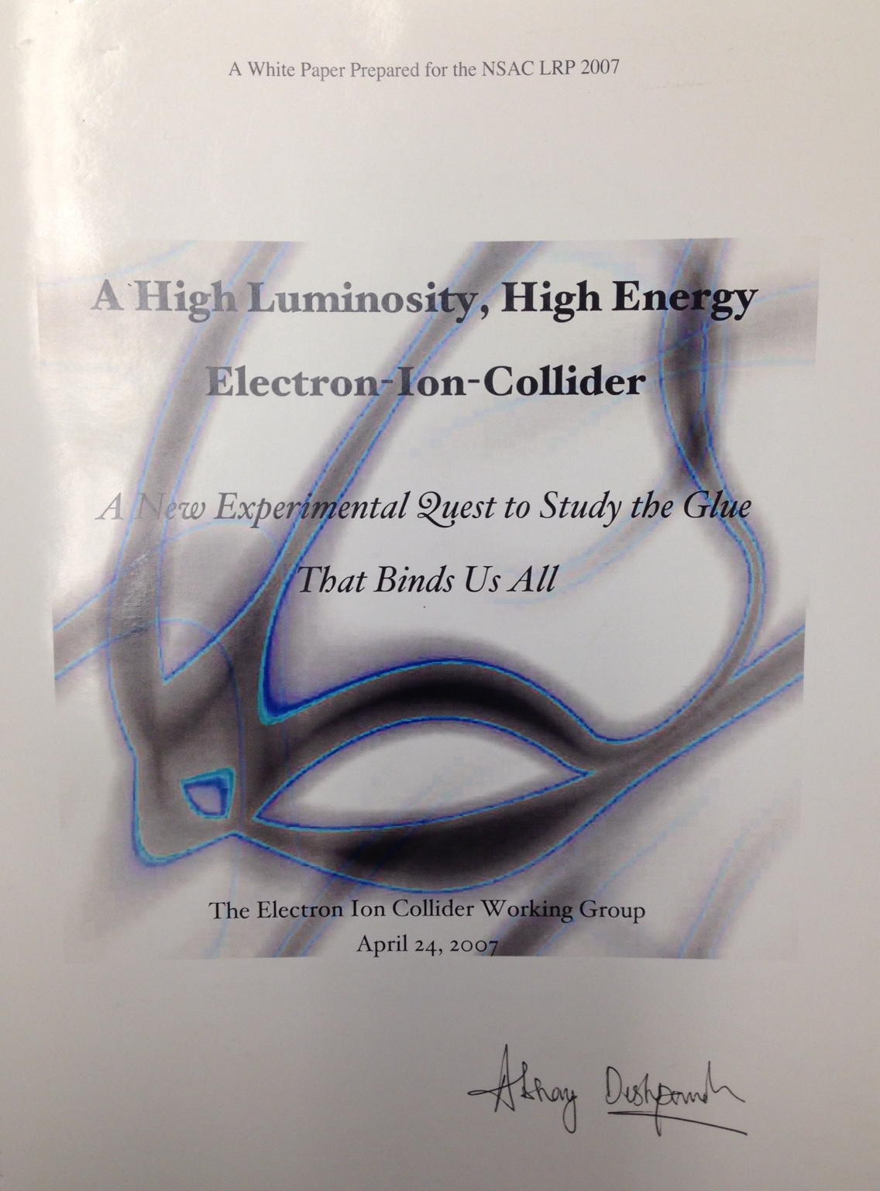
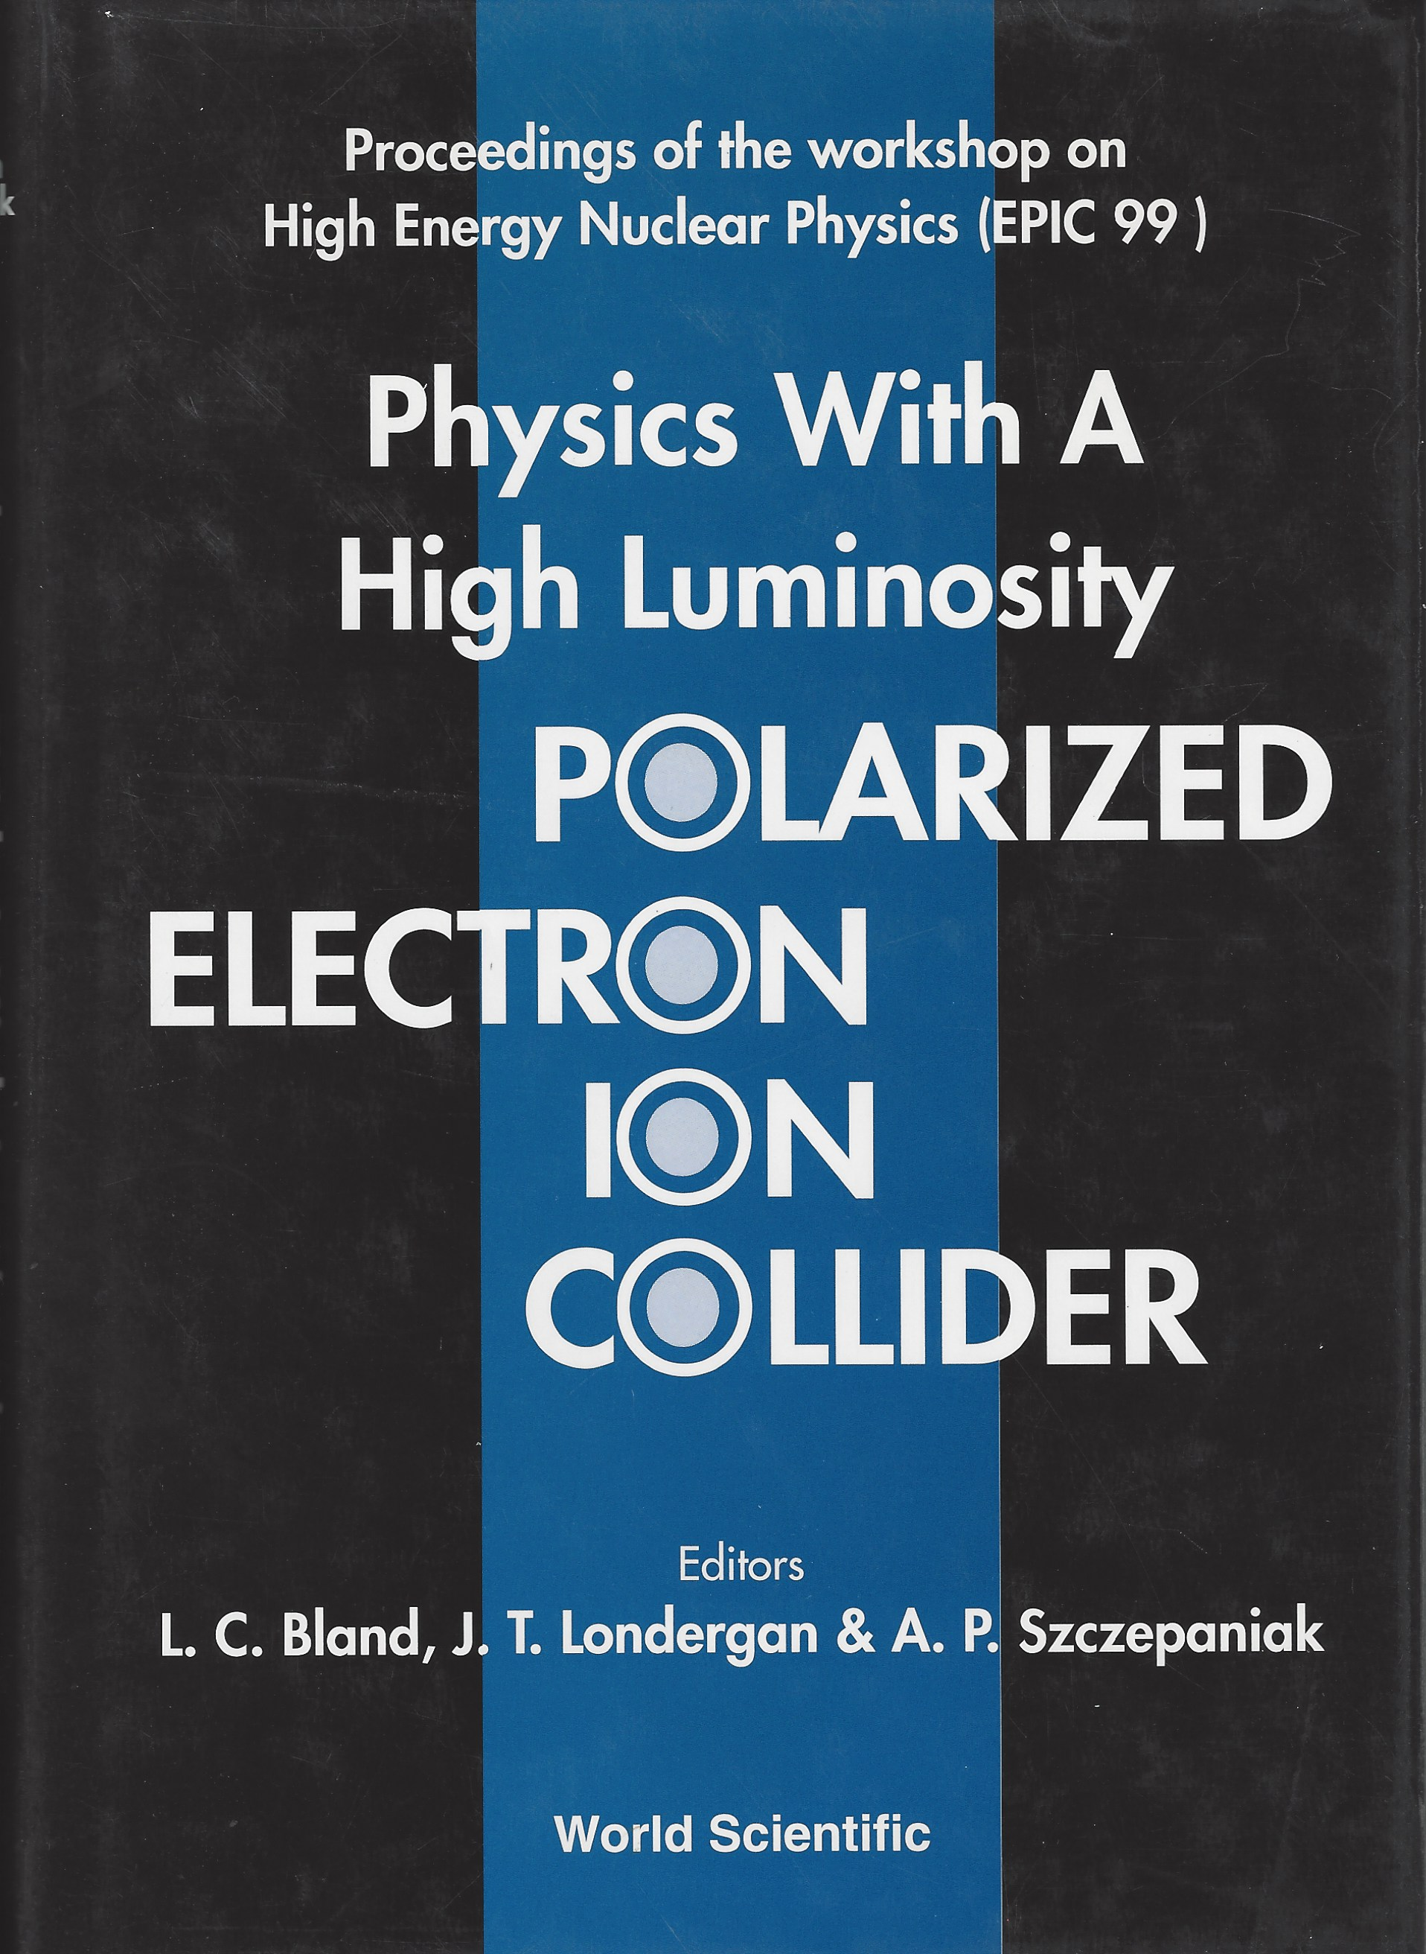
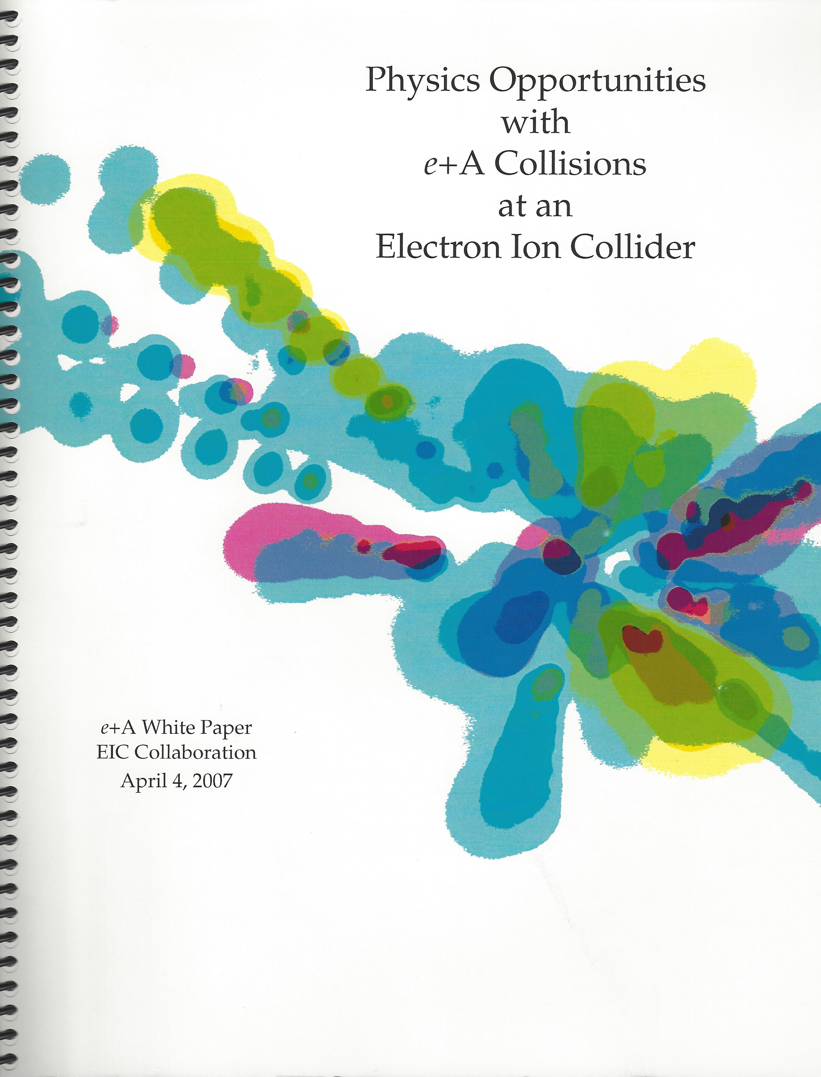
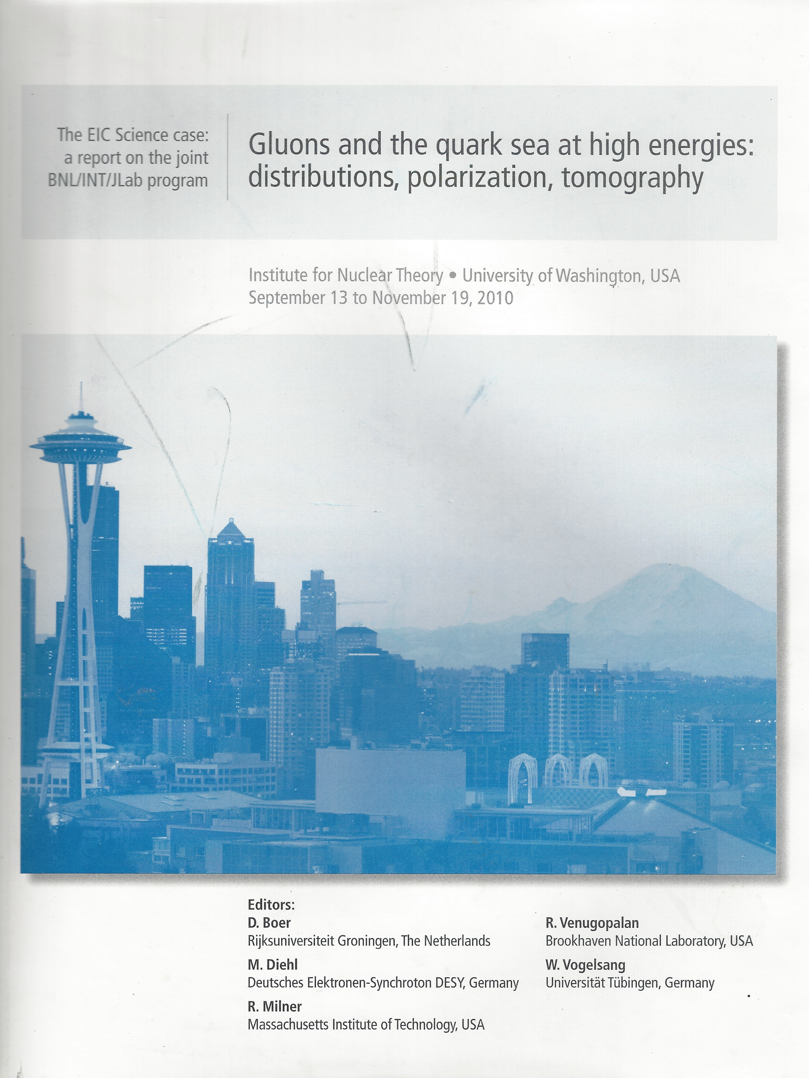
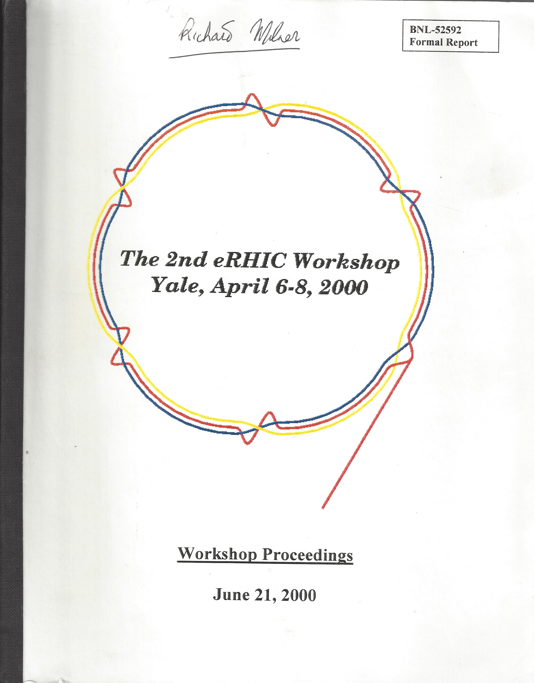
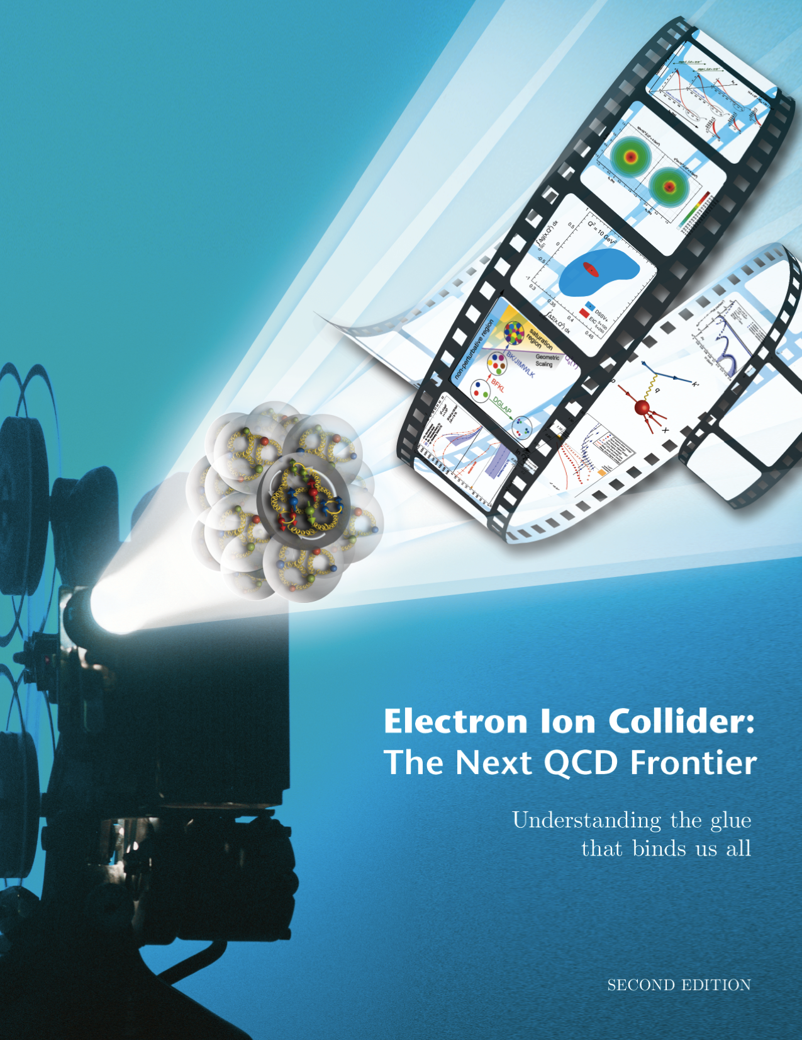
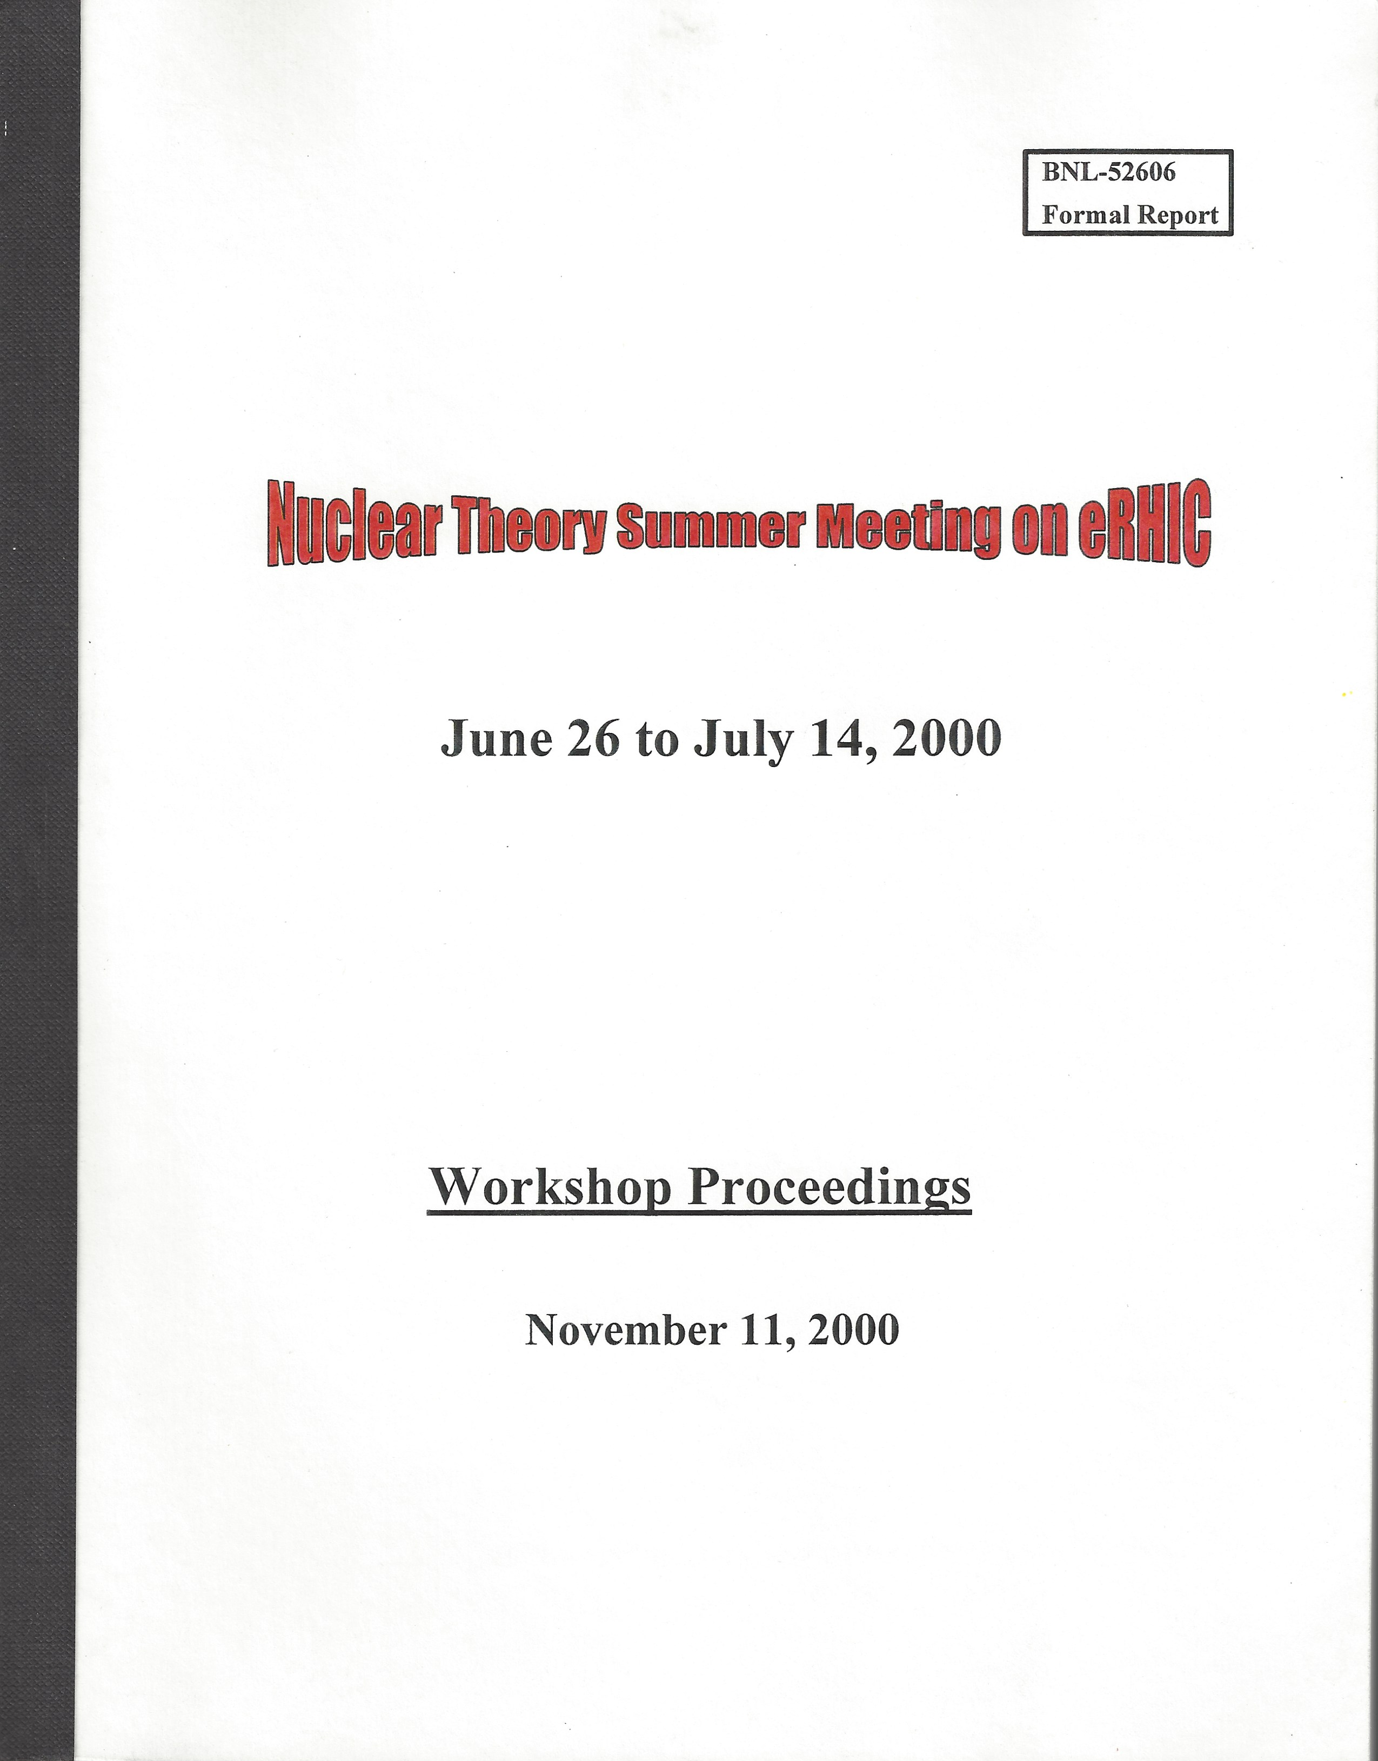
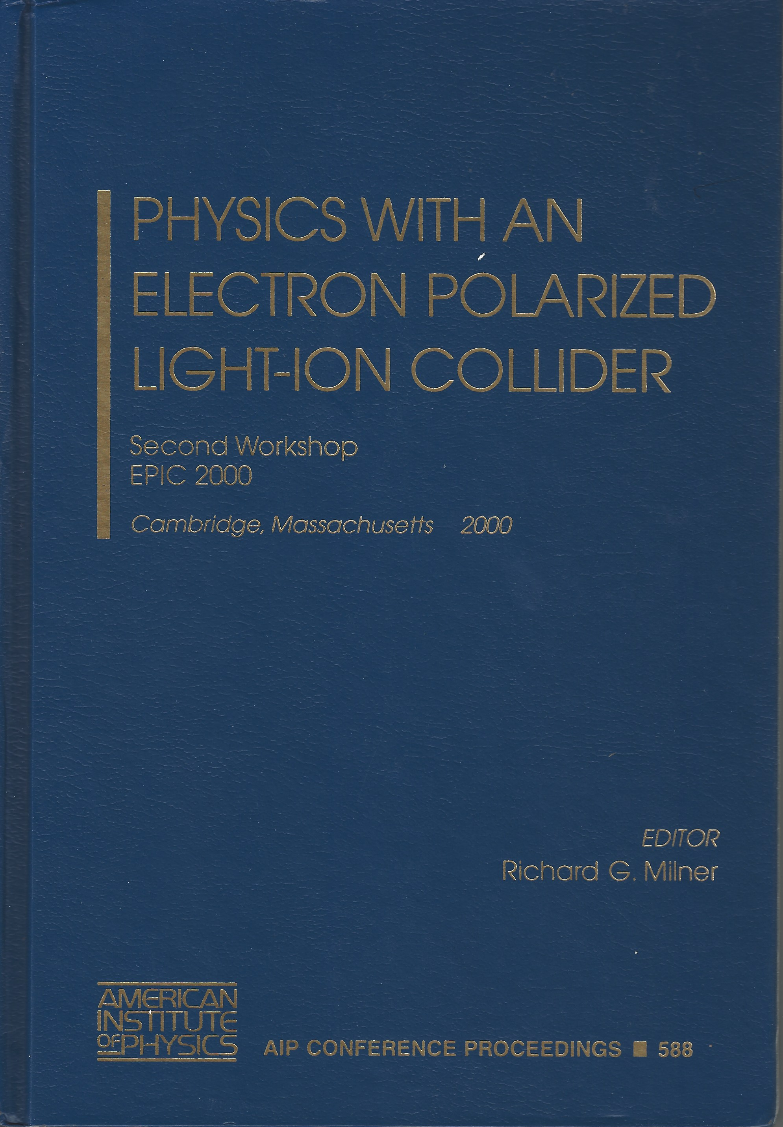
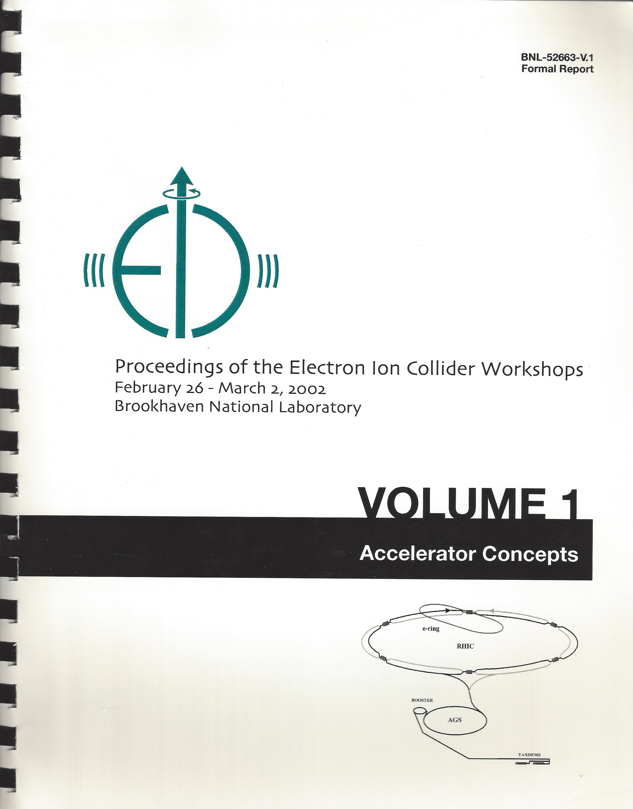
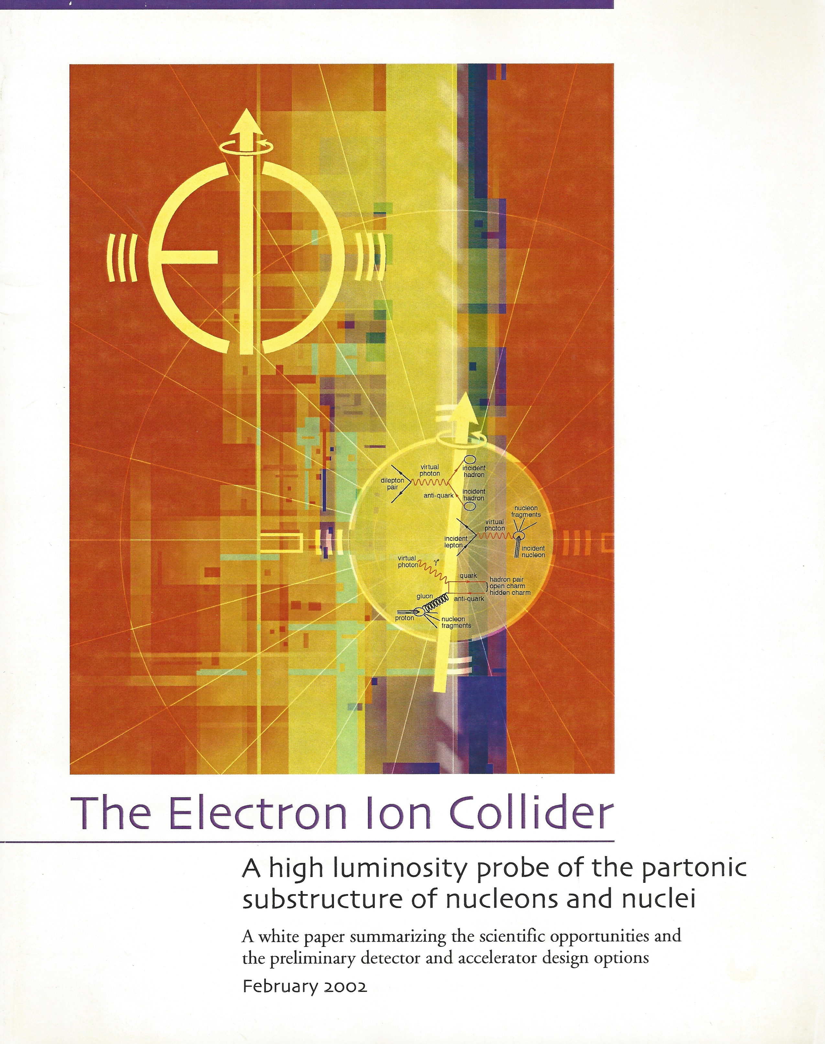
2004
2014
1212.1701.v3
A. Accardi et al
1995
EIC Physics related White Papers and community initiated documents
2002

Slide 4
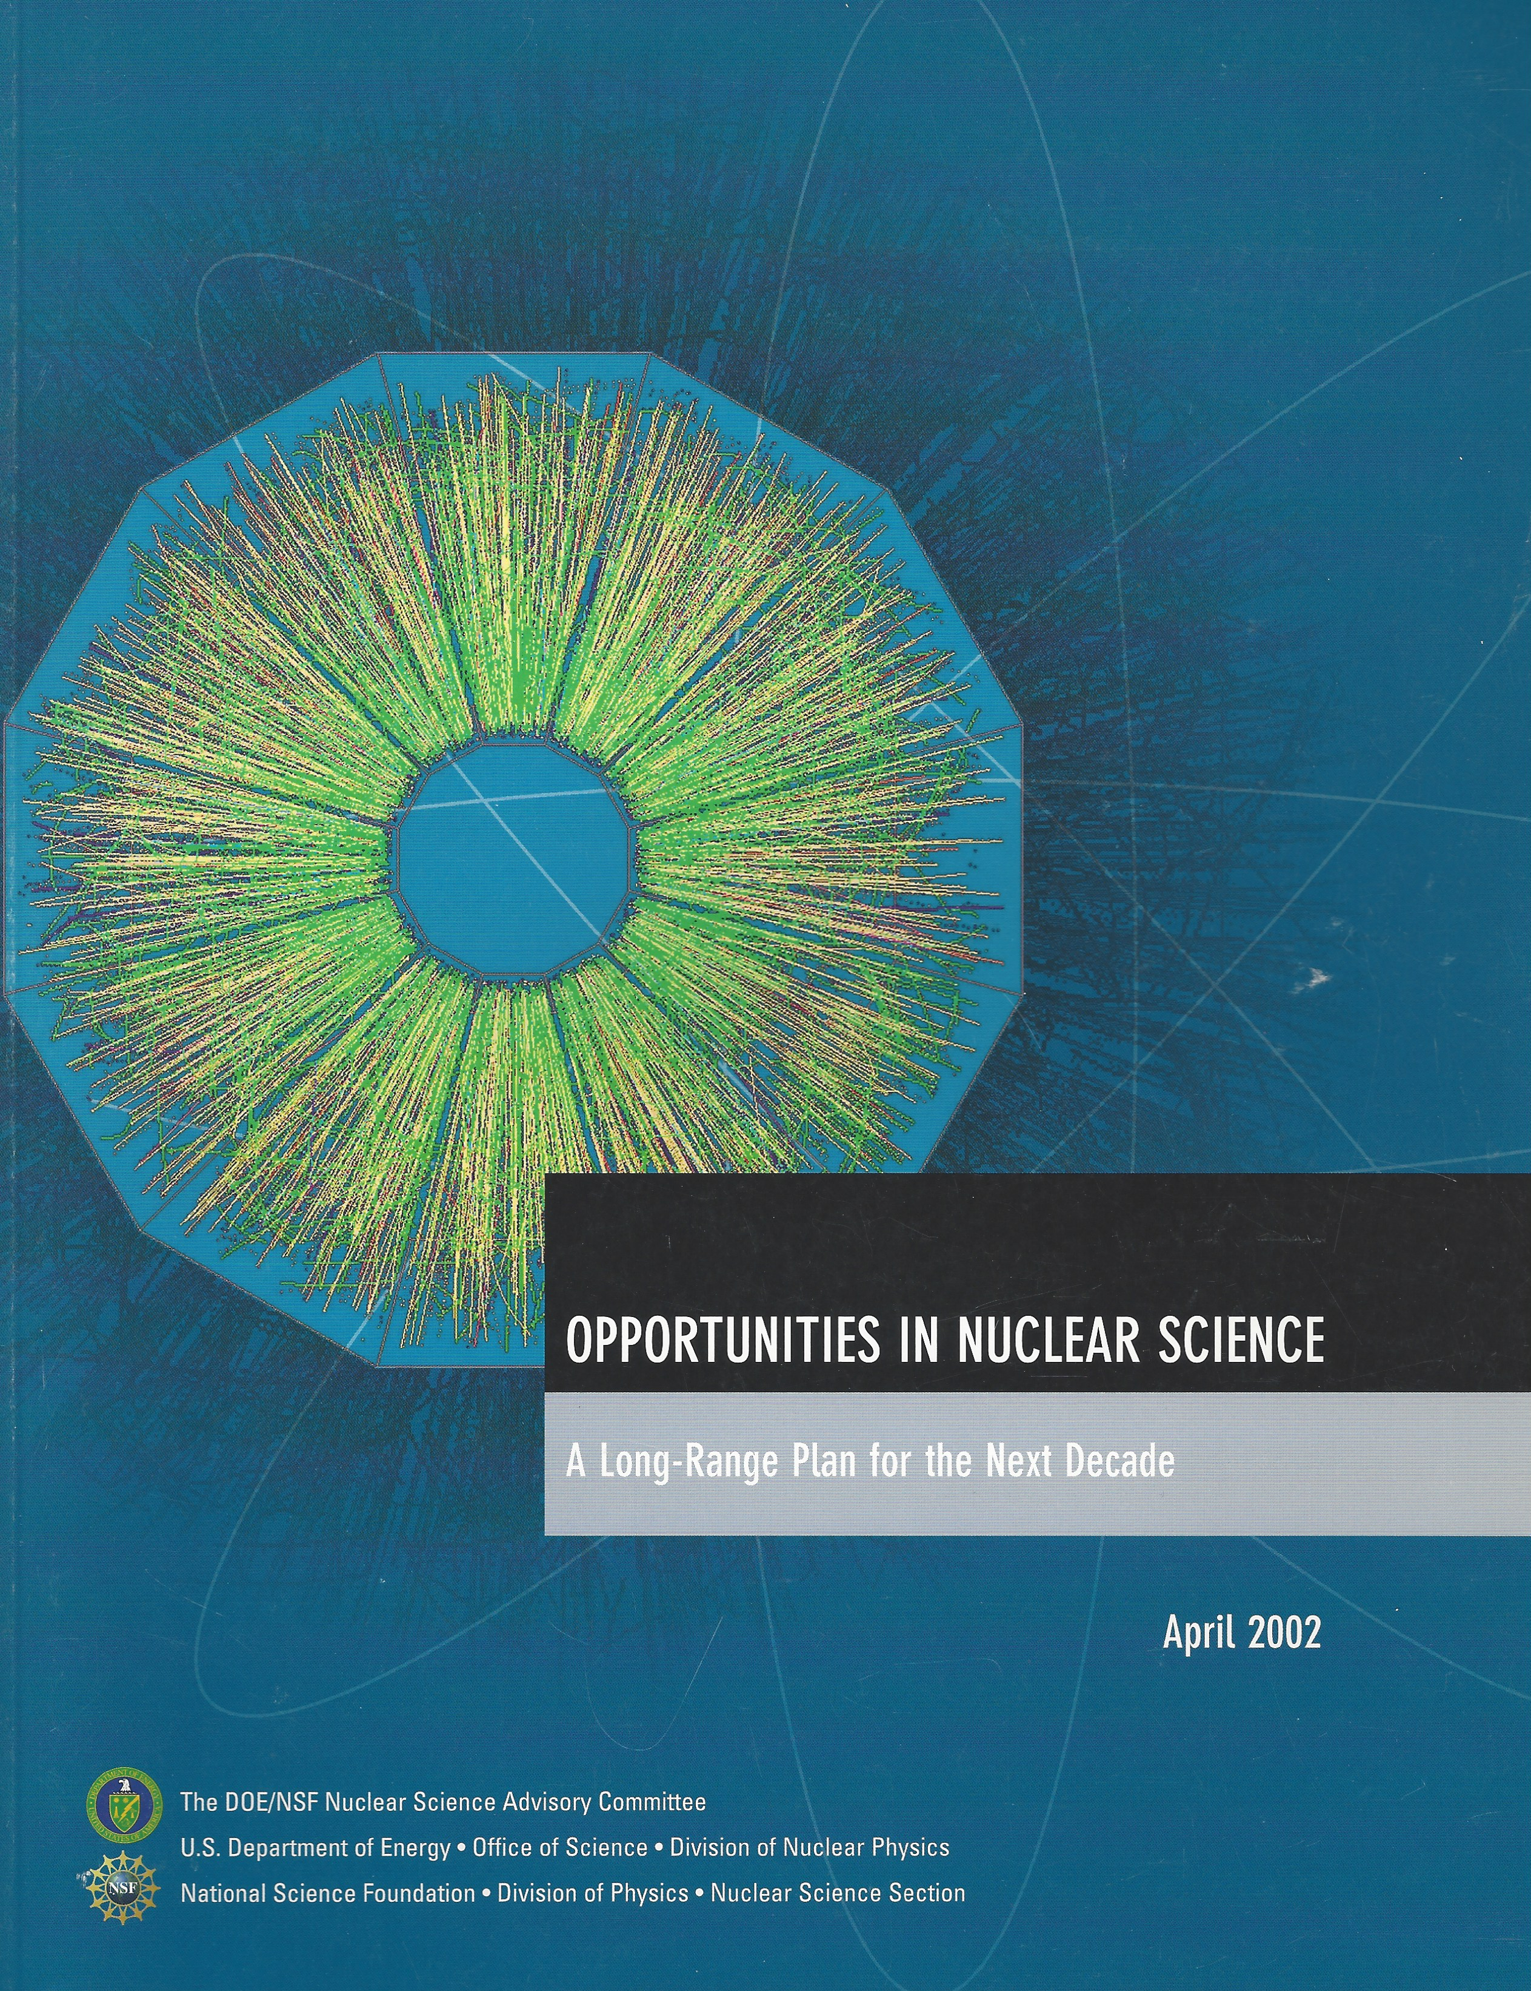
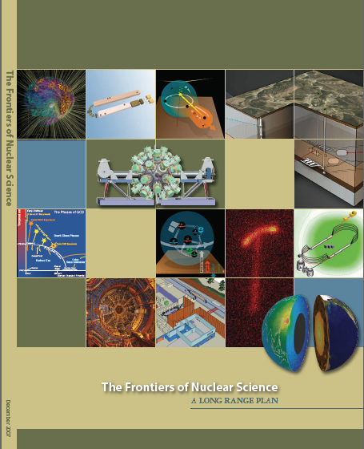

EIC in the NSAC Long Range Plans
Recommendation III
We recommend a high-energy high-luminosity polarized EIC as the highest priority new facility construction after the completion of the FRIB
2002
2007
2015

Slide 5
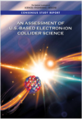
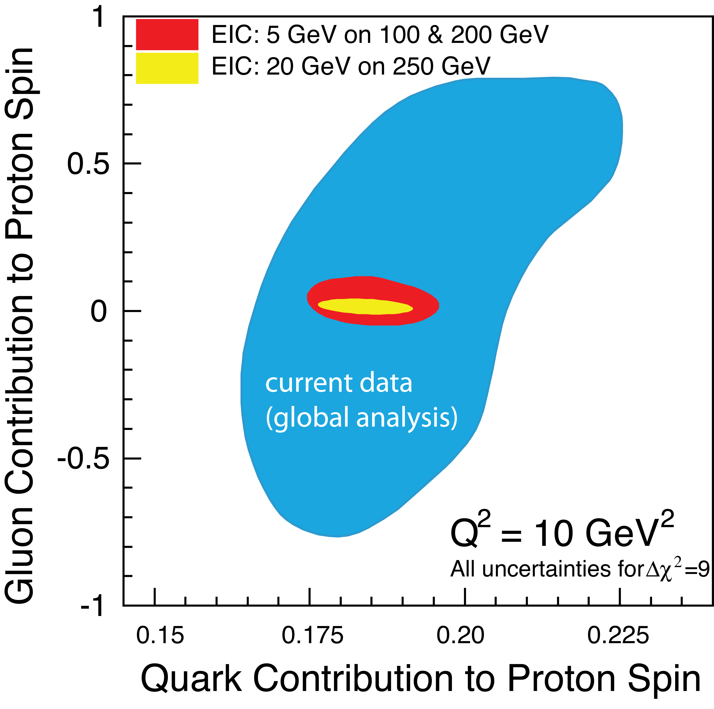

Slide 6

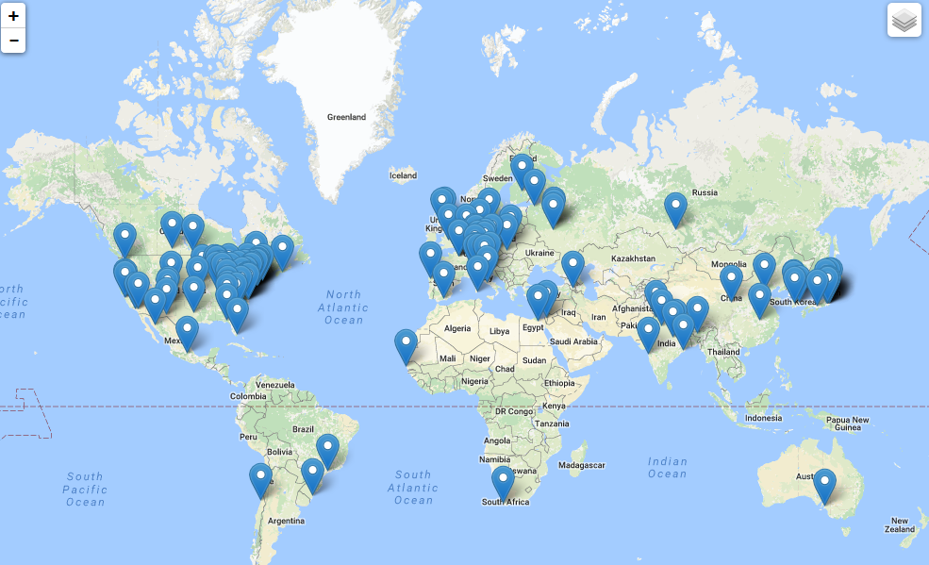
The EIC Users Group: EICUG.ORG
826 collaborators, 30 countries, 176 institutions... (October 2018)
Map of institution’s locations
EICUG Structures in place and active.
EIC UG Steering Committee
EIC UG Institutional Board
EIC UG Speaker’s Committee
Task forces on:
-- Beam polarimetry
-- Luminosity measurement
-- Background studies
-- IR Design
Annual meetings: Stony Brook (2014), Berkeley (2015), ANL (2016), Trieste (2017), CAU (2018), Paris 2019

Slide 7
EIC in the NSAC LRP 2015
(the way I saw it emerge)
Follow the 2007 LRP : operate facilities RHIC/LHC, Jlab6/12, other NP facilities, ongoing upgrades
A ton scale experiment for neutrino-less double beta decay experiment
Build the EIC
Invest in small and large scale projects (MIE’s…etc.)
Initiative: Support for theory for the above experimental initiatives for maximal impact
Outreach education and workforce

Slide 8
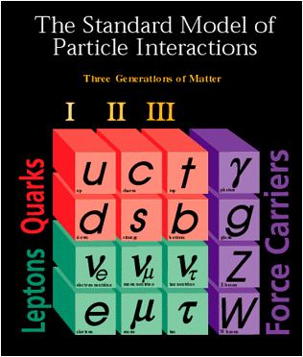
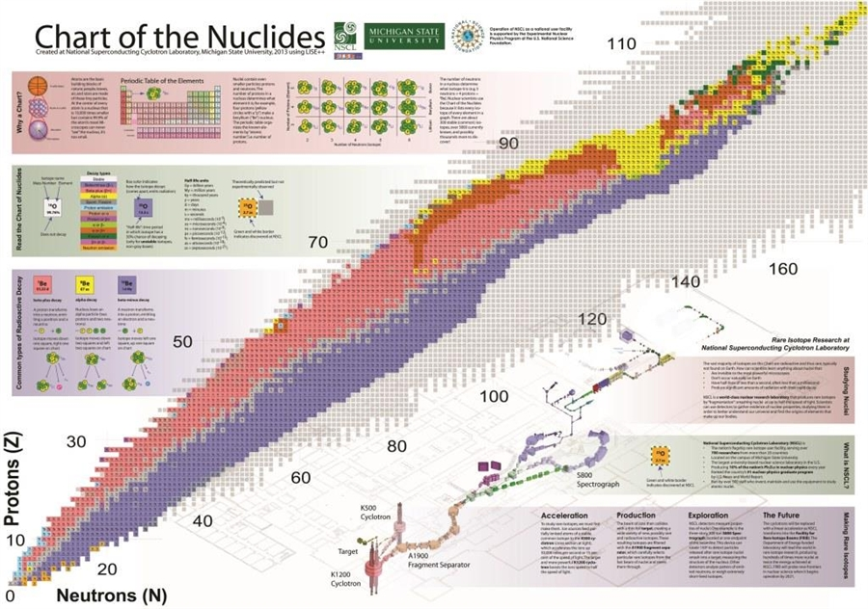
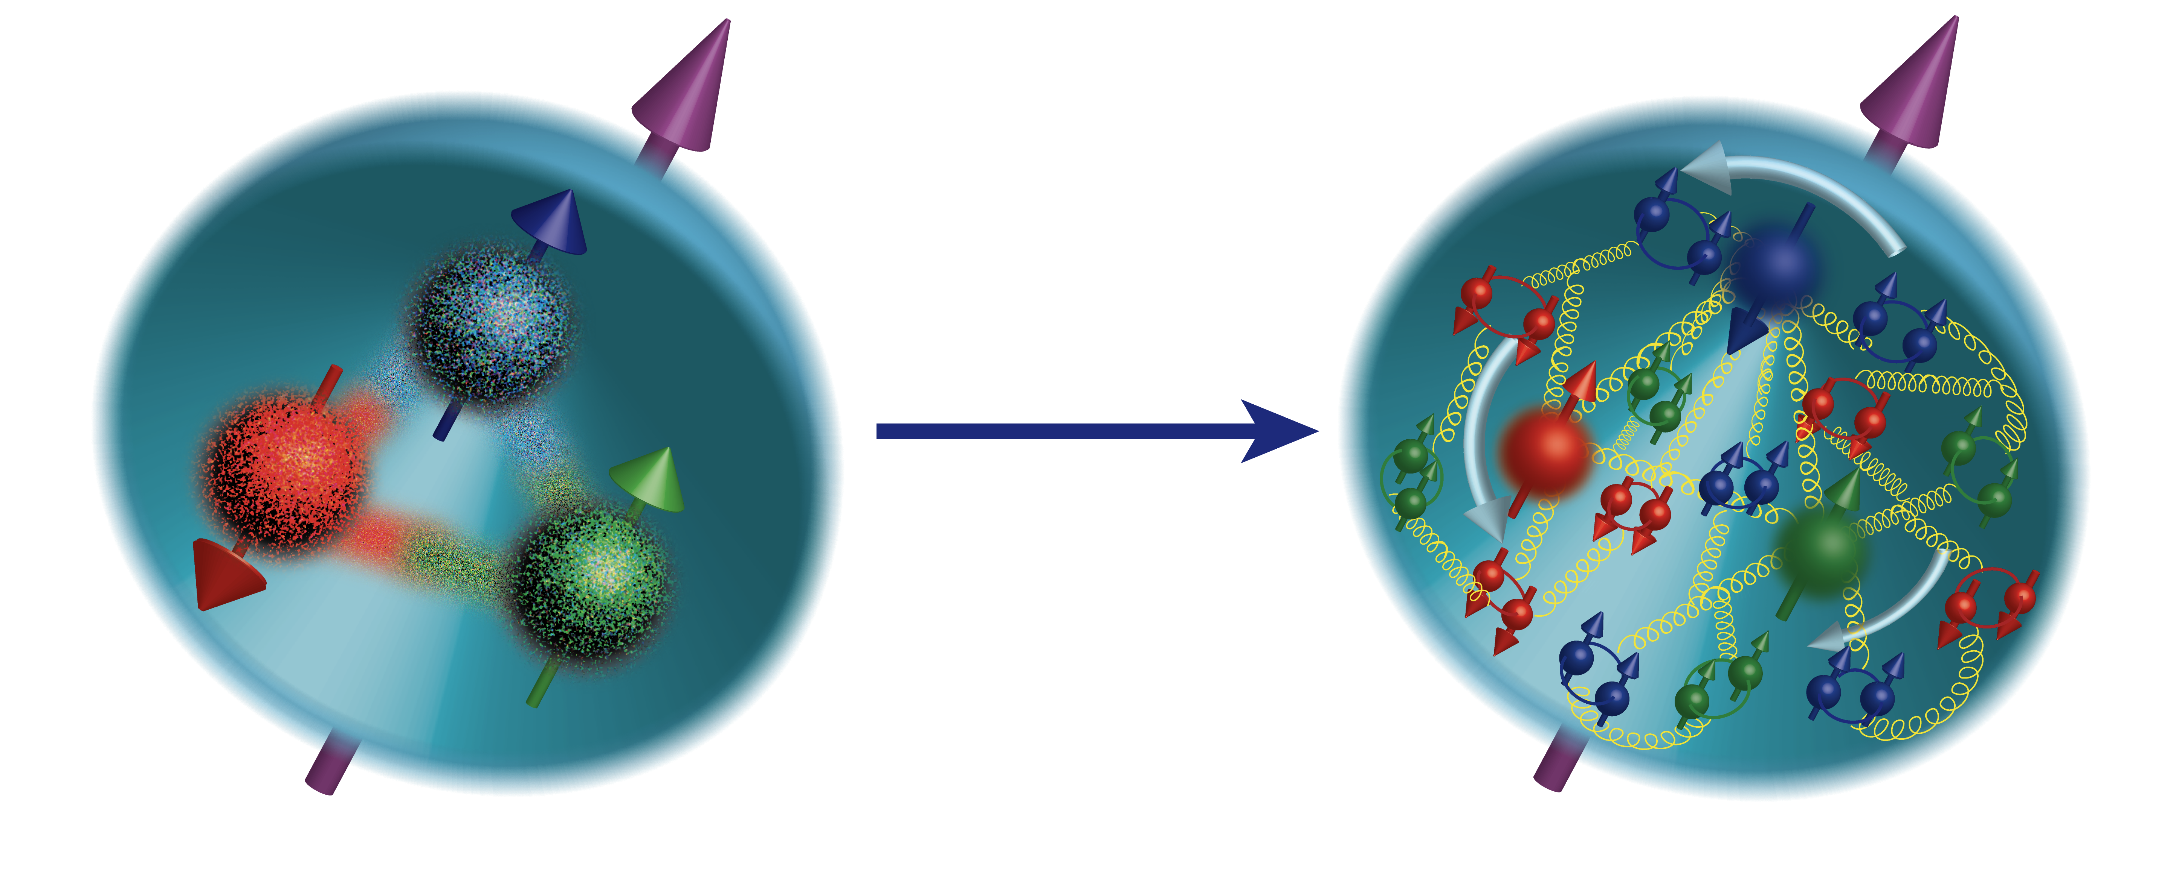
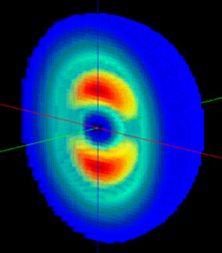
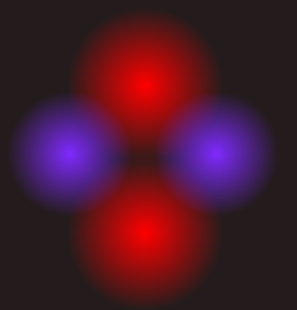
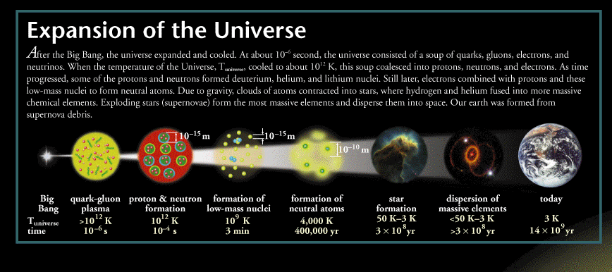
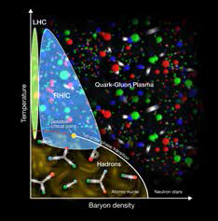

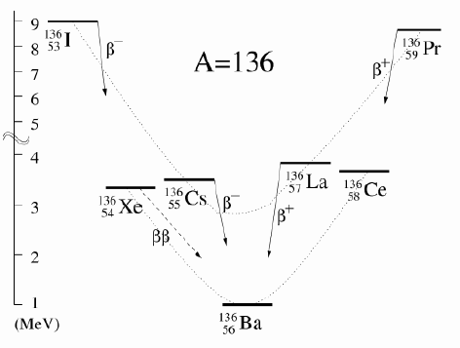
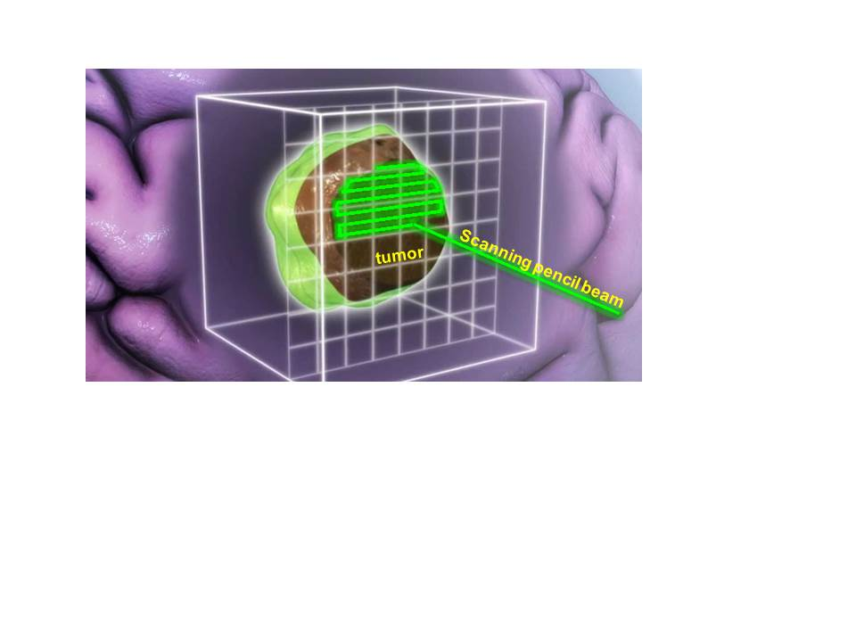
Will 2015
21st Century Nuclear Science:
Probing nuclear matter in all Its forms & exploring their potential for applications
Where in the universe, and how, were the heavy elements formed? How do supernovae explode?
How are the properties of protons and neutrons, and the force between them, built up from quarks, antiquarks and gluons? What is the mechanism by which these fundamental particles materialize as hadrons?
Where are the limits of nuclear existence, and what is the structure of nuclei near those limits?
Accelerator & detector technologies
What is the nature of the different phases of nuclear matter through which the universe has evolved?
Do nucleons and all nuclei, viewed at near light speed, appear as walls of gluons with universal properties?
How are the nuclear building blocks manifested in the internal structure of compact stellar objects, like neutron stars?
How can the properties of nuclei be used to reveal the fundamental processes that produced an imbalance between matter and antimatter in our universe?
How can technologies developed for basic nuclear physics research be adapted to address society’s needs?
A.D. 2015 LRP EIC Presentation

Slide 9
Large projects: Detailed planning important, but so is patience and doggedness, while attracting & supporting activities with constant influx of new/young scientists
Important to recognize the connectedness of science in nuclear physics (and beyond?)
Theory & experiment
Science of RHIC, Jlab6/12, FRIB and Instrumentation
Huge amount of work done by many over two decades: Who supported it? DOE/NSF through the labs and some university support
Fluctuations due to annual variations in DOE/NSF budgets

Slide 10

The Vision guided by these observations, experiences & lessons
What can be achieved with independent (non-DOE/NSF) funding?
How can it be put toward maximal impact?
Can it be used to stabilize the Users Group activities through annual fluctuations?

Slide 11
Towards realization of the US EIC
To deepen the compelling scientific goals of the EIC
  Emergence of spin/mass, 3D structure, high density gluonic matter
  Impact on the detector, IR design
To broaden the scientific scope of the EIC with new ideas:
  Explore connections between QCD and other fields (gravity, condense matter science, atomic physics)
  Detector technologies: NP ←→ HEP (Other?)
Support experiment-theory interplay
Support and train young scientists while doing all the above
  Post doctoral fellows and graduate students during times when EIC needs them, (and) yet little/no formal support exists
Engage and support the EICUG Community in their activities to realize the above

Slide 12
Vision for the Center:
Evolved out this perceived need to support the EIC, through supporting growing the interested community.
A venue for the EIC User Community to call “home” for scientific discourse and collaborations
In the long run, the Center will expand its activities beyond EIC Complement to the established centers like: The INT, The FRIB Theory Center, ECT*,….

Slide 13
The Center
Financial Support/Grant (Thanks!)
The Simons Foundation for 10 years
The NY State/University
With strong backing from Stony Brook University & Brookhaven National Laboratory (and their managements)
Two footprints:
  Stony Brook, Physics Building C-floor you visited yesterday + the labs (Basement)
  BNL, Physics Building : ”Library” now converted to CFNS

Slide 14
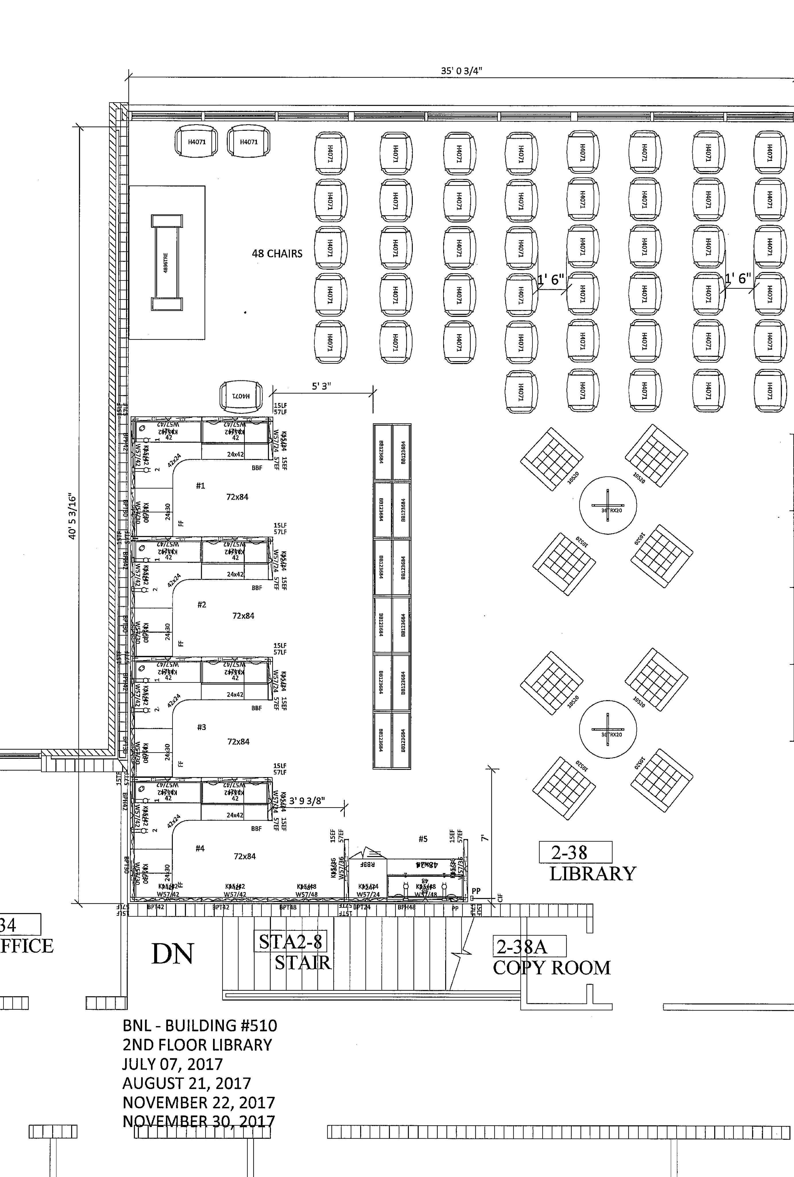
CFNS @ BNL
The Library in the physics building 510A
An excellent coffee machine
Informal discussion area
50 seat seminar area
5 ½ cubical seating area for short term visitors
Additional rooms for longer term visitors (with Raju V. and Thomas U. theory and experimental EIC working groups)

Slide 15
CFNS Structure/Organization
International Advisory Committee:
  R. Milner (MIT, Chair), A. Caldwell (MPI, Munich), L. Elouadrhiri (Jlab), B. Jacak (UCB/LBNL), X. Ji (Shanghai/Maryland), Y. Kovchegov (OSU), Z.-E. Meziani (ANL), W. Nazarewicz (MSU), P. Newman (Birmingham, UK), B. Pasquini (Pavia), F. Pilat (ORNL), J. Qiu (Jlab), G. Sterman (SBU), W. Vogelsang (Teubingen)
  Ex. Officio: B. Mueller (BNL-management), B. Surrow (Chair, EICUG-SC), and R. Yoshida (JLab-management)
Program Steering Committee
  T. Hemmick, D. Kharzeev, J. Kiryluk, K. Kumar, J. H. Lee, T. Ullrich, R. Venugopalan & A. Deshpande
Director, Scientific Coordinators
  A. Deshpande, N. Feege, J. H. Lee, J. Zhang
Administrative support:
  S. Delquaglio (SBU), M. Veri-Viteri (SBU) and R. Nieves (BNL)

Slide 16
Activities in 2018: 1st year!
250+ scientists passed through the center from
Nov. 2017-Nov-2018
SBU-BNL Joint CFNS Seminars
EIC physics topical workshops
CFNS-University/Lab joint (50:50) post doctoral fellowship
Post doctoral fellowships:
  SBU-BNL collaborative LDRD post docs
  CFNS funded SBU post docs
Short (< 7 days) and long term (< 4 months) visitor program
Remote conference support
EIC/QCD summer school for ~30 students first in 2019 planned
Minority colleges outreach : through research and education under consideration

Slide 17
CFNS Seminars
Organized by 4 post docs: 2 each from BNL and SBU
Coordinators: Carlos Perez Lara, Andrey Tarasov, Juan Torres-Rincon, Pia Zurita (replacement soon)
1st and 3rd Thursday at BNL and SBU, respectively, many (if not all) faculty and post docs/students travel to BNL or to SBU.
  Advertised widely and
  All CFNS seminars are broadcast on BlueJeans for remote EICUG participation
In 2017-2018 we had about 30+ seminars including some opportunistic ones

Slide 18
CFNS Workshops 2018
February 5-9, 2018 Polarized Light Ions in the EIC, Ghent,, Belgium
April 15, 2018 Pre-DIS EIC Workshop, Kobe, Japan
June 4-6, 2018 Next Generation GPD WS (@SBU)
  Weiss, Szymanowski, Boer, Fazio
July 23-25 Probing Quark-Gluon matter in with Jets (@BNL)
  Connors, Mehtar-Tani, Page, Ringer, Tywoniuk, Verweij
September 5-7, Short range nuclear correlations in an EIC (@BNL)
  Deshpande, Kharzeev, Nazarewicz, Qiu, Ullrich, Venugopalan, Yoshida
September 10-12, Quantum Entanglement at Collider Energies (@SBU)
  Baker, Cloet, Deshpande, Kharzeev, Lee, Ullrich, Venugopalan
October 17-19 , Forward Physics and Instrumentation from Colliders to Cosmic Rays (@SBU)
  Deshpande, Feege, Goto, Kiryluk, Lee, Royon
In 2019 plan to initiate a proposal driven process to be approved by the Program Committee and the IAC

Slide 19
CFNS Post Docs
Collaboration with BNL EIC LDRD/PD:
Diverse topics identified towards EIC science
8 post docs supported 2018 (some partially)
You will hear from them on Friday 11/30 in the REVIEW
  Kolja Kouder, Alba Soto Ontoso, Abha Rajan, Kong Tu, Renaud Boussarie, James Daniel Brandenberg, Zhenyu Chen
CFNS Simons Fund Supported Post Docs
Diverse topics in Jlab, RHIC and EIC science & instrumentation
1 recently hired (~3 more to be hired) + DOE supported post docs who intend to work on EIC related topics (fraction of the time)
You will hear from some of them on Friday 11/30 in the REVIEW
  Barak Schmookler (CFNS)
  Sanghwa Park, Jinlong Zhang, Chandan Gosh (DOE)

Slide 20
CFNS-Remote-Institute Joint Post Docs
Inspired by the success of RBRC Joint Fellow Program
Funded by the CFNS Simons Fund
Aim: to invite and initiate new groups in to EIC related activities through support for the PI to hire a post doctoral fellow
Realization:
CFNS pays 50% of the base salary
Post Doc spends 3-4 months/yr at CFNS with some local support from the Center
Works on a current topic at the PI’s university group and gets involved in EIC physics for part his/her time
For 2019 we received ~15 proposals, 7 selected (5 to be funded immediately)
AD will work with the PI’s to these in near future

Slide 21
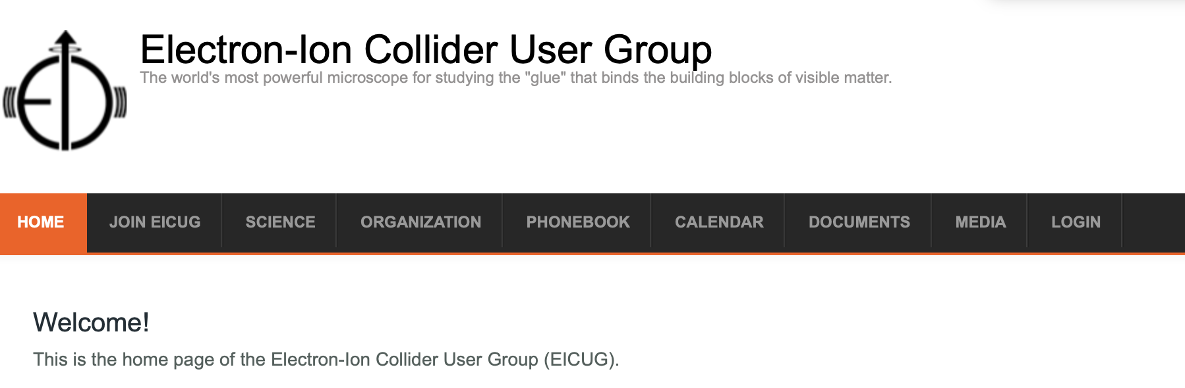
Remote conference & other support
For EIC related conferences: 2k-10k per meeting (size, scope, importance)
  Examples: (EINN 2017), Pre-DIS2018, Gordon Conference 2018, Initial State 2019, EINN 2019
Travel support for students/post docs for EIC related presentations (no matter which institute they are at…) if no other means to realize this is possible.
EIC Users Group Web Page: eicug.org
Topical Group Hadron Physics (APS) Thesis prize support (under discussion)
For Stony Brook Students:
Student support for EIC related topics at SBU or/and BNL
Undergraduate research students working on EIC

Slide 22
EIC/QCD summer school 2019
Annual 2-week summer school on EIC related toics
Physics, detector/technologies, accelerator interface
Organized by members of EIC (Users) community + CFNS post docs at SBU and BNL -- Planning for 2019 about to begin
Significant enthusiasm from faculty & students from Europe, China and India:
CFNS support for students without the constraints of national boundaries

Slide 23
Visitor program
Exchange visitor program through informal communications through other Centers of QCD/Nuclear/Particle Science:
APCTP, Pohang, South Korea,
ICAS, San Martin, Argentina (under exploration/discussion)
Institute of Physics, Bubhaneshwar, India (under exploration/discussion)
Austria, China, Australia (interest shown)
Other: individual visitors to CFNS: self initiated program
2-3 short term visitors in the past
Under discussion for 4+ weeks of visit

Slide 24
Concluding remarks:
CFNS: a broad vision to reflect on US nuclear science in the long run, while focusing on EIC related activities in the near term
Starting in November 2017: (250+ scientists visited)
There has been substantial activity: seminars, workshops, setup of sites, establishing connections
Support young scientists through research and educational programs aimed at them
All of this to support the EIC while working closely with the EICUG
I invite you (EICUG) to participate and help to maximize the impact of these new resources. Your involvement in the Center’s activities: welcome, essential & critical

