Slide 1

Jet Observables and Techniques
Kolja Kauder
CFNS Inaugural Meeting

Slide 2
What we want
p₁
p₂

Slide 3
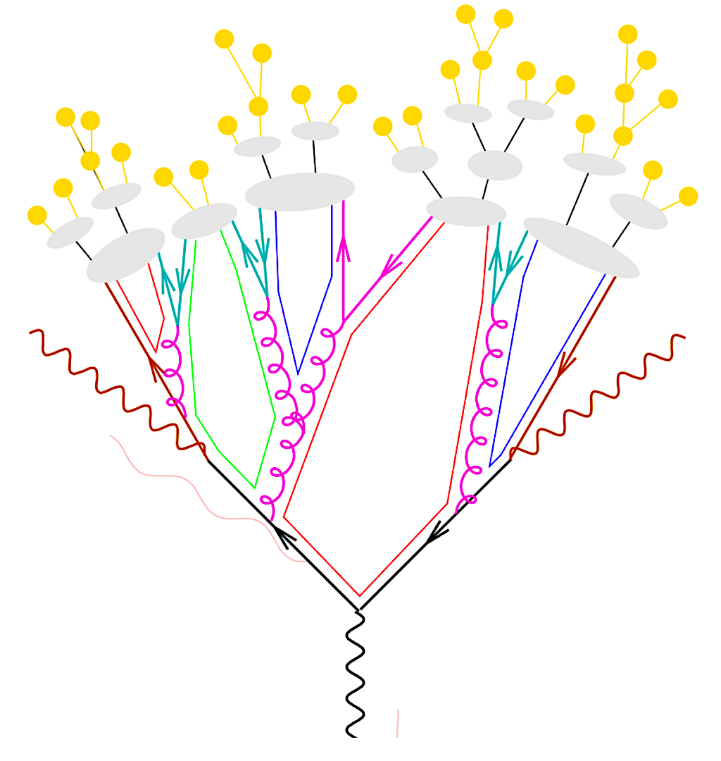
What we get
p₁
p₂

Slide 4
What we get
Plus further obfuscation by a detector
Hadrons
Hadronization
Partonic shower
Hard parton

Slide 5
Jet Reconstruction
Sequential Clustering:
Calculate a distance d_{ij} between two particles and a beam distance d_{iB} for all particles.
Find smallest of all d_{ij}, d_{iB}
If it’s a d_{ij}, recombine particles i and j. If it’s a d_{iB}, call particle i a jet
Repeat from step 2 until no particles are left
Resulting clusters are jets.
Operational definition. No unambiguous jet definition exists!
Advantages:
Minimize sensitivity to hadronization:
IR-safe and collinear-safe algorithm and instrumentation
Measure energy flow: connect to dynamics of partons
Comparison to QCD calculations beyond event generators
De-facto standard. For substructure:
also provides cluster history

Slide 6
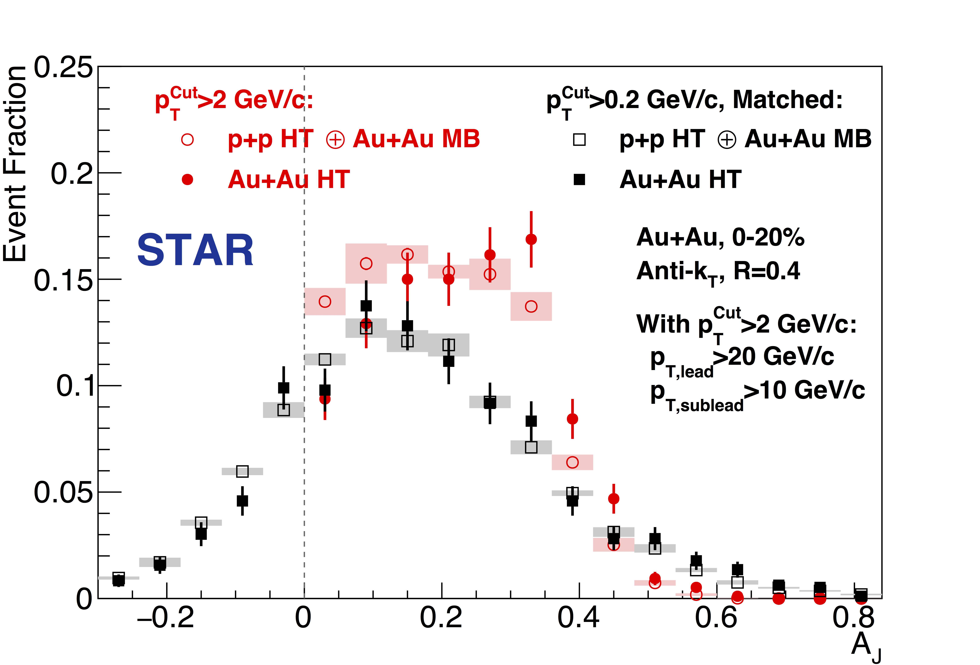
Jets as Probes
PRL 119, 062301 (2017)
Monolithic objects – for differential measurements vary parameters
Ex.: Dijet Imbalance with “Hard Core” Selection:
High Tower trigger E_{T}>5.4 GeV, pTCut = 2 GeV/c
→ Reduce background
→ Reduce combinatorial jets
Jet p_{T}^{Lead}>20 GeV/c
Jet p_{T}^{SubLead}>10 GeV/c
Recover soft component:
match to p_{T}^{Cut} = 0.2 GeV/c
Imbalance in “hard cores” –
restored to p+p level in matched di-jets for R=0.4

Slide 7
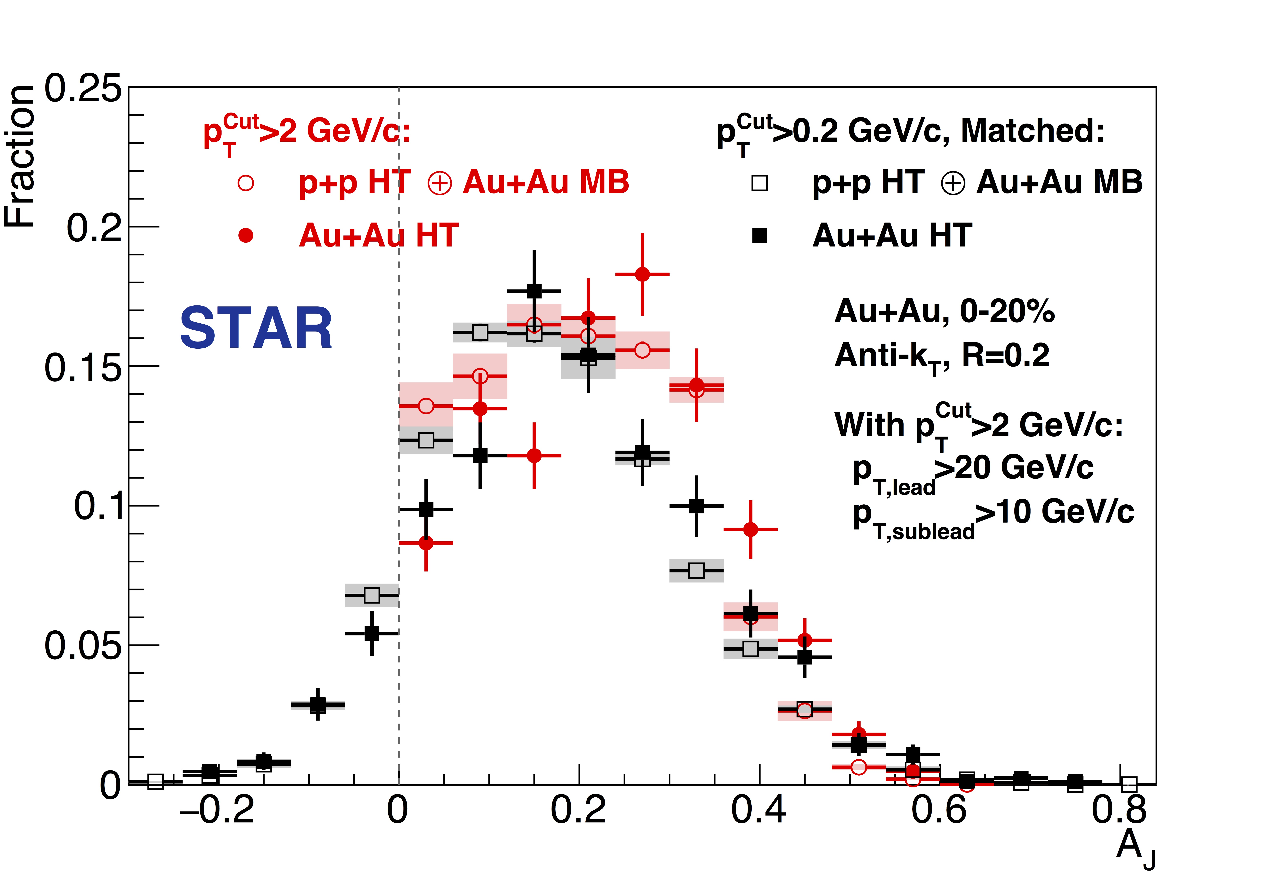
Jets as Probes
PRL 119, 062301 (2017)
Monolithic objects – for differential measurements vary parameters
R=0.2
R=0.4
p+p balance no longer recovered in R=0.2
Energy shifted outward, yet remains inside 0.4 (unique in HIC)

Slide 8
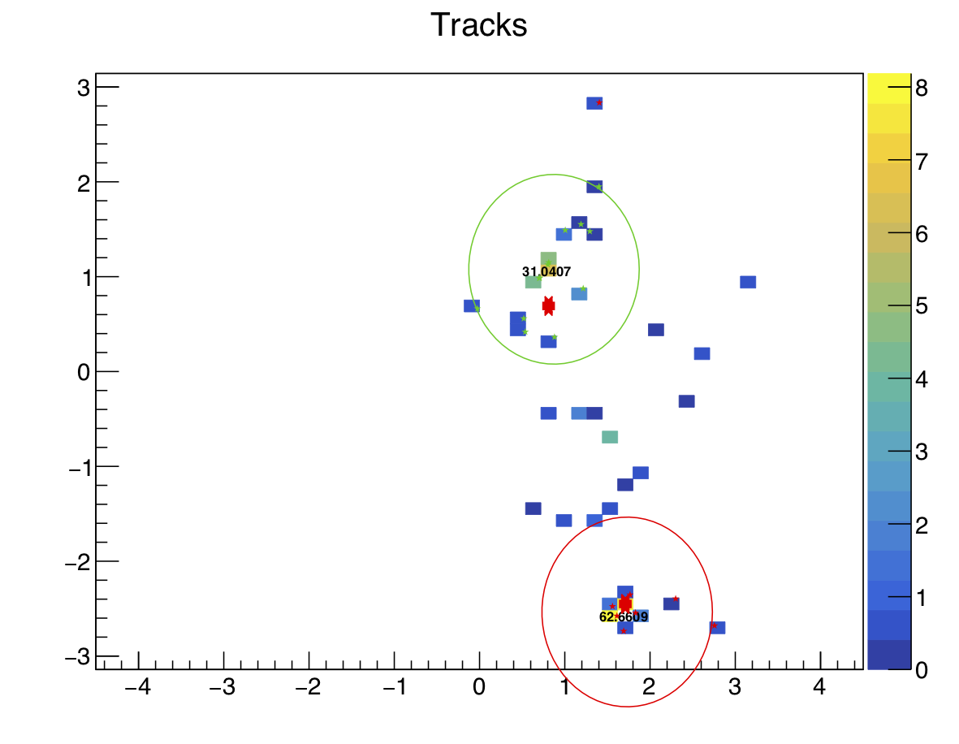
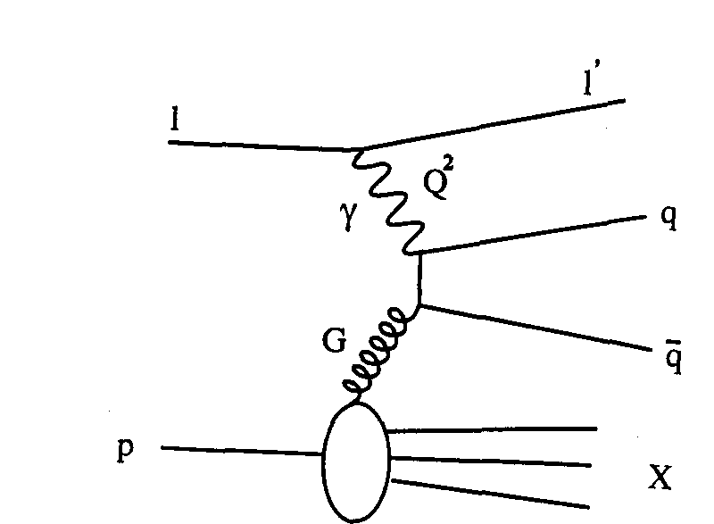
Jets as Parton Proxy
Exploration in Progress
An EIC (e+p) example:
parton x from dijet invariant mass
Focus is on jet ~ parton
What belongs to the jet?
How many jets are in the event?

Slide 9
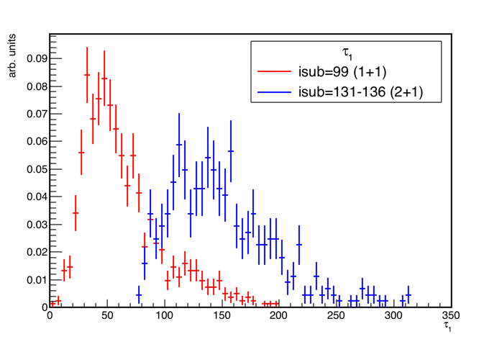
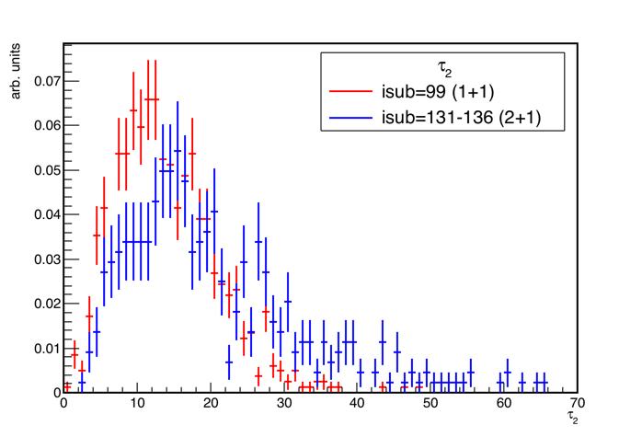

N-Jettiness
Exploration in Progress
Thaler, Van Tilburg, arxiv:1108.2701, arxiv:1108.2701
Stewart et al., arxiv:1508.01516
Given some measure ρ, calculate
and minimize
→ N jets + beam
τ₁ is a good discriminator – τ₂ less so
But τ₂ showed an interesting ”side effect”…

Slide 10
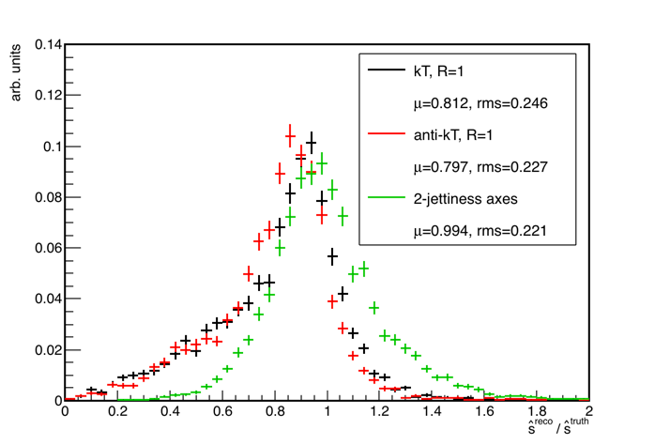

N-Jettiness as Jet Finder
Exploration in Progress
2-Jettiness axes sometimes a better proxy for the initial hard partons than any jet-finding results.
Notes:
  Axes are not jets!
  They do not have constituents
  They do not (with default settings) depend on any R
  But they are true 4-vectors with energy, mass, momentum
Advantage mostly at large Q²
but more to explore using ”jets without jets”
k_{T} and anti-k_{T} perform similarly
Axes from 2-jettiness shift average ratio to unity!
Only considering
processes 131, 132, 135, 136
p_{T}^{jet,lead}> 5 GeV/c
Use all final particles (except scattered e) with p_{T}>0.2 GeV, |η^{Breit}|<4
Where applicable, R=1, |η^{jet}|<η^{max}-R
On this slide, Q² = 100 - 1000

Slide 11
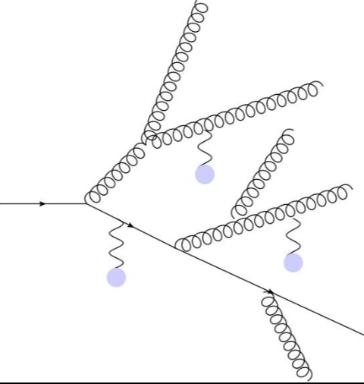
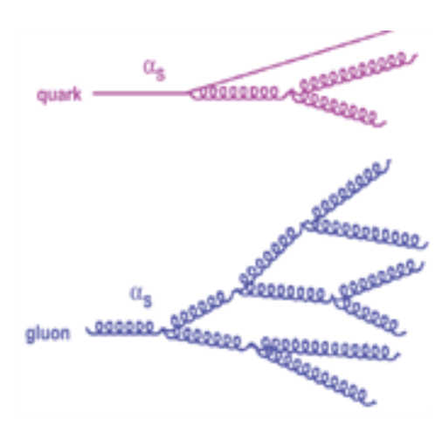
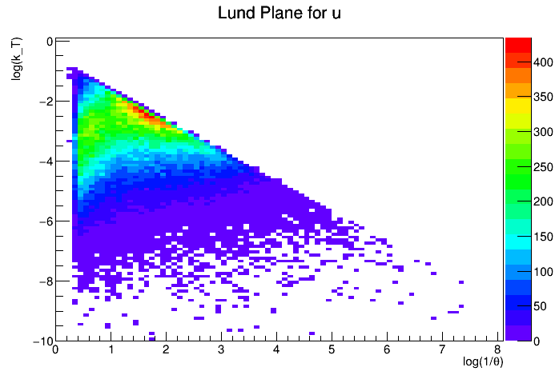
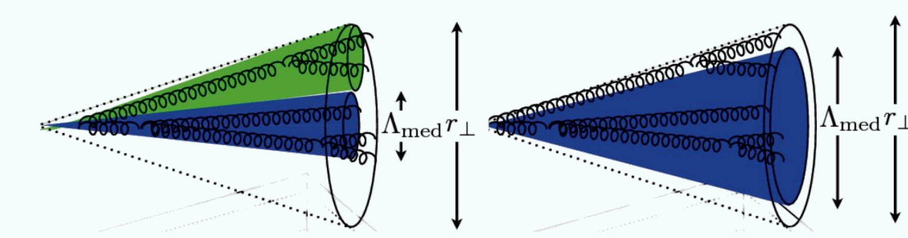
Probing Jets - Substructure
Splitting kernel?
Quark (u, d?) vs. gluon jet?
Radiation Pattern?
What can the clustering history of final hadrons reveal about the parton shower?
De-coherent vs coherent E-loss?

Slide 12
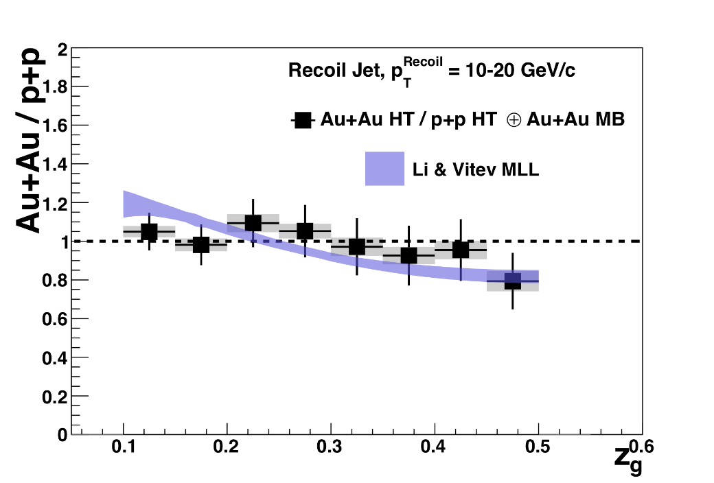
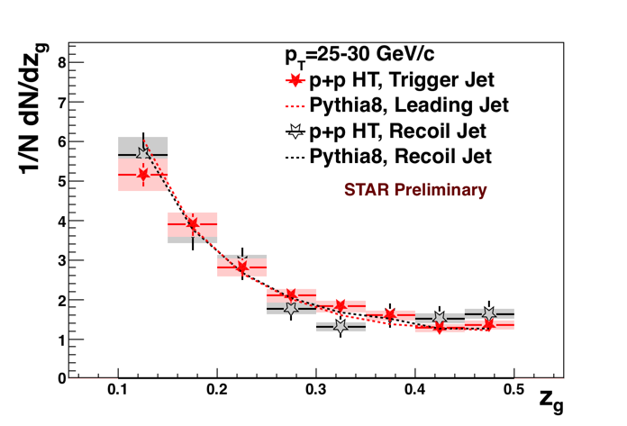
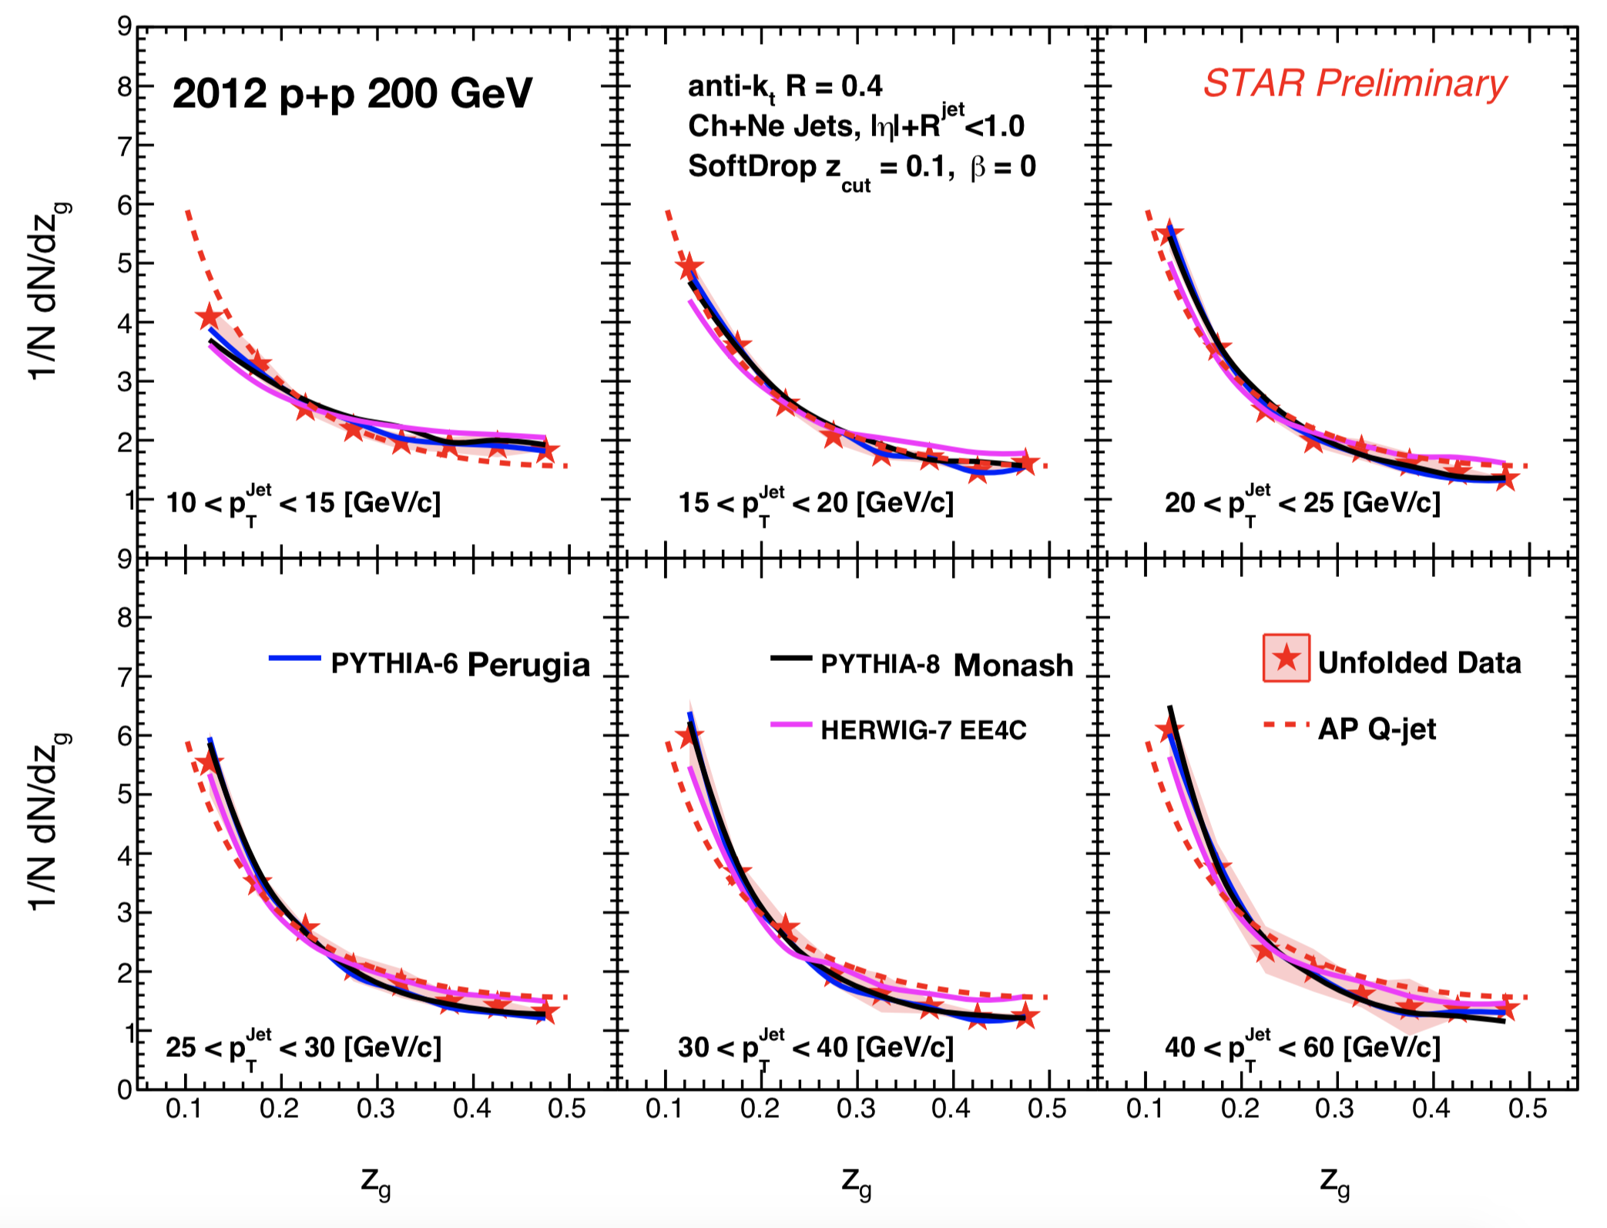
Substructure
With R. Kunnawalkam Elayavalli, J. Putschke
Papers in Preparation
In Vacuum:
“Groomed Momentum Sharing” measures AP Splitting functions, Sudakov-safe
Fundamental QCD
“Groomed Radius” → angular scale
Hard-core jets in central Au+Au:
No appreciable modification of z_{g}
Contrast to LHC!

Slide 13
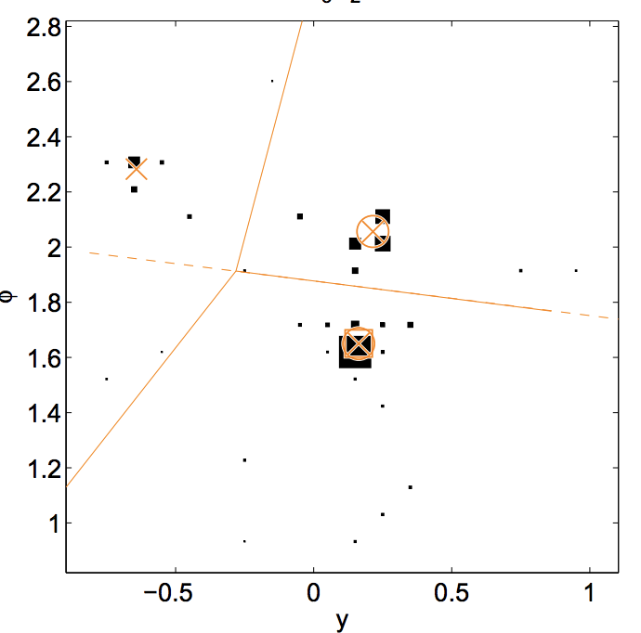
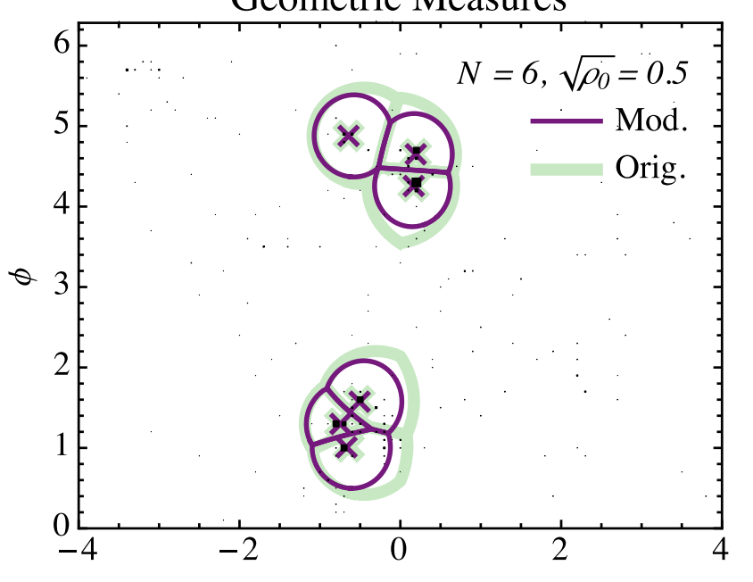
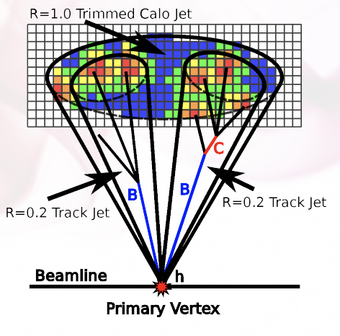
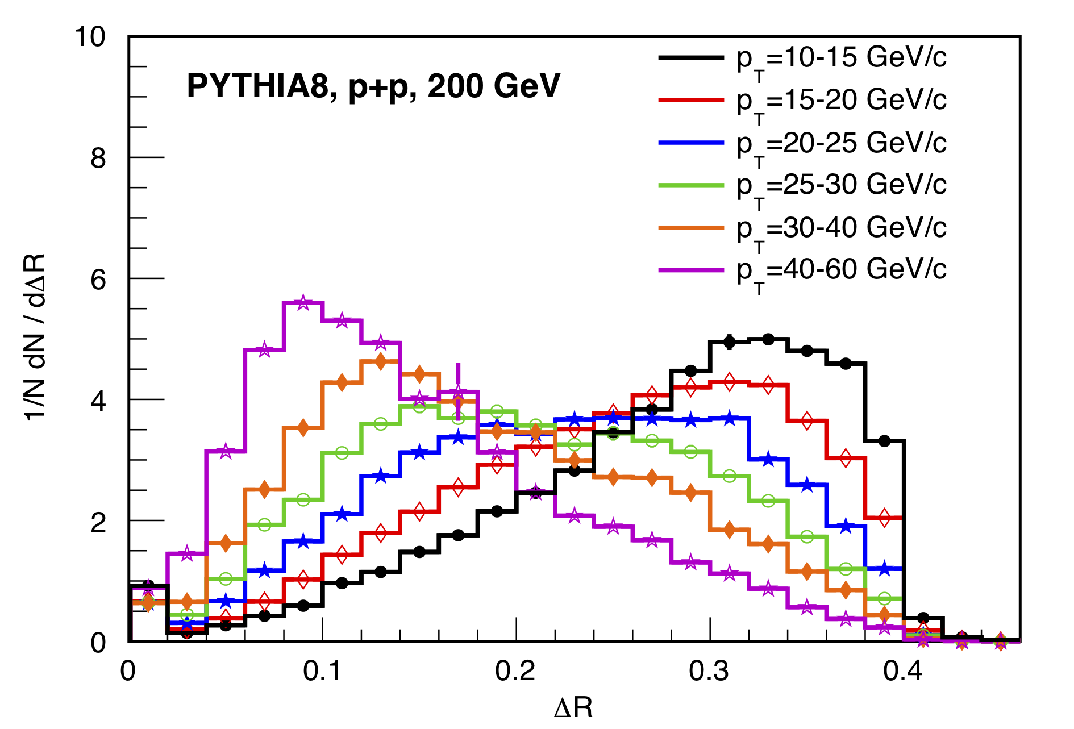
Remark
Jet sub-structure, grooming, trimming, shapes like N-Subjettiness … developments often driven by LHC (narrow, boosted, high-p_{T}) objects
Parameters may be optimized for different environment.
Different applications and physics implications in
clean, broad e+p/e+A world → Exciting times ahead
LHC jets
live here

Slide 14
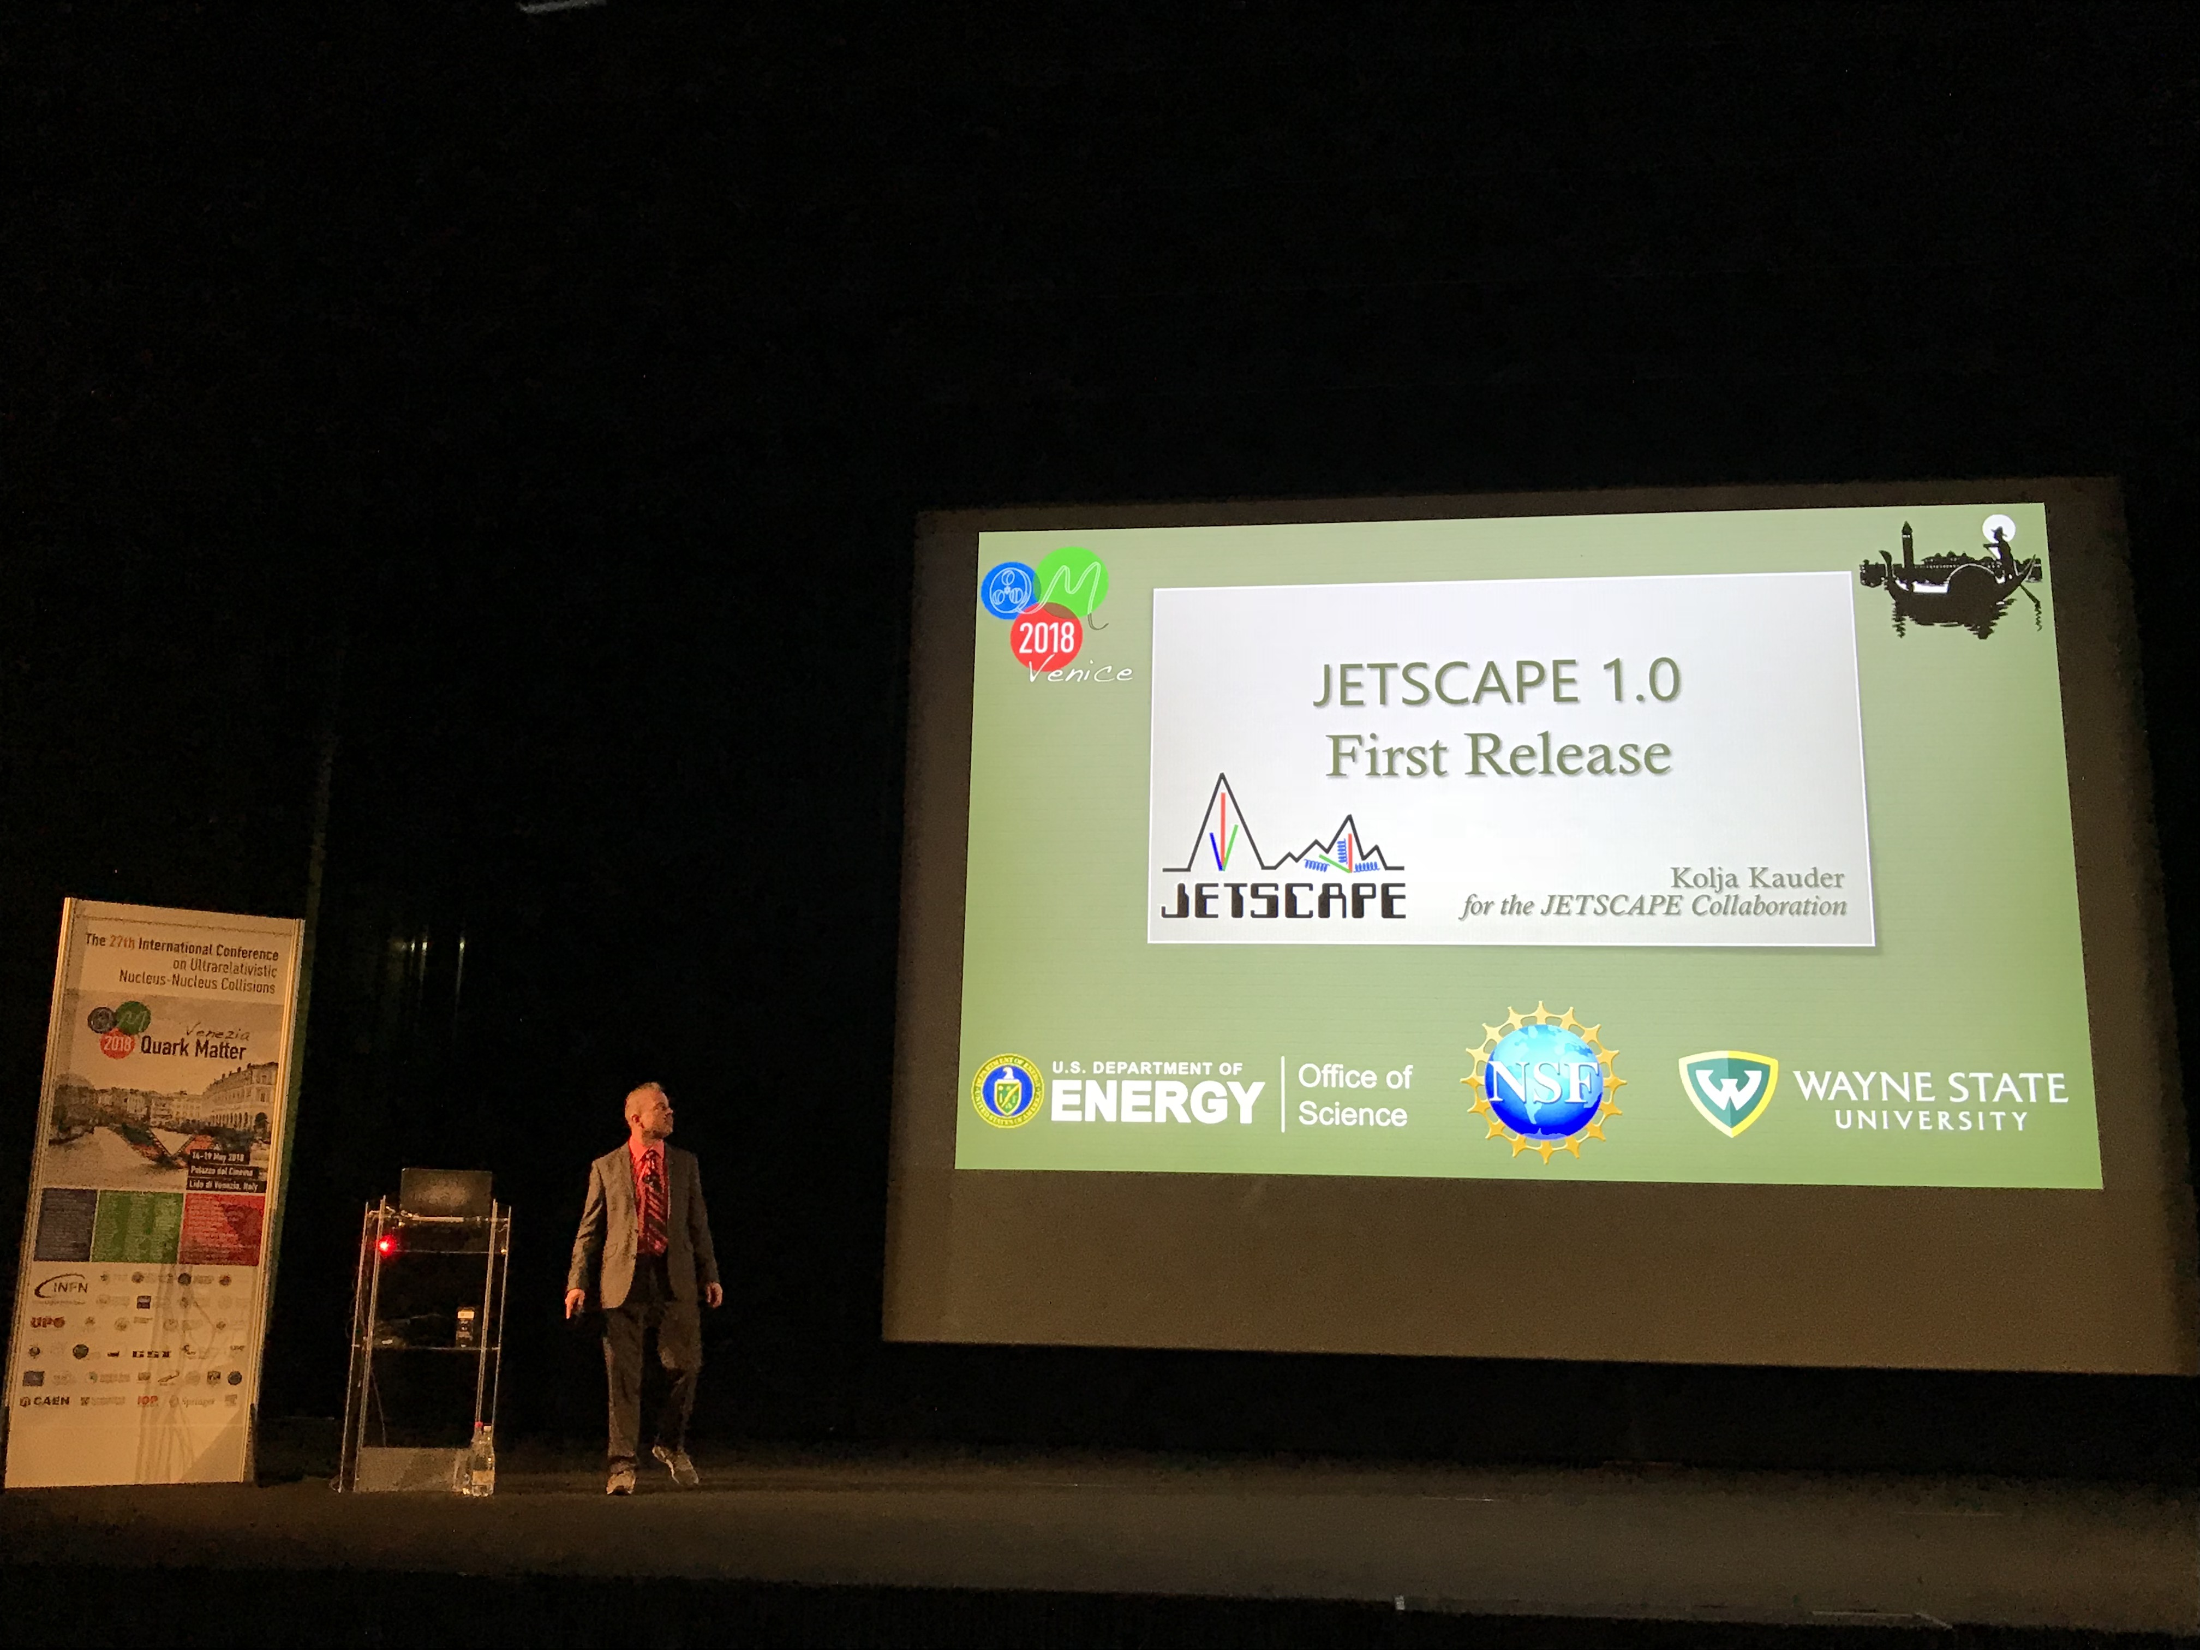
Thanks!
Hopefully I stayed within ten minutes…
But for questions and conversations, find me or email me at kkauder@gmail.com
PS: You can also ask me about

Slide 15
Backup

Slide 16
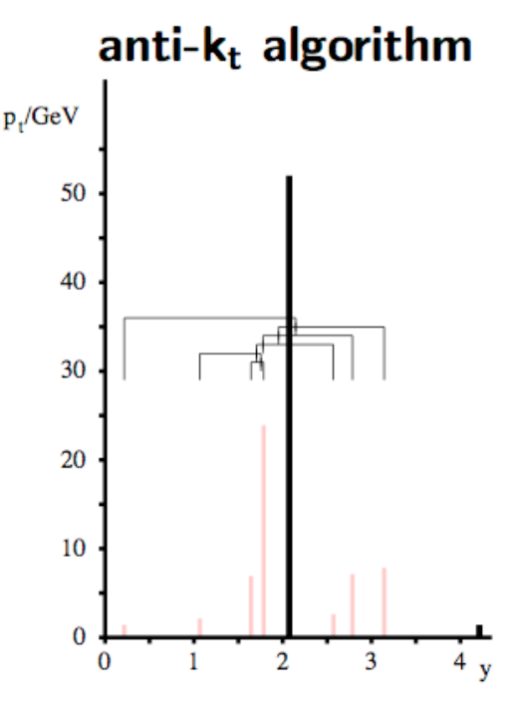
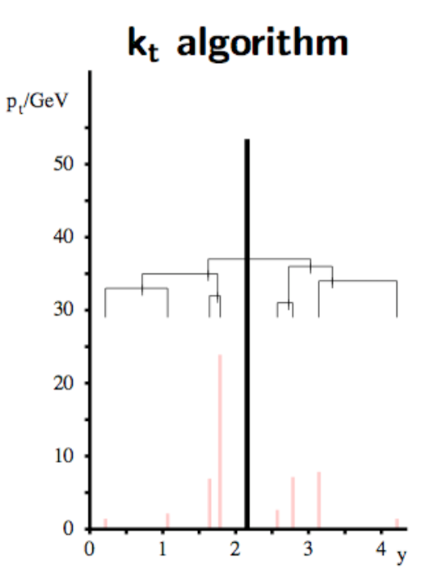
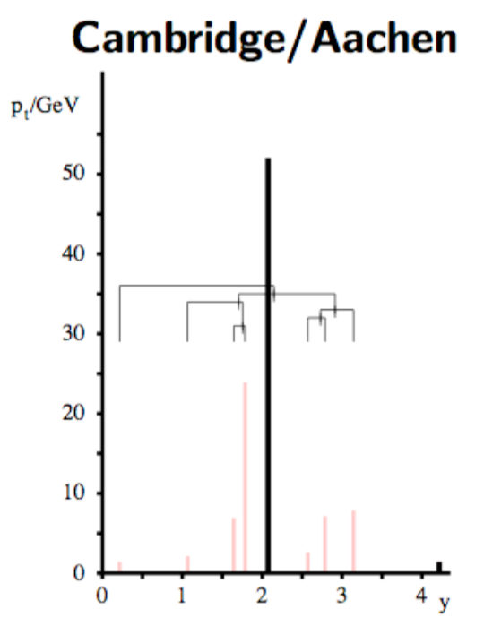
Distance Measures
d_{ij} = f(p_{T,i}, p_{T,j}) ( Δy² + Δφ²) / R²
f = min ( 1/p_{T,i}², 1/p_{T,j}² )
merge to hardest
seed on “real” jets
circular leading jets
f = min ( p_{T,i}², p_{T,j}² )
merge to softest
good characterization of “background” jets
f = 1
merge to closest
angular ordering
→ relevant later!
M. Cacciari , HP ‘16

