Slide 1
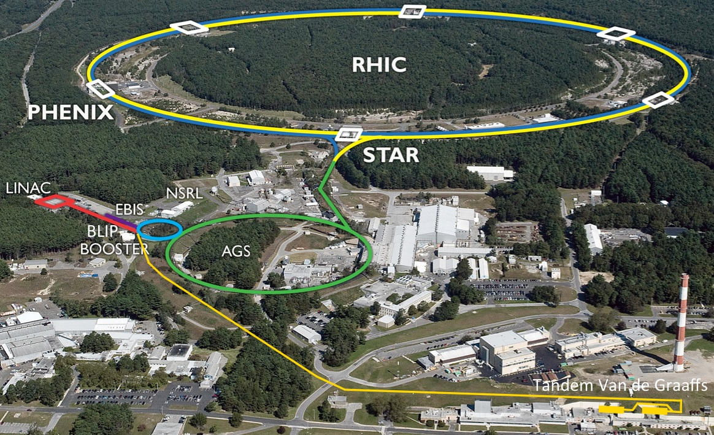
RHIC performance in Run-18 Zr+Zr, Ru+Ru, Au+Au Wolfram Fischer, Gregory Marr (Run Coordinator)
7 June 2018
BNL NPP PAC
Notes:
No talk scheduled, slides prepared for possible discussion.

Slide 2
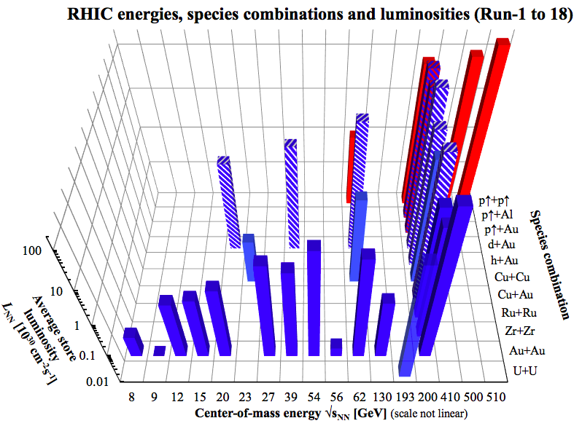

Slide 3
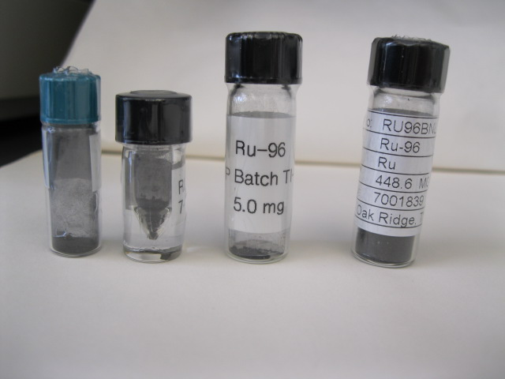
Isobar run: ⁹⁶Zr⁴⁰⁺ on ⁹⁶Zr⁴⁰⁺ and ⁹⁶Ru⁴⁴⁺ on ⁹⁶Ru⁴⁴⁺
Isobar run only possible with simultaneous use of many technologies developed over last 2 decades (ion sources, feedbacks, cooling, injectors …)
First collider operation ever with store-to-store species change
Extensive preparation for ion beam sources:
Zr-96 from LION/EBIS
with merger scheme: Booster 4→2→1, AGS 12→6→2 later 8→4→2
2.75% enriched ZrO commercially available
great support from RIKEN for EBIS target production
chemical expertise from Medical Isotope group for target reprocessing tests
Ru-96 from Tandem with merger scheme: Booster 4→2→1, AGS 8→4→2
5.52 % natural occurrence
special enrichment run at ORNL for 500 mg of Ru-96, great support from DOE NP, Isotope Program and ORNL
luminosity leveled with stochastic cooling and variable vertical offset
nominal store length 20 h
Ru-96

Slide 4
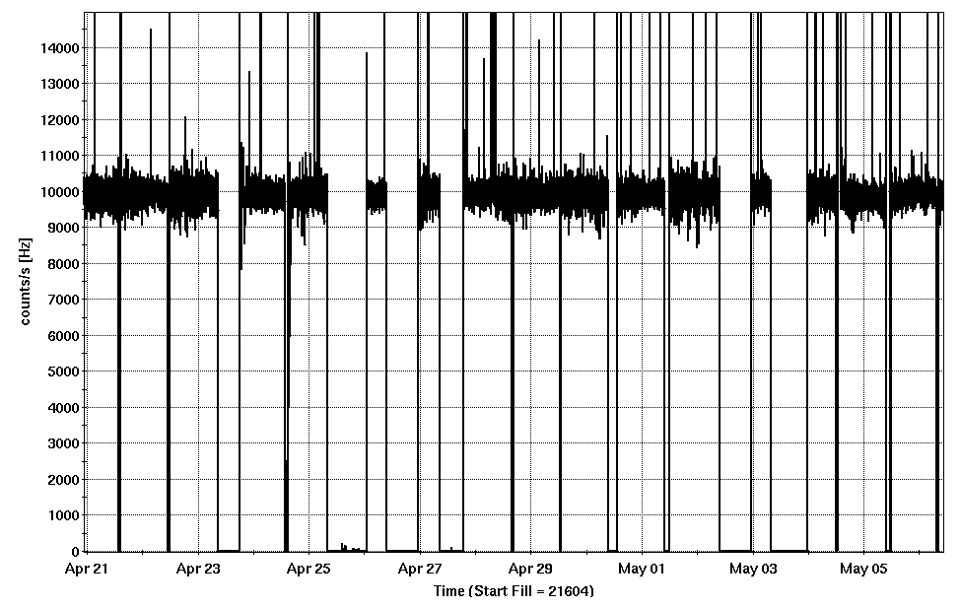
Two week luminosity Ru+Ru/Zr+Zr
leveled ZDC rate: 10 kHz

Slide 5
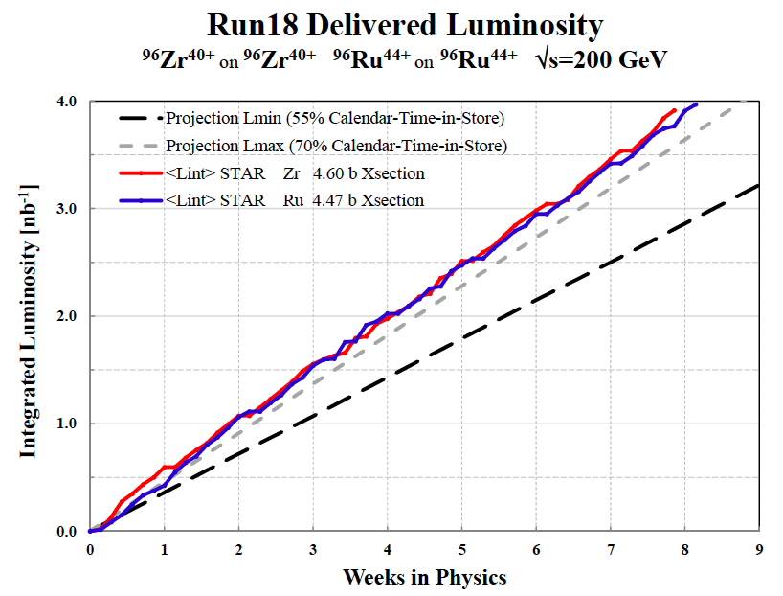

Slide 6
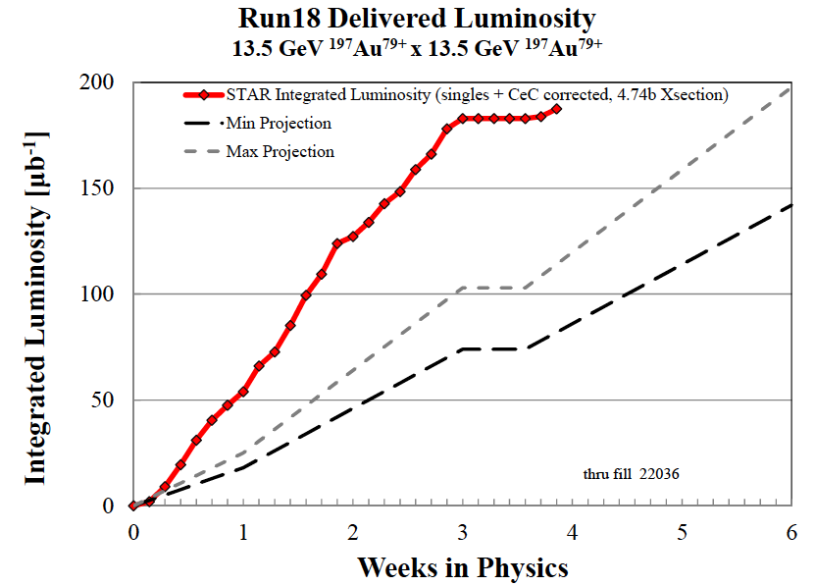
(no vertex cut)
fixed target run (Yellow only)
Run-11 performance

Slide 7
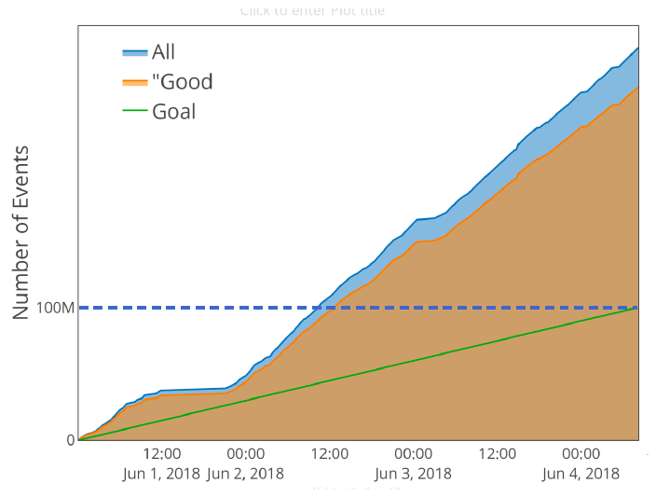
Run-18 fixed target events, 3.85 GeV/nucleon beam energy (from STAR)

Slide 8
RHIC Operation Run-18 Summary
Very successful isobar run with Ru+Ru (A=96) and Zr+Zr (A = 96)
First collider operation ever with store-to-store species change
Required simultaneous use of many technologies developed in last 2 decades (ion sources, feedbacks, cooling, injectors …)
Great support from DOE NP, Isotope Program and ORNL (special Ru-96 enrichment), and RIKEN
Completed fixed target run at 3.85 GeV/nucleon beam energy
4.6 days interleaved with machine development for BES-II
310% of initial data set goal (100M events)
Presently running Au+Au at 13.5 GeV/nucleon (interleaved with CeC PoP)
delivered luminosity per week ~2x of Run-11

Slide 10
LEReC Physics integration BES-II required events
RHIC Beam Energy Scan II (BES-II) for search of critical point in QCD phase diagram
center-of-mass energy √s_{NN} | GeV | 7.7 | 9.1 | 11.5 | 14.6 | 19.6
events BES-I, actual | M | 4.3 |  | 11.7 | 24 | 36
events BES-II, min goal | M | 80 | 100 | 150 | 200 | 300
events BES-II, full goal | M | 100 | 160 | 230 | 300 | 400
General strategy to maximize integrated luminosity:
Cooling at the 3 lowest energies (4x gain in L_{avg}), no cooling at the 2 highest energies (3x gain in L_{avg}) => demonstrated at √s_{NN} = 19.6 GeV in Run-16
Increase cryo-time from 22 to 24 weeks/year
Start BES-II at highest energies (machine ready w/o cooling)
Interleave cooling commissioning with physics operation
Finish BES-II at lowest energies (largest gain in L_{avg} and time)
Notes:
STAR vertex acceptance: +- 1m
STAR contacts: Zhangbu Xu (spokesperson), Bill Christie, Paul Soerensen, Daniel Cebra

Slide 11
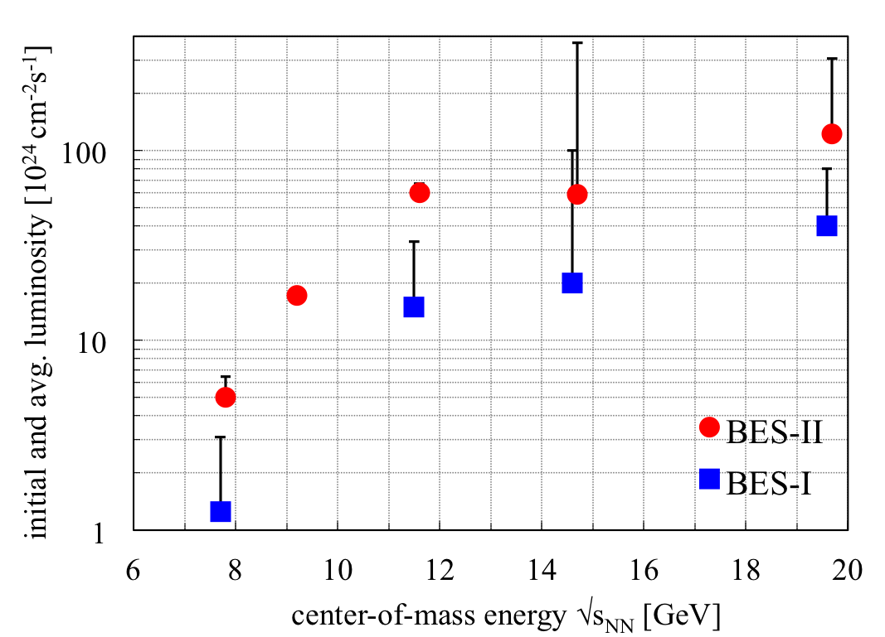
Physics integration BES-I and BES-II luminosities
nominal injection energy
4x increase in L_{avg} with e-cooling
3x increase in L_{avg} without e-cooling

Slide 12
Low Energy RHIC electron Cooling (LEReC)
A. Fedotov
64 m to IP2
(not to scale)
Commissioning
Diagnostic Line 1
704 SRF
Booster Cavity
Commissioning
Diagnostic Line 2
704 MHz Cu Cavity
9 MHz Cu Cavity
2.1 GHz Cu Cavity
DC e⁻ Gun
e⁻
COOLING
in Yellow RHIC ring
e⁻
RHIC TRIPLET
RHIC DX
e⁻
COOLING
in Blue RHIC ring
LEReC Solenoids
Compensating (LF)
Matching (HF)
Merger/Transport
180° Bending Magnet
20° Bending Magnets
Beam Dump
Energies E : 1.6, 2.0 (2.65) MeV Avg. current I_{avg} : 27 mA Momentum δp/p : 5×10⁻⁴
Luminosity gain : 4×
1st bunched beam electron cooler planned operation in 2019/2020

