Slide 1
Surprising forward neutron asymmetries discovered in polarized proton + nucleus collision at RHIC
Minjung Kim (Seoul National Univ./RIKEN)
Gertrude Scharff-Goldhaber Prize, July 17th 2018

Slide 2
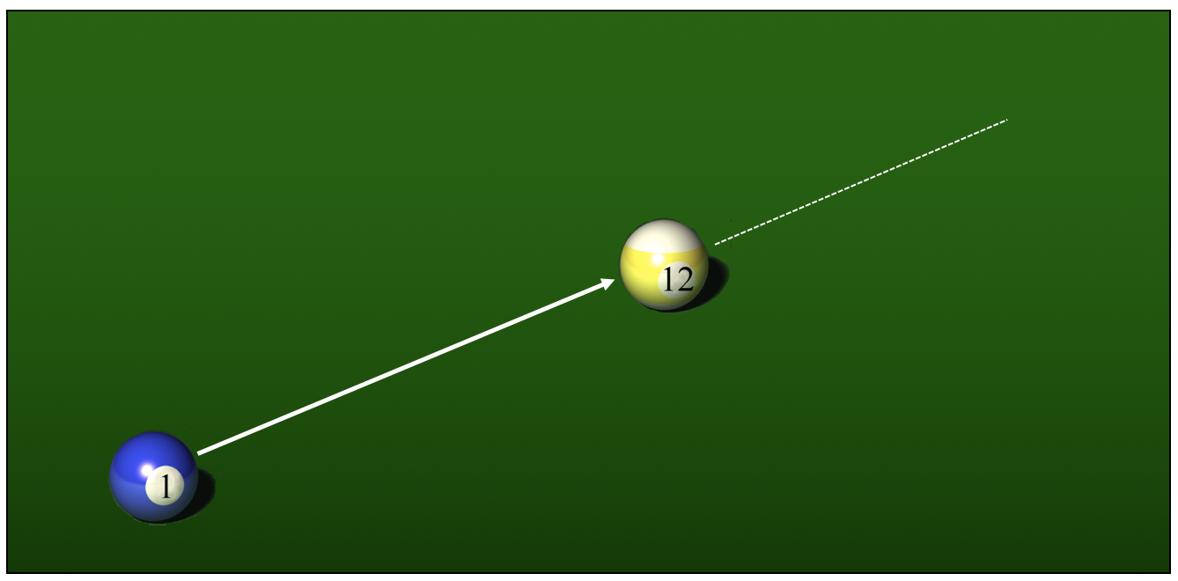
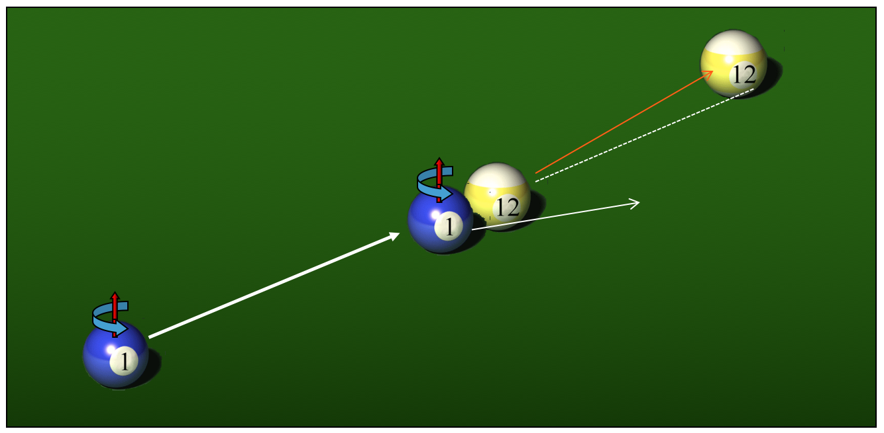
Preview
Without spin
With spin
If we replace the yellow ball to a heavier one…

Slide 3
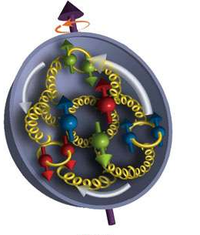
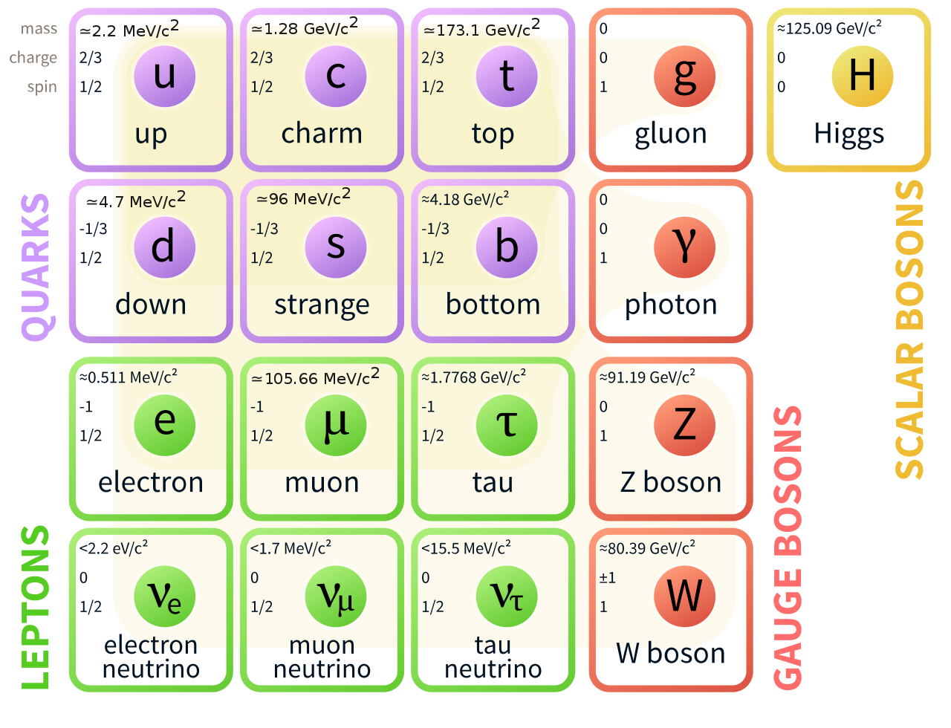
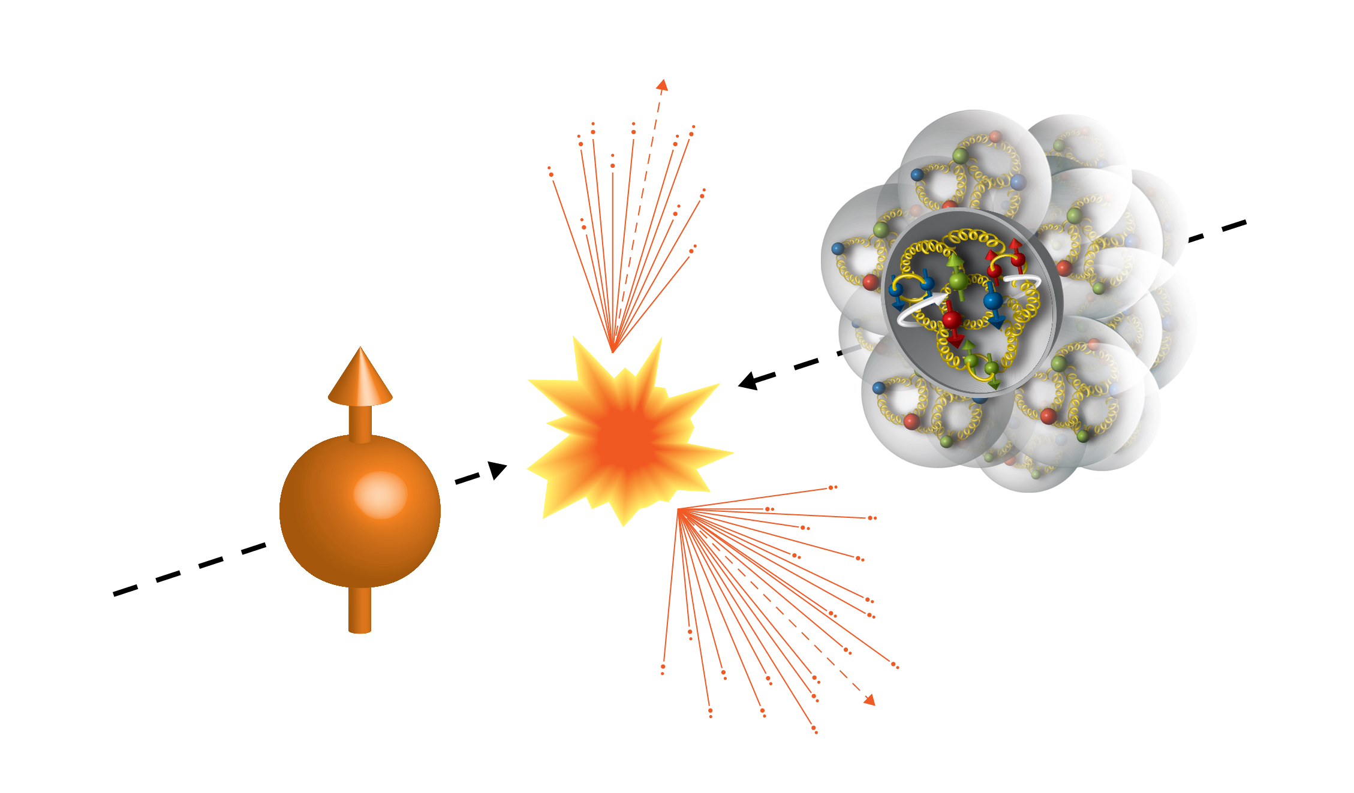
Nuclear physics and Spin
Nuclear physics pursues understanding subatomic phenomena by the properties and interactions of the compositing elementary particles.
Spin ½ | 1 | 0
The elementary particles have spin, and spin affects interactions.

Slide 4
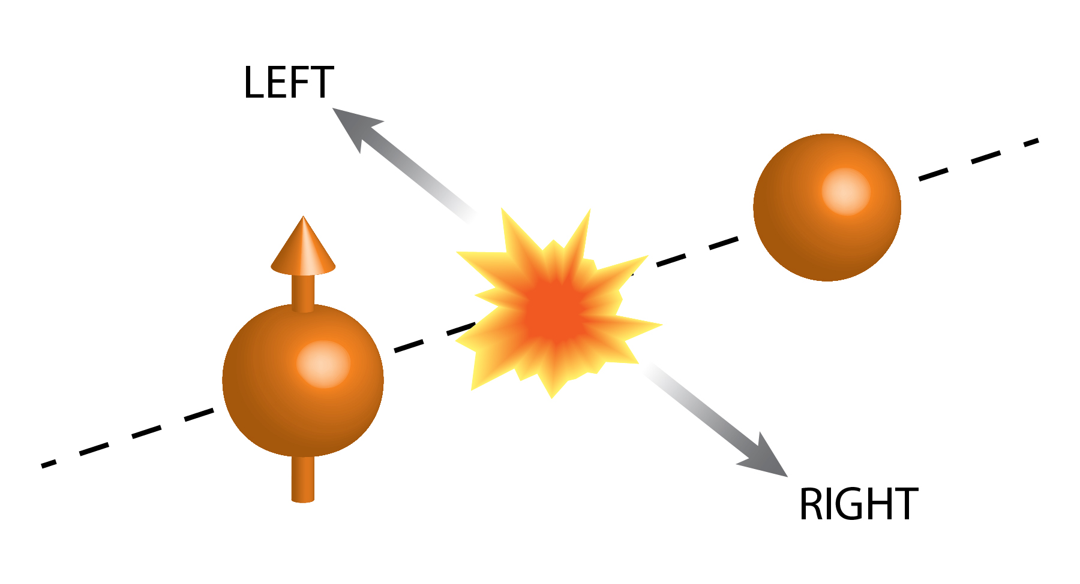
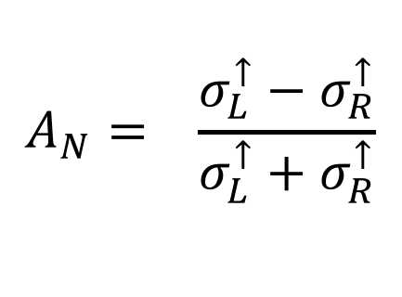
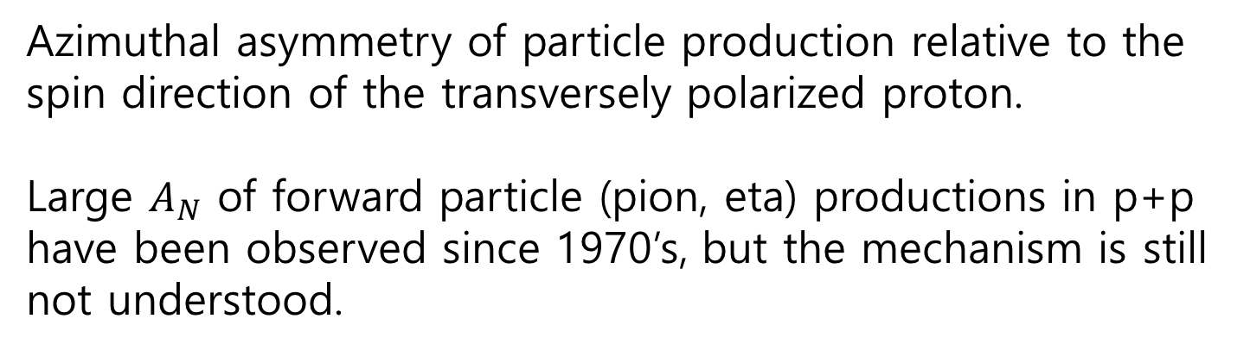

Transverse-single-spin asymmetry $A_{N}$
$$A_{N}= \frac{σ_{L}^{↑}−σ_{R}^{↑}}{σ_{L}^{↑}+σ_{R}^{↑}}$$
Azimuthal asymmetry of particle production relative to the spin direction of the transversely polarized proton.
Large $A_{N}$ of forward particle (pion, eta) productions in p+p have been observed since 1970’s, but the mechanism is still not understood.

Slide 5

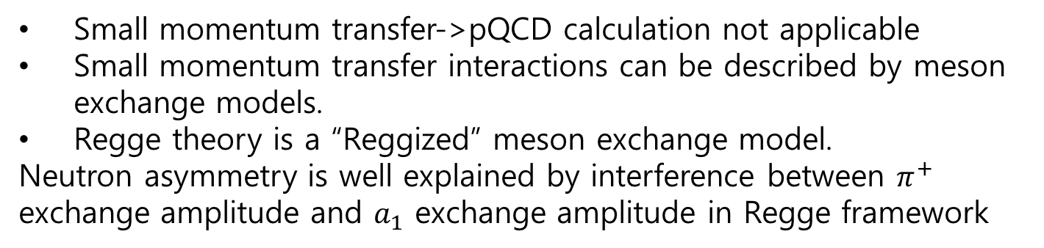
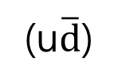
Forward neutron production mechanism
Small momentum transfer->pQCD calculation not applicable
Small momentum transfer interactions can be described by meson exchange models.
Regge theory is a “Reggized” meson exchange model.
Neutron asymmetry is well explained by interference between $π^{+}$ exchange amplitude and $a_{1}$ exchange amplitude in Regge framework
p
$$π^{+}, a_{1}$$
(u$\overline{d}$)
p
n
(uud)
(udd)

Slide 6
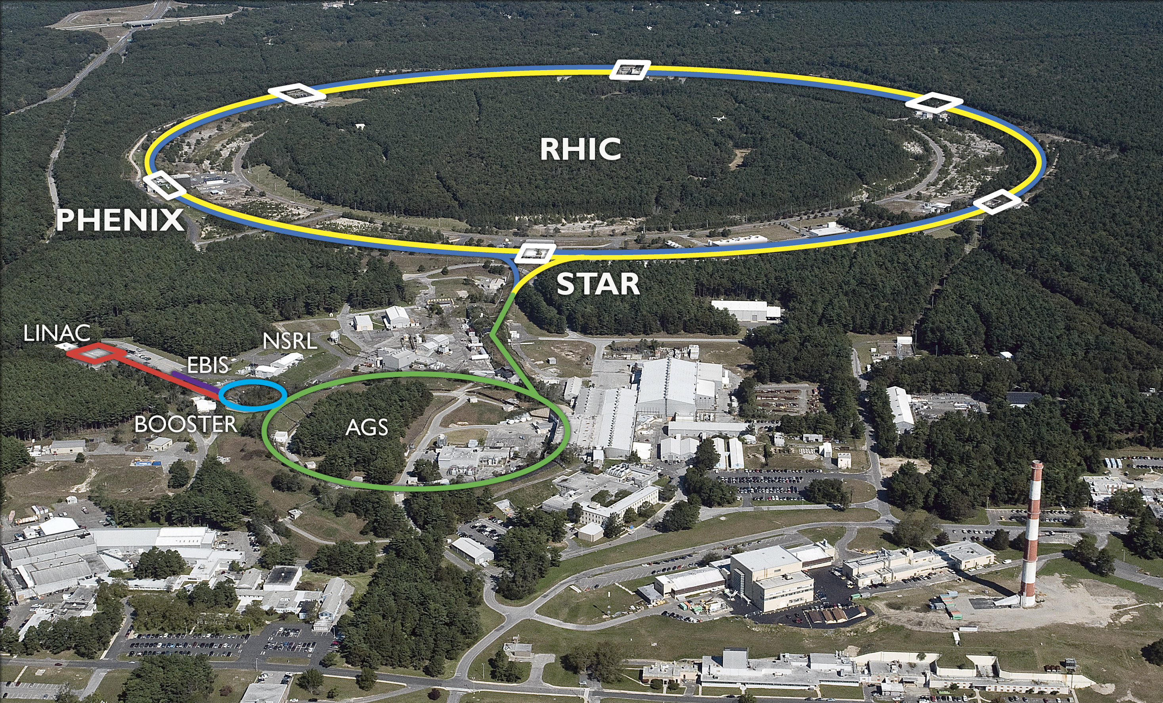
RHIC 2015
p
100 GeV
p, Al, Au
100 GeV (nucleon)
The world 1st high energy polarized proton+nucleus collision

Slide 7
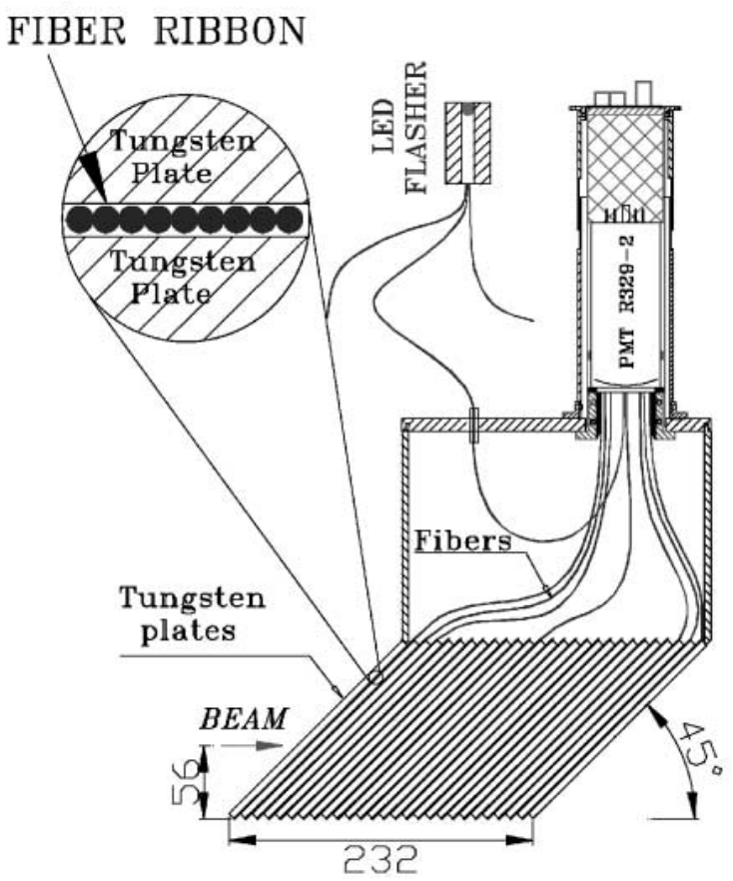
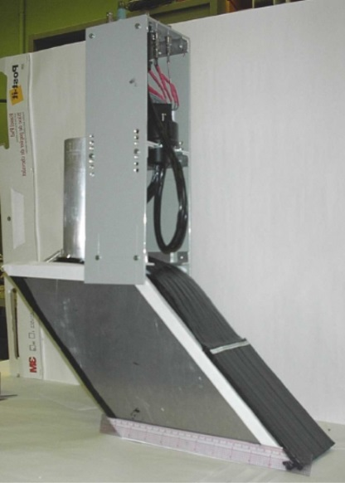
Detectors
Zero-Degree Calorimeter (ZDC): neutron energy
Shower Max Detector (SMD): neutron position
x
7 channels (x)
8 channels (y)
SMD
ZDC 2nd
ZDC
ZDC
ZDC
SMD
Beam

Slide 8
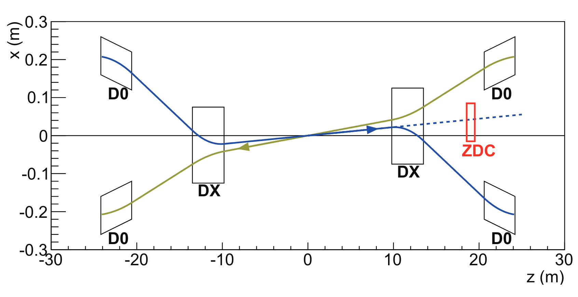
Beam orbit at p+A
To accommodate two beams with different rigidity, beam orbit is asymmetric in p+A
ZDC moved by 3.6 cm, corresponds to 2 mrad
For ZDC dedicated measurement, proton beam orbit was adjusted: proton beam angled off by 2 mrad
pp
p+A ZDC dedicated
(Figures not in scale)

Slide 9
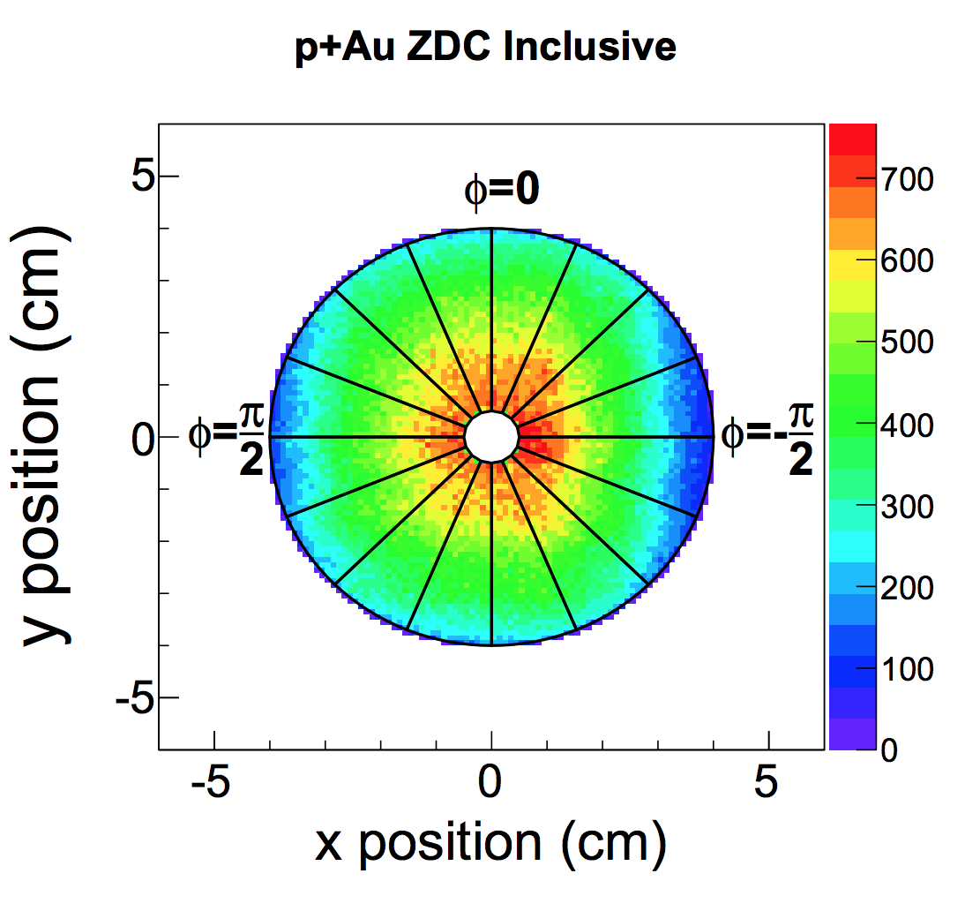
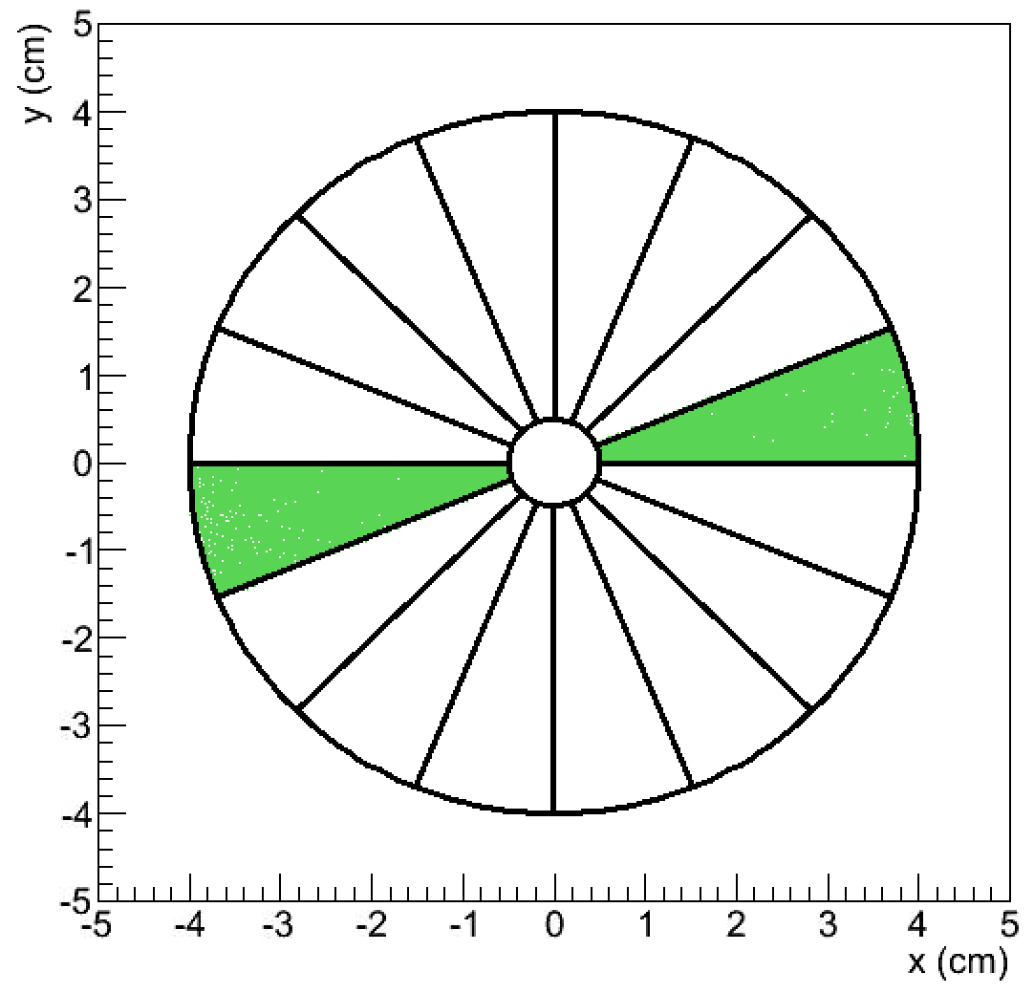
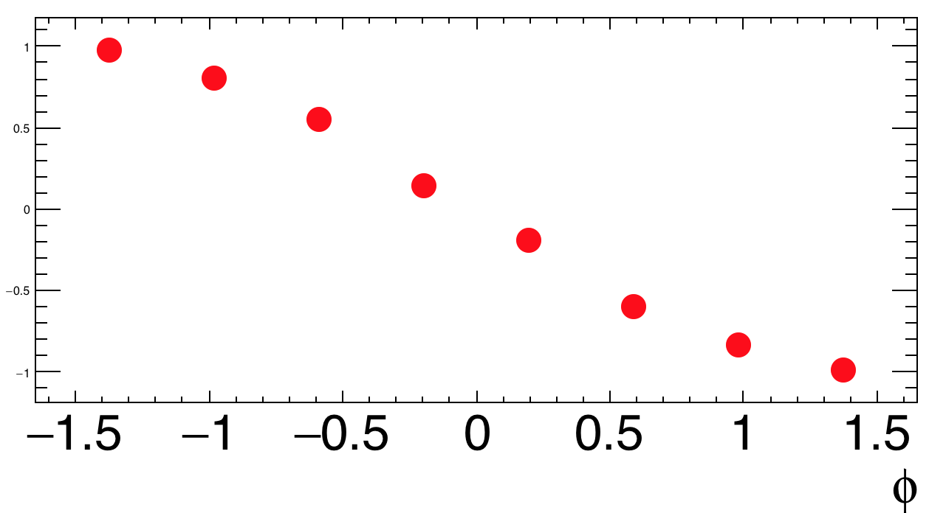
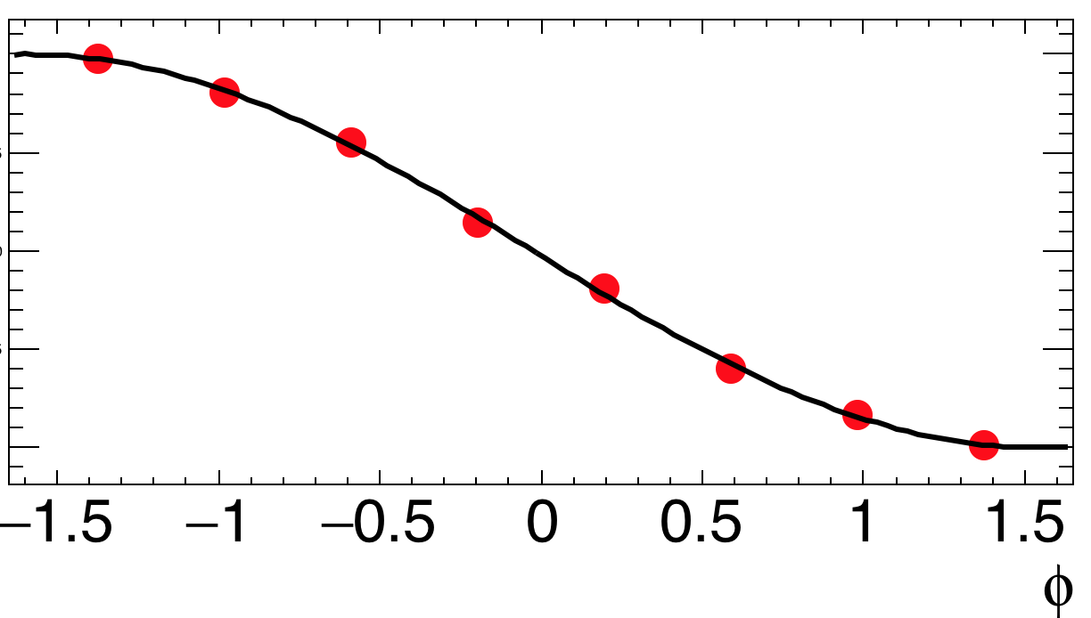




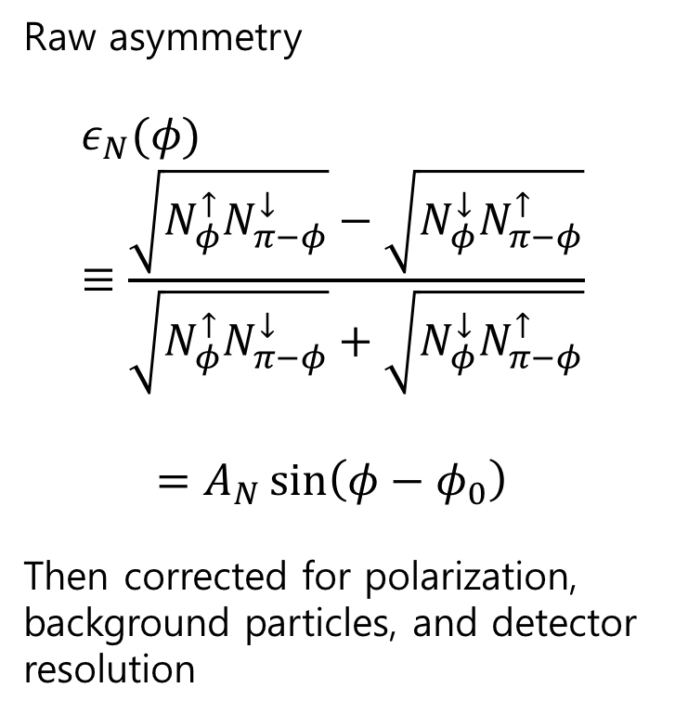
Asymmetry measurement
$$φ=0$$
Raw asymmetry
$$ε_{N}(φ)≡\frac{\sqrt{N_{φ}^{↑}N_{π−φ}^{↓}}−\sqrt{N_{φ}^{↓}N_{π−φ}^{↑}}}{\sqrt{N_{φ}^{↑}N_{π−φ}^{↓}}+\sqrt{N_{φ}^{↓}N_{π−φ}^{↑}}}$$
$$=A_{N}\sin\left(φ−φ_{0}\right)$$
Then corrected for polarization, background particles, and detector resolution
$$φ=\frac{π}{2}$$
$$φ=−\frac{π}{2}$$
$$ε_{N}(φ)$$
Y=0

Slide 10
Naïve expectation
5% more neutrons to the right
Similar result predicted
proton
neutron
heavy nucleus
neutron
Spin polarized proton
Spin polarized proton

Slide 11
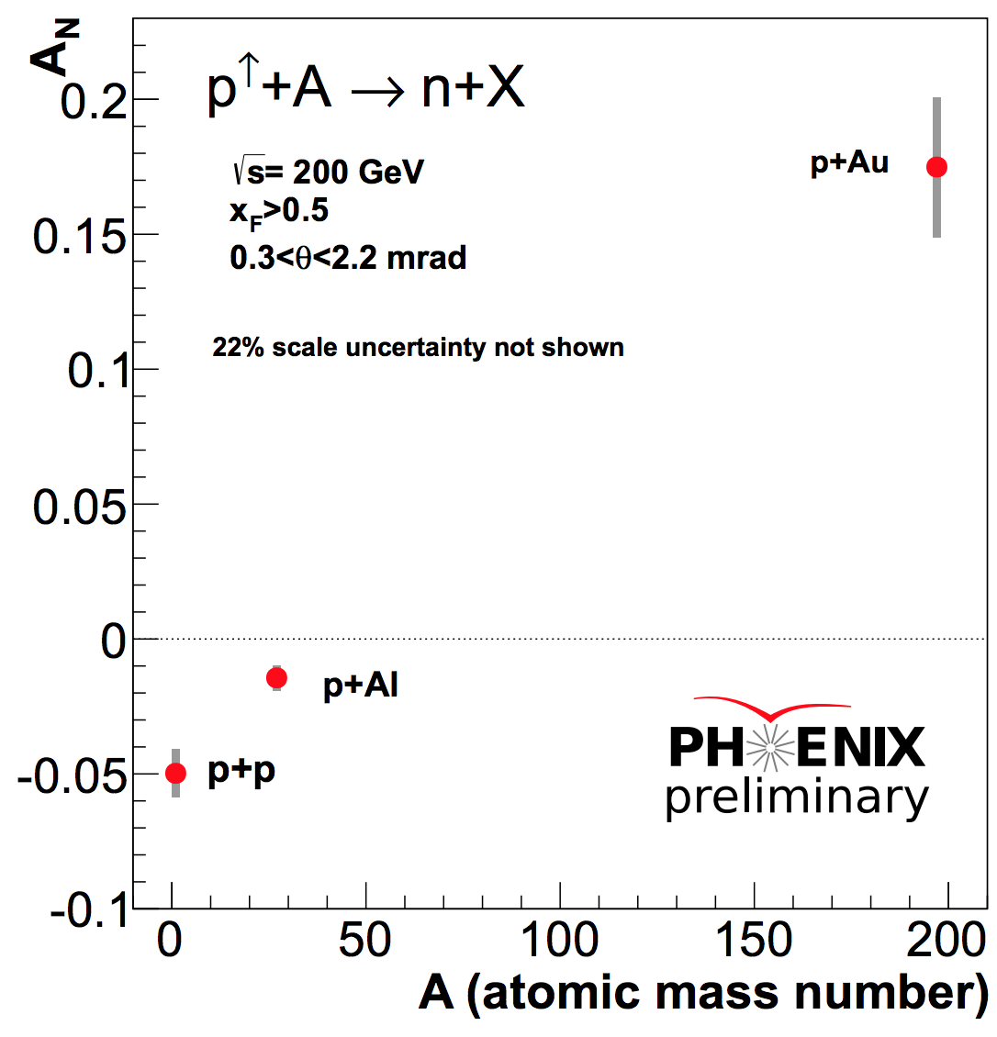
Result
However, 16% more neutrons are produced at the left side in p+Au collision!

Slide 12
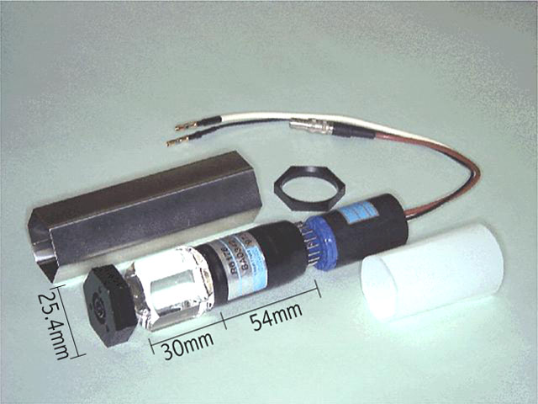
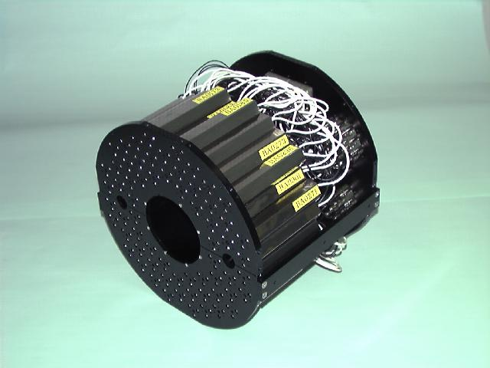
Beam Beam Counter (BBC) taggings
Quartz Cherenkov radiator(β_{th}=.7) + PMT.
ZDC inclusive neutron sample
ZDC&BBC-tag
ZDC&BBC-veto
ZDC&BBC-tag
ZDC&BBC-veto

Slide 13
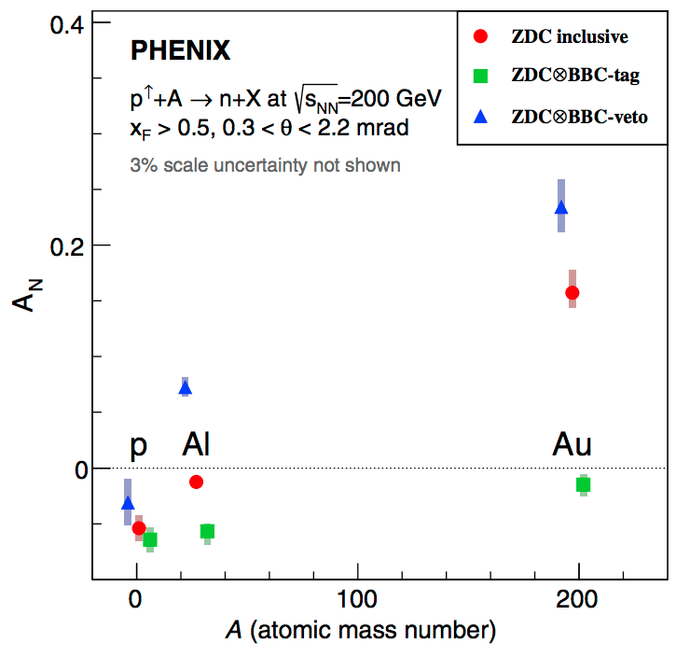
Result
Neutron inclusive
Strong A-dependence
BBC-tag
Drastic A dependence vanishes
Behave as theory prediction
BBC-veto
Stronger A-dependence
Origin of A dependence!

Slide 14
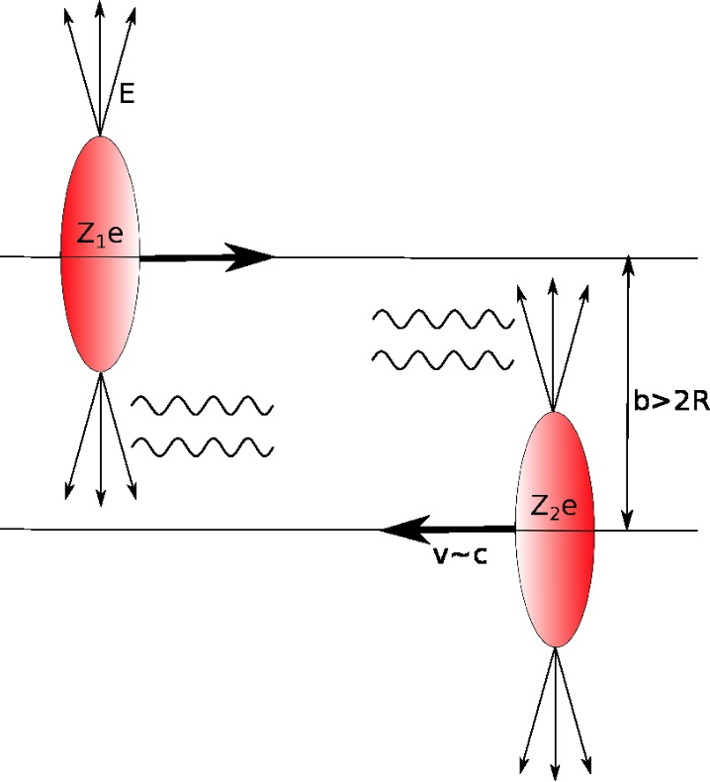
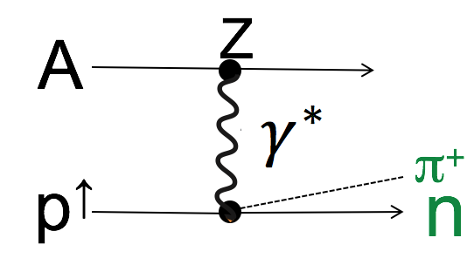
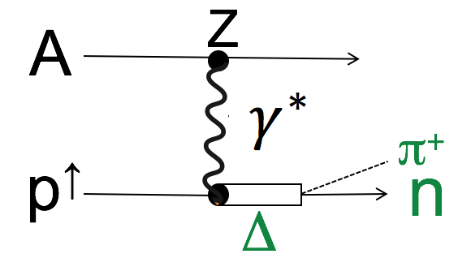
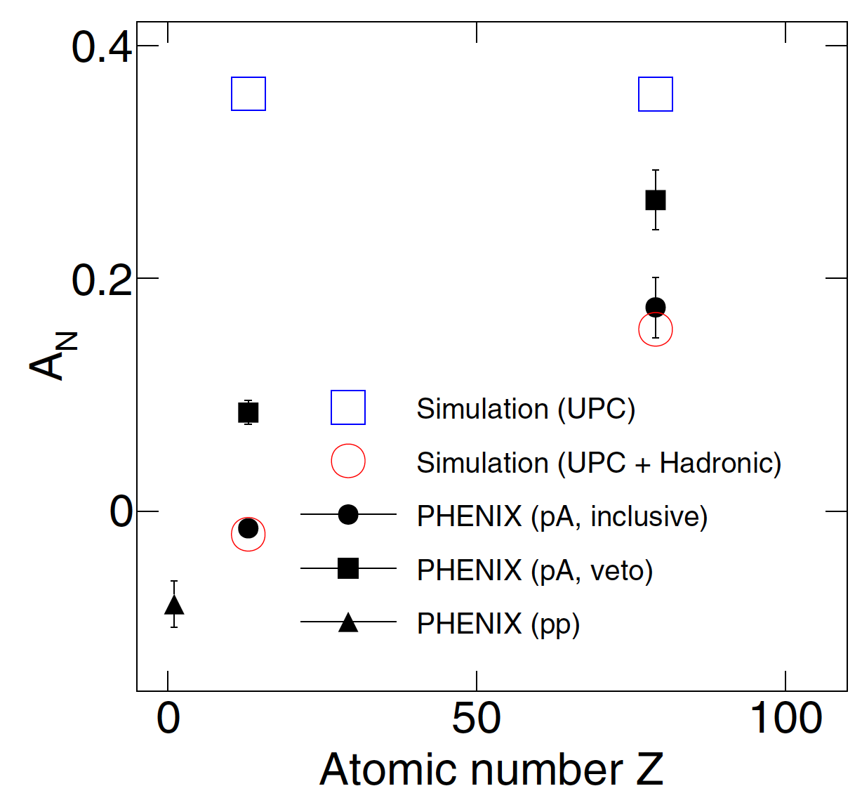
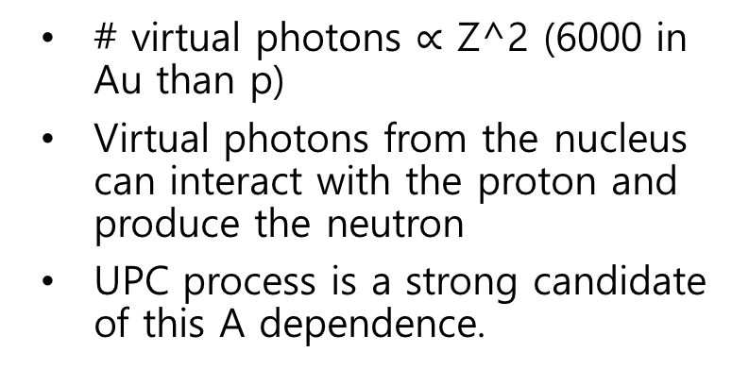
Ultraperipheral collision (UPC)
Mitsuka, PHYSICAL REVIEW C 95, 044908 (2017)
# virtual photons $∝$ Z^2 (6000 in Au than p)
Virtual photons from the nucleus can interact with the proton and produce the neutron
UPC process is a strong candidate of this A dependence.

Slide 15
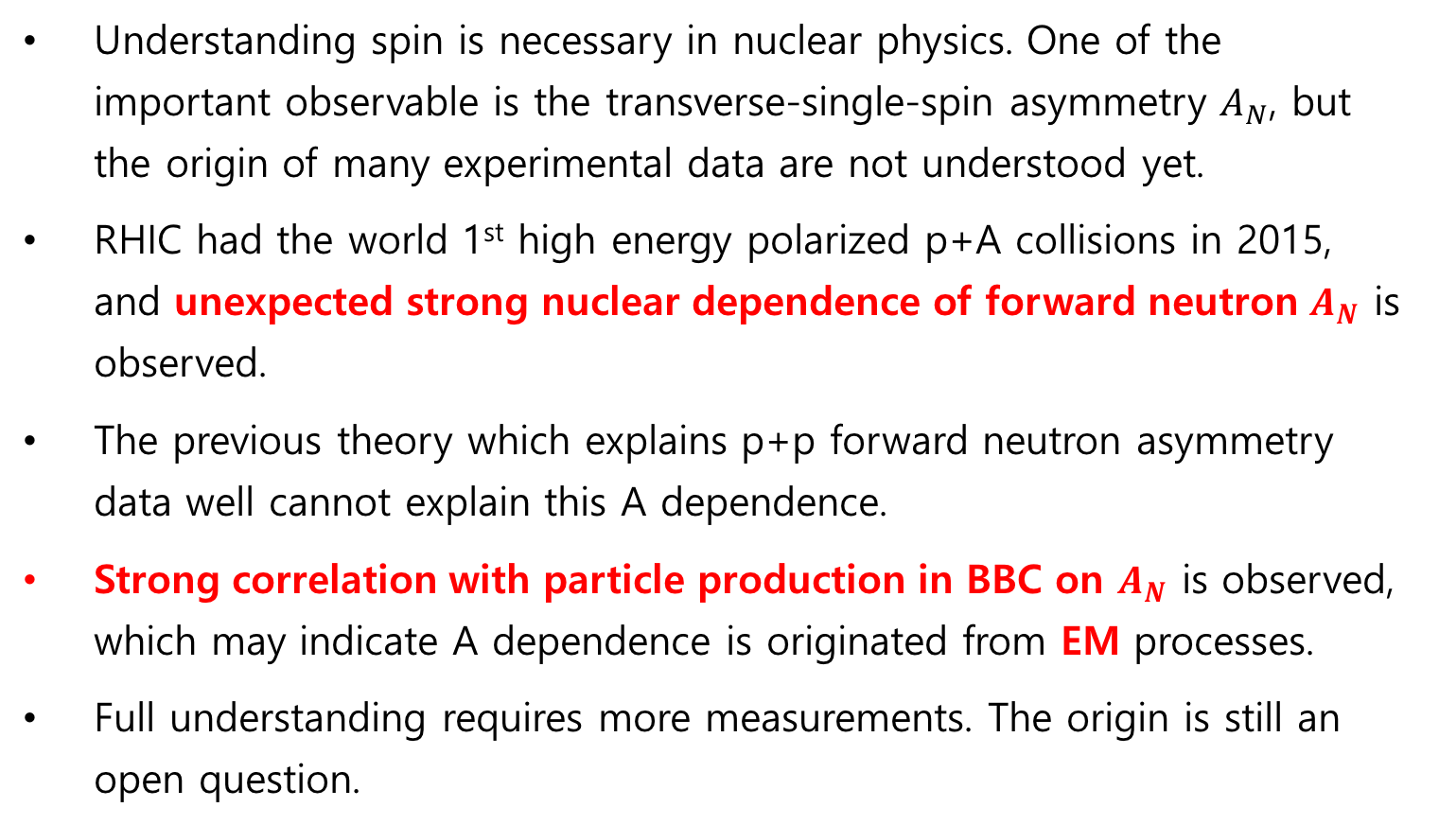
Summary
Understanding spin is necessary in nuclear physics. One of the important observable is the transverse-single-spin asymmetry $A_{N}$, but the origin of many experimental data are not understood yet.
RHIC had the world 1st high energy polarized p+A collisions in 2015, and unexpected strong nuclear dependence of forward neutron $A_{N}$ is observed.
The previous theory which explains p+p forward neutron asymmetry data well cannot explain this A dependence.
Strong correlation with particle production in BBC on $A_{N}$ is observed, which may indicate A dependence is originated from EM processes.
Full understanding requires more measurements. The origin is still an open question.

