Slide 1

The Electron-Ion Collider
Overview and Polarized Light Ion Physics
Introduction
Science
- Femtography
- Mass
- Spin
- Dense Systems of Gluons
Polarized Light Ions
- ³He
- Exotic gluons
E. Aschenauer and R. Ent

Slide 2
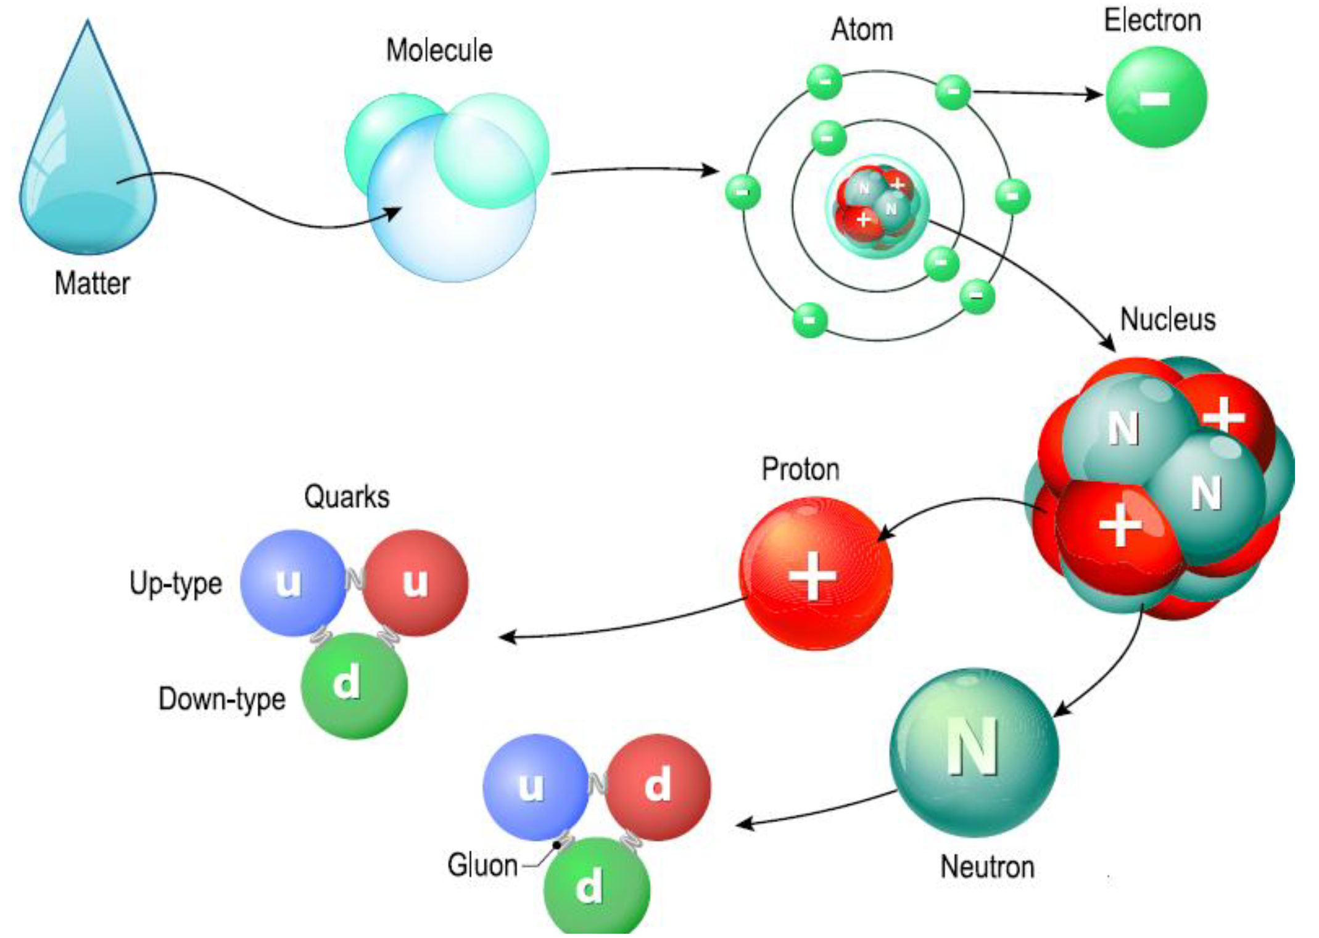
The Quest to Understand the Fundamental Structure of Matter
1808
1874
1911
1913
1968
1932
1978

Slide 3
The Quest to Understand the Fundamental Structure of Matter
Discovery
Application
Understanding

Slide 4
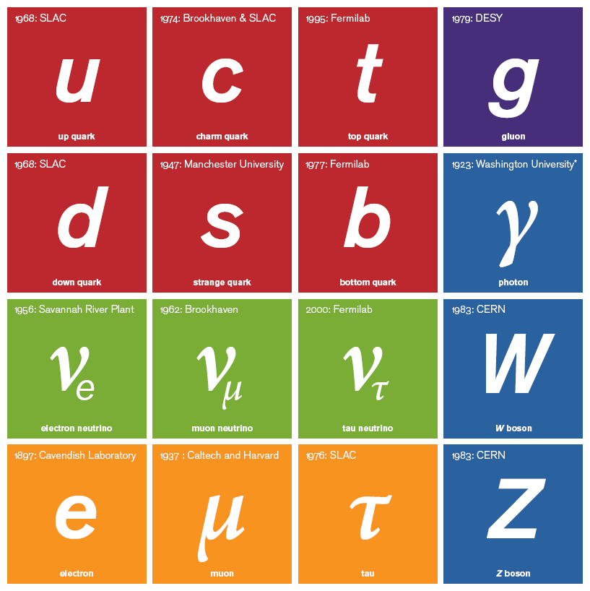
2012: CERN
2012: CERN
Fundamental Building Blocks of Matter 2018
The Standard Model of Physics
2012: CERN
2012: CERN
H
H boson
H boson
+
Einstein
gravity
2015: Gravitational
waves

Slide 5



2012: CERN
Not directly useful for understanding the
visible matter in the universe
Not detectable
Not
Detectable
H
Unstable
Absorption length ≈ 10 light-years
Unstable
H boson
H boson
Unstable

Slide 6



Understanding
The Nucleus
Reality: experiments deal with hadrons
How do we relate the successful hadronic
description of the nucleus to the fundamental
quarks and gluons?
How does the nucleon with its structure and
properties emerge from quarks and gluons of
QCD?
What role does QCD play in the structure and
properties of nuclei?

Slide 7

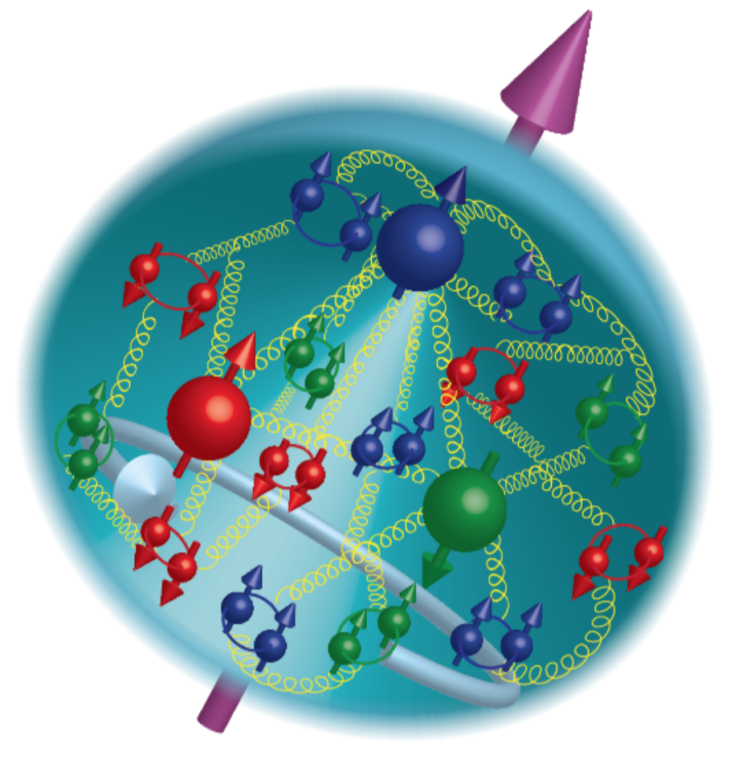
21st Century View of the Proton
Electron scattering determines charge and magnetism of nucleon
Approx. sphere with <r> ≈ 0.85 Fermi
The proton contains quarks,
as well as dynamically
generated
quark-antiquark pairs
and gluons.
The proton spin
and mass have large
contributions from
the quark-gluon
dynamics.
1961

Slide 8
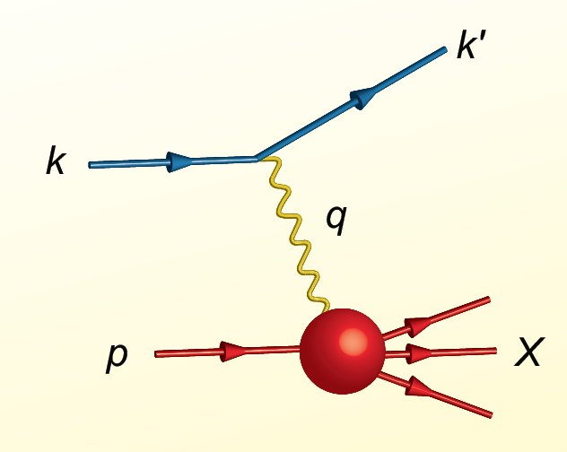
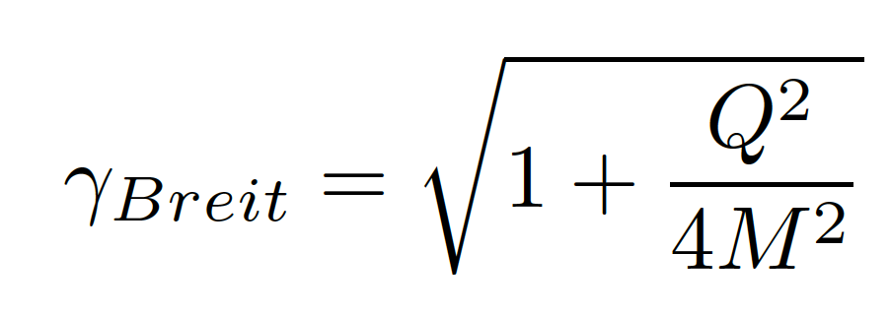
Proton Viewed in High Energy Electron Scattering: 1 Longitudinal Dimension
Viewed from boosted frame,
length contracted by
Internal motion of the proton’s constituents is slowed down by time dilation – the instantaneous charge distribution of the proton is seen.
In boosted frame x is understood as the longitudinal momentum fraction
valence quarks: 0.1 < x < 1
sea quarks: x < 0.1
Lorentz Invariants
E²_{CM} = (p+k)²
Q² = -(k-k’)²
x = Q²/(2p•q)
J. Bjorken, SLAC-PUB-0571
March 1969

Slide 9


Visualization
The camera is a device to capture an image on a desired medium, e.g. CCD or film.
Movie cameras capture a series of individual images in time to give the illusion of having captured motion.
Essential elements of any camera are
- the focus which uses a lens to gather light from
a selected image
- the shutter which is a door that opens for a definite
time to allow selected light to reach the medium.

Slide 10



High Energy Electron Scattering
Snapshots where 0 < x < 1 is the shutter exposure time
x ≈ 10⁻⁴
Probe non-linear dynamics
short exposure time
x ≈ 10⁻²
Probe rad. dominated
medium exposure time
x ≈ 0.3
Probe valence quarks
long exposure time

Slide 11
Quark Structure of Proton from High-Energy Lepton Scattering
2004
e-p cross section ≈ σ_{Mott} •F₂(x,Q²)
Snap shots of the charged structure of the proton taken in the boosted frame
1/Q spatial resolution
x exposure time
QCD prescribes evolution with Q² which
connects quarks and gluons
1990

Slide 12
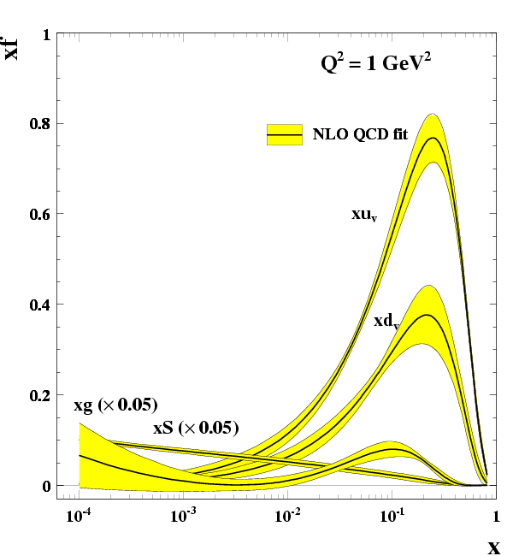
R. Yoshida

Slide 13
Proton Viewed in High Energy Electron Scattering: 1 Longitudinal Dimension

Slide 14

Proton Tomography: 2 New Dimensions Transverse to Longitudinal Momentum
Structure mapped in terms of
b_{T} = transverse position
k_{T} = transverse momentum
Goal:
Unprecedented
21st Century Imaging
of Hadronic Matter
Direction of longitudinal
momentum normal to
plane of slide
Valence Quarks: JLab 12 GeV
Sea Quarks and Gluons: EIC

Slide 15

U.S. Electron-Ion Collider Planning 2007-18
2007 NSAC Long-Range Plan
“An Electron-Ion Collider (EIC) with polarized beams has been embraced by the U.S. nuclear science community as embodying the vision for reaching the next QCD frontier.”
2013 Electron Ion Collider White Paper
(Writing committee convened by Jefferson Lab and BNL)
2013 NSAC Subcommittee on Future Facilities
“Identified EIC as absolutely central to the nuclear science program of the next decade.”
2015 NSAC Long Range Plan
“We recommend a high-energy high-luminosity polarized EIC as the highest priority for new facility construction following the completion of FRIB.”
2018 National Academy of Sciences – Assessment of U.S. Based Electron-Ion Collider Science
“…the committee finds a compelling scientific case for such a facility. The science questions that an EIC will answer are central to completing an understanding of atoms as well as being integral to the agenda of nuclear physics today.”

Slide 16
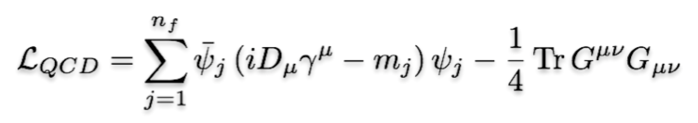
EIC: 21st Century QCD Laboratory
To explore the fundamental structure and dynamics of the matter in the visible world
Interactions arise through fundamental symmetry principles
Properties of the visible universe emerge through complex structure of the QCD vacuum
The proton is a highly relativistic system described by QCD, a fully relativistic quantum field theory.
The goal of the EIC is to provide us with an understanding of the internal structure of the proton and more complex atomic nuclei that is comparable to our knowledge of the electronic structure of atoms themselves, which lies at the heart of modern technologies.

Slide 17
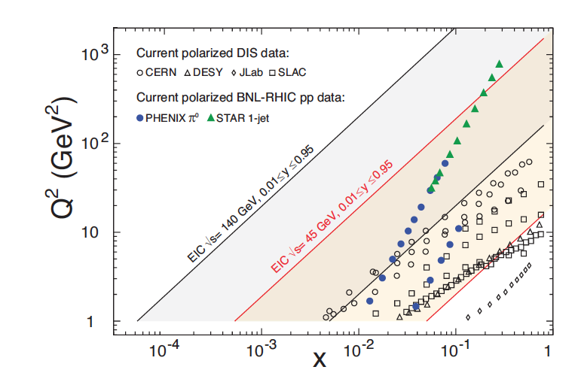

EIC Reach
Collider delivers high E_{CM} with final-state particles distributed over a large angular range
e.g. for E_{CM} = 100 GeV, E_{fixed target} = 5 TeV ➔ all final-state particles are very forward

Slide 18

EIC Physics Case
Developed by US QCD community
over two decades
Developed by NAS committee with
broad science perspective

Slide 19
EIC Physics Case
EIC science is compelling,
timely and fundamental
Developed by US QCD community
over two decades
Developed by NAS committee with
broad science perspective

Slide 20
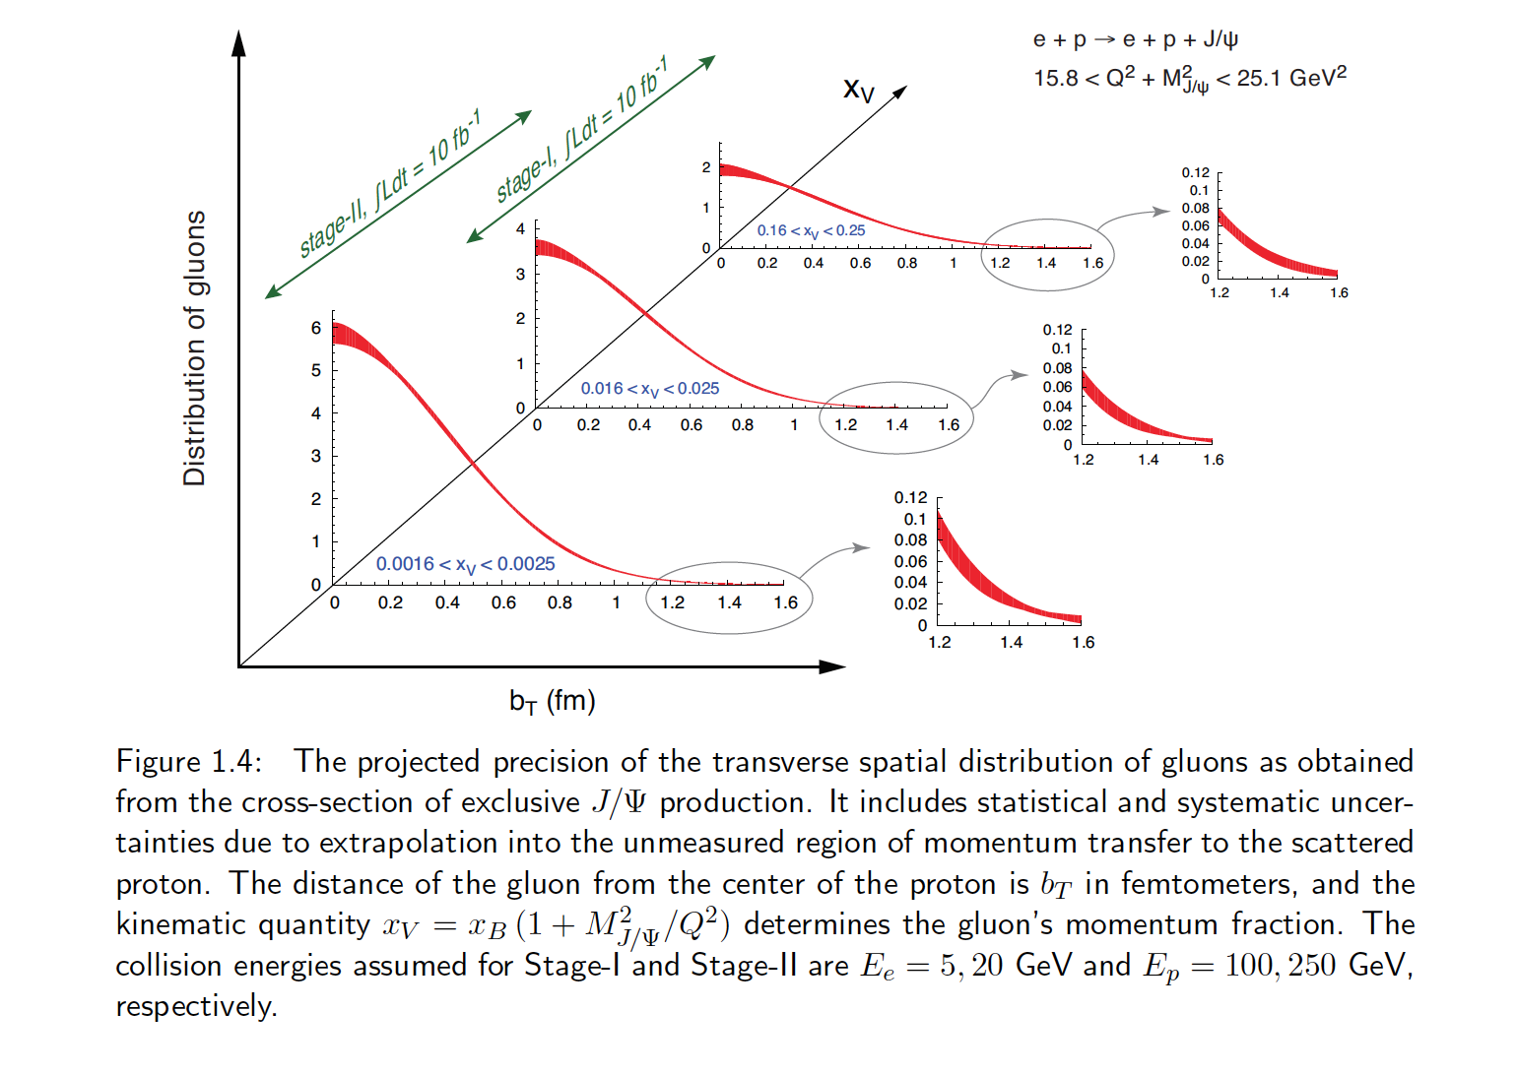
Transverse Spatial Distribution of Gluons
How are gluons spatially distributed in a proton or a nucleus?
Is the distribution smooth?
How does it differ from the charge distribution?
First ever tomographic images of ocean of gluons within matter !

Slide 21
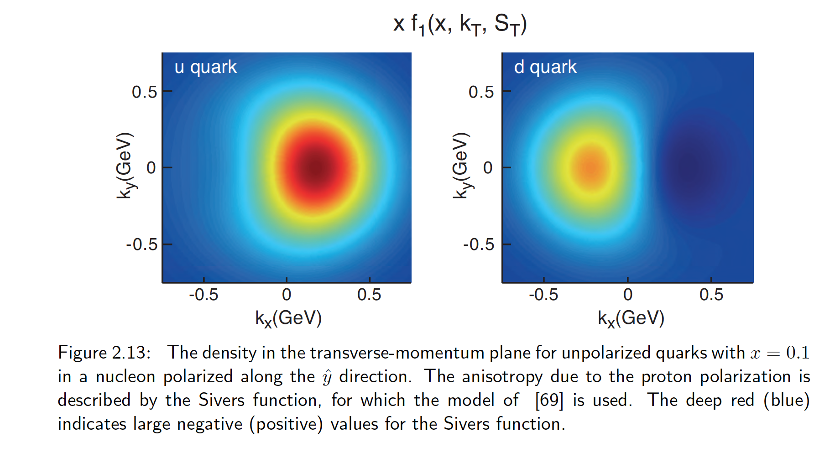
Transverse Momentum Distributions
Spin and the ability to look at transverse momentum together give a powerful new window into QCD
For example, we can explore for the first time interference in quantum phases due to color force – impossible with purely longitudinal experiments

Slide 22
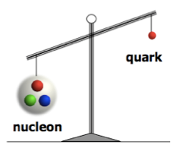
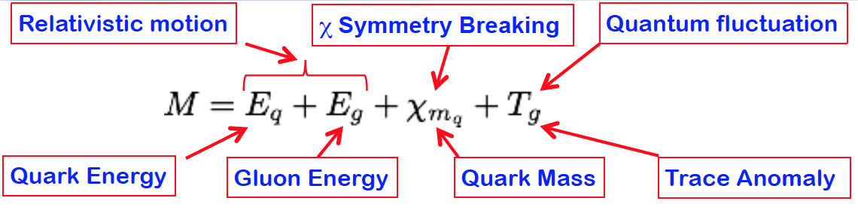
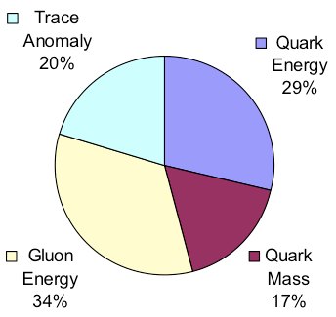
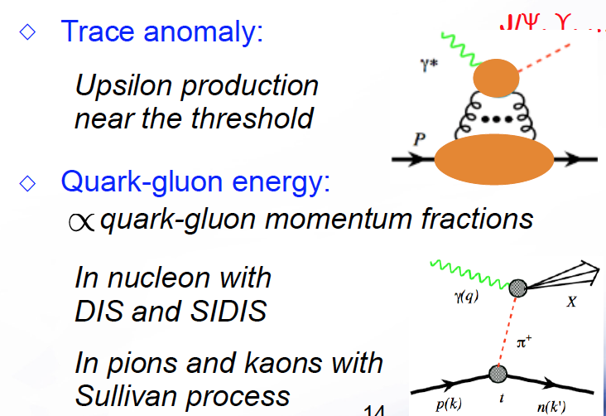
Mass of the Nucleon
“… The vast majority of the nucleon’s mass is due to quantum fluctuations of quark-antiquark pairs, the gluons, and the energy associated with quarks moving around at close to the speed of light. …” The 2015 Long Range Plan for Nuclear Science
Lattice QCD
EIC expected contribution

Slide 23
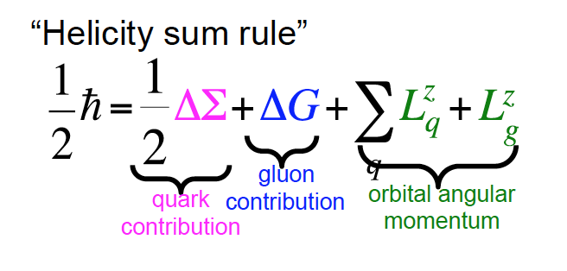
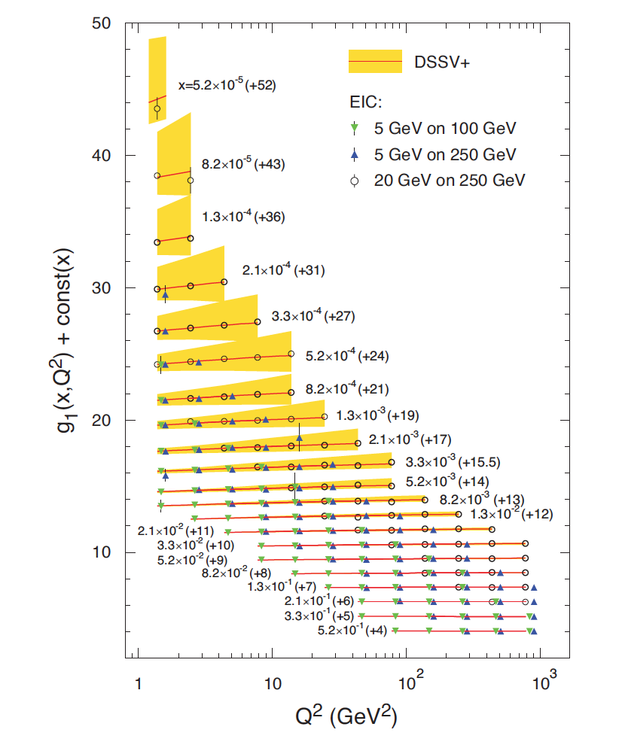
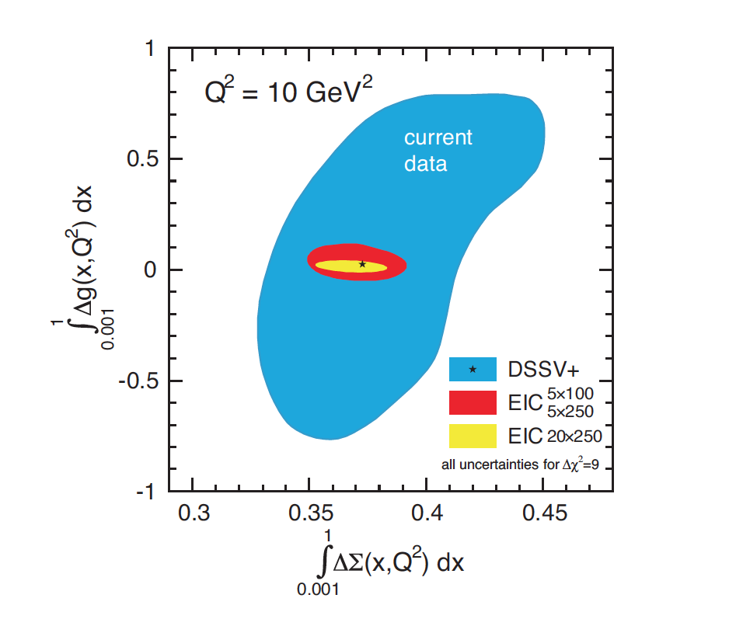
Spin of the Nucleon
EIC projected measurements:
Precise determination of polarized PDFs of
quark sea and gluons ➔ precision ΔG and ΔΣ
➔ Determination of Σ L_{q}+L_{g}

Slide 24
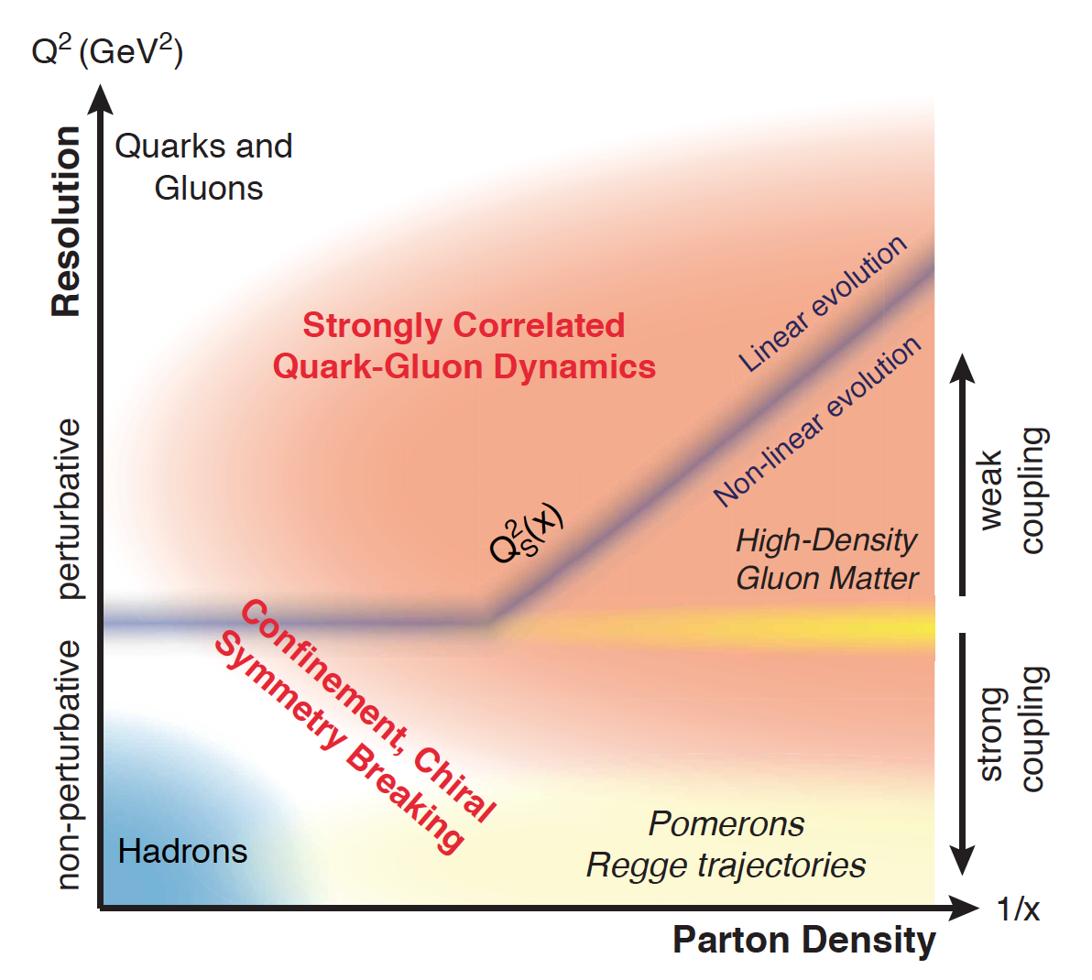
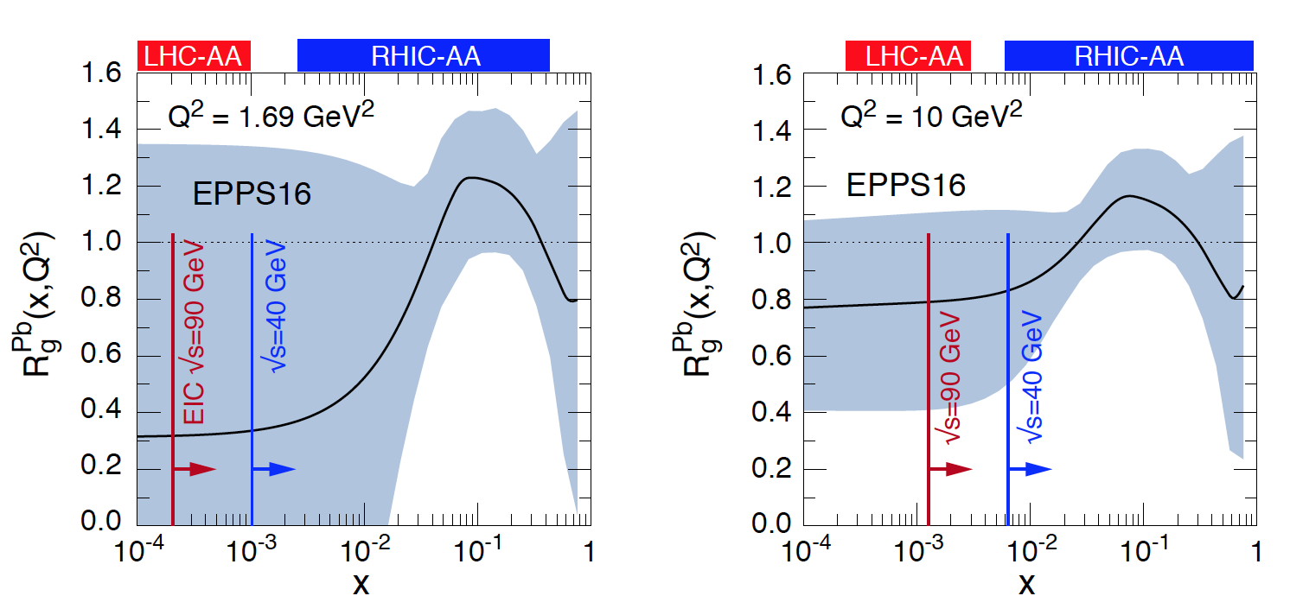
QCD Dynamics in Nuclei
arXiv: 1708.01527
Study modifications of gluons in
nuclear environment complementing
heavy ion programs at RHIC and LHC
Explore QCD landscape over a wide
range in x and Q²
Study high-density gluon matter

Slide 25
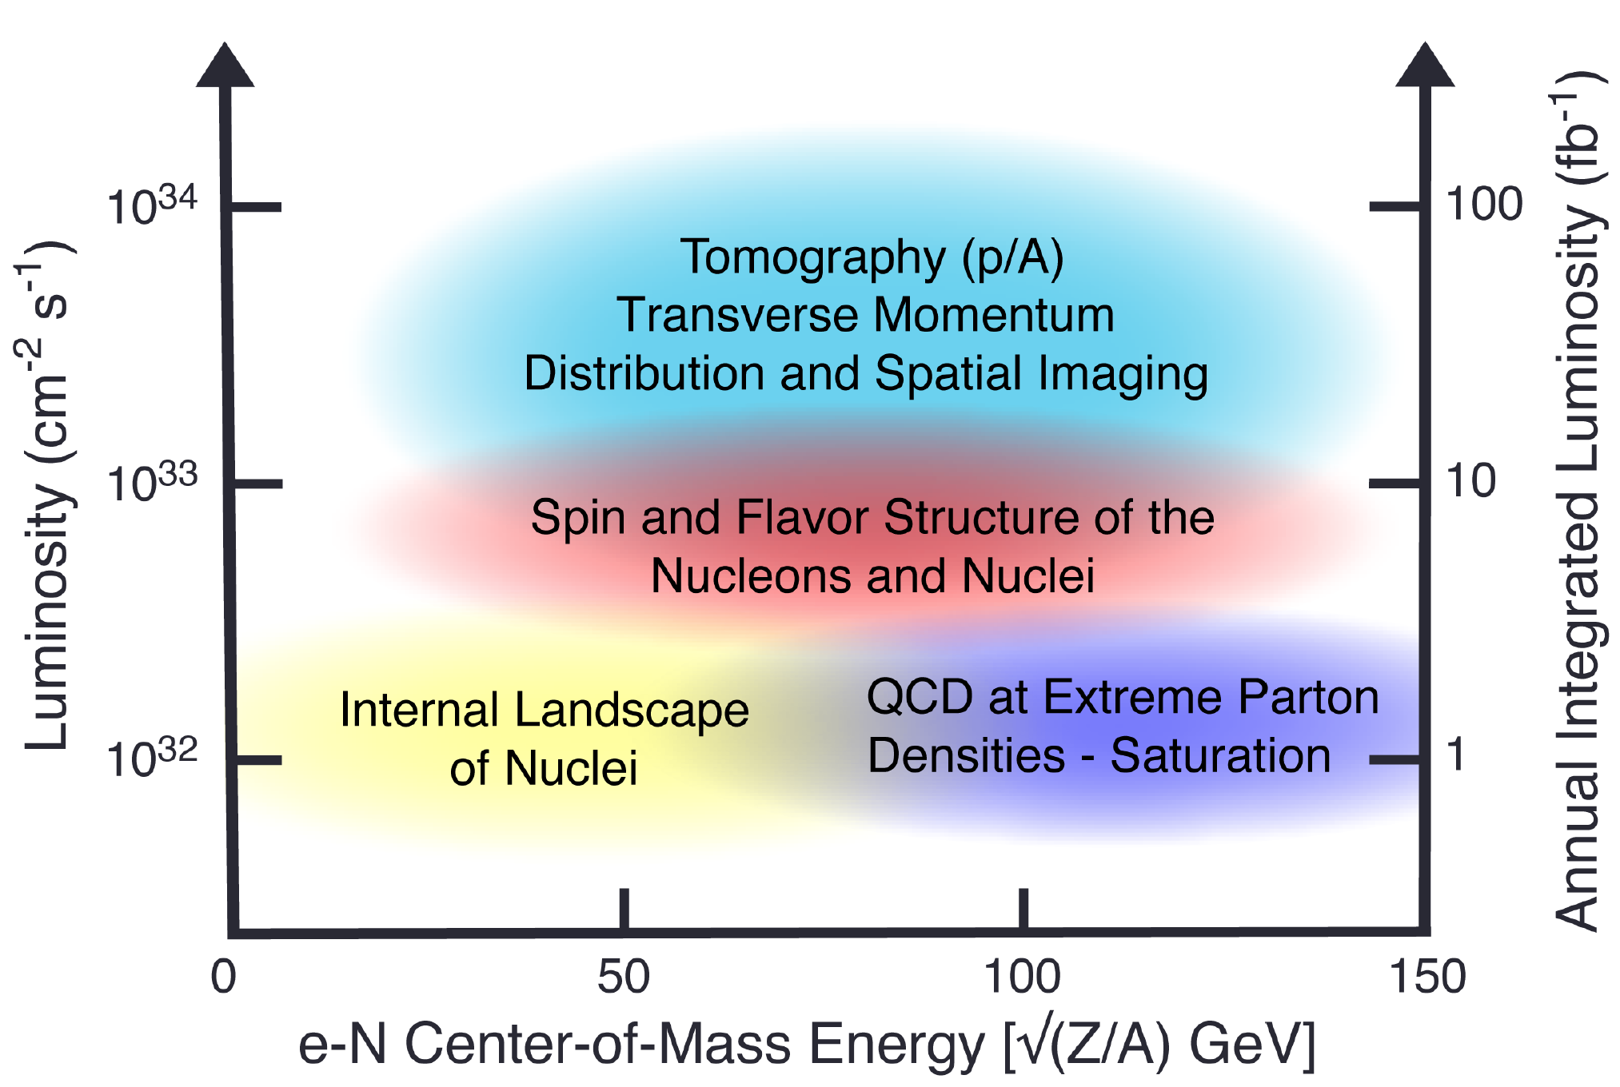
Collider Specifications from Science

Slide 26



NAS report on eic requirements
Note: consistent with 2013 white paper and 2015 NSAC Long Range Plan

Slide 27
New Avenue: Polarized Light Ions
Measurements with light ions address essential elements of the
EIC physics program:
- neutron structure: ²H and ³He
- nucleon interactions in QCD
- imaging nuclear bound states
- search for exotic gluons: ⁶Li and ⁷Li
Light ions have unique features
- polarized beams
- breakup measurements and tagging
- structure can be precisely calculated
Opportunities for large and potent low energy structure
community

Slide 28
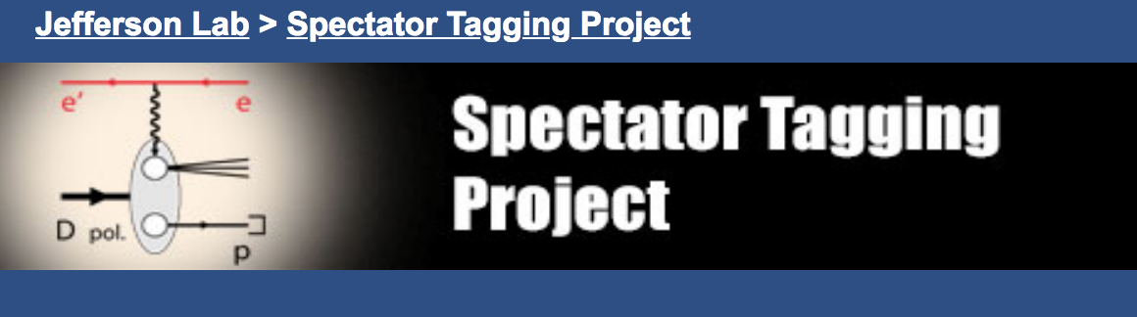
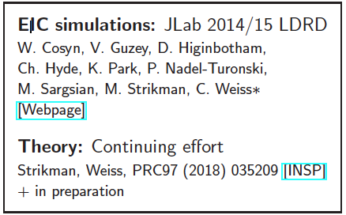
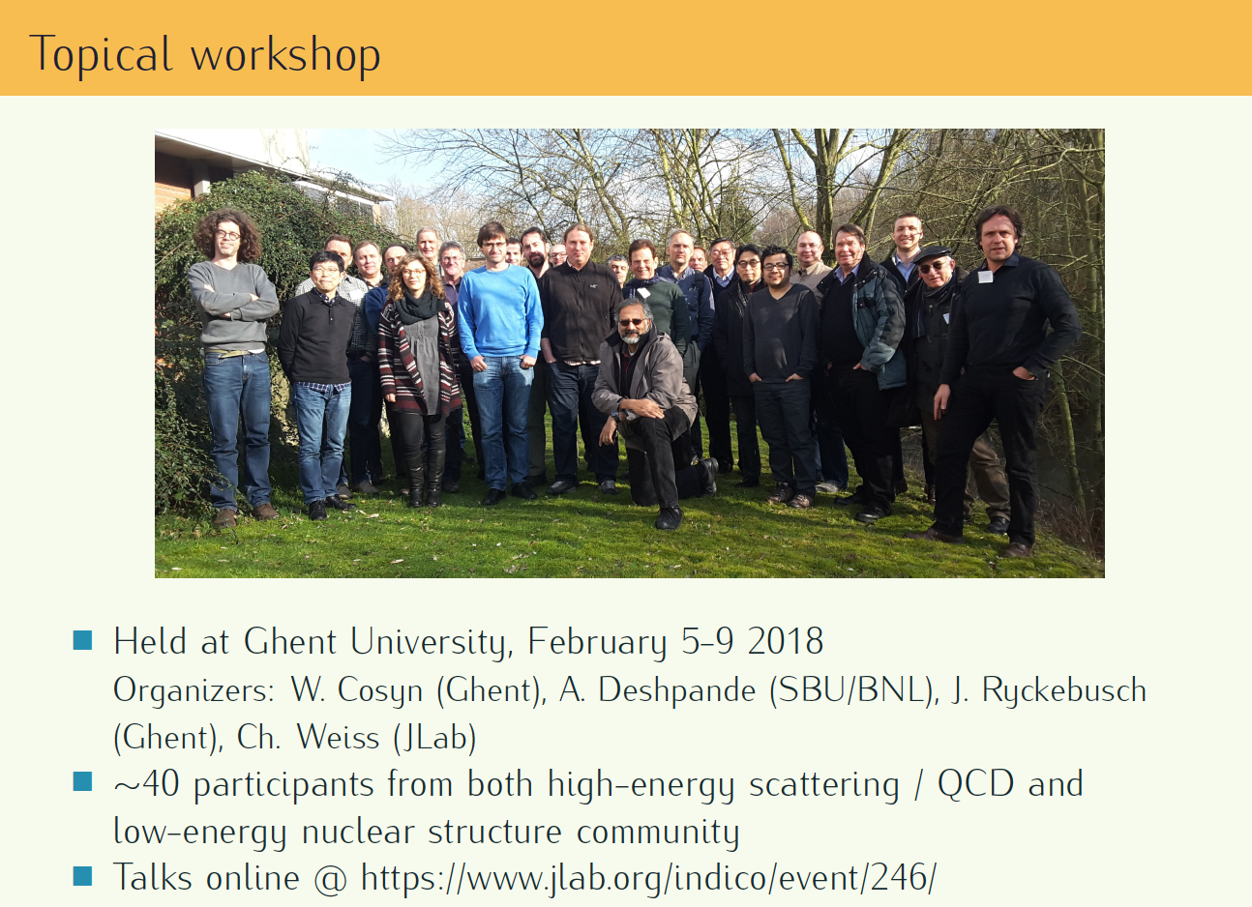
Work in Progress since 2014
Presentations
EICUG meeting: W. Cosyn,
C. Weiss, R.M.
SPIN2018: W. Cosyn
Here: C. Weiss

Slide 29
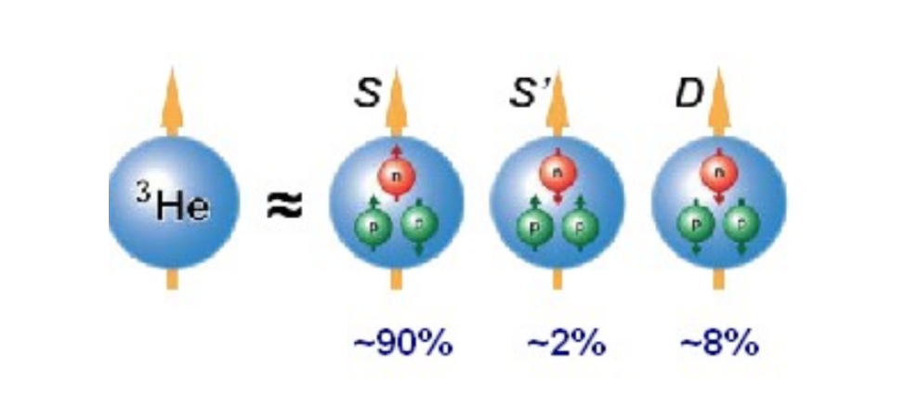
Neutron Spin Structure Function g₁^{n}(x,Q²)
Rest frame of the ³He nucleus
Neutron polarization: 87%
Proton polarization: 2.7%
With successful realization of 70% polarized ³He ion beam in EIC, precision
measurement of g₁^{n}(x,Q²) should be a goal with a day-1 detector
Aim should be to test Bjorken Sum Rule with unprecedented precision
Will require technical development of Siberian Snakes and high energy ³He
polarimeter in RHIC
In spin-dependent DIS if one tagged the spectator proton and deuteron, could
one access the spin structure functions of the deuteron and proton, respectively?

Slide 30
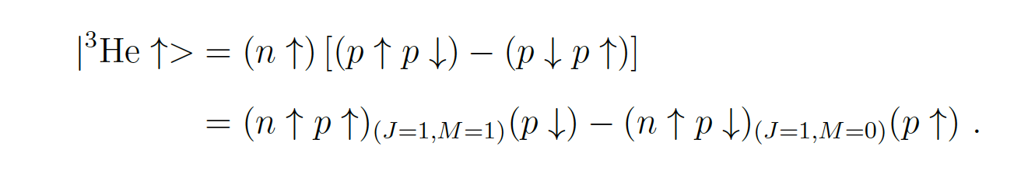
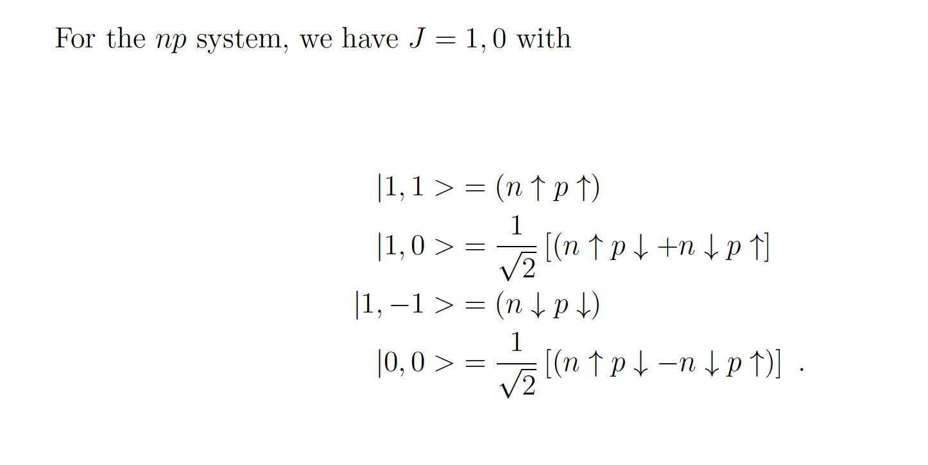

Slide 31
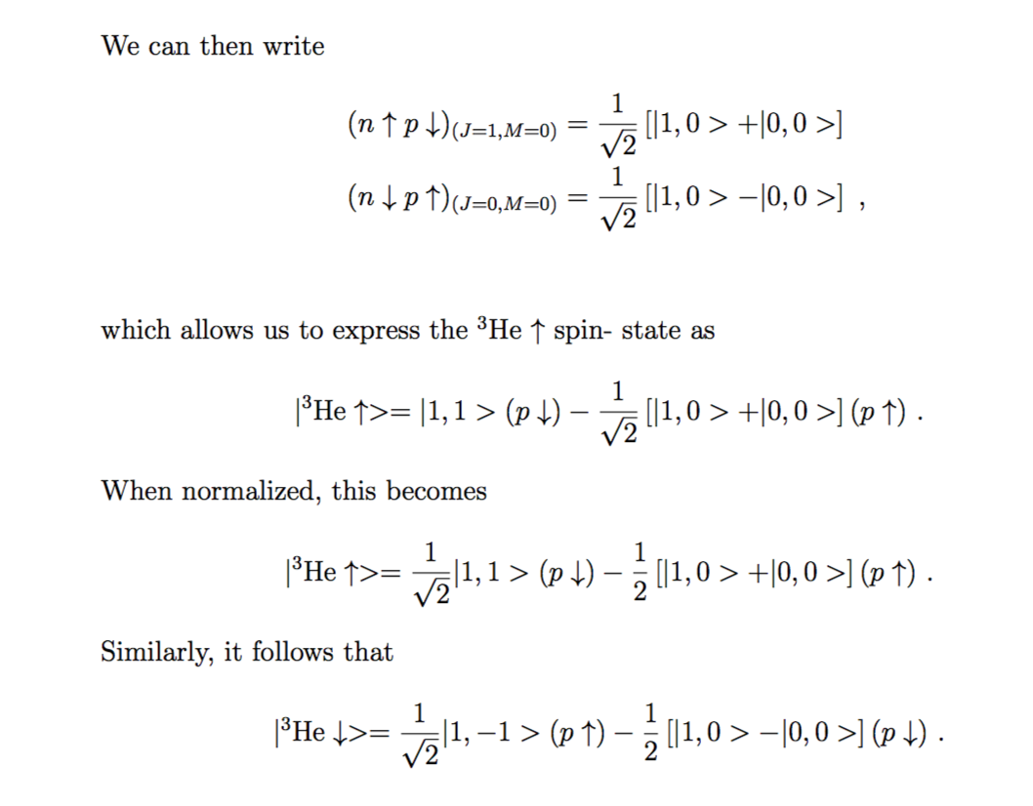

Slide 33
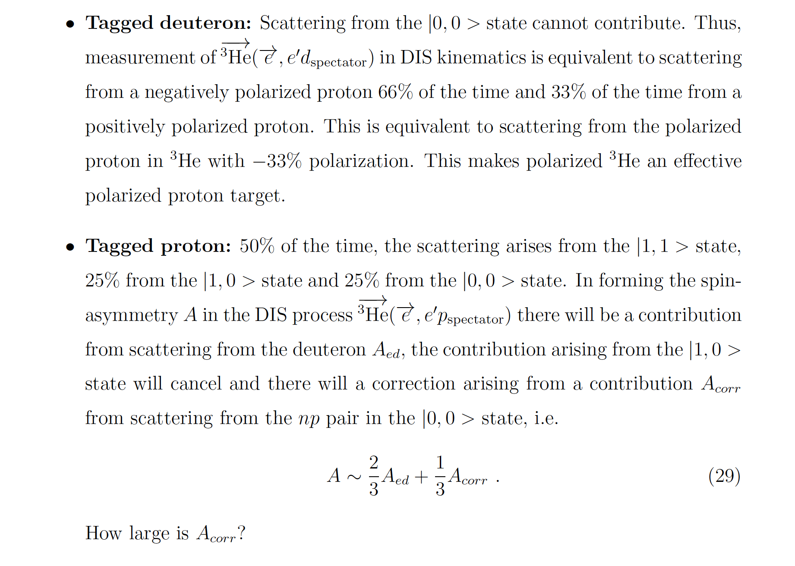

Slide 34
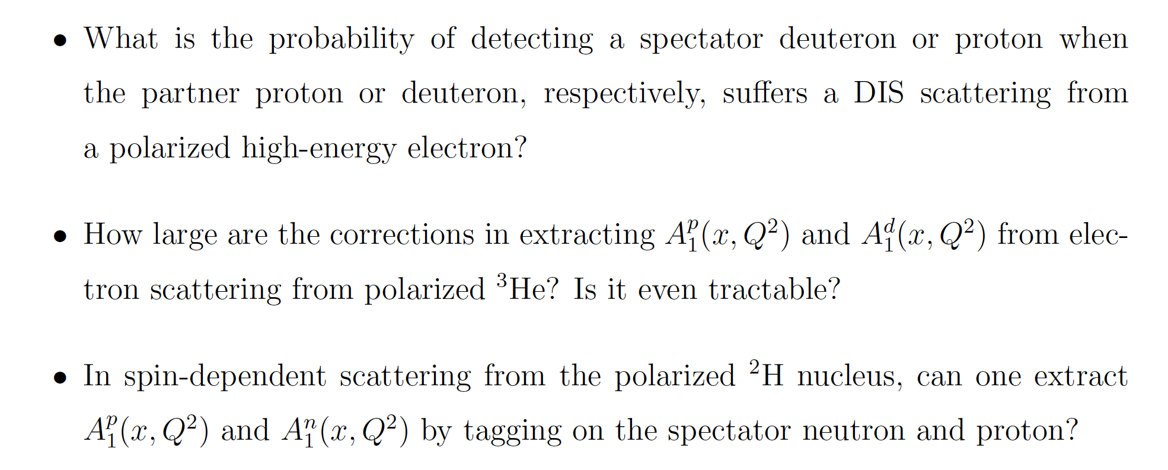
Questions

Slide 35
Perspective
Our perspective on spin-dependent DIS from few-body nuclei is all based on these targets being in their rest frame.
Calculations of spin-dependent DIS in the EIC frame are needed.
T.W. Donnelly: approach is to calculate spin-dependent interaction in nuclear rest-frame and boost to EIC frame.
Donnelly and Sofiatti have done this for e-p elastic:
Phys. Rev. C 84, 14606 (2011)
Sizable effects on spin when boosting.
If needed, boosted ³He spin structure in collider frame could be measured at RHIC once polarized ³He become available.

Slide 36
Nuclear Gluonometry
Jaffe and Manohar in 1989 identified a leading-twist, double-helicity flip structure function Δ(x,Q²).
It would be a clear signature for exotic glue in nuclei, i.e. gluons not associated with individual nucleons.
It is unavailable to bound nucleons or pions in the nucleus.
Recent lattice QCD results (1606.04505) by Detmold, Shanahan and colleagues for first moment of Δ(x,Q²) in a ϕ meson (s-sbar, J=1) is preliminary but promising
It is accessed via inclusive DIS from a transversely polarized nucleus with J≥1.
Experiment using polarized target under development at Jefferson Lab.
LOI-12-14-001 (Spokesman: J. Maxwell) favorably reviewed by PAC42 in July 2014.
Critical technical issue is degree of tensor polarization of ¹⁴N possible in transversely polarized ammonia target.
In addition, also under consideration for future EIC, see Maxwell talk at EICUG meeting ANL in July, 2016: Search for Exotic Gluonic States in the Nucleus.

Slide 37
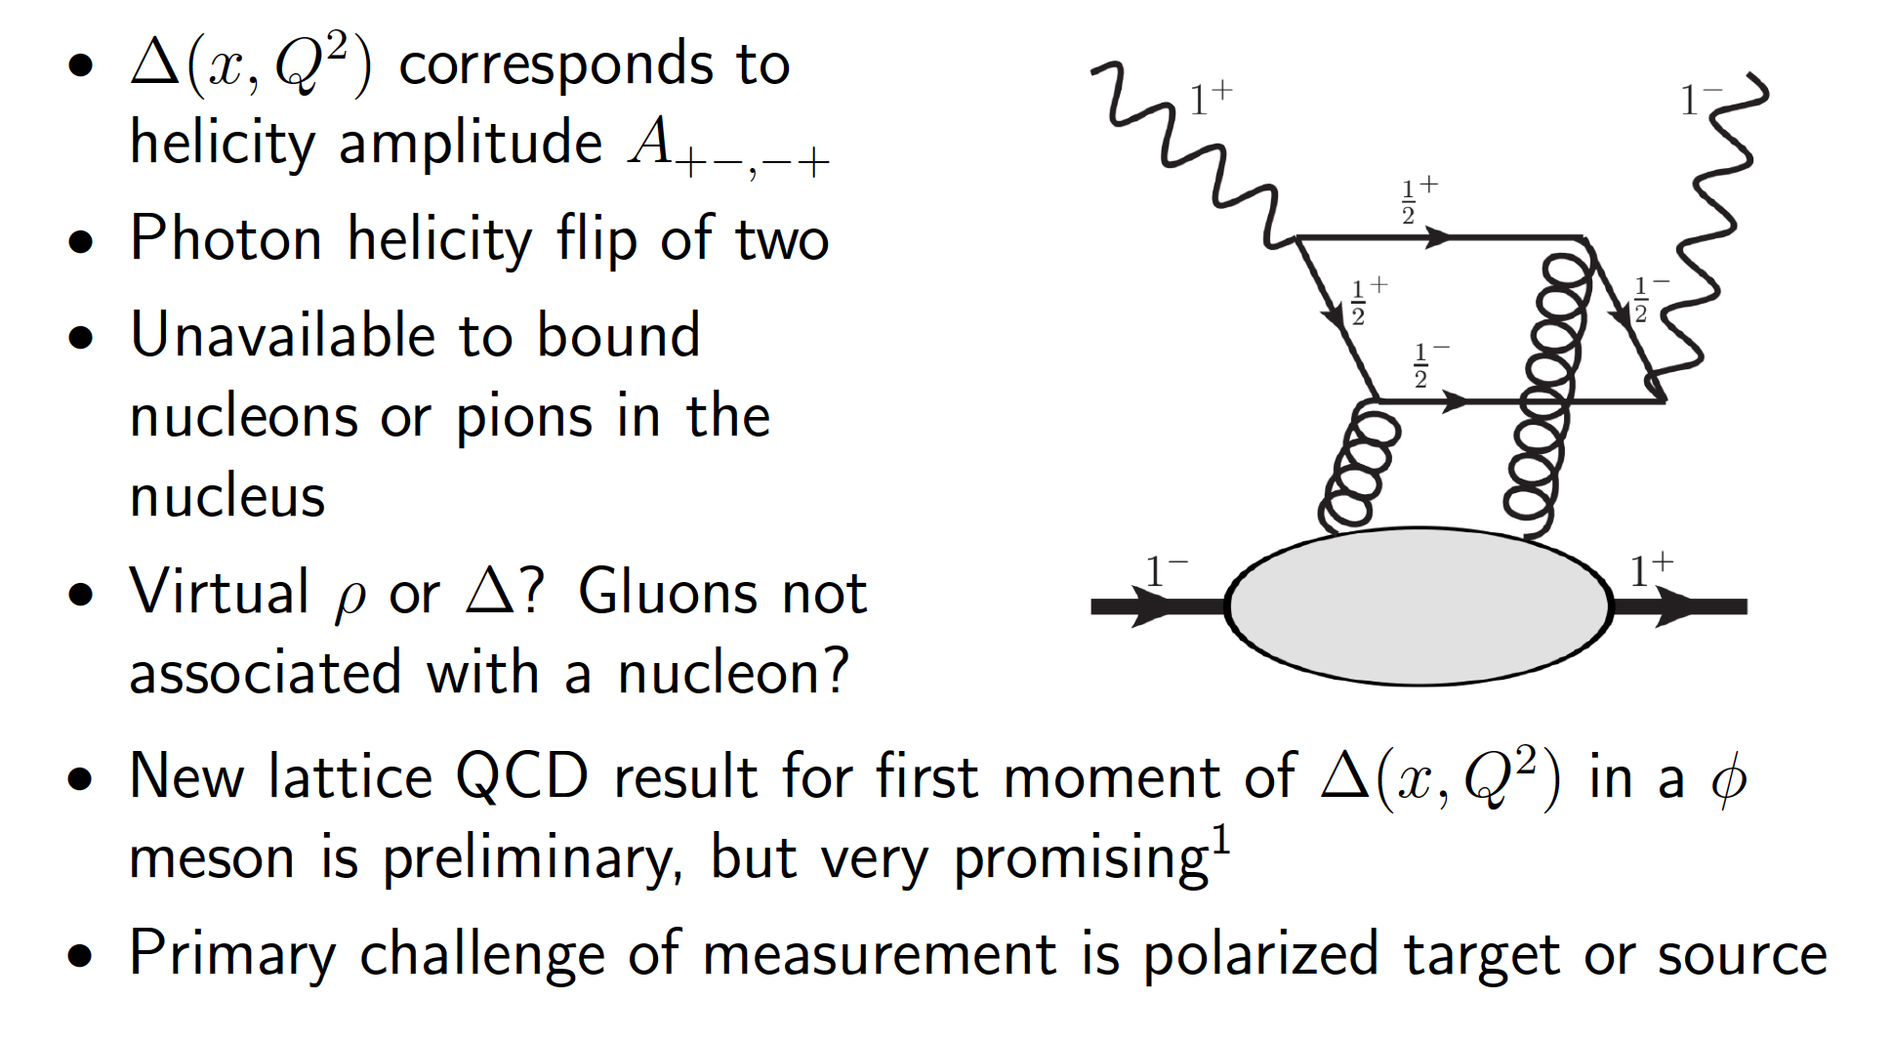
Double Helicity Structure Function Δ(x,Q²)

Slide 38
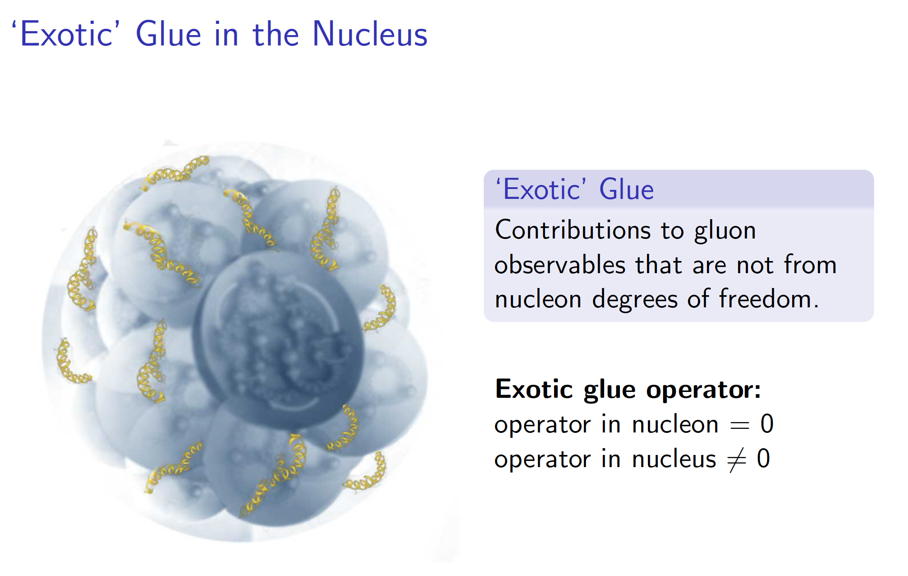
Lattice Calculation of Exotic Glue
See talk by Phiala Shanahan at EICUG meeting at
ANL, July 2016

Slide 39
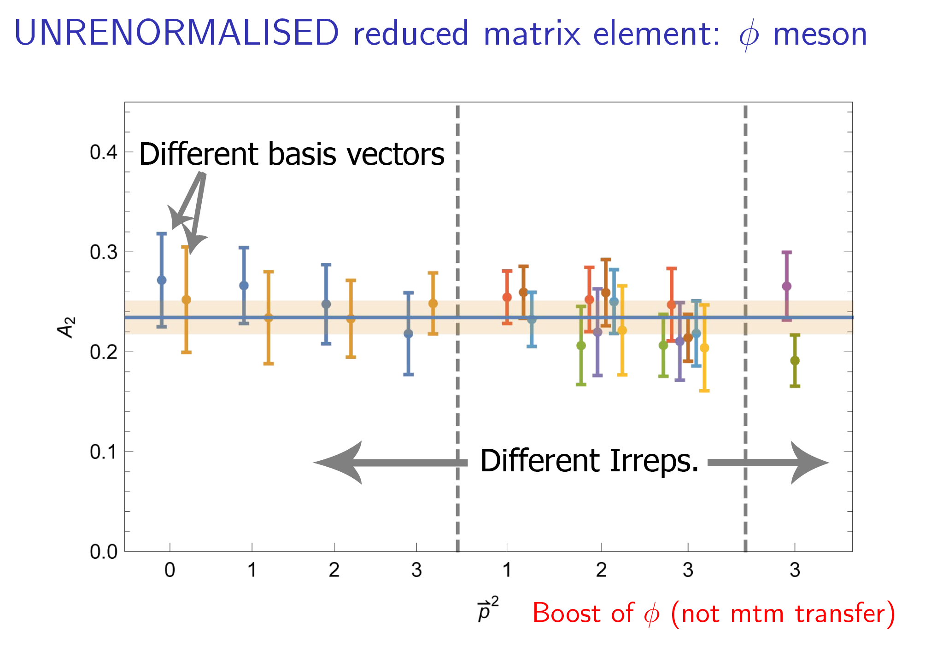

Slide 40
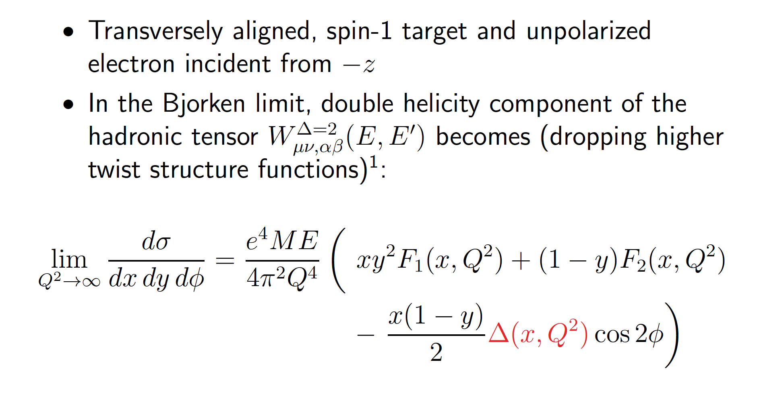
Measuring Δ(x,Q²) via Inclusive DIS

Slide 41
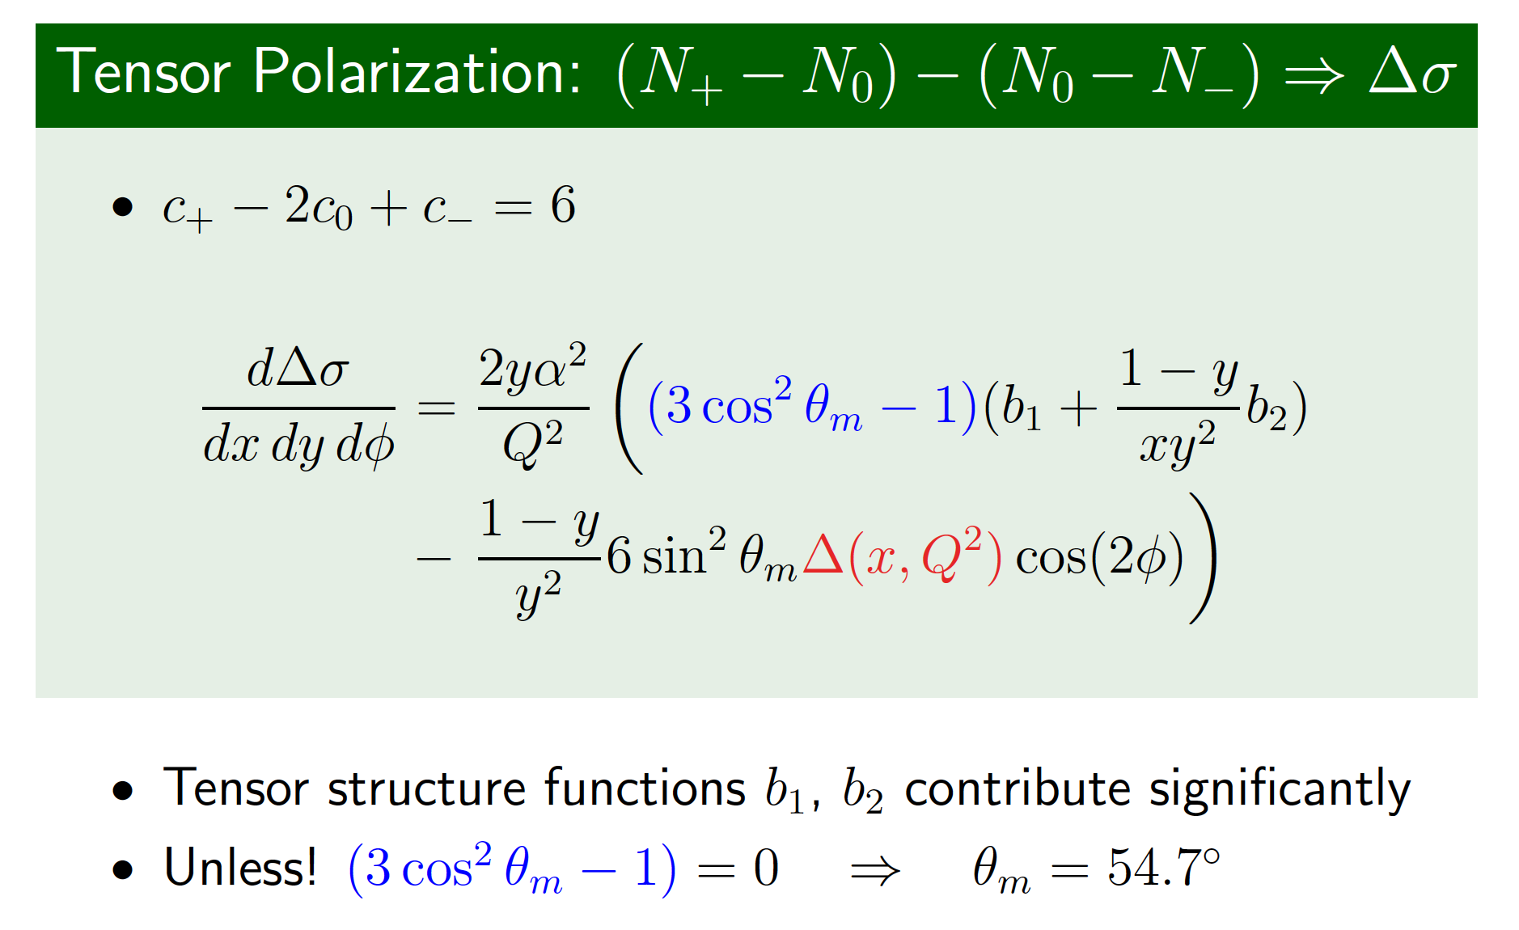
Using Tensor Polarized Nuclei

Slide 42
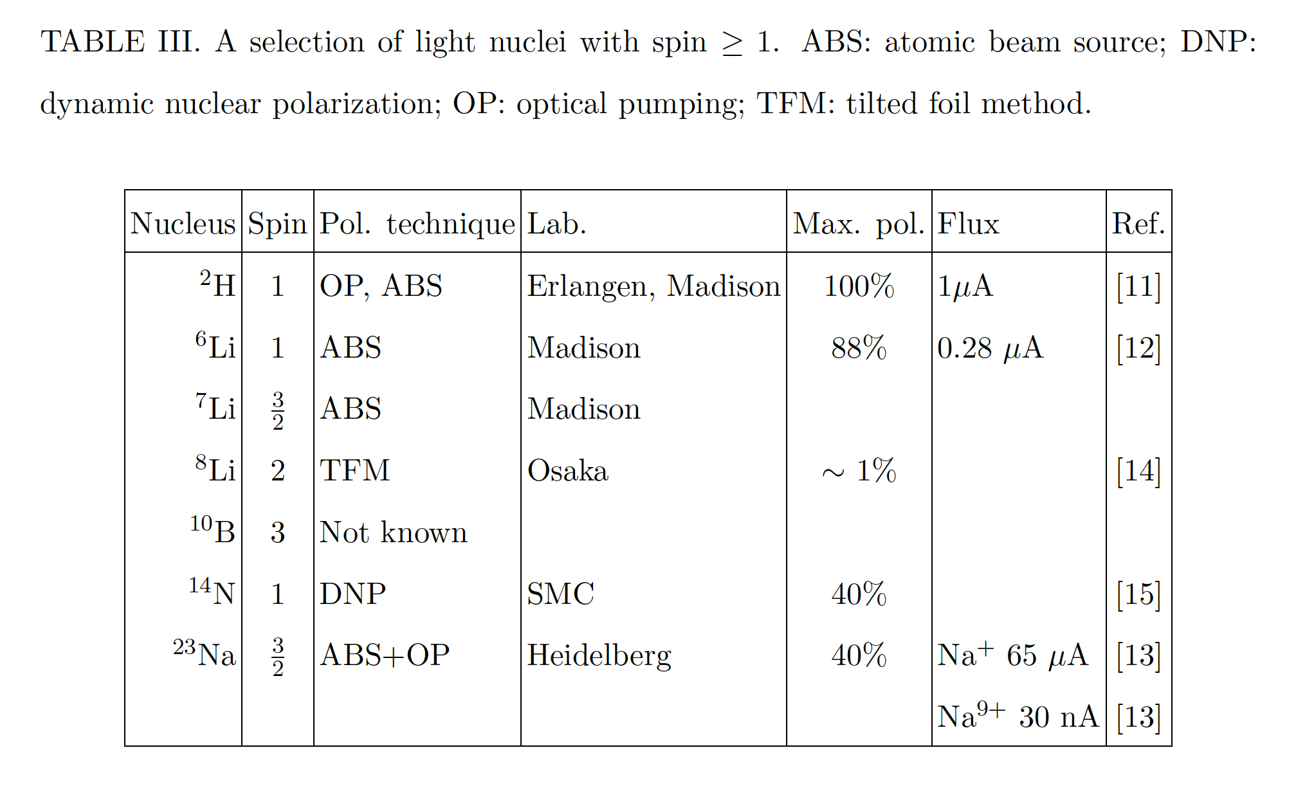
Possible Polarized Ion Beams

Slide 43
Summary
NAS committee strongly endorses EIC science case
“The committee finds that the science that can be addressed by an EIC is compelling, fundamental and timely.”
The development of the science case continues
Polarized light ions offer exciting new scientific opportunities.

