Slide 1
Measuring precisely luminosity at LHC using the ATLAS LUCID: past experience and future plans
Presented at: Forward Physics and Instrumentation from Colliders to Cosmic Rays Workshop
Stony Brook: 17-19 October 2018
by: Marco Bruschi (INFN Bologna, Italy) on behalf of the ATLAS LUCID collaboration

Slide 2
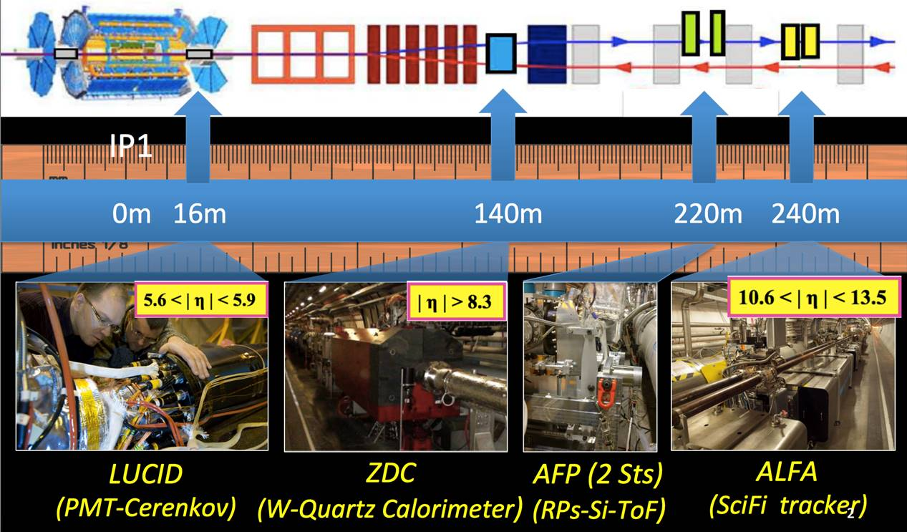
ATLAS and its Forward Detectors
Typical ATLAS measurement with Forward Detectors
•LUCID: Absolute Luminosity
•ALFA: Elastic dσ/dt and σ_{tot} at different Beam Energy (up to 13 TeV)
•AFP: Soft QCD, Hard Diffraction, aQGC
•ZDC: Heavy Ions (event centrality, reaction plane, EM tag)

Slide 3
The luminosity measurement for RUN 2 at LHC
 | RUN 2
Bunch spacing (ns) | 25
Peak lumi (cm⁻²s⁻¹) | ~ 2.1x10³⁴
Bunch spacing → High Speed Readout Electronics
High peak lumi → High occupancy
Luminosity algorithm saturation
Sensitive devices features to be considered:
saturation
lifetime
radiation hardness
Guidelines for the design
A fast readout card deployed close to the detector
A detector with small granularity and dimensions
A robust calibration system to monitor detector stability
G.L. Alberghi et al., Choice and characterization of photomultipliers for the
new ATLAS LUCID detector, 2016 JINST 11 P05014

Slide 4
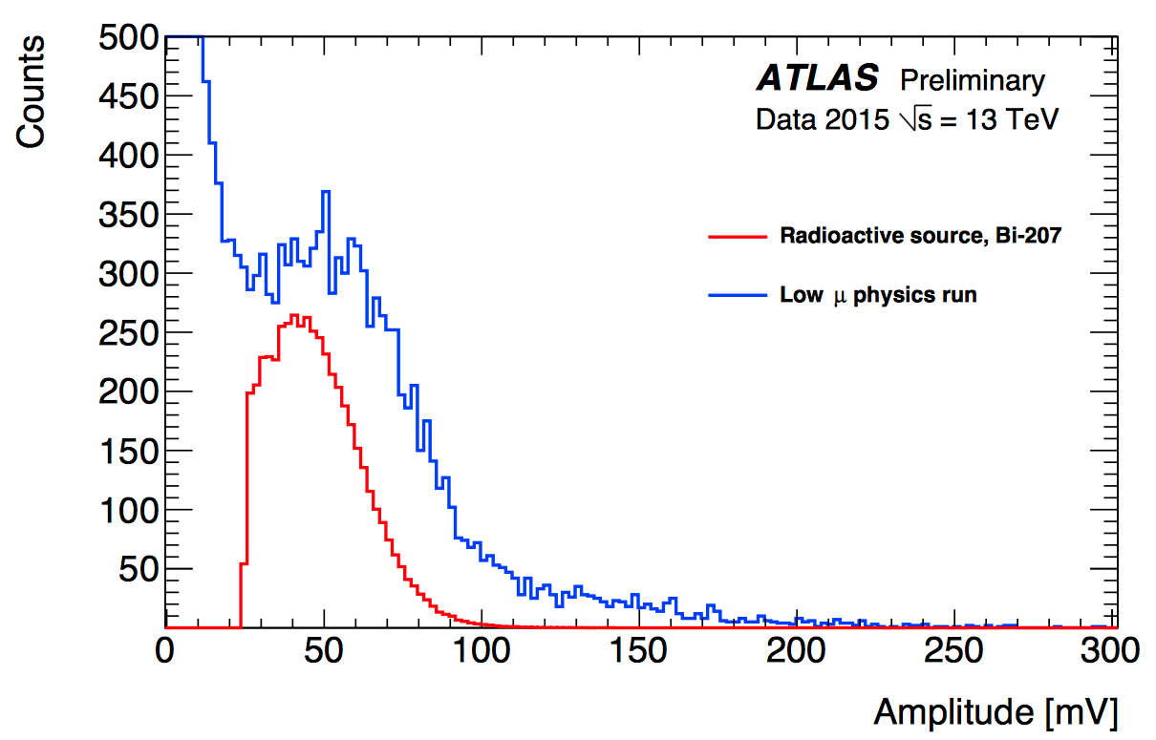
LUCID Detector Principle
μm
(to suppress γ background from the source)
PMT
BASE
HV,
Signal
²⁰⁷Bi source
The PMT quartz window is used as Cherenkov light radiator
The low energy electrons from the Bi source mimic closely the signal from a high energy charged particle (~35 p.e.)
The Bi source has a negligible rate also at the lowest rates foreseen for pp data taking (L~10²⁷/cm²/s)

Slide 5
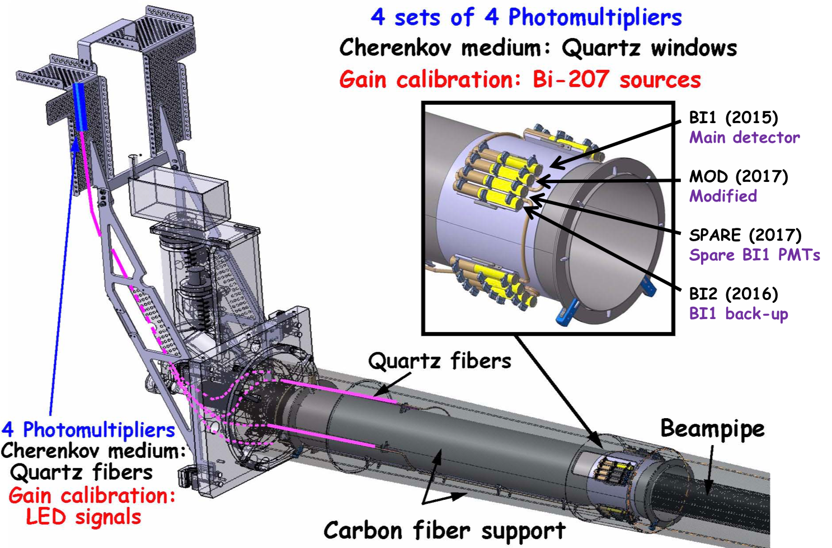
The LUCID-2 Detector in 2018
MOD
G.L. Avoni et al., The new LUCID-2 detector for luminosity measurement and monitoring in ATLAS, 2018 JINST 13 P07017

Slide 6
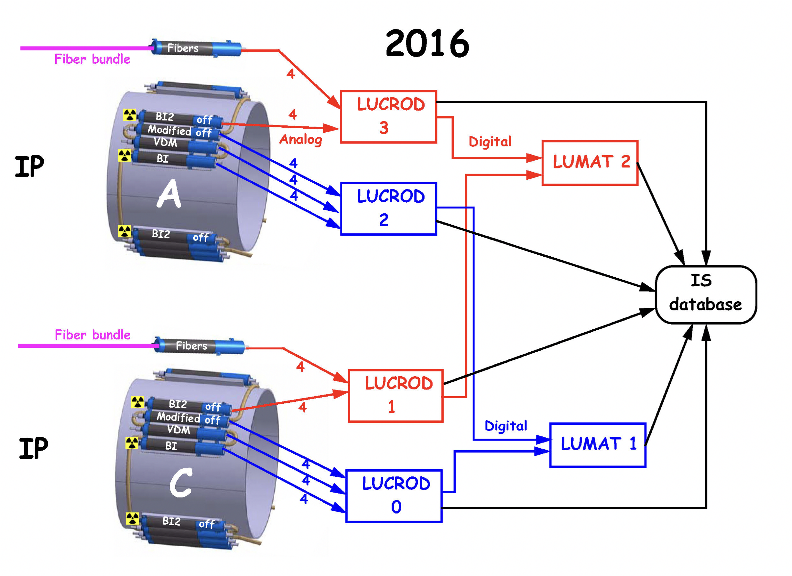
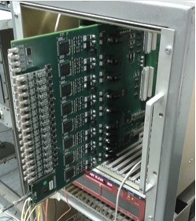
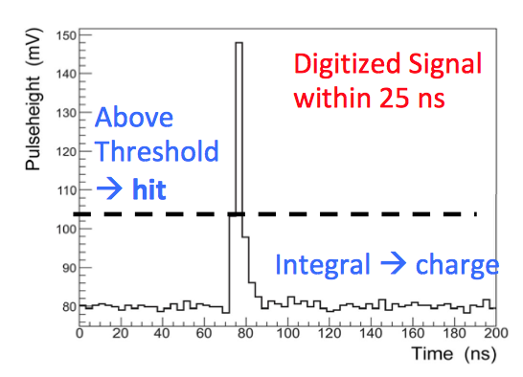
The Readout
LUCROD
Hits: PMT signals amplified, digitized, discriminated
Hits to LUMAT (high speed optical links)
Charge: Signal integrated over 25 ns intervals
Hits and Charges accumulated in FPGA
Digitized signal readout via VME for monitoring and calibration purposes
Occasional SEU recovered using a fully automatized procedure

Slide 7
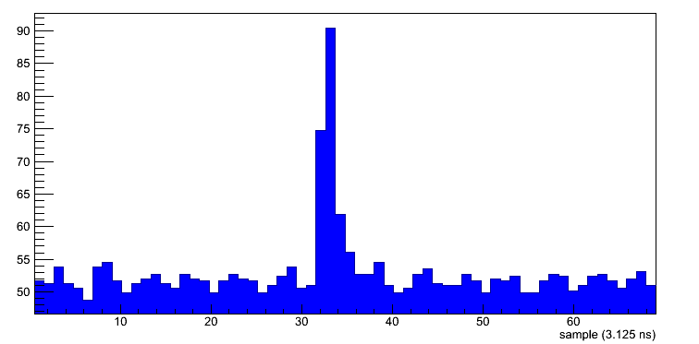
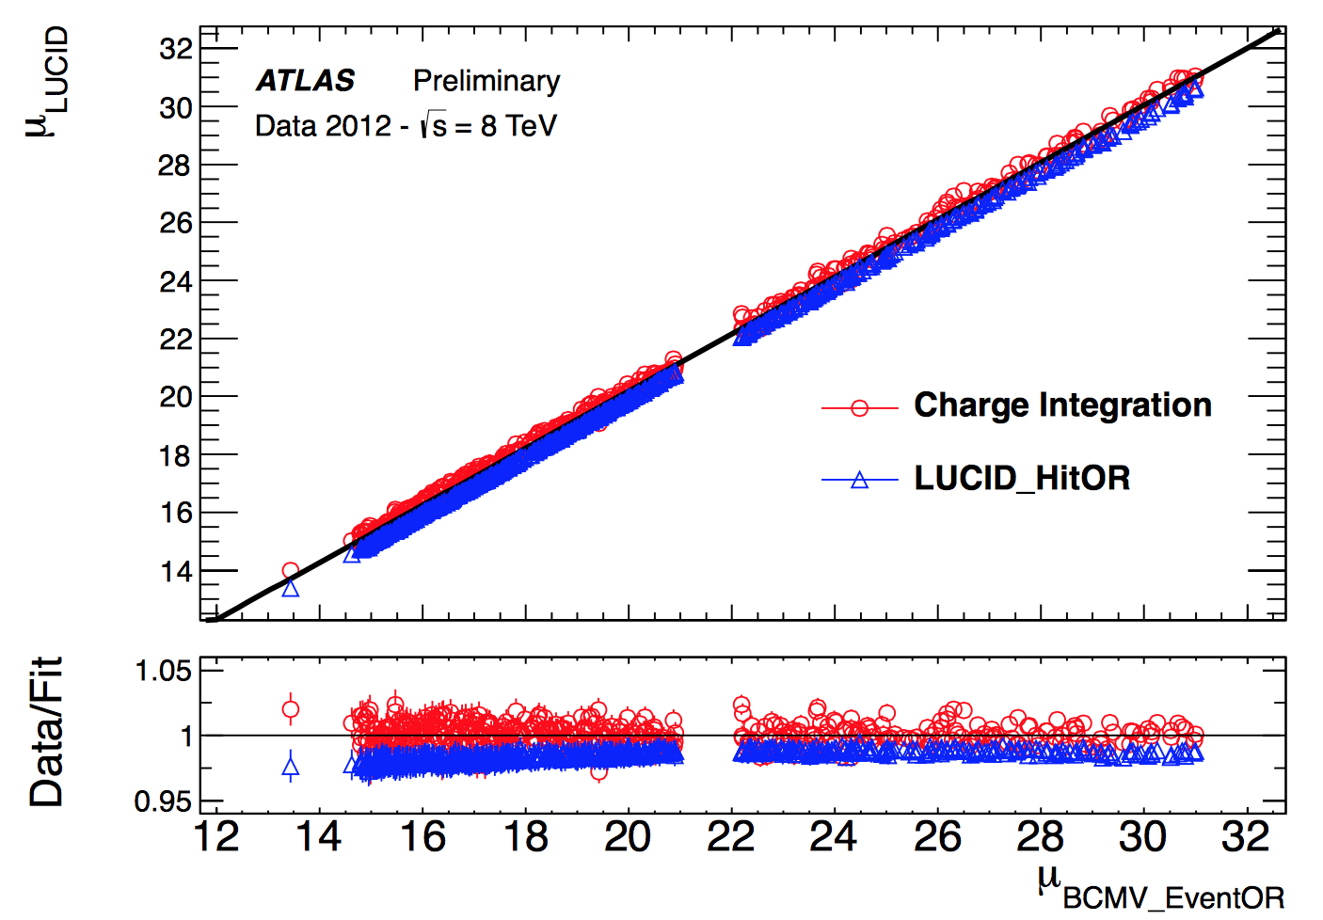
Luminosity measurement Methods
HIT COUNTING (RUN 1 and RUN2)
Count the fraction (f) of pulses above a discriminator threshold (hits)
CHARGE COUNTING (RUN 2)
Measure the charge of the pulse (C)
The Data Taking in RUN 1 has shown the linearity between charge per BC and number of interactions per BC using fibres readout
FADC measurement of PMT pulse
Discriminator
Threshold
Statistical Model dependent
From VDM
Calibration
Samples (3.125 ns)
Statistical Model
independent
Notes:
There are substantially two ways of measuring luminosity implemented in the New Lucid.
The hit counting rate which consists in the counting the fraction of hits, that is the pulses above a discriminator threshold. This is exemplified in the upper figure.
In this case the luminosity per BC depends logarithmically on f and on the so-called visible cross-section, which is the final absolute calibration constant measured with the Van der meer scans. This method has been the main method used in RUN 1 and it will be also adopted in RUN 2. The relation between f and LBC is determined, under certain assumptions, on statistical model and therefore has a systematic uncertainty associated.
Thanks to the newly designed electronics, it will be possible to adopt a new promising method for RUN2. It is based on the fact that the total charge per BC is proportional to the lumi per BC. This relationship does not depend on statistical model and therefore, until the detector is not saturating, is free of statistical uncertainty.
This has been proven on real data already in RUN 1. In the lower plot it is reported the lumi measured by lucid vs the lumi measured by ATLAS with the charge integration method and with the hit counting method. It can be appreciated that the hit or method as a systematic deviation from linearity while the charge methods not

Slide 8
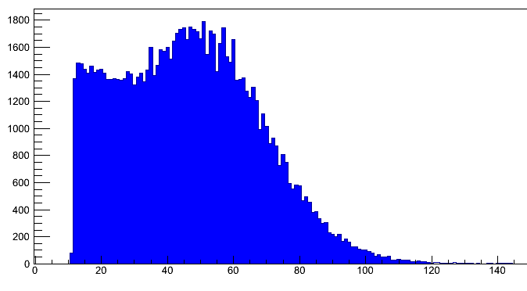
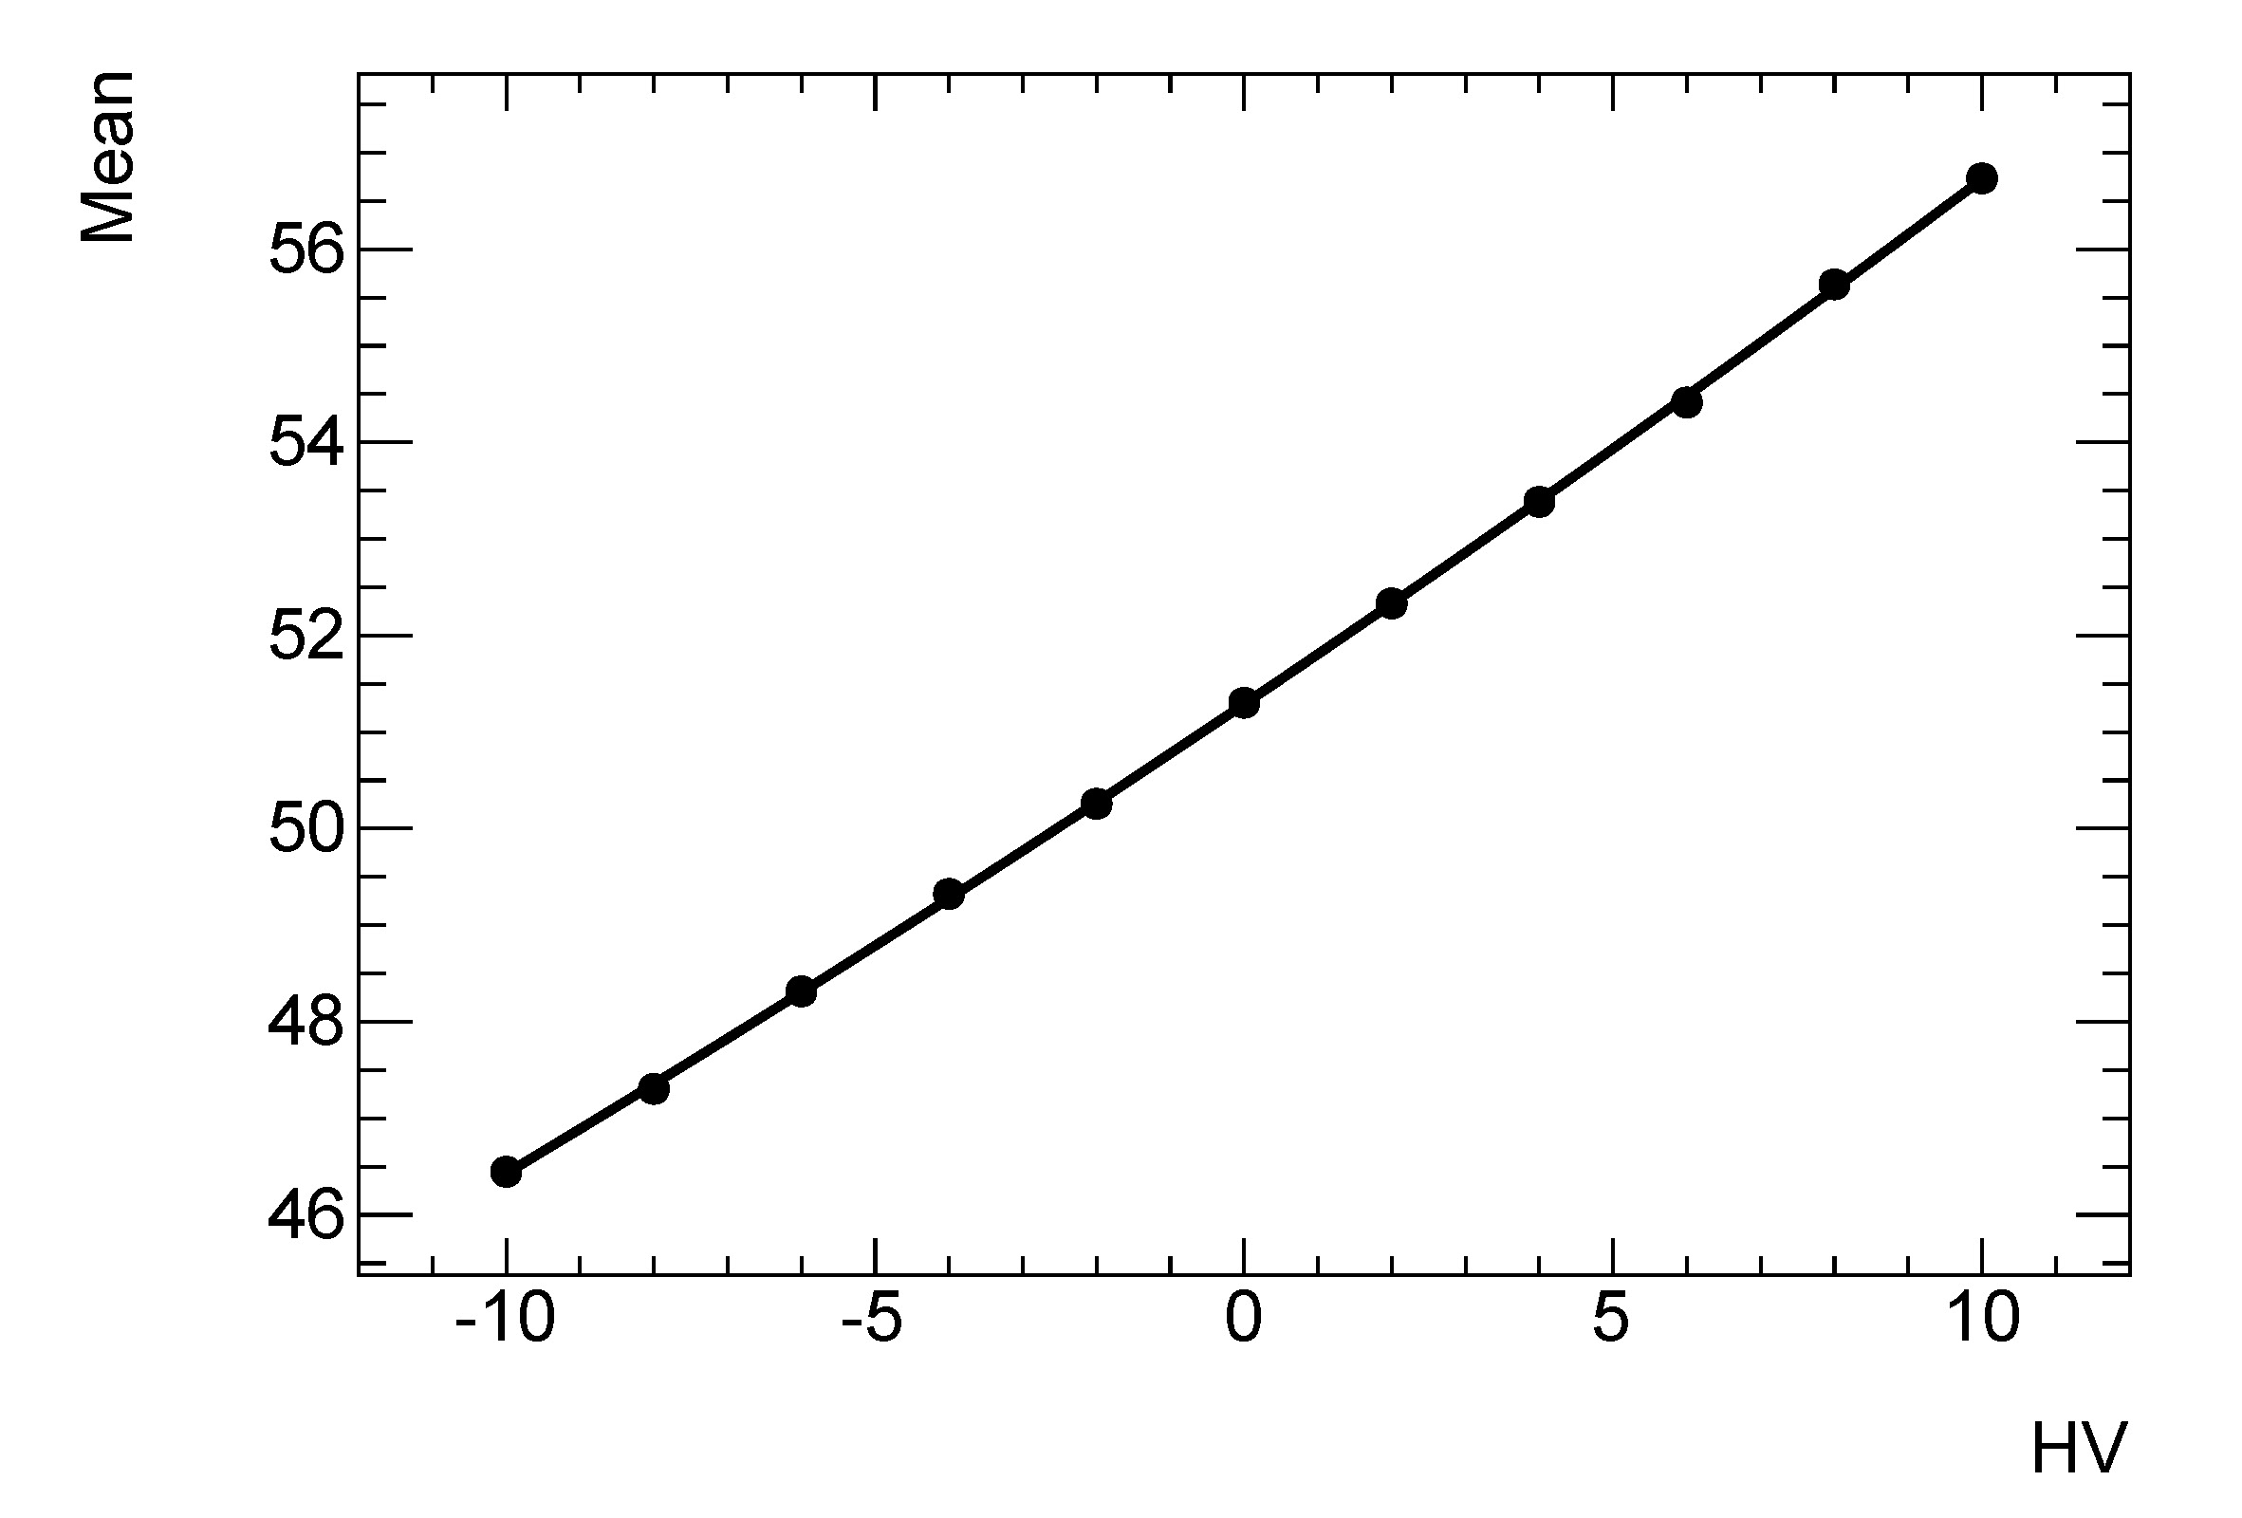
Gain stability monitoring using a ²⁰⁷Bi source
Single ²⁰⁷Bi Signal
A new calibration system based on IC e- from ²⁰⁷Bi has been validated
Single ²⁰⁷Bi signals sampled by the LUCROD
The pulse duration is < 25ns
The measurement of the mean of the amplitude distribution above a preset threshold is a sensitive way of controlling the gain
Better than 1% sensitivity in gain stability
25 ns
Samples (3.125 ns)
Amplitude distribution from ²⁰⁷Bi e⁻
Mean amplitude vs HV change around nominal HV
#
ΔV=1 V → ΔG/G ~ 1.4%
Δ [Volt]
Notes:
The use of Bi207 electron source from IC is quite new and promising. The about 1 MeV electrons from the source have enough kinetic energy in order to completely cross the quartz window and release an amount of photons equivalent to the signal of a high energy particle crossing the same window. This is shown in the bottom left picture, where the amplitude distribution of signals from the source is reported. A nice peak shows up in correspondence of the electrons crossing completely the window.
The upper left plot shows that the calibration signals are well within a BC duration.
The Bottom right plot finally report the stability curve obtained measuring the mean of the amplitude distribution as a function of a few volt variation. It can be appreciated that 1 Volt variation produces a 1.4% variation of the gain.
Preliminary results show that the simple measurement of the mean of the amplitude distribution can monitor the stability of the gain better than at 1% level

Slide 9
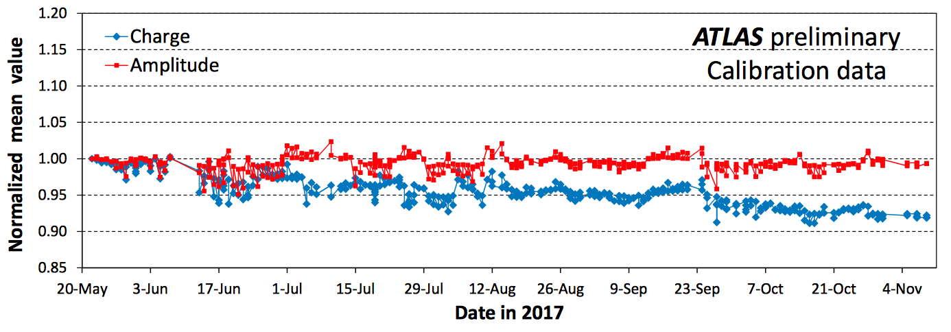
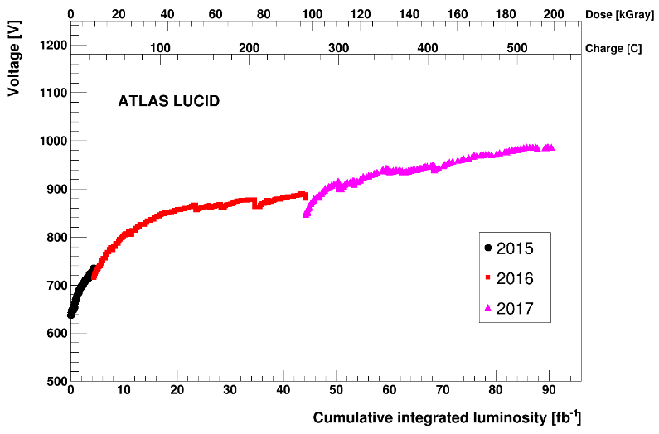
Gain calibration: results
High voltage analysis:
HV increased to compensate for PMT ageing with anodic charge
Annealing observed at each machine stop
Results using mean charge and mean amplitude are different:
Use amplitude for HIT counts
Use charge for CHARGE based algorithms

Slide 10
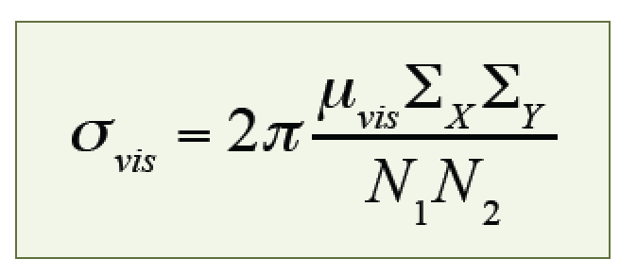
Absolute Luminosity Calibration
The calibration is performed in special LHC machine runs (Van der Meer scans)
low intensity beams are separated in X and Y and the rates measured by the monitors
Symbol | Meaning
μ_{vis} | peak value of the measured # int/BC
Σ_{X}Σ_{Y} | rms value of scan curves
N₁N₂ | number of protons per colliding BC for beam1 and beam2

Slide 11
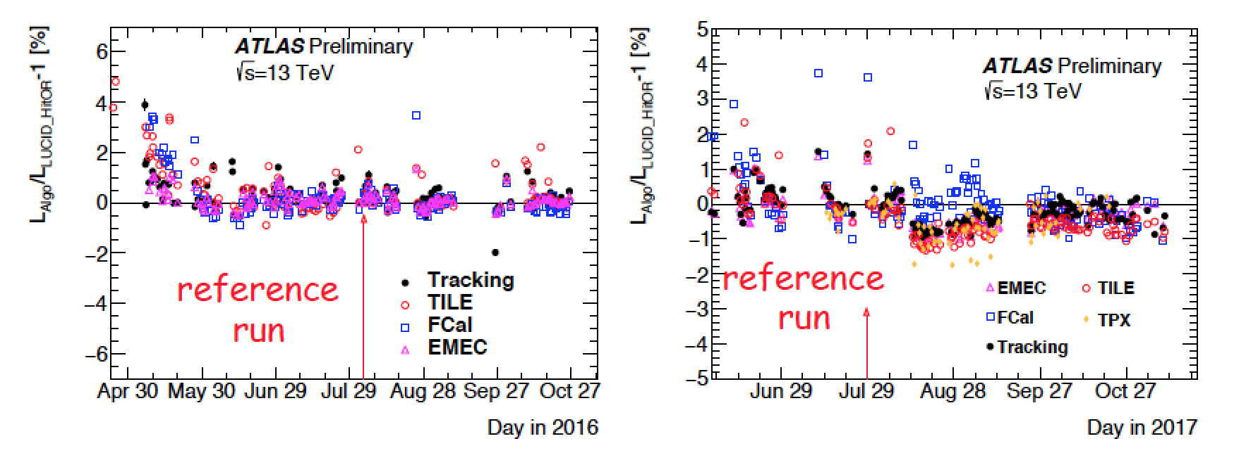
Luminosity measurement precision
HIT counting algorithm (HitOR) corrected offline for non linearity with L using track counting
Other detectors, used to assess the overall stability
Year | Precision (%)
2015 | 2.1
2016 | 2.2
2017 | 2.4 (preliminary)
Long Term
Stability

Slide 12
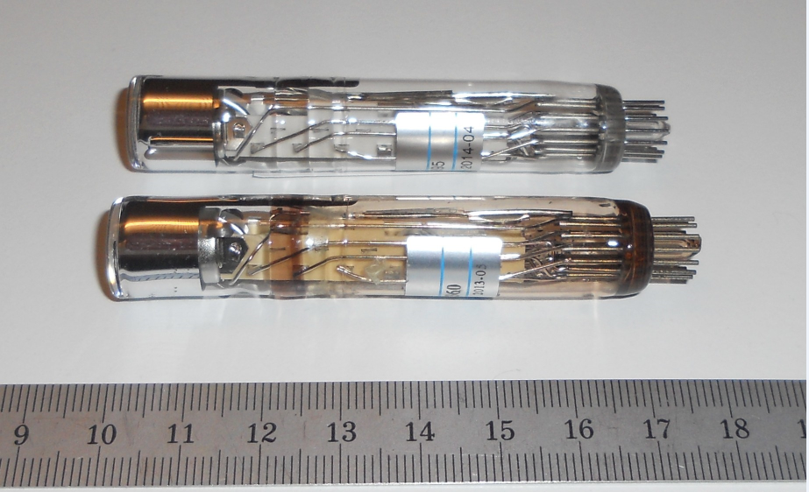
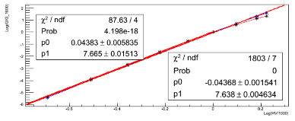
Radiation Hardness
Ionizing dose measured directly during RUN 1 (√(s)=8 TeV): 0.77 kGy/fb⁻¹
Extrapolation for RUN 2 (√(s)≤14 TeV) : < 200 kGy
Neutron flux in RUN 2 (from GCALOR):
<2.6∙10¹⁴ /cm²
BEFORE Irradiation
AFTER Irradiation
Relative Gain Variation
Log(i/i(1000 V))
Irradiation tests at ENEA Casaccia (Rome)
⁶⁰Co source: 200 kGy
1 MeV neutron equivalent fluence: 2.7∙10¹⁴ n/cm²
Source | PMT | α Pre Irr | α Post Irr
γ | R760 Irr | 7.76±0.04 | 7.76±0.04
 | R760 Ref | 7.78±0.09 | 7.79±0.04
n | R760 Irr | 6.01±0.04 | 6.11±0.04
 | R760 Ref | 5.76±0.02 | 5.75±0.04
log(HV/1000 V)

Slide 13
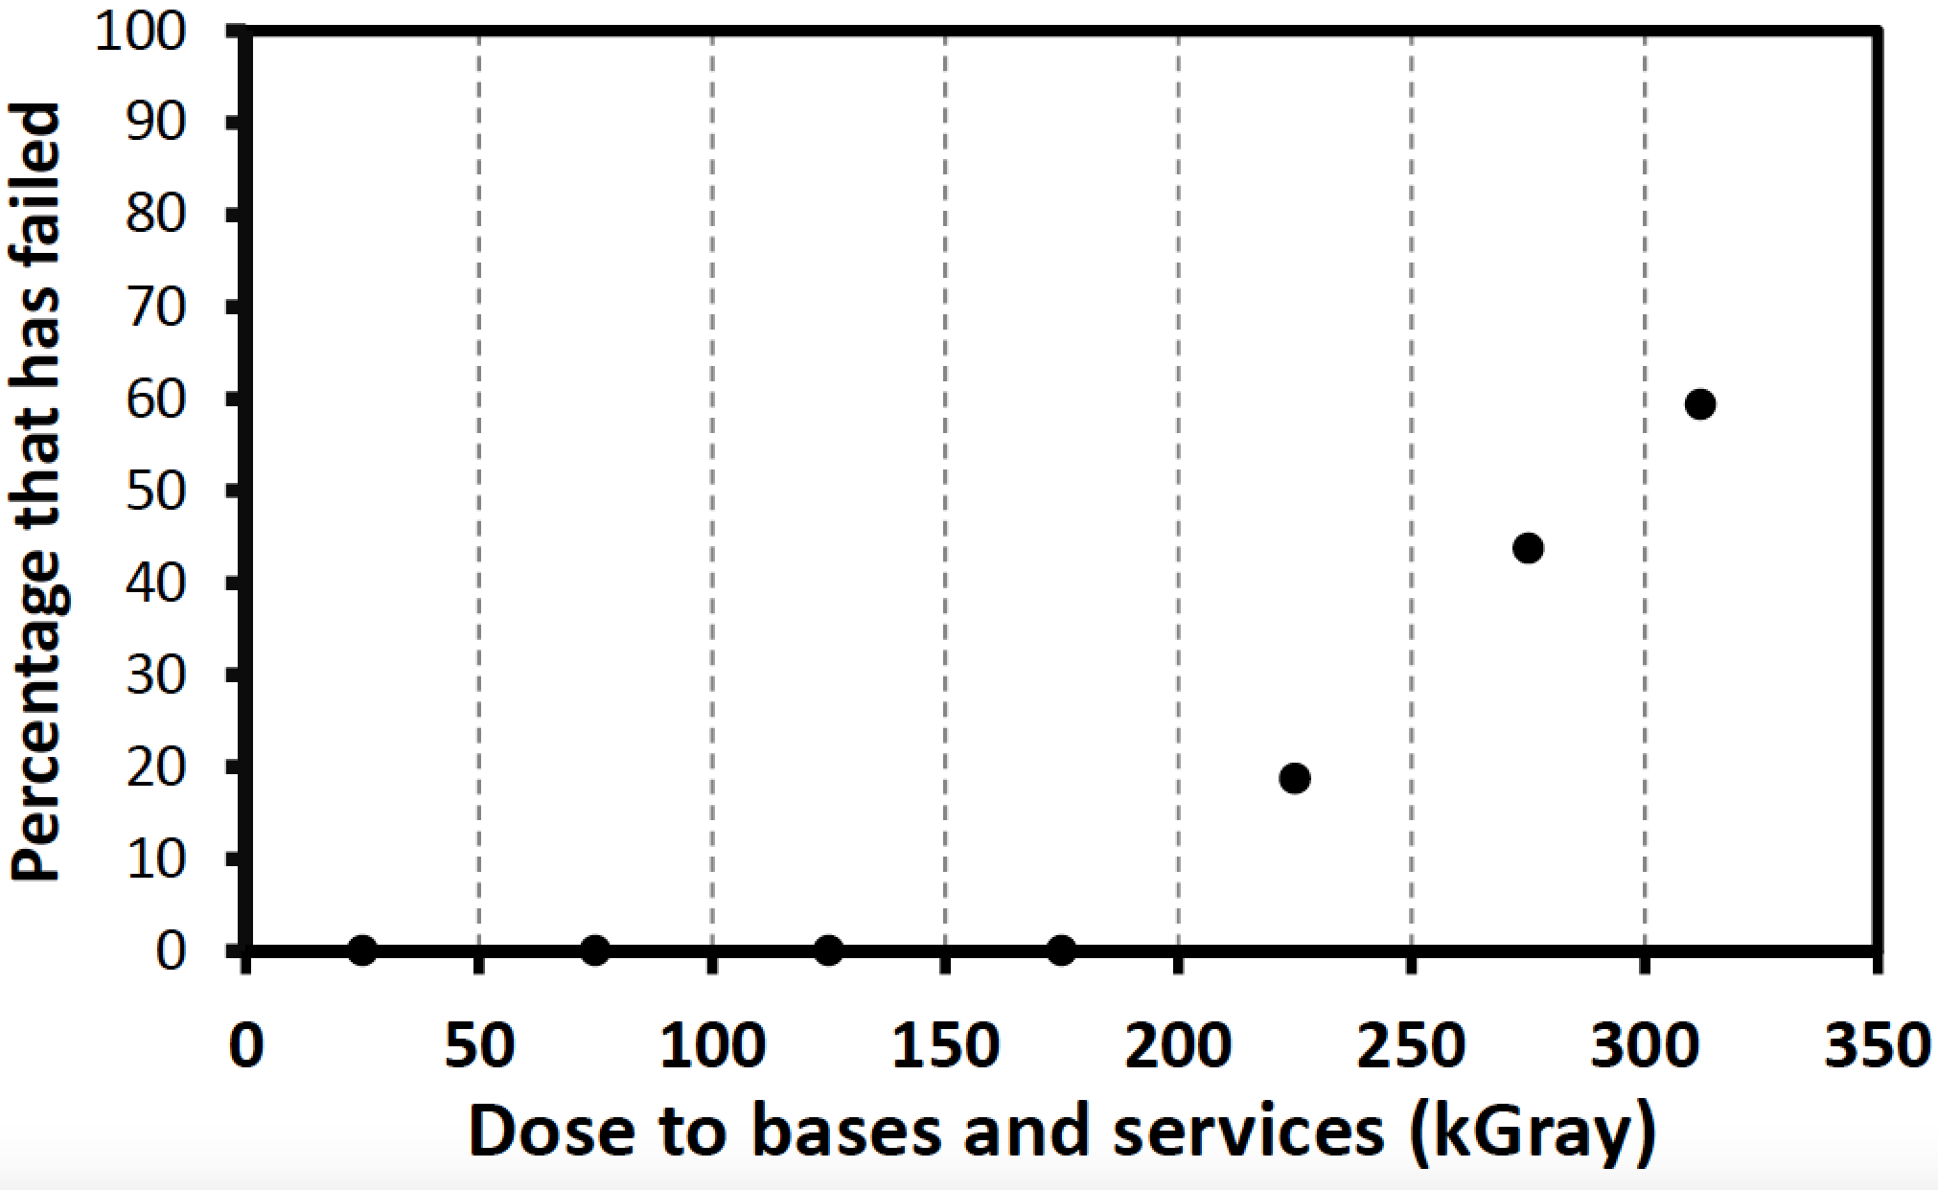
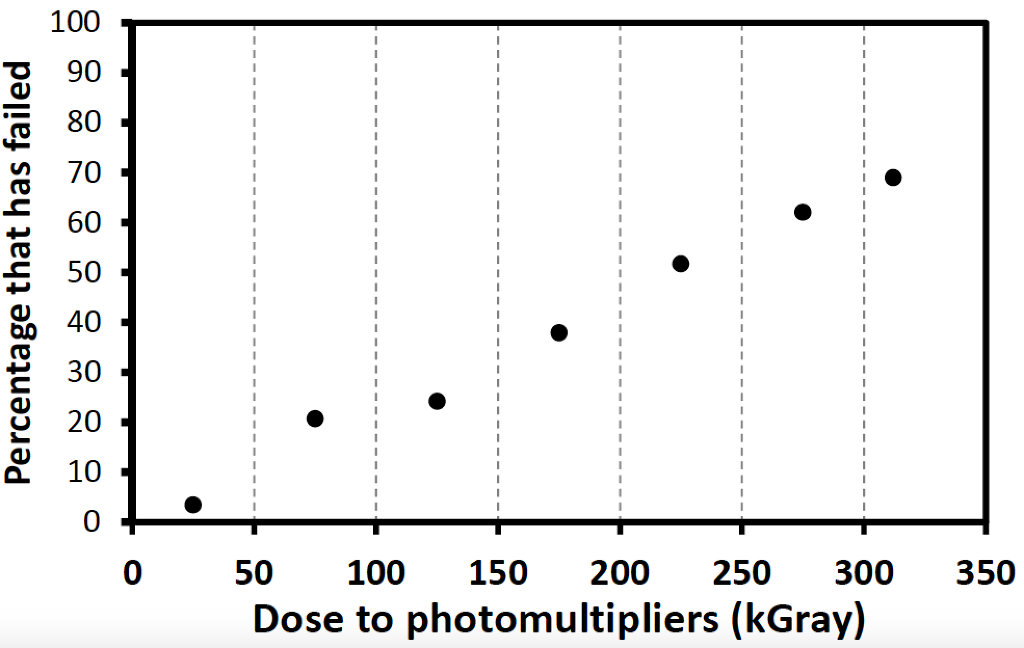
Statistics about channels failure
There is evidence that around 150-200 kGy the number of channels failing increased significantly
NO Fibre channel has failed to date!
Since many of the PMT of the failing ch. were changed at the beginning of 2018, this points to search the cause not in PMT ageing or radiation damage, but in the radiation damage of PMT bases (or cables)
A strategy has been assessed to provide ATLAS with a precise lumi measurement even in case all the PMT will be dead before the end of 2018
In this case fibres with charge algorithms will be used

Slide 14
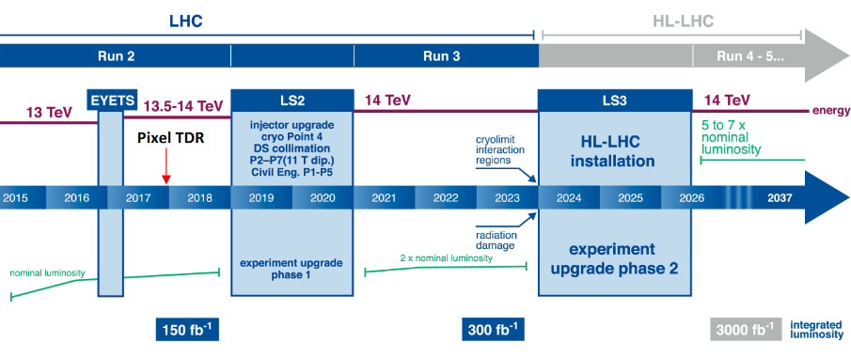
LUCID into the future
Run 3
Issues:
High ∫L, μ similar to RUN 2
Detector components failing at high ∫L
Fiber calibration
Charge integration sensitivity to gain variations
Strategy:
Make Replaceable all PMT+Bases (cables?)
Same electronics system
Development of charge algorithms to avoid saturation
Introduction of prototype systems for HL-LHC
Implement fiber gain-calibration using Bi207
HL-LHC
Conditions:
∫L ~ 3000/fb, μ ∼ 200
Different positioning and geometry required
Strategy:
Bi-calibrated fiber bundles, coupled with photosensitive devices
Charge algorithms
Alternatives under study

Slide 15
Conclusions
LUCID has performed well in RUN2 (2015-2018), being the ATLAS main on/off-line luminosity monitor, thanks to
Construction characteristics → wide L range, stability
Redundancy and flexibility → high reliability
Advanced monitoring system → quick recovery and issue identification
Possibility to measure online luminosity for individual bunch-crossing
Typical precision in lumi determination at LHC in RUN 2: <2.5%
This was accomplished by a totally redesigned detector wrt RUN 1 having NEW
calibration system
readout electronics
monitoring system
Now Planning for RUN 3 and HL-LHC

Slide 16
Backup

