Slide 1


Heavy Flavor Results from LHCb.
With focus on heavy ion collisions.
Cesar Luiz da Silva* for the LHCb collaboration
*Los Alamos National Lab
Forward Physics And Instrumentation From Colliders To Cosmic Rays – SBU 2018

Slide 2
The LHCb Detector
Rapidity: 2<η<5

Slide 3
Rapidity coverage
-7.5<η<-3.5
5.0< η <8.0
The only fully instrumented detector at forward rapidity in LHC.

Slide 4
Heavy Ion Program
- SMOG
Results in PbPb only from UPC. Talk tomorrow.

Slide 5
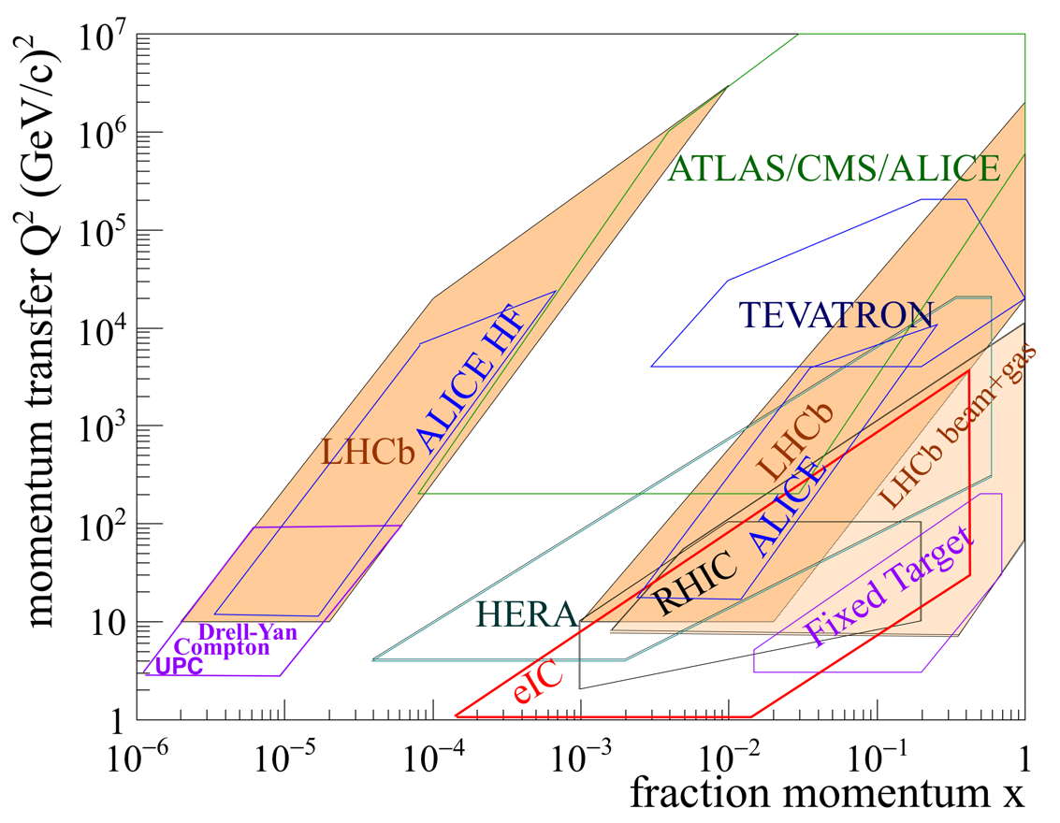
Kinematic Coverage

Slide 6
p+Pb and Pb+p configuration

Slide 7
Fixed Target Program
Inject 10⁻⁷ to 10⁻⁶ mbar nobel gas inside vertex detector cage (part of the beam pipe)

Slide 8
Open Charm and Bottom

Slide 9
Prompt D⁰ in pPb at 5 TeV

Slide 10
Prompt D⁰ in pPb at 5 TeV
JHEP 10 (2017) 090
B. Duclou´e et al., PRD91(2015)114005
Experimental uncertainties smaller than in current nPDFs
Consistent with nPDFs and Color-Glass condensate

Slide 11
Prompt D⁰ in pPb at 5 TeV
B. Duclou´e et al., PRD91(2015)114005
JHEP 10 (2017) 090
Experimental uncertainties smaller than in current nPDFs
Consistent with nPDFs and Color-Glass condensate

Slide 12
Prompt D⁰ in pPb at 5 TeV
JHEP 10 (2017) 090
8 rapidity ranges
Strong enhancement at very backward rapidity, similar to what was seen by PHENIX

Slide 13
LHCb-PAPER-2018-21 arXiv:1809.01404

Slide 14
LHCb-PAPER-2018-21 arXiv:1809.01404
Ratio between charmed baryon and meson
Consistency with nPDFs with a stronger suppression at high p_{T} in forward region
Not much room for coalescence scenarios

Slide 15
LHCb-PAPER-2018-21 arXiv:1809.01404
Ratio between charmed baryon and meson
Consistency with nPDFs with a stronger suppression at high p_{T} in forward region
Not much room for coalescence scenarios

Slide 16
D⁰ in pHe and pAr fixed target
EPJC(2017) 77:1
LHCb-PAPER-2018-021 in preparation
No evidence for enhancement caused by intrinsic charm.

Slide 17
LHCb-CONF-2018-004

Slide 18
Consistency with nPDFs at large Q², where uncertainties are smaller
LHCb-CONF-2018-004

Slide 19
LHCb-CONF-2018-004
Baryon/meson ratio doesn’t change from pp at forward rapidity
Large fluctuation at backward rapidity

Slide 20
Quarkonia

Slide 21
Agreement between data, nPDFs and CGC at forward rapidity
Suppression at backward rapidity contrast with enhancement of open charm, indicating the breaking of charmonia with comoving particles

Slide 22
JHEP03(2016)133
PRC95, 034904 (2017)
ψ(2S) state has stronger suppression than J/ψ
Difference depends on local particle density

Slide 23
LHCb-PAPER-2018-035 to be submitted

Slide 24
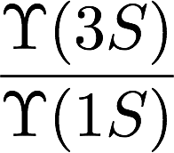
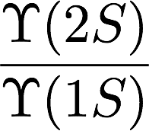
LHCb-PAPER-2018-035 to be submitted
Upsilon states are broken by comoving particles at backward rapidity, where particle densities are higher.

Slide 25
Conclusions
Heavy flavor yields are well described by nPDFs and CGC(when applicable) in general
No evidence of charmed baryon enhancement from coalescence
No evidence of valence-like intrinsic charm at large-x for now
suppression of J/Ψ and stronger suppression of excited state charmonia and bottomonia indicates that quarkonia is affected by comoving particles
Comoving effect stronger at backward rapidity caused by the larger particle density
Much more results to be analyzed: 𝝌_{C} may come next

Slide 26
BACKUP SLIDES

Slide 27
a different baryon/meson ratio at mid-rapidity ?

