Slide 1
Hadronic and Nuclear Interactions in Particle Astrophysics
Anatoli Fedynitch
Deutsches Elektronen Synchrotron (DESY)
Zeuthen, Germany

Slide 2
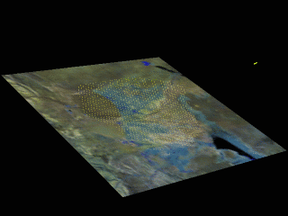
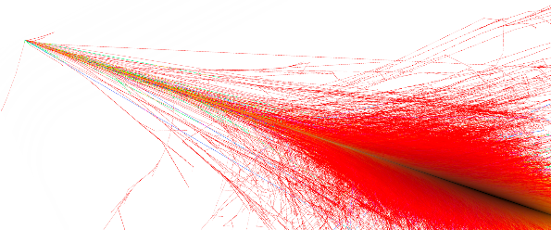
Cosmic Ray interactions with the atmosphere
Multi-messenger picture (hope)
No formal theory → artful
combination of different methods
radiation model
Source model and distribution
transport/propagation model
Physics of astrophysical neutrino sources = physics of cosmic ray sources
Interactions
with Earth
Nuclei
2

Slide 3
Extragalactic accelerators
Blazar TXS 0506+056 (DESY/Science lab)
NGC 253 (Hubble, NASA)
Radiation dominated environments (e.g. Blazars)
Usually compact sources (size vs. energy density)
Photo-hadronic/-nuclear interactions
Typical interaction energies $\sqrt{s}∼20−200$MeV
Not clear if high-energy radiation is hadronic ($π^{0})$
Matter dominated environments (Starburst galaxies)
Extended sources (no so high radiation density)
Likely hadronic interactions, pp, GeV – PeV (lab)
Likely not the sources of UHECR but can be “hosts”
Mixture of different accelerators (Supernovae, Pulsars, etc.)

Slide 4
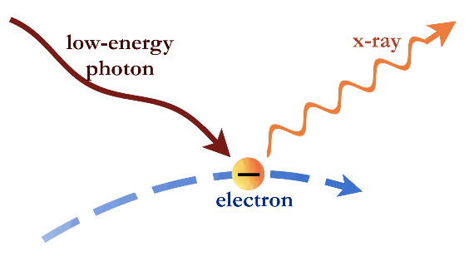
High-energy universe and photo-hadronic physics (0th order)
Photo-hadronic interactions of CR
γ
Trace many things
Neutrino emission
CR
ν
Photon emission
Trace cosmic accelerators
Trace interactions of accelerated baryons
GW?
Most of the radiation is EM ☹
Trace cosmic nuclear fusion factories?

Slide 5
Why does photo-nuclear physics matter?
How often does a nucleus/particle in a source interact?
Real photon energy in nucleus rest frame
high energy CR nucleus
x
“low” energy photon
=
photo-nuclear physics in MeV – GeV range
Depends on target photon field n_{γ}
n_{γ} isotropic in shock rest frame
σ_{j}^{abs} from nuclear models or parametrizations
j = p, n, α, … ¹²C, ...⁵⁶Fe
(Photon energy in nucleon rest frame)

Slide 6
Photo-nuclear models
Measured GDR cross sections (EXFOR db: red & yellow) and used in our calculations (blue)
Processes that matter in CR astrophysics
pions
free nucleons
remnants
de-excitation γ
light fragments
Very few measurements of pion production off nuclei above threshold <~1 GeV
Extremely few measurements of fragment yields (p, n, He)
No clear theoretical path. Measurements crucial
Boncioli, AF, Winter, Nat.Sci.Rep. (2017)

Slide 7
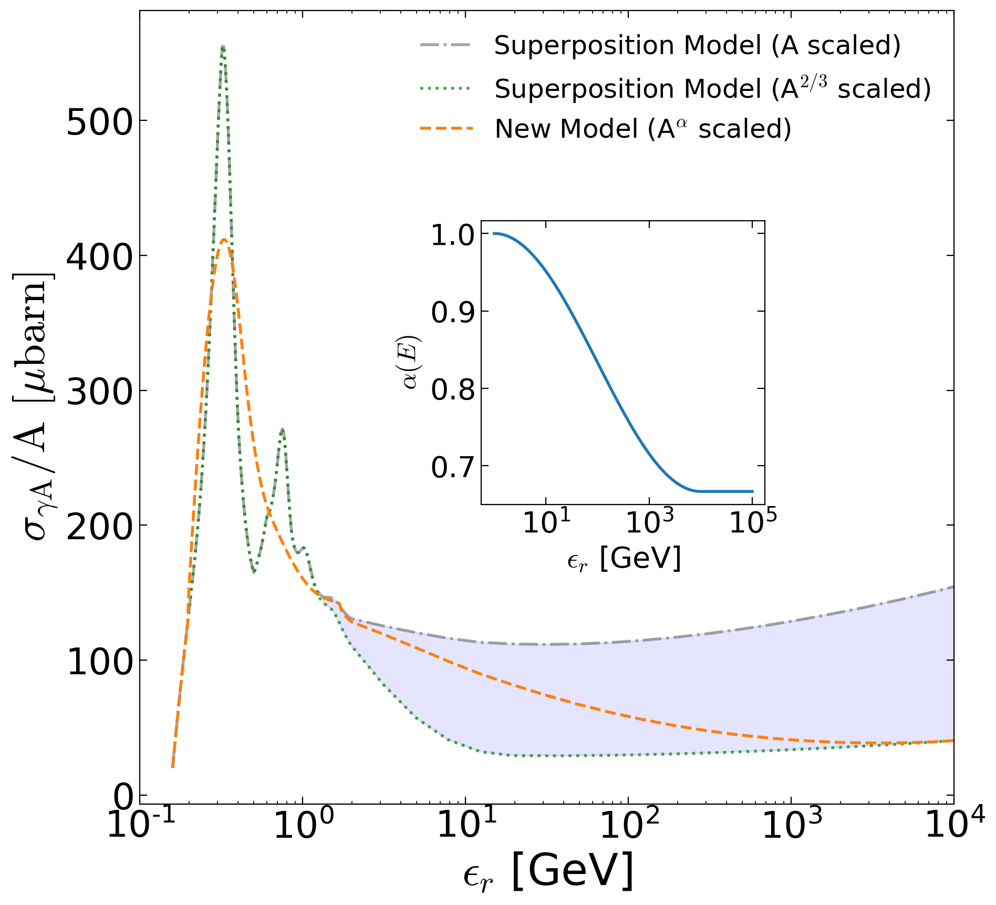
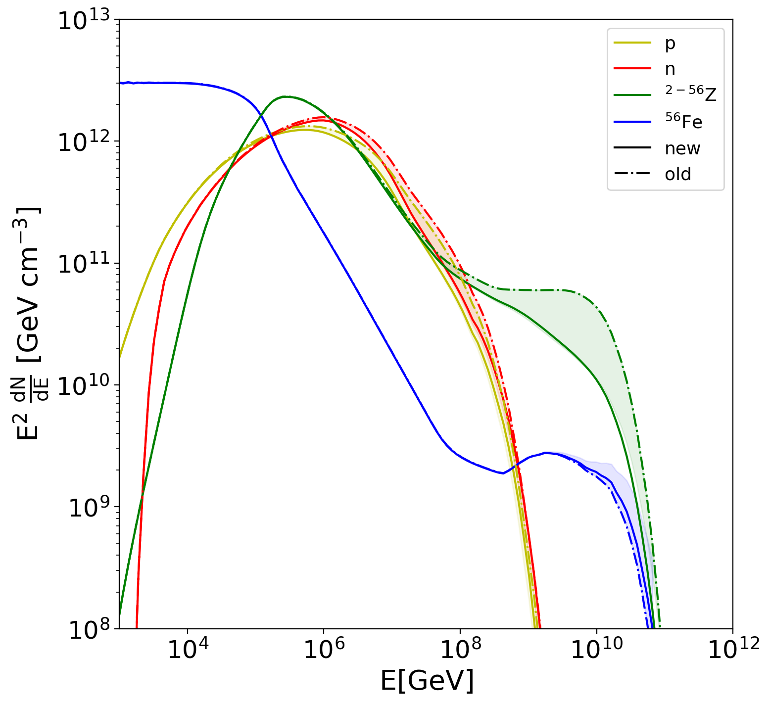
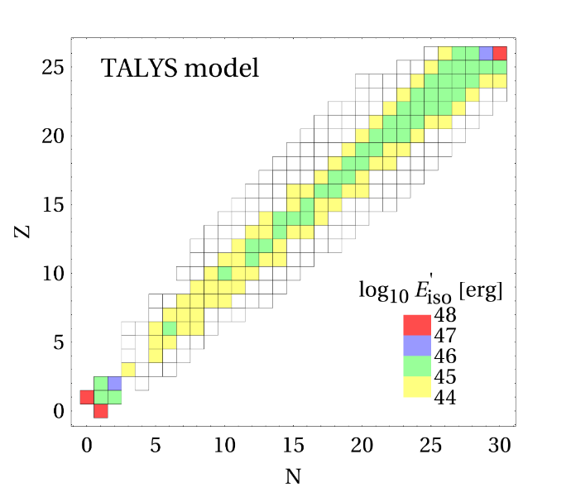
High energy γ-A cross sections in source physics
Extrapolation of γ-A cross section
In-source CR densities (TDE)
Astrophysical neutrino emission
Nuclear cascades
No measurements of total or inelastic γ-A cross sections above 3.5 GeV, and very few below that energy
Unclear how to re-scale pγ behavior with nuclear mass
For astrophysics only “simple” observables valuable, interaction cross sections, inclusive fragment yields, remnant mass distributions in boosted frame of the nucleus. No spectra or angular distributions needed.
Future opportunities at EIC?
Morejon, AF, Boncioli, Winter, in prep. (TeVPa 2018)

Slide 8
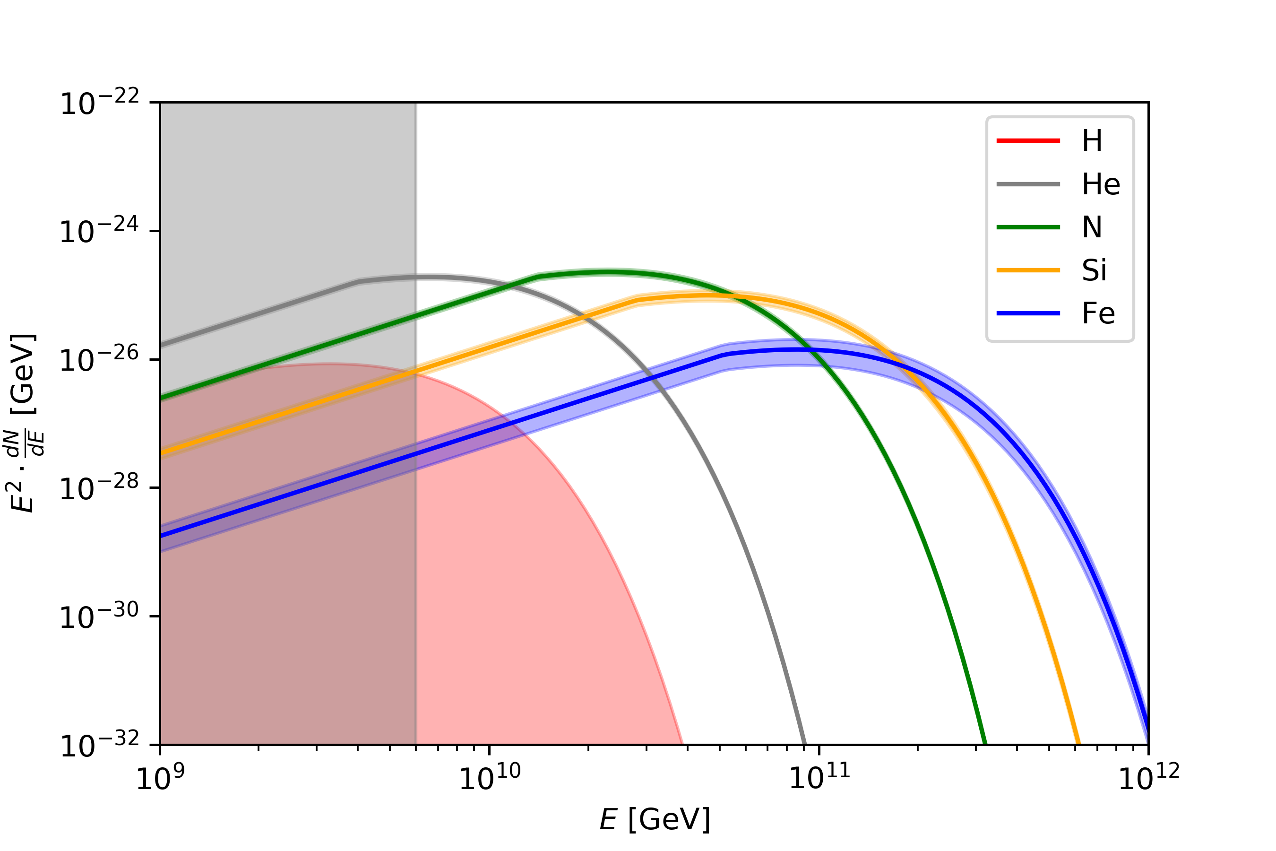
UHECR interactions with the intergalactic medium
Rigidity dependent accelerator
Expectation: features in UHECR spectrum come from propagation through intergalactic medium
Assumption: there is one dominant source type, accelerating nuclei according to their rigidity (~Z)
Spectrum:
Source density evolution:

Slide 9
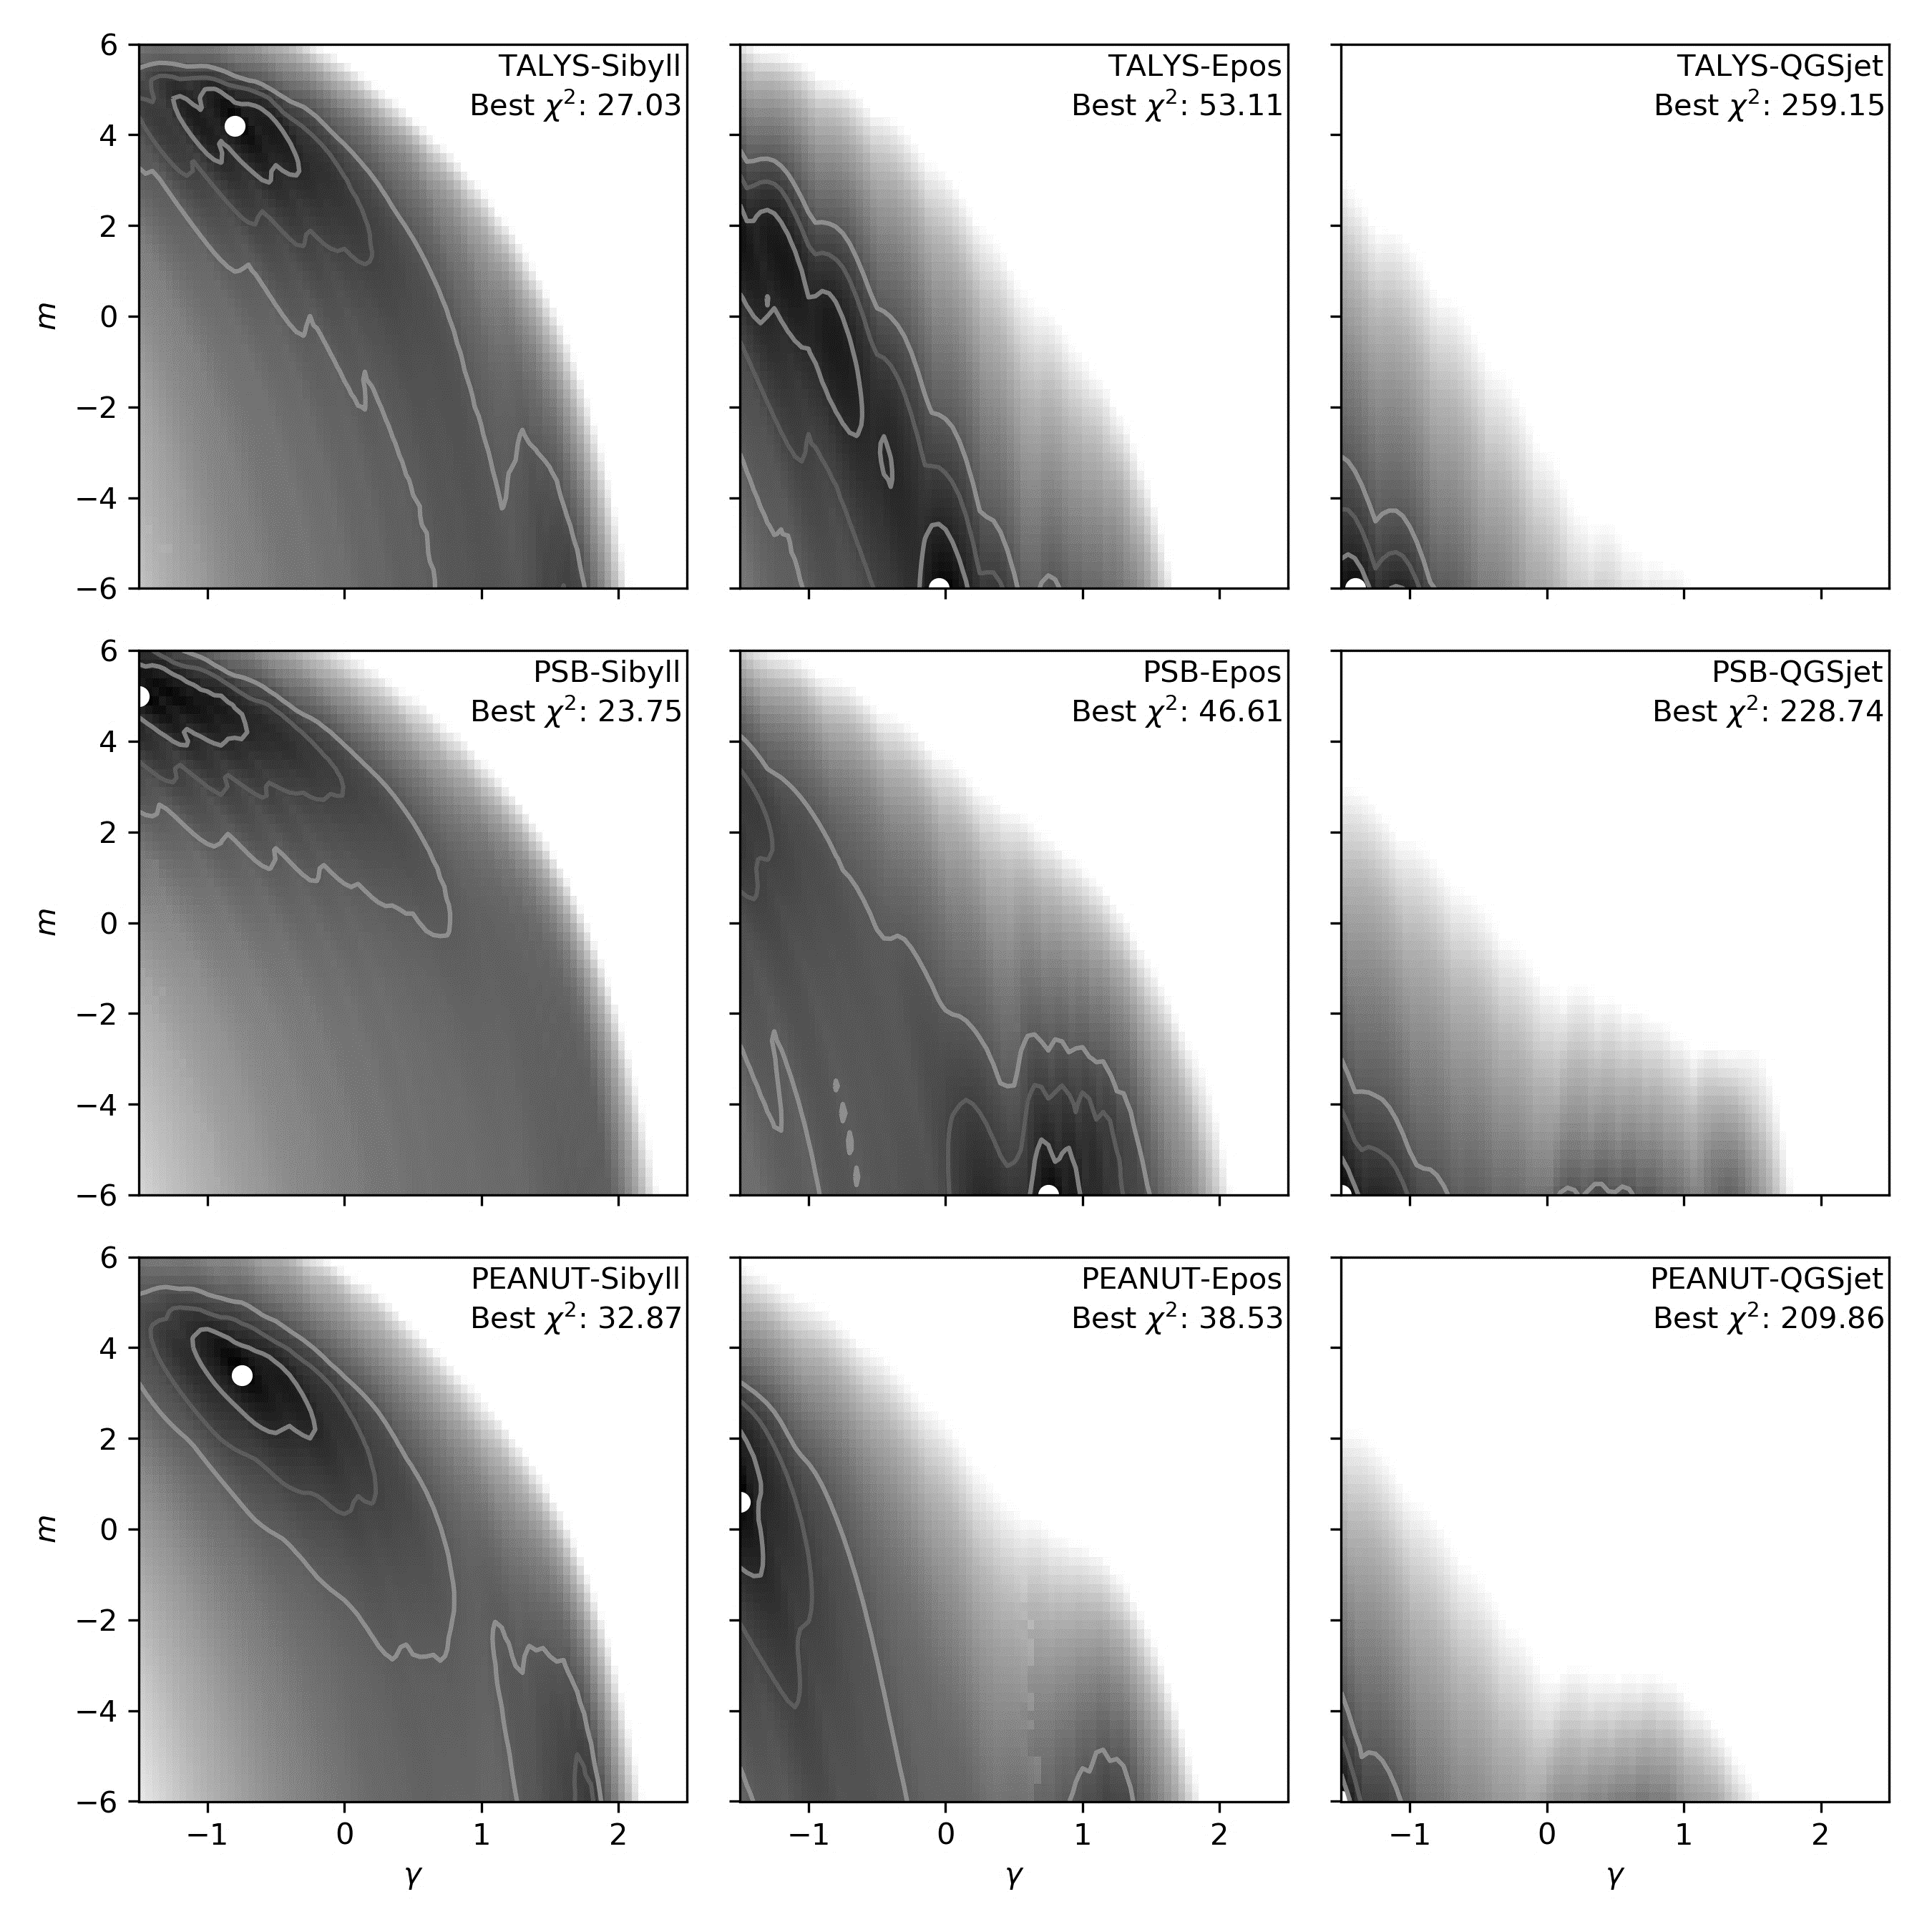
Model dependence of the Fit
Compared in $γ−m$ space
Sibyll 2.3
Epos-LHC
QGSjet-04 II
Disintegration model
Qualitatively similar fits
PSB: Ligher masses at source
Peanut/Talys: Heavier masses at source
Shower model
Epos-LHC: Two distinct minima avoids disintegration
Sibyll 2.3: Larger allowed space prefers disintegration
QGSjet 4 II: Overall rather bad fit
$χ^{2}:27.$0
$$χ^{2}:53.1$$
$χ^{2}:259.$1
Talys
$$χ^{2}:23.8$$
$χ^{2}:46.$6
$$χ^{2}:228.7$$
Photo-nuclear physics from prev. slides
PSB
$$χ^{2}:32.9$$
$$χ^{2}:38.5$$
$$χ^{2}:209.9$$
See also: Auger Collaboration JCAP02(2013)026
Auger Collaboration JCAP04(2017)038
Peanut
Jonas Heinze,
AF, D. Boncioli, W. Winter, in prep.

Slide 10
Model dependence of the Fit
Hadronic physics at detection
Compared in $γ−m$ space
Sibyll 2.3
Epos-LHC
QGSjet-04 II
Disintegration model
Qualitatively similar fits
PSB: Ligher masses at source
Peanut/Talys: Heavier masses at source
Shower model
Epos-LHC: Two distinct minima avoids disintegration
Sibyll 2.3: Larger allowed space prefers disintegration
QGSjet 4 II: Overall rather bad fit
$χ^{2}:27.$0
$$χ^{2}:53.1$$
$χ^{2}:259.$1
Talys
$$χ^{2}:23.8$$
$χ^{2}:46.$6
$$χ^{2}:228.7$$
PSB
$$χ^{2}:32.9$$
$$χ^{2}:38.5$$
$$χ^{2}:209.9$$
See also: Auger Collaboration JCAP02(2013)026
Auger Collaboration JCAP04(2017)038
Peanut

Slide 11
Model dependence of the Fit
Compared in $γ−m$ space
Sibyll 2.3
Epos-LHC
QGSjet-04 II
Density evolves like Stars, Galaxies, Supernovae
Disintegration model
Qualitatively similar fits
PSB: Lighter masses at source
Peanut/Talys: Heavier masses at source
Shower model
Epos-LHC: Two distinct minima avoids disintegration
Sibyll 2.3: Larger allowed space prefers disintegration
QGSjet 4 II: Overall rather bad fit
$χ^{2}:27.$0
$$χ^{2}:53.1$$
$χ^{2}:259.$1
Talys
Accuracy at detection, i.e. interpretation of mass composition is more relevant. Hadronic interaction models need to become better!
$$χ^{2}:228.7$$
$$χ^{2}:23.8$$
$χ^{2}:46.$6
PSB
Few local sources, or intermediate mass black holes
$$χ^{2}:32.9$$
$$χ^{2}:38.5$$
$$χ^{2}:209.9$$
See also: Auger Collaboration JCAP02(2013)026
Auger Collaboration JCAP04(2017)038
Peanut

Slide 12
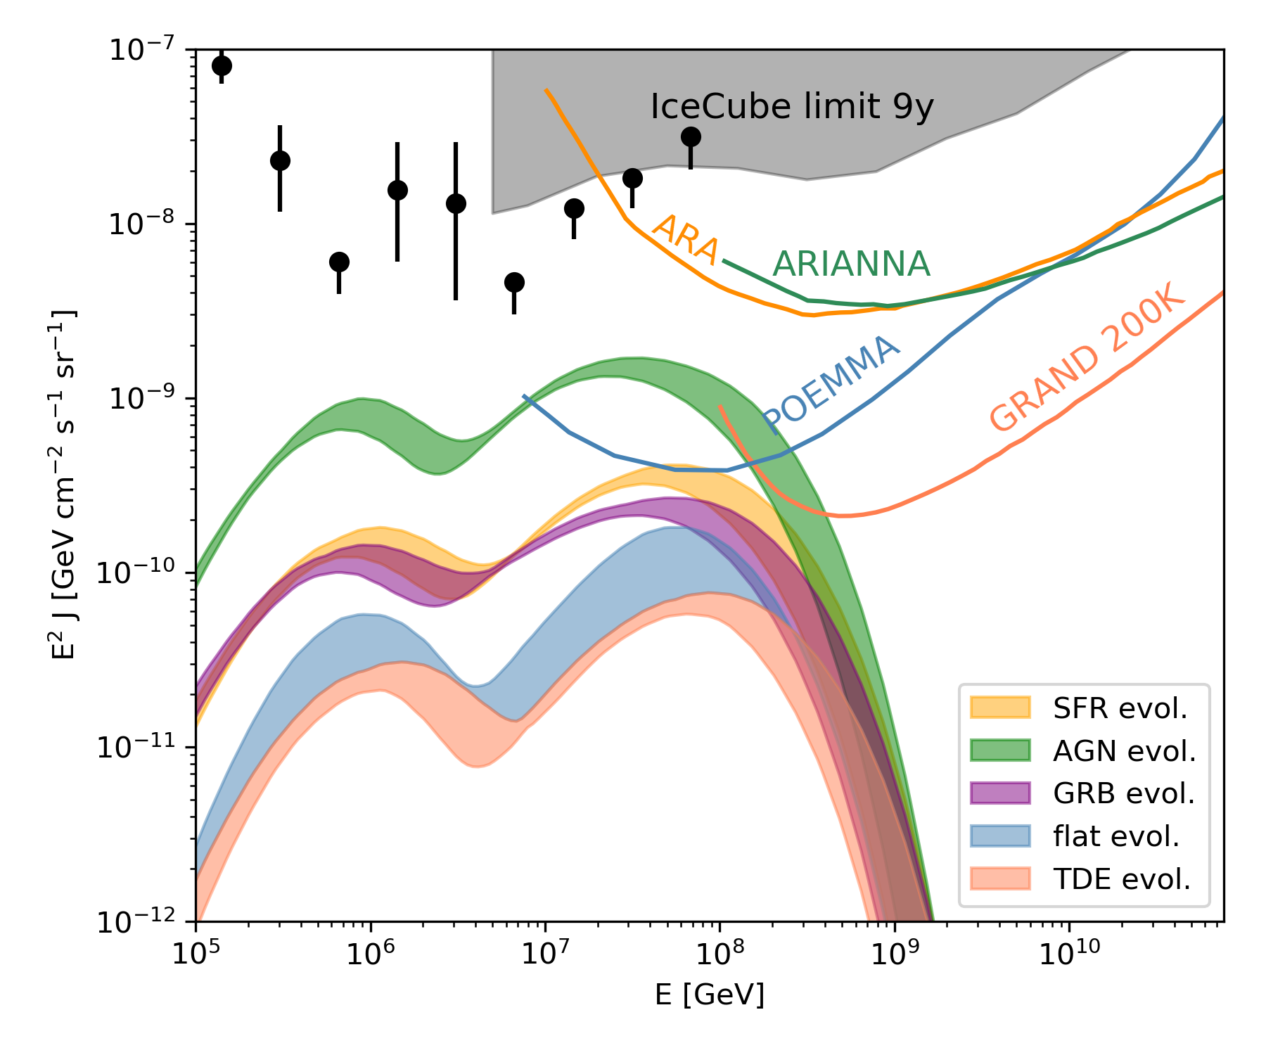
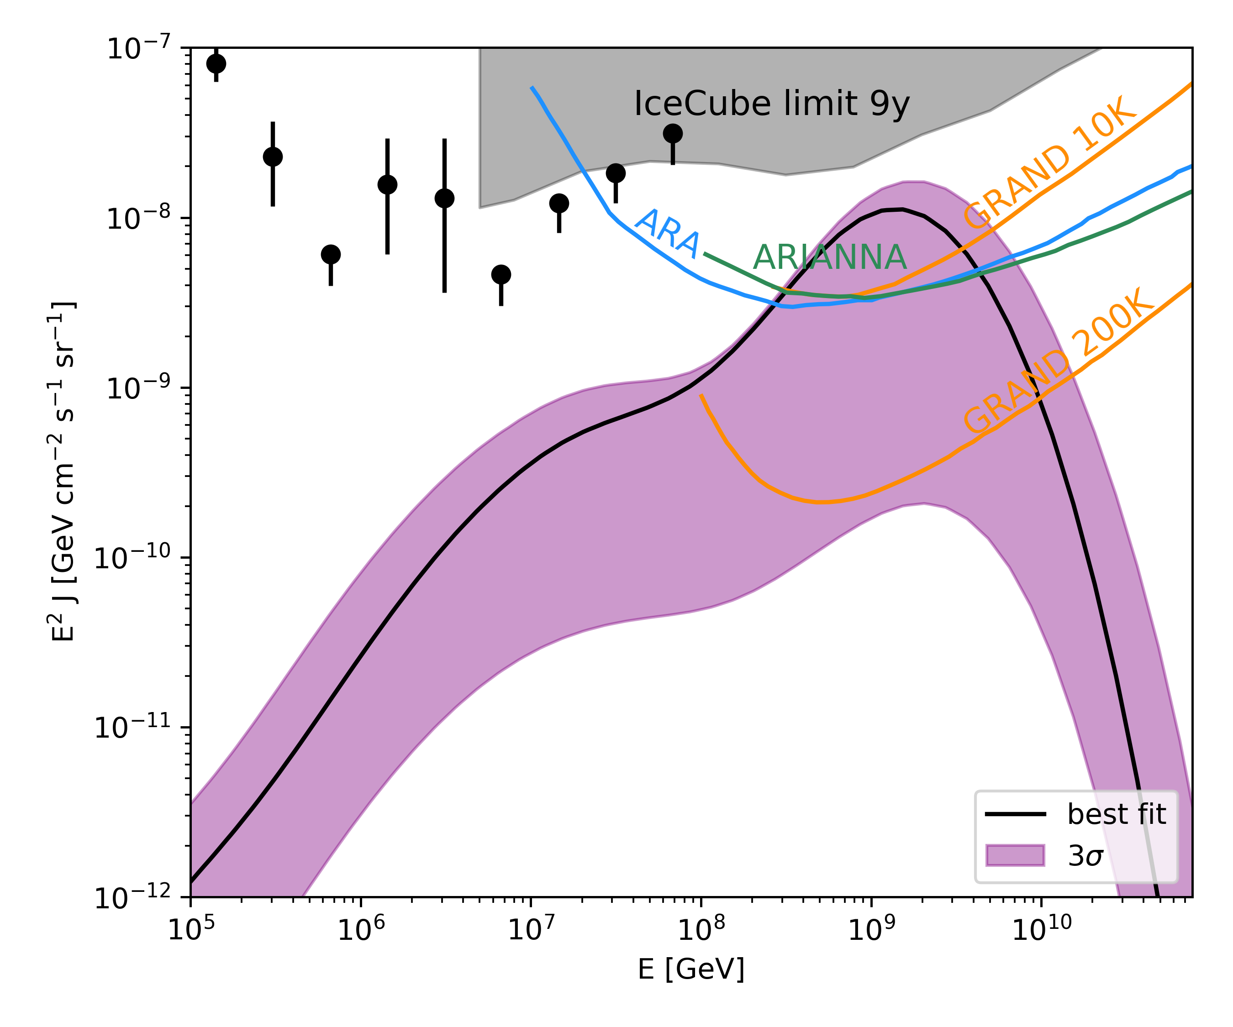
Future neutrino experiments optimized for protons?
Expensive future experiments)
Expected neutrino flux from interactions of UHECR nuclei
If UHECR were protons…
Different source types
Future neutrino experiments will all miss the required sensitivity and energy, if UHECR are nuclei

Slide 13
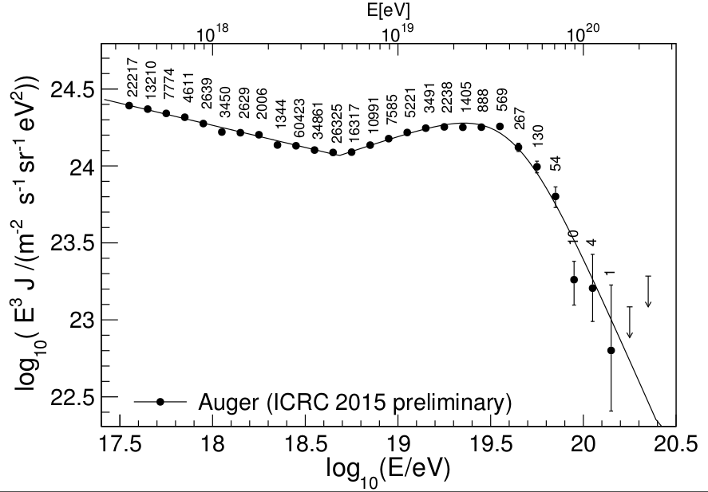
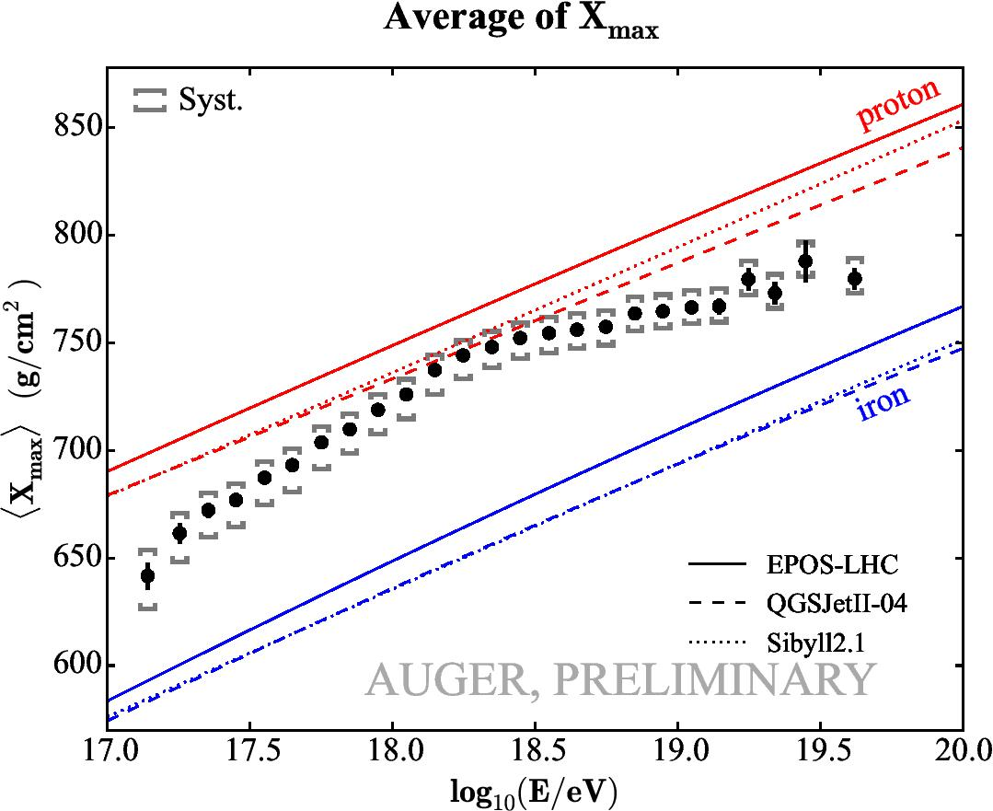
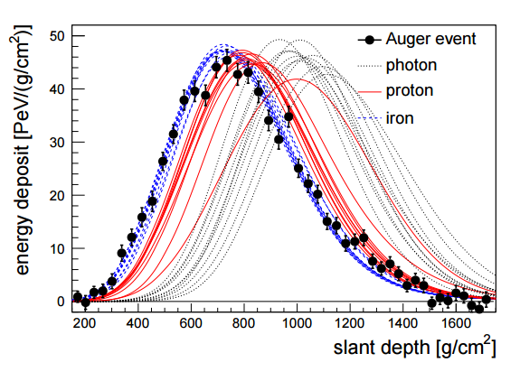
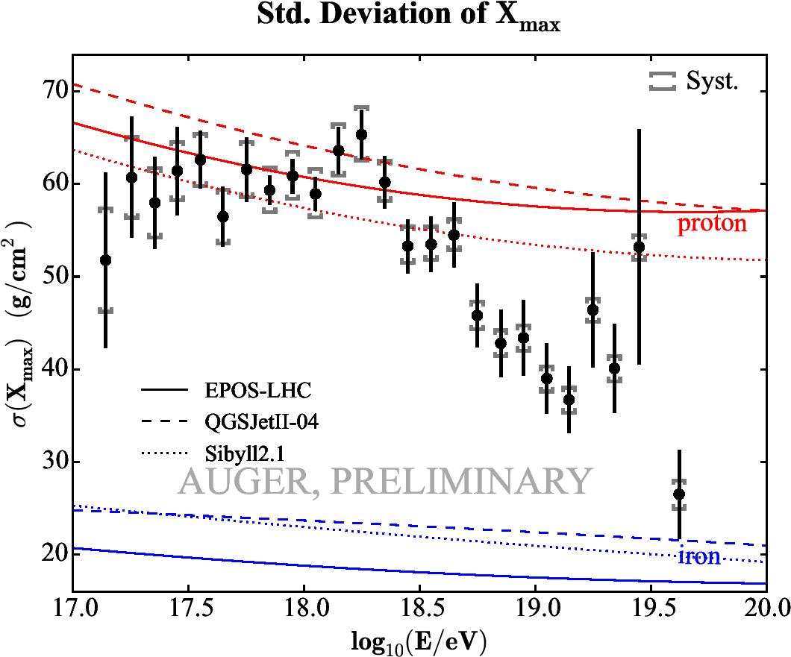
UHECR composition
Data
Model territory
Spectrum measured “calorimetrically”
“smooth” increase of mean mass
UHECR are nuclei(?)
Decrease of fluctuations $→$ mixture masses
Auger, ICRC 2015

Slide 14
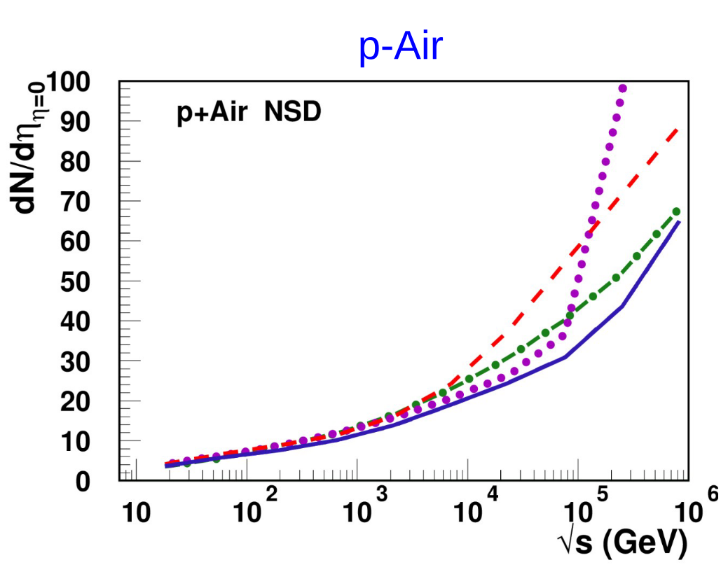
A black-disc-like behavior in DPMJET-III at high energies
T. Pierog 2018

Slide 15
Neutrinos as cosmic messengers
C. Kopper ICRC 2017
Latest status: 103 HESE astrophysical neutrinos in 7.5yr, 60 events > 60 TeV (Neutrino 2018), ~40 events background
Background almost cut away by self-VETO

Slide 16
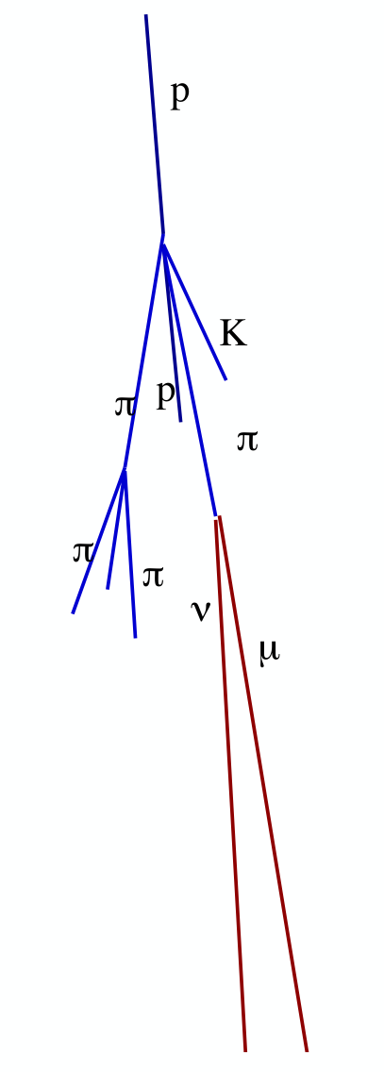
Atmospheric neutrino backgrounds
At high energies contribution from atmospheric charm (prompt neutrinos)
Muons could constrain prompt due to absence of astrophysical signal
..but have additional component from electromagnetic decays of unflavofred mesons (ρ, ω, φ, ƞ)
AF, F. Riehn, R. Engel, T. Gaisser, T. Stanev arxiv:1806.04140

Slide 17
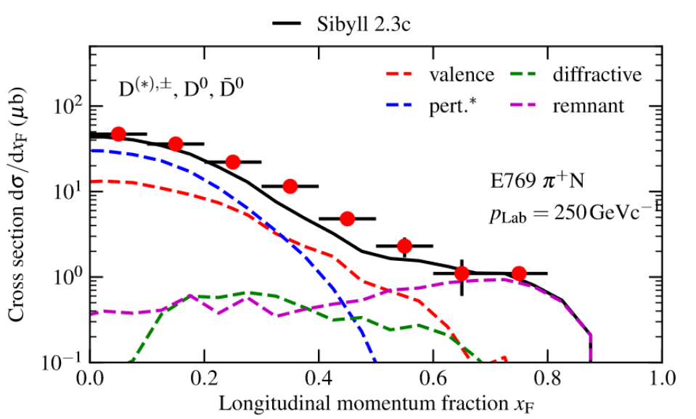
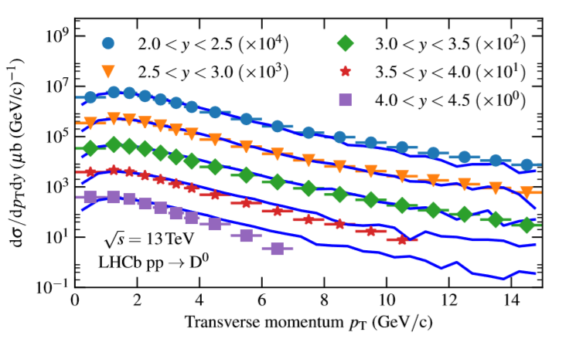
Prompt neutrinos in SIBYLL 2.3c
Astrophysical flux
Only cosmic ray event generator with charm implementation
Tuned to variety of data from fixed target to LHC
Consistent with more sophisticated NLO or dipole calculations
AF, F. Riehn, R. Engel, T. Gaisser, T. Stanev arxiv:1806.04140

Slide 18
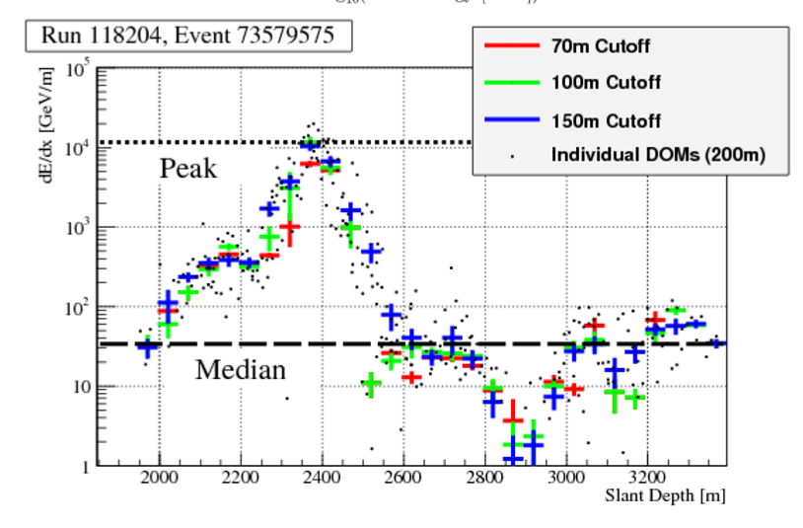
High-energy muons in IceCube
See talk by D. Soldin at UHECR 2018
Angular distribution has tilt
Energy loss pattern
Energy loss pattern sensitive to muon multiplicity and energy
Angular distribution of muon bundles always tilted compared to MC
Neither hadronic interactions nor cosmic ray models can explain this
Maybe unknown detector systematics
IceCube, Astropart. Phys. 78 (2016)

Slide 19
Possible origin from prompt muons (not necessarily charm)
First indication that zenith shift is a signature of prompt muons
But! Other processes contribute
Muon pair production $γ→μ^{+}μ^{−}$
Quasi-elastic vector meson production $γ+A→(ρ, ω,φ)+A^{′}→$hadrons + X
The “electromagnetic” processes might be under better controll and thus would allow for constraining the contribution of charm (50%)
Feedback from EM to muon cascade
EIC?

Slide 20
Conclusions
Two distinct types of sources that produce observed high-energy radiation and neutrinos
Relevant are photo-nuclear interactions at MeV/GeV or hadronic pp interactions at all energies
Photo-nuclear interactions are weakly constrained due to lack of high-quality measurements. Good input would be “fragment” and pion yields, “$γA“$ cross sections at GeV and above
For UHECR interpretations, the uncertainties from hadronic interaction models are dominant. Composition is crucial to further advance in the field
Astrophysical neutrino physics arrives at the end of the first generation experiments. Impact of atmospheric backgrounds can be large, but colliders are not sensitive in the relevant forward phase space ($x_{F}>0.2)$
Contribution from charm hard to constrain from neutrino data due to astrophysical foreground
Atmospheric muons show first indication of measurable prompt flux, but more work is needed

