Slide 1
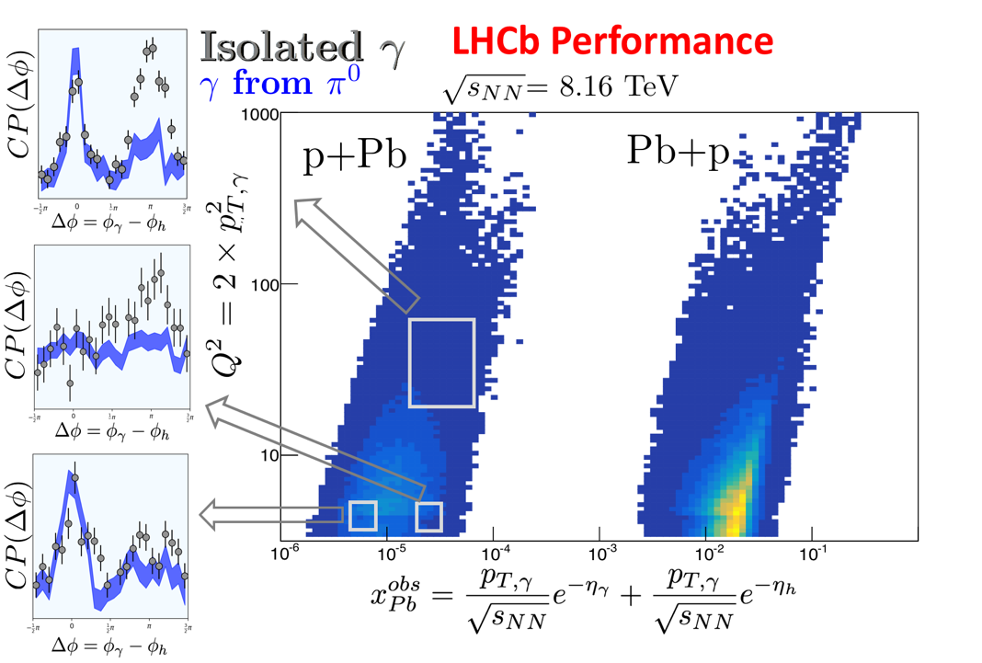
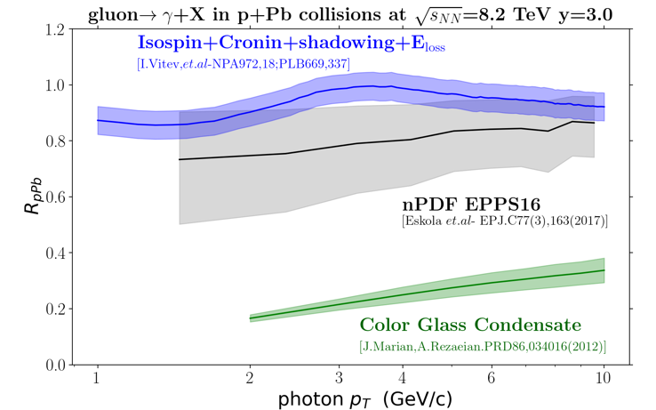
Opportunity to scan small-x, small Q² nPDFs and determined the saturation scale in hadronic collisions.
Important to have results from LHCb and ALICE/FOCAL for confirmation.

