Slide 1
Low-Energy RHIC electron Cooling (LEReC) Commissioning progress and needs July 2, 2018

Slide 2
LEReC Commissioning Timeline
March 5: DOE approval to start LEReC commissioning
March 22: Start commissioning SRF booster with beam .
March 23: Beam has been accelerated to the first LEReC design energy KE=1.6 MeV, and it is delivered to inj. line beam dump.
March 27: 1.6 MeV beam transported to 704 MHz warm cavity
Apr 2: 1.6 MeV Beam at RF diagnostic line PM. Comm. BPMs, PMs, FCs
Apr 5: 704 deflecting cavity commissioned with beam
Apr 6: 2.1 GHz commissioned with beam. It runs at 11% of booster cavity.
Apr 11: 704 MHz warm cavity de-chirper commissioned with beam
Apr 12 Insert new cathode with good QE (~3%).
Apr 13: Finish RF and transport set up to delivery good quality beam 10-200pC per pulse at KE of 1.6 MeV
Apr 18: Laser Delivered 10 Watts to the gun table. Switching to running resistor. Preparation for CW operation.

Slide 3
Remaining major goals (KPPs) for July
Establish required electron beam parameters (emittance and energy spread) in both cooling sections for design electron beam charge.
Transport 1mA CW current to high-power beam dump.
Study cathode QE lifetime with 30mA current (at reduced energy to injection dump (can we go to 15kW?) or at full energy to high power beam dump). Need several long term (>1 hour) runs at 30mA.

Slide 4
LEReC Commissioning Timeline (continue)
Apr 25: First beam in RHIC cooling section (pulsed mode). Comm. BPMs, PMs, FCT, FC
Apr 26: 1.2 mA CW operation injection at KE=1.6 MeV
May 3: 2nd Ferris Wheel with 6 good cathode (QE=4-6%) delivered to IP2
May 11: 17 mA CW, KE=500 keV at the dump, DC gun V=300 kV
June 2: 100m journey is completed. 1.6 MeV Beam delivered to HP beam dump (Pulsed mode)
June 5 First time observed ion –electron interaction in cooling sections
June 5 Measurement of beam quality is available online: energy spread < 1.e-3 and geometrical emittance in injection line 0.4-0.6 um for 50 pC,
June 6: 20 mA CW, DC Gun V= 320kV delivered to injection beam dump
June 18: 3rd Package of good cathodes delivered to IP2
June 22:Comm. movable slit emittance measurements system with beam starts
June 28: DC Gun tested with Cornell’s controller upto 17mA. No strong instability has been observed.
June 28: First test of LLRF feed forward system
Towards to KPP#3
Towards to KPP#2
Towards to KPP#1
Towards to KPP#3
Towards to KPP#1
Towards to KPP#2-3

Slide 5
In pulsed mode:
Most of beam commissioning goals could be done running single macrobunche
Beam instrumentation commissioning
Beam quality measurements
Beam transport and optics optimization
For better tuning of RF cavities and stability studies we planned to use long trains of macrobunches duration upto 1msec (10k macrobunches)
Due to strong beam loading to cavity, significant MB2MB energy variation is observed (in non zero dispersion regions)
First tests of LLRF feed forward system shows significant improvement in RF cavities phase and voltage stability
The result of FF compensation to beam quality needs more studies.
There is also DC gun beam loading effect:
HV PS Voltage regulation loop studies continue

Slide 6
CW operation : Learning experience: DC Gun
DC Gun HV PS is not stable at some current settings at 300-350kV. But we can jump through
Update: with Cornell's controller PS is much more stable at 350 kV
For nominal voltage of 400kV we were not able to jump through 2-2.5 mA average current instability barrier.
Needs to be tested with new controller.
Cathode is damaged in several spots as a result of CW operation
New evidences show that damaged spots could be results of Gun trips. Needs more data.
Gun needs reconditioning after CW operation to run at 400kV
DC gun HV PS invertor failed twice during this run. Needs to be replaced each time. There is one spare invertor. Repair damaged one takes several days.
Moving the chassis outside the tunnel could reduced probability to upset invertor. Plan to test this summer.

Slide 7
CW operation : Learning experience: Laser
Pulsed /CW switch requires laser expert.
Switching CW/Pulse could be done by operator if fast shutters in placed
Putting fast shutter could be done by expert only and needs an access to laser trailer
Currently not an issue since laser experts normally available any time during work hours and by request for off hours .
Transverse size at Gun table significantly changes for different average power of operation
eBeam setup is performed in pulsed mode at very low average laser power. Normal operation is expected with laser at several (1-10) watts power. Transverse laser profile changes significantly between these modes.
Aperture at gun table help with laser spot stability but it limited tp cathode laser power since laser transverse size significantly increased with laser power.
20 minute AC cycles effect on Laser power fluctuation needs to be addressed
Independent from eBeam online diagnostic and control of laser power and laser position stability is needed in both CW and pulsed mode.

Slide 8
Learning experience: instrumentation and MPS
BPMs keep to hang up time to time need resetting and tweaking. It especially true during switching modes of beam operation
BLM system needs to be commissioned and thresholds have to be established
Some effort was made during RHIC run to commission BLMs system
There were too many false trips due to strong background noise from other operation systems (CEC or RHIC itself ). Needs more tuning to make this system work.
FCT (and particularly Gun FCT) calibration is far from perfect
Many hours have been spent already to tune this system. The numbers still not match ICT in short train and DCCT in CW mode.
RF noise might be more problematic when we start commissioning higher energy (higher voltage SRF booster)
Several times BPMs switch boxes were damaged during CW operation
Improvement have been made to protect BPMs
More studies are needed
MPS works very well
false trips are very rare due to other equipment provides nonsense signal
Final HP beam dump line certification is needed
Using GUI/Sindy based interface is tricky at first but become very natural if one has been trained once

Slide 9
More online application/tools are needed
Response matrix measurements and comparison with model
Orbit correction with User friendly interface
RF phase/voltage online correction (similar to orbit correction) Under development
Online Energy measurement and logging using 180 degree magnet
Small MatLab based useful tools:
Solenoid based energy measurements is tested.
QE map scan is tested
RF phasing script is ready needs to be tested
DC gun conditioning is operational with some tweaks
Solenoid scan Emittance measurements (offline analysis)

Slide 10
Energy and beam current increases during summer time.
May-June: RF diagnostics beamline:
Development of feedforward system to compensate beam-loading in RF cavities is part of this task. Development of automatic correction of energy spread
June-July:
@1.6MeV Energy feedback development based on 180deg. BPM.
Test DC gun PS with Cornell Control Chassis (repeat at 400kV)
July 1-31:
@1.6MeV (Booster=1.35MV; 2.1GHz=150kV; 704MHz=60kV) high-current (up to 50mA) beam transport to final dump. Testing both 9MHz and 704MHz CW modes at high current. Do we still have to test CW704?
August 1-15:
@ 2.0MeV (Booster=1.8MV; 2.1GHz=245kV; 704MHz=80kV), up to 50mA; testing Booster up to 85kW power
August 15-September 1:
@ 2.6MeV (Booster=2.2MV; 2.1GHz=220kV; 704MHz=250kV, Pbeam=13kW,Pcavity=10kW), up to 50mA; testing Booster up to 110kW power
Sept1-15: Commissioning 78 kHz system

Slide 11
Discussion
Questions?

Slide 12
Backup and some illustrations

Slide 13
DC Gun HV PS
PS group met with HV PS manufacture got some ideas how to improve stability for CW operation
On Thursday stepdown transformer will be installed
Bandwidth and ripple studies continues
One more set of R&C has been tested more is coming today
Next week (June 27-28) we will test Gun stability running with Cornell version of control board
Some times in July we need to move controller chassis outside of the tunnel and test DC gun operation. It could take at least 2 days without beam

Slide 14
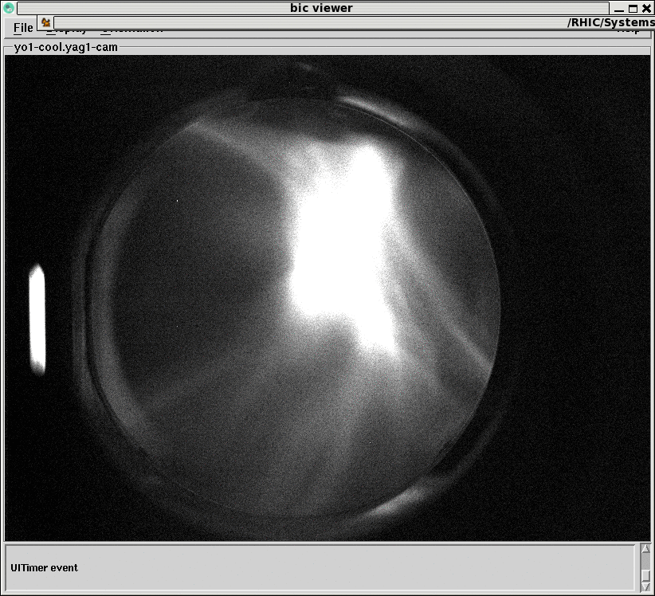
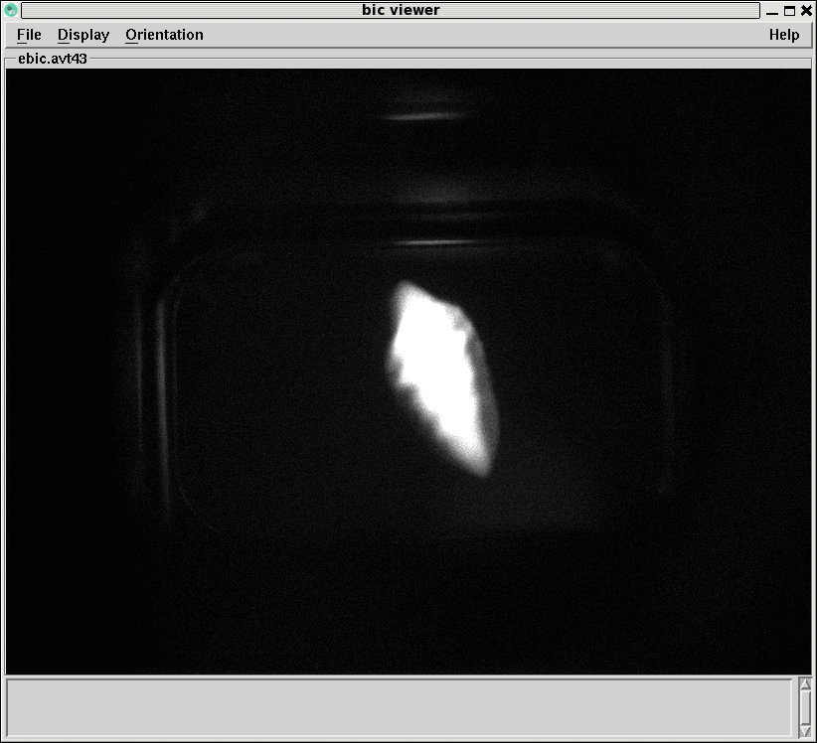
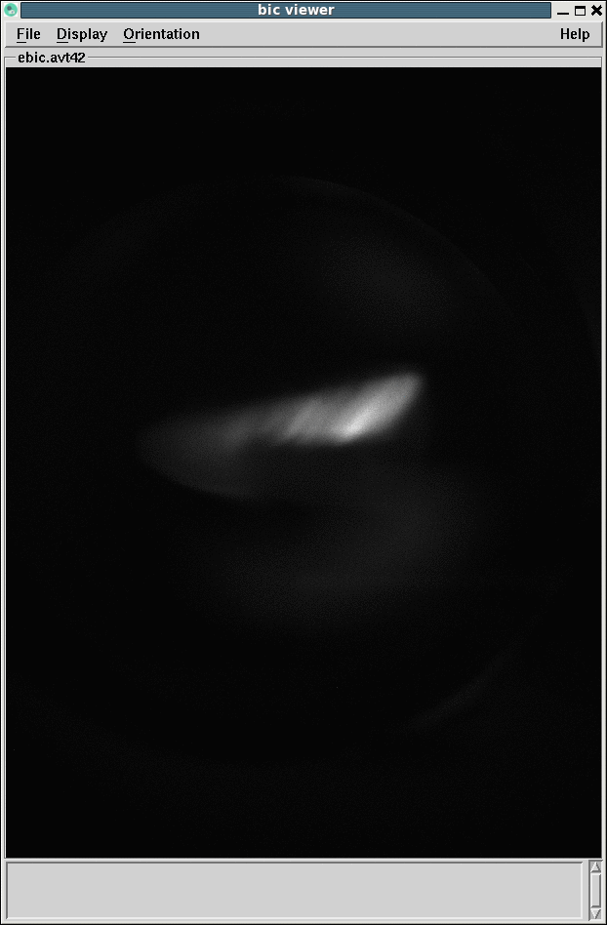
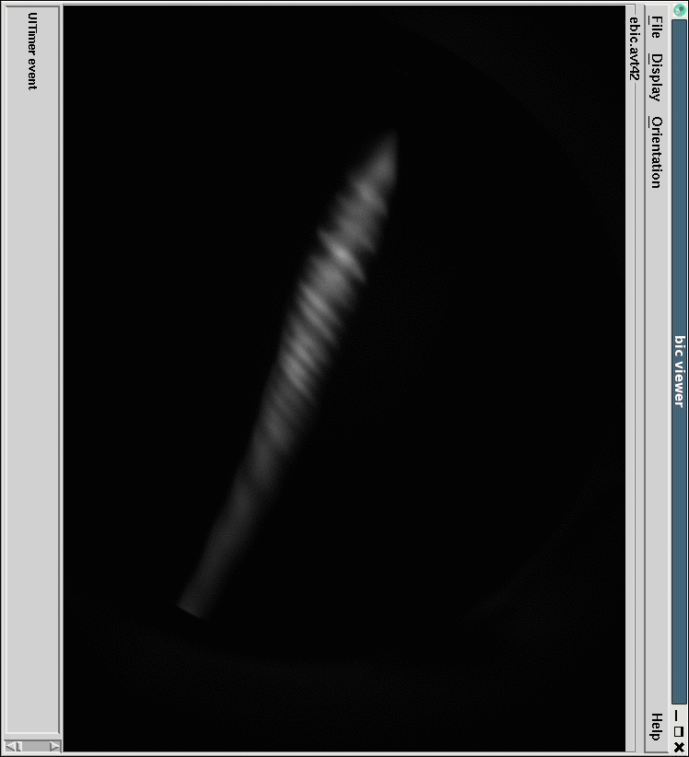
Apr 25
1st YaG in cooling section
Beam reached Diagn line and Cooling section PMs
Apr 25, 2017
DC Gun
Test Line
Diagnostic Beamline
704 SRF
Booster Cavity
704 MHz Cu Cavity
9 MHz Cu Cavity
2.1 GHz Cu Cavity
e⁻
e⁻
COOLING
in Yellow RHIC ring
RHIC TRIPLET
IP02
DC e⁻ Gun
e⁻
COOLING
in Blue RHIC ring
Apr 2 DiagnLine PM
Apr 5 DiagnLine PM
With deflecting cavity on
Apr 11 DiagnLine PM
With dichirper and deflecting cavity on
Apr 10 Dogleg PM

Slide 15
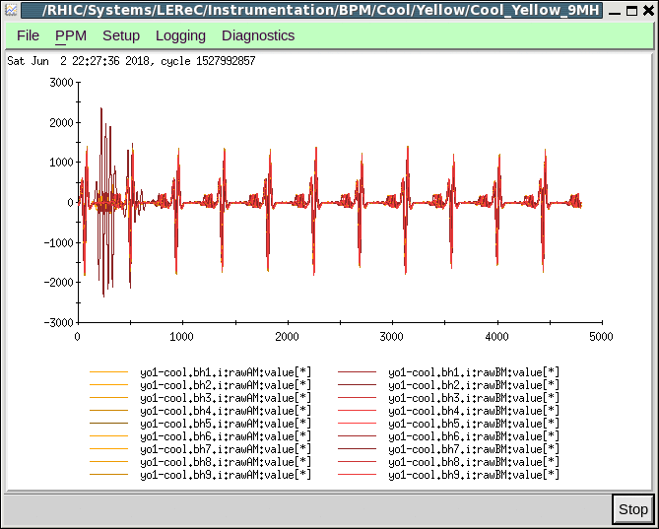
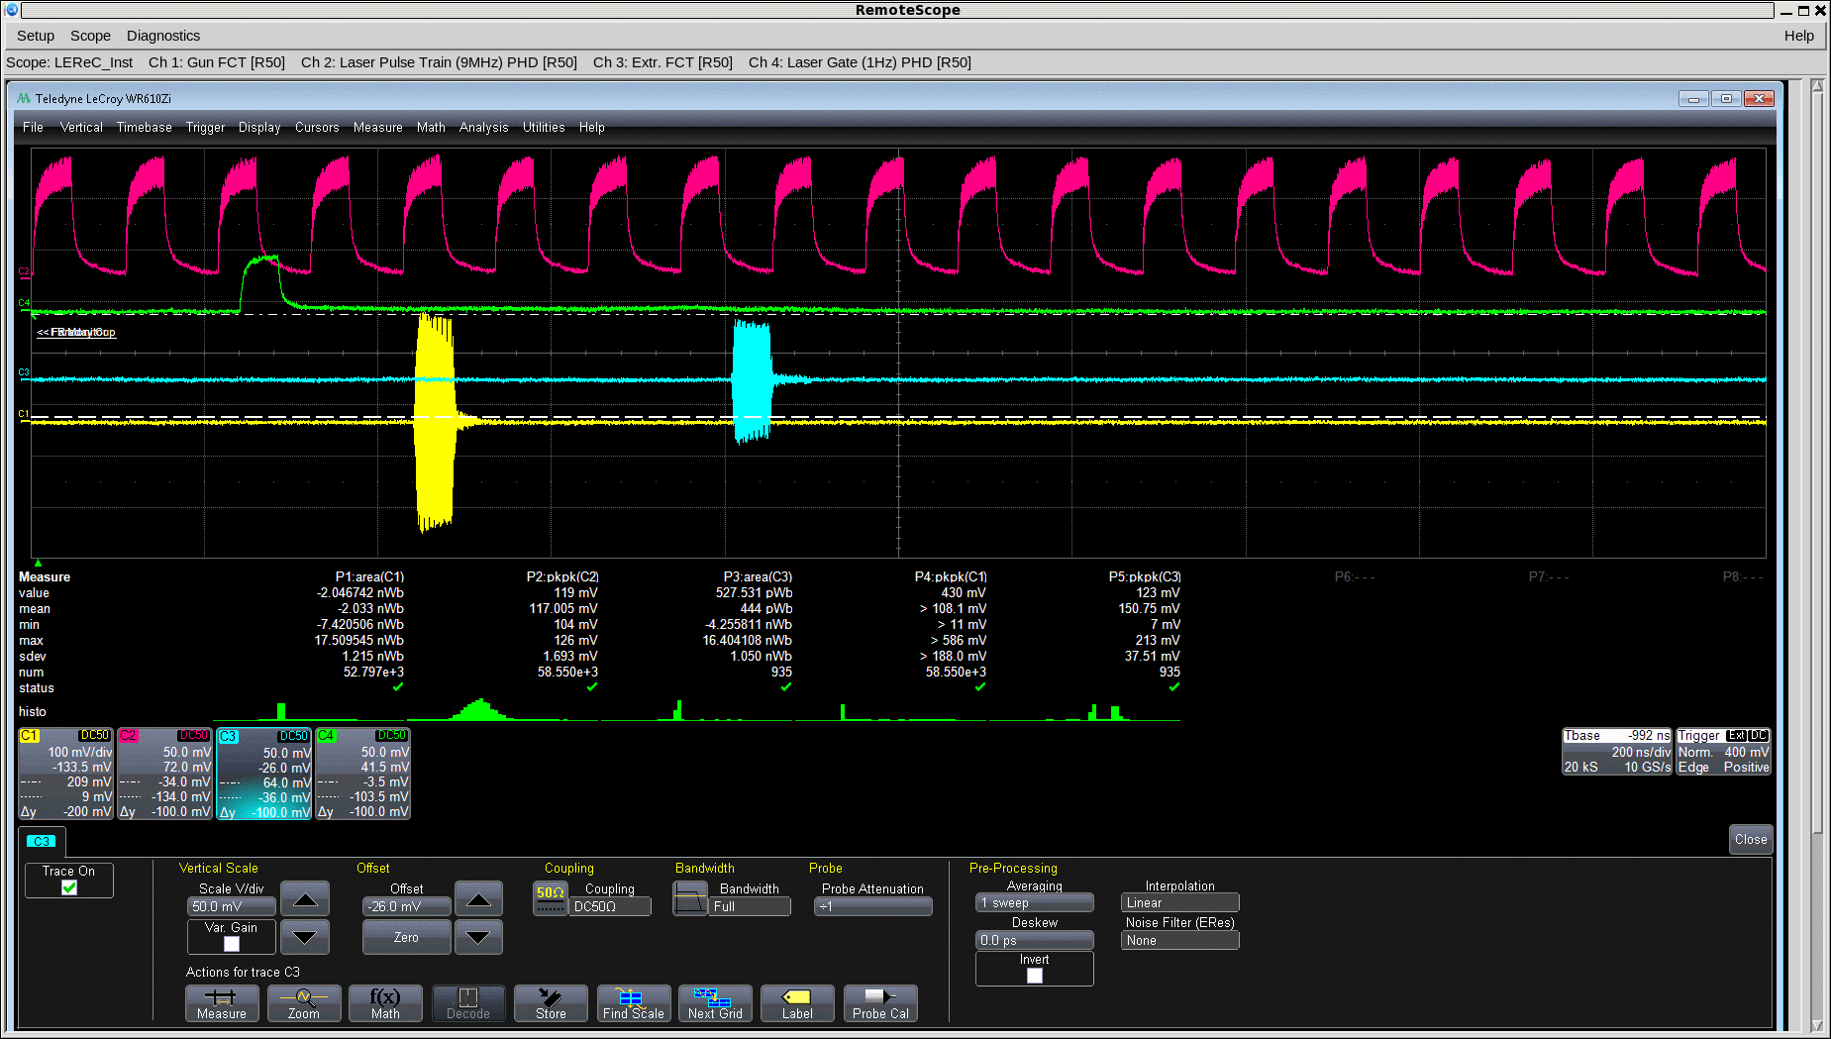
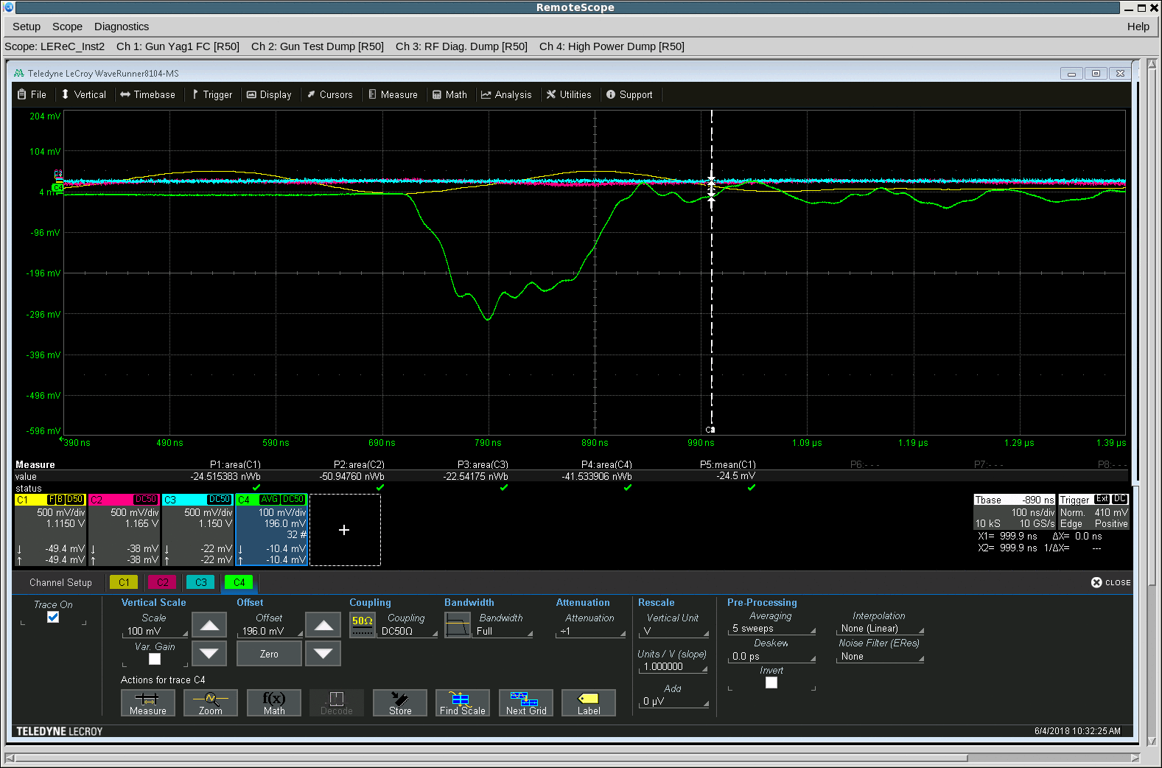
LEReC: beam propagated all the way to final beam dump
June 2, 2018
HP Beam Dump FC signal
Laser pulses,
Gun FCT
HP BD FCT signals

Slide 16
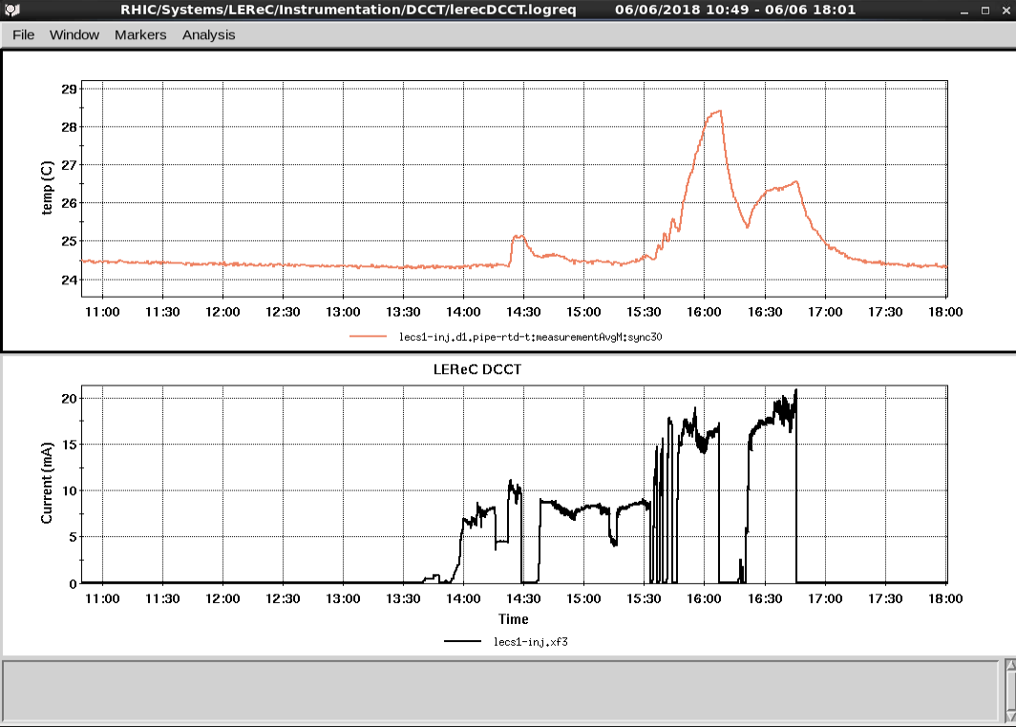
Marching to 30 mA from the gun
Beam line Temperature at the bending magnet vacuum chamber stabilized
Before Gun tripped
DCCT average current
DC gun at 320kV
20 mA average current CW operation June 6, 2018

Slide 17
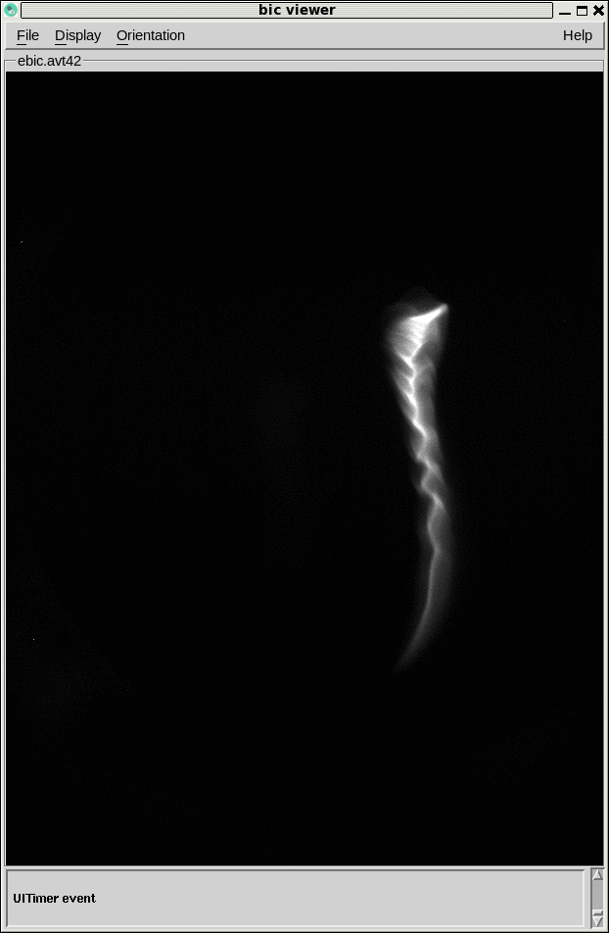
Longitudinal phase space and slice energy spread at RF diagnostic line
Single bunch Charge 50 pC,
Sliced energy spread 0.8-1.4e-3
Bunch length +/-200 psec

Slide 18
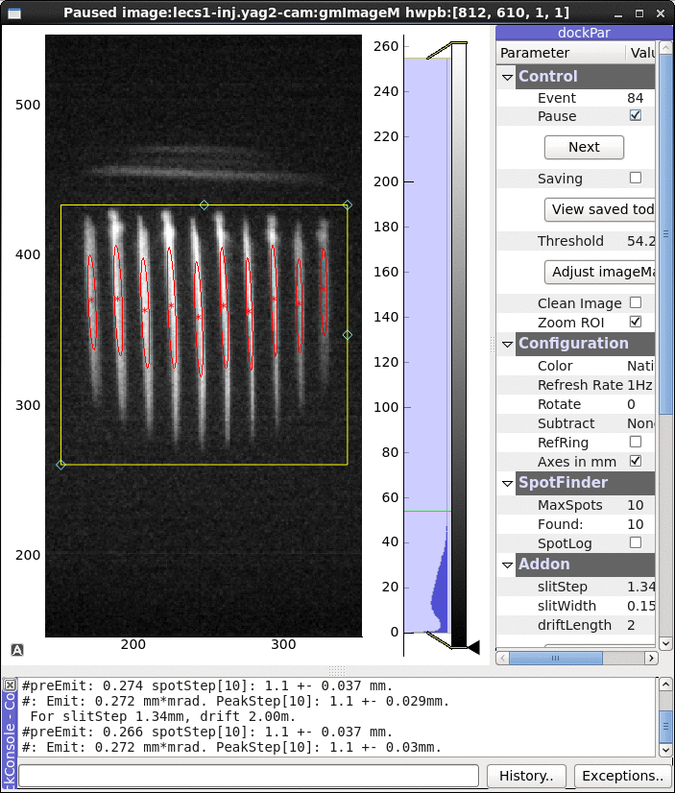
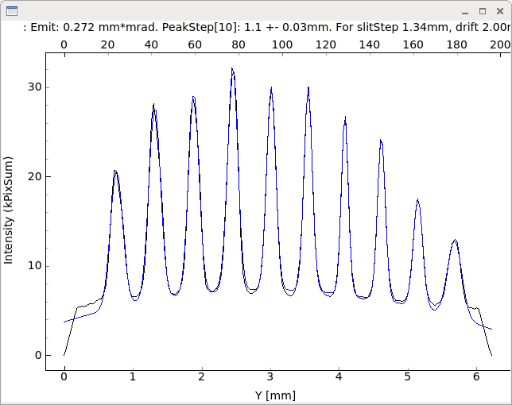
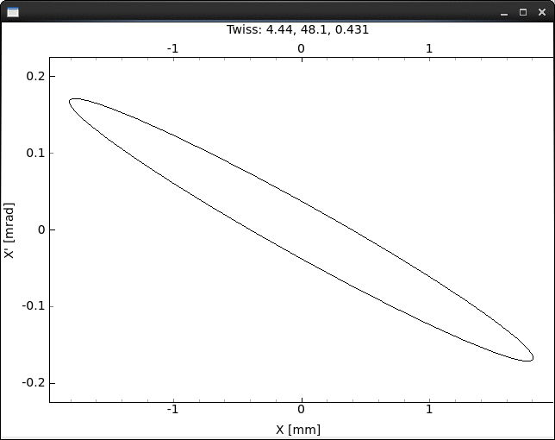
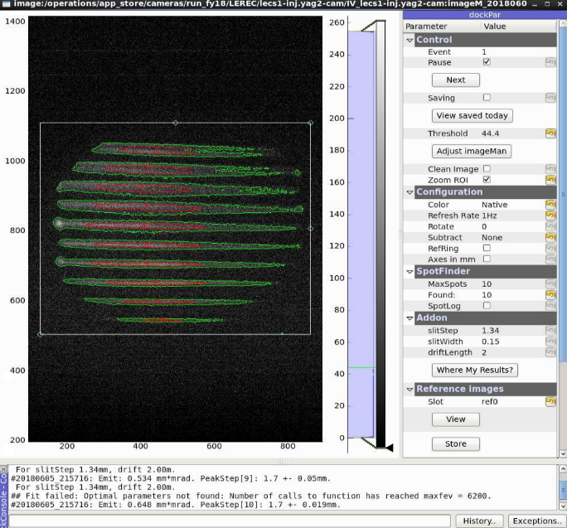
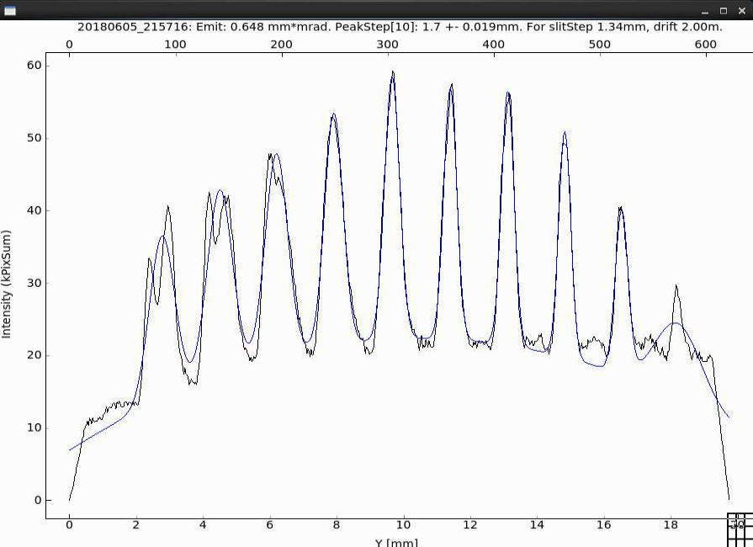
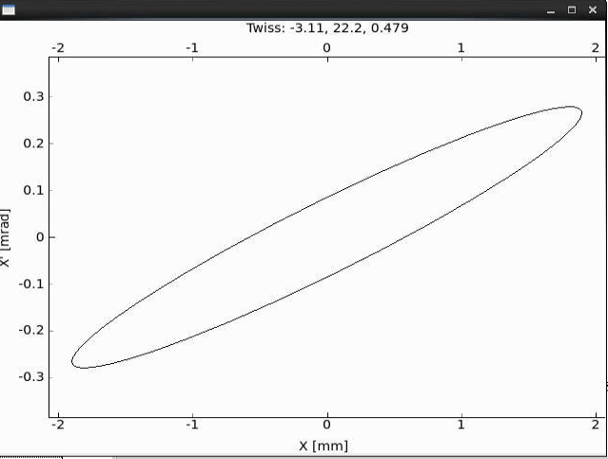
Multislits emittance measurements
On Line Transverse phase space reconstruction
Live image
Intensity profile with fit
Reduced upstream solenoid strength

Slide 19
Beam loading effect observed at HP Beam Dump FCT
Yellow GUN FCT
Cyan HP beam dump FCT
Charge per bunch 100pC
Due to beam loading effect to RF cavities later bunches get less acceleration and some particles have been lost most likely in the merger section with largest dispersion

Slide 20
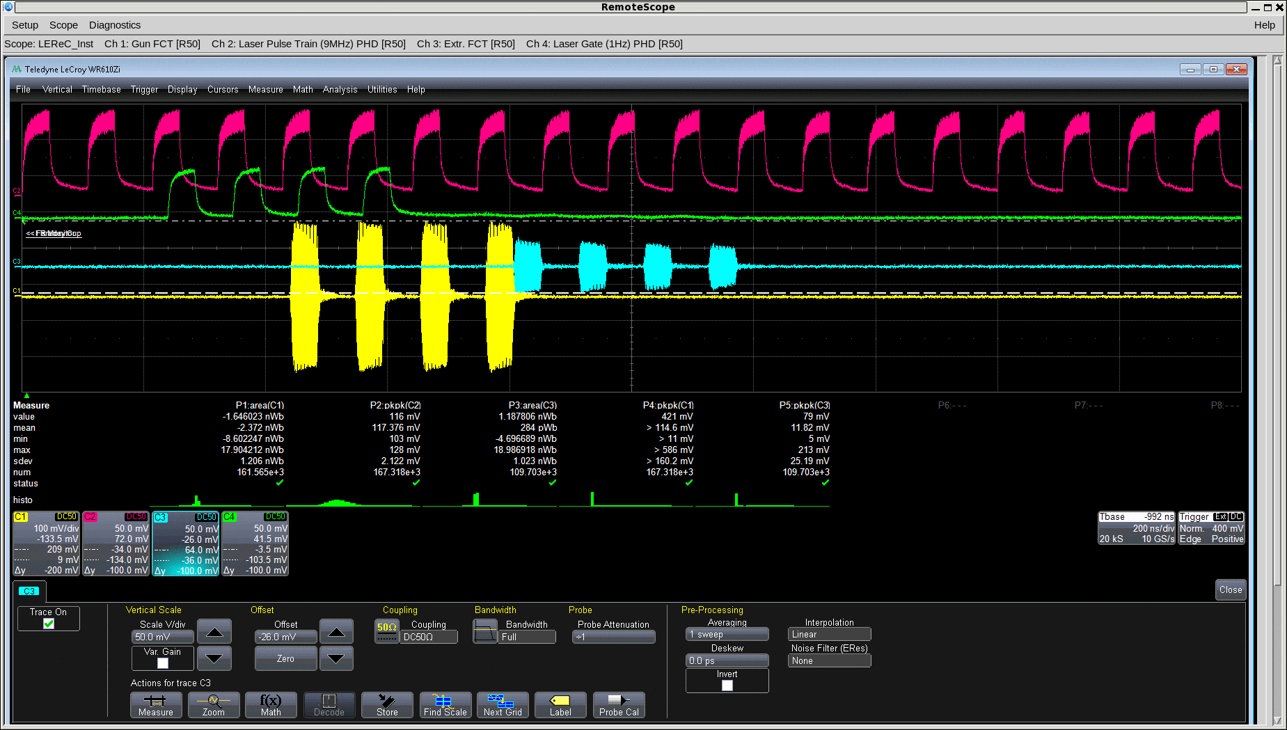
NO interaction with RHIC beam

Slide 21
RHIC beam imprint to electron beam
Ion beam footprint

