Slide 1
DC Gun Power Supply
D. Bruno, J. Drozd, R. Lambiase, C. Mi,
J. Sandberg, C. Schultheiss
July 2, 2018

Slide 2
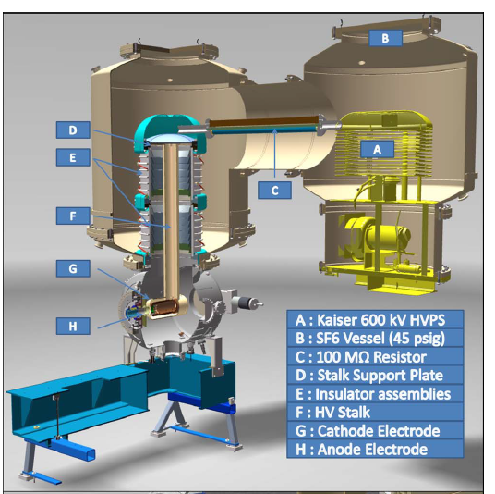
DC Gun Power Supply

Slide 3
DC Gun Power Supply
Instability
Determine why we have an instability problem at operating Voltages unlike Cornell or Sealed Air
Has our regulator been updated correctly or is it broken. Comparison to Cornell’s unit is essential
Experience running with Cornell Controller switching between our modified controller and Cornell’s controller (5 blocks of 4 hrs)
Examination of as built prints (ongoing)
Is the voltage where instability appears related to maximum stack voltage, i.e. the number of boards.
Reduce the input voltage to the inverter to match the maximum voltage at Cornell or Sealed Air. (8 hrs)
Change the number of boards in multiplier (5 days +prep work of several weeks)

Slide 4
DC Gun Power Supply
Bandwidth Problems
Compensation testing to determine system limitations and verify computer model. Increasing the bandwidth may enhance stability problem (5 blocks of 4 hours)
It maybe necessary to redesign the controller to get a wider bandwidth with stable performance (could be done by January)
Improve computer model (on going)

Slide 5
DC Gun Power Supply
Bandwidth Problems
Move controller out of the ring. (12 hrs + 2 days prep + 2 days to test)
Integrate the Stanford Research System (SRS) controller into existing control unit? (8 hrs + 1 week prep time + 4 blocks of 2 hrs beam time for studies)
Study noise problems in readback systems (5 blocks of four hours)

Slide 6
DC Gun Power Supply
Ripple Reduction
Install Capacitors. 3300 pF, 40 kV capacitors have been procured. Concepts for mounting have been discussed but no actual design completed. Location of the capacitors not finalized (multiplier or gun). A Capacitor has been pulsed at 40 kV and 850 A over three hundred times with no perceived degradation (one 60ms pulse every 10 seconds). Possible damage to gun by increased stored energy. (4 days + 4 weeks of prep + 8 hours of test time to compensate)
B. Reducing the number of boards from 52 (650 kV) to 48(600kV) or 40 (500kV)? should improve the ripple slightly, perhaps by 5% (5 days + prep work of 4 weeks)

Slide 7
DC Gun Power Supply
Reliability issues
Move controller out of the ring.(12 hrs + 2 days prep + 2 days to test)
Replace switch mode auxiliary supply in inverter (8 hrs + 2 days prep)
Build new inverter (many parts ordered waiting on agreement with OEM). The inverters are rated by power. At 400 kV they should be able to deliver 100 mA
Build new controller (started but manpower restricted, could be done by January)

Slide 8
DC Gun Power Supply
Reliability issues
Build new Multiplier. Partnering with Sealed Air but making slow progress. Ferrites ordered and prototype board being tested at Sealed Air. (8 to 12 months?)
Some chokes an tests fixtures for the inverter boards are being built. (2 months)
A full power test load is being built for the inverter (4-5 months)
Repair bad voltage divider Gun side (1 week + 4 weeks prep)

Slide 9
DC Gun Power Supply
OEM
The relationship with the OEM has improved dramatically in the last few weeks. BNL has been given access to the “as built drawings” and hopefully will have an agreement that allows us to build new inverters.
BNL has had some limited access to the engineer that designed these supplies and much greater access to the engineer in charge of the production of these supplies.
BNL has been assured that while the supplies exhibit regions of instabilities at certain voltages these can be avoided by running nearer the rated voltage of the supplies, adjusting the compensation and optimizing the operating frequency

Slide 10
DC Gun Power Supply
New Vendors
Several different Vendors of high voltage power supplies have been contacted concerning a replacement supply that may better fit our needs. While there was interest in developing such a supply as an R&D project, no Vendor had ever built a suitable power supply.
7. Possibility of Remotely shorting the Processing Resistor

Slide 11
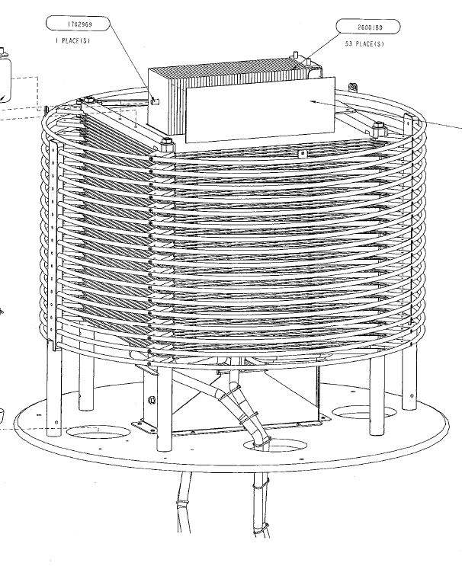
DC Gun Power Supply

Slide 12
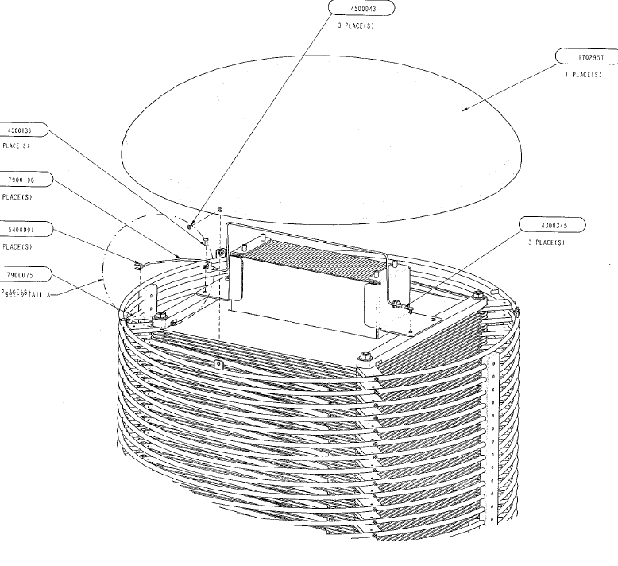
DC Gun Power Supply

Slide 13
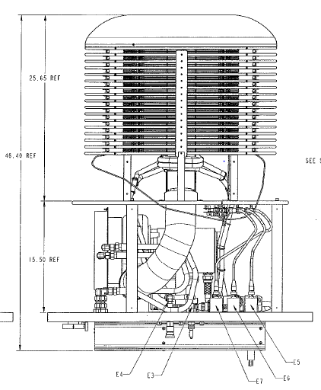
DC Gun Power Supply

