Slide 1
LEReC Retreat Laser System Performance
by
Patrick Inacker

Slide 2
LEReC Laser Parameters
Parameter | Target Value | Currently Achieved Value
Power on Gun Table | 15 W | 8 W
Green Power in Trailer | 26 W | 26 W
Stability (Green Power) | 5% PV | 12% PV
Stability (Pointing) | 8% Beam D. | 50% Beam D.
Beam Profile | Gaussian | Distorted
Temp. Profile | Modulated Flat Top | ???
Extinction Ratio (Pulsed) | >10^6 | >10^7
MPS Shut OFF extinction (Pulsed) | >100 | >10^7
MPS Shut OFF extinction (CW) | >100 | <80

Slide 3
LEReC Laser Overview
976nm Pump
1W
976nm Pump
DC
YDF
SC
YDF
SC
YDF
Mach-Zehnder
704 MHz High-Order-Modelocked Oscillator
EOM
ISO
60W
976nm Pump
160-200W
Non-Critically PM LBO Crystal
85µm, 80cm fiber rod
PC
SHG
Polarizer
Temporal Shaping
Intensity Control
EOM
Output
12-18W cw 9.1&704MHz
Output
20-30W cw 9.1&704MHz

Slide 4
LEReC Laser Overview
976nm Pump
1W
976nm Pump
DC
YDF
SC
YDF
SC
YDF
Mach-Zehnder
704 MHz High-Order-Modelocked Oscillator
EOM
ISO
60W
976nm Pump
Oscillator:
Has shown sensitivities to humidity fluctuations
Source (?) of 30-50Hz power modulations
Non-Critically PM LBO Crystal
160-200W
85µm, 80cm fiber rod
PC
SHG
Polarizer
Temporal Shaping
Intensity Control
EOM
Output
12-18W cw 9.1&704MHz
Output
20-30W cw 9.1&704MHz

Slide 5
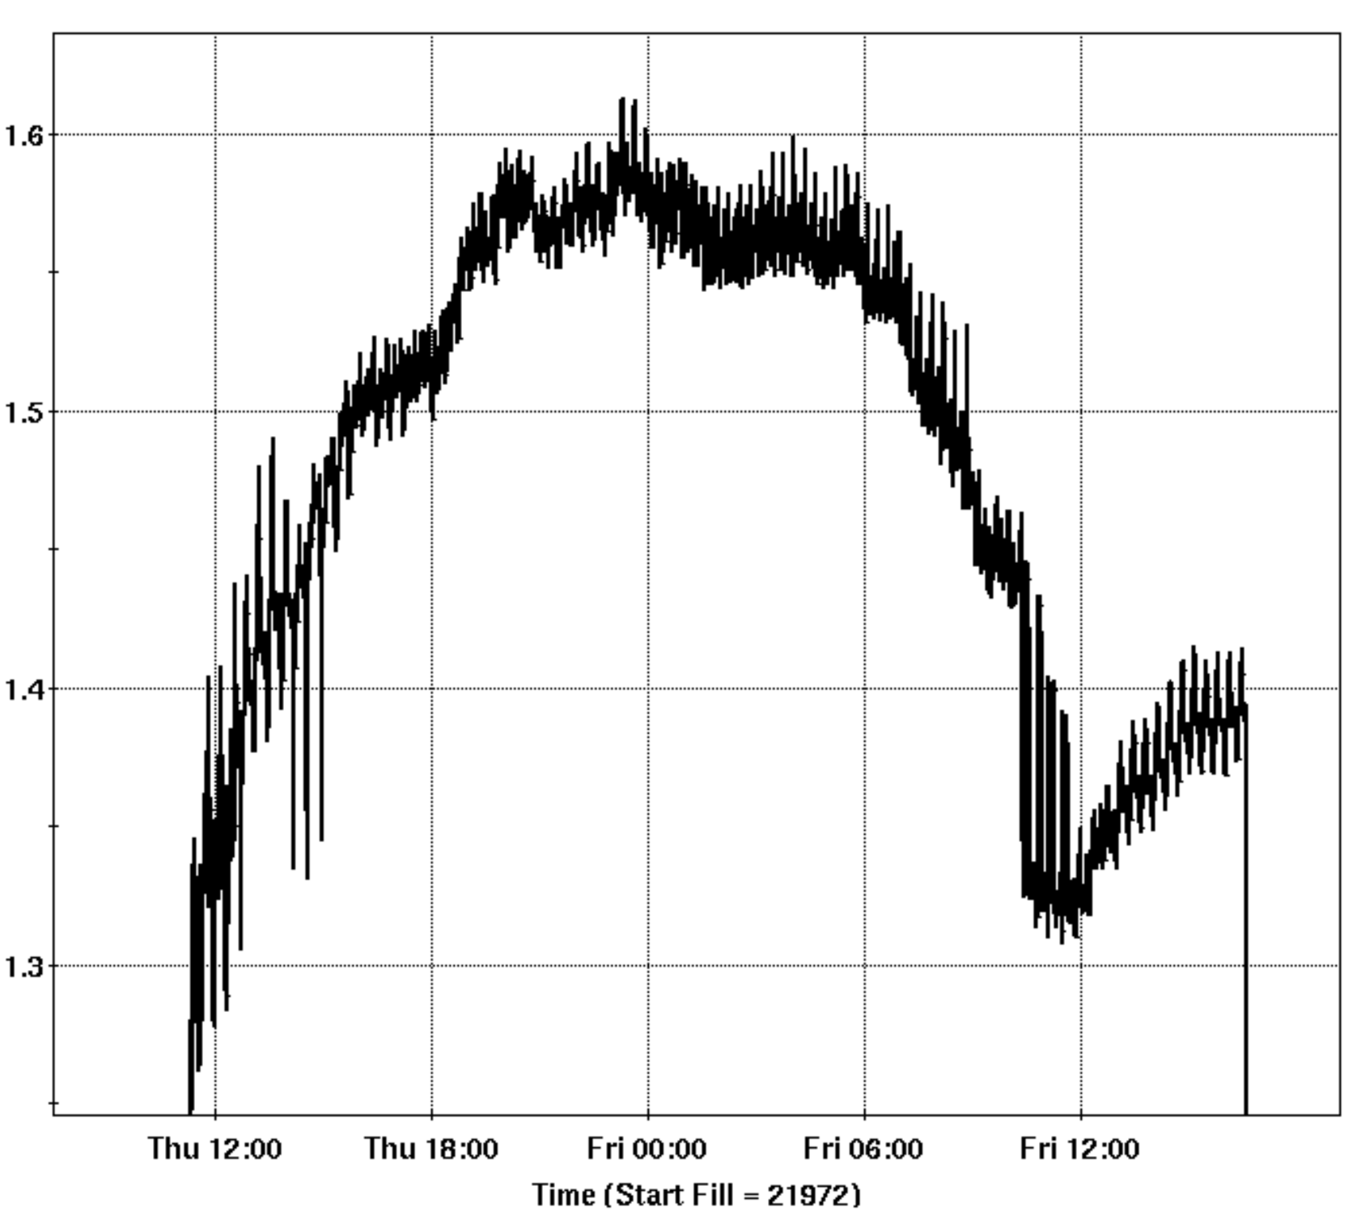
LEReC IR Power Monitor before and after Shielding of the Oscillator
IR Power Monitor:
Before Shielding
After Shielding

Slide 6
LEReC Laser Overview
60W Amp. Pump:
Inappropriate cooling water flow
Required daily current adjustments to reach nominal output power
976nm Pump
1W
976nm Pump
DC
YDF
SC
YDF
SC
YDF
Mach-Zehnder
704 MHz High-Order-Modelocked Oscillator
EOM
ISO
60W
976nm Pump
160-200W
Non-Critically PM LBO Crystal
85µm, 80cm fiber rod
PC
SHG
Polarizer
Temporal Shaping
Intensity Control
EOM
Output
12-18W cw 9.1&704MHz
Output
20-30W cw 9.1&704MHz

Slide 7
60W Amplifier effects of insufficient Flow
Returnline
Temp.
Flow
60W Amp OFF
60W Amp ON

Slide 8
LEReC Laser Overview
Optics and Rod cooling loop:
Inappropriate cooling water flow
Room temperature related power fluctuations
976nm Pump
1W
976nm Pump
DC
YDF
SC
YDF
SC
YDF
Mach-Zehnder
704 MHz High-Order-Modelocked Oscillator
EOM
ISO
60W
976nm Pump
160-200W
Non-Critically PM LBO Crystal
85µm, 80cm fiber rod
PC
SHG
Polarizer
Temporal Shaping
Intensity Control
EOM
Output
12-18W cw 9.1&704MHz
Output
20-30W cw 9.1&704MHz

Slide 9
Old LEReC Laser Cooling System
60W Amplifier Pump Diode
Fiber coupling heat sinks
Beam dumps
Main Amplifier Rod
Main Amplifier Pump laser
Thermotek
T255
Flow: <0.5 l/min
Temp: 24°C/31°C
Thermofischer
AC125A50 Circulating Bath
Flow: <0.5 l/min
Temp: 16°C/18°C
Thermofischer 1400
Flow: 11 l/min
Temp: 37.5°C

Slide 10
New LEReC Laser Cooling System Upgraded last week of May
60W Amplifier Pump Diode
Fiber coupling heat sinks
Beam dumps
Main Amplifier Rod
Main Amplifier Pump laser
Thermotek
T257p
Flow: 1.3 l/min
Temp: 29.5°C/30°C
Polyscience
LS51
Flow: 2 l/min
Temp: 18°C/18.5°C
Thermofischer 1400
Flow: 11 l/min
Temp: 37.5°C

Slide 11
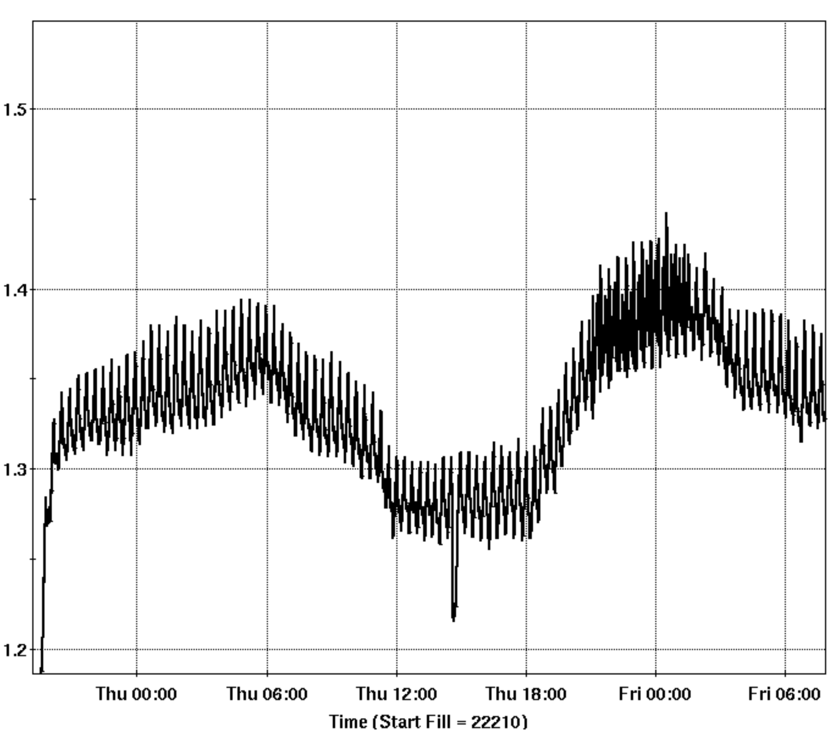
Results with new Cooling System
IR Power Monitor:
Old Cooling system
New Cooling system

Slide 12
Results with new Cooling System 60W Amplifier
Returnline
Temp.
Flow
60W Amp OFF
60W Amp ON Flow higher after removing algae

Slide 13
LEReC Laser Overview
976nm Pump
Non-Critically PM SHG stage:
12-15% PV Power fluctuations driven by room temperature and IR power fluctuations
1W
976nm Pump
DC
YDF
SC
YDF
SC
YDF
Mach-Zehnder
704 MHz High-Order-Modelocked Oscillator
EOM
ISO
60W
976nm Pump
160-200W
Non-Critically PM LBO Crystal
85µm, 80cm fiber rod
PC
SHG
Polarizer
Temporal Shaping
Intensity Control
EOM
Output
12-18W cw 9.1&704MHz
Output
20-30W cw 9.1&704MHz

Slide 14
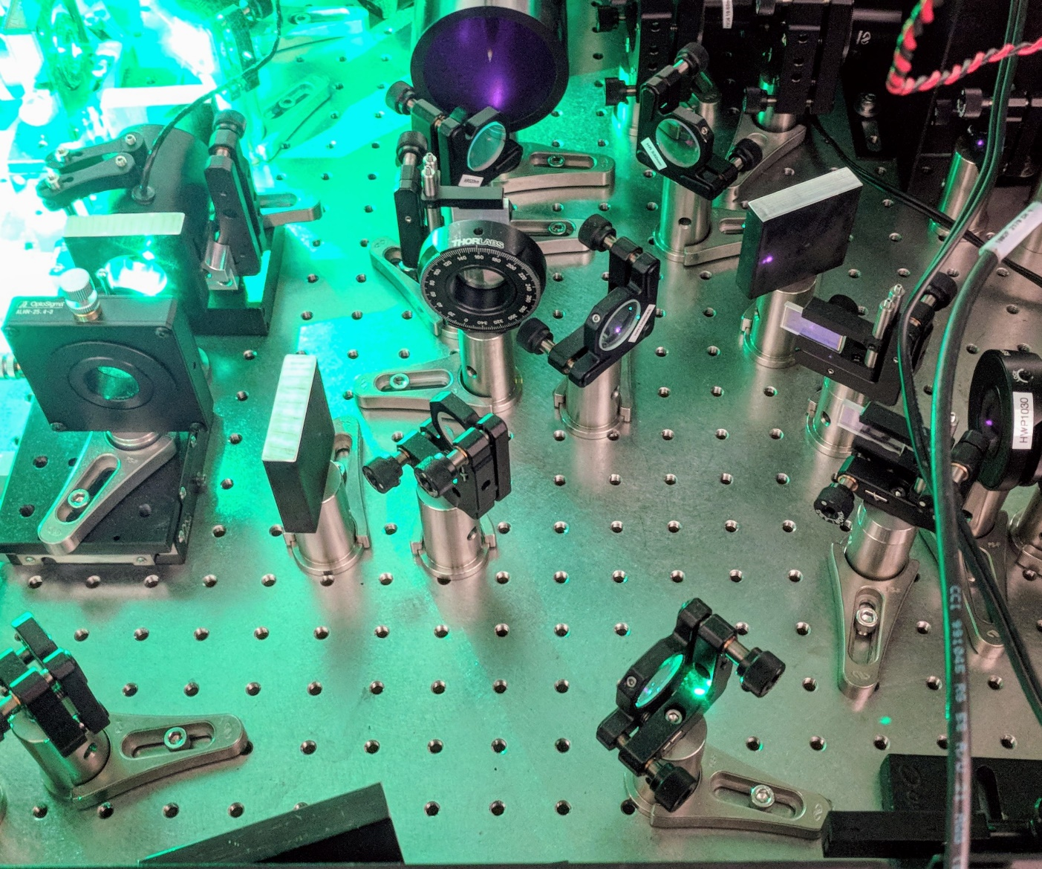
Phase matching Technique comparison
Non-Crititally PM Crystal
Experiment to examine the output stability of both techniques in an unstable environment
The IR Beam is Split after the Pockels Cell
Converted Beam Power is measured individually and simultaneously
Critically PM Crystal is cut for 1064nm light => low conversion efficiency, but relative power fluctuations for 1030nm cut crystal are equivalent
Crititally PM Crystal

Slide 15
Phasematching Technique comparison
Power Split:
Total: 49W
Non-Critical: 41W
Critical: 8W
Average Powers (W):
Non-Critical: 16.92
Critical: 0.07

Slide 16
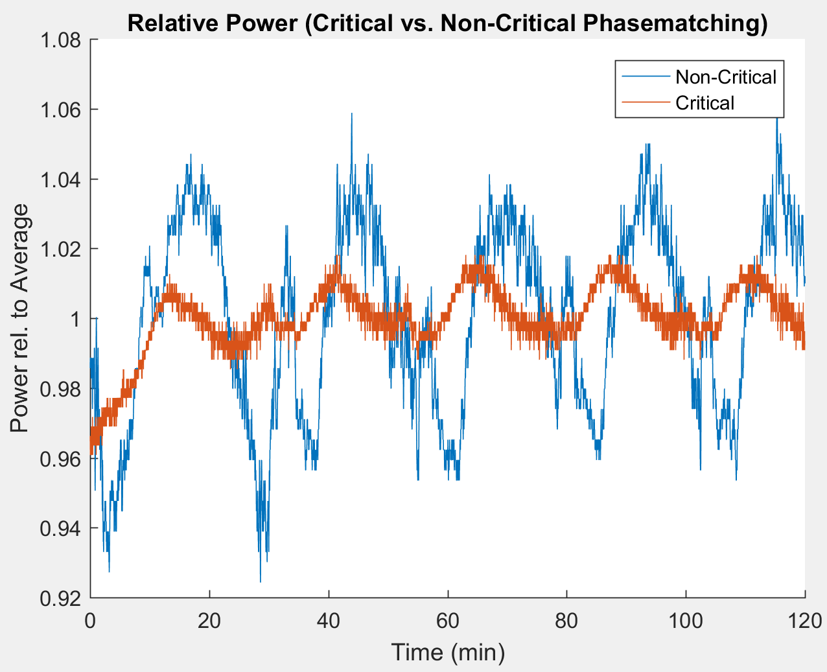
Phasematching Technique comparison
Power Split:
Total: 49W
Non-Critical: 9W
Critical: 40W
Average Powers (W):
Non-Critical: 3.41
Critical: 0.366

Slide 17
LEReC Laser Overview
976nm Pump
1W
976nm Pump
DC
YDF
SC
YDF
SC
YDF
Mach-Zehnder
704 MHz High-Order-Modelocked Oscillator
EOM
ISO
60W
Intensity Control EOM:
Insufficient and unstable extinction ratio due to temperature fluctuations induced by room temperature and Laser power fluctuations.
976nm Pump
160-200W
Non-Critically PM LBO Crystal
85µm, 80cm fiber rod
PC
SHG
Polarizer
Temporal Shaping
Intensity Control
EOM
Output
12-18W cw 9.1&704MHz
Output
20-30W cw 9.1&704MHz

Slide 18
Measurement of the EOM Extinction Ratio
Extinction Ratio requirement: >100
EOM extinction ratio fluctuates with AC cycle.
Could be room temperature or laser heating related
Further measurements have to be conducted after system improvements
Possible replacement with AOM or regular Pockels Cell
Small Crystal Aperture and long crystal leads to wavefront distortions

Slide 19
LEReC Laser Overview
976nm Pump
1W
976nm Pump
DC
YDF
SC
YDF
SC
YDF
Mach-Zehnder
Temporal Shaping:
Small Crystal aperture leads to clipping and beam distortion
High power induces thermal lens
704 MHz High-Order-Modelocked Oscillator
EOM
ISO
60W
976nm Pump
160-200W
Non-Critically PM LBO Crystal
85µm, 80cm fiber rod
PC
SHG
Polarizer
Temporal Shaping
Intensity Control
EOM
Output
12-18W cw 9.1&704MHz
Output
20-30W cw 9.1&704MHz

Slide 20
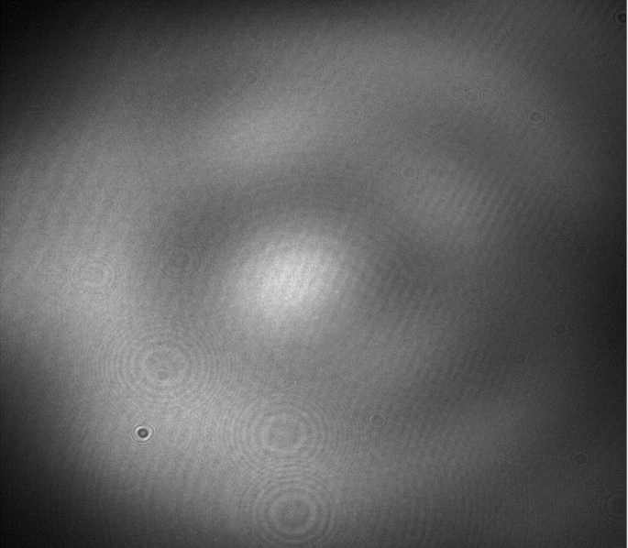
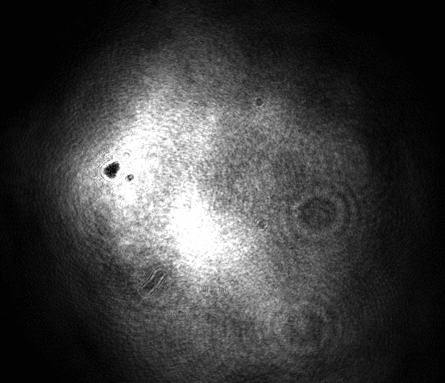
Beam Quality Degradation
Relay Table
Gun Table
Wavefront distortion and clipping leads to non-uniform laser beam profile on the Gun table.
Sources need to be identified and removed to achieve the proposed Gaussian Profile.

Slide 21
Remote Control and Diagnostics
Pockels Cell
- Analog Control through VME, Error Readback
Intensity Control
- RS232 Control over the rotation of a HWP
Steering
- Piezo Mirror in Trailer and on Relay Table
- Zoom Lens to adjust beam size on Gun Table
- 2 Axis motion for steering on Cathode on Gun
Table
- Position Feedback
Chillers
- T257p
- Polyscience LS51
- ThermoFischer 1400
Power supplies
- Newport (PreAmps)
- TDK Lambda (60W Amp)
- Main Amp
Sensors and Cameras
Temp: Main Amplifier Coolant
Power Amplifier Coolant
Main Amplifier Surface Flow: Main Amplifier
Power Amplifier
Dump Loop
Power: LP on Gun Table (Live) (3W Thermal Sensor)
LP on Gun Table (Flipper) (50W Thermal Sensor)
IR Monitor in Trailer
IR Dump Power in Trailer
Green Power monitor in Trailer Diodes: IR 9.1MHz Macrobunch Signal SHG Train Signal
PreAmp signal 60WAmp Signal
Cameras: Relay Table
Gun Table
Exit Table
Current Planned

Slide 22
General Open Tasks
Finalizing Laser enclosures in the trailer
Shot-to-Shot motion of the Laser beam due to airflow blowing at the beam in the trailer
Installation of more diagnostics
Output power information after every amplification stage
Dumped pump laser power
Upgrade of Cooling loops
Separation of beam dumps from sensitive amplifier equipment
Rework loops to remove mixed metal configurations

Slide 23
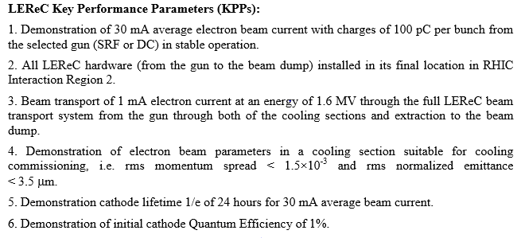
Critical Questions Where are we and where should we be?
Key Parameters affected by laser performance To be completed by end of LEReC commissioning phase
(End of 2018)
Demonstration of 30mA requires sufficient Laser Power. - 8W on the Gun table have been demonstrated without aperture (1%QE 8W Laser = 33mA)
All Hardware Installed. - Beam stabilization through the Transport, as well as other Laser design changes are not yet installed
4. Demonstration of Beam parameters suitable for cooling. - Temporal Laser Pulse shape measurement still outstanding. Electron Pulse shape with Transverse Deflecting Cavity performed and temp. shaping setup optimized.

Slide 24
Critical Questions
BM = Before cooling system modifications
AM = After cooling system modifications
When can we expect stable laser intensity: Both short and long term?
When can we expect the thermal lens issues in the temp. shaping crystals to be resolved?
Should we expect 10W on the gun table or on the cathode as maximum?
What can be done to provide a more uniform laser profile on the gun table
Laser intensity stability in IR already incresed (BM: Short term 6% PV Long term 20% PV) (AM: Short term 4% PV Long term 18% PV) Main part of power fluctuations originate in SHG stage, not IR. (Still >12% PV Short term)
2,3,4: All connected to the same stage: Temporal Shaping Long crystals = Strong thermal lensing Very Large laser beam diameter = Clipping and beam quality degradation Stage is last in system. Improvements happen from the top to bottom of the system Possible solutions: Larger Aperture Crystals = Less clipping for same beam size YVO4 Crystals not available with larger aperture
BBO Available, but twice the crystal thickness necessary
Use of interferometers to reduce total crystal length (Misalignment robust interferometer in design stage)

Slide 25
Conclusion
Many open tasks to reach the originally proposed performance specifications
Appropriate steps have been taken during Run18 which led to improvements
24/7 capability
System protection
Increased repeatability and reliability
Increased power transport to the gun
Time remains very tight to enable remote control, performance improvements and diagnostic design, installation and comissioning before the end of LEReC commissioning phase

Slide 26
Acknowledgements
Laser group: Michiko Minty, Brian Sheehy (retired), Zhi Zhao, Patrick Inacker & Linh Nguyen
LEReC AIP Project Team under the lead of Alexei Fedotov
CAD Support groups

Slide 27
Measurement of the EOM Extinction Ratio
EOM was set up to dump all light into the High power meter (Simulates Tripped MPS system)
Leaking light intensity was measured and compared to EOM in 100% transmission mode
Intensity Control
Low Power Meter
High Power Meter
Temp. Shaping
EOM

Slide 28
Temporal Shaping
Large beam in Temp. Shaping Crystals clips on the Crystal edges
Small beam in Temp. Shaping Crystals leads to extreme thermal lens
YVO4 Crystals
Crystal Length | Transparency
19.68mm | 88%
9.84mm | 96%
4.92mm | 98%
2.46mm | 99%
Total | 82%

Slide 29
Temp. Shaping with interferometers
No Misalignment
Angle Misalignment
Not Robust
Robust

Slide 30
Laser Protection System
Room Interlock
Personal Protection
Interlock Box
Machine Protection (Laser MPS)
Independent systems
Both have to agree to enable the Laser
Sensor Box
Laser
Power/Fluorescence
Temperature
Chiller
Temperature
Flow

Slide 31
Laser Protection System Flow Chart
Monitoring Loop
If YES Enable System
Monitored Parameters
In Range to SetPoints?
YES
Look up Failure Mode
Chiller Temp.
Chiller Flow
Module Temp.
Power
...
if Main_Amp_Chiller_Flow == 0 Interlock_Main_Amp;
Alert_Operators;
If Chiller_Pre_Amp_Flow == 0
Interlock_Entire_System;
Alert_Operators;
...
NO
When Interlocked: Wait for RESET

Slide 32
LEReC Laser Transport

Slide 33
Relay Table Layout
To LEReC
+35“
f = 7m
Camera
+12“
To CEC
Camera

Slide 34
Gun Table Layout
From Relay Table
Photodiode
Motorized
Zoom lens
Pinhole Wheel
Power Meter
Sampler
X-Motion
f = 1m
Flip-Mirror
Filter Wheel
Motorized
tilt-mirror
Y-Motion
Power meter
To DC-Gun
Camera

