Slide 1
Laser for Low-Energy RHIC electron Cooling (LEReC)
Zhi Zhao
July 2, 2018

Slide 2
Topics
Average green power
Spatiotemporal profile
Short-term & long-term stability

Slide 3
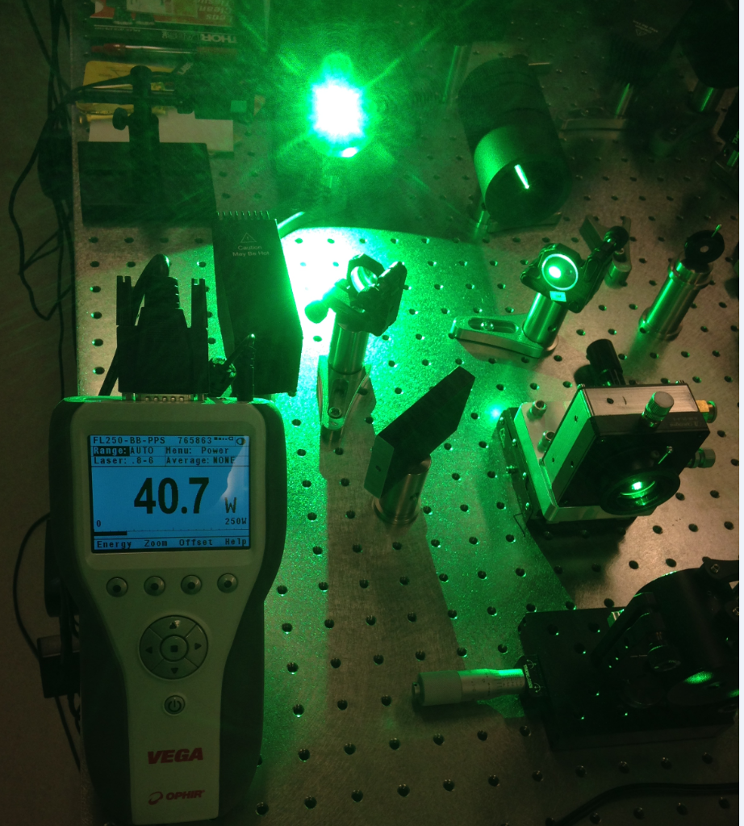
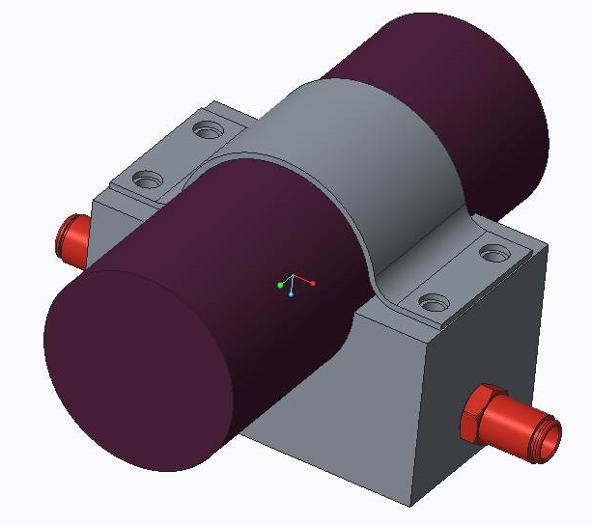
Green Power (I): EOM
Delivery power: 40 W
Operation value: 25 W
Damage threshold: 20 W (specification)
Heat sink for EOM:
(1) raising the damage threshold
(2) stabilizing the bias voltage
Drawing by Steven Bellavia

Slide 4
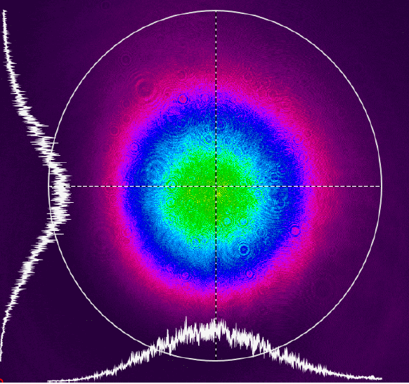
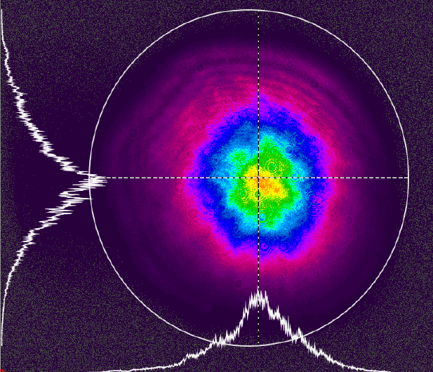
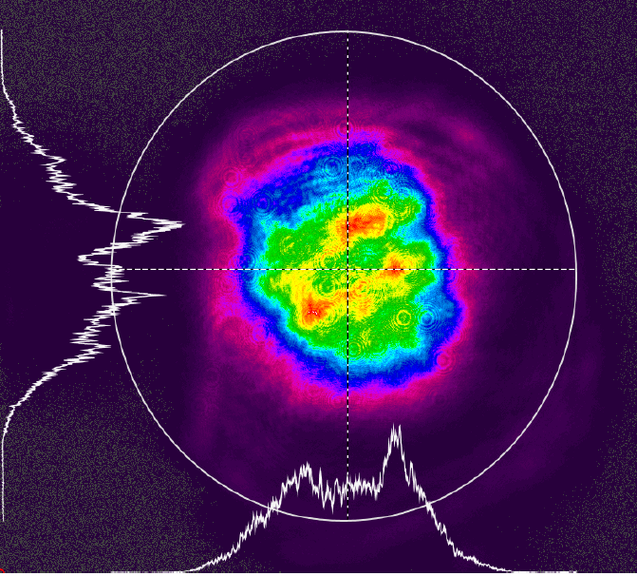
Green Power (II): Shaping Crystals
Input
40 W: 6.2 mm/6.2 mm
4 crystals
6 crystals
Output
25 W, 4.5 mm/5.1 mm
20 W, 4.2 mm/4.5 mm
Small thermal lensing
Modest thermal lensing

Slide 5
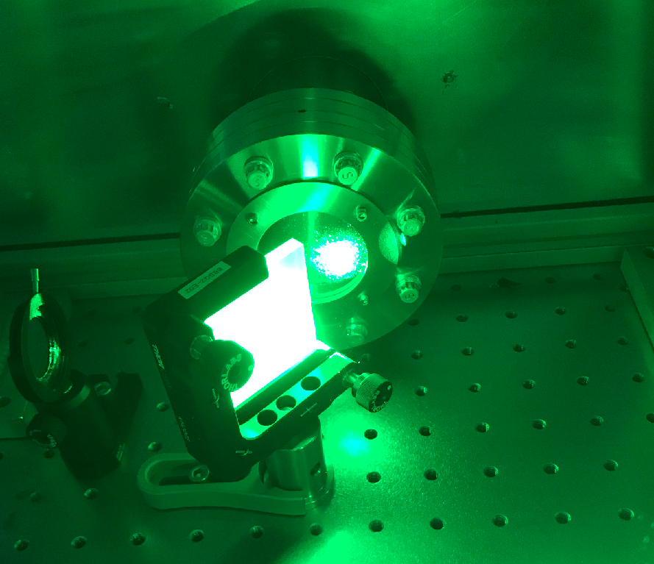
Green Power (III): Transport
Big beam size!
Efficiency is not reduced from low to high power.
Clipping in mirrors
Aperture in the pipe
Pipe replacement?
80% transport efficiency: 20 W (4 crystals) and 16 W (6 crystals) at the DC gun table and > 10 W at the cathode.
Alignment in EOM, crystals, and transport: excellent spatial mode.

Slide 6
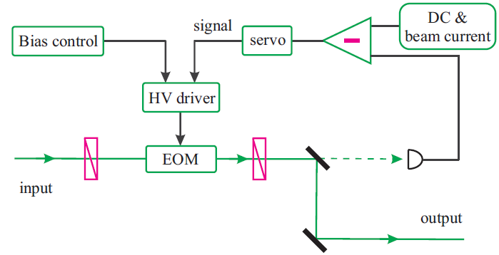
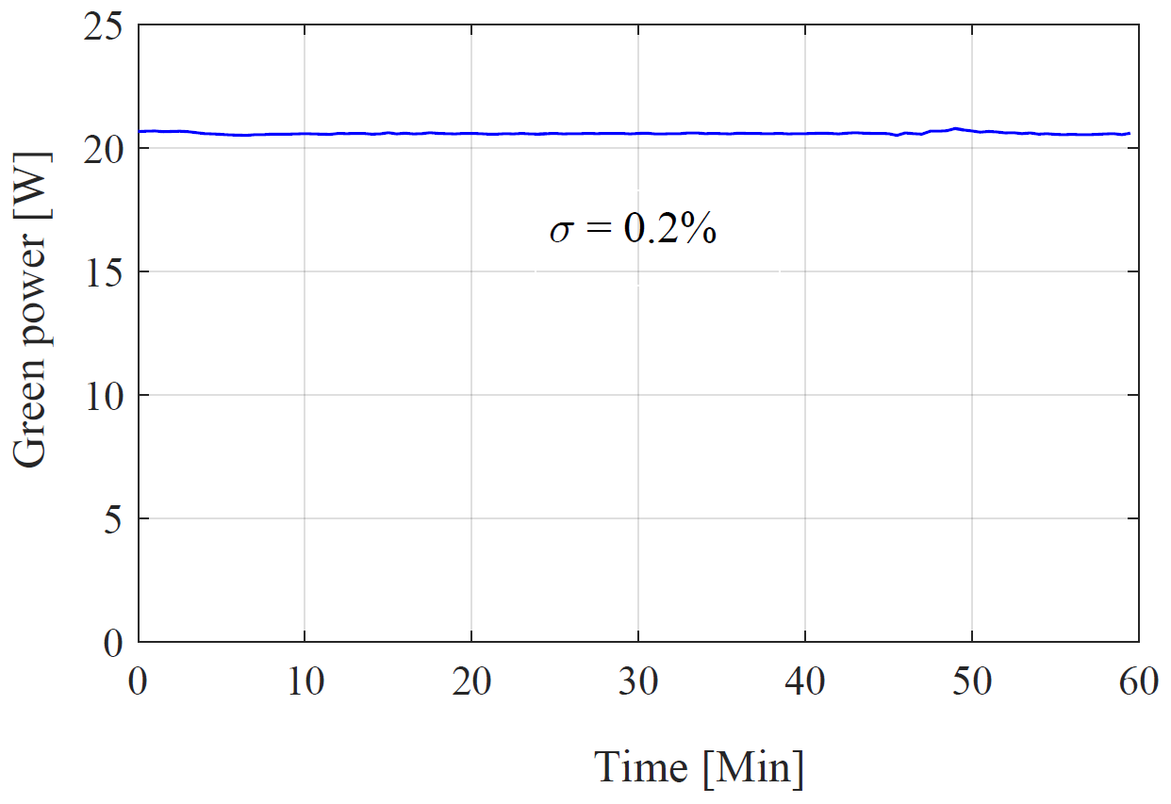
Green Power (IV): Stabilization
Feedback functions:
Stabilizing light intensity
Stabilizing beam current
Remote control by Michael Costanzo
Enabling/disabling feedback
Optimizing the bias voltage
Stability limited by meter accuracy

Slide 7
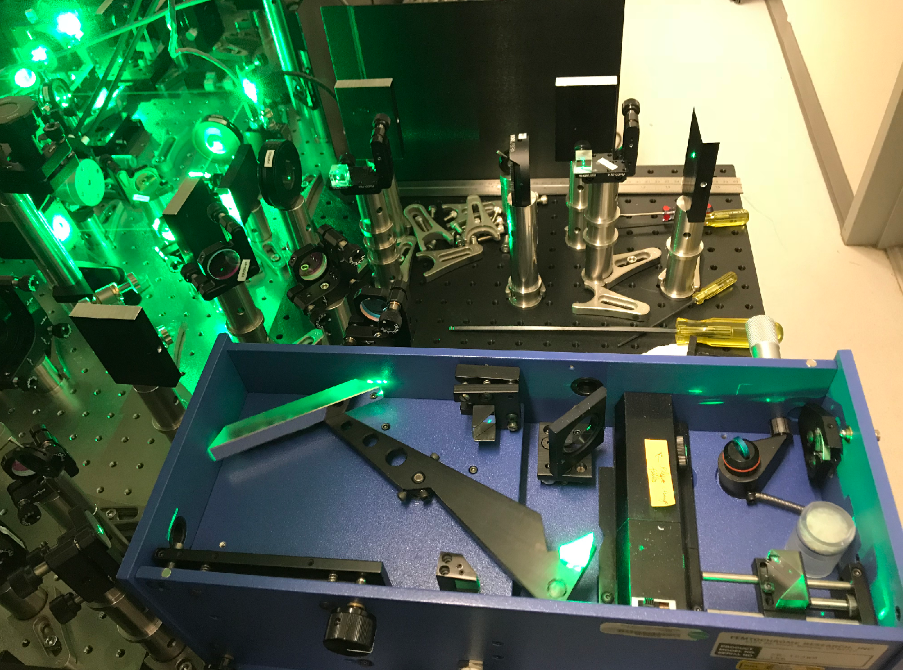
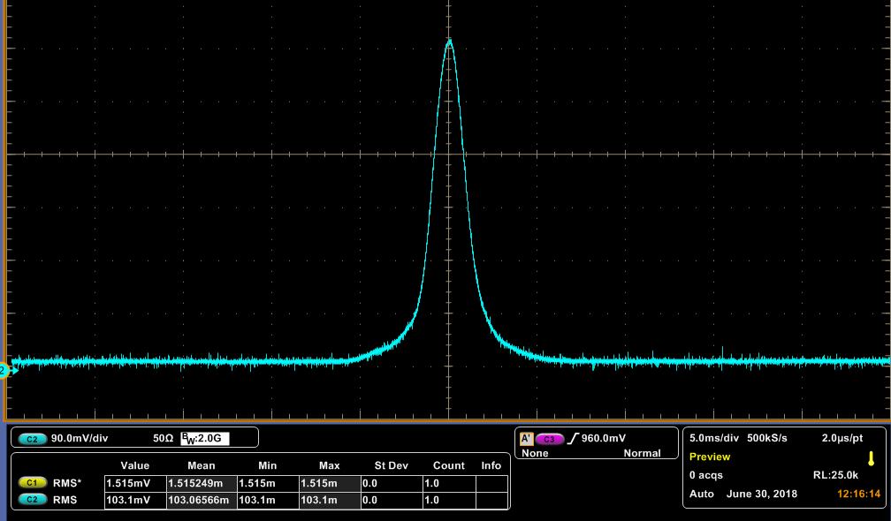
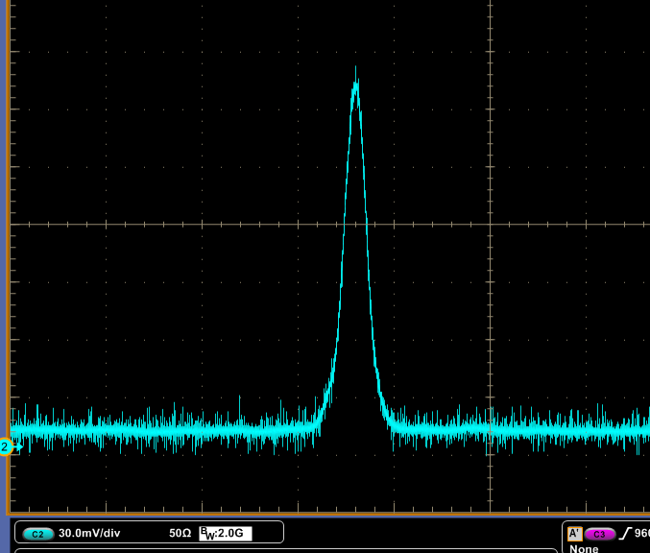
Temporal Profile
AC signal
CC signal
Cross-correlation measurement is underway.

Slide 8
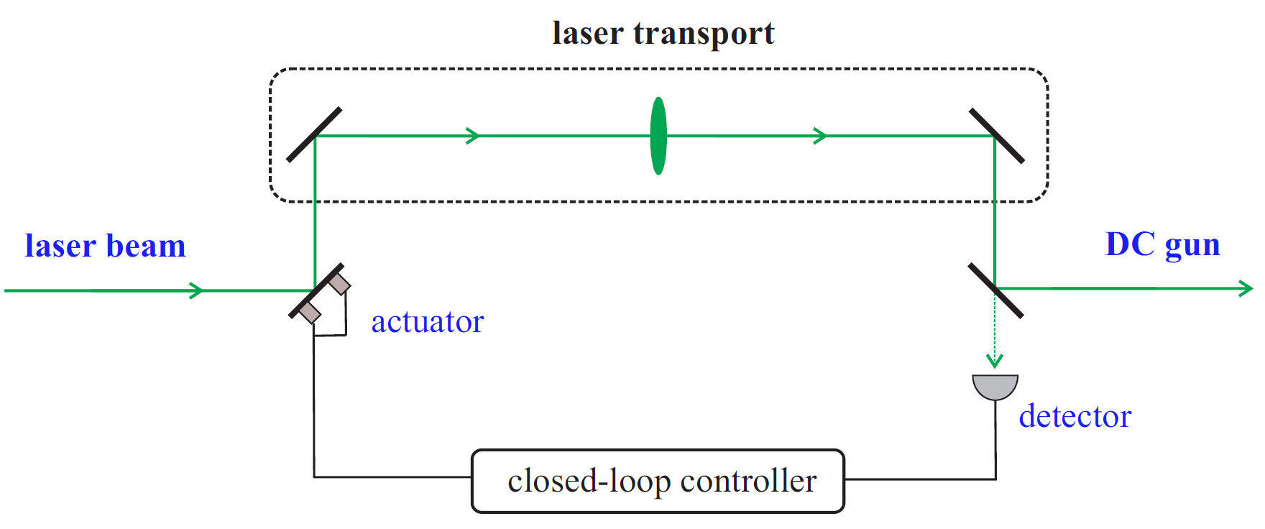
Beam Point Stability: Active Feedback
Target:
Correcting range: <2 mm
Vibration freq.: <100 Hz
Operation mode: cw & pulsed
Point instability: <40 µm & 10% beam size
It is very likely two feedback systems will be used.

Slide 9
Summary
Average green power for >10 W @ cathode
(1) heat sink for EOM; (2) transport improvement.
Uniform spatiotemporal profile
(1) transport improvement; (2) cross-correlation measurement.
Short-term & long-term stability
(1) remote EOM feedback for light intensity and beam current;
(2) position feedback for beam point stability.

