Slide 1
Photocathode production, transport and use
Erdong Wang on behalf of photocathode team
Brookhaven National Laboratory

Slide 2
Outline
Overview of photocathode systems for LEReC
Achievements
Upgrades of cathode growth system and cathode transport
To do list
Questions and answers
Summary

Slide 3
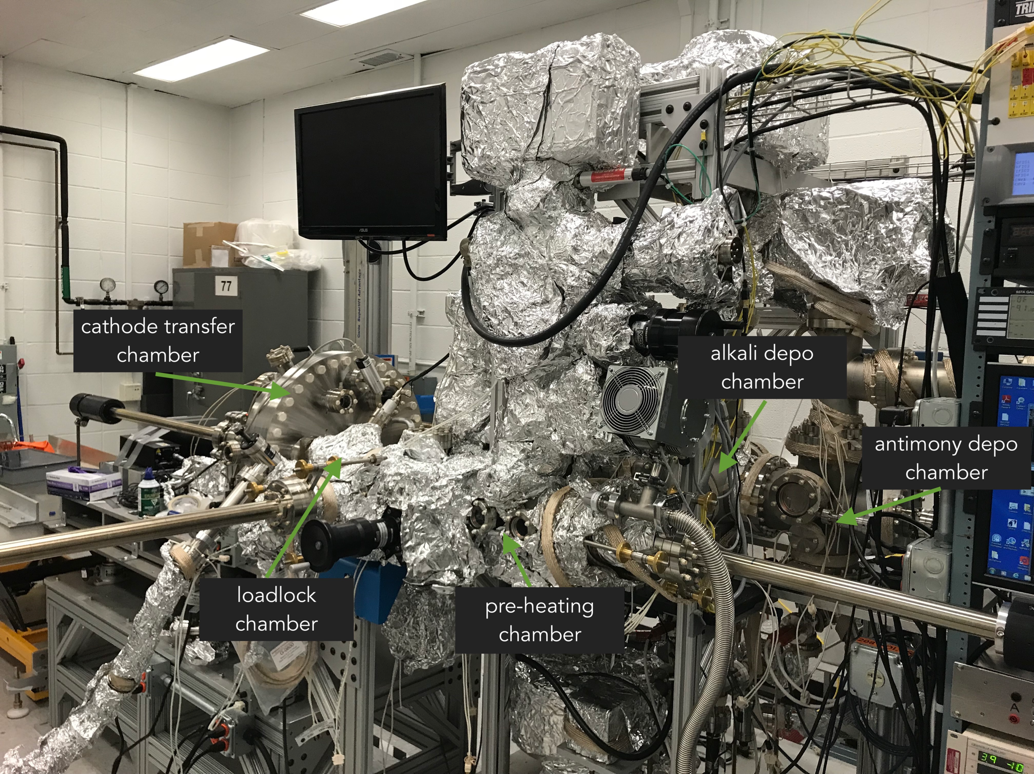
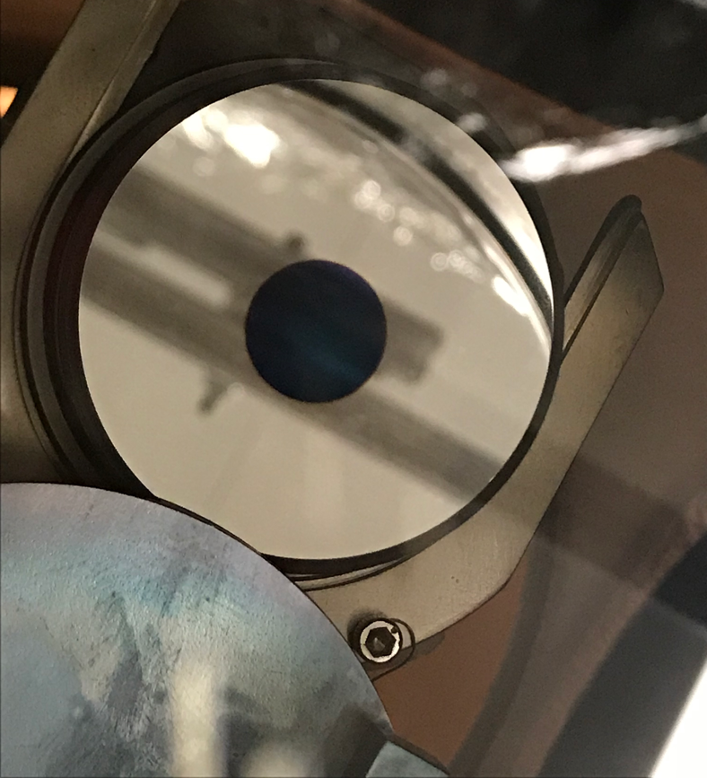
Photocathode growth systems
e e
K
K
K_{x}Sb
Mo
CsK₂Sb
Sb

Slide 4
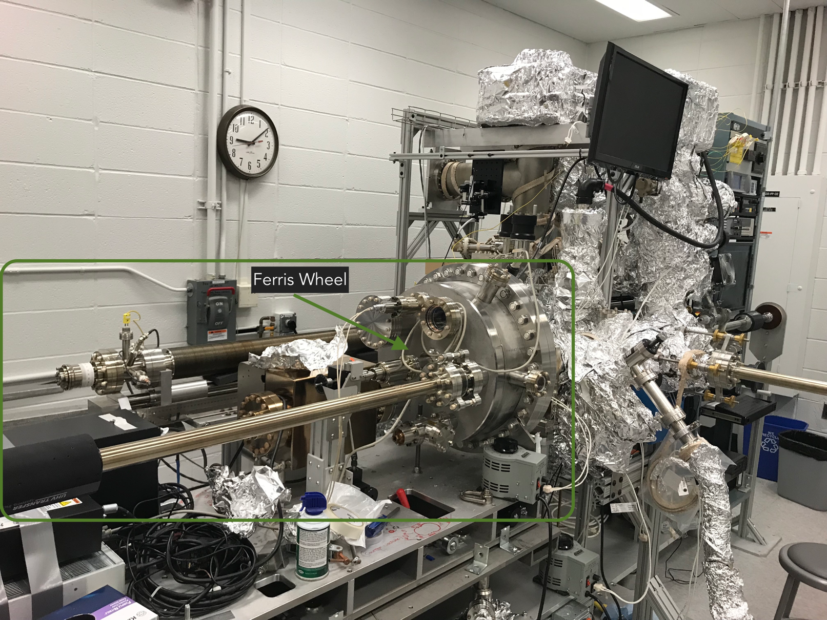
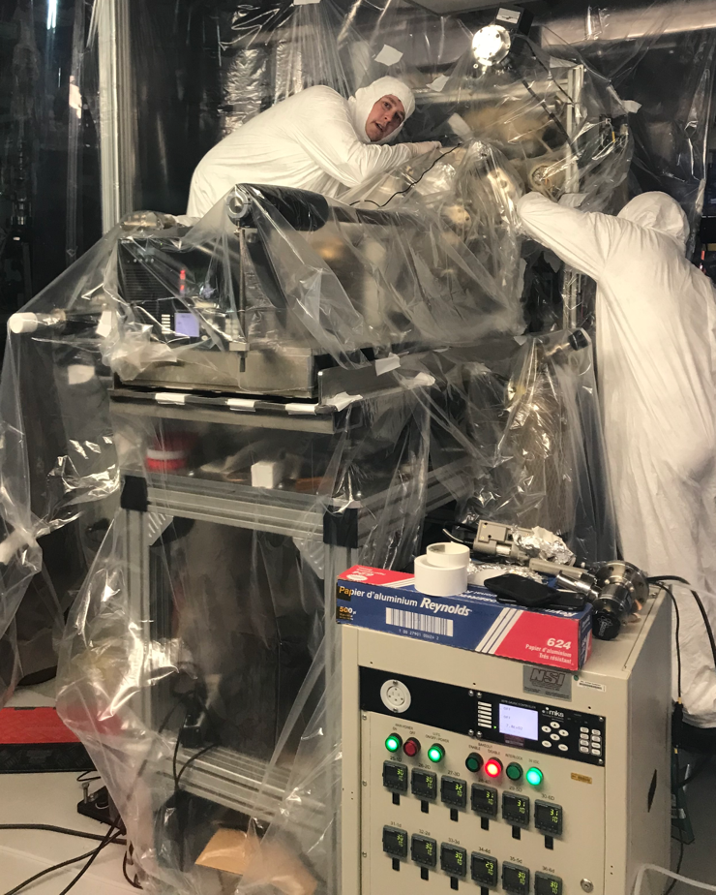
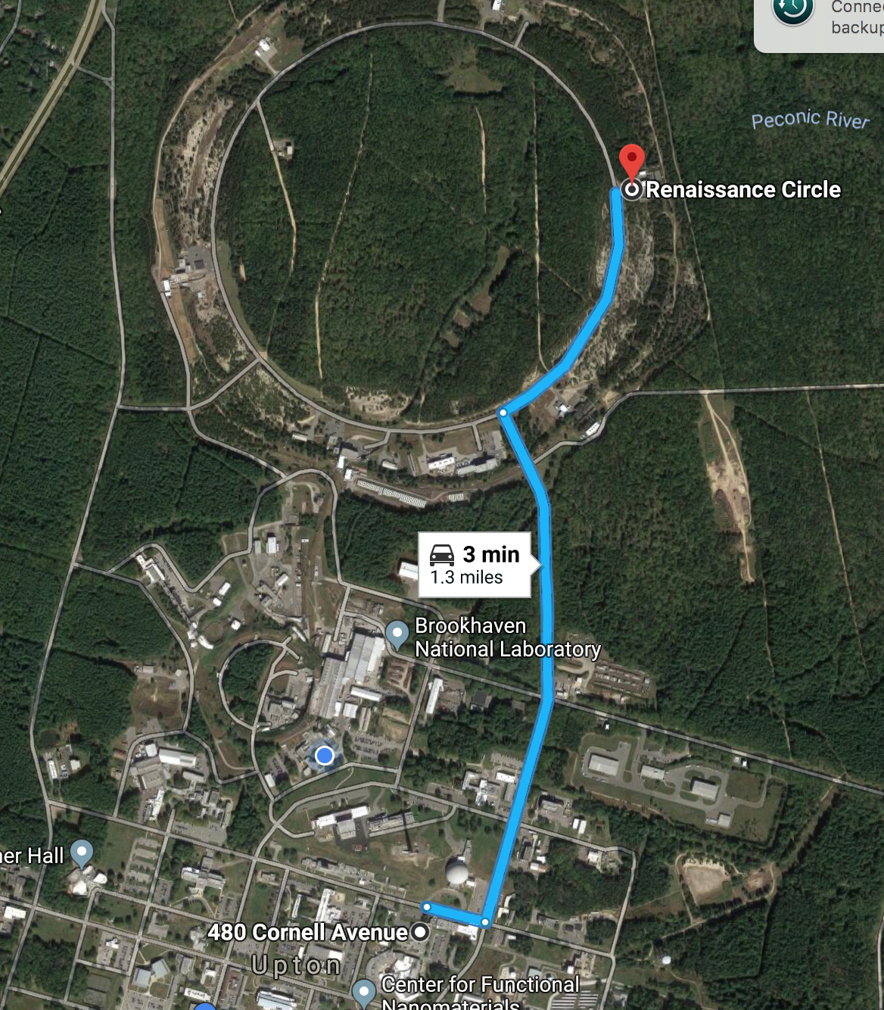
Cathode transport system
2 Ferris wheels are in use.
Third one is in assembly.

Slide 5
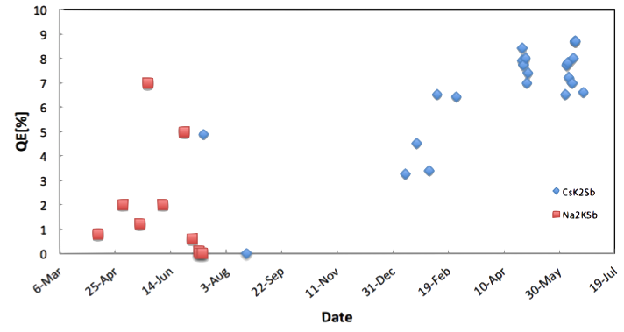
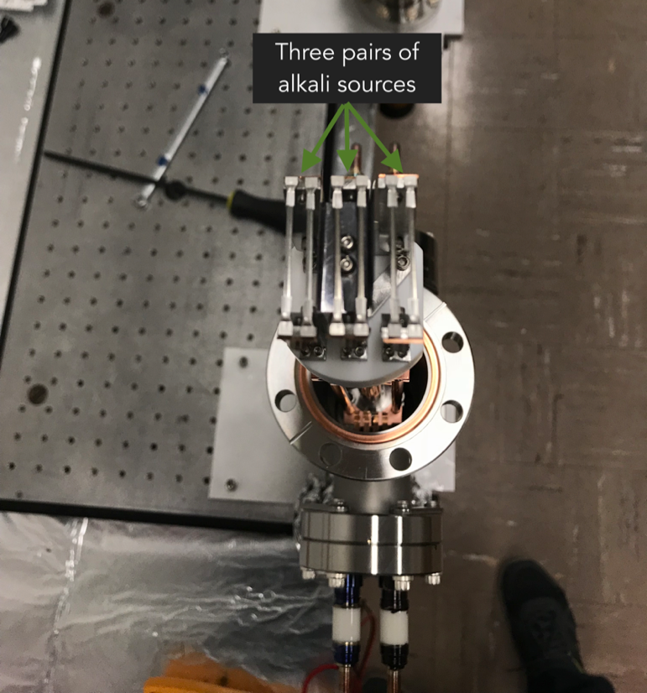
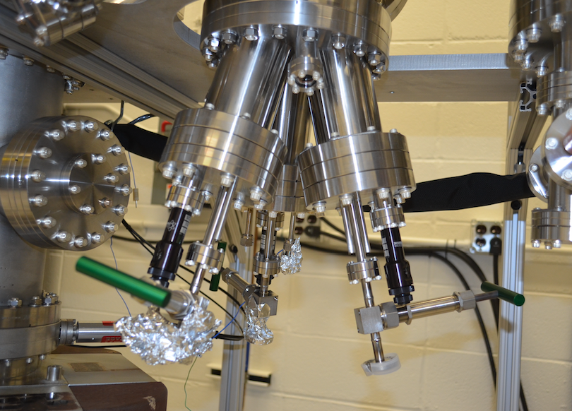
Progress in this run_cathode growth I
We switched Na₂KSb to CsK₂Sb which we have many years experience.
- Quickly get into production mode.
The homemade Effusion cells have been changed to Commercial SAES alkali source.
- Reliable and sufficient for growing 12 cathodes.
The co-evaporation has been changed to sequential evaporation.
- Controllable and simplified recipe; Better uniform.
Total: 31
Tested in gun:10

Slide 6
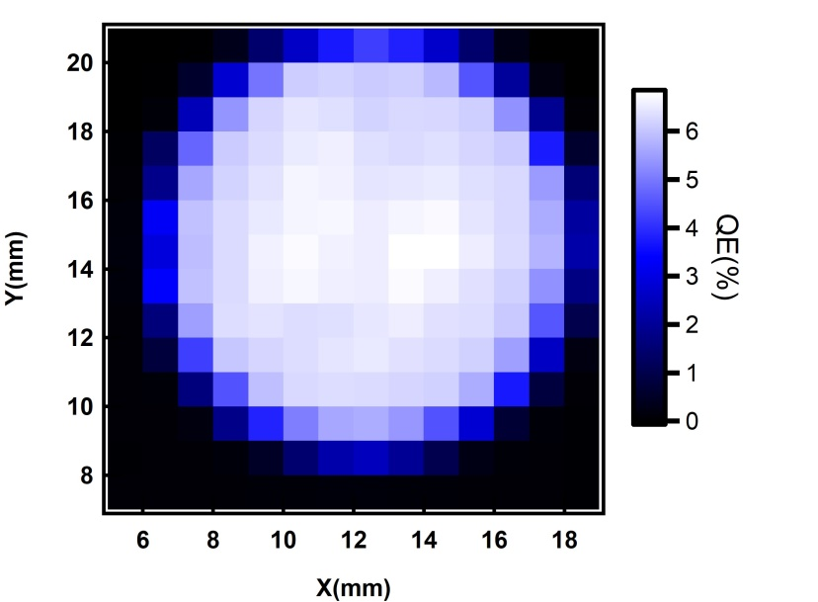
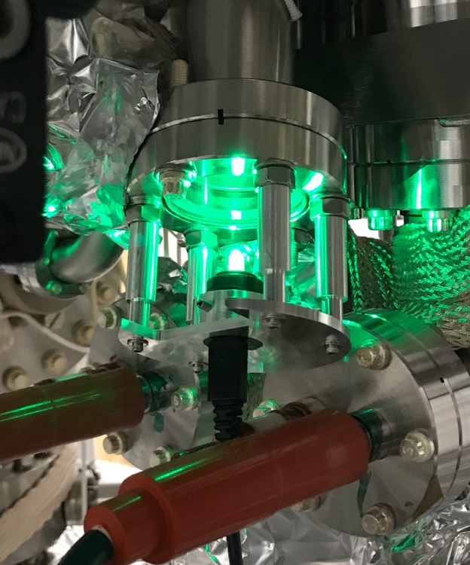
Progress in this run_cathode growth II
X-Y stage for cathode uniformity measurement are available.
-Fast QE scan, save couple hours.
Pre-heating chamber has been installed.
-Heat two pucks together, save a half day.
Developed a detail procedure.
-Reproducible and reliable
LEDs replace lasers in cathode preparation
-For small and off-center cathode preparation avoid time consuming laser alignment

Slide 7
Upgrade on 1st deposition system
Fix damaged parts
-Two 30 years valves; leaked wobble stick;
Off-center mask installation
- Fixed 6 mm diameter ,off-center 4mm, Ti mask
Improve the vacuum
-Install a NEG cartridge in growth chamber.
Replace the borrowed RGA.
Three to four weeks upgrade. In progress.

Slide 8
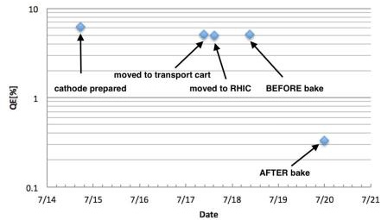
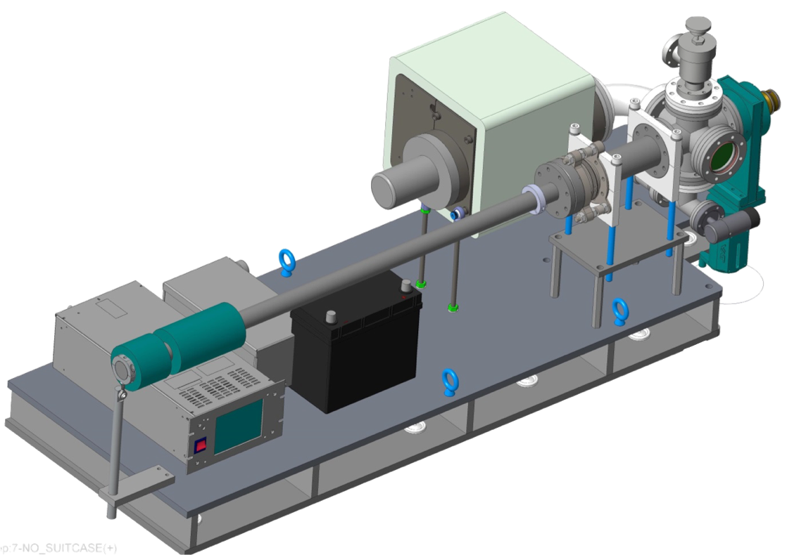
Cathode transport at 2017
 | Material | Suitcase | Lab QE | In Gun QE (est)
Cath#1 | Na₂KSb | #2 | 1.7% | 0.1%
Cath#2 | Na₂KSb | #1 | 7% | 0.3%
Cath#3 | Na₂KSb | #2 | 4% | 1.2 %
Cath#4 | CsK₂Sb | #1 | 5% | 0.7%
Single cathode transport is not work due to cathode cold gas trap…
We were in trouble at 2017…

Slide 9
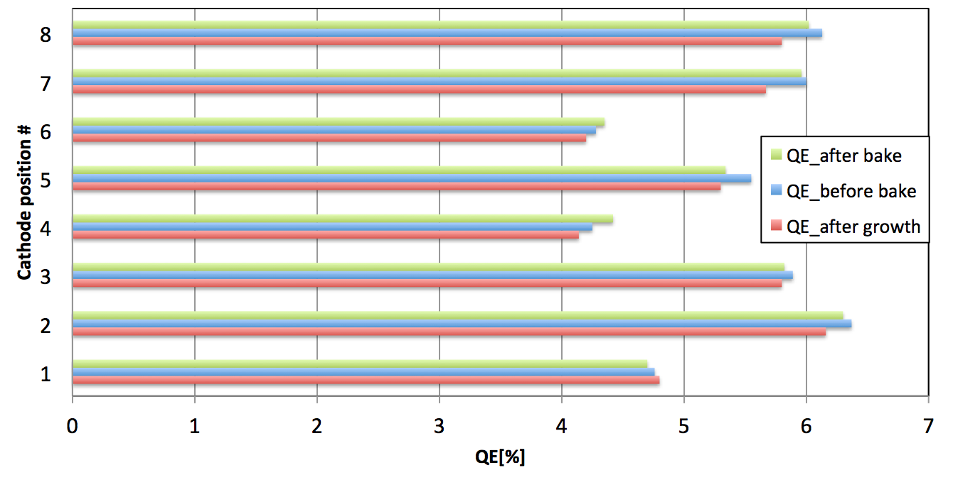
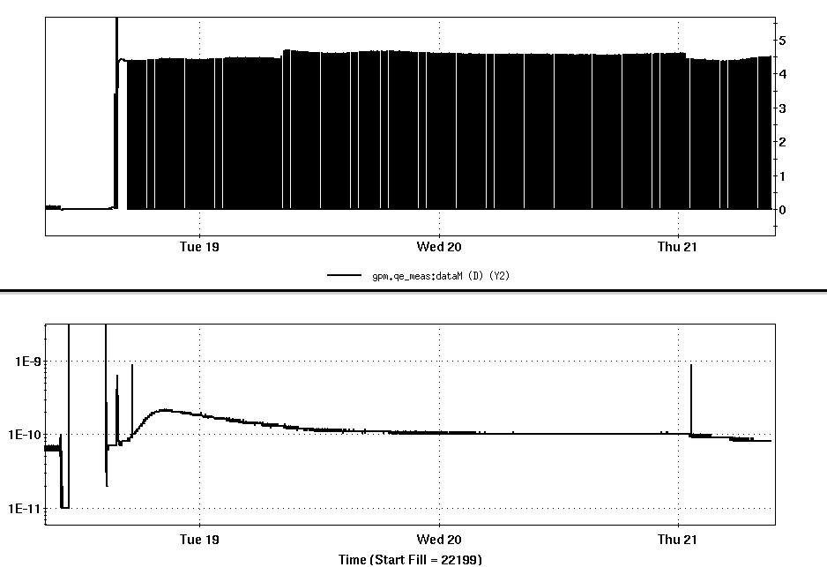
Progress in cathode transport at 2018
8 Cathodes were prepared in 10 days. All survive with good QE in transport.
Load lock has been baked for 52 hrs, no QE drops!
Change valve and seal
Very well bake
Problem solved !

Slide 10
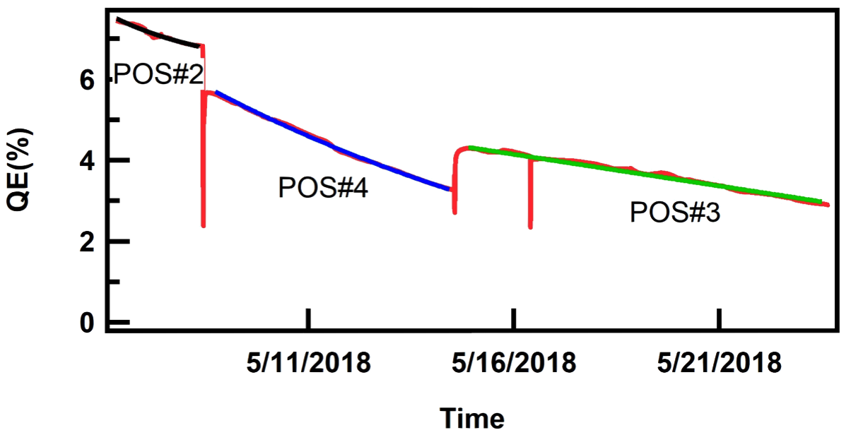
Lessons we learned
Not well bake : leaking, virture leak, spray seal…
Pucks exposed to bad vacuum for long time.
Not only bad initial QE, also very short lifetime

Slide 11
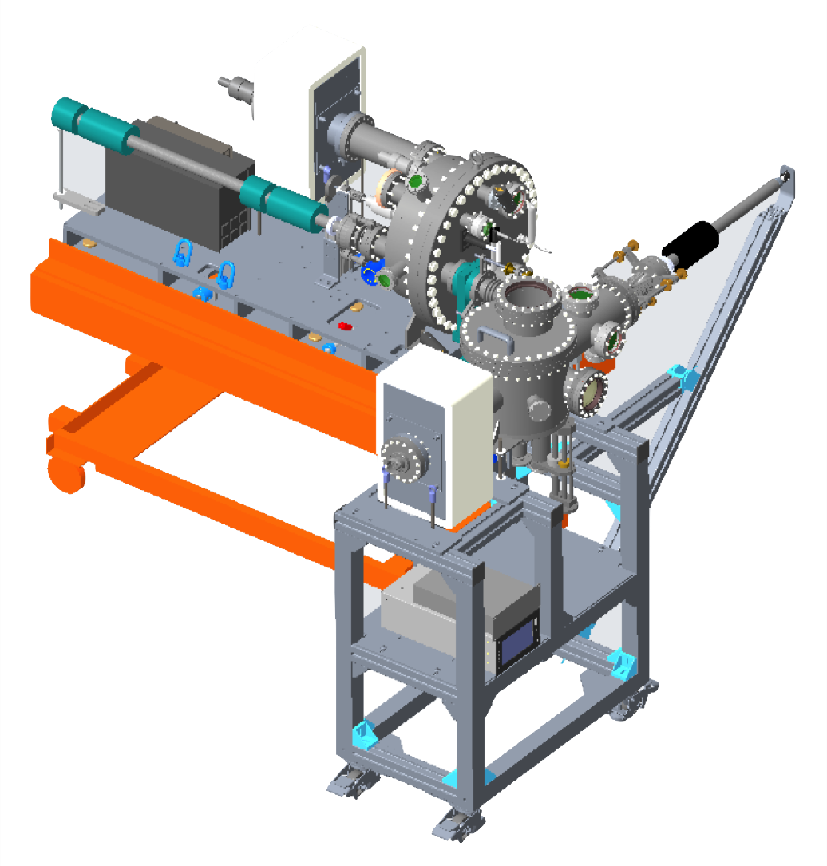
Next step
The second cathode deposition chamber has been designed and in fabrication.(schedule into production mode by mid-Nov.)
Movable off-center mask
Evaporation efficiency design, could grow more cathodes and quickly.
Puck cooling device: Shorten the time for growing cathodes.
Dual puck pre-heating chamber-manipulator design: Convince to transfer puck.
Providing capability to hold two pucks in the deposition chamber.
Providing short evaporation distance for the sources on the cathode deposition chambers: Save alkali material.
Puck exchange equipment has been designed and will be available next year.
Avoid multiple bakes on FW
Quick turn around, save weeks.
Study NaK₂Sb recipe in shutdown
May increase lifetime
Clean room setup at Bldg 535
Ferris wheel
Exchange chamber

Slide 12
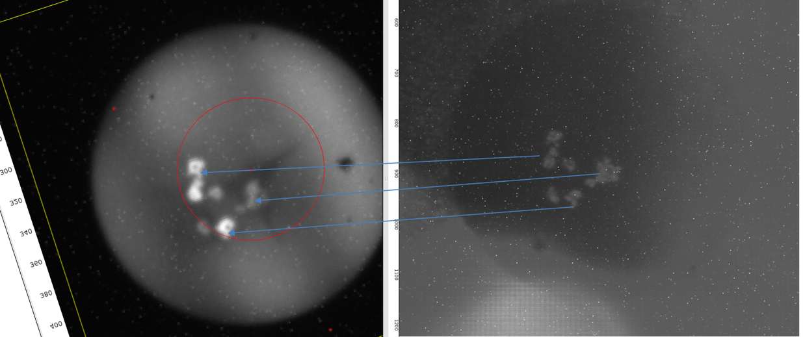
Questions and answers
Will off cathode area help with constant requirement to re-condition the Gun after CW running?
Answer: Yes and no. Cathode material may drop to the electrodes and reduce the work function…
However, both JLab and Cornell don’t need re-conditioning; QE increasing on discolor spots also not support cathode material peel off, it may be caused by crystal annealing.
My opinion: The gun may not be fully conditioned. The radiation must be exactly zero after HV conditioning.
Many hours
Go to higher voltage and stay there for more than 24 hrs.

Slide 13
Summary
The cathode deposition system has been commissioned and demonstrated its capability of producing high QE and uniform bi-alkali antimonide photocathodes repeatedly.
We will provide off-center and small area cathode after deposition system upgrade.
The cathode transportation and storage system works very well. Recent results show that all 8 cathodes has no QE decay in cathode transport, load-lock bake and cathode transferring.
Second deposition system, puck exchange chamber, third Ferris wheel will be ready for next year run.

Slide 14
Photocathode team
Joe Tuozzolo
Mengjia Gaowei
CJ Liaw (with all designer support)
John Walsh
Robert D Lehn
Donald Vonlintig
Mike Mapes (all techs support)
John Smedley
Zenggong Jiang

Slide 15
Thanks for your attention!

Slide 16
Cathodes
Second cathode production system, timeline?
Production of cathode with off center active area.
Looks like we have established reliable cathode production with very good QE.
Cathode delivery and baking procedure is also established.
Will off cathode area help with constant requirement to re-condition the Gun after CW running?

