Slide 1
Low-Energy RHIC electron Cooling (LEReC) RF To-Do Items for Summer/Shutdown 2018
K. Mernick
2 July 2018

Slide 2
2.1 GHz Cavity
Getting more power delivered to the cavity
New 20 kW circulator – delivered last week, install this week
Improved 12-way combiner – install week of 7/9
Second 12-way combiner plus 2-way combiner – week of 7/26
Cavity trips
Hopefully cavity conditions better once more power is available
Source of trips seems to be multipactoring when tuner moves, but the tuner behavior is not totally understood
If this continues to be a problem, might have to address during shutdown (maybe open cavity to inspect/replace tuner, maybe try to figure out a way to work around it with some combination of LLRF and cavity temperature)

Slide 3
Cavity Field Regulation
Multiple inter-related items are required to meet energy specification
Long term drift (t > seconds, minutes, hours, days) performance needs to be investigated – some data from CeC is surprising, need to collect similar data on LEReC systems and then correlate with beam based measurements
Feedback loop performance for medium range time scales (~10 s > t > ~100s μs) looks to be close to meeting requirements
Very short term performance for pulsed beam (t < ~100s us) addressed with feedforward – firmware/software support for this was loaded about a week ago and first beam tests on Thursday 6/28

Slide 4
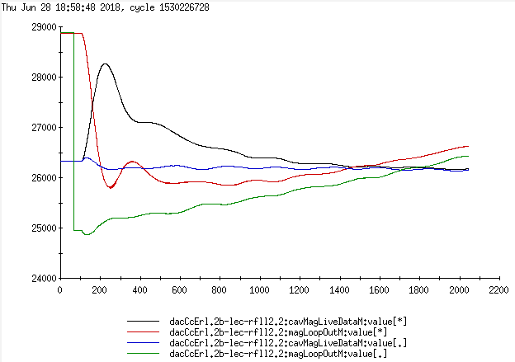
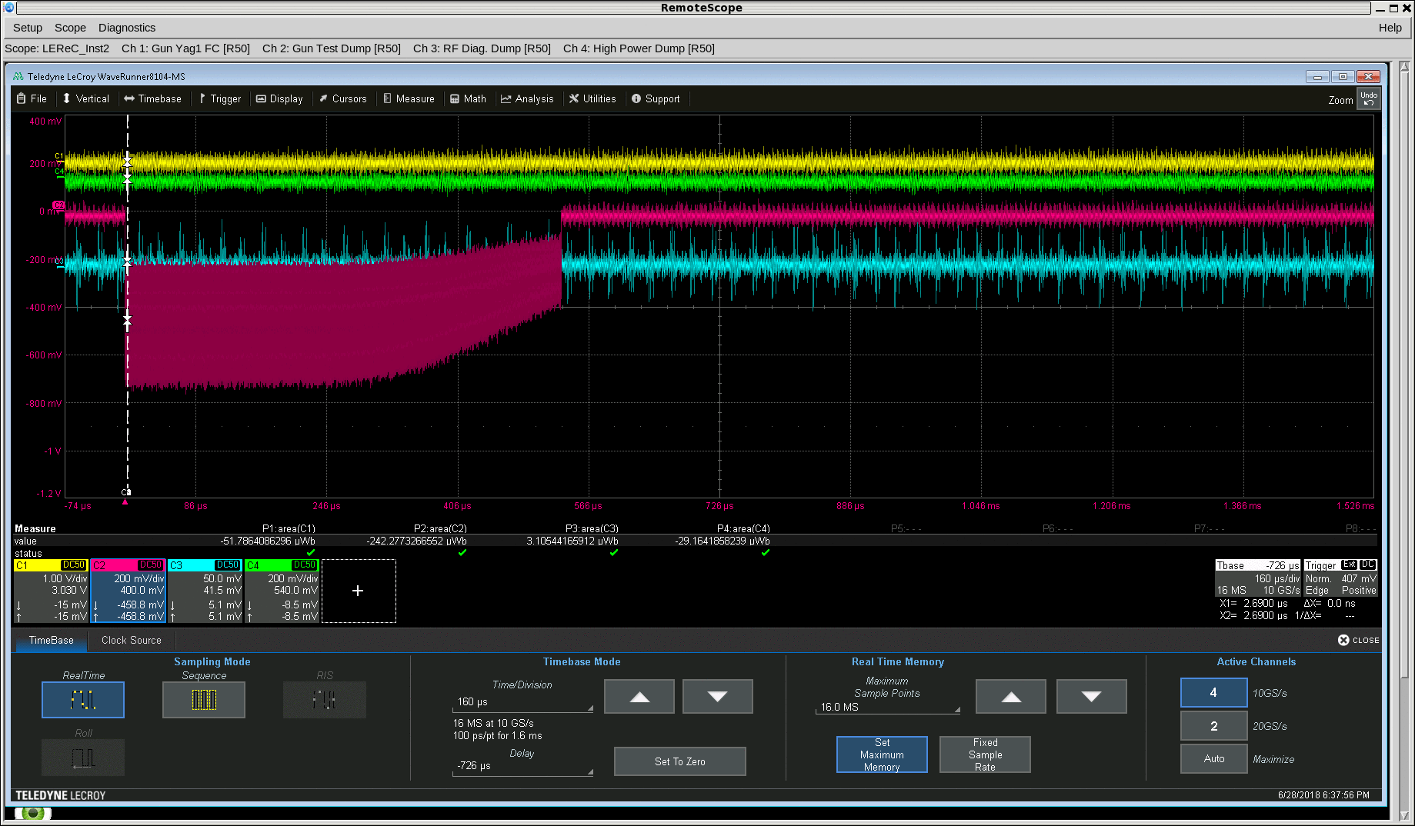
Feedforward Beam Loading Compensation
~100 μs, 20 MSps
1 kV ≈ 172 counts
500 μs beam pulse
Feedforward compensation of cavity worked (in non-automated test) – but it doesn’t stop the beam loss by itself
Looks like energy loss from gun is still dominant effect
Arrival phase of beam at cavities looks like it’s changing
Feedforward is basically irrelevant at time scales > time constant of RF feedback loops

Slide 5
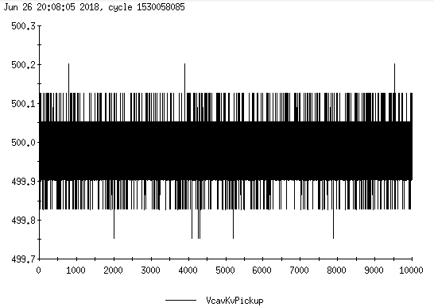
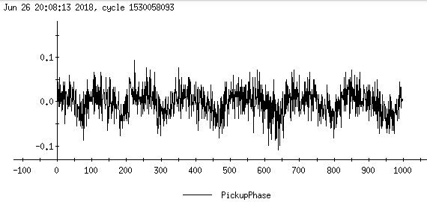
Feedback / Short Term Regulation
“In loop” measurements of amplitude and phase regulation of cavities meet the requirements when there is no beam*
Need more tests with significant amounts of beam in the expected operating conditions (i.e. not CW tests with 100-200 kV on booster)
Need “out of loop” measurements to verify (and compare all cavities to each other
Need more development of laser and beam pickup measurements
*when cryo noise is not too bad
and assuming pickup measures cavity field seen by beam

Slide 6
Long Term Energy Stability
We have several efforts for “open loop” long term stability – rack temperature stabilization, cable temperature stabilization, loopback cable measurements – which all need development time
But beam based measurements are the only answer that matters
Diagnostic line could be used at some level, but relies on stability of magnets, etc. – shot to shot variation at this point is probably too much to get a useful long term measurement
180 degree bend spectrometer – as soon as possible we should start collecting long term data, hopefully leaving beam running through cooling section for entire night shifts with no changes (i.e. needs dedicated time, not parasitic to other commissioning efforts)
We can start collecting data for analysis using standard BPM logs. Energy feedback has some technical issues TBD (how to get necessary data from BPMs to RF). Rob H and LLRF have discussed this previously, but work remains. The technical solution depends on necessary bandwidth of energy correction.

Slide 7
Timing
It’s clear that “timing” means different things to different people in discussions. In general for LEReC, I consider it to include:
Generation and control of signals necessary to create the required laser pulse structure at the cathode (704 MHz reference to seed, 9 MHz gating to “fast” EOM, Pockels cell gate, fast shutter control)
Generation of required timing signals for instrumentation and other systems (much of this is handled by Controls with their standard hardware, but the initial source of the clock, “rev tick,” and “master event” come from LLRF)
Synchronization of LEReC systems to RHIC

Slide 8
Laser Timing
The constraints on RF development from having to provide the 704 MHz oscillator signal and EOM gate without interruption are significant. We have generally worked around this, but need better communication and an ability to switch the laser to a local 704 MHz reference sometimes (obviously only during no-beam times).
We have been running with what was initially called the “interim timing system” for about 18 months. This does not support the various configurations of harmonic numbers required for synchronizing to RHIC at any of the BES-II beam energies.
Various pieces of the “full” timing system were demonstrated to work about 2 years ago, but it requires significant engineering work to integrate and test the pieces. Mainly Mike C and LLRF (Tom, Geetha, me, probably Freddy at some point too), but also some Controls software support may be required. When it is far enough along to test integration with the laser, it would be very helpful to have a setup with just the laser oscillator and EOM (I believe there are spares of both) that we could work on without bring down the entire laser system. This would probably be in the October-December time frame.
We have no phase measurement from any laser signals now. This needs to be addressed. (I’m not trying to point fingers, this is as much my fault as anyone’s.)

Slide 9
“78 kHz” Mode
Is this required?
Is this going to happen?
What does it really mean?
Who does it affect?

Slide 10
Master Clock
The LEReC LLRF runs on a separate master clock from the RHIC LLRF now. This is an insignificant detail almost all the time. When it becomes relevant, it is a big deal. Switching the clock will have no impact on LEReC as currently operating except for the downtime it requires. Synchronization to RHIC is a trivial operation.
We had a plan for installing a new master clock in the LEReC system and using it as the master for RHIC, LEReC, AGS, Booster, CeC, etc.
Some of our testing has made us question whether that is the best approach. Basically, it comes down to a trade off between close-in phase noise (bad for RHIC ions) and broadband phase noise (bad for LEReC electrons).
Tom and I will figure out what we’re going to do and make sure it’s ready for September/October.

Slide 11
RF
Backup Slide: Alexei’s questions
1. 2.1 GHz PA: When we expect permanent fix to allow up to 250kV operation?
2. Beamloading feedback development
3. Achieving design specs on amplitude and phase.
4. Stability of energy to 1e-4 level. Feedback from hybrid BPM
5. RF clock timing. When can we expect it?

