Slide 1
LEReC Status Review Retreat
Instrumentation Systems
Toby Miller
July 2, 2018

Slide 2
LEReC Instrumentation Quantities & Progress
All systems installed.
Varying degrees of commissioning & operation

Slide 3
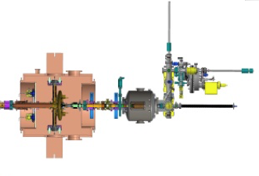
Gun Radiation Monitor
Canberra Calibrated System
2 probes
Used during gun conditioning
System Complete
(1) Downstream
(1) Upstream

Slide 4
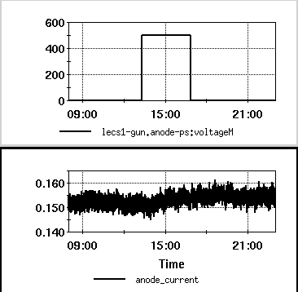
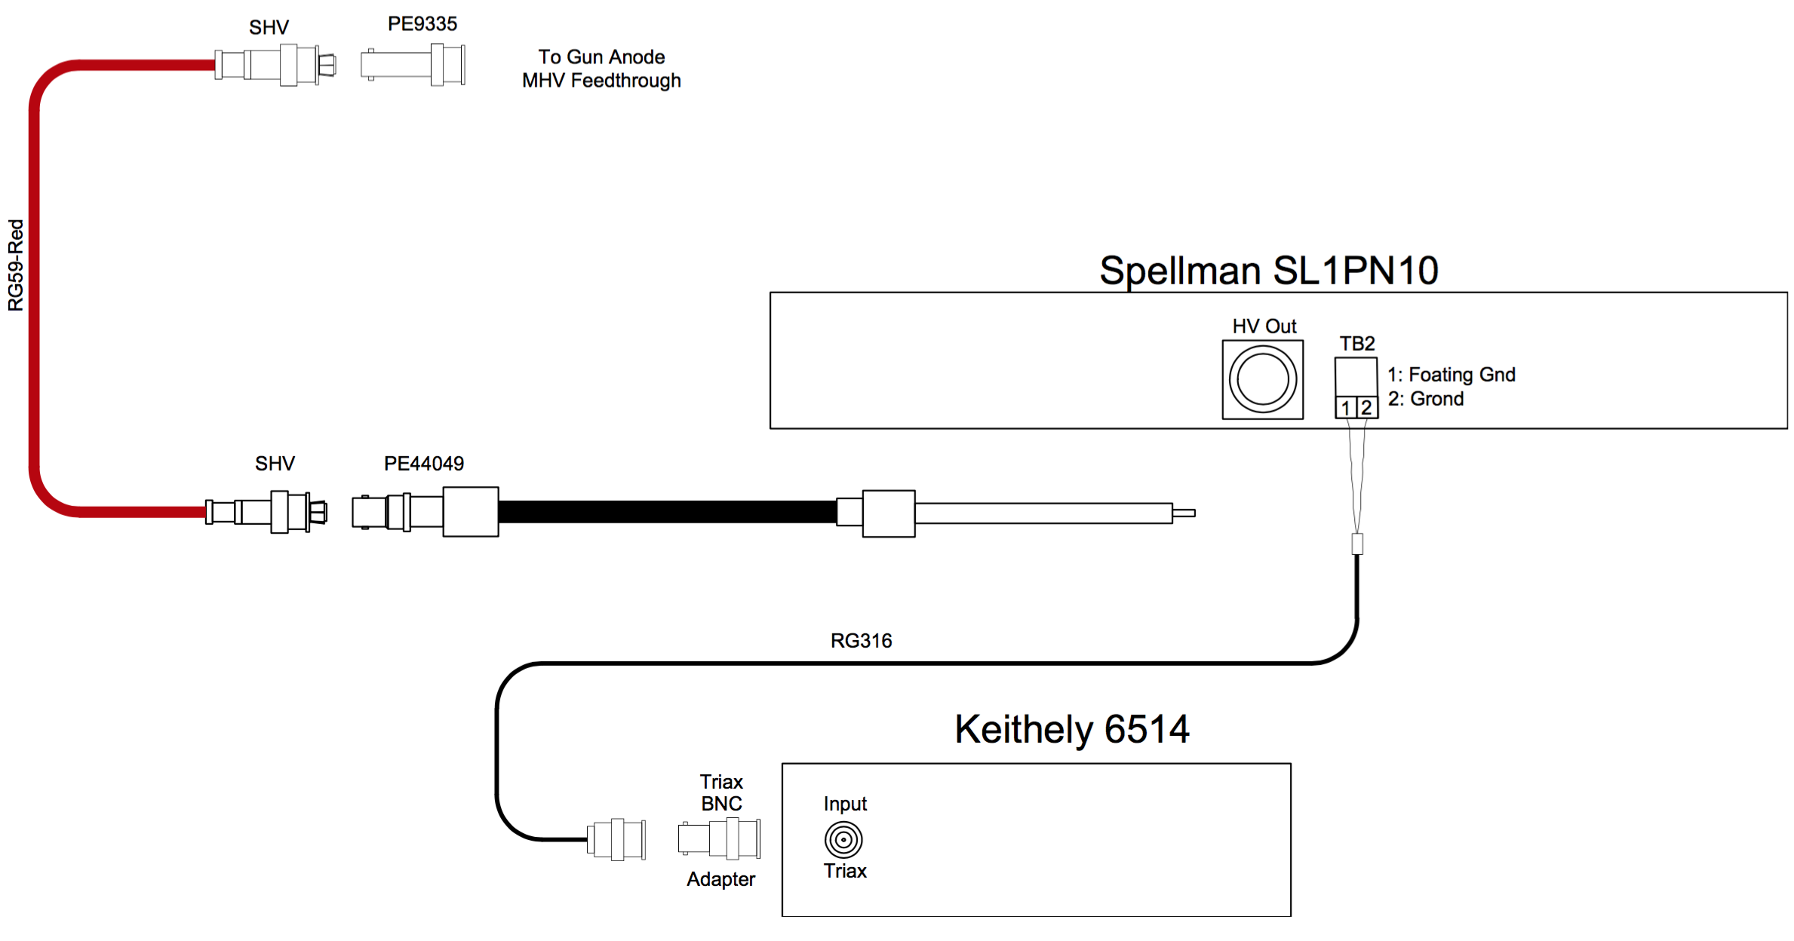
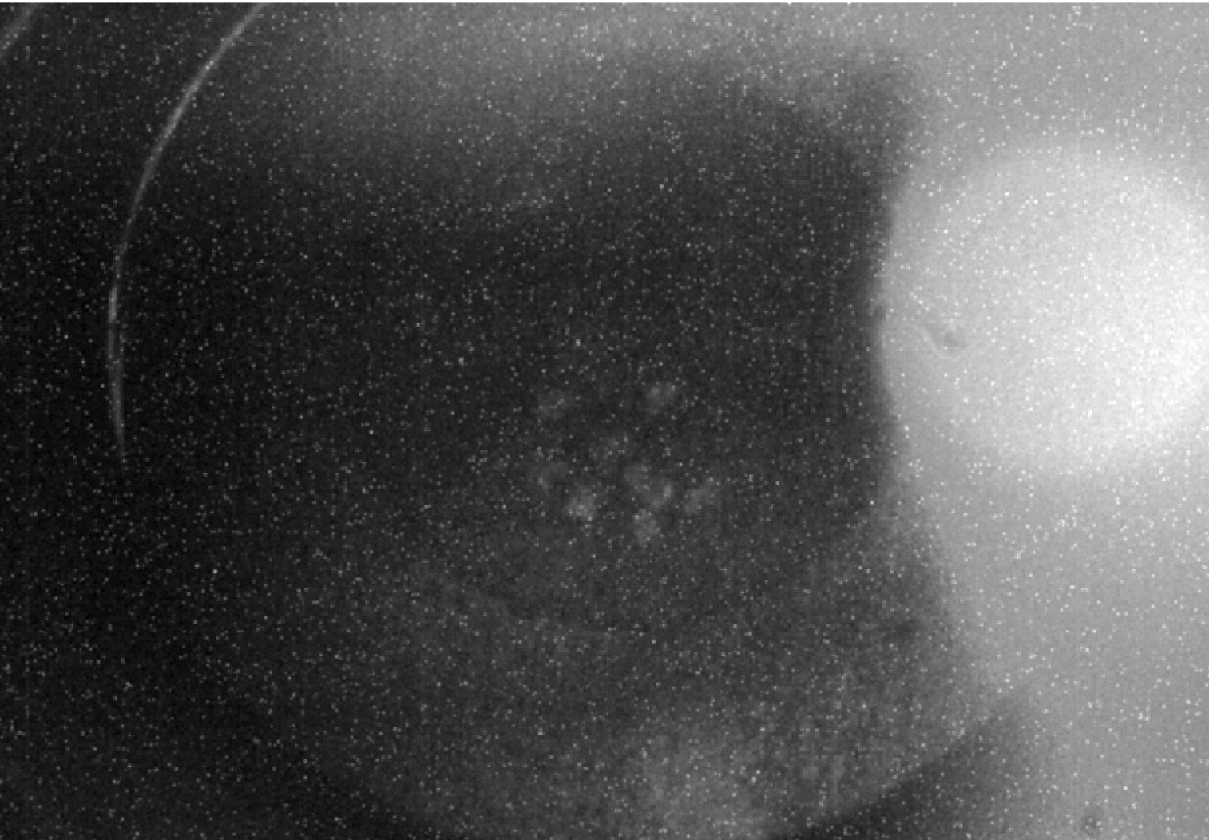
Gun Anode Bias
Bias Voltage: 0 – 1,000V
Series pA meter
No measured current thus far.
Is bias voltage enough to prevent ion back-bombardment?
Do we need higher bias voltage?
Cathode damage during CW

Slide 5
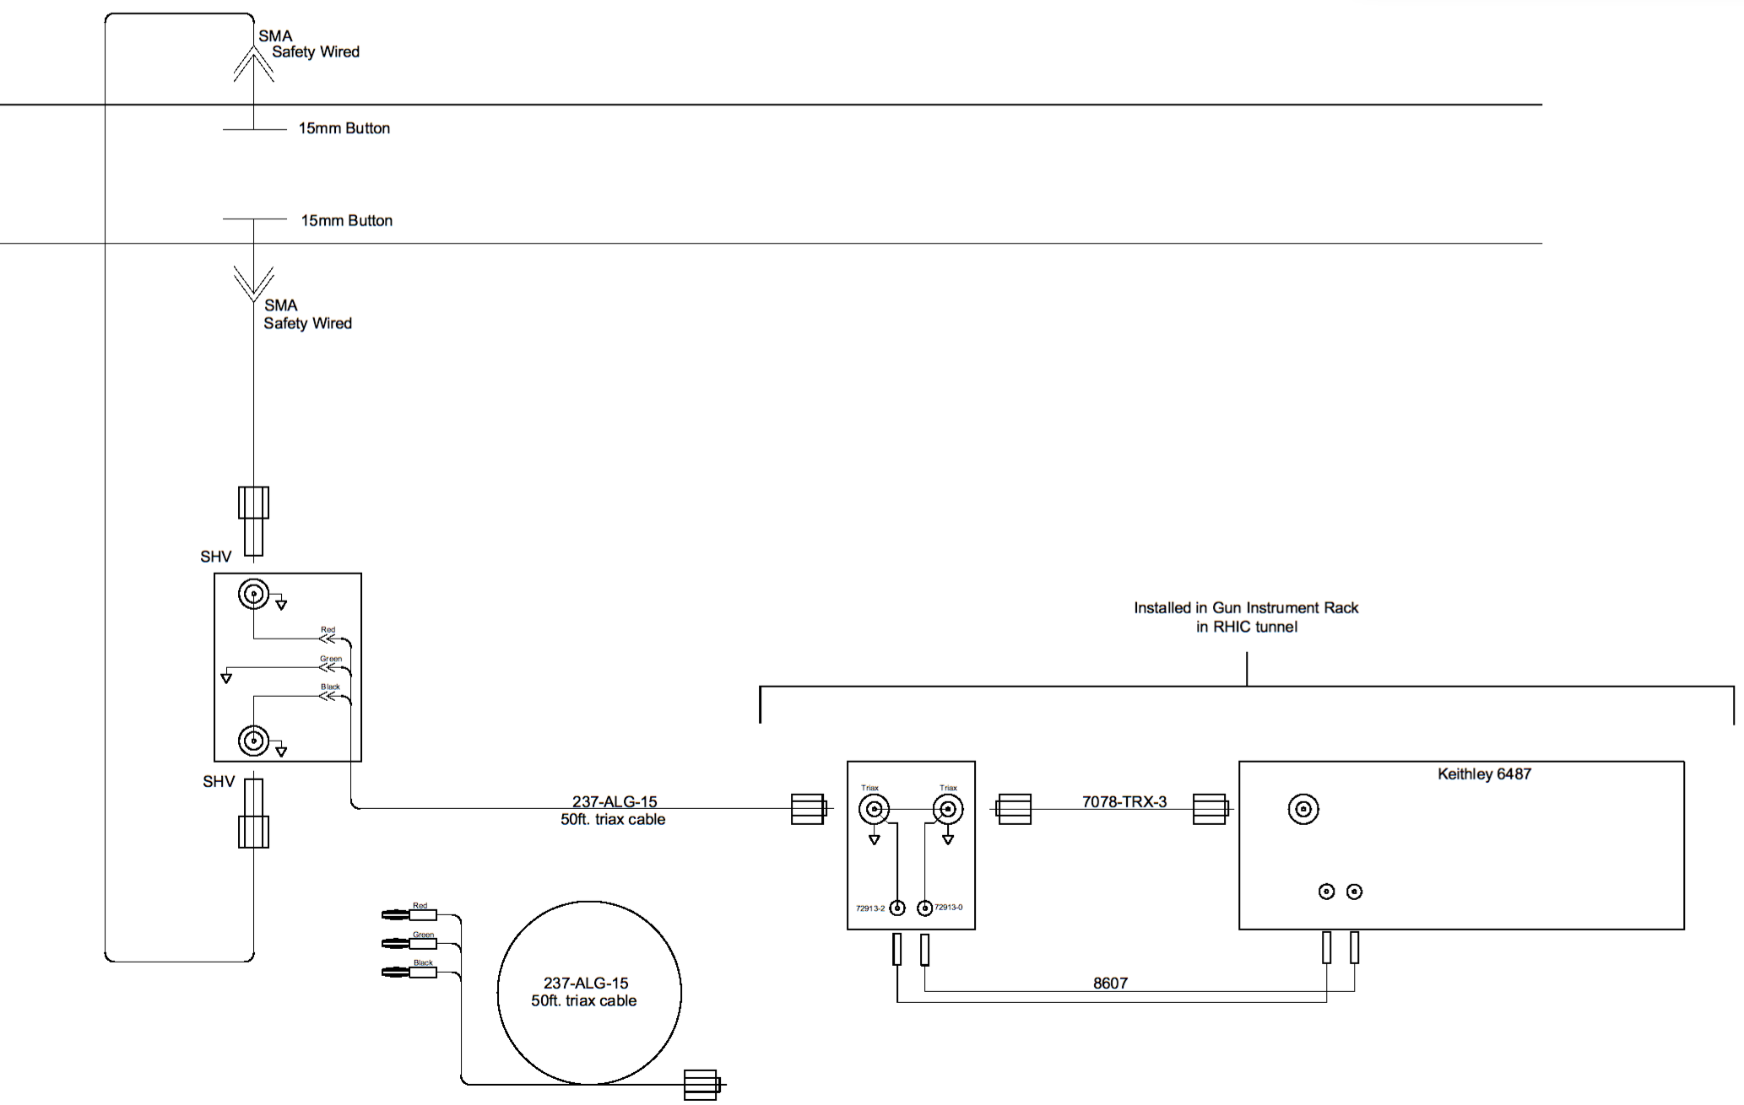
Ion Clearing Electrodes & pAmmeter
0 – 500V Bias across horizontal electrodes
15 mm buttons in Gun-to-Booster chamber
More testing needed to prove effectiveness with CW beam
Integrated pico amp current measurement

Slide 6
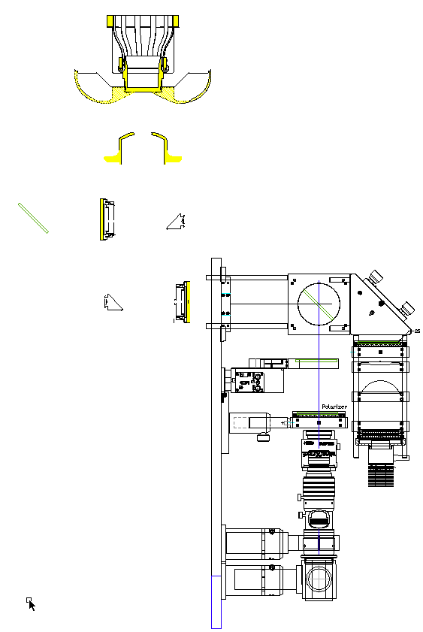
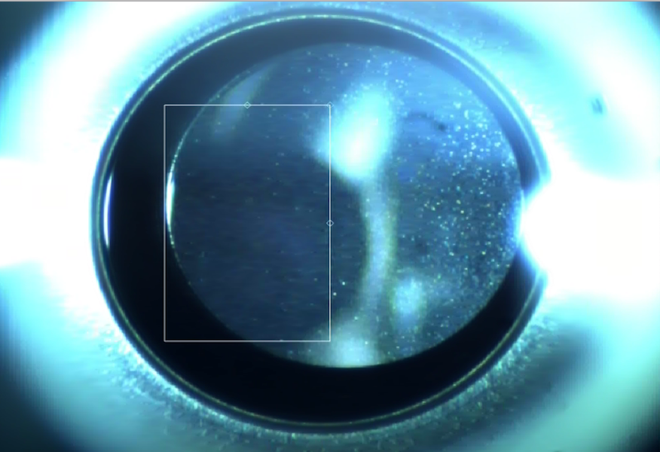
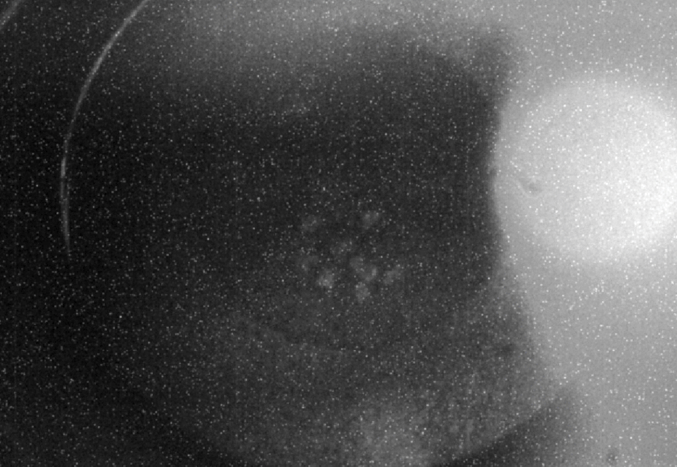
Laser Exit Table & Cathode Imaging
Laser IN
Status
Reduced image quality
shifted laser mirror reduced aperture
Red lamp makes poorer image in color camera – may switch back to monochrome camera
Limiting lamp intensity (10%) to guard against DC emission from cathode!
Need increased illumination –
add iris & lens system to get light through tight aperture
Full laser extraction for CW.
Need power meter installed to monitor extracted laser power.
Image after commissioning with white lamp
Most recent image with red lamp at 10% intensity & high gain

Slide 7
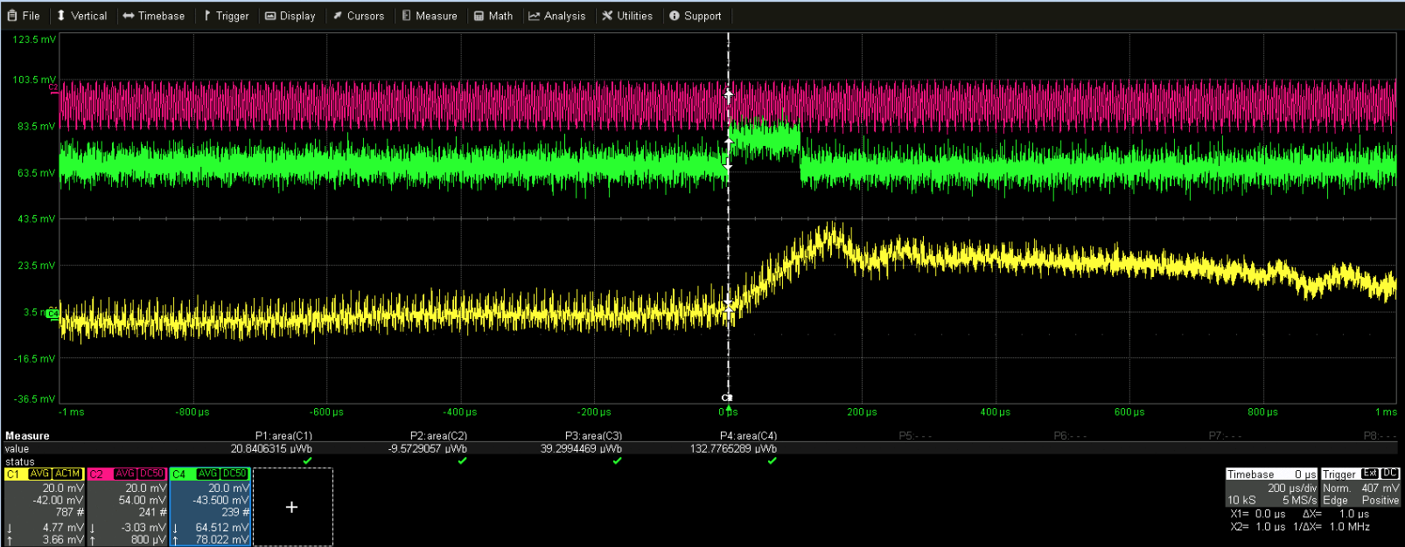
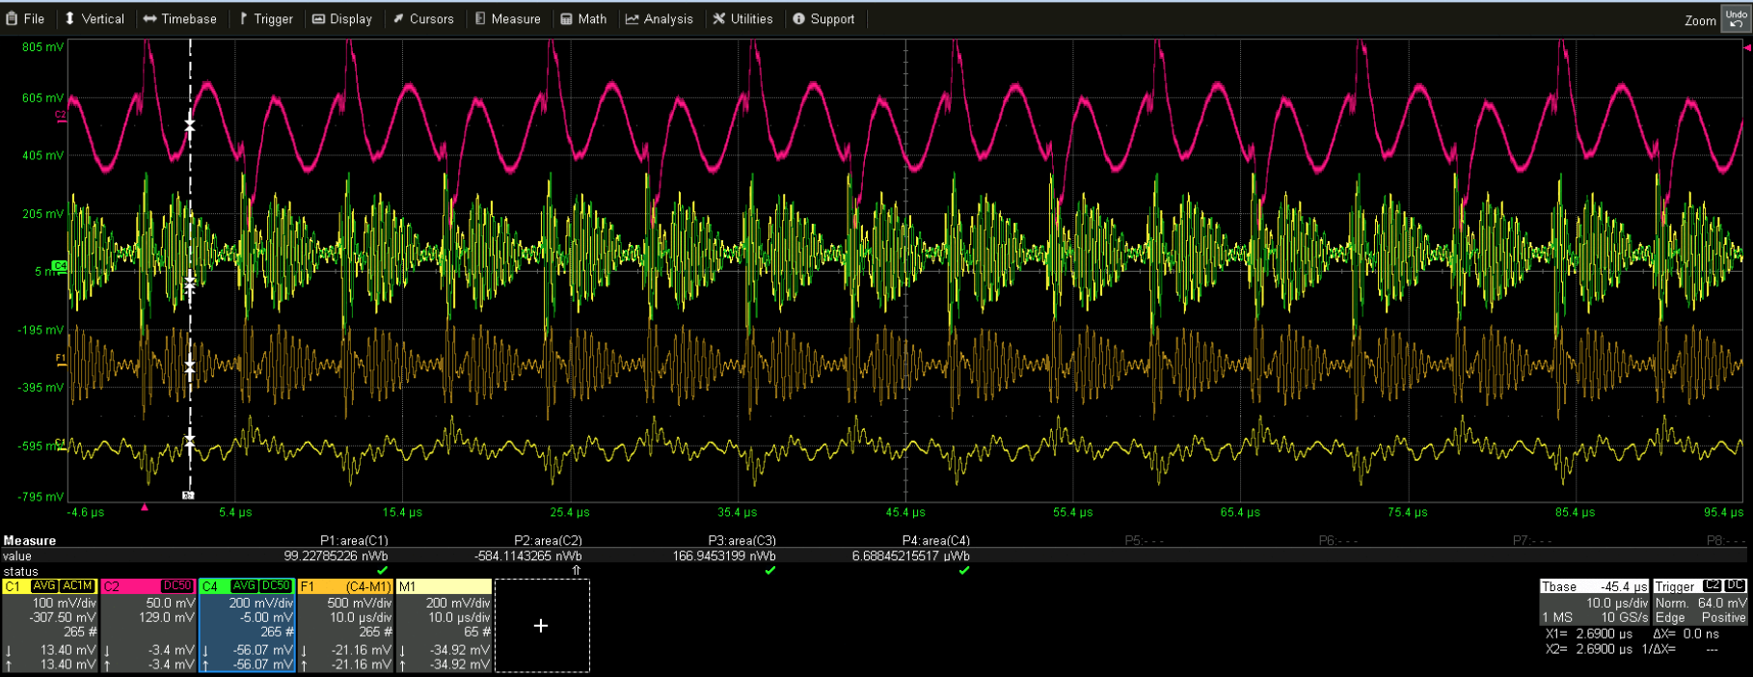
Gun HV Ripple Monitor
Measurements underway
(1) HVPS droop response to beam load in pulsed beam mode, but nonlinearity in FCT was discovered – Additional Tests Planned:
Delta Q tests
FCT
ICT
DCCT (with trains >100 us)
BPM sum
Delta Train Length tests with FCT at fixed Q
(2) HVPS ripple @ PS switching frequency in CW beam mode, results being analyzed
Gun capacitance measurement pending
Special probe being fabricated
Results to help predict added capacitance needed to mitigate ripple
Special probe for capacitance measurement
1
2

Slide 8
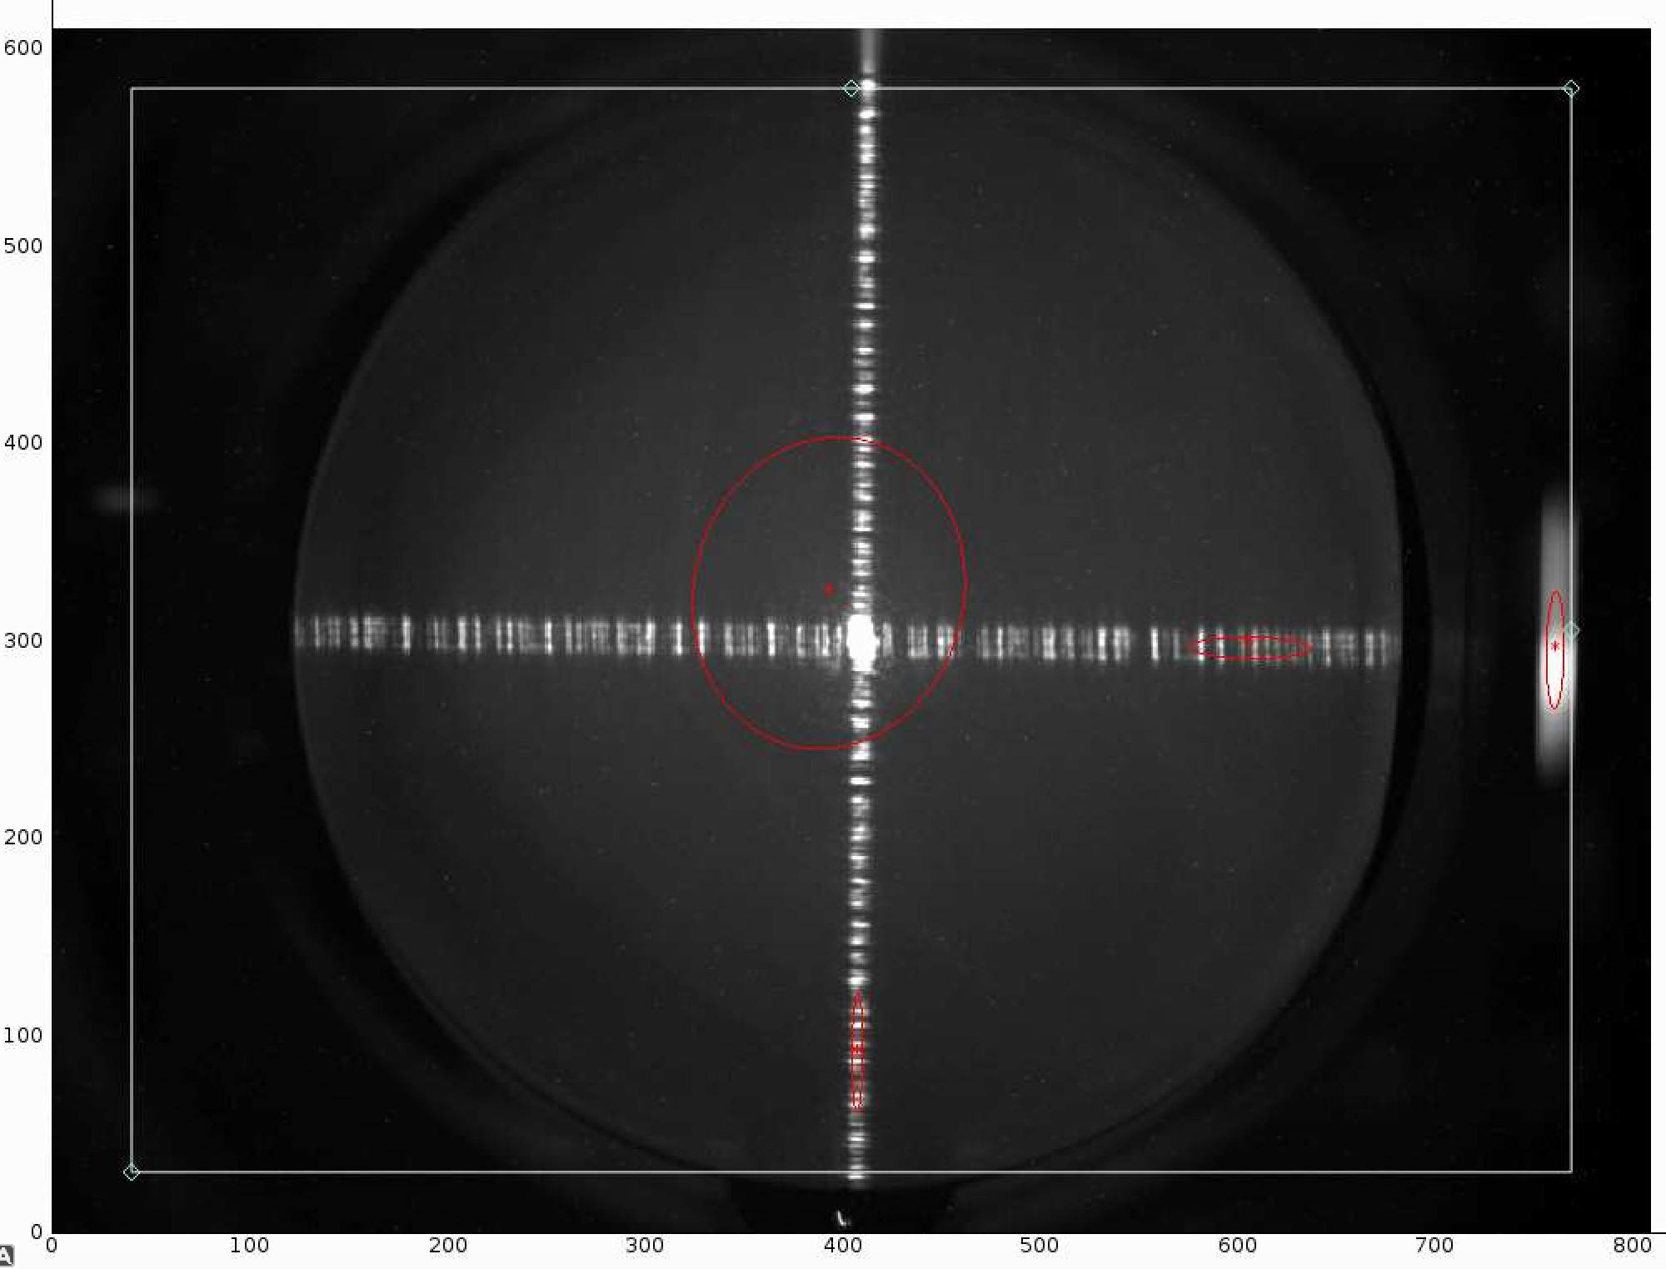
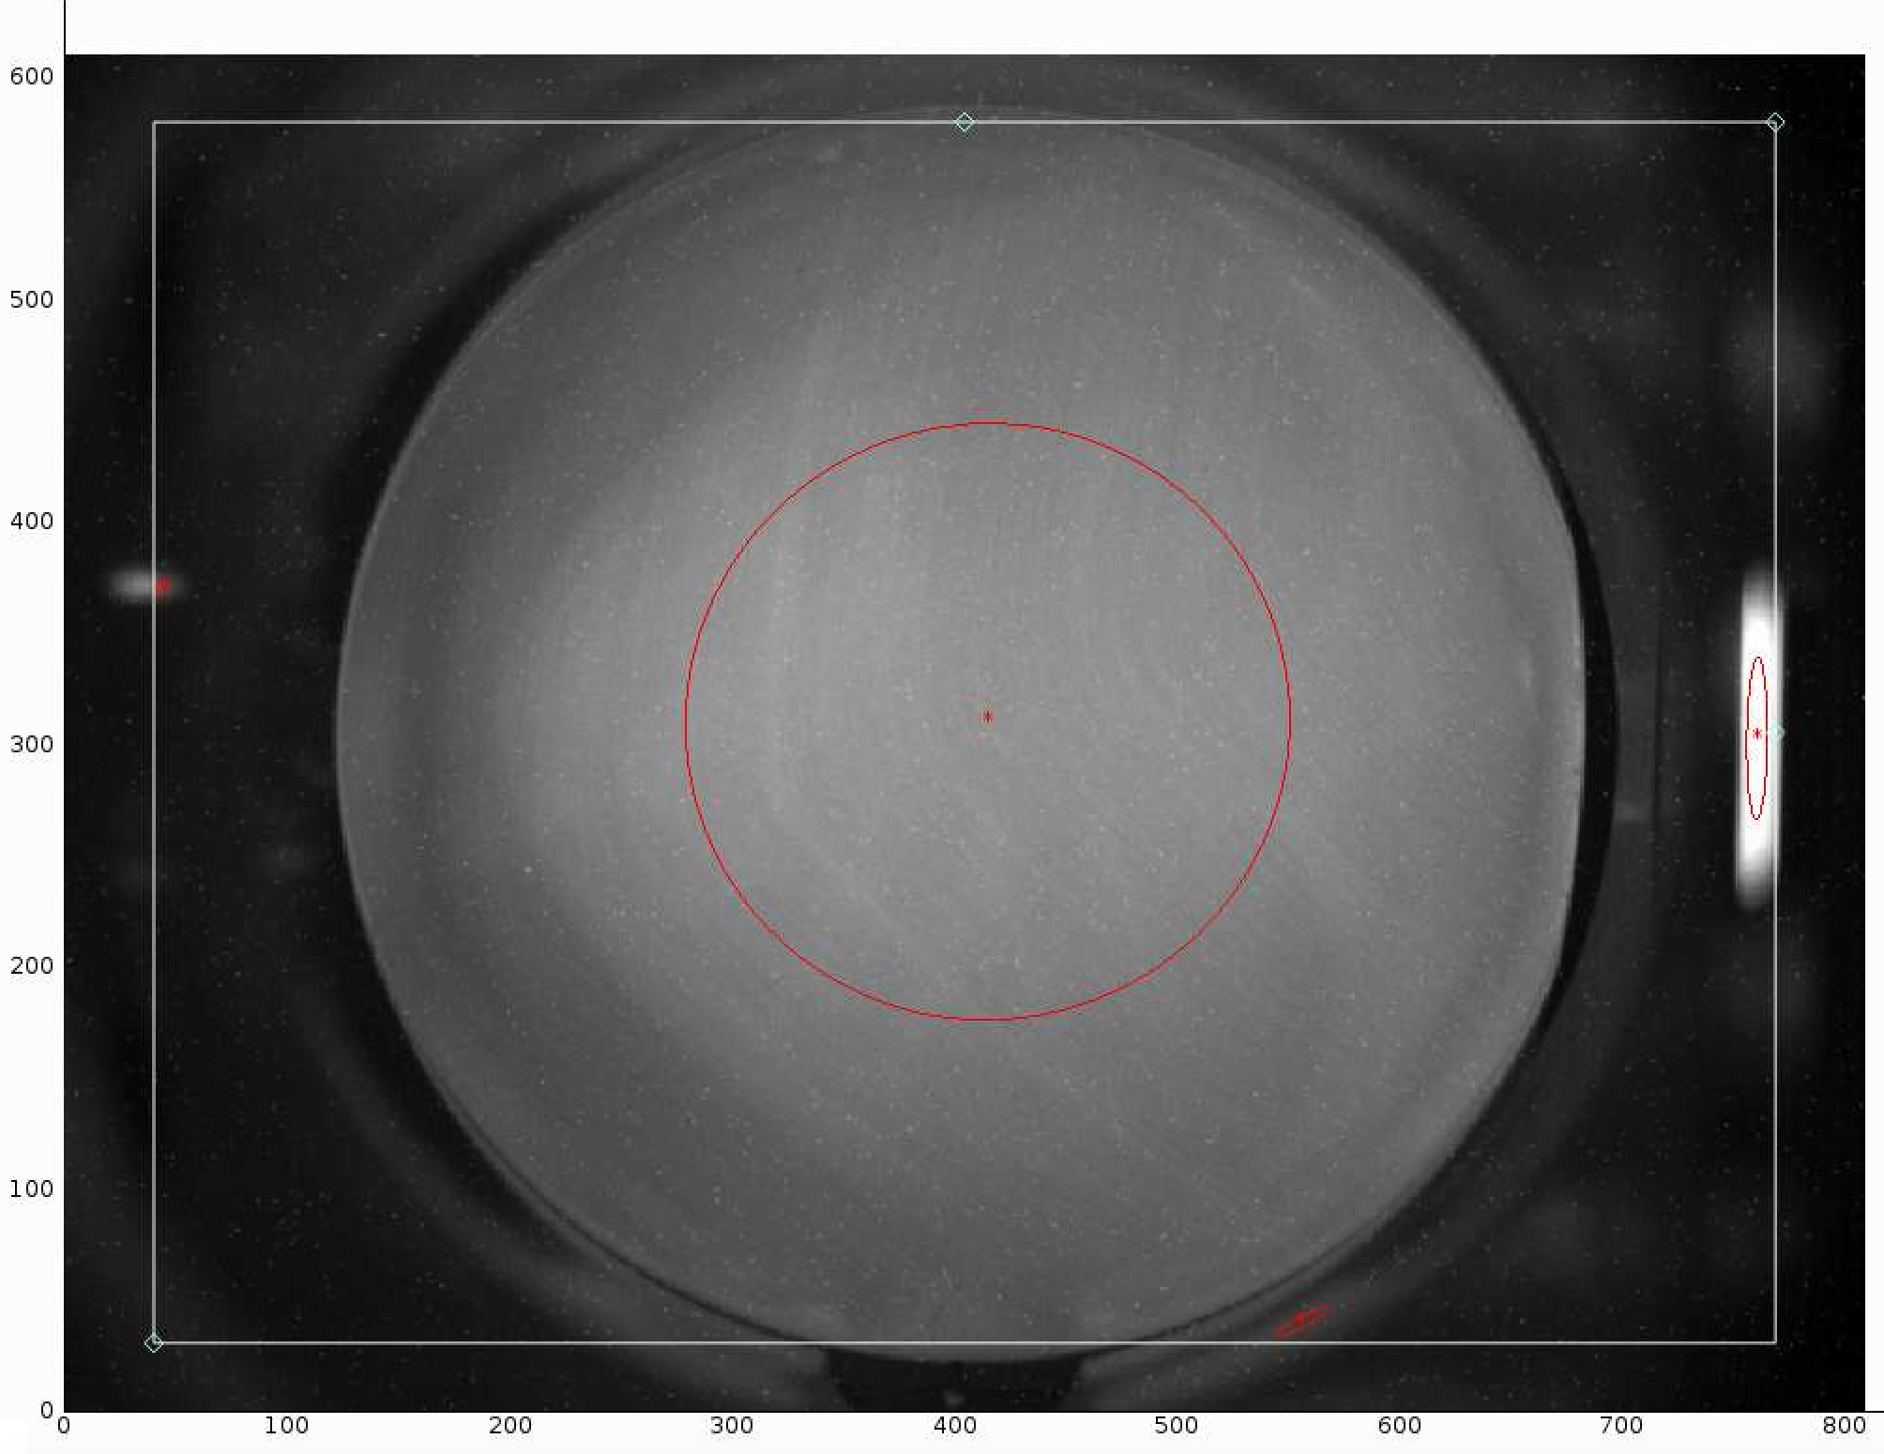
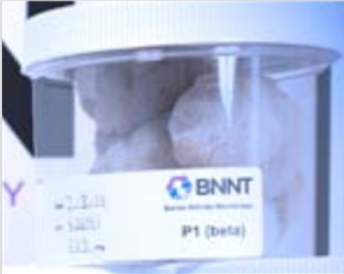
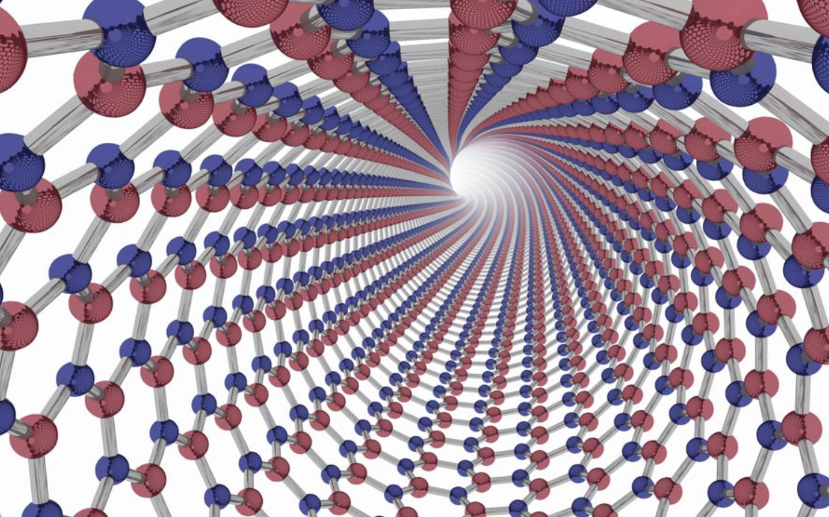
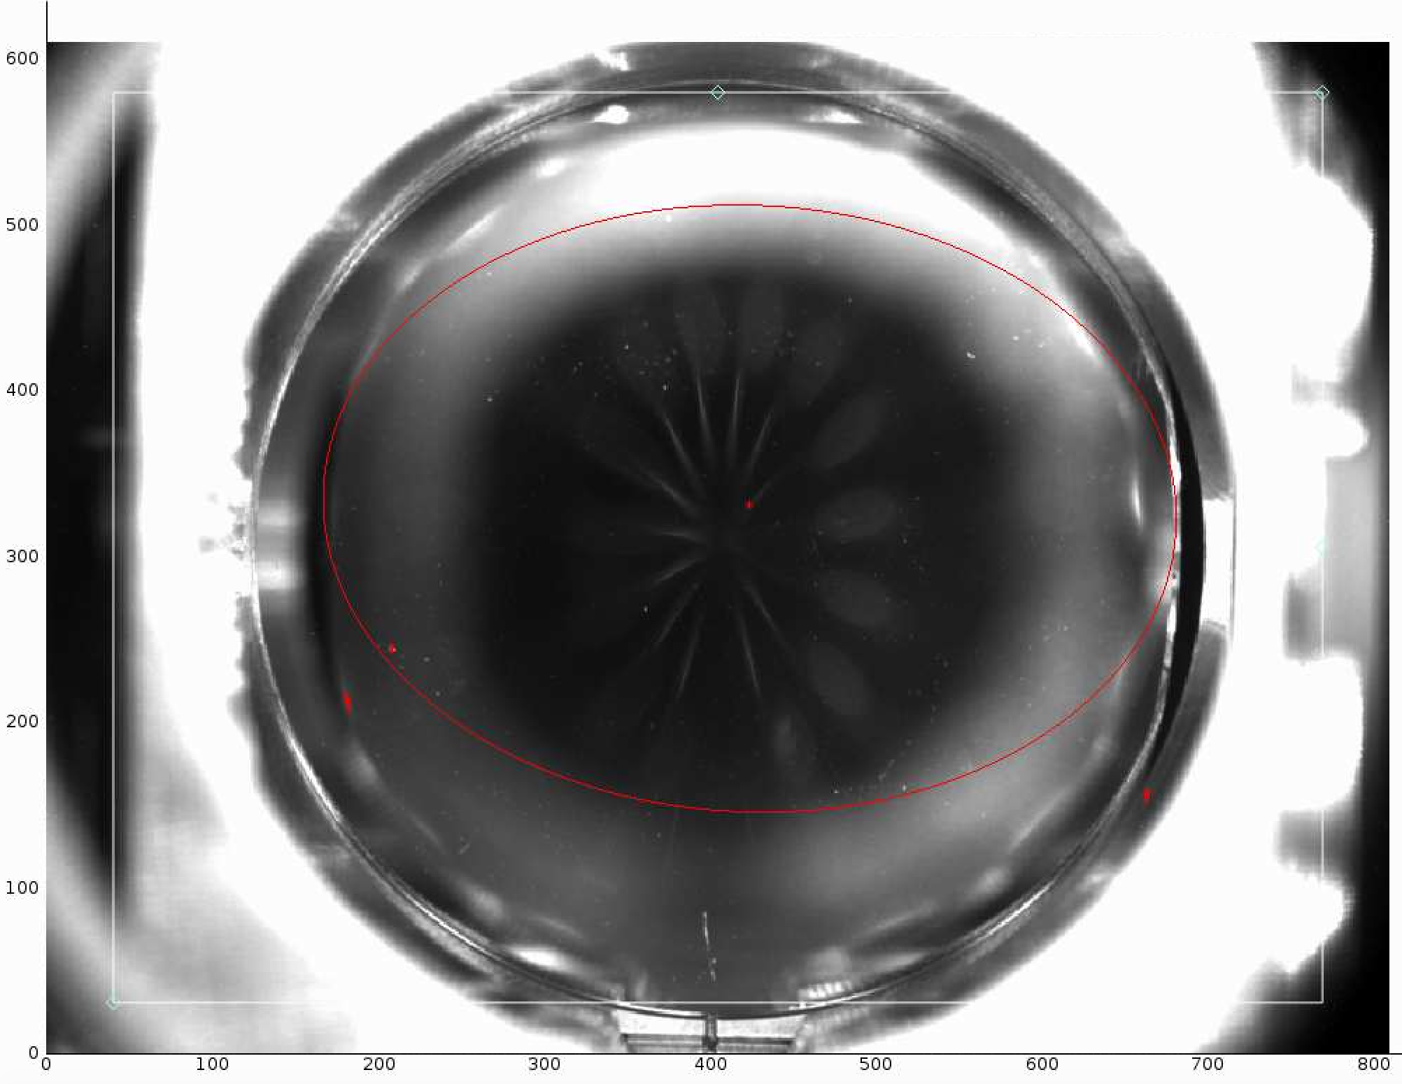
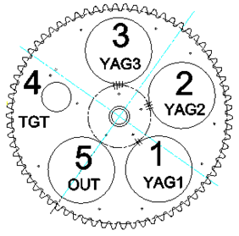
Profile Monitors (15)
Fluorescent Laser
Profile Monitors: all 15 units are operational
High Power Profile Monitor – Possible Modification
Extraction line YAG3 – proposed change of YAG to a mirrorless screen for CW using Boron Nitride Nano Tube (BNNT) fibers
awaiting response from Kevin Jordan
BNNT fibers can be compacted into a flat screen
RF Diagnostic Beam Line – Operational
Mechanical Rework (optional)
YAG wheel installed backwards (position marks not visible to camera)
Resolution target is not visible enough – need reflective type
Could replace with a test screen
BNNT or Undoped YAG
60mm YAG crystals available to replace 50mm YAGs
PET controls upgrade pending
Labeled dropdown menu for position selection – YAG1/YAG2/YAG3/TARGET/OUT
Fluorescent Lamp
(UV)
”White” Lamp
(Lamp)
RF Diagnostic Line PM:
Position Control (in pet)
YAG1
YAG2
YAG3
Target
OUT

Slide 9
Beam Position Monitors (41)
Other Issues
Dynamic range challenges (auto-gain):
Off center beams, laser intensity, and cathode QE cause wide dynamic range
Manual attenuation changes have been made up until now (pet archives help)
Auto-gain is available on Libera electronics, needs commissioning time
V301 auto-gain is also under development, needs commissioning as well
Development time needed to determine calibration in cooling section across multiple gain settings
May need to keep cooling section gains fixed or limited discrete steps
Libera Hangs
Libera units (transport) very sensitive to window settings, can get locked up.
Fine-tuning of window settings still underway to prevent this issue
User-friendly reset capability for shift operators being developed (pet/fit)
Status Summary
All 41 BPM stations – Operational
MPS position alarms – Zones 1 – 5 are Operational
Response time tested 6/11/18: <5µs (data taken from eLog entry - Seletskiy)
Orbit Display – Under development
Current Challenges:
Switch/Amplifier failures – mitigated by limiters
Ion BPM noise – solved by Digital HPF in FPGA
Booster RF Interference – rework planned:
Amplifier boxes to be moved further away or out of the tunnel
BPM cables for b1 & b2 to be rerouted away form booster

Slide 10
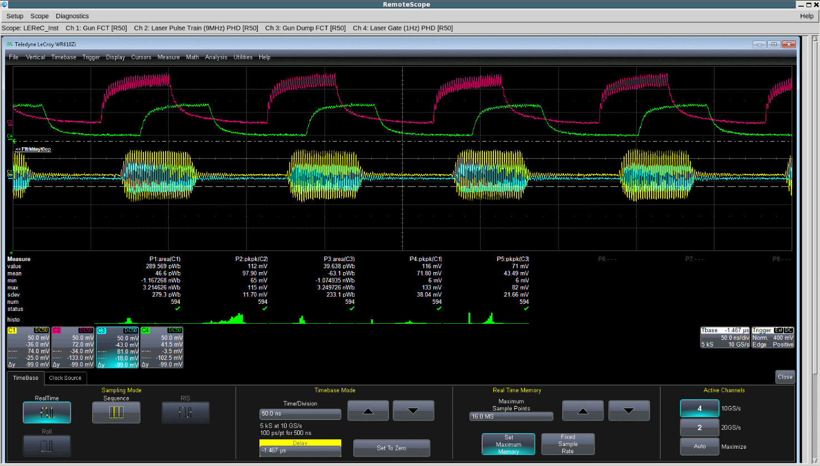
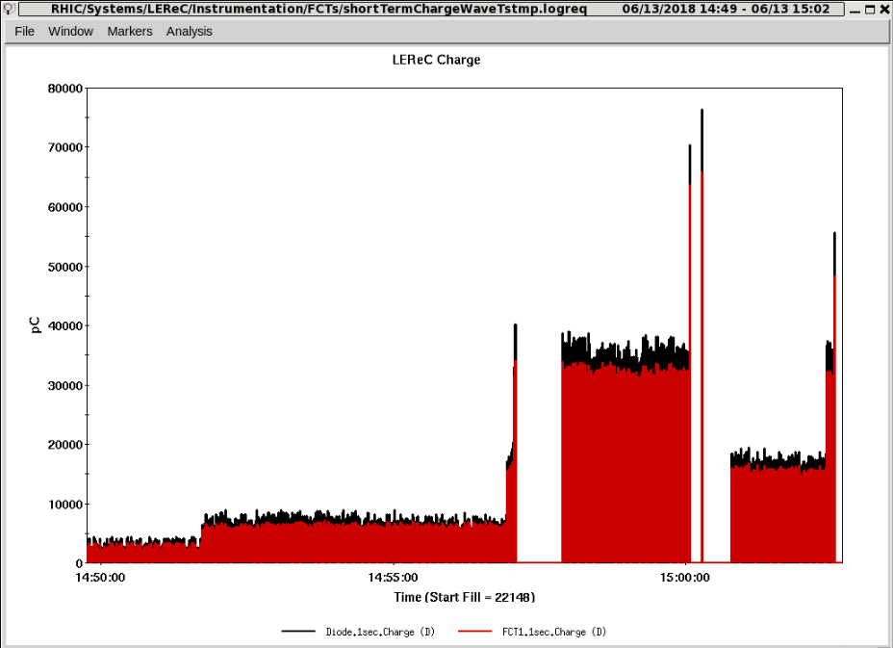
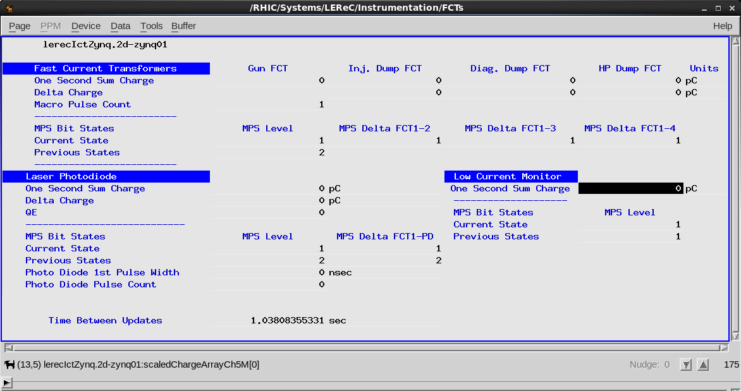
Charge & Current Monitors – FCTs (4)
Status
MPS Level Detection – Operational
1-sec sliding average charge reading determines the MPS level & updates every 200ns.
Gun FCT – Operational
MPS Photodiode – Operational
Low level detector – Adjustment needed
MPS Difference Measurements – Not Operational
Bug in the difference calculation has been fixed
Requires beam time to recalibrate each FCT and test
Issues
Detector baseline shifts cause MPS trips
Gun FCT trips believed to be related to Booster RF cavity
Need time to run cavity and access the tunnel to try different shielding techniques
MPS Photodiode trips while people are in 1002F, need to investigate cause
Nonlinearity in current measurements
Requires beam time to recalibrate each FCT
Small reflection pulses
Believed to be in the receiver chassis, will be addressed during shut down

Slide 11
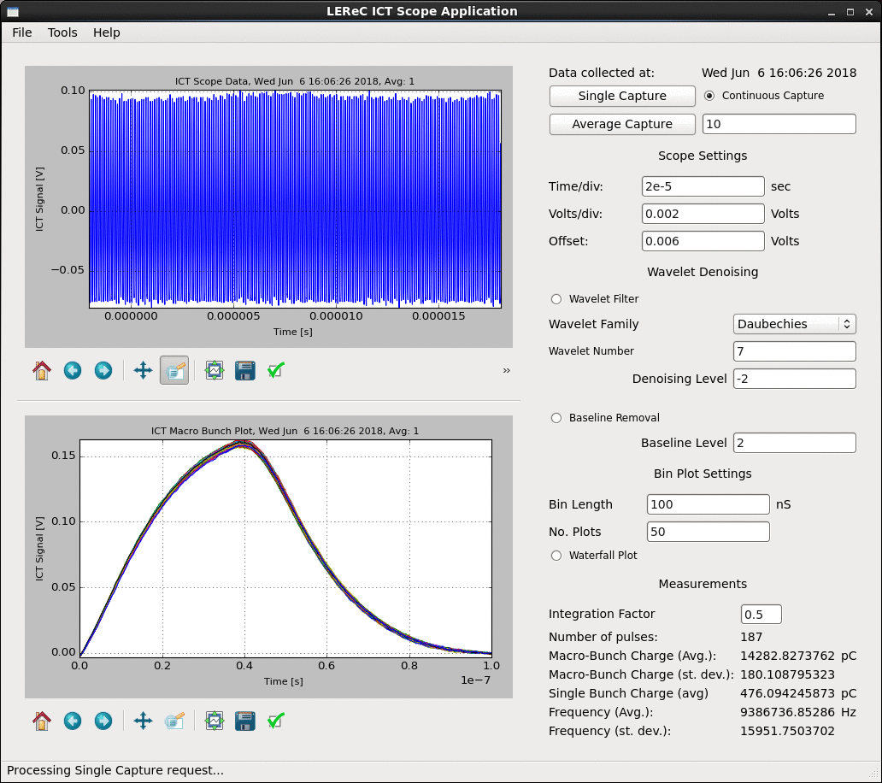
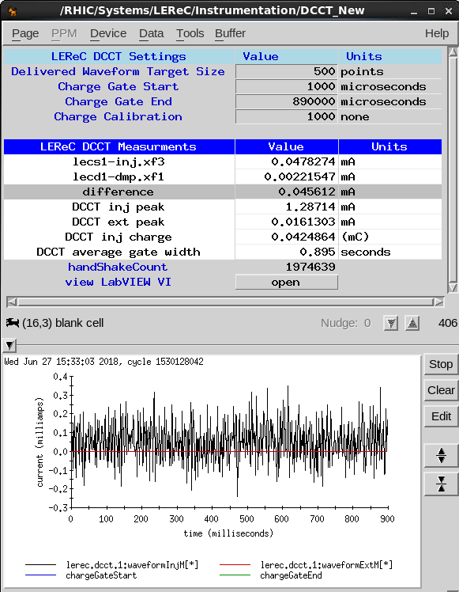
Charge & Current Monitors – ICT (1) & DCCT (1)
ICT Status
Pulsed: Bergoz / Zynq measurements - Operational
CW: Scope Application – Adjustments needed
Need to calibrate the integration factor
Needs to resolve connection drop-outs
Issues
Bergoz electronics limited to 22 nC instead of 40 nC
Believed to be due to amplifier between output and Zynq
Zynq digitized value offset of 130 pC
Requires time to recalibrate BCM-IHR output to Zynq input
DCCT Status – Operational
The DCCT is a Bergoz NPCT capable of measuring CW beams down to < 5 µA with 1s averaging
The system can be used for CW and with pulse trains >100µs long
Issues
Delayed timestamps in logged data needs repair
Possible Redesign of chamber without cooling coils for increased aperture in extraction line.
-> loss of temperature regulation method…

Slide 12
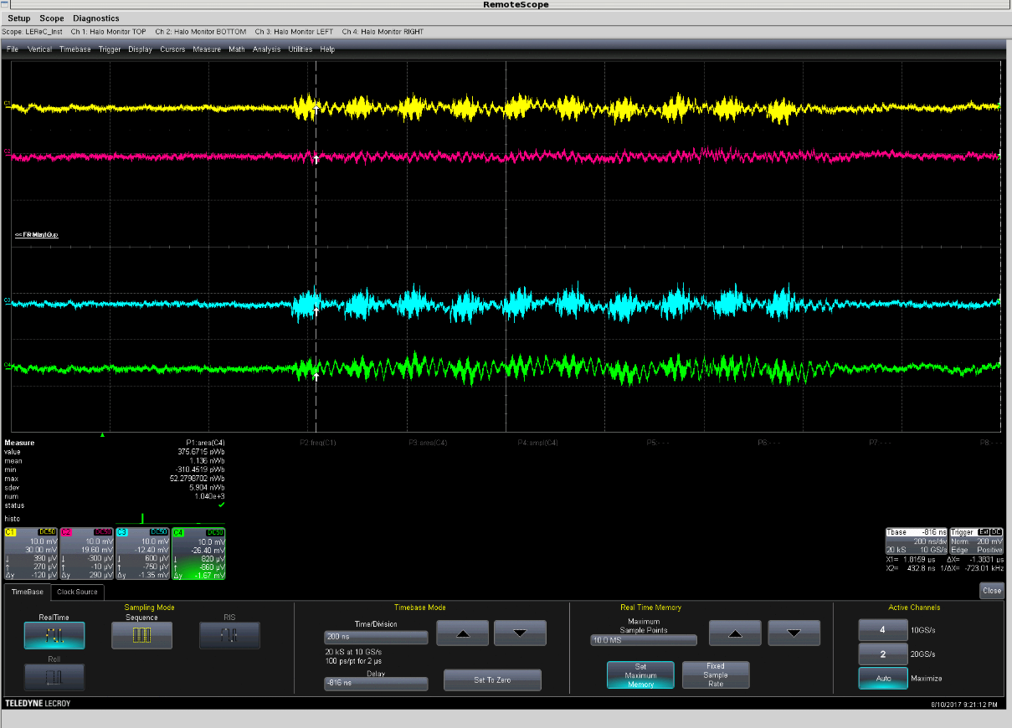
Charge & Current Monitors – FCs (5) / Halos (4)
All signals can be switched between:
Scope for viewing
Zynq system to be logged
Status – Faraday Cups
Scope Measurements – Operational
Zynq Measurements – Not finished testing w/ Beam
Last tested with beam: 8/10/17
DVM Measurements – Not yet tested w/ Beam
Status – Halo Scrapers
Scope Measurements – Operational
Zynq Measurements – Not yet tested w/ Beam
Issues
Scope/Zynq relay boards distorted waveforms – New relays boards are being tested
Need to connect & test RF Diagnostic halo pick-up
Temporarily connected to Gun Fast Detect channel on 2nd scope
Engineers: M. Paniccia, W. Pekrul
Wiki page:

Slide 13
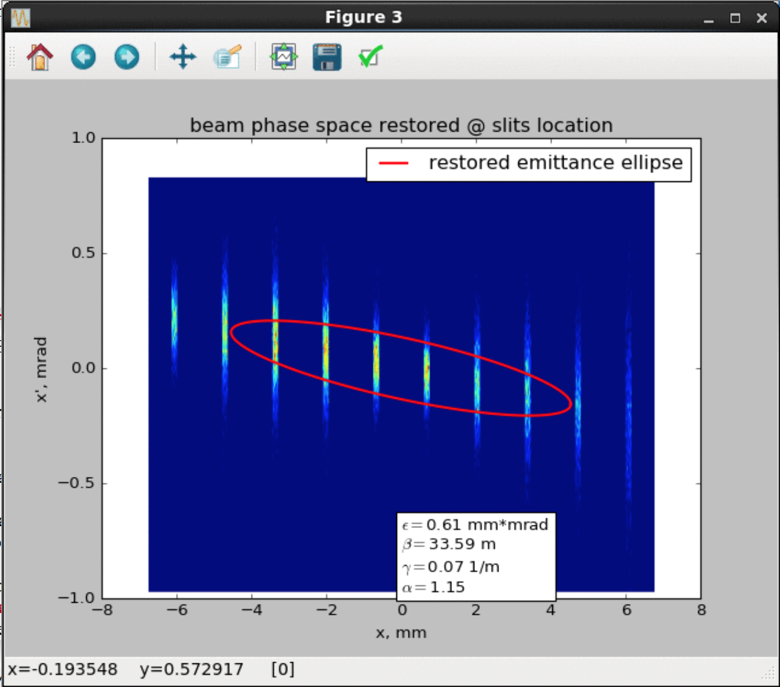
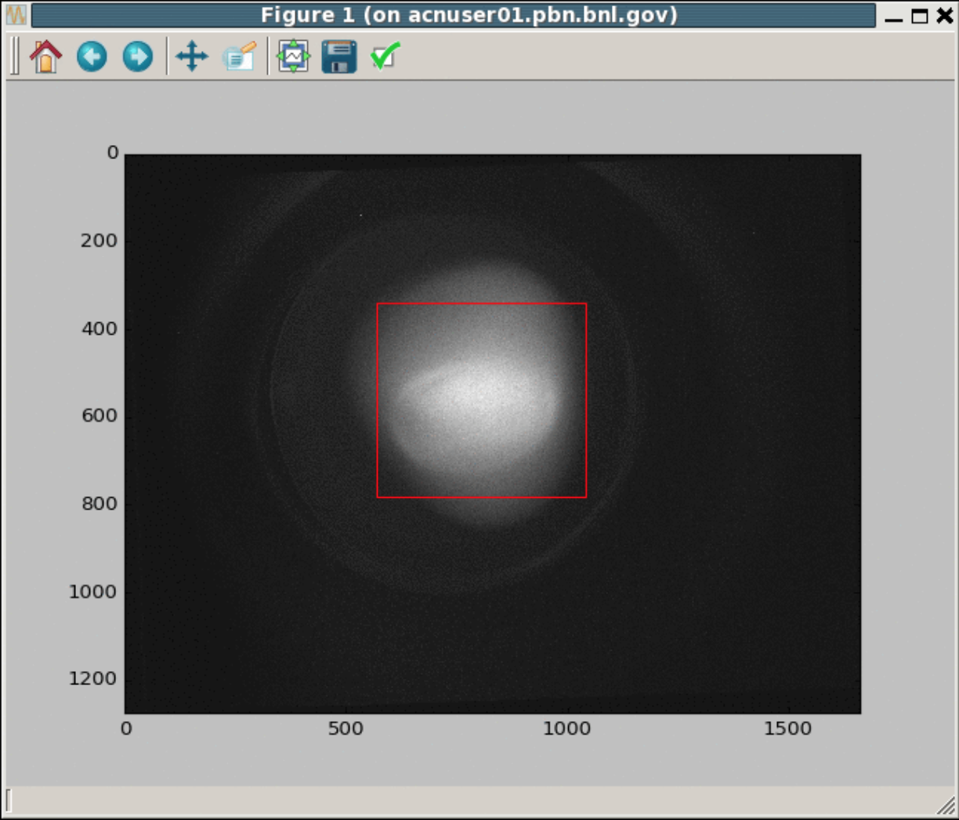
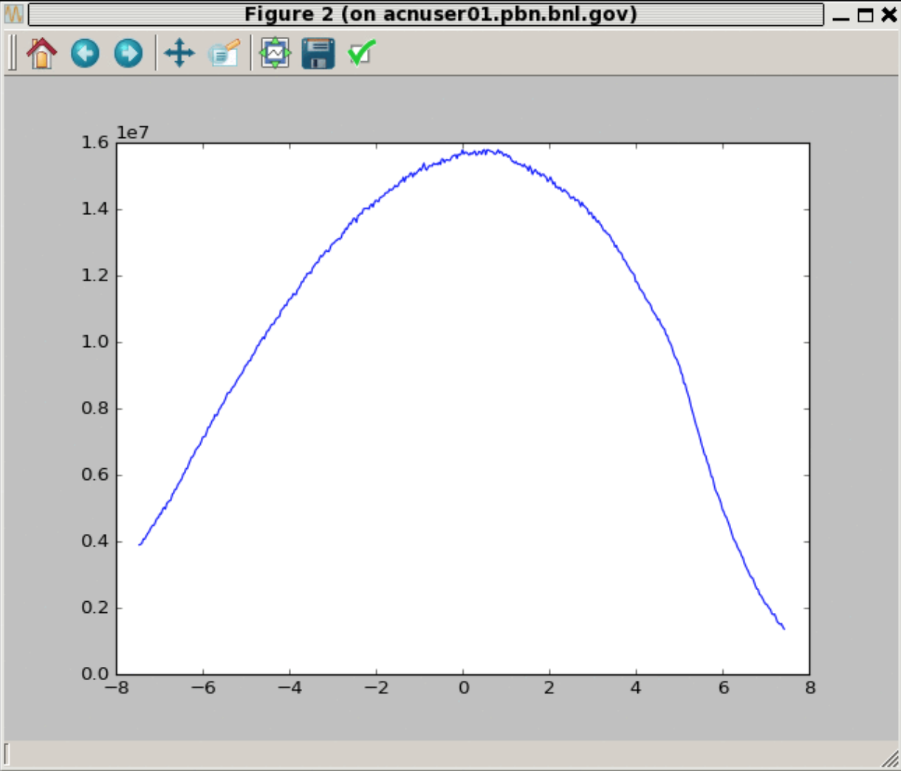
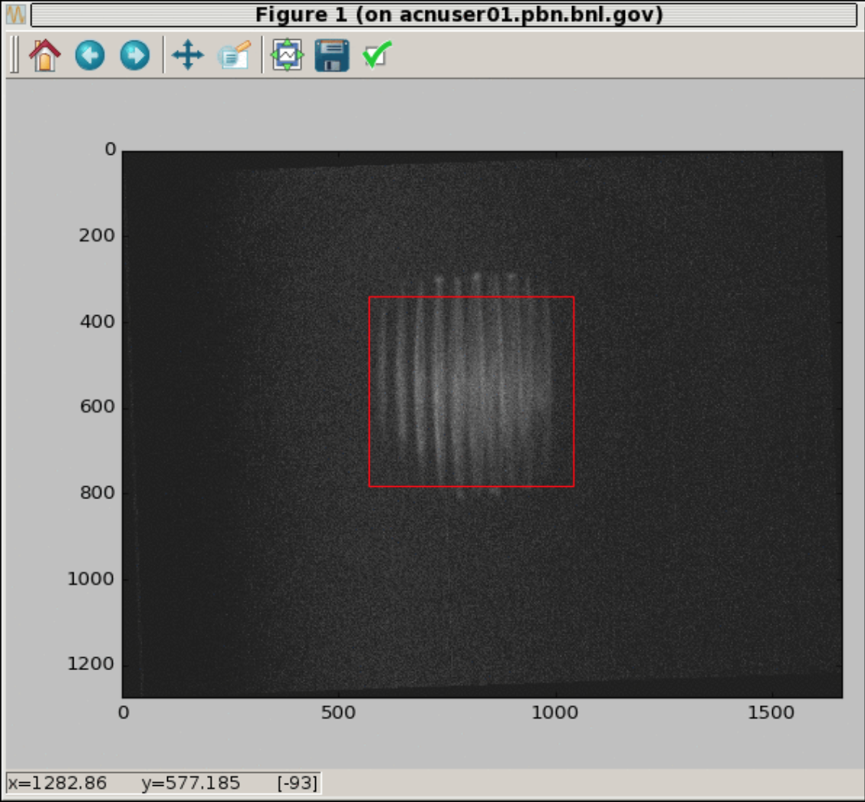
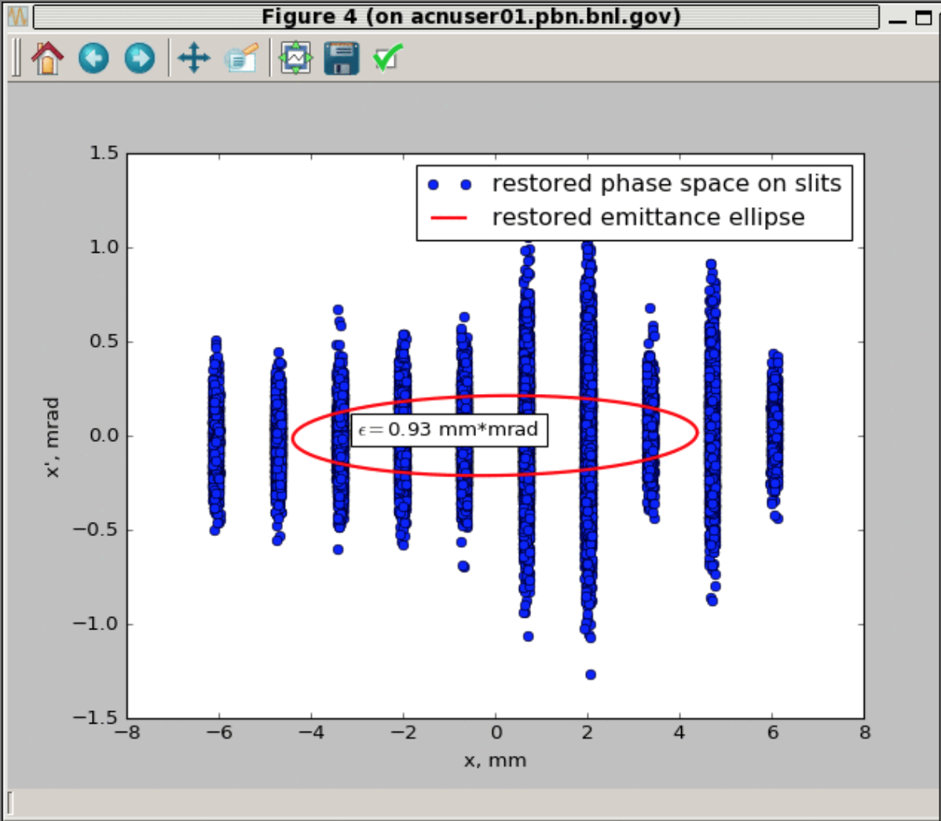
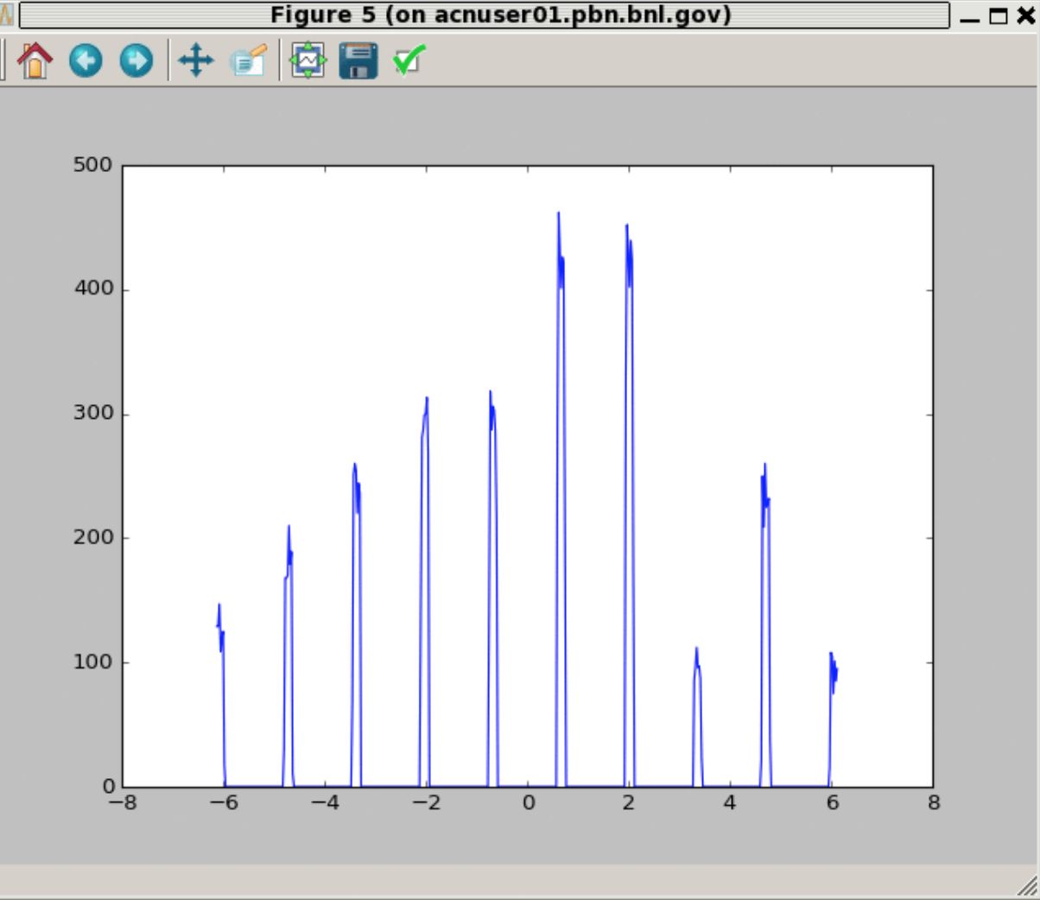
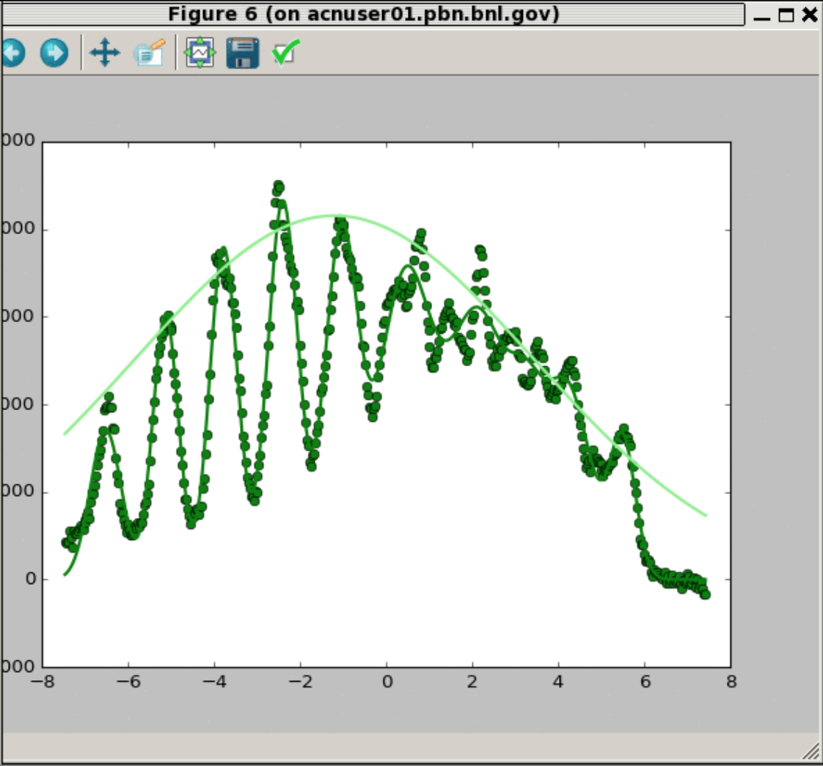
Injection Emittance Slit Multi-Slit Mask
Status - Operational
Dual Horizontal & Vertical Mask
Successful measurements made:
ε = ~0.56mm*mrad (@ 60pC/bunch)
Data from eLog: LEReC_2018 6/11/18

Slide 14
Emittance Slit Scanners (2)
Status - ready for testing with beam
Automated scan with image acquisition & emittance calculation implemented
Save & reply of stored images.
position control
control of mm’s for positioning
Go To buttons for putting H & V slits at beam center for testing

Slide 15
Beam Loss Monitors
System Status
16 PMTs & fibers – operational
8 PIN diode detectors – operational
8 Ion RHIC style ion Chamber detectors – operational
Beam Dump Distribution LM’s – installed & ready to test with CW
Diamond detector – installed
experimental hardware from I-Tech being set up.
Controls interface being set up
Issues
PMT BLM work & tests needed
Display interfaces are being developed by the controls group
S-coordinate display with overlays for:
PMTs
PIN Diodes
Ion Chambers
Radial & Longitudinal display charts for long LM’s around dump
PMT BLM Work/Tests
Fiber End test LED’s installed – driver electronics installation pending
Repair light leaks in PMT BLM fiber pick-ups
electronics hardware modifications
Change front-end OP Amps to reduce nuisance tripping noise
Work planned during shutdown to be ready for 2019 run
Response time test
Need to test overall response time through MPS.
Test pending to investigate response time as a function of pulse length. (longer response – up to 60us – with shorter pulses)

Slide 16
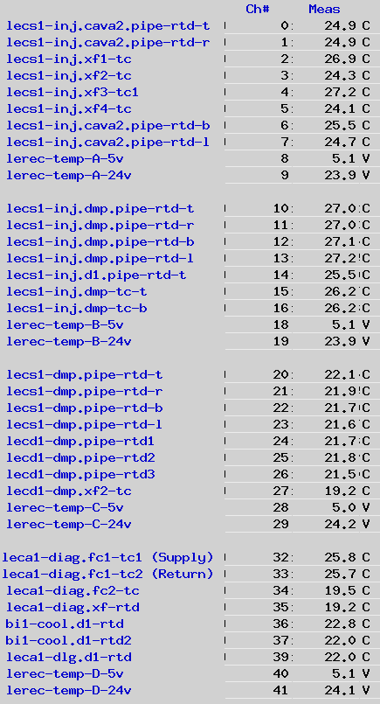
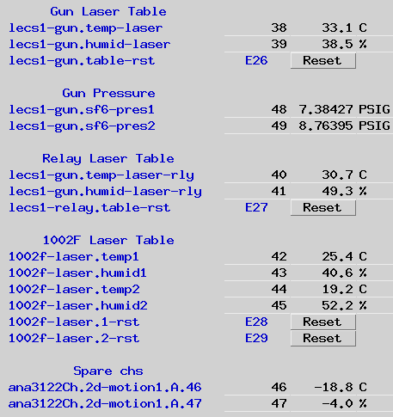
Temperature Measurement
(4) Beam pipe
(1) DCCT
(1) ICT
(1) FCT
Dipole
chamber
(2) Beam Dump
(1) Dipole
chamber
(1) FCT
(1) FC
(1) FCT
(2) Beam Dump
Cooling water
Supply & Return
e⁻
RHIC TRIPLET
RHIC DX
DC e⁻ Gun
(4) Beam pipe
(1) Dipole Core
(1) FCT
(4) Beam pipe
(1) Beam Pipe
(3) Beam pipe
Status - Operational
5 Field chassis with transmitters
4 House chassis with receivers & alarm modules
11 RTDs
19 TCs
2 spare channels
Temp & Humidity Readings:
Laser Trailer (1002F)
Gun Laser Table (IP2)
Relay Table (IP2)

Slide 17
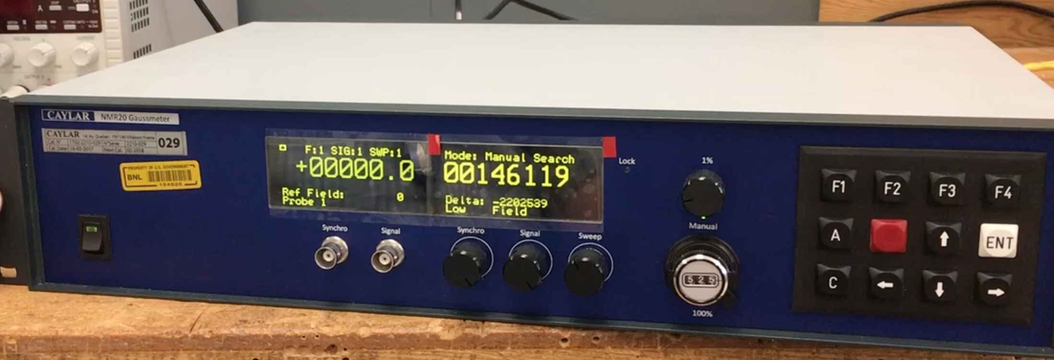
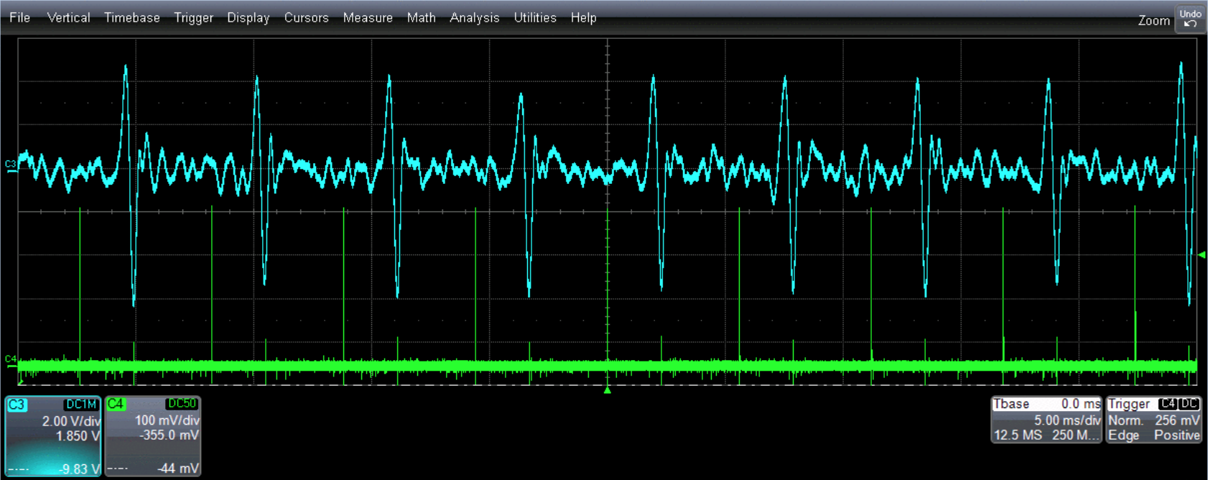
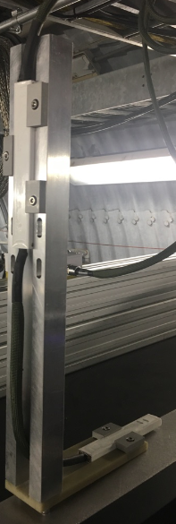
NMR Gaussmeter for 180º Dipole
NMR probe: Operational
15mG measurement stability @ ~200Gauss (0.7x10⁻⁴) 40% better than requirement
Spare probe repaired – due mid July
Recommend to buy spare chassis for ~$15K
Permanent magnet test chamber built & measured for bench testing the NMR probe with a suitable filed uniformity
Hysteresis Cycle generator implemented – magnet tests pending
Issues:
Waiting on repaired spare probe

Slide 18
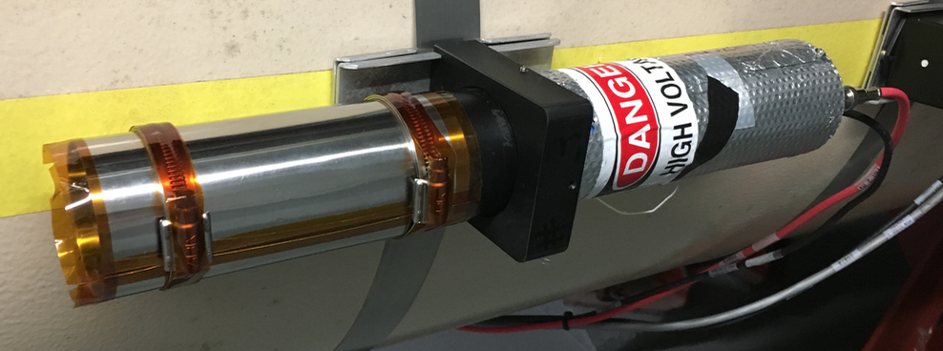
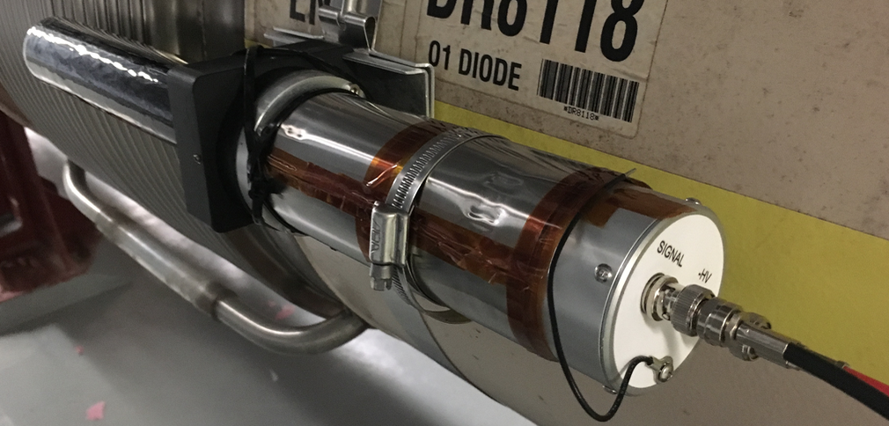
Recombination Montior (2)
New high gain scintillators + PMTs
1 cm L upgraded to ~30 cm L
Time digitizer installed for measuring arrival time histogram
Losses sync’d with ion bunches should grow with increased overlap & energy matching.
Status
1 of 2 installed (+1 spare), 2nd installation pending
Synchronous Data – RHIC bunch pattern observed
Controls interface
Temporary LabView GUI
Integration into controls system under development

Slide 19
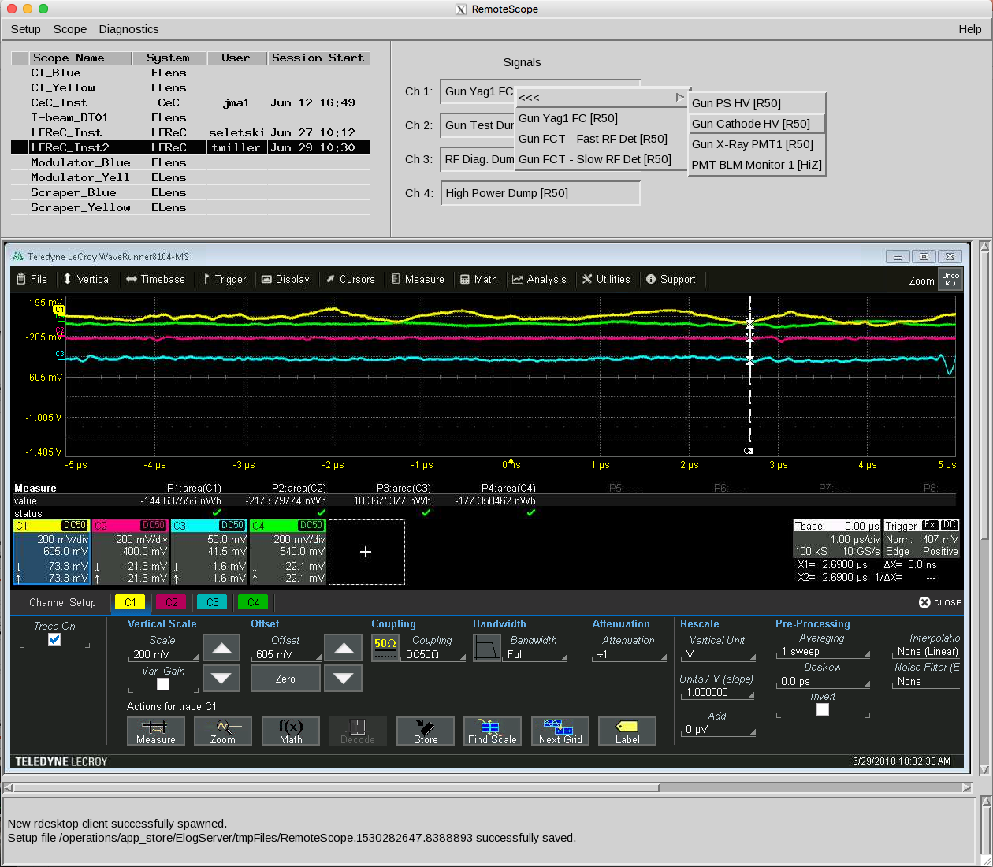
Remote Scopes (2) & Multiplexed Signals
10 Dual 1x4 MUX cards (80 channel capacity)
creative grouping but still have limited combinational viewing
Possible Upgrade:
Full matrix switch would be much better

Slide 20
Subsystems
GigE Camera Systems:
Regular controls interface failure mitigated by supervisory monitor program to restart
High traffic mitigated by automatic mutually exclusive device triggering
3 failures in CeC !
Feature requested to control triggers with insertion of profile monitors
Spare Parts
profile monitor cameras, 10% spares for ~$5k (these are not critical, but ~3-4week lead time)
spare NMR chassis ~$15k
CT system critical components ~$8k
possible spare FCT for the gun (MPS critical link)
PMT BLM system - (1) 8ch spare card in hand
BPM system spares already in hand

Slide 21
Status Summary

Slide 22
Summary of Remaining Work
Gun Rad Mon – Operational
Anode - Do we need higher bias voltage?
ICE - More testing needed to prove effectiveness with CW beam
Laser Exit – increase illumination, add power meter
Gun Ripple – Retest with calibrated FCT, incr. capacitance
PM’s - High Power dmp.yag3, diag. yag screens & controls
BPM’s – orbit display, amplifier relocation, autogain calibration & commissioning, Libera lock-up fine tuning
FCTs – nonlinearity recalibration tests, difference measurement, need shielding to mitigate FCT trips, MPS photodiode sensitivity to laser work, reflection pulses in receiver chassis, low level detector adj.’s
ICT - CW scope application
CW scope application adj.’s, cal integration factor, remote connection drop-outs
22/40nC limitation in amplifier
130pC offset in digitization
DCCT - delayed time stamps in logged data, extraction chamber redesign & DCCT reinstallation
FC’s & Halo’s – Zync beam tests, DVM meas beam tests, new relay boards, new conn. to RF Diag. Halo Pk-Up
Emittance Slits – Inj. Operational, cooling ready for beam tests
BLMs – Dump beam tests, diamond detector test dev. & set-up, s-coord. Display dev, PMT electronics mod’s, Fiber end LED drvr, PMT detector light leaks, PMT BLM response time test, PMT BLM threshold tuning with beam.
Temperature – Operational
NMR - Operational
Recombination Mon – Install 2nd Detector, controls integration
Remote Scopes & MUX’s – Operational
Subsystems – cameras: GUI upgrades for trigger control, new spares purchase…

Slide 23
BACK-UP SLIDES

Slide 24
Charge & Current Monitors – FCTs
The FCTs generate 704MHz sinusoidal bursts that are
approximately equal macro-bunch length
with output power proportional to the single bunch charge
A fast logarithmic detector measures the signal power and converts it into an equivalent voltage
Fast detector signals are continuously sampled at 100 MSa/s, and each sample is converted to an equivalent charge in pC
The charge reading is accumulated over one second and the one-second charge value is used to determine the MPS level; which is updated to the MPS every 200ns.
Engineers: M. Paniccia, W. Pekrul
Wiki page: Fast Current Transformers (FCT), LEReC

Slide 25
Charge & Current Monitors – ICT
The ICT provides macro-bunch charge measurements
For pulsed operation the ICT signals are measured using the Bergoz BCM-IHR electronics and digitized using the Zynq module
For CW operations the ICT Signals can be measured continuously using a remote scope application
Engineers: M. Paniccia, W. Pekrul
Wiki page: Integrating Current Transformers (ICT), LEReC

Slide 26
Charge & Current Monitors – DCCT
The DCCT is a Bergoz NPCT capable of measuring CW beams down to < 5 µA with 1s averaging
The output is processed by a NI PIXe chassis
The system can be used for CW and with pulse trains >100µs long
Engineers: L. DeSanto, C. Degen
Wiki page:

Slide 27
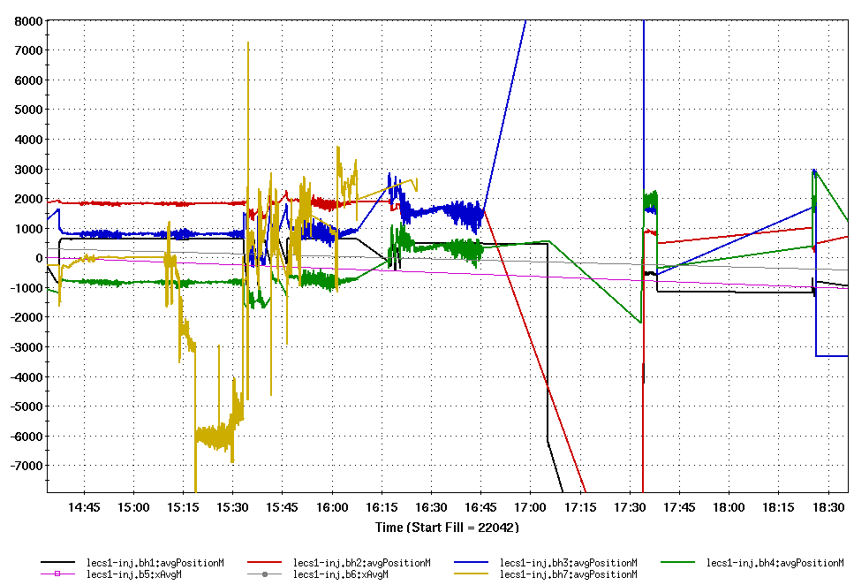
BPMs
LEReC BPM Switch / Amplifier Failures
Failures in the cross-bar switch electronics occur for a subset of the LEReC BPMs during continuous wave applications. The RF switching IC’s used in this circuit fail to an “open” state. The RF amplifiers have also failed “open” in some cases.
BPM inj.b3 had (2) failures and inj.b7 had (3). inj.b4 has experienced this failure once.
In all cases there was beam instability in a dispersive region (b7) or a booster cavity trip (b3/b4) leading up to the failure.
No large signal amplitudes or voltage spikes have ever been logged during these failures.
BPM position log from June 15th 2018, lecs1-inj.b7 (yellow) stops reporting.

Slide 28
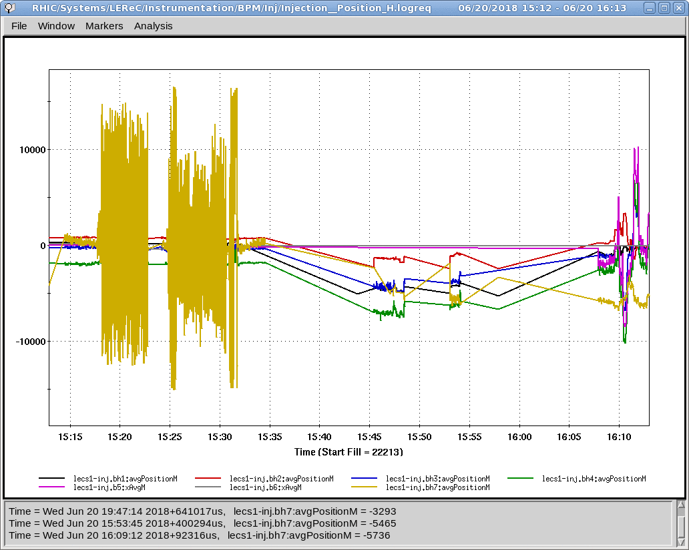
BPMs
LEReC BPM Switch / Amplifier Failures
~250ft. of cable between the switch and BPM did not prevent the failure, they still occurred even after moving them to the trailer.
Installing 1.2GHz low-pass filters did not remedy the problem, two subsequent failures occurred with filters installed.
Having RF splitters installed on one plane of b4 seemed to have saved those channels. Splitters were installed on the other two channels and no failures have occurred since.
RF diode limiters were installed on b3 and subsequently b7. No failures have occurred (even with several instability events) since installing the limiters.
BPM position log from June 20th 2018.
After installing limiters, b7 continues working with large (30mm pk-pk) beam excursions.

Slide 29
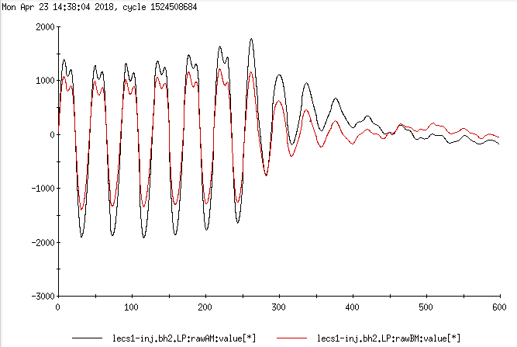
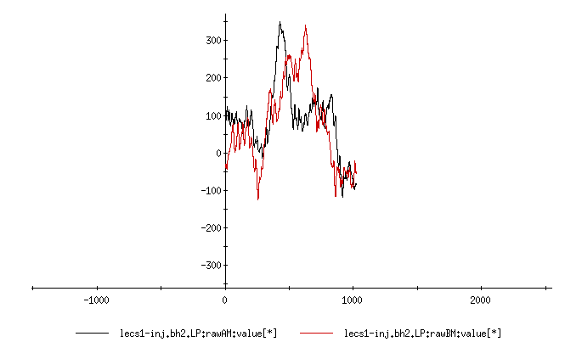
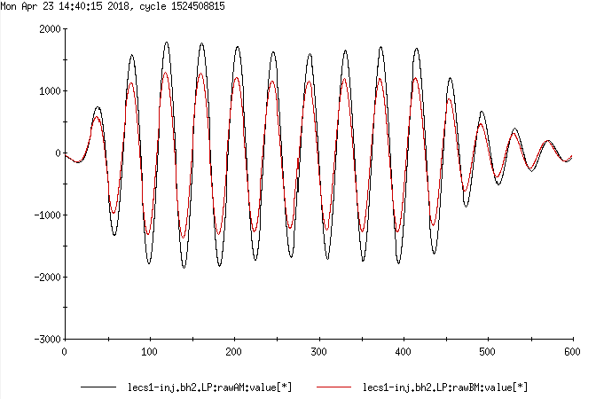
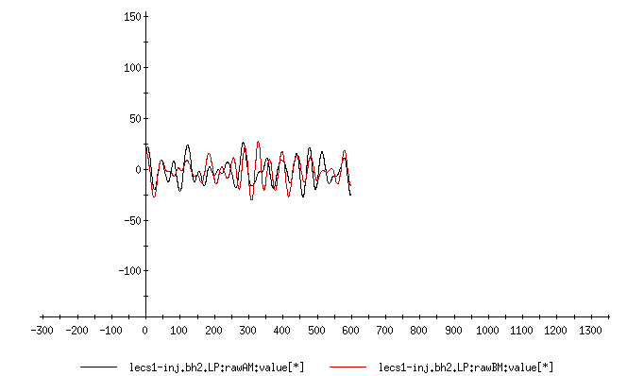
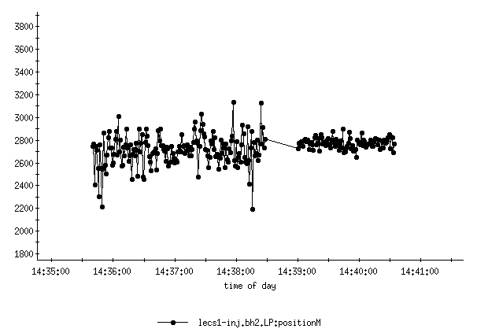
BPMs
LEReC Digital High Pass Filter
During the spring of 2018, low frequency noise was observed on the LEReC ion BPMs. This noise caused large variations in the position measurements. To eliminate this noise a digital high pass filter was implemented in the FPGA. The filter was implemented at one quarter of the original sampling rate of the BPM signal to reduce resource utilization. The coefficients were generated by a hamming window method with 41 taps and a cutoff at 5 MHz.
Raw BPM signal with beam and low frequency noise.
Raw BPM signal showing low frequency noise without beam.
CIC Decimator
N = 4
FIR High Pass
Number of Taps = 41
Cutoff = π/10
CIC Interpolator
N = 4
BPM signal after high pass filter with beam.
BPM signal after high pass filter without beam.
Beam position measurements: without filter before time 14:39, and with filter after wards

Slide 30
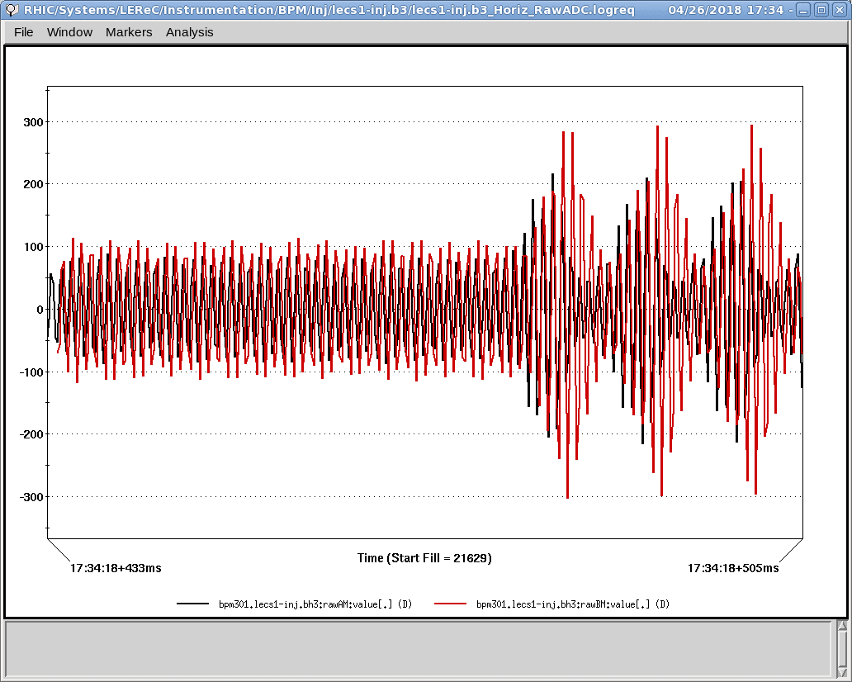
BPMs
Booster RF Interference
Injection BPMs 1,2,3 see a very small ~1mV 704MHz signal from the booster.
This only has a strong effect on position when at very low intensities.
Replacing b1 coaxial cables did not help much (RG-142 vs. LMR-200).
Moving the b3 amplifier box out of tunnel reduced noise signal by x5.
This summer, the b1 and b2 boxes will be moved further away or even out of the tunnel as well.
Long term solution is to reroute b1/b2 cables away from booster.
b3 amp box in tunnel ~100 counts
b3 amp box in trailer ~20 counts

Slide 31
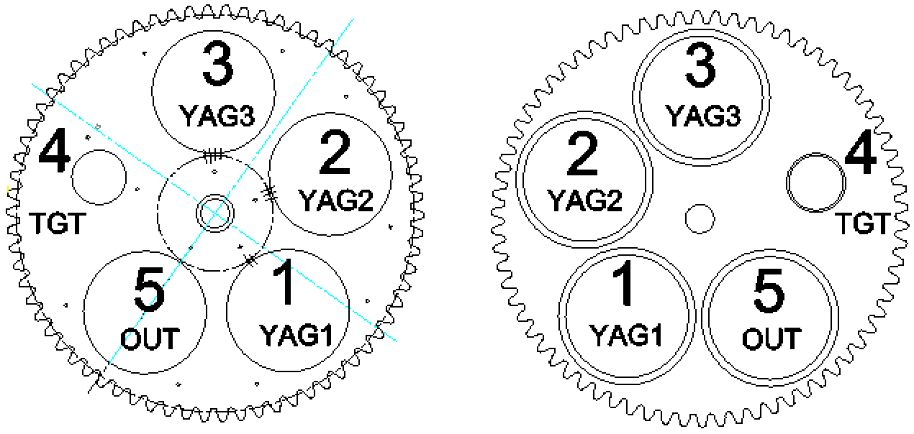
Diagnostic Beam Line Profile Monitor YAG Position Definition
Position Control (in pet)
YAG1
YAG2
YAG3
Target
OUT
YAG Wheel Design
(numbered per pet control)
This side (with fiducial holes) now faces the beam
This side now faces the camera.
Wheel installed backwards where fiducial holes on YAG positions are not visible to the side the camera is mounted on.

Slide 32
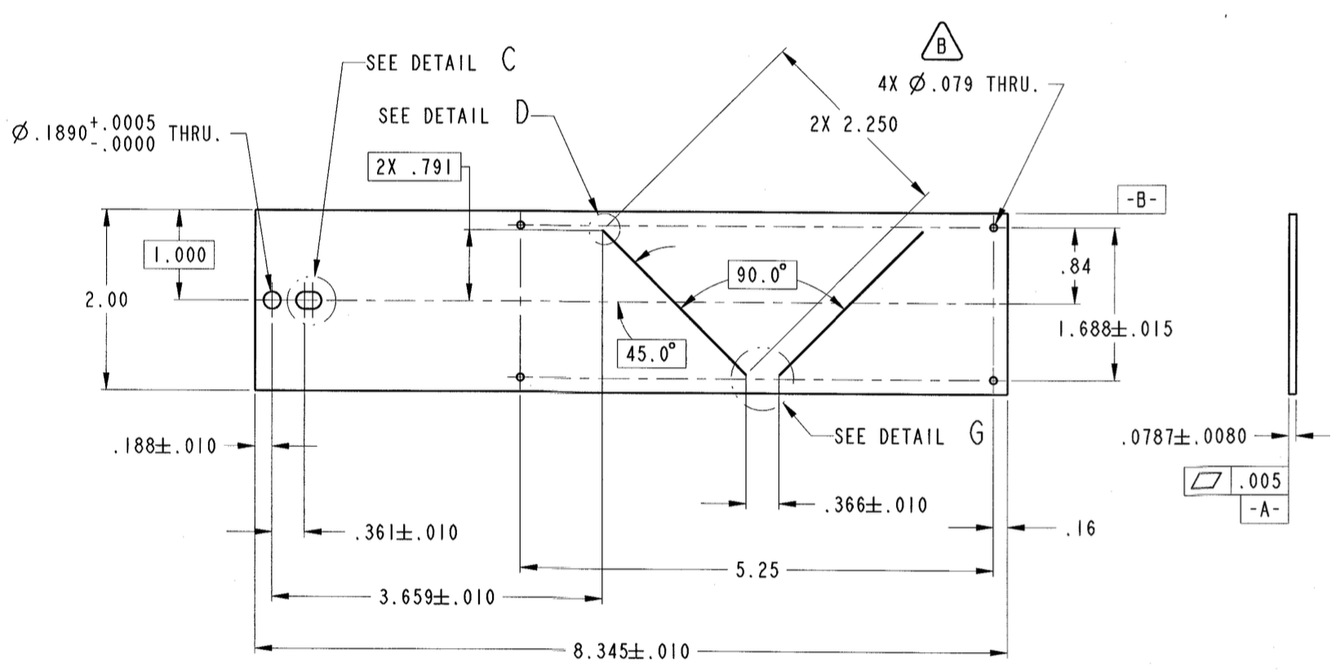
Scanning Emittance Slit Tungsten Mask

Slide 33
Beam Loss Monitors
System Status
16 PMTs & fibers – operational
8 PIN diode detectors – operational
8 Ion RHIC style ion Chamber detectors – operational
Beam Dump Distribution LM’s – installed & ready to test with CW
Diamond detector – installed
experimental hardware from I-Tech being set up.
Controls interface being set up
Issues
Fiber End test LED’s installed – driver electronics installation pending
Repair light leaks in PMT BLM fiber pick-ups
Display interfaces are being developed by the controls group
S-coordinate display with overlays for:
PMTs
PIN Diodes
Ion Chambers
Radial & Longitudinal display charts for long LM’s around dump
PMT BLM Hardware upgrades needed
PMT BLM tests with beam needed
PMT BLM Work
electronics hardware modifications
Change front-end OP Amps to reduce nuisance tripping noise
Work planned during shutdown to be ready for 2019 run
Response time test
Need to test overall response time through MPS.
Test pending to investigate response time as a function of pulse length. (longer response – up to 60us – with shorter pulses)
Possible Upgrades
New user interface needed
Need more intricate method to set trip point as a function of 3 variables
Input bias – to match tolerable loss level
Threshold – to minimize response time
PMT bias – to set trip point
Need to factor in PMT gain curve in a look-up table

