Slide 1
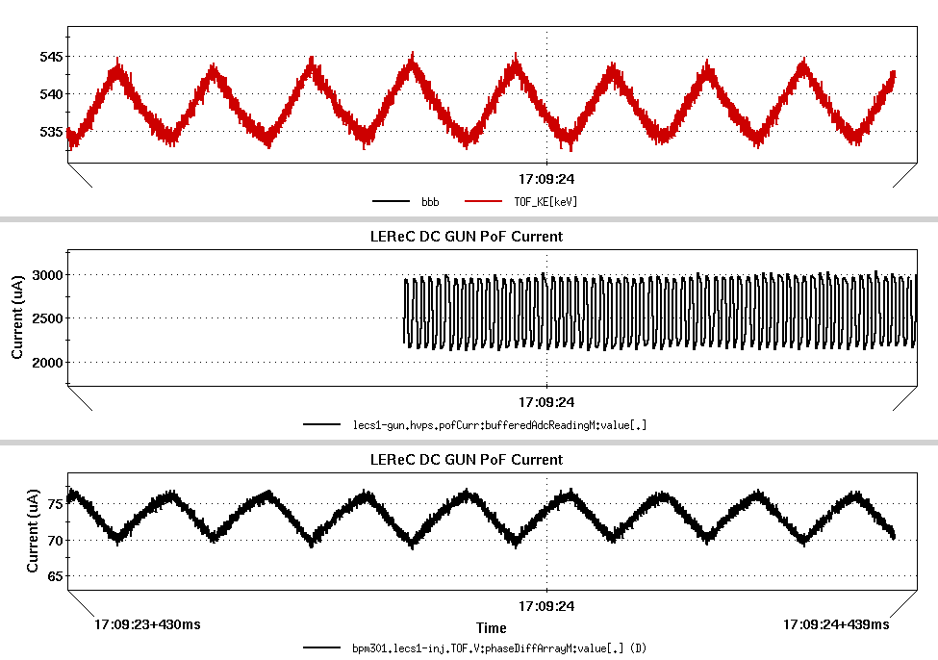
LEReC TOF During PS Instability
During the study on the power supply instability, time-of-flight system measured phase variations corresponding to the variations in the energy. The TOF measurement, indicated an energy variation of approximately +/- 5 KeV. This test was performed without calibrating the TOF system for absolute energy measurements. Future work will involve making a push-button approach for calibration based on the RF switches.

