Slide 1
Low-Energy RHIC electron Cooling (LEReC) DC Gun Modifications Photocathode Transport J. Halinski, C.J. Liaw, J. Tuozzolo, D. Lehn, . . . Photocathode Production E. Wang, M. Gaowei, J. Walsh . . .

Slide 2
To Do items by subsystems
DC Gun:
Require better vacuum - YES
Will add more pumps to the Gun? YES, & changing pumps.
Not taking Gun apart? Will remove upstream anode flange to inspect cathode and anode. Consider changing anode assembly, will build a spare.
Time estimate to complete these tasks? 3 months – a project schedule as not been done yet.
HVPS:
Stability issues. Results of transformer. Results of Cornell’s control chassis. When should we expect stable PS?
Voltage ripple measurement. Are we are adding capacitance? On the Gun side?
Repair resister chain on the Gun side?

Slide 3
DC Gun
Better vacuum: presently 1 x 10⁻¹⁰ goal < 5 x 10⁻¹¹
Will add larger pumps – same pumps as in the cathode transfer section.
Will remove spool pieces on the upstream and downstream end of the DC Gun Vacuum chamber because flanges lack leak check grooves.
Will use high strength studs on the valves.
Will inspect cathode and anode assembly surfaces.
Consider replacing anode assembly.
Long bake-out.

Slide 4
DC Gun
Will Vent, Modify, and Re-bake DC Gun to improve vacuum:
Need to remove Gun side SF6 dome.
Need to install cleanroom filter assemblies above the DC gun and temporarily reconfigure the adjacent cleanrooms. Only if the cathode needs to be removed and repolished.
Establish cleanroom conditions on both sides – no access in area.
Remove upstream section of GtB line. Need lifting device.
Do the inspections and modifications to the GtB line and the DC gun. Rebake line (present vacuum 3 x 10⁻¹⁰T)
Rebake DC gun and GtB line, reinstall SF6 dome and power supply.

Slide 5
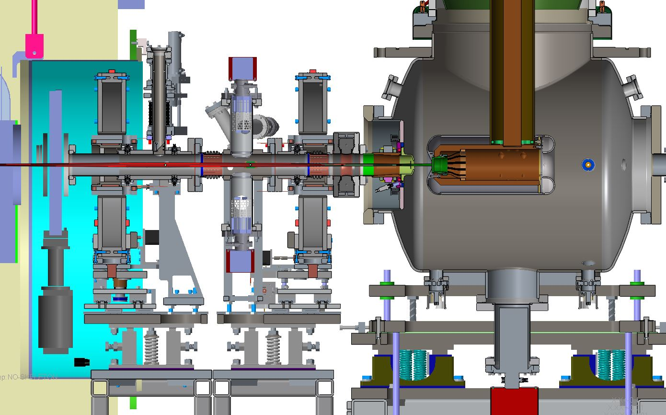
DC Gun

Slide 6
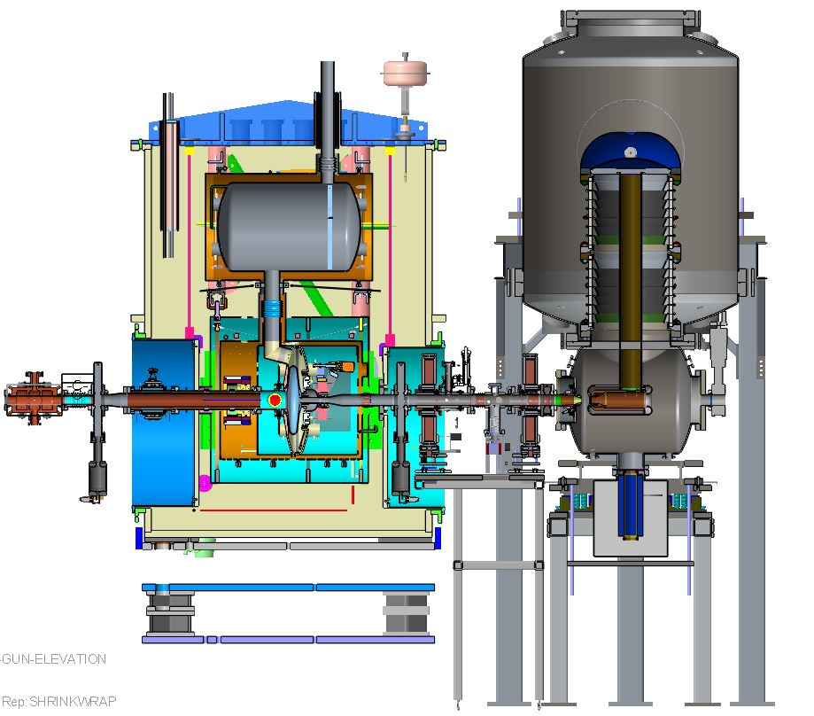
DC Gun

Slide 7
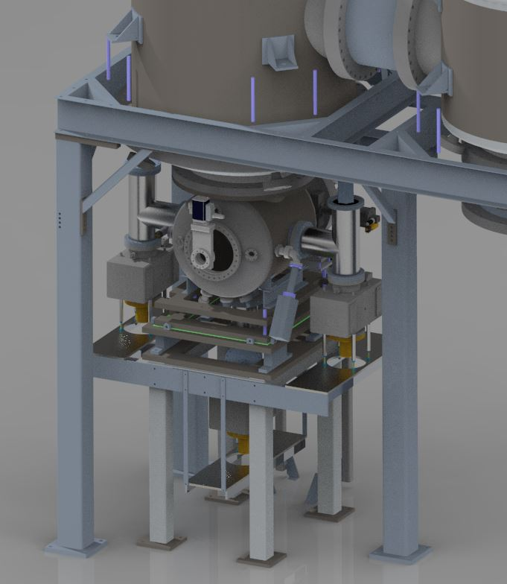
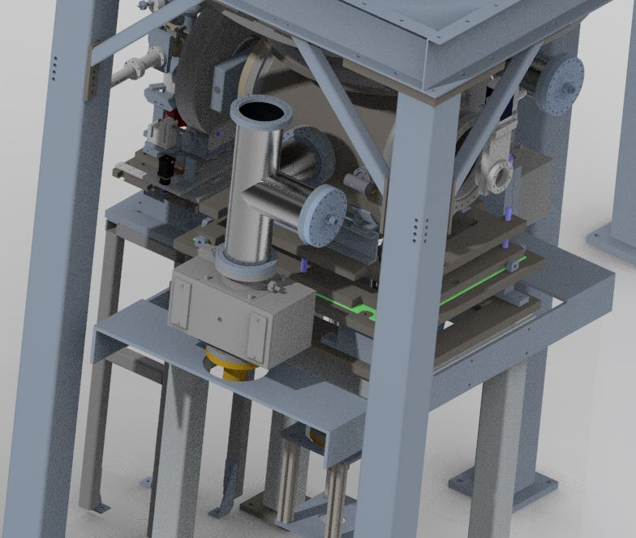
DC Gun
New pumps and vacuum fitting in hand, vacuum fittings scheduled for firing

Slide 8
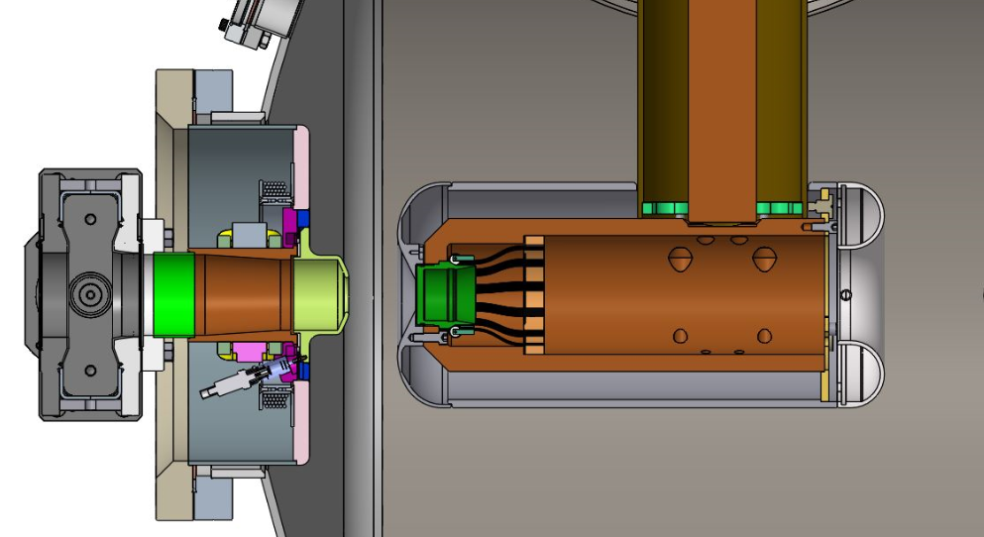
DC Gun Anode Assembly
Inspect and possibly replace assembly.
No anode spare, present assembly has a welded feedthrough for the anode bias, can not be quickly repaired.
Anode assembly has transitions close to the high field regions of the anode/cathode assembly and screw heads in the region.
Will make larger Titanium assembly and remove bolt heads
Will use flanges with leak check grooves. Will use high strength studs.

Slide 9
DC Gun Anode Assembly
Anode Insulators
8x Flat Head Screws
Welded bias voltage feedthrough
Titanium, biased anode
Stainless steel cover ring
Stainless steel flange assy

Slide 10
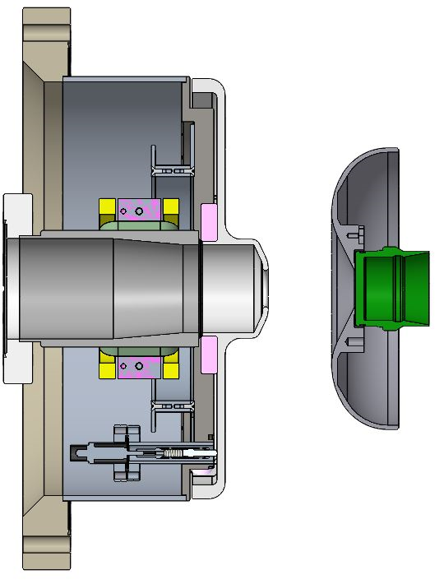
DC Gun New or Spare Anode Assembly
Titanium, biased anode
Fully polished
Retaining Insulator
Alignment Insulator
Flanged bias voltage feedthrough
Stainless steel flange assy

Slide 11
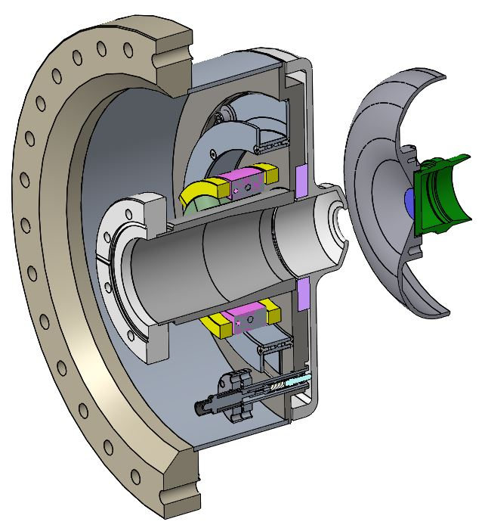
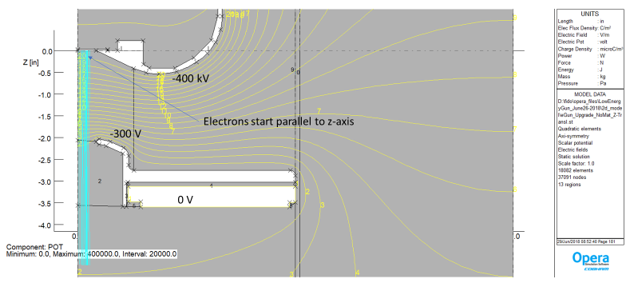
There is risk with changing the field profile in the anode/cathode area.
Should the anode opening be changed? (It was modified for off-center beam)
Should the anode shape be modified? (No; but, it is being analyzed).
Are the correctors and solenoid adequate? (Need further commissioning with off center cathode).

Slide 12
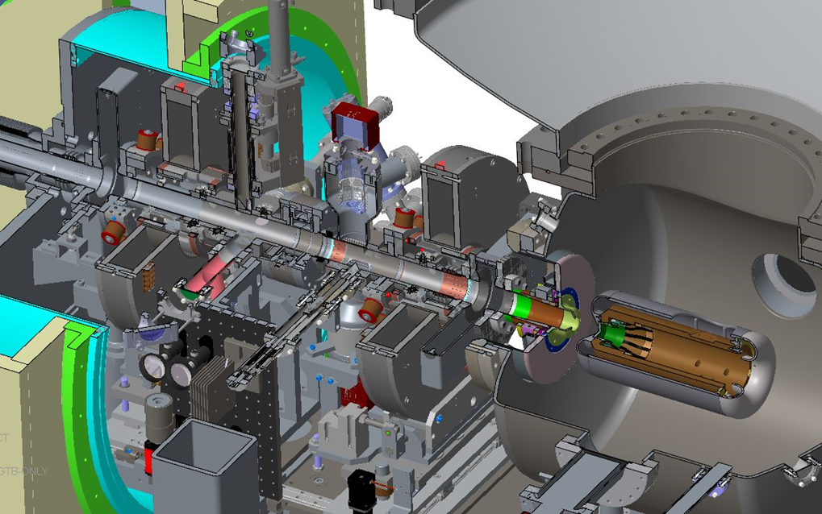
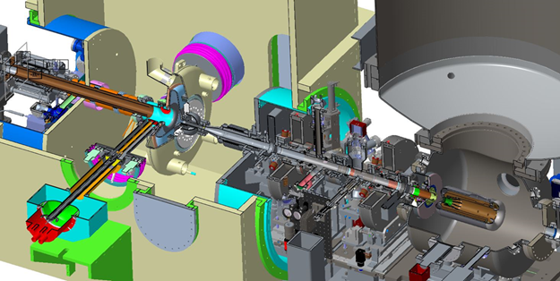
DC Gun Anode Assembly/GTB
GtB U/S Vacuum Chamber
Vacuum Valve
Anode assembly
Moveable Solenoid
Dipole Corrector

Slide 13
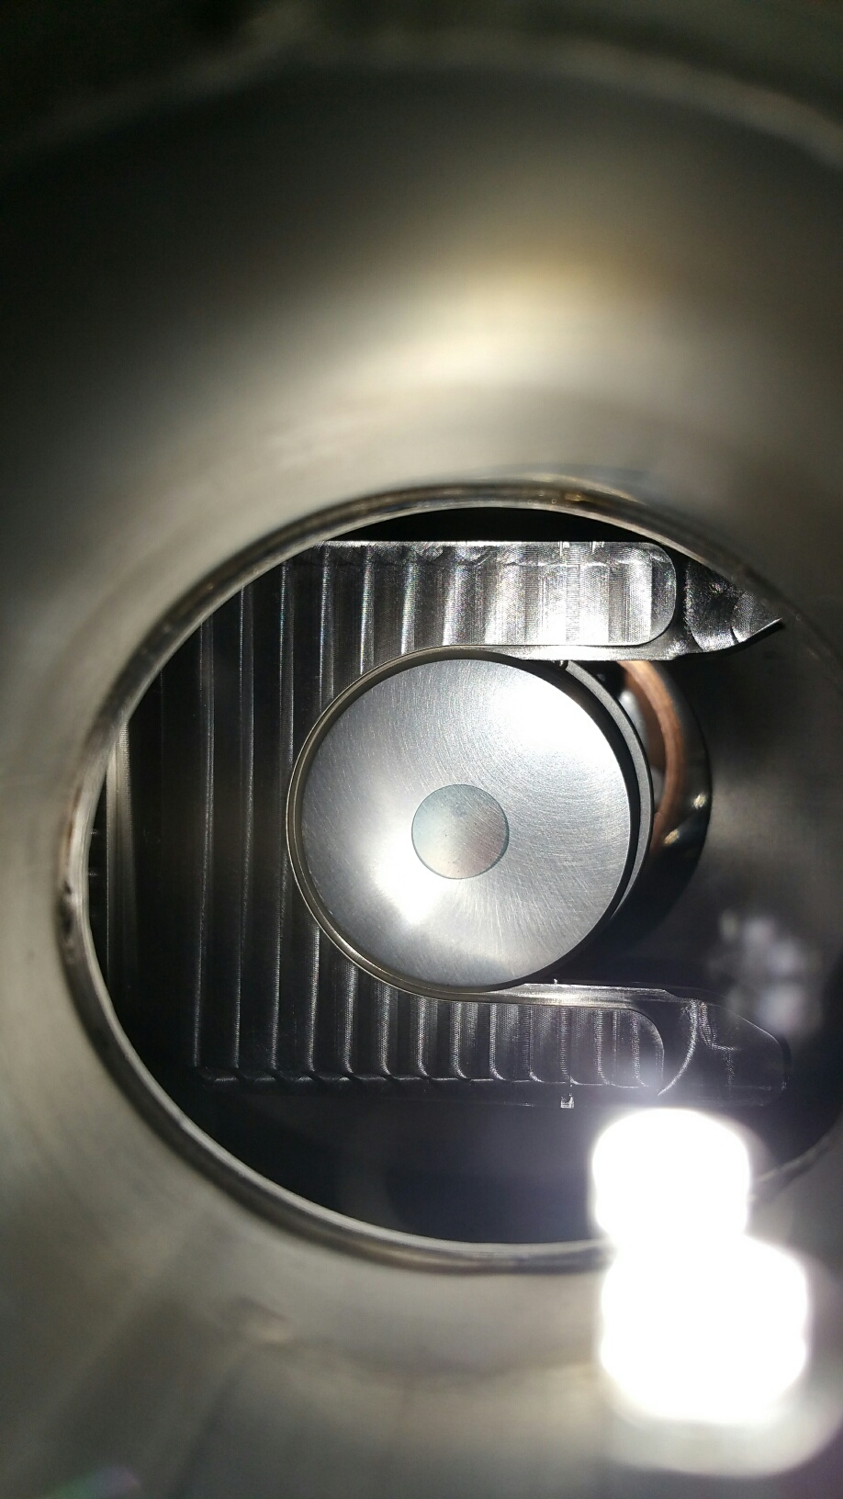
Cathodes
Second cathode production system, timeline? Erdong
Production of cathode with off center active area. Erdong
Looks like we have established reliable cathode production with very good QE. Erdong
Cathode delivery and baking procedure is also established. C.J, Dan Lehn . . .
Will off cathode area help with constant requirement to re-condition the Gun after CW running? ??

Slide 14
Cathodes
Status cathode transporters and insertion system:
Transporters 1 and 2 in service.
Transporter 3 assembled ready for pucks and bake-out.
Transporter 1 needs upgrade. Soften detents, modify “fork” dimensions, modify transport “spokes” (in September)
Cathode swap chamber in production (no transporter bake-outs).
New load lock chamber in fabrication. (faster, easier, connection).
Valve switch interlock fixed, switch moved, procedure in place.
Puck polishing machines in place being prepped for operations
10 additional pucks to be purchased (33 in hand).

Slide 15
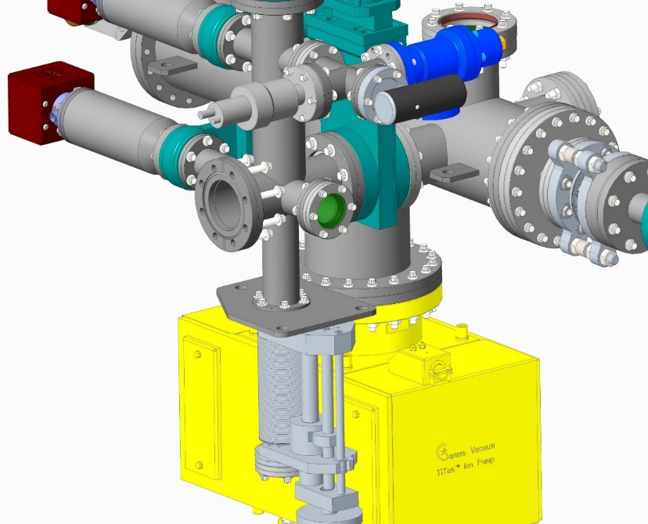
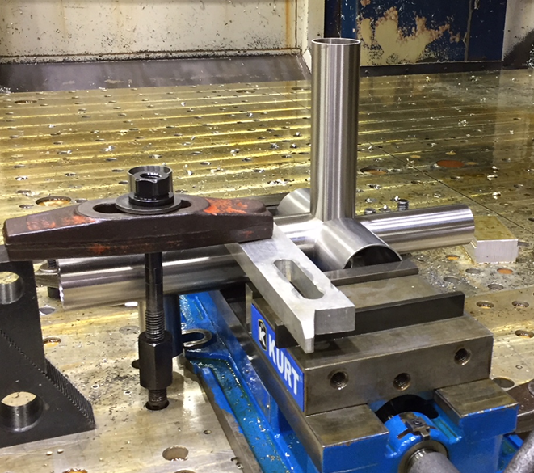
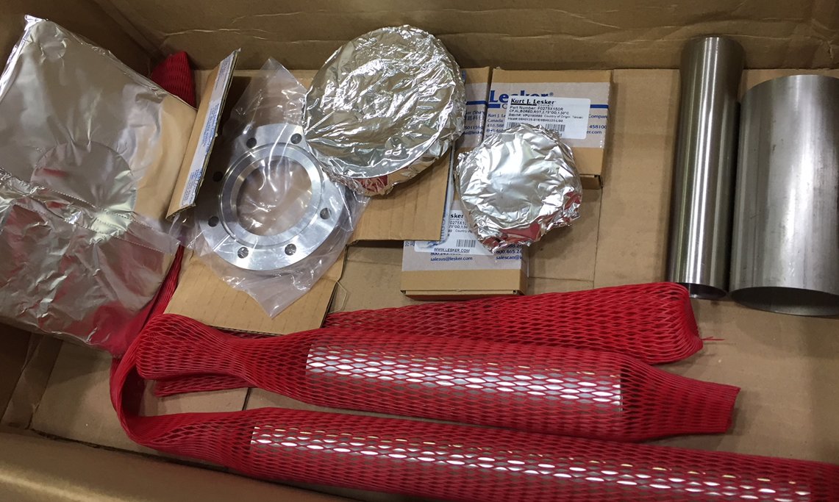
New LOADLOCK
SUITCASE SIDE

Slide 16
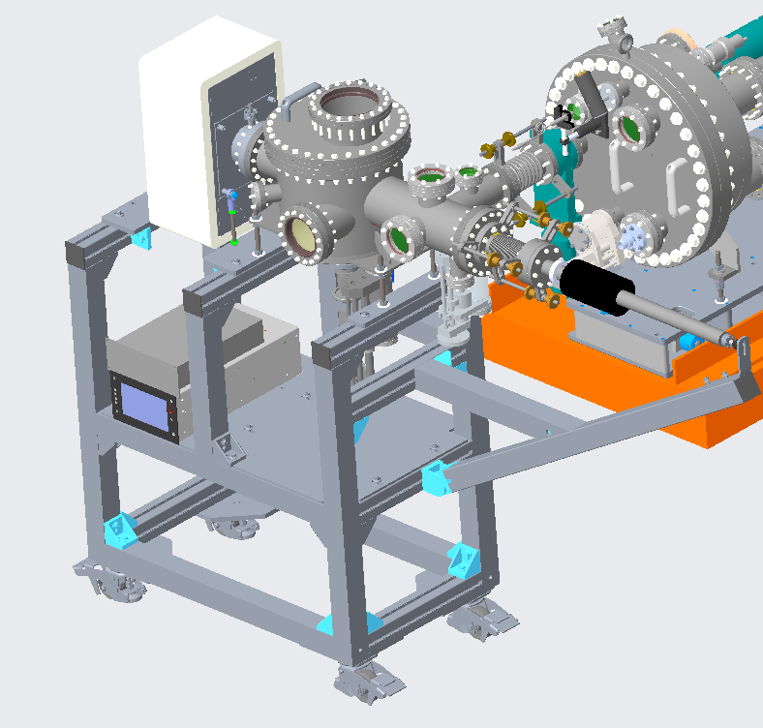
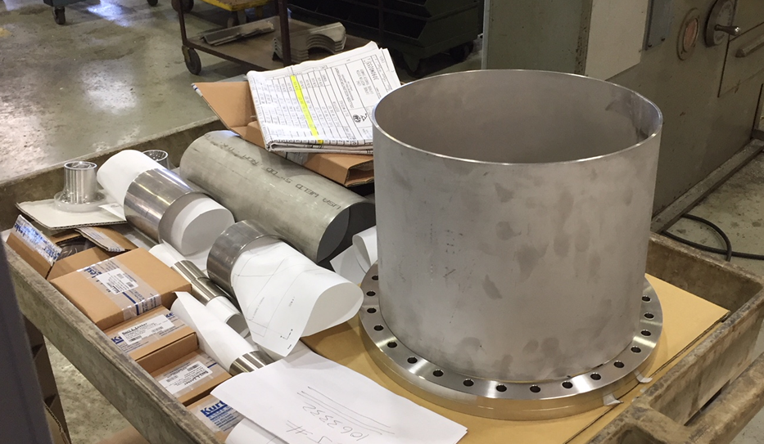
Puck Exchange Equipment
All the commercial vacuum equipment are either received or on order.
Fabricating main chamber at Central Shop.
(Just received 12” tubing from KJL.)

Slide 17
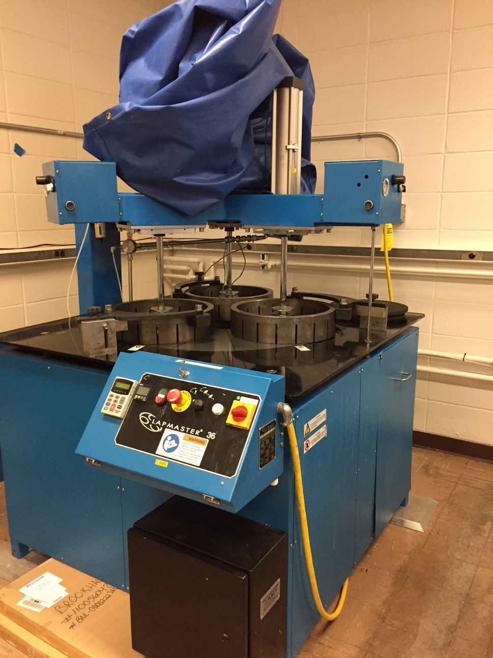
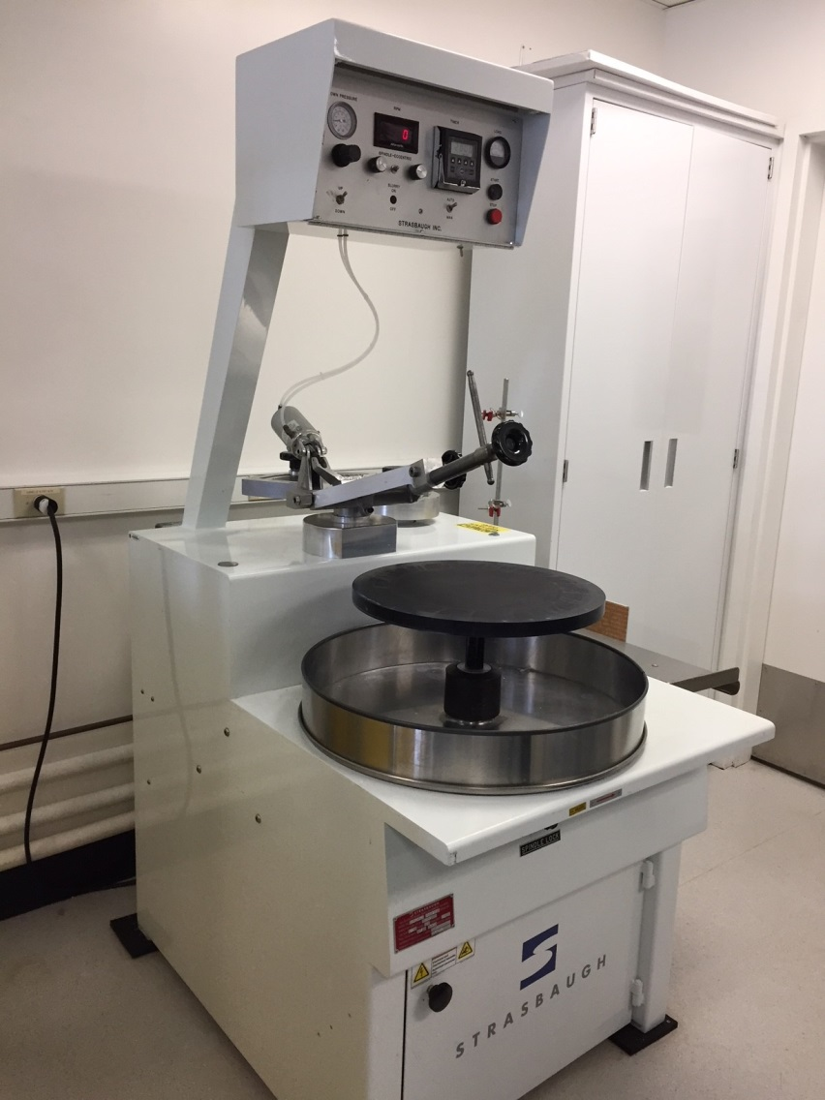

Slide 18
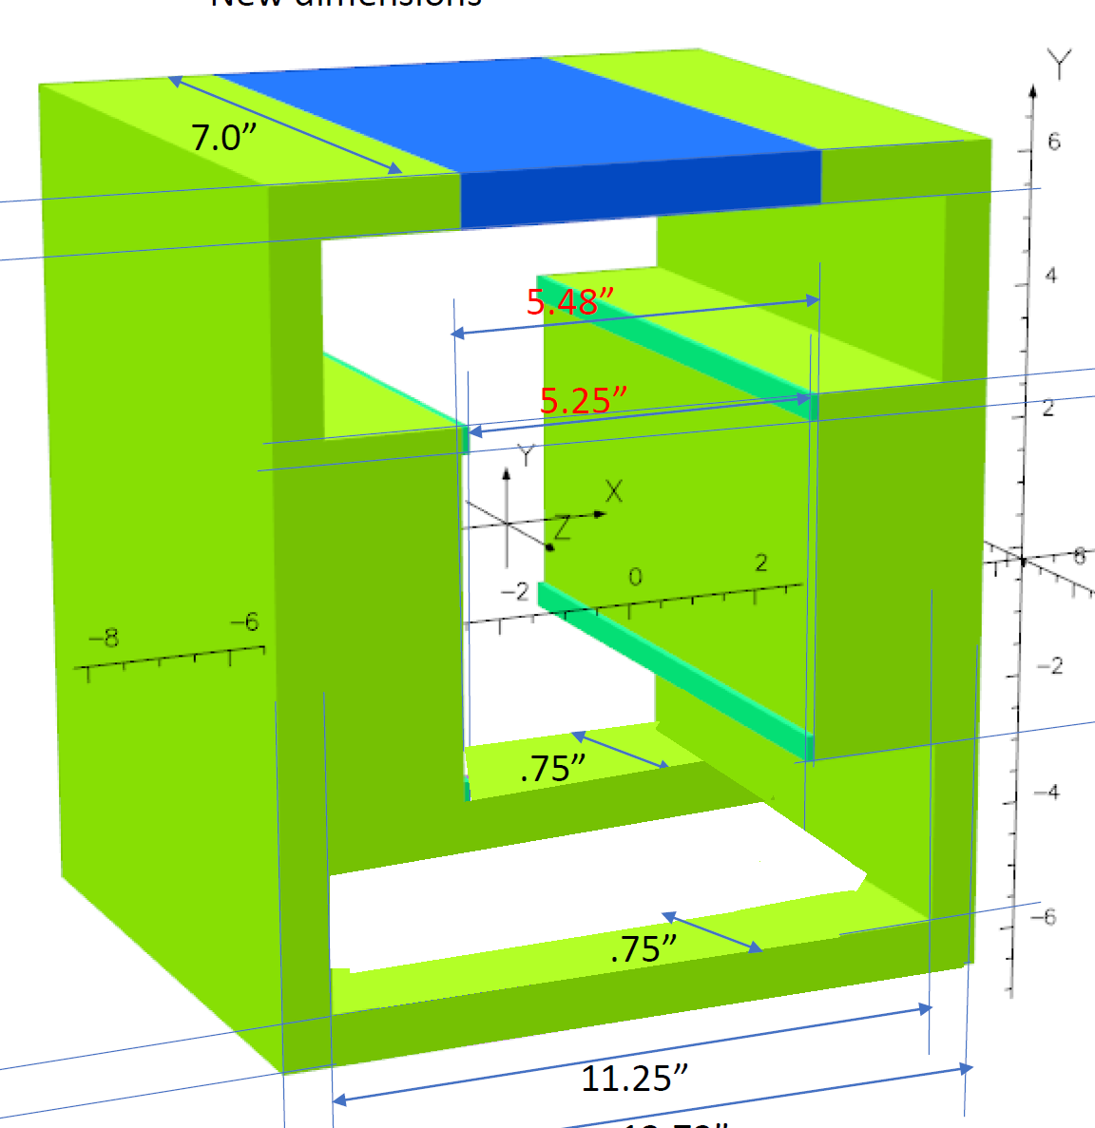
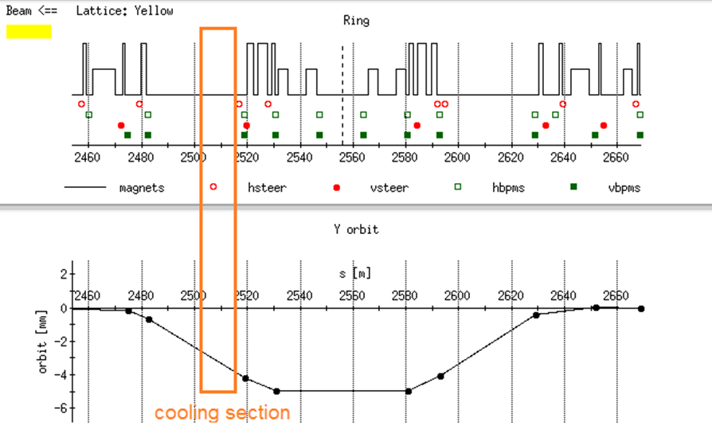
New beam line corrector (Chuyu Liu)
Add new IR corrector in beam line to allow beamline alignement in the cooling section and beam separation in the IR.
Developing design to Chuyu’s specifications
Nick Tsoupas magnetic design
Cliff Brutus magnetic design
Will meet with Don on power supply when Cliff returns from vacation.

Slide 19
Extra

Slide 20
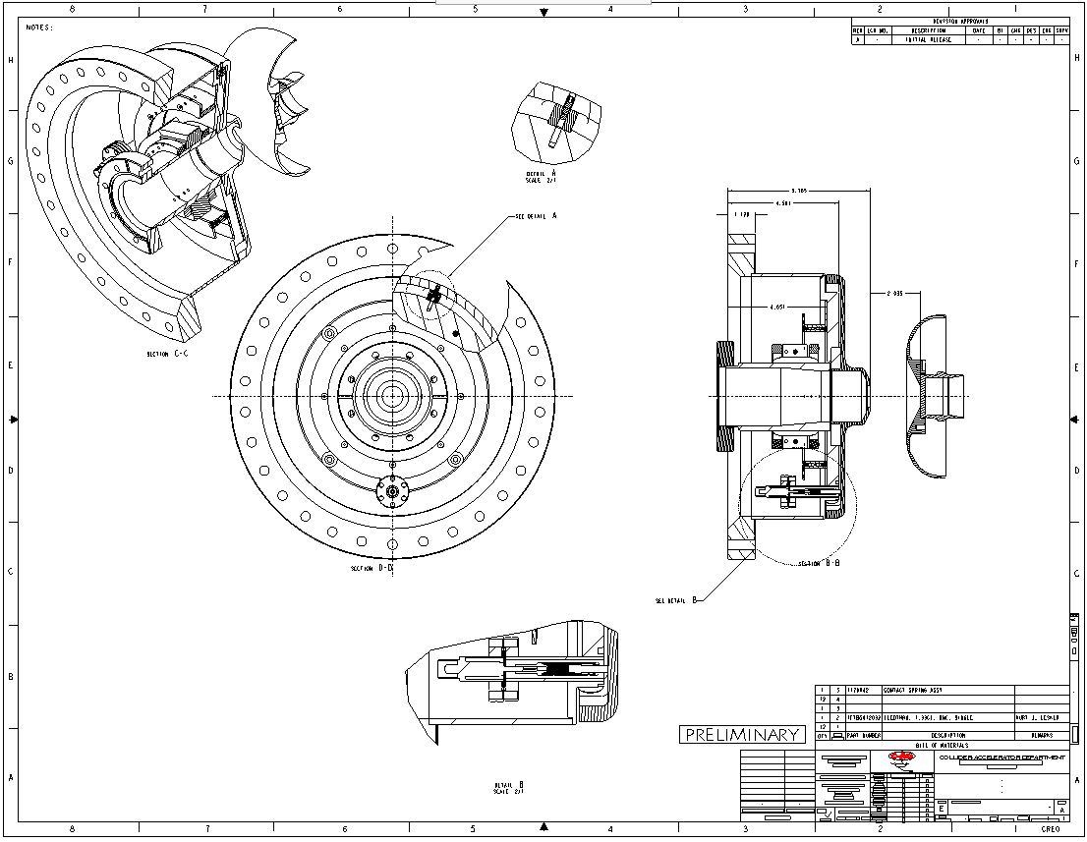

Slide 21
A new dipole in IR2 common section for ion beam
Chuyu Liu

Slide 22
What’s the issue?
There are conflicting requirements on ion trajectory in LEReC cooling section. The ion trajectory is required to be more or less in center of beam pipe (1 mm tolerance) for good alignment with e beam to achieve cooling, however, the separation bump, which separate ion beams in common section, puts the ion beam away from the center of beam pipe.

Slide 23
New 4-corrector bump
New vertical dipole common for both beams
New separation bump in Yellow
The blue beam separation bump goes the opposite way (positive).

Slide 24
Requirement
With 0.22 mrad from this new dipole magnet, Blue separation bump is +5 mm, Yellow separation bump is -7.1 mm.
BL = theta*Brho = 0.32E-3*47T*m ~ 15 kG*cm for 5.75 GeV, with ~45% head room.
0.5% uniformity for radius +/-10mm.

Slide 25
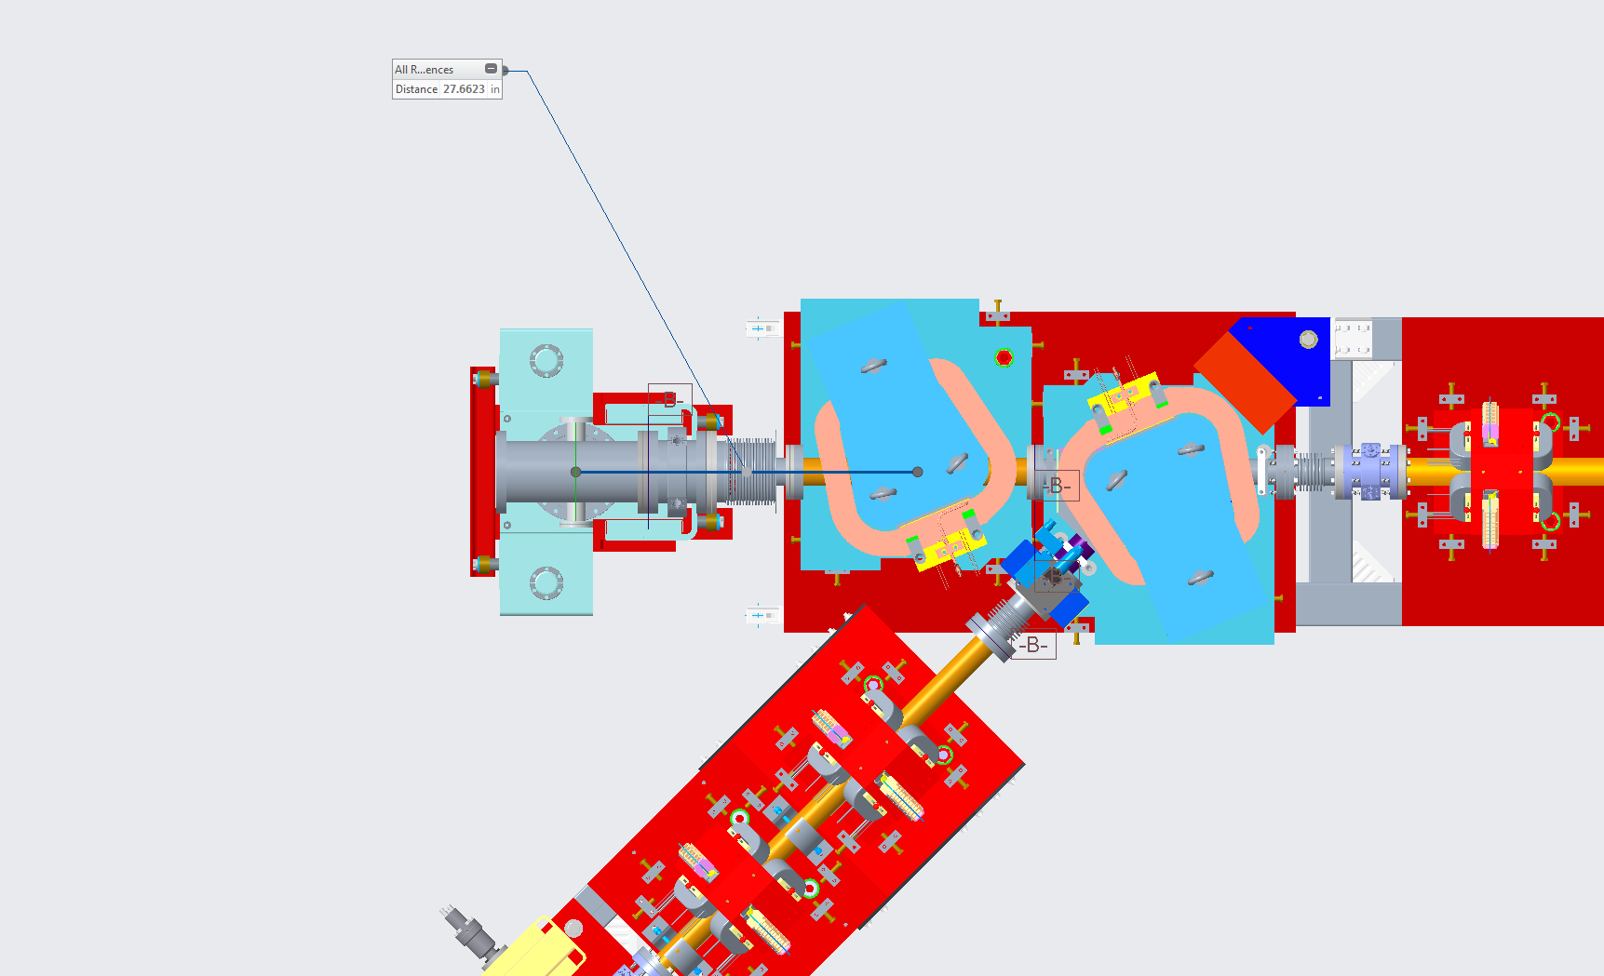
Layout
New dipole location
Ion compensation dipole
CeC dipole
DX
CeC dump

Slide 26
Gun issues
Established that Gun can be conditioned with running resistor.
Will off cathode area help with constant requirement to re-condition the Gun after CW running?

