Slide 1
The View from Operations
RHIC Retreat 2018

Slide 2
First some Good News...
No catastrophes this year:
No broken diodes, cryo breakers, or booster electrical feeds.
LINAC LLRF upgrades have been close to perfect.
Mode switching for Ru/Zr/Au was very smooth.
Fewer desperate calls to Al in the middle of the night.
Most telling: very few people had gripes when I went asking.

Slide 3
Leading to our biggest complaint…
Pulsed Power
Every single person in Operations I asked brought this up.
Reliability and time to resolution were both issues.
H10’s setup was changed over the summer for both charging and calibration. The only way to find the right settings was a long tedious scan of the beam where any wrong shot pulled the AGS permit.
H10 also took to lurching by hundreds of counts in output. A normal tuning nudge is ~5 counts. We would need to change it by 100s. You can find comments in the logs on: 3/21, 4/5, 4/18, 4/25, 5/20, 5/23, 5/25, 5/30, 6/4 and 6/7.

Slide 4
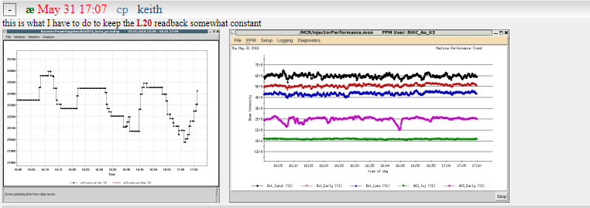
Pulsed Power Part 2
L20 did not work normally during checkout, then drifted throughout most of the run. Operators and Specialists had to act as human servos just to keep the beam running.

Slide 5
Pulsed Power Part 3
A5 also drifted. G10 had issues with its DG535 module and GPIB.
The tolerances for this equipment are very tight, per the RHIC TDR:
Arlene, Wisman, Yugang, Jianlin, and Pulsed Power personnel have been responsive to our calls, although issues persist. Additionally they were saddled with the task of re-engineering the delayed abort system. Do we have sufficient resources available for them to succeed?
 | Beta (m) | Angle (mrad) | Tolerance (% max)
AGS G-10 Kicker | 15 | 2 | 0.9
AGS H-10 Septum | 15 | 22 | 0.09
AGS Orbit Bumps | 22 | 2 | 0.8
Switch (X-Y) | 54 | 48 | 0.02
RHIC Kicker | 31 | 1.9 | 0.7

Slide 6
Scheduling/Experimenter requests:
A Mixed Bag
Bill’s weekly emails help keep the ship sailing smoothly.
Experienced Run Coordinators make a big difference.
We “struggled” to get accurate species lists from NSRL in a timely manner. Last-minute changes were common.
STAR crying “We need double the integrated luminosity!” near the end of the medium energy run was unexpected.
All shift crews (not just MCR) seem to suffer from late-notice changes. For example, CAS’s switch to single-staffing or MCR’s summer plans.

Slide 7
Smoke Detectors and OPM Madness
The OPMs allow us some leeway when safety equipment breaks. Those are called “Authorized Alternatives.” A typical example is one for smoke detectors:
This run we had extended failures for smoke detection in RHIC sectors 8 and 12.
(By extended, I mean months. This was entirely the responsibility of Fire Rescue and their technicians.)

Slide 8
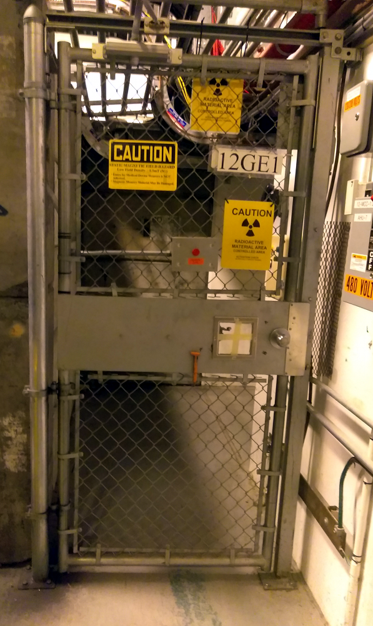
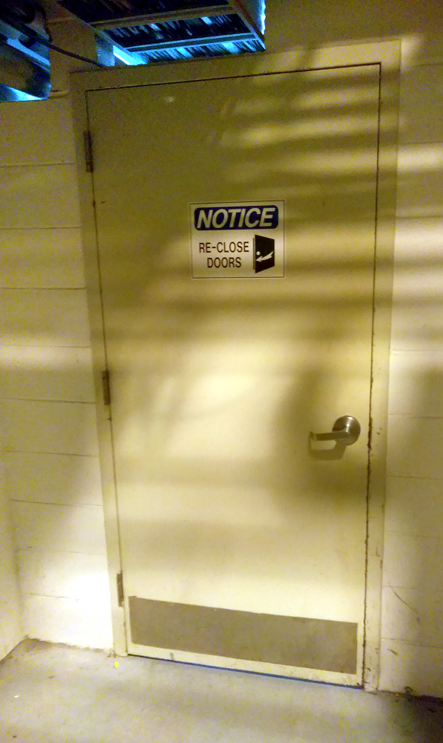
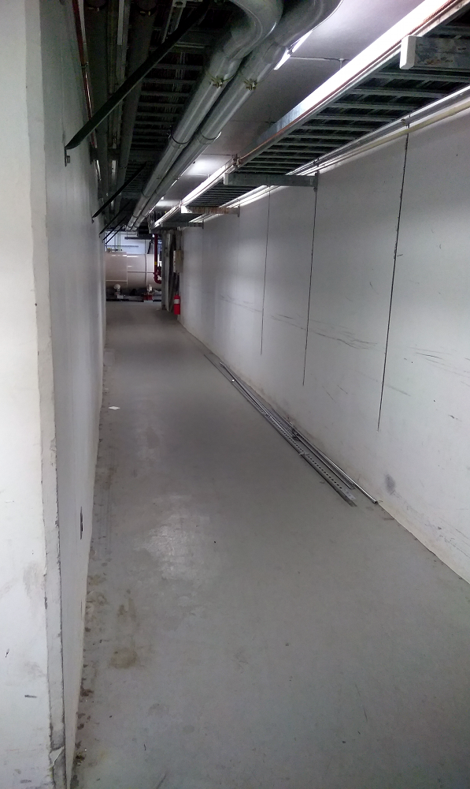
Smoke Detectors and OPM Madness (Part 2)
The gate at sector 12:
The door behind the gate at sector 12:
The corridor behind the door behind the gate at sector 12:

Slide 9
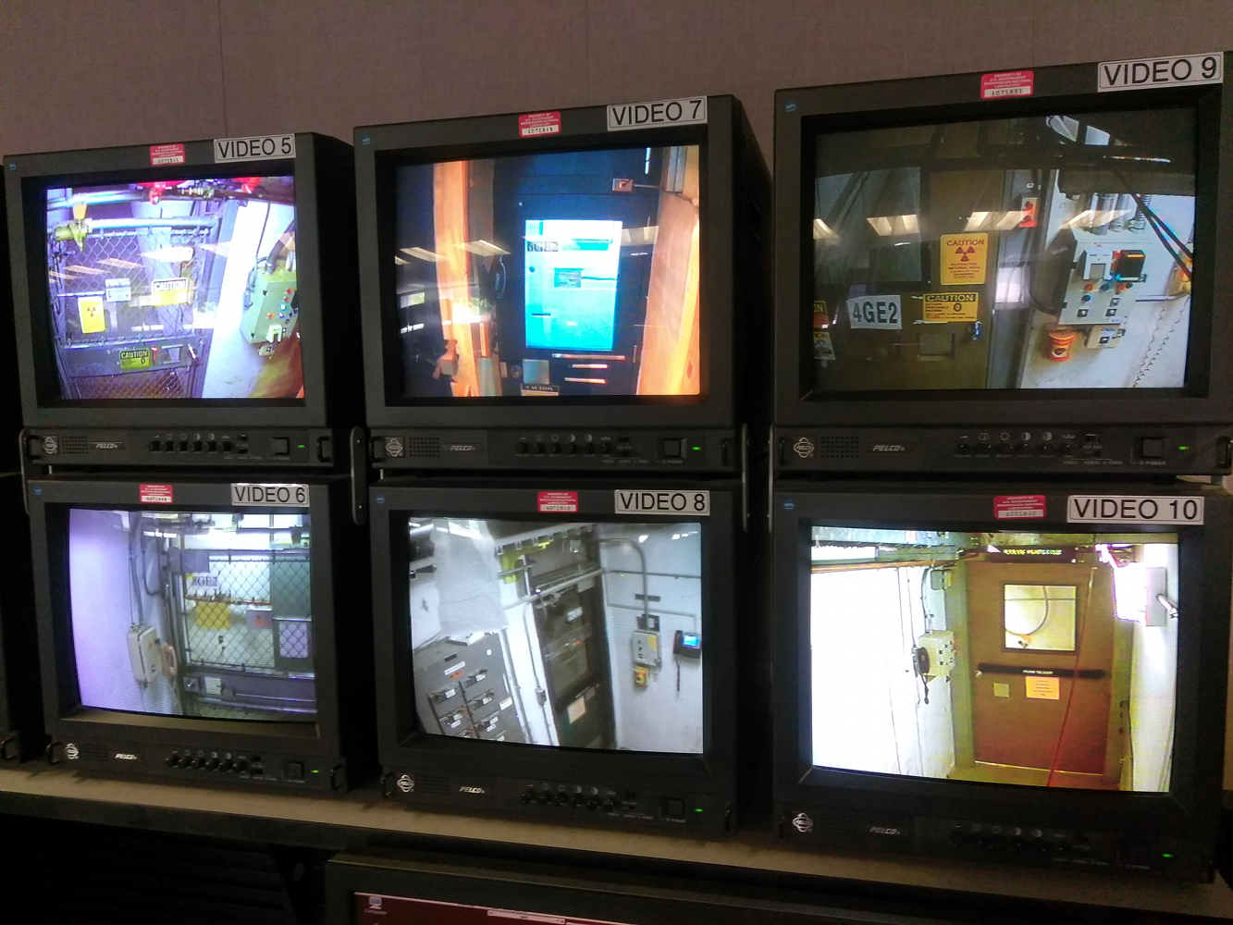
Smoke Detectors and OPM Madness (Part 3)
Because this ran so long and stopped CAS being able to do useful things, we got a workaround. Check the gate monitors in MCR:
Perhaps it’s time for us to review our OPMs. Is this really how we want to do business?

Slide 10
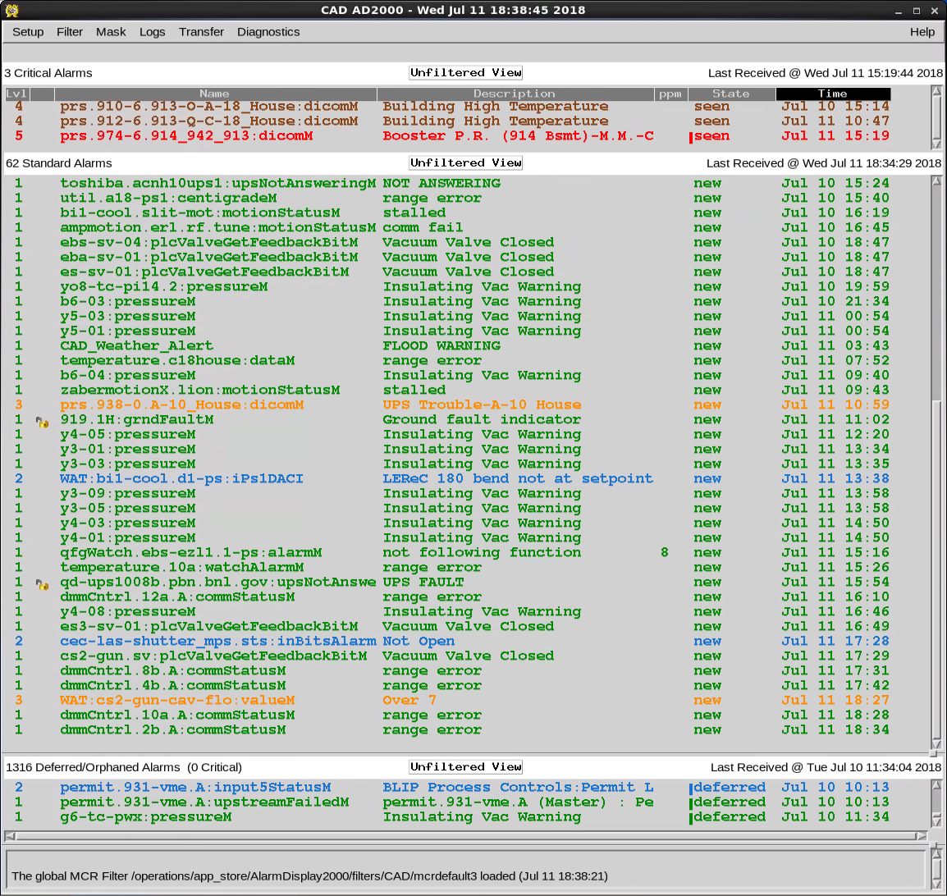
Alarms
With smoke detectors down, the quickest way we would find out about a fire in this case would be from equipment failure. Which we would see on the alarm display.
Except we are still suffering with “fields of green.”
There is a real (hidden) price being paid for these alarms. Every useless alarm hinders our ability to find the real ones.
MCR and Controls are working on this.
You can help too!

Slide 11
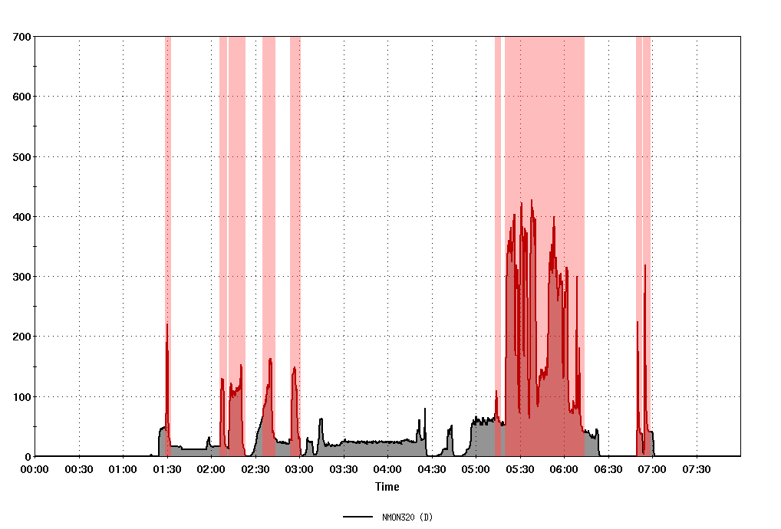
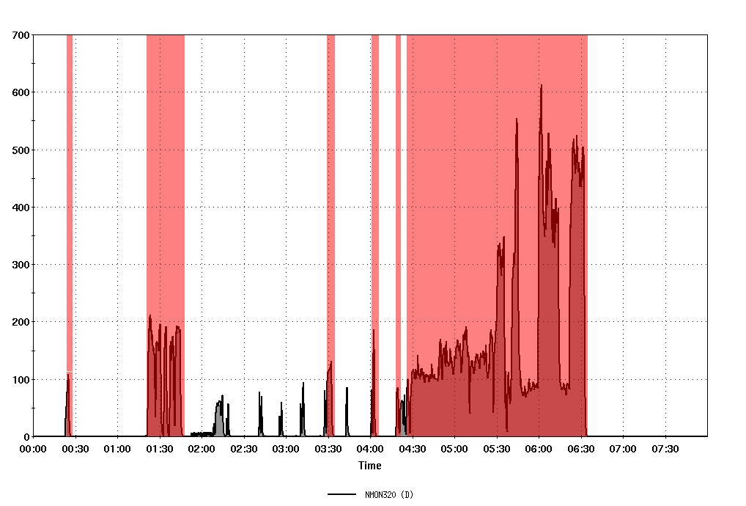
Working with the New Guys: CeC & LEReC
CeC had rough start with us: morning shifts on March 6th and 7th:
The red areas are persistent chipmunk alarms for NM320.
Once they were given clear direction by those with more operations experience, they became very conscientious.

Slide 12
Working with the New Guys: CeC & LEReC
Communication remained an occasional problem throughout the run. “I didn’t think those quads would do that” was a common refrain. That and “Operations didn’t complain,” (Operations didn’t know).
MCR can offer a lot to these projects. We can do grunt work, take scans, troubleshoot, build monitors, mine for data, advise on best practices...
CeC scratched the surface with us during the run.
LEReC only really started to leverage our capabilities after the run ended.
We want to help any way we can. Help us help you.

Slide 13
Looking forwards
BES II is coming up.
We have shown that we (C-AD) can do it. But:
Shorter stores mean more stress on MCR. We need full crews.
Pulsed power becomes critical more frequently for filling.
Good communication helps us all. When things get complicated, it becomes critical.
We still have single-point failure people: e.g. Loralie, Zeynep, and Al.
Grumbles aside, we had great support this year. Thank you all.

