Slide 1
RHIC Injection Kicker for Low Energy Run 2018
Arlene Zhang
July 2018

Slide 2
RHIC Injection Kicker Principle
Ideal System:
Pulser, transmission cable, magnet, and resister have well matched impedance.

Slide 3
Technical Issues:
Input impedance mismatch
Output impedance mismatch
Both Input and output impedance mismatch cause wave reflections that deflecting circulating beam, and adding high voltage stress to the system.
Output impedance mismatch also cause electromagnetic field distortion. It also increase kicker field rise time and shorten useful field flat top duration.
Tri-Axial oil filled Blumlein Pulse Generator and kicker magnet experienced high voltage stress limit, etc.

Slide 4
Emergency Request from Physicists for Ion Low Energy RUN2018 and Beyond
From Haixin Huang et. al. on May 16, 2018, needed by May 30, 2018.
The 0.3-0.4eVs beam for 110 bunch 3.85GeV operation requires injection kicker rise time of <40ns and flattop length of 60ns( with some safety margin).
The minimum requirement is rise time 55ns and flattop length of 55ns. The long bunch length in RHIC is achieved by three new 9MHz cavities and is needed to mitigate the space charge effect.
The actual operation is two years away, in 2020, but the LeREC commissioning is scheduled next year, and interleaved with physics run at higher energies (7.3GeV and 9.8GeV with 28MHz cavities). It is scheduled as 36 physics operation and 8 hours LeREC commissioning.
Although the initial cooling commissioning probably can be done with one or a few bunches, more bunches up to 110 bunches may still be needed next year. Alex reported that it was not clear if the 9MHz cavities could be detuned for the 28MHz operation (9.8GeV and 7.3GeV) and test was needed. This is a new problem.

Slide 5
Prior Work (2005)
First, I’d like to thank Harold Hahn for his study and persistent effort to improve RHIC Injection Kicker.
In 2005, Harald Hahn made an impedance and magnet transmission time measurements of the full ferrite kicker magnet and concluded that:
the magnet impedance is around 40 ohm;
the magnet transmission or fill time is around 38 ns;
the kicker field “rise time is sum of kicker fill time + Blumlein rise time”, with a 35 ns current rise time the kicker field rise time is “~73 ns” @40 ohm.
He made several valuable tests and suggestions:
Initiated the call to change magnet termination resistor from 25 ohm to 40 ohm and increase operation voltage to 38 kV;
Suggest to change high voltage pulse transmission cable pair from two 50-ohm-cable to two 75-ohm-cable, in order to make a 37.5 ohm transmission impedance;
Fabricate shorter magnets; etc.
I found some old records from my file, we tested magnet to 38 kV in 2005.
I also did circuit simulations and field measurements etc. in 2005, …

Slide 6
Prior Work (2009)
In 2009, I proposed a different test setup based on my own experience and understanding.
Purpose: Added a parallel 70 ohm resistor at magnet input to eliminate reflection caused by mismatching impedance of cable to magnet.

Slide 7
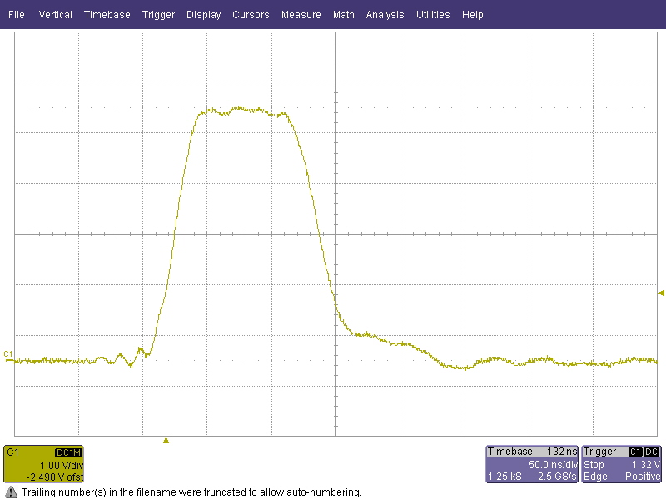
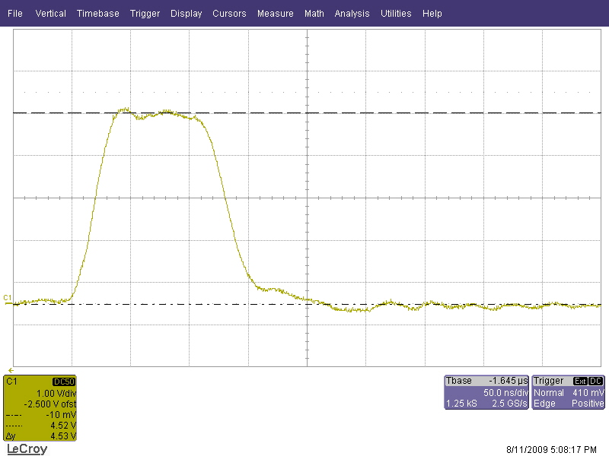
Test Result 2009
I performed my test in 2009 with Ken Hartmann’s assistance at Building 922 test stand and achieved some promising results.
Test with 40 ohm Termination Resistor and 70 ohm input resistor at 20 kV.
Test with 40 ohm Termination Resistor and 70 ohm input resistor at 40 kV.

Slide 8
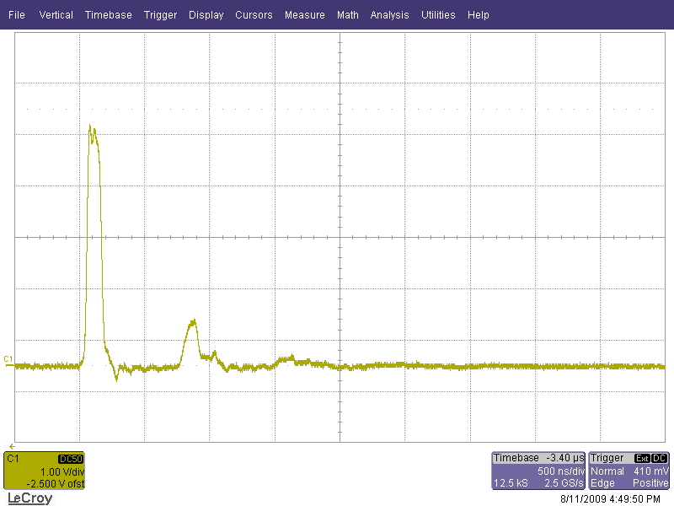
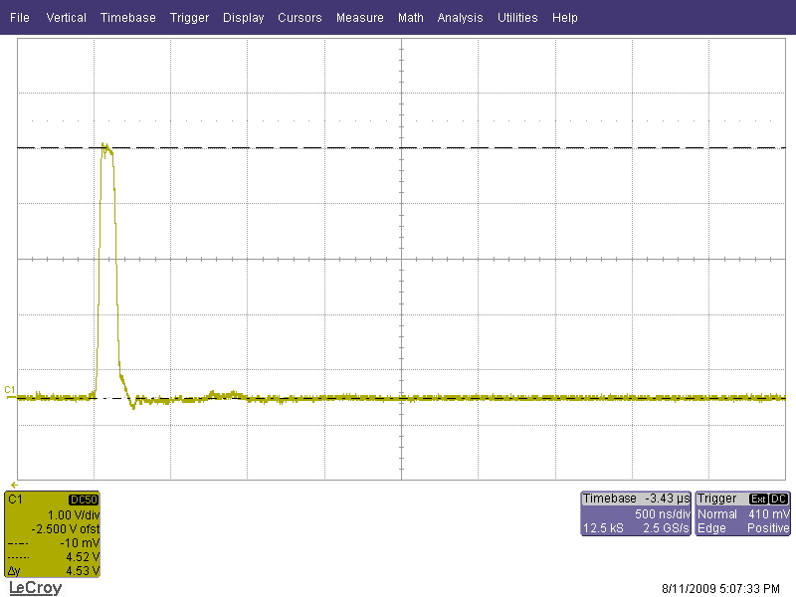
Reflection Comparison Test in 2009
Without 70 ohm input resistor, reflection is large.
With 70 ohm input resistor, reflection is minimal.

Slide 9
RUN2018 Solution
I thought the 2009 test results might be close to the minimal requirement .
Based on my experience and observation, I believe the full ferrite magnet of RHIC Injection Kicker is a semi-transmission and semi-lumped magnet rather than the ideal transmission (travelling) type.
Therefore, I believe the RHIC Injection full ferrite kicker field rise time shall NOT be the summation of current rise time and magnet transmission time.
We changed two yellow injection kickers to 40 ohm termination and raised their thyratron reservoir voltages.

Slide 10
Options to Consider for the near future
Add a 70 ohm input resistor for cable to magnet input impedance match.
Acquire and test a FID Fast Pulse Generator with longer pulse flat top and faster rise time for evaluation. Consider purchasing, testing, and install additional units.
Fabricate a set of shorter magnets as H. Hahn and others have suggested and discussed to shorten magnet fill time.
Use 40 ohm magnet termination resistors to match existing magnet and load resistor impedance for planned Low energy RUN.
Be conservative and raise operation voltage only after successful high voltage stress tests of pulse generators and magnets.
Consider new 25 ohm impedance transmission type kicker magnet design.
New design, construction, testing, and installation of pulse generators and magnets may require three or more years.
Develop laser magnetic field measurement capability.
We need more people in Pulsed Power Group.

Slide 11
Acknowledgement
We are glad to hear the good result achieved in Ion Low Energy RUN2018 and thanks to C. Liu, V. Schoefer, G. Marr, I. Zane, J. Sandberg, H. Huang, A. Fedotov, W. Fischer, J. Tuozzolo, … and many others.
I’d like to thank Pulsed Power Group, especially, Wisman, Ken, John, Steve, Ron and others for their work to support RHIC Yellow Ring Injection Kicker System modification for Ion Low Energy Run 2018.
Special appreciation to H. Hahn and C. Pai. You are missed by all your colleagues.

Slide 12
References
H. Hahn, “RHIC Injection Kicker”, notes, January 24, 2010.
H. Hahn, Full Ferrite Magnet Impedance Measurement, 2005
H. Hahn, “110 Bunch in 200?”, notes, 2005.
C. Pai, “4 Yellow Injection kickers removed from Ring”, June 28, 2010.
H. Hahn, W. Fischer, Y. K. Semertzidis, D. S. Warburton, “UP-GRADED RHIC INJECTION KICKER SYSTEM”, Proceedings of PAC 2003, pp. 1625-1627.
H. Hahn, W. Fischer, V.I. Ptitsyn, and J.E. Tuozzolo, “ALL-FERRITE RHIC INJECTION KICKER”, Proceedings of PAC 2001, pp. 3705-3707.
C. Montag, et al., “FIRST RHIC COLLIDER TEST OPERATION AT 2.5 GEV BEAM ENERGY”, Proceedings of IPAC 2013, pp. 1523-1525.
A. Zhang, “Load Resistance Issues”, white paper, March 2, 2002.
A. Zhang, “RHIC Injection Kicker Test & Upgrade Path (1)”, Power Point Presentation, August 18, 2009
A. Zhang, “Pulsed Power System Performance 2009”, RHIC Retreat 2009, July 16, 2009.
…

