Slide 1
Image Sensors for Precision Astronomy December 3,4 2018 , California Institute of Technology Introductory talk Pierre Antilogus LPNHE-IN2P3, Paris P.Antilogus@in2p3.fr

Slide 2
Workshop Objectives
This 4th workshop on Image Sensors for Precision Astronomy (ISPA) convenes us to address the challenges of making state-of-the-art measurements with imperfect sensors :
the impact of detector systematics on science goals
strategies for characterization, calibration, and mitigation.
The scope of ISPA includes detector issues in any sensor type which affect applications such as photometry, astrometry, spectroscopy, coronagraphy, and shape measurement
ISPA was previously called PACCD - Precision Astronomy with fully depleted CCDs :
➔ CMOS take indeed the challenge of precision

Slide 3
Key measurements by imaging sensors
Position – Astrometry
Shapes
Flux
Main source of distortion from imaging sensors
Field issues ➔ the 2013-1st PACCD highlight
Lateral Electric Field (Edge effect, Tree rings…)
Longitudinal Electric Field (Diffusion , Some Brighter-fatter…)
Space Charge Effect (Brighter-fatter, pocket ? …)
Variable/non uniform hole distribution ( Tearing, Image Distortion )
Mask non-uniformity ( Pixel response non-uniformity )
Defects & traps, non-optimal charge transfer-voltage-clocking (Trailing charge )
Image Persistency , X-talk (electronic ghost )
Electronic stability (vs T , vs previous signal level/baseline stability…) & linearity

Slide 4
Electric Field Issues
1 pixel : 100 μm high
for 10 μm x 10 μm
The field lines are essentially straight down to the last 5 μm
Wave length dependent :
- In bulk Electric Field distortion
- Diffusion
The field line are essentially straight down to the last 5 μm
Marginally wavelength dependent:
Space charge effect (B-F)
Non uniform holes distribution
μ

Slide 5
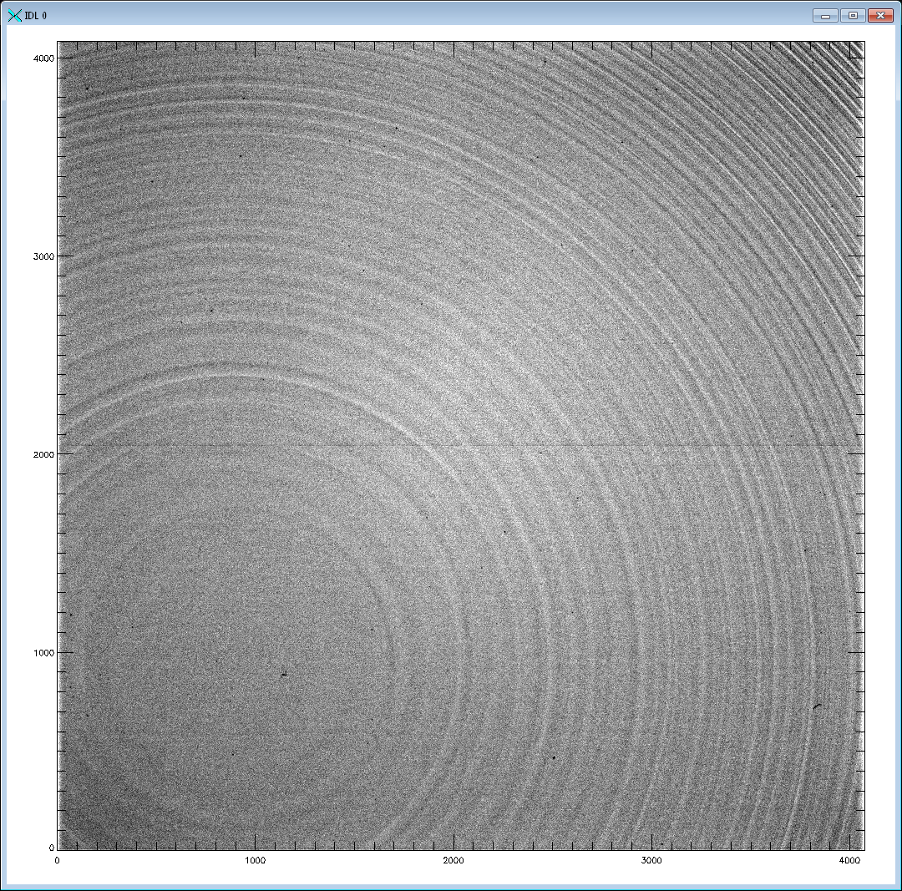
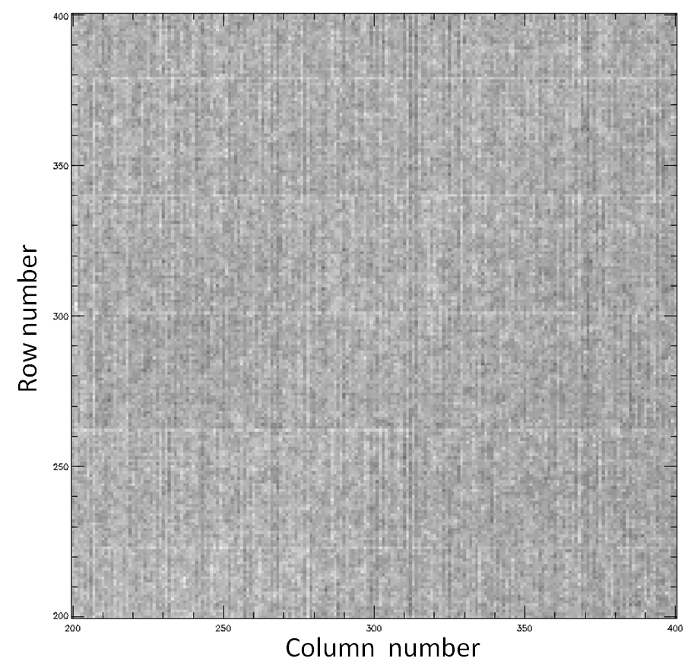
Tree ring & Fixed pattern noise in pixel size : Problem fixed at production level
“Tree ring”
Nothing new since S.Holland talk at PACCD 2016 on the work done in the frame work of the deep depleted CCD development for DESI . The production processes are now under control “every where” , and these effects are not dominant any more ( still higher V_{BSS} , less effect seen) :
Tree ring reduced by more than 1 order of magnitude
Reduce the effect of the resistivity variations by using very high resistivity silicon (>=15 kohm-cm silicon )
Less space charge due to ionized dopants / less lateral field
The Teledyne CCD process using step and repeat systems resulting in periodic pattern-placement errors, has been upgraded : effect amplitude reduced by >~3
“Bamboo”

Slide 6
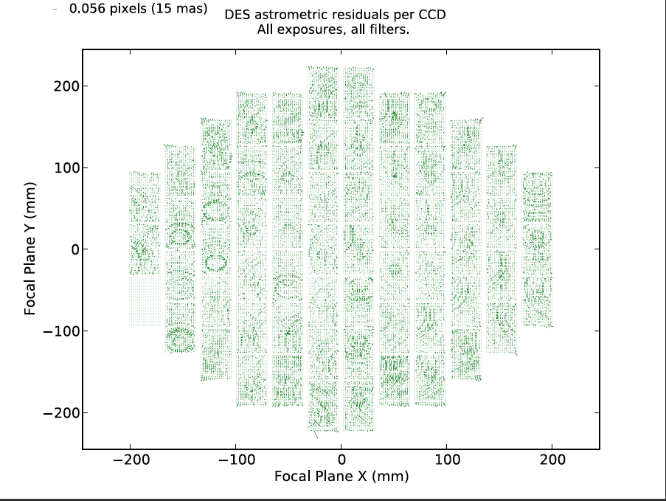
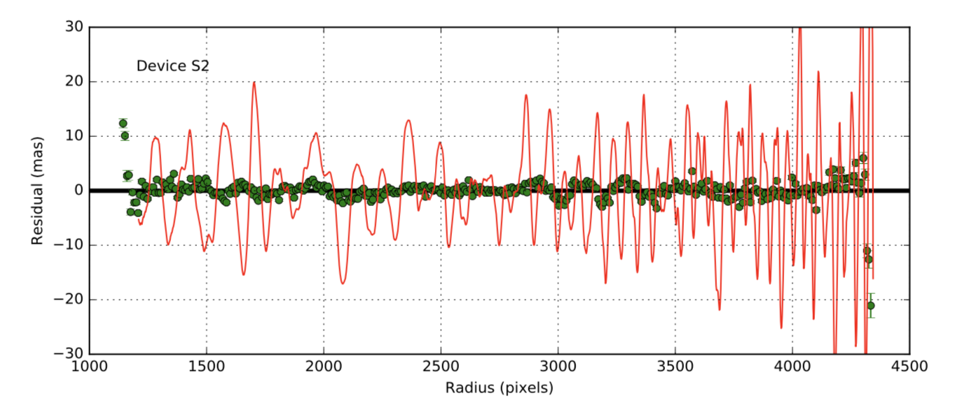
Astrometry & Tree-ring : Highlight from DES results
See Bernstein et al. PASP Volume 129, Issue 977, pp. 074503 (2017), arXiv:1703.01679
Astrometric displacement before and after tree rings correction :
averaged astrometric residual has been reduced to ≈ 1 mas RMS

Slide 7
Today Astrometry Frontier ➔ turbulent atmospheric signature removal
Without tree ring effects at the scale experienced by DES or after correcting for them, the next limitation in the astrometry precision encountered in the current on ground wide surveys is associated to structured atmospheric effect, variable from exposure to exposure :
Best guess : high altitude refraction index variations.
Large parameter space per exposure for a correction at a few arcmin level scale …
Astrometric
JoinCal Astrometric
analysis on HSC Data
Pierre Astier 2017

Slide 8
PSF shape distortion : still THE hot topic
Today bias/systematic in the PSF shape is a hot – worrying topics for the next decade cosmological survey (LSST, Euclid , …)
Their expected break through in Dark Energy constrain, supposes that the weak lensing probe can reach an unprecedented precision that will supersede the precision of all other probes .
The biases from sensor intrinsic PSF distortion has a good chance to become a dominant limitation ( ex PSF ellipticital residual ➔ δe <~0.0004 from a shear-shear constraint on δe₁ δe₂ < ~2.10⁻⁷ for separation > 5 arcmin)

Slide 9
PSF Elliptical distortion : Brighter-Fatter & Charge Transfer Inefficiency
In the Brighter-Fatter (BF) , due to # in Electric field strength between row ( associated to // voltage value) and column ( associated to the implant) , we observe in all devices a larger BF effect in the y (line ) direction than in the x (column) one.
Today, the B-F correction is clamed to remove 90% of the effect … and said to be in control in respect of the current needs … but in practice every body still do a ~ ½ full well cut , removing the brightest objects from their PSF calibration sample .➔ work still to do in the projects under construction
A Charge Transfer Inefficiency (CTI) , will elongate the PSF in the CTI direction.
Request CTI < 5 e-6 to be safe (LSST)… but in large focal plane , channels at 1-5 e-5 will exist , or will appear after some time in space ( radiation damage) : correction will be needed.

Slide 10
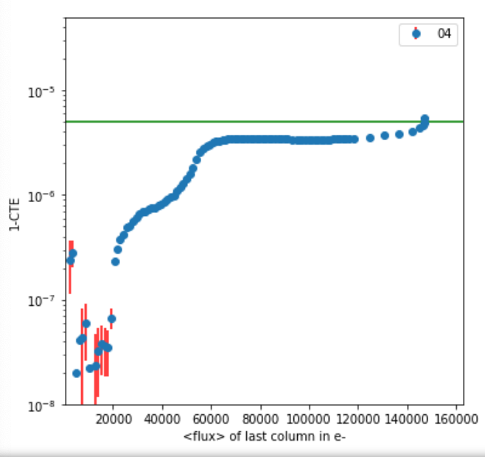
CTI : “pocket” an effect in deep depleted CCD
At a given signal level a jump is observed in the CTI ( here in the Serial, also present in // direction near full well . Probably similar effect seen in ZTF sensor in //direction ,SWD2017 , R.Smith)
It is associated to a peak in the cor(pix, pix+1) ( and has a corresponding deep in the var vs flux )
The full physic is still unclear , but space charge + field configuration in the serial register are at play .
Remark : CTI and correlations for B-F correction should not be just measured at 1 flux !!!!
CTI ➔
Flux in e- ➔
R(1,0) =
cor (pix,pix+1) ➔

Slide 11
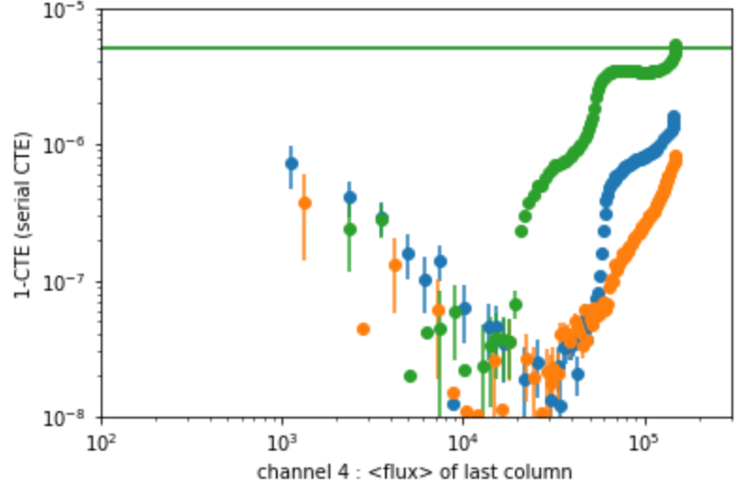
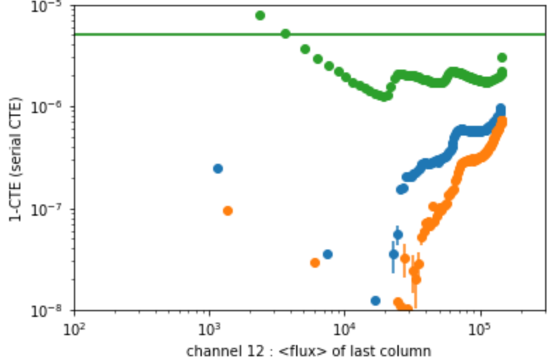
Serial CTE in e2v 250
// < 0
// <0 & S < 0
//>0 & S >0
CTI ➔
Flux in e- ➔
Serial CTI (from EPER) shows that
pockets ( jump in CTI vs flux )
and small traps ( ~ 8e- , bad CTI at low flux )
in E2V CCD 250 are highly sensitive to voltage setup :
➔ field effect / defect at the level of the pre-scan pixels
( e- don’t like to take the curved path )
( between serial register and amplifier)

Slide 12
Flux measurement & flux calibration goal
To further constrain the Dark Energy Equation of State ( “FOM”) with new-large SN Ia sample , requests to go beyond the current state of the art on photometric calibration ( ~.3- .5 %)
The goal is to reach the .1% photometric precision !!!!
This seems achievable with hard work … work at the level of the sensors will help.
From N.Regnault
2018 LSST-DESC

Slide 13
Can we make the response of the 3200 LSST channels uniform , stable in time and measure their linearity … all at .1 % level or better ?
The goal is to target a flux calibration at ~.1% : flat field alone cannot reach this precision ( ghost … )
Mandatory ➔ a good electronic and a stable setup + some time to time calibration .
Highly segmented focal plane : small surface per amplifier , cannot get at “high frequency” - per exposure constrains from the stars … ➔ to calibrate/monitor quickly at ~.1% precision is needed to keep the channels response uniform over time.
The answer to this question is many order of magnitude more complex , and certainly the “ultimate” frontier for CMOS … before we fully “drop” CCD .

Slide 14
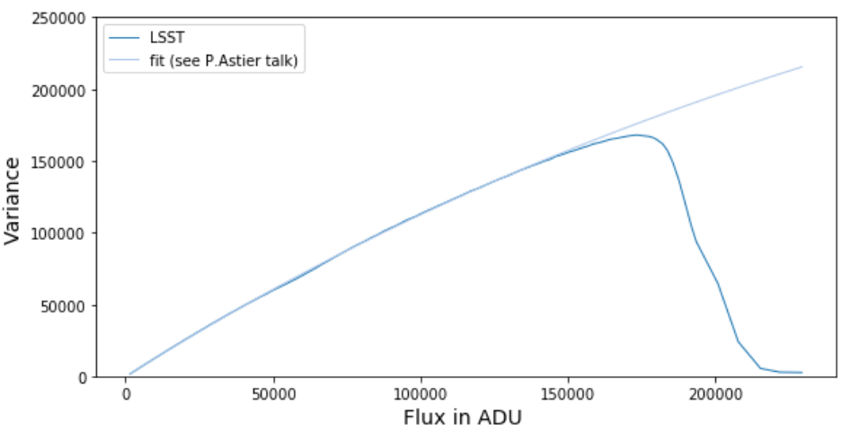
Linearity, Gain, CTI , Field shape : PTC does it all
As we worked on Brighter-Fatter effect on various instruments , we still noticed the difficulty to get good Photon Transfer Curve (PTC) at observatory or lab from todays data taking usage .
The “in lab usage” , is to use Fe55 for gain measurement and at observatory , most of the time a crude gain is used … flux calibration from flat+stars …linearity too often neglected.
But precise PTC are mandatory to measure :
Linearity
Gain , help to align the response of a large number of channels prior of on sky flux calibration (flats alone, due to ghost and non-uniformity doesn’t give alone the .1% level )
CTI in function of the flux (shape distortion )
Brighter-Fatter / electrostatic distortions at the voltages used.(at least 500 flat pairs …. )
At which frequency ?
Beyond for the gain - response uniformity : not often (month-year scale) as it is expected to be stable .

Slide 15
An example : LSST CCD & readout stability
An ~.1% or better gain – video chain stability should be a standard goal today.
For example the LSST video chain during data taking has, as expected, shown variation fully dominated by the temperature change of the amplifiers present in the video chain. ( δgain = -0.2% / deg ) …but this is true only for a few degrees, at some point other components may change the behavior of the system ( ex : voltage delivery ) , making a temperature correction more complex – less precise.
In highly regulated temperature environment ( test lab, with focal plan temperature stabilized at +/-0.01 deg and the electronic board at +/-0.1 deg ) response , beyond thermalization time around Power on, a gain stability of a ~2 10⁻⁴ was observed over days.
Once at telescope site , and correcting for small temperature change (expected at deg scale , as electronic is thermalized ), should allow to achieve easily a corrected gain stability better than ~ 0.1%
➔ To make your life easier : regulate T not only for the CCD but also for the full video chain.

Slide 16
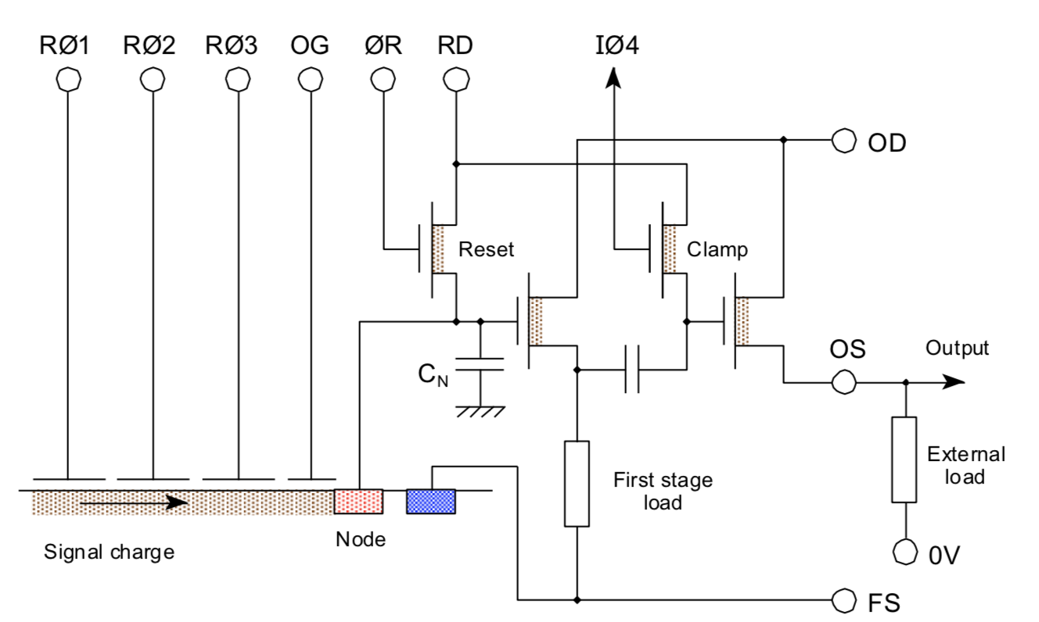
Signal Injection: monitor channels response at high frequency
Beyond a full characterization of your channels by a PTC ➔
to monitor and correct gain drift : signal injection 😃
In LSST a few options considered :
Inject a pulse through RD ( ~ 100 mV) , with reset on (∅R) ➔ not in the final LSST electronic … 😢
There is a signal corresponding to ~ 2500 e- injected by Serial Clock swing during pixel readout in the bias level : This signal see the full video chain …but mixed with other offset source that can change too …
Record the level change between reset on/off ( equivalent to 70 k e- ) . Better than 1% for most change in video channel …but wrong sign dependency for CCD T …
E2V CCD 250
The last 2 are still useful to track some drift ,including within 1 image … but for the moment we haven’t reach .1% level with them … Still if I had the option , I’ll try the first one .

Slide 17
Conclusion
We are not done ! Expectation from sensor , as statistic & Volume of sky increase , rises quickly :
Ex : LSST will be systematic limited …any improvement on systematics from sensor will directly impact the science outcome.
Today it’s “CMOS day” … the goal is clear :
After PACCD yesterday , ISPA today …
tomorrow will we have to rename this workshop PACMOS :
“ Precision Astronomy with CMOS “ ?

