Slide 1
How well do we understand NIR detectors?
(focus on hybrid HgCdTe)
Roger Smith
Caltech
2018-12-03

Slide 2
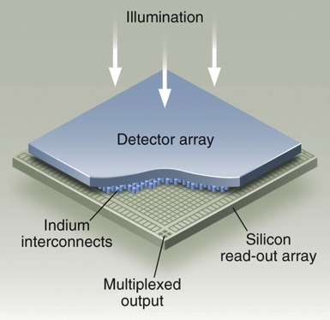
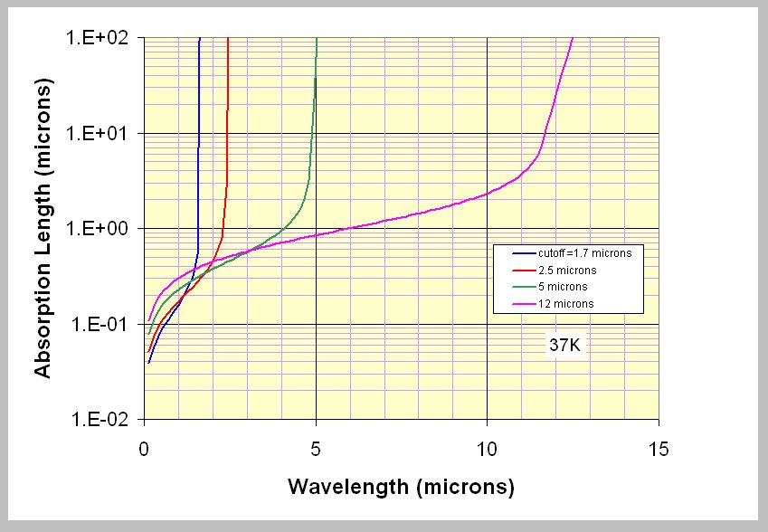
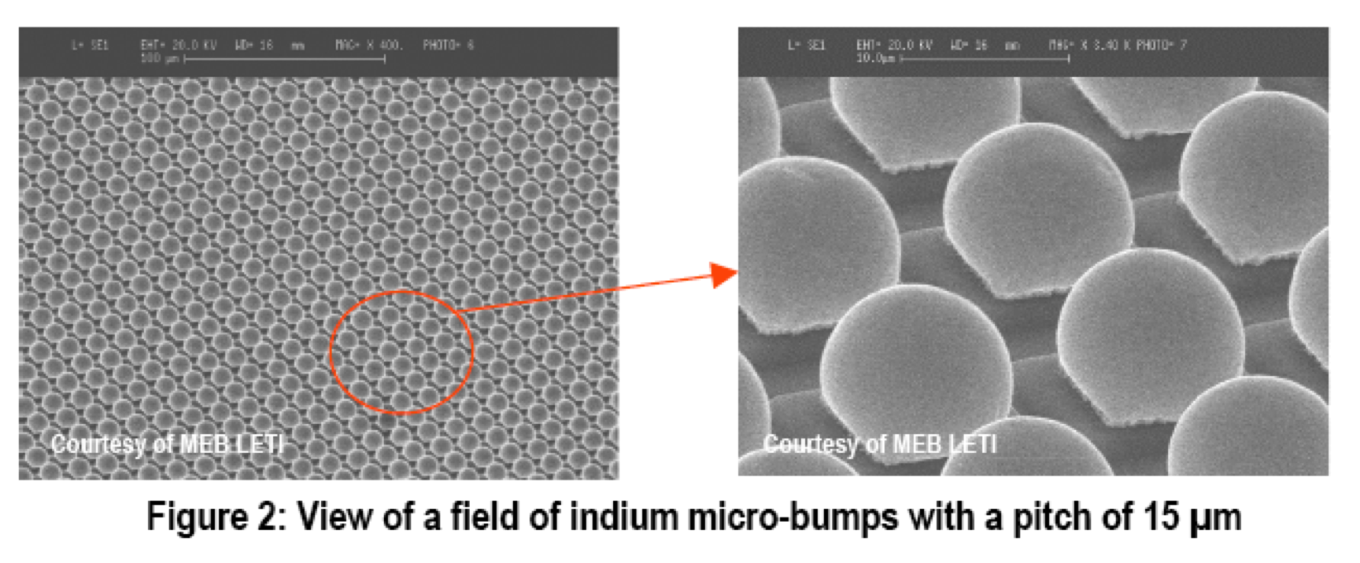
Photodiodes, with low bandgap
Bump bond low bandgap material to silicon readout IC.
Integrate charge on diode capacitance.
Material becomes transparent when
hc/λ < E_{g}

Slide 3
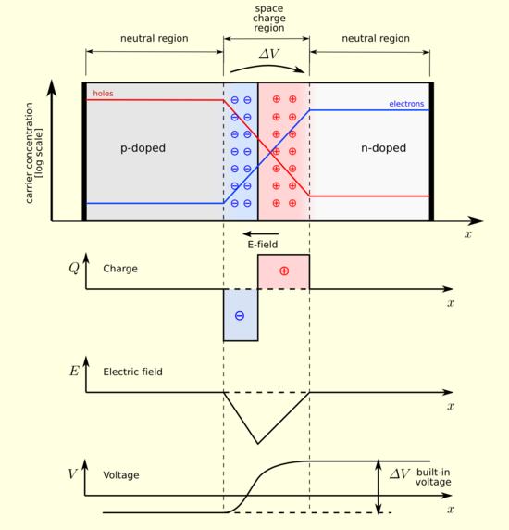
Basic theory of PN junction
When majority carriers diffuse across PN junction they recombine leaving a charged but carrier free region. The charge on the donor atoms produces an E field which opposes further diffusion.
For given donor density profile, Q(x) at equilibrium, within space-charge region:
E α ∫Q(x).dx
V α - ∫E(x).dx
http://en.wikipedia.org/wiki/P-n_junction

Slide 4
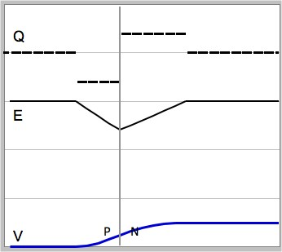
Built in voltage
Depletion width
Equal areas
E α ∫Q(x).dx
Built in voltage
V α - ∫E(x).dx

Slide 5
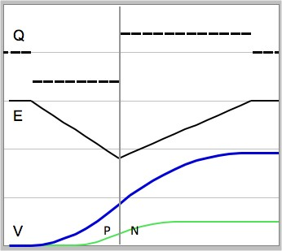
Reverse bias
Depletion width increases
At “reset”, a reverse bias is applied : charge is removed, increasing depletion width.
Reverse bias
Built in voltage

Slide 6
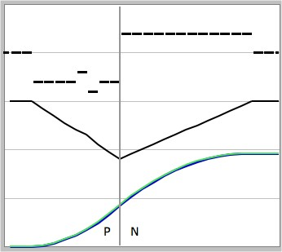
Photon makes electron hole pair
Initial depletion width
Q
h
e
E
V

Slide 7
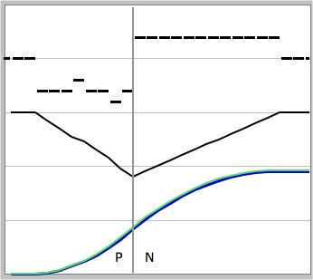
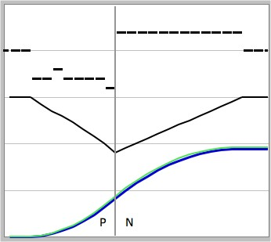

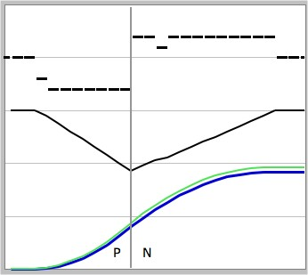
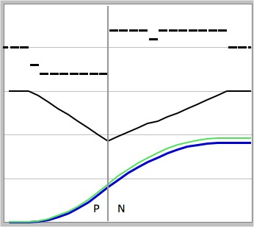

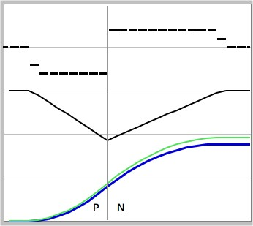
E field separates e-h ⇒ voltage drops
Initial depletion width
Final depletion width
Q
Narrowing of depletion region maps to a drop in the reverse bias.
E
V

Slide 8
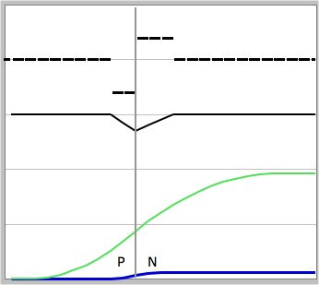
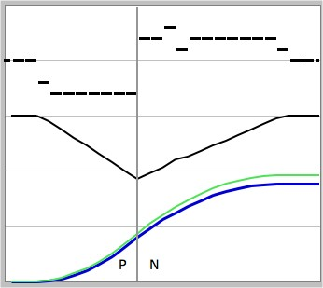


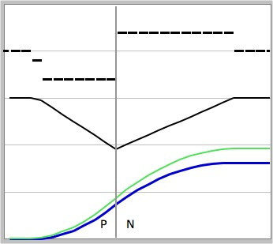

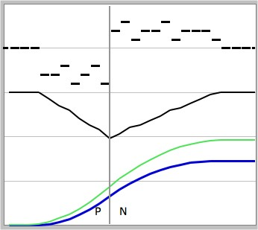
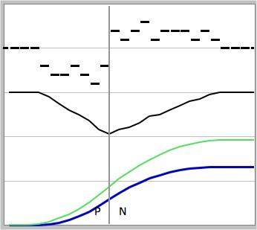
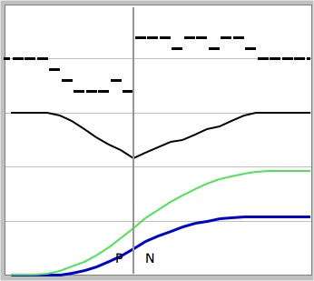
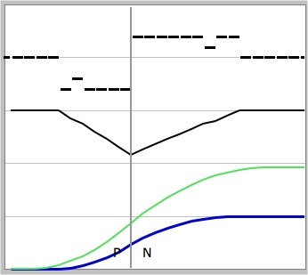
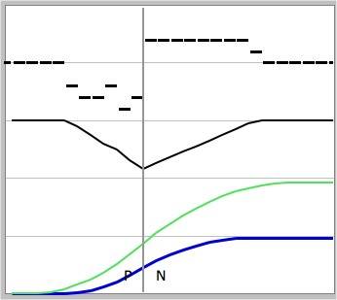
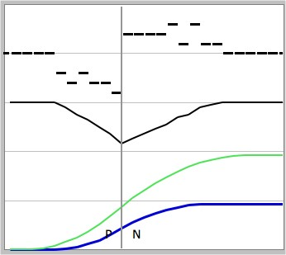
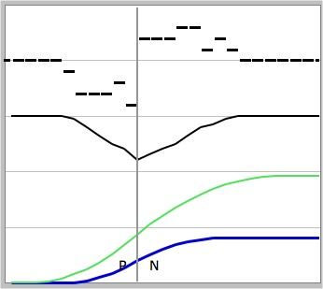
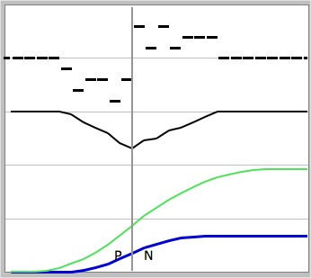
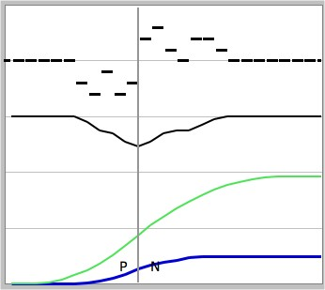
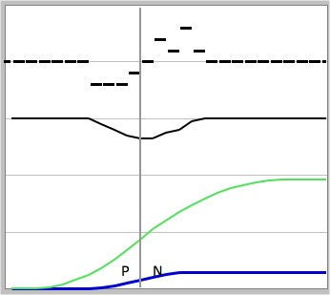
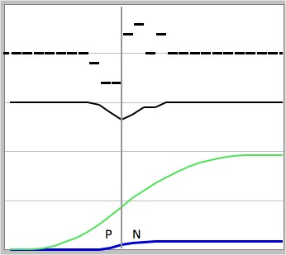
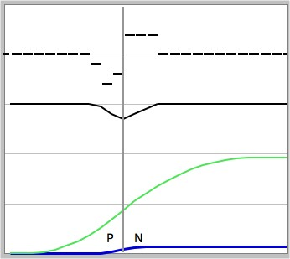
Charge accumulates during exposure
Initial depletion width
h
h
h
h
h
h
h
h
h
h
e
e
e
Saturation = forward bias occurs when depletion region collapses
e
e
e
e
e
e
e
e
Q
h
h
h
h
h
h
h
h
e
e
e
e
e
e
e
E
Signal
V

Slide 9
PN junctions on common substrate
Undepleted Dsub (N)
Depleted N-type
CdZnTe substrate is fully removed
Depleted P-type
~3μm ?
Undepleted implant (P)
Epoxy wicked into voids between bumps prior to substrate removal
HgCdTe
Silicon Multiplexor ~ 600µm thick
18μm
Indium bump bonds
Epoxy
Silicon Carbide or Molybdenum package

Slide 10
PN junctions on common substrate
Undepleted Dsub (N)
Areas with mobile carriers act as capacitor plates
Depleted N-type
Dielectric
Depleted P-type
Undepleted implant (P)
Epoxy wicked into voids between bumps prior to substrate removal
HgCdTe
Silicon Multiplexor ~ 600µm thick
18μm
Epoxy
Silicon Carbide or Molybdenum package

Slide 11
Inter-Pixel Capacitance
Conductive substrate shields pixel from its neighbors
Depletion region is dielectric:
More signal (or lower bias)
Higher capacitance
= non-linear
HgCdTe
Dielectric constant of epoxy underfill increases IPC
Silicon Multiplexor ~ 600µm thick
Silicon Carbide or Molybdenum package

Slide 12
IPC non-linearity
See Kevan Donlon’s talk
Carriers in implant with high signal get closer → increased IPC expected.
At higher fluence, depletion region narrows
HgCdTe
Silicon Multiplexor ~ 600µm thick
Greater IPC?
Silicon Carbide or Molybdenum package

Slide 13
IPC dependent on detector bias ??
SPECULATION:
At high reverse bias depletion regions may merge and open up a new path for electric field lines between pixels
HgCdTe
Silicon Multiplexor ~ 600µm thick
Higher initial IPC
Silicon Carbide or Molybdenum package

Slide 14
Pixel boundaries after reset
HgCdTe
Silicon Multiplexor ~ 600µm thick
Silicon Carbide or Molybdenum package

Slide 15
Signal contrast moves boundary
Brighter-fatter paper by Andres Plazas; see Eric Huff’s talk
Pixel shrinks as charge accumulates so PSF seems to grow.
HgCdTe
Silicon Multiplexor ~ 600µm thick
Silicon Carbide or Molybdenum package

Slide 16
Image persistence
Trapped electrons
Trapped holes
Mobile electrons
-
-
-
-
-
-
-
-
-
-
-
-
-
-
-
-
-
-
-
-
N
-
-
-
-
-
-
Depleted
-
+
+
+
+
+
+
+
P
Mobile holes
+
+
+
+
+
+
+
+
+
+
+
+
+
+
+
+
+
+
+
+
Idle / Reset (initial reverse bias)
Charge diffusing across the PN junction recombines leaving behind charge donor sites that produce an E field opposing the diffusion. When traps in depleted area release charge, it is swept towards depleted areas by this E field, and cannot be recaptured: eventually only undepleted area has populated traps.
Signal (lower bias)
As signal accumulates the depletion width is reduced. Traps newly exposed to charge can capture some mobile carriers.
Reset (increased bias)
At “reset” the reverse bias and wider the depletion region ware restored,but trapped charge stays behind. When this is later released, it is swept by the E field out of the depletion region to rejoin carriers of the same type.
Next Exp. (bias relapses)
The motion of the released charge reduces the E field: the reverse bias and depletion width tend to towards the previous values. The voltage change has the same polarity as signal and is“persistence”.

Slide 17
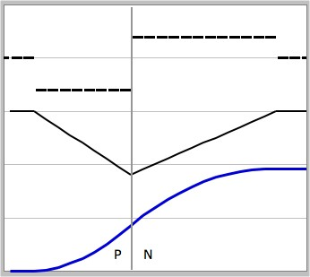
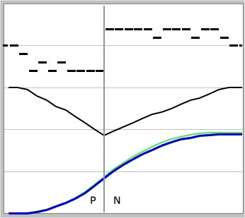
Reset
Ideal Reset
Before Reset
Reverse bias is reapplied at reset.
Ideally this would reestablish the initial depletion width, but..
some charge remains behind in traps.
Actual reset
Q
E
V

Slide 18
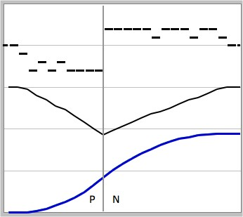
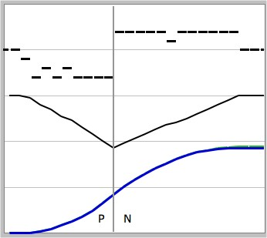
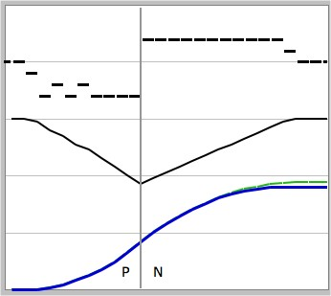
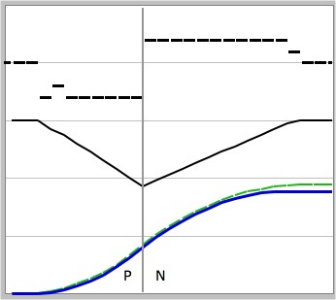
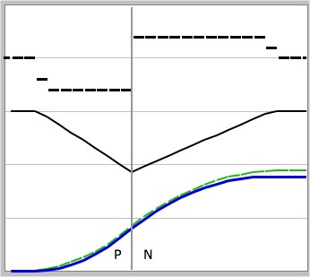
Charge release ⇒ Signal in later frames
Persistence
Q
E
persistence
V

Slide 19
MBE HgCdTe Dark current
10⁸
Typical InSb
Dark Current
10⁷
~9
~5
10⁶
~2.5
Dark
Current
Electrons
per pixel
per sec
18 micron
square
pixel
10⁵
10⁴
10³
~1.7
10²
10
1
10⁻¹
10⁻²
10⁻³
What causes floor ?
10⁻⁴
30
50
70
90
110
130
150
170
190
210
230
Temperature (K)

Slide 20
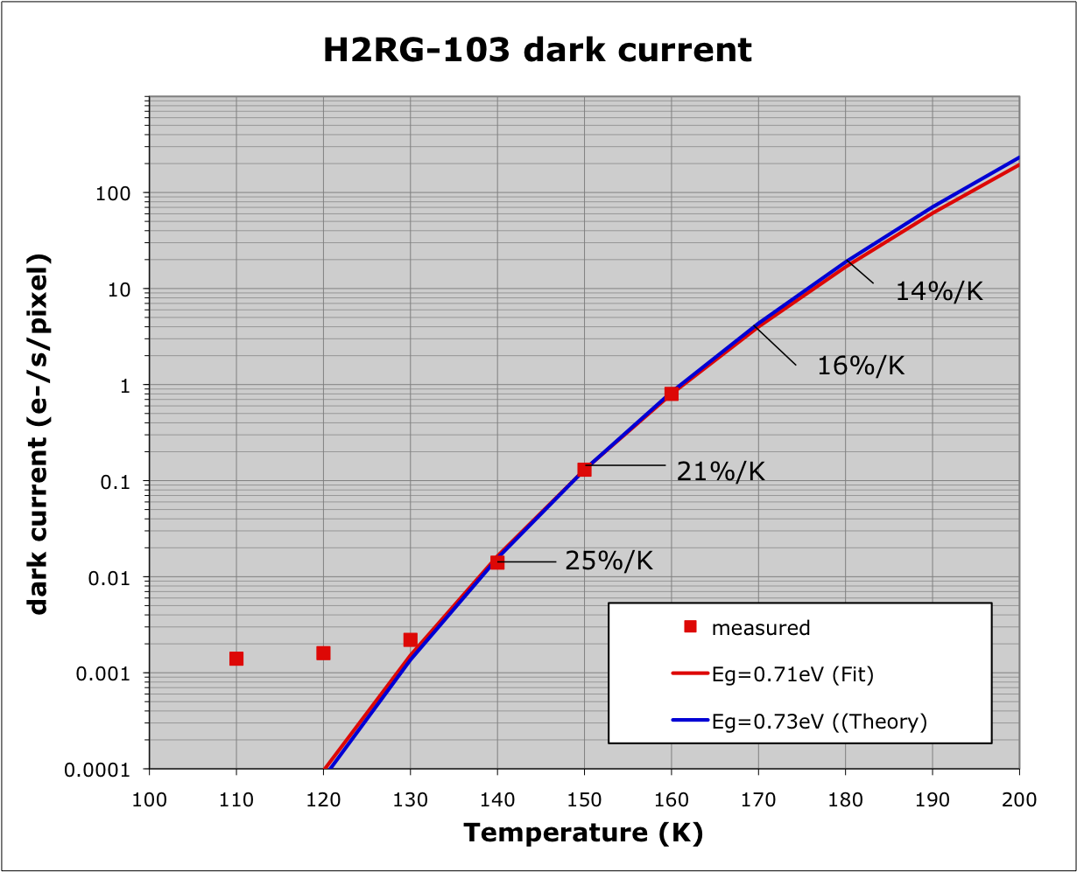
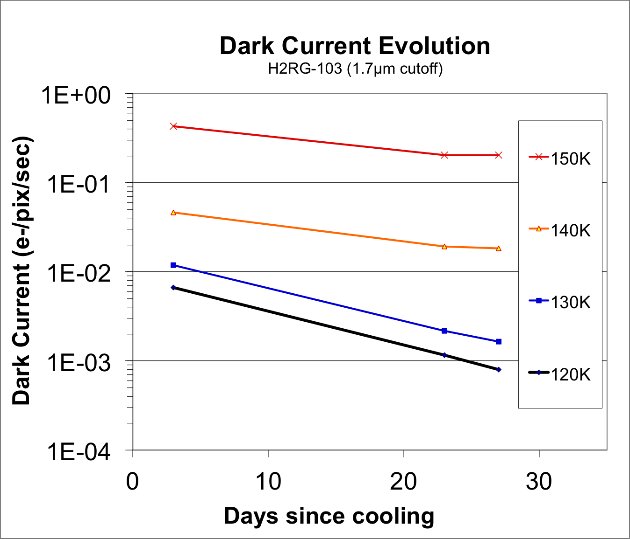
Dark current floor
Dark current is high after turn-on due to de-trapping.
Floor continues to drop for weeks if dark and stable.
De-trapping is less noisy than equivalent photo-generated signal → our noise model may be wrong at low enough temperatures for de-trapping to dominate dark current.

Slide 21
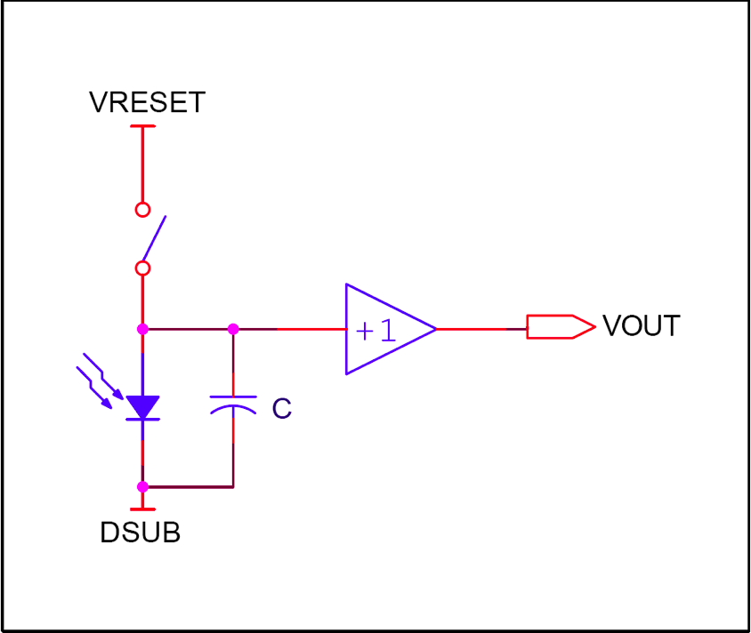
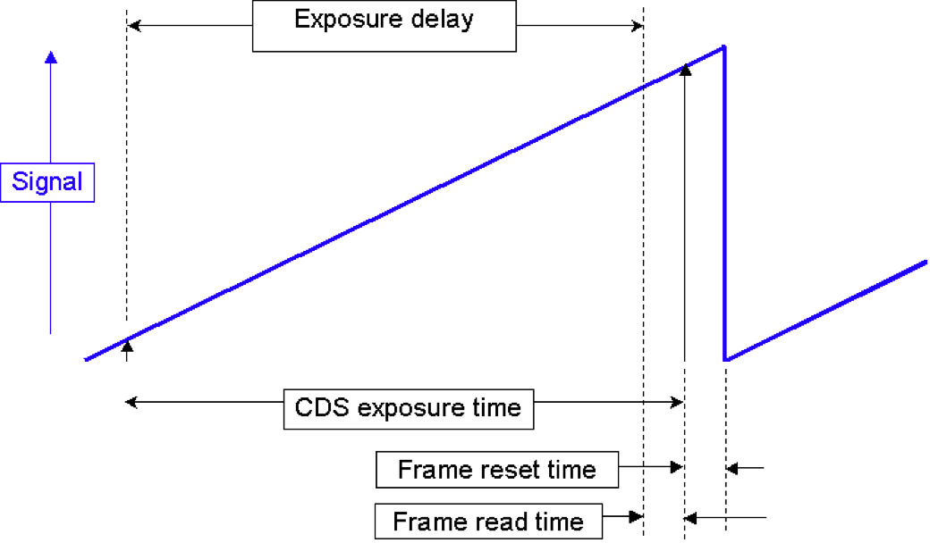
Circuit for one pixel
Photodiode is reverse biased by momentarily closing reset switch,
  DSUB =VRESET+0.5V
Low temperature makes leakage currents in silicon switch and buffer transistor negligible.
Photogenerated e-h pairs are collected on diode capacitance causing drop in reverse bias.
Voltage at output of buffer MOSFET is read as charge accumulates and dV/dt is calculated without effecting charge on diode.
Minimum of 2 reads are required to remove large electronic offsets, bias voltage drift and √kTC noise left behind by thermal noise in reset switch resistance.
….is higher than VRESET!

Slide 22
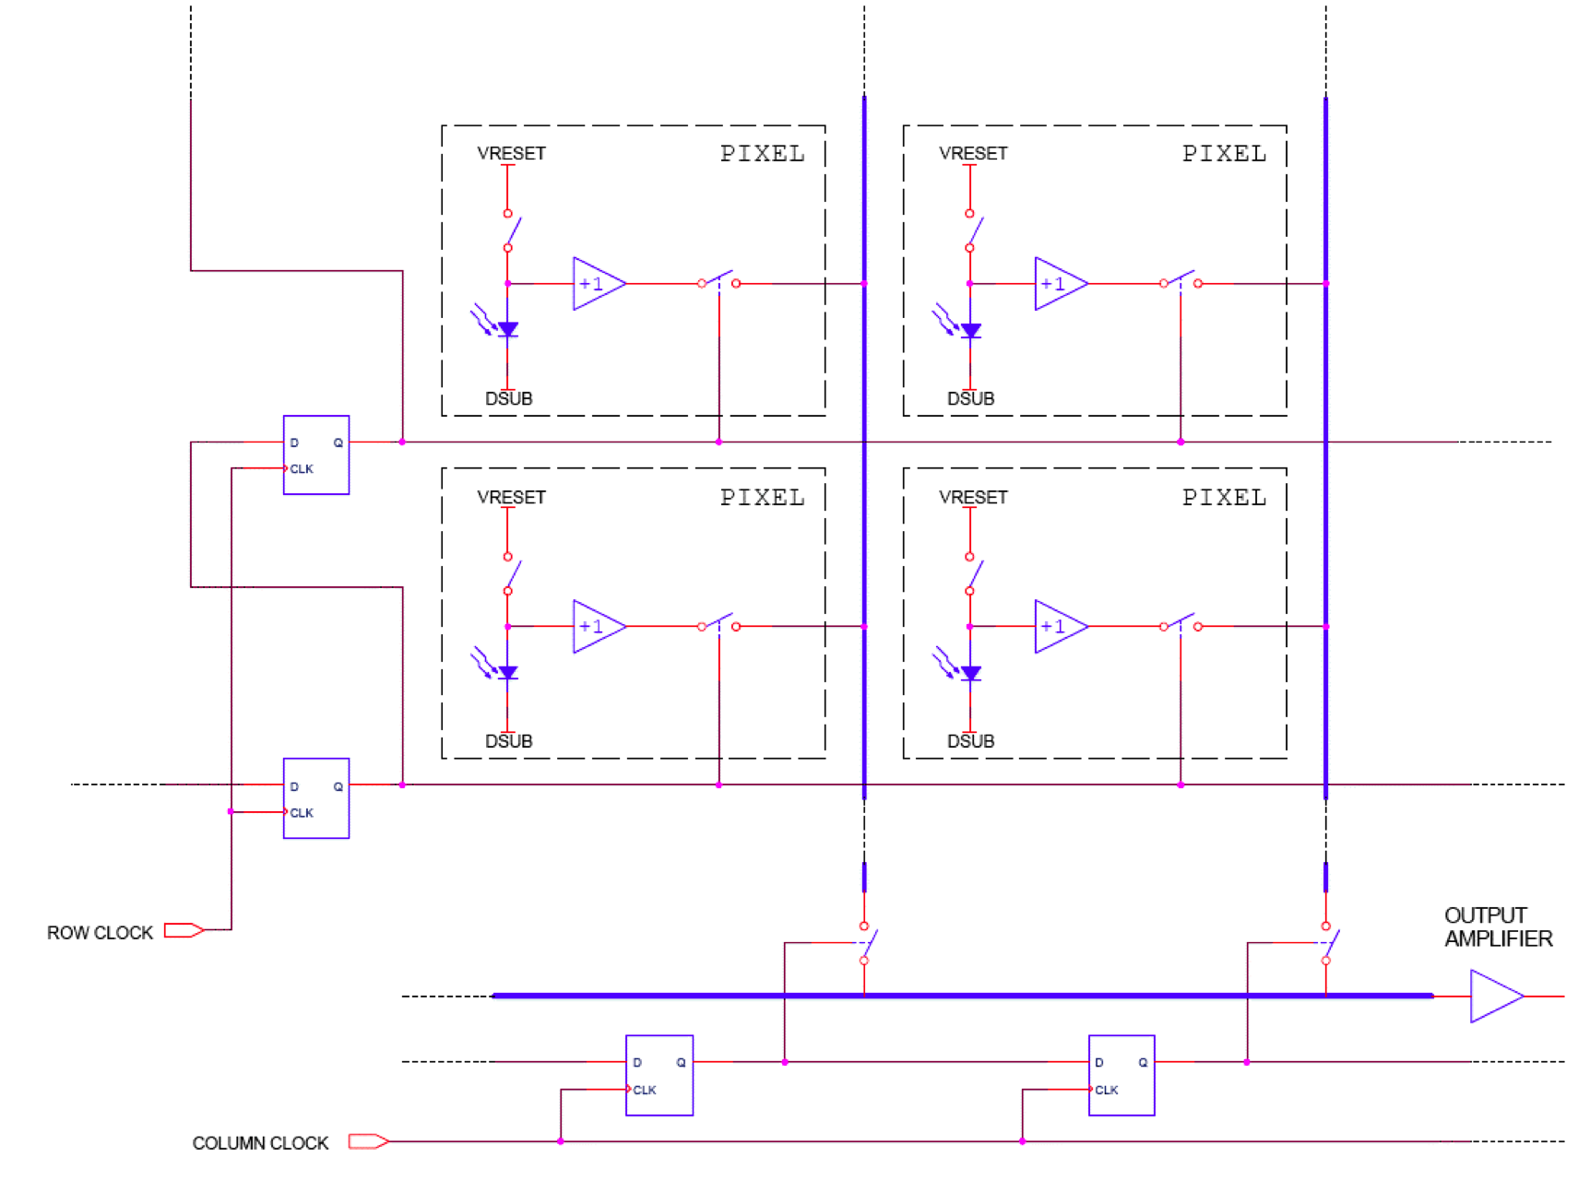
Addressing multiple pixels
Single bit travelling in shift registers along two edges selects one row and one column at a time to implement raster addressing.
Voltage on selected pixel is connected to output buffer by analog switches.
Charge on pixel is unaffected.

Slide 23
Pixel circuit
Tempco = 600 to 800 e-/K
→ Clock continuously whether idle, reset, exposure delay or read
BiasPower, 3.3V
BiasGate 2.1V
10 kΩ
V_{o}
DSUB ~0.8V
ColSelect
RowSelect
Indium Bump
Power dissipated only when pixel is selected
RG
0 – 3.3V
VRESET ~0.3V

Slide 24
Constant Cadence clocking
Temperature coefficient 600-800 e-/K
Both pixel and output amplifier (and load) contribute to temperature coefficient.
Depends on location on detector.
Pixel only dissipates power while selected.
Maintain constant clocking cadence across idle, reset, exposure_delay and reads
Pad timing to make reset and read timing identical, and to avoid changes in cadence when processing commands.

Slide 25
Correlated Double Sampling
Dummy reads to maintain constant power dissipation
Frame time
Exposure time
Reset while idling
Ignore p scans
At least one reset between frames
Initial scan
Final scan
Exposure delay = p dummy reads for constant self heating
Subtract first frame from last frame
Equivalent to Fowler sampling with m = 1

Slide 26
Fowler sampling, … same dissipation
Frame time
“Fowler Sampling”
Exposure time
Coadd m
Ignore p scans
Coadd m
Exposure delay is in units of full scan ties but need not be multiple of m.
Subtract mean of first group from mean of last group.

Slide 27
Sample Up The Ramp … same dissipation
Store every scan (no real time coadd)
Use post facto least squares fit to measure slope with best S/N;
Effective exposure duty cycle due to weighting of shot noise by least squares ~ 90%; reduce this to include effect of the reset overhead.
Equivalent MultiAccumulate with m=1.

Slide 28
Pixel circuit
BiasPower, 3.3V
BiasGate 2.1V
10 kΩ
V_{o}
DSUB ~0.8V
ColSelect
RowSelect
Indium Bump
RG
0 – 3.3V
VRESET ~0.3V

Slide 29
Pixel circuit, showing caps
BiasPower, 3.3V
All capacitors are non-linear
BiasGate 2.1V
10 kΩ
V_{o}
DSUB ~0.8V
ColSelect
RowSelect
Indium Bump
ResetGate
0 – 3.3V
VRESET ~0.3V

Slide 30
Pixel circuit, showing caps
BiasPower, 3.3V
All capacitors are non-linear
BiasGate 2.1V
10 kΩ
V_{o}
DSUB ~0.8V
ColSelect
RowSelect
Indium Bump
See poster by Tim Greffe
Explains Global Reset transient
ResetGate
0 – 3.3V
Capacitive coupling of RG
changes diode voltage
→ trapping charge, even in dark.
VRESET ~0.3V

Slide 31
Large contact Resistance
BiasPower, 3.3V
Slows reset and signal
BiasGate 2.1V
10 kΩ
Deserves more attention
V_{o}
DSUB ~0.8V
ColSelect
RowSelect
Indium Bump
~10¹² Ω
ResetGate
0 – 3.3V
Poster by Tim Greffe:
This limits effectiveness of reset as electronic dark slide.
VRESET ~0.3V

Slide 32
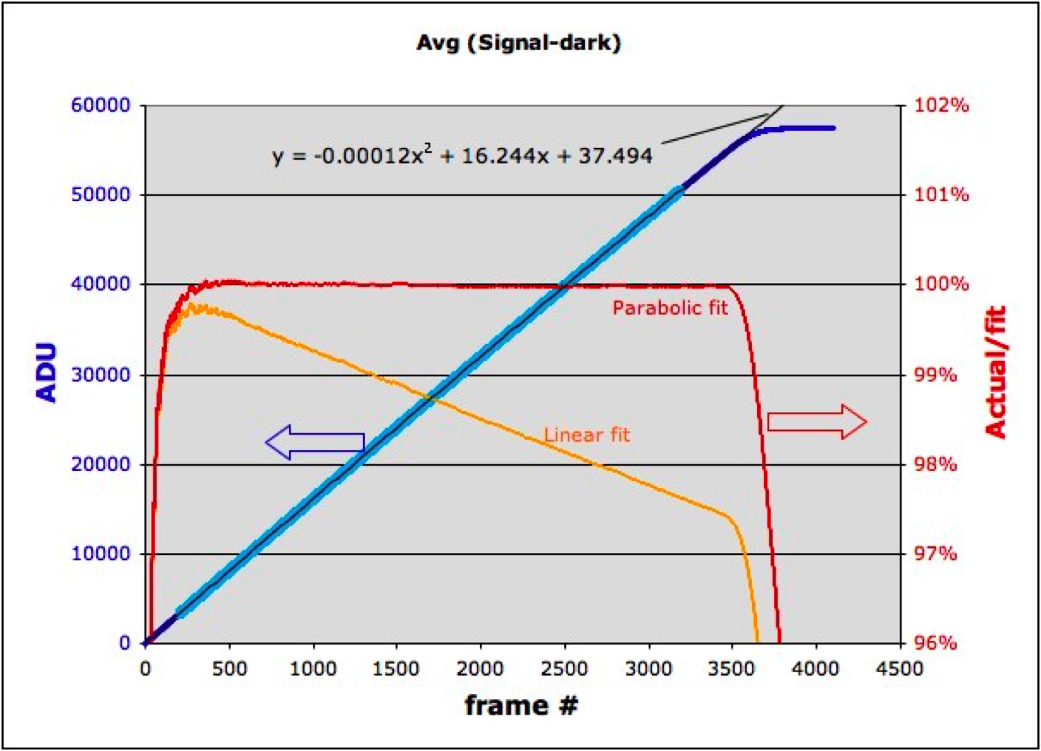
Initial signal deficit
Pixel contact resistance ? …. much larger effect and faster settling than charge trapping
SUTR data acquired at 100 Hz through a single channel. Several illuminated frames were averaged as were several matched darks which have been subtracted.
The fit was derived using the points marked in cyan to eliminate the area affected by the initial signal deficit.
The quadratic fit is extremely good except for the large deviation in the first 3s (300 frames).

Slide 33
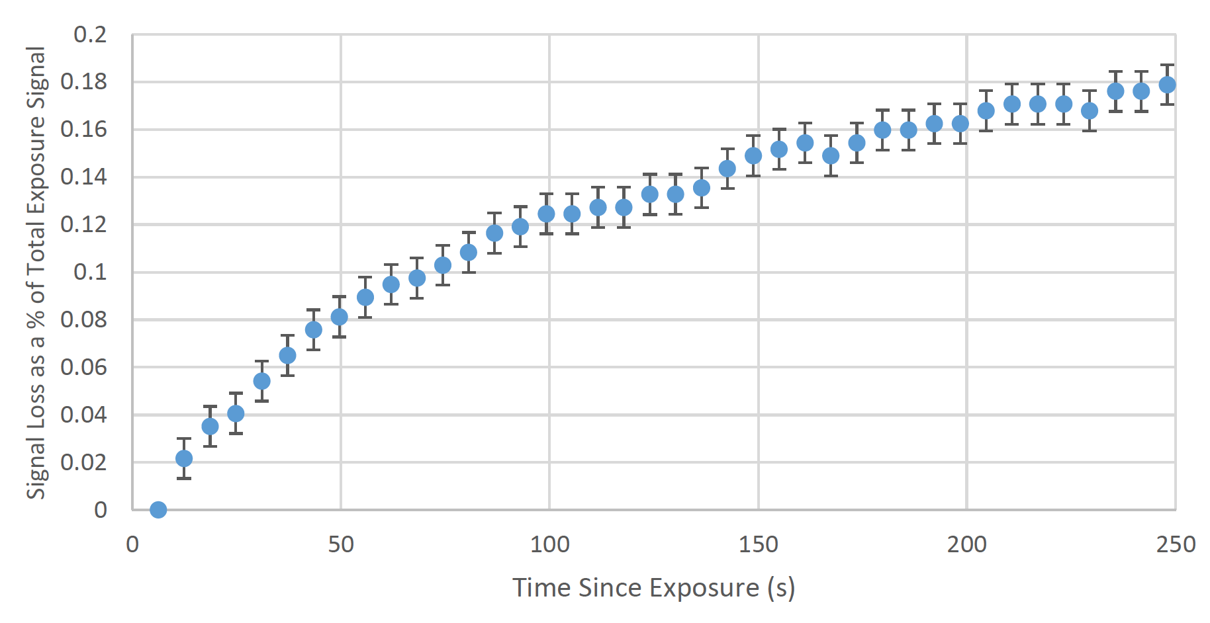
Signal loss due to charge trapping
Reset
Flux
Trapping
De-trapping
Signal
= reciprocity failure ?
Image persistence
Melissa Marshall
SURF 2013

Slide 34
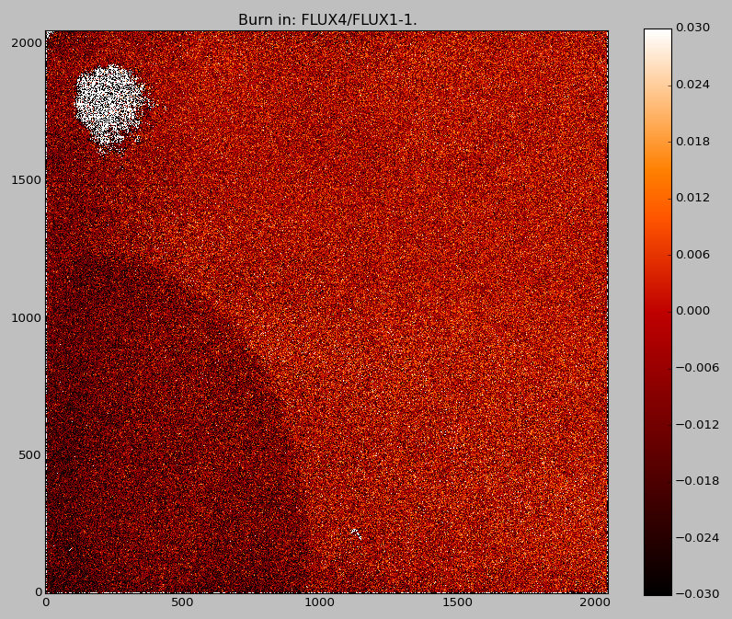
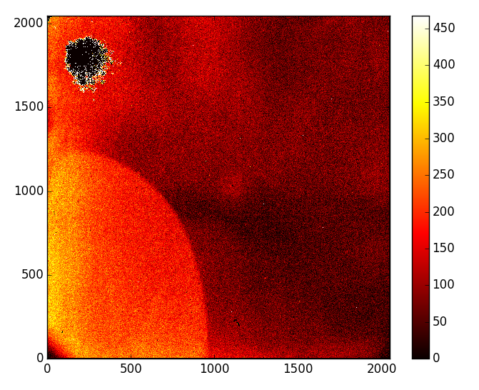
Initial signal deficit (AKA burn in)
Engineering grade H2RG (2.3 µm cutoff from Euclid)
1st frame / 4th frame -1
Image persistence
This suggests that charge trapping is dominant cause of initial signal deficit in some areas of this device.

Slide 35
Read noise
The photodiodes generate more read noise than the ROIC and have much stronger 1/f component, as demonstrated by much lower noise and better reduction by multiple sampling for
  Permanent reset (shorting out detector noise)
  Reference pixels
Is this due to trapping/detrapping?
Contact resistance is about the correct magnitude to produce about this much Johnson noise.
  This is worth investigating since lower contact resistance could improve both dynamics (linearity) and noise.

Slide 36
Linearity
See Bernie Rauscher’s talk
Rarely is this well characterized and corrected
First, subtract time-dependent offsets
  Self heating (minimize by Constant Cadence Clocking)
  Electronic drifts (reference pixels help)
  Reset induced (de)trapping
Correct for dependence of capacitance on voltage
Correct for trapping of charge (complicated)
Correct for photodiode time-constant (contact resistance)
Everything is spatially variable.

Slide 37
Simple test
Applying all corrections to SUTR data for a wide range of fluxes, extrapolate back to zero exposure time.
Do all curves predict zero signal at zero exposure time?
Do they even intersect within some small error box?
Good luck !!

Slide 38
To do list
Characterize contact resistance and its consequences
Study burn-in and reciprocity failure to see how much comes from contact resistance an how much from trapping.
Evaluate noise produced by dark current at floor. Hot pixels may be noisier.
Improve linearity calibration methods and/or fix these odd behaviors which make linearity correction so difficult.

