Slide 1
WFIRST Calibration & Some Lessons Learned from WFC3/IR
Susana Deustua
STSCI
ISPA 2018

Slide 2
WFIRST in Brief
2.4 m primary
Wide Field Imager (WFI)
  18 HI4RG, HgCdTe arrays, 4096² pixels per each.
  Filter wheel: 7 filters, 1 grism, 1 blank
Coronographic Instrument (CGI)

Slide 3
WFIRST Science
with Wide Field Imager
Dark Energy
Microlensing survey for exoplanets
And a lot more: solar system, stellar astrophysics, structure and evolution of galaxies (including the Milky Way), and etc.
with Coronographic Instrument
Exoplanet Discovery

Slide 4
Science Definition Team Document, Spergel et al 2013
Notes:
From Spergel et al, Science Definition Team Document 2013

Slide 5
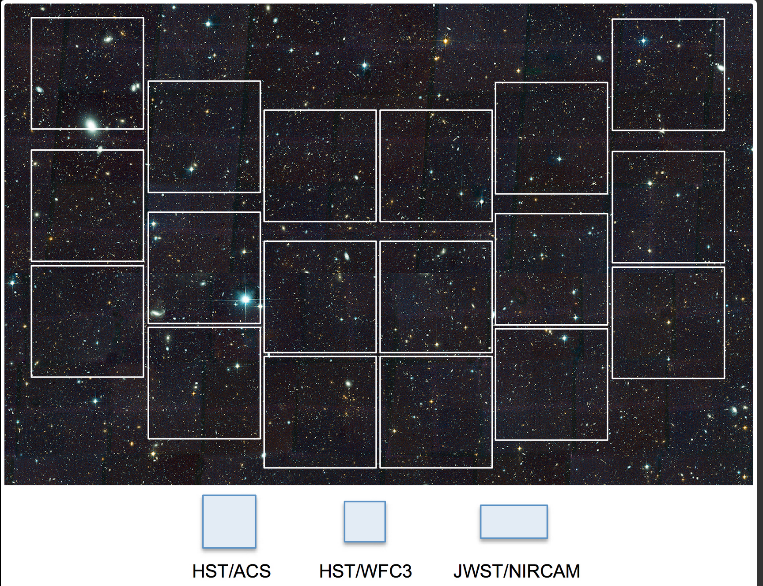
Notes:
18 MCT detector, 302 Mega pixels, 0.,11 arcsec per pixel

Slide 6
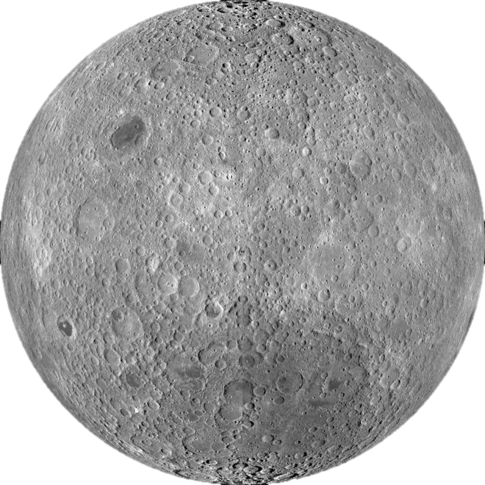
Notes:
18 MCT detector, 302 Mega pixels, 0.,11 arcsec per pixel

Slide 7
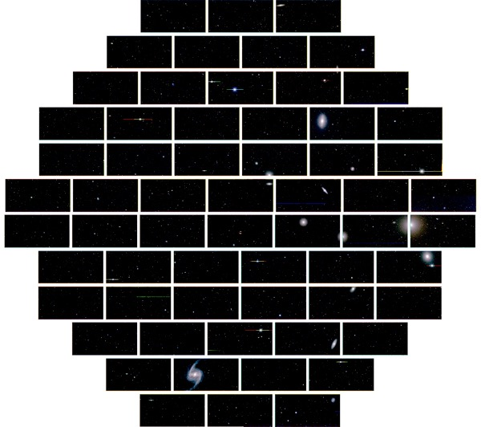
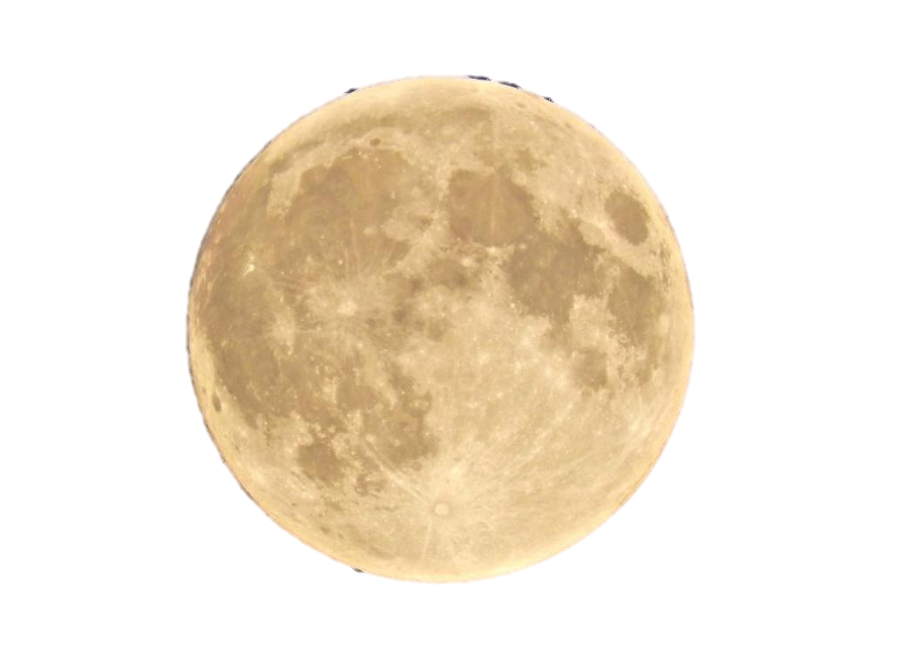
Notes:
DES field of view
62 detectors, CCDs, 520 Mega pixels, 0.236 arcsec/pixel

Slide 8
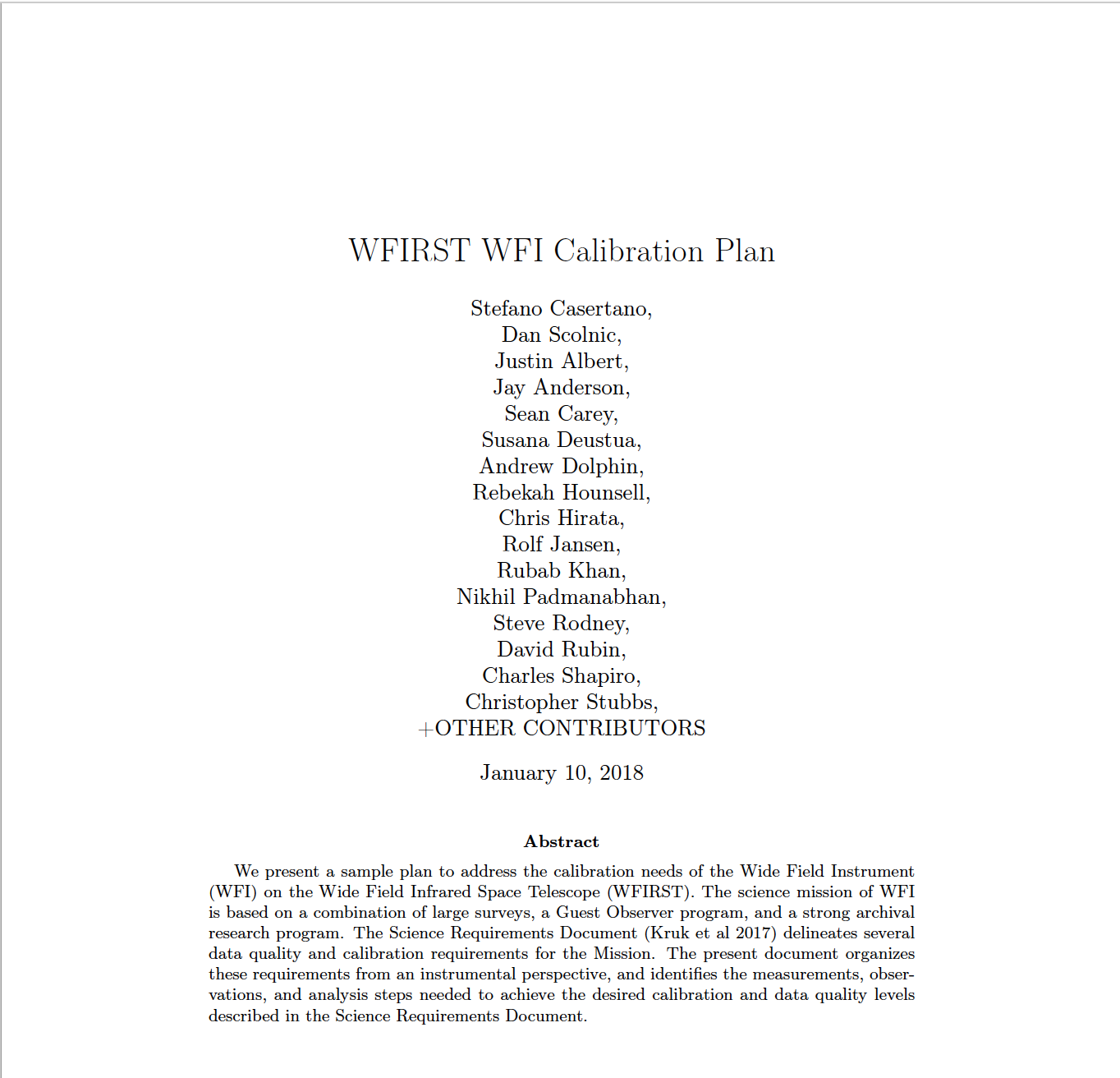
WFIRST WFI Calibration Plan

Slide 9
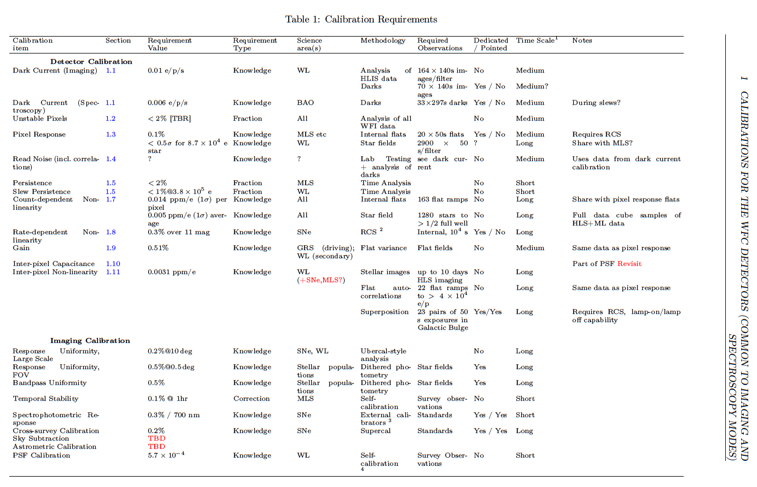

Slide 10
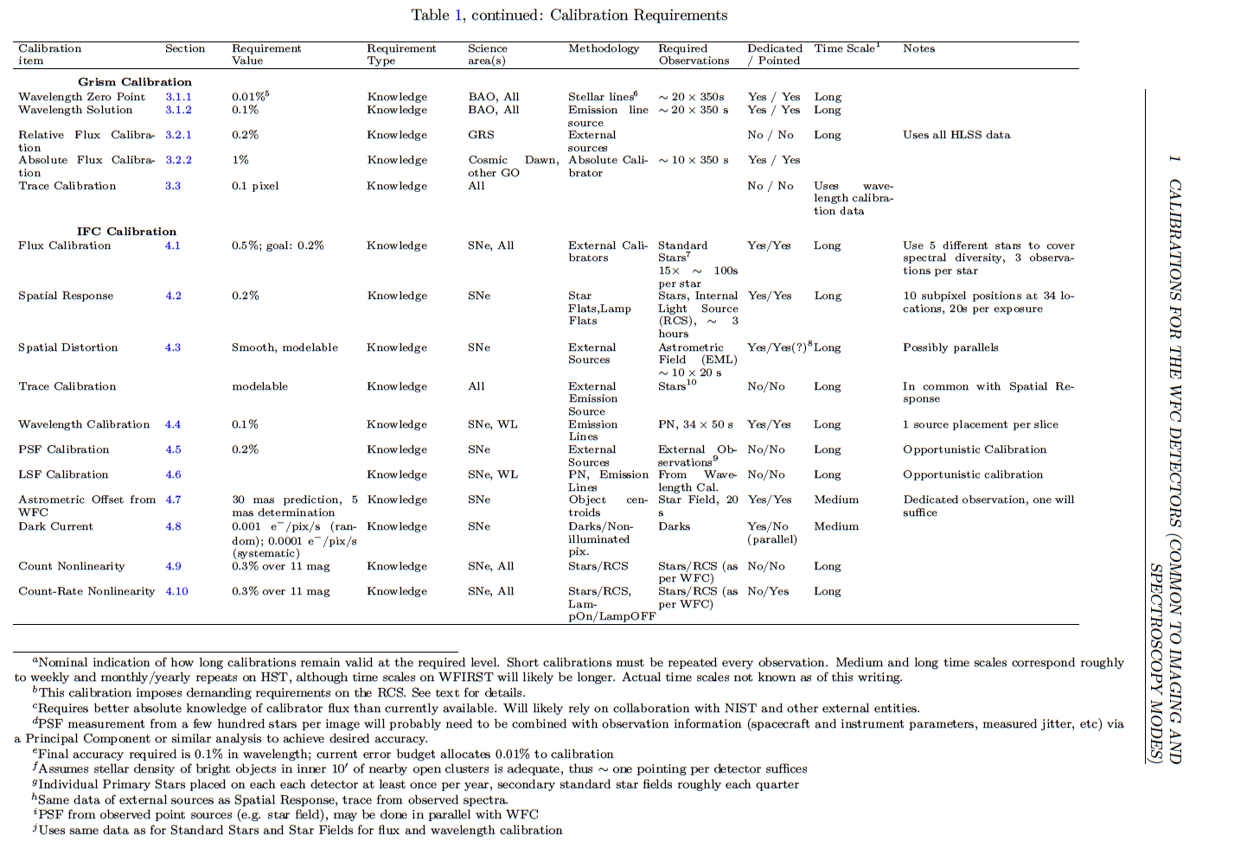

Slide 11
Some Comments
The main science mission of WFIRST requires an unprecedented level of data quality – and thus calibration
  The SN Survey requires very accurate cross-wavelength photometry
  The Weak Lensing Survey requires extreme knowledge of the PSF
  The Microlensing Survey requires exquisite photometric and astrometric stability for point sources
  The BAO Survey requires 0.1% redshift accuracy
  Several surveys and sample GO science require uniformity across the field
Some of the required calibration accuracies exceed substantially what is currently achieved for HST and JWST
Need to meet those accuracies with a combination of methods:
  Ground testing of components
  Careful modeling
  External data (e.g., Gaia astrometric catalog, standard stars)
  On-board calibration sources and mechanisms
  Science data obtained for Surveys and GO Programs
  Dedicated calibration observations

Slide 12
Grism Calibration:
Wavelength accuracy: better than 0.1%
  Based on BAO requirements
  May be as stringent as 0.01%, depending on redshift error budget (see SRD)
  Includes both zero point calibration and wavelength solution
Wavelength zero point vs. source location
  Will likely need external observations
    With HST, need a few points per square arcmin to achieve sufficient density
  Can be achieved with clusters of red stars (current grism resolution sufficient to resolve features)
    Details to be investigated
Wavelength solution:
  Input from instrument model or on-board source
  Will need on-orbit validation using line-rich objects
  Probably needed at lower density than zero point
Spectrophotometric calibration: ~ 1%
  Same flux standards used for standard imaging
  Probably needed at lower density than wavelength calibration
Other calibrations shared with standard imaging

Slide 13
WFIRST Science with Wide Field Imager
Dark Energy
  Parameters: Constant? Time variation?
  Supernova Cosmology-> standard candles
    Measuring the distance to and redshift of the SNe provides a means of measuring the evolution of dark energy over time
  Gravitational Weak Lensing of Galaxies -> mass
    Measures distortion of galaxies to determine the three-dimensional mass distribution in the Universe.
    Cross checks evolution of dark energy over time and growth of large structure of the universe.
  Baryon Acoustic Oscillations-> standard ruler
    measure the growth of large structure of the universe, testing theory of Einstein's General Relativity.
Microlensing survey for exoplanets
And a lot more: solar system, stellar astrophysics, structure and evolution of galaxies (including the Milky Way), and etc.

Slide 14
Calibration Requirements:
Spatial uniformity on FOV scale
Requirement: 0.5% from several programs (e.g., resolved stellar populations)
Combination of detector sensitivity (flat field), filter bandpass, and PSF effects
Flat field requires multiple components:
  Pre-launch or internal source for pixel-scale variations
  Super-sky-flat from normal science data for large-scale variations
  Photometry from large dithers to validate results
    Can be obtained from HLIS data
  May not need dedicated observations; dense stellar fields can be observed occasionally for verification
  Currently HST achieves 0.5-1% in visible, 1-2% in IR
  Caveat: Analysis assumes presence of “dark filter” to separate additive and multiplicative components
    Without Dark Filter, some form of self-calibration may be needed
    More information in following presentations (Deustua, Hirata)
Filter bandpass will require laboratory tests or specialized internal source
  Regular on-orbit tests to validate stability
  Internal calibration sources may help test for time variations
  Details to be determined
PSF stability subsumed by more stringent requirements

Slide 15
Calibration Requirements:
Spatial uniformity on degree+ scale
Requirement: 0.3% from Weak Lensing, BAO surveys
Needed to avoid correlated selection effects in sample selections; simulations needed to improve quantitative limit
Will require partially overlapping fields and telescope modeling, standards observed at different times
Multiple-epoch HLIS data for validation
  Also comparison to external data (e.g., LSST)
Stability in current missions has not been tested to a significant degree
Mostly requires analysis resources

Slide 16
Calibration Requirements:
Temporal stability
Requirement: 0.1% on ~ 1 day scale for microlensing
Directly affects quality of derived planet parameters
Will require instrument stability, well-understood PSF variations
With HST, variations at the 1% level have been seen in microlensing-like programs
  Analysis can mitigate effect (e.g., self-calibration of image-to-image variations)
  Zonal residuals at the 0.3% level remain on ~ 500 pixel scales
Need modeling and post-observation analysis to understand variations and ensure they can be corrected

Slide 17
Calibration requirements:
PSF quality
Size and shape of PSF must be known to 0.1% and 0.05% respectively
  Absolute values needed; stability not sufficient
Required for Weak Lensing measurements
PSF characteristics need to be determined for each observation
  Will require on-orbit calibration in combination with detailed telescope model (to model variations)
  Will benefit from repeated observations of field with many point sources (MLS data); may require revisiting reference fields at different epochs to characterize telescope variations
  Results will benefit all astrometry, photometry programs with WFI
  Requires high fidelity telescope, instrument, and detector models to validate that required calibration level can be achieved

Slide 18
Calibration requirements:
Absolute photometry
Critical item: slope of absolute photometric response must be known to 0.5% between 0.6 and 2.0 microns.
Implies accuracy in the flux scale of +99%
=> luminosity distance determined using SNe Ia
  Degradation below this level has direct impact on accuracy (FoM): simulations by Hounsell et al 2018
The limitation is the lack of stars with actual measured, SI-traceable spectroradiometry (SED) in the WFIRST wavelength range.
Will require:
  Direct measurements of stellar flux to SI calibration standards
  Improvements in stellar models
  Laboratory tests
  Instrument model

Slide 19
Calibration requirements:
Detector effects
Includes multiple effects:
  Non-linearity (flux and signal-dependent)
    Appears to be pixel-dependent
  Persistence
    Lower than in current devices, but may be present at low illumination levels
  Inter-pixel capacitance and intrapixel sensitiviy variations
  Angle dependence of pixel response
  Source-dependent effects (e.g., brighter/fatter)
Extensive laboratory characterization ongoing
Effects need to be characterized and impact quantified
  Some effects can be corrected; others may require identification and flagging

Slide 20
WFC3/IR
Some of what we’ve learned from WFC3/IR
Pixel behavior
Persistence
Sensitivity Changes
And more
Flat Fields
Scanning
Non-linear effects etc.

Slide 21
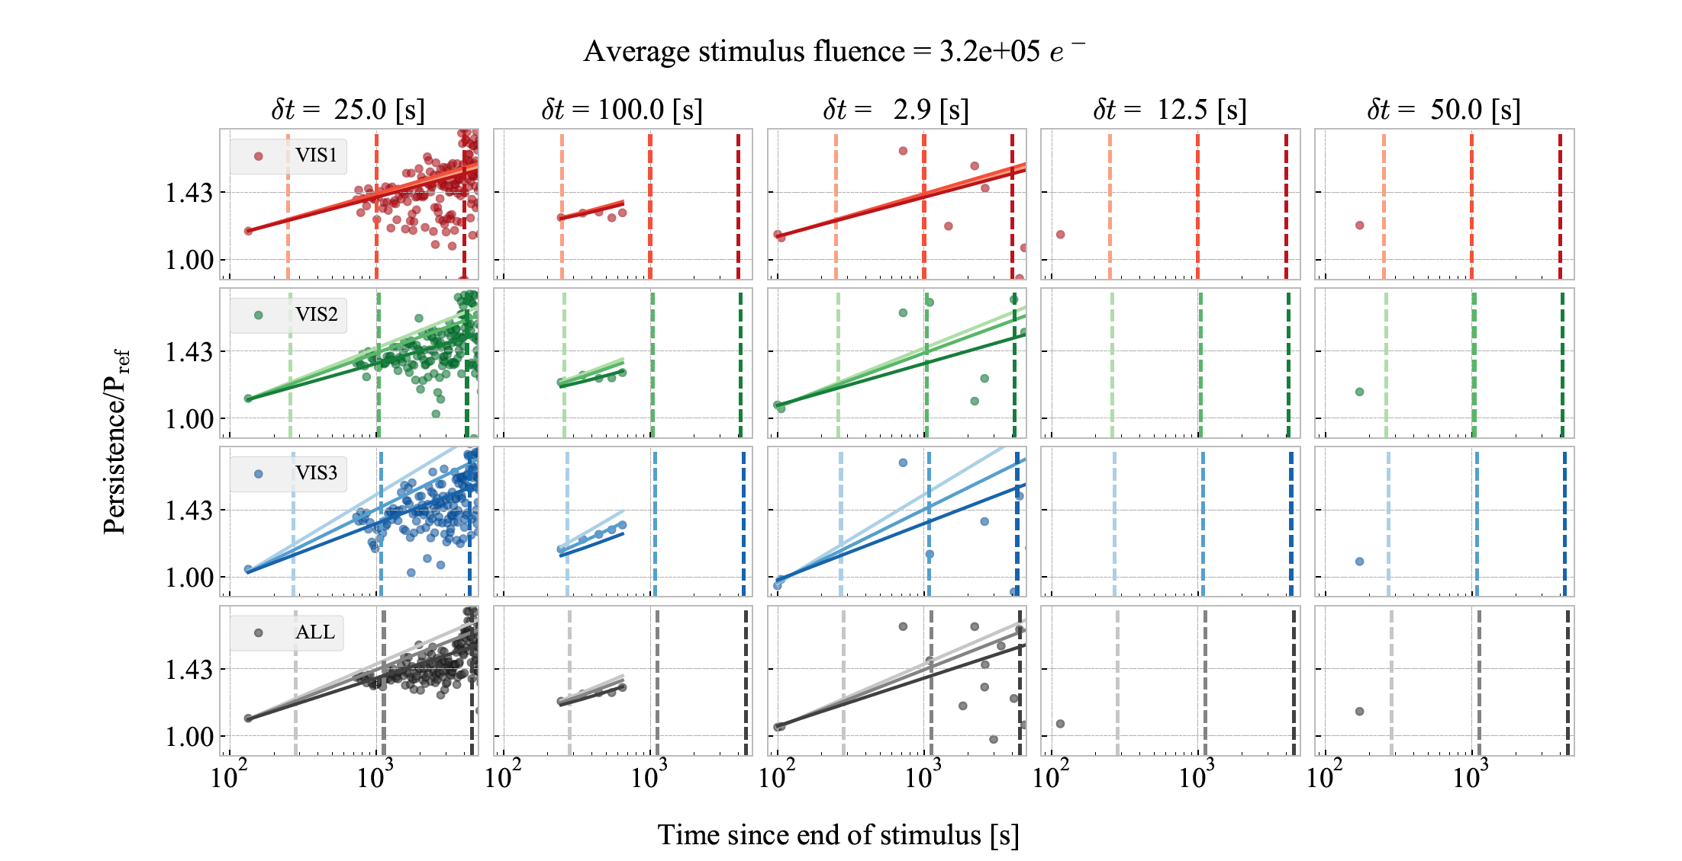
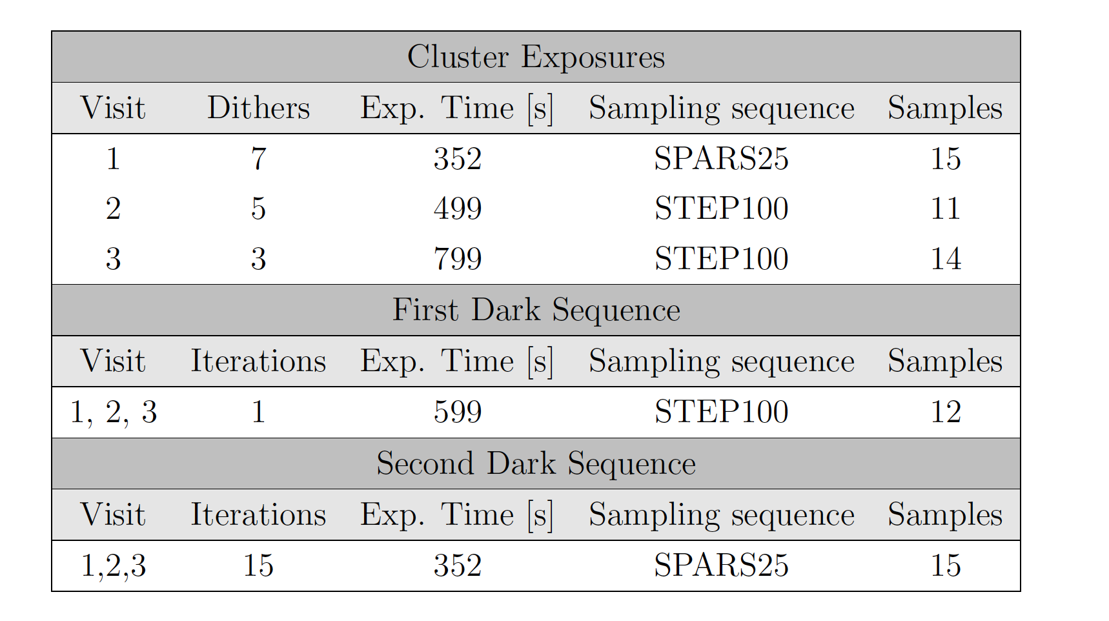
Persistence
From Gennaro, Bajaj & Long 2018
Notes:
Observations of Westerland 1 taken in 3 visits followed by darks
1) We fit a power law to the persistence decay curve, using an upper limit of 250, 1000, 4000 second after the stimulus.
2) Each color in the plot indicate 3 visits with slightly different setups, the black indicates an average of all 3
3) Now, focusing on 1 visit (1 color) only, we have 3 models: P_250, P_1000 and P_4000
4) I compute the value of each model at the end of its fit interval (i.e. P_250 at 250 seconds, P_1000 at 1000 seconds)
5) I divide the predictions of P_1000 and P_4000 by the predictions of P_250 at 1000 and 4000 seconds resp.

Slide 22
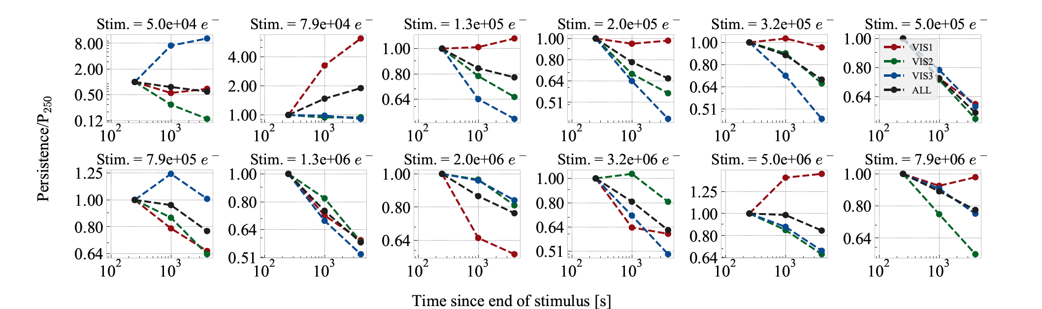
Persistence
Conclusion:
1) the power law model breaks at some point at short time, because otherwise the predictions would not depend on the fitted interval.
2) persistence does not go to infinity as t->0, as expected with a power-law model
3) persistence decays faster as time progresses
Notes:
You can see that P_1000/P_250 at 1000 seconds and P_4000/P_250 at 4000 seconds are generally less than 1.
I.e., the models that have been fit over longer fit intervals predict less persistence at 1000 and 4000 seconds resp., w.r.t to what P_250 predicts.
Translated: if you fit persistence up to 250 seconds only, you’d expect persistence to decay slower that if you do a global fit
up to 1000 or 4000 seconds.

Slide 23
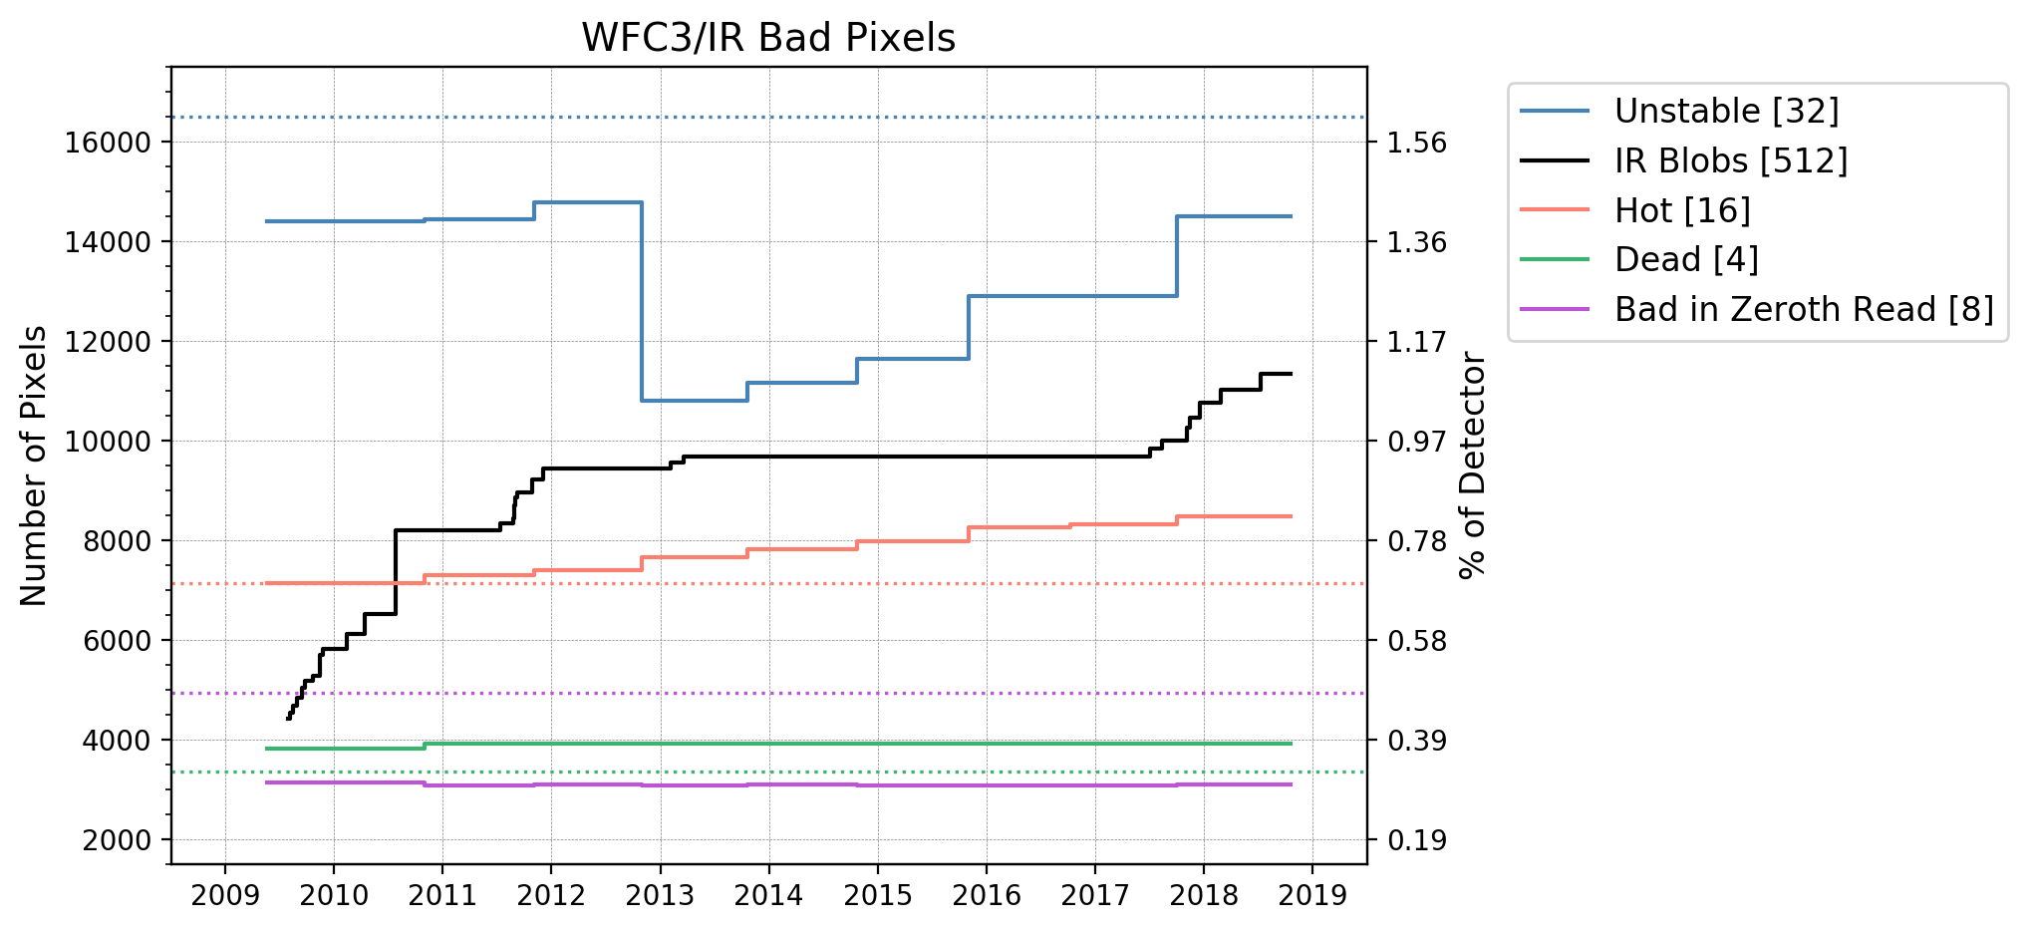
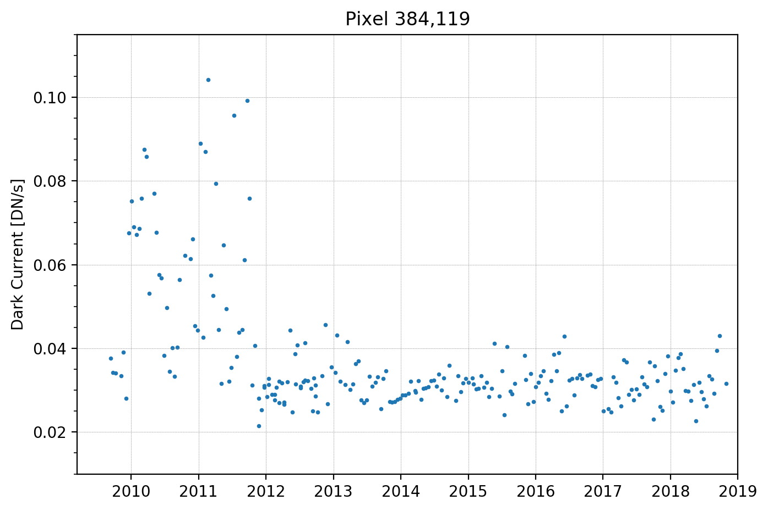
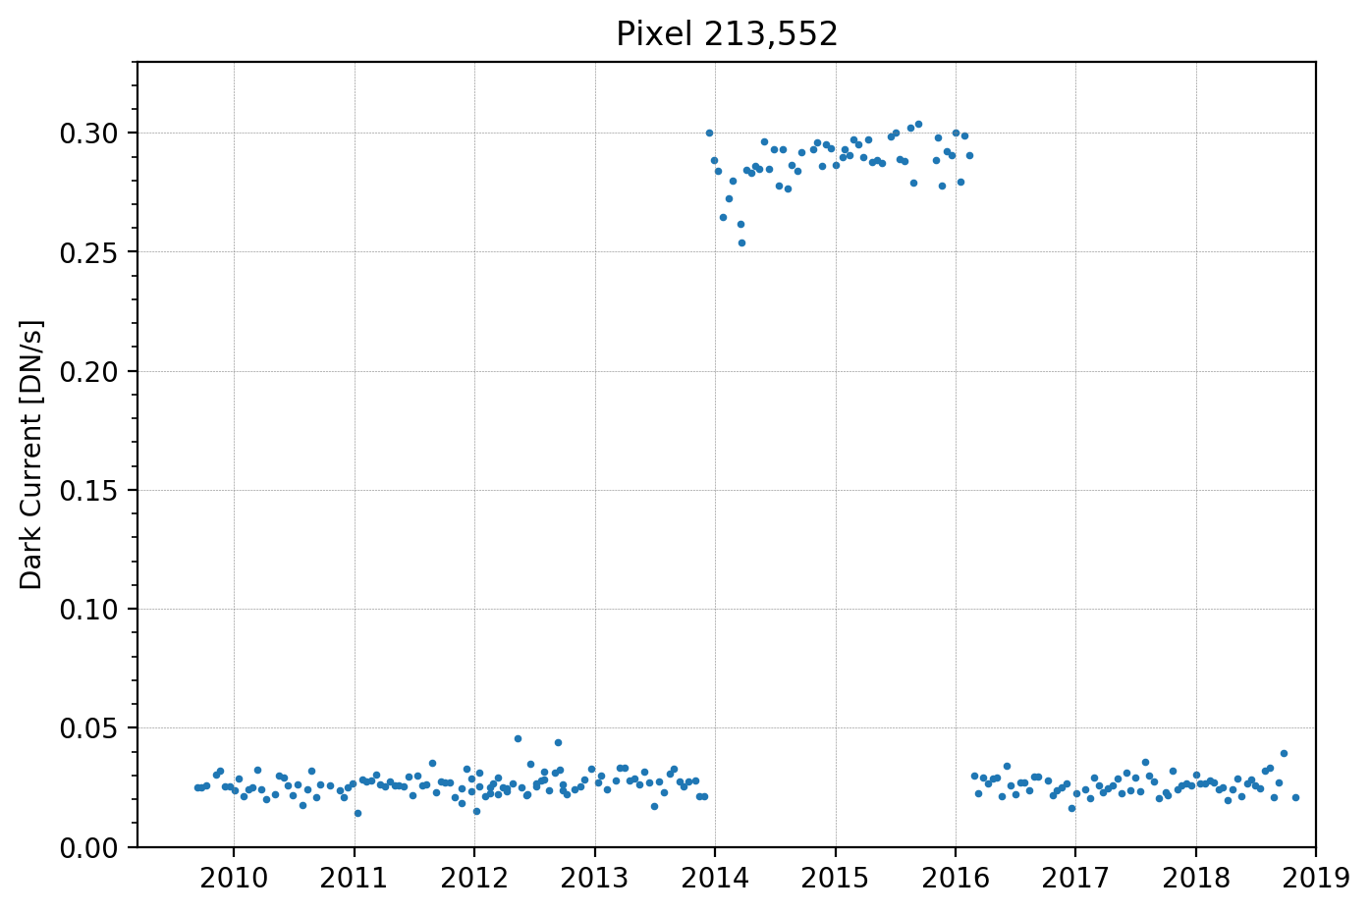
Bad Pixel Evolution
~3.5% of detector pixels have changed their behavior since launch
Most of these changes involve a pixel becoming hot or unstable, but some pixels actually regain their stability over time and can even bounce between multiple stable states
There is a large drop off in the number of unstable pixels around the time we stopped warming the IR detector during UVIS anneals
No trends in the number of dead or bad in zeroth read pixels

Slide 24
sensitivity change with time

Slide 25
sensitivity change with time

Slide 26
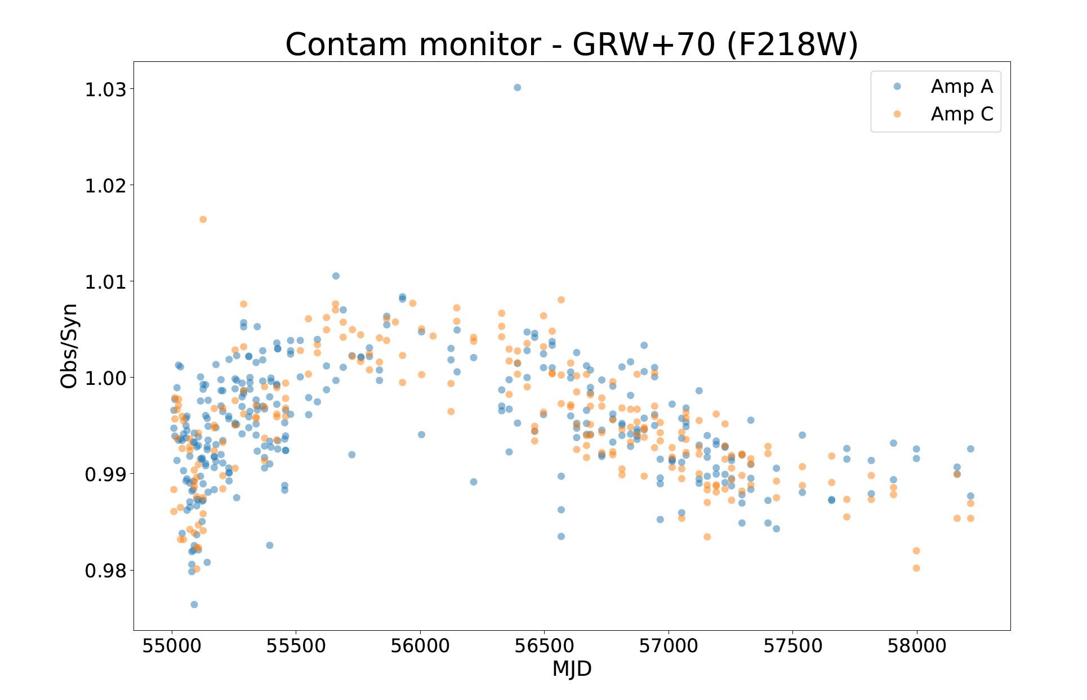
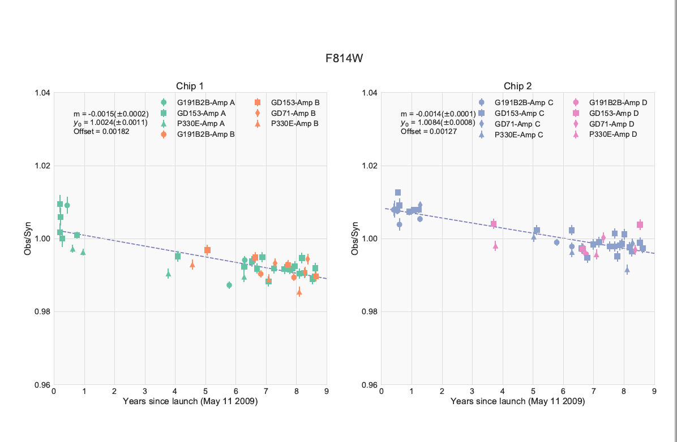
CCD change in sensitivity
WFC3/UVIS
From Khandrika, Deustua & Mack 2018

Slide 27
WFC3/IR
Some of what we’ve learned from WFC3/IR
Pixel behavior – must track, bad pixels increase in number
Persistence – short and long time, affects photometry up to 2%
Sensitivity Changes – must track, can affect response function
And more
Flat Fields – affects photometry
Scanning – up stream/down stream
Non-linear effects etc.
Pixel area maps

Slide 28
Some Challenges for WFIRST
PSF quality validation is challenging to achieve pre-launch
  Engineering/optical models needed to understand telescope-driven variations
  On-orbit data will provide very good characterization
  The quality of PSF knowledge for HLIS observations will depend on the time scales and complexity of telescope variations
Absolute photometric calibration requires standards of higher quality than currently available
Some detector effects identified thus far may require more extensive laboratory characterization
  For some purposes it would be beneficial to add light during an observation, instead of matching the pupil optimally
  Would two internal sources (or light paths) be desirable?

Slide 30
the end

Slide 31
Persistence
1) We fit a power law to the persistence decay curve, using an upper limit of 250, 1000, 4000 second after the stimulus.
2) Each color in the plot indicate 3 visits with slightly different setups, the black indicates an average of all 3
3) Now, focusing on 1 visit (1 color) only, we have 3 models: P_250, P_1000 and P_4000
4) I compute the value of each model at the end of its fit interval (i.e. P_250 at 250 seconds, P_1000 at 1000 seconds)
5) I divide the predictions of P_1000 and P_4000 by the predictions of P_250 at 1000 and 4000 seconds resp.
You can see that P_1000/P_250 at 1000 seconds and P_4000/P_250 at 4000 seconds are generally less than 1.
I.e., the models that have been fit over longer fit intervals predict less persistence at 1000 and 4000 seconds resp., w.r.t to what P_250 predicts.
Translated: if you fit persistence up to 250 seconds only, you’d expect persistence to decay slower that if you do a global fit
up to 1000 or 4000 seconds.
This means that:
1) the power law model breaks at some point at short time, because otherwise the predictions would not depend on the fitted interval.
2) persistence does not go to infinity as t->0, as a power-law model would expect it to
3) persistence decays faster as time progresses

Slide 32
