Slide 1
Interpixel Capacitive Coupling in Hybridized Arrays
Kevan Donlon (KevanADonlon@gmail.com)
Laboratory for Advanced Instrumentation Research
Chester F. Carlson Center for Imaging Science
Rochester Institute of Technology
ISPA: December 3, 2018

Slide 2
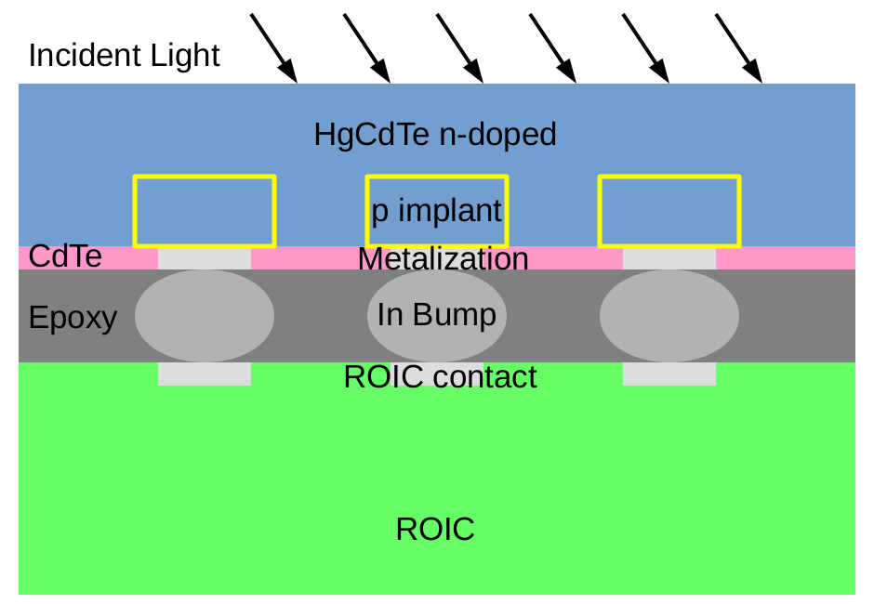
The structure of a hybridized array
V
V
V
Central Pixel
Central Pixel
Central Pixel
0V
0V
0V
ΔV
{
{
ΔV_{sig}
-(V_{bi}+V_{rev})
-y
-y
-y
N-Bulk
N-Bulk
N-Bulk
P-implant
P-implant
P-implant
Depletion
Depletion
Depletion
Indium
Indium
Indium
V
V
Adjacent Pixel
Adjacent Pixel
0V
0V
{
ΔV_{coup}
-(V_{bi}+V_{rev})
-y
-y
N-Bulk
N-Bulk
P-implant
P-implant
Depletion
Depletion
Indium
Indium

Slide 3
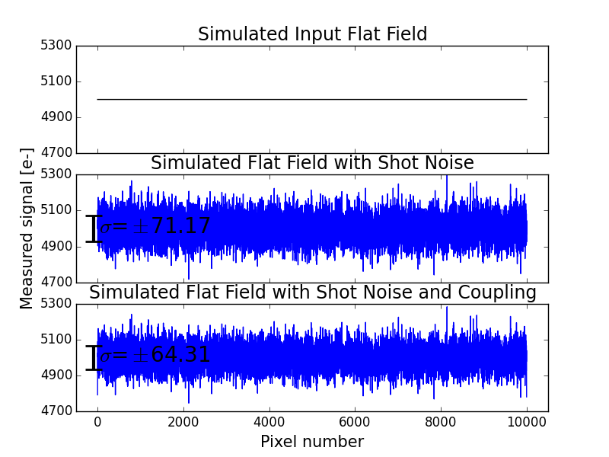
IPC coupling correlates noise

Slide 4
IPC is a capacitance
$$C=\frac{Q}{V}$$
$$K\left(m,n\right)=\left[\begin{matrix}0 & α & 0 \\ α & 1−4α & α \\ 0 & α & 0\end{matrix}\right]$$
$$M\left(i,j\right)=S(i,j)∗K(m,n)$$
$$α=\frac{V_{in}}{V_{1}}=\frac{C_{IPC}}{{4C}_{IPC}+C_{node}}$$

Slide 5
Parameters for physics simulations
LUMERICAL device
Parameter | Value
Pixel Pitch | 18μm
Implant Width | 13.5μm
Implant Depth | 2μm
Thickness | 5μm
Bump thickness | 8μm
Bump diameter | 11μm
In Bump

Slide 6
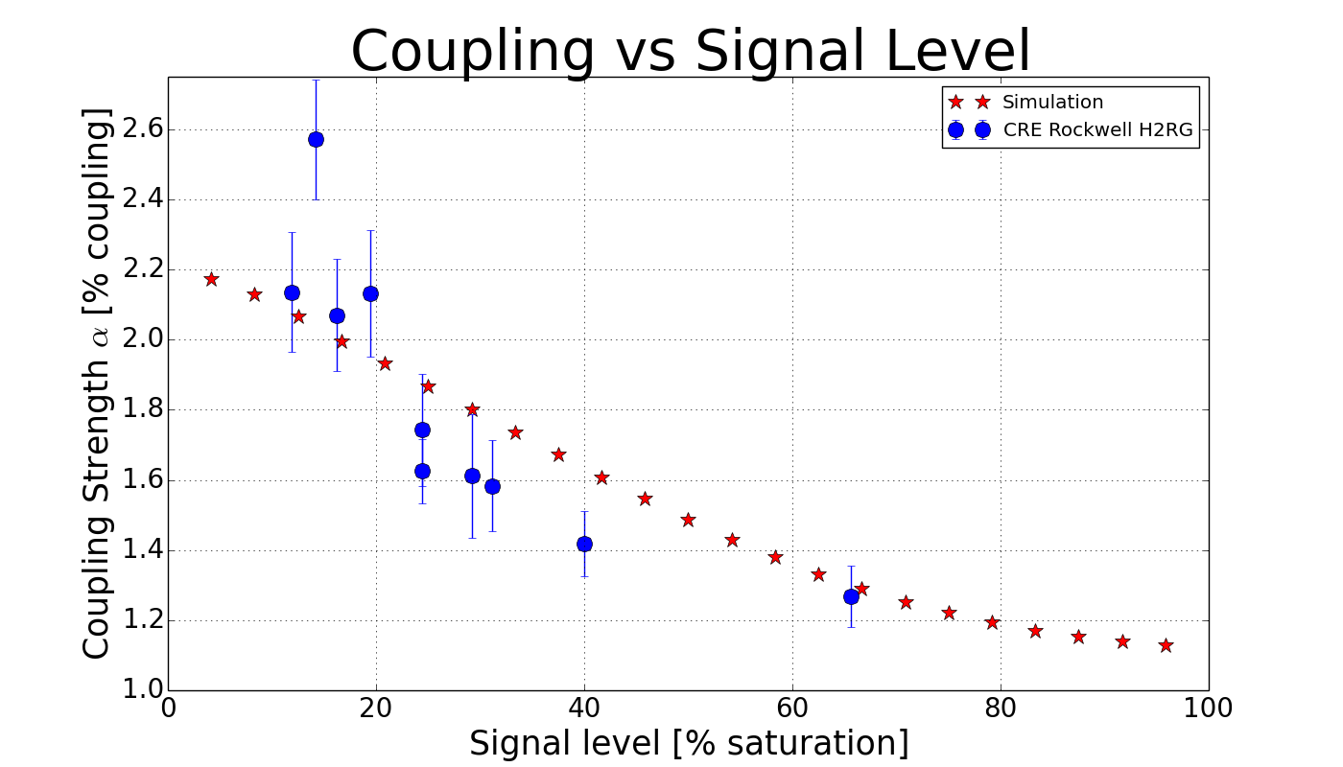
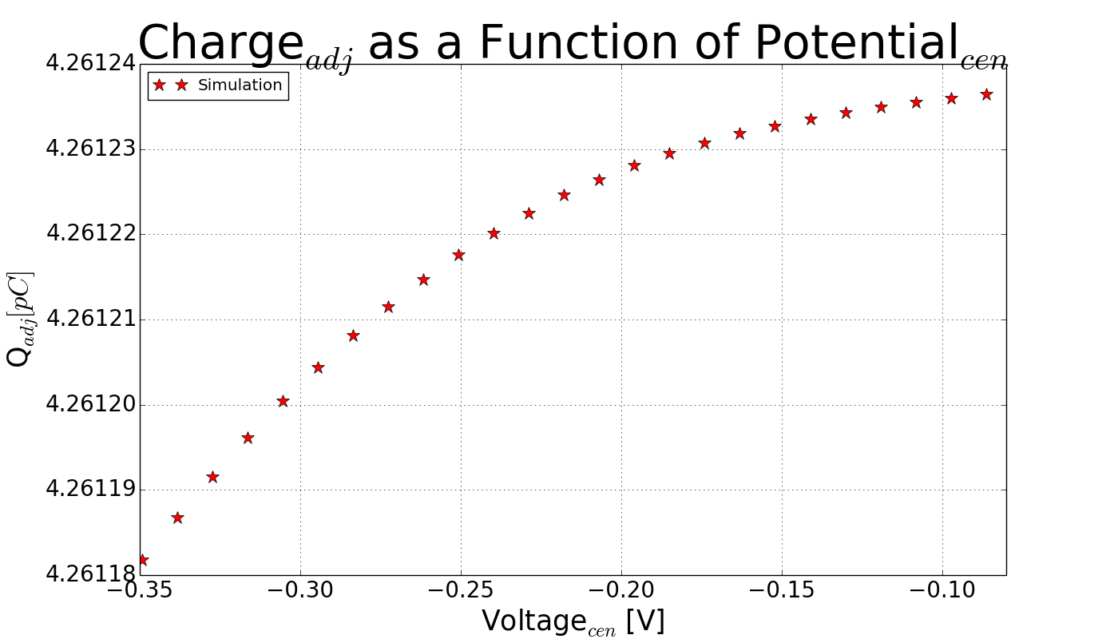
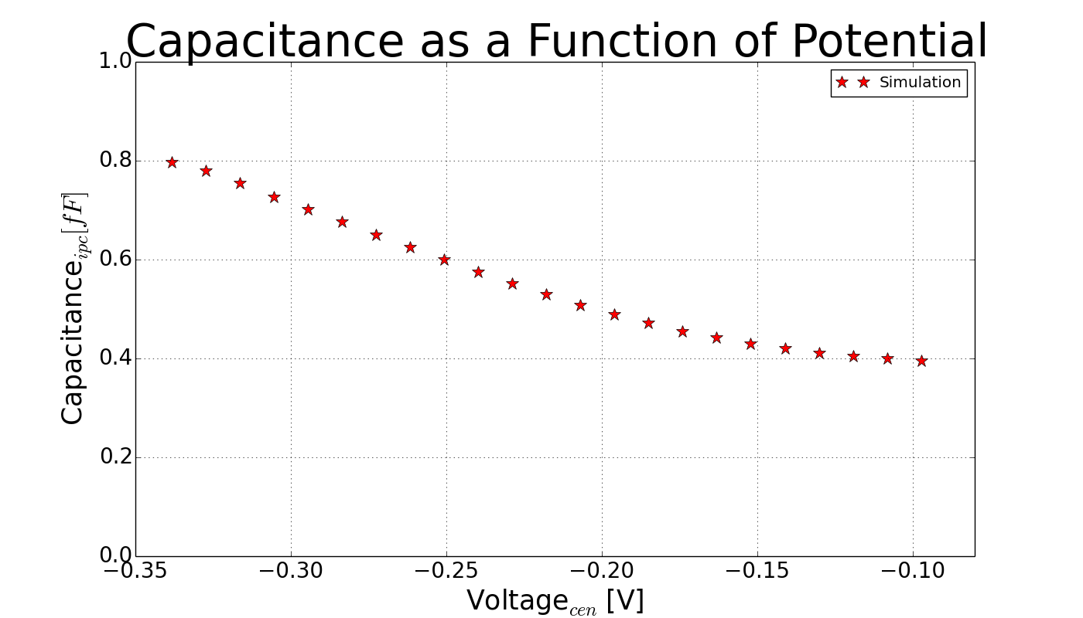
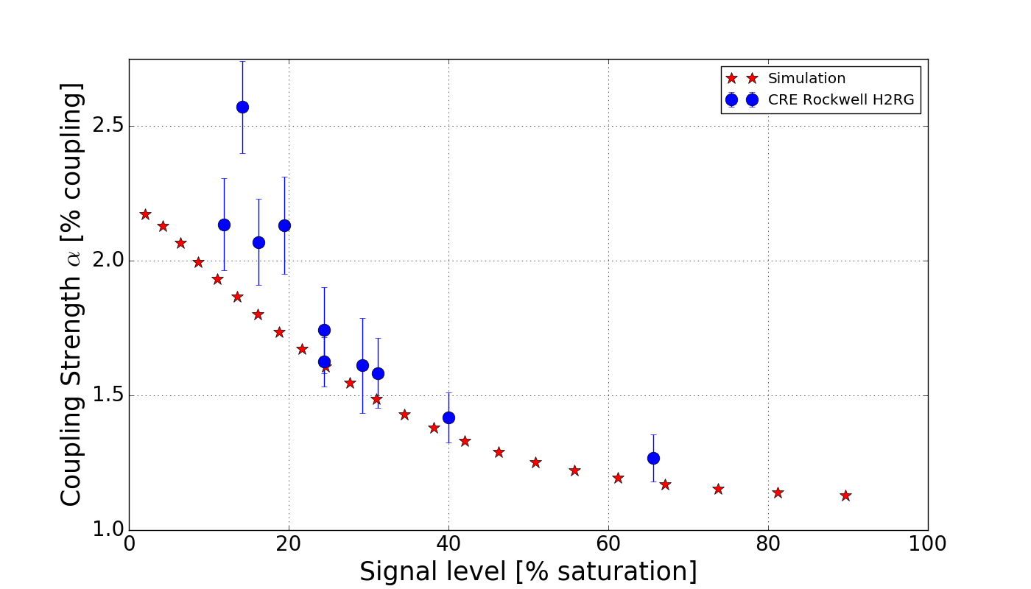
First principle simulations give direct access to electrostatics
$$C=\frac{dQ}{dV}≈\frac{Q_{i}−Q_{i−1}}{V_{i}−V_{i−1}}$$
$$C_{j}=\sqrt{\frac{q_{e}ε}{2(V_{0}−V)}\frac{N_{A}N_{D}}{N_{A}+N_{D}}}$$

Slide 7
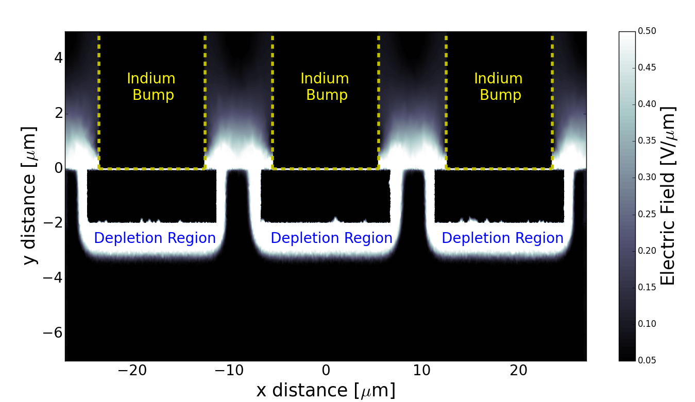
This non-linearity comes from the non-linearity of fields in the diode

Slide 8
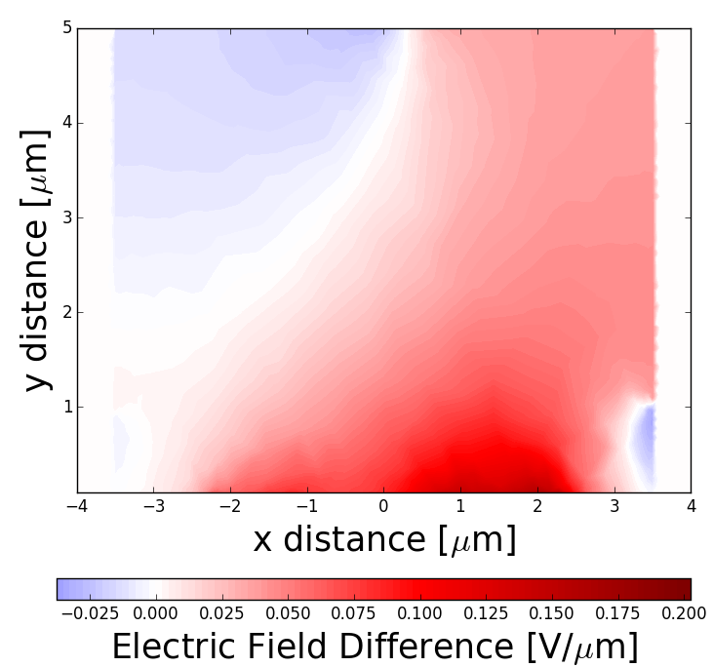
These fields change throughout an exposure

Slide 9
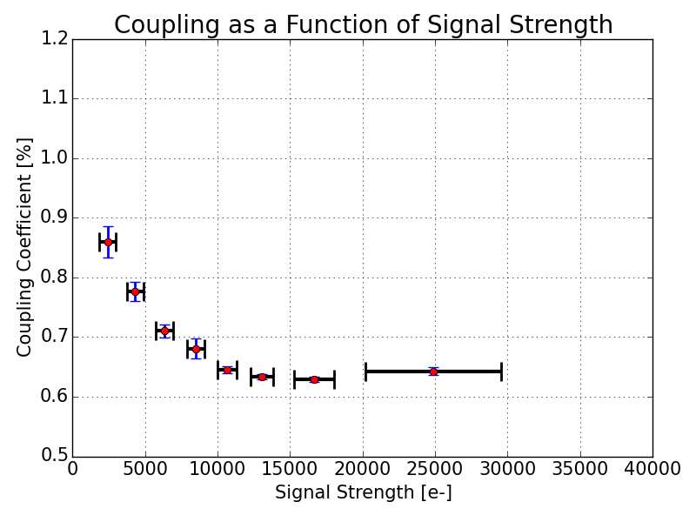
Direct measurement of IPC coupling using hot pixels
$$\left\langle α\right\rangle =\frac{\left\langle N\right\rangle −MED(B)}{\left\langle C\right\rangle +4\left\langle N\right\rangle −5(MED\left(B\right))}$$
[C]entral
[N]eighbor
[B]ackground

Slide 10
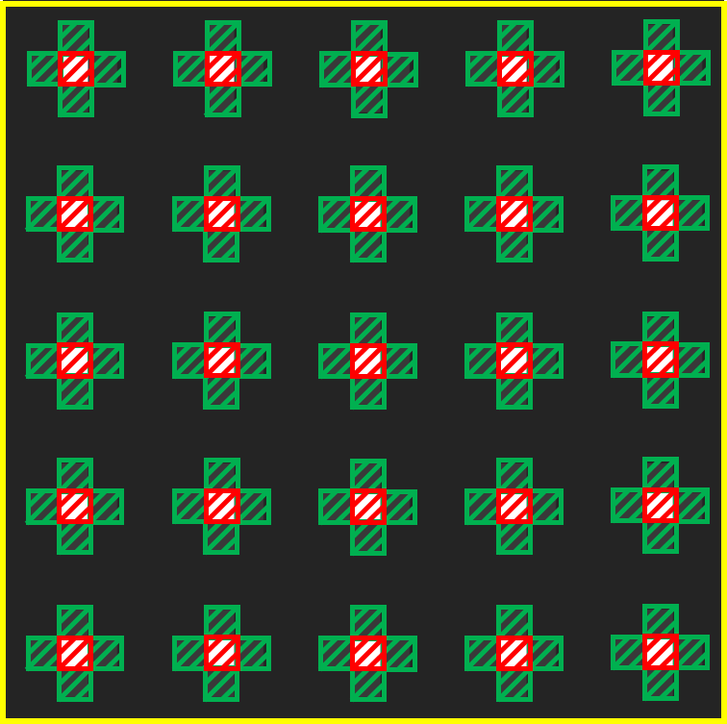
Direct measurement of IPC coupling using single pixel resets
$$\left\langle α\right\rangle =\frac{\left\langle N\right\rangle −MED(B)}{\left\langle C\right\rangle +4\left\langle N\right\rangle −5(MED\left(B\right))}$$
[C]entral
[N]eighbor
[B]ackground

Slide 11
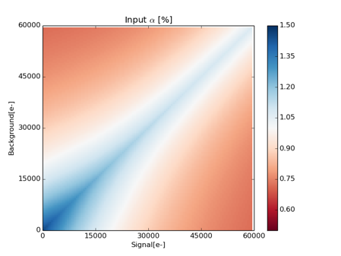
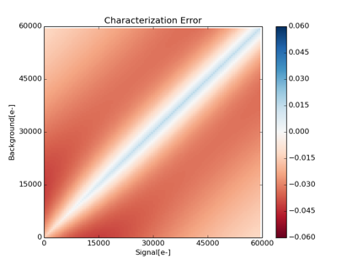
The possibility of direct measurement of IPC coupling using SPR
Peak over estimate:
0.020[%]
Peak under estimate:
0.045[%]

Slide 12
Convolution is not an appropriate mechanism
$$K\left(m,n\right)=\left[\begin{matrix}0 & α & 0 \\ α & 1−4α & α \\ 0 & α & 0\end{matrix}\right]$$
$$M\left(i,j\right)=S\left(i,j\right)+\sum_{m=i−1}^{i+1}{\sum_{n=j−1}^{j+1}{[α\{S\left(i,j\right),S\left(m,n\right)\}∙S(m,n)]}}$$
$$−\sum_{m=i−1}^{i+1}{\sum_{n=j−1}^{j+1}{[α\{S\left(m,n\right),S(i,j)∙S(i,j)]}}$$
$$M\left(i,j\right)=S(i,j)∗K(m,n)$$
$${\hat{S}}_{q}\left(i,j\right)=M\left(i,j\right)−\sum_{m=i−1}^{i+1}{\sum_{n=j−1}^{j+1}{[α\{{\hat{S}}_{q−1}\left(i,j\right),{\hat{S}}_{q−1}\left(m,n\right)\}∙{\hat{S}}_{q−1}(m,n)]}}$$
$$\hat{S}\left(i,j\right)=M\left(i,j\right)−\sum_{m=i−1}^{i+1}{\sum_{n=j−1}^{j+1}{[α\{M\left(i,j\right),M\left(m,n\right)\}∙M(m,n)]}}$$
$$+\sum_{m=i−1}^{i+1}{\sum_{n=j−1}^{j+1}{[α\{M\left(m,n\right),M(i,j)∙M(i,j)]}}$$
$$+\sum_{m=i−1}^{i+1}{\sum_{n=j−1}^{j+1}{[α\{{\hat{S}}_{q−1}\left(m,n\right),{\hat{S}}_{q−1}(i,j)∙{\hat{S}}_{q−1}(i,j)]}}$$
Where:
$${\hat{S}}_{0}(a,b)=M(a,b)$$

Slide 13
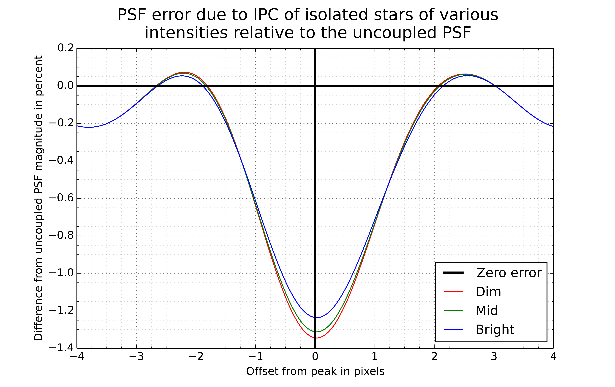
IPC alters PSFs which alters photometry and astrometry
$α$ applied peaks at 1.45% down to 0.65%
PSF | FWHM[pix] | FWHM[mas]
WEBBPSF 405N | 2.080 | 135.2
‘Dim’ | 2.186 | 142.1
‘Mid’ | 2.180 | 141.7
‘Bright’ | 2.169 | 141.0
FWHM up by 5% over theoretical
1% change from ‘Dim’ to ‘Bright’

Slide 14
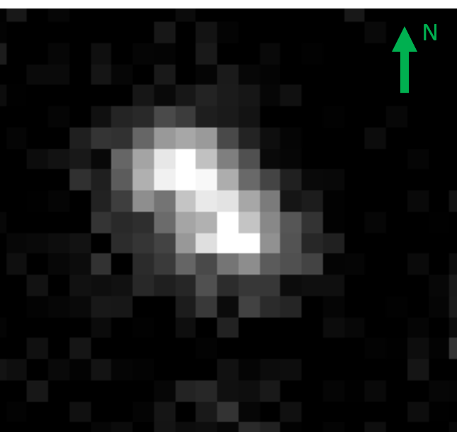
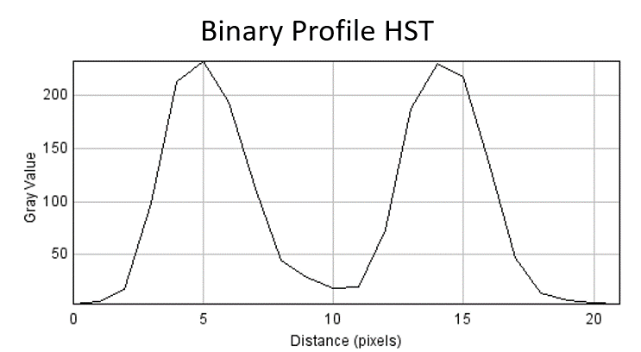
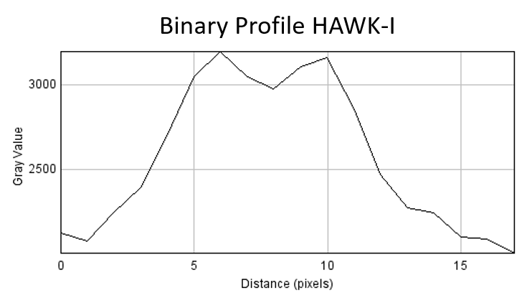
This change in shape impacts PSF fitting of confused binaries
HST ACS/WFC
ESO VLT ULT4 HAWK-I

Slide 15
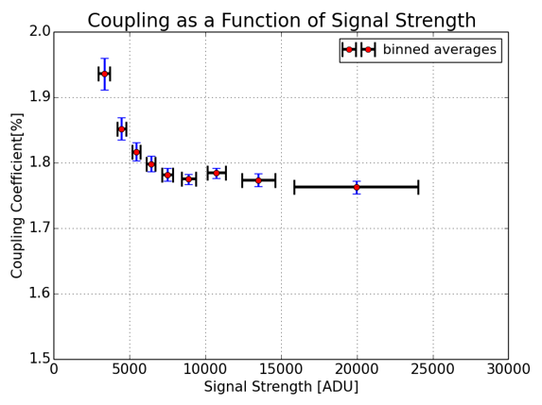
This change in shape impacts PSF fitting of confused binaries
 | HST | HAWK-I, uncorr | HAWK-I, IPC corr
Separation[pix] | 9.265 | 4.288 | 4.320
Separation [mas] | 463.251 ± 0.583 | 456.363 ± 3.149 | 459.823 ± 3.149
Error [mas] | ----- | -6.888 ± 3.203 | -3.428 ± 3.203
Error[%] | ----- | -1.48% | -0.74%
 | HST | HAWK-I, uncorr
Separation[pix] | 9.265 | 4.288
Separation [mas] | 463.251 ± 0.583 | 456.363 ± 3.149
Error [mas] | ----- | -6.888 ± 3.203
Error[%] | ----- | -1.48%

Slide 16
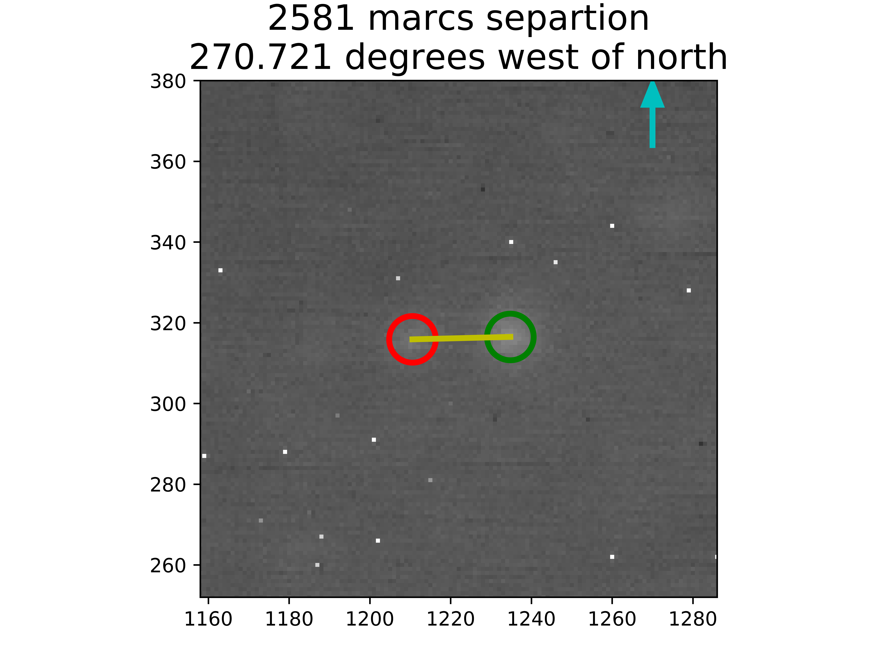
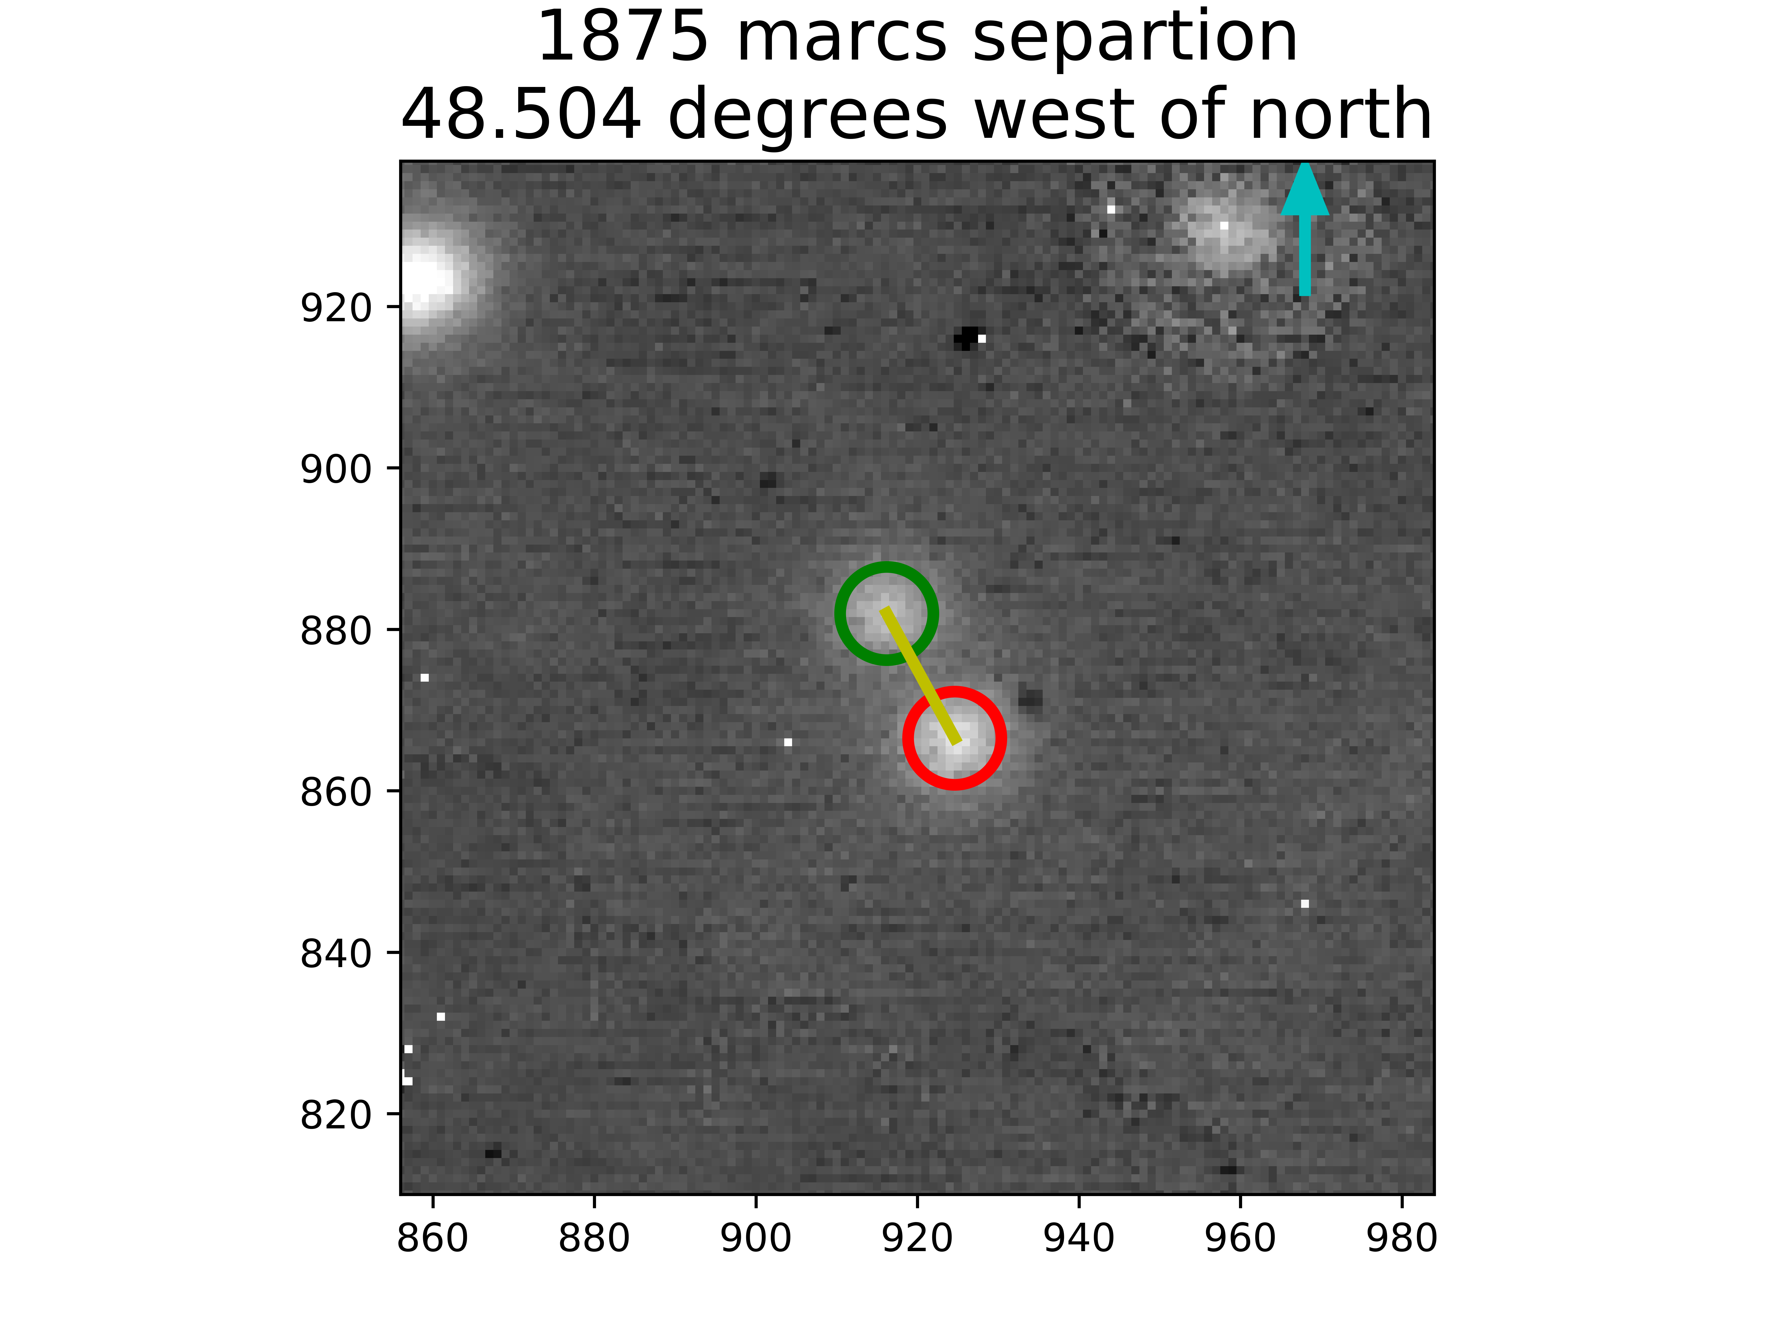
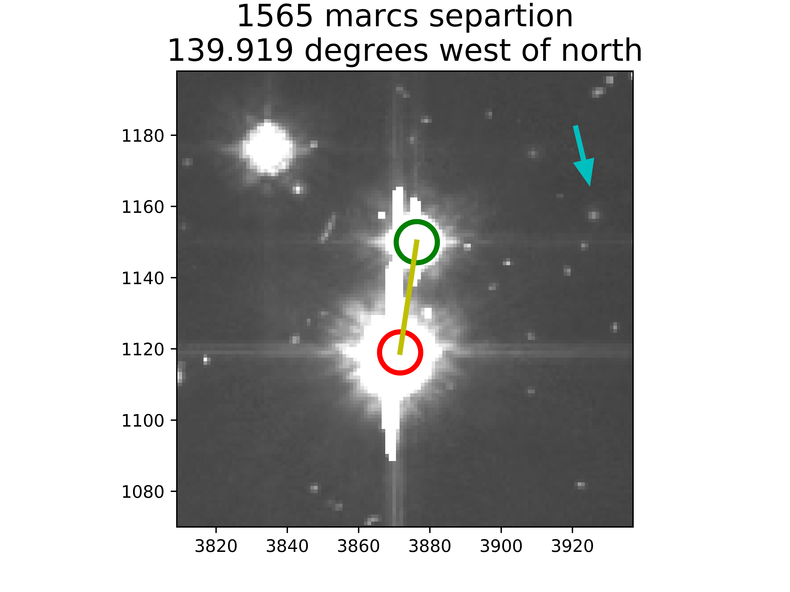
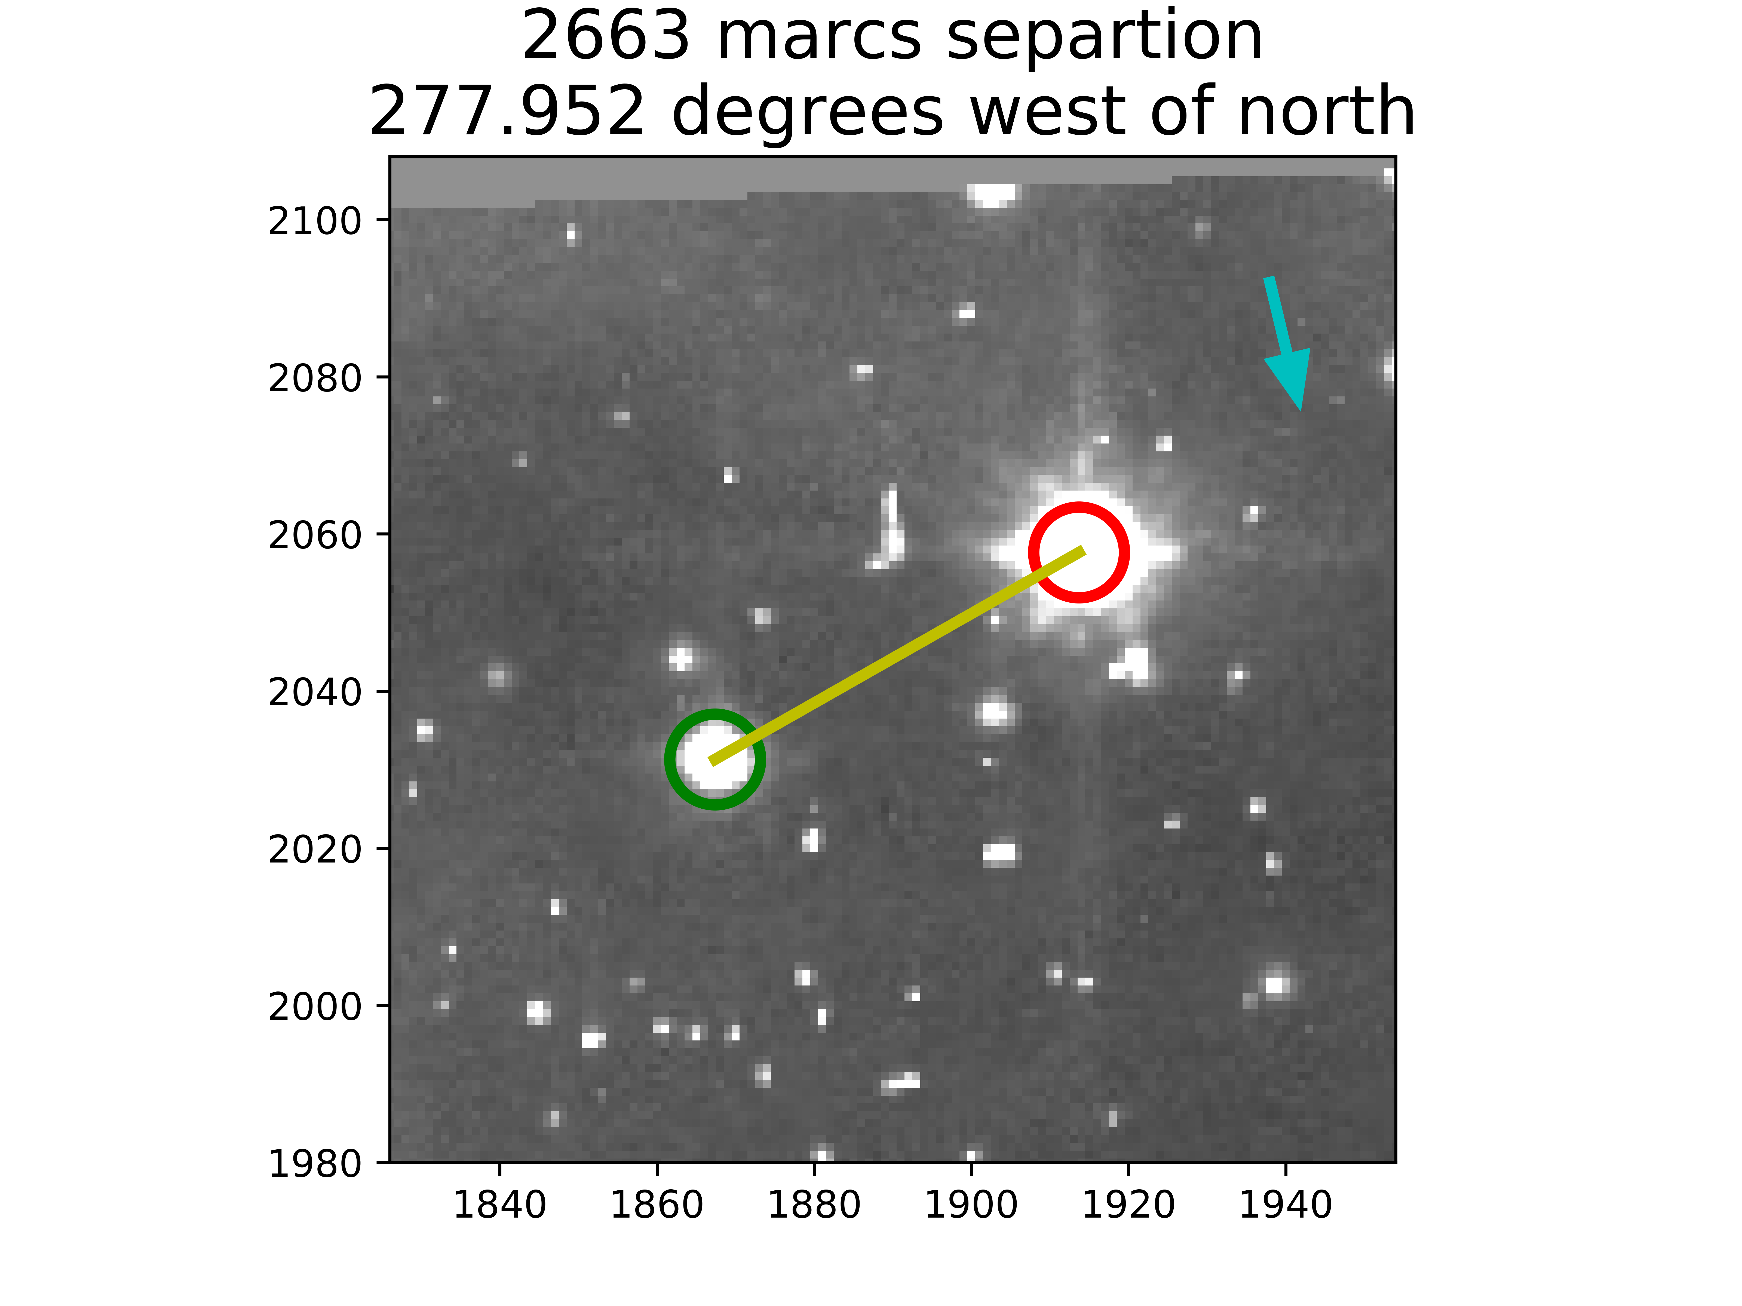
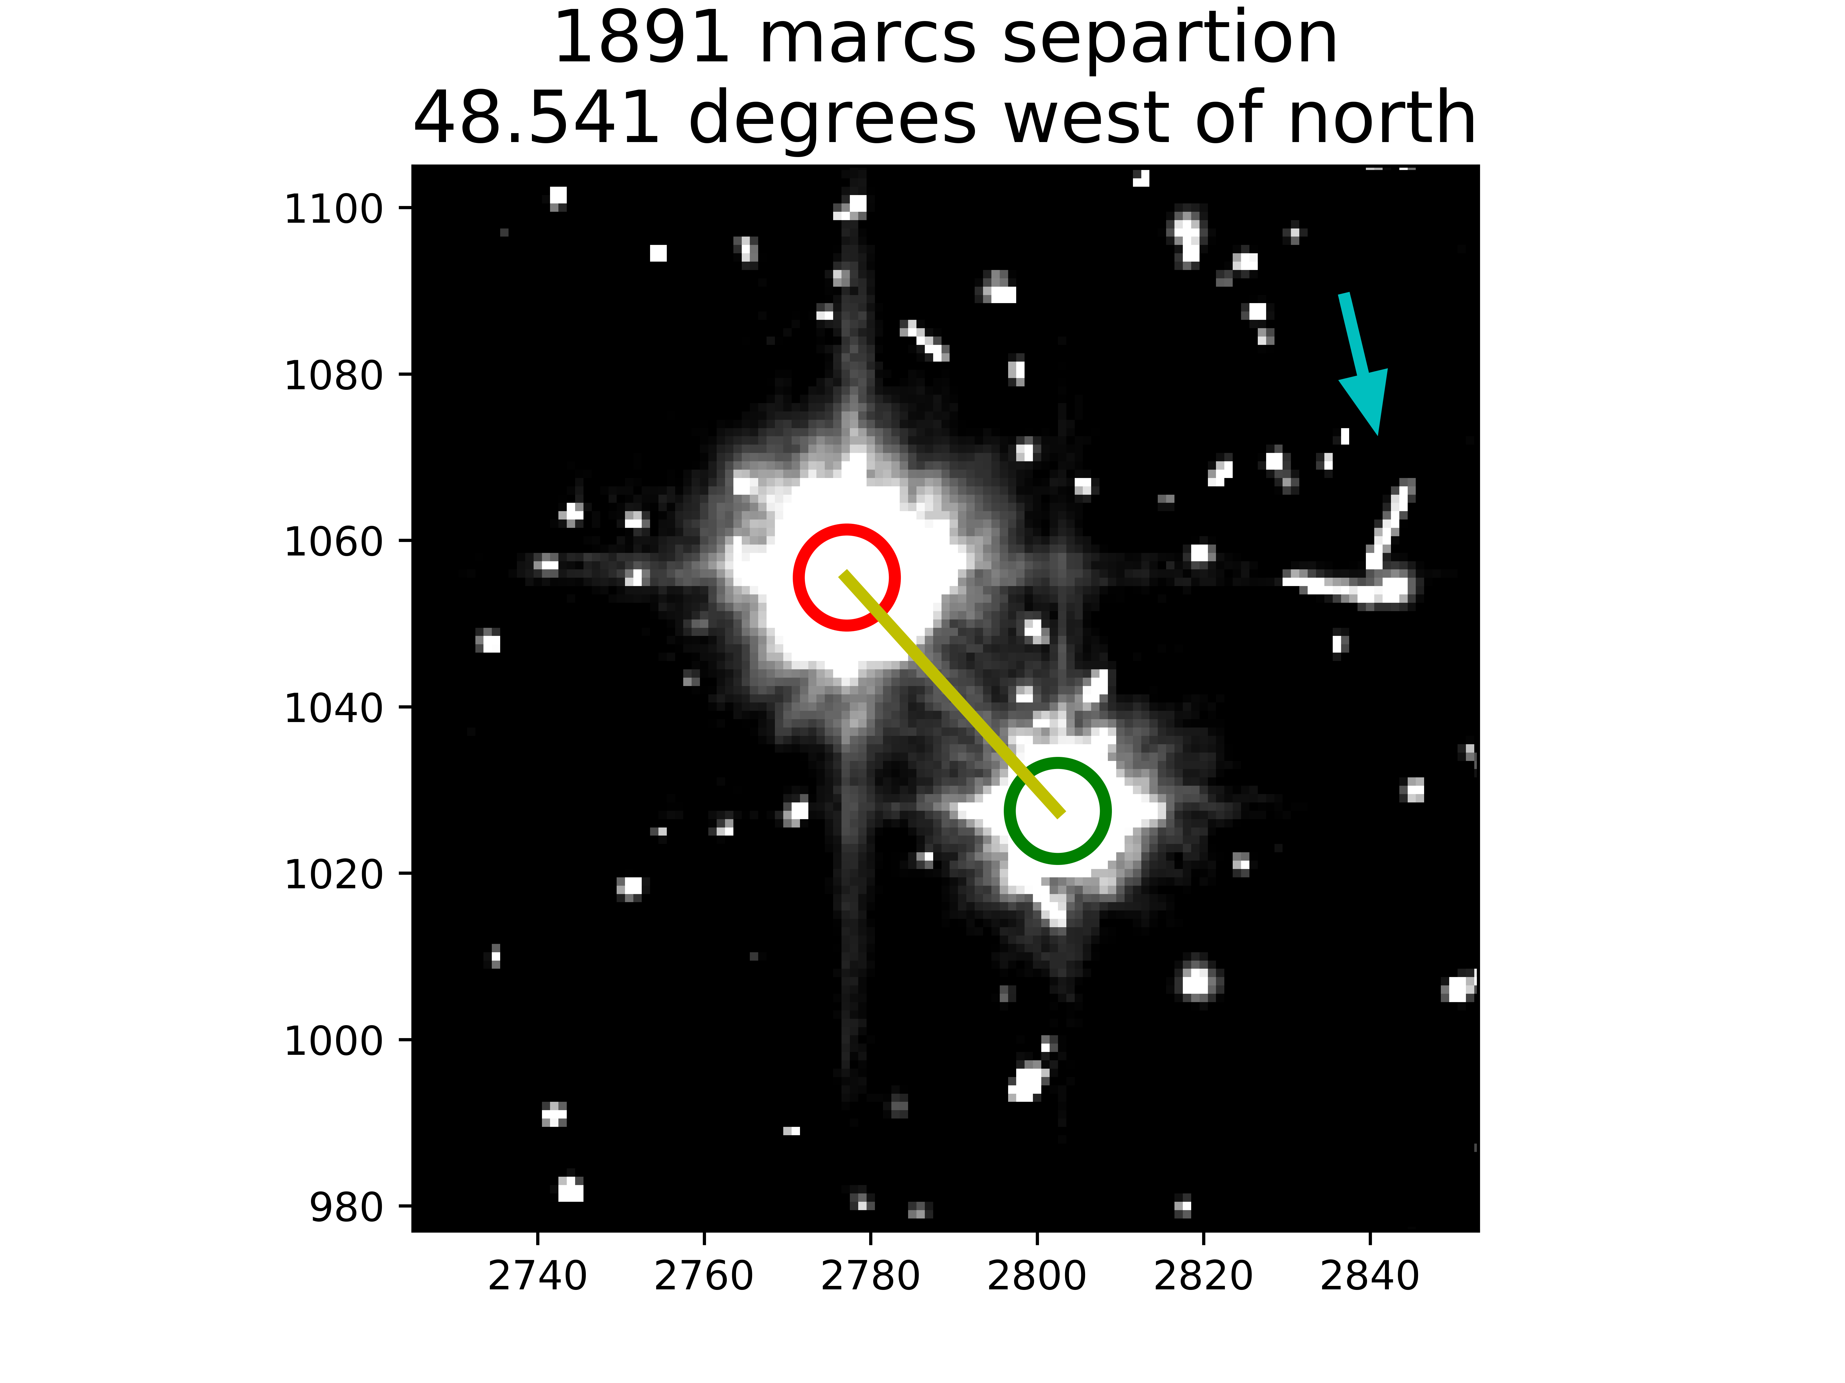
A summary of binary pairs
HAWK-I
HST ACS/WFC

Slide 17
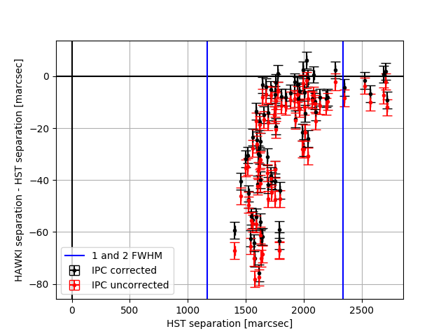
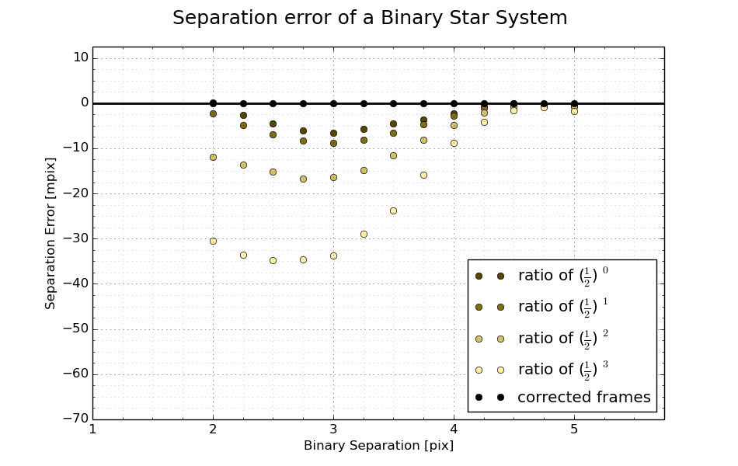
A summary of binary pairs
Separation Error of 74 confused binary pairs
Modeled using JWST and approximate $α$

Slide 18
What needs to come next?
SPR data for complete characterization
More empirical validation
More modeling for particular science cases
Gravitational lensing, spectral lines?

Slide 19
How to decouple: before or after linearity correction
$${\hat{S}}_{q}\left(i,j\right)=M\left(i,j\right)−\sum_{m=i−1}^{i+1}{\sum_{n=j−1}^{j+1}{[α\{{\hat{S}}_{q−1}\left(i,j\right),{\hat{S}}_{q−1}\left(m,n\right)\}∙{\hat{S}}_{q−1}(m,n)]}}$$
$$+\sum_{m=i−1}^{i+1}{\sum_{n=j−1}^{j+1}{[α\{{\hat{S}}_{q−1}\left(m,n\right),{\hat{S}}_{q−1}(i,j)∙{\hat{S}}_{q−1}(i,j)]}}$$
Voltage domain
Charge Domain

Slide 20
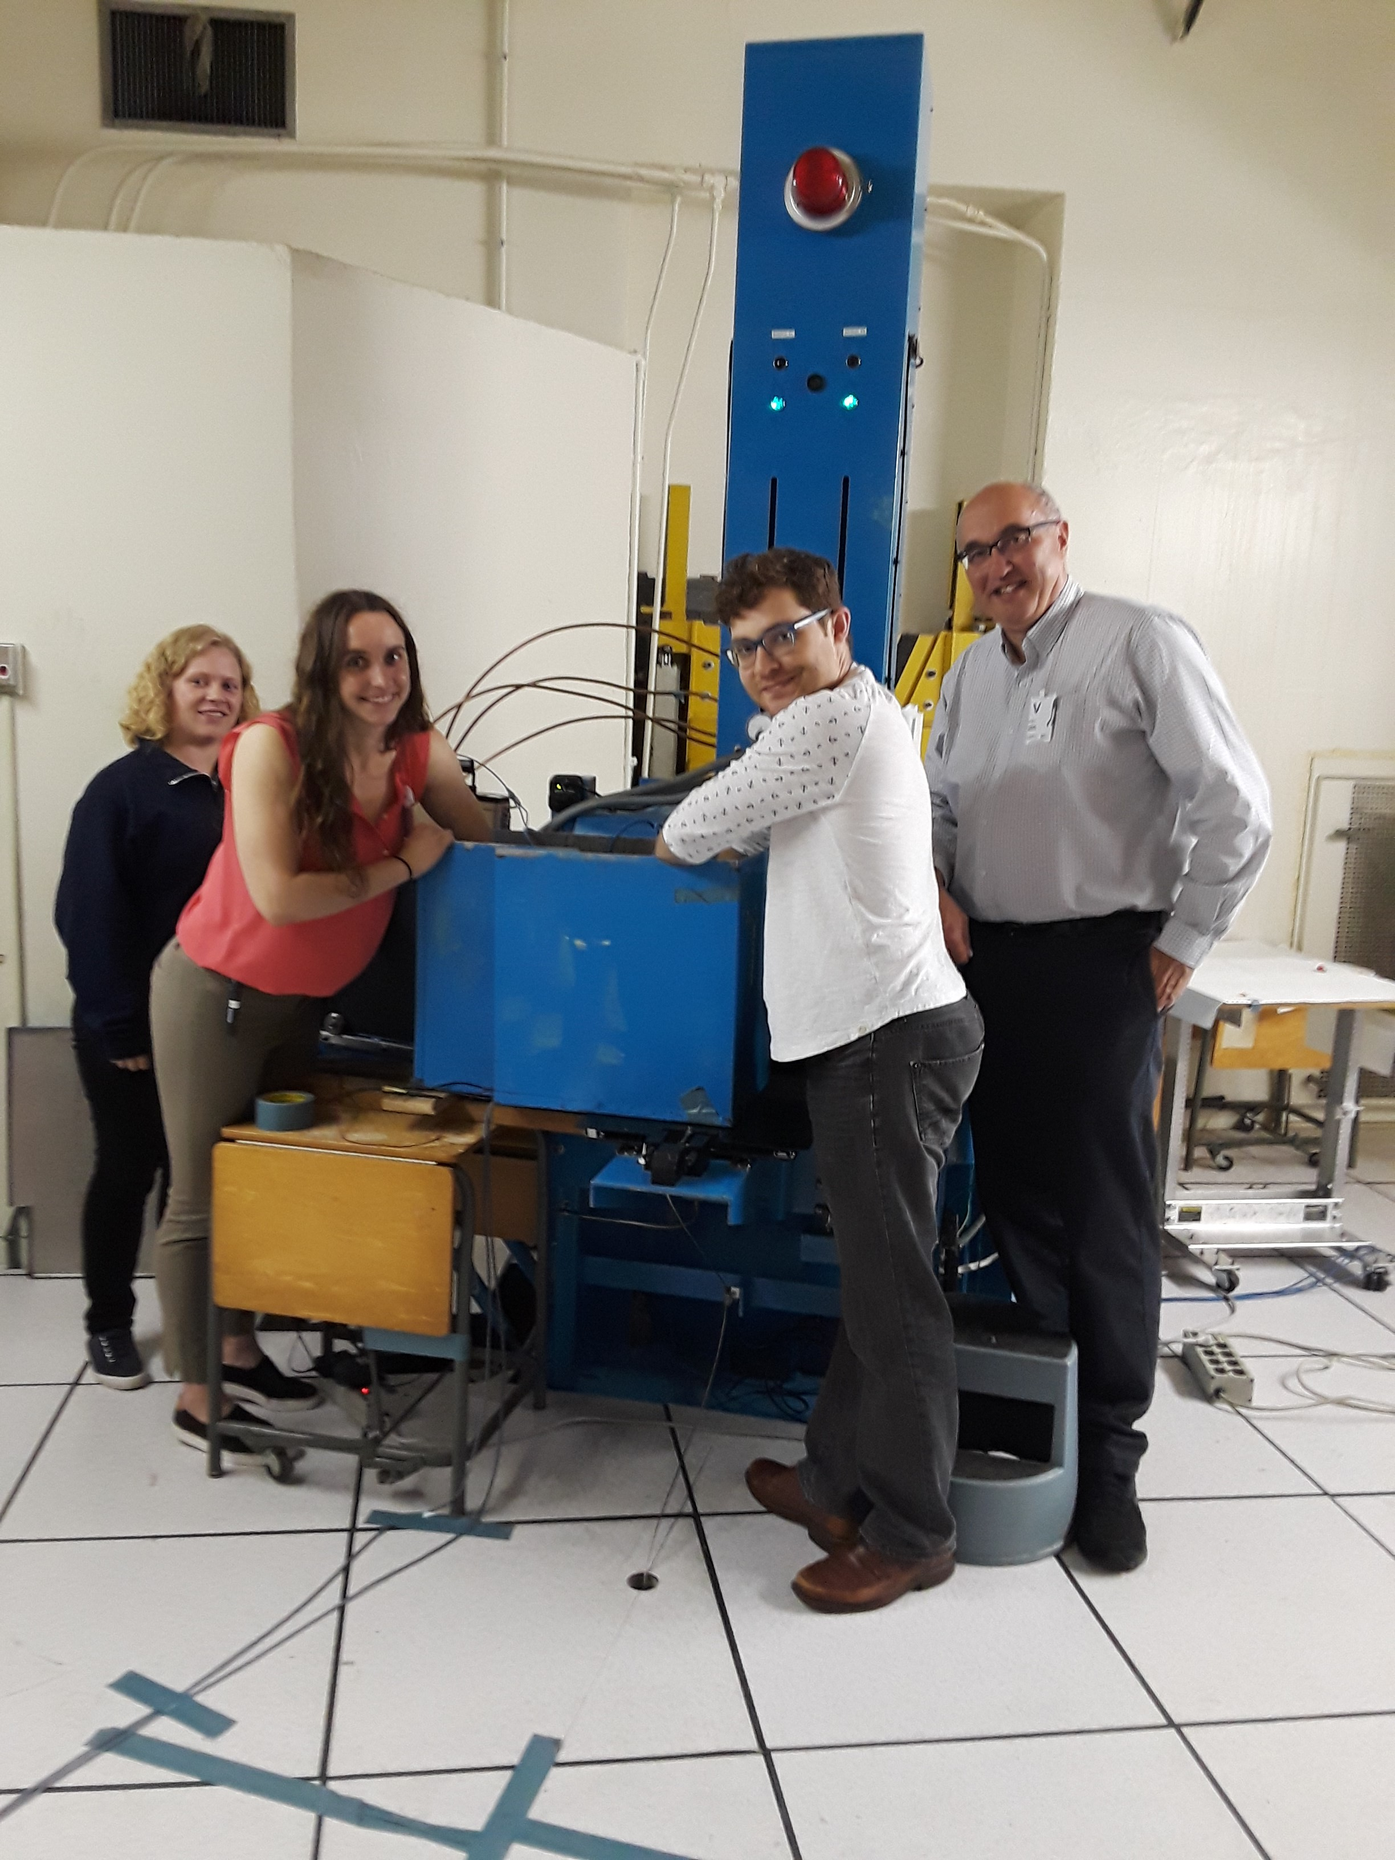
The LAIR lab

