Slide 1
Developing Long-Wave Infrared HgCdTe Detector Arrays for Future Space Missions
Mario S. Cabrera
Supervised by William J. Forrest, Judith L. Pipher, and Craig McMurtry
Monday, December 3, 2018

Slide 2
Outline
Motivation
HgCdTe
Characterization
Previous Work
Current Results
Future Work/Summary

Slide 3
Motivation

Slide 4
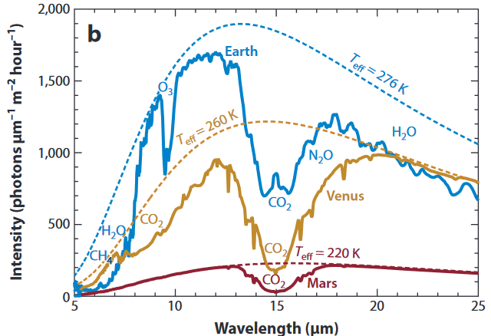
Astronomical Motivation
Atmosphere of Exoplanets
${CO}_{2}$ (strong feature at $15 μm$) can be used to identify terrestrial planets
Possibility for life shown by $H_{2}O$
9.6 $μm$ $O_{3}$ indicates abundant life
Ocean detection in outer solar system (ice-plate tectonics on Europa, $H_{2}O$ geysers on Enceladus)
Accessibility to N-band for ground based observations
Figure Source: Kaltenegger 2017

Slide 5
HgCdTe

Slide 6
$Hg_{1−x}Cd_{x}Te$
$x$ composition parameter (molar concentration of Cd)
Tunable energy band-gap
$E_{g}\left(x,T\right)=−0.302+1.93x−0.81x^{2}+0.832x^{3}+5.35×{10}^{−4}T\left.\left(1−2x\right.\right)$ (Hansen and Schmit 1983)
$E_{g}=\frac{hc}{λ_{c}}$
UR infrared detector team along with JPL and Teledyne Imaging Systems have developed HgCdTe $10 μm$ cut-off arrays
NEOCam (Mainzer 2015)
Operabilities > 90% at a temperature of 40 K
Dark Current < 200 $e^{−}/s$ and well depth > 44 $ke^{−}$
Median dark current at 40 K < 1 $e^{−}/s$ (Dorn et al. 2018)
$15 μm$ goal (LW15 arrays)
$13 μm$ (LW13 arrays) intermediate step

Slide 7
Characterization

Slide 8
Characterization
Capacitance
Non-Linearity
Read-Noise
Operability
Dark current
Well depth
Focus of this talk

Slide 9
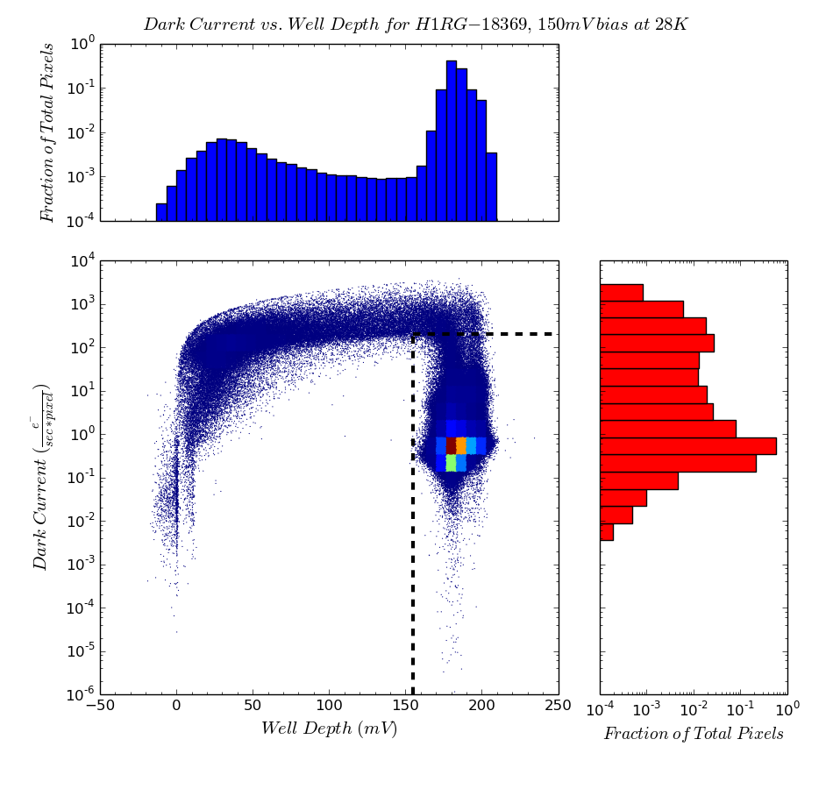
Dark Current vs. Well Depth
High dark current pixels will debias considerably before first read, showing smaller dark currents
Inoperable pixels can then be determined through the low well depth

Slide 10
Previous Work (LW13 phase)

Slide 11
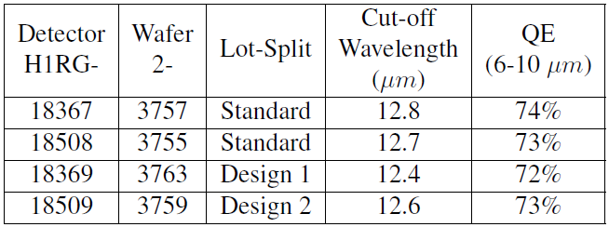
Received four LW13 cut-off detectors
H1RG-18367 and 18508 were grown and processed in the same manner as the 10 $μm$ arrays for NEOCam
H1RG-18369 and H1RG-18509 were designed to mitigate quantum tunneling dark currents
Cabrera et al. 2019

Slide 12
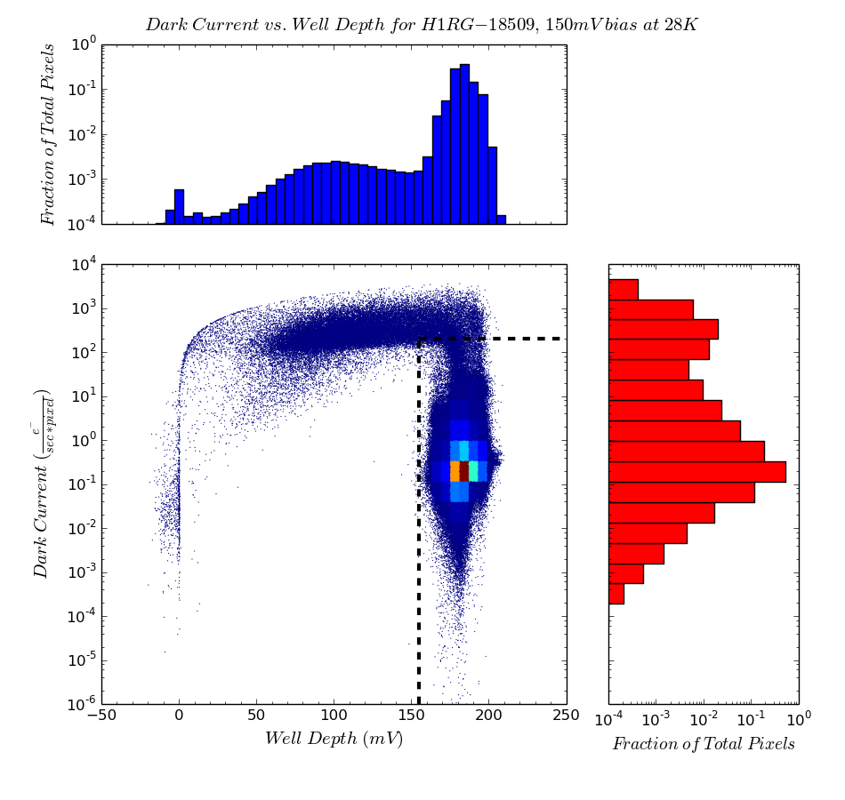
Dark Current vs. Well Depth
The majority of pixels for H1RG-18369, 18508, and 18509 had dark currents below $1\frac{e^{−}}{s}$ (Comparable to the performance of the NEOCam arrays)

Slide 13
Operability Map
Trap-band quantum tunneling dark currents occur when the arrays have traps due to defects and dislocations in the depletion region
A mismatch between the CdZnTe substrate crystal axes and the HgCdTe layers creates cross-hatching pattern
Cabrera et al. 2019

Slide 14
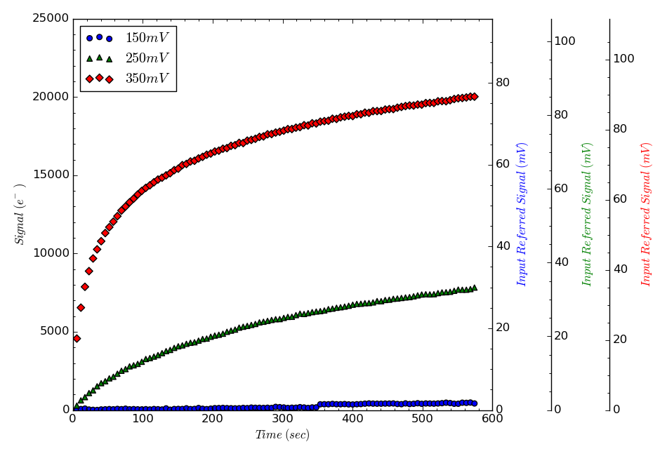
H1RG-18508 SUTR Curvature
$I_{dark}\left(150 mV\right)=0.44 e^{−}/s$
$Well=45ke^{−}/174 mV$
$I_{dark}\left(250 mV\right)=35.7 e^{−}/s$
$Well =64ke^{−}, 271 mV$
$I_{dark}\left(350 mV\right)=787.6 e^{−}/s$
$Well=74ke^{−}, 331 mV$

Slide 15
Thermally Generated Currents
Diffusion Current (Reine et al. 1981)
Direct band-gap thermally generated electron-hole pairs
Generation Recombination (G-R) current (Sah et al. 1957)
Trap assisted thermally generated currents

Slide 16
Tunneling Currents
Band-to-band tunneling current
Electrons tunnel from the valence to the conduction band
Trap-to-band tunneling current
Electrons tunnel from the valence to the conduction band indirectly by using intermediate traps
Both are heavily bias dependent
Sze 1981
Kinch 1981
Kinch 2014

Slide 17
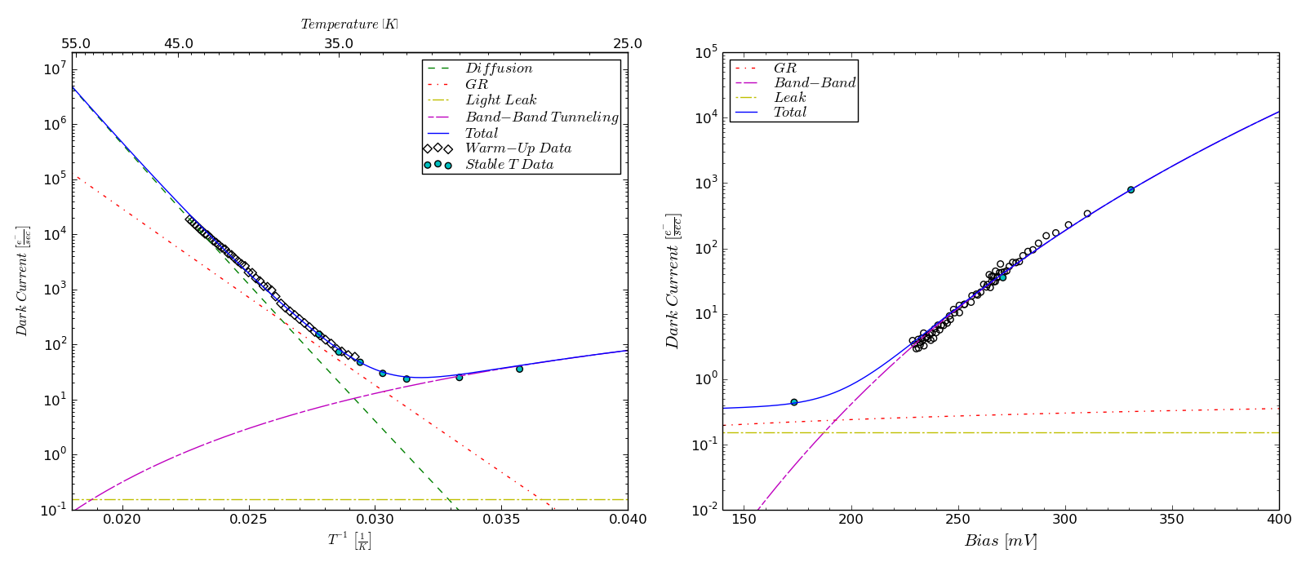
I-T with 250 mV of applied bias
I-V at a temperature of 28 K
Dark current model for pixel in previous slide

Slide 18
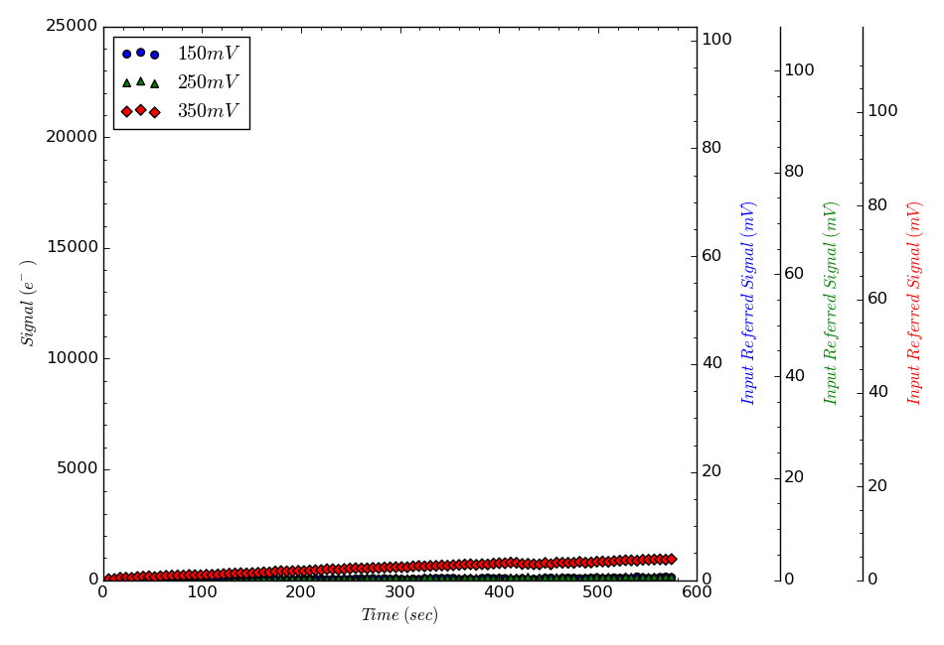
H1RG-18509 SUTR Curvature
$I_{dark}\left(150 mV\right)=0.18 e^{−}/s$
$Well=44ke^{−}/180 mV$
$I_{dark}\left(250 mV\right)=0.22 e^{−}/s$
$Well =64ke^{−}, 280 mV$
$I_{dark}\left(350 mV\right)=1.73 e^{−}/s$
$Well=81ke^{−}, 382 mV$

Slide 19
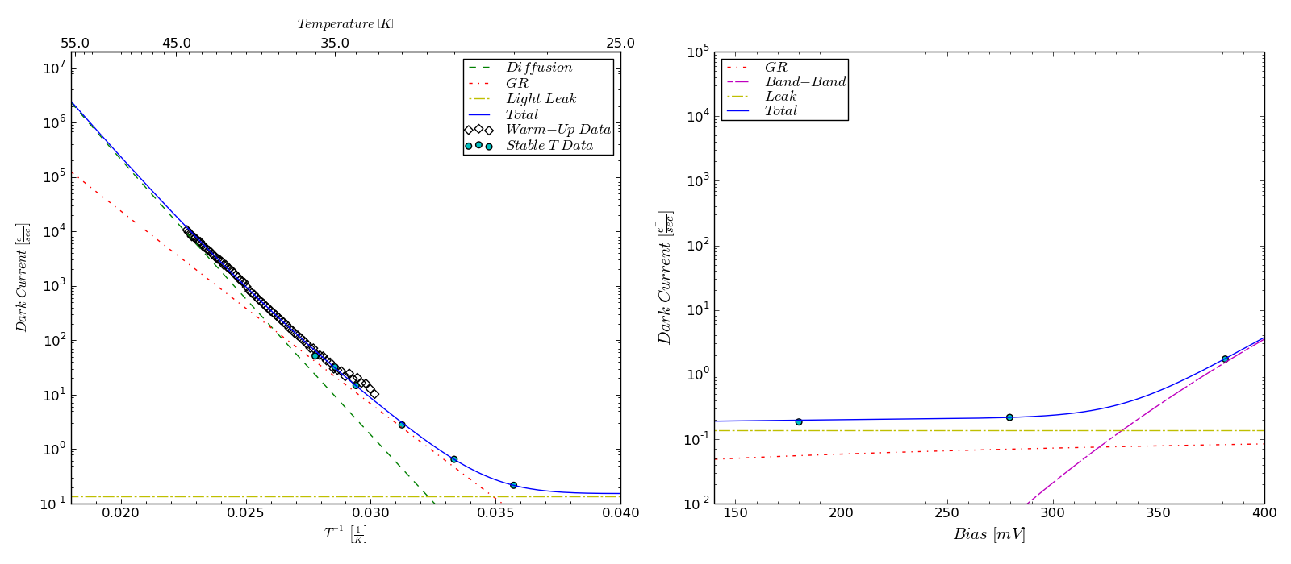
I-T with 250 mV of applied bias
I-V at a temperature of 28 K
Dark current model for pixel in previous slide

Slide 20
LW15 Results

Slide 21
Received three LW15 arrays
H1RG-20302 and 20303 were designed to mitigate quantum tunneling dark currents
H1RG-20304 was grown and processed in the same manner as the 10 $μm$ arrays for NEOCam
Tested H1RG-20303
Cutoff wavelength of 15.5 $μm$
QE of 83% between 6-12 $μm$

Slide 22
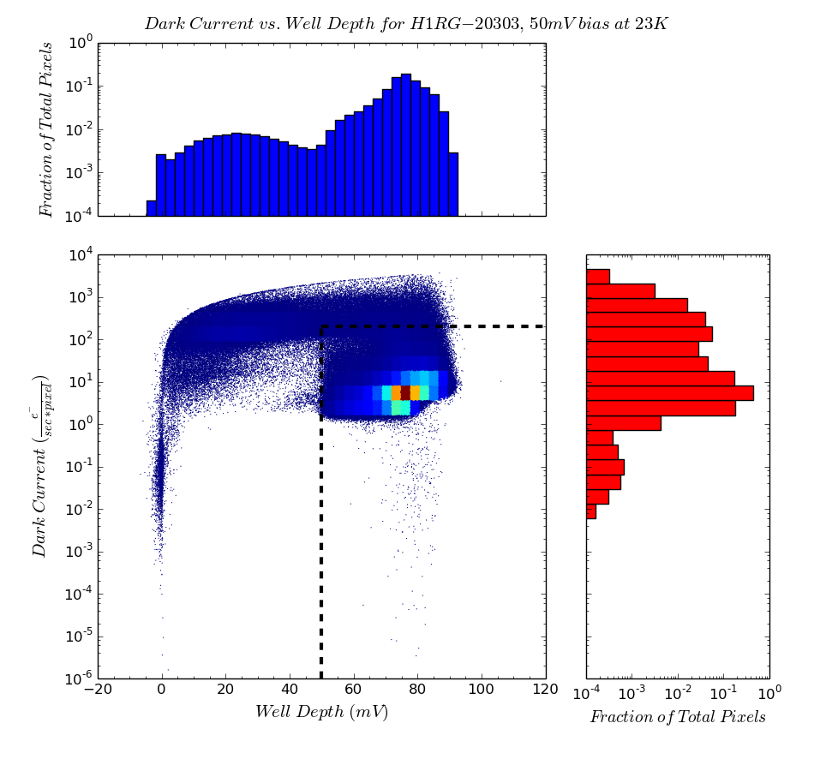
Dark Current vs. Well Depth
Lowest dark currents at a temperature of 23K and 50 mV of applied bias
Median dark current and well depth of 6.22$e^{−}/s$ and ~18$ke^{−}$
87.6% of pixels have dark currents < 200 $e^{−}/s$ and well depth greater than ~ 12$ke^{−}$

Slide 23
Operability Map

Slide 24
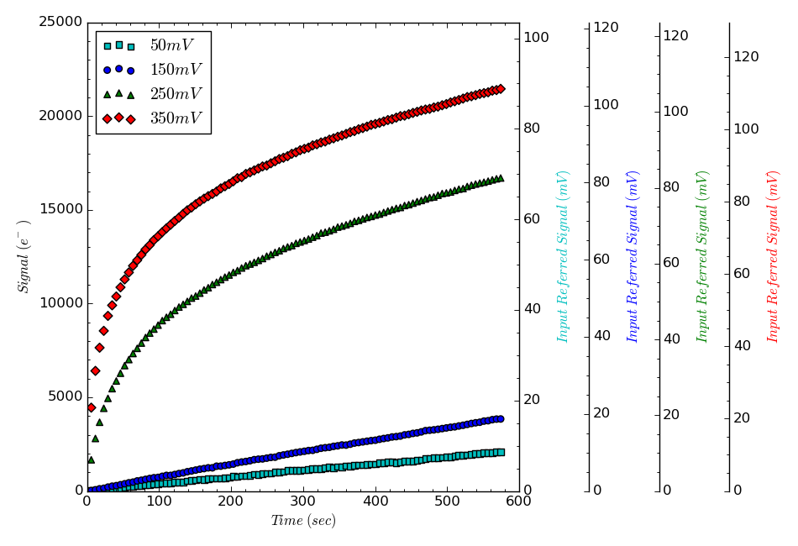
SUTR Curvature
Increasing bias also increases dark current

Slide 25
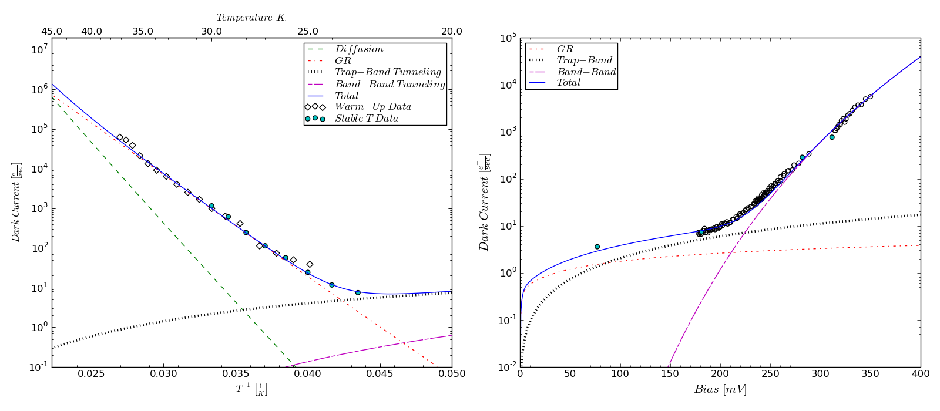
I-T with 150 mV of applied bias
I-V at a temperature of 23 K
Dark current model for pixel in previous slide

Slide 26
LW15 Array Summary
From our fits, we have shown that at 250 and 350 mV of applied bias at a temperature of 23 K, band-to-band tunneling current is the dominating dark current component
At low temperatures and bias, G-R and trap-to-band appear to dominate dark current
TIS improved diode structure to reduce band-to-band tunneling

Slide 27
Future Work
More detailed dark current vs. temperature and bias characterization to determine if the majority of pixels behave similarly as the one presented here
Characterize two other arrays

Slide 28
Thank you!

Slide 29
Questions?

Slide 30
References
L. Kaltenegger, “How to characterize habitable worlds and signs of life,” Annual Review of Astronomy and Astrophysics 55 (1), 433–485 (2017).
G. L. Hansen and J. L. Schmit, “Calculation of Intrinsic Carrier Concentration in Hg1−xCdxTe,” Journal of Applied Physics 54 (3), 1639–1640 (1983).
A. Mainzer, T. Grav, J. Bauer, et al., “Survey simulations of a new near-earth asteroid detec-tion system,” The Astronomical Journal 149 (5), 172 (2015).
M. Dorn, C. McMurtry, J. Pipher, et al., “A Monolithic 2k x 2k LWIR HgCdTe Detector Array for Passively Cooled Space Missions,” Proc. SPIE 10709, 10709 – 10709 – 9 (2018).
M. Cabrera, C. McMurtry, M. Dorn, et al., “Development of 13 μm Cutoff Wavelength HgCdTe Detector Arrays for Astronomy,” Submitted to the Journal of Astronomical Telescopes, Instruments, and Systems.
M. Reine, A. Sood, and T. Tredwell, “Chapter 6 Photovoltaic Infrared Detectors,” in Mercury Cadmium Telluride, R. Willardson and A. C. Beer, Eds., Semiconductors and Semimetals 18, 201 – 311, Elsevier (1981).
C. T. Sah, R. N. Noyce, and W. Shockley, “Carrier Generation and Recombination in P-N Junctions and P-N Junction Characteristics,” Proceedings of the IRE 45 (9), 1228–1243 (1957).
S. M. Sze, Physics of Semiconductor Devices, John Wiley & Sons (1981).
M. Kinch, “Chapter 7 Metal-Insulator-Semiconductor Infrared Detectors,” in Mercury Cadmium Telluride, R. Willardson and A. C. Beer, Eds., Semiconductors and Semimetals 18, 313– 378, Elsevier (1981).
M. A. Kinch, State-of-the-Art Infrared Detector Technology, SPIE press Bellingham (2014).

