Slide 1
Moving Forward with SAPHIRA
An array to Count photons in the near-infrared
Atkinson
ISPA
2 Dec 2018

Slide 2
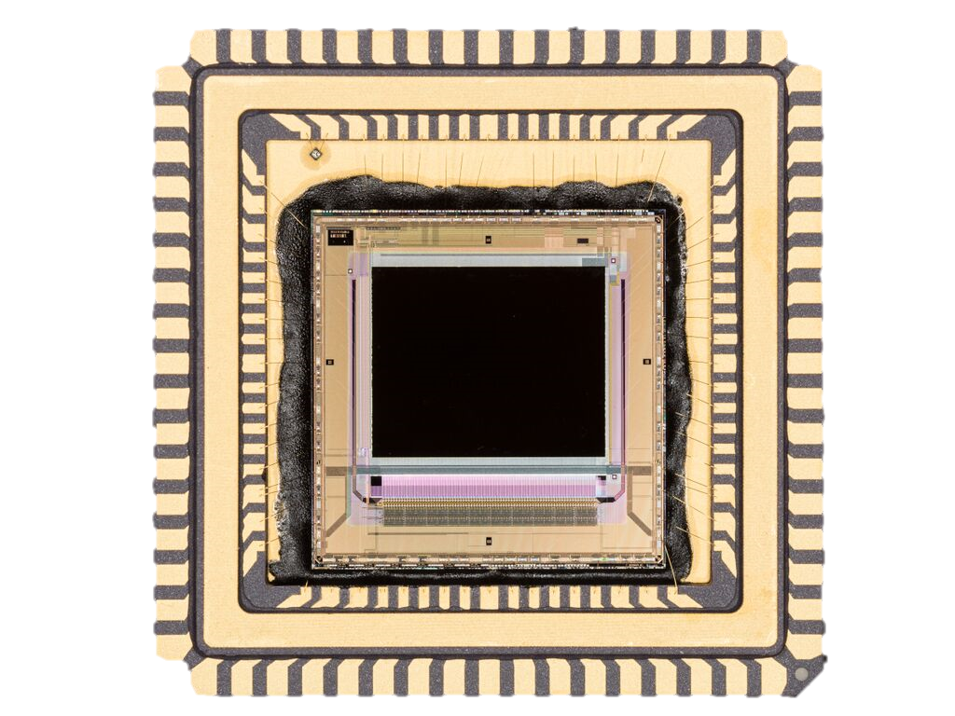
SAPHIRA

Slide 3
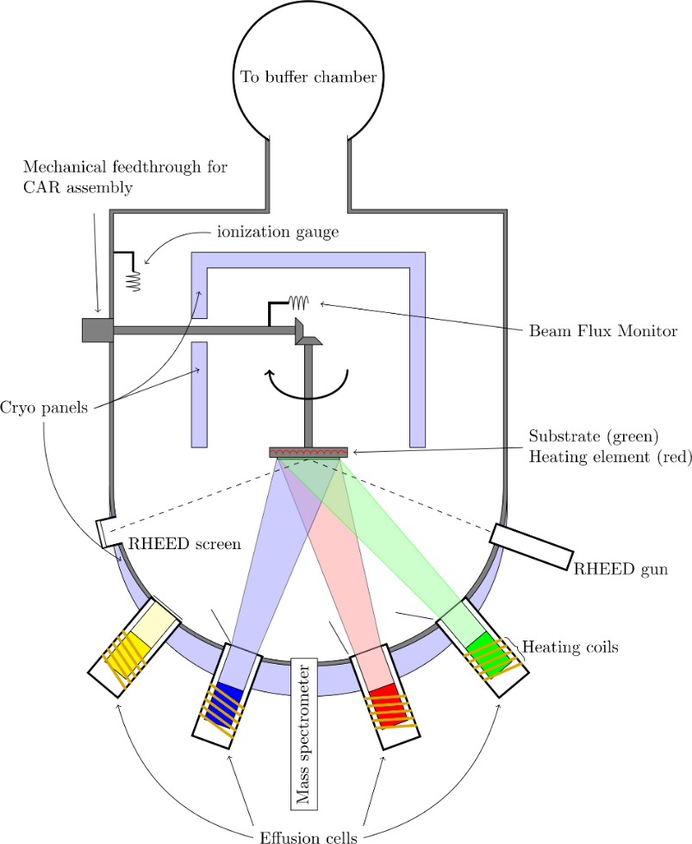
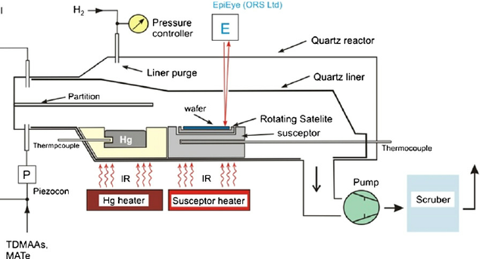
SAPHIRA
Image by Vegar Ottesen
Image from Antoni Rogalski
MBE
MOVPE

Slide 4
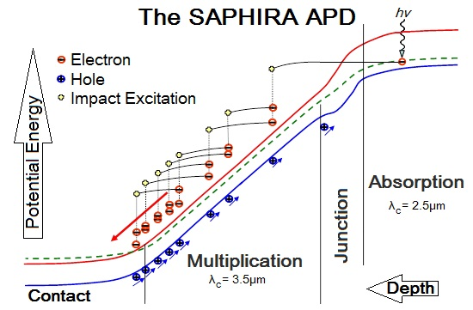

Slide 5
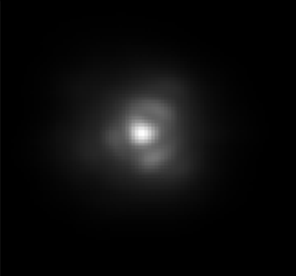
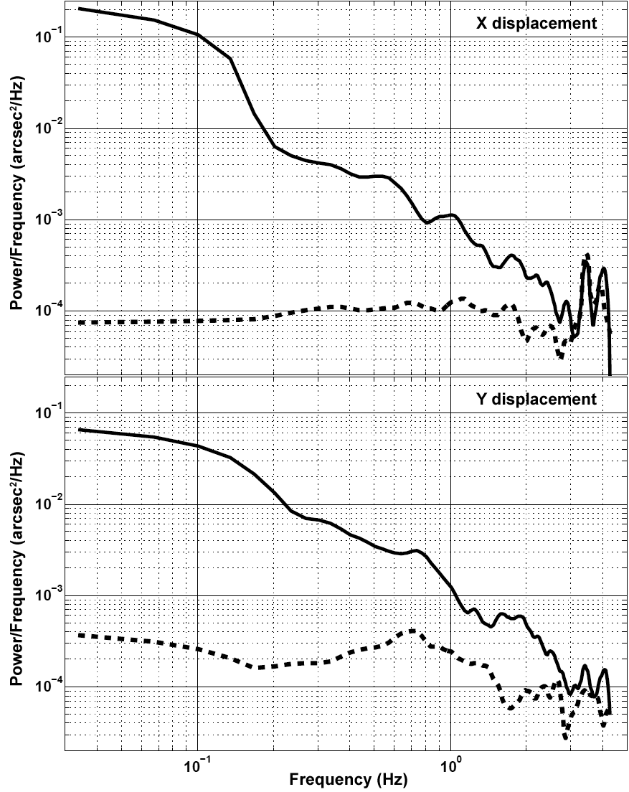
NIR Photon Counting for AO (kinda)
Robo-AO
P60
IRTF

Slide 6
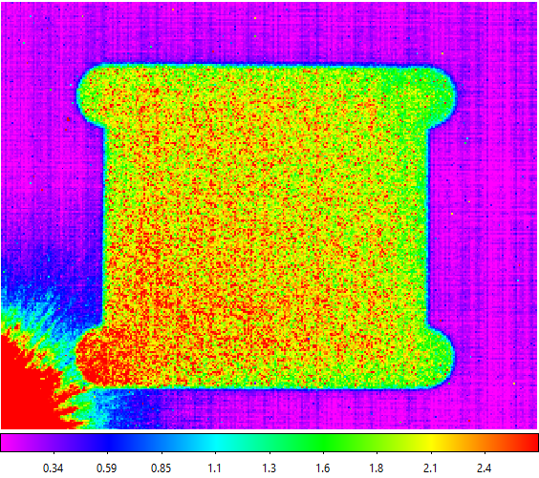
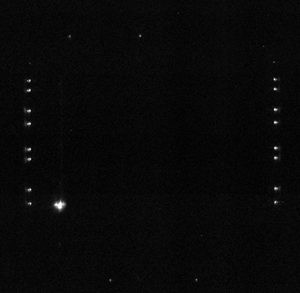
Dark Current

Slide 7
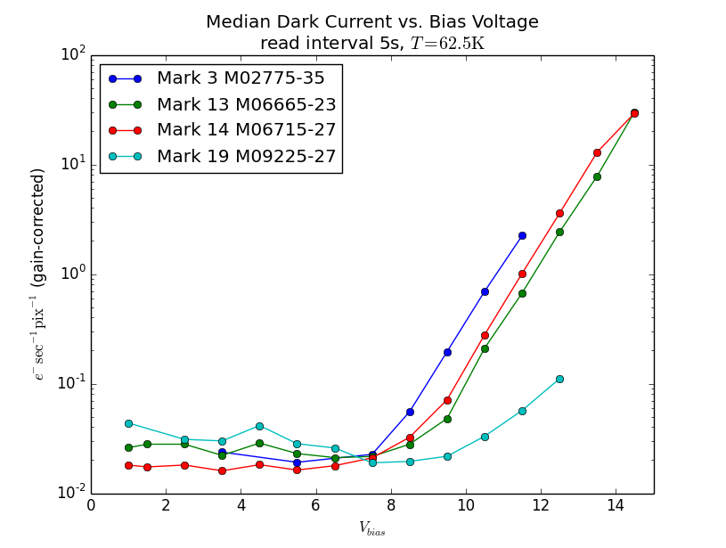
Dark Current vs. Bias
Tunnel-Tunnel
conduction
V
trap
V
valence
e-

Slide 8
Pulse Delay

Slide 9
Pulse Delay

Slide 10
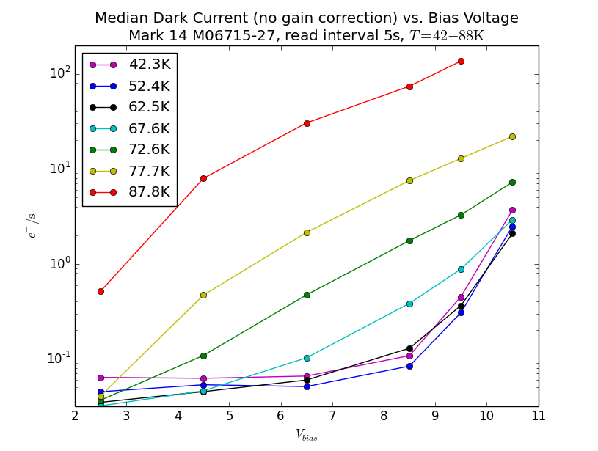
Dark Current vs. Temperature
Tunnel-Thermal
conduction
T
trap
V
valence
e-

Slide 11
Split Personality
Imaging
bias 8V
temp ~60K
dark 0.025e⁻/s
gain ~3
PC
bias 14V
temp ~85K
dark >10e⁻/s
gain >60

Slide 12
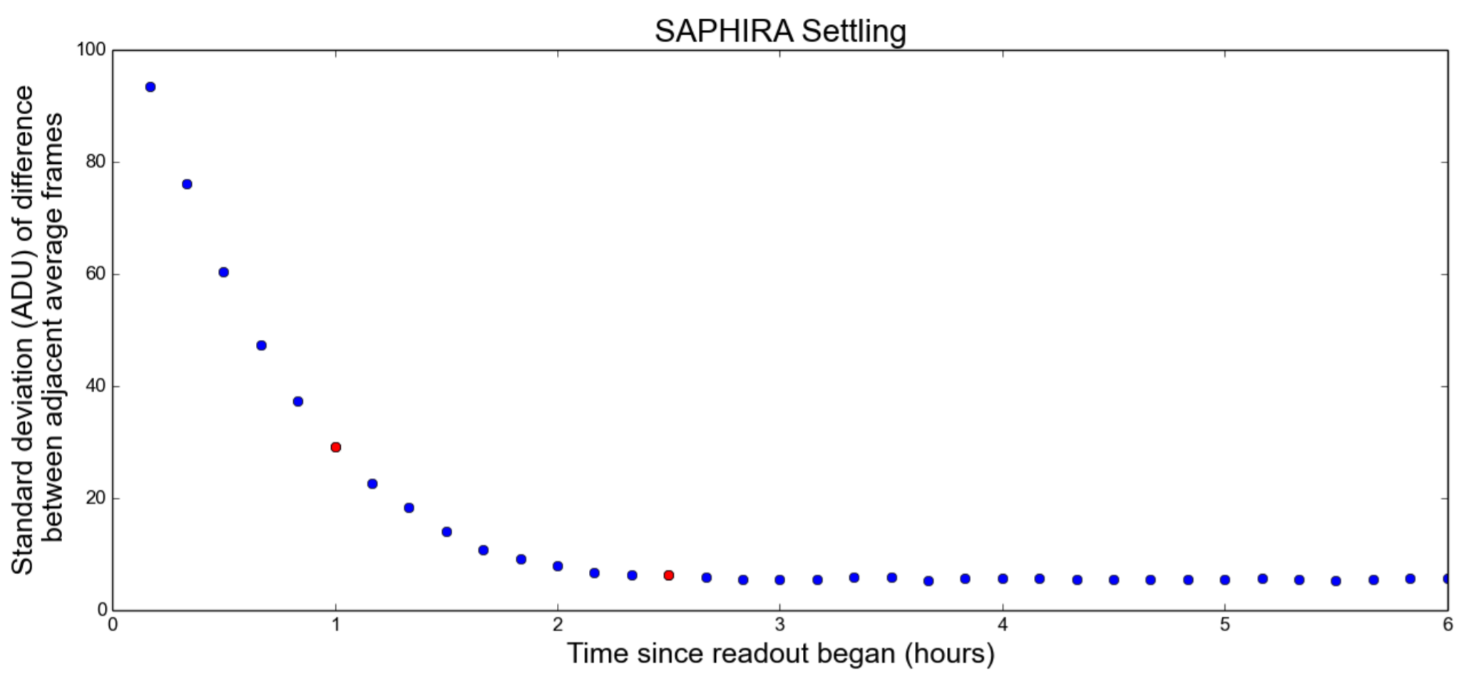
Settling
Image courtesy Sean Goebel

Slide 13
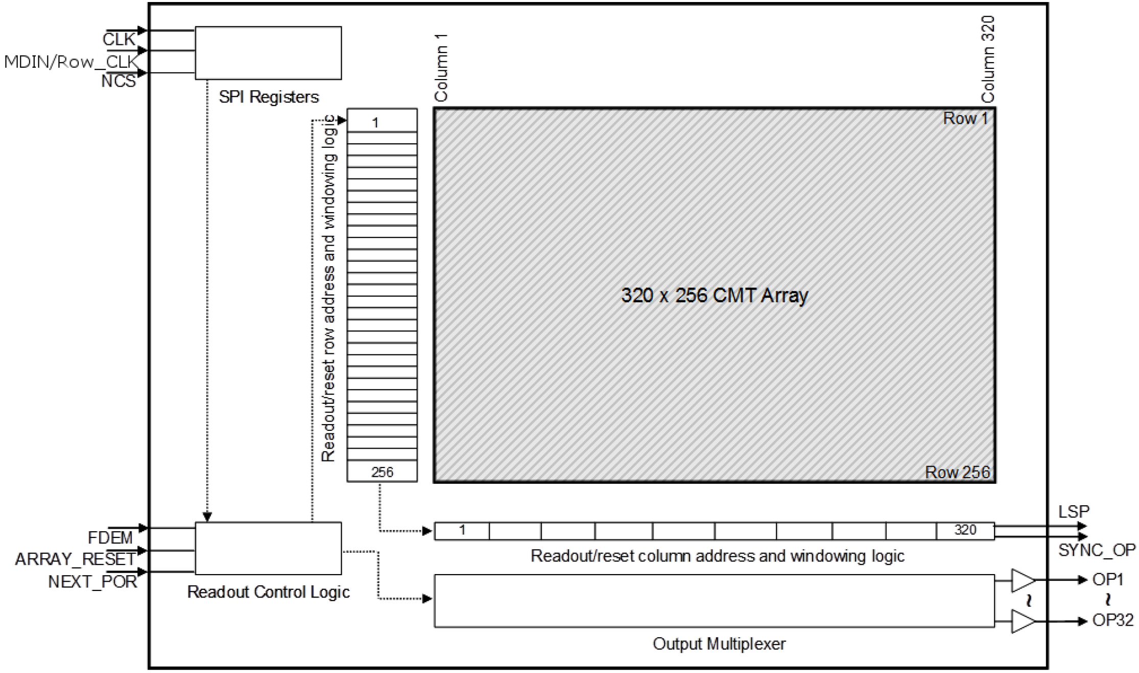
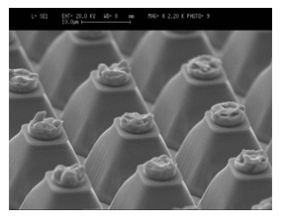
Arrays

Slide 14
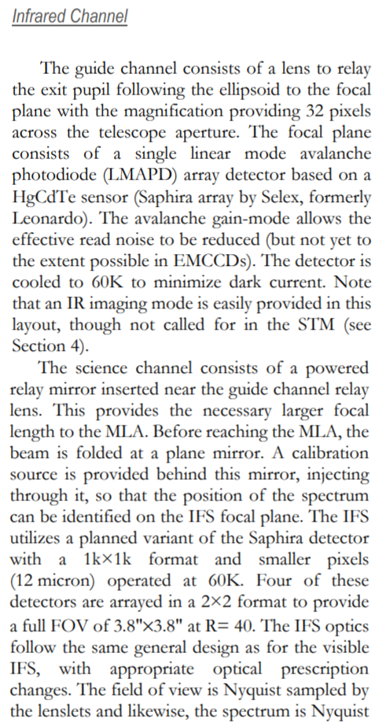
Future Uses

Slide 15
Moving Forward with SAPHIRA
Pulse delay at low temperature
Tunneling at high bias
Array size, pitch

