Slide 1
Poster 90 second talks
ISPA 2018 Pasadena

Slide 2
HyeYun Park

Slide 3
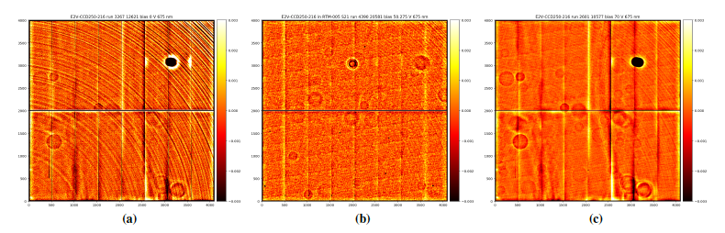
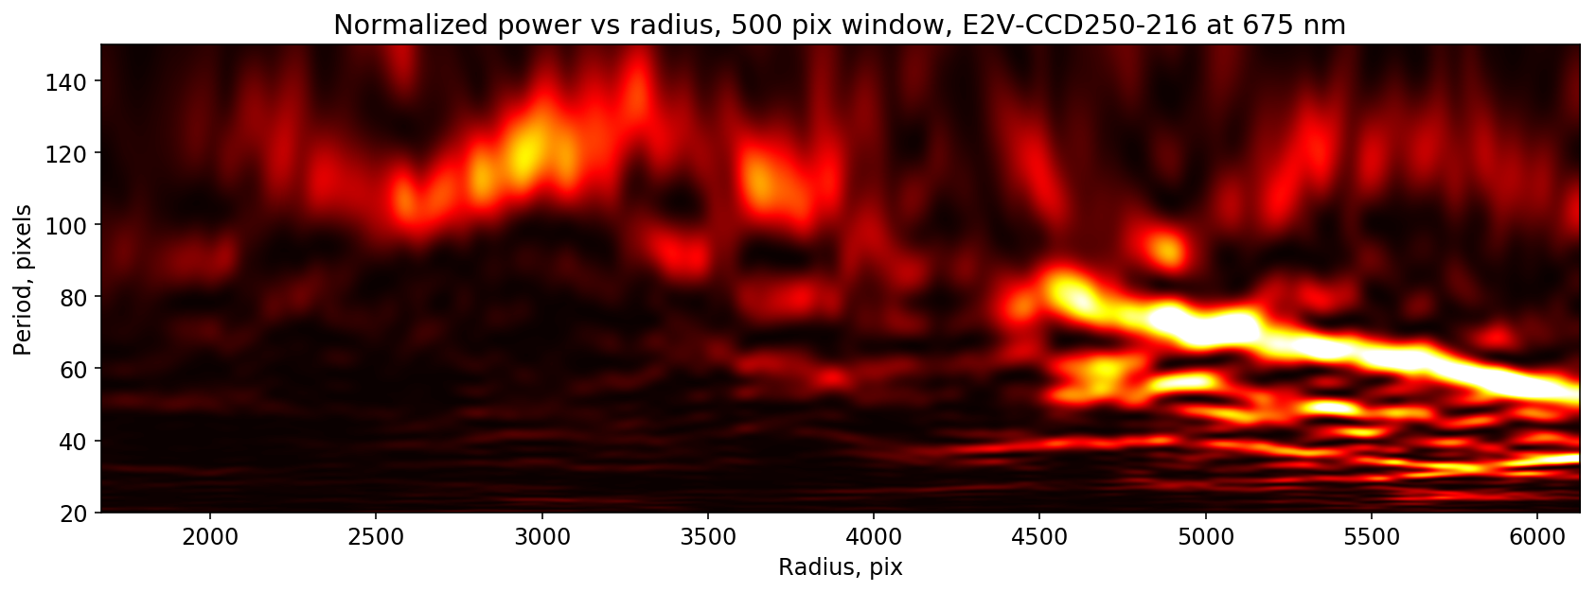
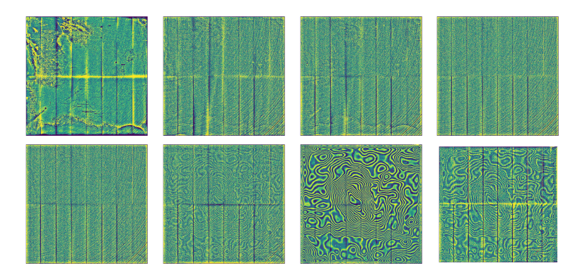
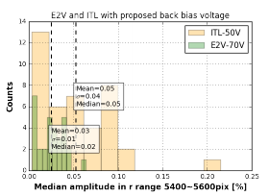
Tree Rings on LSST production sensors : its dependence on radius, wavelength, and back bias voltage
HyeYun Park, Sergey Karpov, Andrei Nomerotski
Stony Brook University, Brookhaven National Laboratory

Slide 4
Joe Ninan

Slide 8
Greg Bredthauer

Slide 9


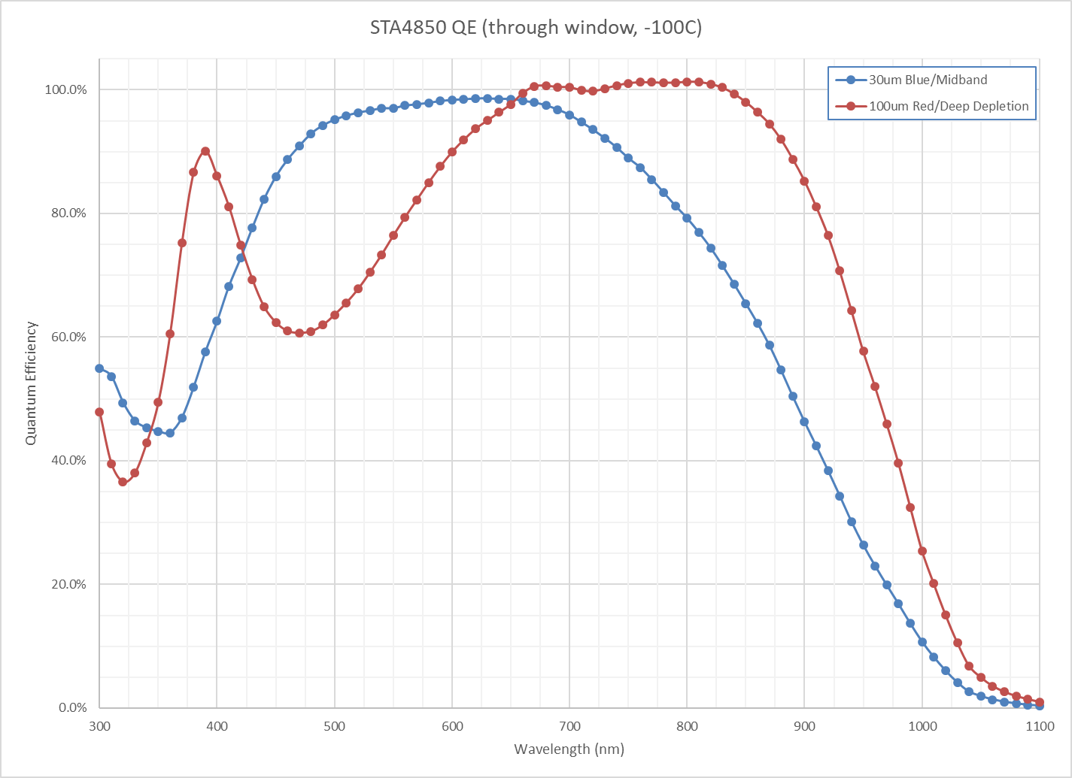
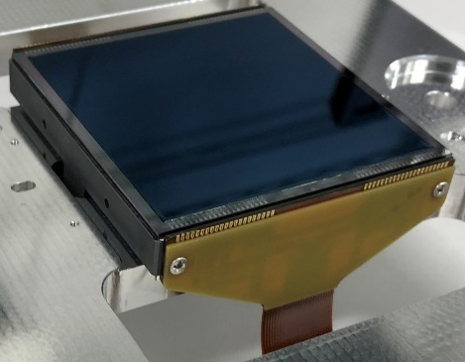
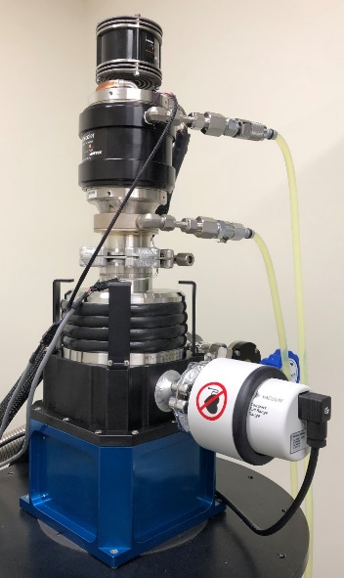
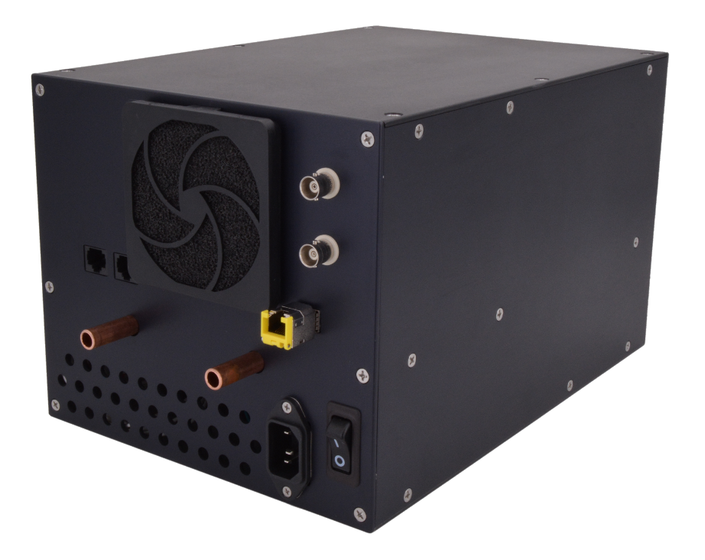
Recent STA Technology
Developments
Greg Bredthauer, Joe Tufts, Kasey Boggs
customerservice@sta-inc.net
4080 x 4080 15um pixels
30um and 100um variants
4 outputs, 3e- RN at 100kHz,
> 300ke- full well
STA4850
Integrated AC/DC and DC/DC power supplies
Integrated liquid cooling interface
(Subtle) AD crosstalk measurements and improvements
Archon AC

Slide 10
Andreas Seifahrt

Slide 12
Andy Rasmussen

Slide 13
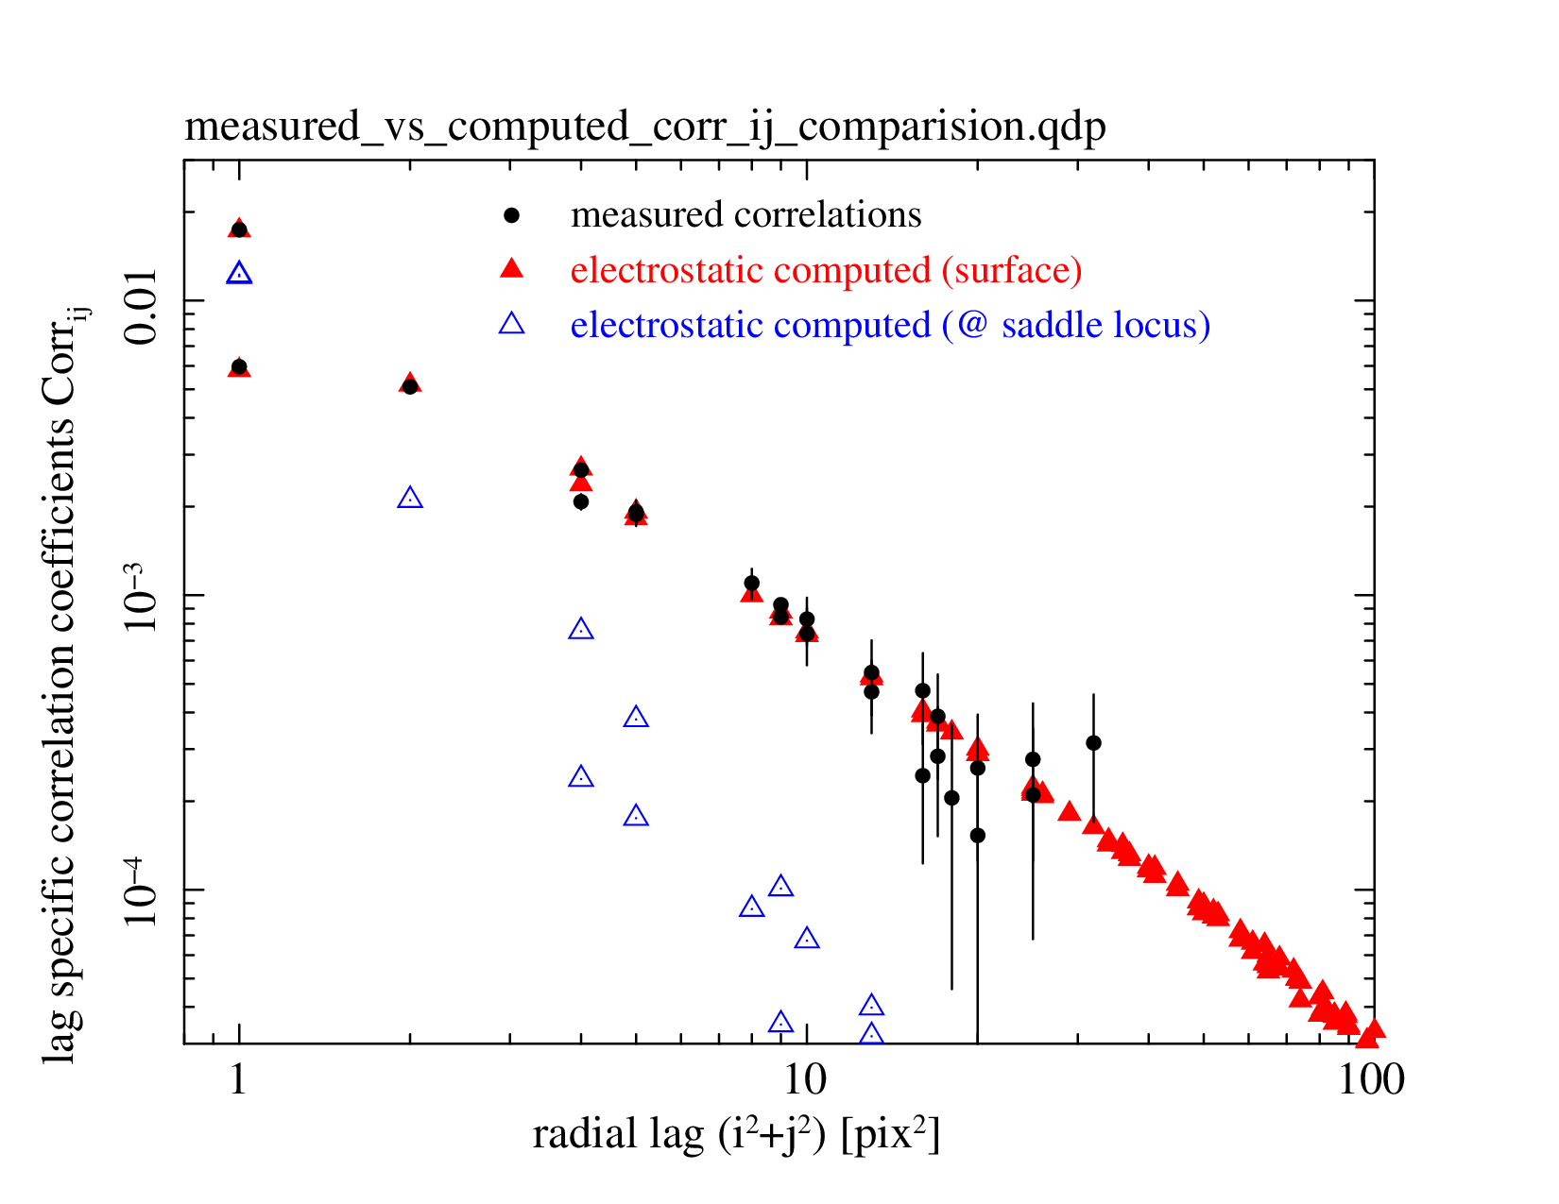
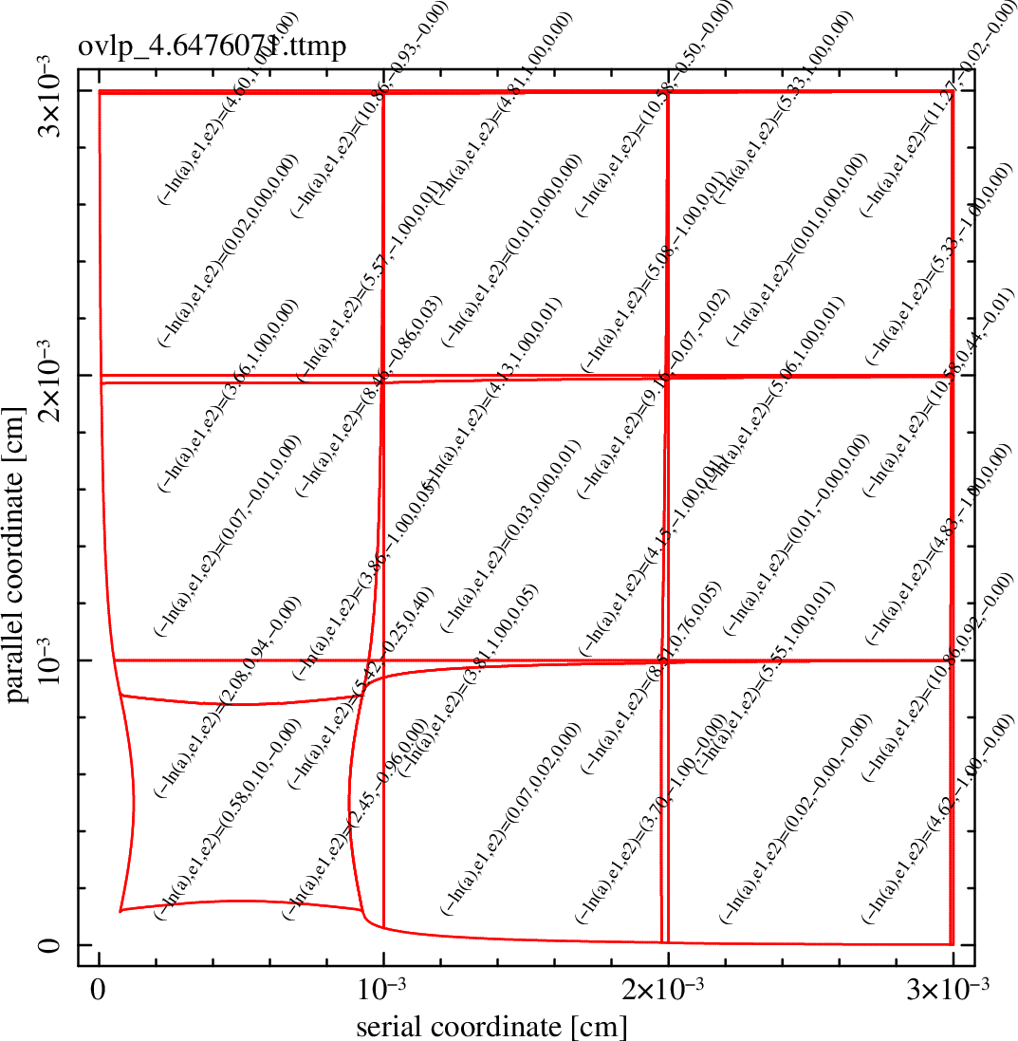
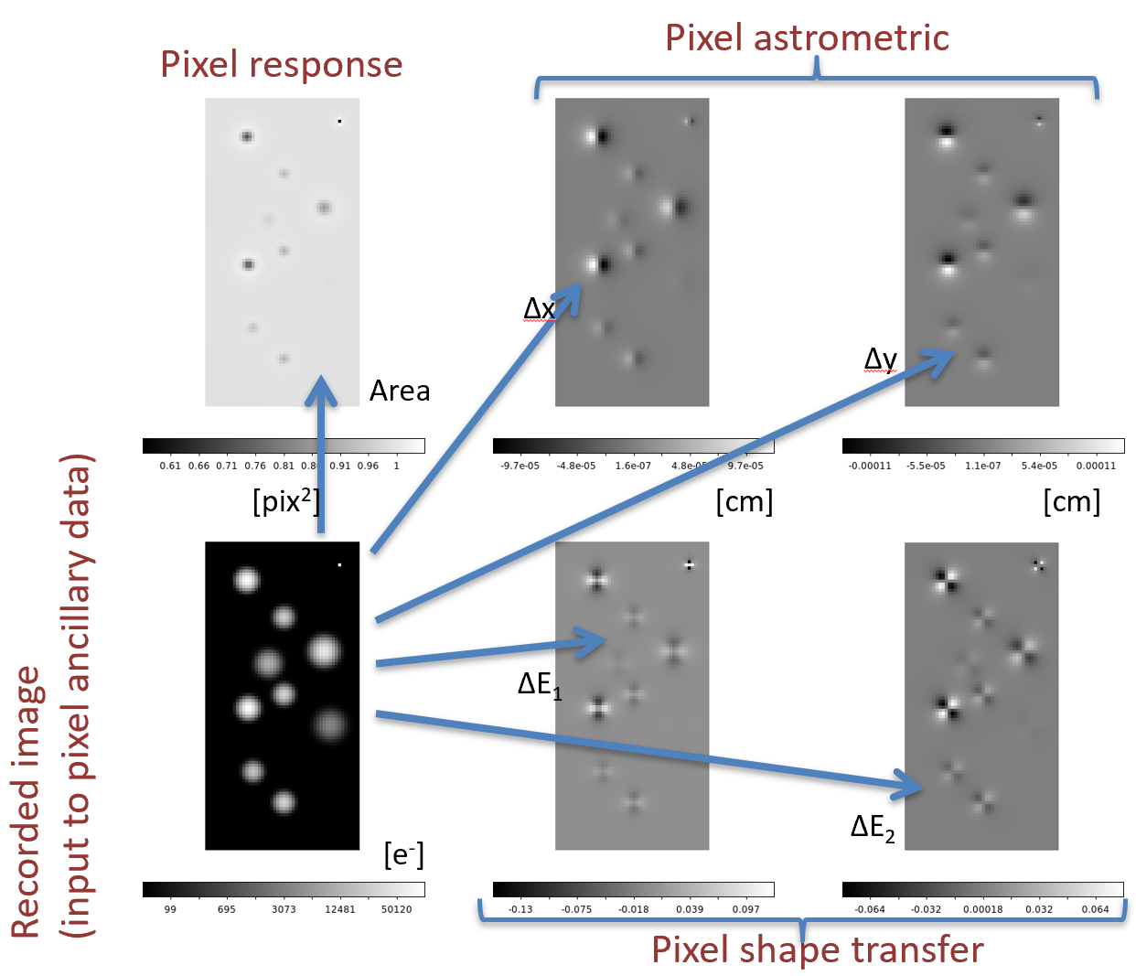
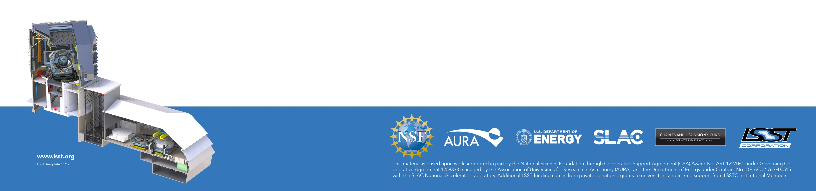
Next-to-leading-order terms for the brighter/fatter effect in thick CCDs: Are perturbations linear over 3 orders of magnitude?
Andy Rasmussen, SLAC National Accelerator Laboratory
Whether to account for electrostatically induced pixel distortions as part of source extraction..
.. or to undo pixel assignment errors from the recording to present an incident flux map?
We test whether flat field correlations provide enough information to perform high contrast corrections.

Slide 14
Timothée Greffe, Roger Smith

Slide 15
Limits to Persistence by Global Reset
Timothée Greffe, Roger Smith
California Institute of Technology

Slide 16
Brightness of the moon: ~4 Me-/s/pixel on the IRIS Imager of the TMT.
Reset
Reset
Reset
Reset
Time
Persistence level is usually around 0.3% of the initial illumination after 3 minutes.
=> It represents 32ke- in the case of the moon.
slew
Can the Global Reset be used as a persistence-free electronic shutter?
Come and see my poster to discover the answer and:
• Experimental results with decay curves.
• Refined model of the persistence theory.

Slide 17
Lily Zhao

Slide 18
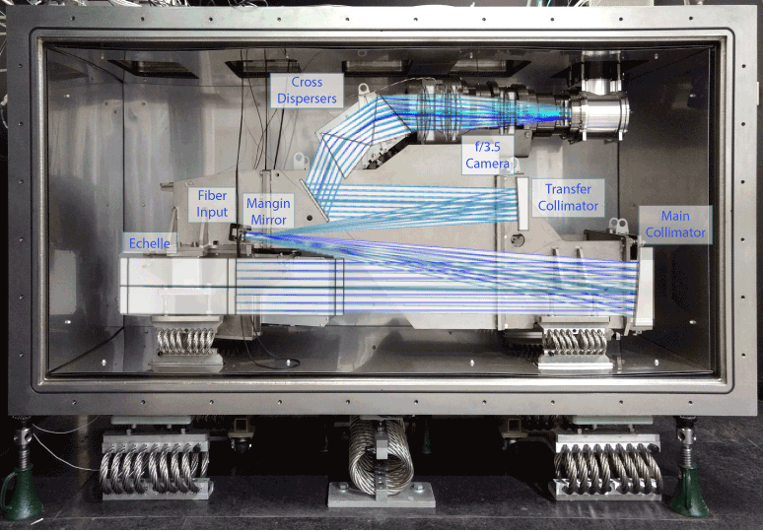
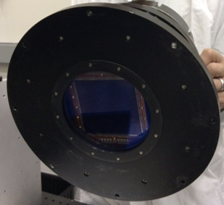
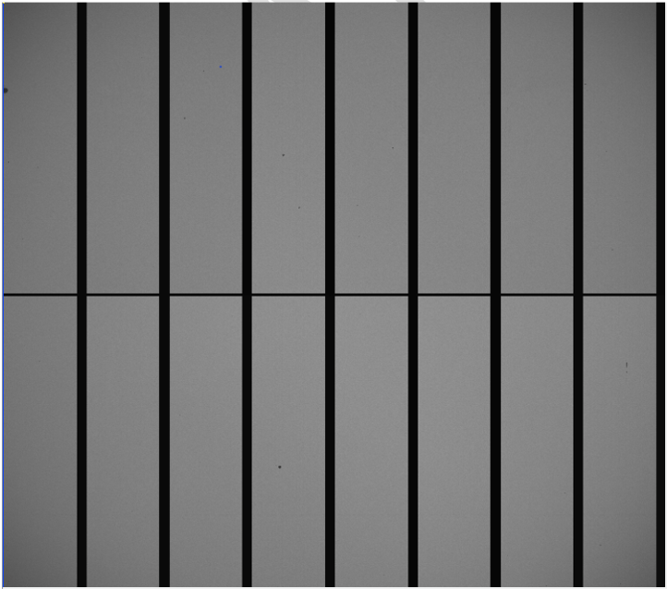
EXPRES: Precision, Radial-Velocity Measurements with an STA 1600 Detector
Lily L. Zhao, Debra A. Fischer, Colby Jurgenson, Dave Sawyer, Tyler McCracken, Andrew Szymkowiak, John Brewer, Ryan Blackman, Ryan Petersburg, Allen Davis, Joel Ong
R=135,000
390-750 nm
Stabilized
@ DCT, AZ
280 nights/year

Slide 19
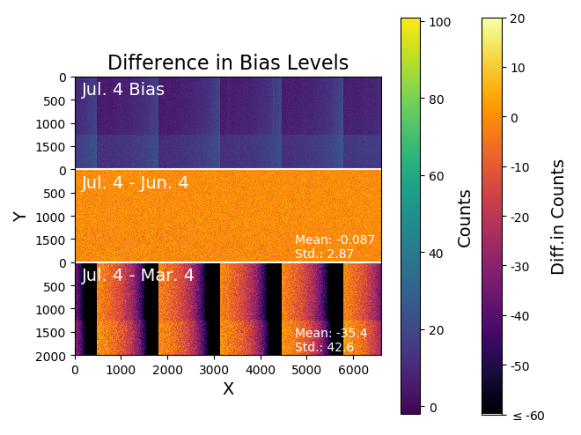
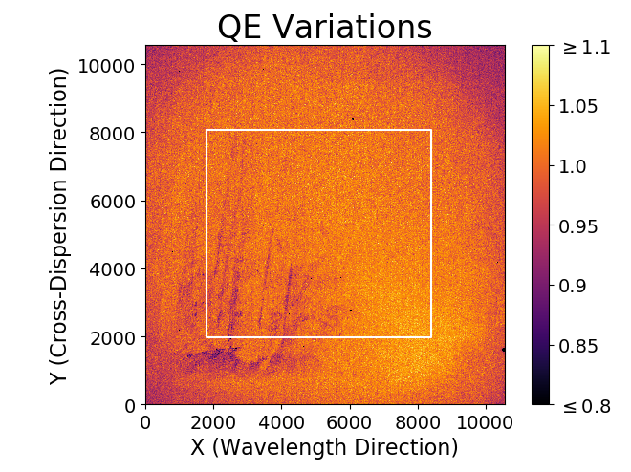
Consistent bias levels and ~3.3% QE Variations

Slide 20
Yousuke Utsumi

Slide 22
Asen Christov

Slide 26
Andrew Bradshaw

Slide 27
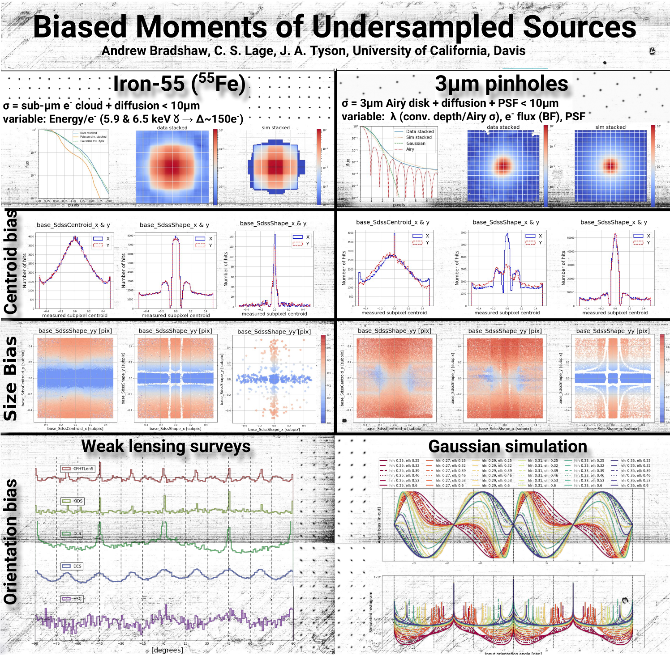

Slide 28
Cullen Blake

Slide 29
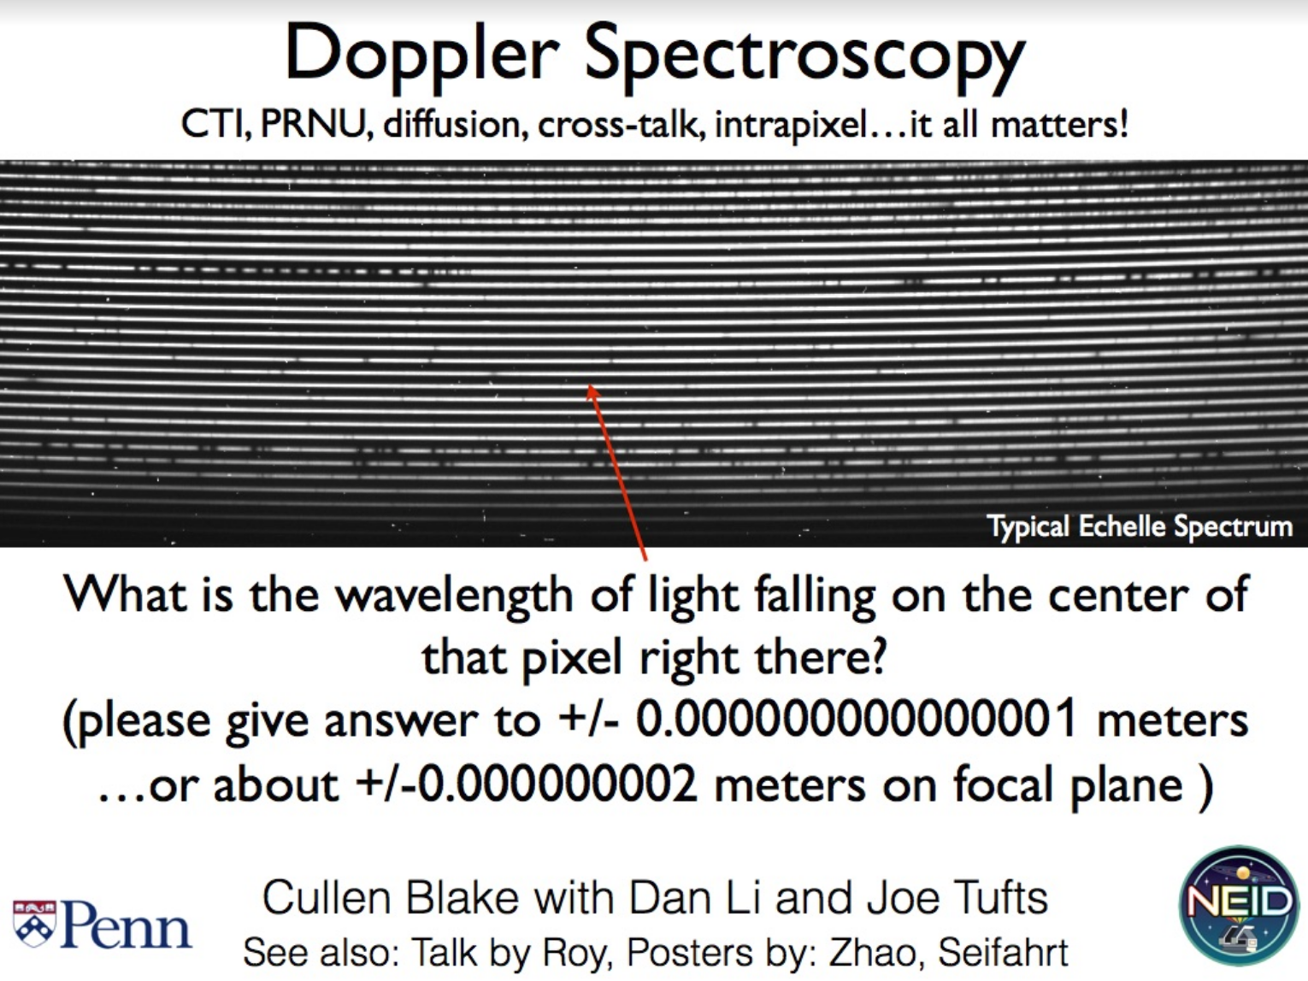

Slide 30
Craig Lage

Slide 32
Greg Mosby

Slide 34
Dmitry Vorobiev, Zoran Ninkov, Lexi Irwin, Kevan Donlon

Slide 35
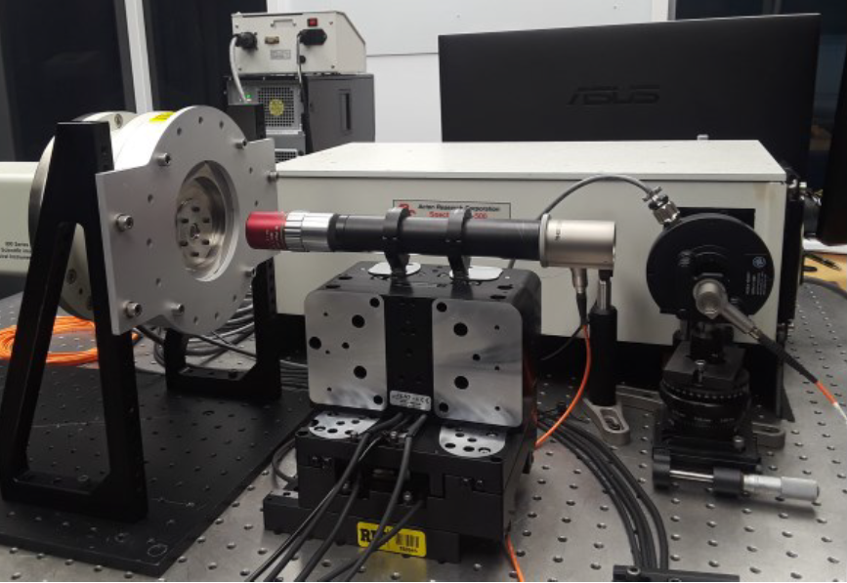
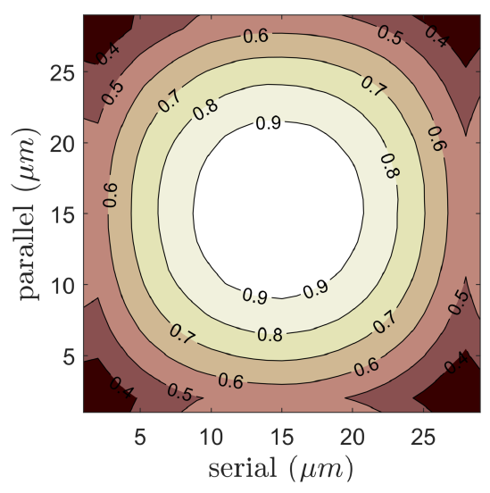
Direct measurement of Kepler’s intra-pixel response function
Dmitry Vorobiev, Zoran Ninkov, Alexis Irwin, and Kevan Donlon
Normalized
Kepler Response
Monochromatic Spot Scanner

Slide 36
Joel Villasenor

Slide 37
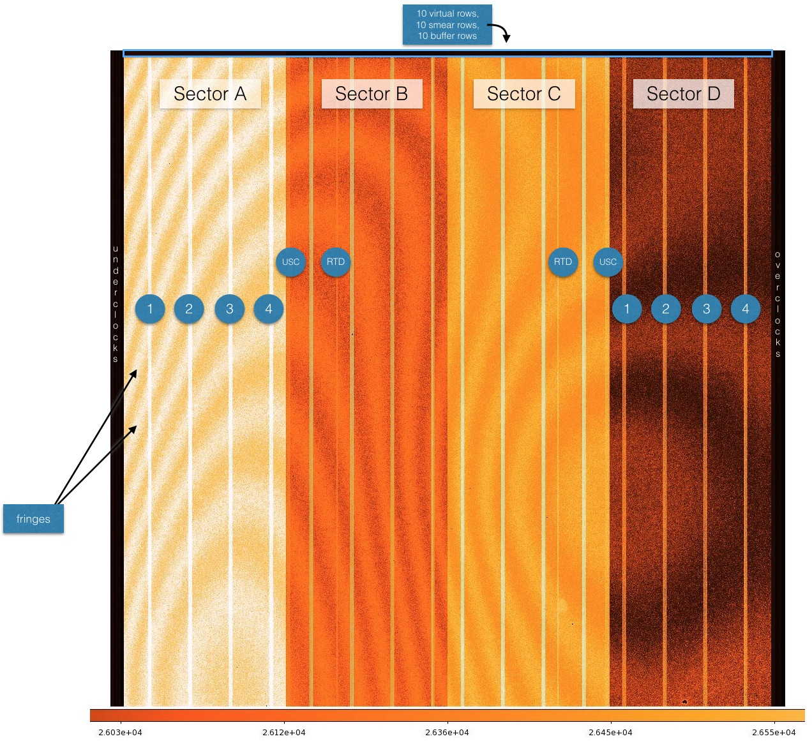
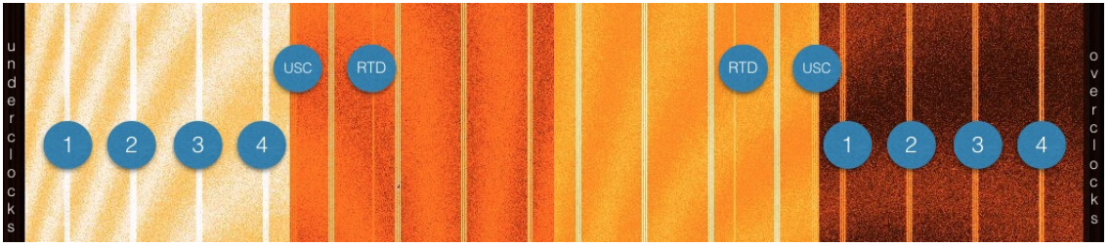
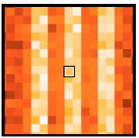
Strap Effects in TESS CCDs
J. Villaseñor, S. Yazdi
TESS is a mission to find exoplanets using the transit method (launched April this year)
Requires photometric precision from the the deep depletion BI CCDs flown in the cameras
CCDs were fabricated with metal straps in order to increase frame readout
The passband is 650nm-1100nm, which include near IR range which is partially transparent
Stars landing at or near the straps will have different integrated counts depending on location and wavelength

Slide 38
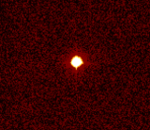
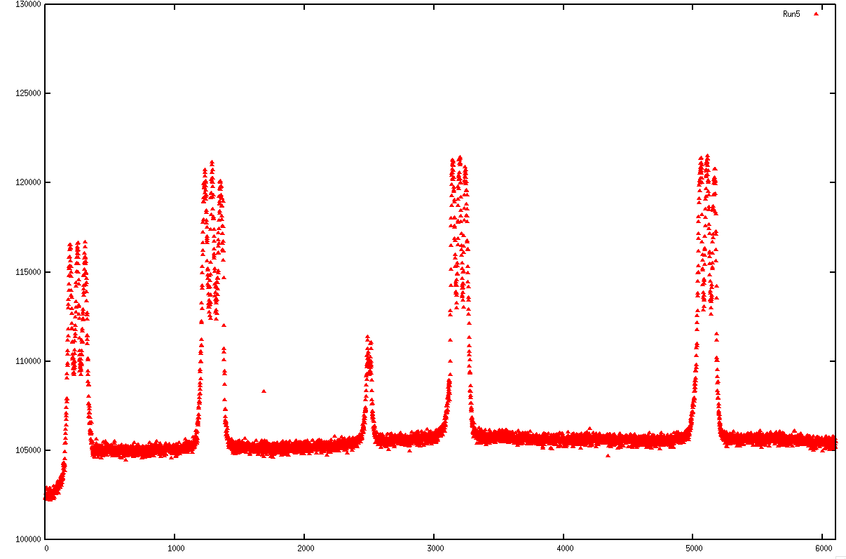
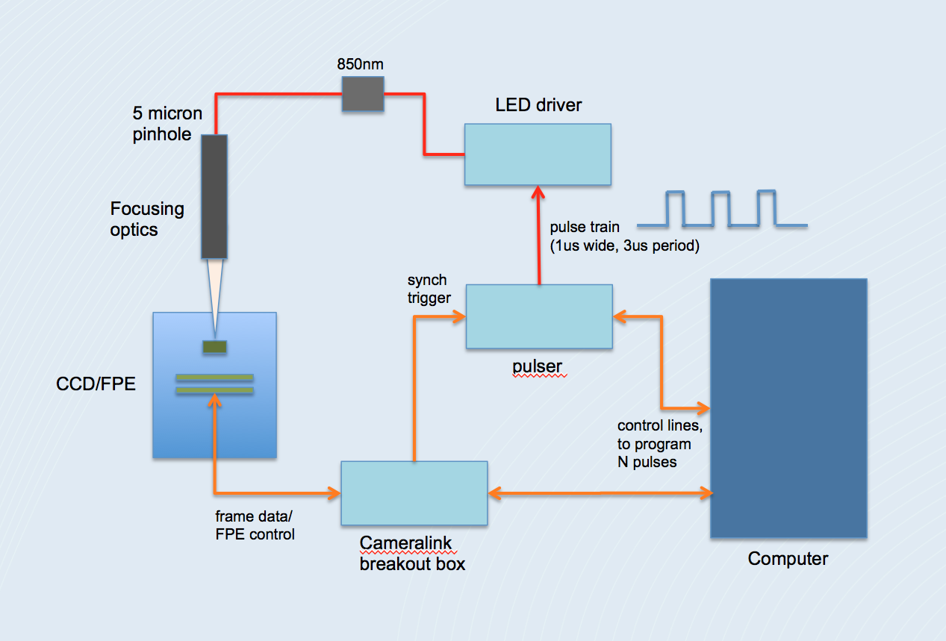
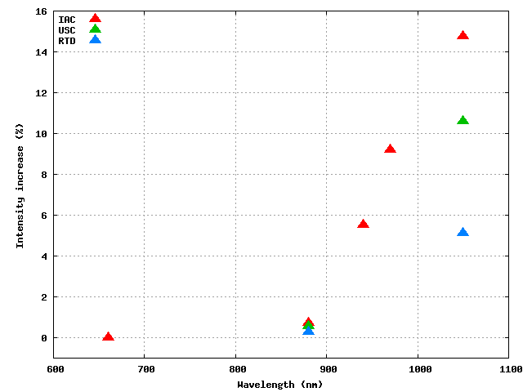
Strap Effects in TESS CCDs
J. Villaseñor, S. Yazdi
Carried out measurements of the photometry from a simulated star
Scanned across the straps at different wavelengths
Effects vary with type of strap; near IR wavelengths can reach to 10-15% additional measured intensities

