Slide 1
Uniformity and Stability of the LSST Focal Plane
P. O’Connor
Instrumentation Division, BNL

Slide 2
Outline
Focal plane
Sensors and rafts
Electro-optic tests
Results
  Uniformity
  Stability
Cadence implications

Slide 3
FOCAL PLANE, SENSORS, and RAFT TOWERS

Slide 4
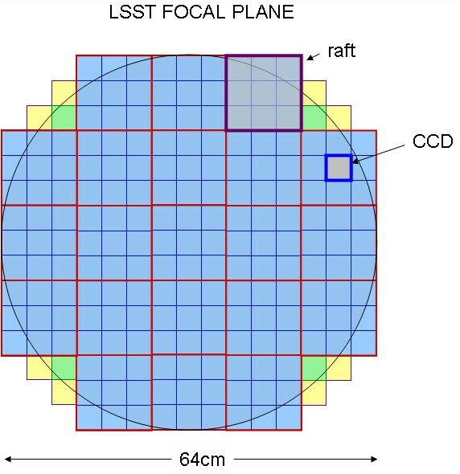
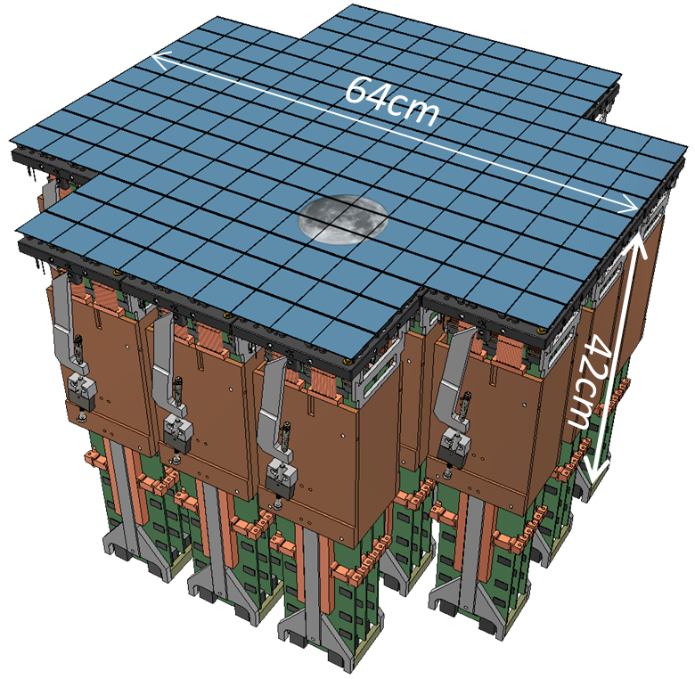
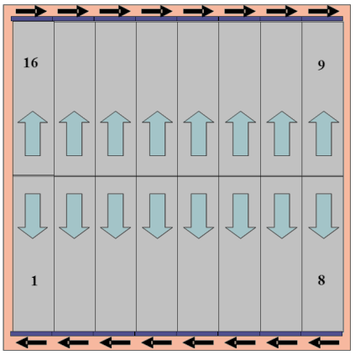
Focal Plane Layout
3.5° diameter
0.2” (10μm) pixels
189 4K × 4K CCDs
21 “rafts”
Fully-butted mosaic (90% fill factor)
WFS
guider
N. Kurita., et al. " Large Synoptic Survey Telescope camera design and construction." SPIE 2016, 9912-28.

Slide 5
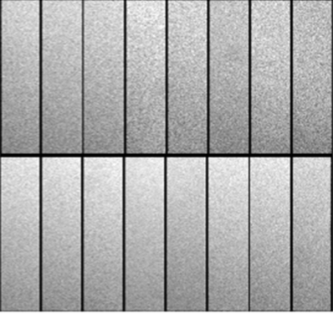
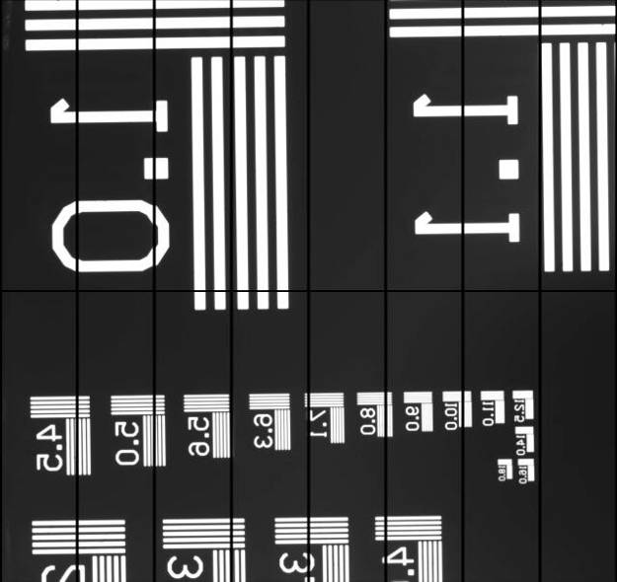
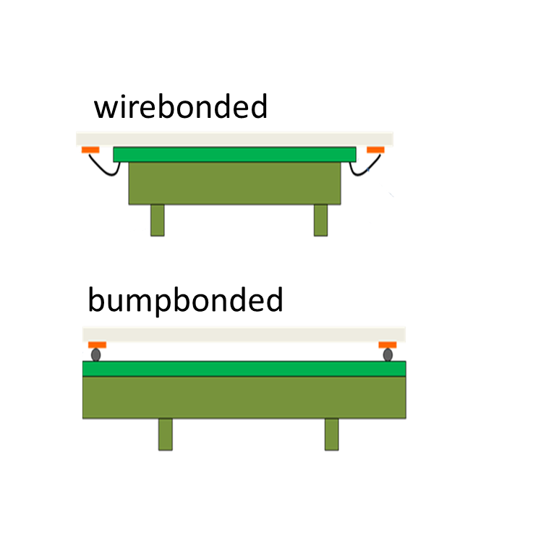
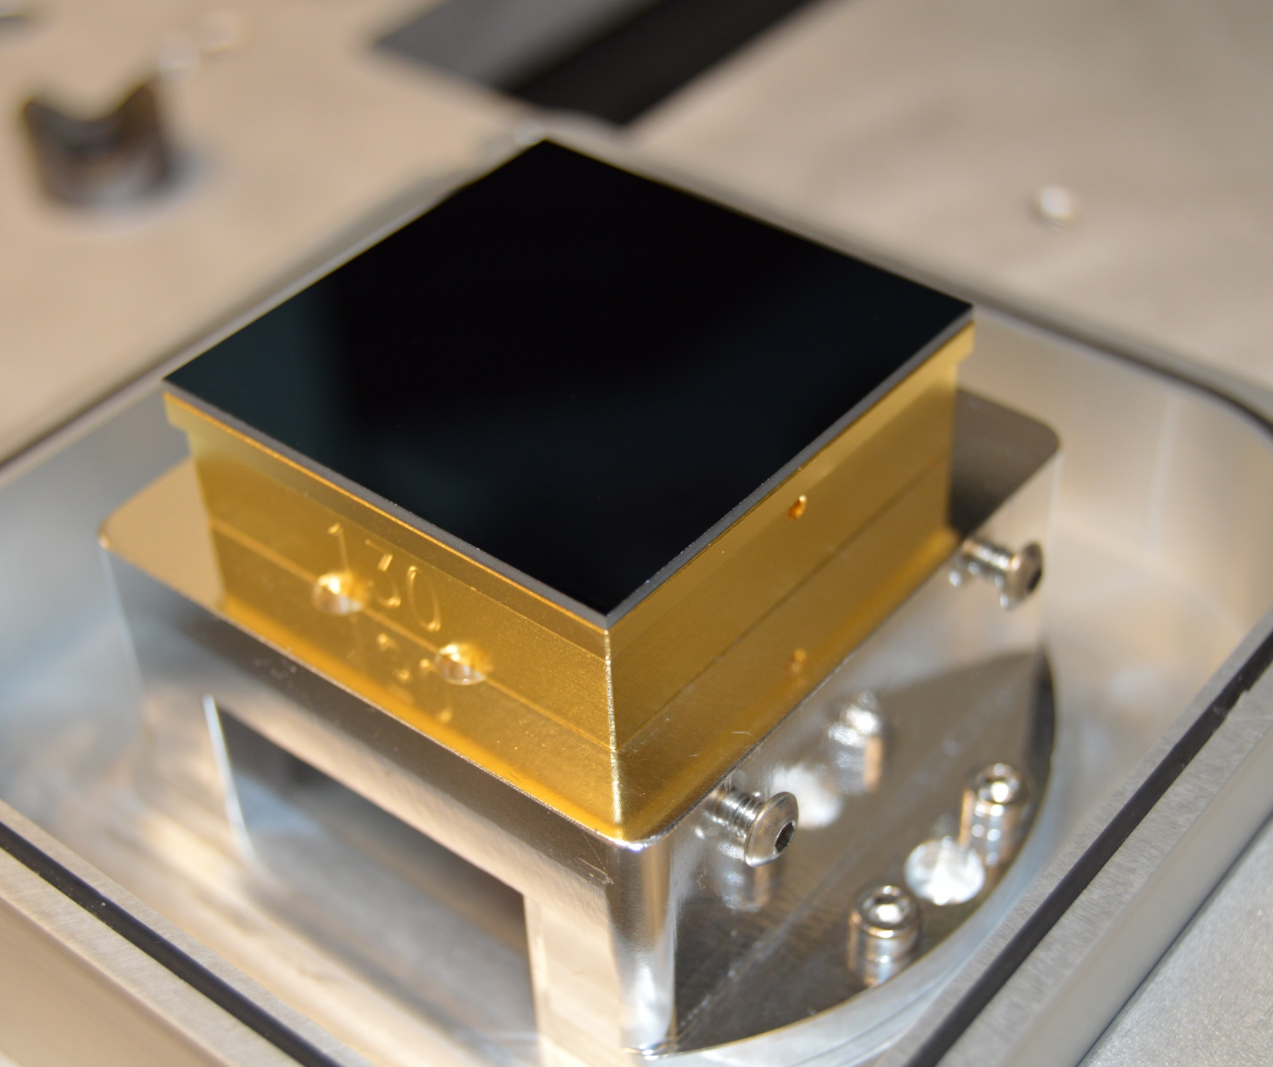
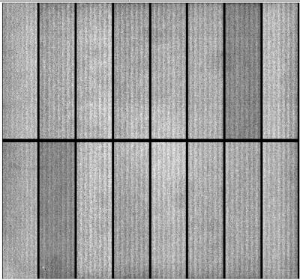
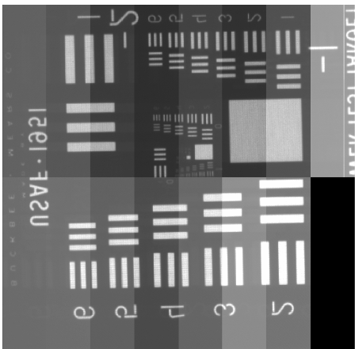
Sensors
CCD in test fixture
Uniform illumination
Test target image
4 parallel phases
2-stage output amplifiers
Entrance window: laser-annealed shallow-B impant
Antiblooming midline stop
T-E2v CCD250
annular shims
3 parallel phases
single-stage output amplifier
JFET source follower buffer
Entrance window: chemisorption process
T-DALSA/ITL STA3800C
plane parallel package body
(overscan displayed)
(overscan suppressed)
Both devices feature: Fully-depleted, high-ρ silicon 100μm thick, 10μm pixels, 4Kx4K format, 16 independent 512x2K segments, 4-side buttable packages with >90% fill factor.
Mechanical mount and electrical interface 100% interchangable

Slide 6
Requirements and verification matrix
Parameter | Req’t. | Meas. | unit
QE u | 41 | 65 | %
QE g | 78 | 83 | %
QE r | 88 | 90 | %
QE i | 81 | 94 | %
QE z | 75 | 88 | %
QE y | 21 | 25 | %
Diffusion | 5.0 | 3.6 | μm rms
Dark current (95%) | 0.2 | 0.02 | e⁻/pix/s
Defects | 0.5 | 0.002 | %
Frame read time (16Mpix) | 2 | 2.0 | sec
Read noise/pixel | 8 | 4.5 | e- rms
CTI (ser/par) at 1ke⁻ signal | 5/3 | 3/0.7 | ppm
Nonlinearity | 2 | 0.6 | %
Video crosstalk | 2 | 0.08 | %
Pixel size | 10 | 10 | μm
Flatness (95%) | ± 5 | 1.9 | μm
Coplanarity (95%) | ± 9 | 6.3 | μm
Inactive area | 8 | 8 | %

Slide 7
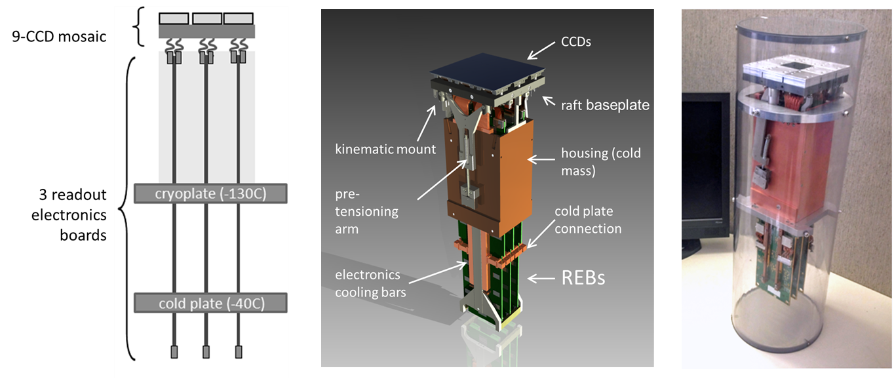
Focal plane is composed of 21 Science Raft Tower modules (RTM)
Complete 12K x 12K imager
Support sensors mechanically to meet strict coplanarity
Thermal management of sensors and electronics
Provide bias, timing, and control signals for CCD operation
144 video channels with low noise analog signal processing, digitizing, multiplexing of pixel data
Diagnostics + monitoring
12.7 x 12.7 x 42cm³
20 kg
39W
Photons in – bits out

Slide 8
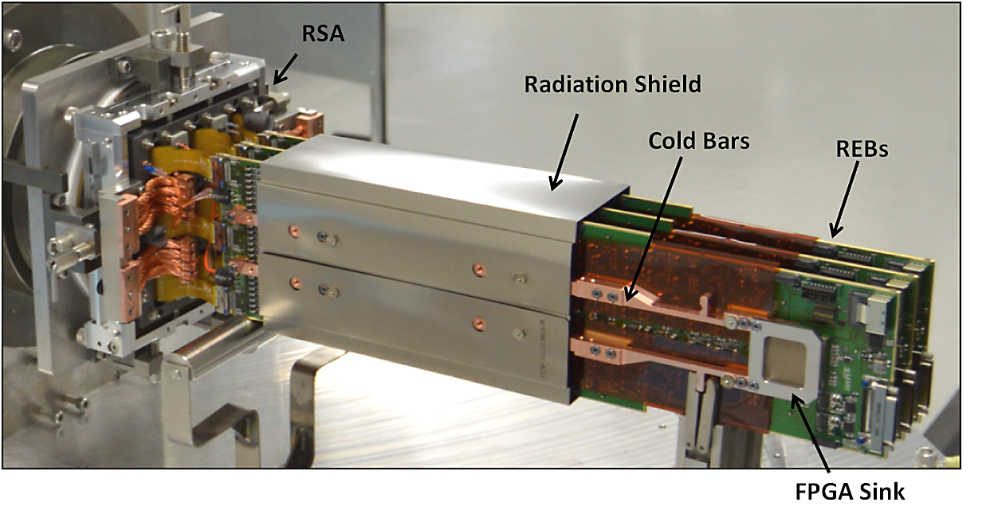
Raft tower (partially assembled condition)

Slide 9
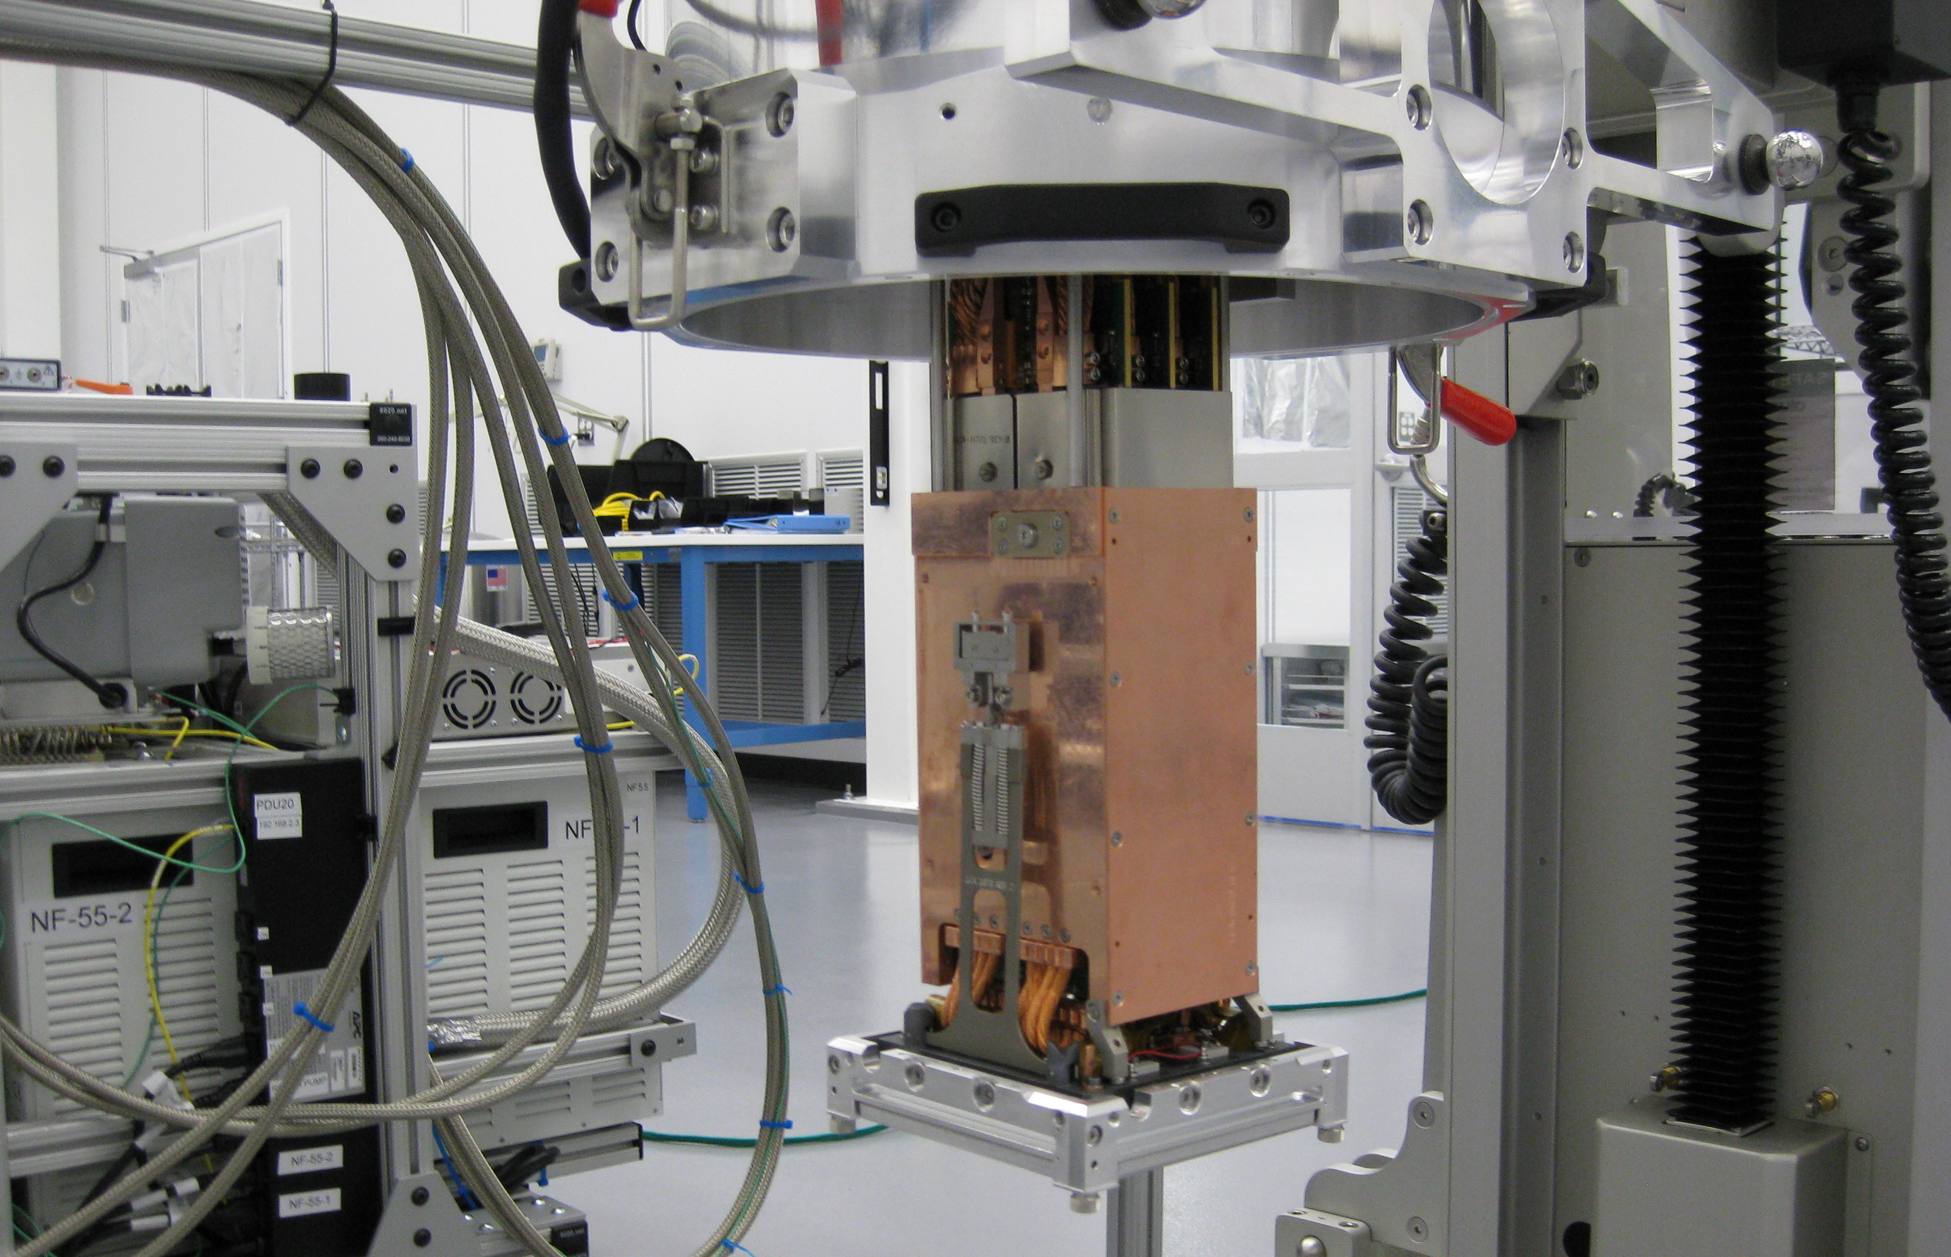
Raft tower in grid installation fixture

Slide 10
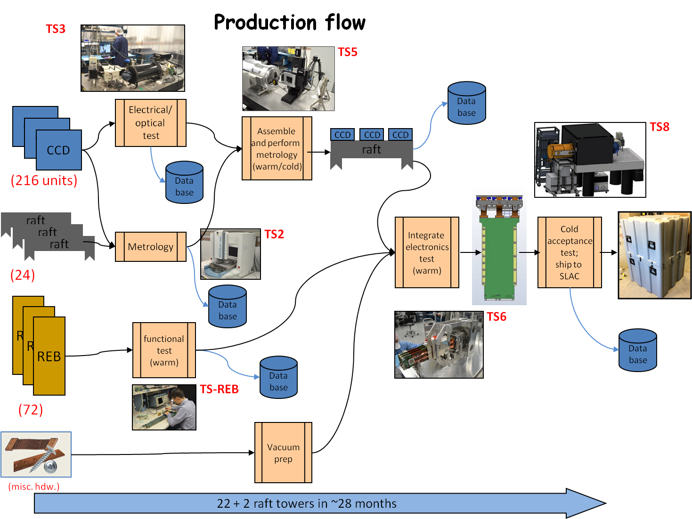
Production flow
ASIC
functional test
Data base
functional test
REB
Data base
Image archive
EO parameter catalog
Human-readable html report
Burn-in,
Thermal cycle

Slide 11
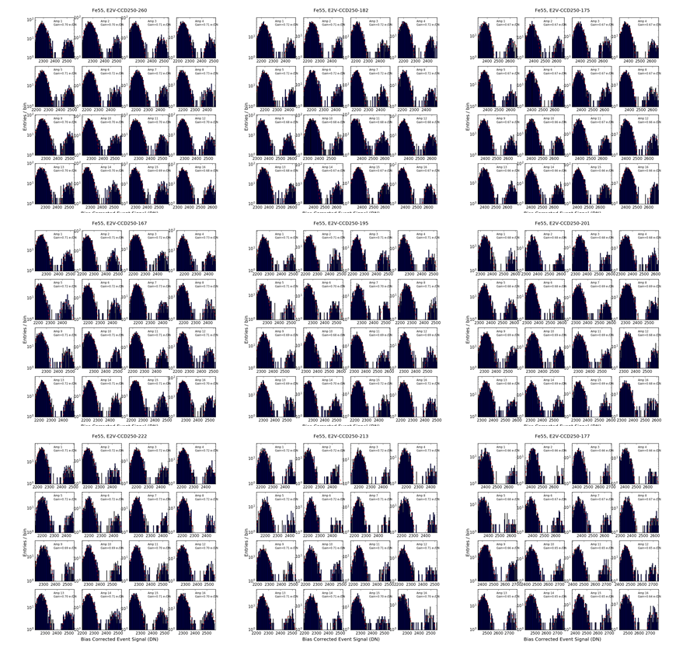
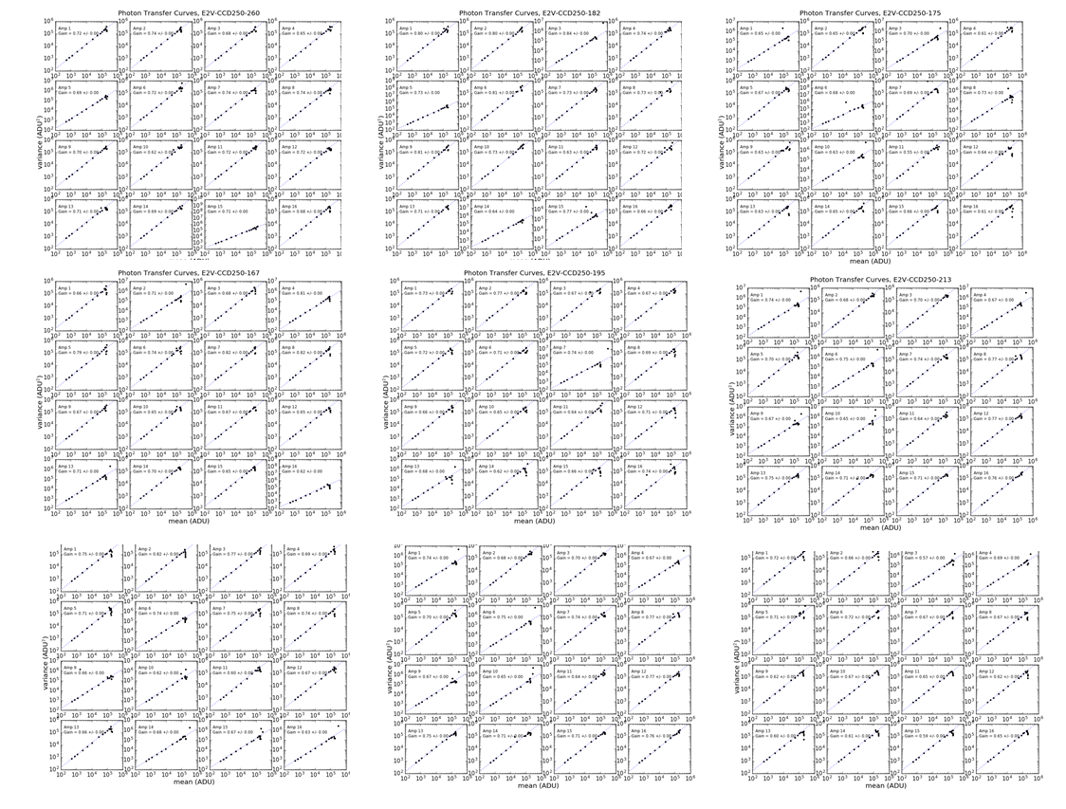
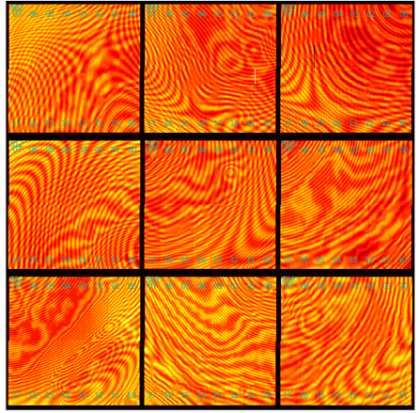
Example outputs:
144 channel ⁵⁵Fe spectra
144 channel PTC
144 channel flatfield

Slide 12
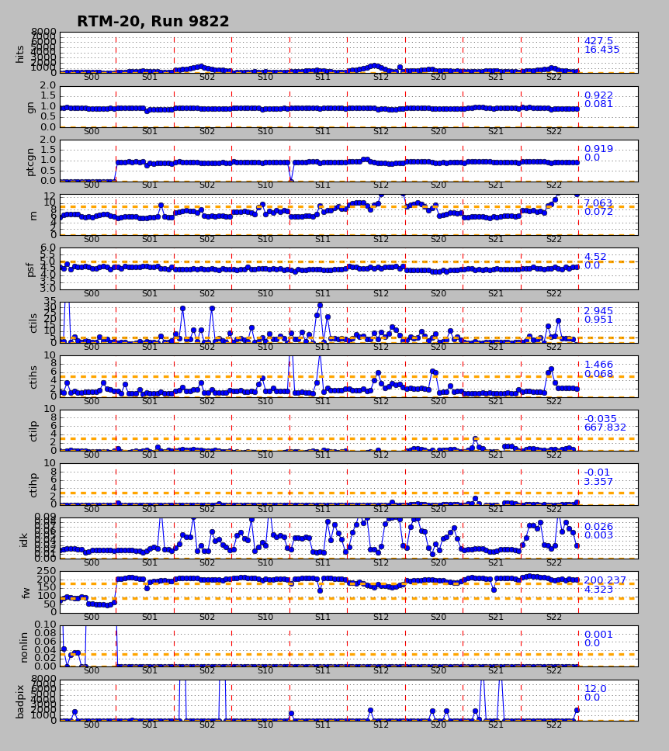
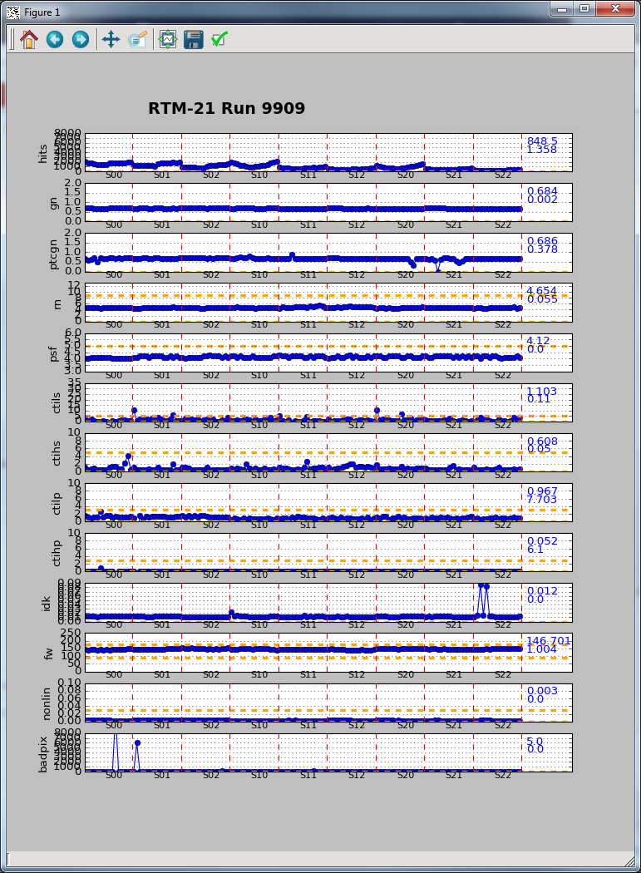
EO parameter summary

Slide 13
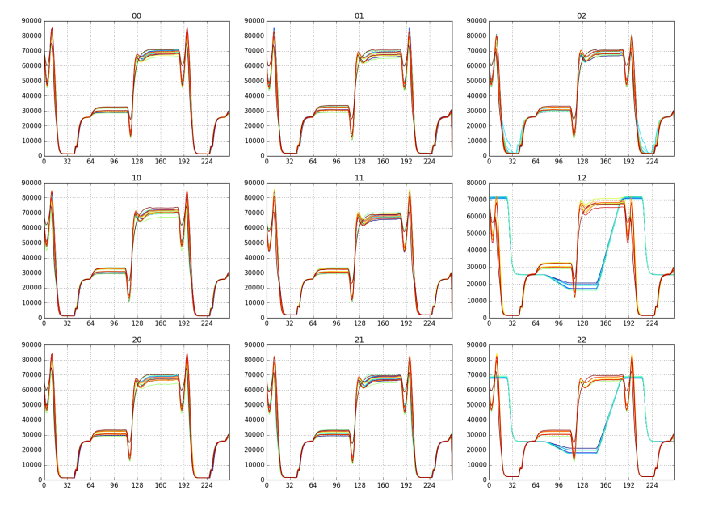
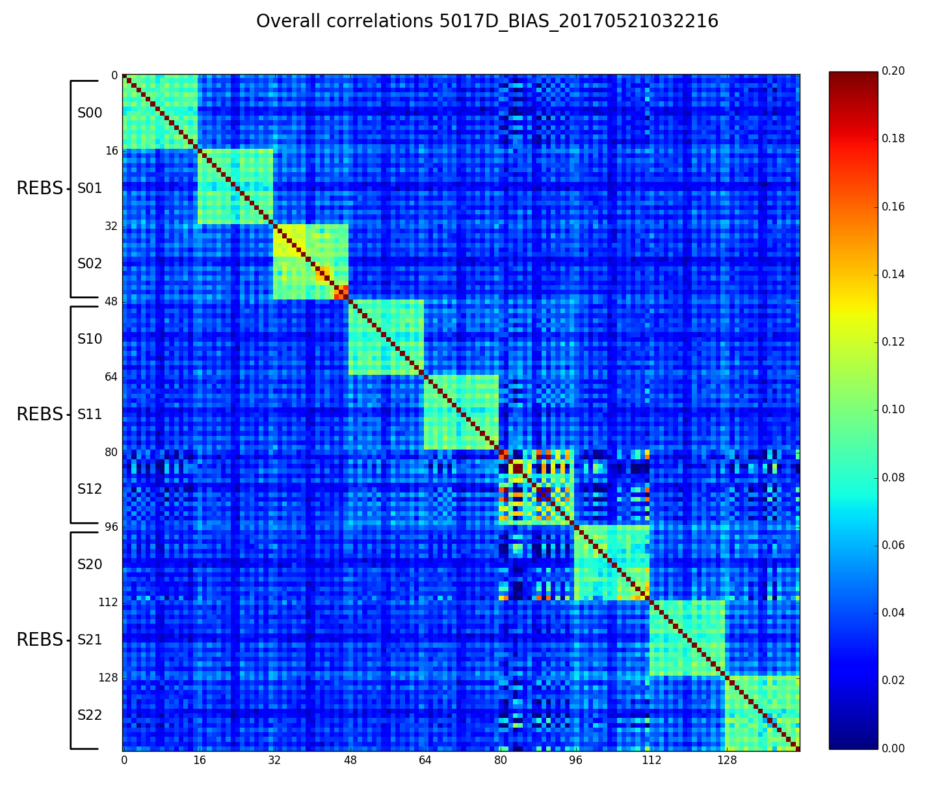
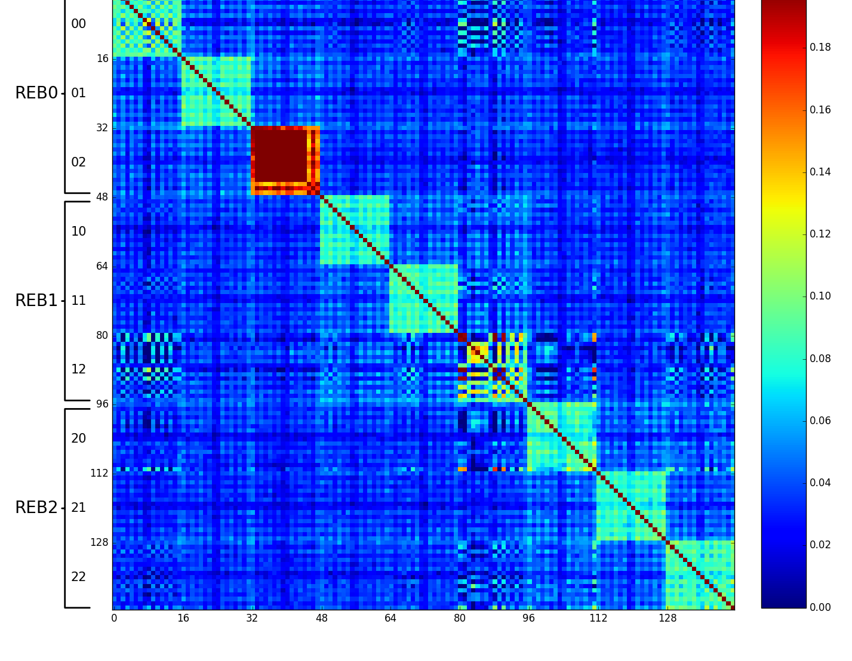
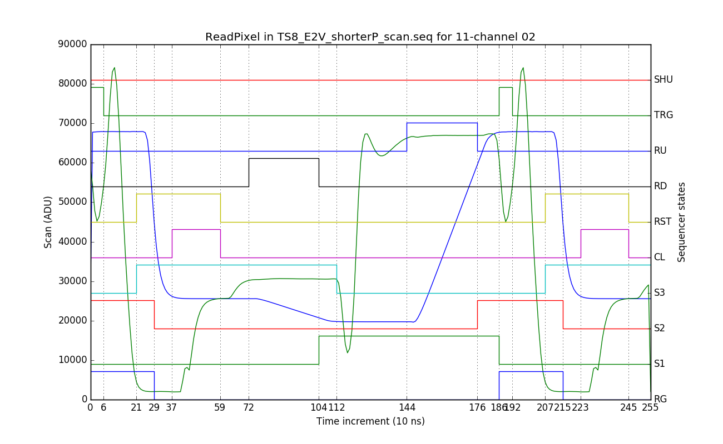
Specialized diagnostics – video waveform reconstruction, noise correlations
144-channel synthetic video waveforms (CCD-output and post-DSI)
144 x 144-channel noise correlation (overscan regions)
Single-channel video chain waveforms
C. Juramy

Slide 14
LSST Science Raft Tower Module Production Status (Dec. 2018)
ETU1
Jan ‘17
ETU2
Mar ‘17
engineering and test units (2)
production units (21 + spare)
RTM1
Feb ‘17
RTM2
May ‘17
RTM3
Sep ‘17
RTM4
Jul ‘17
RTM5
Oct ‘17
RTM6
Dec ‘17
RTM7
Dec ‘17
RTM8
Mar ‘18
RTM9
Feb ‘18
RTM10
Apr ‘18
RTM11
Jun ‘18
RTM12
Apr ‘18
RTM13
Jun ‘18
RTM14
Jul ‘18
RTM15
Aug ‘18
RTM16
Jul ‘18
RTM17
Aug ‘18
RTM18
Aug ‘18
RTM19
Aug ‘18
RTM20
Oct ‘18
RTM21
Nov ‘18
RTM22
Oct ‘18
Key
e2v
ITL
vendor
Assembled and tested: 23 rafts (21 of 22 production deliverables + 2 Engineering/Test units): 207 CCDs, 3,312 video channels (3.3Gpix)
assembled and tested
shipped
future production

Slide 15
UNIFORMITY

Slide 16
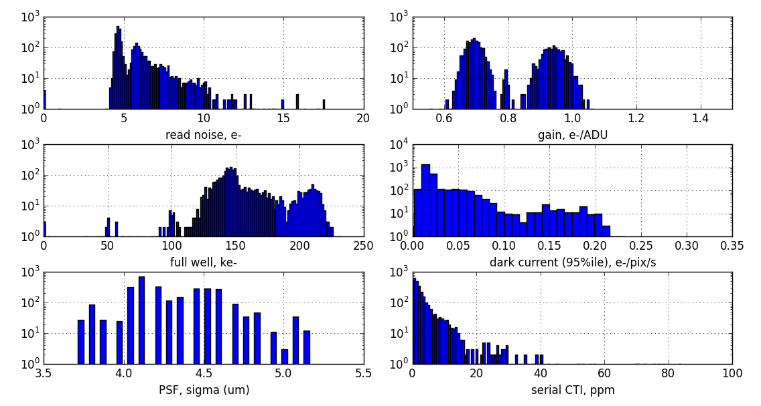
Parameter distributions – 20 rafts, 180 CCDs, 2880 video channels

Slide 17
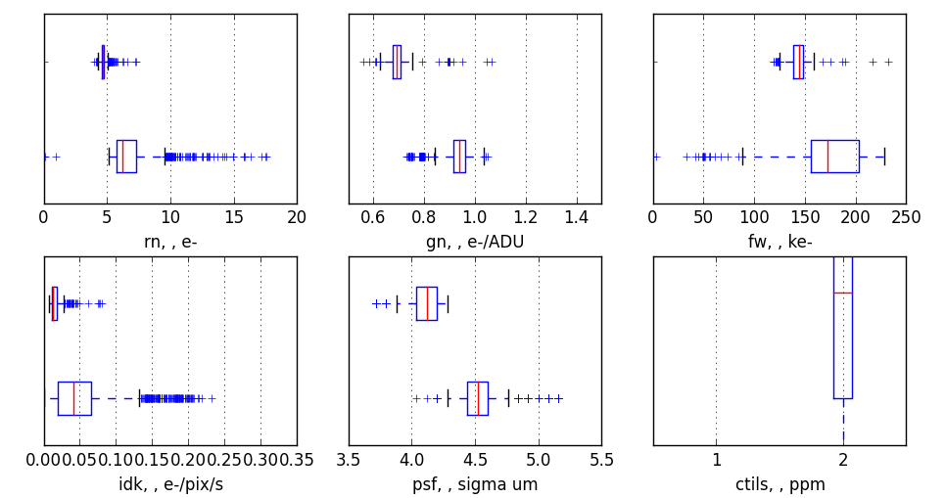
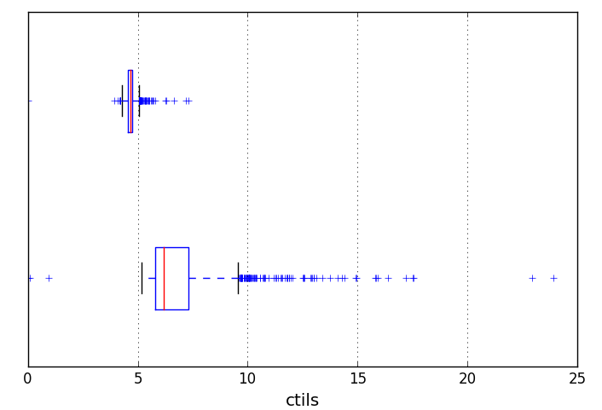
Parameter distributions – 20 rafts, 180 CCDs, 2880 video channels
E2V
ITL
Read noise, e-
Gain, e-/ADU
Full well, e-
E2V
ITL
0.0
0.1
0.2
0.3
Dark current (95th %ile @ -90C) e-/pix/s
PSF, σ (μm)
Serial CTI, ppm

Slide 18
Parameter distributions – 20 rafts, 180 CCDs, 2880 video channels
E2V
4.68 ±0.24
0.69 ±0.04
143 ±8.5
ITL
6.84 ±1.8
0.93 ±0.08
173 ±33.4
Read noise, e-
Gain, e-/ADU
Full well, e-
E2V
0.015 ±0.034
4.09 ±0.15
3.1 ±5.7
ITL
0.054 ±0.046
4.53 ±0.26
4.8 ±28.3
0.0
0.1
0.2
0.3
Dark current (95th %ile @ -90C) e-/pix/s
PSF, σ (μm)
Serial CTI, ppm
<σ_{ITL}/σ_{E2V}> = 3.6

Slide 19
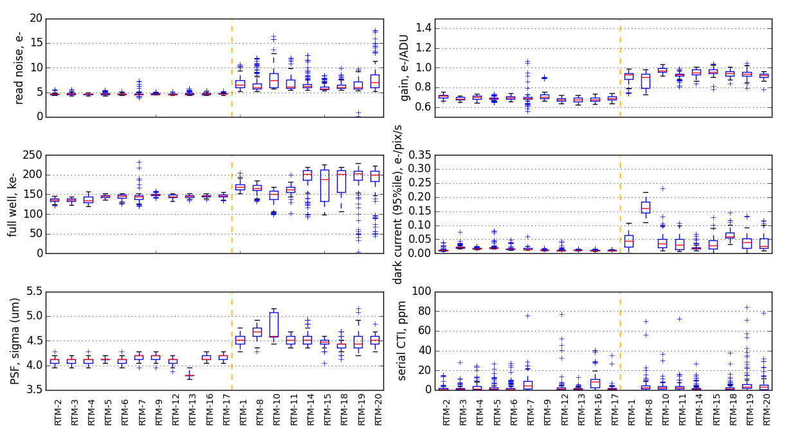
Parameter distributions – 20 rafts, 180 CCDs, 2880 video channels
← E2V
ITL→

Slide 20
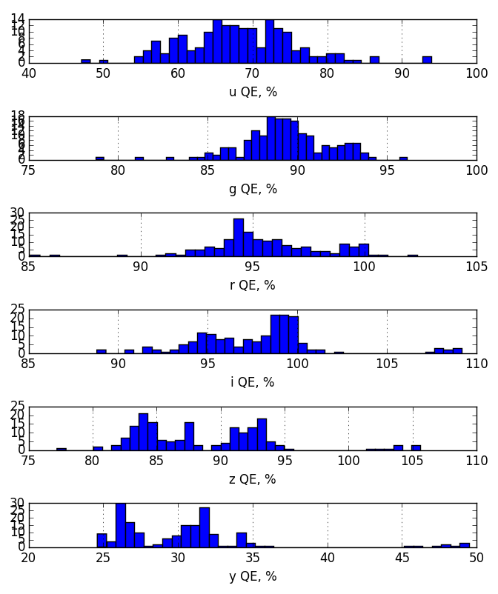
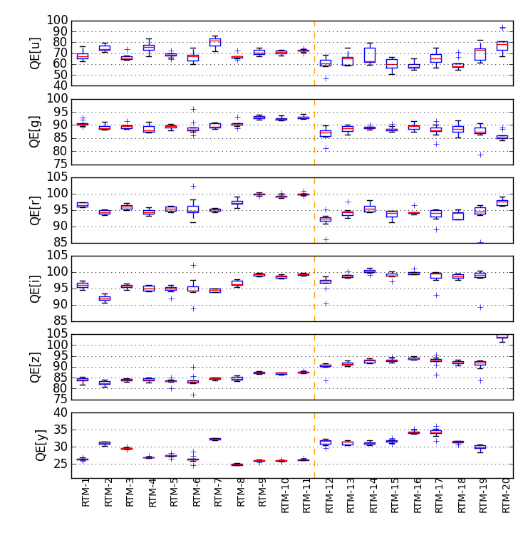
Quantum efficiency – 20 rafts, 180 CCDs

Slide 21
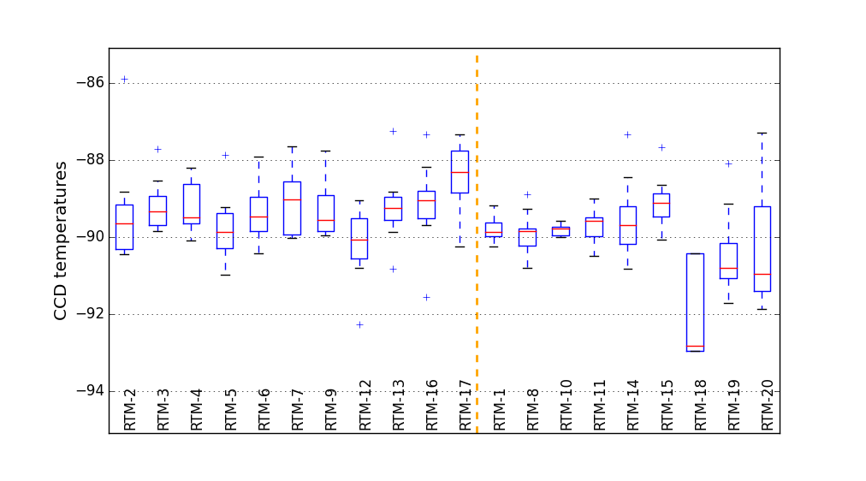
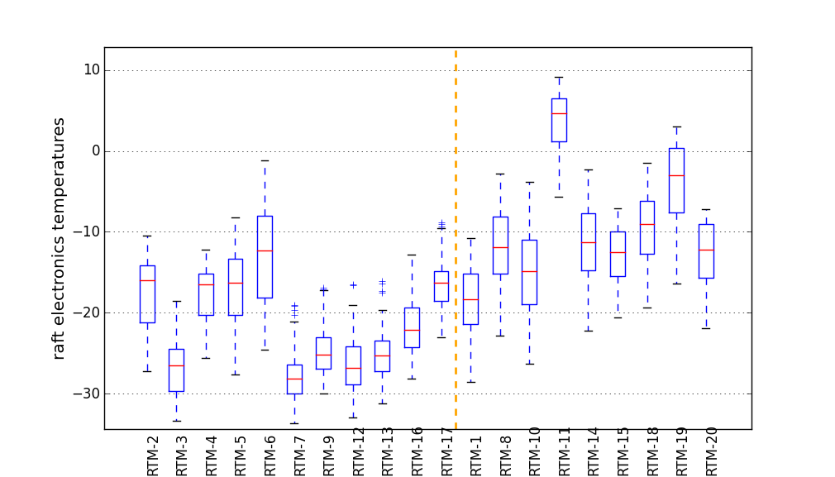
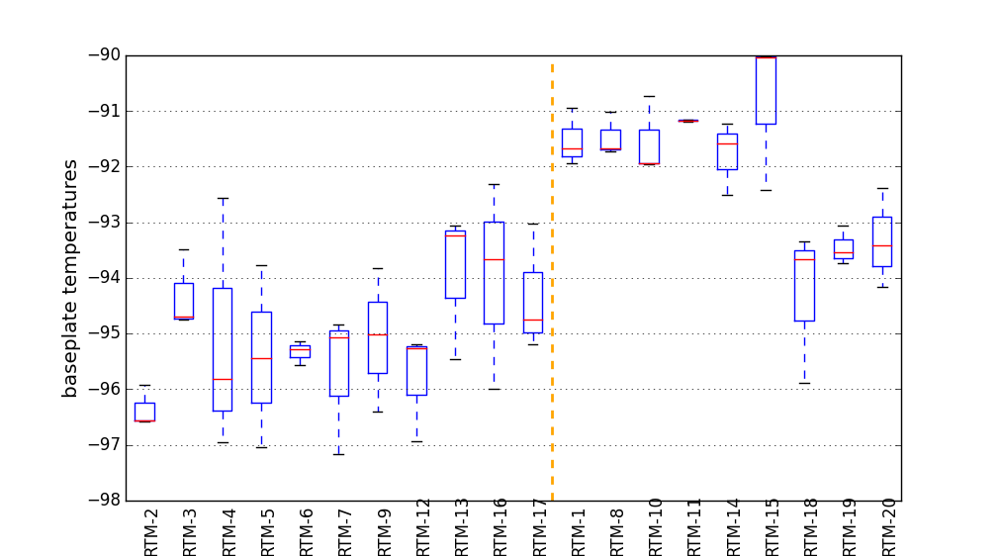
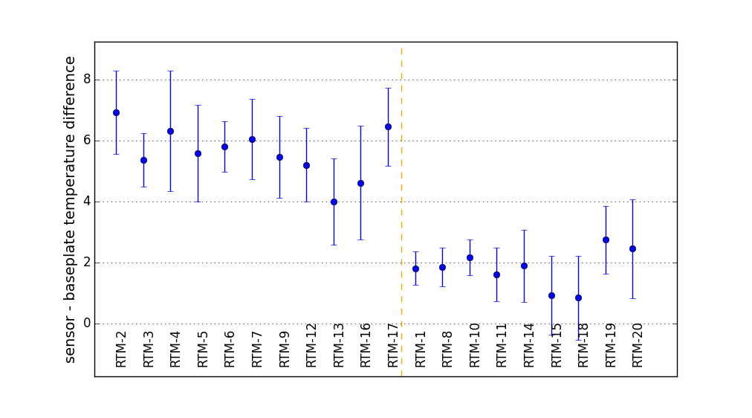
Temperature distributions – 20 rafts, 180 CCDs, 20 baseplates, 600 REB sensors
CCD temperature set by makeup heaters on baseplate. For most rafts, collected full EO suite at -90C and -100C setpoints.
Raft electronics temperatures not actively stabilized and have 15-20C gradients across the long REB boards.
setpoint = -90
coldplate setpoint = -40
CCDs
ELECTRONICS
5.62 ± 0.80
1.81 ± 0.59
BASEPLATEs
CCDs - BASEPLATEs

Slide 22
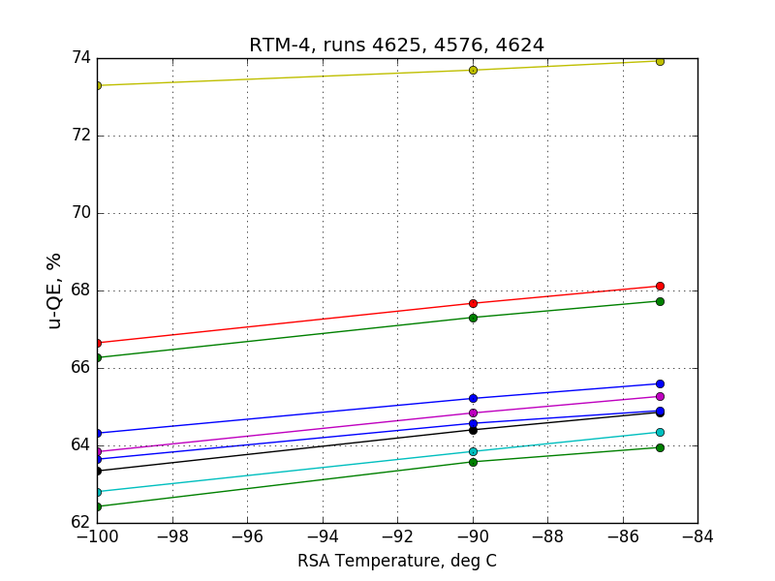
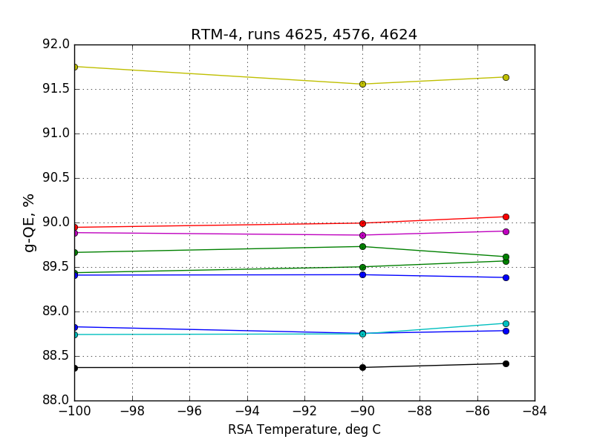
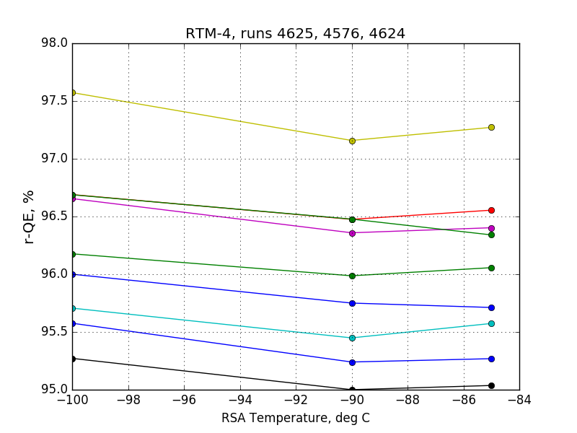
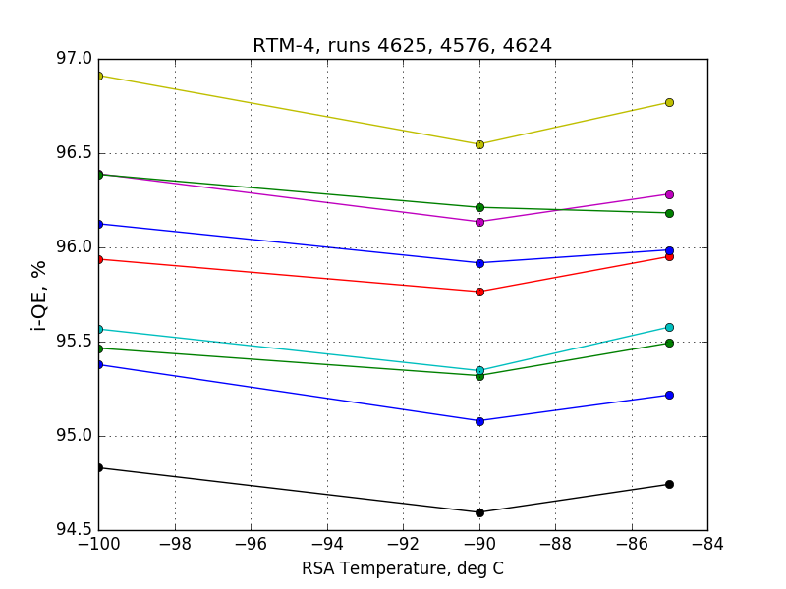
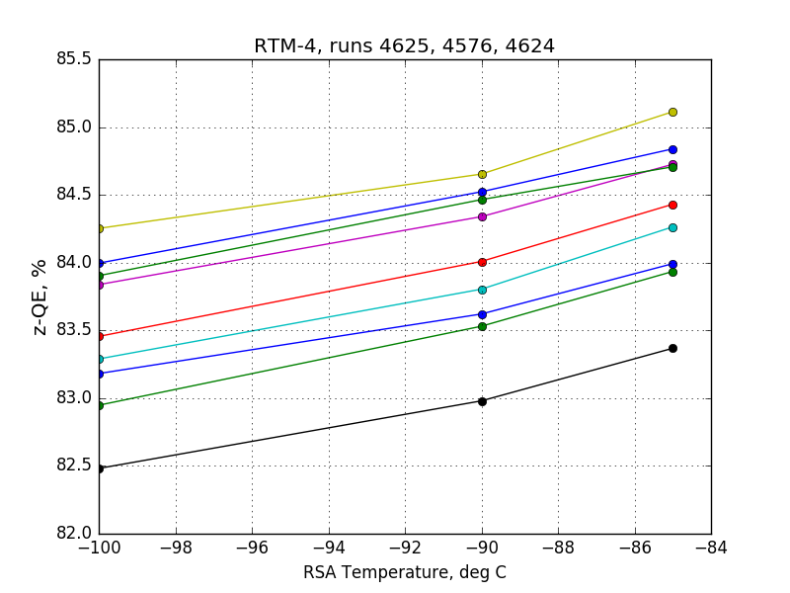
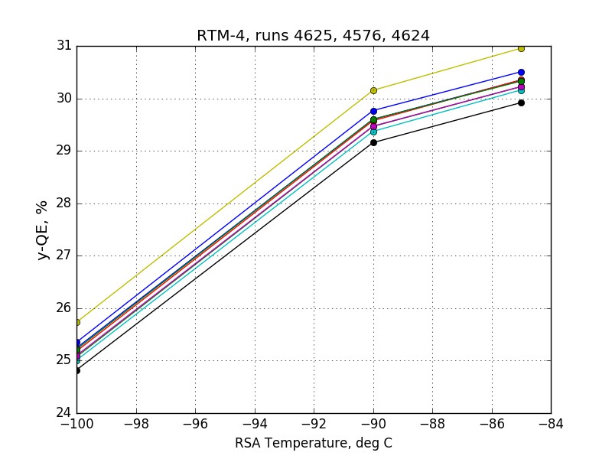
Example: QE dependence on CCD temperature, RTM-4

Slide 23
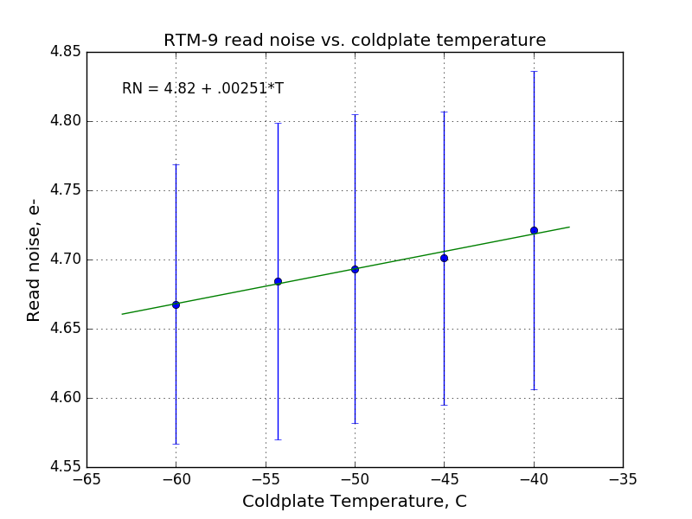
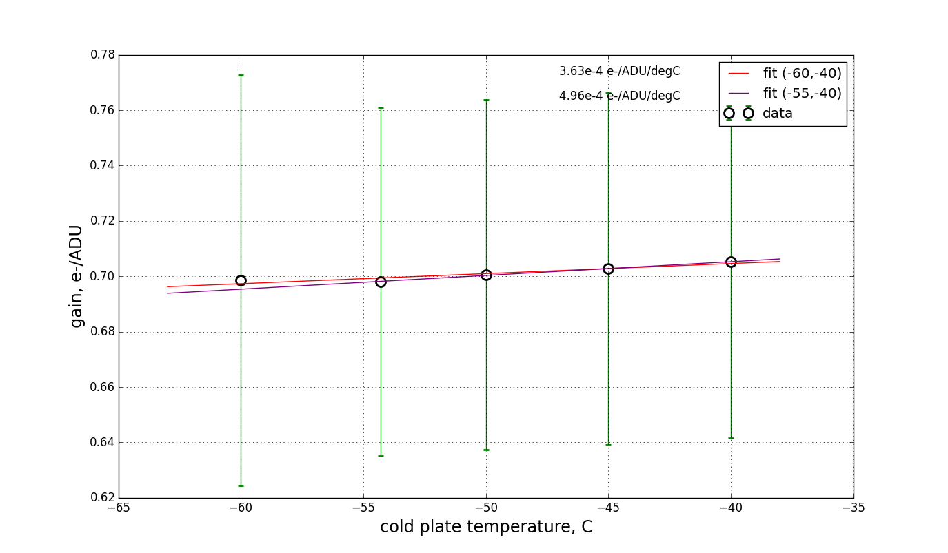
Example: gain and noise dependence on electronics temperature, RTM-9

Slide 24
Parameter statistics and temperature coefficients
Pmt | <E2V> | <ITL> | <TOT> | σ_{E2V} | σ_{ITL} | σ_{TOT} | dp/pdT_{E2V} | dp/pdT_{ITL} | dp/pdT_{TOT} | UNIT
QE-u | 69.8 | 62.2 | 67.9 | 6.3 | 7.8 | 7.8 | 0.0013 | 0.0050 | .00137 | %
QE-g | 89.9 | 88.4 | 89.5 | 2.0 | 3.4 | 2.8 | 0.00027 | -0.00023 | 5.3e-5 | %
QE-r | 95.6 | 94.3 | 95.6 | 2.4 | 3.4 | 3.1 | -0.00017 | -0.00011 | -.00014 | %
QE-I | 95.1 | 99.4 | 98.1 | 3.6 | 4.4 | 4.2 | -0.00016 | -0.00016 | -.00016 | %
QE-z | 84.2 | 92.7 | 86.6 | 2.4 | 4.6 | 5.3 | 0.00088 | 0.00063 | .00075 | %
QE-y | 25.9 | 31.5 | 28.9 | 3.5 | 4.2 | 4.8 | 0.00506 | 0.0080 | .0051 | %
read noise | 4.7 | 6.1 | 4.8 | 0.23 | 1.8 | 1.5 | -0.00035 | 0.0009 | .00017 | e-
gain | 0.69 | 0.94 | 0.71 | 0.034 | 0.11 | 0.14 | 0.00023 | 0.0002 | .00024 | e-/ADU
full well | 144 | 186 | 147 | 8.0 | 40 | 30 | nan | -0.00017 | -2.3e-5 | ke-
dark current | 0.013 | 0.038 | 0.017 | 0.03 | 0.048 | 0.041 | 0.0052 | -0.002 | 0.0029 | e-/pix/s
PSF | 4.12 | 4.48 | 4.2 | 0.14 | 0.28 | 0.28 | 0 | 0 | 0- | Um
CTI-serial | 1.52 | 2.07 | 1.7 | 6.6 | 45 | 27 | nan | nan | -.016 | ppm

Slide 25
STABILITY

Slide 26
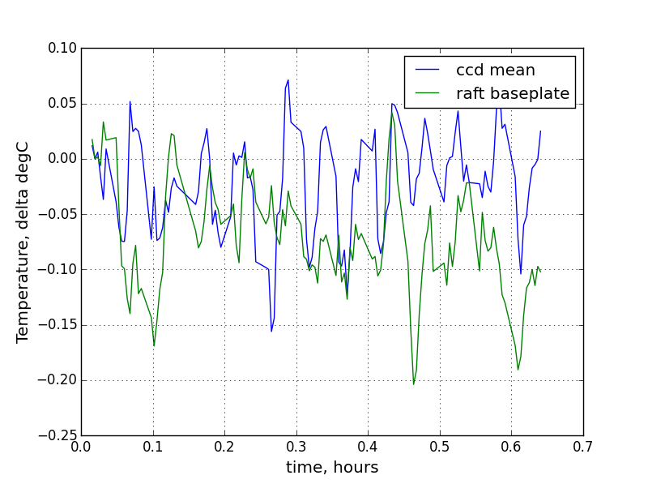
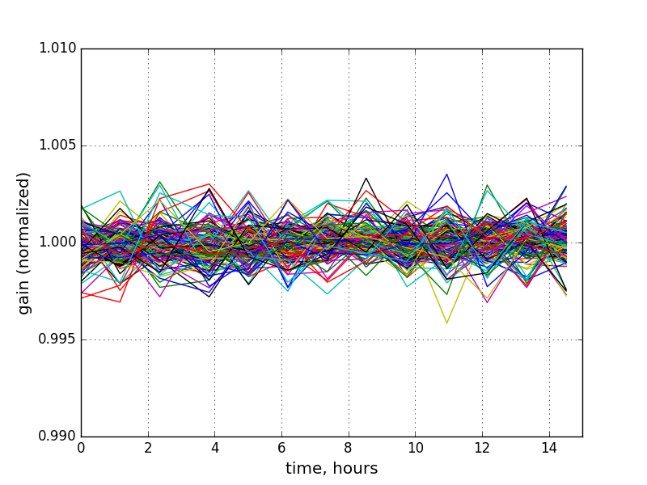
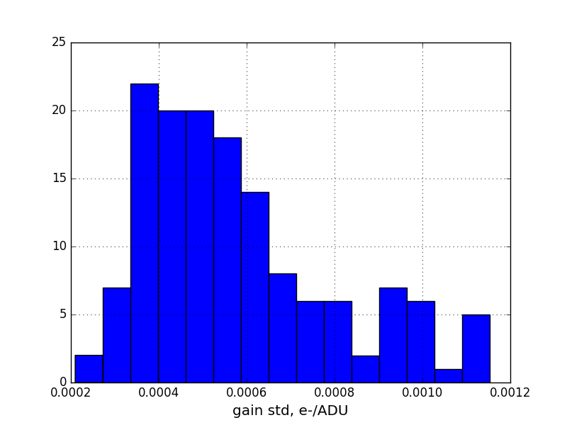
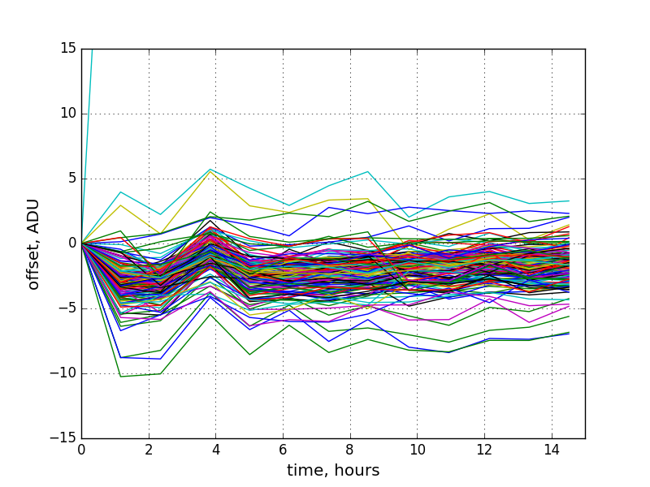
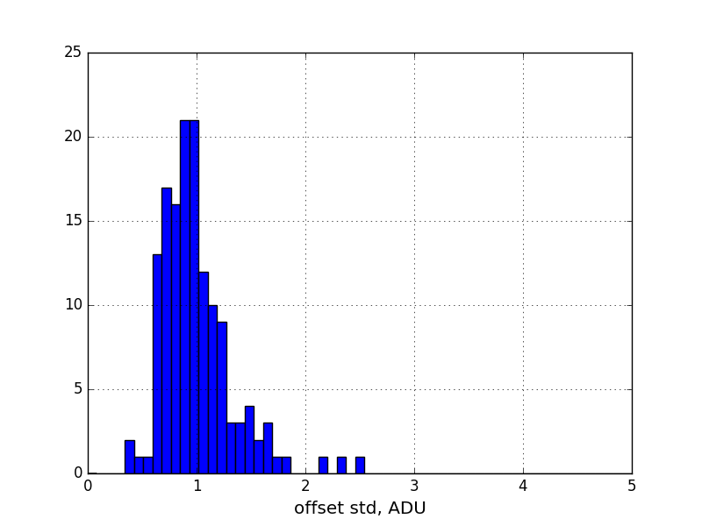
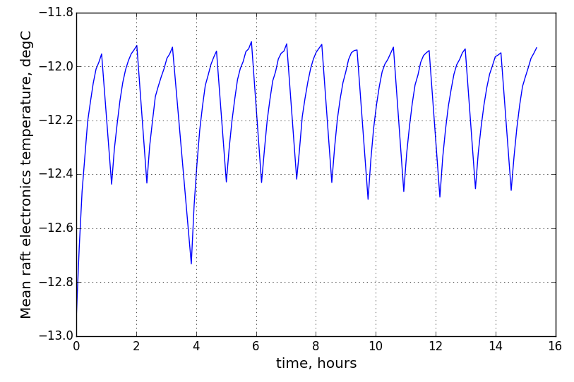
RTM-21, 15-hour gain and offset stability
GAINS
TEMPERATURES
OFFSETS
1 ADU ~ 0.7e⁻

Slide 27
RTM-21, 15-hour gain and offset stability
GAINS
TEMPERATURES
OFFSETS
1 ADU ~ 0.7e⁻

Slide 28
CADENCE IMPLICATIONS

Slide 29
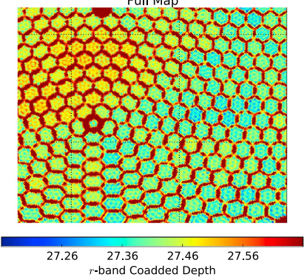
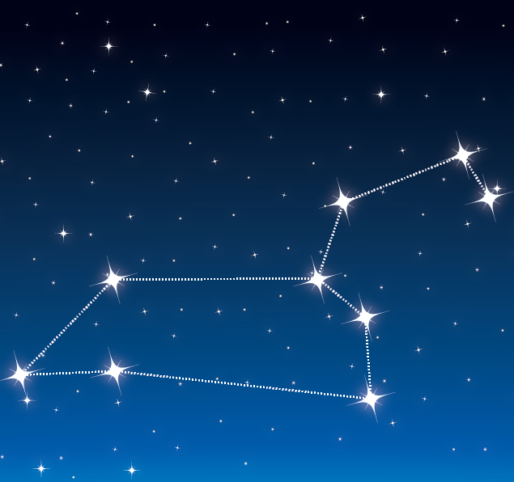
LSST dither strategy
Baseline WFD
no dither
Modified WFD
large field dither
sky rotation
DDF
no field dither
sky rotation
Awan ApJ 2016

Slide 30

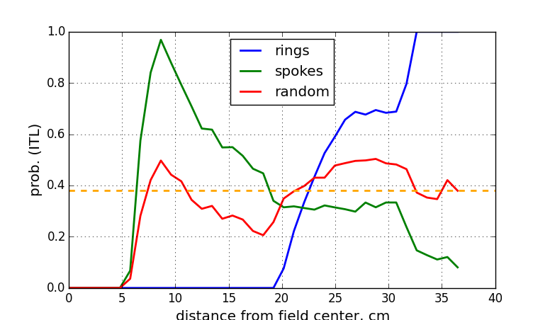
FPA distribution of rafts
“rings”
“spokes”
“random”
(one of 203,490 possibilities)
Depending on the arrangement of rafts in the FPA, in DDF cadence objects will experience unequal fraction of visits to ITL and E2V rafts

Slide 32
SUMMARY
All of the LSST science raft towers have been produced and EO performance measured
Key parameters meet requirements at >98% level
Distribution of EO parameters is strongly tied to CCD supplier
  Central value, spread, and temperature coefficient differences
Gain and offset remain stable at 1e-4 level over 15-hour runs in test cryostat
Choice of placement of rafts across the focal plane may impact the survey uniformity

Slide 33
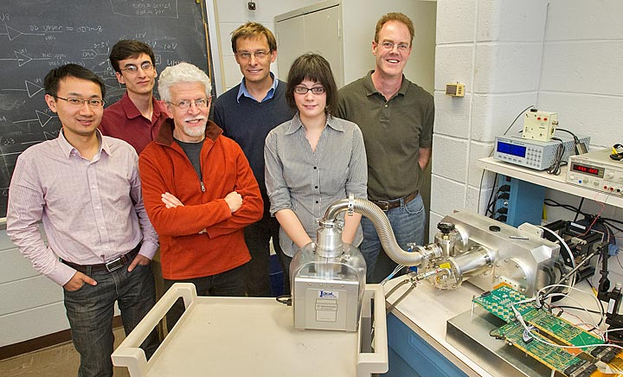
ACKNOWLEDGEMENTS
Justine Haupt
Ivan Kotov
Andrei Nomerotski
Guangyu Zhang
Peter Takacs
Sven Herrmann
Jim Chiang
Claire Juramy-Giles
Pierre Antilogus
Hye-Yun Park
Al DellaPenna
Matthew Rumore
Peter Doherty
John Kuczewski
Wei Lu
Homer Neal
Al DellaPenna
Bill Wahl
Sean Robinson
Brian Walsh
This presentation has been co-authored by employees of Brookhaven Science Associates, LLC. Portions of this work are supported by the Department of Energy under contract DE-AC02-98CH10886 with Brookhaven National Laboratory. LSST project activities are supported in part by the National Science Foundation through Governing Cooperative Agreement 0809409 managed by the Association of Universities for Research in Astronomy (AURA), and the Department of Energy under contract DE-AC02-76-SFO0515 with the SLAC National Accelerator Laboratory. Additional LSST funding comes from private donations, grants to universities, and in-kind support from LSSTC Institutional Members.

Slide 34
Supplementary Material

Slide 35



Raft electronics
Functions:
Video CDS processing, dual-slope integration
18-bit digitization and serialization
HV clock and bias generation
CCD temperature monitoring and control
Onboard diagnostic features including waveform recorder
Implementation:
Three 4” x 16”, 14-layer boards
Video processing in CMOS ASIC
144 video channels
Performance:
72 Mpixels/s readout rate, 2.3Gbits/s
7e- read noise
0.08% crosstalk
380mW/channel total power dissipation
Russo, S., et al. "The LSST Science Raft Electronics." RT2014-19th Real-Time Conference. 2014.

Slide 36


Test stand cryocooler refrigeration capacities
Single PT-30 cryo head for RSA
Dual NF-55 cold head for electronics
ΔT
2X
expected Q
expected Q
ΔT

Slide 37
Parameter distributions – 20 rafts, 180 CCDs, 2880 video channels
(if CTI)
(if trap)

Slide 38

Example: gain and noise dependence on electronics temperature, RTM-

Slide 39




Video sampling-scope mode
Arrange a repetitive CCD output waveform (i.e. dark, flat)
Acquire one sample per pixel period, incrementing the ADC sampling clock 10ns per pixel
Combined with “transparent mode” feature of DSI ASIC, creates virtual 100MHz, 18b oscilloscope for probing video channels
(a) ASPIC DSI mode
(b) ASPIC Transparent mode – amplified CCD output

Slide 40



Virtual sampling scope
Transparent mode
Integration windows
Reset feedthrough
Reset level
Video level
2μsec
Time

Slide 41
Virtual sampling scope
Transparent and DSI modes
Transp.
DSI
2μsec
Time

Slide 42






Flatness
111-01 CCD250 #021
112-01 CCD250 #035
112-05 CCD250
99% range:
1.95μm
1.85μm
2.37μm
1μm
1μm
1μm
P.Z. Takacs, BNL

Slide 43

Bias10%FS
max FWC 82%FS

Slide 44


Slide 45


Specialized diagnostics – video waveform reconstruction

