Slide 1
Some unexpected features of bloomed images in deep depletion TESS CCDs.
G.Prigozhin,
J.Villasenor, J.Doty, B.LaMarr, R.Vanderspek, G.Ricker
MIT Kavli Institute for Astrophysics and Space Research

Slide 2
Outline:
What is TESS.
TESS CCDs.
Lab calibration and voltage selection for maintaining charge conservation at blooming.
Light reflections from pixel “boundaries”.
Mystery humps in bloomed columns.
Conclusions.

Slide 3
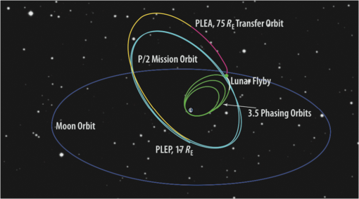
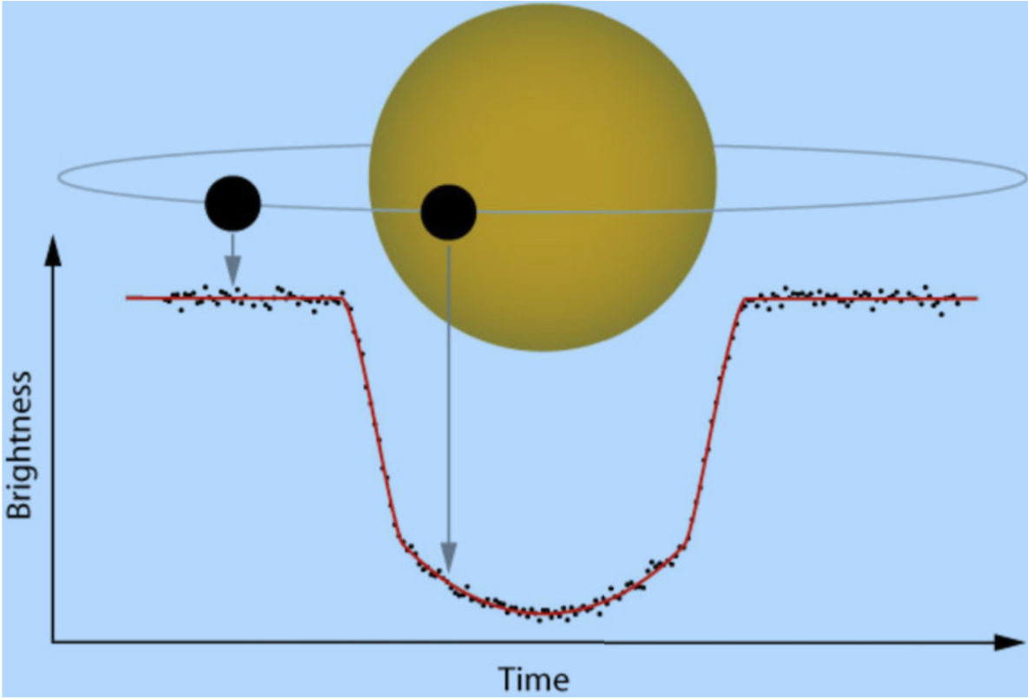
TESS: Transiting Exoplanet Survey Satellite
TESS orbit
The satellite
Exoplanet search

Slide 4
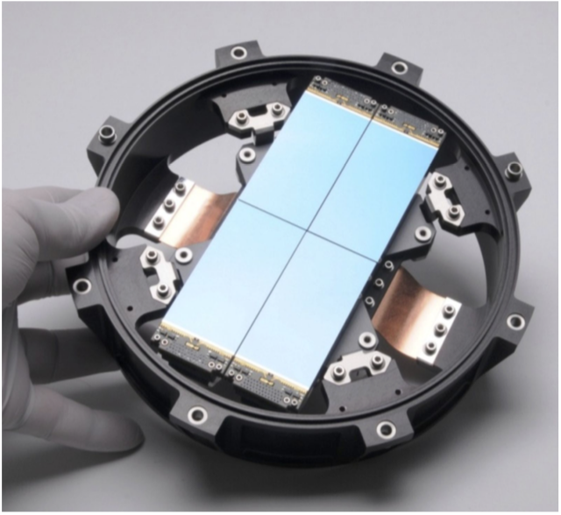
TESS CCDs
Key parameters
Camera cross section
Format | 2048x2048 pixel frame transfer
Pixel size | 15 micron (square)
Technology | 3 phase, 3 poly, 2 metal
Output ports | 4 single stage SF
Transfer rate | H: 625 kHz; V: 100 kHz
Responsivity | 8 μV/electron
Well capacity | ~200,000 electrons
Read noise | 7-10 electrons
Device thickness | 100 microns
Detector module

Slide 5
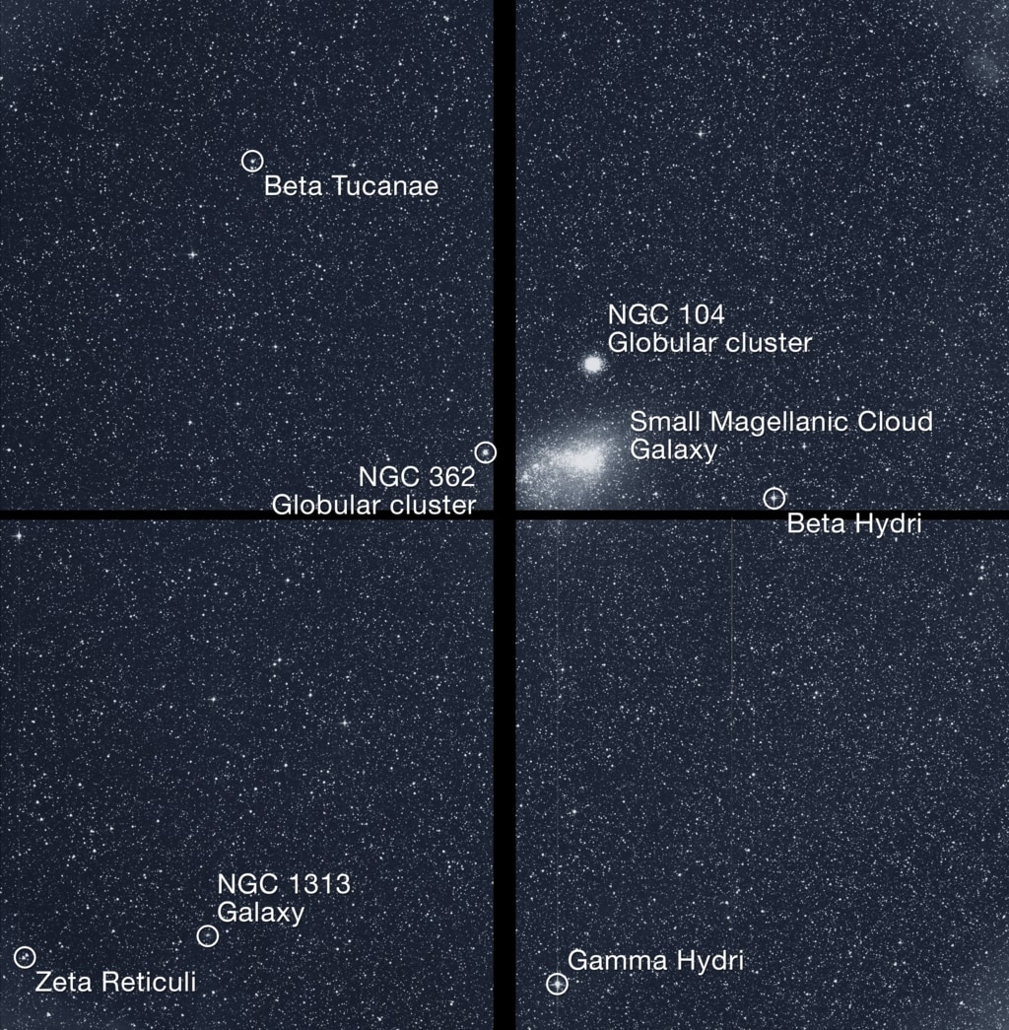
First TESS publicly released science image, camera 3. Multiple blooming objects can be seen in the image.

Slide 6
First publication (accepted last week) of exoplanet detection by TESS is based on bloomed source.

Slide 7
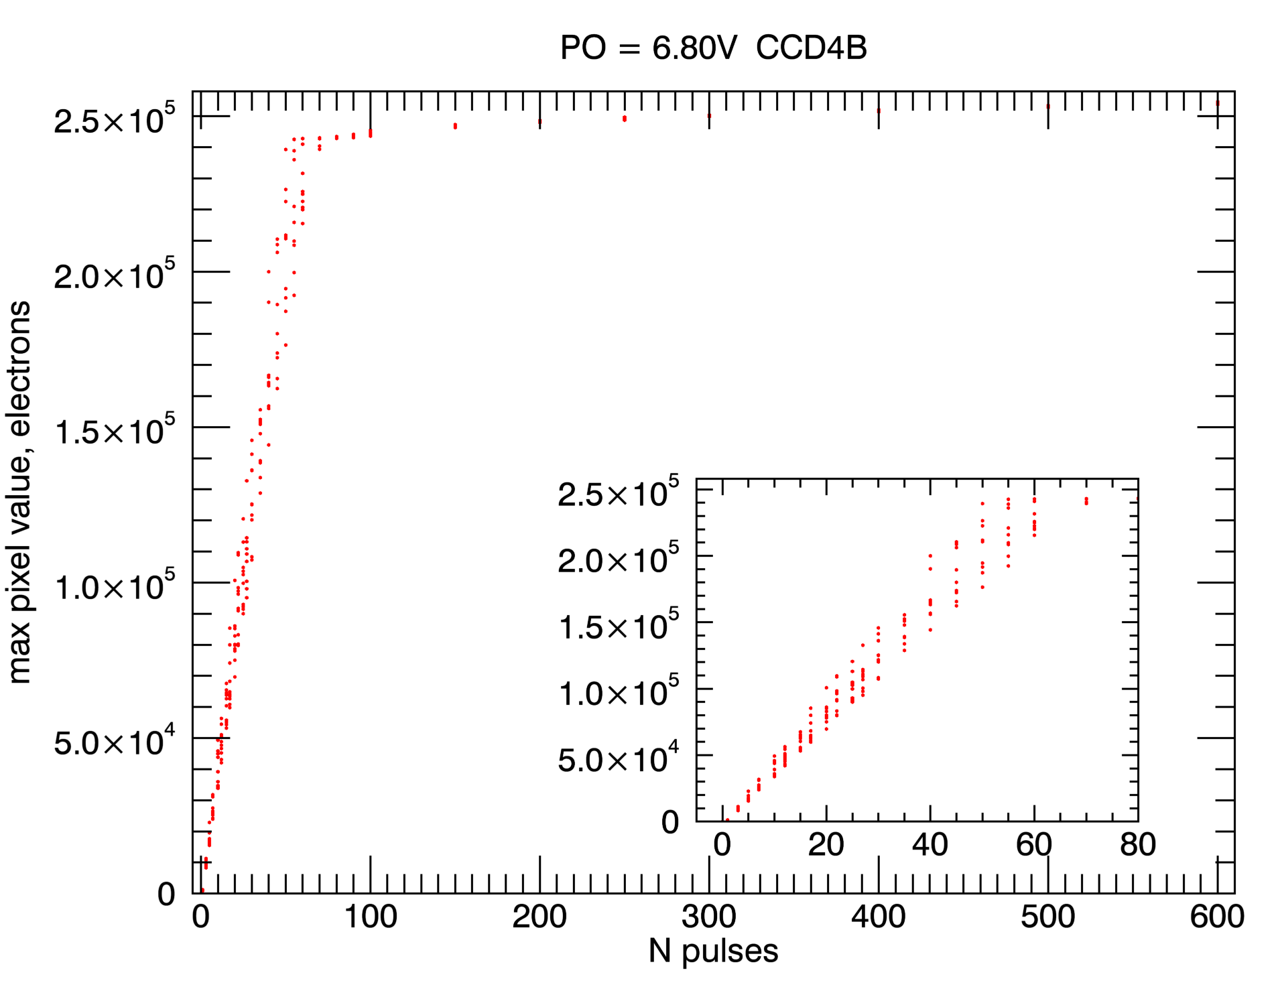
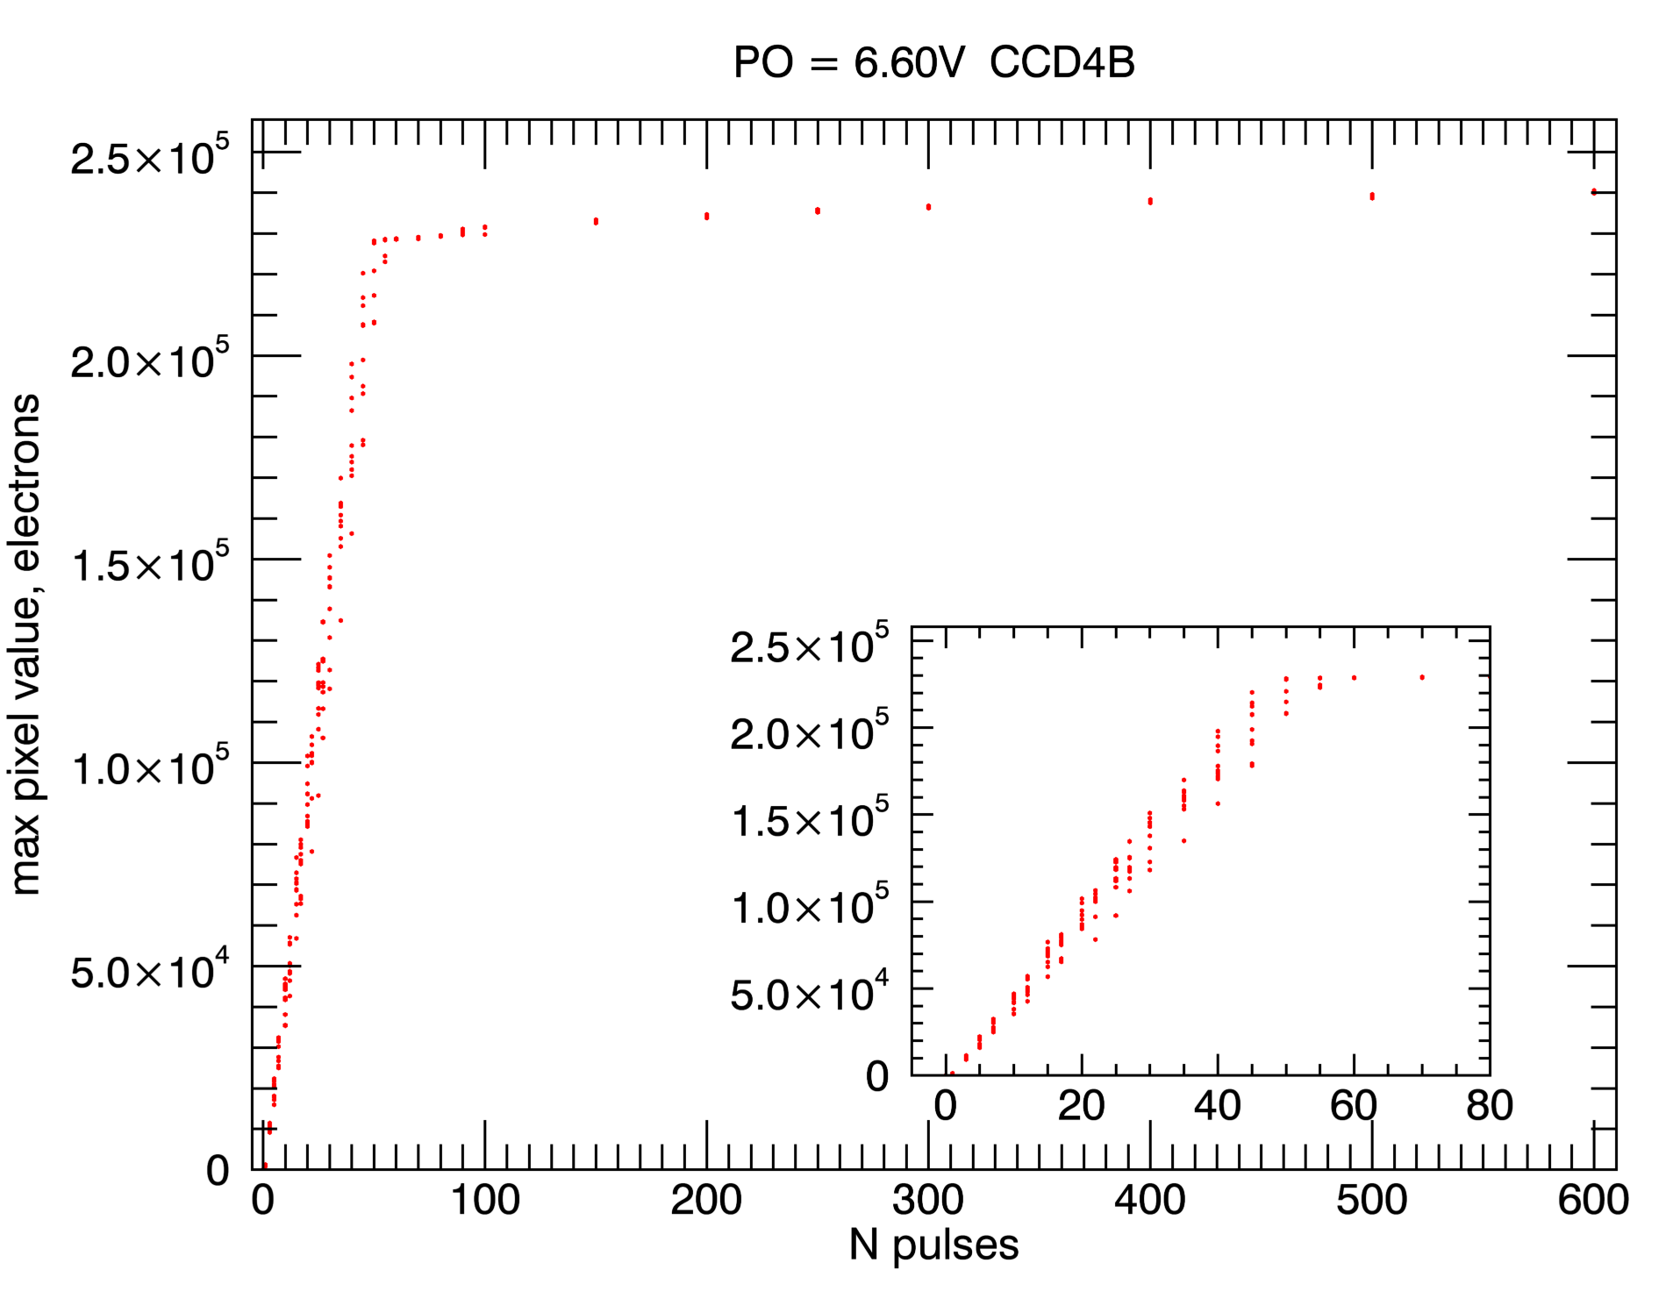
Charge conservation measurement
From the outset, establishing benign charge blooming conditions which would allow full charge collection, was one of the goals of voltage selection for TESS.
For each node of each CCD a sequence of measurement was made where pulsed LED illuminated a small spot inside a pixel with number of pulses changing from 1 to 8000.
Same mesurement was repeated at different gate voltages. Increasing P_{high} leads to larger full well, but at some voltage causes signal charge to come close to surface, resulting in charge loss.
Knee point in the plots below indicates that signal reached full well capacity. Saturated part of the plot corresponds to charge spilling over along the column and beginning of blooming.

Slide 8
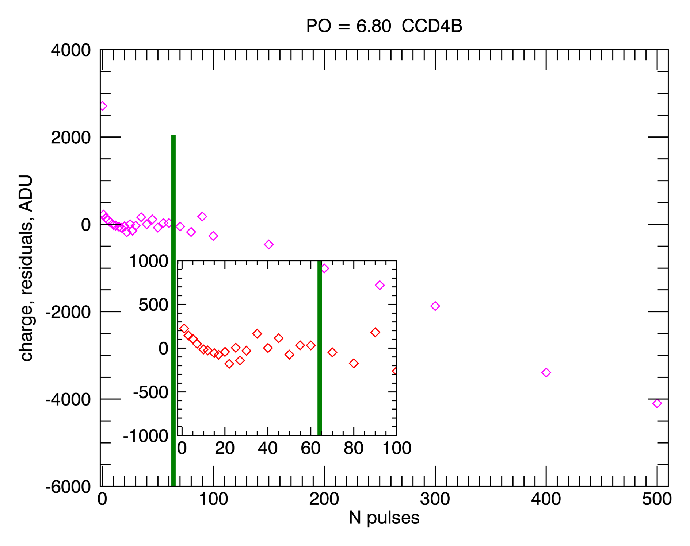
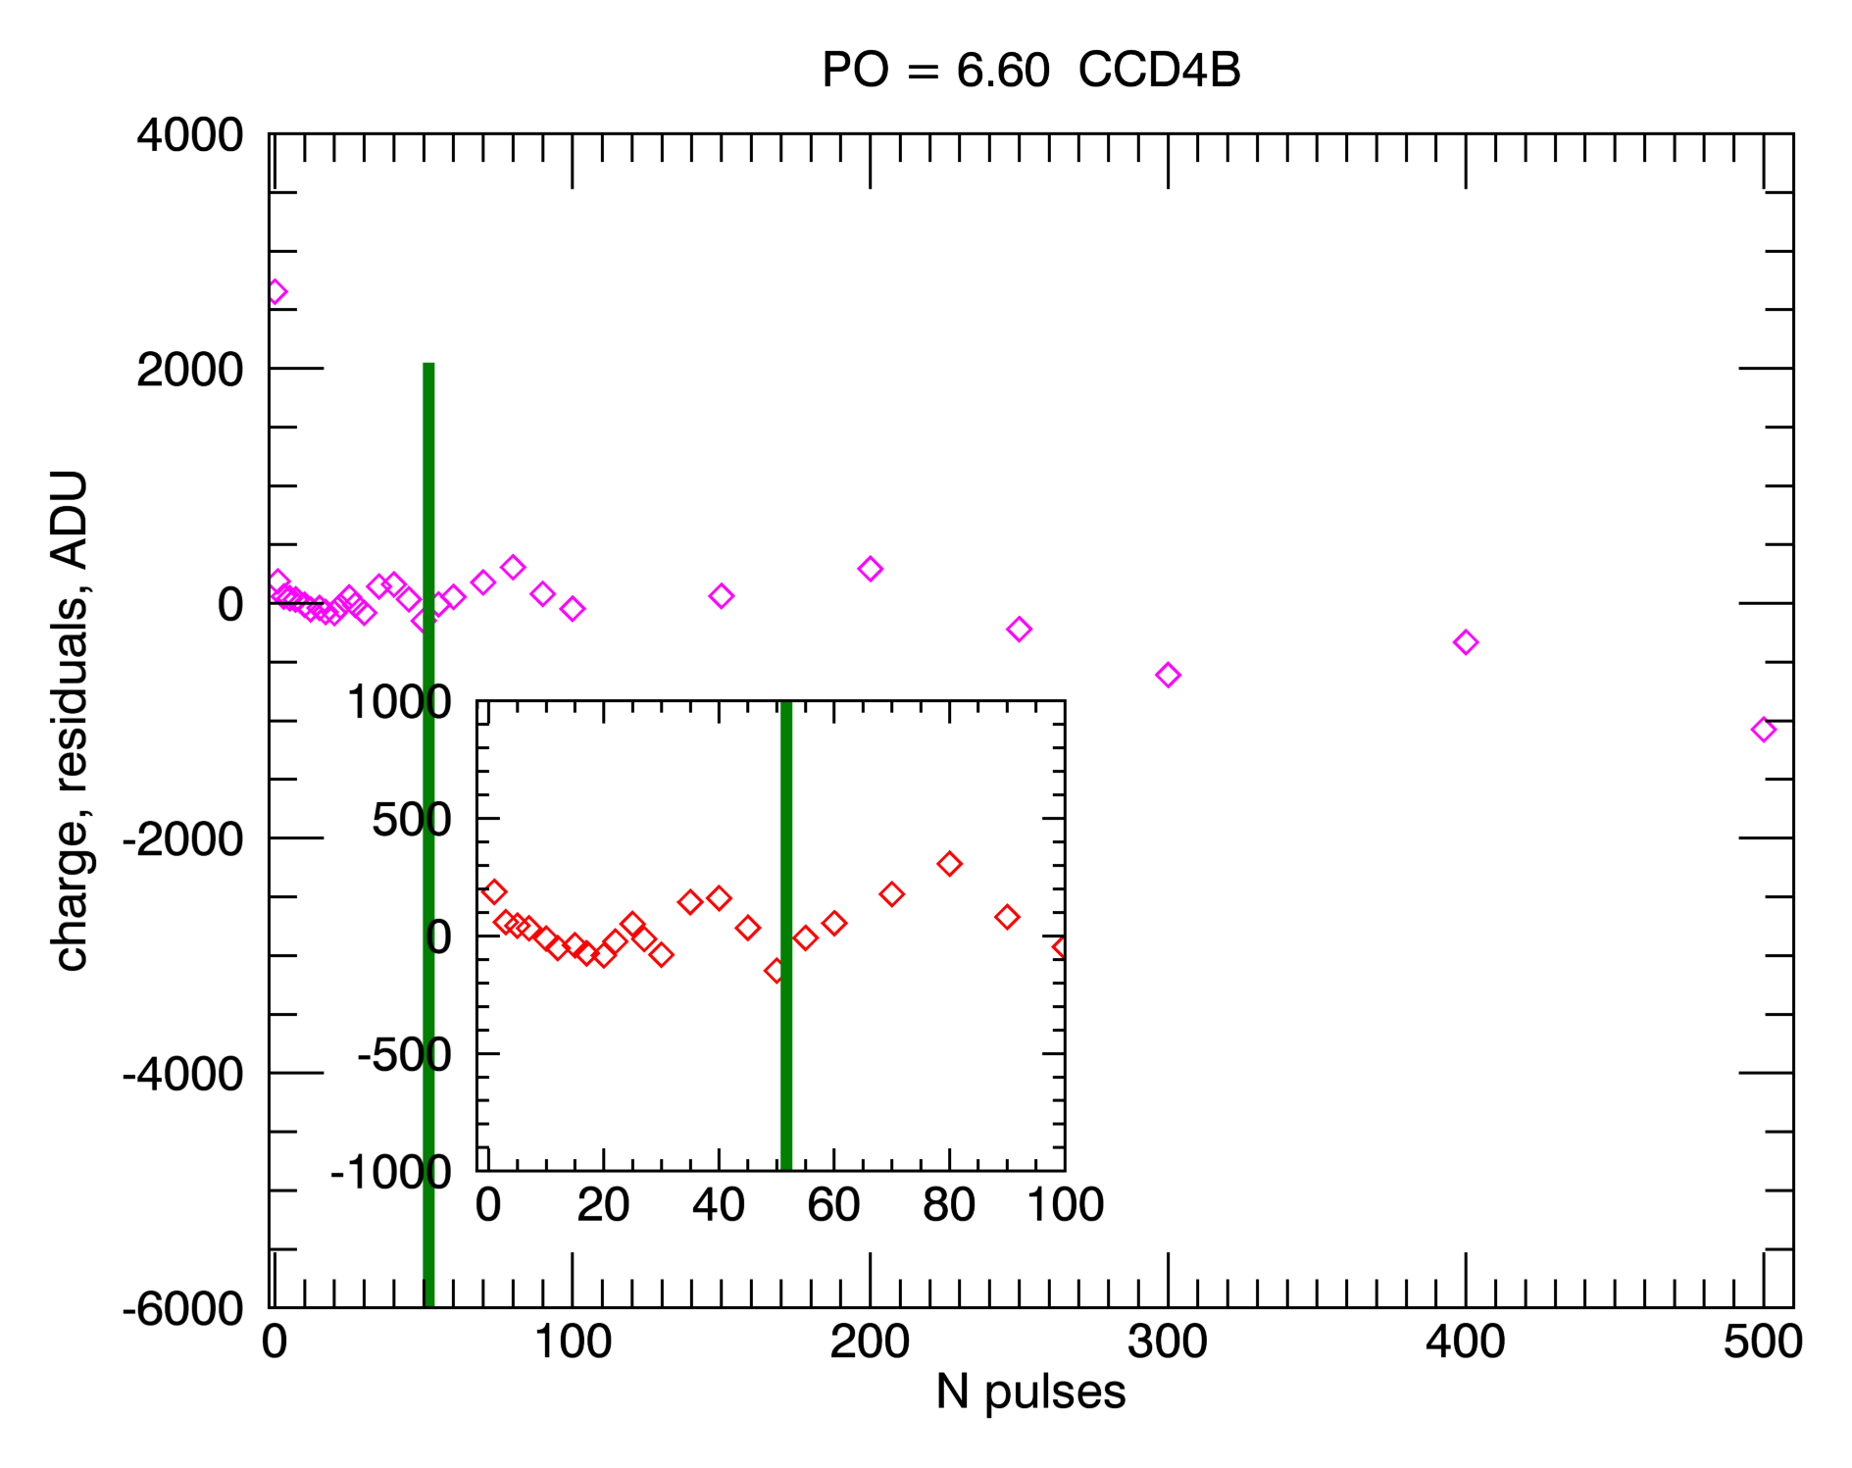
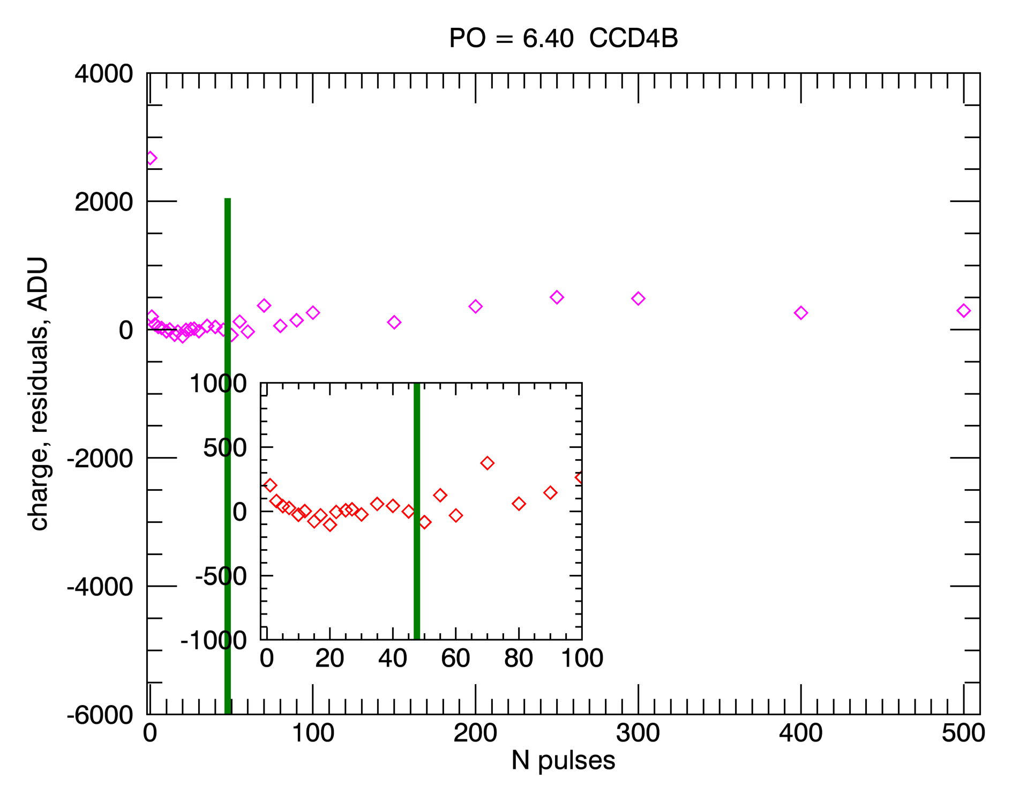
Charge conservation measurement
For the same data as shown in the previous slide, total charge generated in all pixels surrounding the illuminated one was measured by summing signals, including bloomed columns. Total charge increases almost linearly as a function of number of LED pulses.
A linear fit to this dependence was made at signals below full well transition, and the difference between signal and linear fit is plotted on the figures below.
Green vertical line in each plot indicates transition to blooming.
High level of parallel voltage was chosen so that charge loss in the blooming regime would stay low. In the case below it was 6.4 Volts.

Slide 9
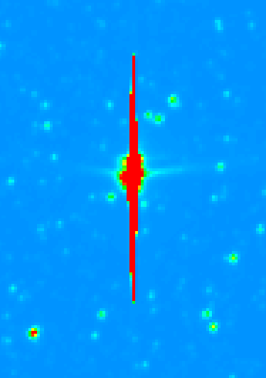
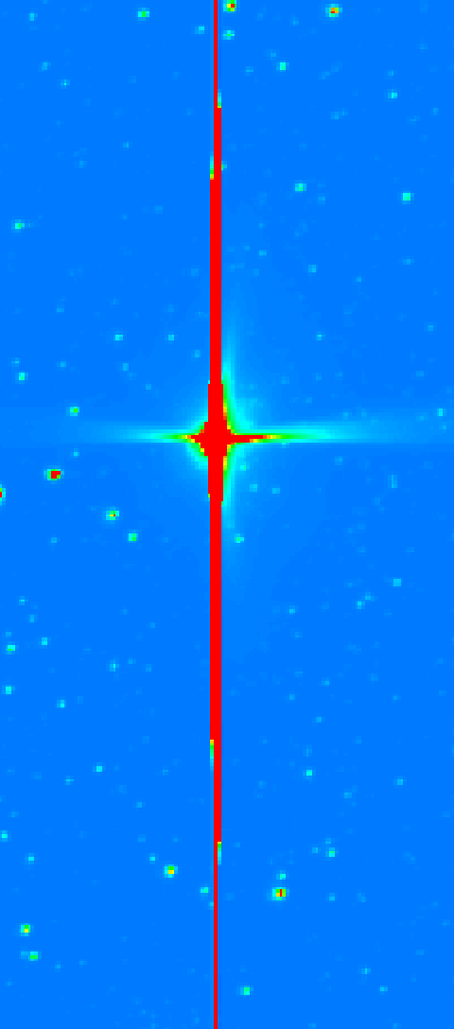
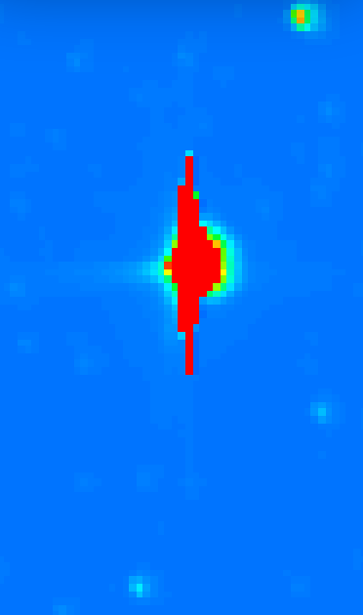
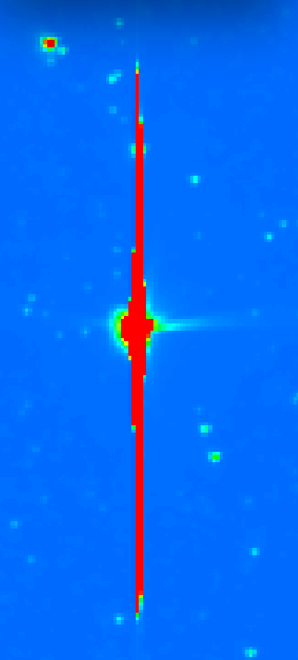
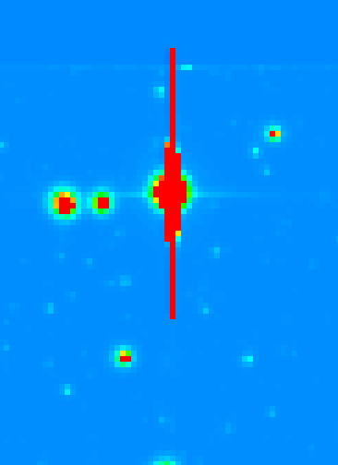
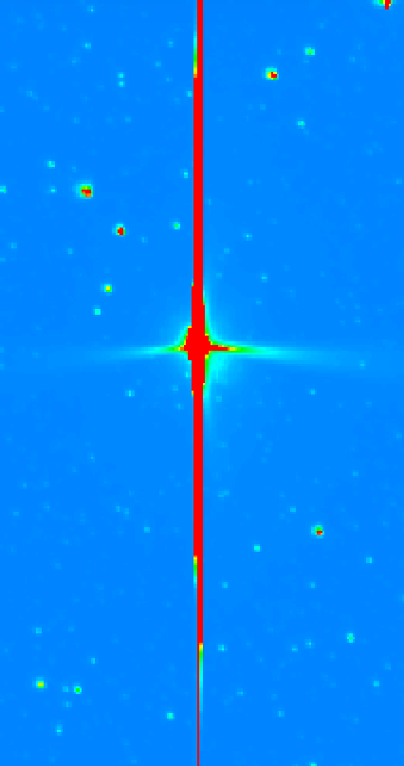
Bright stars in different parts of camera field of view
Top
“Vertical” mustache
Left
Right
Bottom

Slide 10
Qualitative explanation of the images in the previous slide
During lab calibration with monochromatic sources, we found, not too surprisingly, that at red wavelengths, light can reflect from the opposite surface of a CCD back into the silicon bulk.
For point sources located away from the field center, reflections from the elements of the structure that serve to separate pixels can explain the behavior shown in the previous slide.

Slide 11
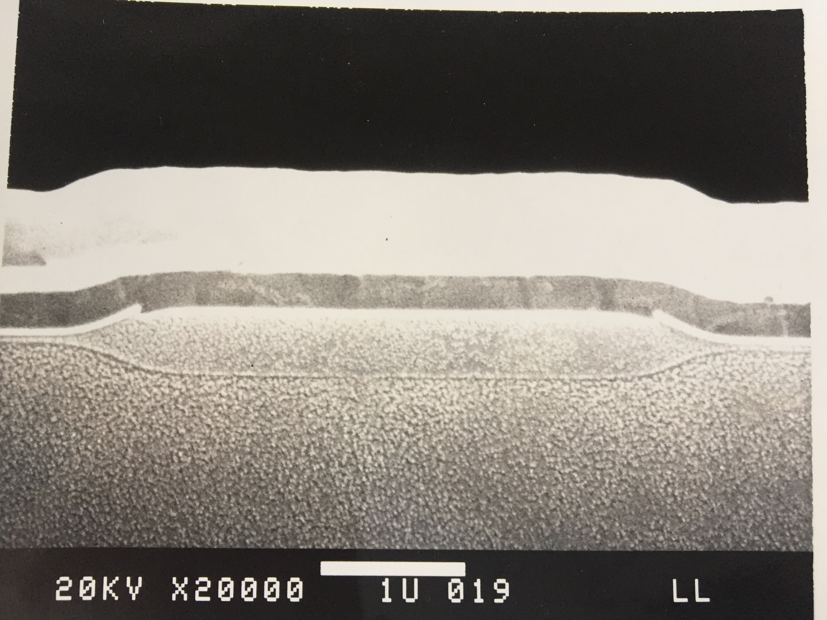
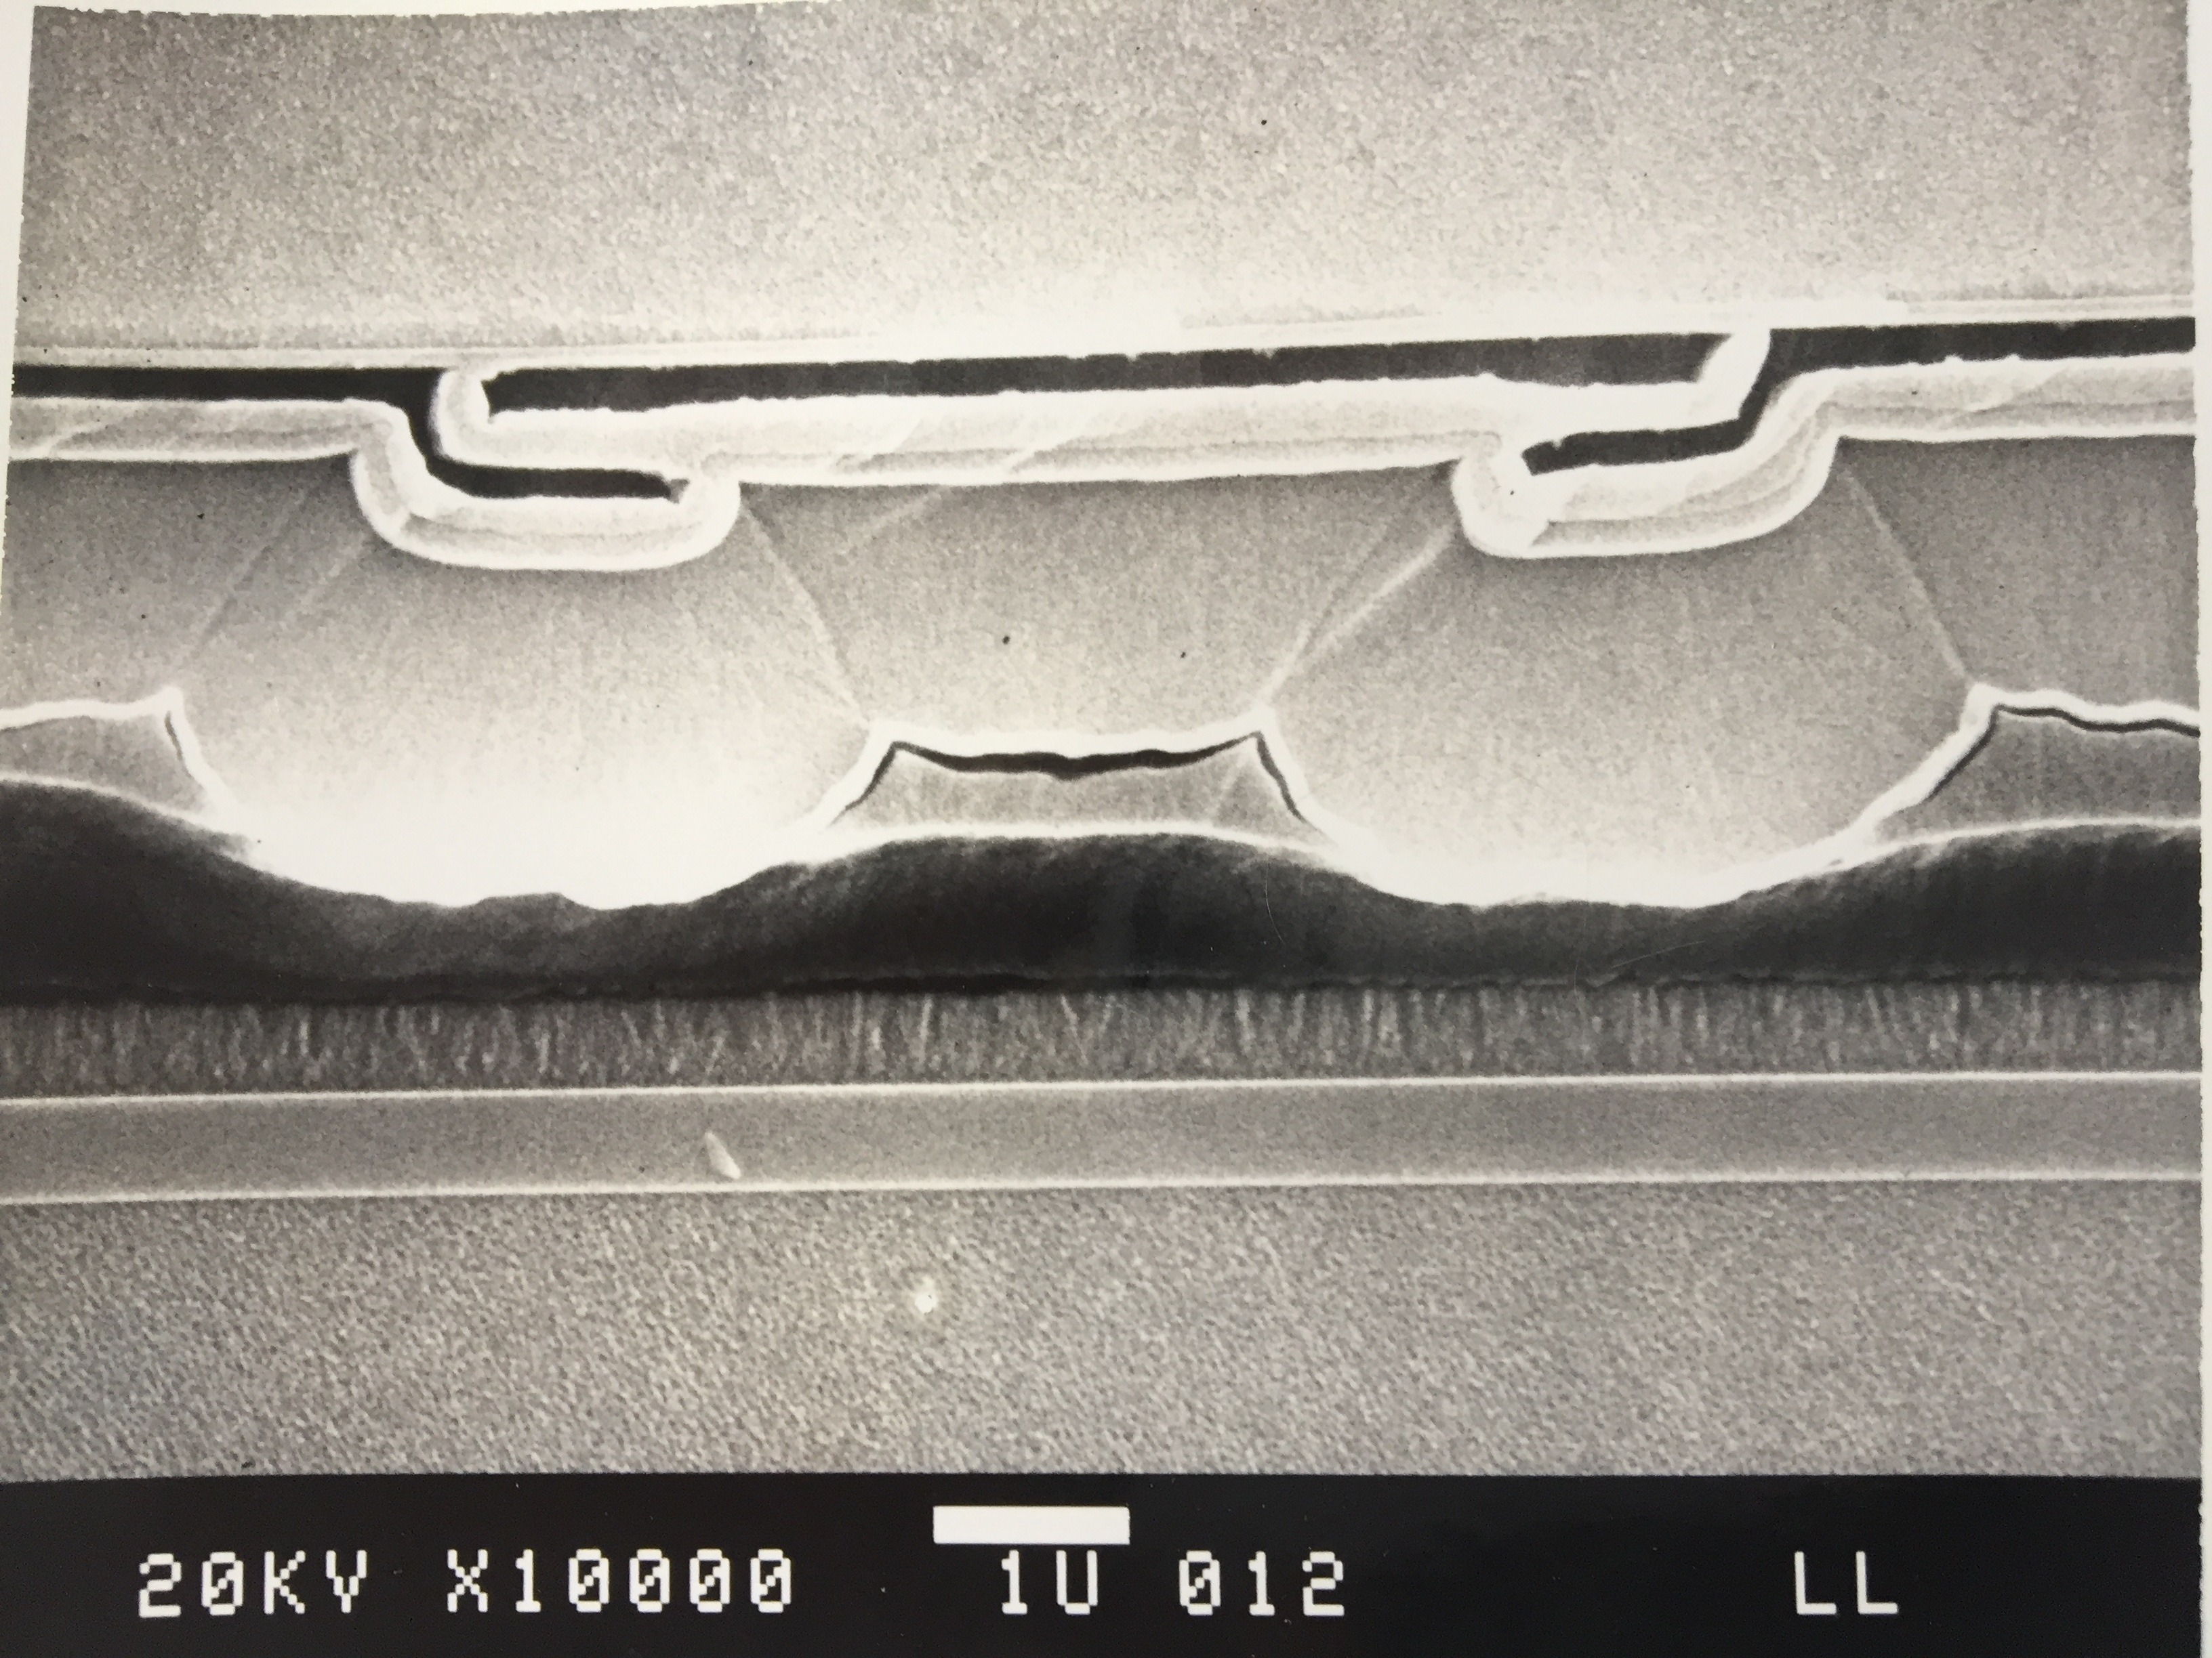
Light reflections from CCD back side
Cross section along column showing gate overlaps
Cross section along row in channel stop area
Light
Silicon
SiO₂
Silicon
Light

Slide 12
Light reflections from channel stop regions
When a star is detected at the periphery of the field of view, reflections to the left and to the right of channel stops become nonsymmetrical.
When an object is detected near top or bottom of a CCD, refelctions from ch-stops deviate from horizontal direction,
Lens
31 mm
156 mm
CCD

Slide 13
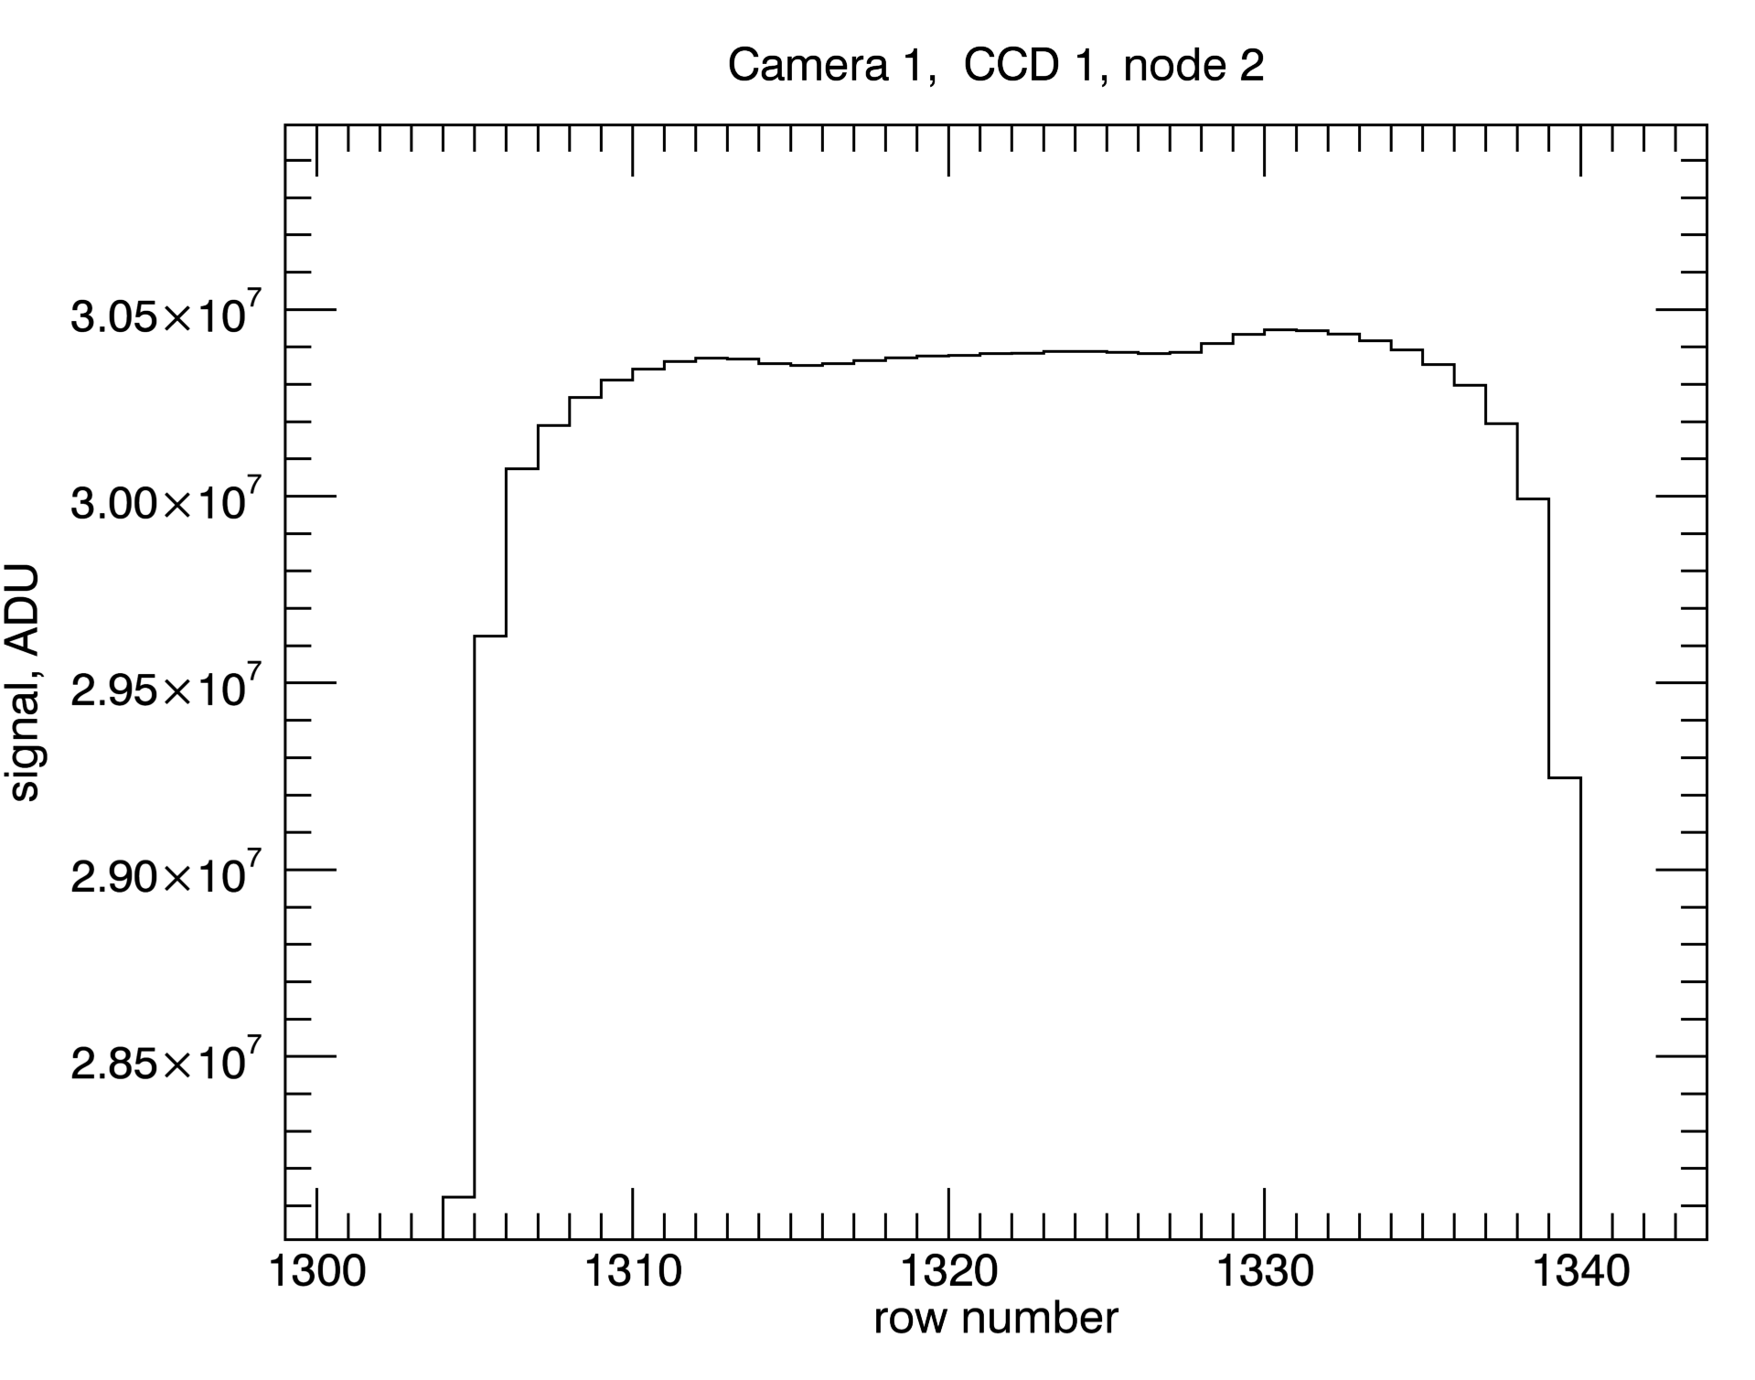
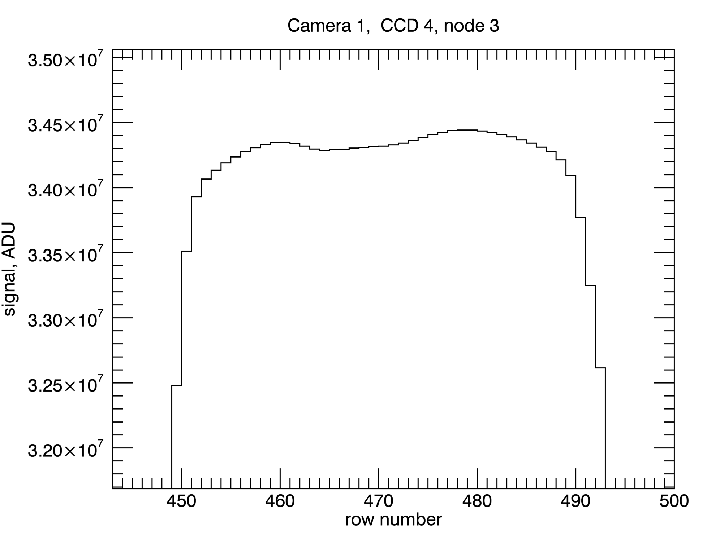
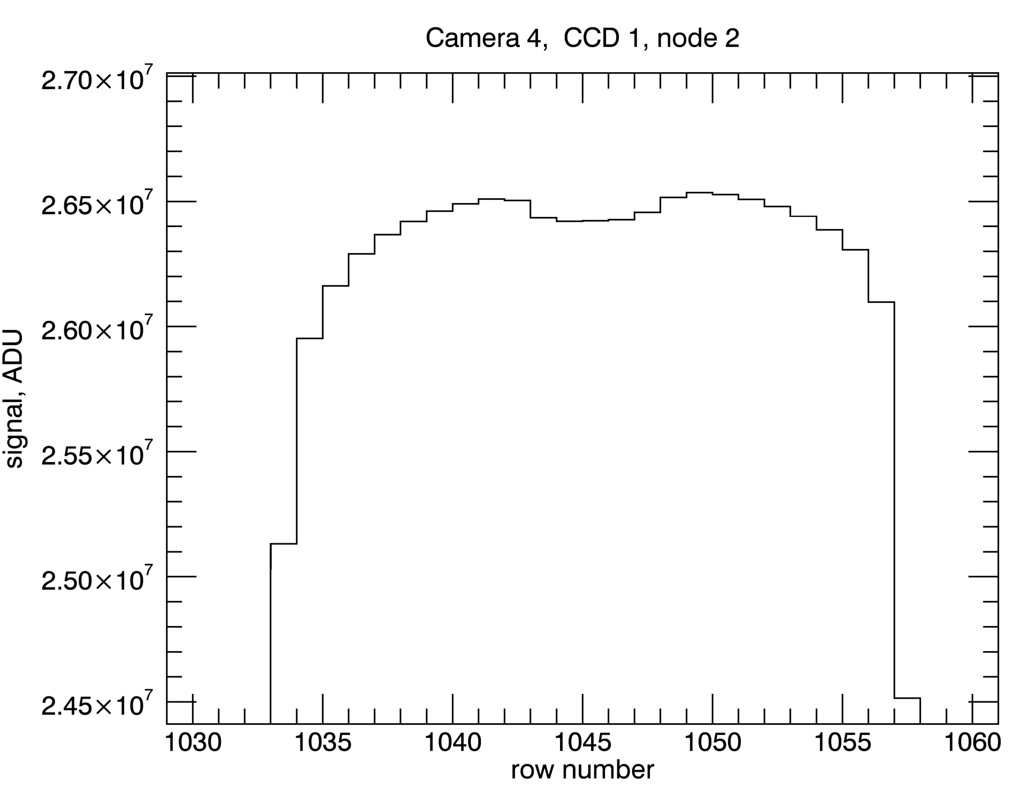
Charge distribution along bloomed columns
Examples from different CCDs in different cameras, showing signal distribution along the longest bloomed column
Humps at both ends of the bloomed columns are quite typical.
Light source causing the blooming is in the center – why is signal increasing at the periphery?

Slide 14
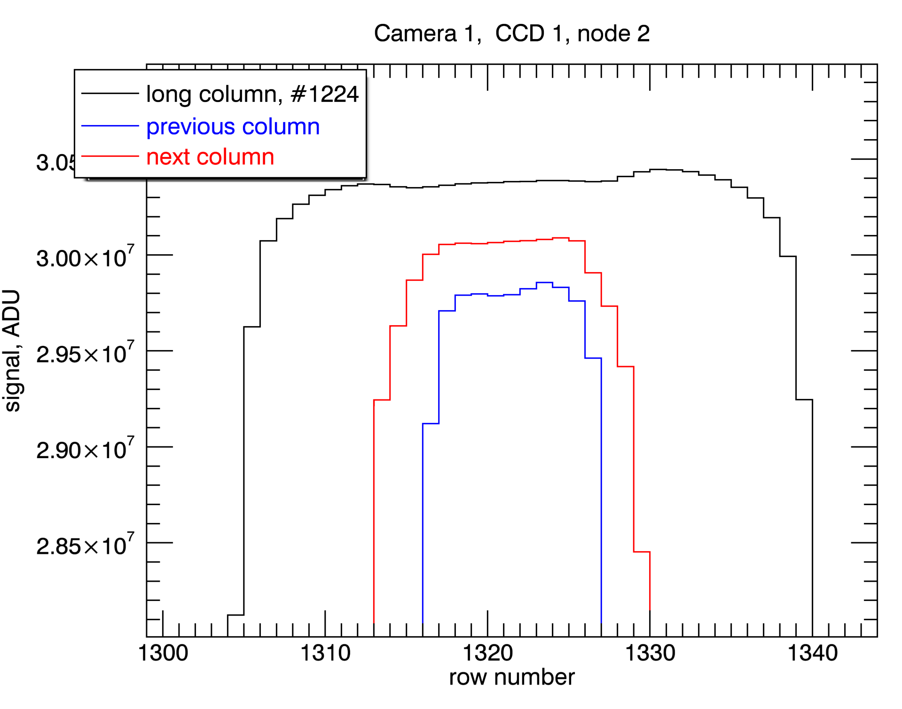
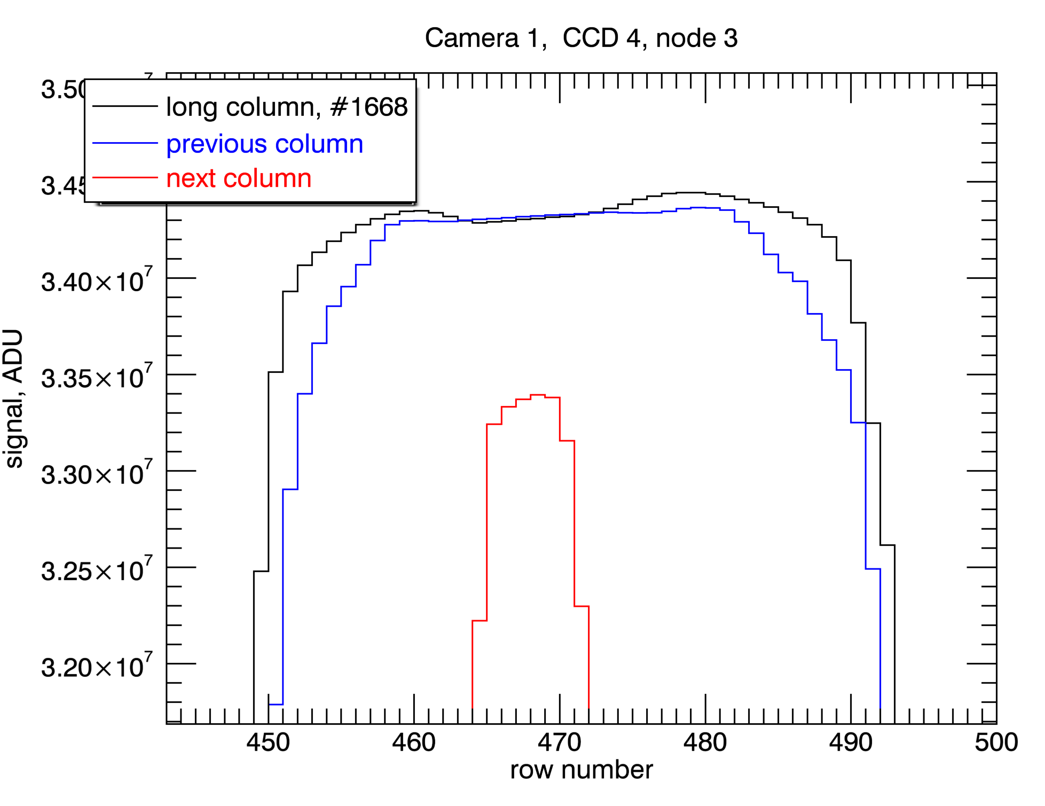
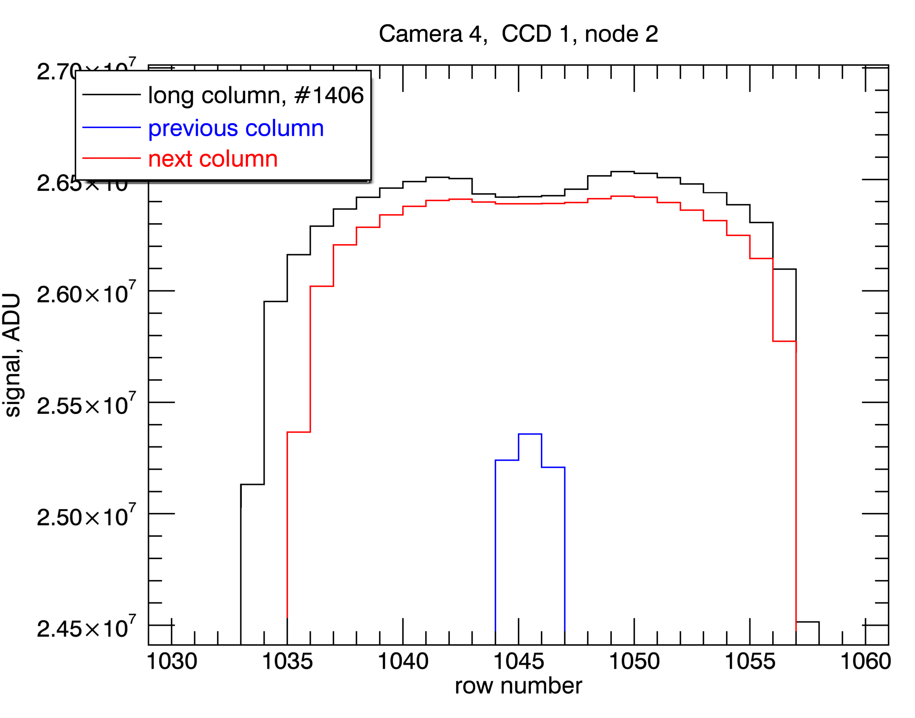
Charge distribution along bloomed columns
Examples from different CCDs in different cameras
Overplotting signal distributions in the adjacent columns helped solving the puzzle.
Hump’s start correlates with signal drop in the adjacent column. It means that empty potential wells nearby result in increased full well capacity.

Slide 15
Charge in adjacent pixels has an effect on the charge in the central pixel
Col n-1
Col n
Col n+1
Signal electrons in adjacent columns have slight repulsion effect on signal in central column. The effect is greatly diminished by shielding effect of channel stops, but is, obviously, measurable. It can only happen in deep depletion devices where neutral channel stop regions are not connected with neutral bulk below.
This phenomenon is a slightly different incarnation of “brighter-fatter” effect – it is caused by a similar cause – signal charge in one pixel affecting signal in the nearby one.

Slide 16
Conclusions
We have studied objects that produce bloomed columns in TESS flight detectors.
We found that bright stars produce reflections from channel stops and from gate structure on the “front” side (where the electrodes are) of the detector.
Those reflections can be tilted relative to the row and column directions for stars that are not near the center of the field of view.
Reflections to the left and to the right are nonsymmetrical, again, depending on the location relative to the center of the field of view.
Signal in bloomed columns forms humps at both ends of the bloomed portion. This phenomenon can be explained by full well capacity dependence on the amount of charge in the adjacent pixels. Empty pixels nearby cause increase of full well, a phenomenon somewhat similar to “brighter-fatter” effect.

