Slide 1
Detector Systems Engineering for
Extremely Large Instruments
E.M. George
ESO Detector Systems Group
ISPA Dec. 4, 2018 Pasadena, CA Public

Slide 2
What is ESO?
Mission
  Develop and operate world-class observing facilities to serve the astronomical research community.
  Hosting 22 telescopes and 41 scientific instruments + more in development.
  Partner in additional observatories (e.g. ALMA)
Intergovernmental treaty-level organization
  Founded in 1962, by 5 countries
  Currently 16 Member States
  ~700 staff (44 nationalities)
Photo: ESO/Babak Tafreshi
Notes:
- Give VERY quick intro to ESO, as this is a US audience.

Slide 3
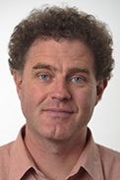
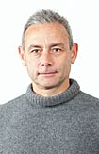
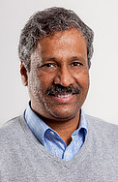
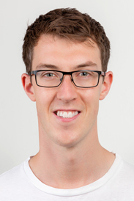
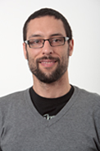
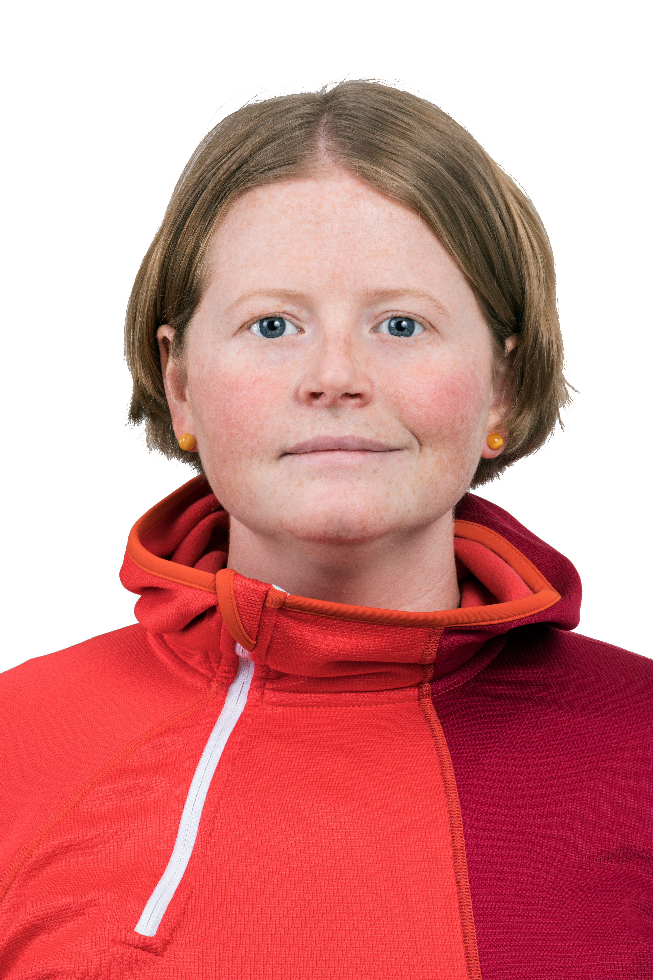
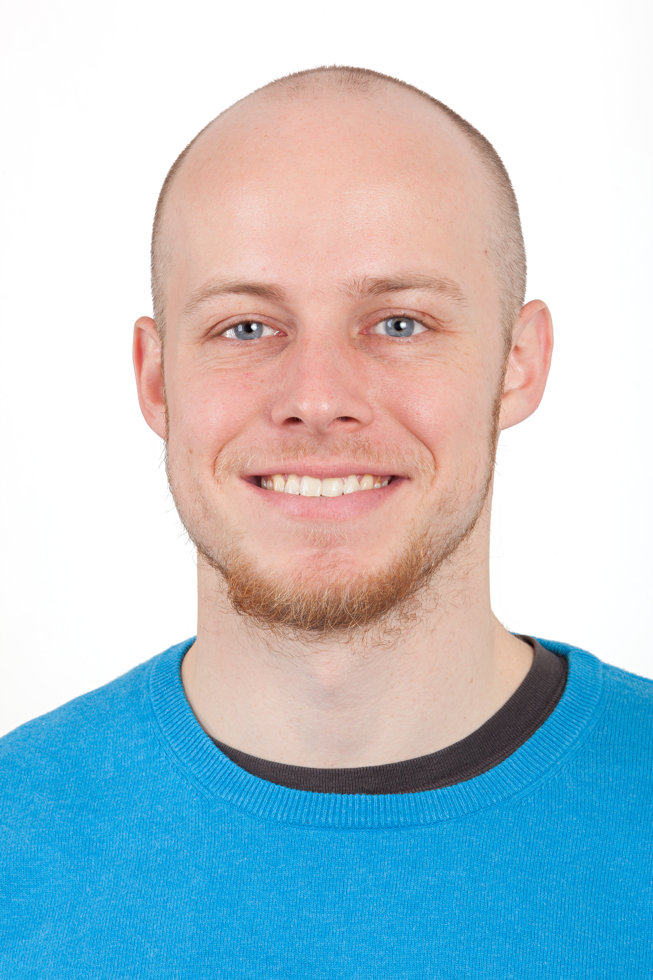
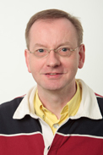
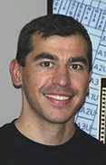
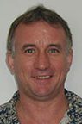
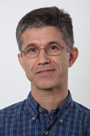
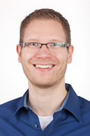
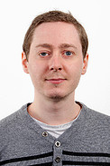
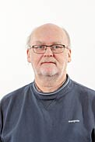
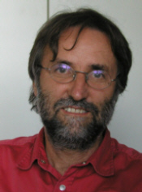
ESO Detector Systems Group
Derek Ives
Simon Tulloch
Naidu Bezawada
Joshua Hopgood
Domingo Alvarez Mendez
Liz George
Christopher Mandla
(PhD student)
Olaf Iwert
Javier Reyes
Mark Downing
Leander Mehrgan
Matthias Seidel
Benoit Serra (Fellow)
Roland Reiss
Gert Finger (Emeritus)
Currently 15 strong: mix of physicists, FPGA/ electronics/detector engineers, plus students and fellows.
We design, build, characterize, deliver, and support detector systems at ESO’s observatories.
  Full system design: software, electronics, mechanics, detectors, etc.
  Many detector technologies covering Visible to Mid-infrared.
  Scientific and AO detector systems.
Notes:
Who is the detector group? What do we do? Core capabilities

Slide 4
Operational (Science) Detectors at ESO with data in the archive
Instrument | IR detector
SINFONI | 1x H2RG (2x2k)
HAWKI | 4x H2RG (2x2k)
X-SHOOTER | 1x H2RG (2x2k)
SPHERE | 2x H2RG (2x2k)
GRAVITY | 2x H2RG (2x2k)
MATISSE | 1x H2RG (2x2k), 1x AQUARIUS (1kx1k)
KMOS | 3x H2RG (2x2k)
VIRCAM | 16x VIRGO2K (2x2k)
VISIR | 1x AQUARIUS (1kx1k)
Instrument | VIS detector
ESPRESSO | 2x CCD-290 (9x9k)
MUSE | 24x CCD231-84 (4x4k)
X-SHOOTER | 1x CCD84-42 (4x2k) 1x CCD MIT/LL CCD ID20
SPHERE | 2x CCD
FORS1 | 2x CCD84-42 (4x2k)
FORS2 | 1x CCD (4x2k)
OMEGACAM | 32x CCD-44-82 (4x2k)
UVES | 1x CCD-20, 1x CCD-40, 1x CCD (4x2k)
VIRCAM | 6 x CCD42-40
VIMOS | 1x CCD (2x2k)
+ >20 detectors coming in next few years for new VLT instruments!
(e.g. MOONS, 4MOST)
Notes:
We support a massive number of detectors on many different instruments......

Slide 5
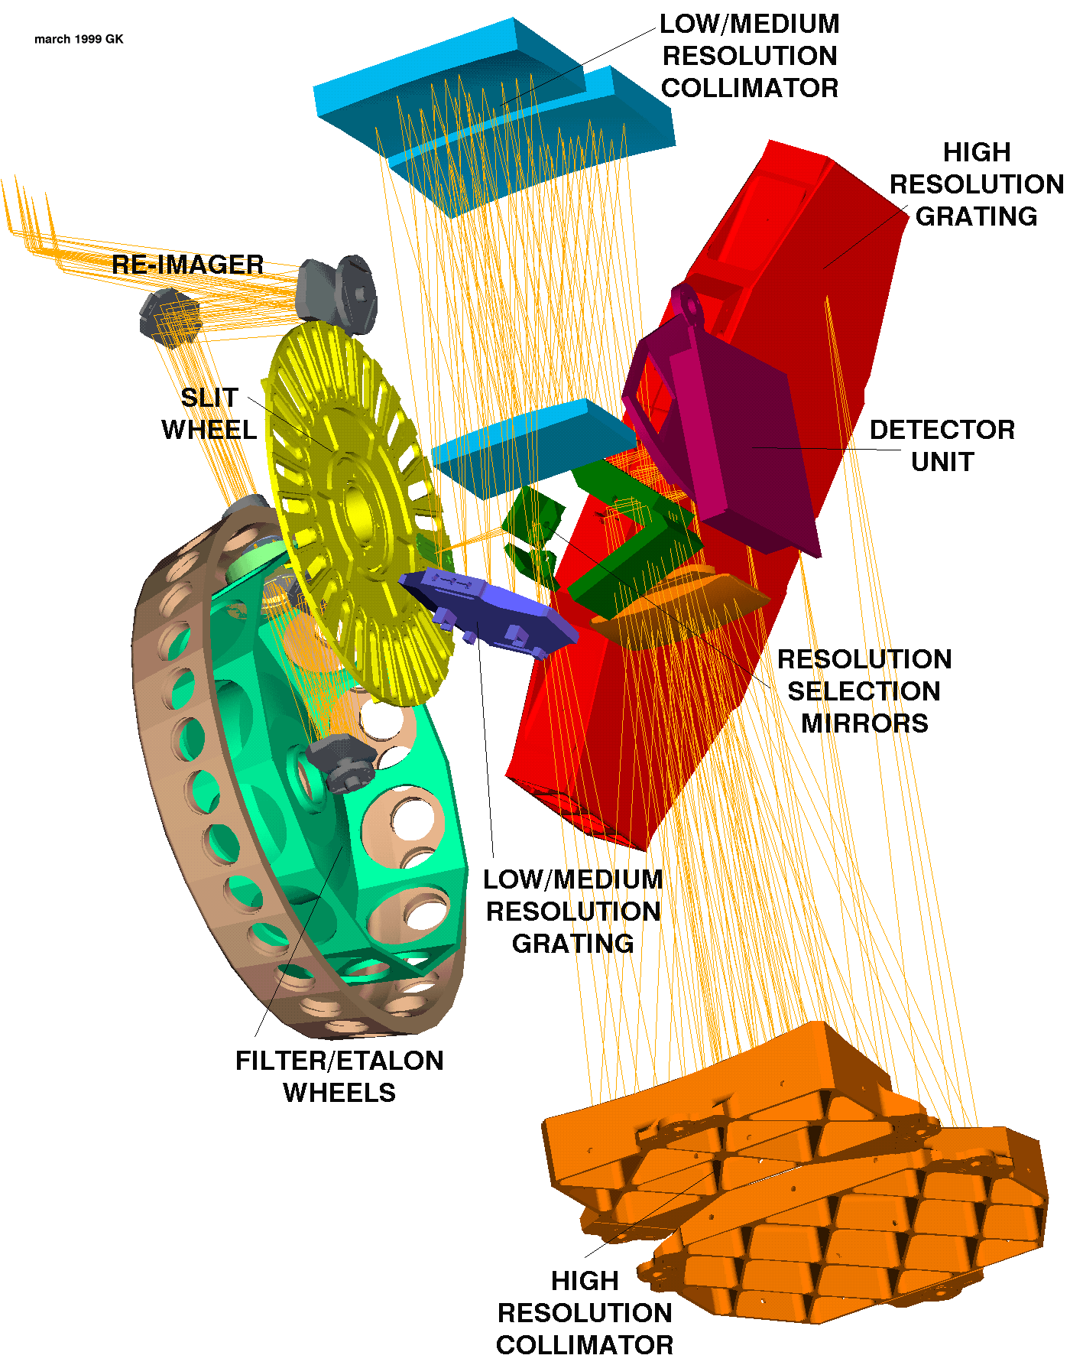
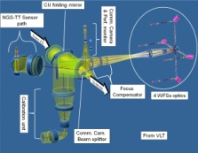
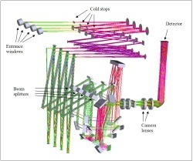
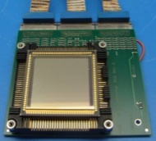
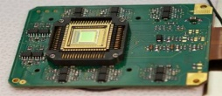
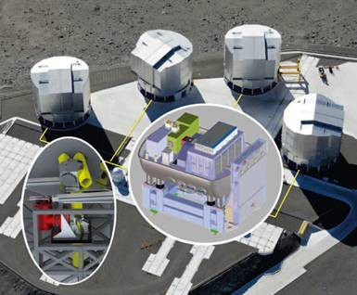


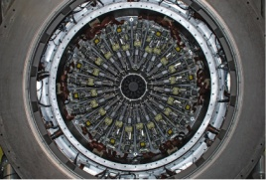
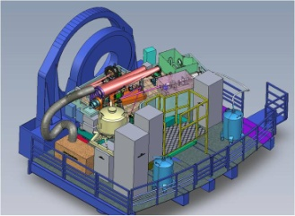
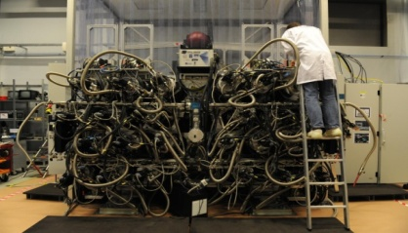
NGC use at ESO
GALACSI / GRAAL
VISIR
MATISSE
AQUARIUS
MID-IR
AO
NIR
MID-IR
NGC
NIR WFS
GRAVITY
SAPHIRA
NIR
NIR
Visible
Visible WFS
Visible
SPHERE
MUSE
Notes:
That‘s why we developed our own controller. 1 thing to design, build, test, characterize, and model.

Slide 6
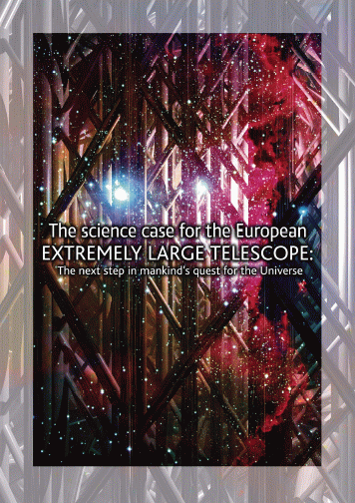
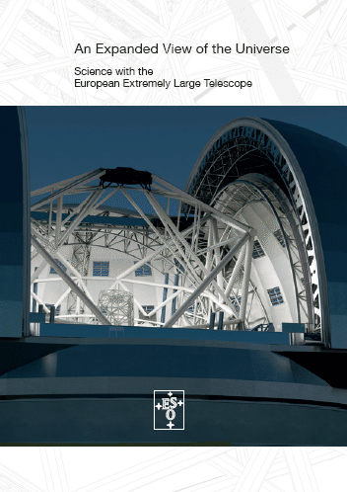
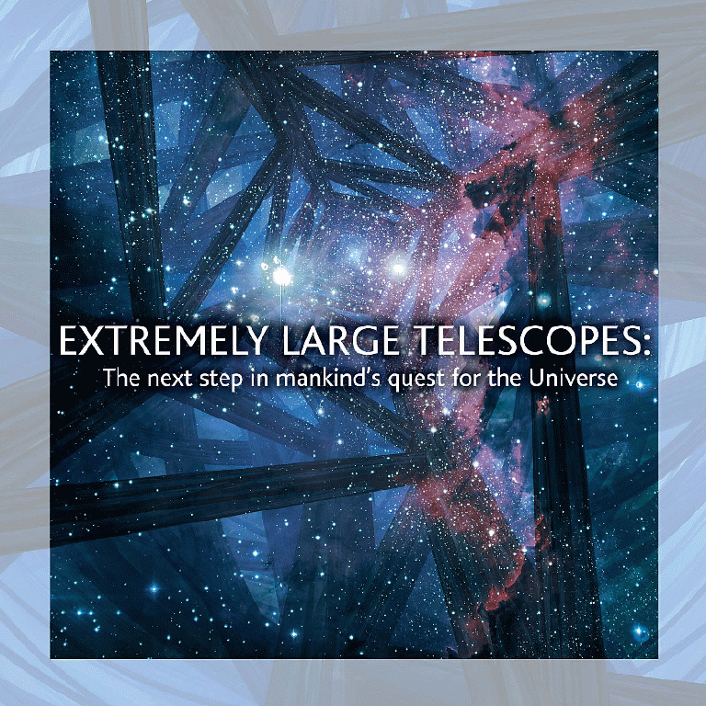
ELT Science Cases
Planets and Stars Comets Intra- and Extra- solar-system comets Extrasolar planets: - Atmospheric characterization - imaging - radial velocities Free-floating planets Stellar clusters (inc. Galactic Centre) Magnetic fields in star formation regions Origin of massive stars LMC field star population - astrometery Circumstellar disks, young and debris Stellar remnants Asteroseismology Stars and Galaxies Intracluster population - Colour-Magnitude diagrams - Spectroscopy of IRGB stars Planetary nebulae and galaxies Stellar clusters and the evolution of galaxies Resolved stellar populations: - Colour-Magnitude diagram Virgo - abundances & kinematics Sculptor galaxies - abundances & kinematics M31- CenA Spectral observations of star clusters: - internal kinematics & chemical abundances - ages and metallicities of star cluster systems | Young, massive star clusters - imaging - spectroscopy The IMF throughout the Local Group Star formation history through Supernovae - search, light curves, spectroscopy Black holes/AGN Galaxies and Cosmology Dark energy: Type Ia SNe as distance indicators - search, light curves, spectroscopy Dynamical measurement of universal expansion Constraining fundamental constants First light - the highest redshift galaxies Galaxies and AGN at the end of reionization Probing reionization: GRBs and quasars Metallicity of the low-density IGM IGM tomography - bright LBGs and quasars - faint LBGs Galaxy formation and evolution: Physics of high-z galaxies - integrated spectroscopy - high resolution imaging - high spatial resolution spectroscopy Gravitational lensing Deep Galaxy Studies at z=2-5
Radial Velocity
Astrometry
High Resolution Spectroscopy
6

Slide 7
ELT science detectors
59 science detectors on ELT, wavelength range 0.37-28 µm, serving tens of different science cases.
Instrument | Number of Detectors | Pixel format | Wavelength µm
MICADO | 9 H4RG (2.5 µm) | 4kx4k | 0.8-2.5
HARMONI | 8 H4RG (2.5 µm) | 4kx4k | 0.8-2.45
 | 4 TBD | 4kx4k | 0.47-0.95
METIS | 1 AQUARIUS | 1kx1k | 5-14(28)
 | 5 H2RG (5.3 µm) | 2kx2k | 3-5
ELT-MOS | 5 TBD | 4kx4k | 0.6-1.7
 | 6 TBD | 6kx6k | 0.37-1
ELT-HIRES | 4 TBD | 4kx4k | 0.8-2.45
 | 5 TBD | 9kx9k | 0.3-0.8
ELT-PCS | 4 TBD | 4kx4k | 0.95-1.65
 | 8 TBD | 4kx2k | 0.6-0.9
1st
generation

Slide 8
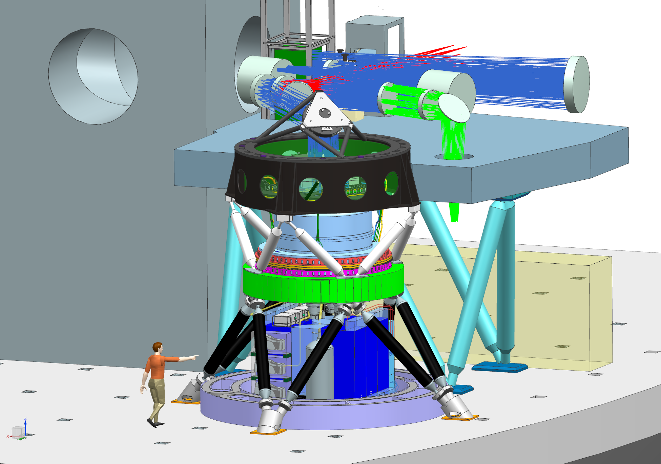
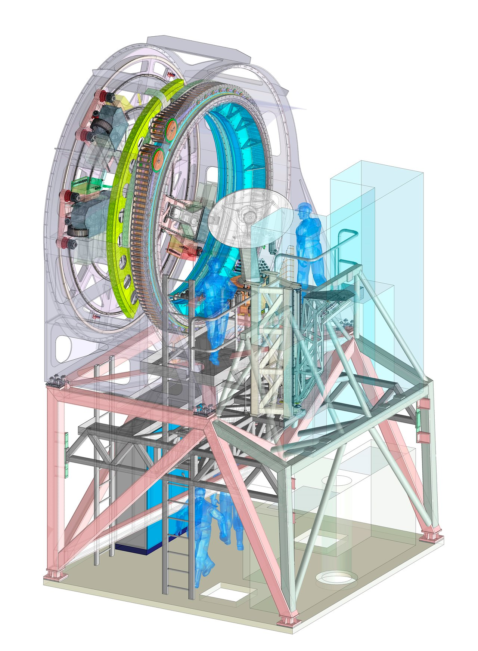

MICADO-MAORY
MAORY
Pre-focal station
MICADO

Slide 9
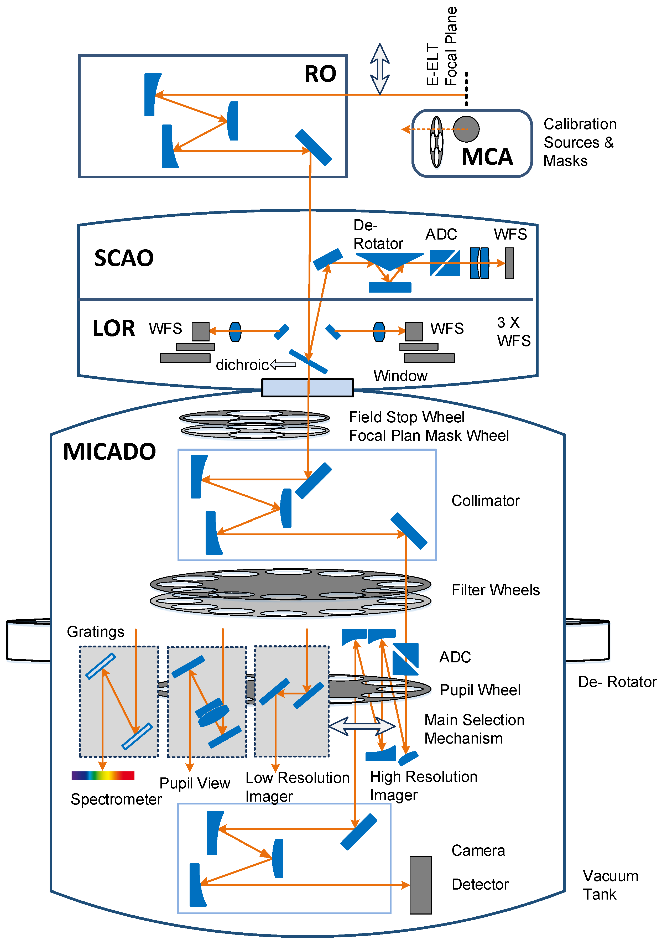
MICADO- MAORY Tech Specs
Imaging from 0.8-2.4µm, > 30 filters
MAORY LGS, conjugated at 4 + 16 km.
Pixel scales of 4mas (FoV ~53”) and 1.5mas (FoV ~20”)
Astrometric imaging to 50µas precision
Photometric accuracy 0.02mag (0.01mag)
Coronagraph plus single conjugate AO
Spectroscopy for single compact objects
  two settings (0.8-1.44µm and 1.21-2.4µm) at spectral resolving power up to 20,000.
  Baseline 3arcsec slit; >16mas width
5σ, 5hr sensitivity (MAORY Strehl = 60%): K_{AB} ~ 29.5 (38%) H_{AB} ~ 30.4 (19%) J_{AB} ~ 29.7 (5%)
Image credit: MICADO consortium: PI: R. Davies, MPE, MPIA, USM, NOVA, IAG, CNRS, INAF, A*, ESO

Slide 10
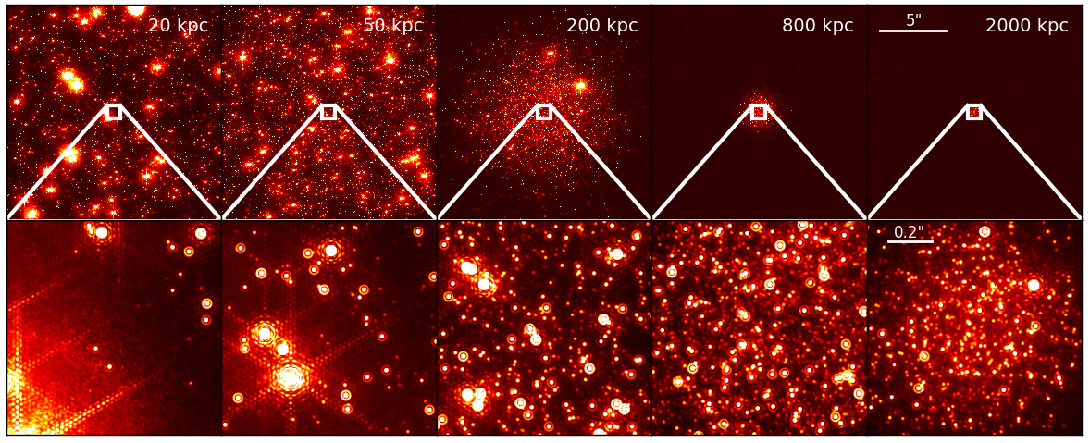
MICADO Science – Dynamics of dense stellar systems
Goal is to achieve 2 µas/year measurement of stellar motion over 10 years → Astrometric precision on detector required to be 10⁻³ of a pixel.
SimCADO images of an M4-like cluster at 50, 200, & 800 kpc.
Panels are 16” (central detector) and a 1” zoom.
Credit: MICADO consortium

Slide 11
MICADO - Astrometry
What are we worried about?
Measurement accuracy of 10⁻³ in pixel space required.
  Read direction
  Cross-hatch (and PRNU)
  Brighter-fatter effect
  Non-linearity
  IPC

Slide 12
HIRES Tech Specs
Wavelength range ~0.4-1.8 μm
Spectral resolving power R > 100,000, Stability ~1m/s
Fibre-fed echelle spectrograph
4 top priority science cases
  Exoplanet atmospheres
  Fundamental constants
  Exoplanet atmospheres in reflection
  The Sandage Test
See also Maiolino et al. arXiv 1310.3163
Image credits: HIRES consortium
HIRES consortium: Federal Univ. of Rio Grande do Norte, Mauá Institute of Technology, Pontificia Univ. Catolica de Chile, Univ. de Chile, Univ. de Concepcion, Univ. de Antofagasta, Univ. of Copenhagen, Univ. of Aarhus, Danish Technical University,Laboratoire d’Astrophysique de Marseille, Institut de Planétologie et d’Astrophysique de Grenoble, Laboratoire LAGRANGE de l’Observatoire de la Côte d’Azur, Astrophysics Institute Potsdam, Univ. Göttingen, Landessternwarte Heidelberg, Thüringer Landesternwarte Tautenburg, Univ. Hamburg, Nicolaus Copernicus Univ. in Toruń, Inst. Astrofísica e Ciências do Espaço, Inst. Astrofísica de Canarias, Inst. Astrofísica de Andalucía , Uppsala Univ., Univ. de Genève, Univ. Bern, Univ. of Cambridge, UK Astronomy Technology Centre, Durham Univ., Heriot-Watt Univ.

Slide 13
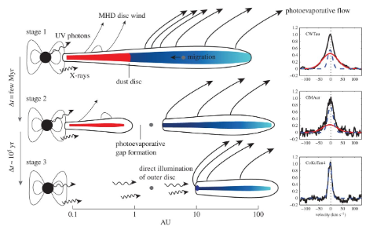
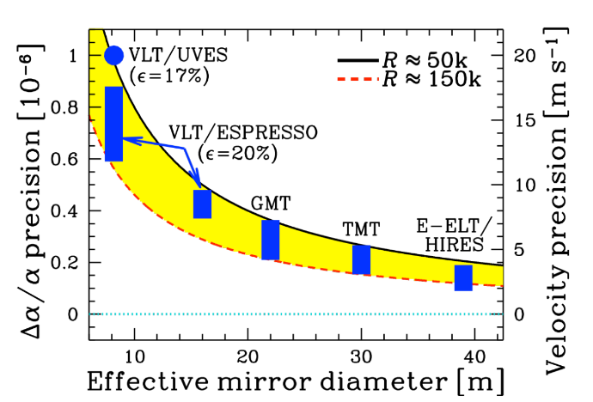
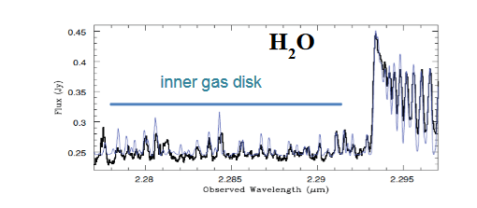
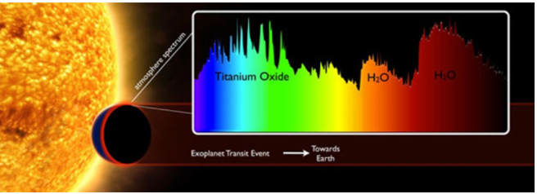
HIRES science
HIRES radial velocity capabilities
Exoplanet atmospheres in transmission (and reflection)
Image credit: HIRES consortium

Slide 14
HIRES – Precision RV
What are we worried about?
Spectroscopy, requirement of < 1 m/s RV measurements.
  Persistence
  Binary offset effect
  PRNU
  Read-direction
  Thermal Stability of detector

Slide 15
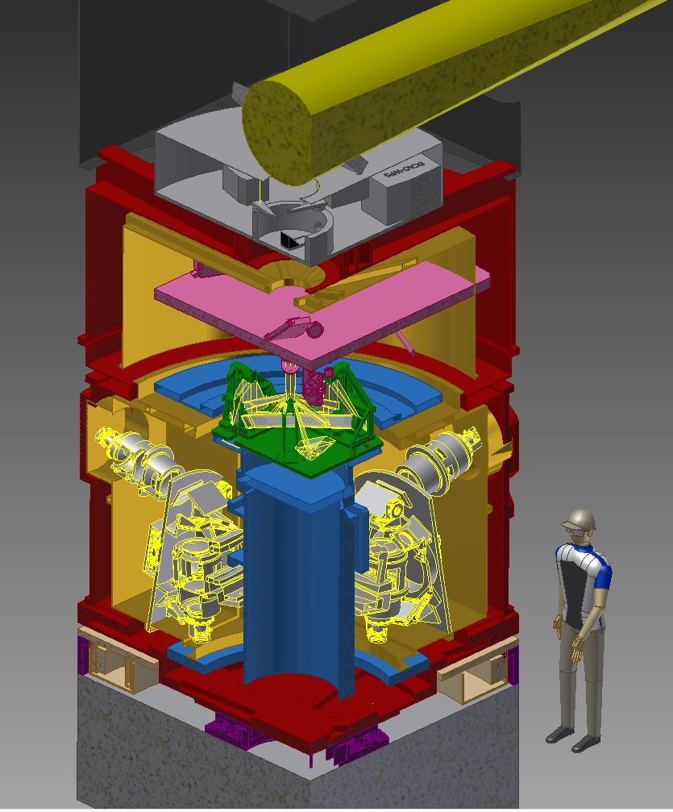
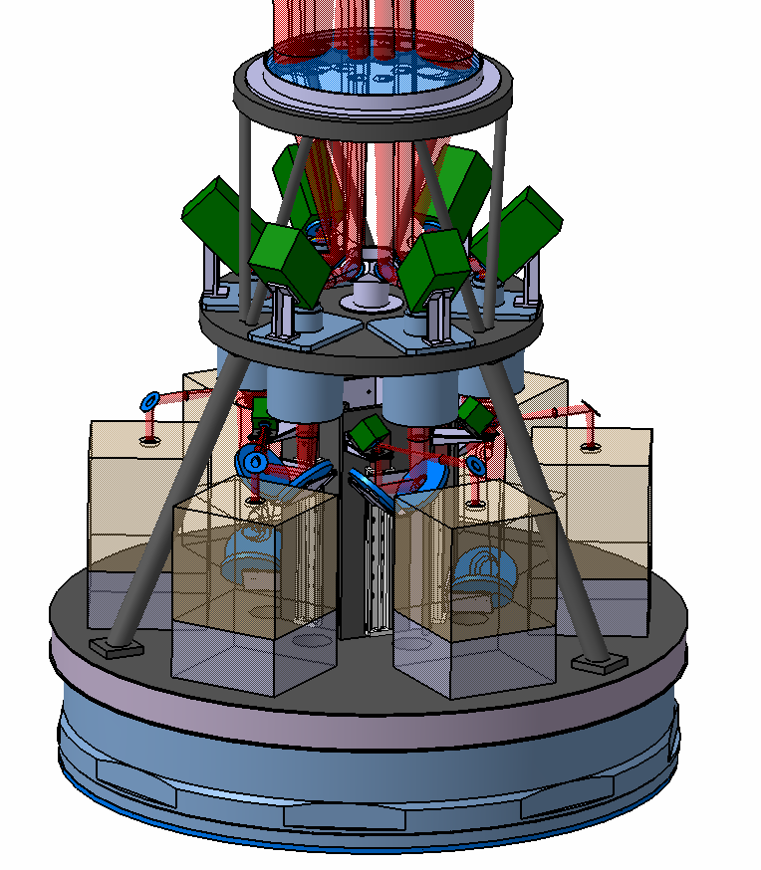
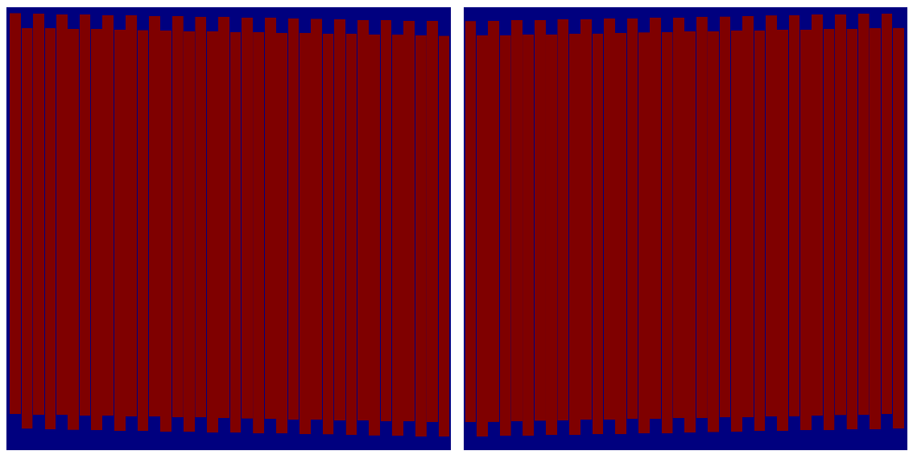
HARMONI Tech Specs
Covering optical (0.47μm) to near-IR (2.45μm) with >10 different diffraction gratings!
Resolving power from R=3500 to 20000
Range of spatial scales with field of views from 9”x6” to 0.8”x0.6” and 32000 spaxels
From seeing limited observations to the diffraction limit with single conjugate AO (SCAO) and laser tomographic AO (LTAO)
Quarter view of the HARMONI spectrometer cryostat.
~ 4m in diameter, cooled to ~140K.
Φ 1600
HARMONI-LTAO concept uses 6 laser guide stars to deliver diffraction limited images over the full sky visible from ELT
Image credits: HARMONI consortium
ELT Instruments, TLC2018, Oct 2018
15

Slide 16
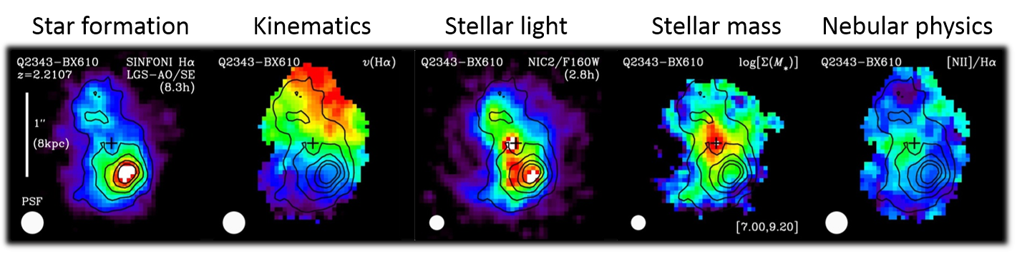
HARMONI Science
Understanding the physical processes governing galaxy formation and evolution by studying individual clumps at z>>1.
Close relationship between star-formation rate and stellar mass well established to z~3 .
At earlier times galaxies are more turbulent, clumpy, star-forming, gas-rich.
Figure 5.1: Different views of a massive z=2.21 SFG revealed by SINFONI+AO observations in the K band and HST J and H band imaging (the cross marks the kinematic centre). With a PSF FWHM ~0.2″, the data resolve detailed structures on ~1.5kpc scales, notably bright off-centre star-forming clumps in Hα (left panel)

Slide 17
HARMONI – faint spectroscopy
What are we worried about?
Faint measurements of continuum required.
  Bias offsets
  ¹/_{f} noise/banding
Many different gratings → bright OH lines move from setup to setup.
  Persistence

Slide 18
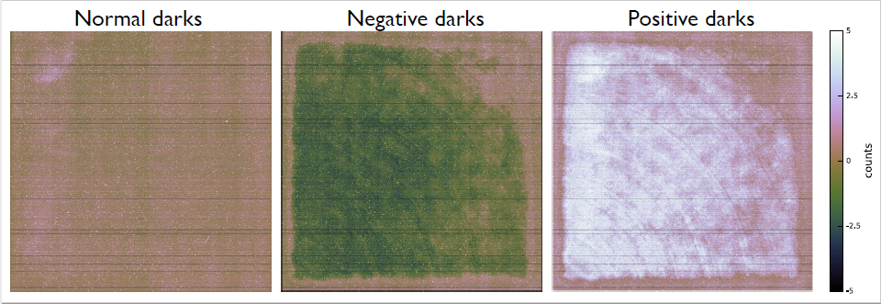
Bias offsets
Image credit: KMOS/Trevor Mendel

Slide 19
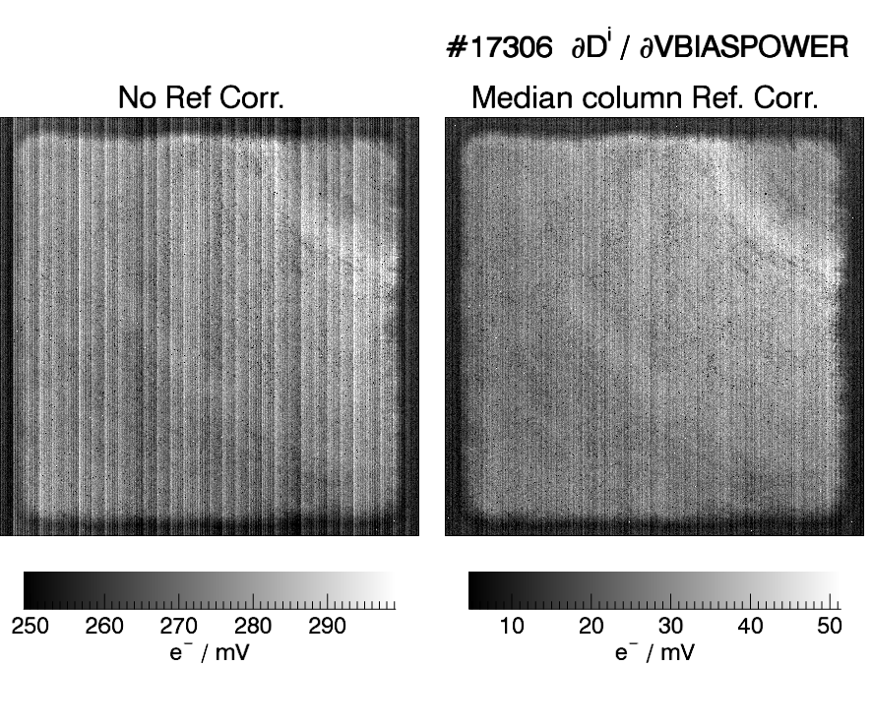
Bias Voltage Fluctutations
Stability requirement to get < 1 e- Picture frame in 99% pixels:
No reference pixel subtraction: < 3 µV RMS
With reference pixel subtraction: < 15 µV RMS
→ NGC2 design for ELT will use these numbers as design goals.

Slide 20
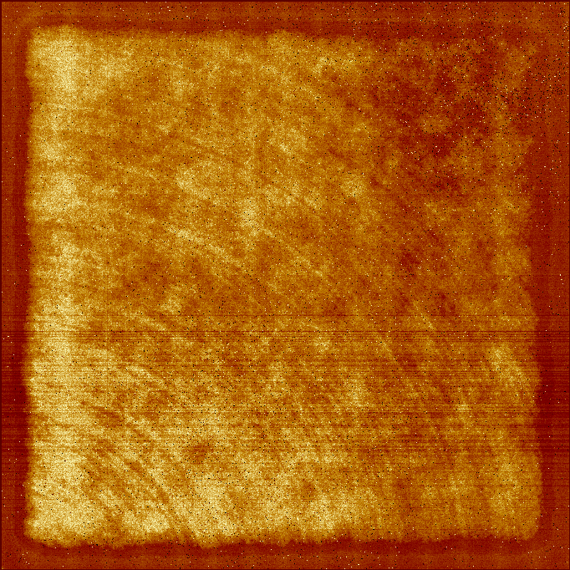
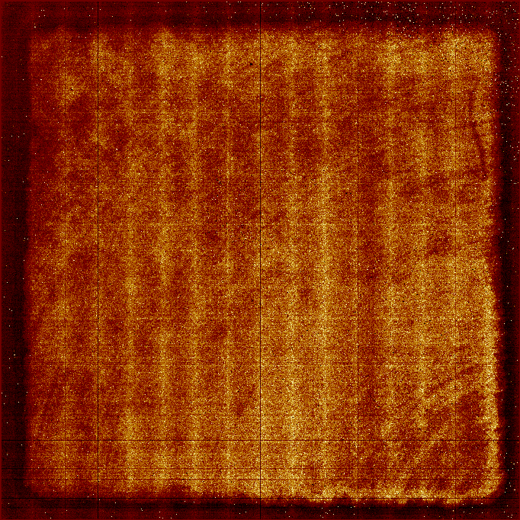
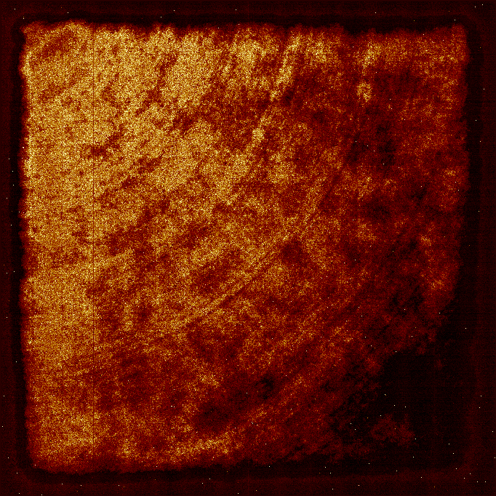
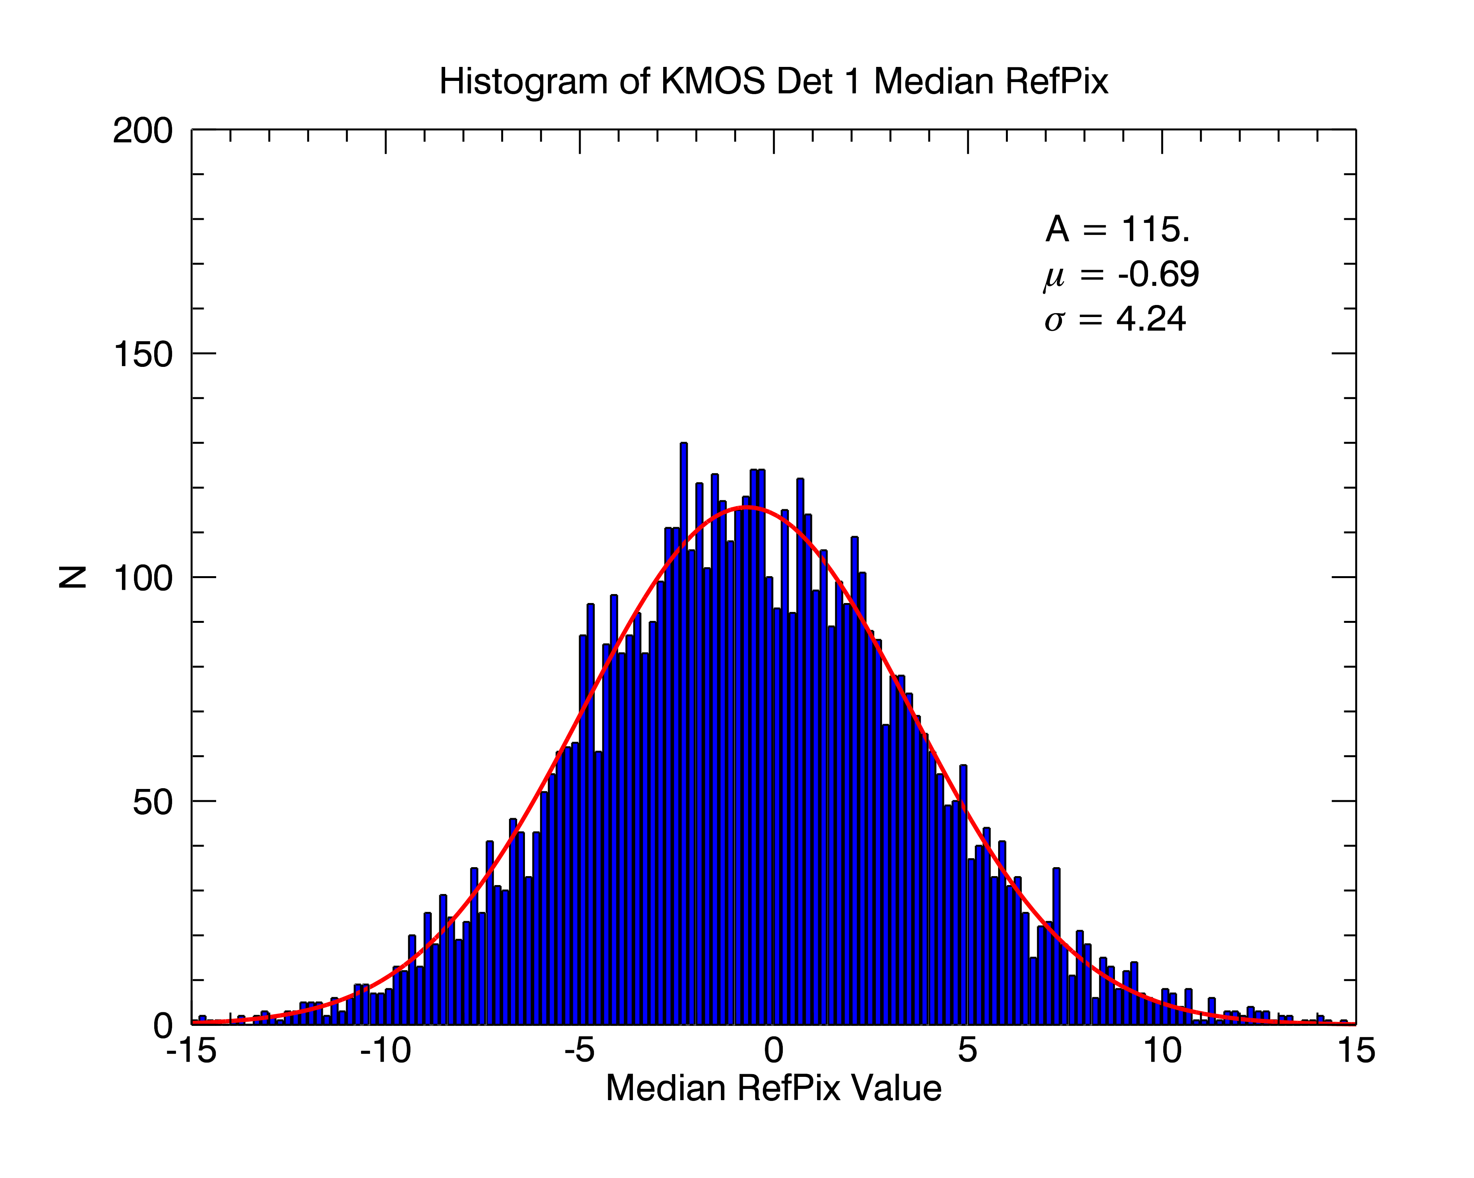
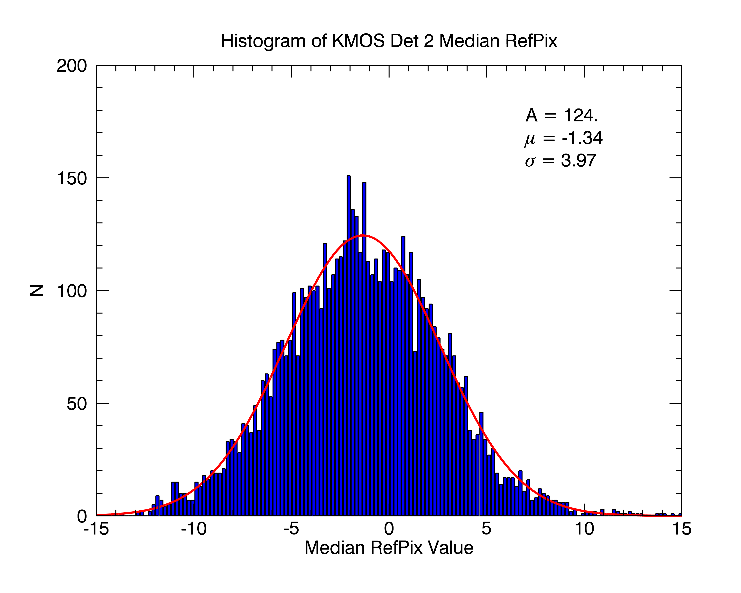

Bias offset correction
Detector 1
Detector 2
Detector 3
dPix/dRefpix
dPix/dRefpix
dPix/dRefpix

Slide 21
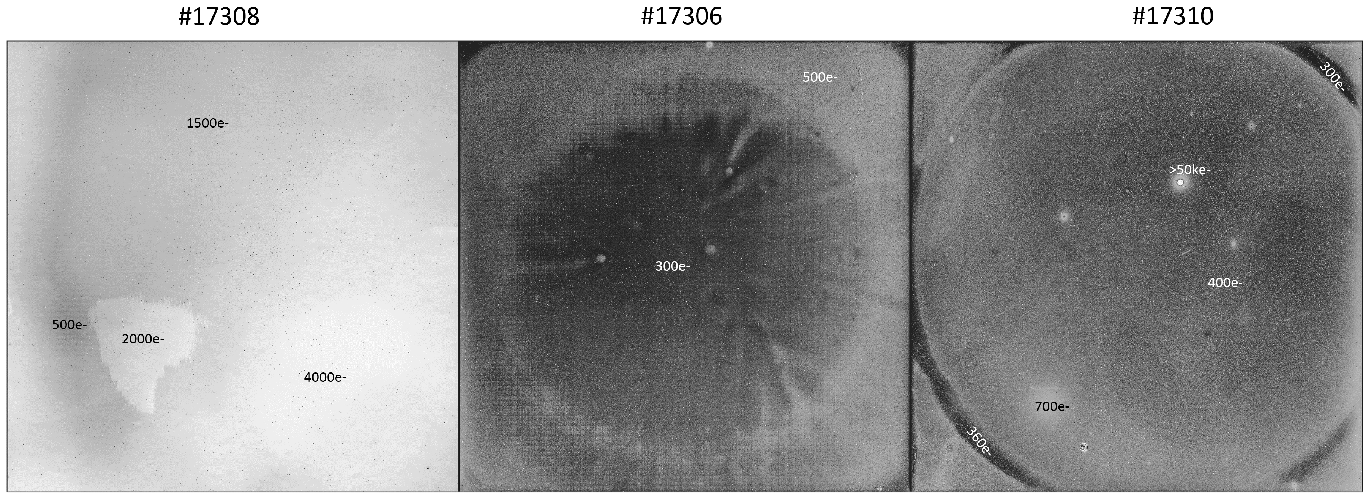
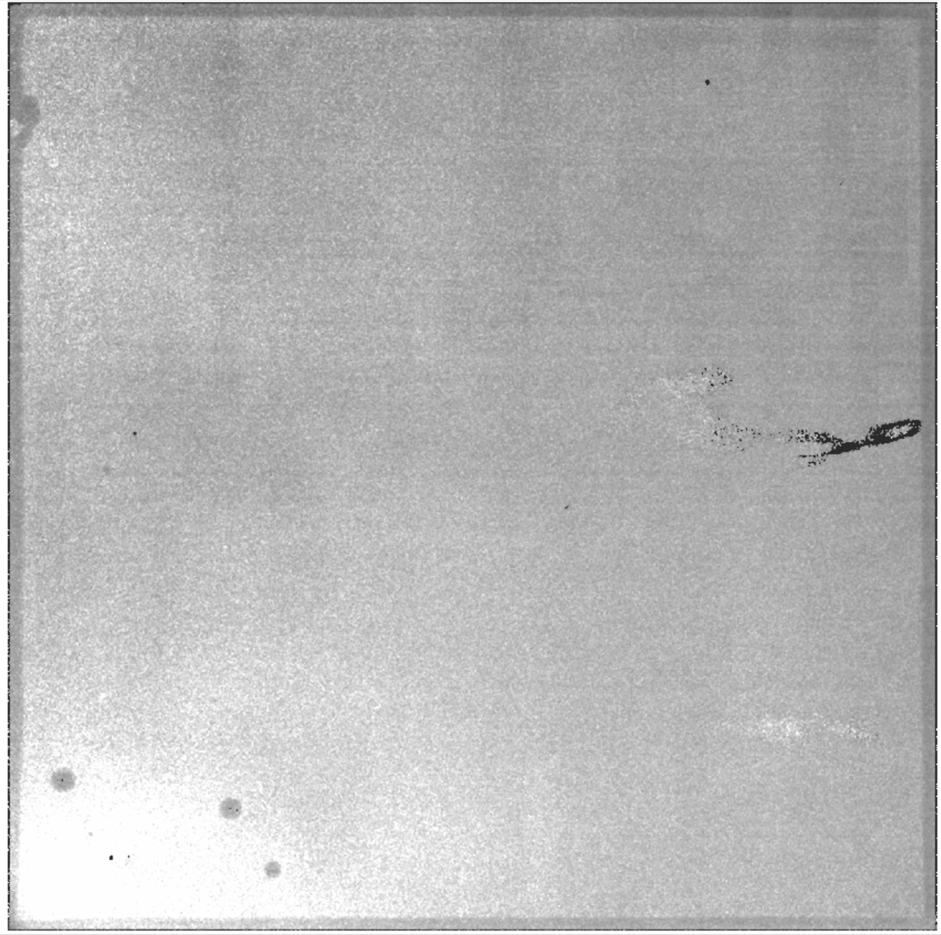
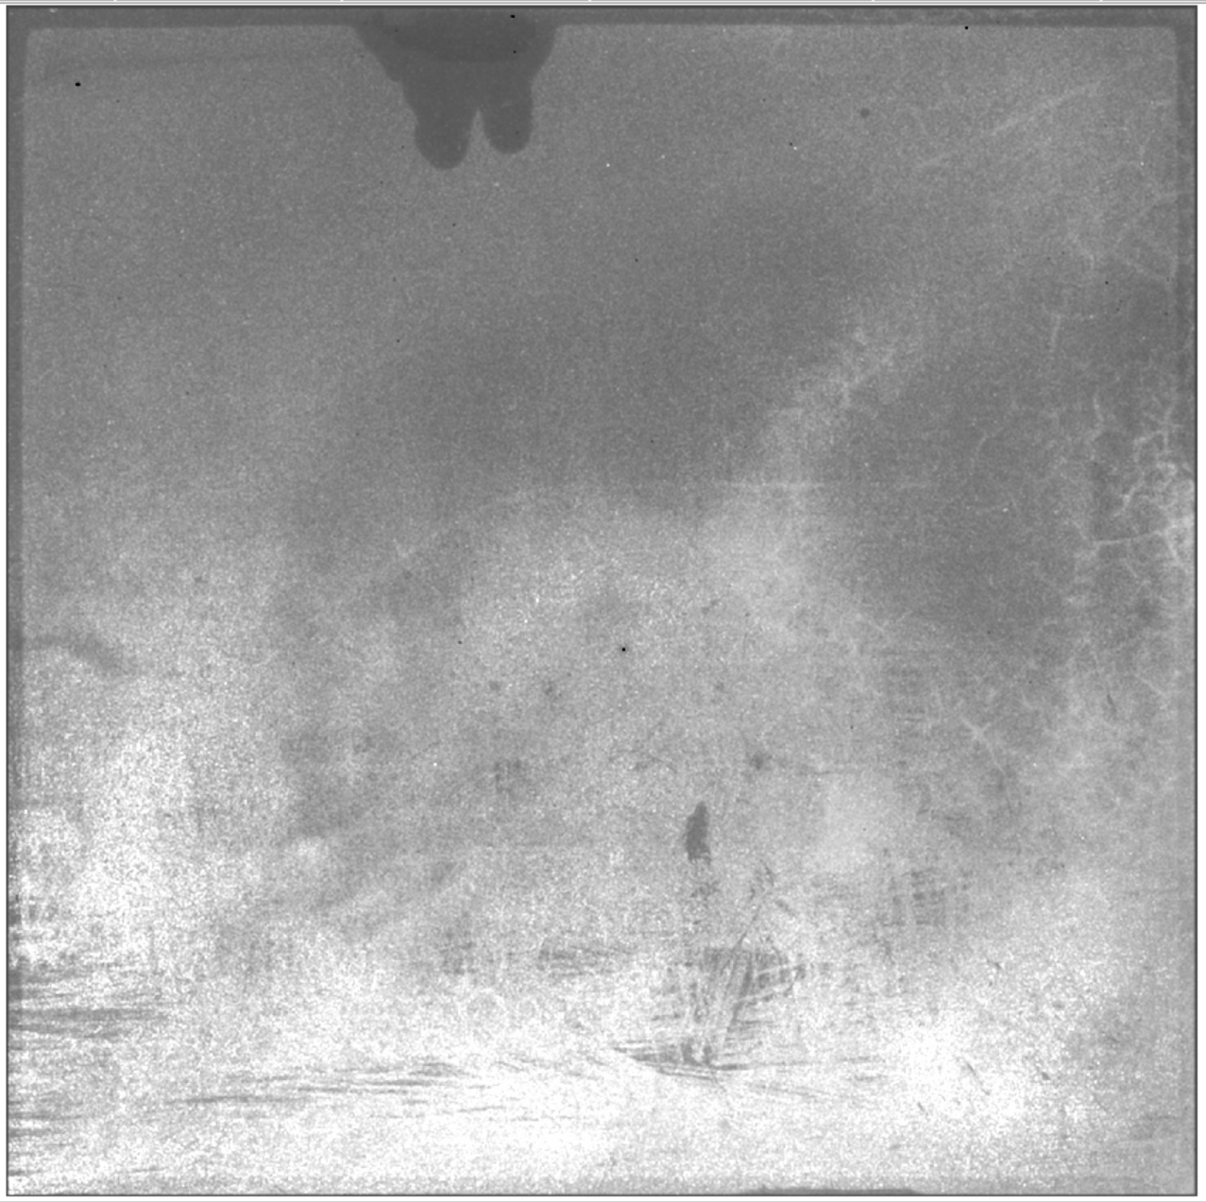
Persistence maps (H2RG)
Large differences from detector to detector. Typically up to 1.5% of the
photocharge can be stored in traps.
5.3um
#G18853 (5.3um)
#G18832 (2.5um)

Slide 22
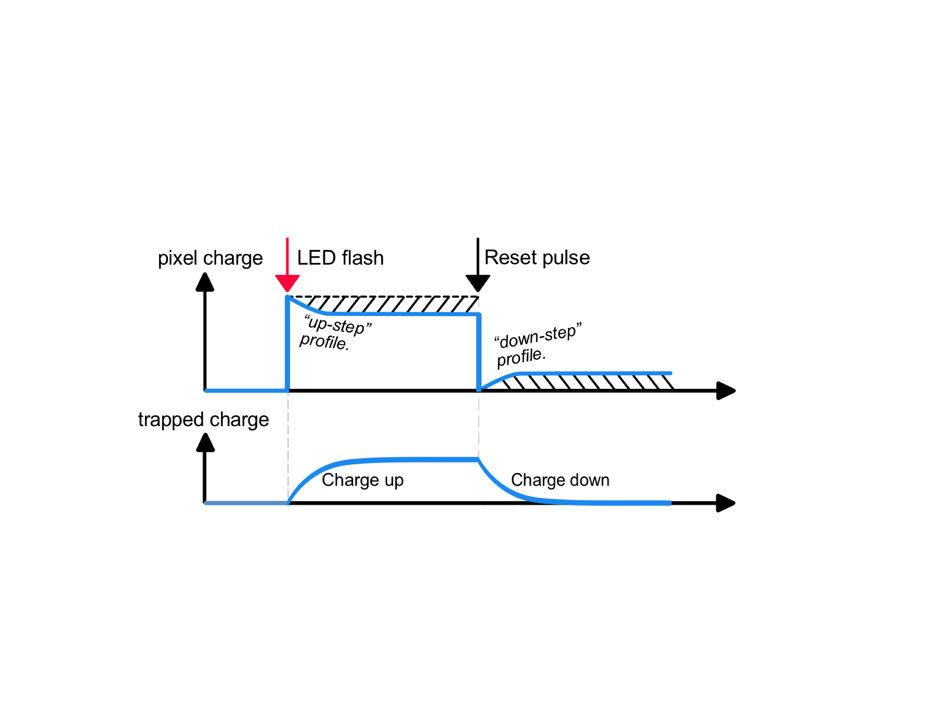


Charge trapping
$$\frac{τ_{trapping} .τ_{detrapping}}{τ_{trapping}+τ_{detrapping}}$$
$$τ_{detrapping}$$

Slide 23

Charge detrapping
Memory effect of previous exposure.

Slide 24

Detrapping time constants

Slide 25


Persistence Processor
Trap time constants are first characterized. The processor then keeps a running total
of the charge trapped in each pixel for each
time-constant bin
5 trap time constants used.
Trap density
Digital filter representation

Slide 26

Persistence Model Results
Predicts decay of trapped charge (i.e. persistence signal) following a
typical observation sequence.
Paper in Prep. Look for it in early 2019!

Slide 27

Persistence Model Results
Correcting persistence over 8500s in ERIS-NIX
Dark reference
Corrected by model
Previously
illuminated
Dark reference
Raw
Previously
illuminated
Being implemented for ERIS using model and automatic archiving of all detector images.

Slide 28


ELT Detector Characterization
FIAT – Facility for Infrared Array Testing
- 2 x H4RG mounting possible
- Also operation of MWIR detectors, 30K - - Low thermal background, cold stop design
- All data archived
PLC controlled
Filter and ND wheels, cold shutter slide
Also measure detector reflectance
Sub-pixel scanning
External black body, internal calibration diodes
Complete turn-around in 1 day

Slide 29

ELT Detector Characterization
FIAT – Facility for Infrared Array Testing
- 2 x H4RG mounting possible
- Also operation of MWIR detectors, 30K - - Low thermal background, cold stop design
- All data archived
PLC controlled
Filter and ND wheels, cold shutter slide
Also measure detector reflectance
Sub-pixel scanning
External black body, internal calibration diodes
Complete turn-around in 1 day

Slide 30
Testing philosophy
Comprehensive
Standardized
Searchable/Linkable
PRNU
QE
Cosmetics
IPC
Reciprocity Failure
Picture Frame
Channel offsets
Persistence
Cross-talk
Full well
Dark Current
Read noise
Linearity
?

Slide 31
Building a Detector Model
Reference pixel correction
Wavelength
ACN
QE
Read Speed
IPC
Cosmetics
Bias Voltage Variations
Picture Frame
Reciprocity Failure
?
?
Temperature Variations
Channel offsets
Persistence
“Epoxy” pattern
Full well
Temperature
Cross-talk
Read noise
Bias voltages
Dark Current
?
Exposure
Linearity
?
Fluence
?
See e.g. PyXel being developed by ESA: https://doi.org/10.1117/12.2314047

Slide 32

Pipeline correction
Reference pixel
correction
Persistence map?
Picture Frame map?
Cross talk?
Amplifier offsets?
ELT working group on detectors:
What properties do we correct, to what level, for each science case?

Slide 33
Conclusion
Almost every known detector effect affects some ELT science case and most detectors are used for a wide variey of science.
Scientists, detector, and electronics engineers collaborate closely to:
  Continuously develop new hardware (e.g. controller) to improve science performance.
  Define detector characterization requirements.
  Build detector models to:
    assess impact of effects on science cases
    plan operational concepts
    Develop calibration/pipeline corrections

Slide 34

Many thanks!
Contact us if you would like to talk detector systematics: egeorge@eso.org Twitter: @egroegzil
Content for this presentation provided by:
  ESO detector group
  Susanne Ramsay (ELT Instruments project lead)
  HARMONI, MICADO, and METIS scientists and consortia

