Slide 1
Advances in Charge-Coupled Devices at MIT Lincoln Laboratory
C. Leitz, B. Burke, V. Suntharalingam, M. Cooper, M. Zhu, K. Ryu, S. Rabe, D. Young, R. Lambert, H. Clark, B. Felton, D. O’Mara, R. Reich, X. Chen, D. Schuette (MITLL)
M. Bautz, G. Prigozhin, B. LaMarr (MIT-MKI)
christopher.leitz@ll.mit.edu
4 December 2018
DISTRIBUTION STATEMENT A. Approved for public release. Distribution is unlimited.
This material is based upon work supported by the Assistant Secretary of Defense for Research and Engineering under Air Force Contract No. FA8702-15-D-0001. Any opinions, findings, conclusions or recommendations expressed in this material are those of the author(s) and do not necessarily reflect the views of the Assistant Secretary of Defense for Research and Engineering.
© 2018 Massachusetts Institute of Technology.
Delivered to the U.S. Government with Unlimited Rights, as defined in DFARS Part 252.227-7013 or 7014 (Feb 2014). Notwithstanding any copyright notice, U.S. Government rights in this work are defined by DFARS 252.227-7013 or DFARS 252.227-7014 as detailed above. Use of this work other than as specifically authorized by the U.S. Government may violate any copyrights that exist in this work.

Slide 2
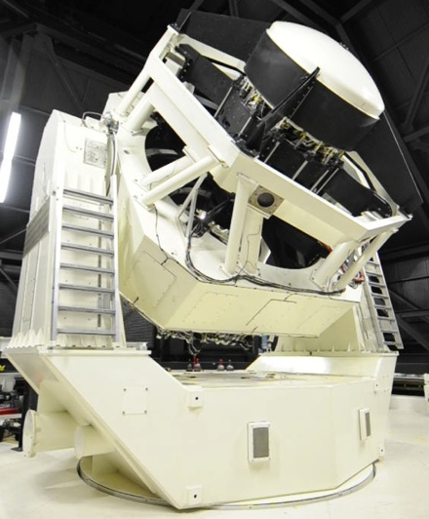
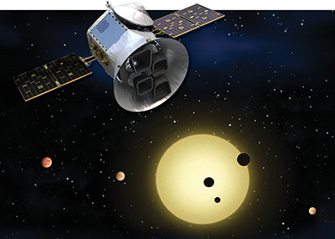
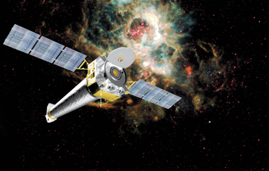
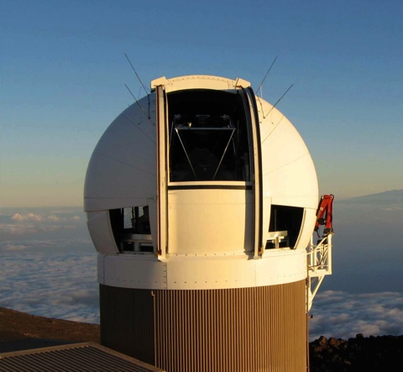
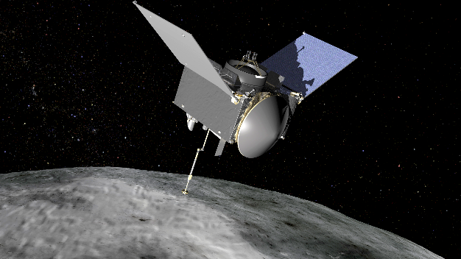
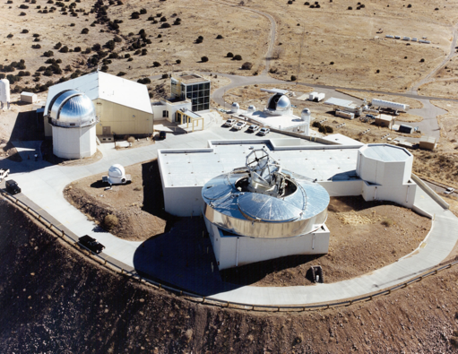
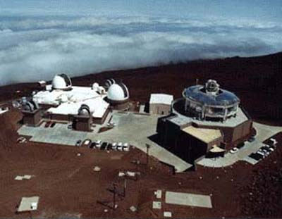
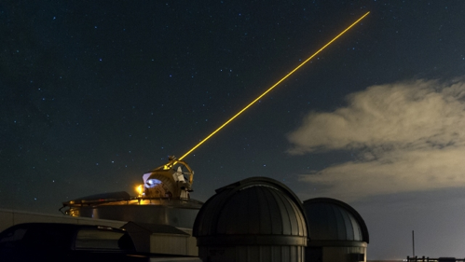
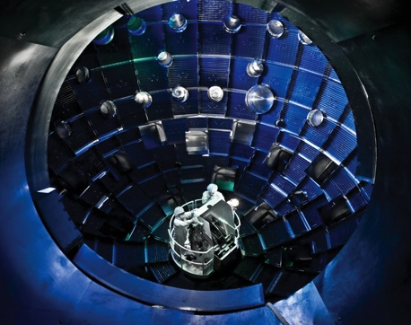
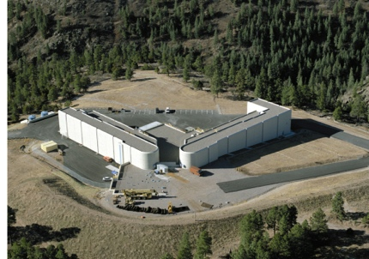
Unique Focal Planes in Support of National Security and Science
Space-Based Astronomy (Astrophysics, Exoplanet Detection, Asteroid Exploration)
Astronomy & Near Earth Object Detection
Space Surveillance
Nuclear Stockpile Stewardship (LANL)
Directed Energy
AFRL SOR
National Ignition Facility (LLNL)
AMOS (AF)

Slide 3
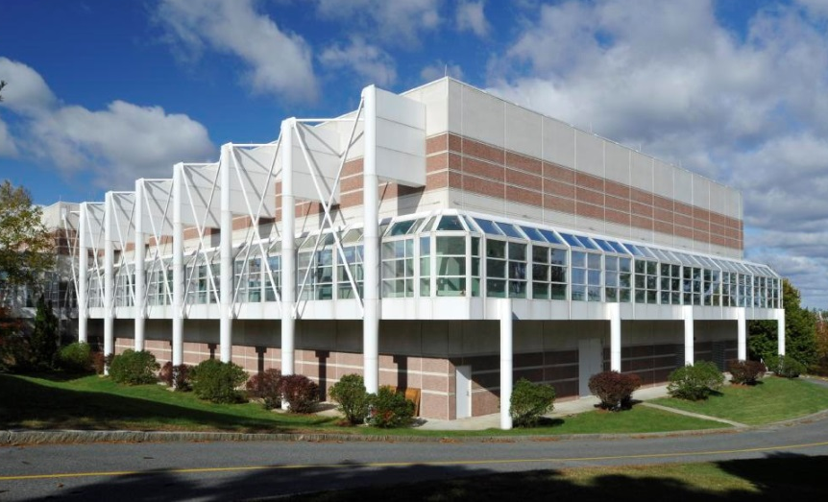
MIT-LL Microelectronics Laboratory An Enabling Resource for Advanced CCD Fabrication
70k ft², 8100 ft² Class-10, 10,000 ft² Class-100
Production-class 90-nm toolset on 200-mm wafers
Lithography capabilities from i-line to e-beam
Process capabilities include CCDs, APDs, low power FDSOI CMOS, 3D integration

Slide 4
Outline
Large-format CCDs running at low clock voltage
Wafer-scale direct bonding for molecular-beam epitaxy back surface passivation
CCDs built on bulk germanium

Slide 5
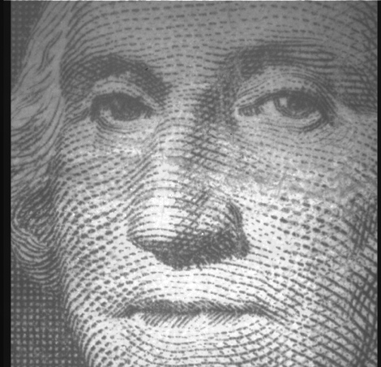
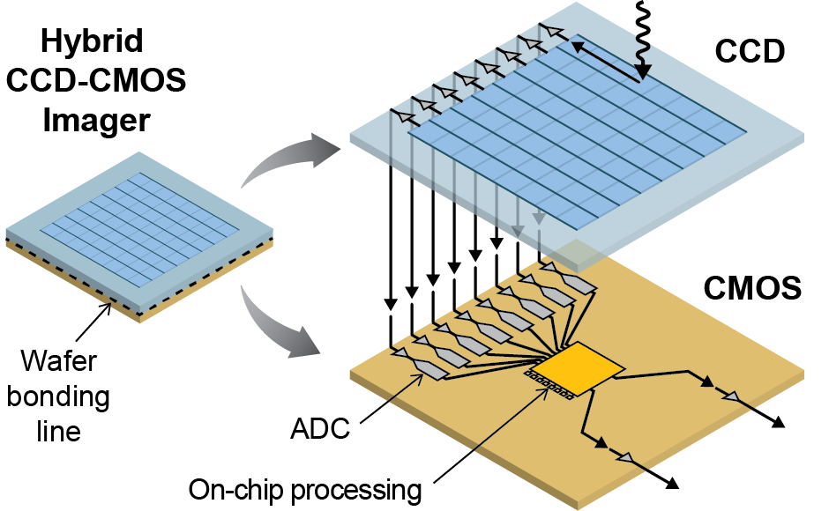
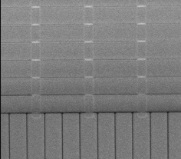
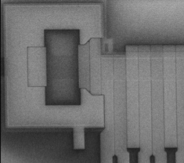
Roadmap for Next-Generation Silicon CCD Capabilities
Low-Voltage CCDs
Novel Low-Noise Amplifiers
High-Speed Focal Planes
512x512, 8-µm pixel CCD operation at 2V
8µm
8µm
100nm
Modified design & fab to enable CCDs running at CMOS-compatible clock voltages
New sub-electron read noise, non-destructive amplifier under development
Tight coupling of focal plane to ADCs via 3D integration for high-speed continuous imaging
M. Bautz, et al., Proc. SPIE 10699 (2018), M. Bautz, et al., submitted to JATIS (2018).

Slide 6
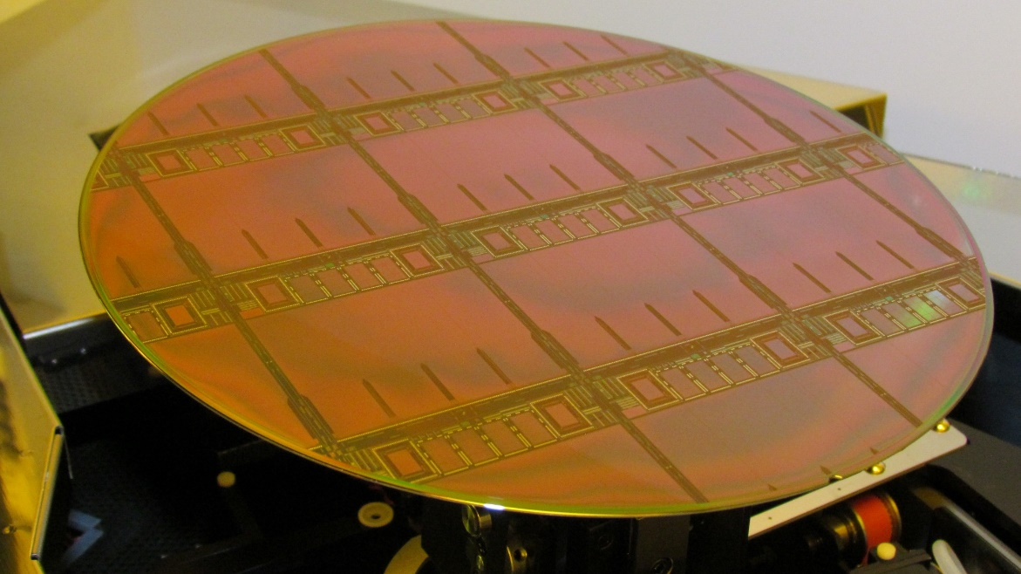
Large-Format CCDs with Single-Poly Fabrication Process
Completed Wafer
Detail of CCD Output Region
5 × 4 cm
Fabricated large-format (reticle-stitched) CCDs with simplified process
Single layer of poly-Si
150 nm inter-poly gaps
Simpler fabrication process, potential path to very large-format devices via reduction of inter-poly shorts

Slide 7
Analysis of Large-Format Single-Poly CCDs
Target Image
Projected Yield Comparison
24 × 24 µm pixels
13.5(H) × 21(V) µm pixels
Capable of operating large-format CCDs at low voltage (down to 2V clock swings). Similar yields to legacy 3-poly process on first fabrication run.

Slide 8
Outline
Large-format CCDs running at low clock voltage
Wafer-scale direct bonding for molecular-beam epitaxy back surface passivation
CCDs built on bulk germanium

Slide 9
Photon Absorption Length in Silicon
X-ray and UV imagers require backside passivation that minimizes absorption
Shallow
dead layer
needed

Slide 10
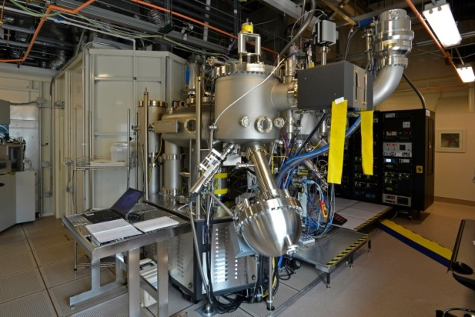
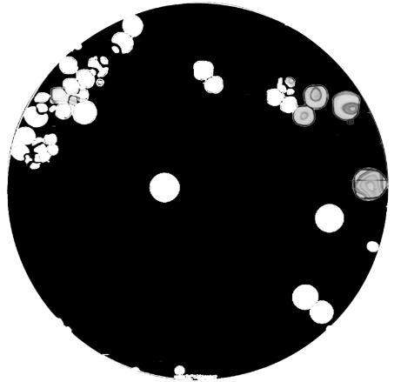
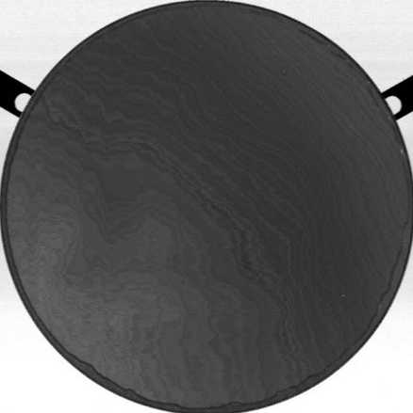
MBE Back-Surface Passivation
Molecular-Beam Epitaxy (MBE)
MBE-Compatible Direct Bonding Process
Default process for PECVD SiO₂ deposition results in large bonding voids at MBE growth temperature
New SiO₂ deposition process enables MBE growth on 200-mm diameter wafers without need for H₂ vents or modified FI process
“Atomic spray painting” used to grow boron-doped silicon one atomic layer at a time
Thin dead layer, uniform passivation
Requires direct wafer bonding, ≥ 400°C growth
K. Ryu, et al., Proc. SPIE 10699 (2018).

Slide 11
Example of MBE-Passivated CCDs
Post-MBE Wafer Photo
Quantum Efficiency Comparison
200 mm
Devices with MBE passivation show reflection-limited QE in UV. Currently running single-poly CCDs through MBE process for characterization of soft X-ray energy resolution.
K. Ryu, et al., Proc. SPIE 10699 (2018).

Slide 12
Outline
Large-format CCDs running at low clock voltage
Wafer-scale direct bonding for molecular-beam epitaxy back surface passivation
CCDs built on bulk germanium

Slide 13
Opportunity for Large-Format, Broadband Imaging with Germanium
Broadband sensitivity
…in a large format
200 mm
Large-diameter wafers, compatible with Si CCD tool set
Monolithic detectors → no bump-bonding, small pixels
Potentially lower read noise than Si CCDs

Slide 14
Germanium CCD Fabrication
Silicon CCD
Germanium CCD
Silicon Dioxide
Poly 1
Poly 2
Poly 3
TiN Gate Electrode
Gate Dielectric
Gap Between Phases
~200 nm Gap Between Phases

Slide 15
Prototype Germanium CCDs
32 × 32 Pixel Array Dark Response
Histogram of Single ¹⁰⁹Cd Events & Imaging
Pixel arrays up to 128 × 128 demonstrated, device performance rapidly improving

Slide 16
Analysis of Charge-Transfer Efficiency in Germanium CCDs (1024-pixel linear devices)
Ideal Case
Observed Case
Charge Deficit
Explore dynamics of charge trapping by injecting groups of pulses, varying spacing between groups
We observed charge deficit was more prominent than trailing charge
Signal
Trailing Charge
No. Clock Cycles

Slide 17
Charge Trapping Dynamics
Theory: Charge Deficit for different Bulk Trap Emission Times
Experiment: Charge Deficit Measurements on 1024-pixel Ge CCD
Measuring charge deficit vs. spacing between pulse groups yields insight into trapping dynamics [1]
Observed pulse deficit due to slow (~ ms) bulk traps
Emission times follow Arrhenius relation (E_{A} ~ 0.2 eV)
Surprising result suggests metallic contamination is currently limiting CTE of Ge CCD
A.M. Mohsen & M.F. Tompsett, IEEE Trans. Elec. Dev. 21 (1974) 701.

Slide 18
CTE Estimates for Germanium CCD
Calculated Charge-Transfer Efficiency
Calculated CTE through two techniques:
First pixel edge response (FPER), analyzing charge deficit:
$${CTE}_{FPER}=1 − \frac{S_{D}}{S(e^{−}{)N}_{P}}=1− \frac{Normalized Pulse Deficit}{1024}$$
(First) trailing charge:
$$S_{N_{P}+1}=S\left(e^{−}\right)N_{P}×CTI×exp\left(−N_{P}CTI\right)$$
$=1024×S\left(e^{−}\right)$ $×CTI×exp\left(−1024×CTI\right)$
Generally, CTE is in the 99.9x% range, up from first reports in the 98.5% range
S_{D} = charge loss, S(e⁻) average charge level, N_{P} = number of transfers
Exploring paths to CTE improvement through gettering and more aggressive wet cleans
J.R. Janesick, Scientific Charge-Coupled Devices, SPIE Press, Bellingham, Washington (2000), p 387, 429.

Slide 19
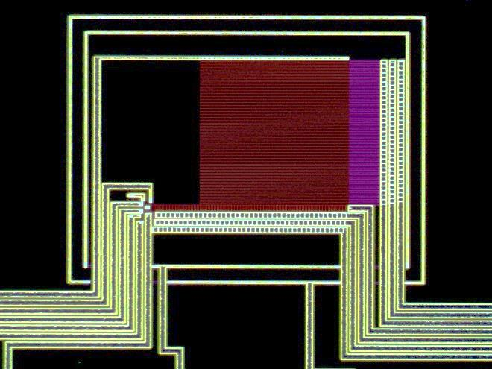
Summary
MIT Lincoln Laboratory has a long history of delivering imaging devices to the DoD and scientific communities
The CCD offers unique advantages and is well-suited to challenging imaging applications
We continue to improve CCDs by expanding the capabilities and sensitivity of these devices
Large-format CCDs running at low clock voltages | MBE-passivated devices for soft X-ray, UV sensitivity | Germanium imagers for wider spectral response

