Slide 1
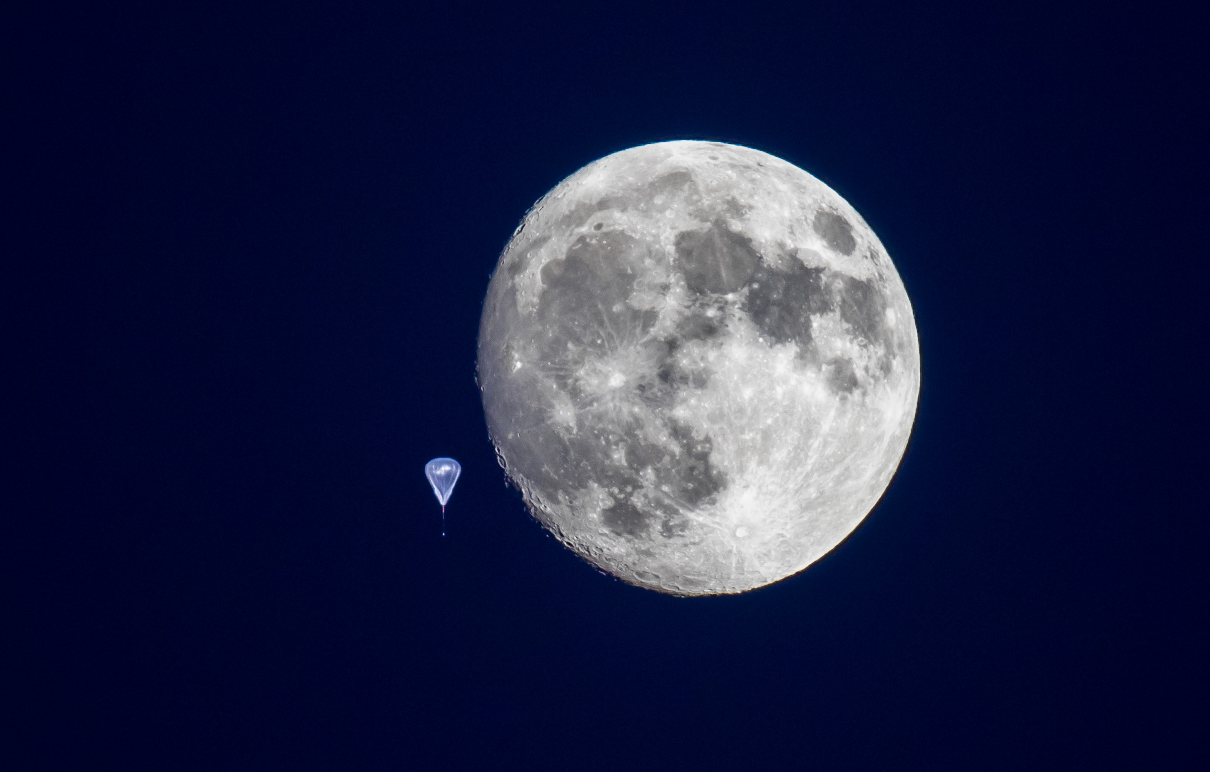
Photo: M. Williams
EMCCDs for Astrophysical Use
ISPA 2018, Caltech
December 4th, 2018
Prof. Erika Hamden
University of Arizona

Slide 2
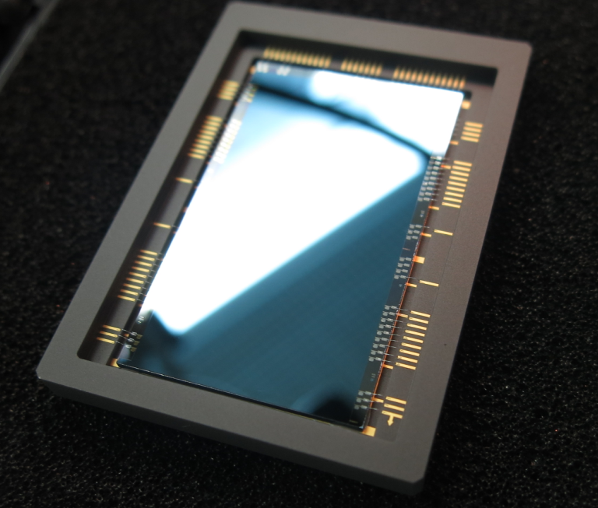
Electron Multiplying CCDs
Conventional
Photon counting
Our work: e2v CCD201-20 device
1k x 2k device
13 µm pixels
Engineering grade is a frame transfer
Delta-doped devices are full frame
604 multiplication pixels
Coincidence losses
Figure from N. Konidaris

Slide 3
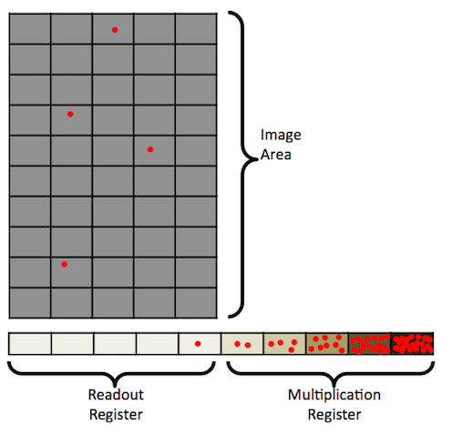
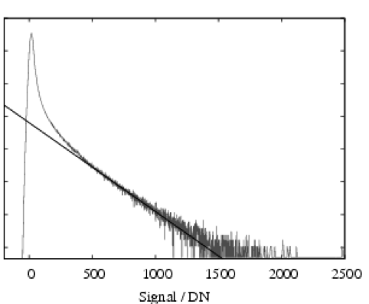
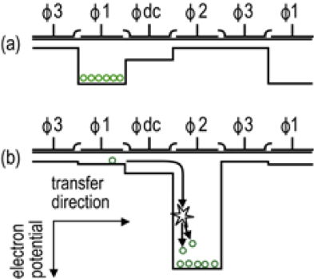
EMCCD operation!
Number
EMCCD Layout
Multiplication mechanism
Histogram of a multiplied image

Slide 4
Normal
CCD
EMCCD
CCD
Dark Current (DC) and Clock induced charge (CIC) <<< RN
under the right conditions
EMCCDs effectively eliminate read noise, but then one must deal with DC & CIC
Ideally, this is your limiting noise source, but for very LOW signal, Read Noise is a significant source of excess noise

Slide 5
Drawbacks
Signal electrons will be multiplied
But this “dark” electron will also be multiplied
So will this “CIC” electron
So these other electron sources need to be addressed more careful than a conventional CCD
Read Noise added after amplification

Slide 6
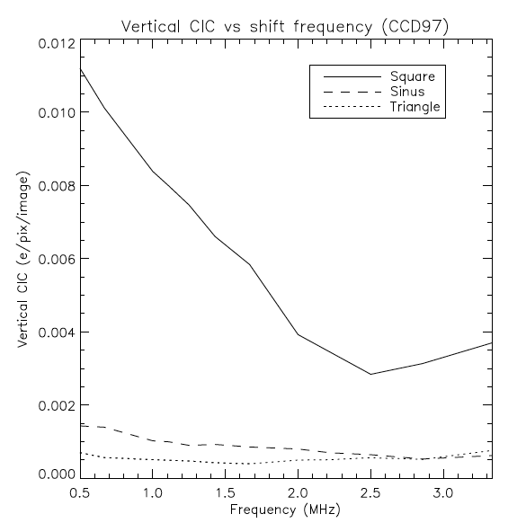
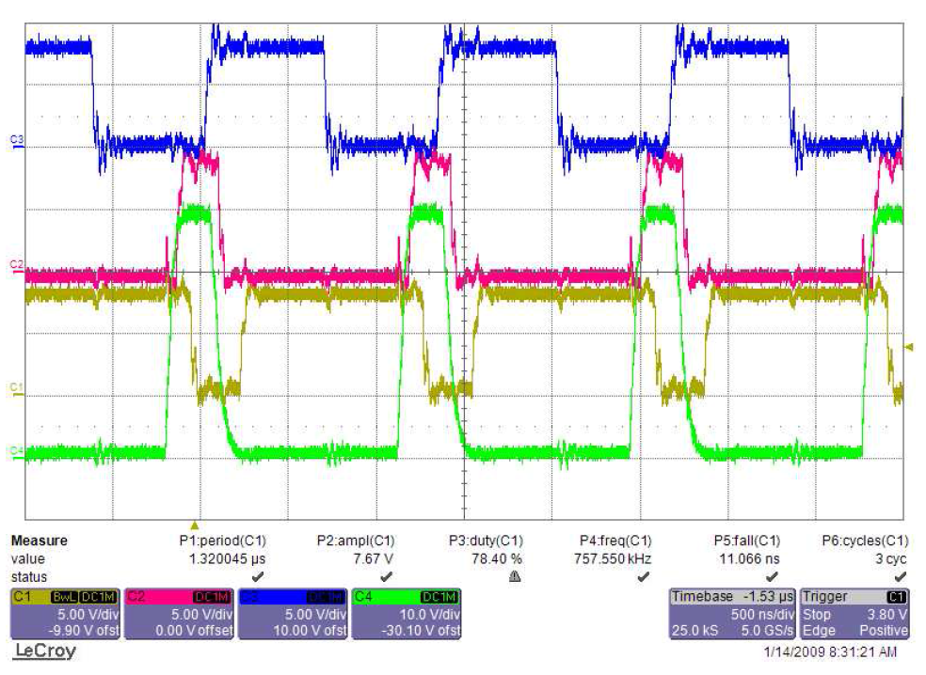
Minimizing CIC in an EMCCD
Diagle, 2010
Tulloch, 2010

Slide 7
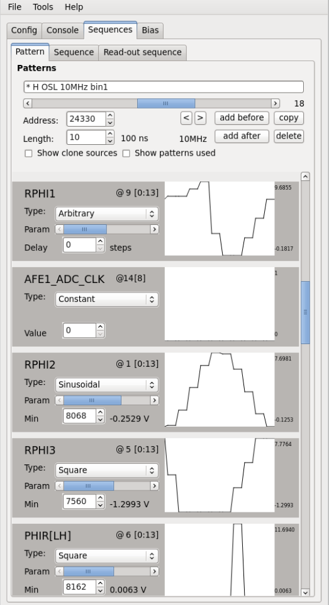
Minimizing CIC in an EMCCD
Examples of shaped serial clocks. Minimum possible well depth
is used to lower CIC while still transferring charge.
At start, CIC was 0.1 events/pix/frame. Current lowest levels
0.0012 events/pix/frame

Slide 8
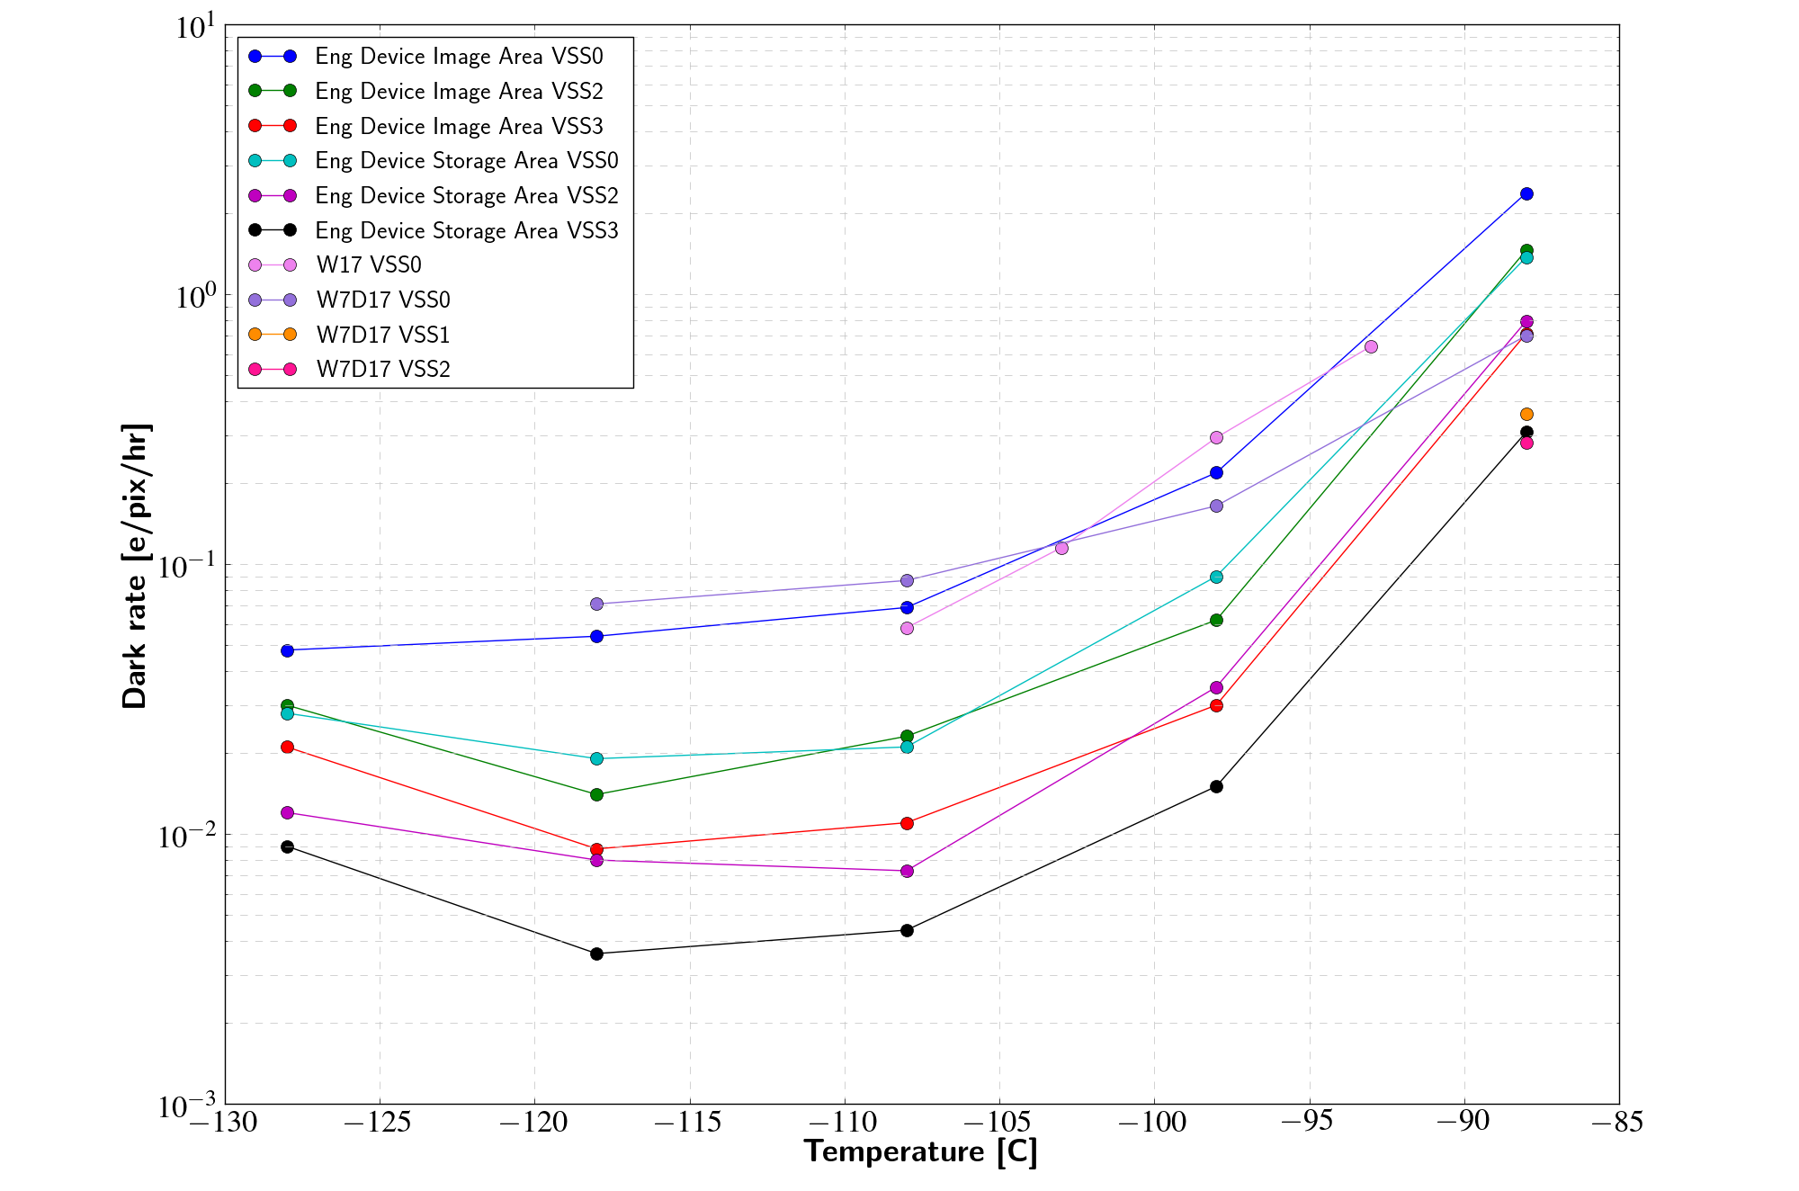
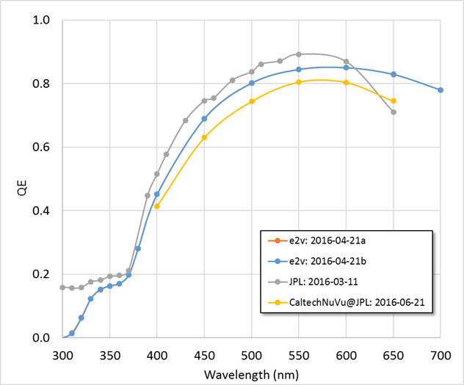
Dark Current & QE
Figures by G. Kyne and JPL

Slide 9
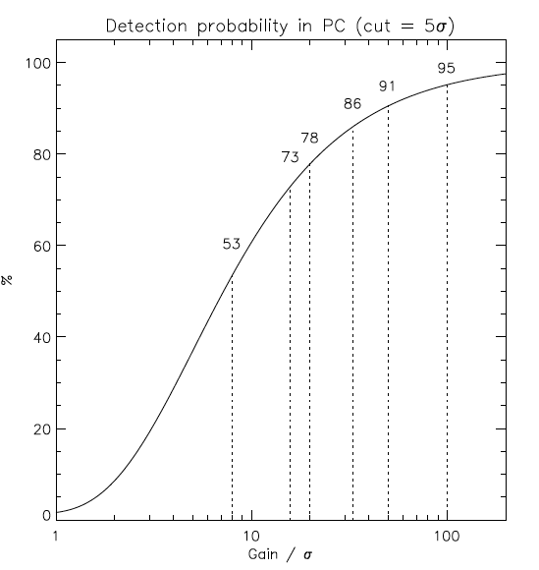
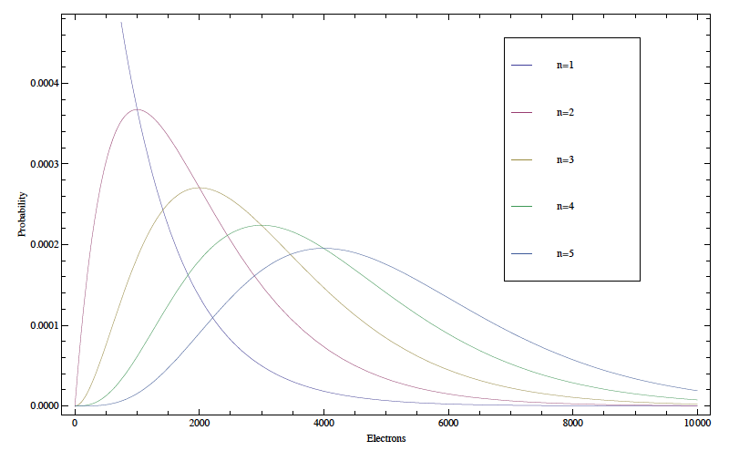

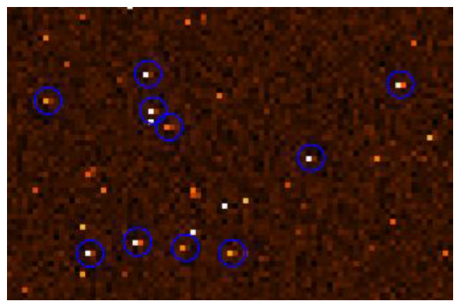
Other noise sources
Coincidence Losses
Harpsoe 2012
Threshold Losses
Daigle 2010
CTE and Serial saturation
Tulloch 2010, Diagle 2010

Slide 10
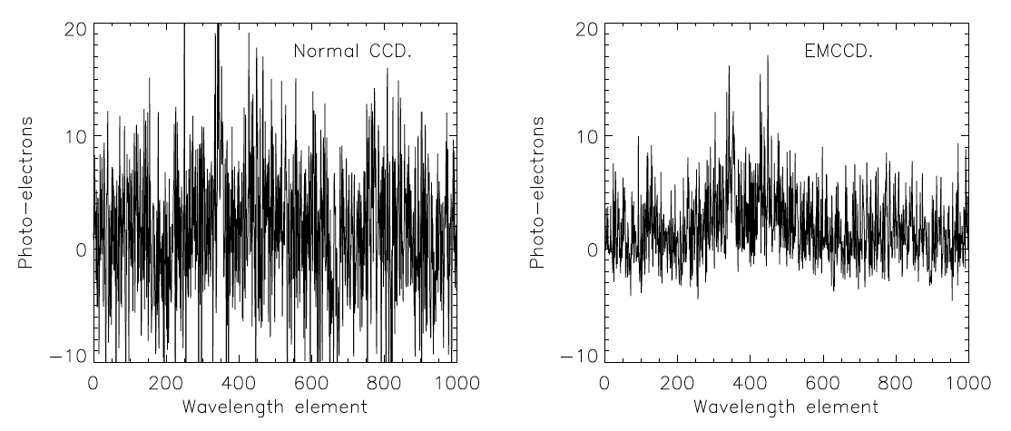
But clear benefits
Tulloch, 2010

Slide 11
Electron Multiplying CCDs
Conventional
Photon counting
Our work: e2v CCD201-20 device
1k x 2k device
13 µm pixels
Engineering grade is a frame transfer
Delta-doped devices are full frame
604 multiplication pixels
Coincidence losses
Figure from N. Konidaris

Slide 12
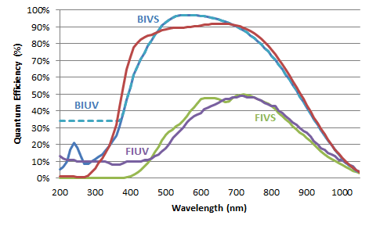
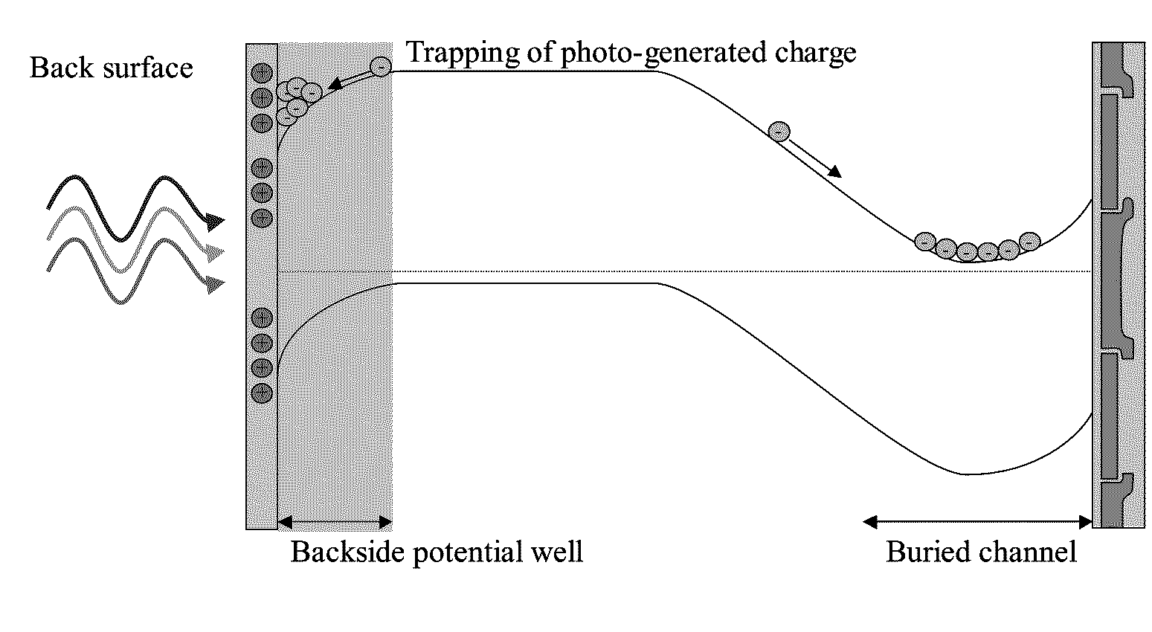
Delta-doping for UV optimization
Horiba
Hoenk, Patent 2009

Slide 13
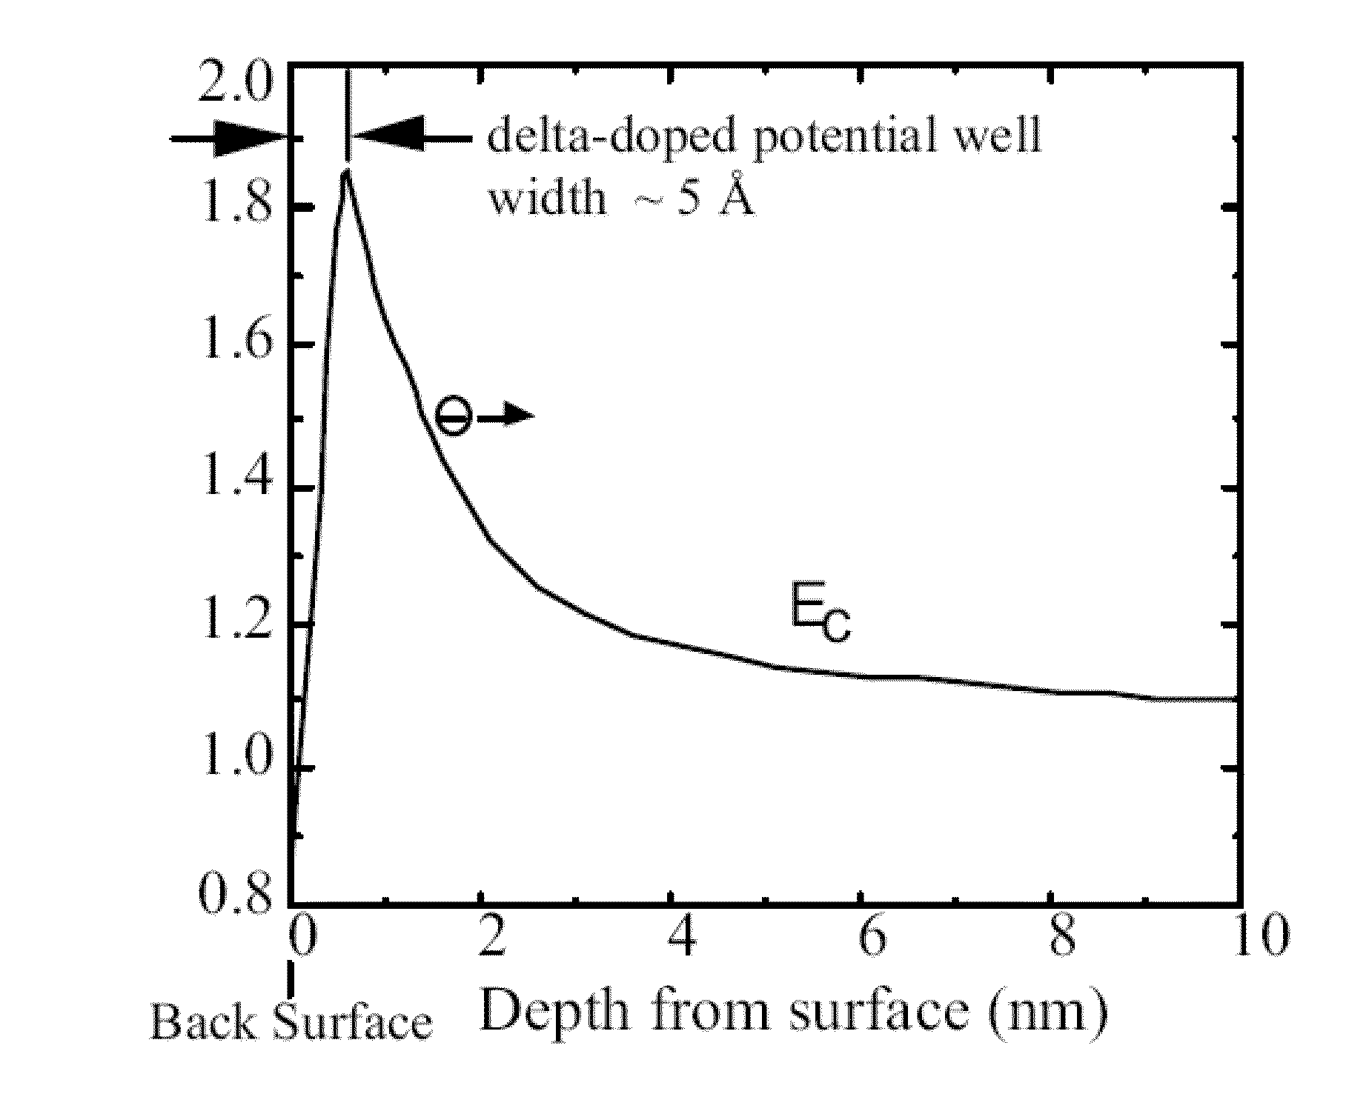
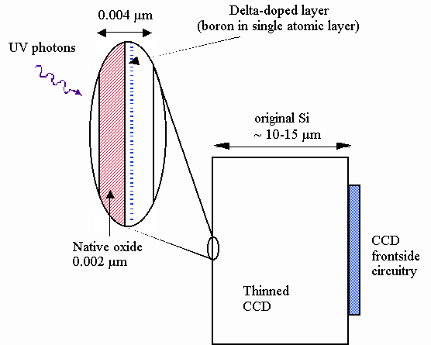
Delta-doping for UV optimization
eV
Nikzad 2013 Patent

Slide 14
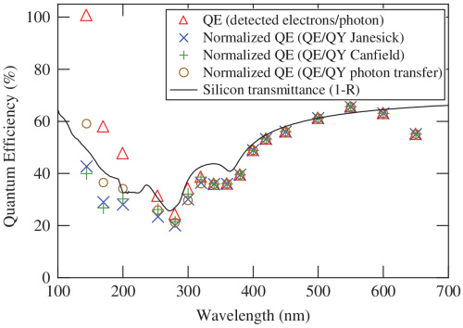
Delta-doping for UV optimization
Delta-doped
QE follows
Silicon reflection limit
Nikzad, 2004

Slide 15
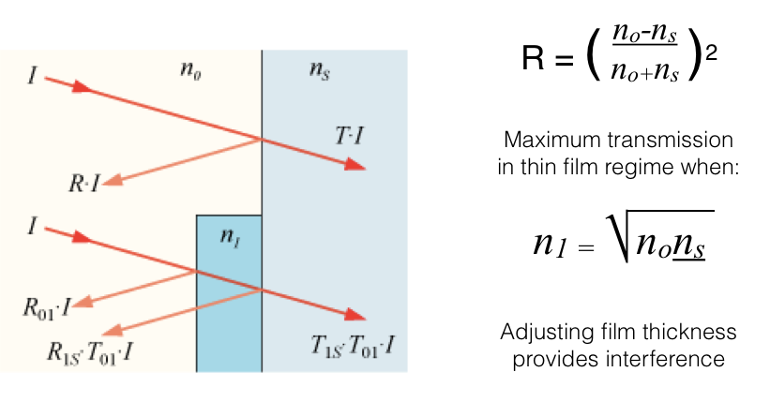
Anti-Reflection Coatings

Slide 16
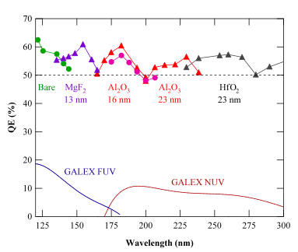
Anti-Reflection Coatings + delta-doping
Delta-doping creates a CCD with 100% internal QE- any photons which are not reflected by the surface will be detected.
Anti-reflection coatings reduce surface reflection and improve QE.
Single Layer
AR-Coating
Thinned CCD
Delta-Layer
Nikzad, 2012

Slide 17
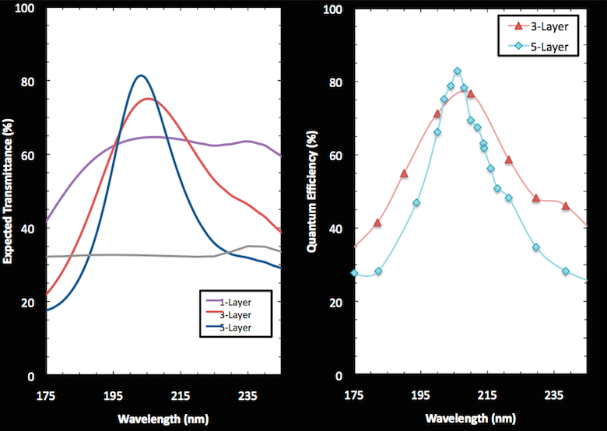
Previous state of the art shown in Black.
Anti-reflection coatings coatings can provide better transmission into the CCD, increasing quantum efficiency and performance.
Ask me about other wavelengths!!!
Figure by April Jewell

Slide 18





The Faint Intergalactic-medium
redshifted Emission Balloon
A UV multi-object spectrograph designed to detect the low-z circumgalactic medium in emission via Lyman-alpha, CIV, and OIV.
Caltech
Christopher Martin- PI
Erika Hamden
Nicole Lingner
Gillian Kyne
Keri Hoadley
Matt Matuszewski
Donal O’Sullivan
Zeren Lin
Marty Crabill
Jill Burnham+
JPL
Shouleh Nikzad
April Jewell
Tim Goodsall
Todd Jones
John Hennessey
Alex Carver
Chaz Shapiro
Michael Hoenk
Sam Cheng+
LAM/CNES
Bruno Milliard
Robert Grange
Samuel Quiret
Vincent Picouet
Didier Vibert
Philippe Balard
Patrick Blanchard
Johan Montel
Etienne Perot
Jean Evrard
Frederi Mirc
Nicolas Bray+
Columbia
David Schiminovich
Lauren Corlies
Jose Zorilla
Julia Gross
Nicole Melso
Michele Limon
Sam Gordon
Hwei Ru Ong+

Slide 19
UV image with Zn Lamp illumination, Field 2 sky mask

Slide 20
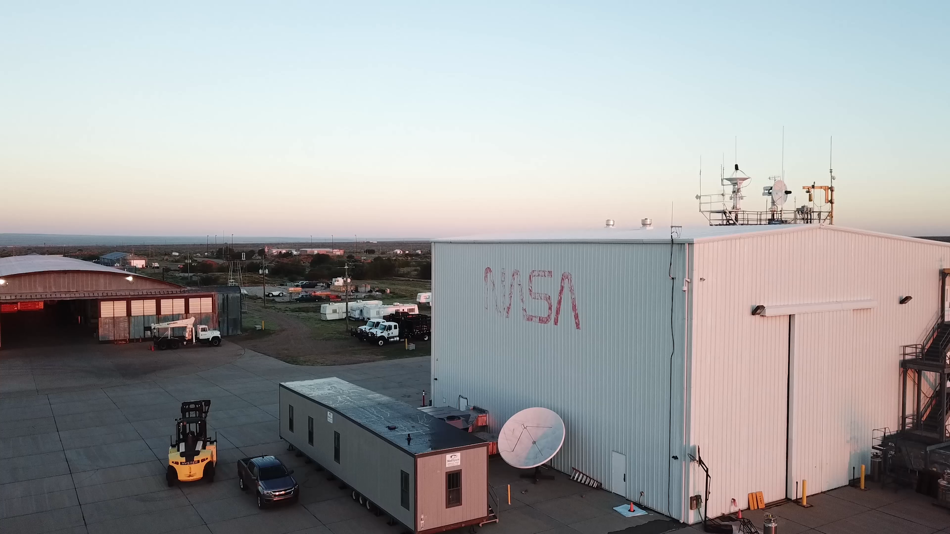

Slide 21
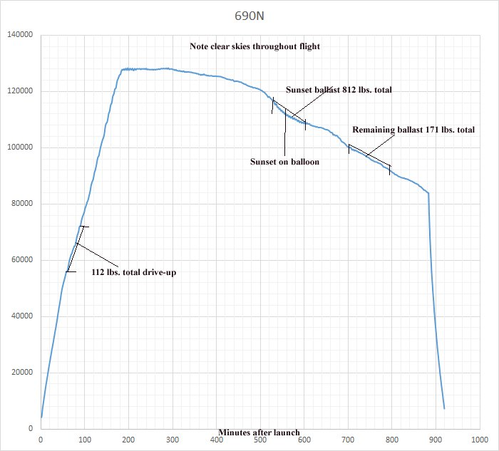
Flight profile from CSBF

Slide 22
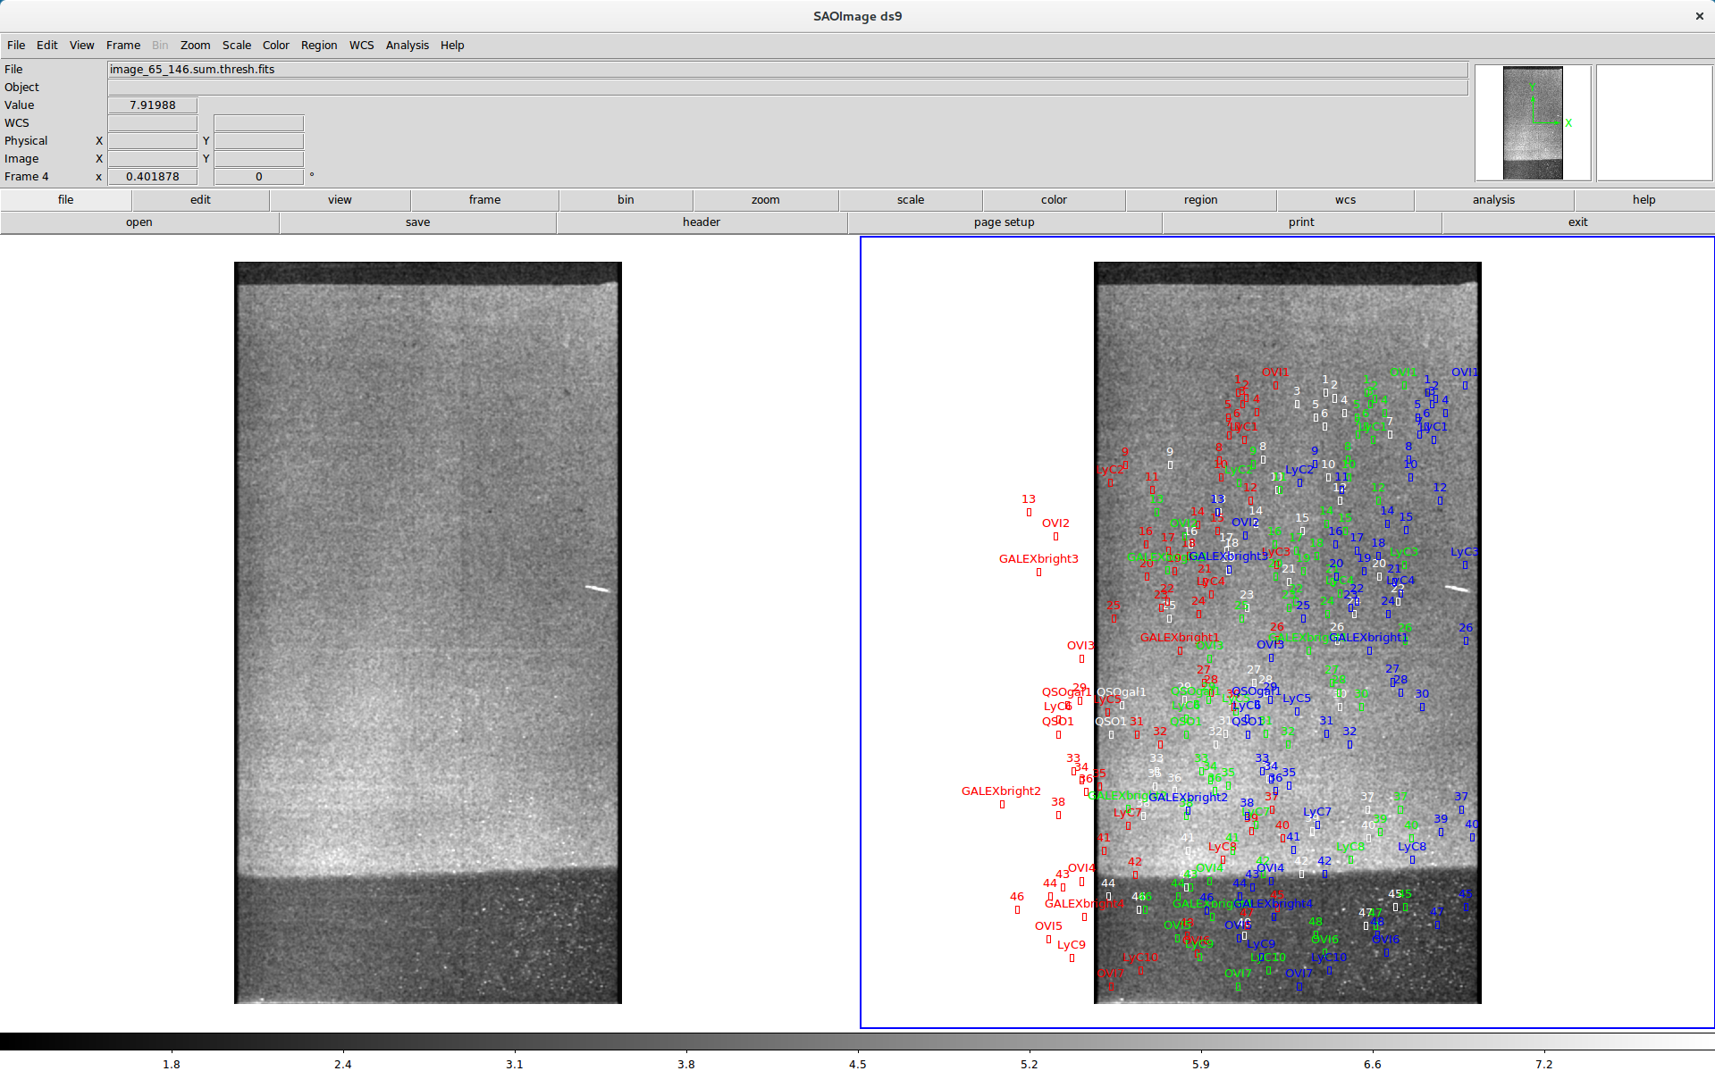
Very preliminary stacked Image from Sept 22 flight
82 images
~40 seconds per image
3300 seconds total
EM Gain ~2000 e/e

Slide 23
Questions?
Photo: Mouser Williams
Notes:
Go-pro video

